Slide 1
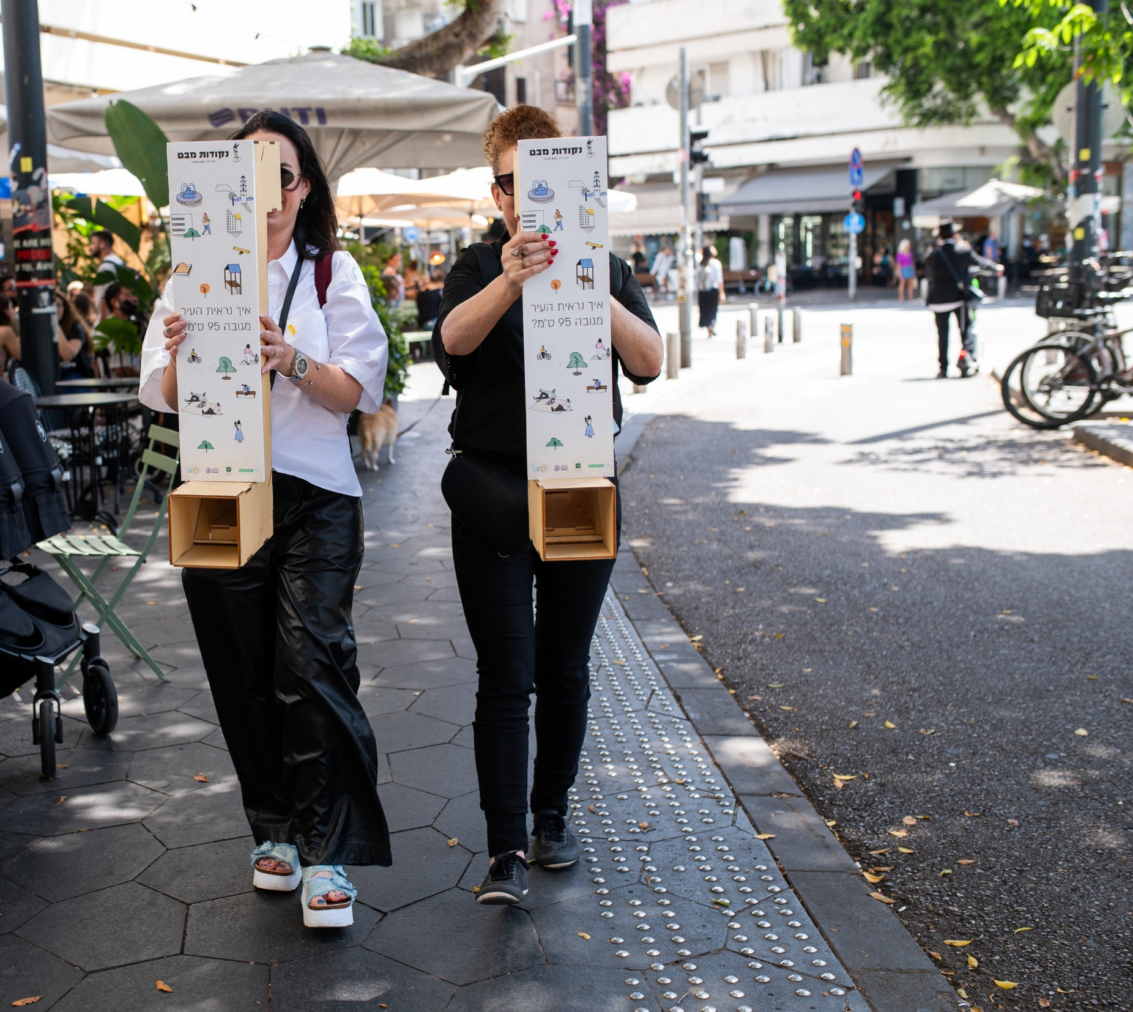
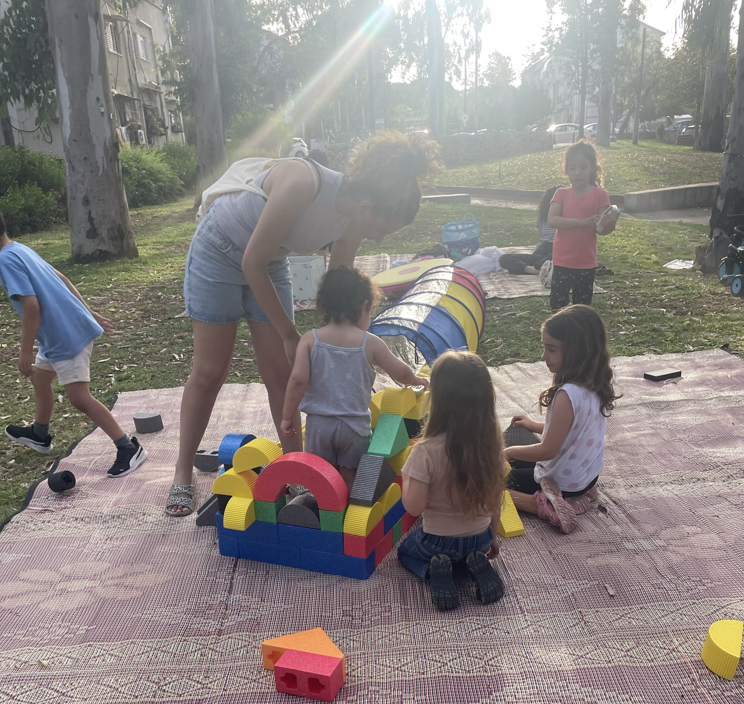



Urban95 Summative Activity Evaluation Report for 2020-2024
May 2025

Slide 2


“Promoting the development of safe and child-friendly cities for young children and their caregivers and to improve the ways in which children develop, play, interact, and move through the urban environment."
Urban Infrastructure
From:
https://urban95israel.org/
Community Services
The Public Space
Residents

Slide 3
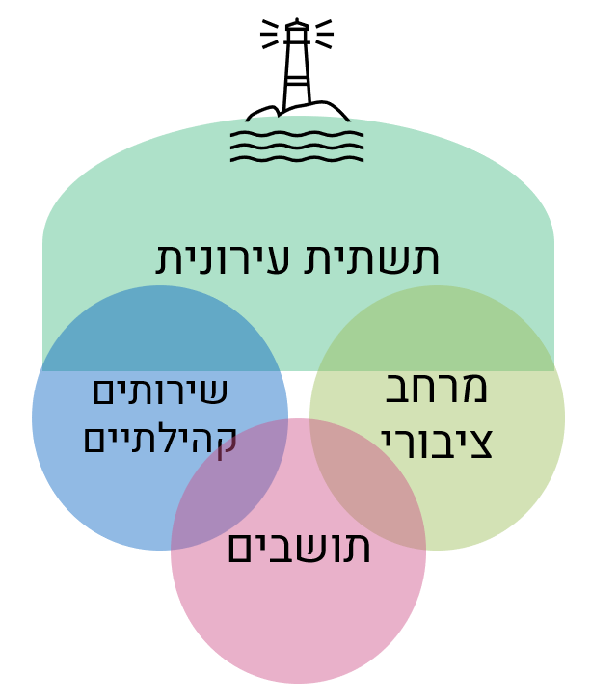
Expanding knowledge and awareness
Shifting perceptions
Engaging partners and establishing interdepartmental mechanisms
Project implementation and resource expansion
  Community services
  The public space
Systemic Change

Slide 4
EC is on the municipal agenda
76% increase in knowledge and awareness of EC issues
A shift in perception after working with Urban95:
Nurturing the next generation
Parental well-being
Generating communities
Reducing inequality
Urban innovation and development
N=25

Slide 5
Engaging partners and establishing interdepartmental mechanisms
Working with Urban95 as a model for a collaborative and holistic organizational culture.
Digitaf and Community Well-Baby Clinics
City
Beautification
City Architect
Community Administration
Transportation
Strategy
Modes of action
Engagement
Bridging and building connections
Familiarization and active listening
Transparency and reciprocity
Challenges
Personnel turnover
Differing work methods
Regulatory policies
"We're in a different place now. Until recently, no one sat down and said, ‘It’s one area—let’s figure out how to advance it together.' If we succeed in building a strong network here, we’ll all support one another, generate more high-quality, sustained activity, and learn from each other along the way." (Community)

Slide 6
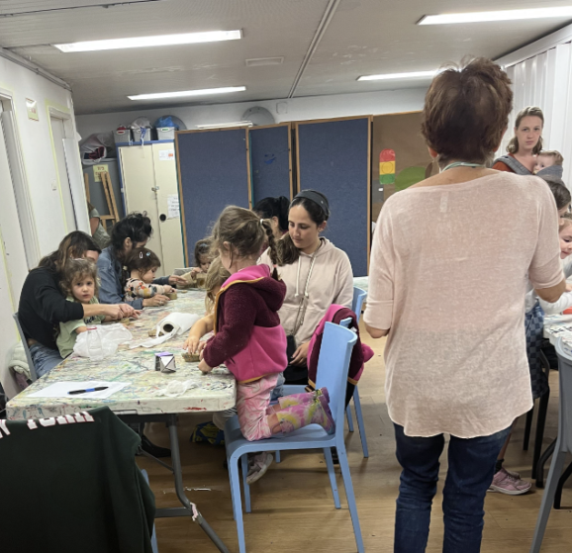
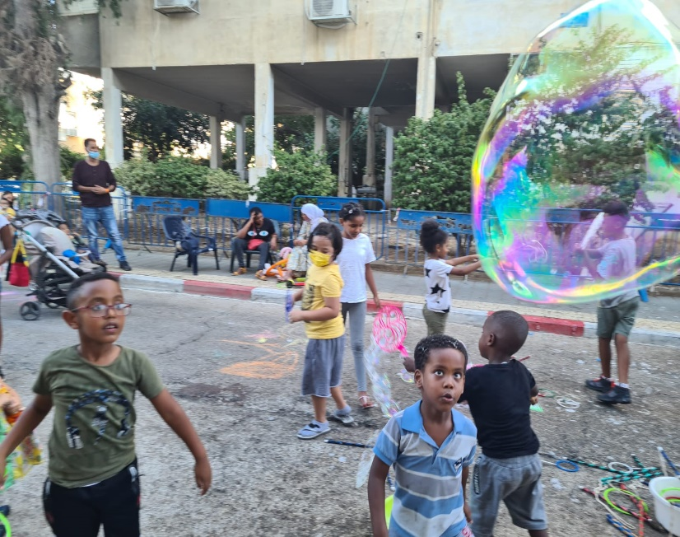
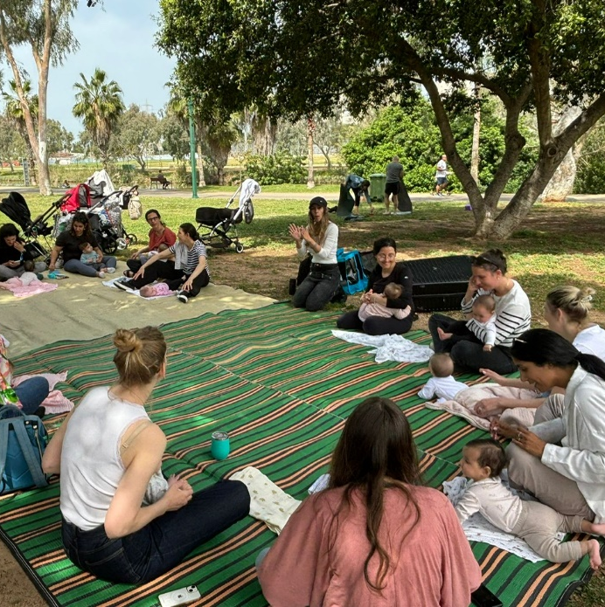
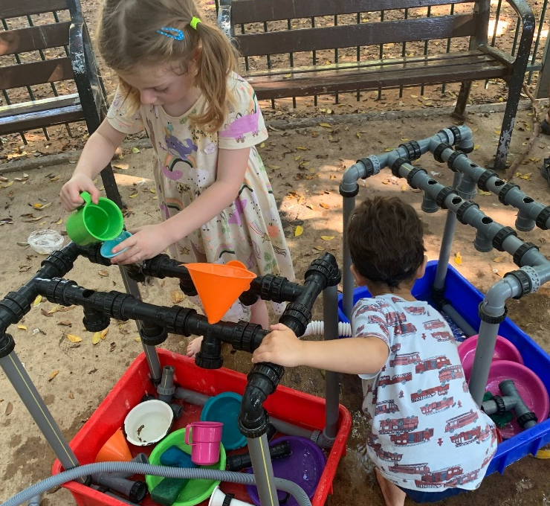

Implementation of
city-wide projects
Independent initiatives in public spaces
Serving underprivileged populations
“The meetings were a real bright spot in my week.”
Group of mothers on maternity leave

Slide 7
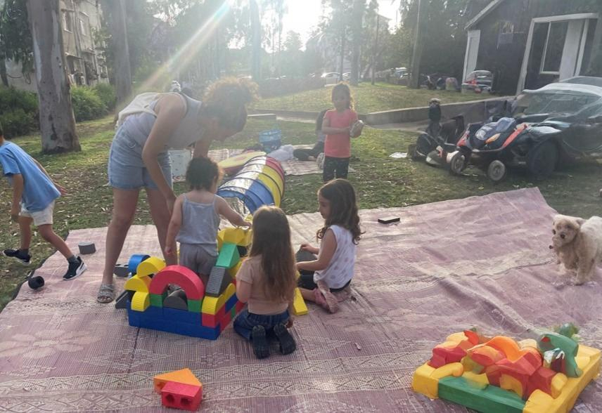
Growth in Service Provision and Participation Throughout the Program’s Operation
Implementation of city-wide projects
Independent initiatives in public spaces
Serving underprivileged populations
95% participate and stay informed about early childhood activities
91% said the activity environment was comfortable and well-adapted to EC needs
91% said they would recommend the activity to friends
80% reported that the activity contributed to positive interaction with their children

Slide 8
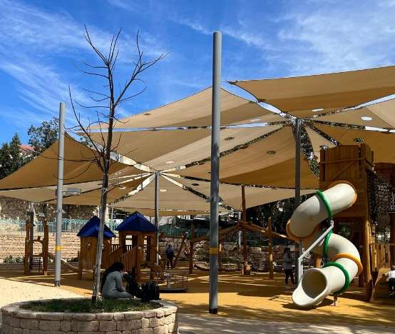
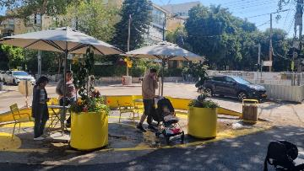
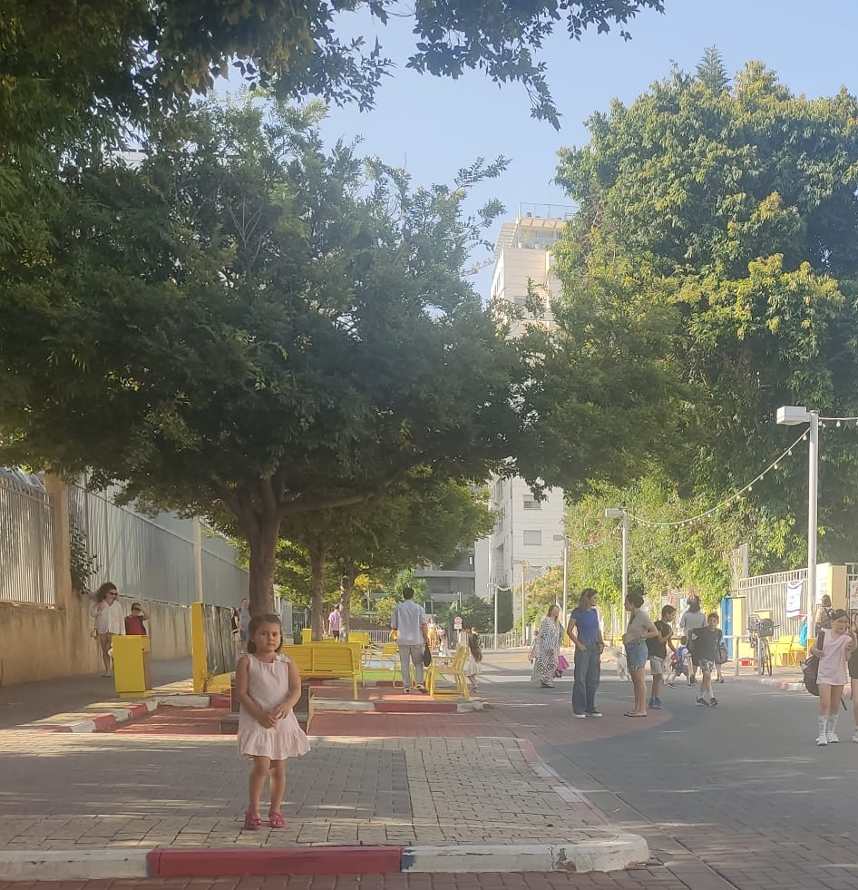
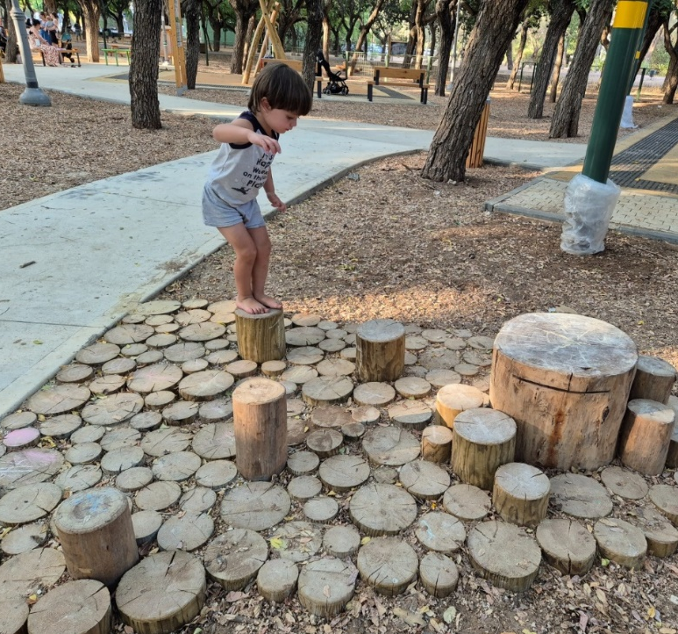
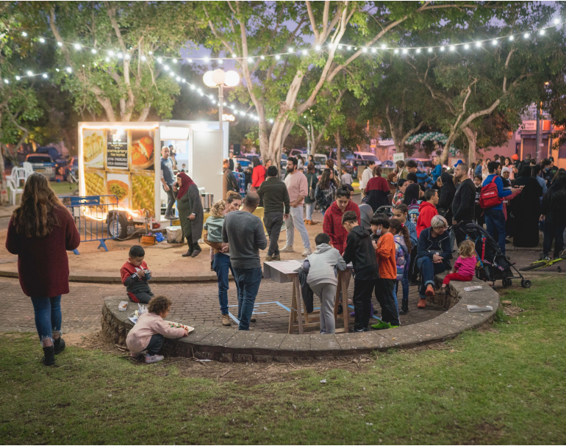
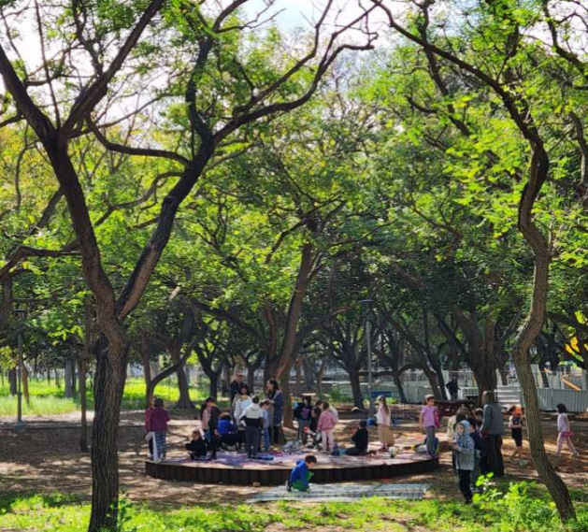
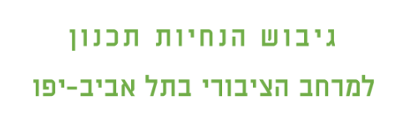

Investment in urban infrastructure:
Urban environment and public spaces adapted for young children and their caregivers

Slide 9
Shift in perception
Systemic change
Municipal Budgeting for Early Childhood Throughout the Program’s Operation
  In Phase B
  the total
  investment
  was 18
  times higher
Increasing municipal resources:
Dedicated budgets and positions for advancing early childhood issues
  Municipal Budgeting in Key Areas During Phases A and B
 | Phase A |  |  | Phase B
 | 2017 | 2018 | 2019 | 2020 | 2021 | 2022 | 2023
Community Administration
City Beautification Department |  |  | -
Social Services Adm (inc. Jaffa in Phase B) | -
Construction & Infrastructure Adm. (Phase A) / Transportation Adm. (Phase B) | - |  |  | - | - | -
Engineering Adm. (Phase A) / City Architect’s Office (Phase B) |  |  | - | - | - | -
Spokesperson’s Office (Phase A) / Spokesperson’s Office – Digitaf (Phase B) |  | - |  | -
Education Administration | - | - |  | -
  Total investment increased significantly in Phase B.
  By 2023, resources were allocated across all key areas.
Urban95 Program Director Position
Department-Level EC Coordinator Position
  Legend:
  Up to 50,000 NIS
  50,000-100,000 NIS
  100,000-1,000,000 NIS
  1,000,000-2,000,000 NIS
  Over 2,000,000 NIS

Slide 10
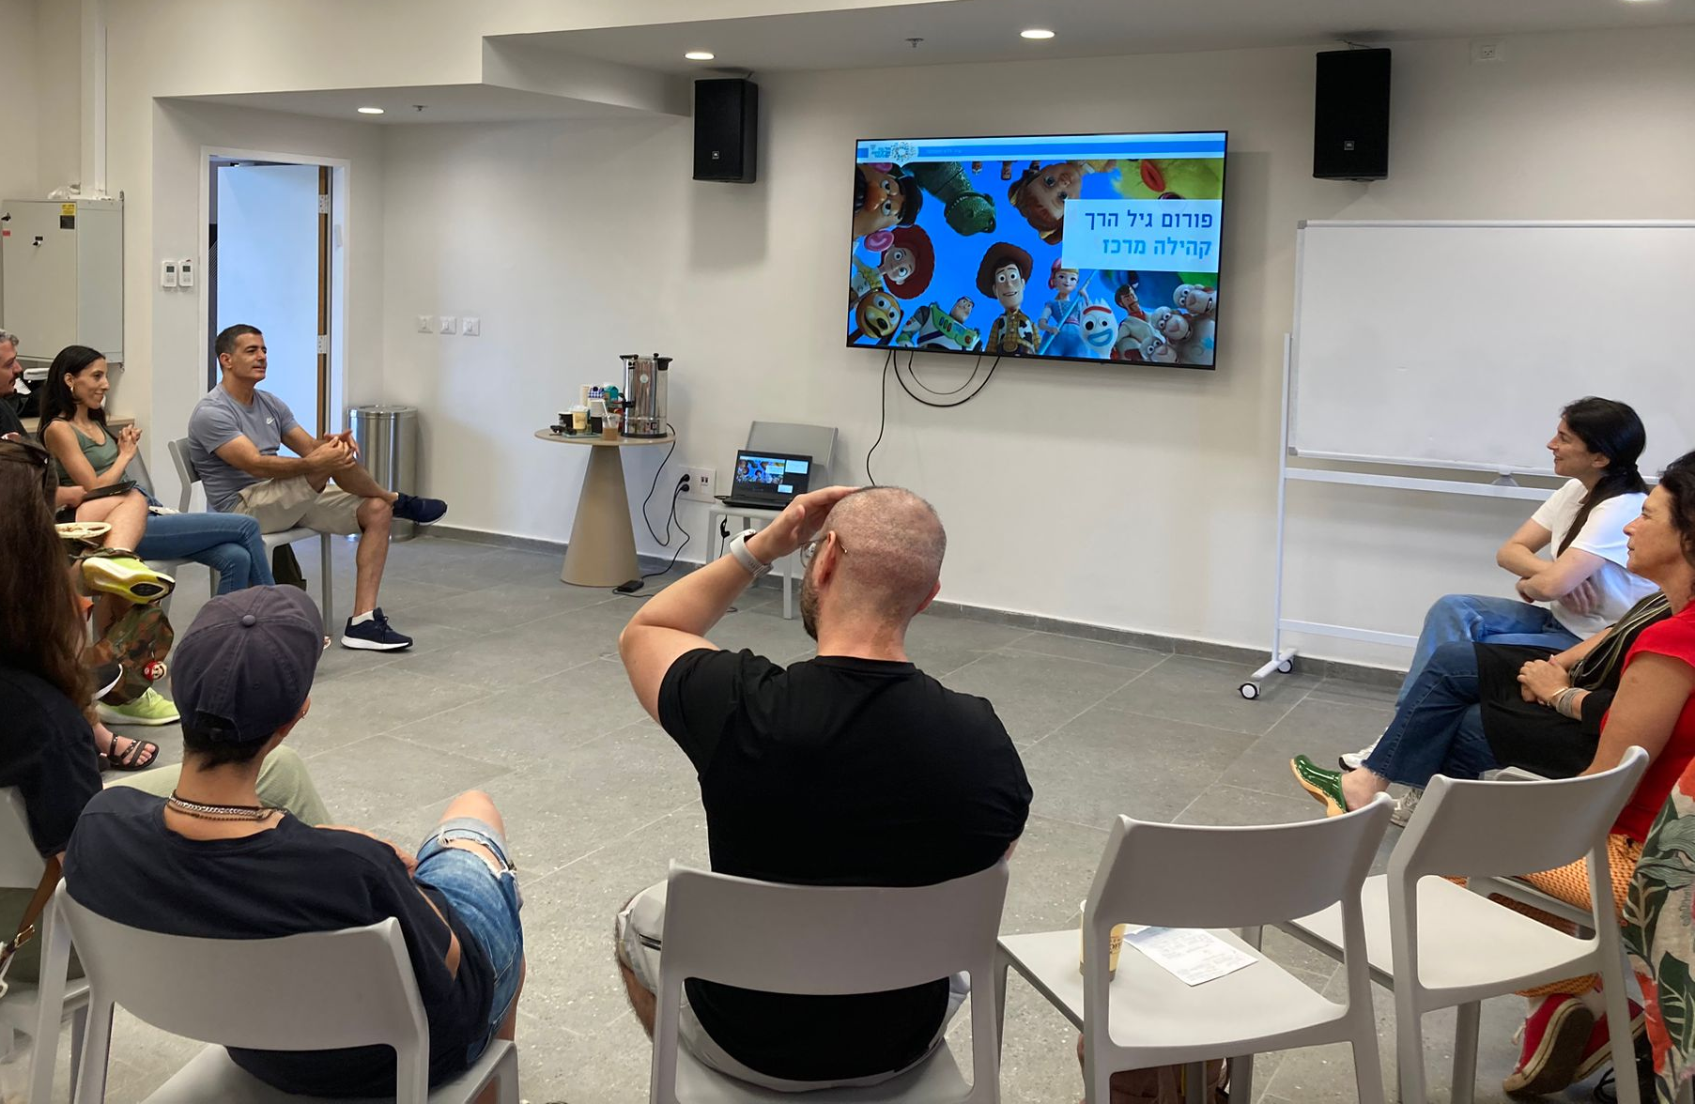
Shift in perception
Systemic change
Strategic plan for early childhood
Playroom planning and design guidelines
Public space planning and design guidelines
Project implementation manuals
EC-driven policy implementation
Data-driven long-term urban planning
Data-driven decision-making
Public engagement processes
Departmental operating model
  “Just like there’s a ‘gender lens,’ here we have an ‘EC lens’ when it comes to analyzing municipal services. The wide range of municipal services available is a clear sign that early childhood has become a central priority, reflected in dedicated budgeting.” (Strategy)

Slide 11

Tel Aviv as a Lighthouse –
A professional knowledge hub for internal and external stakeholders
The “Points of View” Tour
Internal organi-zational learning
Round A – June 2024
Afula
Netanya
Ra’anana
Rishon Lezion
Be’er Sheva
Round B – May 2025
Kiryat Bialik
Karmiel
Herzliya
Rosh Ha’ain
Nes Ziona
Online knowledge platform
City Beautification
Community
Strategy
City Architect
Mishlama for Jaffa
Education
Transportation
"You're lucky to have such professional, friendly, and insightful staff. The tour was fascinating—and above all, practical. It opened up meaningful internal dialogue and sparked plenty of ideas for what comes next."
“Now, I approach everything from the perspective we gained on the tour”

Slide 12
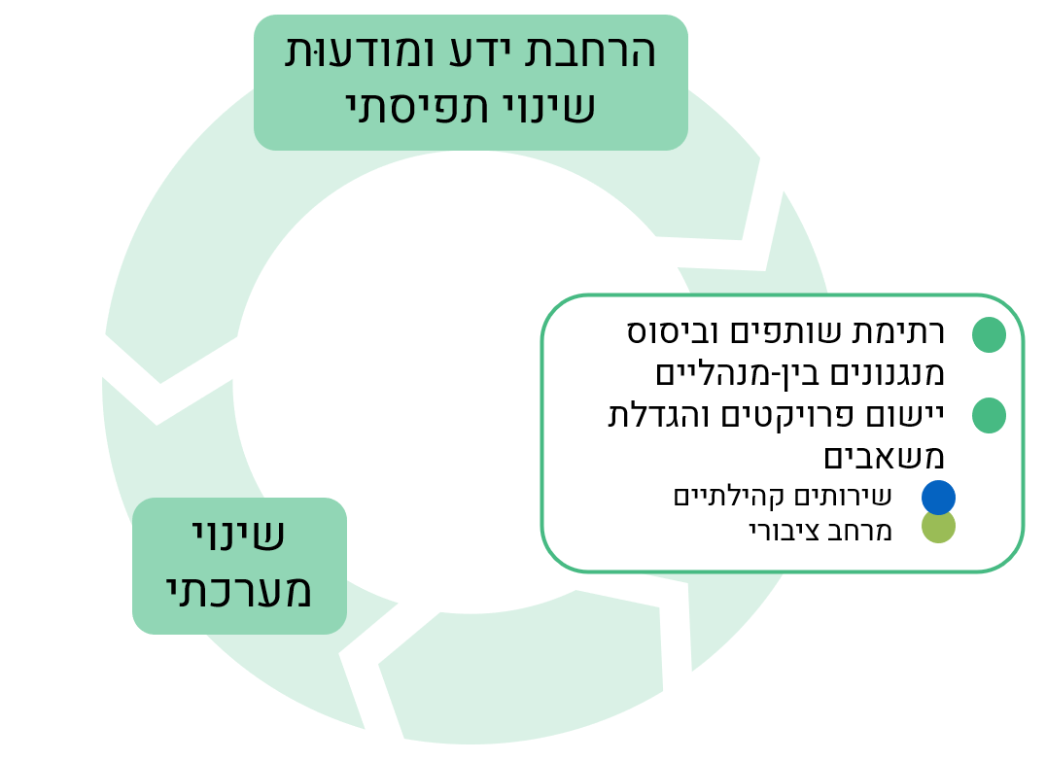
Challenges and barriers
Personnel turnover → Difficulty maintaining continuity; limited familiarity
Different work methods → Tendency to revert to old habits
Regulatory policies → Implementation barriers and limited influence over national-level decision-makers
Pilots and initiatives that were less successful among residents
Issues for improving the continued implementation of the program in the city
Community services: Expansion and diversification
Targeted responses for specific populations: Ages 3–6, underprivileged and/or unique populations, emergency situations
Public space and mobility: Environmental quality, air and noise pollution
Sustaining existing municipal partnerships and engaging new stakeholders
Strategic early childhood plan: Integrating EC into the work plans of various municipal departments
Sustainability: Embedding Urban95 principles within the municipal system
Tel Aviv-Jaffa as a Lighthouse:
  External knowledge hub: Tours, online knowledge platform
  Urban95 as an internal knowledge resource: Continued learning, tool development, training programs
Residents

