Slide 1
New measurement of the British height points from the leveling carried out between Gaza and Imera
Land baseline measurement in Gaza 1922 by the British
MSL measurement in Gaza by the British
New measurement of the British height points from the national leveling network in Haifa and Jaffa
Land baseline measurement in 1934 Haifa by the British
MSL measurement in Jaffa and Haifa by the British
Calculation of the change in MSL from the British Mandate period until the present day
Determination of the baseline in the State of Israel, from founding until the present day
Figure 1: Flow chart of the research process

Slide 2
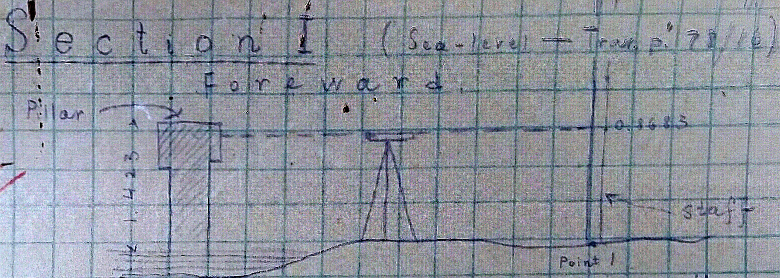
Figure 2: Description of methods of measurement for the Gaza MSL, in the measurements that took place between December 1921 and January 1922. (Measurers’ notebook for 1922 – Calculations Division Archives, Survey of Israel)

Slide 3
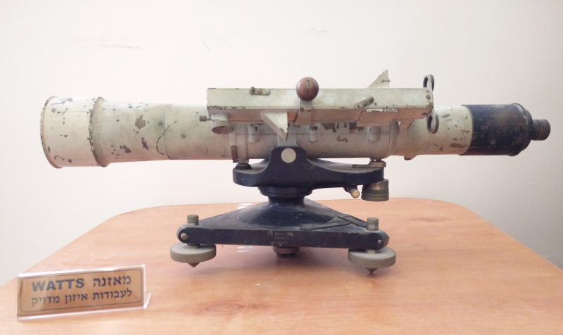
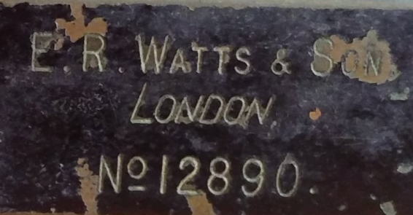
Plan Parallel, acts as a telescope; the eyepiece is divided into scale marks which allow precision to the micrometer.
Built-in level in the base of the level.
Figure 3: Level from the display case of measuring instruments at the Survey of Israel. According to the serial number, the level precedes the Second World War.

Slide 4
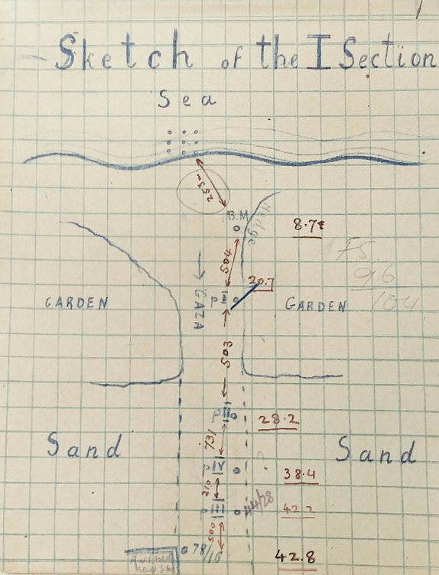
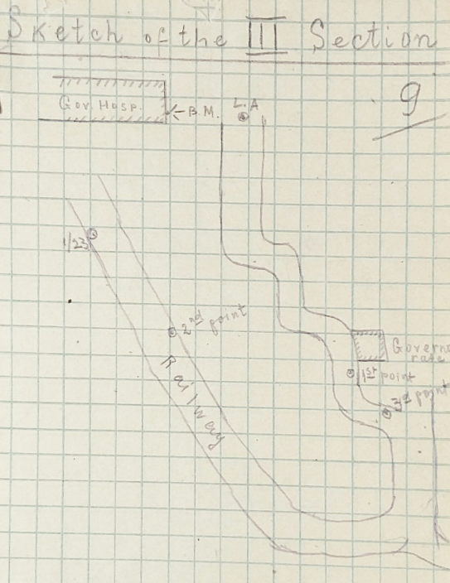
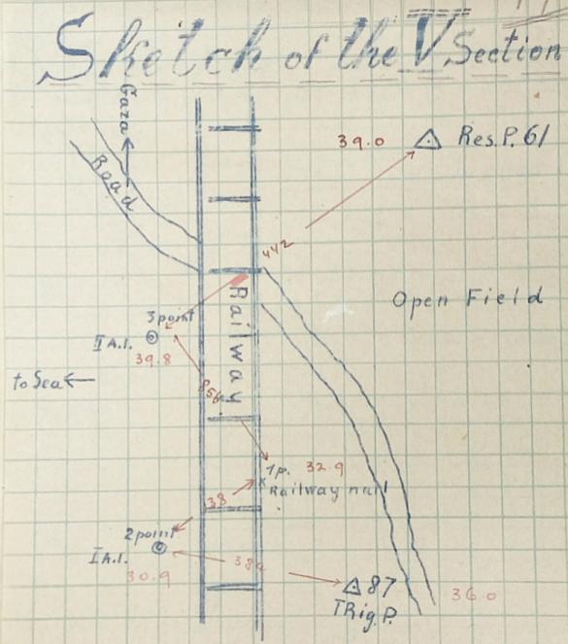
א
ב
ג
Figure 4: Sketches from the measurers’ notebooks of leveling sections between Gaza and Imera in 1922. Sketch A presents the first measurement section, from the sea to the destroyed house. Throughout the route of the measurement, the measurers sketched the distances between interim points as well as their height. Sketch B portrays the third measured section, which went from the government hospital to a point located on the railway tracks. Sketch C shows the route between trig point 61 and trig point 87, including interim points, their heights and the distances between them. (Measurers’ notebooks 1922 – Calculation division archives, Survey of Israel)

Slide 5
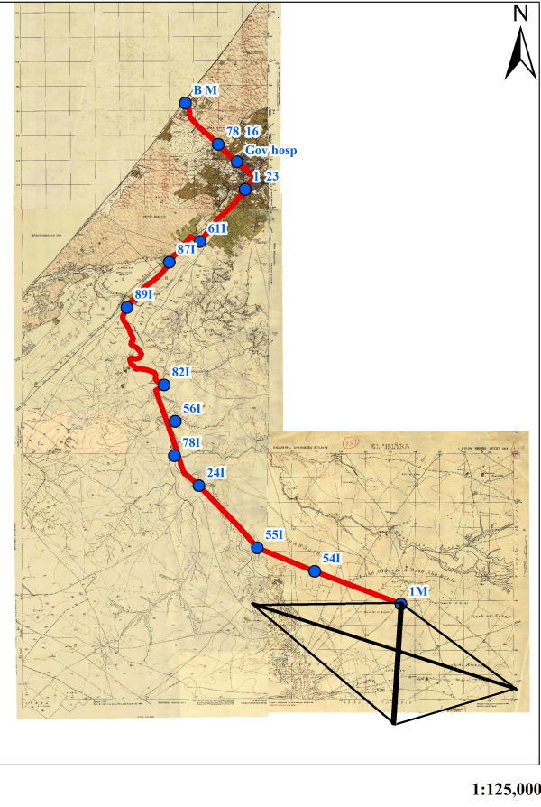
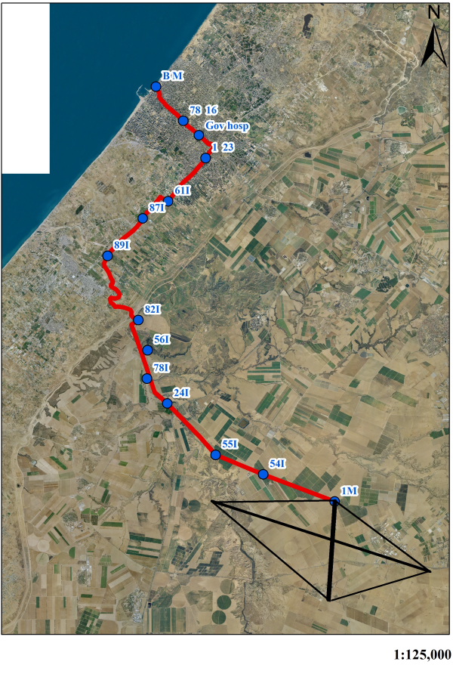
Figure 5: A. Topographic map from 1934 with height point notation and measurement route between the Gaza port and Imera (Map archives of Survey of Israel). B. Aerial photograph from 2008 showing the height measurement route from Gaza to Imera (Survey of Israel archives).

Slide 6
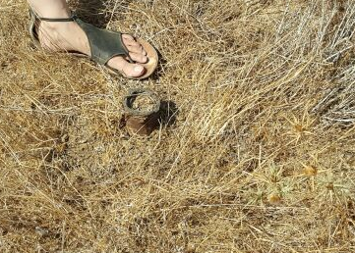
Figure 6: Height point 55I, measured by Meir Melin using the RTK GPS. Photographed by Oded Pochter in July 2015. (Photograph Oded Pochter July 2015).

Slide 7
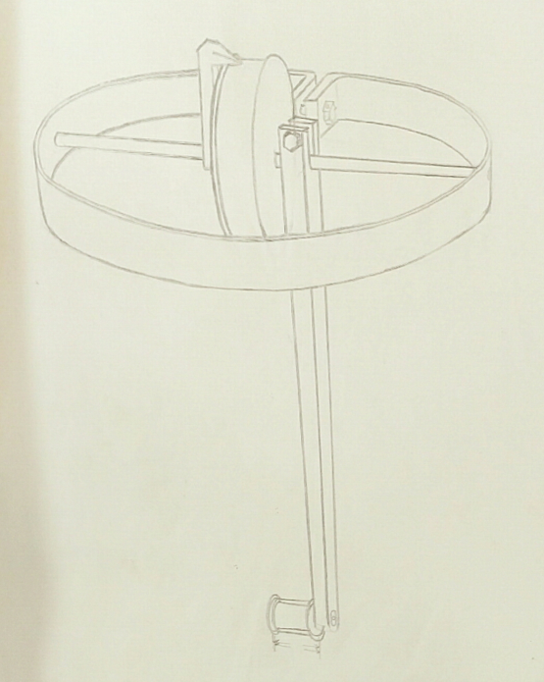
Figure 7: Analog tide gauge from 1927 in Jaffa. A float at the bottom, above it a paper roll, and above that the marking pencil. (Calculation division archive at Survey of Israel),

Slide 8
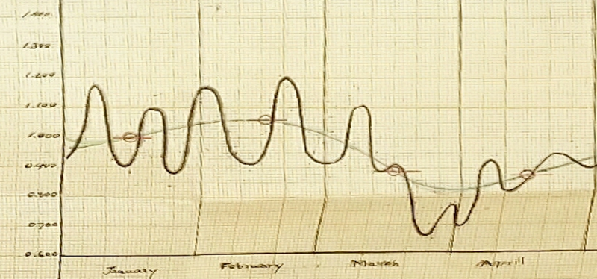
Figure 8: Summary of measures in Jaffa from 1929, monthly mean from January through April. Heights scattered around the 1.000 meter mark. (Calculations division archive at Survey of Israel).

Slide 9
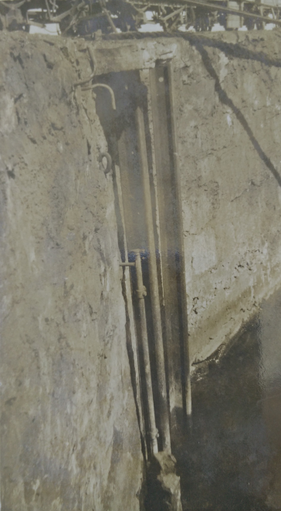
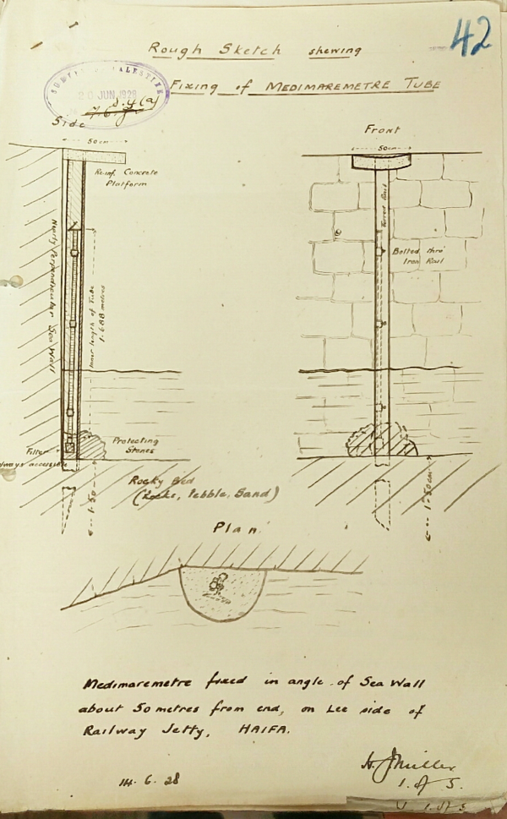
א
ב
Figure 9: Installation of the medimaremeter at the customs quay in the Turkish port of Haifa. A. Photograph of the instrument itself. B. Sketch explaining the installation. (Calculations division archive at Survey of Israel).

Slide 10
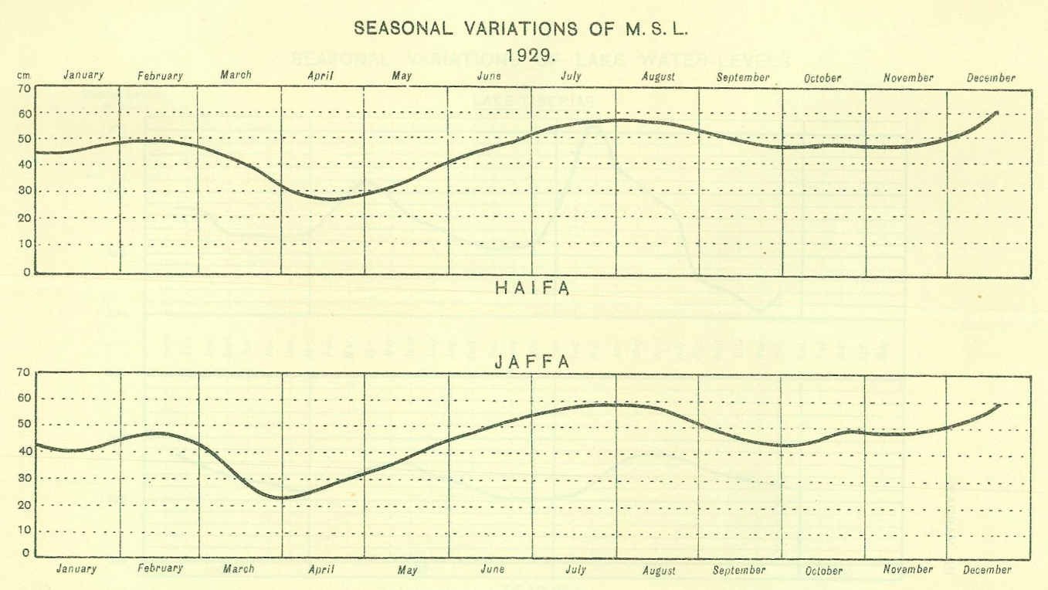
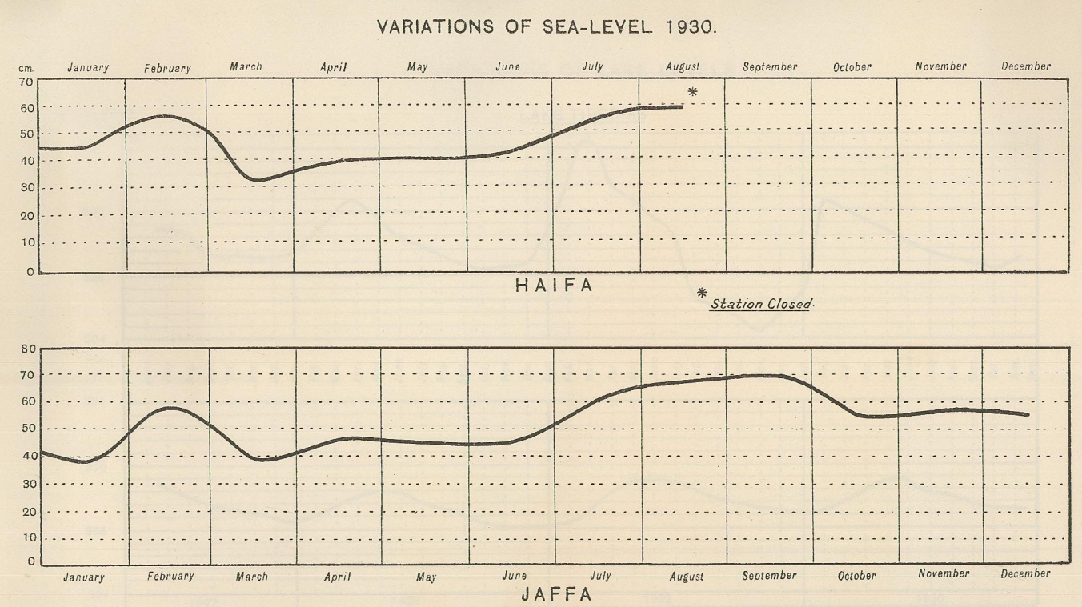
Figure 10: Summary graph of the medimaremeter measurements in Jaffa and Haifa in the annual summary notebooks of the British measurements department. A. 1929, B. 1930. The asterisk denotes the closure of the measurement station at the Haifa port. MSL is 50 cm above the baseline. (Annual notebooks 1929-1930 from the British measurements department.)

Slide 11
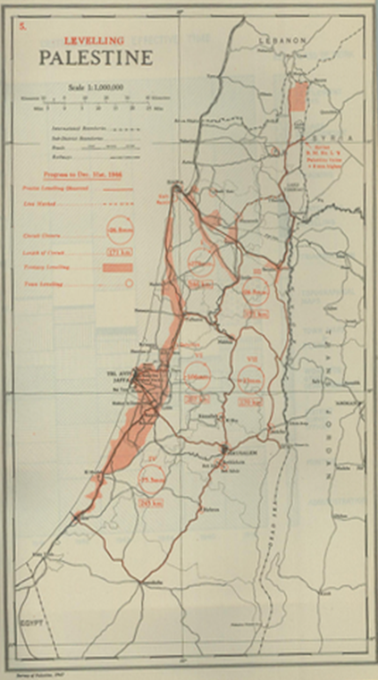
Figure 11: Map of the precision balance loops made by the British up to the end of 1946, and all F points measured in Israel. (Annual notebooks 1946 of the British measurements department).

Slide 12
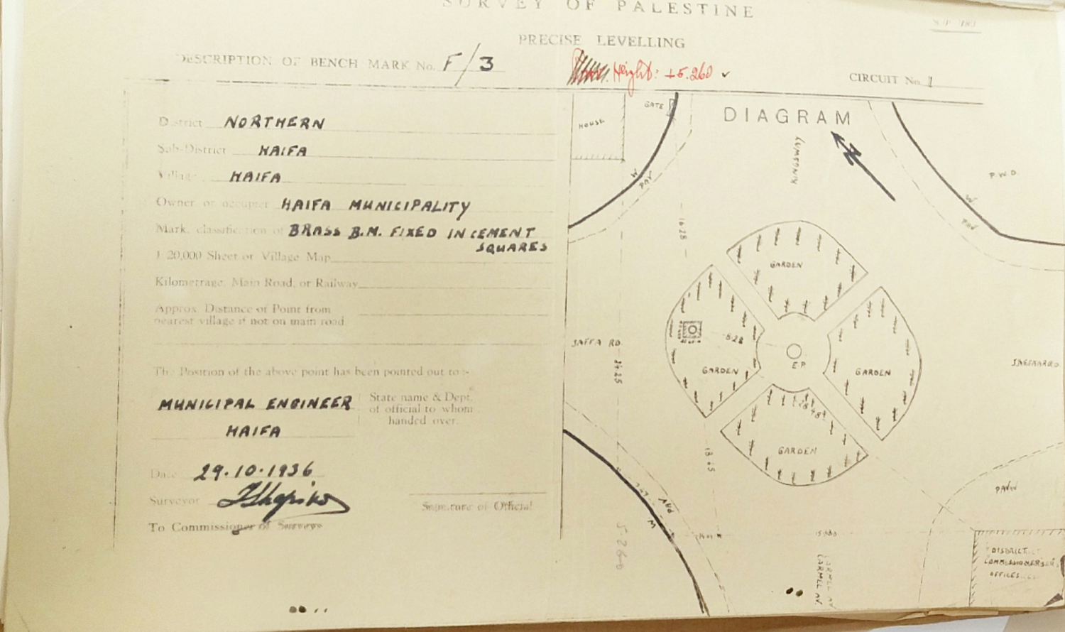
Figure 12: Description of the 3F point in Haifa at the meeting point of the Templar neighborhood and the port. The red ink above states that the height point is 5.269. (Description of F points in the Calculations division archive of Survey of Israel).

Slide 13
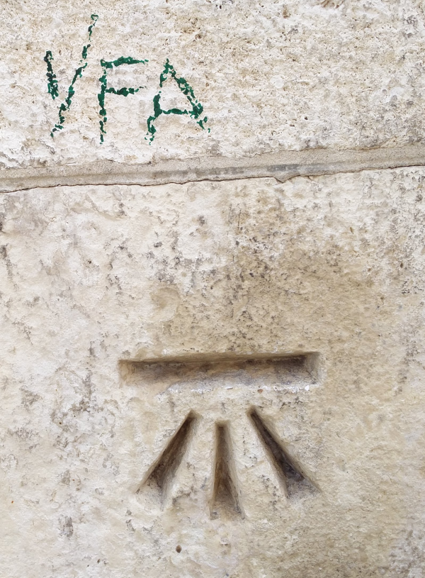
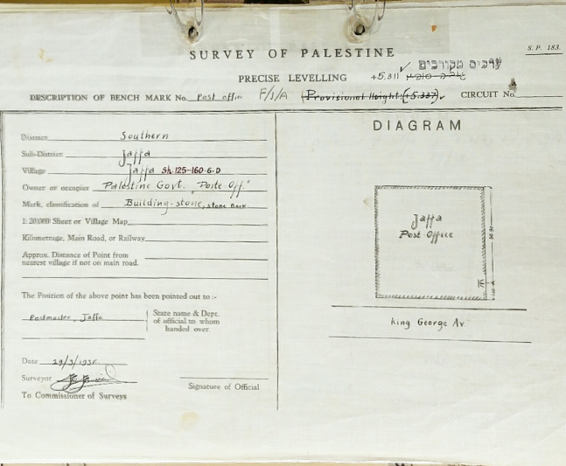
ב
א
Figure 13: A. Description of point 1F A on the Post Office building in Jaffa. The street mentioned is King George Blvd., today called Jerusalem Blvd. (Description of F points in the Calculations division archive at Survey of Israel). B. Marking of the BM carved on the wall of the building and still there today. British height measure: 5.3337, above it the Israeli correction: 5.311. (Photographed by Ayelet Toker 2017).

Slide 14
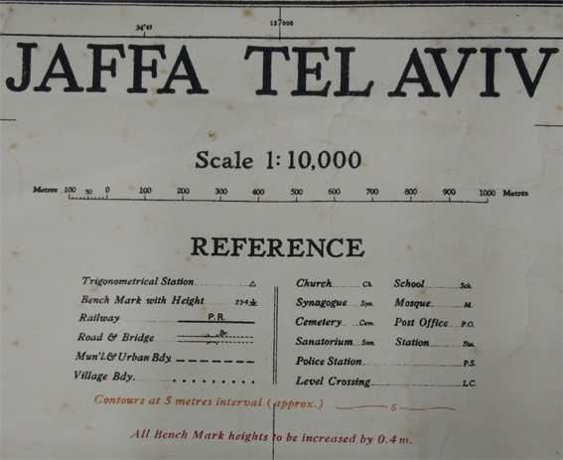
Figure 14: “All Bench Mark heights to be increased by 0.4 m” – red stamp at the foot of the illustration from the map of Tel Aviv-Jaffa, British Mandate survey department, 1:10000, 1936.

Slide 15
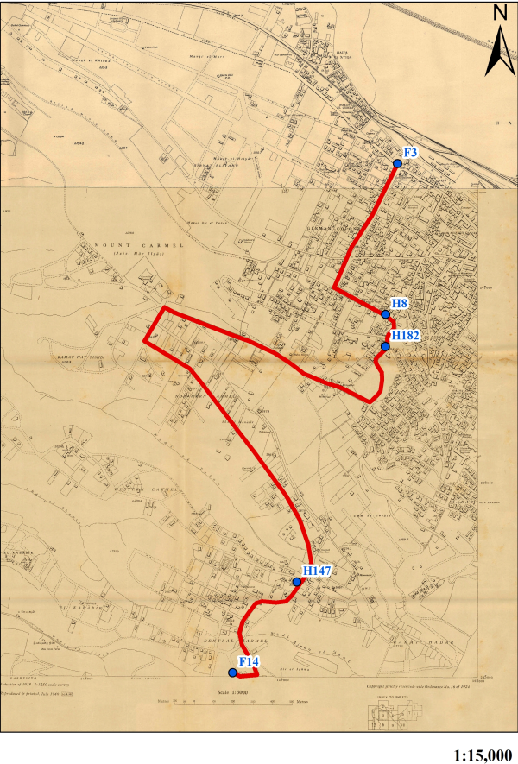
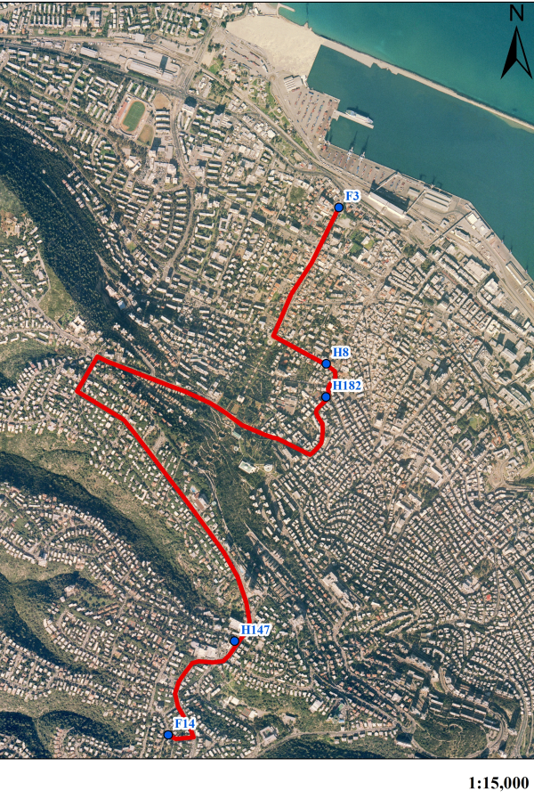
ב
א
Figure 15: Measurement route for reference point 14F measured in 1938: A) On the aerial photograph from (2015), B) On of the historic map from 1924. (Maps archives at Survey of Israel).

Slide 16
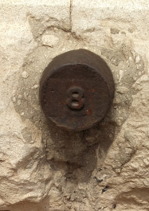
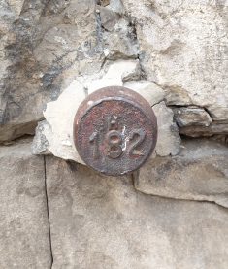
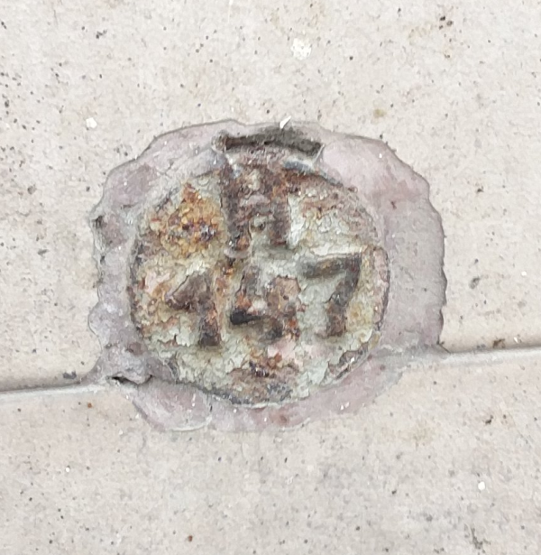
א
ב
ג
Figure 16: Height points discovered in Haifa along the measurement route between 3F and 14F. A) 4 HaGefen Street, B) 30 HaTzionut Boulevard, C. 128 HaNasi Boulevard. (Photographs Eilat Toker 2016).

Slide 17
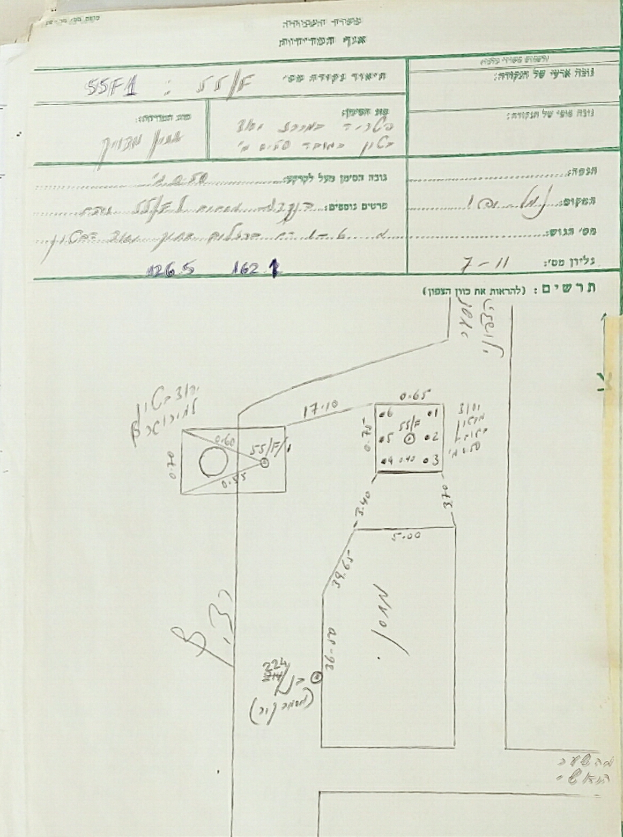
Figure 17: Description of height point 55F was measured in relation to point BN 224, (Description of F point in the Calculations department archives at Survey of Israel).

Slide 18
Figure 18: Historic MSLs according to baseline confirmations established in Israel in relation to the current baseline set in Ashdod in 1995.
MSL (Centtimeters)
YEARS

