Slide 1
Gilboa Engineering
Gilboa Engineering (2010) is a research and development services company in the field of engineering, for the medical, high-tech, agriculture, defense industry, technological innovation, and heavy industry markets.
The company specializes in providing and developing creative research and engineering solutions while thinking outside the box, emphasizing simplicity, creativity and cost reduction.
The company's activity
From concept to production
while providing creative solutions at intermediate stages
of existing processes and developments.
Emphasis on quality and excellence
Among our clients
Start-up companies in a variety of areas such as:
Agriculture, industry, medical, environmental engineering and energy.
High-tech
Medical
Defense Industry
Heavy Industry
Agriculture

Slide 2
Gilboa Engineering is engaged in...
Design Development
Mechanical/plastic
Electro-Mechanical Systems
Planning and Development
Setting up Production Lines
Optimizing Production Lines
Management and control
Project Management
Process Systems
Improve Performance
Product Tree Design and Optimization
Improving Low-cost Production Processes
Composing procedures and Risk Assessment
Integration and Cooperation
Implementing Validation
Process Engineering

Slide 3
Gilboa Engineering – The Founder
Gilboa Engineering was founded by Kobi Gilboa (Mechanical Engineer, Technion), an expert in creative planning and developing mechanical engineering and development.
Experience:
Kobi Gilboa has accumulated 11 years of research and development experience on various medical projects at Rafael Advance Defense Systems Ltd.
Development of innovative machinery and solutions in the medical field, including design services, new product development, new technologies and materials.
Agriculture development and innovation
And a variety of independent or subcontracted engineering services for companies and startups in different areas.

Slide 4
Areas of Specialization
Medical
Product research and development from concept to production – A to Z.
Environmental and Energy Engineering
Developing and planning of recycling facilities.
Agriculture
Heavy/Traditional industry
Setting up production lines and process optimization.
Building in process automation.
Consulting.
Development of agricultural processing machinery.
Improving existing machine.
Developing and manufacturing industrial facilities.
Developing processing facilities.
Improving and upgrading existing systems, adapting to changes in new manufacturing processes.
Consulting and cost reduction.
Project management and consultation for setting up plants.
Reducing costs and improving existing facilities.
Quality Engineering
Process Validation.

Slide 5
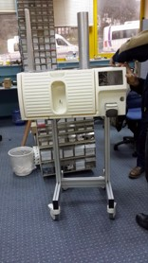
Medical Devices
The medical field makes ongoing developments and improvements, while seeking to conserve manpower and improve efficiency in a variety of processes, from treating typical patients to the execution of complex surgeries. Due to this ongoing need, there are companies engaged in this field who develop medical devices for various areas and specialties.
Some companies have several different products for the same area and some focus on a single product. Some have a product idea or are just beginning product development.
Many projects require support or different ways of thinking about development. Occasionally, they require engineering capabilities for product planning and development, including consultation, support and management of the project.
Through our collaborations with companies in the field, we have developed products and have built and established production lines up to successful Process Validation.

Slide 6
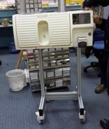
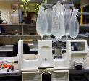
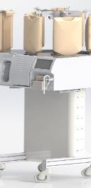
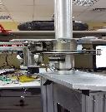
Medical Device Operating Room Equipment ─ Auxiliary Machine for Procedures
A project incorporating plastic, servos, a real-time monitoring and measurement system, user interface, and alert and operation screen.
The Problem
The Need
Project Requirements
Activity Modes
Results
In some surgical procedures, there is a need for ample rinsing of excreted body fluids. This requires a relatively large flow of infusion fluid and frequent replacement. A nurse generally performs the replacements throughout the surgery process.
Creating a free flow, independent of staff member intervention, to exchange the bags during surgery.
Ordering a large number of infusions for the course of surgery, splitting and switching between infusion bags without impeding fluid flow when the infusion bag empties. Compliance with operating room standards
implementing a study on the average amount of fluids used during surgery. Checking different types of infusions.
Conducting infusion splitting and penetration tests. Developing a splitting and inserting mechanism based on tests.
Proof of feasibility for critical process mechanisms. Planning, manufacturing, accompanying and integration.
As part of O.R. preparation, the nurse feeds the desired number of infusions needed to perform the surgery into the machine. There is no need to intervene with infusion replacement when the bag empties. The nurse is available for other activity in the O.R., thus one less nurse is required in the O.R.

Slide 7
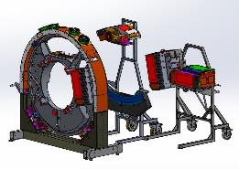
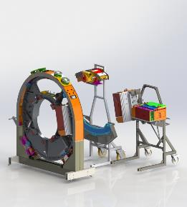
Medical Device Production Line Inclusion – MRI Machines
A project integrating air balancing pistons, familiarity with ESD standards, learning the production process in a short amount of time.
The Problem
The Need
Project Requirements
Activity Modes
Results
In the process of assembling MRI scanning machines, there are high-weight components of about 70 kg per part. Preliminary work is necessary before system inclusion and exact positioning within the system.
An assembly jig array allowing for complementary work to be performed on the component, complying with the ESD Standards, allowing for transportation with its components, enabling transport via hallways and doorways without them turning over, precision/locking the component into the system’s location.
Free access to the assembly in order to complete all component assembly for the system, compliance with ESD standards, loading the component onto the facility by one person, 85 kg carrying capacity, capability of transporting the components without fear of overturning of up to 8 degrees each way.
Work-process documentation: Studying the process from component reception stage at the line within the transportation containers, removal and execution of complementary work on the components and their mounting upon the machine, including the location and access methods, studying the extent of limitations in transition between steps. Displaying concepts and planning arrays.
Assembly jigs for implementing component assembly, reducing the number of people working on each assembly from 3 to 1. Reduce the work-time from the time of component receipt until assembly by 30%.

Slide 8
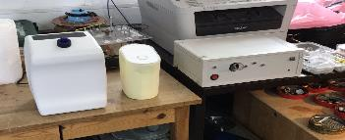
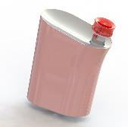
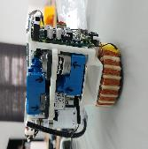
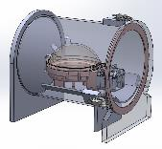
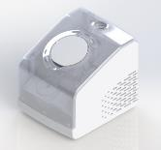
Medical Device Auxiliary instrument for Operating Room – Improved Analysis Process
A project that integrates plastics and electronics,
work, and interfacing with various electronics and product design companies.
The Problem
The Need
Project Requirements
Activity Modes
Results
The device is used in operating rooms, on-site handling of an instrument used in abdominal cavity operations; narrow opening without opening the abdomen, the device is obscured because of fluids clinging to it, thereby limiting the surgeon’s view of the operating area.
Preventing visual impediments during a procedure. Optimizing processes.
Including the prototype device inside a practical casing, working with product designers, reducing to minimum size, which allows for a one-handed grip.
Work-process documentation: Studying the process from component reception stage at the line within the transportation containers, removal and execution of complementary work on the components and their mounting upon the machine, including the location and access methods, studying the extent of limitations in transition between steps. Displaying concepts and planning arrays.
The device is still under development.

Slide 9
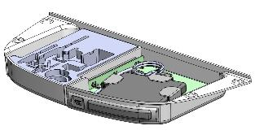
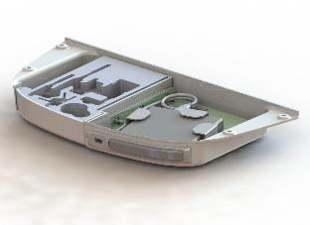
Medical Device Service Drawer – Redesign
A project integrating plastics, electronics, working and interfacing with an existing system, flexible thought, use of off-the-shelf parts.
The Problem
The Need
Project Requirements
Activity Modes
Results
A service drawer in use as part of an operating machine would collapse after a number of times being opened by the surgeon during procedures.
Preventing failures when opening and closing, improving drawer storage area, and a defined arrangement for each drawer element, installing a CD drive and USB reader.
Existing service drawer in machine for operating room use, the customer requires a resolution for the drawer crash problem after a number of uses during a procedure, distinct locations for the drawer’s service components, adding data storage components and retrieval by a removable component. Separating the areas in the tool drawer and data drawer, composing a BOM of all system components, interfacing with the existing product without altering the existing product, except for a critical component.
Collect several drawers and checking failed mechanism, reviewing existing models and comparing them to the existing system, presenting a replacement solution and implementing design, producing one array, and repeatedly opening and closing to check for failures.
The working drawer replaced the existing mechanism. Simple assembly without altering the existing machine. Prevention of problems of drawer failure in on-site machines by simply replacing with a new drawer, on-site implementation.

Slide 10
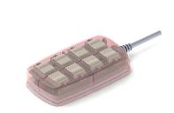
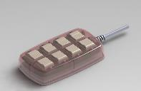
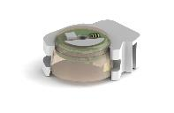
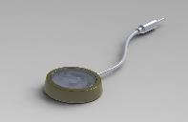
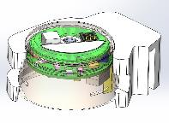
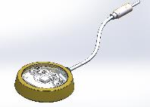
Medical Device Development of products that integrates plastics and electronics
A project that integrates plastics and electronics, working and interfacing with an existing system, flexible thinking, use off-the-shelf parts, working with different disciplines.
The Problem
The Need
Project Requirements
Activity Modes
Results
Development of systems integrating electronics and plastics for various fields in medicine and electronics
Development of various products integrating electronics, plastics, and housing.
Development project in various fields in the high-tech industry, projects integrating electronics and plastics, interfacing with new or existing systems, working with designers, various manufacturing options in process development and going to production.
Studying the extent of the need for various projects, working with various project groups, proposals and on-the-go problem-solving while making progress, prototype production in printing technologies, and gaining familiarity with various materials.
Different products in different fields.

Slide 11
Automation – Medical
The need for ongoing development and improvement of production lines in industry, particularly in the medical field
Requires switching to automatic or semi-automatic machines, with an emphasis on reducing the number of employees involved in the production process and/or product assembly.
Additionally, there was also a requirement that the machine conduct a self-inspection of the project quality and have the ability to sort out at the end of each sub-phase of the process, thereby reducing the number of complete systems that were disqualified because of a recurring need for disassembling and reassembling. In most cases, this is a manually implemented process which increases total product cost.
Switch to full or semi-automatic machinery
Allows for reliable and stable production, with very low quantity of rejects, and performing production line sample checks.
The medical field takes the production issue one step further and performs validations for the production line, machinery, and processes, and thereby increases the production stability up to zero rejects, and high repeatability as well as production stability and reliability.

Slide 12
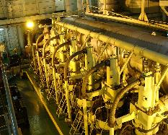
Automation – Medical
Development of machines for production lines
Requires deep familiarity with advanced technologies, adaptability of off-the-shelf components for maintaining machinery production costs, except for special cases where there is no other option and the development of designated components is necessary.
Additionally, the product requires studying the finer details, and the existing assembly process. Sometimes this requires changes, carrying out product adjustments to automated production systems.
Machine development stages are conducted in collaboration with the client, thinking and considering various production rates to match market requirements, or adapting an existing machine array to enable continuous production line work without impediments between one process and another in the case of dependence between machines.
Gilboa Engineering is experienced with the development of products, accompanying and constructing production lines while collaborating with companies in the sector.
The company has been involved in machine development, characterization, planning, adapting to an existing line, constructing new lines, construction management, simulation and placing an array on-site, integration, composing manuals, conducting training, and more.

Slide 13
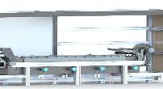
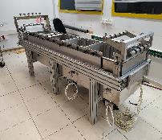
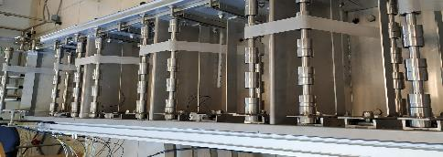
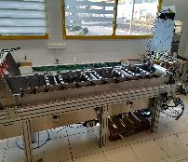
Automation Machine Development of Medical Processes – Cleanroom Compliance.
A project integrating pneumatics, user control and user interface and locking users according to definitions as part of regulations.
The Problem
The Need
Project Requirements
Activity Modes
Results
A multi-component medical product, where the main part is produced from a screen roll of between 100 to 300 meters of varying widths. It is necessary to clean it before introducing into the cleanroom.
Developing an automated process for cleaning the components, complying with cleanroom requirements, flexible adjusting for parts of different sizes and lengths, serves as part of an entire production array, requires speedy adjustment to the production line rate, and the ability to comply with process validation.
Cleaning parts of different sizes and lengths, emphasizing adjustment and transition without requiring tools. Interfacing work speed to production speed of the product assembly line. Required workspace – Cleanroom.
Studying the existing process-line cleanup. Research and development of a new process. Implementing tests. Submitting samples to the laboratory for checking the cleaning quality of cleaning and germ contamination. Proof of feasibility for critical mechanisms. Manufacturing and assembly.
A machine that optimizes production speed and complies with production time, reducing the number of people involved in the process to only a single person. Cleaning quality at a level higher than that obtained in the old process.

Slide 14
Environment and Energy Engineering
The field of environment and heavy industry is undergoing technological and procedural advancement
In environmental engineering, waste recycling technologies are introducing the use of natural reactions that are created among various natural materials, these would take place anyway without human involvement, but with process improvements and bringing it to a controlled facility, it can be enhanced while reducing the side effects of odor and fluids, and germ sterilization.
Another aspect of environmental engineering in industry is the field of simulating the processes resulting from the harnessing, transportation, and development of products, which require failure resistance for day-to-day functioning. By developing simulated systems for this area, they can be researched under laboratory conditions while simulating the real situation, enabling acceleration of product-aging processes, expediting breaking-down processes, and so on.
In collaboration with companies in this sector, we have developed machinery for various fields of agriculture. In some cases, we have significantly improved existing machines, emphasizing low costs and reducing the manpower involved in the process.

Slide 15
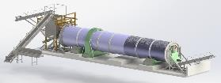
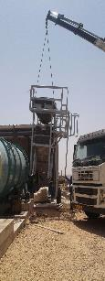
Environmental & Energy Engineering Sludge-to-Compost Conversion Array
A project that integrates hydraulics, control and end-user protection systems, finding advanced production technologies for non-standard sizes.
The Problem
The Need
Project Requirements
Activity Modes
Results
Accumulated sludge in wastewater settling pools requires evacuation after one or more months, otherwise the pool will be “choked” – the sludge’s height will significantly reduce the pool’s volume, so that the fluid volume will significantly decrease.
Creating a sludge recycling system, while sterilizing the bacteria during the process, so when it is finished, a compost mixture is obtained for dispersing over the fields and orchards. The aim is replacing spreading cow manure and reducing environmental odors.
A company came with an existing process, and a relatively small device that partially works with multiple faults throughout the process, requires development and research of existing system failures, planning new recycling arrays dependent on recycled waste, on-site placement plans, working with environmental development companies and construction engineers and architects, automatic feeding array without a person's involvement, adjusting the array to different wastes according to the area and/or the factory to which it is associated, accompanying the construction and the manufacturers,
Studying the process with the customer for the production of compost. Transition of the existing facility and improving it to work continuously and without problems, the development of new arrays according to the materials fed for recycling, adapting production quantity according to the sludge supply structure according to compost requirement, testing critical system mechanisms and failure points.
The processing arrays of various kinds of organic waste, from sludge in settling pools, chicken cadavers, up to paper. Compost production is carried out within a few weeks, significantly reducing naturally created processes without a person's involvement, without environmental odors and pollution; all the waste entering a recycling array, is sterilized and returned to fields and orchards as compost. No chemicals are used at all for the process.

Slide 16
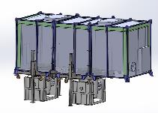
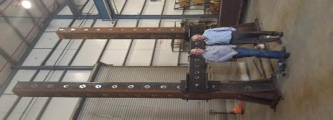
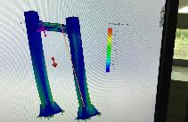
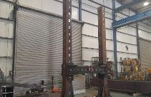
Energy & Environmental Engineering Bridge Loading and Harnessing
A project incorporating advanced building materials, non-standard sizes, thinking outside the box, adapting to a unique structure and size, integrating existing systems and concepts in different sizes.
The Problem
The Need
Project Requirements
Activity Modes
Results
In the defense industry, as part of environmental engineering activity, testing of systems that simulate real-life processes occurring in a system during the actual military activity it is associated with. Since the systems differ in their sizes and working conditions, a dynamic testing system is required that can be modified, adjusted to testing needs and simulating the environmental conditions in which the system will operate.
Design a "flexible" array with the ability to match the required tests. Ability to disassemble and re-assemble by two to three people in a very short time.
Easy to operate and adjust for tests to be implemented, capable of bearing weights of up to 50 tons at frequencies of 5-8 Hz, working temperatures of -20 to 80° C. Operate and change the array structure with up to 3 people and in a very short time. Structure modularity: Project accompaniment and installation, including user training.
Obtaining SOW from the client defining array requirements, project start meeting, present schedule, marking points with special difficulties for which non-standard solutions need to be found, design concepts, implementing DR, PDR, CDR, carrying out strength analysis, notifying manufacturers and choosing a manufacturer acceptable to the military system, and compliance with MIL standards. Accompanying production and installation at client’s site, user training.
Flexible testing salutations that enable testing and examination of various bodies and systems according by their implementation in various environmental conditions, adjustable to theoretical calculations performed by the engineers, an easy-to-use array to operate and modify to the client’s requirements.

Slide 17
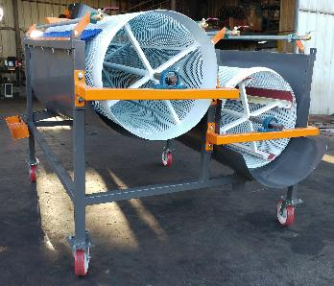
Agriculture
In recent years, the agricultural field has undergone significant changes and optimization through the introduction of machines with advanced technologies. As a result, agriculture has become quite like a high-tech field.
Introducing advanced machinery allowed for improved processes and reduction of manpower, which is the main cost component alongside Israel country’s dearth of resources.
Cooperation with companies in this sector enables us to develop machinery for various areas of agriculture. In projects we implemented, we have succeeded in significantly improving the existing machines in the sector, while reducing both the processing and manpower costs involved.

Slide 18
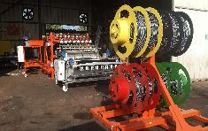
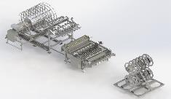
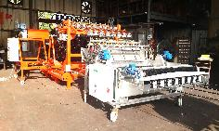
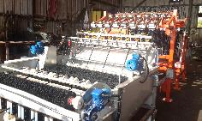
Agriculture Roll-up and Renewal of Buried Irrigation Systems
A project integrating pneumatic control, maintaining roll-up speed in relation to the constant speed of pipe movement, limit stretch, worker protection.
The Problem
The Need
Project Requirements
Activity Modes
Results
Mushroom irrigation is performed by wetting rather than sprinkling, the benefit of wetting is that the entire substrate receives water in a uniform amount, while the sprinkler does not always cover the entire area. The main problem is mushroom vulnerability to fungus, the fungus remains wet and develops further. Therefore, the wetting method was invented. The disadvantage of this method is in the need to clean the tubing from bedding remains and disinfection, for the purpose of reburying it for the next growing cycle. This takes a long time and a great deal of manpower.
Expediting the cleaning and disinfecting process, saving manpower and time, preparing for automatically re-burying as the growth bedding is laid down.
Developing a machine for cleaning and preparing for reburying the tubing, rolling up onto a uniform structure of organized tubing, a uniform and orderly formation of the number of rolls in parallel, restraining tension on the tubing to prevent damage and maintaining tube quality, adjusting to the buried lines from different companies, simple operation by two workers, disinfection process, cleansing and drying as part of the process, and low production costs.
Studying the burial method by visiting various growth habitats, studying the cleaning process that is currently being performed by workers on-site, characterizing an automatic process with an emphasis on critical systems for testing as part of a proof of feasibility, constructing a "flexible" array for making changes and adjusting for the site, completing process development by feedback from on-site, and completing construction of the array.
Manufacturing an entire array, for the rolling up, disinfecting and cleaning irrigation piping for reburial for the mushroom-growing sector. The system has emerged in a number of derivatives, adapting to the grower’s size; the entire array is supplied to sector growers in several countries worldwide.

Slide 19
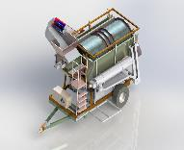
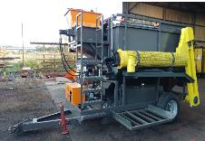
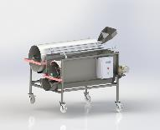
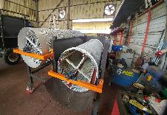
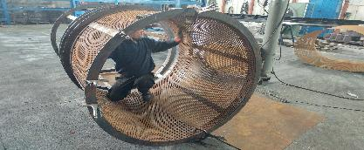
Agriculture Seed Production Process
A project that integrates hydraulic and electrical systems with servos in a wet environment.
The Problem
The Need
Project Requirements
Activity Modes
Results
The seed production process begins in the field with crop harvesting. In the past, this was done by a tractor towing a station with many workers feeding it. A large number of processes later were required for separating the seeds, but a substantial portion of the seeds were damaged during the separation stages.
Planning and developing a three-stage array to remove and clean seeds from different vegetables and sizes, while shortening today's existing process.
Integrates a different number of solutions to a limited number of machines, according to the machine’s place in the production process, field, secondary cleaning line, and sifting. Semi-automatic process, reducing manpower.
Studying the existing process, from the harvesting stage in the field until transferring to the seed production line. Studying each machine and its role significance of each process activity, offering alternatives, examining critical process assemblies, for each stage, planning sending to manufacture, accompaniment and production support, composing machine manuals.
The machines were given to customers, in the case of this project, the final client is not from Israel, including composing machine files.

Slide 20
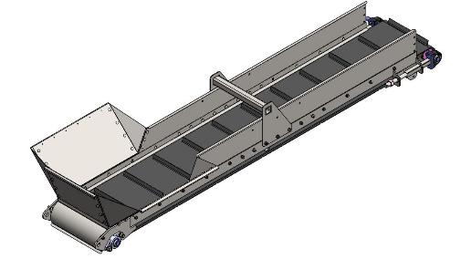
Agriculture Conveyors
A project that integrates hydraulic and electrical systems with servos in a wet environment.
The Problem
The Need
Project Requirements
Activity Modes
Results
Process-adjusted conveyors and/or machinery in the agricultural sector
Planning and adapting new or existing conveyors for existing or new machines in various agricultural fields.
Upgraded or rebuilt machines, the need to adapt conveyors for them to comply with the new requirement, whether regarding work rate, angles, transportation distances, or the type of transported product.
Studying the existing process, from the harvesting stage in the field until transferring to the seed production line. If necessary, studying the production line, collecting data, movement rate, product type, new or existing interfacing, planning and sending to production.
Transport systems are tailored to the requirement.

Slide 21
Traditional/Heavy Industry
The traditional/heavy industry is known for its process conservatism and "if it ain’t broke, don’t fix it” attitude. But this industry also requires optimization, upgrading and renewing of the existing elements, so that it can continue to thrive in the face of competition in an ever-evolving market.
In this industry, one must be very creative, gain familiarity with various mechanical disciplines and aspects, integrating technologies from various/advanced fields into conservative areas. This is in order to save R&D costs, but also to advance and upgrade the technology in these areas.
By collaborating with companies in this sector, we have developed machinery and installations for various sub-sectors. In some of the cases, we have significantly improved existing processes, emphasizing low costs and reducing the manpower involved in the process.

Slide 22
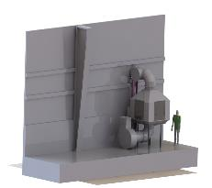
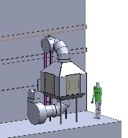
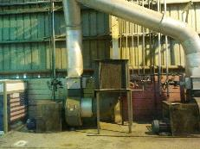
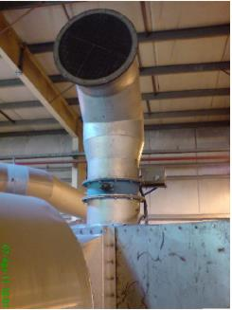
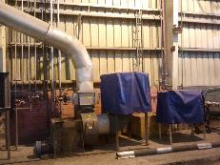
Traditional/Heavy industry Upgrading Air Exhaust and Cooling System
A project integrating existing systems, interfacing with differences between them, creativity, and automatic dampers for air routing.
The Problem
The Need
Project Requirements
Activity Modes
Results
In glass manufacturing it is necessary to implement cooling. This process uses large quantities of filtered air. The air temperatures greatly differ between winter and summer and this poses a problem. In summer the air is too hot and is insufficient for cooling, and in winter the air is too cold for cooling, causing cracks in the glass due to large temperature differences.
Planning a "flexible" design with the ability to adjust to existing air cooling and filtering systems, capacity to choose air exhaustion, based on seasonal air temperature variations, by means of automatic routing of the air streams.
Interfacing with existing systems, modularity in manufacturing components, maintaining the current system's air capacity, easy access for simple filter cleaning by one person, accompanying production and assembly.
Studying the air flows and falls in capacity as dependent on distances and duct diameter. Studying the existing system, reverse engineering the existing array, designing a system that will be laid over the existing system, presenting the array to the customer, and sending to production.
An air-exhaust system that routes the exhausted air from the room in winter, and from outside the room in summer, thus the system maintains the difference of air temperatures for cooling the glass whether in summer or winter.

Slide 23
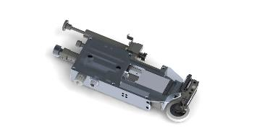
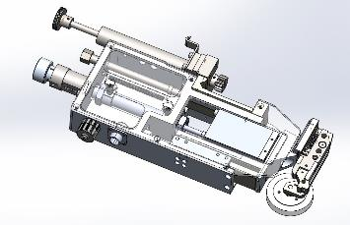
Traditional/Heavy Industry Upgrading Automatic Cutting System
A project integrating existing systems, interfacing with differences between them, creative thinking, and automatic dampers for air routing.
The Problem
The Need
Project Requirements
Activity Modes
Results
A system for cutting plates, purchased in Germany but no longer manufactured, began to "create" many faults and to damage the production line capacity.
Designing a new cutting system, based on the same cutting concept, is based on components that have a single replacement option for a component and, if necessary, to manufacture an adapter for the same component due to the manufacturer’s modifications.
Improving the system and planning new components, the interfacing the existing machine and the ability to work with the old concept of cutting arrays.
Studying the existing cutting system, modeling the interface component, finding off-the-shelf components with the same working principle, the manufacturer's shelf life for future component production. System planning and manufacturing.
A project integrating existing systems interfacing with differences between them, creativity, electronic and pneumatic components.

Slide 24
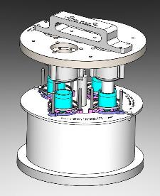
Traditional/Heavy Industrial Manufacturing Press Mold – Composite Materials
A project involving gaining familiarity with new production processes in the field of composite materials.
The Problem
The Need
Project Requirements
Activity Modes
Results
Improving production of an existing production line.
Improving the quantity of products exiting at one pressing, which was very low. Due to demands for large quantities of the product, improvement of the production process was required.
Use of presses with a specific and limited aperture, a significantly larger amount of products that will quickly return the cost of investment and on the other hand will significantly improve production time.
A multi-cell template that produces 4 parts at the same time as the individual template produces 1 part, while the work template makes a new set so that it opens and is introduced without waiting, making for a 50% shorter feed time than the single-item template. Production is optimized by a factor of 4.
A project integrating existing systems interfacing with differences between them, creativity, electronic and pneumatic components.

Slide 25
Industrial automation Developing Machine Processing for the Production Line
A project that integrates pneumatics, a control array, and user interface.
The Problem
The Need
Project Requirements
Activity Modes
Results
Automatic placement of hard items on plastic wings integrated with rubber areas, high work rate, without causing damage to plastic and rubber parts.
In the automotive industry: improving work rates, introducing hard parts into plastic ones with rubber areas, execution of time costs and on-the-go inspection during assembly, marking off with a “Pass”/”Fail” stamp.
Designing a machine for the automobile industry to improve quality of insertion of a hard part into another piece made of plastic and rubber. This part comes in right and left versions and in two different lengths. Performing an on-the-go component assembly check during the process, and marking with, “OK”/”Not OK.” The customer determines the machine size and location in the production line.
Studying the assembly process, examining the insertion of hard parts into different products, defining the quality check — Pass or Fail. Presentation of concept and improvement, receiving comments, planning and sending to production, integration, and activation.
A machine was introduced into the line and improved the process, significantly increasing the work rate. One person operates the machine, and there is a very low quantity of rejects in comparison to the previous manual process.

Slide 26
Gilboa Engineering
Gilboa Engineering (2010) provides a professional and reliable engineering service with flexible, open-minded planning. We involving the client every step of the way, while emphasizing sticking to a schedule.
At the end of the process, all the material is at the client's disposal in live files, so there is no dependence between the companies.
We offer a full service package from concept stage to manufacturing, including the constructing production lines, implementing equipment and process validation (Process Validation, TMV, IQ/OQ/PQ), performing pFMEA risk analysis, and writing high-standard work procedures and instructions.
Our clients include:
Plasmatica, Chromagen, Phoenicia, Netafim, Nova Plasma, Rafael, GE, Ziv Av, and many others.
We would be delighted to have you among our clients...
052-3123440
kobigil2@gmail.com

