Slide 1


SEL Simulation as a Stimulus for Development
Research Forum on Simulations in Education
Khawla Zoabi
Iman Abu-Hana Nachas
Hanadi Abu Ahmed
22.6.21

Slide 2

Research Rationale
Despite the importance of developing social and emotional learning (SEL) for the education system, we still need to understand how to promote these skills (Esor, 2019).
In the field of education, simulation is a tool that can help support, instil, and improve personal and professional skills, such as self-awareness, knowing the other, and interpersonal communication (Weissblueth & Linder, 2020).

Slide 3
Research Topic
This research examines the contribution that simulation can make to SEL development in a specific cultural context; in this case, in Arab society.

Slide 4
Arab Cultural Indices
Centrality of Religion
Collectiveness
Unequal Allocation of Gender Roles
(Khawla Zoabi, 2013)

Slide 5

Simulation and the cultural context
Research shows that culture influences an individual’s ways of thinking, viewpoints, and decision-making (Zoabi & Anson, 2017; Hoshino-Browne et al., 2005).

Slide 6

RESEARCH QUESTION
How does simulation as an educational tool contribute to developing SEL among teachers from an Arab cultural background?

Slide 7
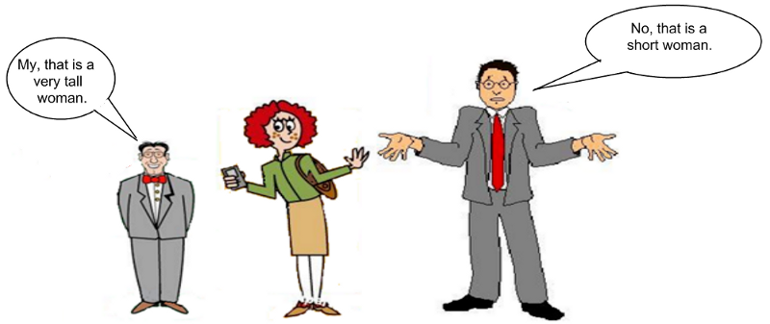
Methodology
The research was conducted using an integrated quantitative-qualitative Mixed Method approach.

Slide 8
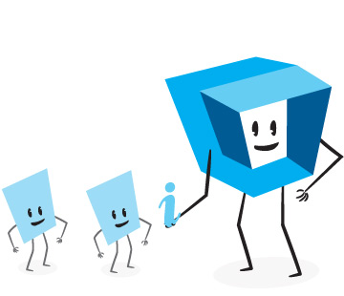

PARTICIPANTS
Control Group
N=65
Intervention Group
N=62
Two Groups of 15 Participants
Two Groups of 16 Participants
127 Arabic teachers studying for a Master’s degree (second year) in different programs at the Arabic College for Education in Haifa

Slide 9
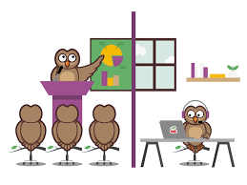


PROCESS
Control Group
Remote Online Course
Intervention Group
Simultaneous Course on Zoom
Notes:
The remote online course was based on reading materials from the course website and three focus sessions with the help of presentations.

Slide 10
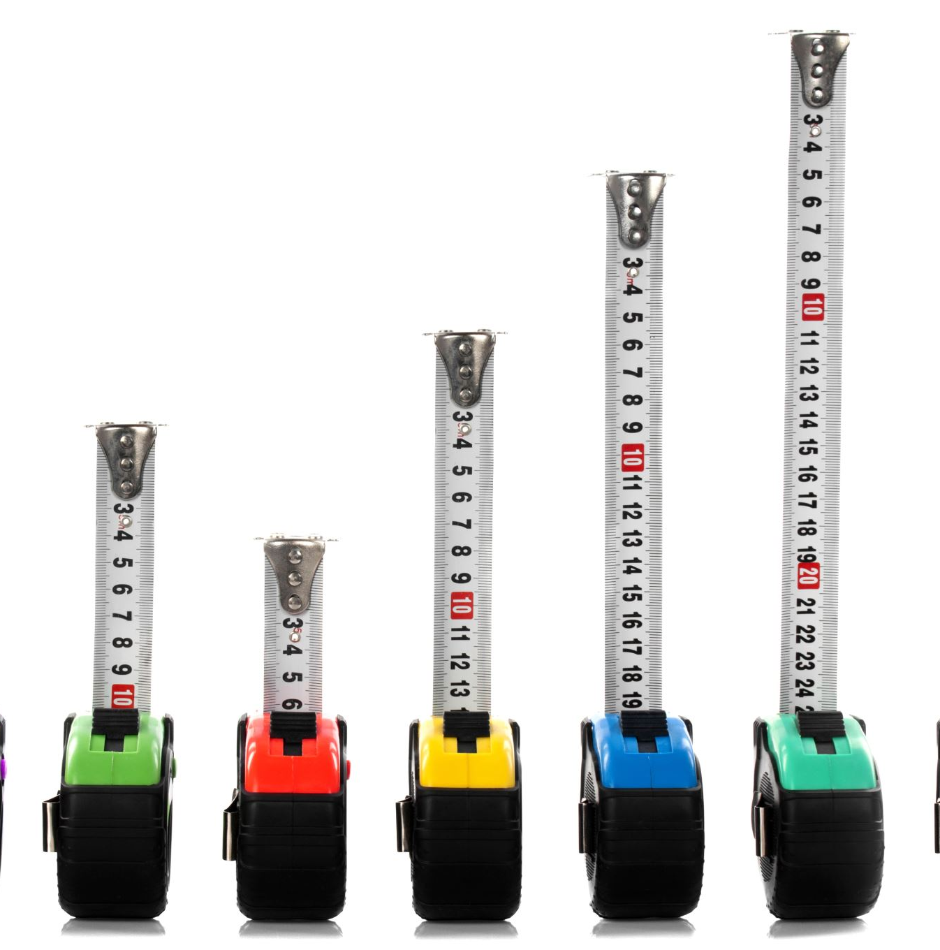
RESEARCH TOOLS
SEL skills survey
Cultural identity survey including indices for collectiveness, religion, and gender equality
Five scenarios according to the five SEL components in the CASEL model
Semi-structured interview to assess the teachers’ perceptions about the contribution of using simulation tools
Notes:
מודעות העצמית (Self-Awareness);
ניהול העצמי (Self-Management);
מודעות חברתית (Social Awareness);
מיומנויות יחסים בין אישיים (Relationship Skill);
יכולת קבלת החלטות אחראית (Responsible Decision Making).

Slide 11
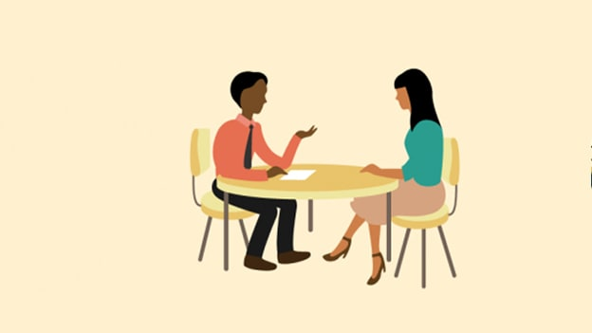
SEMI-STRUCTURED INTERVIEW: SAMPLE QUESTIONS
How did you feel during the course that included a simulation?
How did your participation in the simulation contribute to developing your self-awareness?
How did your participation in the simulation affect your interpersonal skills?

Slide 12

The simulation meetings
Through Zoom, colloaborating with an actor and a moderator
Scenario length of eight minutes
15/16 student participants
The scenarios were drawn from the cultural context of the participants: Arab women, teachers and students from Northern Israel.

Slide 13
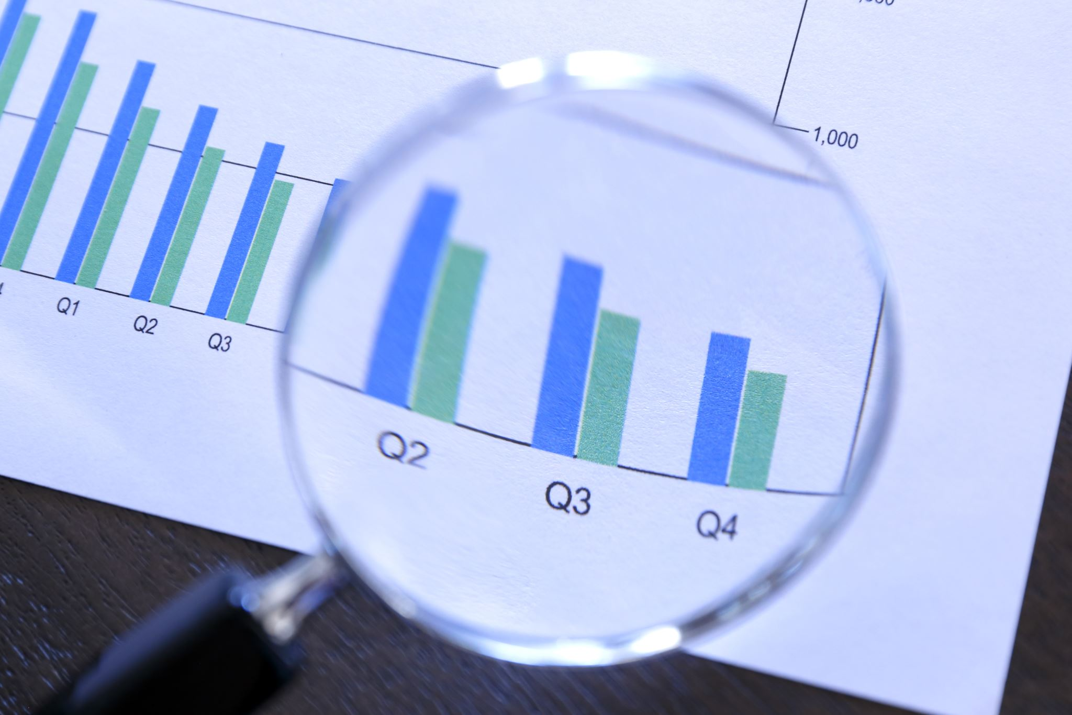
Initial findings

Slide 14
From the sel reliability survey
SURVEY NAME | VARIABLE | VALUE α
SEC-Q | Self-awareness | .79
 | Self-management and motivation | .76
 | Social awareness and pro-social behavior | .74
 | Decision-making | .73
 | General survey | .84
The SEL skills survey underwent content review and Arabic language peer review.

Slide 15
From the sel reliability survey
SURVEY NAME | VARIABLE | VALUE α
MESH | Social awareness | .78
Self-efficacy | Self-efficacy | .93
Teachers’ beliefs about Social and Emotional Learning | Teachers’ beliefs about Social and Emotional Learning | .76
General Survey | 60 statements | .94
The SEL skills survey underwent content review and Arabic language peer review.

Slide 16

CULTURAL IDENTITY SURVEY
The cultural identity survey underwent validation and credibility assessment (Awad et al., 2010) according to collectiveness (α=.62), religion (α=.80), and gender equality (α=.92).

Slide 17
SEL SKILL DIFFERENCES BETWEEN THE CONTROL GROUP AND THE Intervention GROUP PRIOR TO THE COURSE
The independent samples t-test found an insignificant difference between the control group and the intervention groups in SEL skills prior to taking the course (t₍₁₂₅₎= 0.22, p>.05) , with an identical average in both groups (M=4.9).
Notes:
Are there differences in SEL skills before and after studying a course on SEL due to differences in the method of course learning (remote learning versus a course based on the use of simulation)?
Theoretically, the lack of difference in emotional social skills from the beginning is attributable to the participants being teachers and educators.

Slide 18
An explanation for the identical average for the control group and the INTERVENTION group prior to the course.
One can explain the identical average in the two groups by the fact that the “Being” style of existence is dominant among educators (Bar-Ziv, 2002; Reichenberg, 1995).

Slide 19
Differences in sel skills among the control GROUP
The paired samples t-test showed that there was no major difference in SEL skills before and after taking part in the non-simulation skills course - (t₍₆₄₎= -1.50, p>.05). The survey average before the course was (M=4.9) and after the course it was (M=5.0).
.
Notes:
Are there differences in the SEL skills before and after studying a course on emotional learning that does not use the simulation tool?

Slide 20
FEEDBACK FROM STUDENTS in the course
Nada: “A constructive and fun experience, mostly helping us gain in-depth knowledge of the psychological and social environment, and providing tools for coping and inspiration.”
Re’em emphasized: “I really liked it, the simulation introduced many new things to me that I already need to change in my life…an exciting experience; it provided me with social skills and [taught me] how to be braver.”
Noal summarized all the skills, writing: “During the course, I learned about really important issues that I had never paid attention to before. Now, though, in every situation, I will take two minutes to think to myself and try to identify my feelings, gather my self-confidence, look deeply at myself, and definitely recognize my strengths in order to continue. I improved my social awareness through empathy, listening, and inter-personal communication.”

Slide 21


challenges......
Running a simulation on Zoom
Composing a scenario based on the cultural indices (a difficult task)
Duplicating the SEL skills model with simulations for the rest of the college’s programs

Slide 22
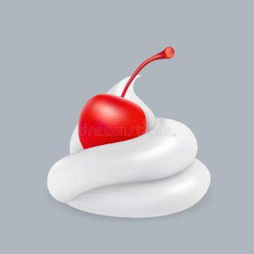
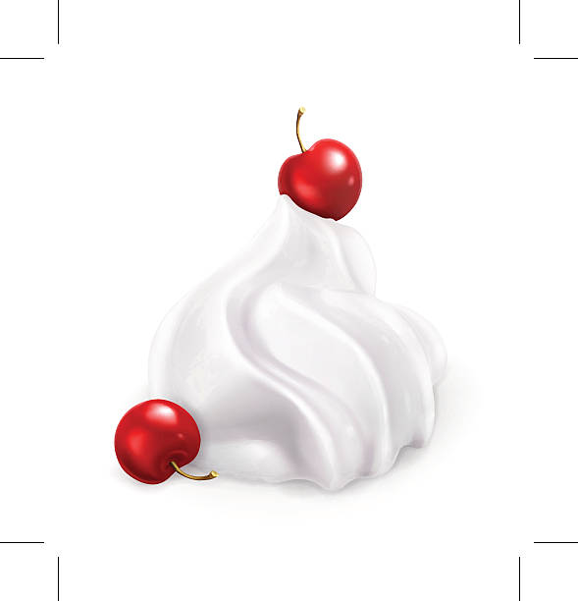
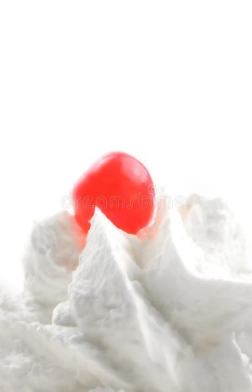
THE CHERRY ON TOP
The researchers’ reflections about the research, which formed an anchor for personal-professional development
The creation of a shared academic discourse, the development of SEL skills, and conducting an educated discussion

Slide 23
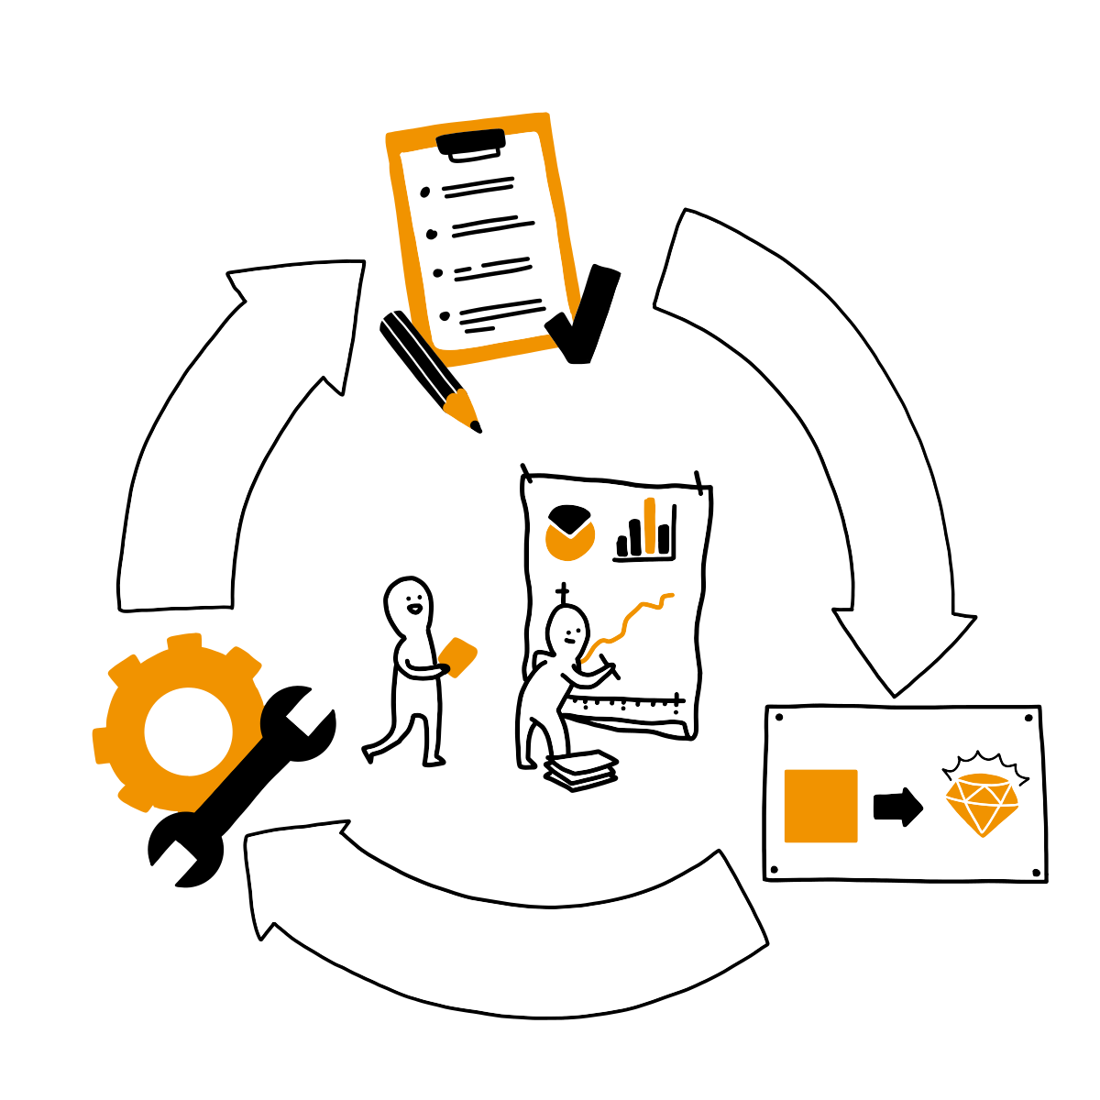
RECOMMENDATIONS

Slide 24


