Slide 1
SEL Simulation as a Stimulus for Development
Research Forum on Simulations in Education
Khawla Zoabi
Iman Abu-Hana Nachas
Hanadi Abu Ahmed
22.6.21

Slide 2
Research Rationale
Despite the importance of developing social and emotional learning (SEL) for the education system, we still need to understand how to promote these skills (Esor, 2019).
In the field of education, simulation is a tool that can help support, instil and improve personal and professional skills, for example self-awareness, knowing the other, and inter-personal communication (Weissblueth & Linder, 2020).

Slide 3
Research Topic
This research deals with the contribution that simulation can make to SEL development in a specific cultural context, namely Arabic society.

Slide 4
Arab Cultural Indices
The Centrality of Religion
Unequal Allocation of Gender Roles
Collectiveness
(Khawla Zoabi, 2013)

Slide 5
Simulation and the cultural context
Research shows that culture influences an individual’s ways of thinking, viewpoints, and decision-making (Zoabi & Anson., 2017; Hoshino-Browne et al., 2005).

Slide 6
RESEARCH QUESTION
How does simulation as an educational tool contribute to developing SEL among teachers from an Arabic cultural background?

Slide 7
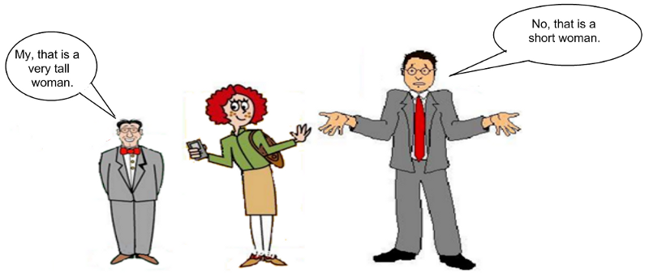
Methodology
The research was carried out using a quantitatively integrated approach –qualitative mixed method.

Slide 8
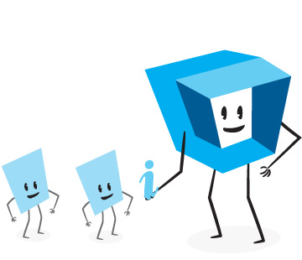
PARTICIPANTS
Control Group
N=65
Intervention Group
N=62
Two Groups of 15 Participants
Two Groups of 16 Participants
127 Arabic teachers studying for a Master’s degree (second year) in different programs at the Arabic College for Education in Haifa.

Slide 9
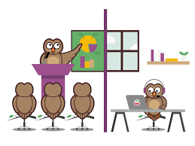
PROCESS
Control Group
Remote Online Course
Intervention Group
Simultaneous Course on Zoom
Notes:
הקורס מרחוק התבסס על קריאת חומרים מאתר הקורס ו3 מפגשי מיקוד בעזרת מצגות

Slide 10
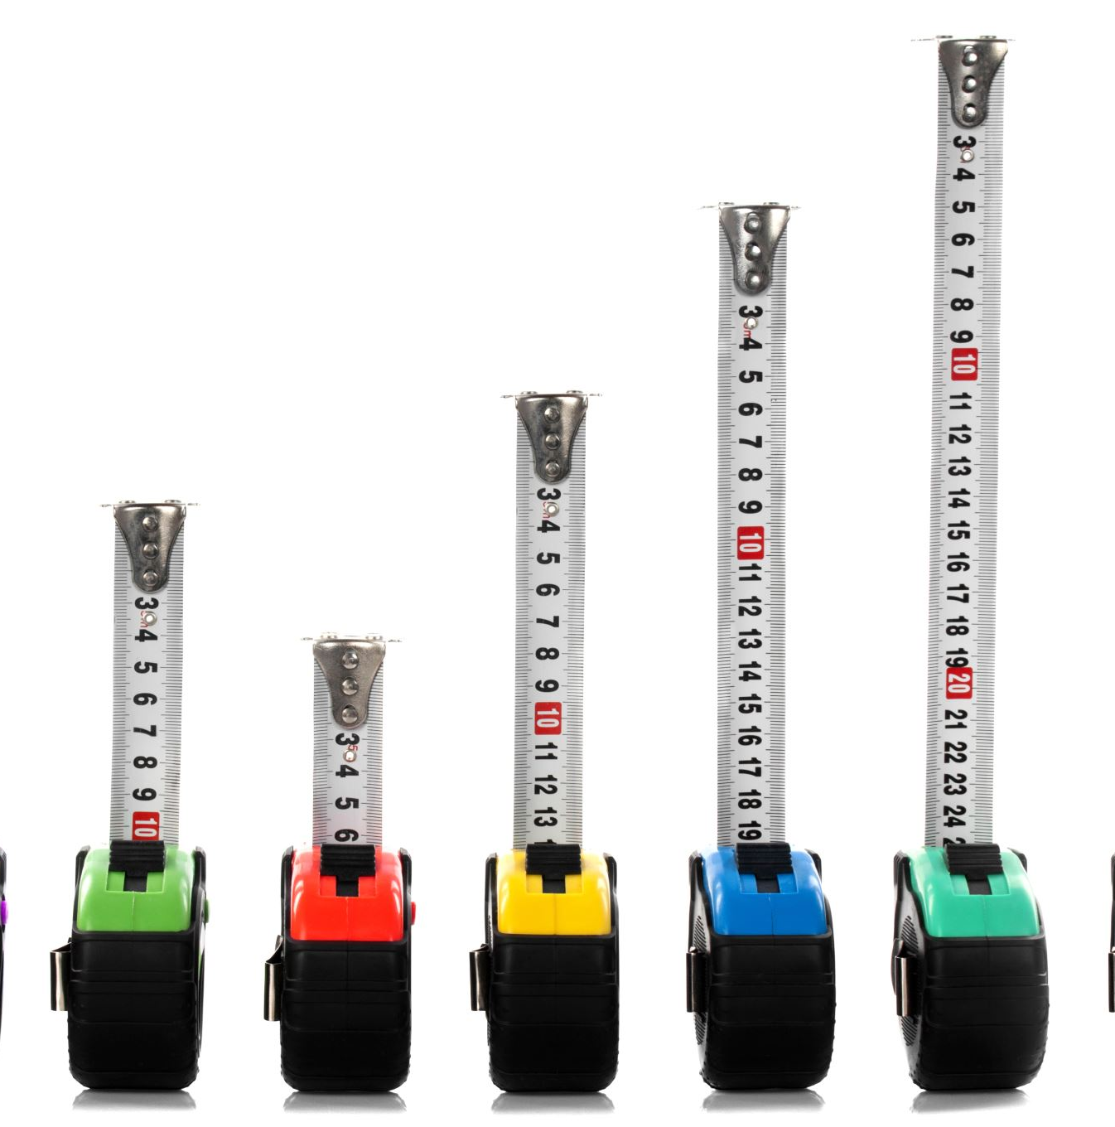
RESEARCH TOOLS
SEL skills survey.
Cultural identity survey including indices for collectiveness, religion, and gender equality.
Five scenarios according to the five SEL components in the CASEL model.
Semi-structured interview to assess the teachers’ outlook regarding the use of simulation tools.
Notes:
מודעות העצמית (Self-Awareness);
ניהול העצמי (Self-Management);
מודעות חברתית (Social Awareness);
מיומנויות יחסים בין אישיים (Relationship Skill);
יכולת קבלת החלטות אחראית (Responsible Decision Making).

Slide 11
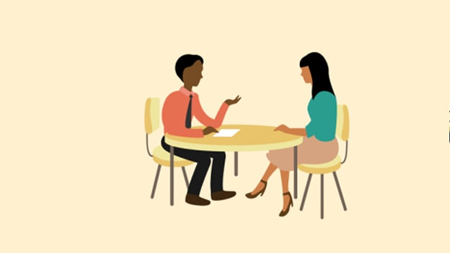
SEMI-STRUCTURED INTERVIEW: EXAMPLE QUESTIONS
How did you feel during the course that included a simulation?
How did your participation in the simulation contribute to developing your self-awareness?
How did your participation in the simulation affect your interpersonal skills?

Slide 12
The simulation meetings
Via Zoom in collaboration with an actor and a moderator.
Scenario length of eight minutes.
15/16 student participants.
The scenarios were drawn from the participants’ cultural contexts; Arab women, teachers and students from Northern Israel.

Slide 13
Initial findings

Slide 14
From the sel reliability survey
VALUE α | VARIABLE | SURVEY NAME
.79 | Self-awareness | SEC-Q
.76 | Self-management and motivation
.74 | Social awareness and pro-social behavior
.73 | Decision-making
.84 | General survey
The SEL skills survey underwent content and Arabic language peer review.

Slide 15
From the sel reliability survey
VALUE α | VARIABLE | SURVEY NAME
.78 | Social awareness | MESH
.93 | Self-efficacy | Self-efficacy
.76 | Teachers’ beliefs about Social and Emotional Learning | Teachers’ beliefs about Social and Emotional Learning
.94 | 60 statements | General Survey
The SEL skills survey underwent content and Arabic language peer review.

Slide 16
CULTURAL IDENTITY SURVEY
The cultural identity survey underwent validation and credibility assessment according to (Awad et al., 2010) collectiveness (α=.62), religion (α=.80), and gender equality (α=.92).

Slide 17
SEL SKILL DIFFERENCES BETWEEN THE CONTROL GROUP AND THE INTERVENTION GROUP PRIOR TO THE COURSE
The independent samples t-test found an insignificant difference between the control group and the intervention groups in SEL skills prior to taking the course (t₍₁₂₅₎= 0.22, p>.05) , with an identical average in both groups (M=4.9).
Notes:
האם קיימים הבדלים במיומנויות הלמידה החברתיות-רגשיות לפני ואחרי לימוד קורס בנושא הלמידה החברתי-רגשית עקב שוני בשיטת לימוד הקורס (למידה מרחוק לעומת קורס המתבסס על שימוש בסימולציה) ?
חוסר ההבדל מנקודת ההתחלה במיומניות חברתיות רגשיות כרוך בזה שהמשתתפים מורים ואנשי חינוך ולפי תיאוריית

Slide 18
An explanation for the identical average for the control group and the INTERVENTION group prior to the course.
One can explain the identical average in the two groups by the fact that the “Being” style of existence is dominant among educators (Bar-Ziv, 2002; Reichenberg, 1995).

Slide 19
Differences in sel skills among the control GROUP
The paired samples t-test showed that there was no major difference in SEL skills before and after taking part in the non-simulation skills course - (t₍₆₄₎= -1.50, p>.05). The survey average before the course was (M=4.9) and after the course it was (M=5.0).
.
Notes:
האם קיימים הבדלים במיומנויות הלמידה החברתית-רגשית לפני ואחרי לימוד קורס בנושא הלמידה החברתי-רגשית שלא משתמש בכלי הסימולציה ?

Slide 20
FEEDBACK FROM THE COURSE STUDENTS.
Nada: “A constructive and fun experience, mostly allowing in-depth knowledge of the spirit and the social environment, providing tools for coping and inspiration.”
Re’em emphasized: “I really liked it, the simulation introduced many new things for me that I already need to change in my life…an exciting experience, it provided me with social skills and [taught me] how to be braver.”
Noal summarized all the skills and wrote: “During the course I learnt really important issues that beforehand I had never paid attention to. Now, though, in every situation I will take two minutes to think to myself and try to identify feelings, try to gather self-confidence, and to look deeply at myself, and definitely to recognize my strengths in order to continue. I gained social ideas like empathy, listening, inter-personal communication.”

Slide 21
challenges......
Running a simulation on Zoom.
Composing a scenario based on the cultural indices (a difficult task)…
Duplicating the SEL skills model with simulations for the rest of the college’s programs.

Slide 22
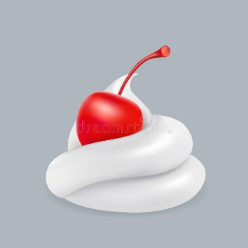
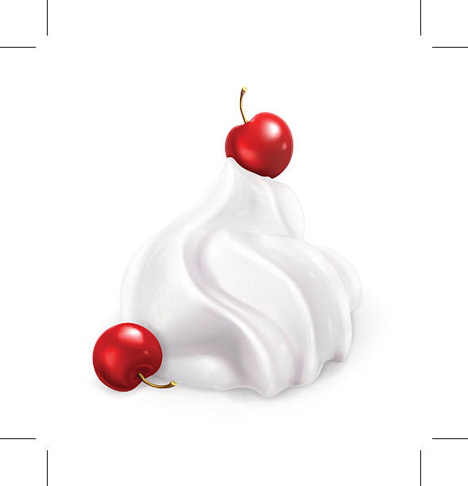
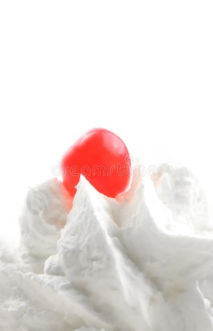
THE CHERRY ON TOP
The researchers’ reflections about the research, which formed an anchor for personal-professional development.
The creation of a shared academic discourse, the development of SEL skills, and conducting an educated conversation.

Slide 23
RECOMMENDATIONS

