Slide 1
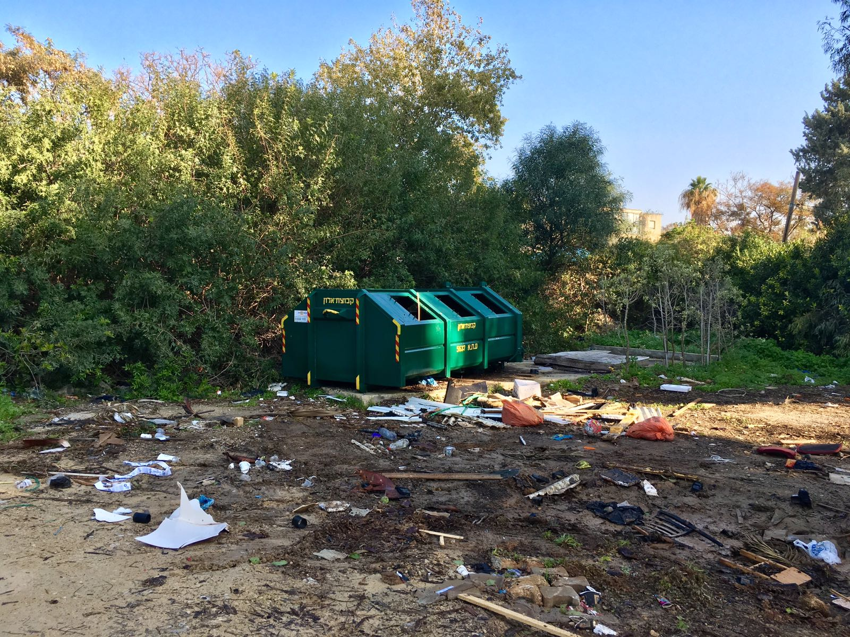
Naturally clean
Cultural change initiative

Slide 2

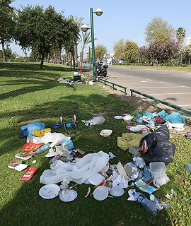
Don’t trash my home
Trash is a symptom alienation from one’s surrounding

Slide 3
Key factors
Public Awareness
Recognizing the environmental and personal effects of littering and trash, as well as the public’s ability to make a change
Suitable trash bin infrastructure
Even distribution in the public sphere, proper capacity and sealing, removal frequency
Enforcement
Promotes change in habits and actions

Slide 4
The future – our overarching goal: social-change driven clean nature in Israel
Clean Spaces
Behavioral pattern change

Slide 5
Making a real change
Effective project duration: 5-10 years
Educational and instructional activity
Enforcement
Suitable infrastructure
Establish the role of the community and the individual as makers of change

Slide 6
Partners and collaborations
Local municipalities
Formal education system
Informal education system
Citizens
Academia
Ministry of Environmental Protection
Public sphere organizations
Nature preservation organizations
Civic enforcement –
establishing public influence
Donors

Slide 7


This time we will make it work
Piecing together the puzzle, turning initiatives into world-changing actions
Education
Municipal and civic enforcement
Information
Advertising campaign
Infrastructure
Unique educational action for change-making schools, including lesson plans for teachers and students.
Unique educational process for the informal education system.
Implementation in all regular Society for the Protection of Nature in Israel activities
Form an activist group for face to face education
Formulating an effective municipal enforcement plan, in collaboration with local authorities.
Create an app to notify about dirty areas.
Report follow-up and goal review.
Feedback between reporter and local authority
Team up with the Cleaning Fund.
Efficient use of infrastructure.
Local authority and municipality-led infrastructure surveys.

Slide 8
Already in Action
Ongoing Initiatives
Public cleaning initiatives for open-air areas
Public city cleaning initiatives
The Minister of Environmental Protection declaring the National Cleaning Day following appeals from children
Tel Aviv city campaign

Slide 9
Project Timing
Field is ready for cultural change:
* Civic initiatives.
* Authorities-lead campaigns and enforcement.
* Electorate year – opportunity to promote the issue.
Plenty more to be done:
* Not all municipalities are the same.
* Current actions are not operating holistically.

Slide 10
Attraction and Information Campaign
Blue collar, Union media, BB&A
Creative
PR
Powerful campaign
Children as agents of change
Public leaders as agents of change
TV, radio, street signs, internet
Public inclusion
Targeted campaign
Project peak timing
Critical mass infrastructure
Focused campaign
Clear cut message

Slide 11
Frontal information
Citizens
Marketing Campaign
Education systems
Local Authorities
Creating an activist network responsible for civic enforcement – hazard reports, urban nature site adoption, collaboration with local authorities.
Creating platforms for collaboration and dialogue between municipalities and citizens.
Forming an active student associations.
Establishing a Leaders Program for decision makers.

Slide 12
Enforcement
Local Authorities
Citizens
Ministry for Environmental Protection
Nature Preservation Organizations
Municipal enforcement – a tool for cultural change | Civic enforcement – establishing public influence
Enforcement by municipal authorities. The project will include improvement of trash enforcement as a standard for local authority participation. Example: enforcement of dog feces collection and smoking in closed areas have led to significant cultural change. | Developing a hazard report system/app. Establishing a hazard management protocol and an SLA for management and reporting party update. Receive report by the relevant authorities and Nature Preservation Organization; follow up. The system will create a civilian network of “watchmen”. Connect between civilians and authority figures.

Slide 13

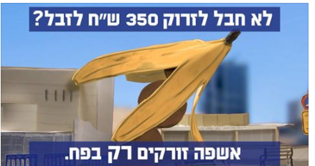
Enforcement in Tel Aviv
Municipal enforcement – a tool for cultural change | Civic enforcement – establishing public influence
We increase enforcement and act on several levels to increase our standard of cleanliness in the city – let’s keep it clean, for everyone. | Trash on the street? Let us know via the +106 app.

Slide 14
Infrastructure
Local Authorities
Ministry of Environmental Protection
Nature Preservation Organization
Federation of Local Authorities in Israel
Foster collaboration between local and country-wide entities to ensure budget integration, for a tangible change to infrastructure.
Encourage local communities to perform field surveys in order to map out areas for improvement and infrastructure adaptation.
Encourage applicant local authorities to conduct operative surveys as a prerequisite for application: mapping and defining the infrastructure needed for cleaning up polluted areas.

Slide 15
Infrastructure: budget integration and allocation
Ministry of Environmental Protection
Nature Preservation Organizations
Federation of Local Authorities in Israel
Local Authorities
Infrastructures are the foundation for project success
Similar initiatives in which civilians took responsibility for waste have increased local authority involvement: the GO ACTIVE in Jerusalem achieved a₪ 3,000,000 budgetary increase for waste management.
Budget merging with national funds for waste management: the Cleaning Fund, the Clean Coast program.
Application for bids and initiatives such as National Cleaning Day.
Increase waste managed budgets in local authorities, as a requisite for participation in the initiative.

Slide 16
Educational Program
Local Authorities
Formal Education System
Informal Education System
Ministry for Environmental Protection
Local Pilot:
Educational program for school-led environmental activism: “children leading change” in local authorities.
Formulating a program that suites the communal routine of the school.
Establishing the school as agent of change in its area.
The plan will include training of leading educational staff, school commitment to conduct educational community activity, local marketing plan for influencing the school and surrounding areas, forming a chaperoning parent group, participating in apex activity, creating apex project for national cleaning day.
National Pilot:
Short activity in general Society for the Protection of Nature activities across the country (focused on “taking trash into our own hands”).

Slide 17
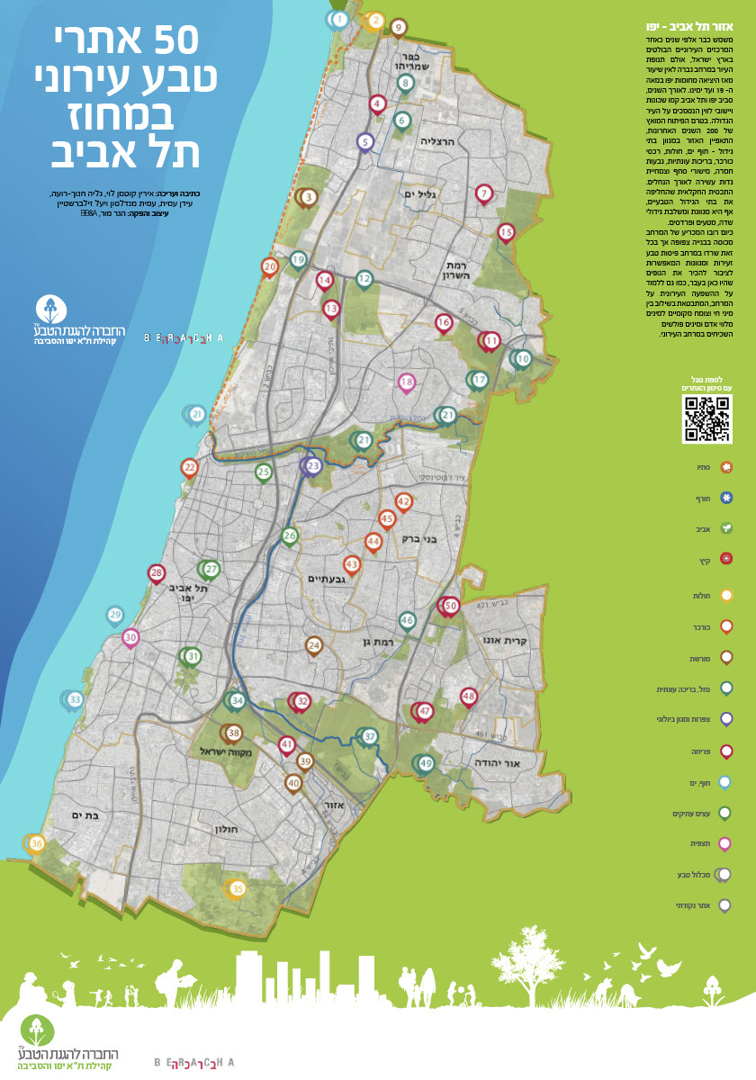
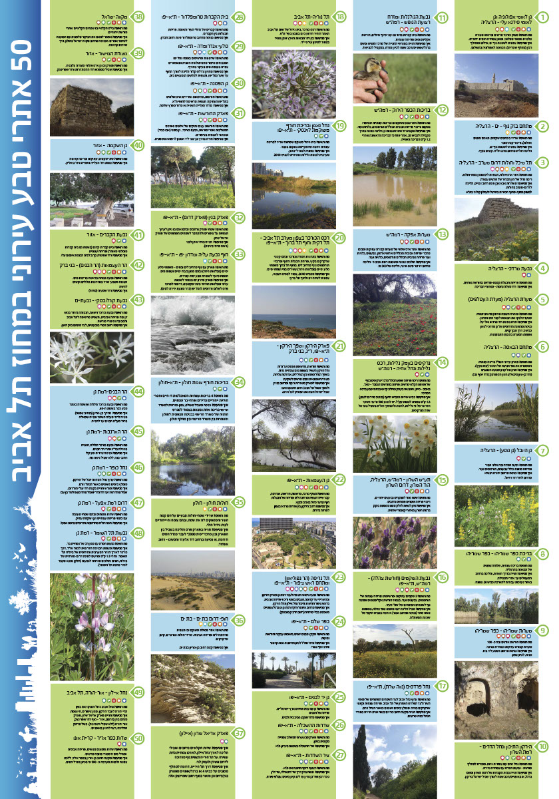

Slide 18
First Year of Activity in
Dan District
3 municipalities in Dan district
Possible municipalities: Bat Yam, Tel Aviv-Yaffo, Herzliya, Ramat Gan

Slide 19
Initiative actions throughout the first year
Planning and Partnership
Write and produce materials.
Map out existing activity.
Construct marketing campaign.
Create civic enforcement platform.
Plan municipal enforcement construct.
Form assessment system.
Conduct round table discussions for collaboration between participating parties.
First Stage
Implement municipal enforcement plan.
Conduct infrastructure survey as basis for improvement.
Initiate local marketing campaign.
Launch environmental education program.
Launch training programs for activist groups.
Plan and execute community apex day.
Second Stage
Apex stage of environmental education programs.
Apex stage of activist group training.
Launch municipal enforcement platform.
Launch civic enforcement platform.
Improve and adjust infrastructure based on surveys.
National Cleaning Day.
Routine
Follow up on regular activity after apex event.
Implement marketing campaign, call for expansion to other municipalities.
Publish bids for projects expansion
Support independent group activities
Continue routine civic and municipal enforcement.
Assessment and control.
April-July 2019
September-December 2018
December 2018-April 2019
April-September 2018

Slide 20
Campaign
Stage 3
Publicize Dan district success story, encourage participation in following years: bring change home.
Bids for participation of additional authorities.
Stage 2
National action surrounding Cleaning Day – “Israel won’t give up it’s home”.
Encourage smaller initiatives to join a bigger movement.
Stage 1
Dan district campaign, focused on local activity.
Call for civic enforcement + awareness of municipal enforcement

Slide 21
Initiative plan
Planning stage: April 1-June 1, 2018
National Level | Local Level
Map out potential areas for activity towards Cleaning Day and future pilot expansion. Identify potential partners. Map out existing activity (Society for the Protection of Nature and partners). Plan PR campaign to operate on a national level on Cleaning Day. | Outline areas of activity by local structure and schools. Identify partners. Map out infrastructures and partners. Define enforcement procedures with local authorities. Map out existing activity that fits in with the initiative (Society for the Protection of Nature and partners). Construct schedule, taking into account partner availability. Identify “holdback” factors – risk management. Bids. Begin assessment and control actions – Measure stage 0. PR campaign – hone campaign messages. Form educational initiative Create reporting platform - civic enforcement.

Slide 22
Initiative plan
Partnership stage – June 1-September 1, 2018
Local Level | National Level
Determine municipal and civic enforcement policy and define roles among partners. Nominate topical steering committees to create an outline for each field of the initiative. Exposure meeting for all participating parties. | National round table session attended by representatives of the four fields – present initiative and pilot area, discuss initiative expansion and effective action in different areas.
A final action plan will be created at the end of the partnership stage. This is the optimal launch point for all partners. The Society for the Protection of Nature will foster collaboration between all initiative partners and lead the way to success!

Slide 23
Initiative plan
Stage 1 – September 1-December 1, 2018
Pilot Level | National Level
Initiate municipal enforcement initiative. Initiate civic enforcement initiative. Employ infrastructure improvement plan in response to preceding survey. Begin activist group training. Operate educational program. Launch local PR campaign. | Publicize initiative in all Nature Preservation Organization activities.
Apex event for initiative awareness – one or several public events within a short period, preceded by targeted advertising, led by participating municipalities.

Slide 24
Initiative plan
Second Stage – February 1-April 1, 2019
Pilot Level | National Level
Second stage of intensive activity in all project areas (education, information, enforcement and infrastructure) – expansion. | Marketing campaign targeted at recruiting and National Cleaning Day and
National apex event – National Cleaning Day Public apex event with targeted PR. Two options: National Cleaning Day, March 26, 2019. Israel’s Birthday gift– state-wide cleaning day following independence day, May 10, 2019.

Slide 25
National
Cleaning Day!
March 26, 2019
State level grand vision
Taking charge
Reality changing project apex day
Campaign apex
Population-specific cleaning operations
Waste collection patent contest
Do it together
Be an agent of change

Slide 26
Initiative plan
Stage 3 – Routine – April 1-July 1, 2019
Pilot Level | National Level
Strategy and roadmap, pay it forward. Continue activity in all initiative areas as a routine – cleanup is not a one-time operation, it is a way of life! | Compare between participating and non-participating areas, in order to examine magnitude of change. Indispensable stage for the success of the initiative and identification of future areas of activity. Advertise bids for project expansion.
This stage will include assessment and monitoring processes for lesson learning and process refinement before expanding the initiative.

Slide 27
Initiative Expansion
Initiative expansion plan will be determined according to the level of commitment and collaboration of local authorities and municipalities.
The Dan district pilot will serve as a model for tangible change in public-led cleaning and waste management, in cooperation with the municipalities.
Additional municipalities will bid to expand the initiative to additional years, while taking responsibility.

Slide 28
Project Budget Planning

