Slide 1
Test Summary Flex Cylinder = 32, 42 & 74 mm 15.12.2020
Yossi Dayan

Slide 2
Experiment Summary (1/2)
In order to examine the cylinder spring constant, several experiments were carried out by stretching the flexible cylinder centers – without fibers – including measuring the force exerted on the centers of 3 cylinder diameters: Ø32, 42 & 74 mm.
For measuring the applied force and center’s movement, a threaded rod was screwed at the exact center of the flexible cylinder, to which a steel cable was attached. The cable was then attached to a dynamometer. This was implemented when the cylinder was in a horizontal and fastened at both ends
Thereby, it was possible to measure the applied force to the center and the movement of the cylinder’s center.

Slide 3
Experiment Summary (1/2) – cont.
Attached further on is a description of the experimental array where the system used was employed for all the fiber compression experiments, only now without the fiber within the flexible cylinder.
A continuous sampling was taken of the applied force on the cylinder center and the movement of the flexible cylinder from its starting centerline.
In some of the flexible cylinder diameters, experiments were carried out until a movement of 65 mm of the cylinder center from its centerline at the experiment’s start.

Slide 4
Experiment Summary (2/2)
Each experiment was carried out in three iterations to test for hysteresis; that is, until reaching the required lengthening of the flexible cylinder and then releasing to the starting zero shortening.
From the summary of the results in the comparative graphs of the experiments, one can observe that with small movements of the flexible cylinder’s center (10 mm), the relation between the movement and the force is linear; with larger movements in Ø42 & 74 mm cylinders, the relationship is polynomial.
In the last slide, one can observe a comparison of the implemented experiment on a Ø42 mm cylinder with the results obtained from the numerical simulation
carried out with Abaqus.

Slide 5
Experiments System (Without Fiber)

Slide 6
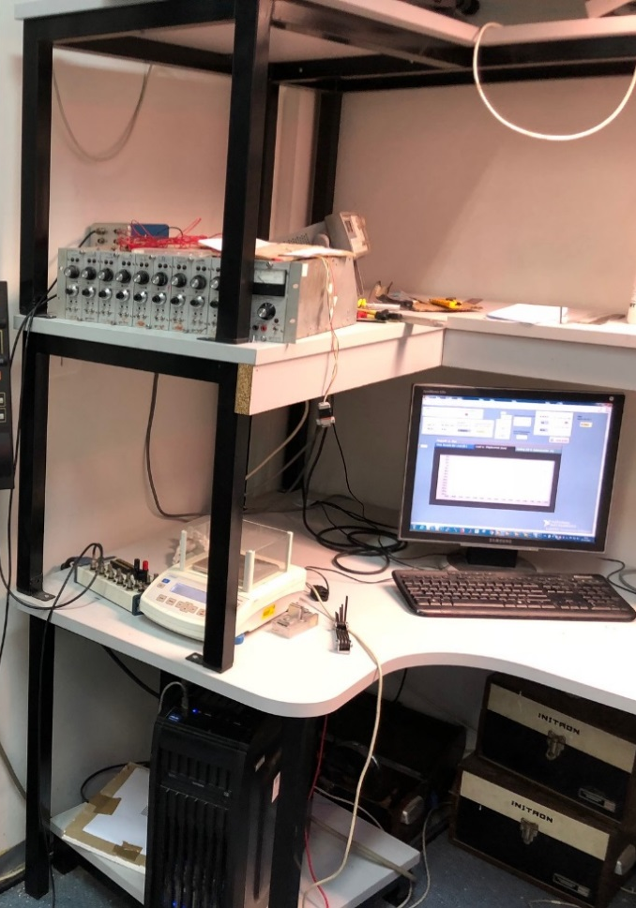
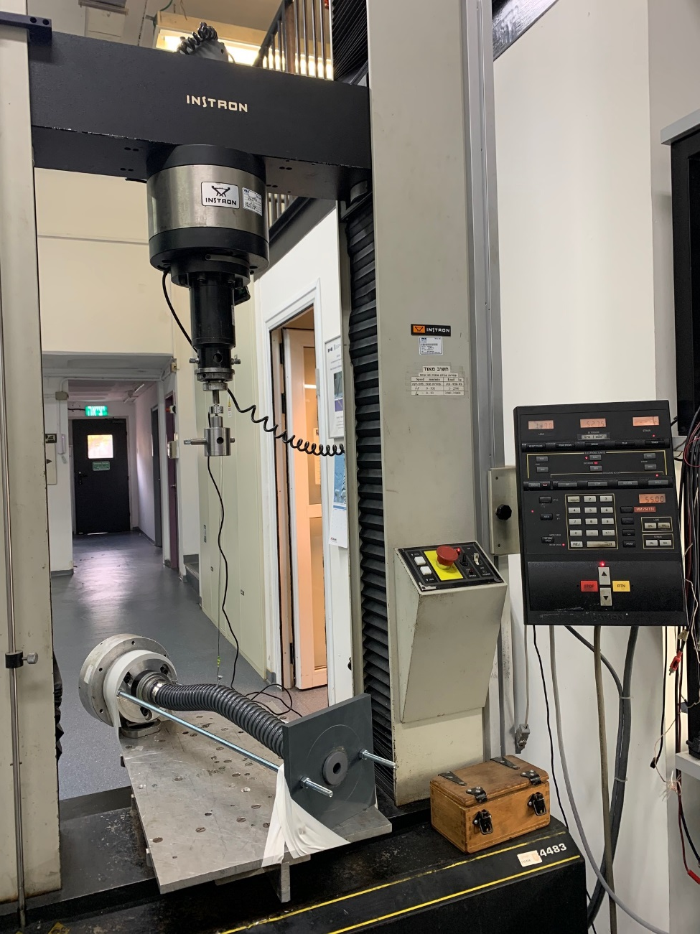
Experiment System (1/2)
GUI
Strain gauge
Sampling Computer
Flexible Cylinder
Instron
Controller
Cylinder Holder
Cylinder Holder

Slide 7
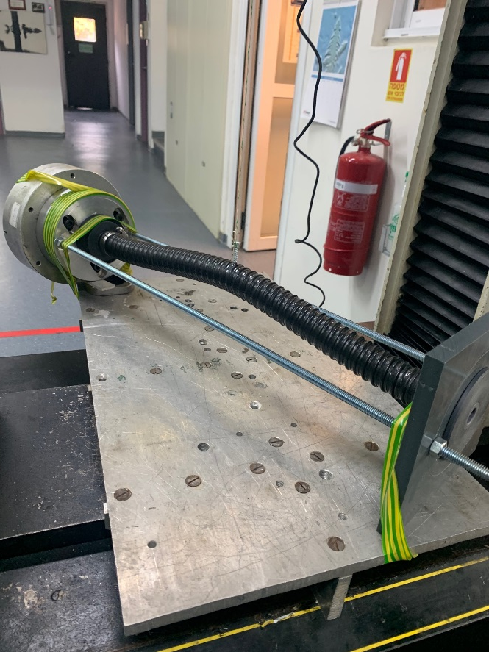
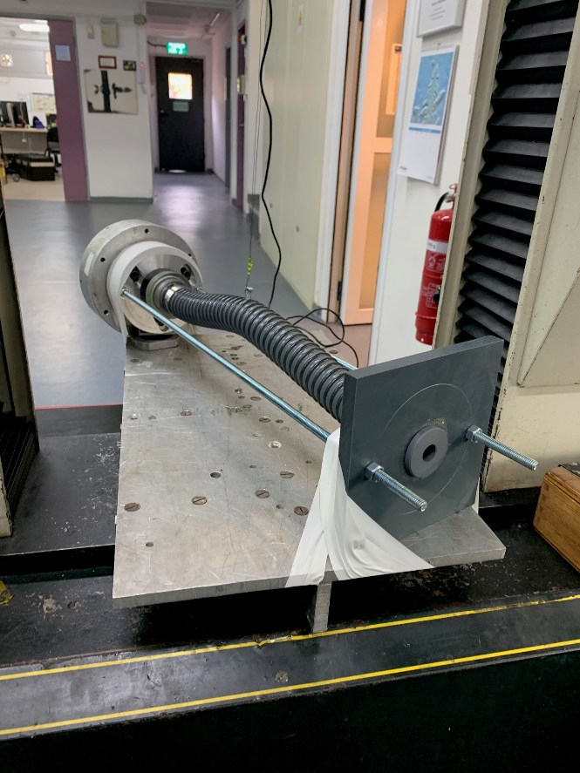
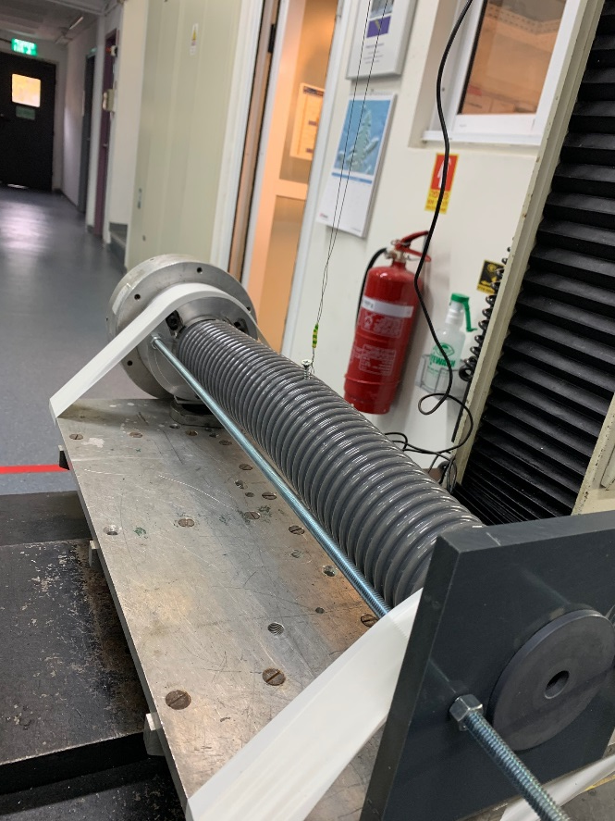
Experiment System (2/2)
Flexible Cylinder, ∅32 mm
Flexible Cylinder, ∅42 mm
Flexible Cylinder, ∅74 mm

Slide 8
Experiments Results

Slide 9
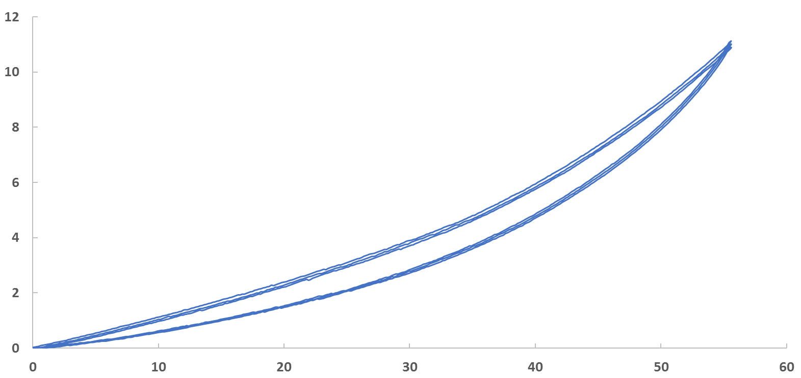
Reaction force in the flexible cylinder center as a function of movement of the cylinder’s center from the centerline Flexible cylinder = ∅32 mm
Force, N

Slide 10
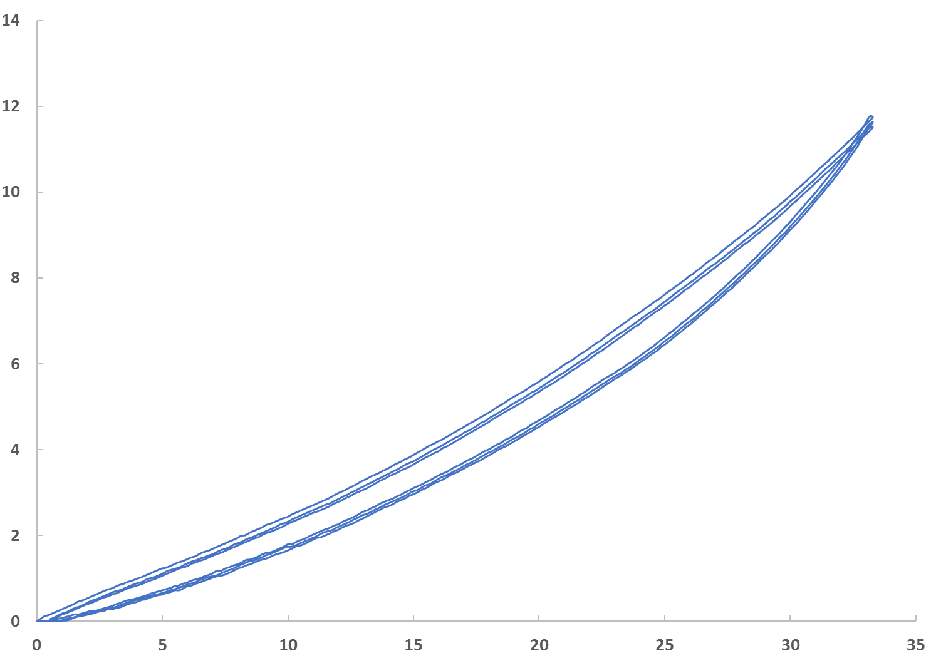
Reaction force in the flexible cylinder center as a function of movement of the cylinder’s center from the centerline Flexible cylinder = ∅42 mm
Force, N

Slide 11
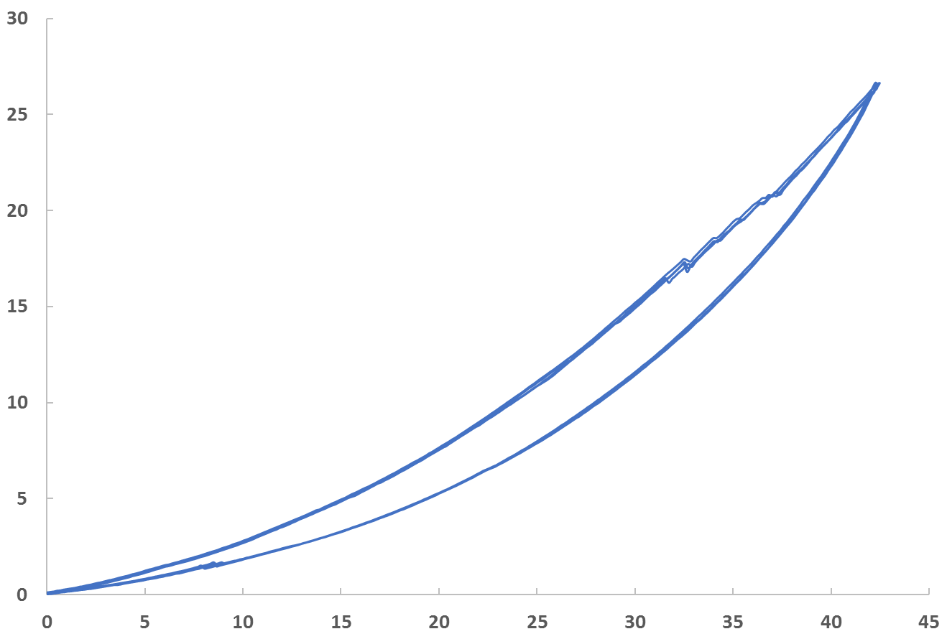
Reaction force in the flexible cylinder center as a function of movement of the cylinder’s center from the centerline Flexible cylinder = ∅74 mm
Force, N

Slide 12
Comparing experiment and ABAQUS results

Slide 13
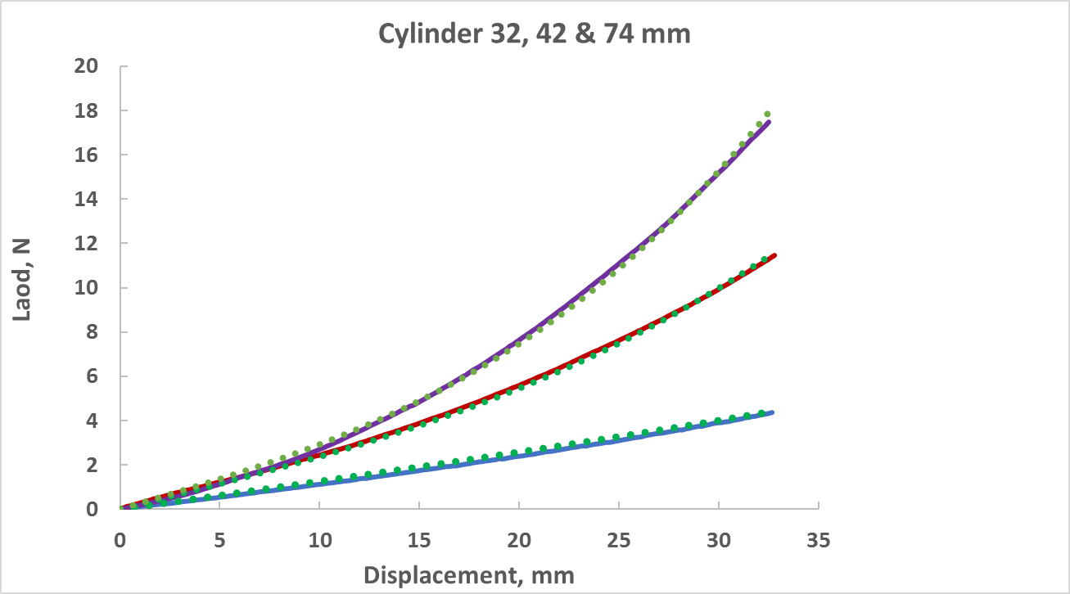
Reaction force in the flexible cylinder center as a function of movement of the cylinder’s center from the centerline Flexible cylinder = ∅32, 42 & 74 mm
(large movements)
Force, N

Slide 14
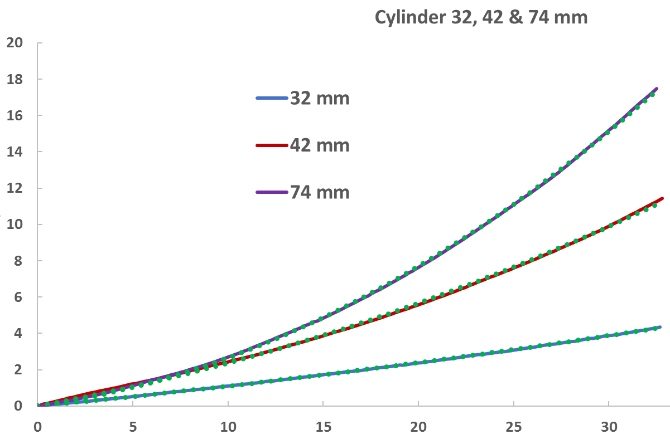
Reaction force in the flexible cylinder center as a function of movement of the cylinder’s center from the centerline Flexible cylinder = ∅32, 42 & 74 mm
(large movements)
Force, N

Slide 15
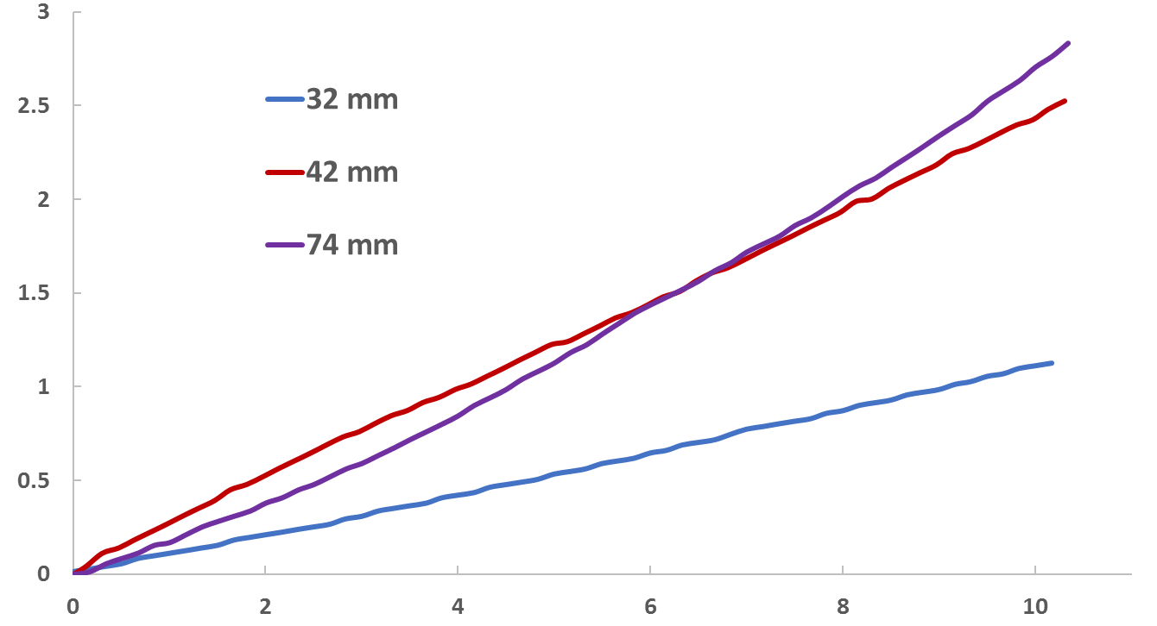
Reaction force in the flexible cylinder center as a function of movement of the cylinder’s center from the centerline Flexible cylinder = ∅32, 42 & 74 mm
(small movements)
Force, N

Slide 16
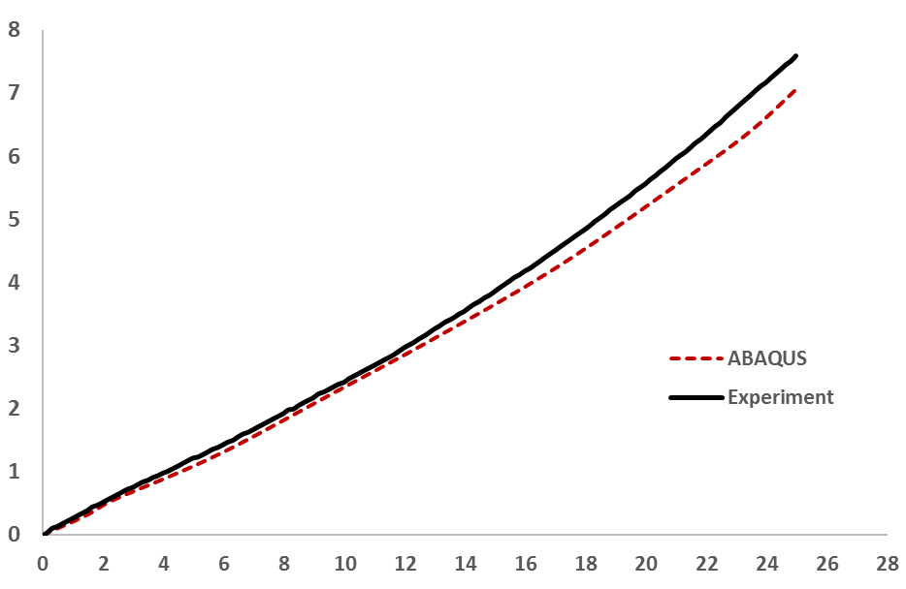
Reaction force in the flexible cylinder center as a function of movement of the cylinder’s center from the centerline Flexible cylinder = ∅42 mm
(Comparison of experimental results to the numerical simulation in Abaqus)
Force, N

