Slide 2
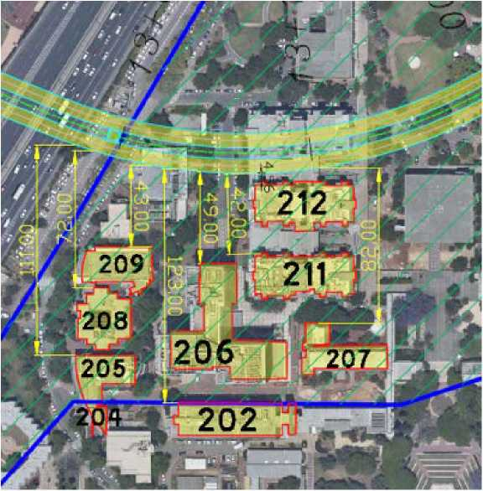
NIP 102 | EM Radiation: Concerns for interference with sensitive equipment
1. Objections:
The Southern alternative (Ramat Gan) passes under a large
number of research buildings containing EM-sensitive
equipment. No consideration was made concerning these,
especially sensitive installations.
Response:
• All the aforesaid about tremors, stray currents and electromagnetic
fields are concerns and hypotheses only, without any scientific
evidence presented by the University.
• The topic of radiation was discussed extensively in Section 4.4
of the survey.
• EM radiation levels from the Metro tracks were calculated at surface
level along the planned route.
23

Slide 3
NIP 102 | EM Radiation: Concerns for interference with sensitive equipment
1. Objections (cont):
• Calculations were conducted using dedicated MMI software according to equipment characteristics of SYSTRA’s specifications.
• Additionally, NTA conducted measurements of background EM radiation and found that calculated values from the metro were significantly lower than background values. Since radiation is measured on a logarithmic scale, the radiation effect from the Metro is expected to be much lower.
Note –The University’s objection does not concern effects
on human beings. According to the project’s
acoustical survey report, no impacts are expected.
However, there is concern for effects upon equipment.
3

Slide 4
NIP 102 | EM Radiation: Concerns for interference with sensitive equipment
Coordination with the University: EM
• On December 3, 2020, the University submitted its objection, attaching a report drawn up on its behalf (the Van Bekkum report from September 5, 2020), presenting the laboratories and installations where there is a concern regarding disturbances, and instrument sensitivity thresholds.⁽¹⁾
• On December 6, 2020, an initial expert’s opinion on behalf of NTA (by Engineer Moshe Netzer) was prepared, which included a reference to the potential for disturbances based on calculations carried out as part of the survey of EM levels at ground level above the route and the instructions for operating permits by the Environmental Protection Ministry.
• On March 17, 2021, the NTA conducted EM measurements in the University’s sensitive buildings. The measurements were coordinated and approved by the University – all the points where the University sought to measure EM fields, including points far away from the route. The measurements were carried out in the presence of University representatives.
4

Slide 5
NIP 102 | EM Radiation: Concerns for interference with sensitive equipment
Coordination with the University: EMA
• On March 17, 2021, the NTA conducted EM measurements in the University’s sensitive buildings. The measurements were coordinated and approved by the University – all the points where the University sought to measure EM fields, including points at a distance from the route. The measurements were carried out with along with representatives from the University.
• In addition, NTA’s expert specifically conducted computations of EM field levels at those locations where the University’s sensitive installations are located, comparing the computational results to measured background levels. Furthermore, the claims in the Van Bekkum report were examined in depth; significant flaws were found.
(1) Summary of damage to research laboratories and sensitivity levels of university instrumentation, Document of the Office of the Deputy Director of Operations in the Faculty of Life Sciences and Exact Sciences, #2020-13319 from 16.9.2020).
5

Slide 6
The Nanotechnology building (Building 206) houses the most sensitive installations and is only about 48 m from the route. The sensitive installations are just slightly more distant
(about 50 m), taking into consideration wall thickness, etc.
R260
47.92m
6

Slide 7
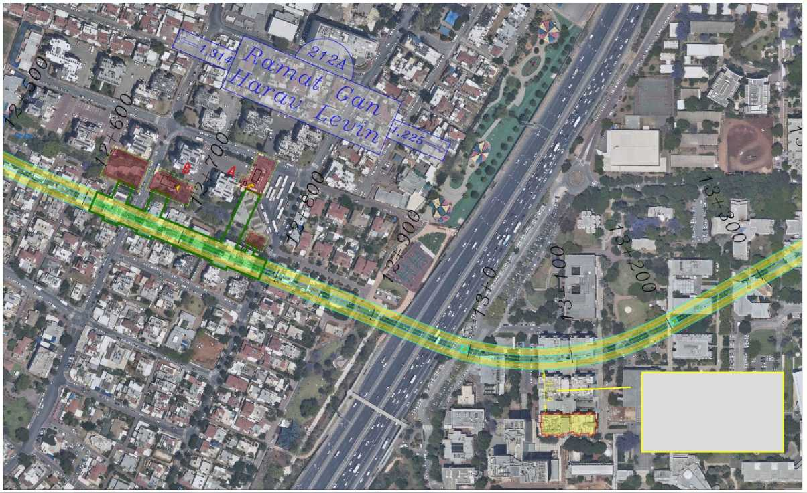
NIP 102 | Bar-Ilan – Distance of the Chemistry Laboratory Building – Building 211
Building 211 (chemistry laboratories) is the closest structure housing highly sensitive equipment. The structure is about 42 m from the track route.
42.4 m
7

Slide 8
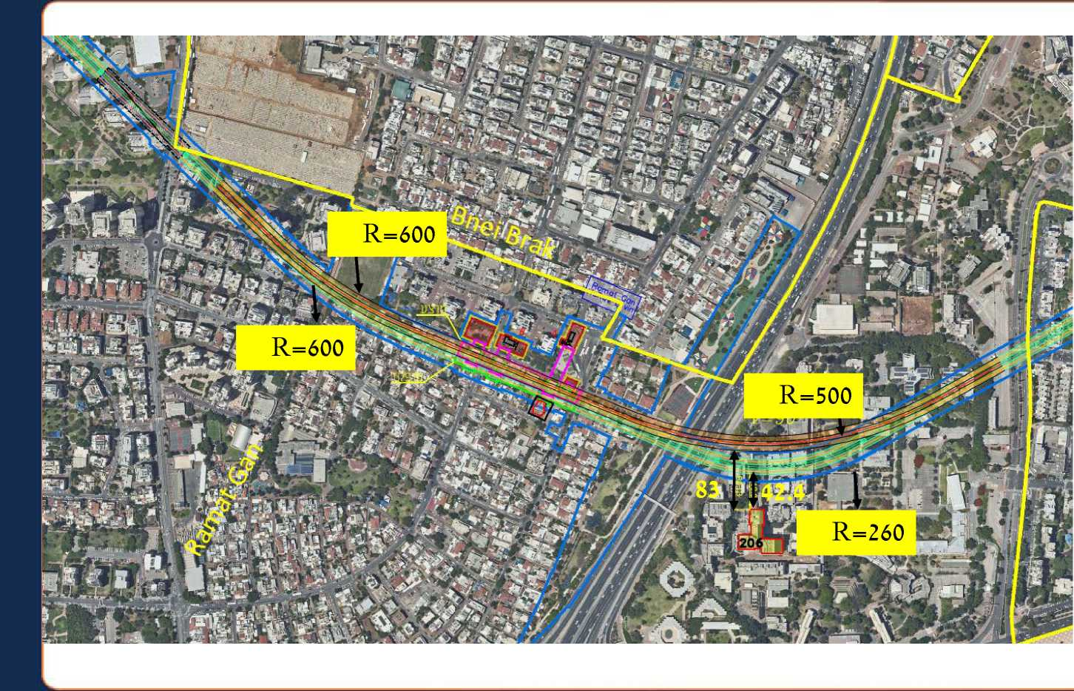
NIP 102 | Moving the Route Northward
Following a private objection in Ramat Gan – at 7 Dangor St. – if the objection is accepted, the route distance from the Nanotechnology Building increases by about 41 m.
8

Slide 9
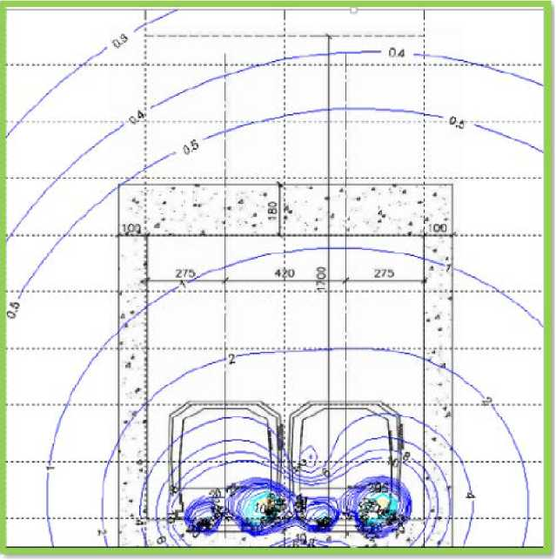
NIP 102 | Environment – EM
Objection:
The Southern alternative (Ramat Gan) passes under a large number of research buildings containing EM-sensitive equipment.
No consideration was made concerning these especially sensitive installations.
Response:
• The topic of radiation was discussed extensively in Section 4.4 of the survey.
• A computation of EM fields was conducted from the track route. The results were compared to the Environmental Protection Ministry’s recommended thresholds.
Magnetic field flux over background of the tunnel cross section
9

Slide 10
NIP 102 | Environment – EM
Objection:
• The calculations show that:
A threshold of 4 mG (Environmental Protection Ministry’s strict criteria for exposure to humans is obtained inside the tunnels at about 7 m above the track). The calculated radiation levels at ground level above the Metro are significantly lower than this threshold.
Above surface level, a flux density of about 0.1 mG was obtained; lower than characteristic background radiation.
• No limits to development above the track [route].
• No expected disturbances to electromagnetic systems, medical equipment, etc.
• No expected negative effects from stray currents.
Magnetic field flux over background of the tunnel cross-section
10

Slide 11
Measuring background values at Bar-Ilan – Moshe Netzer
EM measurements of background radiation levels were conducted at 21 points at Bar-Ilan University in the presence of a University representative. The measurements were performed at those points requested by the University.
• At all the points examined, the existing magnetic field flux level was between 0.25-1 mG, except at Point 4 (structure) in which a level of about 20 mG was measured because the measurement was carried out below the existing shield (concealed electricity cable ladder).
Background radiation at all measured locations is significantly higher than the predicted magnetic field flux from the Metro at ground level (0.1 mG).
Current consumption in Amps | Measurement results In mG | Coordinate | Building number | Description of coordinate | №
 | 0.88 | 185130/663886 | 215 | Outside near | 1
400 | 0.75 | 185136/663870 | 215 | Southeast side | 2
 | 0.38 | 885164/66387 |  | Between Buildings 212 & 215 | 3
130 | 20 | 185195/663877 | 212 | Inside building | 4
 | 2.6 | 185203/663878 | 212 | Near power cabinet, Room S6 | 5
120 | 0.5 | 185211/663918 | 213 | Near stairs across from elevator | 6
120 | 0.43 | 185182/663935 | 213 | In front of Gessner House entrance | 7
 | 1.2 | 185260/663927 |  | Courtyard between Buildings 213 & 403 | 8
 | 0.3 | 185316/663964 | 403 | West side | 9
663 | 1 | 182348/663958 | 403 | Near Men’s bathroom | 10
 | 0.3 | 185352/663970 | 403 | School for Advanced Studies | 11
 | 0.25 | 185368/663983 | 405 | Outside near canteen | 12
100 | 0.4 | 182363/663996 | 405 | Hallway | 13
112 | 0.25 | 185436/664006 | 411 | Synagogue | 14
 | 0.25 | 185447/664040 | 411 | Outside | 15
1800 | 0.25 | 185194/663795 | Nano Building | 2nd storey, Room A001 HIMFIV | 16
 | 0.49 | 185329/663817 | Nano Building | 1st storey – Parking lot № 62 | 17
11

Slide 12
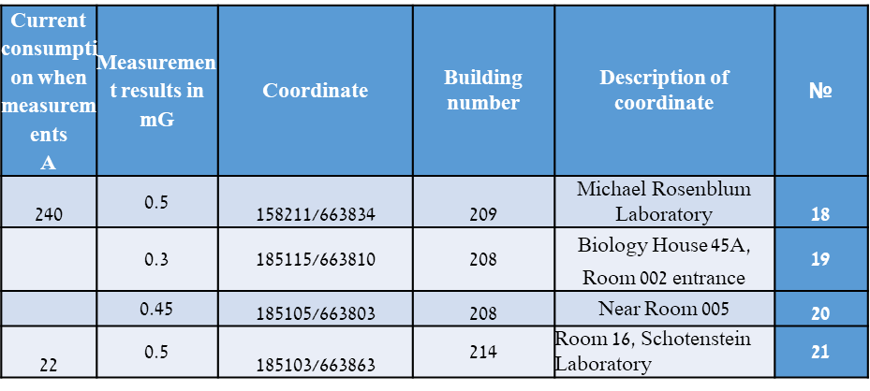
Measuring background values at Bar-Ilan – Moshe Netzer
EM measurements of background radiation levels were conducted at 21 points at Bar-Ilan University.
• Each addition to the background radiation is calculated by a mean vector (not a conventional arithmetic increment). According to the data, the Metro's effect is expected to be significantly weaker than the existing ones, and is accordingly expected to be absorbed by background radiation.
• No significant change in the EM flux is expected because of the Metro to the University’s sensitive installations.
12

Slide 13
NIP 102 | EM Radiation: Concerns for interference with sensitive equipment
Response (continued)
Results of Theoretical Estimate: magnetic field flux changes with time | Background measurement results | Bar-Ilan’s Data: Sensitivity of scientific equipment to EM fields | Distance from Metro | Building
mG | mG | mG | m
0.0094 | - | 1-10 mG AC – no DC data | 123 | 202
0.0094 | - | Low sensitivity | 123 | 204
0,011 | - | No data | 111 | 205
0,053 | 0.49 | 0.01 mG AC | 49 | 206
0.021 |  | Medium sensitivity | 82 | 207
0.03 | 0.45 | not given | 72 | 208
0.07 | 0.5 | High sensitivity | 43 | 209
0.07 |  | 1-10mG AC – no DC data | 42 | 211
0.41 | 2.6 | Low sensitivity | 5 | 212
• Furthermore, after receiving the University's objections, another inspection was conducted by Engineer Moshe Netzer, consultant on non-ionizing radiation for this project, to examine the equipment’s sensitivity.
• The inspection was conducted at nearby buildings and facilities according to the expert opinion submitted with the University’s objection (“Summary of Damage to Research Laboratories and Sensitivity Levels of University Instrumentation, document by The Office of the Deputy Director of Operations in the Faculty of Life Sciences and Exact Sciences, 2020-13319 from September 16, 2020”).
13

Slide 14
NIP 102 | EM Radiation: Concerns for interference with sensitive equipment
Response (continued)
Results of Theoretical Estimate: magnetic field flux changes with time | Background measurement results | Bar-Ilan’s Data: Sensitivity of scientific equipment to EM fields | Distance from Metro | Building
mG | mG | mG | m
0.0094 | - | 1-10 mG AC – no DC data | 123 | 202
0.0094 | - | Low sensitivity | 123 | 204
0,011 | - | No data | 111 | 205
0,053 | 0.49 | 0.01 mG AC | 49 | 206
0.021 |  | Medium sensitivity | 82 | 207
0.03 | 0.45 | not given | 72 | 208
0.07 | 0.5 | High sensitivity | 43 | 209
0.07 |  | 1-10mG AC – no DC data | 42 | 211
0.41 | 2.6 | Low sensitivity | 5 | 212
• The sensitivity levels of resistance-sensitive equipment are lower than the external background without the Metro, and accordingly, it is likely that the equipment is currently shielded in order to enable its functioning.
• The impact levels in sensitive buildings are expected to be lower than the background [radiation] – the Metro’s additional radiation will be "absorbed" in the already existing background radiation. Accordingly, there is no expected impact from the Metro on the equipment.
It should be clarified that in the detailed planning, the impact will be carefully examined and, if necessary, shielding will be installed.
14

Slide 15
NIP 102 | EM [Radiation] – Reference to expert opinion regarding the effect of radiation on instruments (Van Bekkum)
Discrepancies found between Van Bekkum’s
report data and the [Metro] design data.
Criticism –
According to his calculations, Dick Van Bekkum predicts an impact on sensitive instrumentation at the University.
Response –
Van Bekkum’s report (hereinafter: The Report)
contains fundamental errors:
• The calculations in the report were conducted according to a higher feed current than the one used by the Metro.
• The report incorrectly compares a static magnetic field from the Metro to the sensitivity of University’s instruments, but a static magnetic field does not have an impact on electronic equipment.
• The report does not take into account that the background radiation is significantly higher than Metro’s radiation. Therefore, the additional radiation from the Metro will be "absorbed" by the existing background.
Property | Van Bekkum data | NTA data | Notes
Track depth | 17 m | 30 m
 |  | 1500 V
Metro current feed | 1750 A | 1500 A | 3 cars, 500 A each
AC ripple on DC | No reference | 0.92% (13.8 A)
Temp. load current | No data | 5145 S | 2 min.
Current return to station inverters | Metro rail | Possible spec. 4th rail or Metro rail | A 4th rail removes problem w/ stray current
Minimum Depth Tested

Slide 16
NIP 102 | EM [Radiation] – Reference to expert opinion regarding the effect of radiation on instruments (Van Bekkum), cont.
• The report does not consider that the background radiation is higher than the sensitivity threshold of the sensitive instruments. Accordingly, for proper operation, the University’s equipment already requires shielding.
• The report uses incorrect data and does not take into account important parameters.
Accordingly, its findings and conclusions are without foundation:
• It uses current and voltage values (including feed voltage) different from that designed for the Metro.
• Lack of consideration of alternating current ripples upon direct current.
• Lack of reference to momentary loading current.
• Wrong tunnel depth.
Conclusion: Contrary to the claim in the Van Bekkum report, there is no concern about the impact on sensitive scientific instrumentation in nearby University buildings.

Slide 17
NIP 102 | EM [Radiation] – Reference to expert opinion regarding the effect of radiation on instruments (Van Bekkum)
Summary – The reasons for which the objection should be rejected because of the EM effect from the Metro on University equipment:
• The objection and the expert report attached to it ignore the fact that the background EM levels are significantly higher than the Metro's predicted contribution. Therefore, (since this contribution is attached to the background as a vector average), its effect is expected to be very low.
• The objection and the expert report ignore the fact that the background EM levels measured in the actual University buildings are higher than instrumentation sensitivity levels specified in the objection, which already requires the equipment to be shielded for its proper functioning (this shielding is probably already installed in sensitive buildings/facilities at the University in order to enable proper equipment operation).
17

Slide 18
NIP 102 | EM [Radiation] – Reference to expert opinion regarding the effect of radiation on instruments (Van Bekkum)
Summary – (Continued)
• The conclusions of the expert report on Metro effects are fundamentally wrong – they are based on a static field flux from the Metro, which does not affect electronic equipment. Therefore, the comparison made by the report to the sensitivity of the University's equipment is irrelevant.
• The expert's report is based on incorrect data, including placing a higher operating voltage than the Metro line will be using and ignoring other substantive data, and according to its forecast, is flawed and its results have no basis.
Conclusions:
• The objection’s claims and the consultant's report are inherently wrong – there is no significant impact on sensitive instruments at the University.
• As aforesaid, the calculations conducted by NTA expert Engineer Moshe Netzer show that the predicted effect on sensitive instruments at the University is insignificant and materially lower than the background radiation (expected to be absorbed within it) and the equipment sensitivity values.
• It should be noted that in the detailed planning the impact will be verified, and if necessary, standard shielding will be installed to further reduce EM flux.
18

