Slide 1
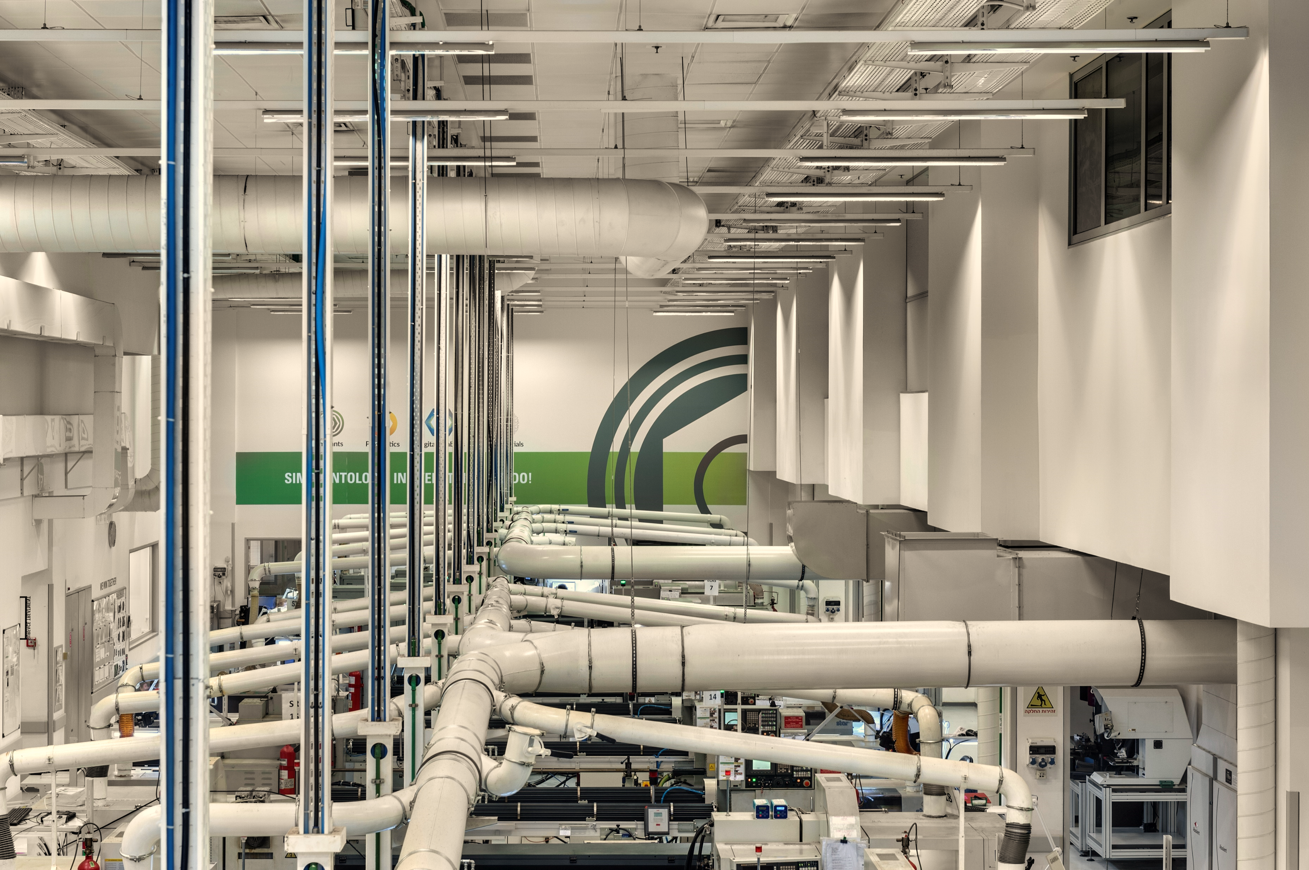
A Factory Tour
Alpha BioTec

Slide 2
Work Procedure – Factory Tour
When the need arises for a tour, these are the steps that need to be followed:
Send an email, distribution all (the entire factory staff) at least 3 days prior to the visit date - to inform of the time and date of the tour and the number of visitors.
Tour hours - due to the factory workers’ lunch break hour, it is best not to have the tour between 12pm and 2 pm.
Number of participants in the tour - 15-20 individuals (it is best to minimize this number due to very narrow passages)
It is advisable to secure a inside guide from the quality engineering department in advance (through Levy Steinberg or Yuval Bitti).
Before the tour begins, it is advisable to check which machine is active so as to reach it directly with the customers for a live demonstration.
Photography is forbidden on the production floor.

Slide 3
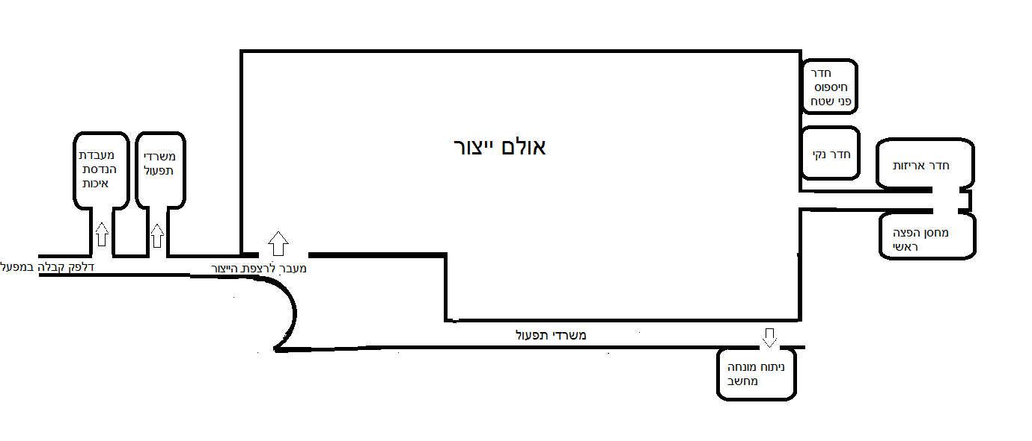
Follow the factory layout diagram to track your location
Work Procedure – Factory Tour
Surface Roughening Room
Quality Engineering Lab
Packing Room
Production Hall
Clean Room
Development
Reception Desk
Main Distribution Warehouse
Passage to Production Floor
Safety goggles and anti-slip shoe cover cabinet
Operation Offices
Computer-Aided Surgery

Slide 4
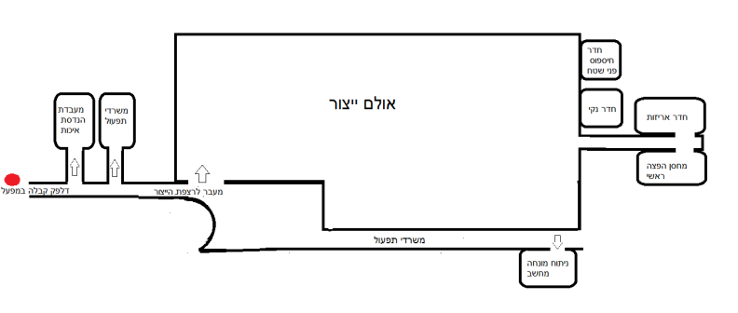
Entrance and Safety Station
Hello,
My name is _____________ and my job description is
A moment before we enter the factory gate, we would like to tell you about Kodak House. This is one of the greenest and most modern production and headquarters buildings in Israel and indeed in the world. It complies with the American standard for environmentally friendly buildings.
Why green? Because all of the building systems - air, electricity and water - are economical, they are monitored and they make efficient, calculated use of energy and resources.
Besides that, Alpha BioTec has placed safety and the environment at the top of its values list and has made them an integral part of every activity within the company. We are committed to safeguarding the safety of our employees and our guests and to that end we invest considerable resources.

Slide 5
Safety Procedures:
Opposite the entrance to the factory kitchenette is a cabinet with safety accessories for the guests:
Branded safety card in English and Hebrew with a summary of the factory safety procedures, which can be distributed to the guests prior to entering the factory.
Safety goggles - throughout the entire stay in the production hall, safety goggles must be kept on - air guns are used in the production hall. Safety goggles will protect you against fine grains coming in contact with your eyes.
Anti-slip shoe covers - the floor in the production hall is slippery due to the use of oil in the production process - all guests, including escorts, are required to wear protective covers (the covers are arranged by shoe size in the cabinet, sized between 34-46. There are also covers for high heeled shoes).
In an emergency - a public address system will be activated. Exit through the nearest emergency exit. These are located throughout the factory - they can be identified by the green sign saying “Exit”.
Do not touch any equipment or reach into any of the machines. Do not enter with food or drink.
Note: The guide must make sure that after everyone has received the equipment, the station is left tidy. Also, at the end of the tour, the guide must make sure all the safety accessories have been put back in their place.
If necessary, Paulina can be contacted for further assistance.
Entrance and Safety Station

Slide 6
Training Center
Alpha BioTec’s training and professional skilling center provides a broad range of professional courses, ranging from basic courses on dental implants through to advanced courses for experienced dentists.
Alpha BioTec has made training a top priority. Our goal is to deliver added value for dentists in their work, to make their everyday work easier through providing them access to the knowledge and by exposing the dentist to the most recent and advanced clinical studies in the world.
In order to make the information accessible, Alpha BioTec hosts scientific conferences and international courses while at the same time providing local training and skilling in each one of the countries in which the Alpha BioTec products are sold.

Slide 7
Factory Reception Desk
Welcome to the Alpha BioTec manufacturing facility. Over the next half-hour you will be exposed, in a nutshell, to the complex, rigorous process of manufacturing the Alpha BioTec implants, the prosthetic components and the surgical tools.
We will be passing through the various manufacturing stations, the surface room, the clean room and the con and quality stations which are an integral part of the entire process.
Let’s first tell you a few words about the company:
Alpha BioTec is a global company specializing in development and manufacture of advanced dental solutions with special focus on implants and prosthetics.
Alpha BioTec was established in 1988 by Dr. Ophir Fromovich.
In 1996 the ATID implant was launched, followed by the DFI implant in 1999.
The world’s first spiral implant was launched in 2003, which led to Alpha BioTec being acquired in 2008 by Nobel Biocare, the world’s leading implant company. In September 2010, a decision was made to relocate our manufacturing facility to its current home, where emphasis was placed on enhancing and streamlining the manufacturing processes while improving the control and quality processes. The cost of the relocation is estimated at about 6 million Euros.

Slide 8
Factory Reception Desk
Alpha BioTec has developed a long line of innovative products intended to provide the most comprehensive, efficient set of solutions when it comes to dental implants:
The ICE implant in 2013, the NICE in 2014, the 2015 launch of the digital division (computer-guided surgery and digital CAM/CAD restoration) and the NEO implant in 2016.
Our close work with our customers has opened a window for us into their everyday routines at the clinics and laboratories. We have gained valuable insights into their needs and through that we have been able to manufacture products to make their work easier, more convenient and efficient.
Now let’s move down station by station through the implant’s lifecycle. feel free to ask questions as we go along.

Slide 11
Alpha BioTec Departments
Quality Control
A department that will always be present throughout the tour is the quality control department, which accompanies the product through each and every one of the stations along the product “lifecycle”.
From the very beginning, during the product development and design stage and through to final packing, thought processes are in motion planning ahead to find the best way to carry out stringent product quality tests.

Slide 12
Research and Development Department
The department where it all starts - the clinical research and development department - we cannot allow anyone to see this part since they are working on patents currently being registered.
This department has engineers who work together with dentistry experts to develop the new products and on the improvements and changes to the existing products.
The first stage in the development is a drawing. The next stage is to produce a prototype for clinical evaluation of the product.
The development proceeds in close cooperation with the clinical research people, who contribute by raising the needs and the clinical indications necessary for the development. The researchers then conduct the research and clinical trials at universities in Israel and worldwide to obtain proven results and clinical collateral proving the advantages, capabilities and safety of using the product.
The development team relies on the work of the research groups.
This team is intended to ensure maximum correlation between our products and the market’s changing needs. Besides these, the team provides solutions for the clinical needs dentists encounter daily using state of the art technologies.

Slide 13
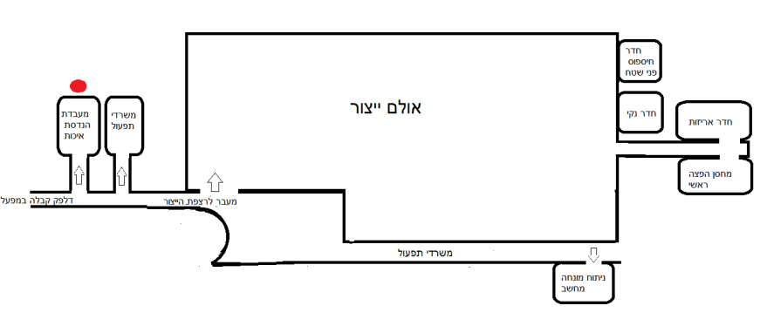
Quality Engineering Laboratory
Quality engineering is the most important link in the transfer from development to production.
The Quality engineering people play an active role in the development process. At the end of the process they prepare testing instructions which are handed down to production.
The testing instructions guide quality control on how to test the part as efficiently, safely, and simply as possible.
A lot of thought goes into preparing the testing instructions since they form the basis for the manufacturing work done in the milling department.
The quality engineering laboratory is where measurements are made of parts in the development process, where the first parts in the manufacturing process are measured (validations) and where special cases are investigated, such as manufacturing non-conformances, or customer complaints. In other words, these are out-of-the-ordinary tests and investigations which are not related to the ongoing manufacturing process.

Slide 14
Quality Engineering Laboratory
The control machines are used for a variety of quality tests.
The optical scanner, Alicona, is one of the most advanced in the world. It performs three-dimensional scanning of the parts at a resolution of less than one micron to provide surface quality results and dimensions at the highest possible level of accuracy available in the industry today.
The laboratory comparator is also one od the most advanced of its kind. It enables us to upload drawings of products which have been designed by the development department and to run comparisons with it. This machine provides a precise dimension of the manufacturing quality against the drawing.
The multisensor measurement machine is quite unique in that it combines four measurement machines in one. Besides the large instruments there are also special instruments in the laboratory, some of which are our own proprietary developments. Here we can make any measurement we need of any dimension we need without exception.
The rationale behind quality engineering is that if you invest the bulk of your efforts at the start of the process, beginning with the development stage, bearing in mind first and foremost the product quality, while keeping sight of manufacturing efficiency, you will avoid tremendous delays and problems downstream, after handing over to production.
The measurement equipment itself gets calibrated in this laboratory. We regularly test their accuracy on an ongoing basis.
Notes:
The multisensor measurement machine is quite unique in that it combines four measurement machines in one. It enables the following measurements:
A unique scanning probe with a measurement accuracy of 0.001 mm
A unique 180 ° scanning laser with a measurement accuracy of 0.001 mm
Optical measurement of a “blind hole”, overhead light.
Regular optical measurement, backlight.
Has a fourth axis, enabling a 360 ° testing of the part.

Slide 15
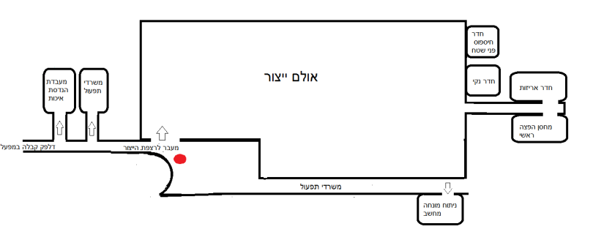
Production Floor – Raw Materials
The process of manufacturing the implant begins with a hive of titanium rods (the titanium is medical-grade titanium), which forms the basic raw material for manufacturing the implants (we can see also other raw materials, such as peek bars, from which temporary structures are made).
* The titanium is ELI-type titanium - with high biocompatibility - it includes 6% aluminum and 4% vanadium.
We will talk about the medical oil when we reach the CNC machines in a few minutes.
Each raw material is marked from the moment it arrives in the factory. Its traceability is maintained throughout the manufacturing process from the raw material batches , to the machine on which it was fabricated, the oil used for the milling, the tester who performed the quality control, and ending with the final packing.
In other words, even after the implant has been sold, we can, if called upon, find the precise composition and even the manufacturing date of the raw material of each and every implant.
Every raw material has to bear a medical standard certificate. Every raw material also undergoes several tests before being entered into the manufacturing line:
Material traceability inspection at the supplier.
Testing compliance with the requirements - dimensions, standards, rigidity, weight.
Notes:
Biocompatibility an index property of the compatibility of materials with the host body. Biocompatible materials do not interact or create a harmful reaction with the live biological tissue. The use of biocompatible materials is vital to the clinical success of implanting a medical device and an important criterion in selecting the materials used in the field of bionanotechnology. For example, the coating of nanocapsules for controlled drug delivery has to be made of biocompatible materials.

Slide 16
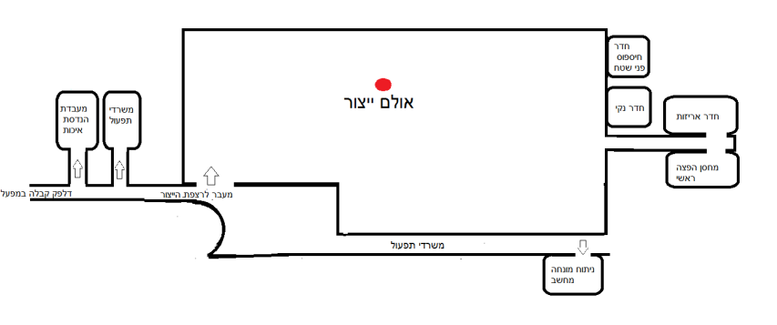
Production Halls
The new production halls facilitate substantial growth of our manufacturing capacity while at the same time improving the working conditions and the manufacturing environment. The factory is equipped with a controlled climate system, which includes advanced air purification systems.
This modern system ensures a clean working environment, free of oil vapors in the air. This is an important factor in safeguarding employee health. We are among the first factories in Israel to install such a system - we believe the key to success lies in a high standard of working conditions for the employees.
The entire manufacturing apparatus is controlled by a computerized system which receives real-time reports from production and enables precise control and planning.

Slide 17
CNC Machine Row
The CNC machines are machines which perform milling
aided by computer software. For each product, the software is written
which instructs the machine how to produce the part.
Each machine has 2 production areas -
primary and secondary. The primary area will begin the manufacturing process by working on the external/bottom part (for example exterior threads), and after this has been completed, the part will move to the secondary area where the internal/top part will be manufactured (forming the internal hexagon and internal threads for example).
We currently have 30 working machines. The machines are made in Japan and Switzerland. Some of the machines are used by the development, not for manufacturing inventory.
We work on the production floor on a 24/5 basis (we do not work on weekends and holidays). The machines are operated by skilled machine operators.

Slide 18
CNC Machine Row
The oil used in the machines is medical oil. It is extremely expensive and it enables accomplishing high-precision, high-quality milling through softening the friction between the metals. Note that thanks to the advanced air monitoring systems, we can hardly notice any smell. We can see an oil vapor suction system overhead. We talked about this when we entered the hall.
The inspection is done according to quality engineering instructions, on a separate inspection instruction for each and every part individually.
Manufacturing is done in batches. When work begins the operator receives a batch file with a drawing, machine setup instructions and inspection sheets.
During the manufacture of the batch, all of the manufacturing data are collected (passed quantity, rejected quantity, inspection results, changes of machine tool, etc.)
The batch file accompanies the product throughout the manufacturing process to its final “release” to the distribution warehouse.
The batch files are archived for more than 15 years.

Slide 19
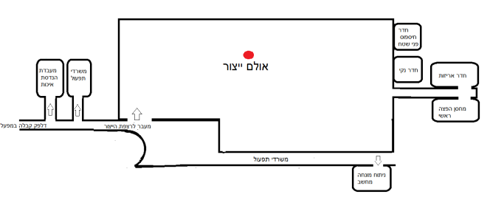
Quality Test Bench
The product’s first quality control test is performed on the quality testing bench. between 30 and 40 different dimensions are tested on the implant. Each product undergoes visual inspection. The first part exiting the machine is also always tested at the functional level, and every hour one more part is tested visually and functionally.
We can also see the comparators spread throughout the production floor, on which all of the implant’s dimensions are measured.
If any irregularity is found, production is halted and more thorough tests are made.
Each machine has its own inspection bench - it is impossible to mix between batches.
Besides the tests done in the factory, external tests are also performed - for example, a sample quantity of implants is sent to a laboratory at the Technion to obtain scanning electron microscope (SEM) images - electron microscope testing (at the Technion), which produces a close-up image for thorough scrutiny of the surface - to ensure that the level of surface roughness and cleanliness are at the required level.
X-ray photoelectron spectroscopy (XPS) test - a test of the top layer of the metal surface using a laser beam - ensures that the chemical composition of the metal is identical and consistent.
Fourier Transform Infrared Spectroscopy (FTIR) test - tests for remnants of mineral oil after cleaning and prior to sterilization.

Slide 20
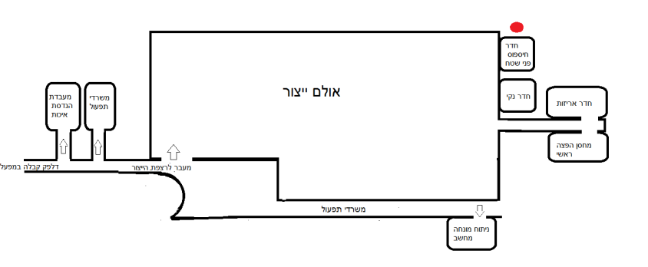
Initial Washing & Separation of the Prosthetic Parts from the Implants
From the production floor the implants and the prosthetic parts are transferred for washing in a degreaser machine, which removes the oil residues and the particles from the production process.
The cleaning process is carried out in the chemical room, which is off limits due to work safety procedures.
After the wash the implants and the prosthetic parts part ways.
The implants continue to a surface roughening stage, which we will be following in the next stations.
The prosthetics are passed on for exterior finishing (not biological - color coding through anodization, gloss, laser marking, tempering - hardening the material, etc.). The prosthetics are then transferred for quality control, inspections and packing.
Anodization - applying an electric current through an acid in which the particles needed for the coloring are suspended. The metal from which the part is made conducts the current and its color gets permanently altered.
The color is determined by the current sent and the acid concentration.
Washing
Prosthetics
Exterior finishing
Quality Control and packing

Slide 21
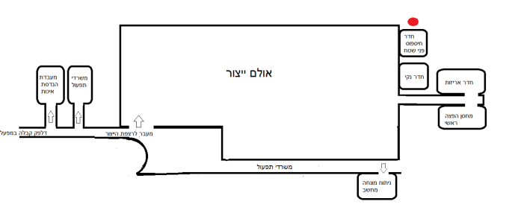
Surface Finishing
The process of finishing the surface of the implant using Alpha BioTec’s NanoTecTM technology is a two stage process:
First stage: Roughening through sandblasting with aluminum oxide sand, which causes surface macro-roughening - 20-40 microns.
Each time between one and three implants are loaded into the machines (varies from one machine to another). The machine assures of a homogeneous, high-quality roughening of the surface. The machine works the surface so that perfect homogeneity is assured at the end of the process. The process is very precise and thorough.
This is followed by a wash in an ultrasonic bath* (this was is always done with **purified water).
Second stage: ***Chemical etching, creating micron-level pores - 1-5 microns in size - this stage is achieved by connecting the implants to a tray by means of its internal hexagon (a part of the implant which must be protected against the roughening stage in order to retain the accuracy of the bond between implant and the abutment).
The washing and chemical etching stage is carried out in the chemical room, which is off limits due to work safety procedures. We will, however, be able to see the final wash stage in the clean room.
Notes:
* Washing in an ultrasonic bath - the ultrasonic frequencies transmitted by the bath generate vibration, which detaches the particles from the roughening process from the implant.
**Purified water - water is purified through a process of removing undesirable materials, chemicals, and contaminants, from the water. The goal is to produce water fit for (but not only for) medical purposes. The purification process reduces the concentration of materials and contaminants, which include various dissolved particles, parasites, bacteria, algae, viruses, and fungi.
***Chemical etching - a dual etching process using heat and acid, which deepen the surface pores.

Slide 22
Surface Finishing
The case at other manufacturers, where products are recalled, the reason is usually problems with the surface quality.
The advantages of the NanoTecTM technology are:
Increasing the implant surface area, thereby increasing the interface area between the bone and the implant.
Achieving high stability
Shorter recovery time
Improved ability to predict the results

Slide 23
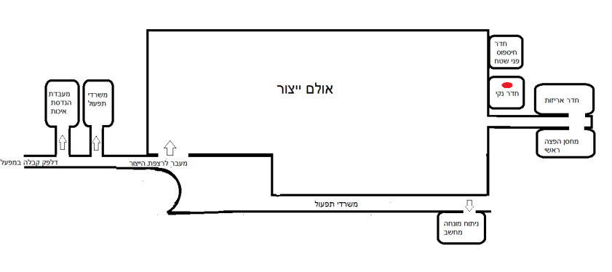
The Clean Room
Following the surface roughening process, the implants undergo another cleaning in an ultrasonic bath inside the clean room in order to achieve a higher level of cleanliness.
Every space within the factory is assigned different grades of permitted particles (measured in PPM). The higher the grade, the lower the levels of particles permitted and therefore in each one of the rooms, numerous microbial tests are performed to ensure the required level is maintained.
The air pressure inside the clean room is higher than the normal atmospheric pressure. That way, air can escape it but not penetrate it except through purification systems.
The clean room undergoes routine inspections, daily, monthly and yearly inspections to monitor the bacterial load and the particles on the implants. We check the level of bacteria in the air, on the work surfaces, on the workers themselves and of course on the implants in order to ensure the effectiveness of the sterilization process and the safety of the patients.
The clean room has passed the most stringent testing and has been found to be in compliance with the relevant international standards.
Every product which comes in contact with the skin (up until being implanted within live tissue) has to undergo biocompatibility testing.

Slide 24
The Clean Room
After the implants have been packed in the transparent vial only, they are sent to be sterilized using Gamma rays.
The implants must reach the Gamma ray stage at a high degree of surface cleanliness. Why?
When the Gamma rays kill the bacteria, the bacteria membrane decomposes and endotoxins are released - these are substances which lead to infections, inflammations, and allergies in the patient’s body. The goal therefore is to arrive at the sterilization stage with the lowest possible number of bacteria, This requires that a high level of sterility and stringent control be maintained throughout the entire process.
Following the packing in the clean room, the implants are sent for final inspection - 100% of the implants undergo visual inspection to match the product against the description on the packaging, and to ensure integrity of the packaging. For the prosthetics, the same tests are performed although they are done only on a sampling from the entire batch.
The prosthetic part is transferred from the packing room to the distribution warehouse.

Slide 25
The Clean Room
Alpha BioTec supports a stringent quality control system, which is subject to the following main quality standards: Standard ISO 13485:2006 of the International Standard Organization (ISO), including the Canadian Medical Devices Conformity Assessment System, and the Council directive 93/42/EEC. The company products are approved by the European standard mark (CE) and are approved for use in the United States.

Slide 26
Process Overview
Exterior finishing
Quality Control and packing
Final inspection
Prosthetics
Washing
Implants
Surface roughening stage 1
Washing
Surface roughening stage 2
Washing
Packing
Irradiation
Final inspection

Slide 27
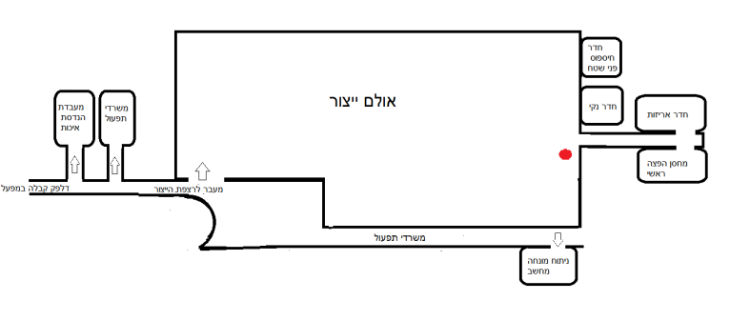
Packing Room
This is where all the company products manufactured in the factory are packed.
In this room the final visual inspection is performed on all the prosthetic products and final inspection of the implant packages.
This is also the room where the final quality assurance inspections are performed on each batch without exception.
In the final inspection we check that every one of the processes has been performed and approved, that all the forms are present, that the labels are correct, that the rejects have been separated from the good parts, that all the processes have been properly reported in the manufacturing control system (ERP) and that the part matches the manufacturing order.

Slide 28
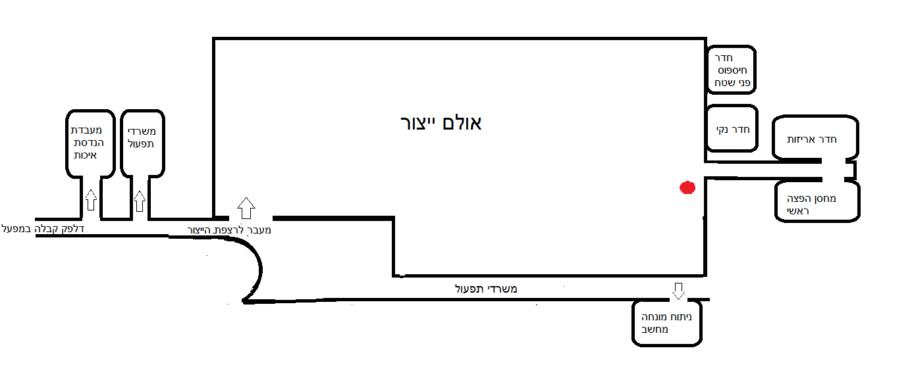
Distribution Warehouse
Alpha BioTec has two distribution warehouses - one in Israel and one in Holland - the two distribution warehouses are responsible for delivering the products to over 50 different countries. We cannot show you the distribution warehouse due to security reasons.

Slide 29
As mentioned when we talked about the historical background of Alpha BioTec, in 2015 we launched the digital division at Alpha BioTec. The division was set up to provide our customers with a range of solutions, services and products they need in order to be successful in the world of digital dentistry.
Computer-Assisted Surgery provides dentists with accessibility to the most advanced technologies in the world of dentistry at a level of quality and precision among the highest in the industry.
All this is done through a dedicated computer program which uses CT technology and advanced 3D imaging.
Guidelines for the clinical process:
Clinical examination and measurement.
Preparation of a laboratory plaster cast.
CT scan of the patient.
Positioning the implants according to the dentist’s instructions and the clinical parameters - the dentist sees the design via the Viewer program, which is provided free of charge.
Manufacture of the (printed) surgical splint by Alpha BioTec.
The local manufacture assures an especially rapid response time (we can show the 3D printer which produces the splints), uncompromising precision and quality (compliant with the highest standards in the world, the only company with ISO Standard certification) - particularly high compatibility between the planned location of the implants and the actual location enables secure positioning of the implants adjacent to the physiological structures.
The high level of precision assures the planning dentist a high level of predictability necessary for preparing the interim provisional restoration prior to the surgery.
Computer-Assisted Surgery

Slide 30
Customer Service Center
Alpha BioTec operates a local customer service center and service and sales centers in over 50 countries worldwide through a carefully selected network of distributors.
The customer service centers are skilled centers capable of providing professional support for all the distributor needs and for the needs of the end customers alike.
This is where our tour comes to an end. Questions?

