Slide 1
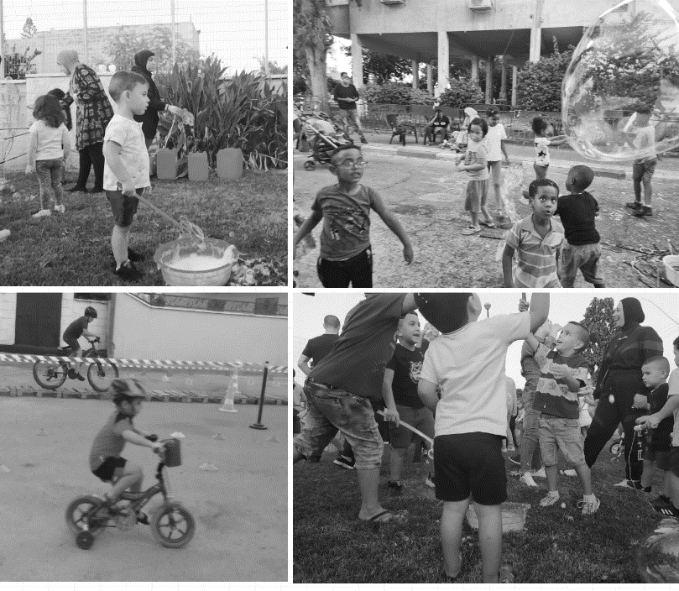
Baseline Report for the Urban95 Program in Tira
Status Report Prior to Intervention Implementation
April 2022
צילום: "מסע"
The CET’s Program Evaluation Unit offers a range of tools and services to support social and educational initiatives and aid in their success

Slide 2
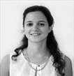
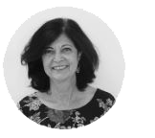
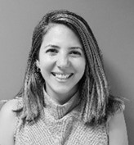
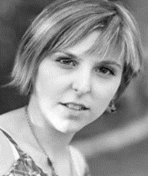
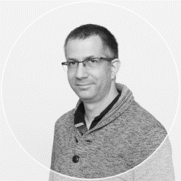
The Accompanying Team
Dr. Tal Mishaan Spiegel
Director of the Program
Evaluation Unit
Dr. Hava Newman
Head of Measurement & Evaluation Administration
Shimrit Slonim Franco
Program Researcher &
Evaluator
Alona Tsirulnikov
Researcher & Program
Evaluator
Tasneem Masri
Statistician & Research
Coordinator
Dudu Ben Shitrit
Program Researcher &
Evaluator
The CET’s Program Evaluation Unit offers a range of tools and services to support social and educational initiatives and aid in their success

Slide 3
Table of Contents
Background…...............…..…………………………………………………………………………........................................... 4-16
Young Children and Their Caregivers in Arab Society in Israel…………………………………………………………………….….4-12
Data from Tira Pertaining to Young Children and Their Caregivers…………………………………………………………..…..13-16
Research Goals…..……...………………………………………………………………........................................................…..17
Research Design……...…………………………………………………………..…..................................................................18
Inputs and Outputs……………………………………………………………………………………………………………………..19
Chapter 1: Target Audience – Officials and Decision Makers in Tira’s Municipality………………………………….20-28
Perceptions and Expectations among the Target Audience Based on Learning Interviews, Steering
Committees and a Flowchart……………………………………………………………………………..………………………….…………….……21-27
Summary and Recommendations…………………………………………………………………………………………………………………….28
Chapter 2: Target Audience –Tira Residents: Parents and Their 0-6 Year Old Children……………………………...29-41
Needs and Obstacles among the Target Audience Based on the Focus Group, a Resident Survey and Field
Observations…………………………………………………………………………………………………………………………………………………….30-40
Summary and Recommendations……………………………………………………………………………………………………………………..41
Chapter 3: Buds of Change in Tira………………………...............…………………………………………...........................42-53
The Perceptual Shift among Municipal Officials .....………………..................................................................................................43-46
Case Study – Findings from Field Observations on Walking Day - October 29th, 2021…………………………………........47-53
Appendixes.……………………………………………………………………………………………………..... ............................54-69
Bibliography – List of References and Documents…………………………… …………………………… ……………………………………55
List of Interviewees …………………………… …………………………… …………………………… …………………………… ……………………….56
Need Mapping Survey Questionnaire among Tira Residents – Parents of Young Children ………………………………….57-62
Example of a Field Observation Indicator …………………………… …………………………… …………………………………………………63-66
The CET’s Program Evaluation Unit offers a range of tools and services to support social and educational initiatives and aid in their success

Slide 4
תוכן העניינים
רקע…...............…..…………………………………………………………………………........................................... 4-16
ילדי הגיל הרך ומלוויהם בחברה הערבית בישראל..................................................................................................... 4-12
נתונים אודות העיר טירה בהקשר של הגיל הרך ומלוויהם....................................................................................... 13-16
מטרות המחקר……...………………………………………………………………..................................................... 17
מערך מחקר ……...…………………………………………………………..….......................................................... 18
תשומות ותפוקות.........…………………………..……………………………………………...................................... 19
פרק א': קהל היעד – גורמי עירייה ובעלי תפקידים ברשות טירה................................................................... 20-28
תפיסות וציפיות בקרב קהל היעד, על בסיס ראיונות למידה, סיכומי וועדות היגוי וסדנת מודל לוגי...............21-27
סיכום והמלצות..................................................................................................................................................................... 28
פרק ב': קהל היעד – הורים תושבי העיר טירה וילדיהם מגילי לידה עד 6 .…........…...................................... 29-41
צרכים וחסמים בקרב קהל היעד על בסיס קבוצות המיקוד, סקר תושבים ותצפיות שטח...............................30-40
סיכום והמלצות.....................................................................................................................................................................41
פרק ג': ניצני שינוי בטירה...............................................................................................................................42-53
שינוי תפיסתי בקרב בעלי תפקידים בעירייה...................................................................................................................43-46
מקרה בוחן – ממצאי תצפיות ביום הליכות 29.10.21....................................................................................................47-53
נספחים...........................................................................................................................................................54-69
ביבליוגרפיה – רשימת מקורות ומסמכים.........................................................................................................................55
רשימת מרואיינים....................................................................................................................................................................56
שאלון סקר מיפוי צרכים בקרב תושבי טירה – הורים לילדים בגיל הרך..................................................................57-62
מחוון תצפית שטח לדוגמה...................................................................................................................................................63-66
The CET’s Program Evaluation Unit offers a range of tools and services to support social and educational initiatives and aid in their success

Slide 5
Background – Urban95 in the Social & Geographic Periphery of Israel
The Urban95 program in the social and geographic periphery of Israel is a joint initiative funded by the Bernard Van Leer Foundation (BvLF) and operated by the Israeli Green Building Council (ILGBC). In the first stage, the program operates in the two “anchor” municipalities of Tira and Beit Shemesh. In the second stage it will operate in a third municipality located in the social and geographic periphery of Israel. The program’s activity in the three municipalities will serve as a model for other cities for promoting early childhood needs. In the third stage of the program interventions at a more limited scope are intended to be implemented in 9-12 additional satellite municipal councils.
The goal of the Urban95 program is to promote the development of a supportive urban-communal environment that provides equal opportunity in regard to raising and nurturing young children and the welfare of their caregivers.
The following report focuses on the findings of the evaluation conducted at the start of the program’s activity in the Tira municipality and describing the state of the city prior to implementing the interventions on the ground.
The CET’s Program Evaluation Unit offers a range of tools and services to support social and educational initiatives and aid in their success
Notes:
The joint initiative part – I assumed the foundation was funding the program – but if you say the ILGBC is operating it then you need to say what the foundation is doing, or not refer to what either of them is doing and just say that it’s a joint initiative of the foundation and the ILGBC…

Slide 6
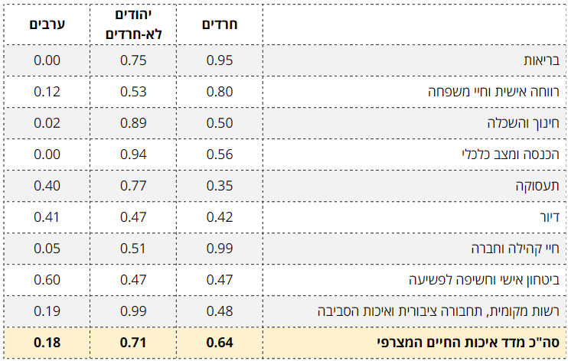
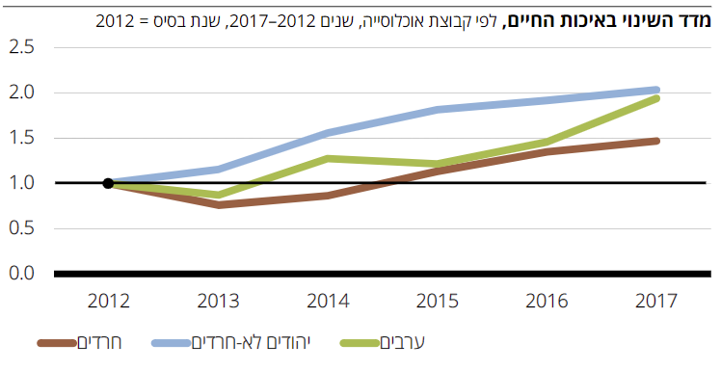
The Quality of Life Index of the Arab Population in Israel*
Summary of the Weighted Quality of Life Index for 2017
According to the Quality of Life Index for 2017, the weighted index value ffor the Arab population in Israel was only 0.18. The Arab population ranked low in relation to the orthodox Jewish population (0.64) and the non-orthodox Jewish population (0.71). The Arab population is underprivileged compared to the other groups in most areas of life, with significant gaps found in the fields of healthcare, education and higher education, income and economic situation, as well as infrastructure, public transportation and the environment.
Change in Quality of Life Index, by population groups, 2012-2017
Between 2012-2017 the trend of change in the Arab population's quality of life rose gradually together with the considerable rise observed across the population in Israel. However, the trend of change in the Arab population’s quality of life is more moderate compared to the non-orthodox Jewish population.
*Source: The Quality of Life of Populations in Israel – The 2019 Quality of Life Index, October 2019. The Haredi Institute for Public Affairs
6
The CET’s Program Evaluation Unit offers a range of tools and services to support social and educational initiatives and aid in their success

Slide 7
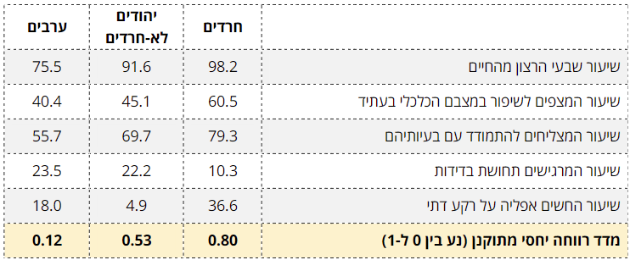
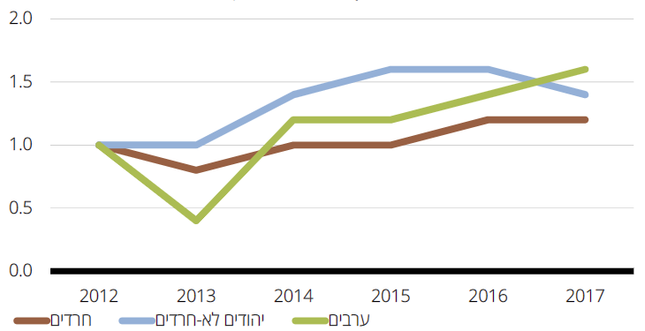
The Quality of Life Index of the Arab Population in Israel – Personal Welfare and Family Life*
The Personal Welfare and Family Life Indexes for 2017
In the personal welfare and family life indexes, the rate of those satisfied with life among the Arab population was the lowest compared to the other Jewish population groups. Likewise, 40.4% of Arab residents expected their economic situation to improve in the future, data that signifies a decrease in this index compared to previous years. In addition, the sense of loneliness and religious discrimination was higher among Arab residents compared to non-orthodox Jewish residents and orthodox residents.
Change in Personal Welfare and Family Life Indexes, 2012-2017
However, the change in the fields of personal welfare and family life indexes indicates ongoing improvement over time, with an upsurge observed in recent years among the Arab population.
*Source: The Quality of Life of Populations in Israel – The 2019 Quality of Life Index, October 2019. The Haredi Institute for Public Affairs
7
The CET’s Program Evaluation Unit offers a range of tools and services to support social and educational initiatives and aid in their success

Slide 8
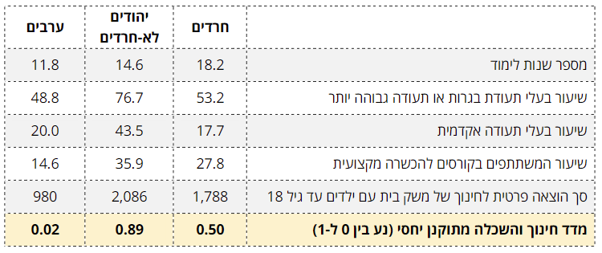
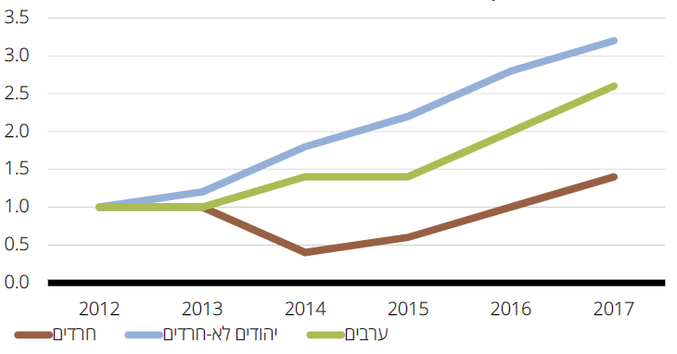
The Quality of Life Index of the Arab Population in Israel – Education and Higher Education*
The Education and Higher Education Indexes for 2017
Compared to other populations in Israel, Arab residents are less educated (with an average of 11.8 years of education, compared to 14.6 among the non-orthodox Jewish population). Relative to the population, the rate of academics among the Arab population is the lowest. Similarly, the total private expenditure on education per household with children up to the age of 18 is the lowest, with an average expenditure equal to about half the private expenditure on education among orthodox and non-orthodox Jewish households
Change in Education and Higher Education Indexes, 2012-2017
However, there is a rising trend of change in the education and higher education index across the population in Israel, including the Arab population.
*Source: The Quality of Life of Populations in Israel – The 2019 Quality of Life Index, October 2019. The Haredi Institute for Public Affairs
8
The CET’s Program Evaluation Unit offers a range of tools and services to support social and educational initiatives and aid in their success

Slide 9
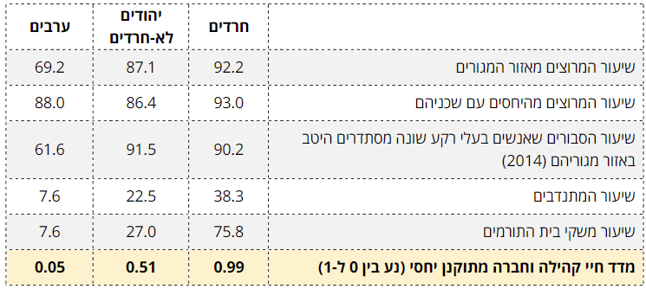
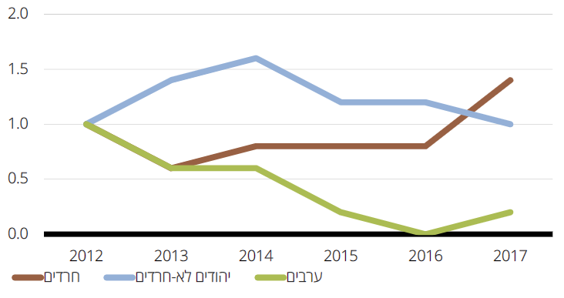
The Quality of Life Index of the Arab Population in Israel – Community and Social Life*
Community Life Indexes for 2017
In the community life indexes Arab residents also ranked lower compared to orthodox and non-orthodox Jewish residents. The rate of those pleased with their place of residence was 69.2% and few of this population’s members volunteered and contributed to their community (7.6%). The rate of Arab residents pleased with their relationship with their neighbors was high (88.0%), however 61.6% of Arab residents believed people from different backgrounds get along well in their place of residence (measured in 2014). It is possible that this data reflects tensions between Jews and Arabs in mixed cities.
Change in Community Life Indexes, 2012-2017
The change in the community life index has seen a steep and ongoing decline from 2012 to 2017 among the Arab population, yet a downward trend of change in the community life index has also been observed among the non-orthodox Jewish population.
*Source: The Quality of Life of Populations in Israel – The 2019 Quality of Life Index, October 2019. The Haredi Institute for Public Affairs
9
The CET’s Program Evaluation Unit offers a range of tools and services to support social and educational initiatives and aid in their success

Slide 10
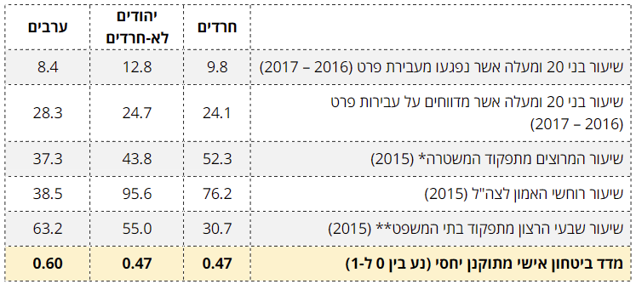
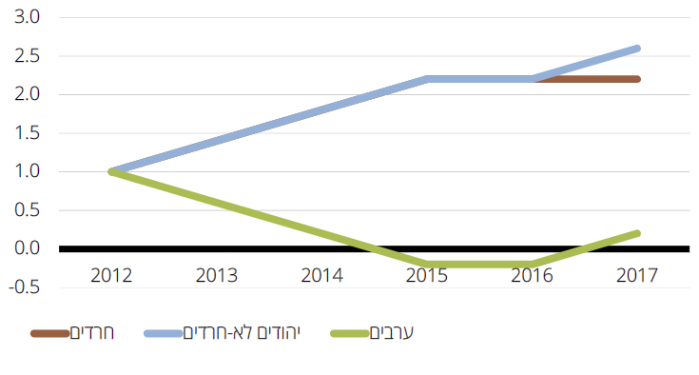
The Quality of Life Index of the Arab Population in Israel – Personal Safety and Exposure to Crime*
The Field of Personal Safety and Exposure to Crime Indexes for 2017
Compared to the Jewish population, the Arab population in Israel is not as pleased with how the police force functions (37.3% of Arabs as opposed to 43.8% of non-orthodox Jews and 52.3% of orthodox Jews) as well as how the Israeli security forces and legal system functions. However, no considerable differences were found regarding the rate of people over 20 who reported crimes and victims of crimes committed by individuals.
Change in Personal Security and Exposure to Crime Indexes, 2012-2017
It is clear that the trend of change in personal security and exposure to crime has seen a major decline among the Arab population over the years, in contrast to the upward trend observed among the orthodox and non-orthodox Jewish populations.
*Source: The Quality of Life of Populations in Israel – The 2019 Quality of Life Index, October 2019. The Haredi Institute for Public Affairs
Due to changes in the measurement system that have taken place in recent years, a critical view should be taken regarding the trends appearing in the change in the field of personal security index.
10
The CET’s Program Evaluation Unit offers a range of tools and services to support social and educational initiatives and aid in their success

Slide 11
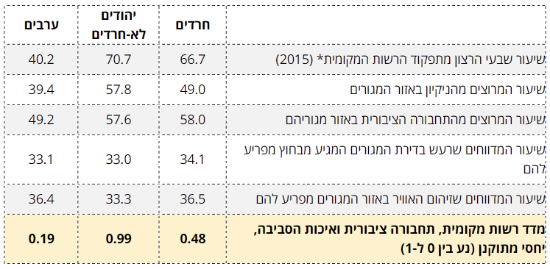
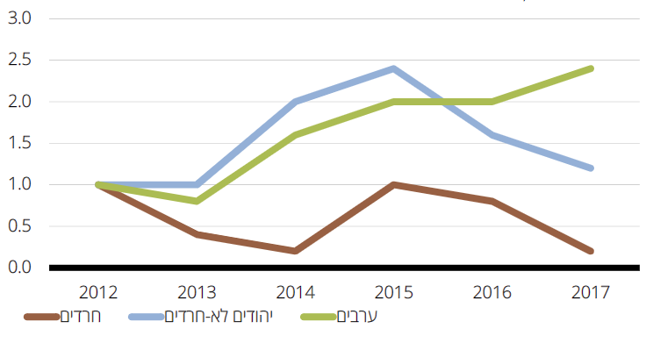
The Quality of Life Index of the Arab Population in Israel – Municipality, Public Transportation and the Environment*
There is considerably lower satisfaction with the functioning of the municipality and level of cleanliness in living areas among the Arab population compared to the orthodox and non-orthodox Jewish populations. The rate of those reporting noise hazards and air pollution is the same across all the population groups, however it is still relatively low (33.1% reported noise pollution and 36.4% reported air pollution). In recent years there has been a rise in satisfaction rates regarding local public transportation among Arab residents, probably due to ongoing investment in the field.
Municipality, Public Transportation and the Environment Indexes, 2017
Change in Municipality, Public Transportation, and the Environment Indexes, 2012-2017
In addition, it appears that over the years the Arab public has experienced ongoing improvement in regard to their local municipality, public transportation, and the environment, in contrast to orthodox and non-orthodox Jews who have experienced an ongoing decline in these indexes.
צילום: צוות עמית
*Source: The Quality of Life of Populations in Israel – The 2019 Quality of Life Index, October 2019. The Haredi Institute for Public Affairs
11
The CET’s Program Evaluation Unit offers a range of tools and services to support social and educational initiatives and aid in their success

Slide 12
Daycare for Young Children in Arab Society in Israel*
The participation rate of children in supervised daycare for young children in Arab society is particularly low. In 2019 the employment rate of Arab women aged 25-64 was only 37%, a low number compared to non-orthodox
Jewish women (83%) and orthodox Jewish women (77%).
There are several explanations for this phenomenon:
Parents prefer their young children be taken care of by their mothers or other family members.
The limited number of supervised frameworks in Arab society, due to planning difficulties and the lack of appropriate physical and professional infrastructures.
Conditioning funding the children’s participation on the mother being employed – pre-excluding a large number of Arab children.
The bureaucratic difficulty Arab parents face when attempting to enroll their children in supervised daycare and exercise their right to funding.
The lack of an appropriate public transportation infrastructure and daycare activity hours that are incongruent with many Arab women’s work hours.
The limited participation of Arab toddlers in Israel in state funded supervised daycare is problematic. This is because these frameworks are a vital component of the social investment in children living in poverty that contributes to the children’s cognitive, social, and emotional development and improves their talents and skills.
Despite the fact that over half of Arab children live in poverty stricken households, their participation rate in supervised daycare for children aged 0-3 is only 18%.
*Source: Participation of Arab Children in Supervised Educational Frameworks for Young Children, Research Paper No. 7, Jerusalem, November 2021. Taub Center Early Childhood Research Series.
The CET’s Program Evaluation Unit offers a range of tools and services to support social and educational initiatives and aid in their success

Slide 13
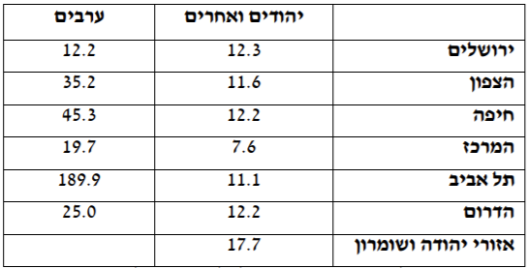
Safety, Public Spaces and Parks for Young Children in Arab Society in Israel
Parks and play areas: Arab towns lack parks, areas for leisure activities, boardwalks and green roadside areas and green areas separating neighborhoods.* Population growth and transitioning to a modern urban society has involved moving from standalone houses with surrounding land to apartments, a development that has led to a change in demand patterns and a reduction of privately-owned areas, alongside a rise in demand for open public parks and playgrounds for the town and neighborhood children.
Transitioning from an agrarian society to an urban one has led to changes in urban planning and raised the importance of spatial planning in order to meet the substantial demand for public areas.**
Child-Pedestrian Injuries from Serious Car Accidents, by Age and Sector, 2018
Safety, Infrastructures, and Car Accidents Involving Children and Pedestrians***
In 2017 the rate of serious injuries among Arab children in the center of Israel was 19.7 per 100K children, as opposed to 7.6 among Jewish children. This is likely due to infrastructure differences leading Arab children to cross roads in an unsafe manner compared to Jewish children.
Serious Injuries per 100K Young Children, by Sector (2017)
In general, the rate of Arab children injured in car accidents is much higher than that of Jewish children.
* Based on the Knesset’s 2008 Information and Research Center Report.
** Source: “The Public Space and Appearance of Arab Towns in Israel – Removing the Obstacles and Realizing Development Challenges.” The Friedrich Ebert Foundation in Israel and the Jewish Arab Center at Haifa University, December 2016.
*** Data from the National Highway Traffic Safety Administration (NHTSA) for 2017.
The CET’s Program Evaluation Unit offers a range of tools and services to support social and educational initiatives and aid in their success

Slide 14
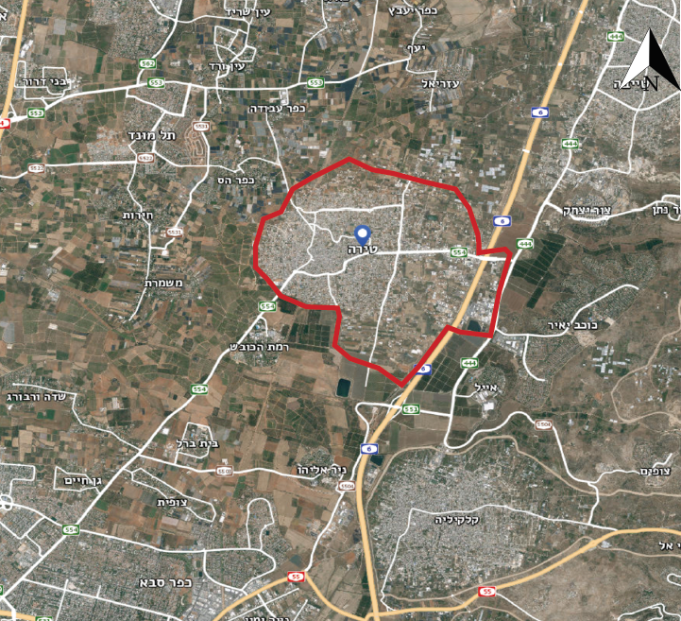
General Data and Demographics (From the Report of the Central Bureau of Statistics)
A municipal area of about 12,000 dunams | 26,500 residents, the majority of which are Muslim | 2,500 children aged 0-4 Constituting 9.3% of the population
Tira belongs to socio-economic cluster 4, which attracts intra-Arab immigration. A strong middle class is emerging alongside an underprivileged population in the old core of the city. | Average salary of a salaried employee NIS 8,353/month High employment rate among women | Annual population growth rate of 1.7%, 2.7 children on average per family
The unemployment rate in Tira is relatively low compared to the national average In February 2020* the national unemployment rate was 3.9% while in Tira it was only 1.7% | Number of children per family:
Based on data from the Employment Service site for February 2020, just before the COVID lockdowns began,
which led to a dramatic rise in unemployment rates. The website does not offer more updated data segmented by towns.
The CET’s Program Evaluation Unit offers a range of tools and services to support social and educational initiatives and aid in their success

Slide 15
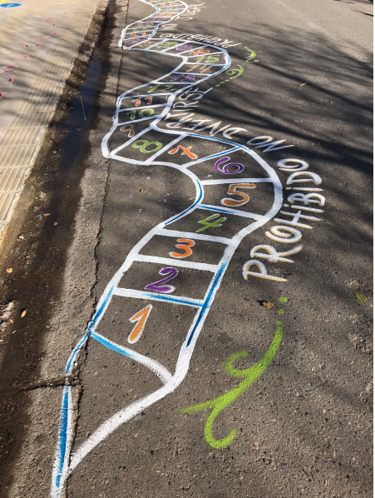
Tira: Public Space
Low level of awareness regarding cleanliness
Vandalism
Violence
Illegal parking
Most of the land is privately held
Lack of shading and trees
Inadequate infrastructures for walking
There is a plan to establish the National Water Carrier Park. A call for proposals has been submitted.
There is a plan to establish a park in the north-east of the city.
Open areas in the core of the city are currently being mapped
רקע – נתונים אודות העיר טירה
*Data from the Tira Municipal Authority’s Database
The CET’s Program Evaluation Unit offers a range of tools and services to support social and educational initiatives and aid in their success

Slide 16
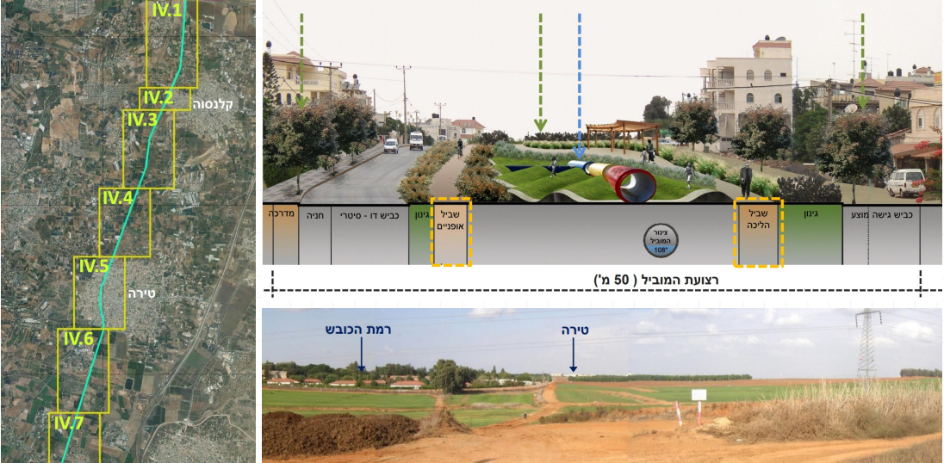
Tira: Transportation & Mobility
Most of the residents use cars
There are two intra-city public transportation lines and a plan for adding more lines and means of public transportation.
High potential for temporary / partial closure of traffic routes in favor of public spaces.
Potential for walking and bike riding based on former routes and lifestyles.
A train station will be built on the east side of the city.
Most children come to kindergarten by car, making it unpleasant to enter the premises.
רקע – נתונים אודות העיר טירה
In 2019, 7 children under the age of 19 were victims of traffic accidents, one of whom was under the age of 9 and another who was between 10-14 years old. In total there were 19 traffic accidents with casualties (one of which with fatalities) in Tira. Of these, 10 accidents also included injuries to pedestrians. The data does not include information about the victims’ age.
* Data from Tira’s municipal database
The CET’s Program Evaluation Unit offers a range of tools and services to support social and educational initiatives and aid in their success

Slide 17
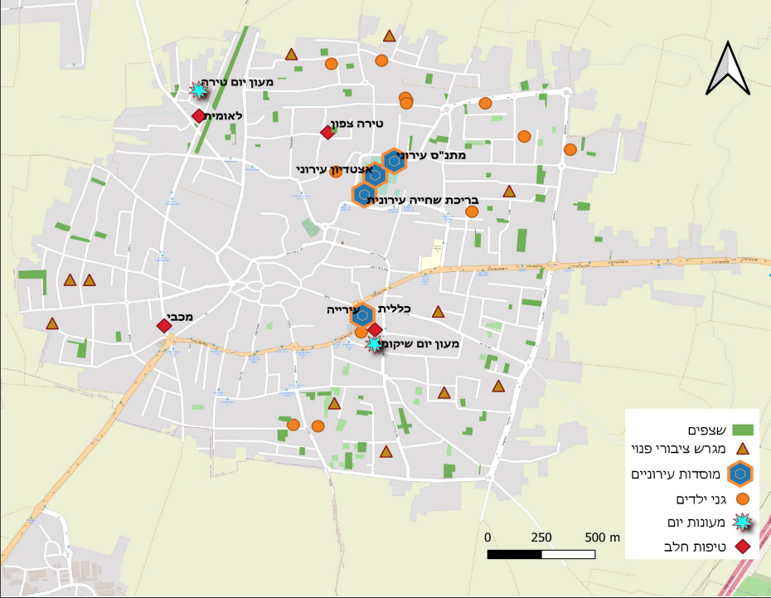
Tira: Public Buildings
4 family health centers
One library, not fully functional
The community center is being renovated and is currently inactive.
There is a budget for developing a therapeutic garden in the area of the municipality’s Welfare Department building
There are plans for utilizing a multipurpose building
A city pool that needs to be renovated
There are plans for developing an early childhood center
4 מבני טיפות חלב
ספרייה אחת, לא בתפקוד מלא
המתנ"ס בשלבי שיפוצים, כרגע לא בתפקוד
קיים תקציב לפיתוח גינה טיפולית בשטח מבנה העירייה – מחלקת רווחה
ישנן תוכניות להשמשה של מבנה רב תכליתי
בריכה עירונית שצריכה לעבור שיפוץ
ישנן תוכניות לפיתוח מרכז לגיל הרך
* Data from Tira’s municipal database
The CET’s Program Evaluation Unit offers a range of tools and services to support social and educational initiatives and aid in their success

Slide 18
Outlining the evaluation research for the Urban95 program in Tira, including developing a primary logic model for the program and a separate one for Tira, including mapping and formulating evaluation indicators congruent with BvLF indicators.
Accompanying evaluation research: Research to map needs in order to examine possible interventions for Tira.
Formative evaluation research: conducting pre-intervention measurements as part of a range of pilot programs in Tira, in order to refine intervention processes and solutions based on the needs of the target audience and examine the effect post-intervention.
Evaluation Research Goals
for the Urban95 Program in Tira
The CET’s Program Evaluation Unit offers a range of tools and services to support social and educational initiatives and aid in their success

Slide 19
Research Design
Evaluation Period – Stage 1 of the Urban95 Program in Tira, May 2021-March 2022
Baseline Evaluation Municipal Stakeholders
Pilot Programs - Formative Evaluation
Learning and Planning
Baseline Evaluation
Residents
Training Evaluation
8 learning interviews to identify needs and align expectations
Key officials at the ILGBC
The BvLF team
Key stakeholders in Tira’s municipality.
Logic model workshop on June 9th 2021 with key participants:
The BvLF team
The ILGBC team
Various key officials from Tira’s municipality, including an impressive number of women in key positions.
Evaluation indicators were defined.
3 focus groups with residents
Resident survey
Feedback survey to assess team training sessions
Focus group with the National Carrier team
7 observations on the ground pre-intervention
4 observations conducted as part of the “Walking Day” pilot.
The CET’s Program Evaluation Unit offers a range of tools and services to support social and educational initiatives and aid in their success

Slide 20
Inputs & Outputs
Goals and Inputs | Outputs and Results at the End of the 2021 Activity Year
Training and seminars for acquiring knowledge and tools to raise awareness of the importance of addressing early childhood needs in all areas of life | Tours of day care centers (“Parparim” at Tel Aviv Port, “Tif-Taf” in Holon, a learning day dedicated to walking) Participants highly satisfied with the training
Mapping needs and identifying opportunities for creating accessible content for young children and their caregivers to support interventions in the municipality’s urban environment | Learning interviews conducted to identify needs and align expectations Definition of the program’s action steps, goals, impact, and target audience in Tira using the logic model Focus groups conducted with residents and distribution of a resident survey Distribution of a feedback survey about the professional team training sessions
Engaging various municipality officials with the Urban95 vision, with a focus on senior officials | Engaging the director of the city’s Child Development Department, the deputy mayor and the principal of a nearby school to improve the public spaces and increase the residents’ sense of safety and security.
Initiating pilot programs that include an array of accompanying content in the municipality’s physical environment | A therapeutic community garden in the municipal welfare building: there are architectural plans, a pathway has been built and there is a budget for the watering system; once the second floor is built, development of the garden will continue A playground at the educational campus – budgeted and executed by the city’s Engineering Department and accompanied by landscapers recommended by Urban95 The community center – renovations that began as Urban95 entered the city have been completed and it is now functional. An orchard is currently being set up in the community center A space for therapeutic gardening at the entrance to the Child Development Department has been established A community garden near Salwah’s garden, with the participation of the Technion through its 1:1 course, the municipality and Treellion
Building a work team in the municipality and forming collaborations inside and outside the municipality | Launching the activity in Tira during a meeting of the broad municipal team A session in which the team members were exposed to design thinking tools for planning public spaces for children Getting to know kindergarten teachers and distributing pamphlets in Arabic about parent training and activities for parents and children, in collaboration with “Magic Moments” Collaboration with SFI – the program’s director is participating in the strategic development of a program for children with developmental delay Collaborations with Mifal Hapayis (Israel’s state lottery) and Netafim Kick-starting the “Edible Forest” initiative with ReForest
The CET’s Program Evaluation Unit offers a range of tools and services to support social and educational initiatives and aid in their success

Slide 21
Chapter 1
Target Audience – Officials and Decision Makers in Tira’s Municipality
The CET’s Program Evaluation Unit offers a range of tools and services to support social and educational initiatives and aid in their success

Slide 22
מודל לוגי לרשות העיר טירה - תוכנית Urban95בפריפריה החברתית והגיאוגרפית בישראל
Target Audience | Inputs | Actions | Outputs | Short to Mid-Term Results (up to 3 years from program’s onset) | Long Term Results (3-5 Years) | Impact
Officials & municipal decision makers, and professionals in the field | Personnel: - ILGBC team - Anchor municipality program manager - Municipal officials - External consultants - Program partners (inside and outside of the municipality) - Previous knowledge and experience from BvLF, ILGBC, Urban95 TLV and at the national roundtable - Projects’ funding - Measurement and evaluation | Participation in meetings and committees to promote early childhood development (ECD) in the anchor municipality Participation in trainings & seminars to acquire knowledge and tools and to raise awareness for ECD in all aspects of life Mapping of potential interventions in public spaces and mobility domains in the anchor municipality Mapping needs and identifying opportunities to provide relevant contents for young children and their caregivers, supporting the interventions in the urban environment in the anchor municipality Engaging municipal stakeholders in pilots’ implementation Connecting with external partners for pooling resources and expending opportunities for additional collaborations Initiating pilots in the urban environment, including providing accompanying contents The municipal program manager will support pilots’ implementation and accompany municipal stakeholders in assimilating inter-administrative collaborative work models | A permanent seat for program leaders at the anchor municipality’s decision-making table, to examine possible touching points between the early childhood domain and the municipality’s ongoing work-plans Extent of municipal officials who have participated in seminars for acquiring local and international knowledge and tools regarding early childhood needs Satisfaction of trainings’ participants Extent of new partners engagement and inter-department collaborations Identification of well defined and differentiated intervention locations, to implement pilots in the domains of public space and mobility Initiating pilots’ implementation while defining inter-departmental division of labor and engaging relevant officials from in and outside of the anchor municipality Extent of data-based work: using knowledge and experience accumulated from the program’s partners network, the program’s website, and peer learning | Early childhood is permanently present on the municipal agenda Municipal officials are knowledgeable and understanding of early childhood needs Municipal officials are using work mechanisms and new management practices, along with inter-department collaborations Collaborations between municipal officials and external partners, while seeking resources dedicated to promoting early childhood in the city (pooling resources) Interventions’ implementation in the mobility and public space domains: adjusting them for young children and their caregivers use, and providing contents for young children and caregivers to support these interventions Promotion of municipal investment in adjusting the urban environment for safe and accessible use and mobility of young children and their caregivers Tira constitutes a source for peer learning to other municipalities | Municipal officials are implementing acquired knowledge & understanding of ECD needs for decision making and for promoting solutions for young children and their caregivers’ benefit Young children & caregivers’ P.O.V is considered when planning early-childhood-suitable public spaces Increase in number of public spaces and infrastructures renovated and adjusted for the use of caregivers and their children, by the Urban95 principles & standards Tira’s municipality is seeking for external funding resources and acts independently to promote ECD needs The anchor municipal urban planning, that is based on Urban95 principles, is recognized as a “success story” and echoes in other municipalities | A policy for promoting an urban environment that is adjusted for optimal development of early childhood is properly and sustainably embedded in all of Tira’s municipal administrations, that are acting in full coordination and collaboration
The CET’s Program Evaluation Unit offers a range of tools and services to support social and educational initiatives and aid in their success

Slide 23
Mapping Evaluation and Research Tools and Indicators
Indicator / Tool | Data Review & Analysis | In-depth Interviews | Focus Groups | Trainings’ Participants Feedback
ECD is on the municipal agenda | V | V | V | V
Young children & caregivers’ P.O.V considered when planning public spaces | V | V | V | V
Knowledge in and understanding of ECD needs | V | V | V | V
Establish inter-administrative collaboration mechanisms | V | V | V | V
New collaboration with external partners, including resource allocation | V | V | V | V
Municipal positions & budgets allocation, dedicated to ECD | V | V | V | V
Public space & mobility pilots’ initiation, including accompanying contents development | V | V | V | V
The CET’s Program Evaluation Unit offers a range of tools and services to support social and educational initiatives and aid in their success

Slide 24
Extent to which Early Childhood is on the Municipality’s Agenda and Integration of the Child and Caregiver’s Point of View in Planning Appropriate Public Spaces
“There’s no one in charge of early childhood. There are a few frameworks that cater to young children as part of their target audience, such as the 360 program, the Welfare Department, and informal education, but we don’t have a dedicated early childhood department nor do we have public institutions for young children.”
"The field has been completely neglected by the department and in Tira in general. There are no community centers and no urban frameworks. There are no municipal activities for young children, only private ones. As a result, families who are most in need of these services get nothing, because they can’t pay. There are practically no services for underprivileged populations.”
“There are many unused public spaces that are filled with garbage, or there’s a tacit agreement that they’ll be used for private construction.”
“We don’t have extracurricular classes and activities. None of the activities for young children are free.”
“We never aimed to make physical buildings accessible to children as part of our goals. Today we take it into account, we think about it. Urban95 has raised our awareness in this regard. The whole team was involved in the thinking and planning process and we are currently thinking about developing supplementary services.”
Some municipal officials have dealt with certain issues related to early childhood before their introduction to Urban95, however for others this was a completely new field. Up till now, early childhood had not been taken into account at the project execution stage in the various departments and on a systemic level the needs of parents and their young children were not being met. As a result, residents sought out solutions on their own.
The CET’s Program Evaluation Unit offers a range of tools and services to support social and educational initiatives and aid in their success
Notes:
גיל הרך על סדר היום
אנשים בעלי ידע והבנה
עד כמה התרחש שינוי תפיסה
חשיבות ומרכזיות של גיל הרך
שקפים מתוך מודל לוגי טירה – מצגות טירה
מה העמדות והתפיסות של בעלי תפקידים

Slide 25
Extent to which Municipal Officials Are Knowledgeable and Have an Understanding of Early Childhood Needs
“Despite the fact that Tira is considered to be modern and developed, we can’t imagine having public gardens, playgrounds, and parks. There are currently very few throughout the city and it’s not enough (one lot for every 5-6K residents). There are also no children’s clubs. I walk around outside and I see what they have over there and what we have here. I imagine it but it’s unrealistic. There are no budgets.”
“Many services were missing in the Welfare Department – in terms of treatment as well as prevention, and this is how it related to Urban95, because if we think about programs for young children and their parents and enrichment, it’s all related to prevention.”
“The thinking was that if there’d be a playground it would be possible to have enriching activities, to think about enriching parent groups for young mothers on topics such as parenting skills. “
“Clearing a workday is no simple feat, but personally I feel committed to the program. I have to gain knowledge in order to be able to contribute and that’s why the training is necessary. My approach is that we need to lead and be change agents in the city, even if it’s not always directly related to our role.
“Because we’re very busy and don’t have time to learn, when it does become possible and there’s an opportunity, I try to make time for it.”
Municipal officials acknowledge early childhood needs and are aware of the gaps between what the municipality currently provides and the residents’ needs, such as the lack of parks and playgrounds in the city.
Officials demonstrate a commitment to the program and promoting early childhood needs by consistently participating in Urban95’s professional training, despite the their ongoing workload.
The CET’s Program Evaluation Unit offers a range of tools and services to support social and educational initiatives and aid in their success

Slide 26
Extent to which Officials Make Use of Inter-Administration Collaboration Practices and Mechanisms
“We’re setting up three projects called “Pathways to Parenting” for early childhood, school children, and adolescents. The early childhood program is being set up in collaboration with the Child Development Department. It’s going to be a center that provides treatment services focusing on parent-child relationships. One of its goals is to work on enrichment at the community level.”
“I have a project for senior citizens where we want to build collaborations with the HMOs. When the municipality initiates and invites them they come. There’s a willingness, but someone needs to take the lead. If Urban95 takes it forward I believe we’ll have a collaboration, especially if it’s under the auspices of the mayor.”
“A lot of the welfare services can be operated through the community center. In any case the municipality doesn’t operate them directly because it’s all privatized and operated by nonprofit organizations. The municipality should keep handling their operation even when the budgets come from the Welfare Ministry. The direction of thought needs to be changed.
“There is no roundtable for thinking about the municipality as a whole in the long term. The departments communicated with each other regarding a specific collaboration for building a playground in a municipal area – it wasn’t on the level of the municipality.”
“There’s a lack of community work in regard to communicating with residents and getting them join in, not about the high level of violence, there’s a lack of belongingness.”
Departments have collaborated on specific joint projects in the past. However, there are no organized municipal mechanisms for inter-departmental collaborations such roundtable discussions that include long-term thinking about the municipality as a whole.
In the learning interviews officials demonstrated an understanding of the importance of working together and spoke about potential collaborations for promoting the Urban95 project in Tira:
The CET’s Program Evaluation Unit offers a range of tools and services to support social and educational initiatives and aid in their success

Slide 27
Scope of Collaborations Initiated with External Entities, Including for Pooling Dedicated Resources to Promoting Young Children and Allocating Positions and Budgets to Promote Adaptation of the Urban Environment to Meet Early Childhood Needs
“There are all kinds of reasons why external entities want to collaborate with us. In terms of cities and neighborhoods, this city is part of the Sharon cluster, which is a fairly new cluster that’s been established recently. So far we haven’t seen any big changes, but we can think about suggesting some collaborations.”
“Tira is a central city in the Triangle and I would open a discussion and start thinking about how to create collaborations that don’t rely on the municipality alone, but also on the third and business sectors.”
“In terms of partners from the business sector, Tira has a lot of small and medium businesses (over 1000 according to our business licensing records), so this would include business owners who want to sponsor projects and be involved. It can go down to the micro level of local businesses who want to partner on projects.”
“We should create a plan for the entire town for collaborating with various entities.”
Tira is characterized by a large number of nonprofit organizations with which collaborations can be initiated. These include the Engineers’ Association, the Lawyers’ Association, the Academics’ Association, and others.
Various proposals for collaborations with HMOs or business owners in the city were raised in the past.
The CET’s Program Evaluation Unit offers a range of tools and services to support social and educational initiatives and aid in their success

Slide 28
Scope of Pilot Program Initiation in the Fields of Mobility and Public Spaces, Including Accompanying Content
“The Tira South neighborhood is on state lands. Planning is easier compared to privately owned lands, where public spaces are not a given.”
“Our flagship project: a multipurpose building and the National Carrier park, which Urban95 can get involved with.”
“Establishing parent enrichment groups focusing on parenting skills.”
“We’ll locate small plots that up to now have been a public and environmental nuisance and turn them into something that’s accessible to children.”
“We want to create a therapeutic playground or garden for families and children who come to the department.”
During the learning interviews municipal officials suggested various pilot programs that were congruent with Urban95. For example, regarding accompanying content for promoting parental welfare they suggested holding parent training and enrichment groups.
In regard to public spaces they suggested setting up a therapeutic garden in the welfare building’s area for families and children coming to receive welfare services.
In the field of mobility they suggested establishing the National Carrier park and getting the Urban95 team involved in planning it.
The CET’s Program Evaluation Unit offers a range of tools and services to support social and educational initiatives and aid in their success

Slide 29
Summary of Chapter 1 - Target Audience: Municipal Officials
Tira has a lot of potential for collaborations with external entities such as nonprofit organizations, business owners, etc., which can help promote the program in Tira | There are currently no inter-departmental collaboration mechanisms, only specific collaborations focusing on addressing specific issues | Officials understand early childhood needs, are aware of the gaps between the current situation and the desirable one in terms of the municipal services provided to residents and want to act to reduce these gaps | The field of early childhood is considered relatively new to many municipal officials and early childhood needs had not previously been integrated in the various planning projects
Partnerships should be initiated with external entities where there is potential and an alignment of interests. In addition, engaging residents can promote their sense of trust in the municipality and promote potential partnerships with members of the community. | We recommend promoting meetings with representatives from all the municipal department to design collaborations on issues that need to be solved. | Accordingly, we recommend promoting a discussion about the about these gaps and ways to reduce them. We recommend providing support regarding resource management in order to promote initiatives for reducing these gaps, as well as setting benchmarks for success. Likewise, measures should be taken to raise the officials’ sense of competence regarding their ability to reduce these gaps. This should be done by setting achievable short-term goals to give them a sense of achievement every time they meet a target. | Accordingly, some of the professional training content should focus on helping the officials gain knowledge, tools, and practices that will serve them in their ongoing work in regard to promoting the early childhood needs in the municipality.
The CET’s Program Evaluation Unit offers a range of tools and services to support social and educational initiatives and aid in their success

Slide 30
Chapter 2
Target Audience
Tira Residents: Parents and their 0-6-Year-Old Children
The CET’s Program Evaluation Unit offers a range of tools and services to support social and educational initiatives and aid in their success

Slide 31
Flowchart for the Tira Municipality Authority: the Urban95 Program in Israel’s Social and Geographical Periphery
Target Audience | Inputs | Actions | Outputs | Short to Mid-Term Results (up to 3 years from program’s onset) | Long Term Results (3-5 Years) | Impact
Tira’s residents - children from birth to the age of 6 and their caregivers | Personnel: - ILGBC team - Anchor municipality program manager - Municipal officials - External consultants - Program partners (inside and outside the municipality) - Previous knowledge and experience from BvLF, ILGBC, Urban95 TLV and at the national roundtable - Projects’ funding - Measurement and evaluation | Identifying and characterizing needs and barriers among city residents and their young children, regarding adjustment of the build environment in their neighborhoods for suitable and accessible use. Identifying and characterizing the needs of city residents and their young children, from all socio-economic populations, to develop accompanying contents, promoting sense of parental welfare. Engaging partners to pilots’ implementation (inter-municipality and cross-sectional), including partners among city residents. Initiating pilots benefitting young children, promoting safe mobility, prioritizing walking, and riding bicycles, over car use. Initiating establishment / renovation of playgrounds or play areas near municipal public buildings, based on Urban95 principles (for example combining developmental elements, multi-age adjustment) across different areas in the anchor municipality. Development of accompanying contents for municipal services and interventions in the urban environment, to strengthen sense of parental welfare and promote community ties, while characterizing and adjusting services and contents to weakened populations. Promoting processes of public participation within pilots’ implementation. Promoting sense of security and safety as part of implementing interventions in the public space (for example by building fencing, collaboration with neighborhood trustees and municipal officials). | Extent of interventions in public spaces and mobility that have been implemented Extent of activities and events for young children and caregivers, taking place in the anchor municipality City residents, parents of young children, are aware of and familiar with the program and the pilots promoted within it Parents of young children are aware of services and events realized as part of the pilots across the city The number of city residents, parents of young children, involved in public participation actions Parents of young children report sense of safety and security when using and staying in public spaces undergone interventions | The post-intervention public spaces are suitable for safe use, stay and mobility on foot and with a stroller Increase in contents and services consumption (provided as part of the program’s interventions) by caregivers’ and their young children, across the anchor municipality and especially by weakened populations High satisfaction of caregivers and their young children, from the contents and services consumption (provided as part of the program’s interventions) Increase in number of young children and caregivers staying in post-intervention playgrounds / public space play areas Increase in number of young children and caregivers not using cars (walking or by bicycles), in post-intervention public spaces Increase in number of young children and caregivers participating in activities in tactic intervention areas (place making) on city streets Increase in extent of promoting communal ties among city residents, parents of young children | Residents are satisfied with the city-life experience, relating to use, stay and mobility in public spaces suitable for young children needs Residents and their young children frequently spend time in public spaces, which were adjusted to their needs and designed by the Urban95 principles Strong sense of security among young children and their caregivers when staying and mobilizing in post-intervention urban area Strengthening sense of community and social interactions among city residents, parents and their young children (including between children) Sense of parental welfare improved among city residents, parents of young children | An equal urban environment that optimally promotes ECD and sense of parental welfare in the anchor municipality
The CET’s Program Evaluation Unit offers a range of tools and services to support social and educational initiatives and aid in their success

Slide 32
Indexes
 | Indicator / Tool | Field Observations | Focus Groups | Caregivers’ Surveys
Adjusting the Urban Environment for Safe Mobility | Suitable infrastructures for young children and caregivers | V | V | V
 | Using a suitable urban space | V | V | V
 | Safe mobility without the use of a private car | V | V | V
 | Frequency of mobility via foot, bicycle, or public transport | V | V | V
Establishing areas for Spending Time and Playing Together | Playground deployment and suitable public space | V | V | V
 | Use of public space and playgrounds | V | V | V
 | Satisfaction from facilities and space | V | V | V
 | Interaction & joint play in the public space | V | V | V
Accompanying Content to Promote Parental Welfare | Service - utilization & satisfaction | V | V | V
 | Parental welfare improvement | V | V | V
 | Sense of community and social belongingness | V | V | V
Index Across the 3 Areas | City-life experience improvement | V | V | V
The CET’s Program Evaluation Unit offers a range of tools and services to support social and educational initiatives and aid in their success

Slide 33
Research Design – Evaluation Actions
The research actions took place between May-December 2021
Research Tool | Quantity | No. of Participants/ Respondents | Gender | Age | Area | Data Collection Date
Activity observations | 4 observations before and during the interventions 2 observations on Walking Day; An observation in the Welfare Department’s therapeutic garden; An observation of the entrance to playgrounds |  |  | Adults (the vast majority of whom were parents) aged 28-62 Children aged 0–9 | An observation in the Welfare Department’s therapeutic garden, an observation in the entry to the gardens, 2 observations on Walking Day | August-November 2021
Interviews with activity participants (as part of the observations) | 4 observations of activity stations on Walking Day The soap bubbles station; The bicycle path; The inflatables station; The performance | About 35 interviewees | 27 women 8 men |  | The vast majority came to the activity from their neighborhood
Discussion groups | Men’s group | 7 | Men | Parents aged 30-42 | Tira | June 2021
 | High socioeconomic women’s group | 6 | Women |  | Tira | June 2021
 | Low socioeconomic women’s group | 3 | Women |  | Tira | July 2021
Parent survey among Tira residents |  | 153 residents | 77 women 76 men |  | Tira | September 2021
The CET’s Program Evaluation Unit offers a range of tools and services to support social and educational initiatives and aid in their success

Slide 34
Demographic Profile of Survey Respondents
153 Parents with children aged 0-6
Gender
Age
Children’s Age
5+
0-2
Level of Religiousness
Number of Children
3-4
The CET’s Program Evaluation Unit offers a range of tools and services to support social and educational initiatives and aid in their success

Slide 35
Socioeconomic Profile of Survey Respondents
Employment
Income
Education
Spouse’s Employment
The CET’s Program Evaluation Unit offers a range of tools and services to support social and educational initiatives and aid in their success

Slide 36
Findings Adjusting the Urban Environment to Ensure Safe Mobility
The vast majority of Tira’s residents use cars to get around the city during all hours of the day (to take children to and from their schools, afternoon recreation activities, get to work, etc.). The baseline research findings point to the following reasons for this:
They feel the roads are unsafe
Poor infrastructures and blocked sidewalks
(Focus groups, women)
“There’s no sidewalk, no sense of security. It feels like public spaces have been exploited and privatized. I don’t feel accepted by the space, it’s completely uninviting.”
“There’s no way of walking on the sidewalk. It’s blocked by cars so if you want to walk you have to go down to the road.”
“There are potholes on the sidewalk. Once I was walking to the grocery store near our house with my son and he fell into one of them. There are some potholes I haven’t even noticed. There’s no maintenance, no infrastructures.”
(Focus group, men)
“You get to Tzur Yitzchak and you see a mother walking with her child in a stroller on the sidewalk, all happy go lucky, and we don’t have a sidewalk to walk on.”
“I’m not willing for my children to get around on foot because it’s unsafe. There are no sidewalks. Nothing guarantees that my son won’t get run over on the way.”
“My son bought a new bicycle and learned how to ride it, but there’s nowhere for us to use it.”
“The roads are very dangerous. People drive way too fast, there are no crosswalks. The most dangerous thing I’ve ever done with my children was go out on the road.”
74%
report that walking with children on the streets of Tira, with or without a stroller, and riding bicycles is completely unsafe.
88%
use cars to take their children to or from their
schools
Use cars to get around in the afternoon
95%
38%
of residents would like to use subsidized transportation services to and from their children’s schools.
Why don’t they walk or ride a bicycle to get around? (Resident survey)
“The municipality has neglected the roads”
“The roads are unsafe”
“To save time”
“The children refuse to walk”
“The sidewalks are blocked by cars.”
“We have a car”
“The children are young and can’t ride bikes.
“We need to get to far places”
The CET’s Program Evaluation Unit offers a range of tools and services to support social and educational initiatives and aid in their success

Slide 37
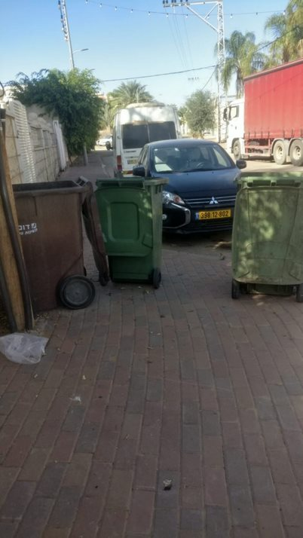
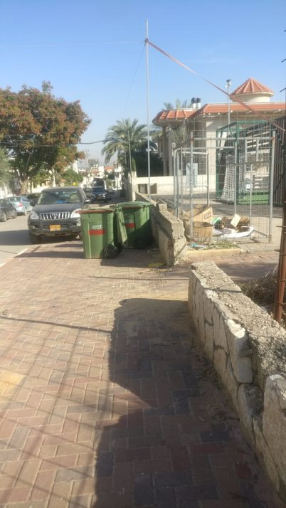
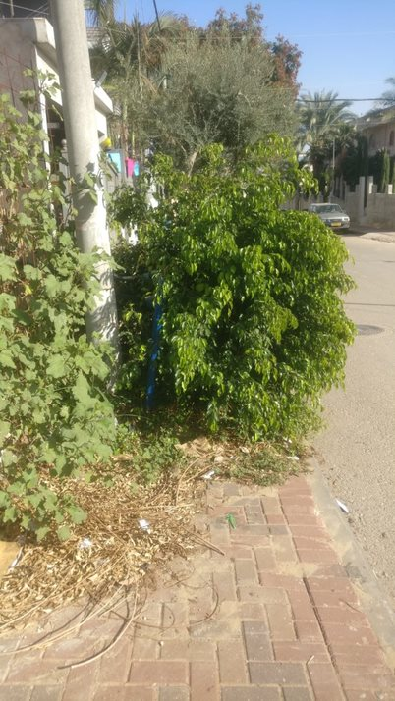
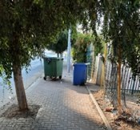
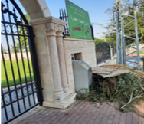
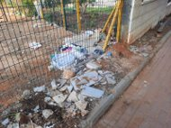
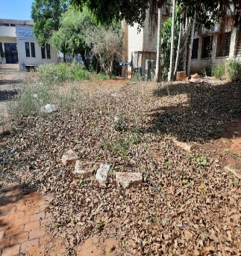
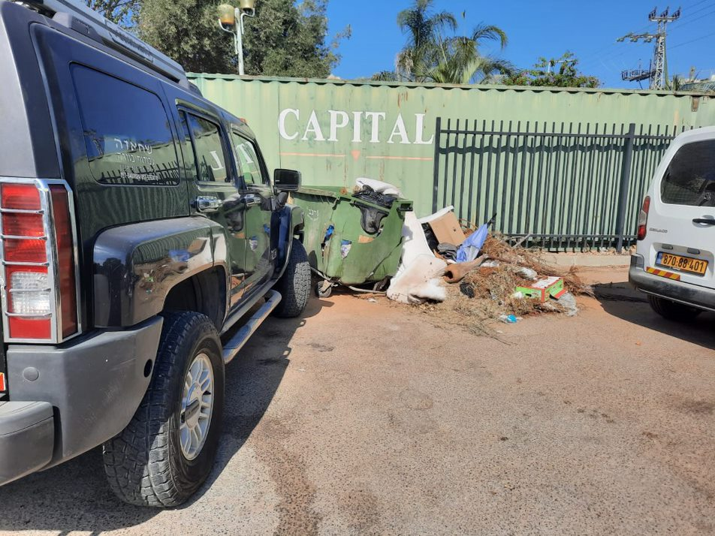
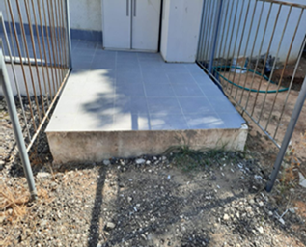
Observations & Pictures from the Ground Adjusting the Urban Environment for Safe Mobility
The Payis & Ajiyal Playgrounds
In observations conducted as part of the research, the issue of poor infrastructures was particularly salient in various places throughout the city:
The municipality complex: We observed broken and irregular sidewalks, a pathway that was inaccessible to strollers, and nothing separating pedestrians from bicycle riders.
Walking Day: We observed sidewalks blocked by garbage cans or parked cars, crosswalks that were wiped out, and narrow and broken sidewalks.
The playground area: We observed trees and electric poles in the middle of the narrow sidewalk that obstruct pedestrians. Furthermore, there is no fencing or anything separating pedestrians from the road.
Walking Day Observation
"It’s dangerous for children outside. Things need to be cleaned up and improved.”
(Welfare building observation)
“It’s very rough here in the winter. It’s all mud and puddles.” (Welfare building observation)
“Sometimes we help get the strollers in and when people with disabilities come, we go out and hold the meeting outdoors, in the heat, because there’s no other way to do it (Welfare building observation)
“There’s no way to make it easier. 500 meters is a long way for a five-year-old to walk there and back and riding a bicycle is out of the question.” (Observation of the playground area)
“There’s a problem with parking/stopping to let passengers get in or out. That’s why my wife and I make sure we arrive early, but then there’s a chance that I’ll get blocked. Maybe transportation could be arranged to eliminate the traffic.” (Observation of the playground area)
The Welfare Building
The CET’s Program Evaluation Unit offers a range of tools and services to support social and educational initiatives and aid in their success

Slide 38
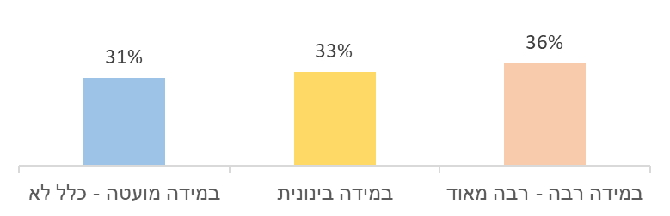
Findings Establishing Areas for Spending Time and Playing Together
Most of the residents are unaware of the options available to them for spending time with their young children in public spaces in Tira, and those who are aware of them rarely use the playgrounds because they are unsafe, dirty, and unmaintained.
“In all of Tira there are three playing areas. There’s no shading, no playground facilities for children of all ages. They install these things but there’s no continuity. There’s a problem with maintenance and care."
50%
do not know the Abu Akfa playground and 16% of those who do know it report that it is unsafe
do not know the play ground near the Vav elementary school and 25% of those who know it report that it is unsafe.
“If you’re hoping to hear that we go out with our kids to the nearest park – it’s not going to happen. Not because we don’t want to, but because there just isn’t one.”
31%
“I wasn’t aware of this before COVID. when we weren’t allowed to go to the parks outside the city and we were locked indoors. Only then did we realize the depth of the problem, because we had nowhere to be with our children within the permissible range.
Only 5% reported that they spent time with their children in public spaces/playgrounds when the children were not in school, and 67% spent time at home.
“Every public area that belongs to the municipality is used for parking trucks or large pieces of junk.”
“The park looks like a dump, everything’s broken and they wrecked all the
playground facilities
Conversations and Interactions with Parents/Neighbors While Spending Time in Public Spaces
“The area is dangerous and unsafe. The park is right next to the road, unlike the one in Kfar Saba, where I take my children to play.”
“We want public parks and playgrounds in Tira, we want it to be safe for children so they can be independent.
“We learned to get by and weren’t aware of what other people had. We coped with what we had and played with what we could. Now the kids can compare and see the difference and understand that what Tira has is not good enough compared to Jewish cities.”
In an observation of the educational campus playground very few visitors were observed, along with a low level of satisfaction with the playground’s cleanliness and maintenance and a low sense of safety. Parents stated that they came to the playground because there were no other options in Tira.
An observation of the playground area pointed to the need for a public area/playground where children could play after school, a place close to home that would allow children to play outside their regular framework and parents to get to know each other better.
The parents raised an important point, which was the need for law enforcement and maintenance of the area so children will be able to enjoy it. They also suggested that the space should enable sports activities, include a bicycle track and an agricultural plot or community garden, in addition to playground facilities.
“There’s no reason for us to go to the 2.5 parks we have here. It’s very dirty and the interaction and facilities are not that great.” (Observation of the garden area)
“I didn’t even know we had any parks in Tira.” (Interview from the garden area observation)
“When I realized that every time I wanted to spend time with my kids I had to go to a Jewish city, I decided to bring the playground to our home. We have a swimming pool and facilities, a swing, a slide, a trampoline and all kinds of games, and I also invite the neighborhood kids over to play, because not everyone can go out of town and every child deserves to play.” (Interview based on an observation of a community garden)
The CET’s Program Evaluation Unit offers a range of tools and services to support social and educational initiatives and aid in their success

Slide 39
Findings Establishing Areas for Spending Time and Playing Together
Why do they only spend time at home? (Based on the resident survey)
“We prefer to stay at home because of COVID and diseases”
"It doesn’t feel safe outside”
“My child is very young and there are no suitable activities for his age”
“We have everything we need at home and in the yard”
“Lack of time”
Most of the children spend the afternoon at their parents’ or relatives’ home
90% of the children spend the afternoon with their mother
Other: swimming pool, library, the mall
The CET’s Program Evaluation Unit offers a range of tools and services to support social and educational initiatives and aid in their success

Slide 40
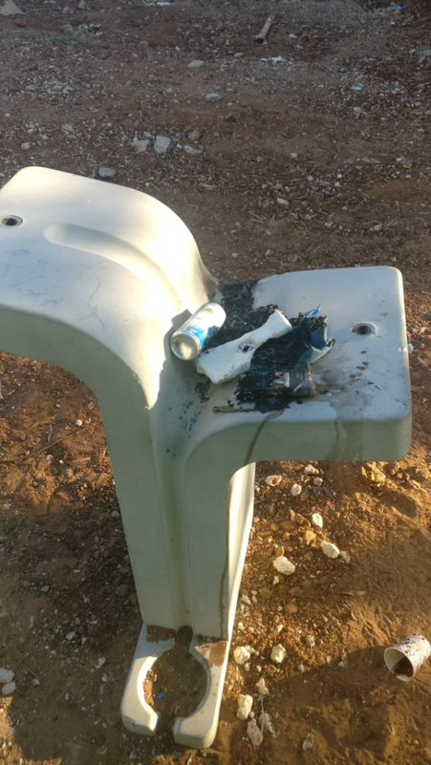
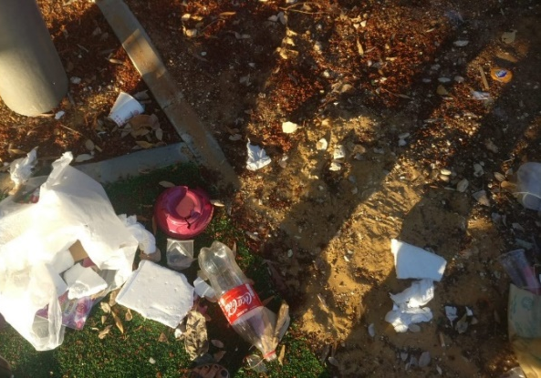
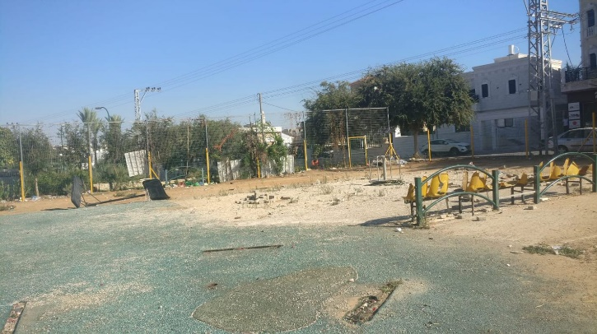
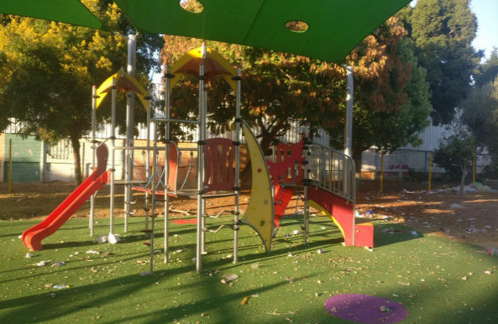
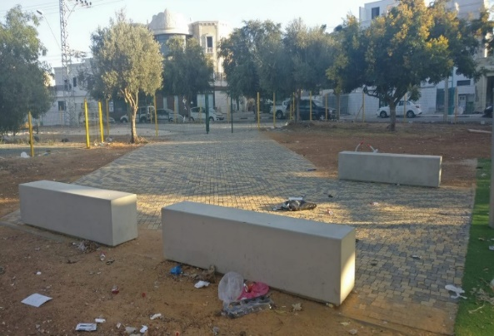
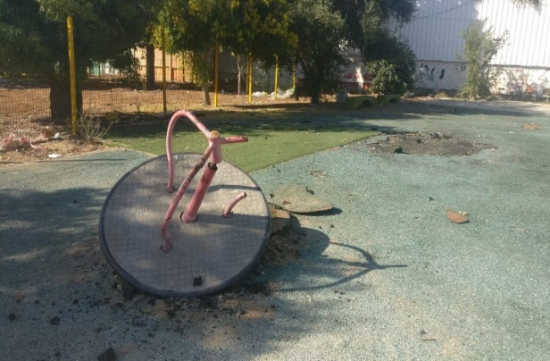
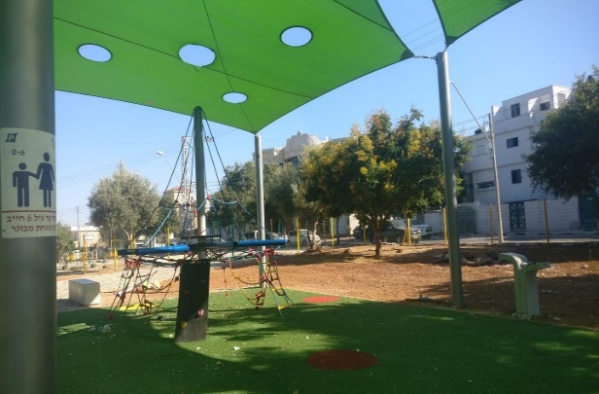
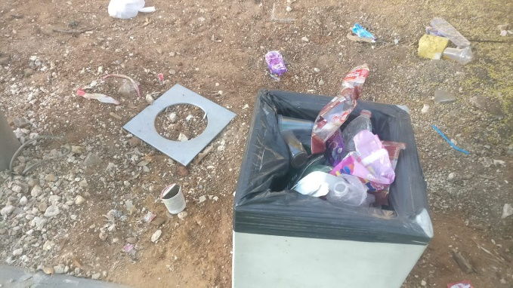
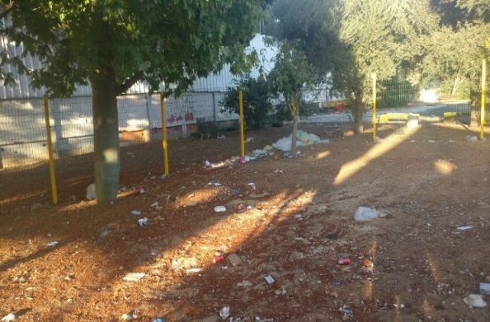
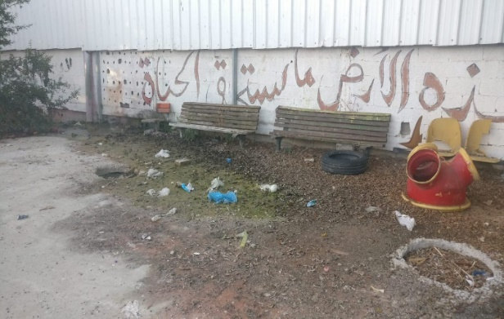
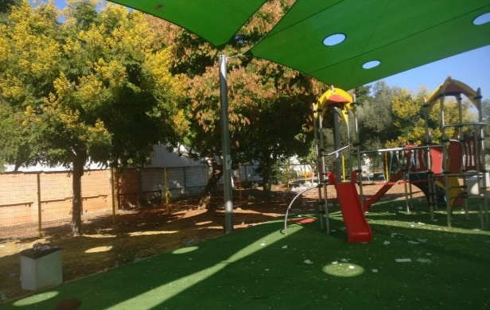
Pictures of the Community Playground Pre-Intervention
Broken facilities in the abandoned area
Drinking fountain
Dirt and garbage everywhere
Shaded facilities
Only one garbage can
The CET’s Program Evaluation Unit offers a range of tools and services to support social and educational initiatives and aid in their success

Slide 41
Findings Accompanying Content to Promote Parental Welfare
Early childhood activities residents want to receive from the municipality
Subsidized parent training on everything related to early childhood
Enrichment programs and activities for children
Playrooms and playgrounds
A swimming pool and swimming lessons
Transportation to the parks
Treatment centers
Clean and safe public parks
Other channels through which parents want to receive information:
HMOs
Mail
Phone calls and text messages
Signs on roads
School WhatsApp groups
Instagram
Flyers distributed in schools and on the street
Most residents do not use early childhood services in Tira. Interviews with parents revealed a lack of dedicated early childhood services in the city, and alternatively, that services existed but residents where unaware of them, or that some of the services where too expensive and unsubsidized.
59% of children participate in privately funded extracurricular and enrichment activities.
56% of children have never used any early childhood service. Of them, 46% of parents said they had never needed any of these services, and 28% where unaware of such services.
25% of parents used counselling/parent training after giving birth provided by a family health center/HMO and 31% used child development services provided by an HMO in Tira.
Only 9% of residents are pleased with the municipality’s functioning in regard to providing for early childhood needs on a regular basis.
11% reported that the municipality tried to solve issues related to infrastructures in public areas in response to residents’ requests.
59% of residents receive information about what is happening in the city and the municipality’s activities for young children through the municipality’s Facebook page.
“I’m missing guidance and counseling regarding my behavior – what I should and shouldn’t do when dealing with my child.”
“There aren’t enough workshops for parents, because at the end of the day, parent workshops are meant to be implemented .”
“There’s no body that makes sure there are enrichment activities for children under 6. There isn’t even a swimming pool for children. Any parent who wants to takes the initiative and teaches their kids privately.”
“Even the community center isn’t active. The kindergarten teacher held the end of year party in Tayibe and not in Tira, because she could find a place to do it in.”
The CET’s Program Evaluation Unit offers a range of tools and services to support social and educational initiatives and aid in their success

Slide 42
Summary of Chapter 2 – Target Audience: Tira Residents, Parents and Their 0-6-Year-Old Children
Many of the residents do not use early childhood services. This is due to a lack of dedicated early childhood services in Tira, a lack of awareness regarding the existence of these services, or a lack of funding for services that are perceived as expensive | Residents are unaware of the options available to them for spending time with their children in public spaces. Those who are aware hardly use the playgrounds due to the low level maintenance, safety hazards, and the lack of cleanliness | Many of the residents choose to use cars to get around due to the low sense of safety and security, the need to save time, and the poor infrastructures available for pedestrians
We recommend holding activities at the centers that provide services (e.g. the community center and the child development center in Tira) to raise awareness among the residents in regard to the existence of these services. We recommend promoting initiatives with relevant partners to raise a budget for subsidizing early childhood services that are in high demand. | We recommend investing in resources to raise awareness regarding public recreational areas in the city and to address the deficiencies in the public playgrounds. We recommend holding activities together with the community to clean, cultivate and maintain the playgrounds over time. | We recommend promoting initiatives that contribute to the residents’ sense of safety and security (e.g. road safety activities in kindergartens and enrichment frameworks, paving safe walking areas separated from the road, paving bicycle tracks, painting crosswalks, and more). In addition, we recommend holding walking activities throughout the city to strengthen the sense of safety and raise awareness to the benefits of walking as a means of getting around the neighborhood.
The CET’s Program Evaluation Unit offers a range of tools and services to support social and educational initiatives and aid in their success

Slide 43
Chapter 3
Hints of Change in Tira
The CET’s Program Evaluation Unit offers a range of tools and services to support social and educational initiatives and aid in their success

Slide 44
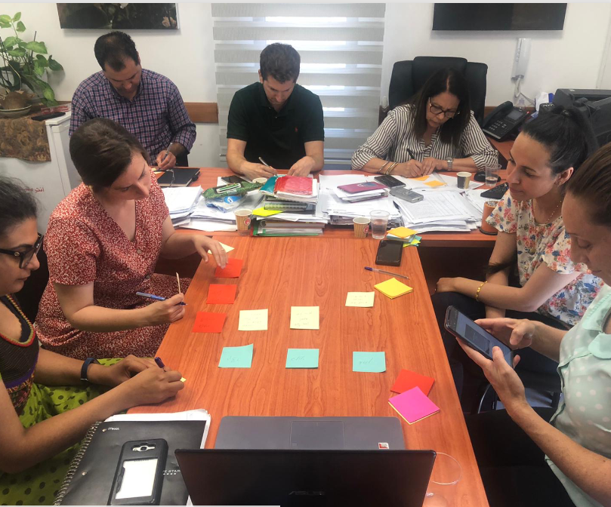
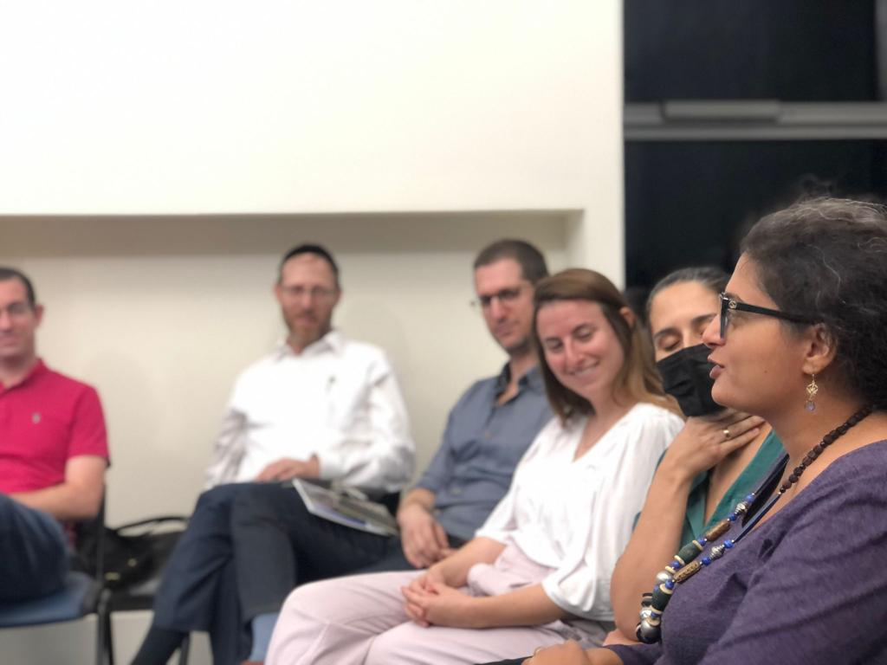
The Burgeoning Perceptual Shift among Municipal Officials
Three training sessions were held as part of the training for team members from the anchor cities participating in the Urban95 national expansion program:
A day tour at early childhood centers in Holon and Tel Aviv Port
A joint seminar with the Beit Shemesh team in Holon
An educational session on public spaces provided by architect Anat Horowitz Harel on behalf of the ILGBC.
At the end of each training session the participants were given a questionnaire. In the following slides we present the feedback findings regarding the training provided thus far for Tira’s leadership team (N=19)
In addition, a focus group with key municipal officials was held in order to characterize their perception of the potential for change.
The CET’s Program Evaluation Unit offers a range of tools and services to support social and educational initiatives and aid in their success
Notes:
גיל הרך על סדר היום
אנשים בעלי ידע והבנה
עד כמה התרחש שינוי תפיסה
חשיבות ומרכזיות של גיל הרך
שקפים מתוך מודל לוגי טירה – מצגות טירה
מה העמדות והתפיסות של בעלי תפקידים

Slide 45
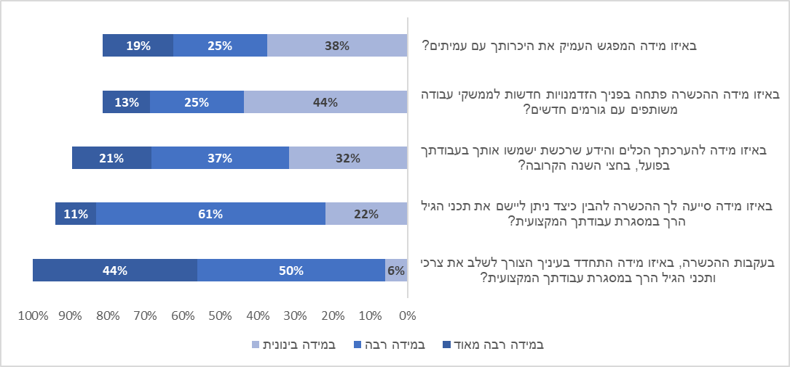
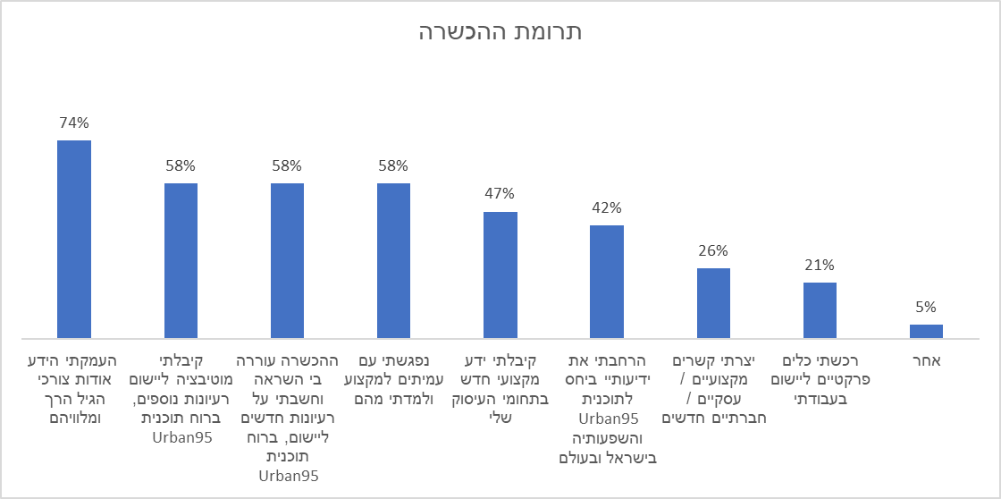
Post-Training Feedback Findings
Over a third of the participants felt the training sessions deepened collegial relationships and opened them to new possibilities for working together on joint topics.
Half of the participants felt they had acquired new knowledge and tools that would serve them in their work over the upcoming six months.
Most of the participants felt the training sessions helped them understand the need to integrate early childhood content as part of their professional work.
Most of the participants noted that the training primarily contributed to their understanding of early childhood needs, and over half of them felt the training had inspired and motivated them to develop more ideas in the spirit of the principles of Urban95.
The CET’s Program Evaluation Unit offers a range of tools and services to support social and educational initiatives and aid in their success

Slide 46
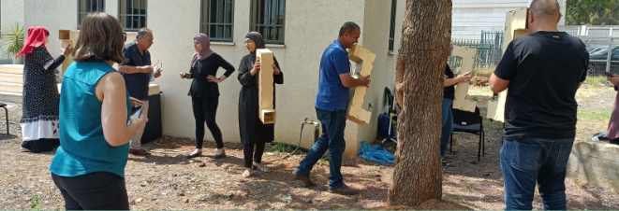
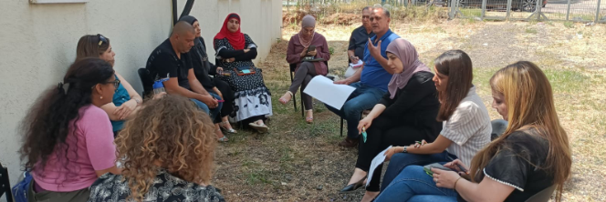
Post-Training Feedback Findings – Open Question Analysis
What new practical tools did you gain from the trainings?
Using empathic tools at work
Strategies for effecting change in three stages
Approaches to changing behavior
Inspiration for architectural elements in the space
Creative thinking in regard to developing early childhood projects
Inspiration from Urban95 community projects taking place in Tel Aviv
What suggestions do you have for adjusting the urban space to early childhood needs?
Adjusting and making public spaces suitable for use – fixing the sidewalks
Removing hazards from sidewalks on main roads
Planting trees in public spaces, creating shaded areas and bicycle tracks
Integrating early childhood needs when planning public spaces
Closing off small streets and creating neighborhood centers with interesting activities
Designing public buildings that are accessible to young children and their caregivers
The CET’s Program Evaluation Unit offers a range of tools and services to support social and educational initiatives and aid in their success

Slide 47
Key Insights from the Focus Group with the Leading Team
Contribution of the Professional Training
A rise in the importance of the issue and its place on the agenda – among employees from all departments
A change in perception was observed regarding early childhood issues as a result of Urban 95’s entry into Tira’s municipality
A sense of commitment to the program – participants feel a commitment to participate in all the training sessions
A change in work habits – meeting with colleagues and initiating pilot programs as part of the training sessions contributed to the creation of new work habits
New connections between municipal entities and with external entities (recruiting partners) – the professional training sessions led to collaborations that had not taken place before
Promoting internal motivation – the participants came up with ideas for various development channels that could be right for the program
“The greatest achievement – in half a year Urban95 has managed to introduce a lot of momentum and get into the minds of municipal officials regarding early childhood needs”
“We were more occupied with providing services, direct treatment. I started looking at the space and the environment, how to make it better and accessible to young children”
“The training taught us that we could do projects and offer activities at a low cost or even for free”
“Regarding collaborations between municipal departments, trying to think together, each of us coming from our own field, about how we could scrape together budgets and pool resources. Working alone would only make things harder”
The CET’s Program Evaluation Unit offers a range of tools and services to support social and educational initiatives and aid in their success

Slide 48
Case Study –
Walking Day in Tira
In September 2021 a survey was distributed among Tira residents to map needs and three focus groups were held with residents. The residents reported that they tended to spend their free time with their children mainly in their own yards (those who had one) or parks and playgrounds outside the city. The findings reveal several salient issues that needed to be addressed and developed, including adjusting the urban environment so residents can get around safely without a car, establishing urban spaces for spending time and playing together, and accompanying content.
The International Walking Day that took place on October 29th 2021 presented an opportunity for implementing the intervention and initiating an activity in the spirit of the day. This was done by holding an event open to the public that included several dedicated activity stations for children and their caregivers, in an aim to give the residents to a positive experience of getting around and spending time in public spaces.
The event, which took place as part of a collaboration between several entities including the National Highway Traffic Safety Administration, Clalit Health Services, and the Urban95 team at Tira’s municipality, included closing off a section of the street and placing activity stations in the dedicated area. The chosen location was adjacent to existing playgrounds and the parking lot near the high school – an area with potential for being closed off in the future for other events.
The CET’s Program Evaluation Unit offers a range of tools and services to support social and educational initiatives and aid in their success

Slide 49
Findings from the Preliminary Observation and a Description of the Area
According to the data from the app, during a 2-hour observation the following were observed:
The area chosen for the activity was a section of the street going from “Beit Al Diafa” to the roundabout near the high school, including the parking lot. There are 2 playgrounds and a park along the street:
A memorial park An old and derelict playground A playground
22 pedestrians
Of which 8 were adults (aged 25-64), 10 were young adults (aged 15-24) and 4 were children aged 7-14, unescorted by an adult
In the playground there were 8 people: a mother and son, a group of 3 children aged 7-9 and a group of 3 children aged 11-14
A total of 50 cars over a 10-minute period
Ane a total of 226 cars over a period of 2 hours
The CET’s Program Evaluation Unit offers a range of tools and services to support social and educational initiatives and aid in their success

Slide 50
Findings from the Preliminary Observation and a Description of the Area
Maintenance: The playground and the adjacent area were very dirty and neglected. garbage was observed in the playground area and under the playing facilities, as well as in the entrances to the playgrounds.
Accessibility and mobility: The sidewalk adjacent to the playgrounds is wide enough, however the sidewalk on the other side is very narrow and cars and trucks were parked right next to it.
Both sidewalks were blocked at times by many garbage cans and gardening waste.
There were very few visitors in the area.
The CET’s Program Evaluation Unit offers a range of tools and services to support social and educational initiatives and aid in their success

Slide 51
Findings from the Walking Day Observation
The Walking Day route began at the pick-up point near “Beit Al Diafa,” which is adjacent to the educational campus playground where all the parents arrived with their children.
After about 15 minutes all the children and those accompanying them began walking towards the central park, where a number of activity stations had been set up. These included a soap bubble station, a hair braiding station, tables and equipment for painting, a slime area, a microphone for children to showcase their talents (singing, performing), and a small playing area. Near the playing area there was also a grass area where some of the children played soccer and a small trampoline had been placed nearby.
The CET’s Program Evaluation Unit offers a range of tools and services to support social and educational initiatives and aid in their success

Slide 52
Findings from the Walking Day Observation
Bicycle activity was held near the school: the children were given bicycles and helmets and they rode along the path leading from the parking lot to the school yard, where children’s activities were taking place that included an inflatable slide.
At the track endpoint in the school yard there was a performance given by children entertainer Idial. The performance included songs and audience participation and was the highlight of the event.
Compared to the preliminary observation, it was clear the playgrounds and park along the street had been thoroughly cleaned. The area was clean, accessible and suitable for recreation.
The CET’s Program Evaluation Unit offers a range of tools and services to support social and educational initiatives and aid in their success

Slide 53
Findings from the Walking Day Observation
According to the data from the app, during a 2-hour observation:
Most of the passersby and those spending time at the venue were women (67%)
Close to 700 visitors were recorded, the vast majority of whom were walking
There were more people in the school yard than there were on Al Nada Street (a road)
34% of the children aged 6-14 used a 2-wheeled vehicle
Half the children aged 6-14 who walked did so without an escort
Of the passersby (N=582)
30% were adults
40% were children aged 6-14
30% were children and toddlers aged 0-5
5 cars were observed over a 2-hour period
School yard
Al Nada Street section
The CET’s Program Evaluation Unit offers a range of tools and services to support social and educational initiatives and aid in their success

Slide 54
Summary
The residents experienced Walking Day as a unique event in the city. Responses were enthusiastic and the residents’ participation uplifted their spirits. The event offered an opportunity for social gatherings and encounters between children and adults that do not normally take place. It also demonstrated that it was possible for them to spend time with their community in an enjoyable way in a public space, with early childhood needs placed at the center.
It was clear a great deal of effort had gone into planning and executing the event.
The event created opportunities for children to play with those who accompanied them.
The event contributed to the sense of community and created social encounters between children and adults
The residents felt that the event had placed children at the center.
The public space was experienced as being safe, inviting, and accessible to residents for recreation.
Participating in the event increased the residents’ sense of belonging. Visitors expressed appreciation for the resources that had been invested in them.
“The collaboration has proved successful – the results speak for themselves. Joy has returned the beautiful faces of Tira’s children and their parents. I was delighted to see them... (thank you to everyone involved) There’s a strong need to continue this kind of activity. Our children are thirsty for it, especially after COVID, which limited children’s activities. Keep working together and contributing to the city’s children” (Tira’s mayor)
The CET’s Program Evaluation Unit offers a range of tools and services to support social and educational initiatives and aid in their success

Slide 55
Bibliography & Appendixes
The CET’s Program Evaluation Unit offers a range of tools and services to support social and educational initiatives and aid in their success

Slide 56
Bibliography – References and Documents Left as Part of the Evaluation
Quality of Life of Populations in Israeli Society – 2019 Quality of Life Index, October 2019. The Haredi Institute for Public Affairs
Participation of Arab Children in Supervised Educational Frameworks for Young Children, Research Paper No. 7, Jerusalem, November 2021. The Taub Center Early Childhood Research Series
The Knesset’s 2008 Information and Research Center Report.
“The Public Space and Appearance of Arab Towns in Israel – Removing the Obstacles and Realizing Development Challenges.” The Friedrich Ebert Foundation in Israel and the Jewish Arab Center at Haifa University, December 2016.
The National Highway Traffic Safety Administration Report for 2017
Tira’s Municipal Database
Input and Output File
Summary of the Kickoff Workshop in Tira
Summary of the Interview Day in Tira
Summary of the Steering Committees Meetings
Summary of the Tira Introduction Meetings
Summary of the Tira Team’s Focus Group – Professional Training
Resident Survey Findings
Observation Reports (Walking Day, Welfare Area, Community Park, Entrance to the Playgrounds)
Walking Day Report
The CET’s Program Evaluation Unit offers a range of tools and services to support social and educational initiatives and aid in their success

Slide 57
List of Interviewees
The CET’s Program Evaluation Unit offers a range of tools and services to support social and educational initiatives and aid in their success

Slide 58
Appendix A: Tira Resident Survey
Hello, this is a survey of parents who are Tira residents regarding daily life in the city. Please answer the questions honestly and deliberately. Your opinion matters to us.
1. Are you currently a resident of Tira?
Yes
No
2. How many children do you have?
a. 0
b. 1
c. 2
d. 3
e. 4
f. 5
g. 6 or more
h. My wife is / I am pregnant
3. How old are your children (please mark all relevant answers)
a. 1-0
b. 1-2
c. 2-3
d. 3-4
e. 4-5
f. 5-6
g. 6 or older
4. What type of frameworks do your children attend? (Please mark all relevant answers)
a. No framework, they stay at home
b. No framework, they stay with their grandparents
c. No framework, they stay with a relative
d. They have a nanny
e. Pre-nursery playgroup
f. Private kindergarten
g. Daycare (WIZO, NA’AMAT)
h. Municipal kindergarten
i. Private afternoon childcare facility
J. Municipal afternoon childcare facility
k. Framework outside of Tira, please specify:
l. Other, please specify:
5. How do you currently get to and from the educational frameworks with your children? (Please mark all relevant answers)
a. On foot
b. Bicycle
c. Bus / shared taxi
d. Car
e. We take turns (with neighbors/friends from kindergarten / relatives)
f. Private transportation we pay for
g. Taxi
h. Other, please specify:
6. If you were offered subsidized transportation to and from your children’s frameworks, how interested would you be in using it?
a. Definitely interested
b. Interested a very large extent
c. Interested to a large extent
d. Somewhat interested
e. Not very interested
f. Hardly interested
g. Not interested at all
7. With whom of the following do your children usually spend the afternoon? (You can mark more than one answer)
a. Their mother
b. Their father
c. Their older siblings
d. Their grandparents
e. Their uncles and aunts
f. A nanny / babysitter
g. Other, please specify:
The CET’s Program Evaluation Unit offers a range of tools and services to support social and educational initiatives and aid in their success

Slide 59
Appendix A: Tira Resident Survey
8. How do your children spend time when they’re not in their school?
Open ended…
9. Here is a list of places where children from Tira can spend time outside their frameworks. Where do your children usually spend time? (Please mark all relevant answers)
a. Home with their parents
b. Home with relatives
c. A friend’s house
d. Playground/park in Tira
e. Playground/park outside Tira in an Arab city
f. Playground/park outside Tira in a Jewish city
g. Playroom in Tira
h. Playroom outside Tira in an Arab city
j. Playroom outside Tira in a Jewish city
k. Swimming pool outside Tira in an Arab city
l. Swimming pool outside Tira in a Jewish city
m.Library outside Tira
n. Extracurricular / enrichment activities
o. Other: _______________________
10. What extracurricular/enrichment activities do your children participate in in addition to their school?
a. Municipal extracurricular/enrichment activities
b. Extracurricular/enrichment activities provided by a nonprofit organization
c. Privately funded extracurricular/enrichment activities in Tira
d. Privately funded extracurricular/enrichment activities outside Tira in an Arab city
e. Privately funded extracurricular/enrichment activities outside Tira in a Jewish city
f. Other: _____________________
11. You previously noted that you only spend the afternoon with your children at home/in other people’s home. Please specify why:
a. I wasn’t aware of any other options
c. There are no other options in Tira
d. It’s too expensive
e. Using public transportation is difficult / I don’t have a car
12. Which of the following services have your children ever used in Tira? (Please mark all relevant answers)
a. Welfare Department services
b. Child Development Institute / family health center services
c. Child development services provided by an HMO
d. Child development services provided by a private institution
E. My child/children has/ve never used any of these services
13. Why have you never used any of the services?
a. My children never needed them.
b. These services aren’t available in the city
c. There are no available appointments
d. They’re expensive/too expensive
e. I didn’t think they would benefit my child
f. I wasn’t familiar with these types of services
The CET’s Program Evaluation Unit offers a range of tools and services to support social and educational initiatives and aid in their success

Slide 60
Appendix A: Tira Resident Survey
Which of the following services have you ever used in Tira as a parent? (Please marks all relevant answers)
a. Counseling / parent training provided by an HMO / family health center before giving birth
b. Privately funded counseling / parent training before giving birth
c. Counseling / parent training provided by an HMO / family health center after giving birth
d. Privately funded counseling / parent training after giving birth
e. Meetings/lectures for parents on parenting related topics provided by an HMO/family health center
f. Privately funded meetings/lectures for parents on parenting related topics
g. I haven’t used/participated in any of these services
15. Why haven’t you used these services?
a. I didn’t need them
b. I didn’t think they would benefit me
c. I didn’t have the time
d. These services aren’t available in Tira
e. I wasn’t able to get an appointment
f. I couldn’t afford it
g. I didn’t know these services were available in Tira
16. What early childhood services would you like the municipality to provide?
Open ended
17. If you were offered a municipal service such as a parenting workshop, guided activity for parents and children, or a playroom for young children that you had to pay for, what price point would you consider reasonable for participating in a single activity?
Axis scale in NIS
18. How safe do you feel walking on the streets of Tira with your children on a bicycle and/or with a stroller?
a. Completely safe
b. Very safe
c. Safe
d. Moderately safe
e. Not very safe
f. Hardly safe
g. Not safe at all
19. How do you usually get around with your children in the afternoon? (Please mark all relevant answers)
a. On foot
b. Bicycle
c. Bus/shared taxi
d. Car
e. Taxi
f. Train
g. Other, please specify: __________________
20. Why don’t you walk or ride a bicycle with your children?(Please mark all relevant
answers)
a. There are no crosswalks
b. There are no continuous sidewalks
c. Public spaces are unsafe
d. There’s no shade
e. There are no bicycle tracks/dedicated areas safe for riding
f. We don’t ride bicycles for religious/cultural reasons
g. Other, please specify:
The CET’s Program Evaluation Unit offers a range of tools and services to support social and educational initiatives and aid in their success

Slide 61
Appendix A: Tira Resident Survey
21. To what extent do you feel it is safe to spend time in playgrounds in Tira?
The Abu Akfa playground
The playground near Vav elementary school
Other: ____________________________
a. Completely
b. To a very large extent
c. To a large extent
d. To a moderate extent
e. To a small extent
f. To a very small extent
g. Not at all
h. I don’t know these playgrounds
22. To what extent do you talk and interact with parents/neighbors when spending time with your children in public spaces/playgrounds in Tira?
a. Always
b. To a very large extent
c. To a large extent
d. To a moderate extent
e. To a small extent
f. To a very small extent
g. Not at all
23. To what extent to you have someone close by you can turn to for help with your children?
a. Always
b. To a very large extent
c. To a large extent
d. To a moderate extent
e. To a small extent
f. To a very small extent
g. Not at all
24. To what extent are you willing to take the initiative and work to promote early childhood needs in your area of residence?
a. Completely
b. To a very large extent
c. To a large extent
d. To a moderate extent
e. To a small extent
f. To a very small extent
g. Not at all
25. Please leave your contact details for further communication:
Telephone no. + name __________________________
26. To what extent are you pleased with the municipality’s functioning in regard to early childhood needs in daily life?
a. Completely
b. To a very large extent
c. To a large extent
d. To a moderate extent
e. To a small extent
f. To a very small extent
g. Not at all
27. To what extent is does the municipality try to solve problems related to infrastructures in public spaces in response to residents’ requests?
a. Absolutely
b. To a very large extent
c. To a large extent
d. To a moderate extent
e. To a small extent
f. To a very small extent
g. Not at all
The CET’s Program Evaluation Unit offers a range of tools and services to support social and educational initiatives and aid in their success

Slide 62
Appendix A: Tira Resident Survey
28. What are the main channels through which you receive or consume information about what’s happening in Tira and what the municipality is doing for young children? (Please mark all relevant answers)
a. I don’t receive this kind of information
b. The municipality’s website
c. The municipality’s Facebook page
d. Signage / announcements
e. Municipal property tax slips
f. Municipal employees
g. City hotline / 106
h. Other, please specify:
29. Through which other channels would you like to receive information about what’s happening in Tira and what the municipality is doing for young children?
Open ended…
Demographic questions
30. What is your gender?
a. Man
b. Woman
31. How old are you?
32. What is your current employment status?
a. Full-time employee
b. Part-time employee
c. Self-employed
d. Unpaid leave / unemployed
e. I don’t work (full-time parent)
f. Other:
33. What is your spouse’s employment status?
a. Irrelevant (I don’t have a spouse)
b. Full-time employee
c. Part-time employee
d. Self-employed
e. Unpaid leave / unemployed
f. I don’t work (full-time parent)
g. Other:
34. The average gross income per Arab household in Israel is NIS 11,000. What is your household’s income?
a. Well below average
b. Slightly below average
c. Average
d. Slightly above average
e. Well above average
35. What is your highest education certificate?
a. Elementary diploma
b. Partial high school diploma
c. High school diploma
d. Tertiary / diploma studies
e. Bachelor's degree
f. Mater’s degree or higher
36. How religious are you?
a. Not religious at all
b. Not very religious
c. Religious
d. Very religious
37. Which neighborhood / area do you live in?
Open ended…
The CET’s Program Evaluation Unit offers a range of tools and services to support social and educational initiatives and aid in their success

Slide 63
Appendix B – Walking Day Observation Indicator
The Urban 95 Initiative:
Indicator for an Observation of a Cluster of Streets in Tira - Walking Day Activity Held on October 29th, 2021
Location: | Observation date: | Observer:
General instructions:
You are about to conduct an Xplore observation - a research and mapping process (analysis of the characteristics of the space and population, mapping communities, surveying the area, physical and urban characteristics)
The observation includes:
Mapping and characterizing the types of uses of the space using an app and manual indicator to get a general impression. Please refer, among other things, to noise and traffic in the area and the sense of safety in the space and map needs – what is missing in the space to make it suitable for visitors and residents; describe the mix of uses in the space.
Structure of an observation hour – each observation hour is divided into 10 minute segments. One segment focuses on counting and demographic characterization of passersby (“movement” in the app), the next segment focuses on describing the behavior of those in the space “stationary” in the app) – who the users are, where they are sitting, what they are doing. At the same time, provide a qualitative impression using the Xplore indicator, and repeat.
The observation focuses on the following questions – who is in the space (and who is not), what they are doing in it, where they are spending time and how they are getting around. Refer to the balances between residential and other uses, meaning between various activities (bars and restaurants, benches, schools, shopping, etc.) and various population groups (residents and visitors, age, gender, etc.)
Observe what is happing according to the observation indicator and document according to the criteria.
Try to take pictures of the area and passersby in the public space.
Thank you and good luck!
The CET’s Urban95 evaluation team
General comments (for documentation during the observation) – This is where you should describe the course of events in broad strokes
The CET’s Program Evaluation Unit offers a range of tools and services to support social and educational initiatives and aid in their success

Slide 64
Appendix B – Walking Day Observation Indicator
Xplore observation criteria | Mapping the physical space, businesses, public institutions and buildings, and points of interest
Mapping the public space and mapping businesses and institutions Provide a physical description of the space, identify points of interest and attractions for passersby as well as potential obstructions and disruptions | Description of the space and main usage characteristics (commerce / leisure / other), mapping points of interest and attractions (public institutions and buildings) – Description of the mix of uses of the space (playgrounds, day care and educational frameworks, houses of worship, sitting / informal gathering / recreation areas): Describe street paths in the area, map obstructions and disruptions for pedestrians (sidewalk width and intactness, separation between pedestrians, bicycles, and cars, parking lot / house entrances and exits, bicycles tracks, emergency services, location of garbage cans and recycling facilities, potholes, infrastructure work, other hazards, untreated greenery, dangerous electrical car / bike traffic in walking areas, etc.):
Score each criterion on a scale from 1 to 7 (1 = not at all / very negative and 7 = positive / to a very large extent) | Score (1–7): walking ease and continuity __ ease of mobility with a stroller / wheelchair __ cleanliness and maintenance (+ animal waste collection)__ shade (during the day)__ lighting (in the evening)__ fencing/separation__ sense of safety__ sitting areas__
Observation criteria – Movement | Qualitative aspects among passersby
 | Mix: adult with 1 child__ 2 children__ 3+ children__ couple with 1 child__ 2 children__ 3+ children__ group (several adults and children): ______________ teenagers__ couples without children__ groups of friends__ senior citizens__ single individuals__ workers__ people with disabilities__ General description of what is happening among passersby (documentation of irregular occurrences and anything noteworthy. Documentation of how families with children conduct themselves and how they get around – strollers, children’s cars…)
Observation criteria – Stationary | Qualitative aspects among those spending time in the area
Types of cars among families with children (percentages) Visitors who are not families with children (percentages) | Mix: adult with 1 child__ 2 children__ 3+ children__ couple with 1 child__ 2 children__ 3+ children__ group (several adults and children): ______________ teenagers__ couples without children__ groups of friends__ senior citizens__ single individuals__ workers__ people with disabilities__ General description of what it going on among those spending time in the area (presence and behavior of parents and children – joint play, what are the children doing? What grabs their attention/interest and what are they occupied with? Are they only focused on the activity stations or are there also spontaneous gatherings in the space? If so – how and what games do they play? How do the children use the space and the various elements in it? Is an adult involved in what the child is doing?)
The CET’s Program Evaluation Unit offers a range of tools and services to support social and educational initiatives and aid in their success

Slide 65
Appendix B – Walking Day Observation Indicator
Observation criteria | Testimonies from observing the activity (the host’s conduct, description of the children and adults’ behavior)
Demographics assess the number of adults and children, assess age and gender characteristics in percentages, assess the mix of visitors in percentages | Adults No. of adults present at the activity during the observation___ Women__ Men__ Relation: Parent__ Grandparents__ Nanny__ Older sibling__ Other__
 | Mix: adult with 1 child__ 2 children__ 3+ children__ couple with 1 child__ 2 children__ 3+ children__ group (several adults and children): ______________ Means of mobility: Adult/s and child/ren walking ___ Adult/s with stroller ___ Adult/s with child riding (bicycle, children’s car, scooter) ___
Assessment of length of time spent | Up to 10 min.: majority / about half / minority 10–30 min. majority / about half / minority Over 30 min. majority / about half / minority
General description and mapping of obstructions Score each criterion on a scale from 1 to 7 (with 1 = not at all / very negative and 7 = positive / to a very large extent) * Were signs put up to invite/direct people to the area? | Score (1–7) The public space: ease of arrival at the activity point (including with a stroller)__ convenience in terms of holding the activity__ shade__ safety (suitable area, hazards, stray dogs)__ cleanliness__ equipment quality (auxiliary items and accessories)__ suitable for the range of children’s ages__ ease of stay for adults__ suitability to the number of participants__ signage and advertising around the activity*__
 | General description of the activity area, verbal description of the measurements above, and noteworthy points:
For each occurrence describe the scope of cases observed (number) and provide a description in the general specification section
** Creative uses that contribute to the activity and participants are not considered a disruption, please specify them in the description of the conduct | Scope of disruptions to the activity: Answering phones (activity leaders)__ Equipment malfunctions__ Unsuitable use** of items related to the activity (use that disrupts the activity) specify:_____ From external elements in the public space: Any type of passersby____ Disruptions from other activities____ Other, please specify:_____ General description:
The CET’s Program Evaluation Unit offers a range of tools and services to support social and educational initiatives and aid in their success

Slide 66
Appendix B – Walking Day Observation Indicator
Activity leaders’ conduct Score each criterion on a scale from 1 to 7 (with 1=not at all/very negative and 7=positive/to a very large extent) Describe and specify how the activity was conducted and how the activity leaders behaved | Score (1–7) Clear instruction__ Adaptability and flexibility (in regard to disruptions, the participants’ needs)___ Encouraging joint play between children and their caregivers___ Encouraging creativity__ Providing more ideas for parents to lead activities for children__ Description of the activity leaders’ conduct during the gathering (specification and examples of the measurements above, number of activity leaders, cooperation between them, mediating information about the event in general and about the other stations, and any other noteworthy issue):
Participants’ conduct (adults and children) and interactions Score each criterion on a scale from 1 to 7 (1=not at all/very negative and 7=positive/to a very large extent) Describe and specify the participants’ behavior and all the types of interactions taking place, including any kind of notable/irregular occurrences | Score (1–7) Maintaining equipment and play facilities__ Attentiveness to activity leaders__ Cooperation and involvement__ Joint adult-child play__ Interaction between children and their caregivers: Assessment of the percent of those whose conduct mostly consists of joint caregiver-child play: to a large extent___ moderate extent___ very little to none (the caregiver only supervises the child)___ Assessment of the percent of children and caregivers who mostly communicate with each other (verbally and physically) in a positive way__ neutral way___ negative way__ Description of the nature of communication and conversation topics between children and caregivers. Does the adult involve and encourage the child’s curiosity in regard to the activity? If so, how? What grabs the children’s attention? What interests and occupies them? Provide examples of expressions of positive and negative emotions of children and their caregivers: Communal aspects: Assessment of the percent of children playing together – siblings/friends who arrived together___ children who met in the area___ children who only play with their caregiver__ Assessment of the percent of interactions between adults – who arrived together___ who met in the area__ did not interact with other visitors__ Obstructions – No. of cases observed where: a phone was given to the child to keep them occupied__ an adult was occupied with their phone__ other obstructions, please specify:___________ Description of the adult and children’s behavior, description of the communication and interactions (specification and examples of the measurements above, the attitude towards the activity leaders, active participation, encouragement of the children’s participation, parent-child relationships, joint play between parents and children and children and other children, interactions and conversations between adults)
The CET’s Program Evaluation Unit offers a range of tools and services to support social and educational initiatives and aid in their success

Slide 67
Appendix B – Indicator for Questions in Conversations with Parents/Families during the Observation
Answers - Family #____________
Adult 1 Relation: parent / grandparent / nanny / other, Gender: M / F, Age:__ |  | Adult 2 Relation: parent / grandparent / nanny / other, Gender: M / F, Age:__
Child 1 Gender: M / F, Age: | Child 2 Gender: M / F, Age: | Child 3 Gender: M / F, Age: | Child 4 Gender: M / F, Age:
Residence: In the neighborhood / outside the neighborhood – where from? Frequency of visits to playgrounds in the area: Daily / several times a week / once a week / less / never Arrived at the event: on foot / bicycle / car / public transportation Normally come (if stated that they do): on foot / bicycle / car / public transportation
Did you come to the event intentionally or by chance? If they came intentionally – How did you hear about the event? From a friend / other community WhatsApp groups, social media, kindergarten WhatsApp group, advertising by the municipality, other _____ If they came by chance – Did you hear / know such an event was going to take place? What made you stop and join in? (I saw friends, the children noticed it and asked to go, I saw adverts in the area…)
How has the experience been so far? What are you/the child enjoying? What’s been good? Refer to specific stations and in general – encourages creativity, allows them to get some air, social encounters
What has been less successful? What needs to be improved? Adapting the content to the children’s ages and number of participants, equipment, organization
How do you feel the activity contributed to you and your child? What are your main “takeaways”? Strengthened bonds and positive interaction, new and applicable ideas and tools for playing together, the possibility of spending recreational time in public spaces
Communal aspects – Did the activity contribute to/encourage the formation of new relationships with other parents? Was that part of your reasons for coming?
To what extent would you recommend this activity to others? Why would / wouldn’t you?
To what extent would you like to participate in a similar event/attend such an event in the future? Why would / wouldn’t you?
Where do you normally spend time with the children? Where do the children normally play? Do you go to other playgrounds with your children in and/or outside Tira? Which ones? (in another Arab city/in a Jewish city) If not, why not? Have you previously participated in activities for children offered by the municipality?
Score (1=the lowest to 7= the highest) how well the space in which the activity is being held is: clean and maintained___ shaded/lit___ safe for children___ had proper auxiliary equipment___ easy to access (in general and with a stroller)___ comfortable for caregivers to spend time in (finding a place to sit)___ duration of the activity (long/short/just right)___ suited to the number of participants (too crowded)___ Score (1=the lowest to 7= the highest) how well the content: strengthens the bond and encourages joint play between adults and children___ encourages interactions between children___ encourages communal relationships and conversations with others___ introduces a change in the child’s play routine___ offers a range of activities for children of different ages (for those arriving with more than one child)___ encourages creativity___ gives them new ideas___ meets their need for fresh air
The CET’s Program Evaluation Unit offers a range of tools and services to support social and educational initiatives and aid in their success

Slide 68
Thank You
شكرا
The CET’s Program Evaluation Unit offers a range of tools and services to support social and educational initiatives and aid in their success

