Slide 1
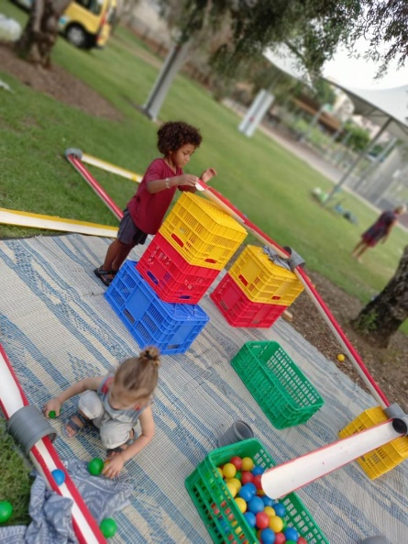
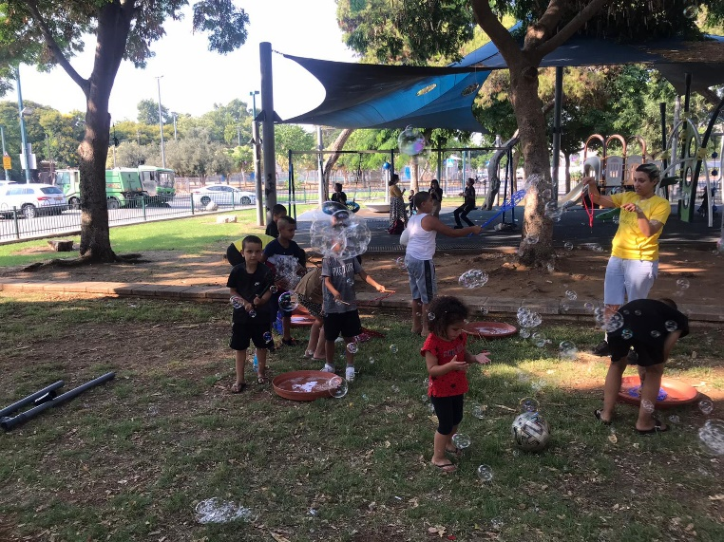
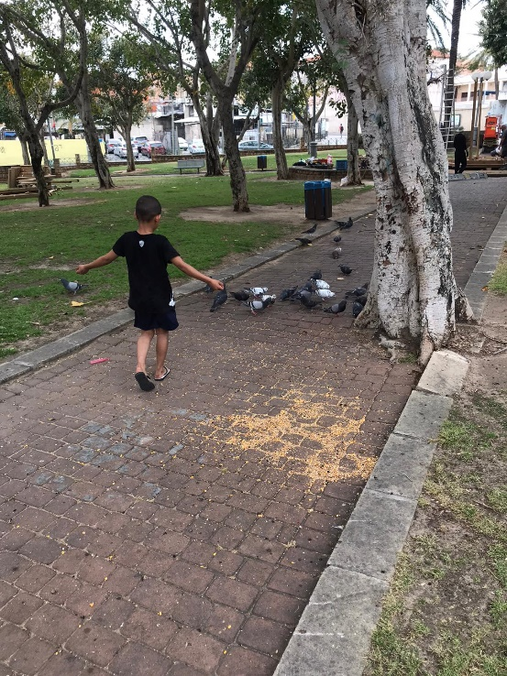
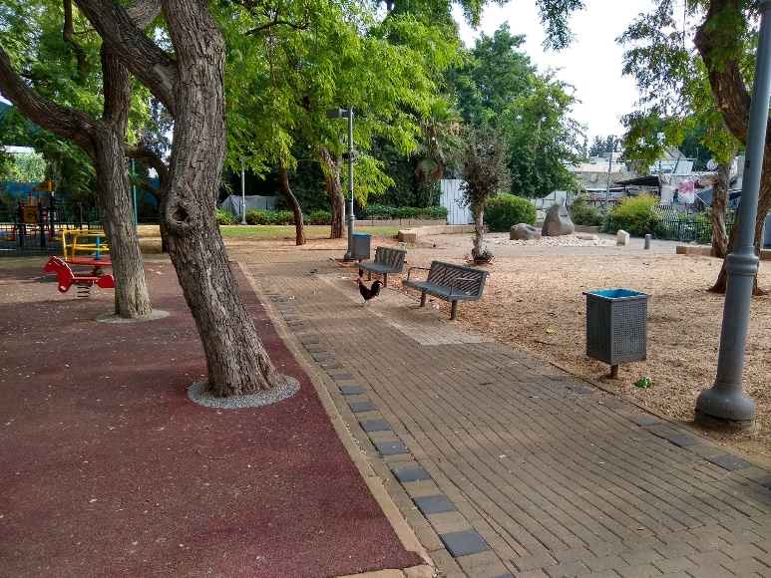
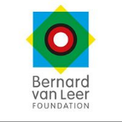



Summary Report of
Urban Public Space and Mobility Domain for 2021
Submitted as Part of Phase B Urban95 TLV
Program Evaluation
April 2022
The Center for Educational Technology, A Public-Benefit Company, 16 Klausner St., Tel Aviv, Tel. 03-6460163 www.cet.ac.il

Slide 2
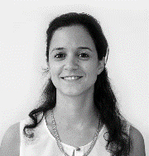
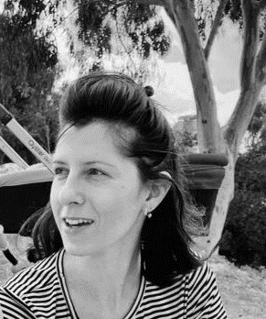
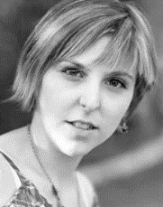
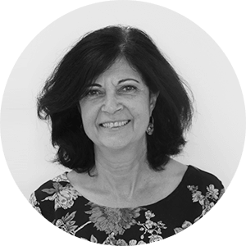
Research Team
Dr. Tal Mishaan Spiegel
Head of Program Evaluation Unit
Sharon Brand Martin
Researcher & Program Evaluator
Alona Tsirulnikov
Researcher & Program Evaluator
Dr. Hava Newman
Head of Assessment and Evaluation Unit

Slide 3
Table of Contents
4 | Summary of activities and outputs in the urban space and mobility domain, 2021 ……..................................................
5-25 | Public parks and urban spaces.........................................................................................................................................
6-18 | Preliminary observations and findings prior to the planned interventions.........................................................................................
7-12 | Gan HaShnayim...............................................................................................................................................................
13-18 | Gan HaShoteret.............................................................................................................................................................
19-25 | Findings of the pre/post-intervention observations………………….............................................................................................
20-25 | Kerem HaTeimanim.........................................................................................................................................................
26-49 | Activities in the public space............................................................................................................................................
27-41 | “Miskhak-auto” Play-Car...........................................................................................................................................................
30-37 | Play-Car Jaffa ..............................................................................................................................................................
38-41 | Play-Car in the Center....................................................................................................................................................
42-49 | Play Street................................................................................................................................................................................
50-53 | Summary and recommendations......................................................................................................................................
54-59 | Appendices.......................................................................................................................................................................

Slide 4
Urban Space and Mobility: Summary of actions & outputs and a formative and ongoing evaluation for 2021
Planned interventions - pre-intervention observations presented in the report:
Gan HaShanyim, Jaffa – Adjusting public spaces for young children: Developing an architectural plan for renovating the park and adjusting it for use by young children, their caregivers, and the general public.
Gan Hashoteret - A specific intervention within an extensive development of walkways to improve mobility in the Ezra and Ha-argazim neighborhood: A public participation process was led by the Community Administration and Urban95 and major walking paths were mapped. Following this, planned renovations in the neighborhood will address obstacles to mobility, and renovations to the park will adjust it to residents’ needs, including community activities for young children.
Completed intervention – pre/post-intervention observations:
Pedestrian zone in Kerem HaTeimanim- The ongoing intervention is based on a tactical urbanism approach: Following demonstrated success of the pilot walkway, Urban95 and the Transportation Administration are collaborating to close selected streets to vehicular traffic and adjust the public space for pedestrians.
Primary findings of the evaluation of activities in the public space:
Game Truck and Play Street
In 2020, Urban95 conducted extensive activities in the areas of public space and mobility, with specific interventions carried out to renovate public spaces and improve mobility in the urban environment. It was subsequently decided to increase the scope and scalability of activity in 2021 at the neighborhood and municipal level. This process was accompanied by a formative evaluation, including pre/post intervention observations.
Play-Car and Play Street: To promote appropriate use of public spaces and make them more accessible to young children and their caregivers, activities were designed for implementation in public areas, parks, and designated streets, which can be replicated throughout the city.
Following the successful collaboration with Gehl Architects, the Public Life App* is being used in the ongoing evaluation. Observers can use this tool to collect data in the field during pre/post-intervention observations.
* The Public Life app helps conduct field observations by documenting and characterizing who is using urban spaces and for what purposes.

Slide 5
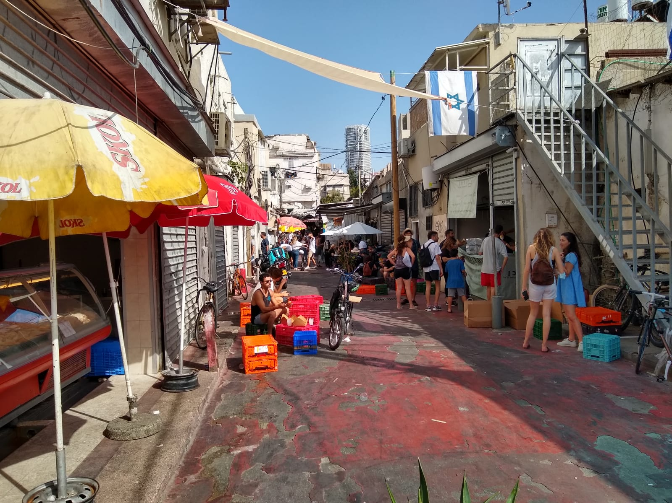
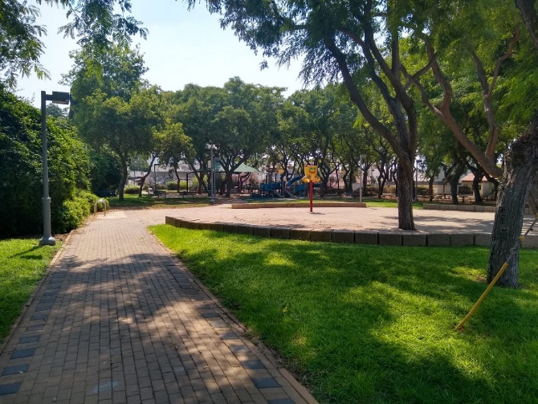
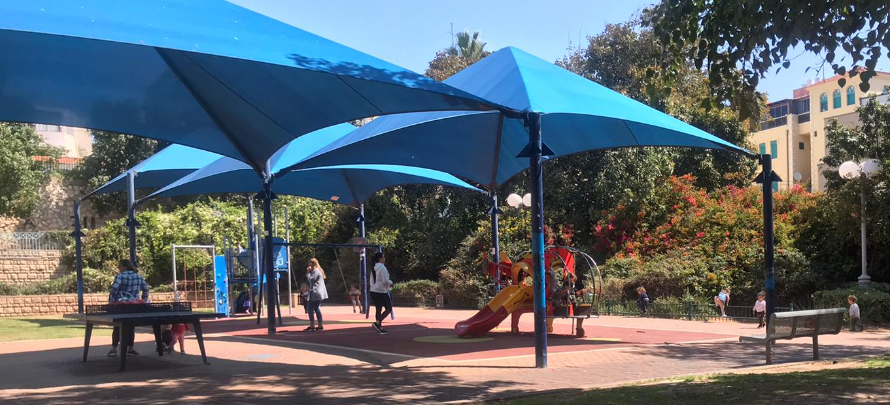
Parks and Urban Spaces

Slide 6
Preliminary findings of pre-intervention observations

Slide 7
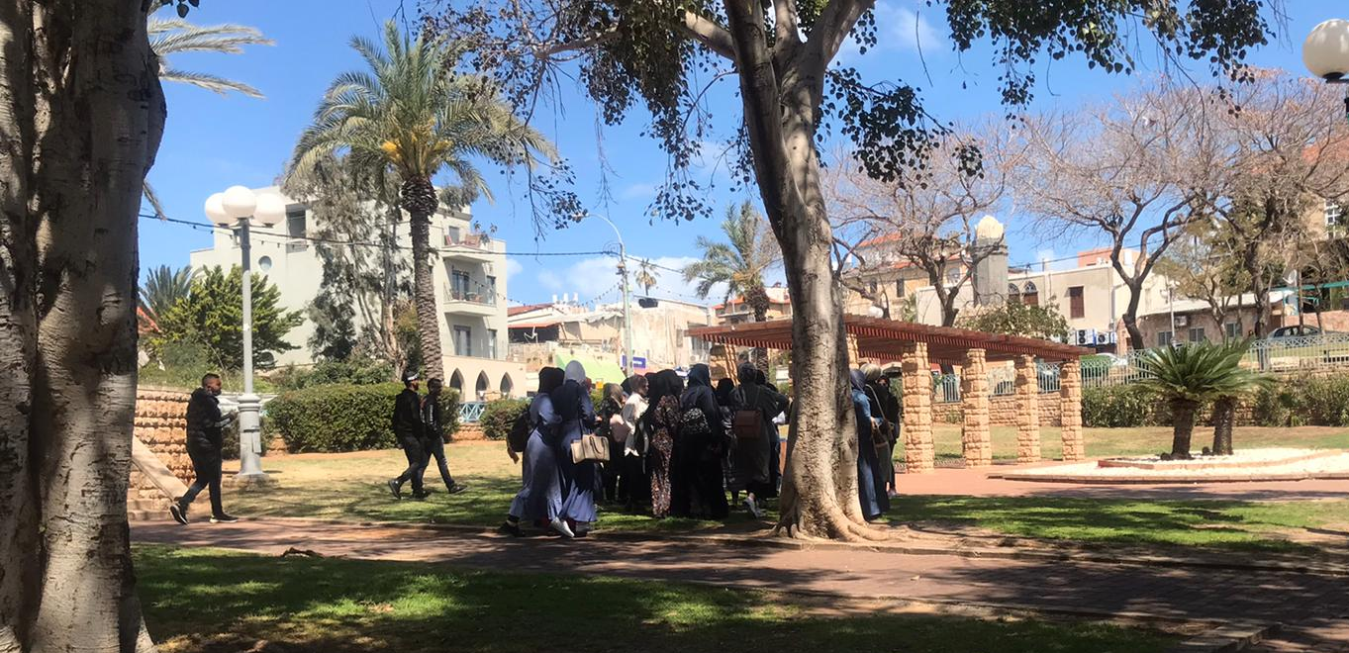
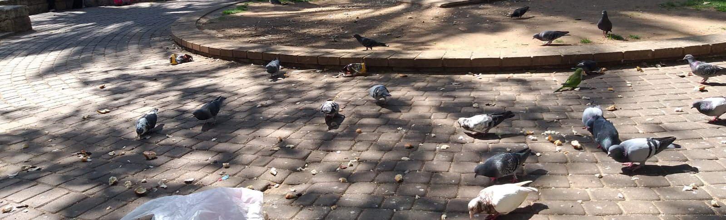
Gan HaShnayim
Background of the Intervention
Gan HaShnayim is centrally located, connecting several neighborhoods in Jaffa. It is a regular meeting place for residents.
The space has important historical and cultural background; Arab residents feel a valuable connection to the park.
The park has inherent potential to be an accessible and high-quality center for enjoyment by all residents, especially families with young children. However, the prevailing opinion among the public is that currently the park is not a safe place to visit.
Therefore, the Tel-Aviv Jaffa Municipality is examining options to improve the park and encourage residents to visits and recreate there.
An in-depth mapping was conducted to assess the existing situation, identify obstacles and opportunities, and generate ideas for appropriate and successful interventions.

Slide 8
Gan HaShnayim: Research Method
Field observations were conducted on two dates, including:
    Mapping with the "XPLORE" approach, which includes reference to features of the space.
    Qualitative documentation of activities, particularly parent-child interactions and joint play, at various times of the day.
    Interviews with 25 park visitors.
    Collection of data on people passing through and staying in the park, using Gehl Architects’ Public Life app.
    Observation dates:
        Friday, March 19, 2021 between 10:00 - 13:00
        Sunday, April 11, 2021 between 09:30 - 21:00 (with an hour and a half break)
Characteristics of Interviewees
Relationship* |  | Adults’ gender |  | Residence |  | Frequency of visits |  | Means of arrival |  | Duration of Stay |  | Purpose of visit
Parent | 10 | M | 43% | In the neighborhood | 62% | Every day | 36% | Bicycle | 12% | Half hour | 28% | Planned | 80%
Grandparent | 4 | F | 57% | Outside the neighborhood | 38% | Several times per week | 20% | By foot | 64% | Hour | 12% | Unplanned | 20%
Caregiver | 4 |  |  | On Sunday, most visitors were neighborhood residents; On Friday, about half were neighborhood residents and about half were from outside the neighborhood. |  | Once a week | 12% | Scooter | 4% | 90 min | 24% | On Sunday, a minority of visits were unplanned. On Friday, about 40% of visitors passed through the area by chance.
Youth | 2 sisters Group of teenaged boys |  |  |  |  | Occasionally | 28% | Car | 16% | Two hours | 12%
Maintenance staff | 1 |  |  |  |  | Seldom | 4% | Bus | 4% | More than two hours | 24%
* The interviewees accompanied approximately 50 children; 22 were 0-3 years old, 20 were 4-8, and about 10 children were 9 or older. About 20 were identified as boys and 8 as girls.

Slide 9
Gan HaShnayim
Use of the Adjusted Urban Space
Primary populations spending time in the park:
Neighborhood children who spend time in the park throughout the day.
Visitors from formal educational frameworks (kindergarten, groups of parents and pupils from an anthropomorphic school).
Multi-generational family and neighborhood reunions. Interviewees from the Arab population reported strong emotional and historical connections to the park.
Transient groups of teenaged boys who gathered to hang out and smoke
On Sunday, when Christian education frameworks are closed, many Arab children and youth were observed in the park, with a significant majority of boys aged 4+, and more children aged 9+ towards the evening. Few youth without families were observed in the park.
On Sunday morning, the majority of adults in the park were women, while more men were observed in the park in the evening. On Friday morning there was balance between male and females spending time in the park.
It was noted that there is little interaction between groups of Jewish and Arab visitors to the park.
Opportunities for discourse and community meeting score: 5.2*
* The score ranges from 1 to 7 (with 1 the lowest and 7 the highest)

Slide 10
Gan HaShanyim
Parent-child interaction and joint play
Main activities:
Many children came to the park unchaperoned. They seem to know each other; for example, a group of about 15 children shared 3-4 bicycles.
Pigeons attract a lot of attention and feeding them is favorite activity among visitors. Proposals have been made to set up a facility for selling pigeon feed for a nominal fee.
Play is the primary activity observed in the park (45%). Visitors were also observed talking (16%), supervising their children (12%), and consuming food and beverages (8%).
Types of play:
  The play facilities appeared neglected and unsafe. Children played in the vicinity of the play facilities and rode bicycles.
  Children ages 5-10 played in the open spaces, hiding, playing tag, climbing on the stair railing & cycling.
  Groups of neighborhood children who saw themselves as "too mature" for the play facilities joined each other in free play, races, and chasing the pigeons.
  Toddlers and infants mostly used the play facilities under parental supervisions; children with caregivers or grandparents were more likely to play and explore things in the open spaces (water puddles, mud, plants).
  The Jewish children tended to play with elements already present in the area, such as climbing on railings, running, and digging in the sand, whereas the Arab children were more likely to play with things brought from home such as balls, bicycles and water balloons.
Groups of more than 5 visitors were usually composed of 2-4 adults and a group of children. Children from birth through 5 were in large groups (about 15-20), and children aged 5-14 were in groups of 5-6 children accompanied by adults, or in groups of 6-10 children without chaperones.

Slide 11
Gan HaShnayim
Adjusting the physical infrastructure to young children and their caregivers
Average score* Based on observations and interviews
Conditions in the park
Findings of the interviews indicate that:
Visitors view the park as a green and shady area with some natural elements. However, the area is not utilized to its full potential, and lacks basic features that would make visits more enjoyable. For example, no visitors were seen sitting on the lawns.
There are fears and a sense of insecurity in the park, due to the poorly maintained infrastructure and the presence of social groups that are perceived as threatening.
Bicyclists ride in the playground and motorcyclists drive on pedestrian paths.
The play facilities are old and dilapidated. Interviewees said they are unsafe. The play facilities are not challenging or interesting for older children.
There is no access to proper toilets or drinking facilities. Children were observed defecating in the bushes.
Passages between various levels in the park are not accessible to disabled people or people pushing strollers.
There are exposed and dangerous electrical switches on the lamp posts.
There are not enough garbage cans for the space and they are not conveniently located; there is a lot of garbage thrown on the ground.
Obstacles to mobility surrounding the park:
There is a parking lot nearby, but it has no pedestrian crosswalk.
There are no bike paths and no separation between riders and pedestrians.
The paving stones around the park are broken or sunken.
Some of the sidewalks leading to the park are narrow. Cars park on the sidewalks.
The crosswalk markings are faded and there is only one sign warning of a crosswalk.
Shade
5.1
Cleanliness and maintenance
4.4
Child safety
3.1
Lighting
3
Seating
2.5
* Scores range from 1 to 7 (with 1 the lowest and 7 the highest)

Slide 12
Gan HaShnayim- Summary and Recommendations
The park is centrally located, connecting several neighborhoods.
It serves as a regular, daily meeting place for residents.
There is a need for frequent maintenance, care, and cleaning of the park area, play facilities, benches, and vegetation.
More seating should be added throughout the park, especially near the play facilities. Interviewees suggested there should be picnic tables and diaper- changing stations.
Neighborhood children play at the park, often unchaperoned.
Play facilities for a wider age range of children should be added, such as swings, climbing equipment, and a sandbox.
Interviewees suggested the park area should be off-limits to (adult) bicyclists.
Interviewees expressed concern about safety threats from crime, drunk teenagers, and dogs. They noted that security cameras and police surveillance are needed.
Little parent-child interaction or joint play of young children and their caregivers was observed.
Improving how the park looks, adding better facilities, and offering workshops and activities for the community could make young children’s caregivers feel more secure and increase their use of the park.
Most local visitors commute to the park by bicycle or on foot.
The park’s physical infrastructure is not suitable for young children and their caregivers.
A wide range of problems weaken the experience of spending time in this park and reduce its suitability for young children, especially: unsafe play facilities, lack of traffic safety, threatening social situations, lack of cleanliness, and low-quality facilities.
Integrating Urban95 policy in public space planning:
In light of these findings, it was decided that the scope of the intervention will be expanded, and its budget significantly increased. An initial framework for park planning has been developed.
To ensure that the public will be positively involved in the process, that their needs will be addressed, and that the intervention will be sustainable, a public meeting was held at the park in Dec. 2021.
This festive, participatory event was held in collaboration with the company Oa.
At three activity stations, residents were invited to express their opinions about the park and what facilities and activities they would like to see there. 550 responses were gathered. Analysis of their responses led to three operational conclusions.
Further Plans include: focus groups of residents to solicit their opinions; processing the insights into a plan; updating the residents; and carrying out the intervention.
As part of the intervention and its follow-up, a community activity in the park will be planned. This will help maintain the changes made and ensure the community’s sense of 'ownership’ of the park complex and its positive use.
This design for extended park improvements integrates Urban95’s principles regarding play facilities in particular, and the needs of young children in general.

Slide 13

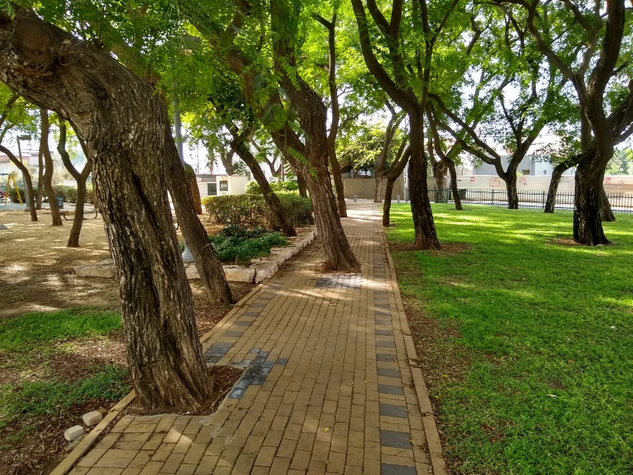

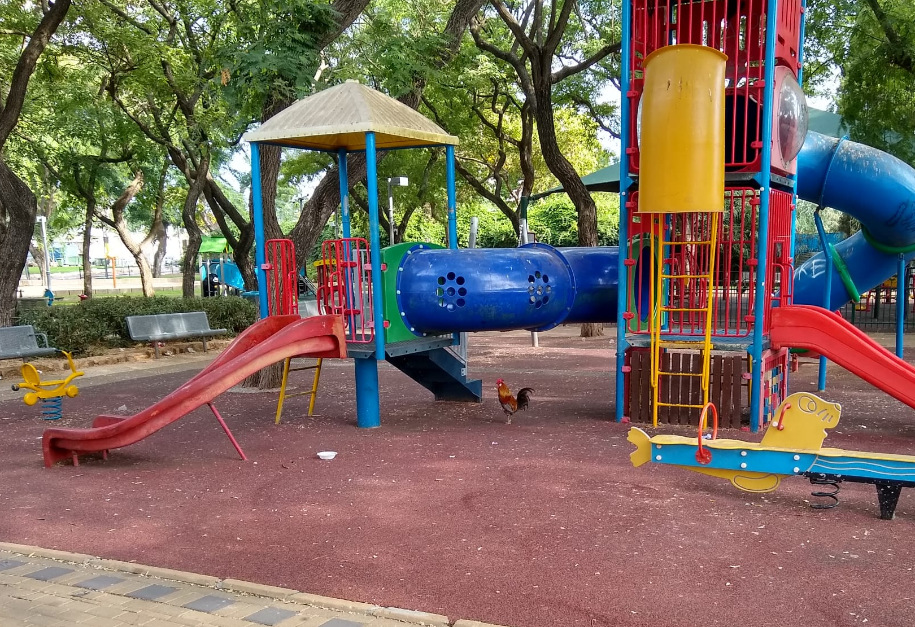
Gan HaShoteret
Background of the Intervention
Gan HaShoteret has been identified as a focus for intervention, as part of a broad effort to upgrade mobility in the Ezra and Ha-argazim neighborhoods.
The intervention goals are improving mobility through the neighborhood for parents and children, connecting residents with public spaces, and strengthening places that are “anchors” for the community.
The Circle Plaza in the center of the park, which is exposed to the sun, has been identified as the main area to be renovated.
Prior to the intervention, a qualitative and quantitative assessment was made of visitors’ movement to and in the park, the primary uses of the park, and opportunities for and challenges to realizing the inherent potential of the park complex.

Slide 14
Gan HaShoteret – Research Method
Research method - Field observations were conducted at four times
Mapping using the "XPLORE" approach, which includes reference to features of the space.
Qualitative documentation of activities at various times of the day.
Interviews with 8 visitors to the park.
Collection of data on traffic through and time spent at the park using Gehl Architects’ Public Life app: Data were collected on 140 visitors, of whom N = 21 passed through and N = 119 stayed at the park.
Observation dates:
    Mornings: Sunday, July 11, 2021 between 8:30 – 11:30; Friday, July 16, 2021 between 9:00 – 12:00
    Afternoons: Sunday, July 11, 2021 between 16:30 – 19:30; Monday, July 19, 2021 between 16:30 – 19:30
Characteristics of Interviewees*
Relationship* |  | Gender (of Adults) |  | Residence
Parent | 5 | Male | 3 | Local neighborhood | 7
Aunt | 1 | Female | (Mothers) 5 | Nearby neighborhood (Shapira) | 1
Visitor without children | 2
The interviewees were adults accompanying a total of 2 infants and 4 boys and girls aged 2-6.
All interviewees reported coming to the park once a week or several times per week, arriving by foot.

Slide 15
Gan HaShoteret
Use of the Adjusted Urban Space
Primary populations using the park:
The number of visitors to the park was very low during most of the observation times.
Female visitors were more common during all the observations (62%).
There were few visitors during the morning hours; groups of unchaperoned children aged 4-11 who live near the park were observed there. Occasionally cyclists or people walking their dogs passed through the area.
Afternoons were busier than mornings; families with young children and infants, groups of unchaperoned children, adults sitting on the benches, and elderly people in wheelchairs accompanied by caregivers were observed in the park.
Most of the visitors observed were from the local Israeli population. A small number of visitors from the population of asylum-seekers were seen, mainly in the afternoons. There seems to be tension around this issue; one interviewee stated that she was glad that few foreigners visited this park, as compared their greater presence in the Hatikva neighborhood.
A homeless man was seen sleeping at the playground in the morning. It is reported that at night, groups of youth come to the park to drink and smoke.
Opportunities for conversation and community meetings
Score* 4.8
* Scores range from 1 to 7 (with 1 the lowest and 7 the highest)
15

Slide 16
Gan HaShoteret
Parent-child interaction and joint play
Main activities during time spent at the park
Activities were focused around the play and fitness facilities and the nearby benches. This was the case for park visitors of all ages and group compositions, especially pairs.
Adults were mostly observed sitting and talking, and the children were playing.
Most parents sat and watched their children from the benches next to the play facilities, and talked with each other. Parents supervised young children more closely and accompanied them on the play facilities.
No interaction was observed between local parents and parents from the population of asylum seekers.
Groups of children were observed playing independently; they played tag, used the play and fitness facilities, and rode bicycles or scooters around the park. The children also searched for, collected, and played with natural objects found in the environment (such as sticks).
In some areas of the park (the grove, the Circle Plaza, and the monument complex), adults and teenagers were seen talking while sitting on benches or standing. Some used digital devices. Groups of kids played basketball.
* The height of the bubbles along the Y-axis represents the number of groups of a particular composition that were observed. The size and color of the bubbles represents the number of people in the group, as specified in the legend.

Slide 17


Gan HaShoteret
Average scores* based on observations and interviews
Adjusting the physical infrastructure young children and their caregivers
Features of the area
The play facilities are in a shady area and in relatively good condition, although some interviewees noted that they could use renovation. The grove of trees and grassy area are pleasant and relatively clean. The other areas of the park areas are so dirty that it is difficult to enjoy the visit.
There are trash cans throughout the park, but there is a lot of mess from pigeon droppings and fallen fruit from the trees.
A number of roosters and hens roamed around the garden. Interviewees reported that they belong to a local resident. Some visitors see them as a nuisance, while others said that the children enjoy their presence.
The Circle Plaza is exposed to the sun at all hours of the day. This is the only area that has a functioning water fountain. The concrete flooring has multiple cracks.
The sidewalks in the park are wide, without separate lanes for bicycles. Trees planted in the center of the paths make walking difficult and uncomfortable, especially for people with disabilities and those with baby strollers.
Outside the park:
It is possible to enter the park from all directions. From the east and west, the pathways are relatively accessible and convenient for entry with strollers. From the north, there is an unofficial passage between bushes, from a residential area.
The street to the south of the park is very dirty and the entrance is blocked by a planted tree.
In places, the access paths to the parks are too narrow and people pushing strollers must step down into the road.
Seating
6.4
Shade
5.5
Child safety
5.1
Enjoyment and convenience
4.6
Ease of movement and mobility
4.5
Cleanliness and maintenance
3.3
* Scores range from 1 to 7 (with 1 the lowest and 7 the highest)

Slide 18
Gan HaShoteret – Summary and recommendations
The park is mainly used by the local population
Natural elements contribute to a pleasant atmosphere and it is important to preserve them. However, cleanliness must be maintained and waste disposed of. Access routes must be adapted to the natural features (for example, paving walkways around trees so they are not blocked).
Improving conditions may attract visitors to under-utilized areas and so the entire park complex reaches its inherent potential. For example, the shelter plaza may be used as a seating and recreation area. The play facilities in the Circle Plaza may be removed and the area converted into a soccer or basketball court or area for play and visiting.
Interviewees expressed the need for security cameras to be installed for purposes of crime deterrence and law enforcement.
The physical infrastructure in the park is only partially adjusted for young children and their caregivers
Recommendations: Renovating and adding facilities to improve visitors’ wellbeing such as toilets, benches and a drinking fountain with cold water; improving routine maintenance and cleanliness; renovating access paths to allow safe and convenient access for wheelchairs and strollers.
Little parent-child interaction or joint play among young children and their caregivers was observed
Activities may enrich the park, for example by creating a branch of the community center in the park area.
Most local park visitors arrive there by foot or bicycle
Integrating Urban95 policy in public space planning
Gan HaShoteret was selected as a focus for intervention, as part of a pilot project to improve walkability. This decision followed Urbn95’s mapping of walkways and spaces used by parents and children in the Ezra and Ha-argazim neighborhood. The mapping was presented to partners and stakeholders, and alternatives were explored.
Urban95 submitted a proposal to develop spaces for recreation and gatherings in the park in order to adjust it for use by young children and their families. This plan will be implemented later this year or next year, with involvement of the local community center and other entities in the overall renovation of the park. Other proposals were rejected at this stage due to issues of transportation and permitting.

Slide 19
Findings of pre/post intervention observations

Slide 20
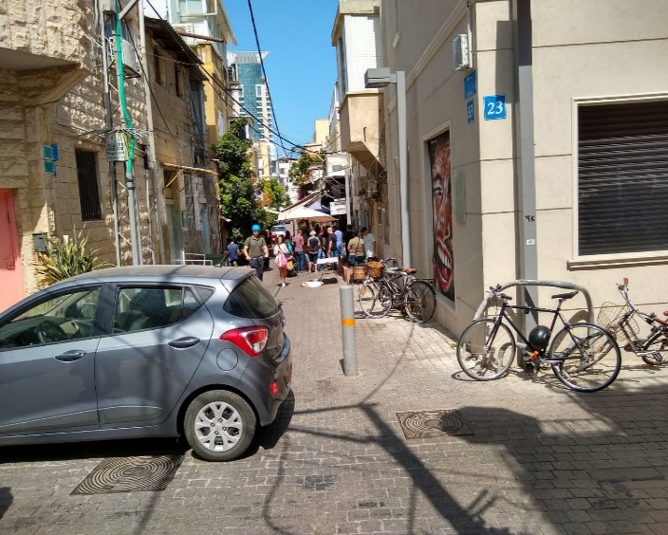
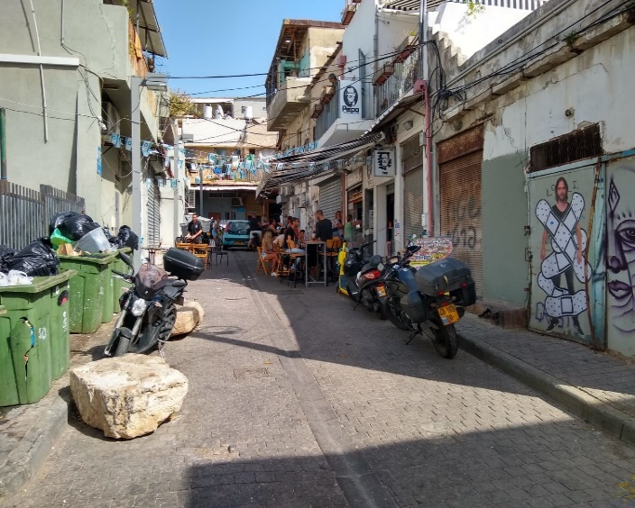
Kerem HaTeimanim
Background of the Intervention
As part of a plan to create a pedestrian-oriented neighborhood, an intervention site in the Kerem HaTeimanim neighborhood was selected.
It consists of several streets and businesses that attract visitors, with an atmosphere of bustling activity. Potential solutions for optimizing daily functioning of the businesses and the well-being of the residents were examined, including changes in traffic arrangements in this complex and the public space as a whole.
In the selected complex, some streets are open for vehicular traffic, and others are geared for pedestrian traffic; in reality, this combines several modes of transportation.
The situation before the intervention was mapped, with a focus on modes of travel, the populations using them, local conditions, and their impacts on the well-being of residents, visitors, and businesses.
Residents were invited to tours and participatory meetings.
The intervention included closing selected streets to vehicles and designating them for pedestrians only.

Slide 21
Kerem HaTeimanim– Research method
Research method – 40 hours of observations were conducted before the intervention and 40 hours afterwards:
Mapping using the "XPLORE" approach, which includes reference to features in the space.
Qualitative documentation of events at different times of day.
Interviews with visitors to the complex: 62 before the intervention and 52 afterwards.
Collection of data on traffic and visits using Gehl Architects’ Public Life app, dividing the observation site into north and south areas.
Observations times: Thursdays from 10:00 to 24:00 and Fridays between 10:00 - 16:00 during April-May 2021 (pre-intervention)
and September-October 2021 (post-intervention).
Characteristics of Interviewees
Gender |  | Residence |  | Frequency of Visits |  | Means of Arrival
M | 60% | In the neighborhood | 71% | Daily | 53% | Bicycle | 19%
F | 40% | Outside the neighborhood | 29% | On Fridays, a third of the interviewees reported visiting the complex daily. A higher percentage of people interviewed in the northern area said they visited daily (62%) compared to those in the southern area (40%). |  | By foot | 58%
Only three interviewees were with children: an infant and two children aged 4-5. |  | On Thursdays and Fridays most visitors were neighborhood residents. |  |  |  | A few individuals arrived by car, mainly in the southern area.
M | 56% | In the neighborhood | 62% |  |  | Bicycle | 10%
F | 44% | Outside the neighborhood | 38% |  |  | By foot | 79%
 |  | On Thursdays most visitors were local residents, on Fridays half were. |  |  |  | A few individuals arrived by car, mainly in the northern area.
Before
After

Slide 22
Kerem HaTeimanim
Use of the Adjusted Space
The two main streets in the complex were different in character and remain different. Kapah Street has bustling traffic and restaurants and bars frequented by visitors. Kanfei HaNesharim is a residential street used for passage through the neighborhood.
The visitors to the complex are mostly adults of a wide age range (20-60), with equal division by gender.
In the mornings, regular customers visit the local businesses. In the evenings, lively traffic was observed in the bar area. Many people were observed walking dogs.
Fridays are busy, with a high turnover of tourists and visitors to the market, cafes, and restaurants. Most are not residents. Residents reported that the congestion keeps them away from the public and outdoor spaces and reduces their mobility.
Businesses put chairs and tables on the street for the many customers. The overflow of businesses into the public area makes it difficult for pedestrians to cross the street, especially on streets with vehicular traffic.
There was no significant change in the visitors following the intervention. Virtually no visitors with children were seen during any of the observation times.
Closing the streets to vehicular traffic and designating places for tables and chairs helped expand commercial activity in the neighborhood, especially in the southern area, where more streets were closed to traffic.
The main documented activity was eating and drinking at the many busy restaurants and cafes.
A small number of visitors were under the age of 14, both before and after the intervention.
The few children observed were in the area mainly on Fridays.

Slide 23
Kerem HaTeimanim
Travelling by foot, bicycle, or public transport, not by car
% of modes of transport | South - before N=1883 | South - after N=1298 | North -before N=2485 | North - after N=1036
Pedestrians | 82% | 78% | 82% | 73%
Bicycles and scooters | 11% | 16% | 10% | 18%
Motorcycles | 4% | 5% | 4% | 6%
Cars | 3% | 2% | 3% | 2%
Both before and after the intervention, most traffic in the complex is by foot (75% after the intervention).
Prior to the intervention, the mix of pedestrians, cyclists and drivers undermined safety and slowed traffic. Interviewees reported traffic disruptions in the residential area from commercial trucks unloading and loading in the narrow streets.
The area is well-lit in the evenings, but the sense of security was undermined by parked cars blocking the alleys, before the intervention. These also reduced the space for walking.
After the intervention, the proportion of cyclists increased (17%) especially female cyclists (26% of cyclists after the intervention, compared with 20% before).
Closing streets reduced friction between vehicles and pedestrians and lowered noise, improving the atmosphere in the public space.
Interviewed residents said the quality of mobility in the area has improved. Some recommended closing a larger area to vehicles.
However, motorcyclists (mostly couriers) still disrupt pedestrians’ movement and some cars were observed driving on closed streets.
After the intervention, fewer parked vehicles were observed; this represents an improvement.
Fewer travelers were observed in the complex post-intervention as compared with pre-intervention. Post-Intervention observations were made on weekdays
between the holidays in autumn 2021, when Covid-19 was declining and air travel resumed, which may have affected the number of visitors in the observation areas.

Slide 24
Kerem HaTeimanim
Adjusting the physical infrastructure
to young children and their caregivers
Average scores* based on observations and interviews
North | South
The visit experience
4.6 | 4.3
Sense of security
6 | 5.2
Comfort of walking
4.9 | 4.6
Cleanliness and maintenance
3.9 | 3.5
Safety from bicycles and cars
3.4 | 3.1
Seating facilities
2.7 | 2.7
Characteristics of the public space
Public spaces outside local businesses are modest, not well-maintained, and lack useful features for the public welfare such as vegetation, child-centered spaces, or garbage bins.
There are almost no public benches or facilities for casual (non-commercial) rests. A few people were observed sitting on the sidewalks or planting boxes by homes.
In the morning, the area is not sufficiently shaded and it is not possible to stay comfortably in the space for an extended time.
There is noise and congestion resulting from renovations and construction.
Interviewees said there is noise from bars and clubs in the evenings and at night, which is a nuisance to the neighbors.
Interviewees reported concern about bicycle theft, due to a lack of facilities for safely locking bicycles and inadequate law enforcement in the area.
Sanitation and basic maintenance are poor, both before and after the intervention. Animal droppings are left on the sidewalks. There are few small garbage cans, only dumpsters that accumulate large amounts of garbage and produce bad odors.
After the intervention, there was a slight improvement in the security index, but no significant changes in other indices.
* Scores range from 1 to 7 (with 1 the lowest and 7 the highest)

Slide 25
Kerem HaTeimanim – Summary and Recommendations
Residents pass through and visit the complex daily
Residents’ attitudes regarding changes in the neighborhood are complicated:
they acknowledge the need to improve conditions in public spaces, but express reservations about possible impacts of gentrification on the character of the neighborhood and the types of visitors.
There is a strong need to improve and enrich public spaces by adding useful features: seating facilities, shade, vegetation, recreation areas and playgrounds, garbage cans, racks for locking bicycles.
There is a friendly community of dog-owners in the neighborhood. However, collection bins for animal waste and designated play areas for dogs should be added.
The complex attracts visitors, due to its proximity to the market, and the many restaurants, cafes and bars in the area
It is important to regulate businesses’ use of public space for seating their customers, so as to balance the needs of businesses and customers with the comfort and safety of movement on the streets and sidewalks. Businesses should be operated in a way that is considerate of neighborhood residents, in terms of noise levels and cleanliness.
Lack of shade affects how much outdoor space businesses can provide for their customers at certain times of the day. Adding shade will benefit both passers-by and restaurant customers.
Residents and visitors move through the neighborhood mainly by foot. In the renovated areas, there has been notable improvement in the quality of mobility.
Residents expressed satisfaction with the closure of streets. Nevertheless, there were reports and observations of motorcycles and vehicles on closed streets.
More parking spaces should be allocated. According to interviewees, parking lots and parking spaces are always full.
The physical infrastructure in the complex is not suitable for young children and their caregivers
All recommendations for improving conditions in the public space could encourage more use by families with children.
In conclusion, visitors and residents approved of and welcomed the closure of streets to vehicular traffic. However, interviews and observations indicate there have not yet been changes in patterns of moving through or staying in the space. There was no increase in the presence of children. In order to maintain the change and promote safe walking throughout the Kerem HaTeimanim neighborhood, conditions must be further improved and adapted to prolonged stays, not just passing through. It is important to enforce the ban on motorized vehicles.

Slide 26
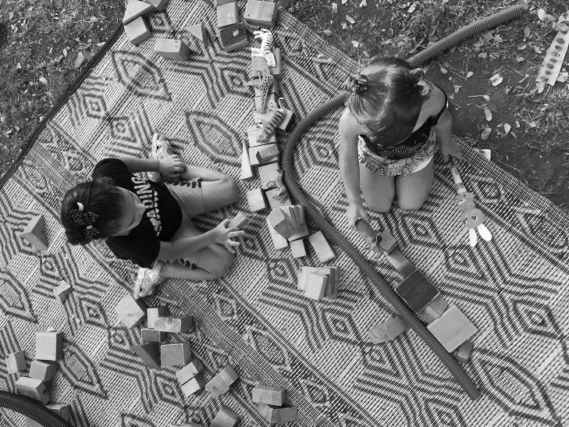
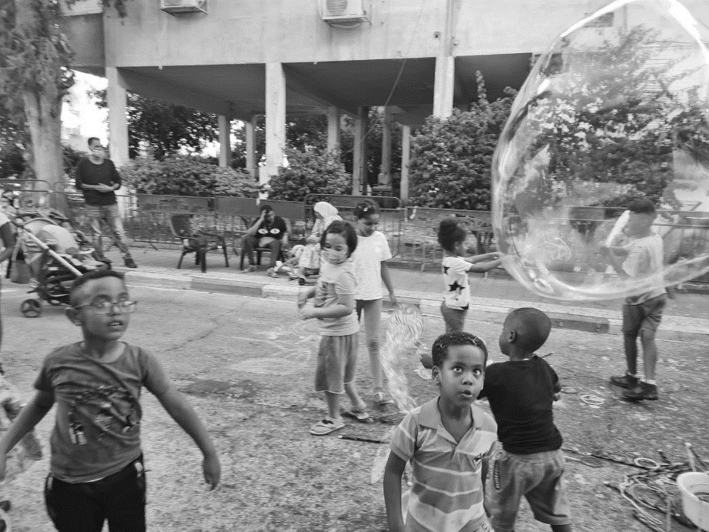
Activities in the public space
Play-Car
Play Street

Slide 27
Play-Car

Slide 28
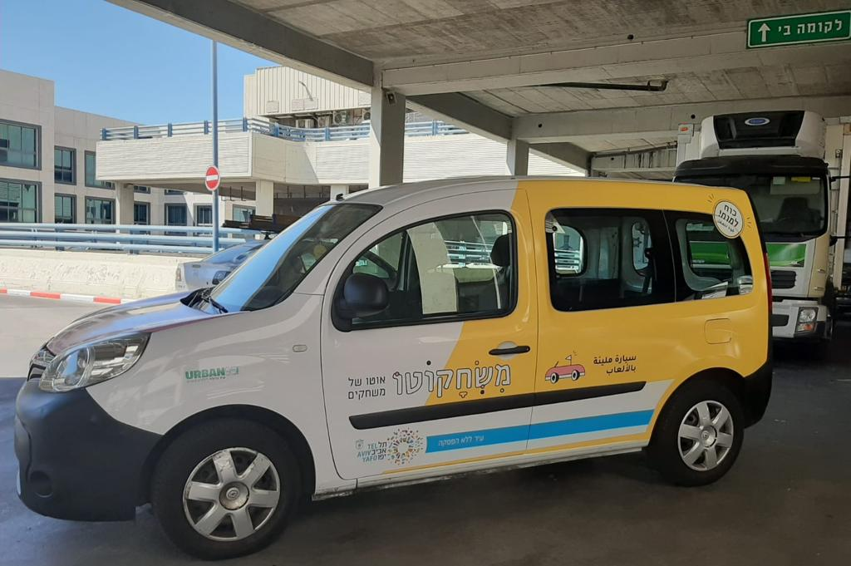
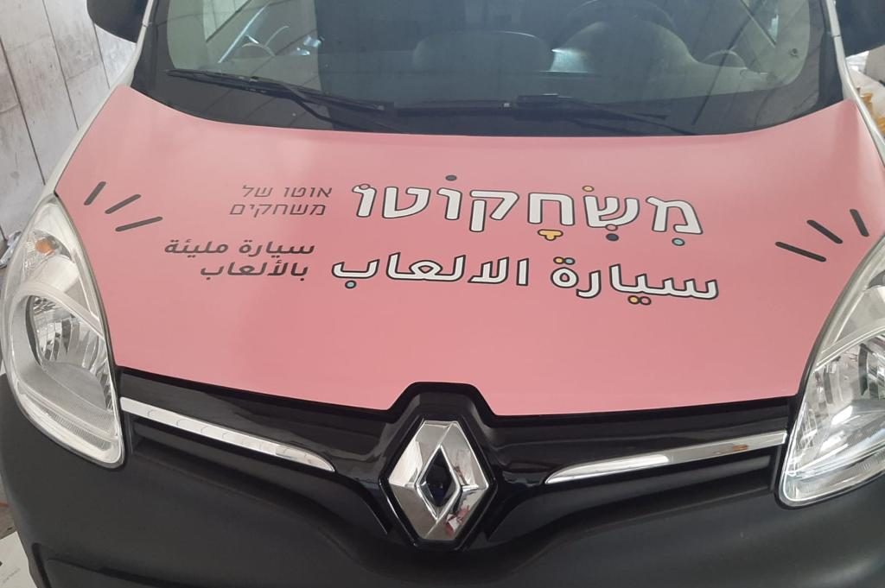
Play-Car - Background
A pilot version of Play-Car was launched in the city center in July 2019, as part of a program to develop activities for young children and their caregivers in public spaces.
In July-August 2021, a series of 14 play-based activities were offered in the afternoons in public parks throughout Jaffa, in collaboration with the Community Administration, Hamishlama for Jaffa, and the Urban95 program.
At the same time, 32 activities were held in public parks in the city center.
The activities revolves around a Play-Car - a branded and specially-designed vehicle containing equipment for setting up activity stations throughout the park.
In Jaffa: The professionally-run sessions were conducted by “My Freedom: Environmental Education Workshops" with two Hebrew-speaking instructors and young Arabic- and Amharic-speaking counselors recruited and trained by the Hamishlama for Jaffa staff.
In the city center: Students in the fields of social sciences and social work were recruited to facilitate the activities on behalf of the Community Administration.
Given the high demand for and the positive effect of the activities, the concept was adopted throughout the city, including in south Tel Aviv. The activities are being funded by the Community Culture and Sport Administration and Hamishlama for Jaffa, with the aim of implementing the model and continuing activities in 2022.

Slide 29
Play-Car – Research Method
Research Method
Three field observations were conducted, which included:
Qualitative documentation of the events, with an emphasis on the characteristics of the space, activity, training, participants and their behavior, including conversations with the training team.
Interviews with 22 participants
Times and locations of observations:
    Jaffa - Kerem al-Dalek neighborhood, Sunday, August 1, 2021 from 16:30-19:30
    Jaffa - The Red Park (Bnei Brit) Sunday, August 8, 2021 from 16:30-19:30
    City Center - Moshe Cohen Garden Friday, August 12, 2021 from 16: 00-19: 00
Personal interview with a professional parent counselor working on behalf of the Hamishlama for Jaffa
Review of social media publications about the activities, collected via the company Zencity
Characteristics of Interviewees
 | Relationship* |  | Gender of Adult |  | Residence |  | Means of Arrival |  | Arrival at Activity
Jaffa | Parent | 10 | M | 1 | In the neighborhood | 11 | Foot | 11 | Intentional | 11
 | Grandparent | 1 | F | 13 | Outside the neighborhood | 5 | Car | 5 | Unintentional | 5
 | Older sibling | 2 |  |  | In Kerem al-Dalek all were residents who arrived by foot; in the Red Park it was varied and some arrived by car from outside. |  |  |  | In Kerem al-Dalek all participants arrived intentionally
 | Children | 4
City Center | Parent | 5 | M | 2 | Neighborhood | 6 | Foot | 6 | Intentional | 1
 | Grandparent | 1 | F | 4 |  |  |  |  | Unintentional | 5
* The interviewees accompanied about 30 children and infants from birth through age 8 in the Jaffa area, and 7 children aged six months to 5 years in the city center

Slide 30
Play-Car - Jaffa - Stats*
# of meetings | Location | New participants** children & parents
2 | Gan HaShnayim | 50-60
2 | Brickner Garden (Raka House) | 50-60
1 | Abu-Din | 50-60
2 | Red Park (Beni Brit) | 75-80
1 | Yerachiani Compound | 50-60
1 | Pardes Dacha | 15-20
1 | Kerem al-Dalek | 55-65
1 | Migdal | 25-30
1 | Dolphin Garden | 30-40
1 | Magen Avraham Garden | 25-30
1 | Name of the Sages Garden (across from the mosque) | 55-65
1-8 years
There were a few children up to the age of 14
Age of children
Truck with Hebrew and Arabic branding
1
Staff
2 | “My Freedom” operators | Hebrew speakers
2 | Young counselors | Amharic speakers
2 | Young counselors | Arabic speakers
1 | Parent counselor and advisor | Hebrew and Arabic speaker
Community traits
Jewish population | Immigrants from Ethiopia | Religious
Arab population | Muslims
 |  | Secular
 | Christians
July-August 2021
Activity period
* Data provided by Hamishlama
*** Return participants were not counted again

Slide 31
Play-Car -- Jaffa
 | Kerem al-Dalek 1/8/21 | The Red Park 8/8/21
Demographics | Most chaperones were mothers Most visitors stayed 1-2 hours Age of participating children: | Most chaperones were mothers Most visitors stayed between half an hour to one hour Age of participants:
Community | Activities were integrated into a routine community gathering at the park. Interviewees said most participants come to the parks daily and know each other. Enthusiastic interaction among the children, physical play, fun, and familiarity among most participants were observed. Most participants were from the Arab population. They learned about the activities through community information channels. They stayed for the entire activity. A few Jewish families passed by and took an interest, but remained only a short time. | There was high turnover during the activity. Participants belong to diverse population groups (Arab, Jewish, Russian- and Amharic-speaking). No population remained if they were in the minority: when most participants were from the Arab population, Jewish children felt uncomfortable and left the activity; when there was a majority from the Jewish population, mothers of Arab descent were likely to leave.
Encouraging community* | 5.4 | 4.0
Interaction among children * | 6.8 | 6.4
Need for rejuvenation * | 6.9 | 6.6
The parent counselor was present at 10 activity sessions in Jaffa. She described the populations she encountered:
Primarily a socially marginalized population, mainly Arabic-speakers. Only one session had an ethnically and socio-demographically mixed population.
Most participants came to the activity closest to their home. There were few returning participants.
Many parents needed assistance. following the Covid-19 crisis, guidance to help parents deal with children’s difficulties has increased (online workshops, school meetings).
Mothers seemed embarrassed by public offers of help, but when the counselor made individual, direct contact, they expressed a desire for advice.
The activities encouraged mothers to leave the house with their children. Usually many of them stay home while their children go out with groups of friends, unchaperoned.
For them to leave the house and gather socially in the parks is a significant achievement and opportunity for change.
under 3
years 3-6
Over 6
* Average scores based on interviewees’ assessment of space/content addressing each: from 1 (low) to 7 (high) :

Slide 32
Play-Car -- Jaffa
 | Kerem al-Dalek 1/8/21 | The Red Park 8/8/21
Environment | No seats were provided in the area where the activity took place. Mostly children were present. The few adults sat on equipment crates near the activity stations. The activity area was close to the road, with no separation fence. There were no garbage bins, water fountains, or toilets. | The activity was conducted in a shady lawn, near a water source (from which the stations could refill their water supply), near the community center where there were accessible toilets. There were no seats or play facilities. The adults brought folding chairs or sat on crates or mats.
Clean & well-maintained* | 4.4 | 6.3
Drinking water & Bathrooms available* | 1.6 | 5.3
Shady* | 5.9 | 6.5
Safe for children* | 4.3 | 6.8
Comfortable seating* | 1.5 | 1.9
Convenient access* | 7.0 | 4.5
Suitable for # of participants* | 6.6 | 5.9
Monitoring social media via the Zencity platform indicated that before the activities there was discussion on Facebook about Play-Car in Jaffa and posts by Hamishlama for Jaffa (4) and Beit Raka (3). These received some likes and shares but almost no comments.
By the end of January 2022, there had been about 50 mentions of Play-Car Jaffa on Facebook, all from formal sources. About half were published by community centers in Jaffa (mainly Hamishlama and Beit Raka), which elicited about 100 reactions, mainly likes and shares.
According to interviewed participants, about a third of them heard about the activity through Hamishlama’s posts and WhatsApp groups.
* Average scores, based on interviewees’ assessment of space/content addressing each item, from 1 (low) to 7 (high)

Slide 33
Play-Car - Jaffa
After activities began, the parent-counselor met with the team of instructors and they discussed difficulties in getting parents to participate. She offered to assist in preparing for activities and/or arranging more meetings to advise the team. One instructor asked for help with linguistic and cultural mediation, and they worked together to find solutions. The rest of the team did not receive assistance from the parent-counselor.
The parent-counselor said the young counselors helped organize the activity and communicated with children, but did not have the tools to encourage parents to participate. The Amharic-speaking instructors had difficulty communicating with Arabic-speaking children, who were the majority at most activities.
 | Kerem al-Dalek 1/8/21 | The Red Park 8/8/21
Train-ing | The same team was at both observed activities. They also referred to previous activity sessions: Hamishlama gave the young counselors helpful tools for leading activities, encouraging participation, and dealing with conflicts and disruptions. The counselors appreciated deepening their knowledge about appropriate emotional language and meaningful communication with children. The instructors dealt with language and cultural gaps that affected communication with participants. Even after assistance from the community coordinator for early childhood education, the language barrier presented difficulties. The presence of young counselors who speak participants’ language is essential. One counselor noted that the Arab and Ethiopian children tended to ignore people who spoke to them a language not their own. According to the young counselors, there are differences in how the games are played, the level of enthusiasm, and unruly behavior among children of different ethnic backgrounds.
 | The Hebrew-speaking instructors each focused on a specific activity station and gave preliminary explanations to the children. The young counselors moved between stations. The children took turns and learned the activities through imitation and improvisation. A Hebrew-speaking instructor, who knew a few words of Arabic, communicated with the children through facial expressions and play. The instructors did not communicate with the mothers (who sat distant from the activity). Interaction was poor, even with the few mothers who joined the activity with their children. An attending parent-counselor spoke with the mothers, but did not interact with parents or counselors during the activity. | The training team was active. Instructors led participants between activity stations communicated with the young counselors. The team did not significantly change how the activity was explained or conducted at this site. Since there was no language barrier, the Hebrew-speaking instructors communicated easily with the parents and children and were able to demonstrate their professionalism in terms of the program, encouraging joint play, and conveying meaningful messages about activities. The parents expressed interest in the activity and approached the staff on their own initiative.
Equip-ment* | 5.8 | 4.6
* Average scores, based on interviewees’ assessment of space/content addressing each item, from 1 (low) to 7 (high)

Slide 34
Play-Car - Jaffa
The parent-counselor said there was low awareness and even criticism of the principle of joint play. Most mothers sat and watched from a distance, unaware of the possibility and value of joint play with their children: “They say 'he knows how to play on his own; I will sit and watch.’”
She said the activity was well structured and appropriate for its goals of encouraging joint play as a tool for strengthening the parent-child bond among populations in Jaffa. She recommended preparation sessions for parents to increase awareness and discuss the importance of this issue, and to provide tools for joint play with the children.
She arrived before the activity, approached parents, listened to them, initiated conversations about parenting challenges, and encouraged them to take part in the activity: "I started talking and more mothers joined our circle and conversation.”
The Red Park 8/8/21 | Kerem al-Dalek 1/8/21
High levels of parental involvement and joint play were observed. All parents stayed close to the activity area and watched their children. Some actively played with them. Many parents photographed their children to document the activity Many parents expressed interest in the games and equipment used, and seemed to enjoy experimenting, planning, and creating, according to the nature of each station. | The activity was mainly attended by children. The mothers sat apart and the children occasionally approached them. A few mothers played with their young children (under 4 years) during the activities. Some older children apparently made fun of them for this. The counselors said the parents from the Arab population viewed the staff as supervisors for the children. Along with the language barrier, this made it difficult to get them to participate in the activities. Parents of Ethiopian descent and from the Jewish population tended to be more involved. Some interviewed parents expressed satisfaction with the very existence of the activity, and found the change in routine refreshing. Some seemed to enjoy letting others supervise their children. Others enjoyed the opportunity to play with their children in a structured framework and having a new experience. | Caregiver-child joint play
5.4 | 4.5 | Strengthening the bond and joint play*
* Average scores, based on interviewees’ assessment of space/content addressing each item, from 1 (low) to 7 (high)

Slide 35
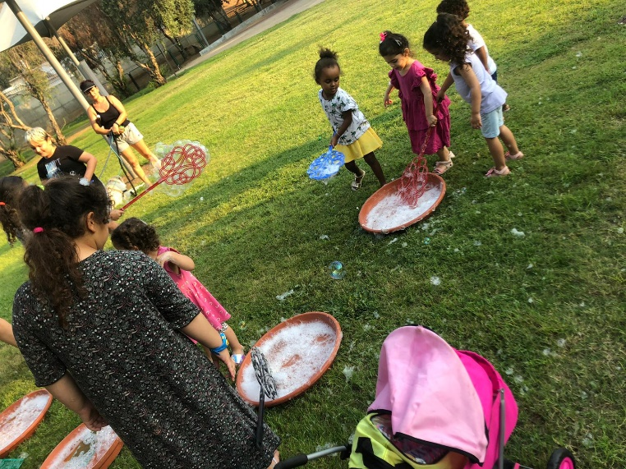
Play-Car - Jaffa
The Red Park 8/8/21 | Kerem al-Dalek 1/8/21
Interviewees said the soap bubble station was particularly successful. Some suggested water activities for older children. Children enjoyed the boat activity. Few children took part in building with pipes or playing with the cubes and balls. Overall, interviewees expressed satisfaction with the unusual experience and the opportunity for children to play with something new. Mothers told their children to take good care of the equipment and to return it to the stations. The equipment was collected and packed up in stages, so the children could move between stations and play with the remaining equipment. | Interviewees’ expressed positive impressions of all activity stations. Some stations were busy (sink with dishes, soap bubbles, balls), while children left other stations quickly (boats, building with pipes, cubes). The water games were highly popular and there was some unruly behavior around them, which the counselors moderated. Some mothers were unhappy that their children got wet and dirty. Some children hit each other (playfully) with the activity props, or took things away from the station to show to their mothers, then returned. The interviews indicated a need for more guidance and assistance from the instructors at the stations. The counselors said there were requests to add a station where children create a soccer field (make goalposts with activity objects) and for puzzles. After the activity, participating children helped instructors collect the equipment. | Participants’ conduct
4.9 | 5.7
5.3 | 5.1
Kerem al-Dalek
The Red Park
* Average scores, based on interviewees’ assessment of space/content addressing each item, from 1 (low) to 7 (high)

Slide 36
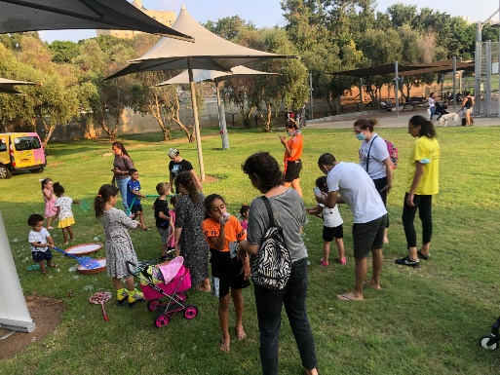
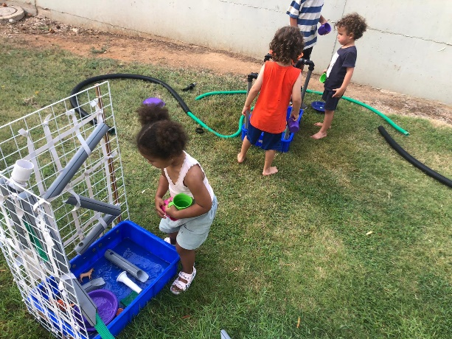
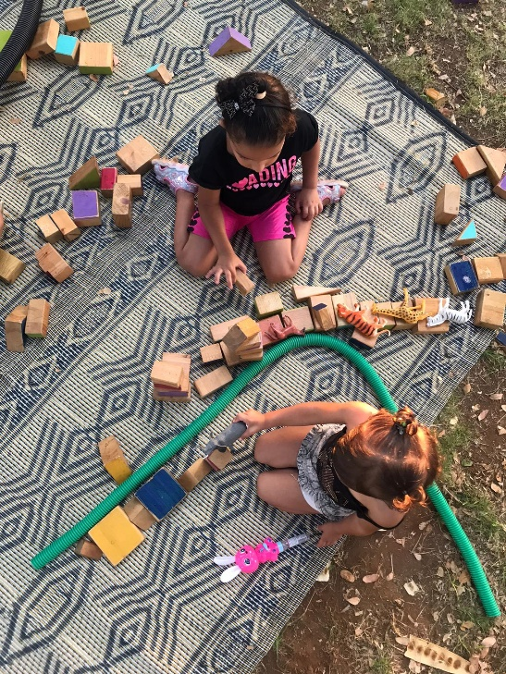
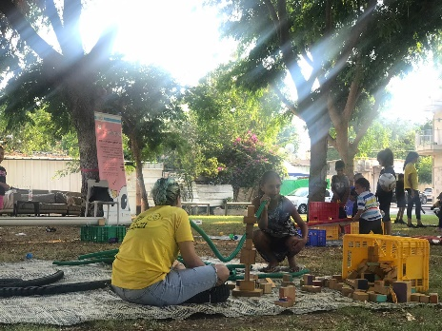
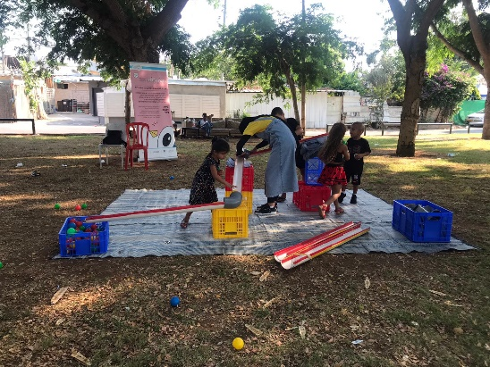
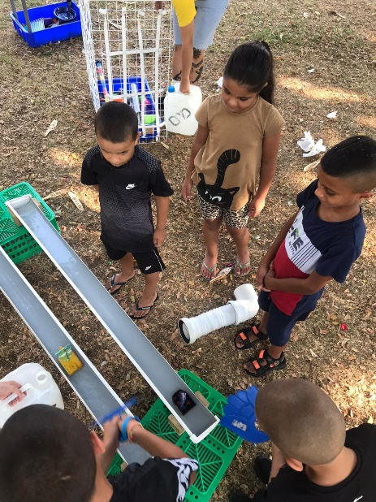

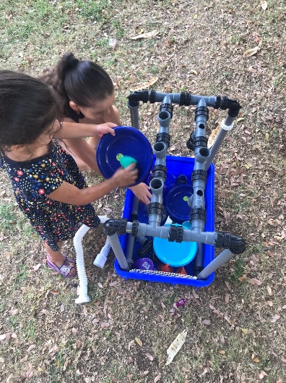
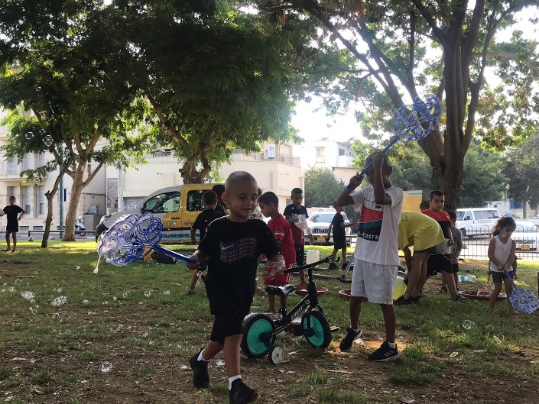
Kerem al-Dalek
The Red Park

Slide 37
Play-Car – Jaffa Summary
The was a strong positive response to this series of activities, which reached many Jaffa residents not otherwise involved in community services. Participants expressed appreciation, satisfaction, and willingness to participate in future activities. The activities gave families an opportunity to gather in the public space, and for parents to be with their children while they played.
Insights and recommendations for future activity
The team’s ability to communicate in participants’ native language is essential for encouraging participation in the activities and for interacting.
Basic features such as comfortable seating should be provided, to encourage caregivers to stay in the activity space and to participate.
A parent-counselor and advisor should be involved in training the staff, to help bridge cultural barriers and provide effective tools appropriate to the staff’s professional background or lack thereof (as in the case of the young counselors).
A structured, ongoing process is necessary to promote meaningful change in caregiver participation and joint play as a means of strengthening the parent-child bond. Play-Car offers an opportunity to apply and practice these principles. There should be active guidance to help parents and children learn these principles through preliminary workshops and during the activity.
  The parent-counselor should be more involved, holding individual and group conversations with caregivers before the activity to give them information about joint play and parenting and to help them relate to the activity. Involvement of a professional parent-counselor who has a shared cultural identity and who is a well-known figure from the local community is key to overcoming barriers to participation.
  The entire staff must show sensitivity and encourage and support the active participation of parents and caregivers, especially participants from a population that is in the minority of those present at the activity.
According to the parent-counselor, mothers had positive feedback about previously-held online workshops and clearly wished to continue. She suggested that barriers to participation stem from, among other things, lack of emotional availability and awareness. Barriers may be overcome by directly appealing to the mothers, empowering them, and only afterwards initiating indirect dialogue about their children.
Posts on WhatsApp and Facebook groups brought participants to the activity site, but received few comments and shares. Social media is perceived as impersonal. Individual, direct contact by community members is needed to encourage residents’ long-term participation in activities and workshops.
Environmentalism and use of recycled materials should be encouraged, along with creative ways to integrate simple elements from participants’ daily lives.

Slide 38
Play-Car – City Center
Moshe Cohen Garden 12/8/21
Most accompanying caregivers were women (mothers). Although female presence among caregivers was still dominant, more men were seen at this site than in Jaffa. Most participants stayed between half an hour and an hour. Age of participating children | Demographics
The activity was integrated into residents’ afternoon routine. A group of friends gathering in the park for a birthday party joined the activities. Attendance was low at first, but increased as the weather became more pleasant. All interviewees were neighborhood residents. Most came upon the activity by chance. Some saw publicity beforehand, but did not realize the activity was planned for that day. Parents and children who came together, tended to talk and play only with each other. Some participants invited friends from the neighborhood to join the activity. No interactions were observed outside of previously-formed groups. Interviewees said they seldom used community center services. One mentioned visiting a local playground and one had participated in parent workshops via Zoom during the Covid-19 pandemic. Instructors were specifically recruited to lead activities in the city center. They characterized the participants as socio-demographically homogeneous. | Community
4.3 | Encouraging community*
4.8 | Interaction among children*
6.5 | Rejuvenation*
Children under 3
Ages 3-6
Over 6
* Average scores, based on interviewees’ assessment of space/content addressing each item, from 1 (low) to 7 (high)

Slide 39
Play-Car – City Center
Moshe Cohen Garden 12/8/21
The activities were set up in a shady area with trees. Parents who brought multiple children let some of them play on the nearby swings (on a poured-rubber surface). Because there were few participants, this use of the swings was safe and under control. However, it could become problematic if there is a large number of children. Caregivers sat near their children on mats and benches in the plaza. There is a water fountain near the activity area, but no toilets. The day of the activity was hot. The garden is between buildings, and there is no breeze to relieve the heat. | Environment
6.7 | Clean and well-maintained*
4.3 | Drinking water and bathrooms available*
6.2 | Shady*
6.3 | Safe for children*
5.8 | Comfortable seating*
6.8 | Convenient access*
6.7 | Appropriate for number of participants*
Social media discourse was monitored via the Zencity platform. By the end of January 2022, there had been approximately 50 mentions of this activity on Facebook, all from formal sources (municipal sites and community centers). Close to 20% were published by community service sites in the city center; about 20% were from service sites from the southern region. The posts evoked some reactions, mostly likes and shares.
Few interviewees said they learned about the activity through online sources.
* Average scores, based on interviewees’ assessment of space/content addressing each item, from 1 (low) to 7 (high)

Slide 40
Play-Car – City Center
Moshe Cohen Garden12/8/21
Guidance was organized, clear and professional. Instructors explained options for experimenting with activity equipment, suggested adaptations according to age, encouraged children to move between activity stations, and communicated frequently and directly with the children. There is apparently no need to intervene and encourage joint play, as parents were involved on their own initiative. The instructors were welcoming and attentive to the parents’ presence. The instructors said their brief training dealt mainly with the logistical aspects of the Play-Car, such as unloading and packing the equipment. They had prior experience and skill in working with children. They said they adopt an experiential approach allowing for creative improvisation, and tend not to correct or guide the children in specific ways to use the props and equipment. | Guidance
6.3 | Activity equipment*
Joint play among parents and their children was observed among most groups. Children and adults alike clearly enjoyed the activities and demonstrated a high level of involvement. Interviewees said the children interacted more intensely and for a longer time with the activity props than they do with normal playground facilities. They enjoyed watching their children and seeing their play routine being diversified. The instructors noted that thus far, most parents engaged in joint play with the children and showed a high level of involvement. | Joint play among children and caregivers
6.8 | Strengthening the bond and joint play *
Visitors’ behavior was dynamic and centered around the existing playground facilities. Children used the activity equipment outside the activity area, but returned them to the activity stations afterwards. Children engaged in creative free play. Most played with the equipment alone or with their caregivers, and were less likely to play in groups with other children. Children aged 4+ seemed less interested in the activity equipment. Most interviewees said their children enjoyed the various ball games. Instructors said they received frequent requests for ongoing activities in the city center. Some participants seemed disappointed that the activity moved to other parks and did not return to the same place. The instructors suggested they follow online to find the locations of future activities in other parks, and some of them did so. | Participants’ behavior
6.3 | Encouraging creativity*
5.8 | Offering new ideas*
* Average scores, based on interviewees’ assessment of space/content addressing each item, from 1 (low) to 7 (high)

Slide 41
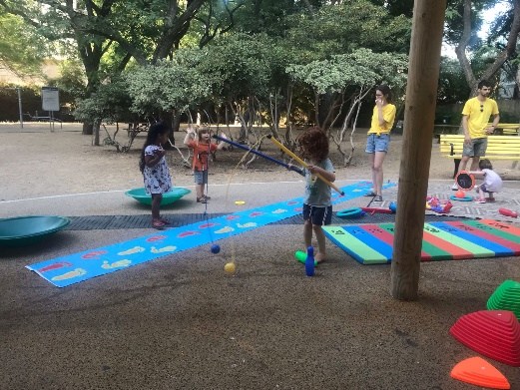
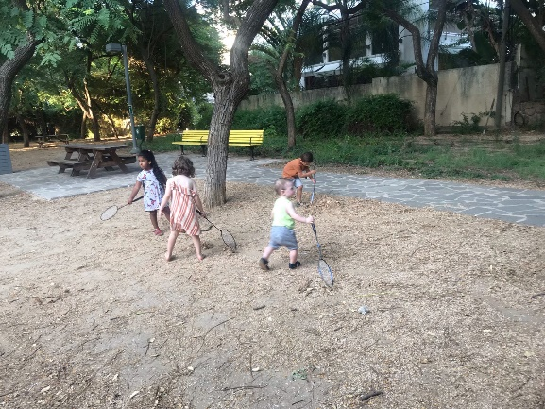
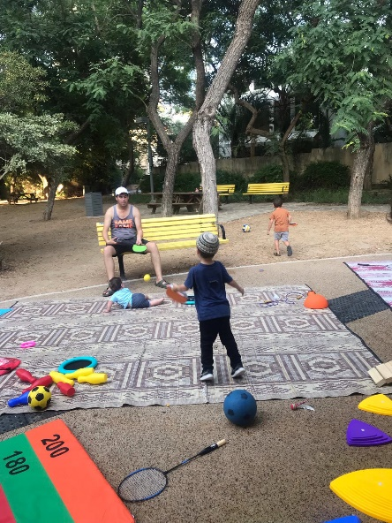
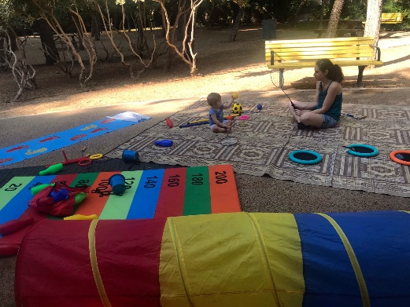
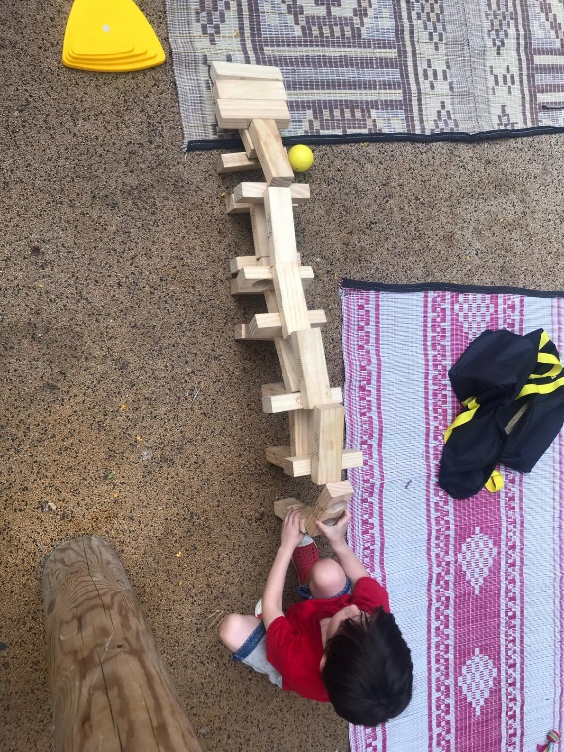
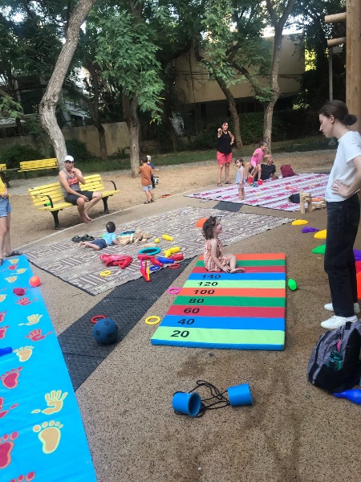
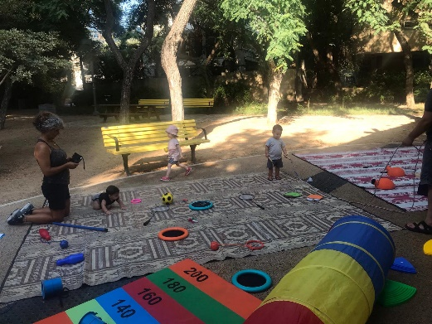
Play-Car – City Center
Insights and recommendations for further activity
At the activity stations, equipment is spread out for participant use. Guidance is dynamic and responsive to events and participants’ behavior. Spontaneity is encouraged.
Activities are integrated into natural community gatherings in the public space, yet without claiming “ownership” of the space. This important aspect needs to be preserved. Activities should be inviting towards all people in the park, not exclusionary.
Activities should be more widespread, to reach a broader audience. However, there is value in keeping the number of participants small to preserve an intimate neighborhood/community atmosphere.
Participants said they would like the program to continue and return to the same locations in the city center. Some said they would go to other locations if they knew about upcoming activities. There should be signs at activity sites about upcoming activities and their locations, for people who do not see online updates.

Slide 42
Play Street

Slide 43
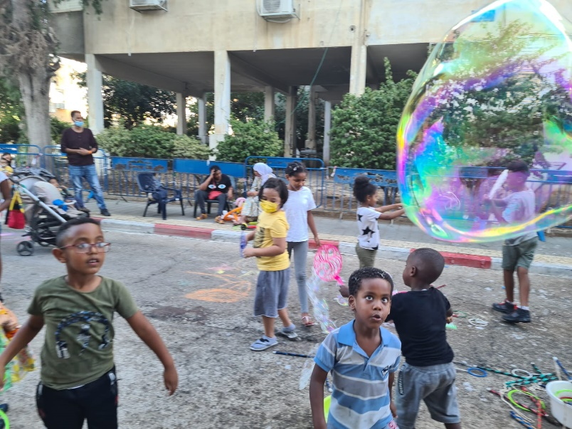
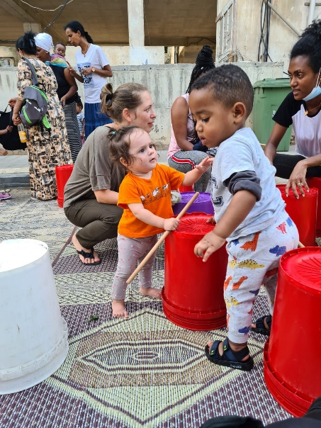
Play Street - Background
'Play Street’ was launched in July 2021 to help meet the needs of young children and their caregivers in public spaces. The initiative was co-promoted by the Community Administration, Urban95, and municipal departments (transportation, sanitation, planning, street lighting, city beautification) that helped with physical infrastructure.
A section of street was closed to motorized vehicles, and transformed into a recreational area with mats, beanbags, soap bubbles, wooden toys, hoops, balloons, etc. The event included music and concluded with a circus/magic show.
The first activity took place on Warsaw Ghetto Street in the Neve Sha'anan neighborhood in south Tel Aviv, in cooperation with the Gan HaRitzifim project* to provide a response to the needs of young children and their caregivers, especially from the population of asylum seekers. The project has been repeated monthly.
Counselors from Gan HaRitzifim operated the stations. The station with wooden toys was operated by the company “Sikhaku".
The Gan HaRitzifim* Project-Interview with project manager
Gan HaRitzifim is a large public park near the old central bus station in Tel Aviv. The area is unsafe due to drug trafficking, prostitution, and crime, which worsened during the Covid-19 crisis.
Given these dangers in the park, and lack of appropriate responses to residents’ needs, neighborhood children gather in places such as parking lots or roads. Since many parents in the community of asylum-seekers work long hours, their children are often seen wandering in these areas until late in the evening.
The Gan HaRitzifim project began in the Neve Sha'anan neighborhood 2021, in collaboration with the Community Administration and the Mesila organization, to promote a safer living environment and suitable public spaces for children and parents in this neighborhood.
The project works to develop and improve the park and surrounding area. The idea for a 'play street’ arose as an additional way to create safe spaces in the neighborhood for children and their families.

Slide 44
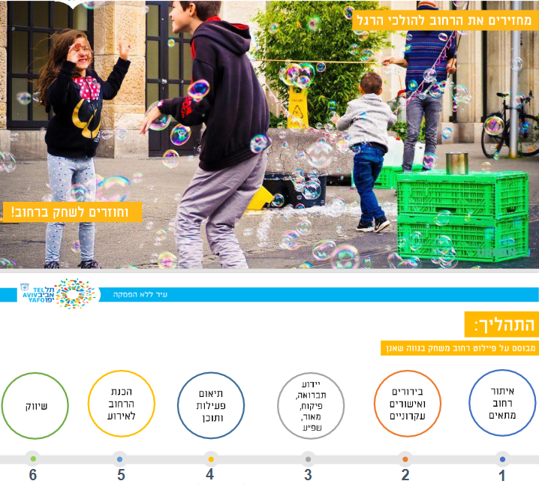
Play Street - Background
The activity was well attended and got positive feedback. The Urban95 team developed a user guide that explains, in an accessible and simple way, how to implement this initiative in other neighborhoods, via community centers. The concept was adopted throughout the city, and incorporated into other activities (past and planned) in the south and center of the city.
Following the success of the pilot project in Neve Sha'anan, Play Street has become a monthly event, funded by the Community, Culture and Sports Administration.
The Play Street concept is well-known around the world and has been researched and validated by numerous studies. Webinars on the subject inspire local teams and promote tailored implementation practices. The Urban95 team in Tel Aviv-Jaffa participated in and provided much of the content for the webinar “Impact of Play Streets - Physical Activity and Public Health”.
From the user guide - Urban95 Tel Aviv-Jaffa

Slide 45
Play Street – Research Method
Research Method
One observation was conducted on the afternoon of September 30, 2021, which included:
  Qualitative documentation of the event, emphasizing conditions of the space, activities, training, participants and their behavior, including interaction with the training team and community facilitator
  Interviews with seven participants
Interview with the director of the Gan HaRitzifim project in the Neve Sha'anan neighborhood
Review of a discussion between the Urban95 team and Southwest Regional Manager of the Community Culture and Sports Administration, documenting the activity
Additional observations are planned for 2022, reflecting the locations and scope of activities.
An observation of the first Play Street in the Neve Ofer neighborhood (southeast area) took place on February 27, 2022.
Reports on all observations conducted in 2022 throughout the city will be submitted in an integrative report evaluating the project.
מאפייני המרואיינים בתצפיות
Arrival at Activity |  | Means of Arrival |  | Residence |  | Gender of the adult |  | Relationship
6 | Intentional | 6 | By foot | 7 | In the neighborhood | 7 | Female | 6 | Parent | South – Neve Sha’anan
1 | Unintentional | 1 | By bicycle |  |  |  |  | 1 | Older sibling
- 6 mothers: 5 from Africa (conversation in English), an Israeli (in Hebrew), a 25-year-old sibling of Asian descent (in English) - With the exception of the Israeli mother, all participants came to the activity intentionally. They received notifications from Mesila on WhatsApp or from the director of the Gan HaRitzifim project. - Interviewees accompanied 16 children between the ages of 1 and 10 years old

Slide 46
Play Street
A mediator between municipal-social entities and community members attended the event, as part of the ongoing Gan HaRitzifim project According to this mediator and the project manager:
This activity is new and innovative for the area. Not all residents understood it was open to everyone, despite invitations and publicity before the event (by the project team, schools, Mesila) and at the site during the activity.
Many parents lack the time, knowledge, and awareness necessary to guide their children and prepare them for their futures. Families are large, parents work long hours, children roam the dangerous streets unchaperoned. There is a need for parents to be more involved in their children’s development.
This activity contributed to expanding the Gan HaRitzifim project and encouraging residents’ participation: “Our presence is more strongly felt and we know the community better. The connection with schools and other entities has become stronger. We are doing more community events that are not necessarily within the 'garden’.”
A notable challenge is getting participants to arrive on time for Gan HaRitzifim activities in the afternoons. Local residents tend to arrive late and stay until the evening. This issue is being addressed through outreach within the framework of the Mesila organization.
Neve Sha’anan 30/9/21
Most caregivers were women (mothers) An adult: child ratio of 1:5 was observed Most adults came with at least 3 children Some children arrived unchaperoned Most participants stayed between one and two hours Ages of participating children | Demographics
Most participants were asylum-seekers of African descent. There were a few individuals from other backgrounds. There was almost no interaction between the mothers, although a few invited friends from the neighborhood to join. Interviewees said they came only to bring their children to the activity; they expressed no interest in meeting new friends or acquaintances. Some children arrived with school bags and wearing school uniforms. It seems the activity offered an after-school alternative for them, rather than going home. There was a warm and communal atmosphere during the circus show. The mothers spoke with each other (unlike during the rest of the activity). Children ate food from their school bags. There was a sense of safety and relaxation. Some parents with children hesitated outside the event and only entered after being invited by the instructors. | Community
3.8 | Encouraging community*
7 | Interaction between children*
6.5 | Rejuvenation*
Children under 3
Ages 3-6
Over 6
* Average scores, based on interviewees’ assessment of space/content addressing each item, from 1 (low) to 7 (high)

Slide 47
Play Street
Neve Sha’anan 30/9/21
The street was closed to motorized vehicles in both directions, allowing only carts and bicycles. The street is shaded in the day and brightly lit at night. Mats and beanbags were placed on the street, with chairs on the sidewalks for caregivers, although some adults sat on the sidewalks. The stations offered varied activities suitable for a wide age range of children: soap bubbles, balloon animals, hoops, martial arts, etc. Children of different ages were able to enjoy playing in different ways at some of the stations. Interviewees’ suggestions for improvement: Adding "quiet" activities for less energetic children Separate stations designated for toddlers Adding activities for adults There was only one sign in Hebrew announcing the closure of the street. According to the staff, the event was announced in schools and via the Social Services department. |  |  | Environment
6.8 | Convenient access* | 6.2 | Clean and well-maintained*
7 | Appropriate for number of participants* | 6.6 | Shady/well-lit*
5.6 | Appropriate for children of various ages* | 6.6 | Safe for children*
Most were satisfied, some suggested lengthening | Duration of activity | 7 | Comfortable for caregivers*
The counselors were open and sociable with community members. They played with, encouraged, and challenged the children. They seemed to enjoy themselves and were dedicated to making the event successful. There was no structured instruction or clear division of stations among the counselors; they moved between stations. The counselors seemed to know and have a warm relationship with many of the children. No interactions with the parents were observed. Social connections among the counselors contributed to a generally positive atmosphere at the event. |  |  | Guidance
7 |  |  | Equipment*
* Average scores, based on interviewees’ assessment of space/content addressing each item, from 1 (low) to 7 (high)

Slide 48
Play Street
Encouraging parents' presence was a project goal. The project manager reported an increase in parents’ attendance and return participants over the course of the monthly meetings.
Community members’ perceptions of public activities are complex, with sensitivity around trust-building and a sense of belonging. At the first meetings, they were reluctant to join and waited for an explicit invitation. Many did not understand that the activity was open to them. Attendance was higher when advertising included distribution of leaflets on the streets.
Activities were varied, interesting, and challenging, which positively affected children’s behavior. The project manager said: “This is something that draws them, offers something quality, appropriate, challenging...a positive atmosphere, music... few cases of misbehavior." She said it is important to include a 'peak activity’ like the circus show, which brings participants together and strengthens their connection to the experience.
Additional goals are to offer parents ways to spend pleasurable time with their children. They should be reassured that the activity is family-oriented and open to them. In contrast to the tension and alertness required of caregivers at the Lewinsky Garden, the Play Street allows a safe space for active participation.
At this stage, the staff’s guidance and interaction focused on the children, reflecting their knowledge and skills. With professional training (i.e. through Mesila) they could learn how to better connect with and involve the parents.
There is a need to involve parents in community activities, although their daily lives are difficult: “They are in survival mode. Something must be established first, then involve them".
Neve Sha’anan 30/9/21
Most of the mothers were passive and sat to the side. Only at the soap bubble station were mothers observed participating. | Caregiver-child joint play
5.2 | Strengthening the bond and joint play
7 | Diversifying children’s play routine
All the children were involved and played cooperatively. They took care of the equipment and used it properly. According to interviewees, the main contributions of the activity were: Providing a safe space for children to play Offering play opportunities that are not usually available Positive interactions and bonding among the children (and with themselves) A refreshing change in the neighborhood’s environment Opportunity for a social gathering and shared family time Participants wanted to make the most of the event; many remained until the stations closed. Interviewees said that if the street is permanently available for this type of activity (closed to traffic), they will continue to come. | Participants’ behavior
5.8 | Encouraging creativity*
6 | Encouraging new ideas*
* Average scores, based on interviewees’ assessment of space/content addressing each item, from 1 (low) to 7 (high)

Slide 49
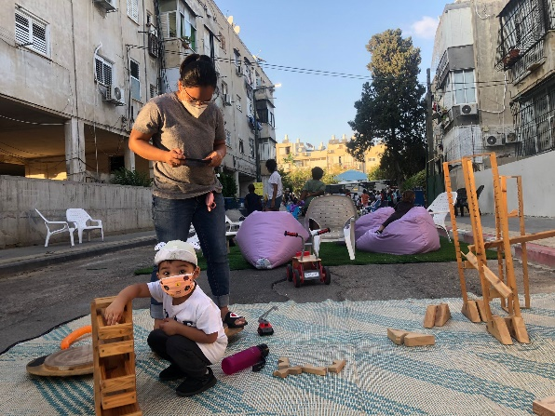
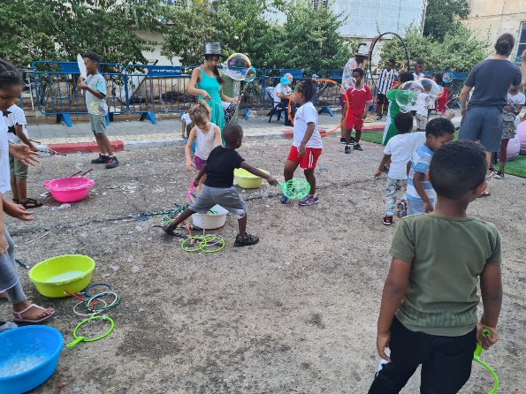
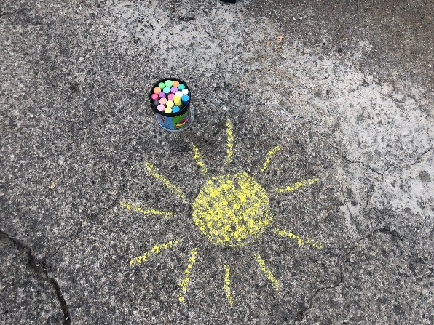
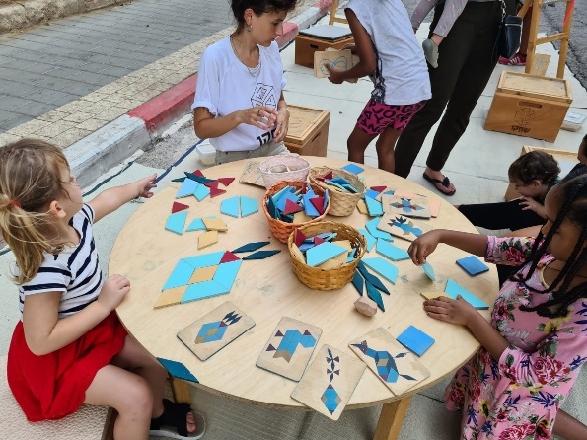
Play Street -- Summary
Insights and recommendations for further activity
This activity offers a refreshing change to the routine in these public spaces, and contributes to a positive atmosphere and sense of security among participants.
The experiential activity offers opportunities for children to play in a safe space with their peers, with a variety of games, appropriate for various ages, that are not usually available to them.
Certain stations should be designated for toddlers, to allow them to play safely. Such stations may encourage more caregiver involvement and joint play.
Mothers appreciated that their children could play freely and independently. They tended to watch from the sidelines and were not actively involved in the games.
The mothers said they came for their children’s sake, and were not seeking community involvement for themselves.
The staff exhibited strong dedication and motivation to contribute positively to the community. They interacted well with the children. Almost no interactions with the mothers were observed.
Continued work with professionals who understand the complexities of this community is recommended, in order to support and enrich parents’ joint play and bonds with their children.
Misunderstandings about the purpose of the event caused some passers-by to hesitate to join. Clear announcements should be posted in the vicinity. It was helpful when counselors initiated contact and actively recruited participants. Direct, personal appeals increased responsiveness.
The staff suggested expanding to other locations to increase the scope of this solution. Developing tools for activities that residents can use independently (e.g. modular kits) would reduce dependence on suppliers and allow budgets to be spent on other beneficial programs.

Slide 50
Conclusions and Recommendations

Slide 51
Conclusions
In 2021, Urban95’s activities in the Mobility and Urban Space domain were expanded to the city-wide level, reaching different target populations: residents of Jaffa and south Tel Aviv, including asylum seekers (scalability).
Our perspective on young children and their caregivers’ needs was integrated into strategic municipal plans on mobility (sustainability)
Urban95 policy is integrated into urban space planning
Urban95's principles for urban environment design, which take into account the needs of young children and their caregivers, are integrated into planning processes in all project units, and reflected in strategic municipal plans (transportation vision, promotion of cycling and walking) and resource allocation.
Pilots were implemented, demonstrating the success potential towards large-scale expansion of interventions: pilots for Play-Car and Play Street had an immediate impact on the participants, and provided useful and instructive experience for expanding and adapting activities for city-wide implementation.
Data-based actions: needs were mapped through the collection of preliminary data on public participation prior to the intervention (e.g., in Gan HaShnayim, Gan HaShoteret); pre/post-intervention data were collected to measure project impact (e.g. in Kerem HaTeimanim).
Physical infrastructure adjusted to young children and their caregivers
The interventions and activities are planned to make the public space accessible, comfortable, and beneficial for the use and stay of young children and their caregivers, in accordance with their needs.
Data was collected at all activity centers, as part of the formative and ongoing assessment, including evaluation of the suitability of the local infrastructure for mobility and time spent at the site by young children and their caregivers.

Slide 52
Conclusions
Use of Adjusted Urban Spaces
Interventions for adjusting public spaces for young children and their caregivers are expected to also provide a response to the needs of the general public, their attitudes towards the current situation and their concerns for improving conditions in the various sites.
Activities in public spaces for young children and their caregivers contribute to residents’ positive use of the sites, strengthen identification and connection with the local environment, and provide solutions the free time of parents and children.
Mobility by foot, bicycle, or public transport, rather than by car
To promote pedestrian mobility in the urban space, interventions were implemented in sites such as Kerem HaTeimanim, to enable safe access and travel by a variety of modes of non-motorized transportation.
The Play-Car and Play Street activities have a modular and flexible structure that can be replicated and adapted to different audiences at sites throughout the city. Making the activities accessible to residents within a reasonable walking / riding distance is important since it seems that most participants are neighborhood residents who arrive by foot or bicycle.
Parent-child interaction and joint play in the urban space
Community activities in the public space (Play-Car and Play Street) encourage joint play and positive interactions between parents and their children. Adaptation to specific local populations may promote changes in perceptions and behaviors by exposing parents to experiential opportunities they were previously unfamiliar with and that can contribute to their children's development.
The planned interventions for Gan HaShnayim and Gan HaShoteret will create favorable conditions for children’s play and for family and community interactions.

Slide 53
A Glimpse Into the Future -- 2022
Planned interventions in the urban space and mobility domain to promote a healthy, pedestrian-friendly city:
Urban95 is a partner in a team working to promote and improve pedestrian mobility in the city. Plans include two seminars and a day of tours. The Urban95 team will lead discussions on incorporating empathic tools to create a positive walking environment for parents, children, and others.
As part of this process, Urban95 is planning and leading two anchoring events: a Healthy City Conference that will integrate the realms of urban planning, environment, and public health in order to raise awareness and formulate long-term initiatives; and a week of public initiatives that include activities and content on the urban environment, health, and children.
Renovations at Gan HaShnayim in Jaffa will continue, to adjust the site space for young children, their caregivers, and the general public. Planned renovations are based on data collected on residents' needs and uses of the space.
Play-Car – Development of a model to implement this activity city-wide, to make play opportunities accessible in public spaces.
Play Street – Implementation as a permanent feature in neighborhoods throughout the city, by locating communities where sustainable continuity can be maintained. A modular kit with adapted equipment is being developed.
School Street – A pilot program for closing streets around educational institutions to promote walking, combined with raising awareness in the community and involving residents.
Monitoring air pollution and its impact – Measurement of air pollution will be integrated into planned projects.
Continued implementation of principles of public space planning for the benefit of parents and children, by drafting policies for planning in urban spaces and parks.

Slide 54
Appendices

Slide 55
Urban Space and Mobility - Logic Model, Mapping of Tools and Indicators
Mid-Term results (3-5 Years) | Short Term results (End of Phase II) | Outputs* | Actions
Caregivers and their children spending time daily in adjusted urban spaces, contributing to their development Caregivers and their children moving around safe and accessible urban spaces Caregiver and children perspectives incorporated into planning of public spaces, making them suitable for young children (playgrounds, accessible sidewalks, public transportation, shade, clear air, green spaces) | # of infrastructures renovated & fitted for the use of caregivers and their children Increase in frequency of parent-child joint walking / riding on designated walkways / paths in their neighborhoods # of caregivers moving around urban spaces designed in accordance with Urban95 principles # of caregivers using accessibility solutions in public spaces (walkability interventions) | # of pilots’ implementation Integration of caregivers and children's perspectives into urban planning principles regarding mobility (such as the strategic urban bicycle program, walkability promotion) # of caregivers walking/riding daily with their children on designated walkways/paths # of caregivers and their children moving around in an urban public space designed in accordance with Urban95 principles # of parent-child interactions and joint play of children and their caregivers in urban public spaces | Mapping the neighborhoods’ physical spaces to adjust them to the suitable and accessible use and needs of caregivers and their children Promoting urban infrastructure investments for optimal, safe and suitable mobility of caregivers and their children via foot and/or bicycle (daycares entry, wide sidewalks, accessible buildings, roads, intersections, crosswalks, walkway markings) Promoting urban investments to adjust urban spaces for use and stay of caregivers and their children (shade, nature, accessible bus stations, public transport, heat and air pollution reduction) Initiation of mobility and urban spaces pilots and recruitment of partners for implementation
Indicator/ Tool | Retrospective Review &Data Analysis | In-depth Interviews | Field Observations
Physical infrastructures suitable for young children and their caregivers | V | V | V
Frequency of walking, bicycling or use of public transit instead of private car |  |  | V
Use of suitable urban spaces |  |  | V
parent-child Interactions and joint play in public spaces |  |  | V
Urban95 principles are integrated into urban planning protocols for public space | V | V
*Collection and measurement of output evaluations is carried out on an ongoing basis by the Urban95 staff of the Tel Aviv - Jaffa municipality.

Slide 56
Public Space & Playgrounds - Logic Model, Mapping of Tools and Indicators
Long Term Results (5-10 Years) | Mid-Term results (3-5 Years) | Short Term results (End of Phase II) | Outputs | Actions
# of families living an approximate 10-15-minute walk from the playgrounds and green spaces Strengthening the child-parent relationship and parental behaviors in public spaces (joint play and communication) | # of caregivers spending time with their children daily in public spaces (informal, playgrounds, ‘green’) reading, playing together # of children spending each day socializing with other children their age in public spaces (informal, playground, ‘green spaces’) | # of caregivers and children satisfied with playgrounds (in terms of accessibility, various facilities, level of safety and options for play) # of caregivers and children using the adjusted public spaces (such as pedestrian zones, avenues and game warehouses) # of Increase in duration and frequency of parent-child play interactions in playgrounds and public spaces # of Increase in the distribution of playgrounds in different neighborhoods around the city, built in accordance with Urban95 principles (specifically southern neighborhoods and Jaffa) | stakeholders and urban partners are recruited to address the issues at hand # of Playgrounds developed/ renewed all over the city (including southern neighborhoods and Jaffa) in accordance with Urban95 principles Increase in number of children and caregivers visiting and spending time at playgrounds, informal public spaces and ‘green’ urban areas near their homes | Establish principles for building playgrounds, based on field research, international knowledge and public participation surveys (include developing elements, in walking distance, suitable for various age groups) Initiate development / renewal of playgrounds across the city, in accordance with Urban95 principles, including onboarding collaborations for implementation Map potential interventions in informal public spaces (to adjust for children and their caregivers) and initiate pilots (e.g. pedestrian zones)
Indicator/ Tool | Retrospective Review &Data Analysis | In-depth Interviews | Field Observations
City-cross distribution of playgrounds & adjusted public spaces | V | V | V
Playgrounds within walking distance from home | V | V | V
Caregivers & children use playgrounds & public spaces |  |  | V
Satisfaction from playgrounds’ facilities & the public spaces |  |  | V
Social interaction & joint play (caregiver-child, children of different ages) |  |  | V
Strengthening caregiver-child relationship |  |  | V
Implementing positive parental behaviors |  |  | V
*Collection and measurement of output evaluations is carried out on an ongoing basis by the Urban95 staff of the Tel Aviv - Jaffa municipality.

Slide 57
Example of Observation Index – Mobility / Public Space – Play Street
Urban 95 Project Indicator - Observations in a Public Urban Space
Observers | Dates and Times of Observations | Name of Activity | Location of Activity
General instructions:
Total observation duration - 3 hours. Observations should be made of the conduct of activity operators; behavior and interactions among adults, between adults and children, and among the children. Document your impressions according to the indicator’s various criteria.
The area of the event and participants in the public space should be documented with photos.
During the observation, initiate short conversations (interviews) with 10 parents / family members / caregivers, according to instructions on the last page of this indicator.
When possible, initiate 1-2 conversations with the team operating the activity:
  Who are they? (Community center staff, residents, from an external organization) What is their role in the activity?
  What do they think about the activity? Do they think it is appropriate for the population?
  Ask them to characterize the population at the activity. What do they think the parents expect / want when they come to this activity?
  What is the degree of involvement among children and adults?
  What can be improved in subsequent rounds of the activity in terms of: conduct / content / marketing / operations / team training
  How can community sustainability be created for this activity?
  Note that they are also invited to share impressions from previous sessions in this round of activities.
Thank you & good luck!
Urban 95 Evaluation Staff - CET

Slide 58
Example of Observation Index – Public Space – Play Street
Observation Criteria | Data from observations of activities (facilitator conduct, behavior of children and adults)
Demographics Estimated number of adults and children Estimated percentage by age and gender Estimated percentage by group composition | Number of adults present at activity/peak time_____ Ethnic diversity (specify as needed) ______ Women___ Men___ Relationship Parent___ Grandparent___ Caregiver___ Older sibling___ Other___ | Number of children present at activity/peak time_____ Girls___Boys___ Age: 0-3___ 3-6___ 6+___
 | Group composition: 1 Adult with 1 child:___ with 2 children___ with 3+ children___ Couple with 1 child ___ with 2 children___ with 3+ children___ Group (number of adults & children):________ Means of arrival: adult(s)/child(ren) _ by foot__ adult with stroller___ adults and children with non-motorized vehicle (bicycle, scooter) ___
Estimated length of stay | Length of stay: Up to half an hour: minority/about half/majority half hour to hour: majority/about half/minority 1 hour – 2 hours majority/about half/minority
General description of area and barriers For each criterion give a score between 1- 7 (1 refers to ‘not at all / very negative and 7 refers to ‘positive / to a large extent’) *Are signs posted announcing the activity / directions to the site? Are the signs designed / branded? In what language are signs? For each, indicate the number of cases observed and give a general description ** Creative use that contributes to the activity and the group is not considered a disturbance, please specify in the description of the conduct | Score (1-7) Public space: Ease of access (with stroller) ___ Convenient for activity____ Shade____ Safety (Fencing, separation from street) ____Cleanliness _____ Quality of equipment (activity props)____ Appropriate for age range_____ Comfortable for adults’ stay____ Appropriate for # of participants_____ Signs and advertising in area*____ Safe for free movement of children____ General description of activity space, list of stations (which ones are more and less popular, instructions, set up for independent use), description of the above criteria and other notable points : Disruptions of activity: Instructors answering phone__ Problems with equipment___ Inappropriate (disruptive) use of activity equipment** specify:______ Other: specify:______ Disruptions from outside the public space: Various passers-by______ parallel activities______ Safety (dogs, bicycles) ______Other: specify ______ General description:
Operators' conduct For each criterion give a score between 1- 7 (1 refers to ‘not at all / very negative and 7 refers to ‘positive / to a large extent’) Describe in detail how the activity is managed operators’ behavior during the activity. | Score (1-7) Clarity of instruction___ adaptation and flexibility (addressing disruptions, participants’ needs, language) ___encouraging movement between stations___ Encouraging caregiver-child joint play___ Encouraging creativity____ Giving parents ideas for engaging children____ Encouraging children’s freedom of movement in the space____ Description of conduct of instructors and community staff (details, examples of the above indices, cooperation between instructors, involvement in guided and non-guided stations. Is a team from the community center present? Are they operating a station? Prominence of their presence, interaction with residents to encourage contact, recruitment and participation. Other issues worth noting: Did local businesses participate in any way (publicity/operation of activity)? If so, who initiated the cooperation (business owner/resident/community center director)? Did residents participate (operate stations, bring equipment from home)? If so, how were they recruited? Are they active in other community settings?
Behavior and interactions of participants (children and adults) For each criterion give a score between 1- 7 (1 refers to ‘not at all / very negative and 7 refers to ‘positive / to a large extent’) Describe in detail participants’ behavior and interactions, including any remarkable or exceptional occurrences | Score (1-7) Caring for equipment____ Listening to instructors____ Participation and cooperation____ Child-adult joint play____ Child-caregiver interaction______ Assess the extent to which most caregivers engaged in joint play with children: Usually___ Somewhat___ Seldom or never (caregiver only observes)___ Assess the tone of most communication (verbal/non-verbal) between caregivers and children: positive____ neutral____negative ____ Community Assess the extent of joint play among children: who came together (friends and siblings)___ who met at the activity____ there was no interaction between children, they played only with their caregiver or alone___ Assess the extent of interaction among adults: who came together__ who met at the activity____ no interaction among adults____ Barriers Number of incidents observed: Giving children a cellphone to “occupy” them___ Adults using cellphones_____ Other (specify) ____ Describe the behavior, communication, and interactions of children and adults (examples of the above indices, attitudes towards counselors and community staff, active participation, encouraging children to participate, parent-child relationship, joint play between children and parents and among children, adults’ interactions and conversation): Did the adults take part in the activity and encourage their children’s curiosity about the activity? If so, how? What attracted the children's attention? What interested and engaged them? Did they spend most of their time in the stations or in the open space? What did the children do?

Slide 59
Example of Observation Index – Public Space – Play Street
 | Questions for field interviews with parents / families during the observation
 | Adult 2 Relationship: parent/ grandparent/ caregiver/ other Gender :M/F Age : |  | Adult 1 Relationship: parent/ grandparent/ caregiver/ other Gender: M/F Age: ___
 | Child 4 Gender: M/F Age: | Child 3 Gender: M/F Age: | Child 2 Gender: M/F Age: | Child 1 Gender: M/F Age:
 | Residence :In neighborhood/ Outside the neighborhood (from where?) Is this your first time participating in this activity? Means of arrival: by foot/ bicycle/ car/ public transport
 | Did you come to the activity intentionally or by chance? If you arrived intentionally, how did you hear about the activity? From a friend/ WhatsApp from the community center / other community WhatsApp groups/ social media/ WhatsApp group of the park/ advertising from the municipality or community center/ Other ___ If you arrived by chance, did you know that such an activity was expected to take place? What made you stop and join? (I saw friends/ the children noticed and asked to join/ I saw advertising at the site)
 | How has your experience been so far? What did you enjoy? What did the child(ren) enjoy? What was successful? Did the activity encourage creativity? Was it rejuvenating? Did it offer a social gathering? Address specific stations as well as the activity in general.
 | What did you enjoy less? What needs improvement, in terms of adapting content to the children's ages and number of participants, the play facilities, organization, etc.?
 | What was the activity’s main contribution for you and your child? What will you "take home" from here? Did it strengthen connections with and offer positive interactions your children? Did it give you new and applicable ideas and tools for joint play with your children?
 | Community: Did the activity contribute to / encourage new relationships with other parents? Was that part of your motivation to come to the activity? Does the activity encourage community-building, and if so, how?
 | To what extent would you recommend the activity to others? Why (or why not)?
 | To what extent would you like to participate in a follow-up or similar activity? Why? What would prevent you from coming again? To what extent would you like such an activity (closing the street for the benefit of the community) to be ongoing and have the same / similar content? Would you suggest different content for such an activity, and if so what? Would you like to be involved in operating such a activity in your neighborhood?
 | Where do you usually spend time with your children? Where do your children usually play? Have you previously participated in similar activities offered by the municipality?
 | Score (from 1-lowest to 7-highest) Extent to which the activity space: is clean and well-maintained___is shady/well-lit___ is safe for children___ has play facilities____ has convenient access (including with a stroller) ____ Is comfortable for caregivers (seating) ______ is appropriate for # of participants (is it too crowded?) ____ Score (from 1-lowest to 7-highest) Extent to which the content of the activity: Strengthens the adult-child bond and joint play _____ Encourages interaction between children _____ Encourages community building and communication with others ______ Diversifies children’s play routine ______ Offers options and varied activities for children of different ages ______ Is rejuvenating ______ Length of activity (too long/too short/fine)

