Slide 1
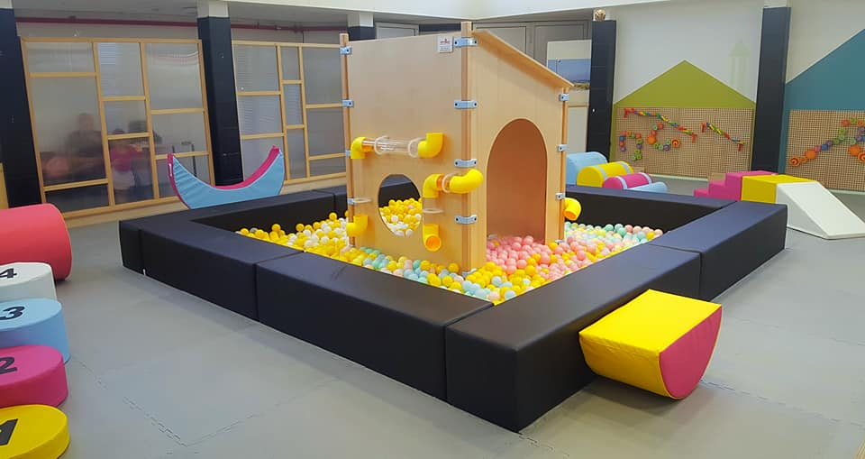

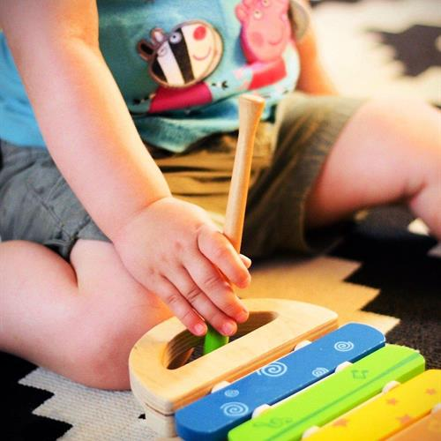




Evaluation of Early Parenthood Domain
Submitted as part of Phase B Urban95 TLV Program Evaluation
May 2022
The Center for Educational Technology, A Public-Benefit Company, 16 Klausner St., Tel Aviv, Tel. 03-6460163 www.cet.ac.il
* Photos are courtesy of the Tel Aviv-Jaffa Municipality website and/or the Rozin Community Center's Facebook page

Slide 2



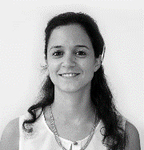
Research Team
Sharon Brand Martin
Researcher & Program Evaluator
Noit Kadosh Maman
Research operations coordinator
Alona Tsirulnikov
Researcher & Program Evaluator
Dr. Tal Mishaan Spiegel
Head of Program Evaluation Unit of CET

Slide 3
Table of Contents
4 | Summary of Activities & Outputs in the Early Parenthood Domain, 2021
5 | Research Layout - Evaluation Actions in the Early Parenthood Domain, 2021
6 | Research Layout- Mapping of Tools and Indicators.........................
7 | Executive Summary.........................................................................
8-16 | SALTA Workshops............................................................................
9 | Demographics........................................................................................
10 | Consumption of Services & Satisfaction....................................................
11-13 | Acquiring Parenting Tools and Experiences...............................................
14 | Community............................................................................................
15 | Marketing & Advertising..........................................................................
16 | Summary – SALTA Workshops.................................................................
17-27 | Indoor Play Areas..........................................................................
18 | Demographics......................................................................................
19-20 | Mapping Characteristics of the Indoor Play Areas....................................
21 | Design of the Indoor Play Areas...........................................................
22-23 | Consumption of Services & Satisfaction..................................................
24 | Community Aspects..............................................................................
25-26 | Professional presence in the indoor play areas: Acquiring and applying parenting tools and skills………………………………………………………………….…
27 | Summary – Indoor Play Areas .............................................................
28-37 | Appendices.....................................................................................

Slide 4
Summary of Activities & Outputs in the Early Parenthood Domain, 2021
During 2021:
Development of solutions during the Covid-19 crisis and Operation ‘Guardian of the Walls’:
One-time online workshops (including activities for children with disabilities), branding and printing of game sets and stickers.
Development of a parent-training program for the ultra-orthodox community.
Training of coordinators and operators in early childhood issues; dedicated training for reading instruction workshops in libraries.
Starting a divisional work model; appointment of early childhood coordinators to lead activities in each municipal division.
SALTA's activities expanded from 14 to 24 community centers throughout the city, thanks, in part, to transition to the divisional work model. In areas with no community center, solutions were offered via the municipal division, with activities in public spaces or other municipal buildings.
In addition to reading instruction workshops, the library department began offering other SALTA activities in several locations throughout the city.
4 indoor play areas were built or renovated throughout the city, in accordance with the Urban95 layout.
Scope of activities in community centers and libraries during 2021
Strengthening the divisional model and the divisional coordinators’ work significantly increased integration of workshops into this year’s activity routine. New centers introduced the SALTA workshops, and residents enjoyed high-quality activities at a subsidized price.
* Based on data provided by the Urban95 team in the Tel Aviv-Jaffa Municipality, Community Administration

Slide 5
Research Layout - Evaluation Actions in the Early Parenthood Domain, 2021
The research, conducted between January 2021 and March 2022, included:*
Surveys – An ongoing formative evaluation:
Survey of participants in SALTA workshops at community centers and library reading instruction workshops (N = 228).
Survey of visitors to indoor play areas (N = 9)
Surveys were distributed via a link shared by the workshop moderator / indoor play area operators.
In-depth evaluation - mapping indoor play areas throughout the city:
Qualitative documentation of events occurring in indoor play area at various times of the day, with an emphasis on parent-child interactions and play characteristics.
13 observations were conducted across city regions, during morning and afternoon operating hours.
During the observations, 51 interviews were conducted with visitors.
Discussion group: a conversation about indoor play areas was conducted with 4 divisional coordinators from all city regions.
Monitoring online discourse: Online discourse data about the indoor play areas was reviewed, based on monitoring and analysis provided by Zencity.
Analysis of data from City Survey 2021
Data from the City Survey conducted in September 2021 were provided by the municipality, including a breakdown by geographical area and among parents of children up to 3 years of age.
* Examples of the outlines of the full research tools are provided in the appendices.

Slide 6
Mapping of Tools and Indicators – What Tool Measures which Indicator*
Indicator*/ Tool | City Survey | In-depth Interviews with various stakeholders | Field Observations With participants | Focus Groups | Activities Feedback Surveys | Caregivers’ Surveys
Service utilization & satisfaction | V | V | V | V | V | V
Availability of all community center services near the home | V | V |  | V |  | V
Satisfaction with operation and staff of community centers |  |  | V | V | V | V
Extent of activities & designated events for caregivers & young children |  | V | V | V | V | V
Acquire and Implement of parental knowledge and tools |  |  | V | V | V | V
Implement of advancing parental practices (joint play) |  |  | V | V | V | V
Strengthen parental perceptions and parent-child relationships |  |  | V | V | V | V
Improved in sense of parental wellbeing and self-efficacy |  |  | V | V | V | V
Community & social belonging | V | V | V | V | V | V
Independent activation model |  | V |  | V
All parental issues will be included under - “Acquiring and Implementation of Knowledge and Tools”.
Some of the tools were implemented as part of the evaluation actions that will be report in periodic reports – Reading Advancing Pilot in Jaffa and Professionals Training Evaluation.
* Evaluation indictors definitions provided at the appendix

Slide 7
Executive Summary
Overall, there was stability in respondents' assessments of their experiences in SALTA workshops this year, compared to last year. The positive assessment was maintained and there was improvement according to some indices.
The workshops seem to meet the criteria established for their development. A series of training sessions* were offered to workshop operators and early childhood coordinators, as part of the process of integrating professional perceptions regarding the content and methods for guiding groups of young children and their caregivers.
Divisional work model:
Continued implementation of public participation practices (Gan HaShnayim in Jaffa*, PlayStreet in Neve Ofer). | Solutions were enriched and adapted for specific populations: the ultra-orthodox community (activities for the Gur Hasidic community), the Arab-speaking community* (reading advancing in Jaffa, PlayCar), and asylum seekers* (PlayStreet). | The solutions improved in terms of the spaces where activities are offered: community centers, libraries, public spaces. | Marketing for community centers’ activities improved; more respondents said they attended activities following advertising by the community center. | Use of community centers for offering SALTA activities grew significantly, with an increase from 14 to 24 community centers across the city now offering SALTA activities. | By implementing recommendations for promoting an independent work model for community centers across the city regions, divisional coordinators were appointed. They plan centers’ activities and services and integrate a professional perspective that considers the needs of young children and their caregivers.
The indoor play areas were identified as a central “anchor” for young children and their caregivers, as part of the community center services. An in-depth assessment of their activities was conducted and resources were channeled towards the development and improvement of indoor play areas’ services. In light of the evaluation’s findings, a pilot program has been planned for integrating a professional facilitator to oversee the ongoing activities in a selected indoor play area.
* Reports on the evaluations of the PlayCar and PlayStreet projects and the intervention in Gan HaShnayim are given in the Urban Space and Mobility Domain Evaluation Report.
Reports on the evaluation of the professional training program and the reading advancing project in Jaffa will be submitted as periodical reports.

Slide 8
SALTA Workshops

Slide 9

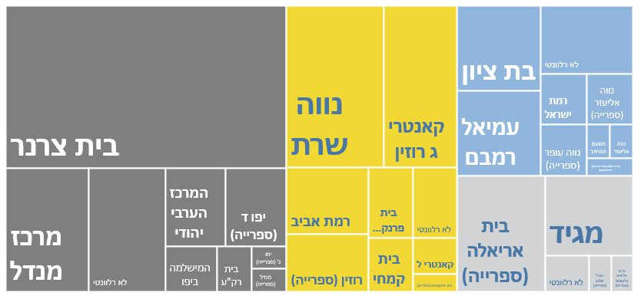
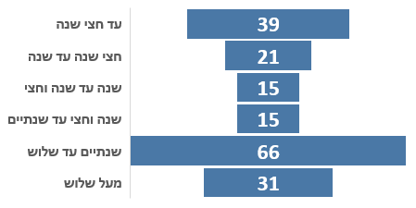
Demographics – SALTA Workshops 2021
Study population includes:
228 participants* who responded to the survey
Mostly parents aged 30-40; 90% were women; 94% came to the activities with one child
*Not including respondents to the City Survey
26
Ages of children in workshops
Types of workshops
Held in community centers/libraries:
N=228
The category “not” refers to activities in public spaces / unknown location
* The area “South” includes the neighborhoods east of the city
** Neighborhoods beyond the Yarkon

Slide 10
Consumption of Services & Satisfaction
There was a high level of satisfaction (84%) among SALTA workshop participants in all regions. 88% said they would very strongly recommend the workshop to their friends.
There was very high satisfaction (93%) with the convenience of the registration process and the relationship with the organizing entity.
The workshops* were assessed as clearly understandable and well-organized (90%) - an improvement of about 10% over last year.
Moderators were assessed as professional and skilled (93%).
82% participated in activities in the area where they live (N = 50). Among the other 18%: residents of the South also participated in activities in Jaffa, residents of the North also participated in activities in the Centre, and residents of the Centre also participated in activities throughout the city.
While Jaffa residents only participated in activities in Jaffa, the Jaffa community centers provided solutions also for residents of the South and Centre.
About half the participants in reading workshops in libraries said they did not know, before the workshop, that library services were accessible to residents free of charge.
The City Survey* data indicate parents of children up to age 3 were highly satisfied with:
Living in the city and their neighborhood
Municipality functioning, and their degree of trust in the municipality
Municipality services and attention to residents:
sensitivity to public opinions, problem solving, and accessibility of services
Additionally, they reported:
A high level of demand for welfare services
Cost of living is an issue that particularly preoccupies and disturbs them
* Survey data were provided by the Tel Aviv-Jaffa Municipality
* Additional details about the workshops are provided in the appendices

Slide 11
Acquiring Parenting Tools and Experiences
N=114
N=184
N=162
N=210
N=140
N=140
N=150
N=127
Participants’ assessments of the quality of the immediate experience were particularly high in terms of: enjoyment, positive interaction, encouraging creativity.
The assessments were moderate regarding acquisition of tools, ability to apply them outside the framework of the workshop, and feelings about parental self-efficacy.
In response to an open-ended question inviting additional comments (N=75):
About 40% said they benefited from participating in the workshop, and felt it made an enriching contribution.
About a quarter made suggestions to maximize the workshops’ benefit: adding meetings to deepen the processes addressed, holding in-depth discussions for reflection on the workshop experiences, and expanding the range of topics of the workshops.
About 10% reported that participating in the workshop strengthened their confidence as parents, provided an enabling, therapeutic and inclusive space, and taught them new content.

Slide 12
Acquiring Parenting Tools and Experiences
To what extent did the workshop provide you with new and applicable knowledge and / or tools for future use with your child?
To what extent do you feel that the workshop contributed to positive interactions between you and your child?
Data segmented according to
ages of
workshop participants’ children
Over 3
2-3 years
1.5 – 2 years
1-1.5 years
6 months– 1 year
Less than 6 months
N=31
N=65
N=64
N=15
N=15
N=13
N=21
N=39
The younger the children, the more likely parents were to say they acquired new and applicable tools for future use with their children
The workshop's contribution to positive interaction with children was higher among parents of children from birth through 6 months (97%) or those over 2 years old (86%)

Slide 13
Acquiring Parenting Tools and Experiences
Major issues raised regarding the workshop’s contribution (open question N = 92):
Acquiring knowledge and expanding perspectives on parenting and education | 24% | Respondents said the workshop exposed them to new content and concepts. Many said the content "opened their minds" about issues related to education and parenting, and they would follow up on these after the workshop’s completion (e.g., the parenting workshop for the Gur Hasidic community). Additionally, 11% of respondents emphasized that they acquired tools for educating and raising children. 10% felt they benefited from learning to recognize their child’s point of view and better understand the child’s experience and interests.
A safe space for emotional support | 18% | Reported that the workshop provided them with a supportive space during various times of need (maternity leave, early parenting, and the Covid-19 crisis). They noted that the meetings summoned emotional exposure, attention and support, as well as space for introspection (this response was particularly common among participants in the Meditation with Infants workshops).
Children's enjoyment, physical exercise and the indoor play areas | 15% | Respondents said their children's enjoyment of the workshop activity was its primary contribution. They noted the benefit of providing enjoyable physical activity that strengthens the body, and encouraging their children to learn in ways that incorporate play (e.g., ContactKids).
Creative experiences and ideas for implementation | 13% | Said they primarily benefited from the creative components incorporated in the workshops, such as developing the imagination and senses, ideas for play to be done at home, experimenting with new games and encouraging playful thinking.
Strengthening the relationship with the children, quality time | 12% | Said that for them, the main contribution of the workshop was strengthening the bond with their children and sharing quality time with them.
Meeting with other parents | 7% | Said meeting other parents undergoing similar experiences was the most significant contribution of the workshop
Tools acquired by respondents in the workshops (open question N = 36):
Tools for internal, emotional contemplation, strengthening confidence as parents.
Tools for better understanding children's world, listening to and responding to their needs.
Tools for strengthening the body, combining physical fitness and play, correct use of the body and muscles.
Creating and adapting ideas for joint play and games at home (i.e.: ContactKids, Playing Together).
Tools for deepening the emotional connection with their children, including physical closeness and contact, and creating a positive atmosphere among household members.
Tools for setting boundaries and expressing authority towards children, for example: a parenting workshop for the Gur Hasidic community).

Slide 14
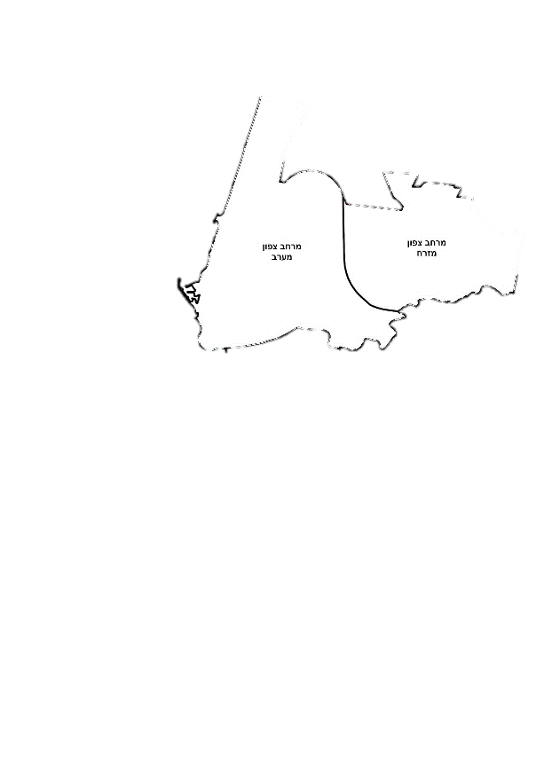
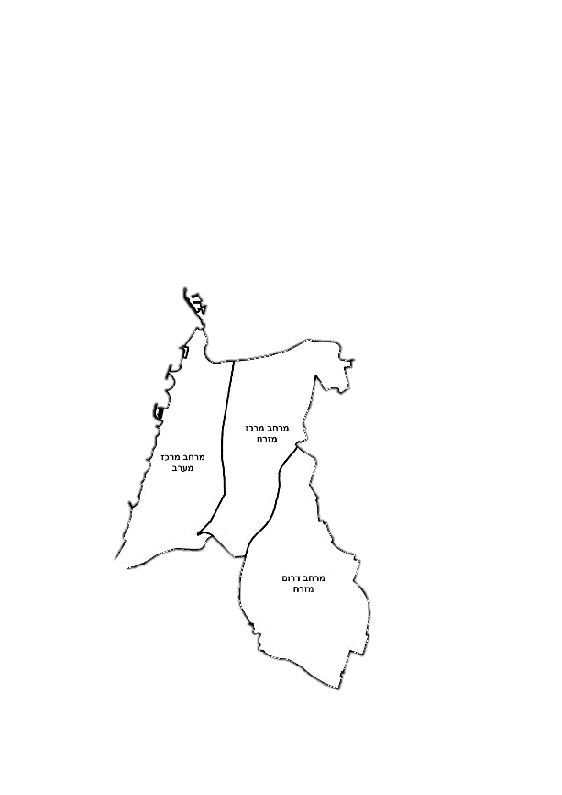
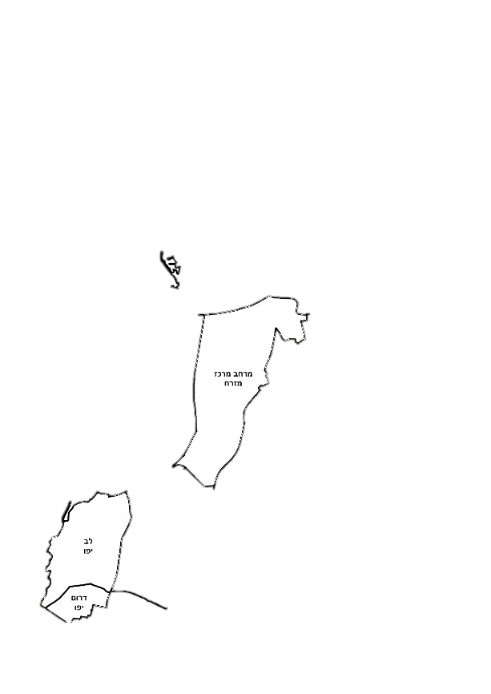
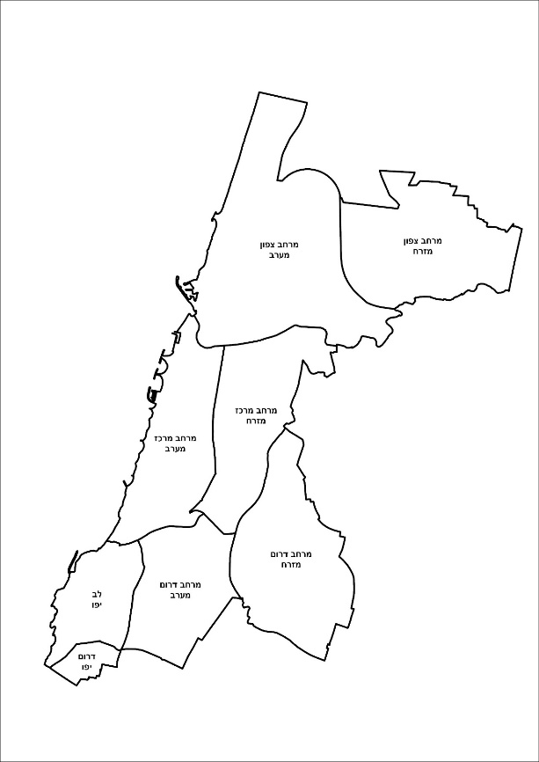

Sense of Community & Social Belonging
Did you meet and/or make connections with new parents / families in the neighborhood as a result of the workshop?
About half (45%) of the workshop respondents said they formed new relationships with other participants in the area where they live.
Parents of infants up to six months old were most likely to report forming new relationships.
Activities for infants and their caregivers enable greater interaction among parents. As observed in previous assessments, parents with infants are more likely to interact and say they are seeking emotional and social support.
Residents of Jaffa and the Southern and Eastern neighborhoods displayed a greater tendency towards community interaction and were more likely to say they made social connections as a result of the workshops.
No relationship was observed between the tendency to make social connections and respondents’ employment status.
34%
N=41
17%
N=23
67%
N=27
51%
N=87
City Survey data* show that parents of children up to 3 years old report strongly positive feelings on:
Personal safety in their neighborhood
Sense of community and belonging among neighborhood residents
Ability to influence community issues, willingness to initiate and act to promote them
Extensive participation in public processes
Other notable results:
Ambivalence about moving
Preference to remain in their neighborhood/area
Main reason for moving: education
* Survey data were provided by the Tel Aviv-Jaffa Municipality

Slide 15
Publicity & Advertising
Respondents said that community centers were the primary source through which they learned about the workshops (27%), especially in Jaffa and the South.
About a quarter (24%) said word-of-mouth information from friends motivated them to come to the activity, especially those from Jaffa and the North.
Publicity about the workshops through DigiTaf (20%) was the most significant factor affecting participants' attendance in the Central region.
Publicity through neighborhood WhatsApp groups (20%) was important, especially among participants from Jaffa and the South.
An activity designed for the ultra-orthodox (Gur Hasidic) community in the Northern region was publicized mainly through educational settings (Talmud Torah for boys and a religious school for girls), and in residential buildings.
Gur Hasidic Community
How did you hear about the workshop / activity? (You can mark more than one answer)
16%
19%
23%
31%
62%
27%
13%
26%
37%
26%
16%
37%

Slide 16
Summary – SALTA Workshops
The workshops met respondents’ expectations to a large extent; this was true for all areas of the city. A high percentage said they would recommend the workshops to their friends.
Respondents said they were satisfied with the organizational aspects of the workshops and assessed the guidance as professional and high-quality. They said participation in workshops was beneficial and enjoyable, especially in the immediate moment, and contributed to positive interaction with their children.
Workshop participants said they acquired applicable tools and new ideas for playing with their children, and strengthened their parental self-efficacy.
  Some respondents suggested making the workshops longer and incorporating discussions to process the experience.
  Parents of young infants were more likely to say that they learned from the workshops and acquired applicable tools.
About half of the respondents said they made new social connections as a result of participation in the workshops. This was more common among parents of infants up to the age of six months, and those from the Jaffa region and the Southern neighborhoods..
The strong sense of community in the Southern region and in Jaffa was reflected in the advertising and publicity channels that motivated their participation in activities: advertising through community centers and neighborhood WhatsApp groups. Respondents from the Jaffa region and the North were especially likely to say that friends’ recommendations encouraged them to participate in the workshops.
* Survey data were provided by the Tel Aviv-Jaffa Municipality

Slide 17
Indoor Play Areas

Slide 18
Demographics – Indoor Play Areas
13
were conducted in August-October 2021 at indoor play areas throughout the city
During the observations, about 100 people visited the indoor play areas, mostly mothers, who accompanied about 120 children from birth to 6 years (according to the age restrictions in each indoor play area).
As part of the observations, interviews were conducted with 51 visitors, mostly mothers -- 13 interviewees were men
A higher number of grandmothers and grandfathers were observed in indoor play areas in the North
About 70% of respondents were residents of the neighborhood where the indoor play area is located; most arrive by foot
observations
North | Country Lamed Rozin
Centre | MESILA Development Center Bavli
South | Urim Neve Eliezer
Jaffa | Bnei Brit Beit Raka
afternoon
morning
afternoon
morning
afternoon
morning
afternoon
morning
afternoon
morning
afternoon
afternoon
afternoon
*The Southern region includes the neighborhoods east of the city
**Neighborhoods beyond the Yarkon

Slide 19
Mapping the Characteristics of Indoor Play Areas
Centre
Space for guided developmental activities | Includes structured activities and a professional who is constantly available, active and accessible to provide general advice and on-site guidance
Indoor play area with hourly professional guidance | Includes structured activities and guidance on various topics on an hourly basis
Indoor play area with an unstructured professional presence | A professional is available to provide general advice and responses to spontaneous events, as needed
Gymboree | Open for free play with basic supervision
South
Jaffa
North
Centre
Centre
South
Jaffa
North
Centre
* In some situations the indoor play area is used as a Gymboree at certain times, and for guided activities at other times.
Target audience:
Parents, grandparents, caregivers
Parents are more frequent consumers of structured guidance services than are caregivers
Mothers with young infants usually attend workshops dedicated to post-birth topics, offered outside the play area
Type of professional intervention:
On-site: encouraging and guiding joint play, mediation of situations arising in the play area
General - counseling on challenges in education and parenting, emotional support, information about child development, sleep issues, weaning, etc.
Characteristics of the Space
Designated operating hours
Pay: full, symbolic, or free
Pre-registration or open to the public
Regular groups or free participation
Designated for certain age groups

Slide 20
Mapping the Characteristics of the Indoor Play Areas
In general, “indoor play area” refers to a space that includes professional guidance, and a “Gymboree” is a space for unguided free play. The main solutions offered by each type of space are: (the degree and quality may vary)
Indoor play area
Cognitive development – games encouraging thinking and imagination, mental challenges, fine motor skills
Strengthening parent-child bond, joint play
Social skills, social play
Free and independent play, physical exercise, gross motor skills
Parental well-being - support, socialization, and rejuvenation | > Support > Rejuvenation
Gymboree
Indoor play area
Gymboree
Indoor play area
Gymboree
Gymboree
Indoor play area
Indoor play area
Gymboree
The degree and quality of solutions that each space provides are affected by a number of key factors:
Quality of professional guidance
In the absence of professional guidance, parents’ skills and availability to independently guide the experience are important
Children’s basic skills and developmental stage
Quality of the facilities and suitability for the desired solution
Parents from high socioeconomic backgrounds are more likely to interact with their children and guide them in mentally stimulating games. Parents from disadvantaged populations are more likely to seek solutions that offer their children an opportunity for free and independent play and an outlet for their energy. This may relate to parents’ level of awareness of their children's developmental needs and the importance of guidance and joint play, and their physical and emotional availability to be involved in joint play.

Slide 21
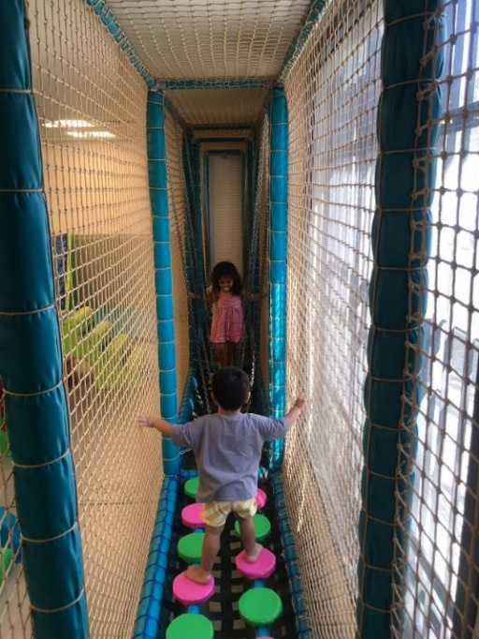
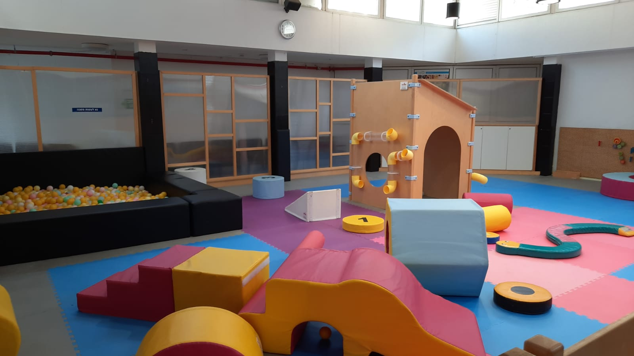
Design of the Indoor Play Area Space
For most categories, the average in the Centre and South is higher than the general average.
The observed indoor play areas offer a space and facilities for physical exercise and for developing and practicing gross and fine motor skills and eye-hand coordination.
The equipment and facilities encourage imaginative play and a creative and symbolic experience.
There is a moderate level of variety in the textures of equipment in the observed play areas. Most spaces have fixtures and equipment made of plastic or wood or covered with soft nylon upholstery.
A moderate amount of interactive game accessories were observed in the play areas. Most games were stored on shelves or in storage containers, so visitors (and observers) could not always see everything that is available.
Most indoor play areas have spaces for reading to groups, but few books were available.
As part of the Urban95 program in the Tel Aviv-Jaffa Municipality, guidelines for indoor play areas for young children are being developed. The plan details the program’s perspective and key values related to activities for young children, principles and specifications for planning and design, and more. Based on this document, a section in the observation indicator was developed to assess the suitability of the physical space:
Average score | Extent to which the space provides a solution:
6.3 | Movement
5.6 | Fine motor skills
4.5 | Symbolic
3.8 | Senses
3.5 | Interactive
2.8 | Literacy
Right: Rozin indoor play area designed in accordance with the Urban95 layout, Northern region Left: Beit Raka indoor play area, Jaffa region
* Scores range from 1 and 7 (1 = not at all, and 7 = very much)

Slide 22
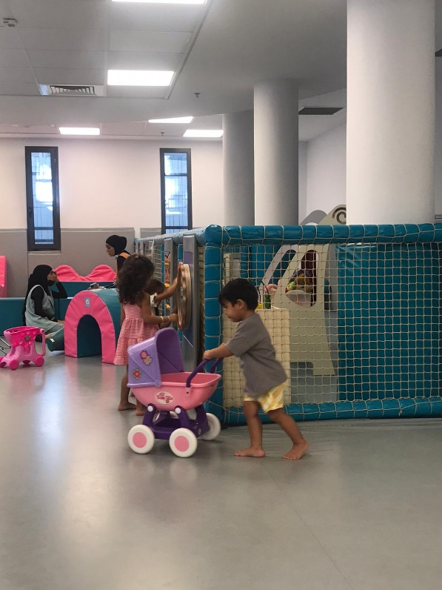
Consumption of Services & Satisfaction
The community center complex is designed to provide a solution for all sectors of the neighborhood population. Within this, the indoor play area is a major “anchor” for young children
A conversation with the branch coordinators revealed the need to establish and strengthen the indoor play area’s importance, by allocating appropriate resources to improve its accessibility:
At the level of spatial-visual appeal and utility – the space should be designed for a pleasant stay, with customized furniture, a coffee corner, and a home-like atmosphere.
This should be combined with a dedicated and appropriate staff (more on this is included in the discussion on professional guidance.)
In the photo: Beit Raka Playhouse, Jaffa region
Main barriers to accessing indoor play area services, and possible solutions:
Divide the space by age
Parallel activities and classes
Multi-age | Families with multiple siblings of different ages cannot receive a full solution given the age limits at indoor play areas
Noise and overcrowding | There is a tendency to avoid spending time in crowded indoor spaces, especially during the Covid-19 pandemic.
Attractiveness of appearance | Wear and tear of equipment gives a feeling of neglect and poor quality
Pre-registration
Extend operating hours
Limit number of attendees
Variety and replacement of equipment
Maintain cleanliness
Frequent maintenance

Slide 23
Consumption of Services & Satisfaction
Jaffa
יפו
Observations and supervisors’ reports indicate that an ethnically and socio-economically diverse population uses the indoor play areas in Jaffa. Cultural differences are reflected in their styles of interaction and play. A regular community of visitors was observed at the Bnei Brit indoor play area.
Interviewees at Beit Raka gave positive assessments to the space for free play, and the “ball pit.” They suggested some improvements:
Extend the operating hours
Add guided sessions and developmental counseling services
Make the space suitable for a wider age range by adding facilities and games for older siblings.
Interviewees and supervisors at Bnei Brit suggested a need for innovation and updating the play facilities and games due to the returning community of visitors. Nevertheless, the children were seen enjoying and playing creatively with what is currently available.
דרום
Updates publicized through various channels reach a relatively limited regular population, with little potential for reaching a new audience.
Some visitors said they had difficulty finding information and learned about indoor play areas by chance or after extensive searching, sometimes via advertising through DigiTaf.
Indoor play areas should be publicized through more varied channels, including visible updates in and around the community center complex.
Visitors appreciate the indoor play areas and said the spaces are well maintained, but some were bothered that they did not know if and when the spaces and equipment had been disinfected.
South
Visitors' feedback (N = 9) indicated that most from the Northern region were satisfied with the operating hours, physical conditions in the indoor play area and responses they received from the staff on operational and general issues. Everyone said they would continue to visit the indoor play area and recommend it to their friends.
The observations found that some visitors were concerned about the cleanliness of the indoor play area and equipment, and wanted details about frequency of cleaning and maintenance. Relevant information on this issue should be provided to visitors.
Centre
In the Central region, observations were conducted at two indoor play areas differing in nature and purpose: one functions like a Gymboree, with only operational supervision, and one offers developmental guidance.
The indoor play area in the Bavli Community Center is a place for neighborhood gatherings. Regular visitors and the presence of many caregivers (in the mornings) reinforce the feeling that it fulfills the function of a useful meeting place for the community, which is central, accessible, indoors, and air-conditioned.
Visitors do not seem to have high expectations for the visit’s terms or services offered.
In contrast, the development center at Mesila is perceived as an exclusive destination for planned visits where children and caregivers will have a full and high-quality experience. There are fewer visitors. The price is perceived as high (although there are regular visitors). Visitors expect a meticulously planned experience and optimal conditions.
Satisfaction is high. Mesila clearly offers high-quality conditions for children. However, its exclusivity affects the community experience and accessibility. It brings together a very specific community of visitors.
North
צפון
Visitors are highly satisfied with the indoor play areas and perceive the sites as pleasant and well-maintained.
There is a lack of information about the frequency of maintenance and cleaning.

Slide 24
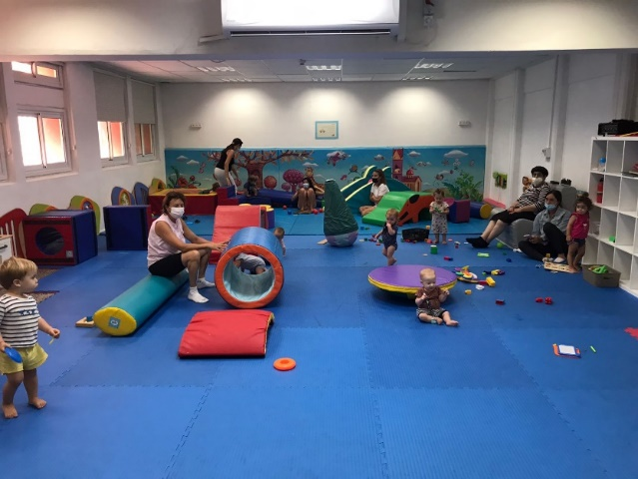
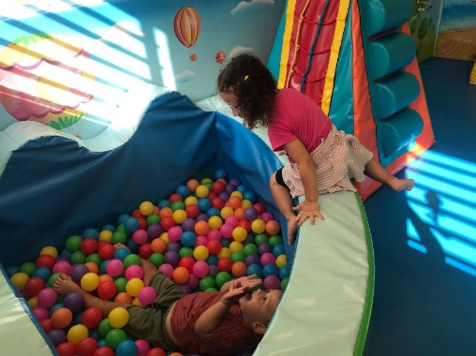
Community-related Aspects
Monitoring Discussion about indoor play areas via Zencity:
About 130 posts were monitored. The vast majority were published by official entities (community center and municipality websites, DigiTaf, etc.)
Most posts dealt with general advertising of municipal services, including indoor play area services.
There were about 900 reactions to the posts, about a third of which were positive and most of the rest were neutral.*
* There were a few negative responses regarding difficulties in utilizing benefits from DigiTaf, orientation to the municipality's website, and requests to have activities in outdoor spaces or via Zoom due to concerns about Covid-19
צפון
Morning hours:
Quiet, plenty of space, not crowded.
Limited group compositions (caregivers/child), activities designed for pairs.
More opportunities for joint play between caregivers and children.
High attendance of seniors (grandparents) was observed. They are less interested in community connections, but can benefit from activities for children that integrate them in an appropriate way.
Afternoon hours:
Busy, many visitors.
Groups of caregivers with multiple children of varying ages
The community aspect is more pronounced – it was observed that caregivers (mostly parents) allowed children to play independently or with friends. Some visitors were already acquainted, had friendly conversations, and some arrived together.
Activities at the community center made visitors aware of the indoor play area services.
North
יפו
According to the supervisors, parents who don’t know each other interact as a result of their children playing together. The interviewed visitors did not say that making community connections was a motivation for coming, although some said it is important to them that their children meet and have encounters with other children.
WhatsApp groups are a significant means of transmitting community-related information. Visitors from the Arab community said they rely on updates from their community WhatsApp group. They said they usually participate in workshops and activities in the open free-play space.
Jaffa
South
דרום
Most caregivers who came with multiple children or with older toddlers enjoyed the social gathering in the indoor play area and were pleased that their children had opportunities to interact, but said that forming community relationships did not motivate them to come.
There is a notable correlation between children’s age and caregivers’ community-related motives for coming: mothers who bring young infants to the indoor play area are more likely to say they have community-related motives for coming, and that they are seeking conversation and sharing with other adults.
It was observed that the presence of a professional supervisor (parent facilitator, counselor) contributes to community connections and promotes communication. By being accessible and actively responsive to what is happening, their presence naturally creates connections and openness between visitors.
Right: Bnei Brit Playground, Jaffa region
Left: Bavli Playground, Central region

Slide 25
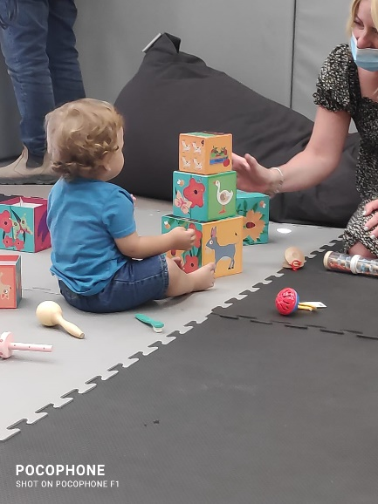
Professional Presence at Indoor Play Areas – Acquiring and Applying Parenting Tools and Skills
The presence of professional staff with knowledge about working with young children:
Contributes to visitors' sense that the play area offers added value, and makes the experience more meaningful and focused on education with a child development perspective.
Contributes to community connections and promotes communication. By being accessible, active and responsive to events, their presence naturally creates connections and openness among visitors.
Contributes to community organization and maintaining inter-personal relationships, by providing updates and ongoing communication with visitors.
However, absence of a professional presence is not always perceived as a lack. Visitors whose children regularly spend time in independent play at the indoor play area do not necessarily want professional guidance services. Some caregivers are unaware that having professional guidance at the community center complex is an option. Their perception of indoor play area services is focused on the physical space (Gymboree format)
Photo: Urim indoor play area, Southern region
Jaffa
דרום
The presence of a professional early childhood counselor contributes to a supportive experience. The mothers talk to her openly and she inspires confidence.
The counselor interacts with the children and adjusts the space and equipment to their needs, ages, and the number of participants.
At one indoor play area without professional guidance, visitors expressed a desire for it, and said they prefer places that do offer this service.
מרכז
Visitors to the Gymboree-format play area (at Bavli) do not perceive it as a place that includes professional guidance. They are satisfied with the basic equipment and facilities.
This community is not unaware or uncritical. Rather, their expectations are adapted to the existing services. Improving conditions (equipment, content, and consulting services) could improve consumer satisfaction and offer them greater benefit.
צפון
In the observed indoor play area, staff members’ addressed only operational aspects. Their role does not include professional guidance in the field of early childhood. However, senior moderators seem motivated and actively involved, and visitors are aware that their presence makes a contribution.
יפו
Staff members lack formal training and professional experience. One senior moderator is an experienced mother, with a pleasant, child-friendly attitude and a confident approach with parents. Another moderator is a young woman with experience in supervising and playing with children.
They said that visitors expect them to interact with the children and assist in supervising their activities. The moderator sometimes experience difficulties due to language barriers, especially with parents who are somewhat reluctant to communicate. Cultural and language differences affect her feelings of legitimacy in expressing opinions to parents aside from offering operational assistance. At the same time, it was observed that she acts with sensitivity and patience and helps visitors feel comfortable. She said that she sometimes lets children borrow games to take home, which contributes to their sense of belonging and connection to the place.
South
Centre
North

Slide 26
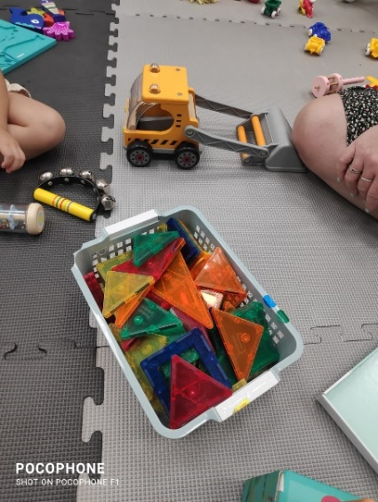
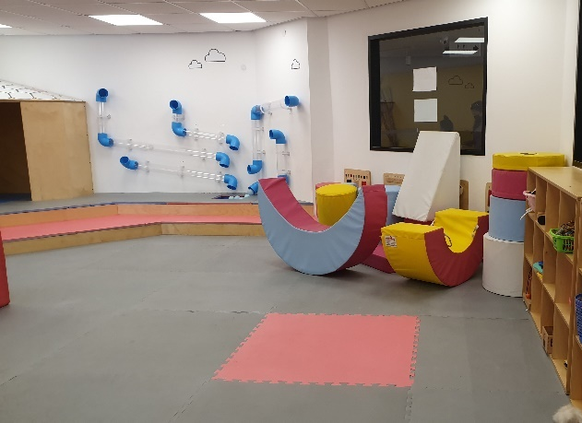
Professional Presence at Indoor Play Areas – Acquiring and Applying Parenting Tools and Skills
Optimally, there is doubtless a need for knowledgeable, trained professionals in indoor play areas. They should have skills to convene and include visitors, and to support and guide the child-caregiver experience. Preferably, this role should be exclusively dedicated to the field of young children and their caregivers.
Barriers to recruitment:
Limited hours
Low pay
Possible solutions:
Train current indoor play area operators: strengthen operators’ inherent qualities, and provide them with tools they can apply when interacting with children and parents, so they can be more significantly involved in activities and their presence will contribute to visitors' experience.
Recruit professionals at the beginning of their careers: offer internships for students in the fields of parent training and early childhood. Because the economic terms are poor, it is necessary to offer other value remuneration that will attract recruits to the role.
Within a limited time frame, offer professionals the option of doing regional / divisional rounds of facilitation sessions, along with others who have basic knowledge and a perspective appropriate to the framework. In this way visitors will see the possibility of receiving professional support in the complex they are familiar with.
Based on feedback from visitors, who mostly come from the Northern region (N = 9), spending time in the indoor play area is fun and helps them make a connection with their children to a great extent. Recreational time in indoor play areas enables acquisition of parenting knowledge and tools. Visitors said they were moderately willing to consult with the available staff members on parenting issues.
Above: Urim indoor play area, Southern region
Below: Neve Eliezer indoor play area designed in accordance with the Urban95 layout, Southern region

Slide 27
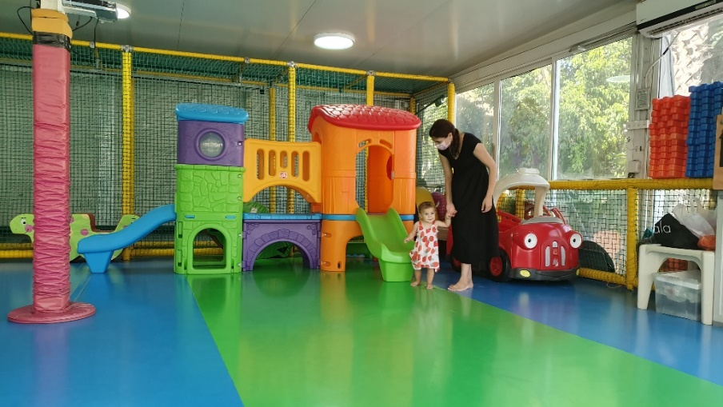
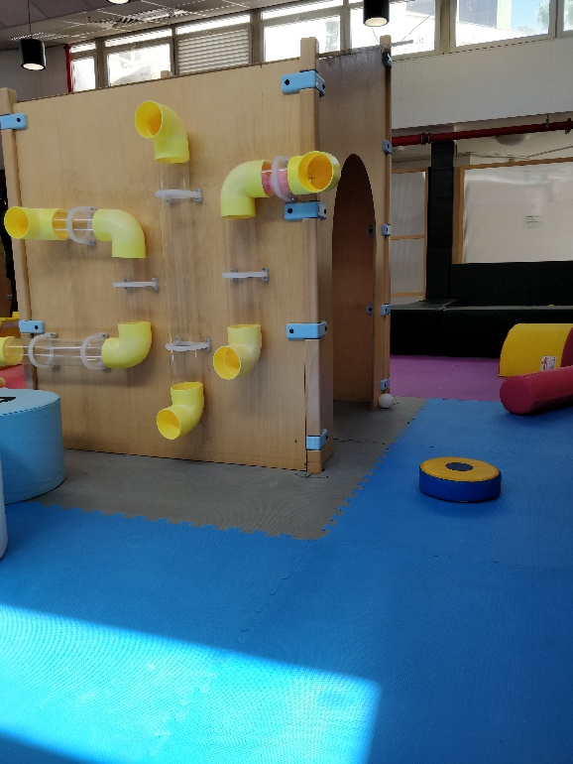
Summary -- Indoor Play Areas
Indoor play areas offer varied solutions to visitors. It is important to preserve this variety and choice for visitors interested in a place that offers active guidance or as well as those who want free play.
Professionals should act sensitively towards consumers and allow free play space for those who are interested in this option.
Since providing regular professional presence at each site is not possible, it is important that the community is aware of the options available at given times, so they can make an informed and conscious choice regarding the various available services.
Current staff members should be trained so they can direct and invest their efforts in appropriate and beneficial interactions with young children and their caregivers.
It is possible and recommended to offer a combination of activities at community center indoor play areas, in order to vary the routine and provide the community with the best possible options.
An optimal combination of guided activities in various areas of the indoor play area can be adjusted to visitors’ characteristics and the level of use (crowdedness) at different times.
Indoor play area offering guided activities should use the existing facilities and equipment in a way that provides visitors with creative ideas that can be implemented during independent (unguided) visits.
Conditions in indoor play areas should be inviting and pleasant for caregivers during children’s guided activities or free play. This will help create a sense of community connection and belonging to the place.
Above: Country Lamed, Northern region
Below: Rozin indoor play area, designed in accordance with the Urban95 layout, Northern region

Slide 28
Appendices

Slide 29
SALTA Workshops – Workshop Organization and Professional Guidance
The workshops were rated as well-structured and organized (90%). Moderators were rated as professional and skilled (93%).
In response to open-ended questions on the workshops’ contribution, many participants said the guided experience was highly positive. They praised the moderators and described them as: professional, skilled, inclusive, thorough, and creative.
סדנת קריאה
מדיטציה עם תינוקות / יעל
סדנת הורות (חסידות גור)
אלעד ואורי מציירים את הצלילים / אודי רז ואלעד רוזן
קישקושולוגיה לקטנטנים / נועה זמיר, איה שטייגמן ואלמוג קידרון
לשחק ביחד / מיכל בורג גפן
קונטקידס / ליעד
משחקי דימיון/ אנה
קרנבל החושים / לימור דוידי
צלילי עולם/ אביה
סדנת משחק יצירתי בחומרים מהטבע / מיכל אבולעפיה
תקשורת רגשית בתנועה "האם וילדה" / מנאל
סדנת יצירה/ לן בוכמן
מדיטציה לנשים בהריון / יעל
סדנת בישול לגיל הרך / מייסר
משחקי תנועה להורים וילדים / איריס מלכא
הורות The Basic / נועה
אמנויות לקטנטנים
לדבר בשפה משותפת / הילה
הורים כותבים / דנית גולד
צלילים למתחילים / קרן
משחקוטו - אוטו של משחקים
מיינדפולנס / דניאלה
יחד הורים וילדים / נאדרה
This response was particularly notable for the workshops:
Meditation with Babies/ Yael; World Sounds /Aviya, and Drawing with Sounds / Udi Raz and Elad Rosen.
Two respondents gave negative ratings to the guiding: one said the moderators were not patient enough with the children; the other said the moderator was too busy with the phone, selecting the songs for the workshop.
Other remarks by individual respondents:
  It would be preferable to make groups with narrower age ranges, for more appropriate content matching.
  For workshops that took place in the open public space, there were complaints about the weather conditions, and distractions from the nearby playground.
  For some, the content of the workshop was overly simplistic and basic.
  For events requiring pre-registration, clarified whether tickets are needed for both caregiver and child.
Participants said that the reading instruction workshops exposed them to the importance and value of reading books to their children, that they received practical tools for implementation, and gained confidence and motivation to read to their children.
To what extent did you feel that the moderators were professional and skilled?
N=213
To what extent did you feel the workshop was organized and structured?
N = 190

Slide 30
Logic Model for Early Parenthood
Long Term Results (5-10 Years) | Mid-Term results (3-5 Years) | Short Term results (End of Phase II) | Outputs* | Actions
All range of services in SALTA community centers, are perceived as providers of professional and qualified assistance and consulting early childhood development Improvement in parental behaviors, sense of parental self-efficacy and wellbeing (including, but not limited to, sense of community, reduction in loneliness) Increase in amount and variety of community and public events focused on caregivers and their children | Services offered to caregivers near their home throughout the city (in each neighborhood: community center services, well-baby clinic, pregnancy and birth communities): - Provide comprehensive, accessible and suitable service to the local community - Services consumption by caregivers and their children -Establishment of parental groups and a sense of connectedness to the community Strengthen parental self-efficacy, and establish best parental practices: Reading stories and joint play in the home and in public spaces Establishment of independent activation model in all SALTA community centers | # of caregivers satisfied with affordability & accessibility of services (near their homes) # of caregivers satisfied with availability, frequency and quality of SALTA services, including staff attitude # of caregivers implementing knowledge and tools acquired through SALTA workshops and services, strengthening parent-child relation and parental self-efficacy Caregivers meet neighbors and establish new relations thanks to SALTA workshops Implementation of independent activation models in primary SALTA community centers | # of caregivers all around the city, and specifically in southern neighborhoods, who are aware and familiar with the various SALTA services # of caregivers and their children who use SALTA services (Workshops, indoor play areas, community well-baby clinics) # of caregivers and their children who participate in workshops, acquiring knowledge and tools # of participants satisfied with services # of new SALTA centers, specifically in southern neighborhoods & Jaffa | Range of high-quality content & accessible services near homes to prompt parental knowledge, awareness and best practices development enabling better early childhood development: - Para-medical activities - Leisure and enrichment activities - Workshops for strengthening parent-child relations and building a ‘parental community’ in the neighborhood - Tailoring services and content for specific needs of vulnerable populations Training professionals to provide qualified service for early childhood (Designated coordinator in community center, instructors and operators) Opening of SALTA community centers all around the city, including fitted content and services (specifically in southern neighborhoods and Jaffa, for asylums, Arabic speakers) Built an independent activation models for SALTA community centers, allowing operation without the support of Urban95 program
*Collection and measurement of output evaluations is carried out on an ongoing basis by the Urban95 staff of the Tel Aviv - Jaffa municipality

Slide 31
Evaluation Indicators - Early Parenthood
Short Term Evaluation Indicators:
- Satisfaction with services (geographically and financially) - Extent of parents or primary caregivers:
Who have used and felt satisfied with a service in the past 30 days, recommending it to others.
Who have expressed satisfaction from the geographical distance of the service from their home.
Who have expressed satisfaction from the cost of the acquired services.
- Satisfaction with services availability, frequency and quality - Extent of parents or primary caregivers:
Highly satisfied from staff: Knowledge, expertise, accessibility and attitude towards participants.
Highly satisfied from services: Variety and quality of content and schedule flexibility.
- Parental knowledge and tools, strengthening parent-child relationship and parental self-efficacy - Extent of parents or primary caregivers, who reported an intent and/or execution of activities and use of tools acquired during the SALTA workshops, regarding their children’s care.
- New social ties - Extent of parents or primary caregivers, who reported meeting new people following their participation in activities and through consumption of services offered by community centers.
- Implementation of independent activation model - Primary community centers independently operate all SALTA workshops, activities and services, without Urban95 program’s assistance.
Mid-Term Evaluation Indicators:
- All services for young children provided near the homes, all around the city (in each neighborhood: community center, well-baby clinic, pregnancy and birth community) – Number of parents or primary caregivers, living near community centers which provide full scope of services (Para-medical content, leisure and enrichment, parental workshops, indoor play areas and well-baby clinic), in an affordable price.
- The range of content & activities provide comprehensive, accessible and tailored service to neighborhood residents’ needs - Number of parents or primary caregivers of young children, who have used the services and reported general satisfaction, specifically in vulnerable neighborhoods.
- Establishment of local community - Extent to which parents or primary caregivers of young child, reported an increase in social support and sense of community, following their participation in activities and consumption of services within their neighborhood community center.
- Strengthen Parental self-efficacy and best parental practices - Parents or primary caregivers report:
Stronger parental self-efficacy regarding caring for their children & quality of parent-child relationship.
Increase in frequency of verbal communication with their children, storytelling and joint reading.
Spending more time with their children and frequency of joint play (in public spaces, community centers, homes).
- Establishing Independent activation model (all centers) – community centers independently operate of all SALTA activities and services, without Urban95 program’s assistance.

Slide 32
Observation Indicator for Indoor Play Areas Combined with Visitor Interviews
Project Urban95 – Observation Indicator for Indoor Play Areas
Location of indoor play area | Date and Time of Observation | Observer:
General Instructions::
Total duration of observation - two and a half hours.
In accordance with the observation indicator, observe the conduct of moderators / operators / supervisors; adults’ behavior and interactions among themselves and with the children. Document your impressions according to the various criteria.
Document with photographs the event area and participants.
During the observation, initiate short conversations (interviews) with 5 accompanying parents / family members / other adults, according to the last page of the indicator.
Initiate conversations (interviews) with the operating staff members:
  What is your role? What is your professional background?
  How do you perceive your role in the framework of the indoor play area?
  Do you feel you received training that gave you the necessary tools to perform this role? Within what framework? (Training from Urban95/ training with the community center/ prior training / received no training)
  Can you describe the population that comes to the indoor play area?
  What do you think the parents/caregivers expect or are interested in receiving when they come to the indoor play area?
  With what do you think visitors are most satisfied, during their visit?
  What can be improved? (In terms of management and operation / design / equipment/ marketing, etc.)
  In addition to their impressions regarding the current day’s activity, staff members can share their impressions from their ongoing routine at the indoor play area (including before the Covid-19 period)
  Thank you and good luck
  Urban95 Team, CET

Slide 33
Observation Indicator for indoor play areas Combined with Visitor Interviews
Criteria for Observations | Data from observations of activities (conduct of operators, description of behavior of children and adults)
Demographics Estimated number of adults and children Estimated percentage by age and gender Estimated percentage by group composition | Number of adults present at activity/peak time _________________ Women___ Men___ Relationship: Parent___ Grandparent___ Caregiver___ Older sibling___ Other___ | Number of children present at activity/peak time ___________ Girls ____ Boys ___ Age: 0-3 ____ 3-6 ____ 6+ ____
 | Group composition: 1 Adult with 1 child:___ with 2 children___ with 3+ children___ Couple with 1 child ___ with 2 children___ with 3+ children___ Group (number of adults & children):________
Estimated length of stay | Length of stay: Up to half an hour: minority/about half/majority half hour - hour: majority/about half/minority 1 hour – 2 hours majority/about half/minority
General description of area and mapping of barriers For each criterion give a score between 1- 7 (1 refers to ‘not at all / very negative and 7 refers to ‘positive / to a large extent’) For each occurrence, indicate the number of cases observed * Creative use that contributes to the activity and the group is not considered a disturbance. Please specify in the description of the behavior | Rate (1-7) the design of the space for each of the following characteristics (according to the attached program plan): Movement ____ Motor ____ Sensory ____ Interactive ____ Literacy ____ Symbolic_____ Please provide details and examples of how the solution is manifest through the design of the space and how it is experienced, in practice, by visitors: ____________________ Conditions of the stay, space, and services: accessibility to young children (less than a meter tall) ____ Safety (removal of hazards below one meter, no sharp corners, ground that is stable and padded for falls) ___ Open space (visibility) ___ Cleaning and maintenance ___ Ventilation and air conditioning ___ Parking for strollers ___ Toilets and diaper changing room ___ Breastfeeding area _____ Drinking facility ___ Quality of equipment (objects and accessories in the indoor play area) ___ Adjustment to the number of visitors _____ Acoustics (limiting noise and echo) ______ General description of the activity area; provide details and examples of the above indices and other notable points: Number of disturbances / distractions: Use of the telephone by staff ___ Improper use* of equipment and facilities (dangerous, detrimental to the behavior and experience of those present) Provide details: _______________________________________ Staff members entering or staying in the space in an interfering manner _____ Technical problems such as power outage _______ Other, specify: __________
Conduct of indoor play area Staff For each criterion give a score between 1- 7 (1 refers to ‘not at all / very negative and 7 refers to ‘positive / to a large extent’) | How many staff members are present in the indoor play area? If possible, specify their roles and professional background, based on staff interviews _________ Rate (1-7) conduct of the main operator in the indoor play area: Availability to visitors (inquiries, discussing viewpoints, conversation, positive and inviting attitude) _____ Oversight and responsiveness to events_______ Assistance in solving problems and difficulties (if any are observed) ______ Encouraging children to participate ______ Description of the staff's conduct (details and examples of the above indices, degree of contact and familiarity with the visitors, and any other noteworthy issues):
Conduct of visitors (adults and children) For each criterion give a score between 1- 7 (1 refers to ‘not at all / very negative and 7 refers to ‘positive / to a large extent’) Give details and examples of participants’ behavior and all types of interactions, including notable occurrences and / or abnormalities of any kind Estimate the number of visitors (children and adults) engaged in joint play, the degree of children's cooperation with activities initiated by adults (general description) Communication and expression of emotions among adults and children Is the discourse relevant and focused on what is happening? Is discourse general and on various topics? Expression of positive and negative emotions | Rate (1-7) Conduct of visitors to the complex: Use of the various available facilities ___ Maintenance of equipment and play facilities ____ Adherence to hygiene (eating and changing diapers in designated areas, proper disposal of waste) ___ Caregiver-child interaction: Estimate the percentage of caregiver-child interactions that involve joint play: to a large extent ___ to a moderate extent ___ to a low extent or not at all (child’s activities are accompanied only by a play area operator) ___ Estimate the percentage of communication (verbal and physical) between caregivers and children that is: positive ____ neutral ____ negative ____ Describe the nature and topics of the child-caregiver communication, including examples of positive and negative expressions by caregivers and children: Community-related aspects: Estimate the frequency of joint play among children: between siblings / friends who came together _____ between children who met in the indoor play area ______ there is no joint play between children, they only play with a caregiver / alone _____ Estimation of the frequency of interactions among adult visitors: who arrived together ____ who met at the indoor play area____ no interaction among adult visitors _____ Estimate the percentage of interactions by topic: on the subject of children _____ about a specific event _____ general discourse _____ Barriers - Number of cases observed: Giving a child a phone to “occupy” him/her ___ Adult preoccupied with phone_____ Other, provide details: ____ Describe the behavior of the adults and children, communication, interactions (provide details and examples of the above indices, staff members’ attitudes, parent-child interactions, joint play between caregivers/parents and children, among children, and interactions and conversation among adults):

Slide 34
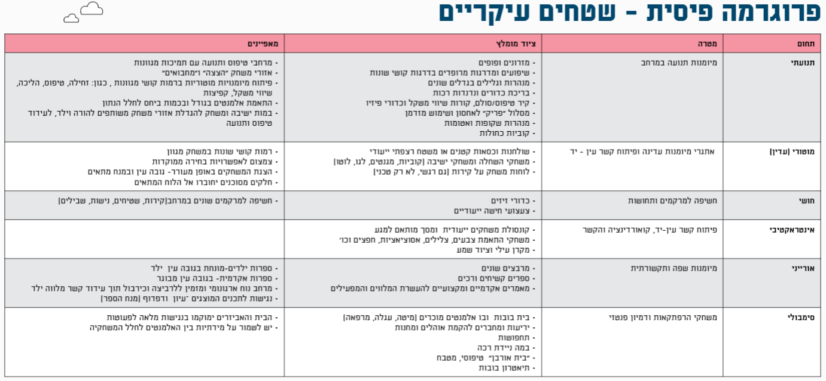
Observation Indicator for Indoor Play Areas Combined with Visitor Interviews
From the report: Games for Early Childhood: Perception, Program and Planning Guidelines
Urban95, Community, Culture and Sports Administration, Construction and Infrastructure Administration - Tel Aviv-Jaffa Municipality

Slide 35
Observation Indicator for Indoor Play Areas Combined with Visitor Interviews
 | Responses - Family # ____________
 | Adult 2 Relationship: Parent/Grandparent/Caregiver/Other Gender: M/F Age:___ |  | Adult 1 Relationship: Parent/Grandparent/Caregiver/Other Gender: M/F Age:___
 | Child 3 Gender: M/F Age: | Child 3 Gender: M/F Age: | Child 2 Gender: M/F Age: | Child 1 Gender: M/F Age:
 | Residence: In neighborhood/Outside neighborhood Frequency of arrival: daily/ several times per week/ once a week/ less often Means of arrival: by foot/bike/car/public transport Duration of stay: half hour/hour/hour and a half/ two hours/more than two hours
 | How was your visit to the indoor play area today? What did you and/or your child play with? Who did you and/or your child play with? (Not to be read: child played alone, with siblings, with friends/other children, with an adult)
 | Which facility/equipment did you and/or your child enjoy the most and why? What did you and/or your child learn? (Not to be read – it was fun, interesting, new, helpful, enriching, instructive) If they indoor play area was renovated: Did you come to this indoor play area before its renovation, or only afterwards? If you were here before the renovation - what was it like before, and what has changed?
 | If the visitor indicates it was their first time (or one of their first times) at this indoor play area, ask: How did you hear about this place? From a friend, from the community center’s WhatsApp group, from another community WhatsApp group, from other social networks, from the kindergarten’s WhatsApp group, advertising from the Municipality / community center, other ___ Management: Did you need help in receiving information and coordination before the visit? Was someone available to answer inquiries and to help you obtain all the necessary information before the visit?
 | Is there anything you would change about the indoor play area? (Not to be read - staff management, diversity of facilities and accessories, supply of toys, practical needs, services, diaper changing station, etc.)
 | Community aspects: Did visiting the indoor play area create / encourage new relationships with other parents? Was this part of your motivation to come?
 | Were you assisted by the staff members in the indoor play area? For operational needs? For advice on other issues, such as parenting? (Not to be read: try to find out if they needed a response to an inquiry or support on parenting issues, ideas for play, problem solving. If so, was a response received?)
 | Will you come here again? Why or why not? What would prevent you from coming again?
 | Do you visit the nearby community center? (near your home / or the location of this indoor play area) If so, do you visit for yourself, or for your children? What services and facilities do you use? What is lacking and should be added?
 | Rate (1 - 7, with 1 as the lowest and 7 the highest): The extent to which the indoor play area addresses: Child safety (removal of hazards below a meter height, no sharp corners, floor that is stable and padded for falls) ____ Open space (visibility)____ Cleaning and maintenance ______ Ventilation and air conditioning _____ Practical services (toilets, diaper changing station, breastfeeding space, drinking facility) _______ Quality of equipment (accessories ) _____ Pleasant and comfortable environment ______ Adjusted to the number of visitors _____ Convenience of arrival and stroller parking space_____ Opportunities for conversation and community interaction _____ Strengthening adult-child interaction and joint play _____ Interaction among children _____ Variety in child's play routine ______

Slide 36
Outline for Discussion Groups with Branch Coordinators about indoor play areas
Date and place: Monday, 05.07.2020 at: 12:00, via ZOOM link (to be sent) Participants: 4 branch coordinators - Renana, Kareen, Moore, and Nasra
Introductions, research goals: We at the Center for Educational Technology (CET) are assisting Urban95 in this evaluative research and assessment. We have spoken with some of you at various stages of the research. Currently, we are putting the spotlight on indoor play areas throughout the city regions, through observations and this conversation. The goal of the observations is to get a direct impression of parents' and children's use of the indoor play areas, to talk to parents and staff, to see and hear what is working well, to learn what is worth strengthening and adapting for other places, and what needs to be improved to make visits to the indoor play areas optimal.
The purpose of this meeting is to hear your insights, since you are familiar with the area and its residents, specifically on the topic of indoor play areas and spaces for early childhood developmental activities.
Introductory round and general questions: Each participant gives their: name, role, seniority, responsibilities in the context of the indoor play area. Which aspect of the indoor play areas do you like most and why?
How and where are indoor play areas located in the overall organizational context of community services? Are they always managed by community centers? Is there a separate management track? To what extent are you involved in this management track?
What types of indoor play areas exist? (Open, pre-registration, guided)? Is there a yearly/multi-year work plan (within the routine)? Does this plan address activity schedules and format? Are activity schedules adjusted for various times of year or other cycles? Is there an effort to promote early childhood issues among residents? If so, why specifically these issues? How are they being addressed?
To the moderator: What is the current situation among parents regarding: parental self-efficacy, parent-child relationships, joint play, child development, reading and literacy, community?
Staff members: Who are the service providers that operate the indoor play areas? Differentiate between permanent and temporary/substitute operators, early childhood coordinator (indicate coordinator’s degree of involvement and responsibility) and those instructing classes at the community center. For each specify: what background do they need to perform the job? Do they receive job training? If so, what training do they receive? Describe the interaction between indoor play area operators and residents. What is expected of them by the indoor play area administration? By parents? How do these expectations compare to what actually happens?
Characteristics of participants: Socio-demographics – what populations visit the indoor play areas? Who is conspicuously absent? What is the composition of groups of visitors? (single parents, parents / couple with child, grandparents, caregivers)? What are the ages of the children who visit? At what times? Are they regular or occasional visitors? What is the average length of visit?
To the moderator: Are there differences between groups (ethnic, cultural, socioeconomic)? What is important to them? What bothers them?
What elements / characteristics of indoor play areas do you think are essential? What most attracts the residents? What is most in demand and why? How do you know? To the moderator : address not only the facilities, but other characteristics such as location, design of the space, cost, cleanliness, presence of a professional staff member, multi-age / for young children only, characteristics of the Urban 95 indoor play area program, staff services, etc.
What are the main barriers that prevent parents of young children from coming to the indoor play areas? How much do you know about residents’ perceptions of the indoor play areas (site, equipment, staff)? Level of awareness of indoor play areas (advertising)? Willingness and desire to visit (in terms of free time, energy)? Are indoor play areas appropriate for the population (cost, hours)? Is pre-registration a barrier? Has a previous study mapped residents’ needs? Was there a public participation process? Has feedback been received on the existing options? Has participants’ satisfaction been examined? If so, were any changes made according to requests or feedback from the field? What was changed?
How are indoor play area services marketed and advertised? Who is responsible for this? To the moderator: Are some indoor play areas publicized to a different extent than others? Has there been mapping of online and offline platforms for advertising, and word-of-mouth publicity? Is there an effort to engage and recruit partners – professionals (kindergarten teachers, counselors) residents (change agents and community leaders)? What can be done to encourage and increase participation rates and consumption of services at indoor play areas? What needs to happen in the municipality / community management / other factors that may influence this?
Do you have anything to add on this subject that was not already addressed in this conversation?

Slide 37
Feedback Questionnaire for Library Reading Instruction Workshop Participants *
Demographics and technical issues | Where did the workshop take place?
 | Region:
 | At which library did the workshop take place?
 | Moderator’s name:
 | How did you hear about the workshop / activity? (You can mark more than one answer)
General satisfaction with workshop format, physical conditions, etc. | To what extent was the registration process and relationship with the organizing entity convenient and simple?
 | To what extent were the physical conditions and the environment comfortable for you and your child?
 | To what extent do you think the ZOOM platform is suitable for these workshops?
 | To what extent did you feel the workshop was well-organized and structured?
 | How often do you read stories to your children?
Quality of guidance | To what extent did you feel that the instruction was professional and the moderator was skilled?
Satisfaction with workshop content | To what extent did the workshop meet your expectations?
 | How did you benefit from the workshop? Please provide details.
Indicate the degree to which you agree with the following statements:
Structured free play | The workshop was enjoyable and encouraged creativity.
Parent-child relationship (emotional) | The workshop contributed to positive interactions between me and my child.
Parenting: knowledge and practices | During the workshop I acquired new and applicable knowledge and / or tools for future use with my child.
Parental self-efficacy + Parental wellbeing, Empowering the experience of parenthood | Following the workshop, I realized that reading with/to my children can be meaningful, quality time.
Parent-child joint play | As a result of the workshop, I noticed a change in my children’s level of interest in reading books.
 | Following the workshop, I plan to read more with/to my children (time spent reading/ number of books).
Community-related aspects | Did the workshop enable you to meet and/or make new connections with parents and families in the neighborhood?
 | To what extent would you recommend the workshop to others?
 | Additional comments: we'd love to hear your opinion! What did you most enjoy? What did you least enjoy? Is there anything you would like to tell us, so we can improve in the future?
Demographics, continued | Your relationship to the child:
 | Age of child(ren) who participated in the activity. (You can mark more than one answer):
 | You are currently in:
 | How often do you visit the municipal library?
 | Are you aware of library services that are offered to city residents at no cost?
 | Area of residence
Some questions were deleted to improve the questionnaire-answering experience.
Attached is the full text of the questionnaire that was given to respondents during most of the research period.

