Slide 1
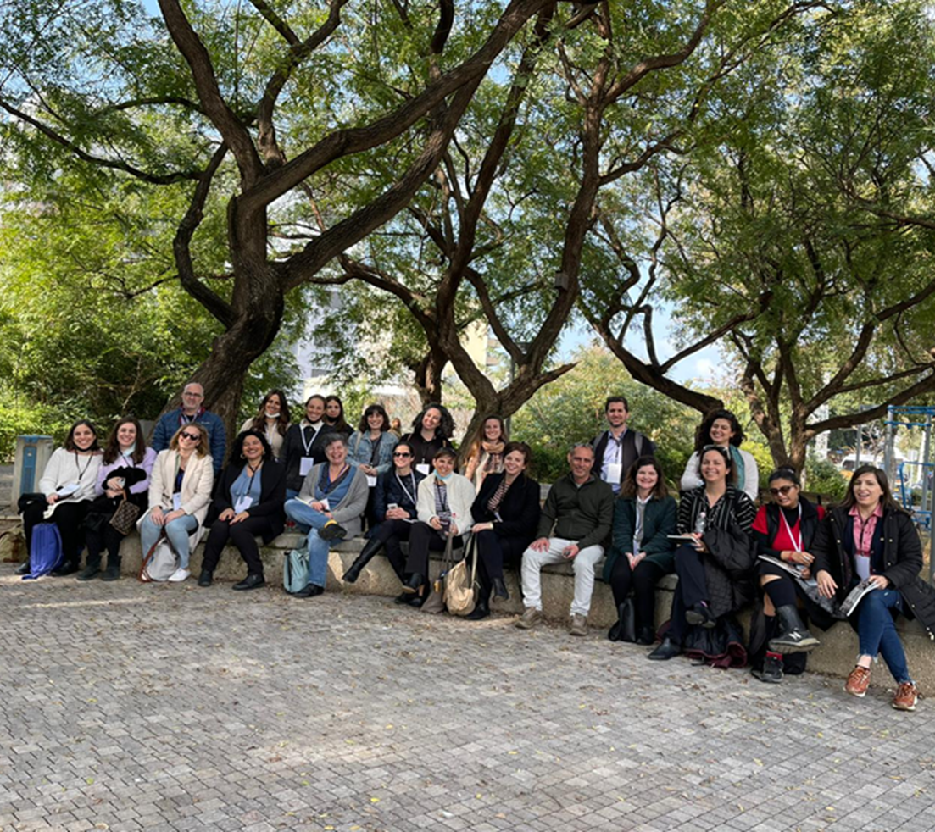
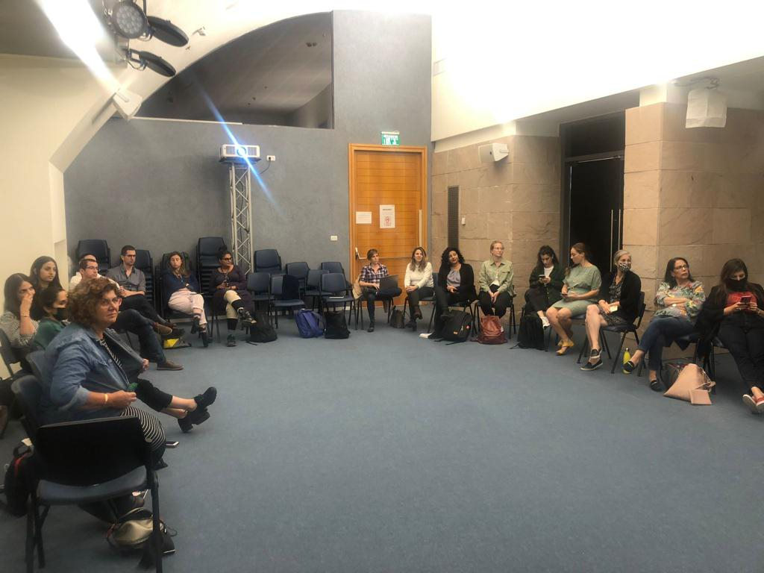
Professional Trainings Report –Beit Shemesh & Tira
June 2022
The CET’s Program Evaluation Unit offers a range of tools and services to support social and educational initiatives and aid in their success
צילום: "מסע"

Slide 2
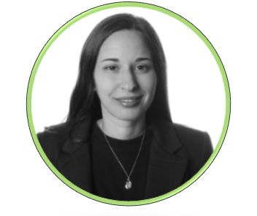
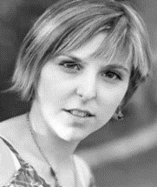
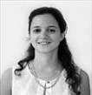
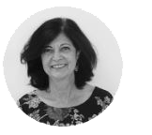
Research Team
Reoute Diamond
Researcher & Program
Evaluator
Alona Tsirulnikov
Researcher & Program
Evaluator
Tal Mishaan Spiegel, Phd
Director of the Program
Evaluation Unit
Hava Newman, Phd
Head of Measurement & Evaluation Administration
The CET’s Program Evaluation Unit offers a range of tools and services to support social and educational initiatives and aid in their success

Slide 3
Table of Contents
רקע….................…..…………………………………………………………………………............................................. 4
שביעות רצון מההכשרות...............................................................................................................................................5
התרומה המקצועית של ההכשרות............................................................................................................................6-8
ידע והבנה לצרכי הגיל הרך...........................................................................................................................................9
מודעות לצרכים ולמענים תכנוניים לטובת שיפור המרחב הציבורי עבור הגיל הרך ומלוויו......................10
רתימת שותפים ומנגנוני שיתוף פעולה בין-מינהליים ועם שותפים שונים.....................................................11
שילוב נקודת המבט של הגיל הרך ומלוויו בתכנון מרחבים ציבוריים מותאמים............................................12-13
למידת עמיתים לרשויות נוספות וליוצרי המרחב הבנוי.........................................................................................14 תוכניתUrban95 ברשויות העוגן מזוהה כ'סיפור הצלחה'...................................................................................15
סיכום...................................................................................................................................................................16
נספחים................................................................................................................................................................17-22
מודל לוגי לתוכנית Urban95 בהרחבה לפריפריה הגיאוגרפית בישראל..................................................................................17
טבלת כלי מחקר ומדדי הערכה.............................................................................................................................................................18
שאלון סקר משתתפי הכשרות מקצועיות.........................................................................................................................................19-21
מחוון קבוצת מיקוד עם הצוותים המובילים.......................................................................................................................................22
The CET’s Program Evaluation Unit offers a range of tools and services to support social and educational initiatives and aid in their success

Slide 4
Background – Professional Training in Anchor Municipalities
One of the main activities Urban95 conducts in Israel's social and geographic periphery involves training and seminars for key officials in the anchor municipalities to provide knowledge and tools and raise awareness regarding the importance of considering early childhood needs in all aspects of life.
The current report findings focus on training sessions for municipal teams that were conducted between August 2021 and February 2022:
1) A tour of early childhood centers in Kfar Saba and Tel Aviv –Tira team, August 2021
2) Training on mobility and spending time in public spaces –Tira team, September 2021
3) A seminar in Holon on walking, mobility, and spending time in public spaces –Tira and Beit Shemesh teams, November 2021
4) A seminar in Tel Aviv-Jaffa on playgrounds and public spaces –Tira and Beit Shemesh teams, February 2022
Tira team members participated in four training sessions at the end of which 22 of them gave feedback; Beit Shemesh team members participated in two training sessions and 14 of them gave feedback.
The training program included formative assessments* that involved answering a short feedback questionnaire at the end of each session, as well as two focus groups held with each of the municipal teams in Tira and Beit Shemesh. We did this to understand how participants perceived the contribution of the training and to surface needs and challenges.
* The research tools appear in the appendixes
The CET’s Program Evaluation Unit offers a range of tools and services to support social and educational initiatives and aid in their success

Slide 5
Satisfaction with the Training
Participants reported high levels of satisfaction:
About 90% of respondents were pleased with the session format (seminar/tour/lecture/webinar), with all Beit Shemesh team members noting that they felt the formats were beneficial.
94% percent of respondents noted that they felt the instructors conveyed the content in a clear and accessible way, and 81% felt that the supporting material helped them understand the topic and content.
In addition, about 70% felt that the number and/or length of the sessions was appropriate and said they would recommend the training to others.
Regarding the seminar in Holon, about half of the respondents, from both municipal teams, felt the seminar was too long.
The CET’s Program Evaluation Unit offers a range of tools and services to support social and educational initiatives and aid in their success

Slide 6
Professional contribution of the Trainings
In Beit Shemesh
Half of the participants noted that the training primarily contributed to their understanding of early childhood needs, their professional relationship with their colleagues, and their knowledge about Urban95 and its impact.
I’ve met with professional colleagues & learned from them
I’m more knowledgeable of Urban95 and its local & global impact
I’m more knowledgeable of EC & caregivers’ needs
I’ve acquired new knowledge in my areas of occupation
The training inspired me to think of new Urban95 ideas
I’ve made new professional / business / social contacts
I’ve acquired tools to implement in my work
I’m motivated to implement Urban95 ideas
In Tira:
Most participants noted that the training primarily contributed to their understanding of early childhood needs, and over half of them felt the training had inspired and motivated them to develop more ideas in the spirit of the principles of Urban95.
The CET’s Program Evaluation Unit offers a range of tools and services to support social and educational initiatives and aid in their success

Slide 7
Professional contribution of the Trainings
Participants reported that the training contributed to their daily professional work:
Almost 60% reported that they intended to apply the tools and knowledge they gained from the training sessions over the next six months.
Almost 20% (n=36) reported that the training helped them acquire practical tools they could implement in their ongoing work*.
36% of Tira team members reported using the supporting material they received during the training after the training was over, as opposed to 14% of Beit Shemesh team members who reported the same.
There were significant differences between the municipal teams regarding the extent to which the training offered them new and relevant information and the extent to which the training provided them with practical tools or methods they could apply (as specified in the graphs).
The tools & knowledge you acquired will serve you in performing your job over the next 6 months
ההכשרה סיפקה פרקטיקות או כלים מעשיים לשימוש בעבודה
ההכשרה סיפקה ידע חדש הרלוונטי לעבודה
What was the main trainings’ contribution? (multi optional question) I’ve acquired tools to implement in my work
The CET’s Program Evaluation Unit offers a range of tools and services to support social and educational initiatives and aid in their success

Slide 8
Professional contribution of the Trainings
Participants stated that the training provided them with practical tools - From acquiring knowledge about early childhood needs to leading major changes by cooperating with various officials in the municipality and outside of it, based on projects conducted in other municipalities. It should be noted that two Beit Shemesh team members reported that they did not gain any practical tools from the training sessions they participated in.
Participants stated that they would be happy to receive more tools and methods in future trainings. Both teams raised the need to go deeper into practical aspects in the training and that it should be adapted to the unique characteristics of each city.
Beit Shemesh team members noted the importance of nurturing relationships and learning from various officials in the municipality and outside of it, as well as government ministry officials.
Tira team members raised additional issues such as the need to gain more knowledge about public spaces for young children and parent training programs, and receive budget management tools.
Some of what Tira team members had to say:
“Addressing this population’s physical, recreational, and emotional development needs on the municipal level”
“Simple ideas for creating temporary or permanent public spaces for children’s activities”
“How to apply it, more answers, basically how it’s done; to get out there and try things”
“Budget tools, what it takes to execute projects like the ones we saw in terms of costs, pooling resources, sources of funding and budgeting”
Some of what Beit Shemesh team members had to say:
“Customized training for the Beit Shemesh population”
“Connecting between municipal departments and officials and recruiting officials”
“Knowledge and getting to know government officials in charge of approving public buildings, education, and public spaces”
“Learning from colleagues. Setting aside time for talking and holding discussions”
The CET’s Program Evaluation Unit offers a range of tools and services to support social and educational initiatives and aid in their success

Slide 9
Knowledge in and understanding of early childhood needs
Two thirds of participants from both cities noted that the training expanded their knowledge regarding EC needs*. There were differences between the two teams, with 73% of Tira team members (n=14) reporting that they felt they had gained in this way, as opposed to 50% of Beit Shemesh team members who reported the same.
In the open-ended questions too, participants noted that the training made the importance of investing in EC more clear.
Some of what Tira team members had to say:
“Thinking about the importance of investing in the relationship between parents and children aged 0-2”
“Learning more about using the urban space for children’s activities and leisure”
Some of what Beit Shemesh team members had to say:
“I refreshed my knowledge regarding the importance of EC activities”
“I was mainly concerned with getting a clear understanding of the situation and setting clear goals. The work we did after that was more intentional and accurate. It’s coherent and expresses a certain spirit”
What was the main trainings’ contribution? (multi optional question) I’m more knowledgeable of EC & caregivers’ needs
The CET’s Program Evaluation Unit offers a range of tools and services to support social and educational initiatives and aid in their success

Slide 10
Awareness of potential planning solutions to improve the public space for young children & caregivers
About two thirds of the participants felt the public spaces and/or municipal services in the city do not currently accommodate EC needs. There were significant differences between the teams on this issue: 82% of Tira team members (n=22) felt public spaces were not accommodating, or were accommodating to a small extent, as opposed to 36% of Beit Shemesh team members (n=14) who felt public spaces in the city accommodated EC needs to a small extent.
Over 70% of the participants felt the training clarified the need to integrate EC needs and content in their work to a large or very large extent. Here too, there were significant differences between the teams: 91% of Tira team members (n=22) as opposed to 43% of Beit Shemesh team members (n=14) who reported this effect.
The CET’s Program Evaluation Unit offers a range of tools and services to support social and educational initiatives and aid in their success

Slide 11
Partners’ onboarding, establishing inter-administrative and cross-sectional collaboration mechanisms
About 25% of all the participants reported that the training helped them create new professional/business/social relationships*, with 27% of Tira team members (n=22) and 21% of Beit Shemesh team members (n=14) having reported this gain.
In addition, about 25% of all the participants reported that the training opened opportunities for new collaborations to a large or very large extent. Here too, significant differences emerged between the Tira team (32%, n=32) and the Beit Shemesh team (14%, n=14).
What was the main trainings’ contribution? (multi optional question) I’ve made new professional / business / social contacts
The CET’s Program Evaluation Unit offers a range of tools and services to support social and educational initiatives and aid in their success

Slide 12
Considering young children & caregivers’ POV when designing public spaces for their use
About 50% of the participants reported that the training helped them, to a large or very large extent, understand how EC content could be implemented in their work. Here too, significant differences emerged between the Tira team (68%, n=22) and the Beit Shemesh team (36%, n=14).
About 50% of participants reported that the training motivated them to implement new ideas in the spirit of Urban95 to benefit young children and their caregivers*, with a higher rate of Tira team members reporting having received this gain (59%) as opposed to Beit Shemesh team members (21%).
In addition, 50% of the participants reported that the training inspired them to think and come up with new actionable ideas in the spirit of Urban95**. Here too, a higher rate of Tira team members reported having received this gain (64%), as opposed to Beit Shemesh team members (29%).
*What was the main trainings’ contribution? (multi optional question) I’m motivated to implement Urban95 ideas
**What was the main trainings’ contribution? (multi optional question) The training inspired me to think of new Urban95 ideas
The CET’s Program Evaluation Unit offers a range of tools and services to support social and educational initiatives and aid in their success

Slide 13
Considering young children & caregivers’ POV when designing public spaces for their use
Following the training the Beit Shemesh and Tira teams made several suggestions regarding how to adapt public spaces to meet EC needs:
Participants noted that the early childhood perspective should be taken into account when planning public institutions and buildings (such as community centers and playrooms), planning parks, and adapting services and content to meet the needs of young children and their caregivers (enrichment services for parents and children).
Infrastructural work to adapt public spaces to meet the needs of young children and their parents:
“To work on adapting the space and making it accessible, for example, building proper sidewalks, planting more trees” (Tira)
“Increasing the number and size of spaces suited to early childhood activities” (Beit Shemesh)
Planning:
“To address the topic at the statutory planning stage” (Beit Shemesh)
“Integrating the Urban95 approach in every physical plan” (Tira)
The work needs to rely on collaboration between municipal officials and the residents:
“Branding the issue of adapting public spaces to meet the needs of young children and their caregivers among municipal officials and the residents. This needs to come from the bottom up and from the top down” (Beit Shemesh) “Onboarding and collaborating with professionals and parents” (Tira)
A work method that incorporates tactical urbanism in the first stage:
“Tactical urbanism enables rapid progress. They introduced a working method in the seminar that was based on pilots, which I think is smart and would give us a lot of leeway to take action in a short time” (Beit Shemesh)
“Closing off small streets in the city; start thinking about neighborhood centers and how to make them attractive” (Tira)
The CET’s Program Evaluation Unit offers a range of tools and services to support social and educational initiatives and aid in their success

Slide 14
Peer-learning among municipalities and build environment creators
About half the participants reported that to a large or very large extent the training helped them get to know their colleagues better. A higher rate of Beit Shemesh team members (50%) reported this gain as opposed to Tira team members (41%).
In addition, about half of the participants reported that they gained from meeting with their colleagues and learning from them*. A higher rate of Tira team members (59%, n=22) reported this gain, as opposed to Beit Shemesh team members (50%, n=14).
Finally, 20% of participants reported that they shared what they learned from the training with colleagues who had not participated in the training to a large or very large extent. Tira team members reported having done so to a greater extent compared to Beit Shemesh team members (23% vs. 14%).
What was the main trainings’ contribution? (multi optional question) I’ve met with professional colleagues & learned from them
The CET’s Program Evaluation Unit offers a range of tools and services to support social and educational initiatives and aid in their success

Slide 15
Urban95 program in anchor municipalities is a "success story," with echoes in other municipalities
Some of what Tira team members had to say:
“Getting out of the city with the various professionals was really beneficial; we saw some very interesting and relevant places”
“The lecture was very high level”
“Training sessions should be held in municipalities that are more like Tira in terms of the nature of the population, its size, and socioeconomic status.
Some of what Beit Shemesh team members had to say:
“Learning about other cities that ‘live’ and promote the process” “The theoretical parts were interesting… inspiring”
About half the participants (41% of Tira team members and 50% of Beit Shemesh team members) reported that the training helped them learn more about Urban95 and its impact in Israel and around the world*.
In addition, when answering the open-ended questions participants noted that they were happy about getting to know other Urban95 municipalities and learning from them and that the lectures were high level and inspiring.
Tira team members requested tours/seminars to be held in nearby cities with similar characteristics.
What was the main trainings’ contribution? (multi optional question) I’m more knowledgeable of Urban95 and its local & global impact
The CET’s Program Evaluation Unit offers a range of tools and services to support social and educational initiatives and aid in their success

Slide 16
Summary
Participants expressed high levels of satisfaction with the technical and content-related aspects of the training, and noted that it contributed to their day-to-day professional work.
Most of the participants reported that they had gained deeper knowledge of early childhood needs and awareness regarding the need to plan and provide solutions for improving public spaces and adapting them to young children and their caregivers.
Participants reported that the training helped them learn more about Urban95 and its impact in Israel and around the world, and that they benefited from getting to know and learning from other Urban95 municipalities.
In addition, about half the participants reported that the training provided them with tools for implementing EC content in their work, that it motivated them to implement ideas, and inspired them to come up with new ideas in the spirit of Urban95 to benefit young children and their caregivers. At the same time, participants raised the need to receive additional practical tools in future training.
About half the participants reported that the training helped them get to know their colleagues better and promoted peer learning and cross-pollination.
A quarter of the participants feel the training created new opportunities for making professional contacts and new collaborations.
In all aspects, the Tira team gained more from the training compared to the Beit Shemesh team, in light of the fact that the Tira team participated in two exclusive training sessions in addition the two sessions held for both teams (which were the only sessions in which the Beit Shemesh team participated).
Accordingly, it appears continuing the training is important and beneficial, and emphasis should be placed on customizing the content to the specific characteristics and needs of each city.
The CET’s Program Evaluation Unit offers a range of tools and services to support social and educational initiatives and aid in their success

Slide 17
Appendix A: Urban95 IL Primary Evaluation Model – For Anchor Municipalities
Target Audience | Inputs | Actions | Outputs | Short and Mid-Term results (up to 3 years from program’s onset) | Long Term Results (5-10 Years) | Impact
Officials & decision-makers in the municipalities & government offices Academics, professionals, and build environment creators (BEC) | ILGBC staff Consultants and experts Urban95 program administrator in the anchor municipality Program partners (outside & within the anchor municipality) Pilots’ budgeting International knowledge from BvLF Accumulated knowledge and experience from the ILGBC, Urban95 TLV, and national committee Assessment & evaluation resources | Participate in meetings with anchor municipalities to promote early childhood development (ECD) in the different administrations. Train and accompany the programs’ administrators in the anchor municipalities. Learn each anchor municipality agenda and strategic outline regarding early childhood to identify possible integrations with the Urban95 program. Engage stakeholders & partners from anchor municipalities to take part in interventions implementation. Develop and conduct trainings & seminars for officials in anchor municipalities to provide knowledge & tools and raise awareness for ECD's importance. Map potential interventions in public spaces and mobility domains in the anchor municipalities. Identify opportunities and map the needs of young children & caregivers to provide them with enriching content to support the interventions in the urban environment in anchor municipalities. Initiate pilots in the urban environment of anchor municipalities, including accompanying contents. Promote inter-administrative collaboration to create models for cooperation between different municipal units. Build a website for data collection & retention to share professional knowledge on facilitating holistic municipal policies for build environment adjustments for young children & caregivers. Hold professional events for BEC on urban planning that considers the needs of young children & caregivers. | Anchor municipality's program manager actively participates in strategic meetings to promote young children & caregivers’ needs in the different municipal units. Key stakeholders & BEC participate in professional trainings & seminars. High satisfaction of trainings & seminars’ participants. Effective engagement of key stakeholders and establishment of inter-administrative collaborations. Openness, willingness, and capability of municipal officials for pilots' implementation. Sharing internal & external knowledge among municipal officials and from the municipality outwards. Pilots' implementation in the public space & mobility domains, including accompanying contents, to scale. The program’s website is operated as a professional knowledge base regarding early childhood, based on models developed in the program. The program’s website gets exposure and users' traffic. | Municipal officials are knowledgeable, understand early childhood needs, and are capable of matching potential responses to these needs. BEC that participated in ILGBC events are conscious of needs and potential planning solutions for improving the public space for young children & caregivers. Urban95 action models & collaboration mechanisms (between anchor municipalities' officials and external partners advancing ECD) are embedded in the work routine. Early childhood is on the anchor municipalities' agenda: re-thinking positions and budget allocation for ECD, using collaboration mechanisms, new management practices, and pooling resources efforts. Young children & caregivers’ POV is considered when planning and designing public spaces (playgrounds, sidewalks, public transportation, shade, clean air, green lungs) – in the short term. Increase in the number of public spaces & urban infrastructures, designed and adjusted for young children & caregivers’ use, according to the Urban95 principles in anchor municipalities – in the short/ mid-term. In-scale projects are executed in all municipalities, adjusting the built environment for a safe and accessible stay, use, and mobility of young children & caregivers – in the mid-term. Anchor municipalities are a source for peer learning to other municipalities and BEC. The nationwide expansion program municipalities are collaborating with municipal & inter-municipal entities while using the program’s website as a professional source of knowledge when deciding on ECD. | Program sustainability: Urban95 is established as a guiding principle for urban planning for early childhood. The urban planning of anchor municipalities, based on Urban95 principles, is recognized as a “success story” and echoes in other municipalities. Young children & caregivers’ POV is considered in public space planning and promotes mobility and accessibility in local municipalities nationwide. The program's website is updated, municipalities and BEC nationwide regularly learn how to implement interventions according to Urban95 principles. All municipalities seek funding sources and act independently to advance young children. All municipalities operate in light of a long-term planning vision, including ECD needs, while making data-driven decisions. | Policies to advance urban environment suitable for optimal early childhood development, properly and sustainably embedded throughout all municipal departments, working in full coordination and collaboration. A supportive urban and communal environment, enabling equal opportunities in early childhood development and parental wellbeing.
The CET’s Program Evaluation Unit offers a range of tools and services to support social and educational initiatives and aid in their success

Slide 18
Appendix B: Mapping Evaluation and Research Tools and Indicators
Indicator/ Tool | Data Review & Analysis | In-depth Interviews | Field Observations | Focus Groups | Activities Feedback Surveys | Caregivers’ Surveys
Target Audience: Municipal and Governmental Officials, Academics, Professionals, and Build Environment Creators
Knowledge in and understanding of early childhood needs | V | V |  | V | V
Awareness of needs & potential planning solutions to improve the public space for young children & caregivers | V | V |  | V | V
Developing potential solutions to early childhood needs | V | V | V | V |  | V
Partners’ onboarding, establishing inter-administrative and cross-sectional collaboration mechanisms | V | V |  | V | V
Professional knowledge database on early childhood, for decision making | V | V |  | V
Peer-learning among municipalities and build environment creators | V | V |  | V | V
Considering young children & caregivers’ POV when designing public spaces for their use | V | V |  | V | V
Implementing pilots in anchor municipalities on a municipal scale | V | V | V | V |  | V
Build environment & public spaces suitable for safe and accessible stay, use, and mobility of young children and caregivers on a municipal scale | V | V | V | V |  | V
Urban95 program in anchor municipalities is a "success story," with echoes in other municipalities | V | V |  | V | V
Urban95 is established as a guiding principle and as a municipal standard for urban planning for early childhood | V | V |  | V
All municipalities act independently to advance young children needs | V | V | V | V |  | V
Guiding principles for a pro-ECD policy are sustainably embedded in anchor municipalities. | V | V |  | V
Long-term & data-driven urban planning, considering ECD | V | V
Municipalities & BEC nationwide regularly use the program’s website | V | V |  | V | V
Scope of municipal investment in urban infrastructure benefiting young children | V | V |  | V
Urban environments & public spaces are suitable for young children & caregivers |  | V | V | V |  | V
The CET’s Program Evaluation Unit offers a range of tools and services to support social and educational initiatives and aid in their success

Slide 19
Appendix C – Team Training Questionnaire
6. How much of the session did you participate in?
a. All of it
b. Part of it
7. Did you know or hear about Urban95 before the training?
a. I hadn’t heard anything about it
b. I heard the name, but didn’t know anything about it
c. I heard and knew about the program
d. I’m part of the Urban95 team/one of the program’s partners
8. Do you think the training was long enough in terms of the number and length of the sessions?
a. It was too short
b. It was too long
c. It was just right
9. To what extent do you feel the training format was successful (tour/seminar/lecture/webinar)?
a. To a very large extent
b. To a large extent
c. To a moderate extent
d. To a small extent
e. Not at all
10. To what extent was the content relayed in clear and coherent way?
a. To a very large extent
b. To a large extent
c. To a moderate extent
d. To a small extent
e. Not at all
11. To what extent did the supporting material contribute to your understanding of the training’s topic and content?
a. To a very large extent
b. To a large extent
c. To a moderate extent
d. To a small extent
e. Not at all
f. Not relevant
12. To what extent did you use the supporting material, if you received any, after the training?
a. To a very large extent
b. To a large extent
c. To a moderate extent
d. To a small extent
e. Not at all
1. Please state your role and organization
Open-ended
2. How long have you been active in the field?
Open-ended
3. What’s your gender?
Woman/man
4. What training did you participate in?
a. Tour of early childhood centers in Holon and Tel Aviv port for Tira municipality officials (held on July 15th, 2021)
b. Training on mobility and spending time in public spaces
c. Seminar on walking, mobility, and spending time in public spaces
d. Seminar in Tel Aviv-Jaffa on playgrounds and public spaces
5. Was the training defined as optional or compulsory as part of your role?
a. Optional
b. Compulsory
The CET’s Program Evaluation Unit offers a range of tools and services to support social and educational initiatives and aid in their success

Slide 20
Appendix C – Team Training Questionnaire
13. What did you gain from the training?
(Please mark all relevant answers)
- I’ve acquired new knowledge in my areas of occupation
- I’m more knowledgeable of EC & caregivers’ needs
- I’ve acquired tools to implement in my work
- I’m more knowledgeable of Urban95 and its local & global impact
- I’m motivated to implement Urban95 ideas
- The training inspired me to think of new Urban95 ideas
- I’ve met with professional colleagues & learned from them
- I’ve made new professional / business / social contacts
- Other, please specify:
14. To what extent did the training provide you with new and relevant knowledge?
a. To a very large extent
b. To a large extent
c. To a moderate extent
d. To a small extent
e. Not at all
18. What additional tools and/or working methods would you like to receive in future Urban95 trainings?
Open-ended
19. Following the training, to what extent do you have a better understanding of the need to integrate EC needs and content in your professional work?
a. To a very large extent
b. To a large extent
c. To a moderate extent
d. To a small extent
e. Not at all
20. To what extent, did the training help you understand how to implement the EC content in your professional work?
a. To a very large extent
b. To a large extent
c. To a moderate extent
d. To a small extent
e. Not at all
15. To what extent did the training provide you with practical tools and/or methods you can implement in your work?
a. To a very large extent
b. To a large extent
c. To a moderate extent
d. To a small extent
e. Not at all
16. What practical tools and/or methods did you gain from the training?
Open-ended
17. To what extent, do you believe the tools and knowledge you acquired will serve you in performing your job over the next 6 months?
a. To a very large extent
b. To a large extent
c. To a moderate extent
d. To a small extent
e. Not at all
The CET’s Program Evaluation Unit offers a range of tools and services to support social and educational initiatives and aid in their success

Slide 21
Appendix C – Team Training Questionnaire
24. To what extent did the training open you to new possibilities for working together on joint areas with new officials?
a. To a very large extent
b. To a large extent
c. To a moderate extent
d. To a small extent
e. Not at all
25. To what extent did you share what you learned from the training with colleagues who didn’t participate in it?
a. To a very large extent
b. To a large extent
c. To a moderate extent
d. To a small extent
e. Not at all
f. Not relevant
26. To what extent would you recommend this training to others?
a. To a very large extent
b. To a large extent
c. To a moderate extent
d. To a small extent
e. Not at all
21. To what extent do you think the public spaces and/or municipal services in the city you work in are suited to EC needs?
a. To a very large extent
b. To a large extent
c. To a moderate extent
d. To a small extent
e. Not at all
22. Do you have any actionable suggestions for adapting the urban space to meet EC needs?
Open-ended
23. To what extent do you know your colleagues better as a result of the training?
a. To a very large extent
b. To a large extent
c. To a moderate extent
d. To a small extent
e. Not at all
27. Please tell us more about what you gained from the training, what should be preserved, and any other insights and thoughts.
Open-ended
28. Please share with us any suggestions for improvements we could implement in future trainings.
Open-ended
The CET’s Program Evaluation Unit offers a range of tools and services to support social and educational initiatives and aid in their success

Slide 22
Appendix D – Blueprint for Conducting Focus Groups on Training with Leading Teams
How is the topic of early childhood relevant to your professional work today, as opposed to before Urban95 became involved your city?
In your opinion, what’s the goal of the training? Why do you participate in it? Did you want to participate from the start? Have you changed your views as a result of the training?
What did the training sessions include? What information were you exposed to? Go deeper by asking:
- Did the content you were exposed to affect your views on the importance and necessity of considering EC needs in you professional work? (Believe they should be considered, believe they should not be considered, the content affected/did not affect their views)
- Did you receive practical tools and methods you can implement in your work (in their specific field) to promote EC needs?
4. What were your most significant takeaways from the training? How did the training contribute to you? (New professional information/expanded existing knowledge/practical tools/motivation and inspiration/networking)
How did participating (in terms of the information/tools they were exposed to) influence your daily work? Did you acquire any new work habits unrelated to Urban95?
Urban95 field activities have and are currently being conducted (Zeira, participating in a hackathon). How do/did you feel about how these projects are/were conducted? Working with a range of municipal and other departments and officials, some of whom are unfamiliar with the field (address collaborations between departments, work mechanisms, integration, inter-administrative relations, onboarding, challenges).
To what extent do you think public spaces/municipal services are currently suited to EC needs? Do you think it’s sufficient? (Find out how important they think it is to adapt the space and how well-suited they think it actually is. They may feel there’s no need to adapt the space to EC needs and that therefore the current situation is fine, etc.)
Do you think EC should be on the municipality’s permanent agenda? Should this apply only to certain departments? Why? Where should it be on the municipality’s overall list of priorities?
I suppose you need to deal with a lot of budget and planning issues. Did the knowledge you acquire affect your work plans (in terms of taking EC needs into account)? To what extent is this up to you? What are the barriers?
What more do you need regarding this issue? What types of sessions/information/instructions? What should be changed/improved in future trainings?
The CET’s Program Evaluation Unit offers a range of tools and services to support social and educational initiatives and aid in their success

Slide 23
Thank You!
The CET’s Program Evaluation Unit offers a range of tools and services to support social and educational initiatives and aid in their success

