Slide 1
Presentation to Retailers
חתפ
2022
eyedo
Field Operation Management Solutions
Proactivity. Productivity. Profitability.

Slide 2
Agenda
Company
Industry and product
Retailer usages and use cases
Onboarding roadmap

Slide 3
Company
Incorporated in 2017 after 3 years’ incubation
Self-funded, held by original founders
60+ clients, 75%+ of IL food and convenience retailers
Team
Ronen Yemini CEO, Product
Former P&G retail execution owner, operations & field operations expert
Daniel Cohen Gindi CTO Technology guru, experience with mature and startup companies worldwide
Mazal Shrem Active Director Former INTEL senior in Israel and Europe
Shlomi Ashkenazi Active Director Pango Polska partner, former Nextcom CEO, and SVP at HOT Telco

Slide 4
Retail industry
Industry of significant complexity, subject to a variety of factors including:
Significant differences between branches (trading area, variety, equipment, size, structure etc.)
Uncontrolled changes as a result of client actions (product return to wrong place, unreported damages and so on)
Rapid staff turnover (creates a need for fast onboarding processes and clear usable procedures)
Rapid floor changes as a result of regulation changes, launches, promotions, recalls and so on

Slide 5
Product
* Real-time PAAS, designed for organizational digitization
* Native apps for iOS/Android smart devices, accessible to users both online and offline
* End-to-end capabilities (plan, execute, analyze)
* Various self-developed and integrated technologies
1
Automate checklists and accelerate completion of action items to reduce regulatory deviations to minimum
2
Validate display accuracy, availability and planogram compliance
3
Generate real-time, actionable performance data, educate new hires on-the-job
4
Cultivate relationships with customers through faster, better and more professional service
5
Communicate on all levels of the organization and motivate employees through greater efficiency and productivity

Slide 6
Product
UX and ROI
Easy to operate
Quick onboarding
~100% efficiency lift
~8% sales lift
~50% cost savings
*Highest is 22%
*Fines and break

Slide 7
Clients and numbers
Critical recall - Chilled food products Large-scale monitored assets, 2,000 users, less than an hour
Supermarket chain
Increased efficiency and sales Sense of confidence & control, reliable field feedback
CS chain
Excellence in field operations For both routine and ad hoc tasks
Food distribution
Product availability and shelf share Shelf share and sales lift
CPG manufacturer
City-wide sensor array management Water-system maintenance and support
Municipality
100%
10%
30%
75%
Customer Satisfaction
Sales Increase
Floor-time Increase
Execution Time Savings

Slide 8
Product strategy
PAAS – We understand that our clients know their business better than us, so we give them a very broad platform, allowing them to implement both structure and methodology
Learning – We know that our clients are the experts, so we learn from them and constantly improve our platform to align with their needs
Collaboration – We know that smart tools increase ROI, so we collaborate with other technologies and integrate 3rd parties’ tech (e.g. BI, sales app, computer vision, optimization and routing, data filing)

Slide 9
Product features
Business process automation
Automatic corrective actions
IoT-generated tasking
Computer vision (for retail)
Manual/auto messaging
Intensive reports system
Management-support dashboards
Offline automatic modulation
Behavioral-based restrictions
Comprehensive dashboarding options
Conclusion-based automatics
Restrictions
Geofencing
Step-by-step process indicators
AI-based time planning
In-app calendar
Goal definition and stimulation perfect execution percentage
Feedback mechanisms for perfect quality of execution
Open architecture for perfect compatibility with your business structure

Slide 10
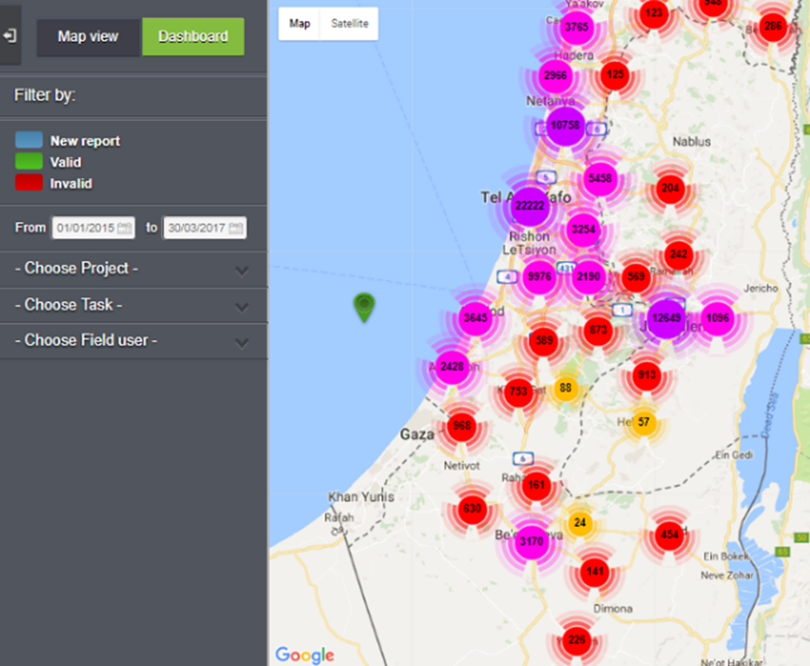
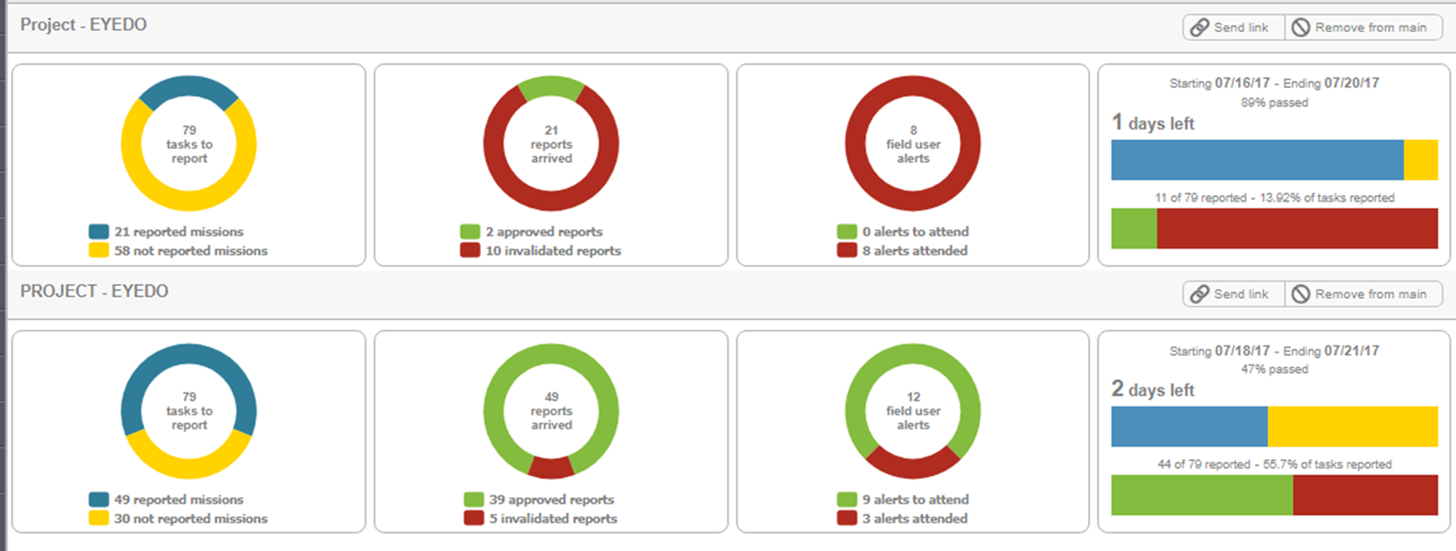
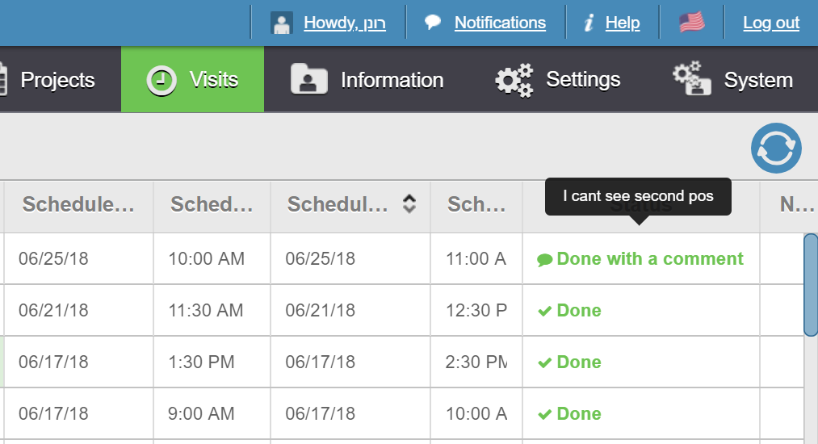
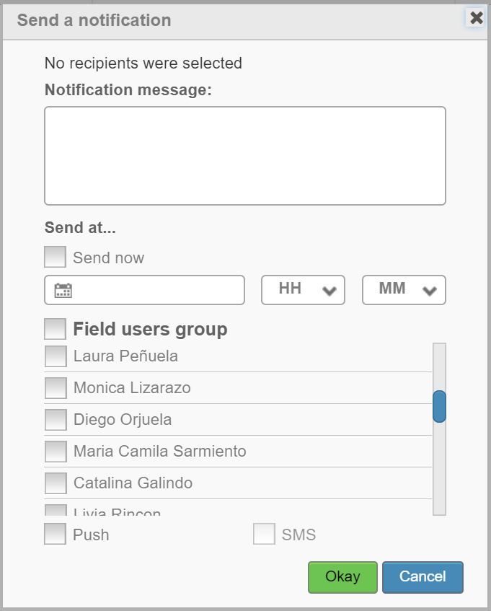
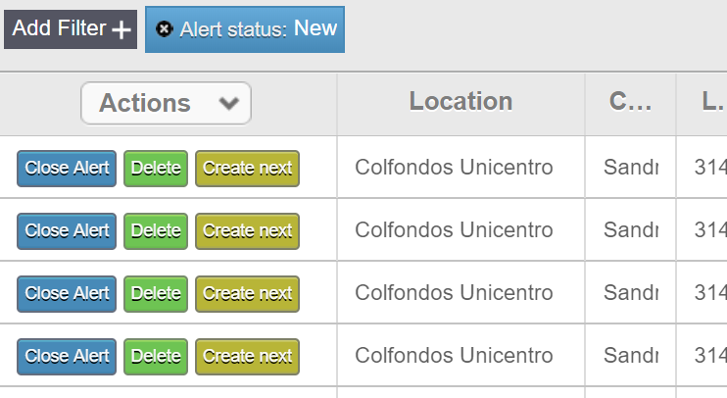
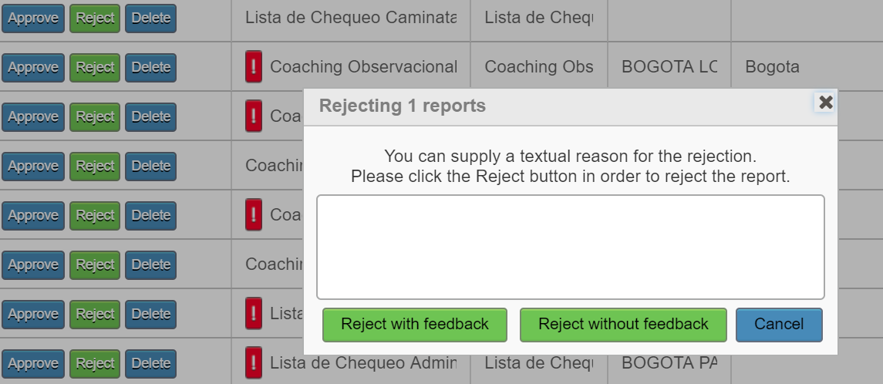
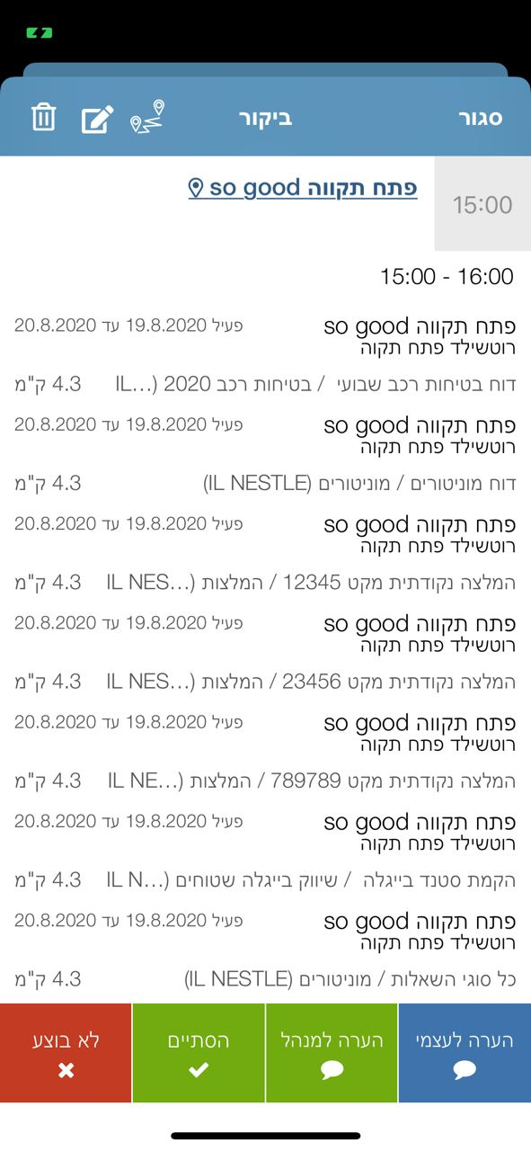
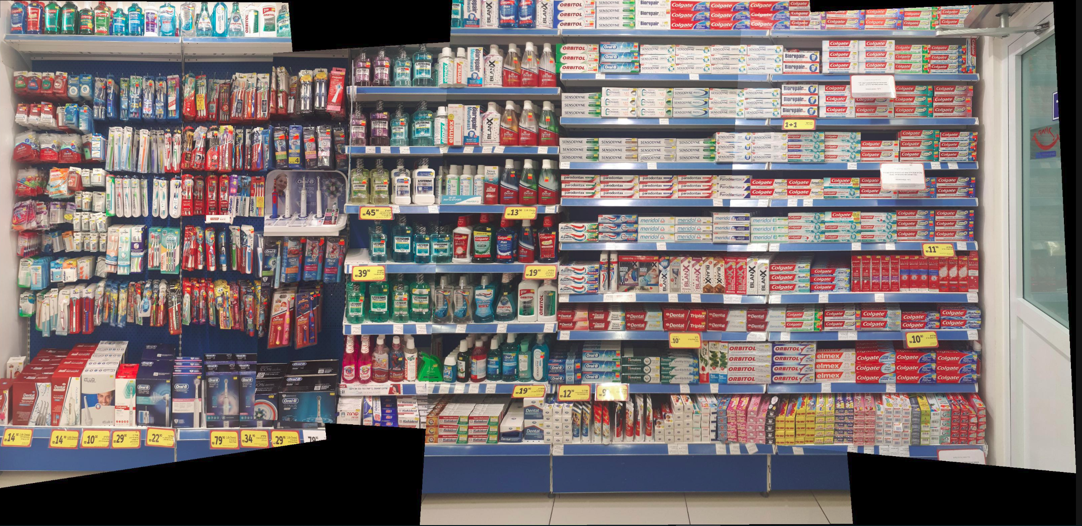
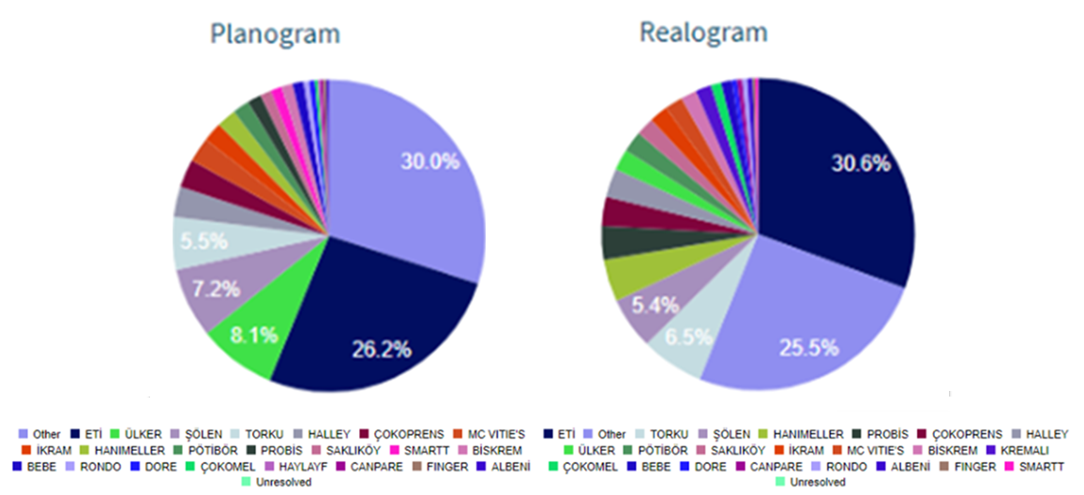
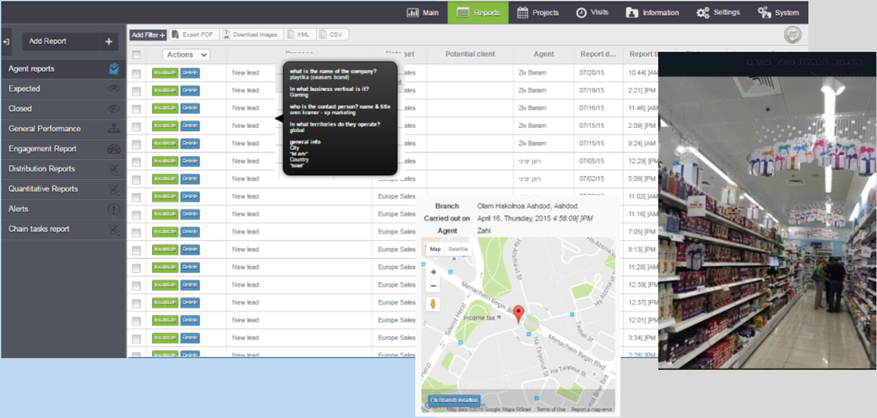
Product features
Comprehensive dashboarding mechanism
Real-time communication
Geolocation reporting
Representative has arrived to your location
Send SMS
Computer-vision-driven shelf analytics
Conclusion-based automatics
Digitize protocols, surveys, audits and more

Slide 11
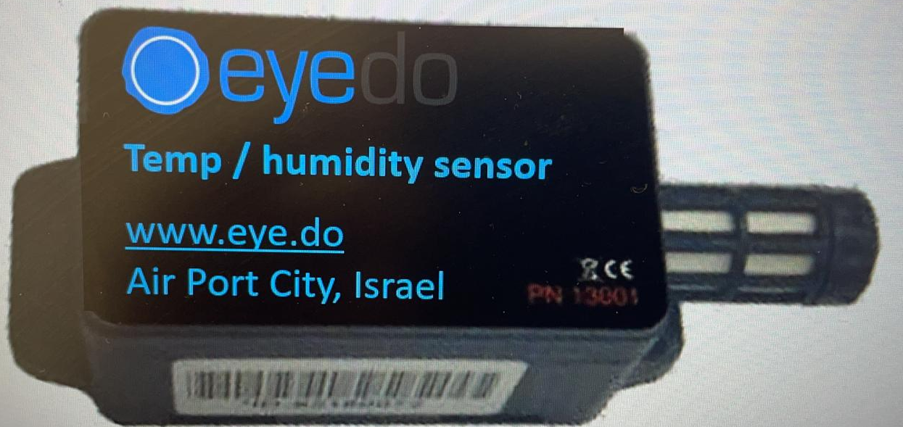
Sensor-based tasking

Slide 12
ESL integrated system

Slide 13
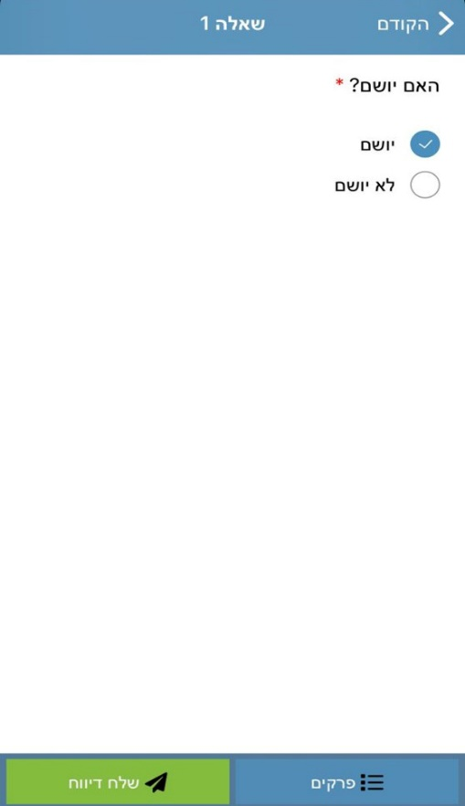
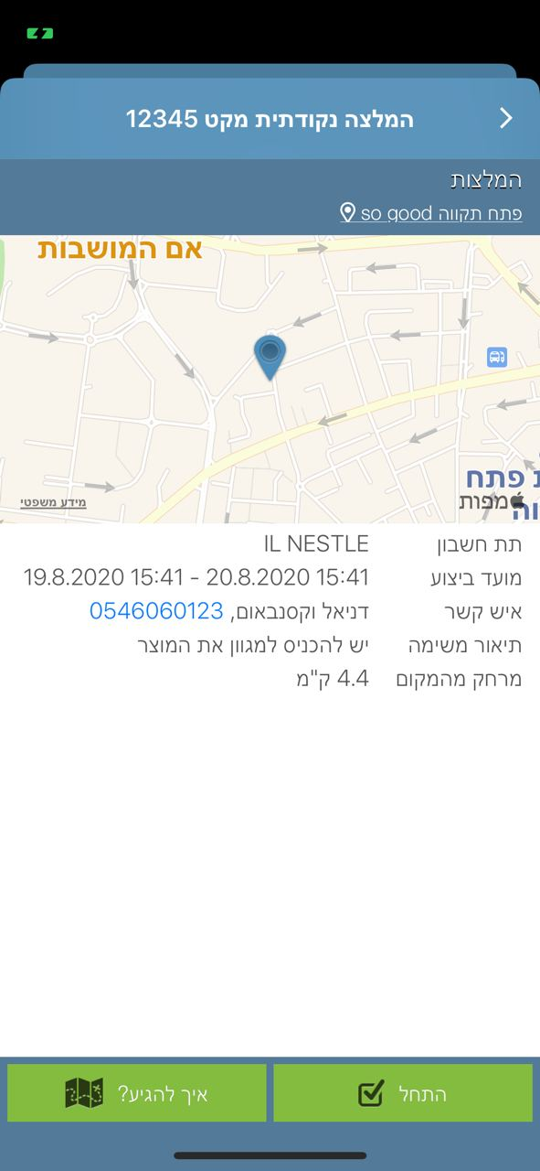
Usages in Retail
Regulatory compliance
Food safety
Promotions
Home-delivery automation
Availability management
Efficiency monitoring
Private brand
Planogram compliance
Safety
Security
HR surveys
Maintenance
Training
Customer experience
Cleaning
Signage
Recall
Data access

Slide 14
Use cases
Use case | Details | Results
Product launch | Successful launch includes thousands of actions that need to be executed, e.g. POS allocation planning, receive POS materials, receive products (all variants), receive planograms, complete setup | 100% execution
Regulatory compliance | Retailers need to comply with various regulators – municipalities, government, internal etc.; digitizing regulations helps HQ to manage real-time change, perform periodic recorded surveys, and make sure nothing is neglected or unprovable | Close to 100% recorded execution saves retailer internal resource (audits, follow up, damage control management) and money (fines and lawsuits)
Recall | Recall completion is complex; completion % is uncertain and liability is sometimes heavy | From ~85% execution within 2 days to 100% validated execution within 30 minutes

Slide 15
Use cases
Use case | Details | Results
Product availability | Product availability is tricky: you can put it in variety and even a planogram but an SKU may easily go OOS or become unavailable due to logistics or operational problems, or as a result of a client intervention; using computer-vision or manual structured tools for availability checks helps retailers to prevent sales loss | 4% lift in category revenues
Home-delivery automation | Home delivery depends on a complex integrated process: from online order, to pick fulfilment in branch, handling replacements, assigning a driver, and supplying within time window; automatic planning of all processes can significantly enhance retailer efficiency | 100% increase in order qty with only 40% increase in # of drivers

Slide 16
ROI
Eyedo ROI is disproportionately high in relation to its price.
Once you start using eyedo, you discover new things on a daily basis that it can help you to improve; eyedo’s main engine of business growth is driven by existing clients.
Using the right PAAS can replace other software and help reduce expense
Using one endpoint for a variety of operations saves implementation effort, integration and cost
Using eyedo can generate a 10- to 100-fold ROI, subject to depth of usage
Supermarket Chain
Convenience Store Chain
Drugstore Chain
«Eyedo is one of the tools that enables us to achieve operational excellence, providing better delivery and differentiating the customers’ experience»
«Our floor-time productivity has increased by 30%; eyedo makes operating each store much more efficient»
«Eyedo enabled us to increase retail execution from 50% to 95%»
VP Operations
CEO
Analyst

Slide 17
Onboarding timeline
Planning
4 weeks
Pilot
8-12 weeks
Rollout
TBD
Setup
4-10 weeks
Modules to be used
Roles and responsibilities
SOPS digitization
Training
Close to HQ
Hands on
Testing, focusing
Finalization of scope
Production setup according to pilot results
Creation of training materials
High- to mid-level management training
AI learning and integrations
Lower-level management and end-user training
Full operation

Slide 18
Thank You!
Ronen Yemini, CEO
ronen@eye.do
+97254-6665446

