Slide 1

חתפ
Digitation platform for retail players
eyedo
Field Operation Management Solutions
Proactivity. Productivity. Profitability.

Slide 2

The problem - Retail industry has unique challenges
Planograms not in place
Decentralized structures make standardization difficult to deploy
Uncontrolled changes are difficult to track and fix
Task execution is hard to validate
Store staff do not have easy access to data
Low efficiency
Signage not in place
2nd POS not in place
Fresh products compromised
Corrective actions not executed
Expired products on shelves
Recalled products on shelves
No regular checkups
Too much office time
Mis-matches
Regulations
not in place
These and more cause damage to equipment, fines, lawsuits, loss of sales, waste of man-hours and many more problems
All affecting the bottom line
Customers disrupt sales area
Fraud and stealth

Slide 3

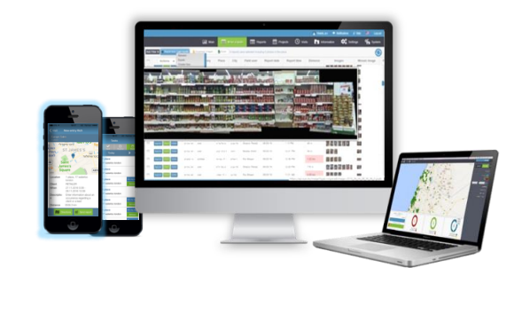
The solution
An all-round playing, end-to-end, robust, flexible and intuitive operations management platform
Decentralized structures make standardization difficult to deploy
Uncontrolled changes are difficult to track and fix
Task execution is hard to validate
Store staff do not have easy access to data

Slide 4
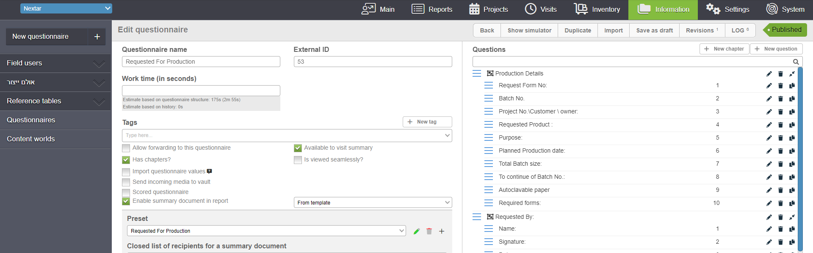
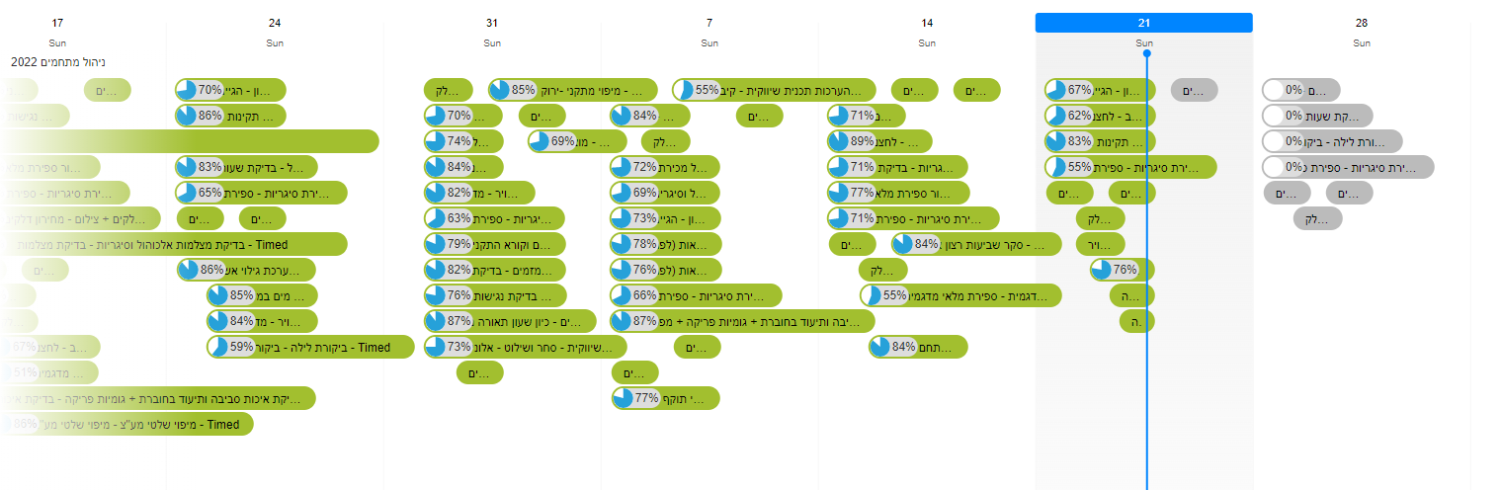
The product - An open-architecture digital platform that provides end-to-end capabilities
Create workflows
Publish to the appropriate population at relevant times

Slide 5

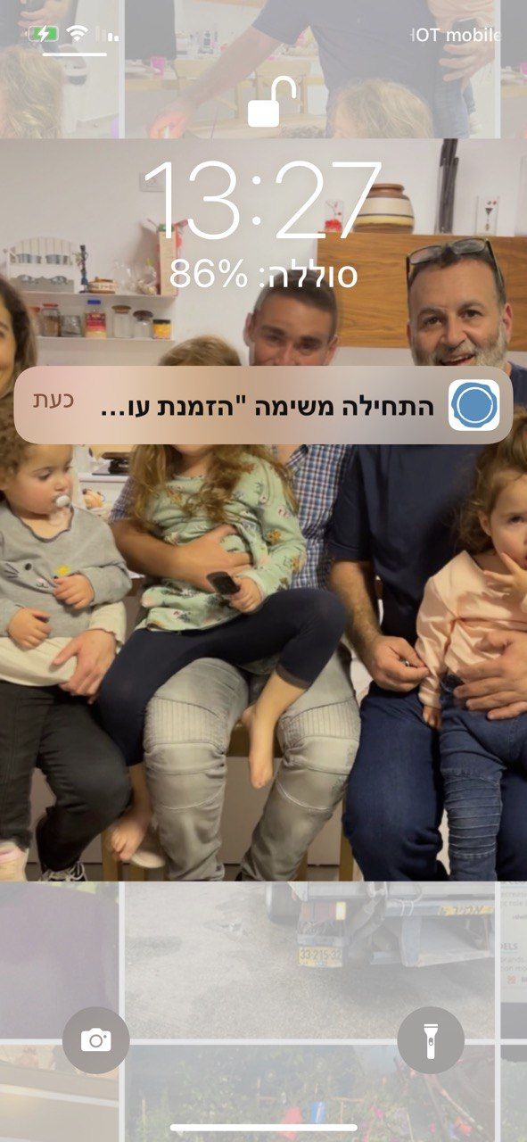
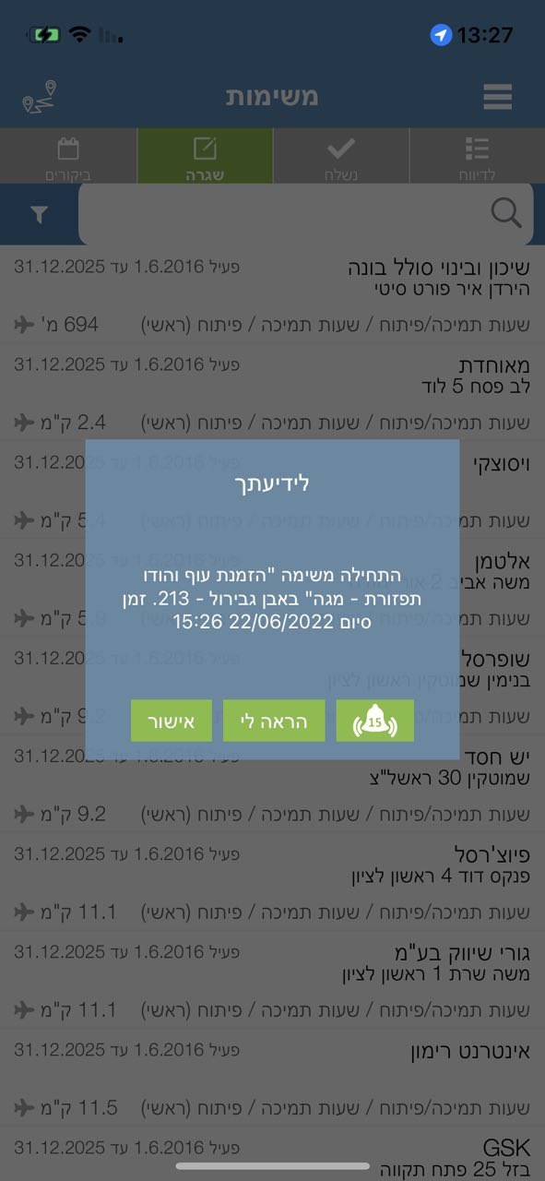
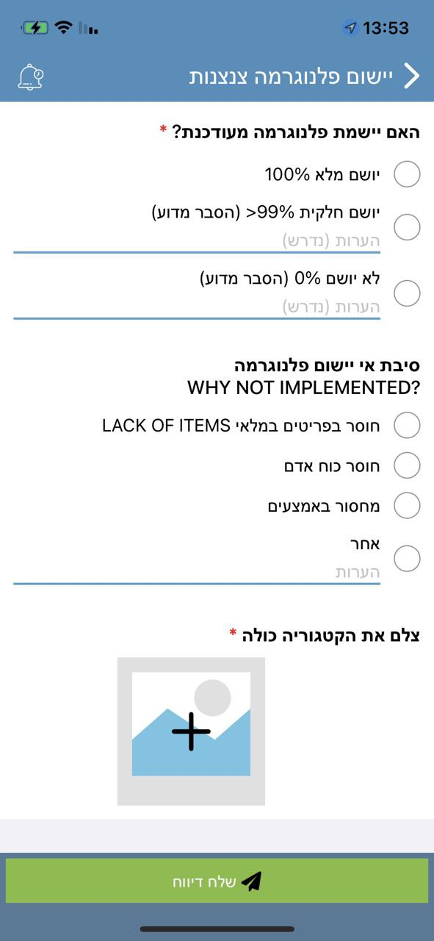

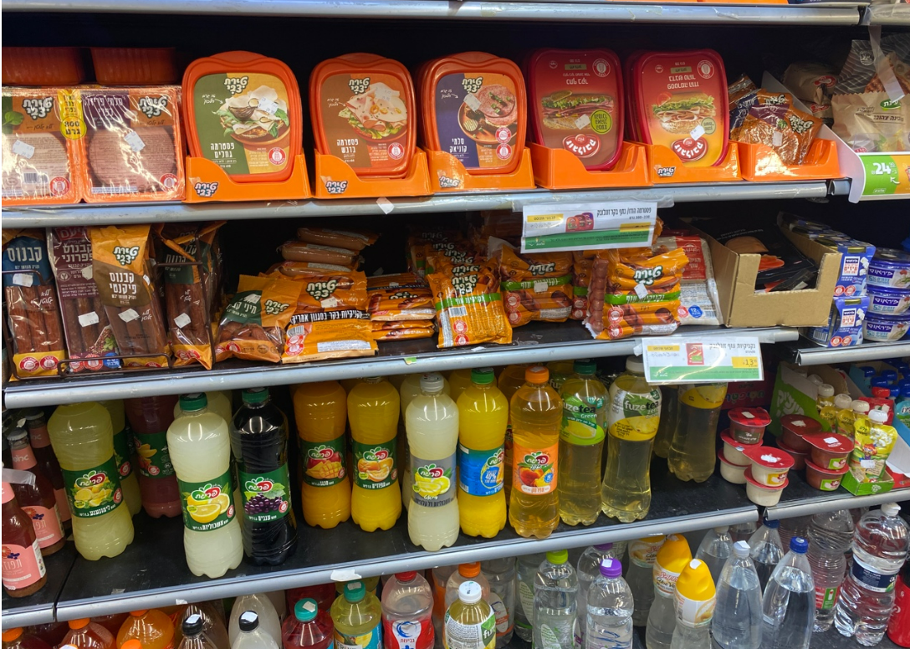
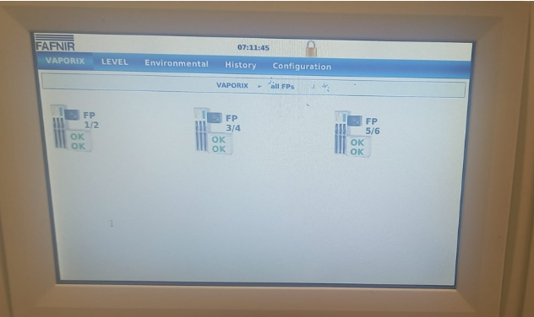
Store staff have easy-to-use endpoints
Everything they need to know or report in the palm of their hand
Predefined workflows, data reach and real-time analysis
Reminders at the right time

Slide 6
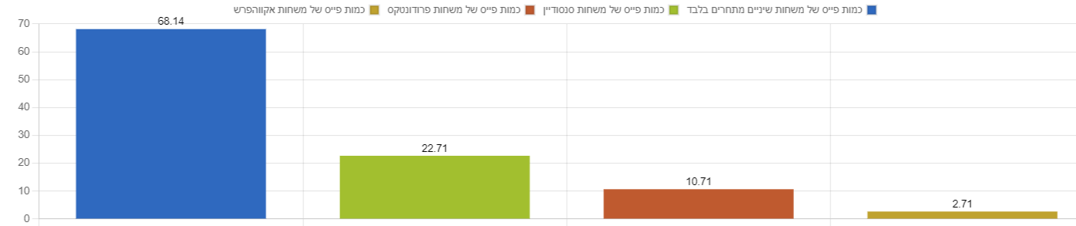
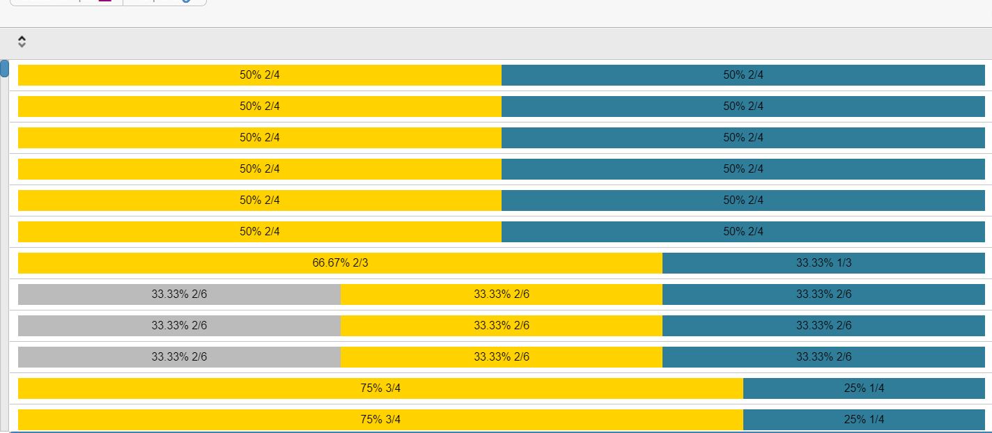
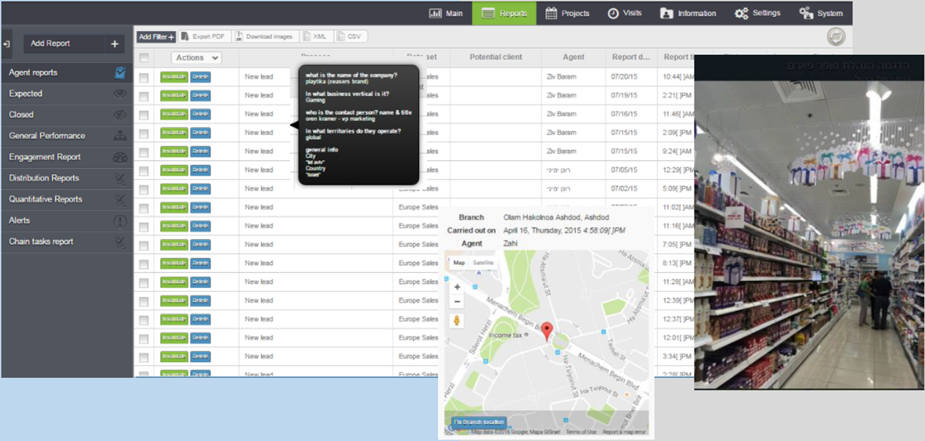
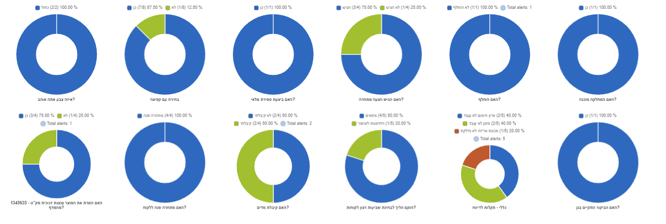
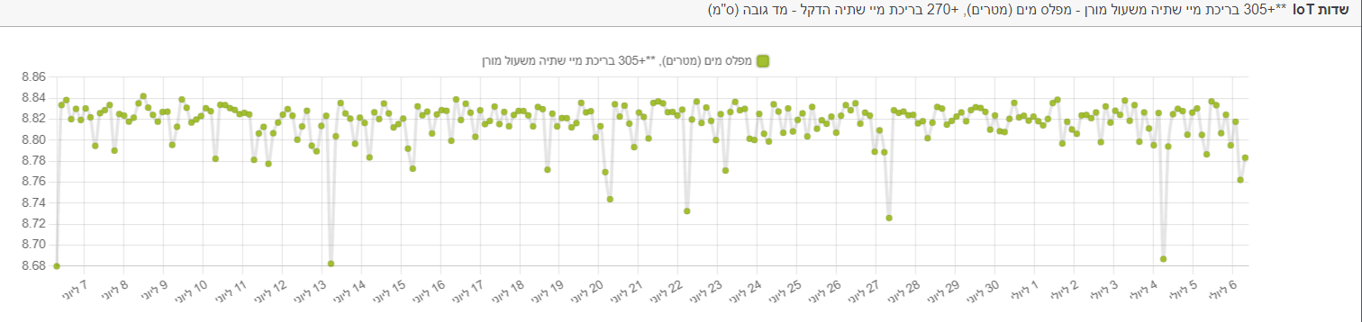
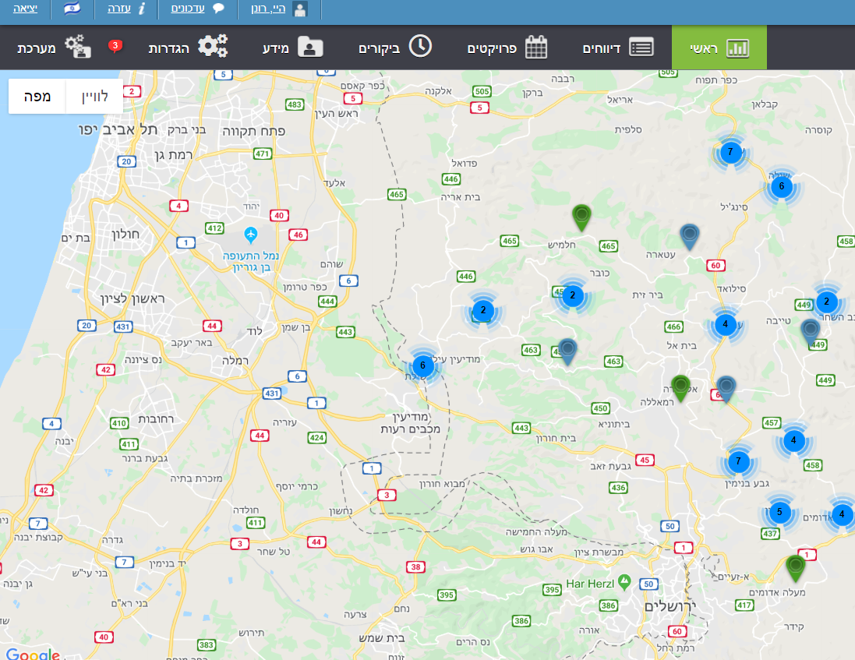
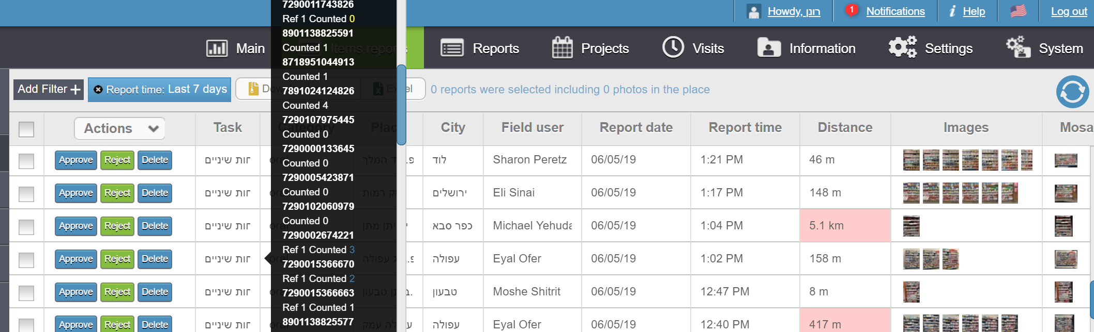
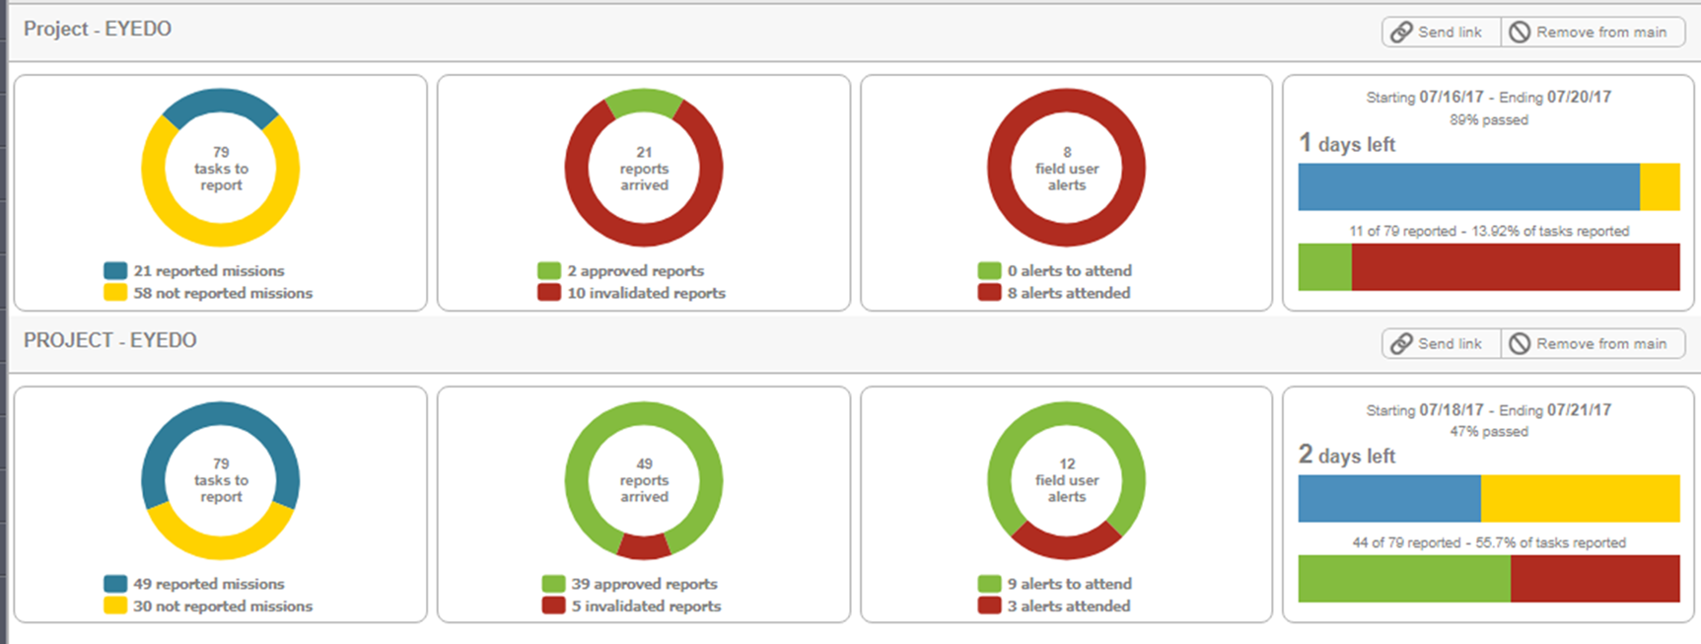
Decision-supporting presentations and robust simulation tools

Slide 7


eyedo’s impact
I’ve seen many technological tools being deployed and operated.
eyedo has changed everything I knew, being unexpectedly easy to deploy, compatible with almost everything and has created an immediate impact. ROI started to show immediately.
Shay Fromovitz
Operations Chief of Staff at Electra Food
Shufersal succeeded in delivering significant savings in the past 3 years by implementing lean culture and by using new digital tools to support its discipline. eyedo’s solution enables us to know in real time if a delivery is 100% or where it fails, as well as to maintain effective operational communication and real-time control.
David Laron
VP Operations and Supply Chain
Other users say:
We add millions to our revenues using eyedo’s unique tools
We make 12% streamlining, translated to more than a million-dollar savings
We finish a recall within 2 hours
300 employees self-onboard the app and the support team drinks coffee
Over 80% of new sales are Net Promoter Score® generated

Slide 8




























Some of eyedo’s users
R E T A I L
Other industries

Slide 9




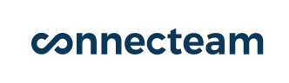

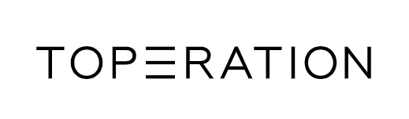
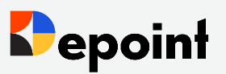
Competition
Performance and reliability
Innovation and market fitness

Slide 10
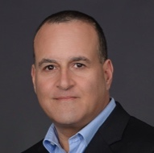



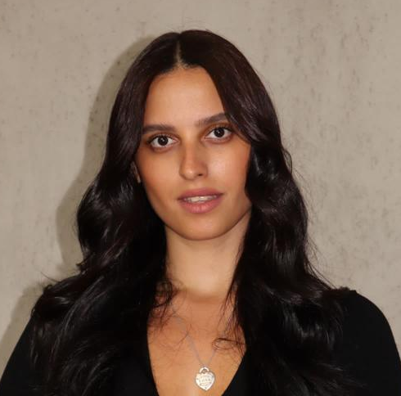

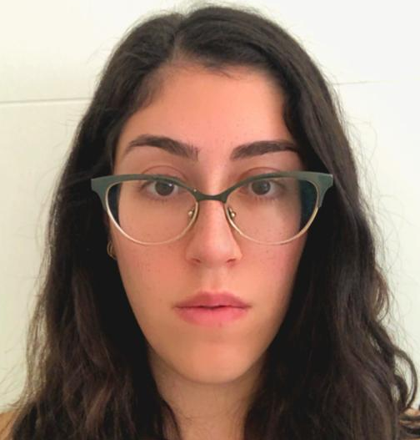
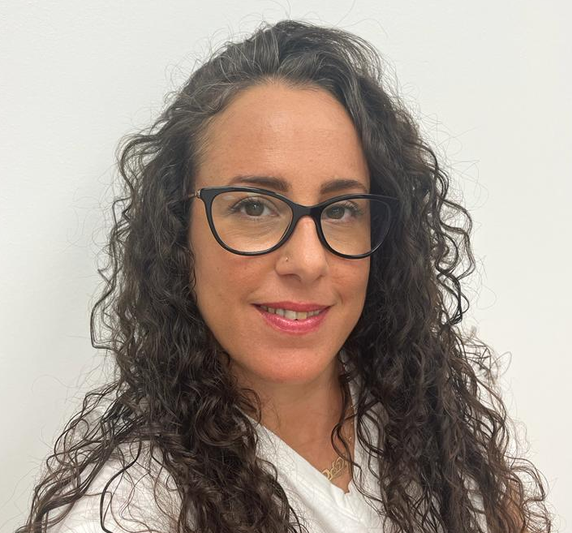
The people
Ronen Yemini
CEO and Product
Ex-P&G retail execution and QA owner
Daniel C Gindi
CTO and App developer
Mazal Shrem
Co-founder
Ex-Intel executive
Shlomi Ashkenazi Co-founder
Ex-CEO @ nextcom Ex-VP at HOT
Hagar Mirlman Customer support
Bar Beniloush
QA
Sari Shahar
Web developer
Naama Amit
Food safety expert

Slide 11
Cohort stats (retail)
Customer satisfaction supported an increase in # of users and revenues
* As a startup, eyedo has not fully charged clients for increased usage

Slide 12
Cohort stats (retail)
Customer satisfaction supported an increase in # of users and revenues
* As a startup, eyedo has not fully charged clients for increased usage

Slide 13




Opportunity
8700+ retailers in 80 developed countries
Top 15 retailers operate more than 250,000 stores
Less than 10% of retailers globally use a Field Service Management (FSM) solution
Retail has least FSM penetration
Source: Retail Index, Markets and Markets
Limited # of players offering FSM software in the global retail sector
Most of them are focused on other industries
Large software players are not flexible and very expensive

Slide 14
We raised $4m over 3 years
To start domestic and international sales operations and generate significant growth
To extend deep tech and unique feature development to increase product value
To implement international standards and maximize trust
To explore and develop support for additional industries
To become a successful, sustainable international company

Slide 15
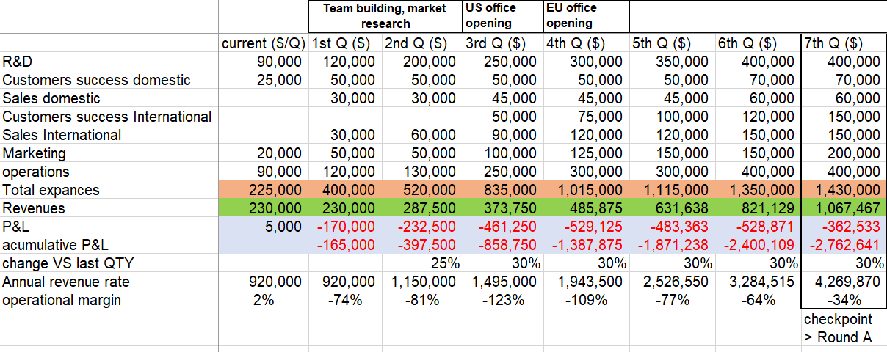
Operational plan (seed only)

Slide 16
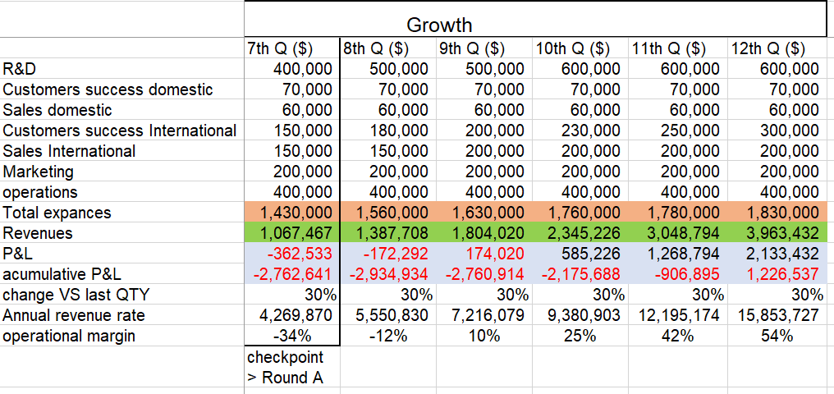
Operational plan (seed only)

Slide 17


Thank you!
www.eye.do
ronen@eye.do
972-54-6665446

