Slide 1
Fact Sheet - Health Management
1
2
3
4
Own representation “based on”:
Possible for all images.
Prerequisite:
other graphical representation +
changed terms/ descriptions/ translations +
intellectual output
Obtaining the rights via Interfoto
The permission for use is obtained and documented via Interfoto.
Prerequisite:
15 requests per script.
Requests that go far beyond this are obtained independently by the authors using our template and documented by the editors.
Public domain use
The use of an image is clearly in the public domain, which is documented (Word document).
Prerequisite:
The source is not from a database that we are not allowed to use.
Databases
Possible for all images.
Databases:
GettyImages
Thieme anatomy database
Google Maps
Statista

Slide 2
Fact Sheet – AI & Data Science
1
2
3
4
Own representation “based on”:
Possible for all images.
Prerequisite:
other graphical representation +
changed terms/ descriptions/ translations +
intellectual output
Obtaining the rights via Interfoto
The permission for use is obtained and documented via Interfoto.
Prerequisite:
15 requests per script.
Requests that go far beyond this are obtained independently by the authors using our template and documented by the editors.
Public domain use
The use of an image is clearly in the public domain, which is documented (Word document).
Prerequisite:
The source is not from a database that we are not allowed to use.
Databases
Possible for all images.
Databases:
GettyImages
Thieme anatomy database
Google Maps
Statista

Slide 3
Fact Sheet – IT & Technology
1
2
3
4
Own representation “based on”:
Possible for all images.
Prerequisite:
other graphical representation +
changed terms/ descriptions/ translations +
intellectual output
Obtaining the rights via Interfoto
The permission for use is obtained and documented via Interfoto.
Prerequisite:
15 requests per script.
Requests that go far beyond this are obtained independently by the authors using our template and documented by the editors.
Public domain use
The use of an image is clearly in the public domain, which is documented (Word document).
Prerequisite:
The source is not from a database that we are not allowed to use.
Databases
Possible for all images.
Databases:
GettyImages
Thieme anatomy database
Google Maps
Statista

Slide 4
Fact Sheet – Engineering
1
2
3
4
Own representation “based on”:
Possible for all images.
Prerequisite:
other graphical representation +
changed terms/ descriptions/ translations +
intellectual output
Obtaining the rights via Interfoto
The permission for use is obtained and documented via Interfoto.
Prerequisite:
15 requests per script.
Requests that go far beyond this are obtained independently by the authors using our template and documented by the editors.
Public domain use
The use of an image is clearly in the public domain, which is documented (Word document).
Prerequisite:
The source is not from a database that we are not allowed to use.
Databases
Possible for all images.
Databases:
GettyImages
Thieme anatomy database
Google Maps
Statista

Slide 5
Fact Sheet – Architecture
1
2
3
4
Own representation “based on”:
Possible for all images.
Prerequisite:
other graphical representation +
changed terms/ descriptions/ translations +
intellectual output
Obtaining the rights via Interfoto
The permission for use is obtained and documented via Interfoto.
Prerequisite:
70 requests per script.
Requests that go far beyond this are obtained independently by the authors using our template and documented by the editors.
Public domain use
The use of an image is clearly in the public domain, which is documented (Word document).
Prerequisite:
The source is not from a database that we are not allowed to use.
Databases
Possible for all images.
Databases:
GettyImages
Thieme anatomy database
Google Maps
Statista

Slide 6
Fact Sheet – Design
1
2
3
4
Own representation “based on”:
Possible for all images.
Prerequisite:
other graphical representation +
changed terms/ descriptions/ translations +
intellectual output
Obtaining the rights via Interfoto
The permission for use is obtained and documented via Interfoto.
Prerequisite:
70 requests per script.
Requests that go far beyond this are obtained independently by the authors using our template and documented by the editors.
Public domain use
The use of an image is clearly in the public domain, which is documented (Word document).
Prerequisite:
The source is not from a database that we are not allowed to use.
Databases
Possible for all images.
Databases:
GettyImages
Thieme anatomy database
Google Maps
Statista

Slide 7
Fact Sheet – Education
1
2
3
4
Own representation “based on”:
Possible for all images.
Prerequisite:
other graphical representation +
changed terms/ descriptions/ translations +
intellectual output
Obtaining the rights via Interfoto
The permission for use is obtained and documented via Interfoto.
Prerequisite:
15 requests per script.
Requests that go far beyond this are obtained independently by the authors using our template and documented by the editors.
Public domain use
The use of an image is clearly in the public domain, which is documented (Word document).
Prerequisite:
The source is not from a database that we are not allowed to use.
Databases
Possible for all images.
Databases:
GettyImages
Thieme anatomy database
Google Maps
Statista

Slide 8
Fact Sheet – Social Work
1
2
3
4
Own representation “based on”:
Possible for all images.
Prerequisite:
other graphical representation +
changed terms/ descriptions/ translations +
intellectual output
Obtaining the rights via Interfoto
The permission for use is obtained and documented via Interfoto.
Prerequisite:
15 requests per script.
Requests that go far beyond this are obtained independently by the authors using our template and documented by the editors.
Public domain use
The use of an image is clearly in the public domain, which is documented (Word document).
Prerequisite:
The source is not from a database that we are not allowed to use.
Databases
Possible for all images.
Databases:
GettyImages
Thieme anatomy database
Google Maps
Statista

Slide 9
Fact Sheet – Psychology & Medschool
1
2
3
4
Own representation “based on”:
Possible for all images.
Prerequisite:
other graphical representation +
changed terms/ descriptions/ translations +
intellectual output
Obtaining the rights via Interfoto
The permission for use is obtained and documented via Interfoto.
Prerequisite:
15 requests per script.
Requests that go far beyond this are obtained independently by the authors using our template and documented by the editors.
Public domain use
The use of an image is clearly in the public domain, which is documented (Word document).
Prerequisite:
The source is not from a database that we are not allowed to use.
Databases
Possible for all images.
Databases:
GettyImages
Thieme anatomy database
Google Maps
Statista

Slide 10
Fact Sheet – Therapy Sciences
1
2
3
4
Own representation “based on”:
Possible for all images.
Prerequisite:
other graphical representation +
changed terms/ descriptions/ translations +
intellectual output
Obtaining the rights via Interfoto
The permission for use is obtained and documented via Interfoto.
Prerequisite:
15 requests per script.
Requests that go far beyond this are obtained independently by the authors using our template and documented by the editors.
Public domain use
The use of an image is clearly in the public domain, which is documented (Word document).
Prerequisite:
The source is not from a database that we are not allowed to use.
Databases
Possible for all images.
Databases:
GettyImages
Thieme anatomy database
Google Maps
Statista

Slide 11
Fact Sheet – Law & PM
1
2
3
4
Own representation “based on”:
Possible for all images.
Prerequisite:
other graphical representation +
changed terms/ descriptions/ translations +
intellectual output
Obtaining the rights via Interfoto
The permission for use is obtained and documented via Interfoto.
Prerequisite:
25 requests per script.
Requests that go far beyond this are obtained independently by the authors using our template and documented by the editors.
Public domain use
The use of an image is clearly in the public domain, which is documented (Word document).
Prerequisite:
The source is not from a database that we are not allowed to use.
Databases
Possible for all images.
Databases:
GettyImages
Thieme anatomy database
Google Maps
Statista

Slide 12
Fact Sheet – BWL & Innovation
1
2
3
4
Own representation “based on”:
Possible for all images.
Prerequisite:
other graphical representation +
changed terms/ descriptions/ translations +
intellectual output
Obtaining the rights via Interfoto
The permission for use is obtained and documented via Interfoto.
Prerequisite:
25 requests per script.
Requests that go far beyond this are obtained independently by the authors using our template and documented by the editors.
Public domain use
The use of an image is clearly in the public domain, which is documented (Word document).
Prerequisite:
The source is not from a database that we are not allowed to use.
Databases
Possible for all images.
Databases:
GettyImages
Thieme anatomy database
Google Maps
Statista

Slide 13
Fact Sheet – MMN
1
2
3
4
Own representation “based on”:
Possible for all images.
Prerequisite:
other graphical representation +
changed terms/ descriptions/ translations +
intellectual output
Obtaining the rights via Interfoto
The permission for use is obtained and documented via Interfoto.
Prerequisite:
25 requests per script.
Requests that go far beyond this are obtained independently by the authors using our template and documented by the editors.
Public domain use
The use of an image is clearly in the public domain, which is documented (Word document).
Prerequisite:
The source is not from a database that we are not allowed to use.
Databases
Possible for all images.
Databases:
GettyImages
Thieme anatomy database
Google Maps
Statista

Slide 14
Fact Sheet – Personnel & Management
1
2
3
4
Own representation “based on”:
Possible for all images.
Prerequisite:
other graphical representation +
changed terms/ descriptions/ translations +
intellectual output
Obtaining the rights via Interfoto
The permission for use is obtained and documented via Interfoto.
Prerequisite:
25 requests per script.
Requests that go far beyond this are obtained independently by the authors using our template and documented by the editors.
Public domain use
The use of an image is clearly in the public domain, which is documented (Word document).
Prerequisite:
The source is not from a database that we are not allowed to use.
Databases
Possible for all images.
Databases:
GettyImages
Thieme anatomy database
Google Maps
Statista

Slide 15
Fact Sheet – Finance & Controlling
1
2
3
4
Own representation “based on”:
Possible for all images.
Prerequisite:
other graphical representation +
changed terms/ descriptions/ translations +
intellectual output
Obtaining the rights via Interfoto
The permission for use is obtained and documented via Interfoto.
Prerequisite:
25 requests per script.
Requests that go far beyond this are obtained independently by the authors using our template and documented by the editors.
Public domain use
The use of an image is clearly in the public domain, which is documented (Word document).
Prerequisite:
The source is not from a database that we are not allowed to use.
Databases
Possible for all images.
Databases:
GettyImages
Thieme anatomy database
Google Maps
Statista

Slide 16
IU International University
PROCEDURE USAGE RIGHTS
INFORMATION FROM CFE DESIGN

Slide 17
Principals
0
Variant 1) Own representation “based on”
1
Variant 2) Obtaining the rights
2
Variant 3) Public domain use
3
Variant 4) Our databases
4

Slide 18
PRINCIPALS

Slide 19
The rights of use must be clarified for all images in scripts and readers.
In the case of images, we do not invoke the right of quotation, but obtain the right of use for each illustration in writing.
This does not apply to public domain motifs or depictions “in imitation of”.
Mix & Match: Images from old scripts can be taken over if the editorial office has checked that the rights of use are on our sharepoint. Otherwise, these must also be requested if it is not an own representation.

Slide 20
Variant 1: OWN REPRESENTATION
“BASED ON”

Slide 21
Own representation “based on”
An image is changed in such a way that an intellectual contribution is recognizable.
To this end, it must:
contain other terms/information or examples
Alternatively, it may be a translation
AND: The graphic representation must differ from the original! The stronger the deviation, the better.

Slide 22
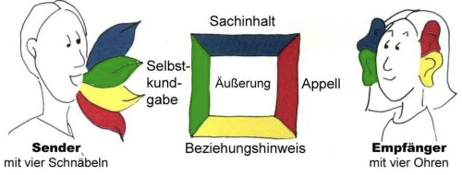
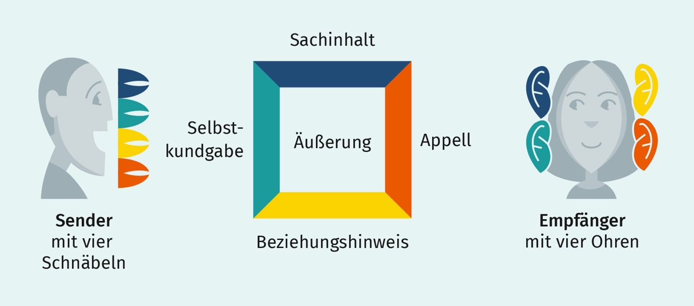
1. EXAMPLE 1
Original
Bad implementation:
nearly identical graphic design
same terms and descriptions
Notes:
Example 1
Subject content
Sender Self-expression
with four beaks Statement
Relationship references
Original
X
Bad implementation:
Nearly identical graphical design
Same terms and descriptions

Slide 23
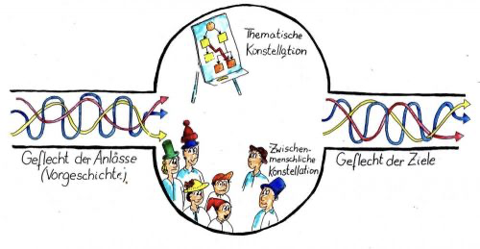
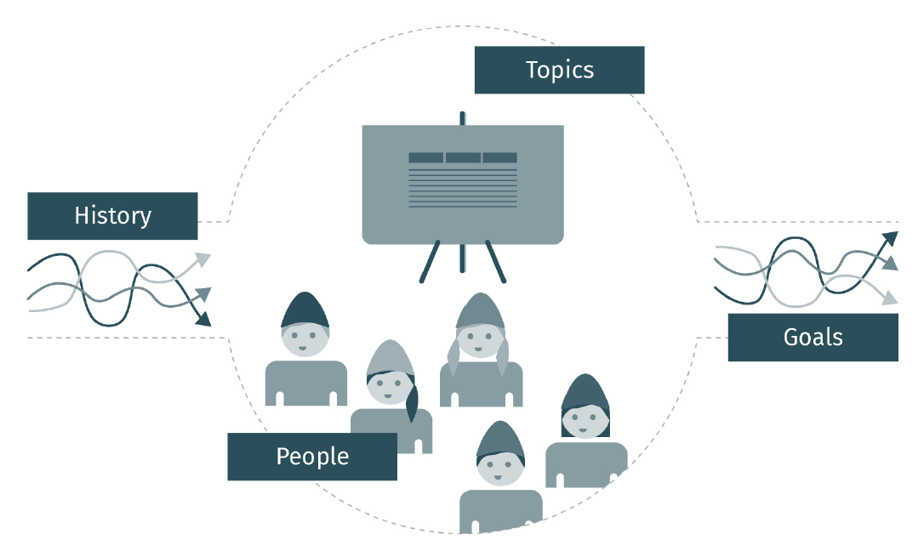
1. EXAMPLE 2
Original
Good implementation:
different graphical implementation
different terms
Notes:
Example 2
Thematical constellation
Network of events Network of targets
(prehistory) Interpersonal constellation
Original
Good implementation:
Different graphical design
Different terms

Slide 24
1. Procedure
The authors hand over the original graphic to the editors, together with as precise a written description as possible of how the graphic is to be changed. The media design team creates the new graphics on this basis.
The authors/editors note in the graphic submission to media design that the graphic is to be changed as much as possible and give media design free rein in the implementation.

Slide 25
Variant 2: OBTAINING OF THE RIGHTS
VIA INTERFOTO

Slide 26
Obtaining the rights via Interfoto
Rights of use are requested via Interfoto.
For this purpose, the authors create a graphic template for the editorial office, which contains the illustrations and the long sources. Several images can be packed into one template. One image counts as one request.
If there are several requests, they should be made in pieces (during the writing process) if possible, in order to have as much time as possible for clarification.
For scripts from spaceship XYZ, a maximum of X requests per script should be made to Interfoto.
The number may be slightly exceeded in case of justified necessity.
If further requests are necessary, the authors can also make their own requests for usage rights to the authors using the IU template. For this purpose, the document must be filled out accordingly and signed by the author at the end. This version will be stored on the sharepoint by the editorial office. No additional budget is available for obtaining rights of use on our own.

Slide 27
Obtaining the rights via Interfoto
For each image requested through Interfoto, a budget of 25 euros is available to be paid to the author.
If there are images for which no budget should be spent, this additional budget can be used for other images (because they are more important, for example).
Example: Image A absolutely has to be in the script, images B, C and D are rather optional. In the assignment of Interfoto, it can thus be noted that image A has an additional budget of 100 euros, as no additional money is to be spent for images B, C and D.

Slide 28
Variant 3: PUBLIC DOMAIN USE

Slide 29
Public domain use
The following license types may be used if the images do not originate from any image database:
This license lets others distribute, remix, adapt, and build upon your work, even commercially, as long as they credit you for the original creation.
This license lets others remix, adapt, and build upon your work even for commercial purposes, as long as they credit you and license their new creations under the identical terms.
This license lets others reuse the work for any purpose, including commercially; however, it cannot be shared with others in adapted form, and credit must be provided to you.
It should be noted here that the media design may only take the screenshot and the image cannot be changed under any circumstances.
https://creativecommons.org/licenses/?lang=de

Slide 30
Public domain use
The following license types may not be used
This license lets others remix, adapt, and build upon your work non-commercially, and although their new works must also acknowledge you and be non-commercial, they don’t have to license their derivative works on the same terms.
This license lets others remix, adapt, and build upon your work non-commercially, as long as they credit you and license their new creations under the identical terms.
This license lets others remix, adapt, and build upon your work non-commercially, as long as they credit you and license their new creations under the identical terms.
These versions cannot be taken because all scripts and readers are used in upskilling, which is why they are classified as commercial.
https://creativecommons.org/licenses/?lang=de

Slide 31
Variant 4: DATABASES

Slide 32
Our databases
For these databases, the rights of use do not need to be requested:
GettyImages
Thieme Anatomy Database
Google Maps
Statista
Other databases are not allowed.

Slide 33
GettyImages
Images from GettyImages can basically be incorporated into the scripts.
However, since the IU has limited access, not all images are included in our license.
If the graphic template is given to media design, media design will check if the image is included in our license.
You are welcome to note on the graphic template how it should be handled if the image is not included:
A) You note if you would like alternative suggestions. The media design will then find an alternative for you.
B) You note that you do not want an alternative and take the image out of the script after feedback.

Slide 34
Thieme Anatomy & Google Maps
Images from the Thieme Anatomy Database can be used without restriction.
Images from Google Maps can also be used without restriction.

Slide 35
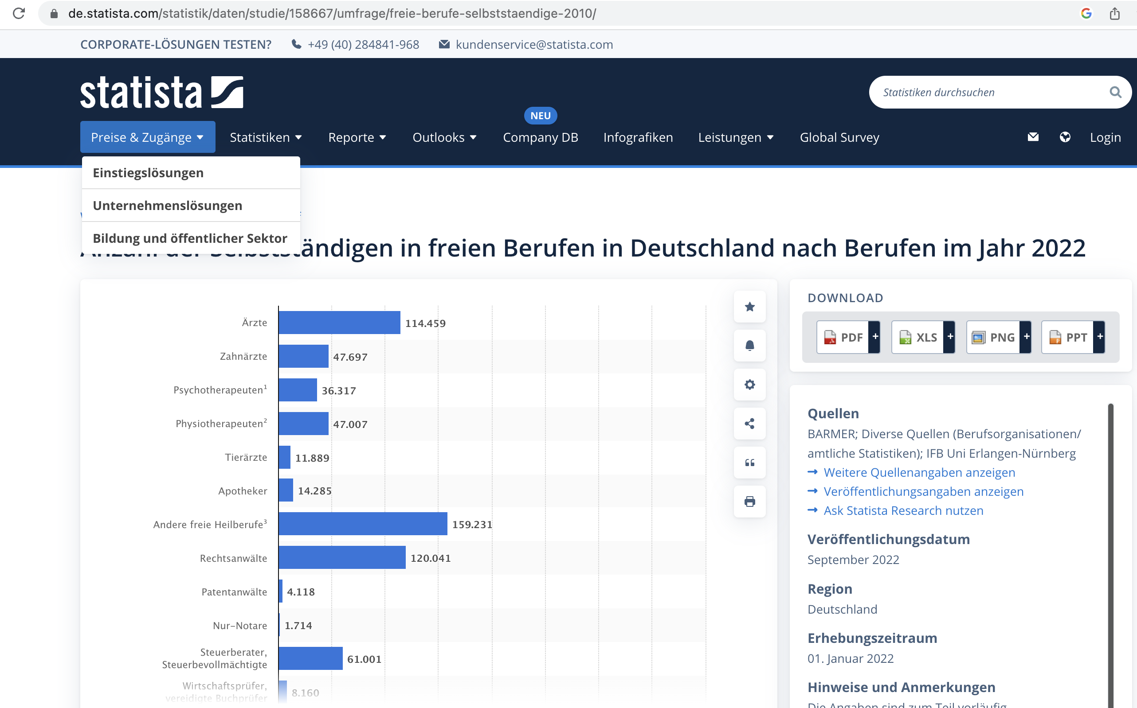
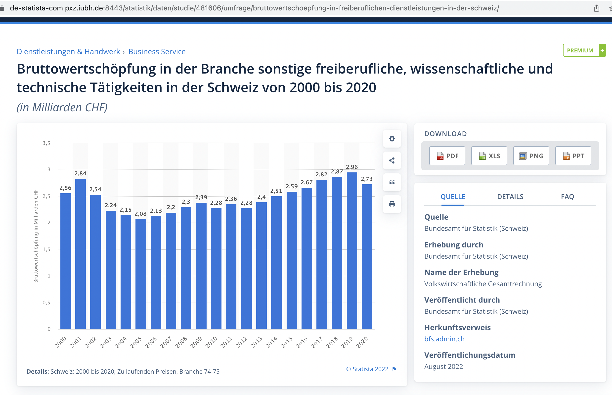
Statista
Statista data and images can only be accessed via MyCampus access.
Data and images that are not accessible via our license cannot be used.
Please make sure that the link to the image is included in the graphic template (marked red on the right).
Source: https://de.statista.com/statistik/daten/studie/158667/umfrage/freie-berufe-selbststaendige-2010/
Source: https://de-statista-com.pxz.iubh.de:8443/statistik/daten/studie/481606/umfrage/bruttowertschoepfung-in-freiberuflichen-dienstleistungen-in-der-schweiz/

Slide 36
Do not use other databases
Other databases like Pixabay, Istock, Wikipedia, Wikimedia etc. are not allowed for script and reader production.
Background: These pages are not managed properly by the creators and sometimes contain illegally acquired images, for which the page operators also regularly receive warnings.
Therefore, sometimes images are suddenly no longer accessible.
Please do not use any other databases except those listed in this presentation.

