Slide 1
Blender Financial Technologies Ltd.
Presentation for the Capital Market
The bankers of tomorrow are not bankers at all.
The bankers of tomorrow are technologists
who enable banking experiences your customers will use across the digital landscape
Brett King, Bank 4.0
Summary of activity
and revenue for 2022

Slide 2
Legal Disclaimer
This presentation constitutes the principle and marketing presentation of Blender Financial Technologies Ltd. and its subsidiaries (henceforth referred to, together, as "the Company" and/or "Blender" and/or "the Group") and is meant for marketing purposes. It does not constitute a public offering of securities by the Company and should not be construed as a public offering of securities by the Company. The information contained in this presentation is solely abridged information to be used as a general presentation of the Company and does not contain exhaustive data on the Company and its activities. The information contained in this presentation and any other information that may be provided when this presentation is presented (henceforth: "the Information") does not constitute a recommendation or the opinion of an investment advisor or a tax advisor. Investment in securities, and particularly, in the Company's securities, carries risk. One must bear in mind that past data is not necessarily indicative of future performance. Purchasing Company securities requires a thorough review of the data the Company publishes in the Company's reports on the Maya and Magna systems (henceforth: "Company Reports") and the performance of a legal, financial, fiscal, and accounting analysis of that data. The presentation contains additional data that will not be displayed in Company Reports to the public and/or information displayed differently than how it will be displayed in the Company Reports to the public. The presentation is not designed to substitute for a review of Company Reports, whenever they are publicized by the Company. In the event of a contradiction between this presentation and Company Reports, the content of the Company Reports shall prevail.
Forward-looking Information Disclaimer
The Company’s forecasts and assumptions specified in this presentation regarding the consolidation of LTL’s financial results, receipt of the banking licence in Europe and the completion of the LTL acquisition as a result (slides 4, 5, 6, 7, 17, 23 and 24); receipt of the licence for providing credit from the Capital Markets Authority to enable BNPL’s activity and the expected start date of said activity (slides 6, 13 and 15); the anticipated risk of failure rate in Israel for 2022 (slide 11); the strategy for activity in Europe after the banking licence is obtained (slide 17); and the accelerated growth in car financing activity (slide 14), are all considered forward-looking information, as defined in the Securities Law of 1968. Among other things, this information is based on the Company’s assessments regarding developments and events that may or may not take place at an uncertain time in the future that are not within the Company’s control.
By nature, forward-looking information might not materialise as it is uncertain, as aforementioned. Whether forward-looking information materialises or not may be affected by risk factors inherent in the Company’s activity, developments in the financial environment in which the Company operates and external factors, including regulation, that can affect its activity. Therefore, it is hereby emphasised and clarified that the Company’s actual future results and achievements may fundamentally differ from the forward-looking information presented here.
For the removal of doubt, let it be clear that the Company does not undertake to update and/or change the information included in the presentation to reflect events and/or circumstances that occur after the presentation has been prepared.

Slide 3
Our Mission
To provide fast and innovative credit solutions according to our clients preferences and needs

Slide 4
Blender’s Success by the Numbers
4
67K
62M
697M
1.4B
Countries:
Israel, Lithuania, Latvia, and Poland
Paying customers
Total annual revenue
Credit portfolio balance
Total financed loans
40%
60%
53%
Financial data in NIS and is accurate as of December 31, 2022; including loans in the credit brokerage system; the rate of increase in revenues and the growth data refer to December 31, 2022 compared to the year 2021; NON-GAAP gross revenues

Slide 5
Blender’s Credit Platform
Blender Car
Investors )P2P(
Blender Pay
Targeted credit solutions
Diverse funding sources
Bank LOC
←
Credit Platform Rating 2.0™
משקיעים ←
מימון / הלוואה
←
Blender Loan
Institutional Facilities
Blender Mortgage Solutions

Slide 6
Key Events from the IPO
January 2021 – March 2023
February 2022
Line of Credit established for car loans from Mizrahi Bank for approximately NIS 50 million
January 2021
IPO at the Tel Aviv Stock Exchange
March 2023
Launching of blenderPay BNPL
January 2023
All approvals received for blenderPay BNPL
December 2022
Completion of rights issue and loans for NIS 22 million
November 2021
Agreement signed establishing the blenderPay BNPL company with Bank Hapoalim
February 2021 blenderPay for E-commerce solution launched for
E-commerce online checkouts
September 2021
Extended consumer credit brokerage licence obtained
Israel
May 2022
LOC obtained from the Pollen Street Capital investment fund for a total funding of € 50 million
January 2022 Credit activity extended in Poland
November 2021
4th LOC received from the French investment group Eiffel, for total funding of € 18 million
April 2021 A 3rd LOC (line of credit) received from the French investment group Eiffel
December 2022- March 2023
Cancelation of the LTL deal and return of the investment money
Europe
February 2022
Acquisition of the LTL credit union in Lithuania
Notes:
נחש שני קווים (ישראל אירופה) כל אחד בצבע שונה, כל אירוע בעיגול בצבע הרלוונטי לגאוגרפיה

Slide 7
Maintaining growth while striving for profitability
Significant growth of approximately 53% in the credit portfolio in the 4th quarter of 2022 (millions of NIS)
53%
Growth
Managed credit portfolio including loans in a credit brokerage system as of December 31, 2022

Slide 8
Maintaining growth while striving for profitability
Increase of about 70% in the group's income 2022
(thousands of NIS)
70%
Growth
NON-GAAP gross revenues include interest from loans in a credit brokerage system; Financial data in thousands of NIS as of December 31, 2022

Slide 9
Technological leadership for fast and accurate credit underwriting
Fast underwriting
Big data systems
Credit risk assessment in seconds without prior client acquaintance
Broad mapping using a variety of information sources for forecasting and managing credit risks
Rating2.0™
Blender’s specially developed underwriting and credit rating system, which allows the customer to receive digital credit quickly and accurately
Secured Integral Architecture
Fraud Prevention
A multi-dimensional model for credit risk assessment and fraud prevention
A robust Salesforce-based financial system, which significantly improves work processes and the ability to interface with databases
Digital
An advanced, accessible, and simple digital platform without forms or paperwork
Notes:
Rating2.0TM

Slide 10
Fast and efficient customer experience
6 steps in 30 seconds
Collateral valuation & underwriting
(vehicle/real estate)
6
5
1
Onboarding (store, car agency, e-commerce site)
Advanced client identification & authentication
30
Seconds to get a loan
4
2
Client rating and maximum loan amount
Client check with Blender’s propriety platform
3
Profile creation and signing based on a variety of advanced information sources
30 seconds - minimal time

Slide 11
Digital Financing Solutions
11

Slide 12
in collaboration with
The preferred option for payment installments for large purchases in Israel
Activity began in March 2023 with a wide spread of thousands of distribution points
Growth in distribution points
A joint venture
80% owned by Blender 20% by Bank Hapoalim, with an initial financing volume of approximately NIS 40 million from Bank Hapoalim
Technology enabling payment through extended installments through rapid, non-bank credit at points of sale
Potential market of NIS 30 billion annually for large purchases in Israel (excluding vehicles)

Slide 13
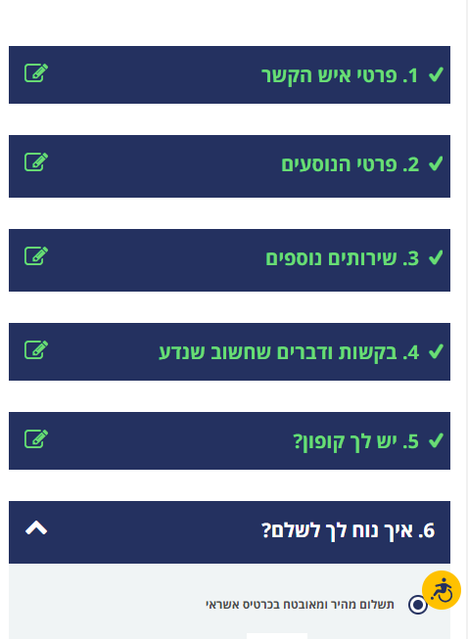
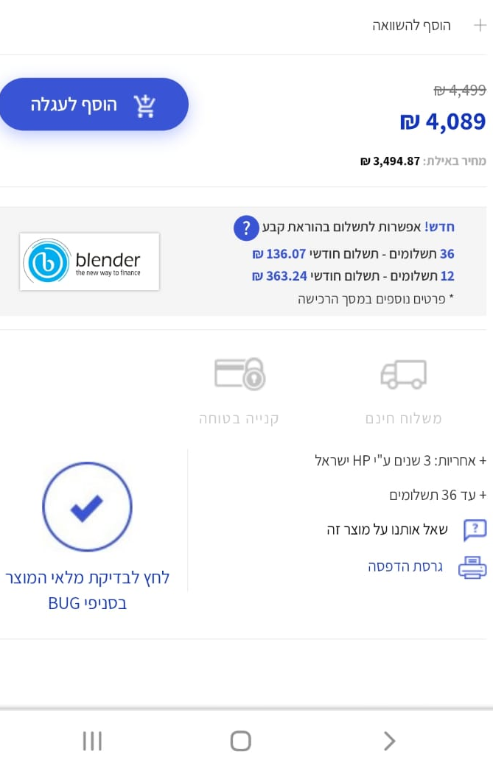
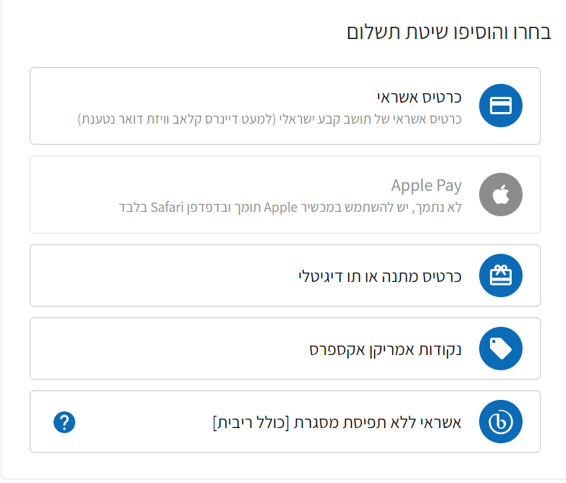
blenderPay- The leader in the BNPL field in Israel
A complete and unique solution for E-commerce sites for leading brands

Slide 14
blenderCar
The fastest option for car loans in Israel and Europe
In collaboration with:
Transaction authorization within seconds -no forms or paperwork!
Wide selection of car dealers that operate with blenderCar in Israel and Europe
Convenient and easy-to-use digital platform for car dealers
A unique technology with a holistic system of rapid credit evaluation and establishment
Wide installment spread tailored to the customer’s needs

Slide 15
Blender Israel: beyond profit
Increase in profits
(in thousands of NIS)
Profits by fiscal half-years
(in thousands of NIS)
Financial data in NIS in the credit brokerage sector as of December 31, 2022

Slide 16
Blender Israel: Continued growth in revenue and credit portfolio
Revenue in Israel
(thousands of NIS)
Total credit portfolio
(thousands of NIS)
Shift to profit while investing in growth
Significant growth in the credit portfolio
114%
Growth
57%
Growth
PROFIT
NON-GAAP gross revenues that include interest from loans in a credit brokerage system; Financial data in NIS as of December 31, 2022

Slide 17
Blender Israel: increased volume of loans
Paying customers
Total loans provided (in thousands of NIS)
Consistent growth in the number of customers
Significant growth from the corresponding quarter in the previous year
41%
Growth
86%
Growth
132%
Growth
Loans in a credit brokerage system; Financial data in NIS as of December 31, 2022

Slide 18
Blender Europe
Revenue (thousands of NIS)
Total credit portfolio (thousands of NIS)
41% Growth
24% Growth
Financial data in NIS regarding loans provided in Europe as of December 31, 2022

Slide 19
Proven and Meticulous Credit Risk Management in a Dynamic Market with Changing Interest Rates
Europe
Israel
Blender Israel
Proven underwriting and risk management model
A safeguard fund, unique in the industry, to protect investors from borrower default
Credit risk insurance for the safeguard fund by an international insurance company
Diversifying loan origination while promoting collateral based loans
Controlled and supervised lender and borrower processes
Blender Europe
Proven underwriting and risk management model
Increasing the financial margin
Controlled and supervised credit provision process
Provisions for
Credit Portfolio Balance
Interest APR
Interest APR
As specified in the security fund’s articles of association and the insurance policy. Data is accurate as of December 31, 2022. The failure rate in Israel for 2021 was estimated at between 2.3% and 3.6% as detailed in the 2021 periodic report. The failure rate for 2020 was estimated between 2.3% and 3.4% as detailed in the periodic report for 2020.
APR for loans placed in the relevant year, as calculated at the time the loan was placed.

Slide 20
Summary of Activity for 2023
Focused activity in Israel as a profit center:
Development and growth of blenderPay in collaboration with Bank Hapoalim
Increase in blenderCar activity
Entered the field of real estate and mortgage financing
Increased variety of financing sources: new lines of credit and strengthening of P2P activity
Europe:
Focus on countries where activity is already taking place, and striving for positive cash flow

Slide 21
Adjusted EBITDA - Half-year financial reports for 2022
Decrease of about 67% in loss in the second half of 2022
Change
% | NIS | 1-6/22 | 7-12/22
40% | 5,143 | 12,930 | 18,073 | Gross revenue
(32%) | 3,314 | (10,244) | (6,930) | Reported net loss
(50%) | (486) | 973 | 487 | Depreciation and amortization
26% | 34 | 134 | 168 | Legal expenses for settling a lawsuit
6% | 25 | 388 | 413 | Share-based payment
118% | 850 | 720 | 1,570 | One-time costs for an international bank license and international line of credit
 | 243 | 10 | 253 | Income taxes
 | 308 | - | 308 | Share-based advertising expenses
 |  | (675) | 837 | Net financing expenses that are not attributable to current activity
(67%) | 5,800 | (8,694) | (2,894) | Adjusted EBITDA
נתונים כספיים באלפי ש"ח נכון ל-31 בדצמבר 2022;

Slide 22
Adjusted EBITDA Annual reports
Change
% | NIS | 2021 | 2022
75% | 13,312 | 17,691 | 31,003 | Gross revenue
(18%) | 3,718 | (20,892) | (17,174) | Reported net loss
5% | 63 | 1,397 | 1,460 | Depreciation and amortization
66% | 120 | 182 | 301 | Legal expenses for settling a lawsuit
24% | 155 | 646 | 801 | Share-based payment
209% | 1,548 | 742 | 2,290 | One-time costs for obtaining an international bank license and international credit line
((19% | (61) | 324 | 263 | Income taxes
50% | (314) | 622 | 308 | Noncash advertising expenses
(82%) | (736) | 898 | 162 | Net financing expenses that are not attributable to current activity
(28%) | 4,493 | (16,081) | ((11,589 | Adjusted EBITDA
Financial data in thousands of NIS as of
December 31, 2022;

Slide 23
Financial data
Profit and loss (thousands of NIS)
 |  | For the years ending on December 31st
 |  | 2022 | 2021 | 2020
Credit operations fees |  | 22,059 | 11,173(*) | 9,588(*)
Income from Interest on loans to customers |  | 8,944 | 6,518(*) | 5,159(*)
Total revenue, gross |  | 31,003 | 17,691 | 14,747
Credit loss provisions |  | (1,815) | (381) | (1,191)
Interest expenses related to lending activity |  | (5,354) | (5,013) | (3,599)
Total revenues, net |  | 23,834 | 12,297 | 9,957
Costs for services |  | (10,402) | (7,296) | (5,544)
Research and development costs |  | (2,218) | (1,595) | (8,555)
Sales and marketing expenses |  | (10,266) | (8,517) | (5,020)
Administrative and general expenses |  | (17,697) | (14,559) | (14,548)
Total operating expenses |  | (40,583) | (31,967) | (33,667)
Financial expenses |  | (162) | (898) | (347)
Income taxes |  | (263) | (324) | (132)
Loss for the year |  | (17,174) | (20,892) | (24,189)
Net profit (loss) attributed to non-controlling interests |  | 16 | (19) | (5)
Net loss attributable to the company's shareholders |  | (17,190) | (20,873) | (24,184)
(*) reclassified

Slide 24
Financial data
Balance sheet (thousands of NIS)
 | Through December 31st
 | 2022 | 2021
Liabilities and equity
Current liabilities:
Current liabilities for loans | 23,695 | 19,365(*)
Credit balances from service providers | 2,377 | 1,182
Eligible credit and remaining credit | 6,370 | 7,556(*)
Current liabilities for lease obligations | 685 | 528
Total current liabilities | 33,127 | 28,631
Non-current liabilities:
Other long-term liabilities | - | 510
Long term loans | 69,921 | 41,793
Lease obligations | 3,097 | 3,460
Total non-current liabilities | 73,018 | 45,763
Total liabilities | 106,145 | 74,394
Equity:
Share capital | 97 | 74
Premiums on shares | 154,146 | 142,040
Transformation fund | 88 | 14
Venture capital fund | 23,921 | 22,002
Accumulated loss | (114,924) | (97,734)
Total equity attributable to the company owners | 63,328 | 66,396
Rights that do not confer control | (7) | (23)
Total equity | 63,321 | 66,373
Total liabilities and capital | 169,466 | 140,767
(*)סווג מחדש
 | Through December 31st
 | 2022 | 2021
Assets
Current assets:
Cash and cash equivalents | 31,533 | 64,928
Limited cash assets | 18,499 | 139
Debt obligations from LTL Credit Union | 14,655 | -
Other debt obligations | 7,599 | 6,476
Current availability of loans to customers | 23,823 | 16,501
Total current assets | 96,109 | 88,044
Non-current assets:
Loans to customers, net | 62,784 | 43,923
Fixed assets, net | 1,598 | 1,336
Intangible assets | 4,860 | 3,041
Right-of-use assets | 3,626 | 3,914
Other long-term debt obligations | 46 | 101
Long-term limited cash assets | 443 | 408
Total non-current assets | 73,357 | 52,723
Total assets | 169,466 | 140,767

Slide 25
Financial data
Profits and losses by sectors (thousands of NIS)
For the year ending December 31, 2022
 | Credit brokerage | Credit | Adjustments | Total
Revenue
Credit operation fees | 21,787 | 272 | - | 22,059
Income from interest on loans to customers | - | 8,944 | - | 8,944
Total revenue, gross | 21,787 | 9,216 | - | 31,003
Interest expenses related to lending activity |  | (5,354) | - | (5,354)
Credit loss provisions |  | (1,815) | - | (1,815)
Total revenue, net | 21,787 | 2,047 | - | 23,834
Total profit (loss) by sector. | 3,636 | (7,789) | - | (4,153)
Research and development costs | - | - | (1,864) | (1,864)
Administrative, general and other expenses | - | - | (10,732) | (10,732)
Total operating profit (loss). | 3,636 | (7,789) | (12,596) | (16,749)
Sector assets and liabilities
Loans to customers | - | 86,607 | - | 86,607
Loans received | - | (93,616) | - | (93,616)

Slide 26
THANK YOU

