Slide 1
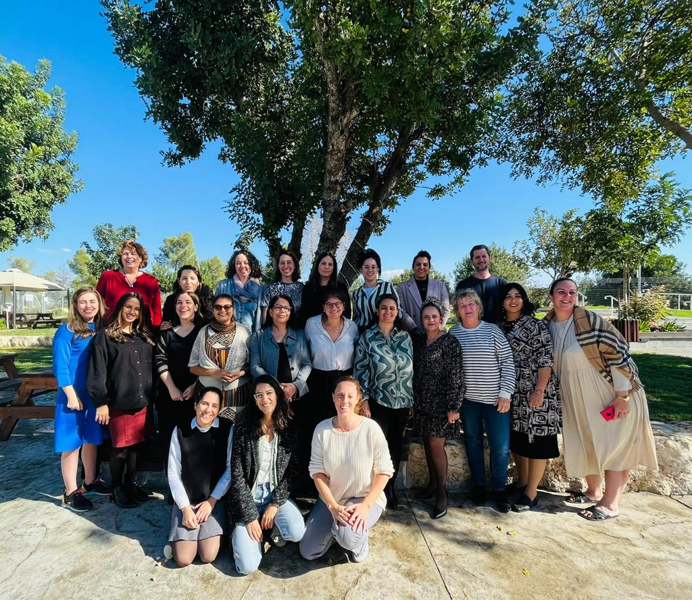



Urban95 IL National Expansion Program
National Trends and Evaluation of Professional Trainings in 2022
April 2023
צילום: "מסע"

Slide 2
תוכן העניינים
מגמות ארציות ב- 2020/21 בתחומי חיים שונים, לפי קבוצות אוכלוסייה..............................................................................3-8
מגמות ארציות בתחומי שייכות, דיגיטל ובריאות, לפי קבוצות אוכלוסייה.............................................................................................................4
מדדי איכות חיים בישראל, פערים בין יהודים לערבים................................................................................................................................................5
מדדי איכות חיים בערים הגדולות.....................................................................................................................................................................................6
מדדי איכות חיים בבית שמש ובאשדוד – השוואתי......................................................................................................................................................8
הערכת הכשרות מקצועיות לקהלי היעד השונים במהלך 2022...........................................................................................9-31 דגשים מן הספרות לקראת התרחבות מערך ההכשרות לקהל ערי הרשת......................................................................................................10
רקע: מערך הכשרות מקצועיות 2022..........................................................................................................................................................................11
רקע על הכשרות עבור קהל יוצרי המרחב הבנוי......................................................................................................................................................12
שביעות רצון כללית מההכשרות: קהל יוצרי המרחב הבנוי...................................................................................................................................13 תרומות הכשרות: קהל יוצרי המרחב הבנוי................................................................................................................................................................14
רקע על ההכשרות: קהל בעלי תפקידים ברשויות העוגן........................................................................................................................................15
תרומות הכשרות: קהל בעלי תפקידים ברשויות העוגן...........................................................................................................................................16
רקע על ההכשרות: קהל יעד צוותים עירוניים...........................................................................................................................................................17
תרומות הכשרות: קהל יעד צוותים עירוניים..............................................................................................................................................................18
סיכום: תרומות ההכשרות עבור קהלי היעד השונים...............................................................................................................20
מקרה בוחן- הכשרת מנהיגות לצוותים עירוניים................................................................................................................................................21-25
רקע על הכשרת מנהיגות לצוותים עירוניים..............................................................................................................................................................22
תרומות הכשרת מנהיגות: משוב סיכום......................................................................................................................................................................23
תרומות הכשרת מנהיגות: משובי פעילויות................................................................................................................................................................24
דוגמאות ליישום רעיונות בהשראת ההכשרה – אשדוד...........................................................................................................................................25
סיכום: השוואה בין סוגי ההכשרות..........................................................................................................................................26
סיכום: השוואה אל מול מדדי המודל הלוגי...............................................................................................................................27
נספח א' - משוב הכשרות קהל יוצרי המרחב הבנוי ובעלי תפקידים ברשויות עוגן.........................................................................................28
נספח ב' - משוב הכשרות צוותים עירוניים.................................................................................................................................................................29
נספח ג' - שאלון הכשרת מנהיגות................................................................................................................................................................................30
נספח ד' - מודל הערכה ראשי Urban95 IL מול רשויות העוגן...............................................................................................................................31
היחידה להערכת תוכניות במטח מציעה מגוון כלים ושירותים התומכים ביוזמות חברתיות וחינוכיות ומסייעים להצלחתן

Slide 3

Nationwide Trends
in Various Life Arenas in 2020/21, by Population Groups
Data source: https://twitter.com/IsraelinHolySee/status/1488780204541628419

Slide 4
Nationwide trends in sense of belonging, digital technology use, and health, by population groups
Indicators of Belonging
In both the Ultra-Orthodox Jewish and Arab populations, a high percentage of adults have social connections, with no significant difference between the populations, or in comparison to the cumulative group average.
The sense of safety and security when going out alone is about 13% higher among Ultra-Orthodox Jews than among Arabs.
Use of Digital Technology
Use of online services is low among all three population groups, as compared to the cumulative group average. Among the three population groups, the highest rate of usage is among the Ultra-Orthodox Jews.
Health indicators
Feelings of anxiety and depression were more prevalent in the periphery than among the Ultra-Orthodox Jews or Arabs, and a lower percentage of those in the periphery gave a positive assessment of their own health.
No significant difference in anxiety and depression between Ultra-Orthodox Jews and Arabs. Ultra-Orthodox Jewish population gave a more positive assessment of their health, as compared to Arabs.
From the Israel Central Bureau of Statistics (CBS) Social Survey, 2020* | הסקר החברתי של הלמ"ס, 2020
Domain | Topic (% of people who...) | Overall population average | Periphery | Ultra-Orthodox Jews | Arabs
Indices of belonging | Meet or talk on the phone with friends at least once a week | 88% | 90% | 87% | 86%
 | Feel safe going out alone (satisfaction with living area) | 87% | 71% | 82% | 69%
Use of digital technology | Use online government services | 63% | 26% | 36% | 22%
Health | Felt anxious in the previous year | 59% | 64% | 51% | 46%
 | Felt depressed in the previous year | 21% | 39% | 12% | 18%
 | Assessed their own health as good to very good | 91% | 60% | 94% | 81%
From the 2021 CBS Social Survey: Percentage who Responded “Never“, by Population Group
Domain | Secular Jews | Ultra-Orthodox Jews | Arabs
Go out for recreational activities | 56% | 81% | 79%
Spend time with family | 10% | 14% | 8%
Visit nature reserves | 33% | 42% | 42%
Visit beaches | 27% | 41% | 43%
Visit parks | 31% | 27% | 50%
These findings show that:
About 80% of Ultra-Orthodox Jews and Arabs do not go out at all for recreational activities; this is a much higher percentage than among secular Jews.
The percentage of people who spend time with family is similarly high among all three population groups.
Similar percentages of Ultra-Orthodox Jews and Arabs visit nature reserves and beaches; this rate is lower than among secular Jews.
Half of those in the Arab group said they do not visit parks at all; this is a higher percentage than among either Ultra-Orthodox or secular Jews.
* Data source: Joint-Ashalim: Promoting Socioeconomic Mobility from Birth to 30 Years https://www.socialmobility.co.il/semi

Slide 5
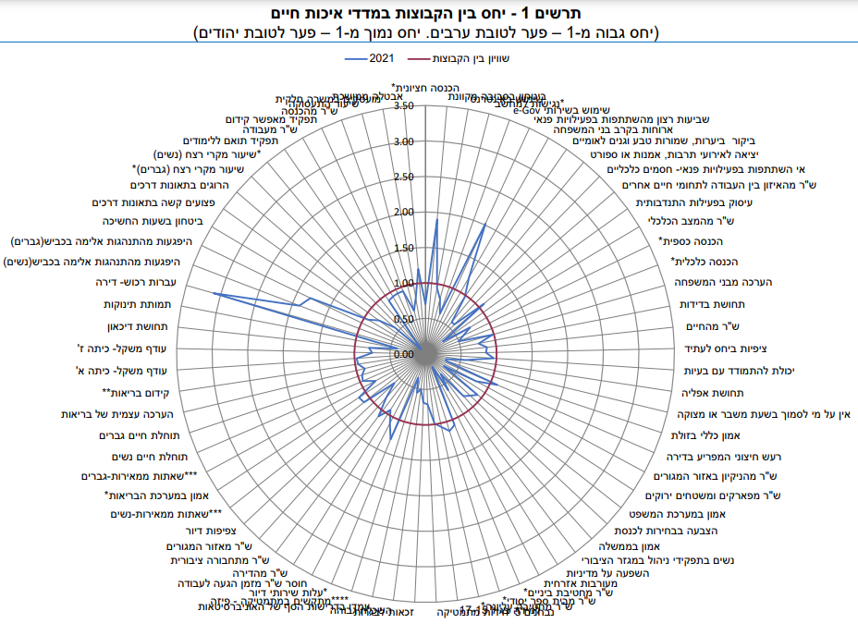
Quality of life indicators in Israel, disparities between Jews and Arabs, from the 2021 CBS survey
Number of indicators for which the situation among one population is better than that of the other population* | Jewish population: 50 out of 67 (75%) Arab population: 13 out of 67 (19%)
Indicators for which the situation among the Jewish population is more positive than among the Arab population | Sense of loneliness Life satisfaction Noise disturbance around the home Satisfaction with cleanliness of the residential area Satisfaction with parks and green spaces
Indicators for which the situation among the Jewish and Arab populations are similar | Visiting forests, nature reserves and national parks Safety and security at night
Indicators for which the situation among the Jewish population is less positive than among the Arab population | Satisfaction with participation in leisure activities Satisfaction with public transportation Satisfaction with the residential area
* For four indicators, there is equality between the populations

Slide 6
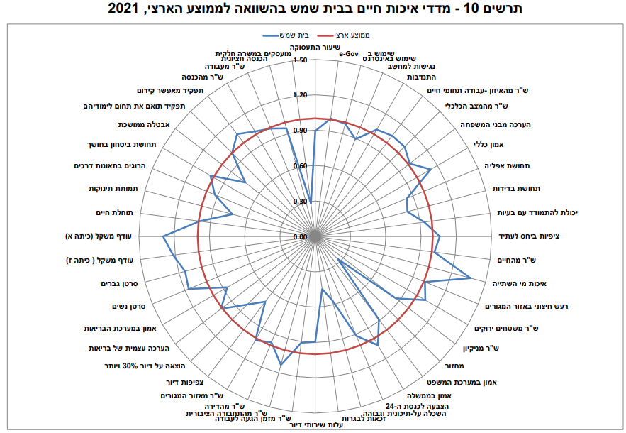
Quality of life indicators in the major cities, Municipal government survey, 2021 - Beit Shemesh
Number of indicators for which the situation in the city is more positive than the national average | 22 out of 48 (46%) Average overall score for quality of life indices
Indicators for which the situation of the city is more positive than the national average | Quality of drinking water Satisfaction with green spaces Satisfaction with public transportation
Indicators for which the situation in the city is similar to the national average | Life satisfaction Noise disturbance around the home Satisfaction with the residential area Safety and security at night
Indicators for which the situation in the city is less positive than the national average | Feeling of loneliness Satisfaction with cleanliness Recycling
National average=
> National average
National average=
< National average
National average=
< National average
> National average
For all indicators, a ratio higher than 1 indicates a higher quality of life as compared to the national average.
A ratio between 0 and 1 indicates a lower quality of life as compared to the national average.
That is: For each indicator, the blue line extending outside the red line indicates a better quality of life in Beit Shemesh relative to the situation in Israel overall.
> National average
National average=
< National average

Slide 7
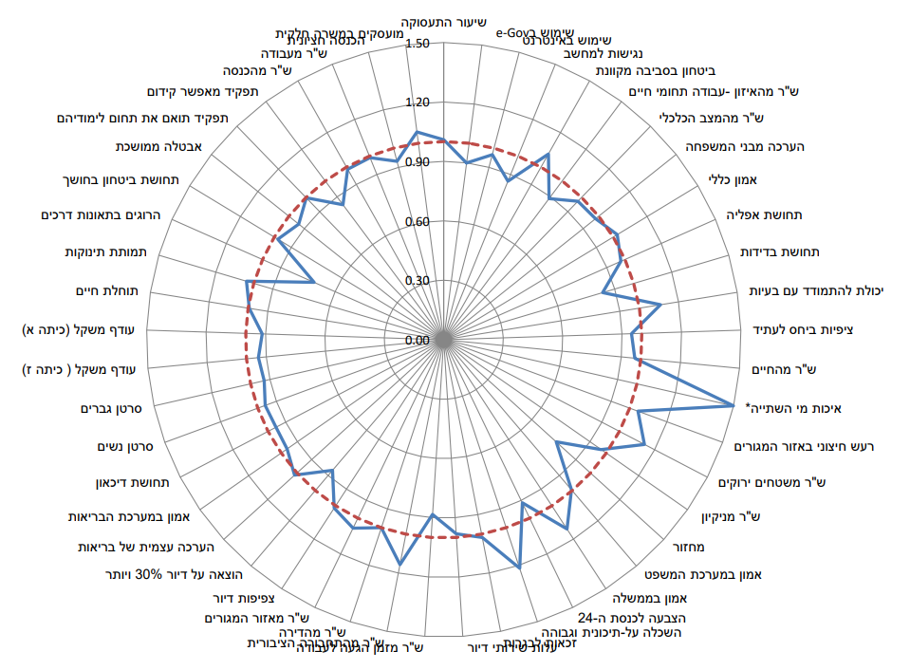
Quality of life indicators in major cities, Municipal government survey, 2021 - Ashdod
Number of indicators for which the situation in the city is more positive than the national average | 15 out of 48 (31%) Low overall score for quality of life indices
Indicators for which the situation of the city is more positive than the national average | Drinking water quality Noise disturbance around the home Satisfaction with green spaces Satisfaction with public transportation Satisfaction with the residential area
Indicators for which the situation in the city is similar to the national average | Life satisfaction Satisfaction with cleanliness Safety and security at night
Indicators for which the situation in the city is less positive than the national average | Sense of loneliness Recycling
National average=
> National average
= National average
< National average
< National average
< National average
National average=
> National average
For all indicators, a ratio higher than 1 indicates a higher quality of life as compared to the national average.
A ratio between 0 and 1 indicates a lower quality of life as compared to the national average.
That is: For each indicator, the blue line extending outside the red line indicates a better quality of life in Ashdod relative to the situation in Israel overall.
> National average
> National average

Slide 8
Comparison of Quality of life indicators in Beit Shemesh and Ashdod
Quality of life indicators in major cities, Ministry of Social Affairs survey, 2021
In both Beit Shemesh and Ashdod: Satisfaction with drinking water quality, public transportation, and green spaces were more positive than the national average. Life satisfaction and feeling safe at night were approximately the same as the national average. Sense of loneliness was higher than the national average and recycling was lower; that is, for these indicators, the situation in the city was less positive than the national average.
For these indicators, the situation in Ashdod is more positive than the national average, and the situation in Beit Shemesh is similar to the national average: Noise disturbances in the residential area and satisfaction with the residential area
Indicator for which the situation in Ashdod was equal to the national average, and the situation in Beit Shemesh was lower than the national average: satisfaction with cleanliness
Sense of personal safety and security*, CBS survey 2021 | Israel | Beit Shemesh | Ashdod
Feel safe walking alone in the residential area at night: to a great or very great extent | 83% | 86% | 81%
Feel general sense of personal security in the residential area: to a great or very great extent | 88% | 86% | 84%
Fear of violence in the residential area: to a small extent or not at all | 90% | 98% | 93%
Fear of online crime or harm via the Internet: to a small extent or not at all | 72% | 73% | 76%
Frequency of noise disturbance near the home after 11:00 PM: never | 58% | 51% | 54%
*A higher percentage in the table expresses a higher sense of personal security
For all indicators, except for fear of being harmed by online crime, there was a greater sese of personal safety and security in Beit Shemesh than in Ashdod.
For all indicators, except general personal security in the residential area, there was a greater sense of personal security in Beit Shemesh than in the country as a whole.
The CBS survey found that, among the major cities surveyed, Ashdod had the lowest percentage of people aged 20+ who said they felt a sense of personal security (84%).
In both Beit Shemesh and Ashdod, only about half of the residents said they were never disturbed by noise near their home at night.

Slide 9
Evaluation of Professional Training for Various Target Audiences
in 2022
Within the Urban95 IL National Expansion Program
צילום: "מסע"

Slide 10
Highlights from the literature on expanding the training program for target audiences in network municipalities
  There is a plan to launch a training program in June 2023 in six municipalities within the Urban95 IL network, in addition to the three anchor municipalities that are currently operating as part of the national program. The planned training will last about a year, and will include learning sessions, tours, and practical workshops, in preparation for the implementation of pilot projects in each of the municipalities in the network. Implementation will be guided by the project team. The goal of the training is to inculcate the Urban95 principles among participants, and to create a community of local authorities to promote an urban environment that is optimal for young children and their caregivers.
  As part of the process of defining the training program’s goals and objectives, formulating the structure and content of the sessions, and ensuring the appropriateness of the training components, we offer several highlights from the academic literature:
Strong systems must be developed to support the implementation of policies regarding early childhood at various levels: international, national, and municipal (Yoshikawa et al., 2018). As part of this process, leadership networks must be expanded to provide resources and support, and to increase the scope of their members’ influence, as individuals and as a group. One type of leadership networks is the Field-Policy Leadership Network, which connects leaders who have shared interests and a commitment to influence a field of practice or policy. Effective and successful leadership networks help participants find common ground, including with unexpected allies, on issues that are important to its members, mobilize support, and influence policy and resource allocation. Participants develop relationships with communities in other parts of the country and entities operating in various areas, levels of government, fields of activity, and sectors (Hoppe & Reinelt, 2010).
These networks can develop within professional communities; groups of individuals with a common professional interest and a desire to lead improvement in their field by sharing their knowledge and insights. To promote a culture that emphasizes ongoing professional development, responsibility for transmitting content should be in the hands of professional coaches, consultants, and group facilitators (Sheridan et al. 2009). The effectiveness of professional training depends on a comprehensive and ongoing system that provides participants with tools, applied practices, and a method for assessing the results of their implementation in the field. In addition, facilitators should encourage participants to undergo a reflective process and independent thinking about the implementation of new practices, in order to realize their vision. Ideally, professional training should take place in cooperation with a professional learning community (Brown & Englehardt, 2016).

Slide 11
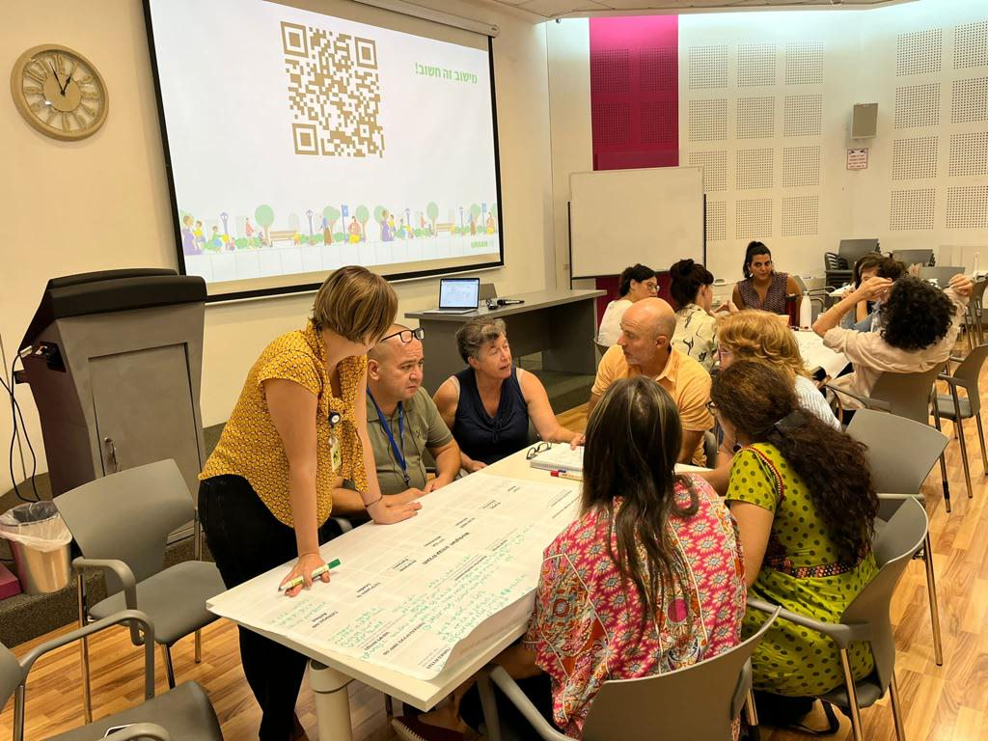
Background: Professional Training System 2022
  One of the main activities* in the Urban95 national expansion program is developing a training system for municipalities. This is in addition to offering seminar days for the target audience - creators of the built environment – so they can acquire knowledge and tools, and to raise their awareness of the importance of addressing early childhood in all aspects of life.
  In this context, the assessed outputs include the participation of various officials in the training sessions and study days and their degree of satisfaction with them, according to various indicators. The expected outcomes include:
  Municipal leaders and creators of the built environment have knowledge and understanding of young children’s needs, and are aware of possible planning constraints, so this issue is on the municipality’s agenda.
  The anchor municipalities promote the issue of early childhood by applying their new knowledge and practices, implementing models that reflect the spirit of Urban95, and utilizing mechanisms for cooperation between municipal officials and their partners in external entities.
  In 2022, 16 professional trainings were held as part of the national expansion program, including Urban95 presentations at seven conferences.
The findings of the current report focus on the feedback on training sessions for various target audiences:*
Lectures at conferences to an audience of creators of the built environment
Lectures and training sessions for officials in the anchor municipalities
Training for Urban95 teams in the anchor municipalities
Case study - leadership training for Urban95 anchor municipalities’ teams
  * The logic model and feedback questionnaires are given in the appendices

Slide 12
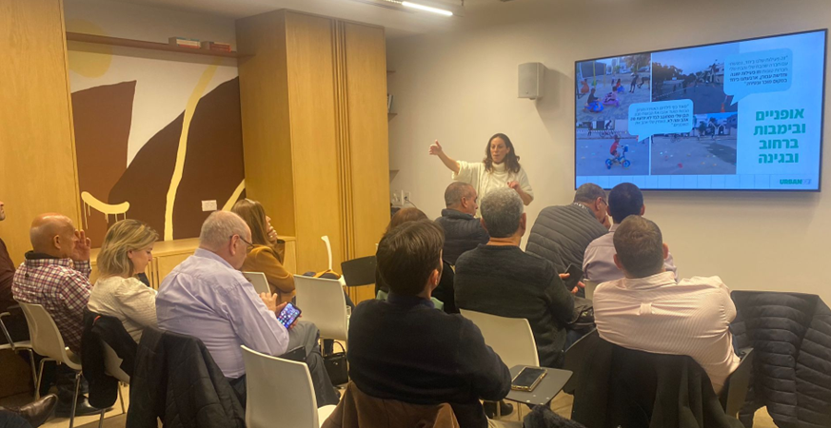
Background on training for creators of the built environment
Participants at the trainings:
Local authority leaders in the 360º Program, programmers, consultants, planning managers for the municipalities of Yavne and Yeruham, an early childhood educational director, urban planners, an architecture student, participants in Cadets for Local Government.
Participants’ seniority in their fields ranges from:
In 2022, five lectures on the Urban95 program were presented to audiences of creators of the built environment (20 completed feedback responses):
Time | Training
June 2022 | Lecture by Urban95 at the Israel Planners Association conference
September 2022 | Session led by Urban95 at the Israeli Green Building Council conference
October 2022 | Forum for local authority leaders and supervisors in the Central District on the 360º National Program for Children and Youth at Risk
January 2023 | Urban95 workshop: “The World from a Height of 95 cm” at the Cadets for Local Government conference
February 2023 | Presentation by Urban95 to 30 director generals and engineers of local authorities at the City Pro conference
65% of respondents said that prior to the training, they had never heard of Urban95 program or were unfamiliar with it.

Slide 13
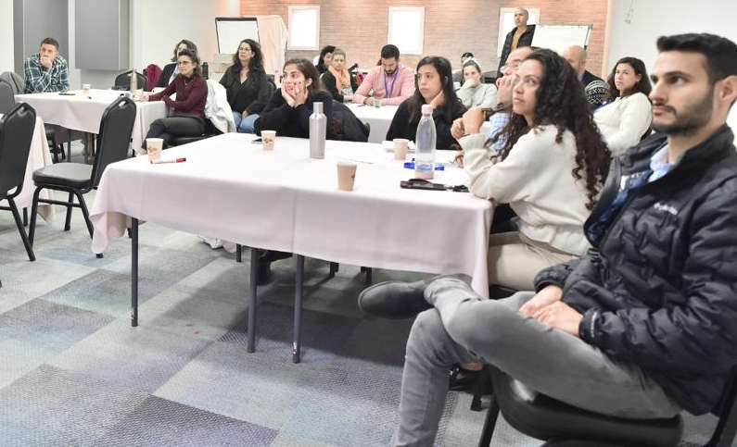
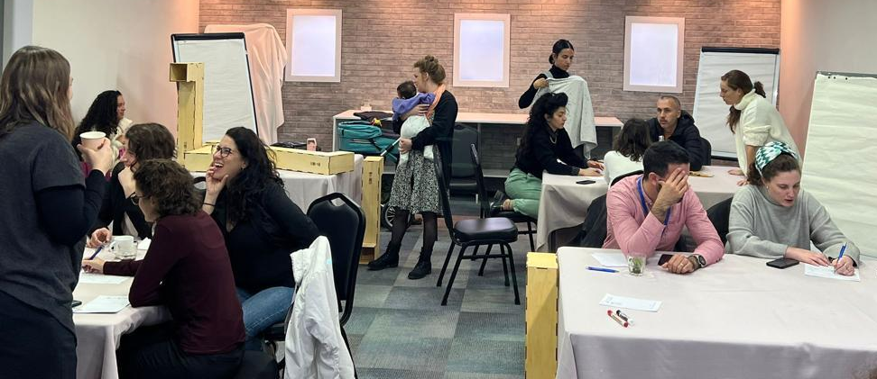
General satisfaction with training, among creators of the built environment
Overall, most surveyed participants in the trainings for creators of the built environment (N=20) reported a generally high level of satisfaction (see graph).
Among the surveyed participants in the forum for the 360º National Program for Children and Youth at Risk, a lower percentage (75%) reported satisfaction with the format.
Among the surveyed participants from the Cadets for Local Government conference, a lower percentage (71%) reported satisfaction with the way the content was delivered.
Respondents requested that future training sessions:
Deepen their understanding of children's needs in the context of adapted planning for public spaces: “Make references to planning for children regarding everything related to streets, sidewalks, crosswalks...more relevant to my work." (Planners Association conference).
Delve deeper into planning solutions that have already been implemented in the field: "I would be happy to hear more explanations about planning solutions that have been implemented in order to meet the specific needs of children (cause and effect).” (Planners Association conference).

Slide 14
Contribution of the trainings for creators of the built environment
Respondents first indicated the ways in which the training made a contribution (multiple choice) then rated the extent to which the training made a contribution regarding each aspect (see graphs):
The main contributions of the trainings were: becoming familiar with Urban95; inspiring and motivating participants to implement new ideas in the program’s spirit; deepening their knowledge about the needs of young children and their caregivers; clarifying the need to integrate this knowledge into the framework of their professional work. Most respondents said they gained relevant and new knowledge for their work, but less than half said they received practical tools and methods for applying it.
The trainings provided opportunities to work with new entities, but the format limited the possibility for meeting and creating new relationships with colleagues.
Training for the 360º Program for Children and Youth at Risk: The training contributed to a great extent to gaining new knowledge (100%); a high percentage said the training deepened their knowledge about young children’s needs and that they will apply the tools they acquired in their work in the next six months (75%).
The Israeli Green Building Council conference: A higher percentage of respondents said they were inspired to implement new ideas (75%) and that they received new professional knowledge (50%).
Association of Planners Conference: A higher percentage said the trainings contributing to learning from their colleagues (75%) and making new connections (50%).
Respondents said benefits of the trainings included "looking at public space from a different perspective" and "thinking about the balance between factors of risks and danger" (Cadets conference) and acquiring tools to enhance public participation and community solidarity (Planners conference).

Slide 15
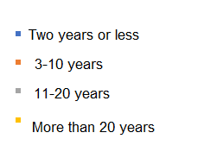
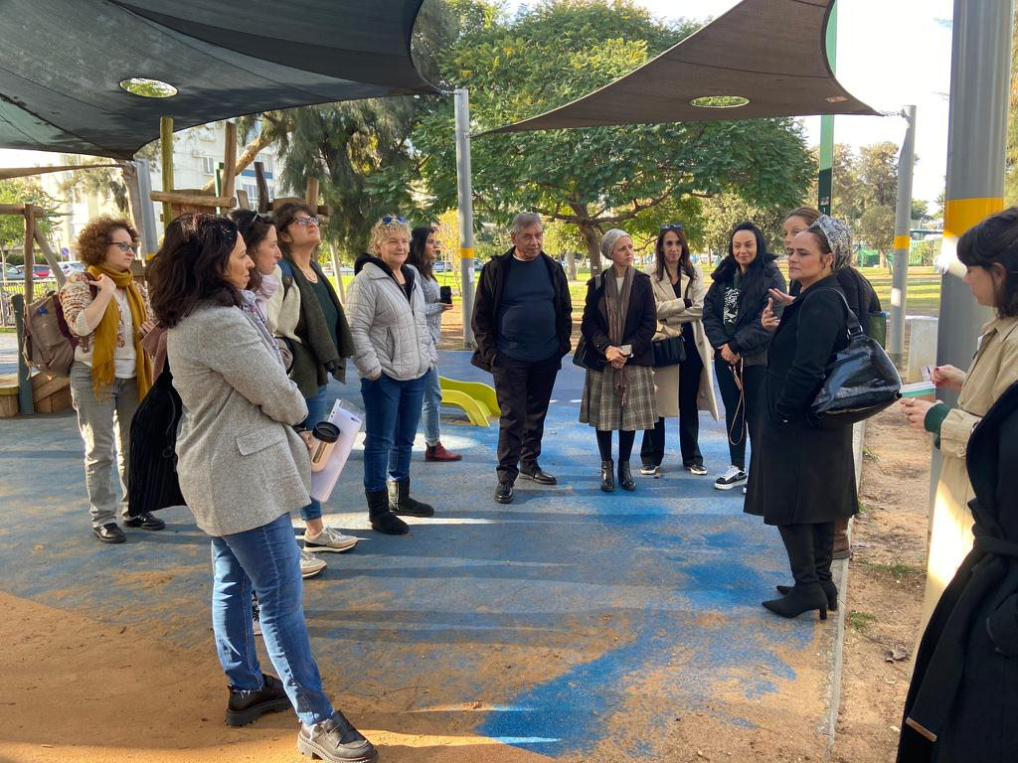
Background on the trainings for officials in the anchor municipalities
Officials participating in the trainings: Architect from Stav Architects, Urban95 teams in anchor municipalities (Beit Shemesh and Ashdod), the architect and plan assessor from the Beit Shemesh municipality, officials in the Ashdod municipality, professionals from organizations in the field of early childhood - educational instructor, directors for the preschool/kindergarten department and afterschool programs.
Participants’ seniority in their fields ranges from:
In 2022, three training sessions were offered to officials in the anchor municipalities:
Time | Participating anchor municipality | Training
July 2022 | Beit Shemesh | Lecture on planning nature play for young children, led by Julie Feld
January 2023 | Ashdod | Study tour in Tel Aviv-Yafo
January 2023 | Ashdod | Lecture on the natural playground
The training participants (N=18) reported a very high level of satisfaction: All respondents said they were satisfied to a large/very large extent with the format of the meetings (seminar/tour/lecture/webinar) and that the instruction team conveyed the content in a clear and comprehensible way, to a large/very large extent.
Half of the respondents are part of the Urban95 municipal teams or program in the anchor municipalities; 22% of respondents said they had not heard of the Urban95 program or were not familiar it, prior to the training.

Slide 16
Contributions of the trainings for officials in the anchor municipalities
Respondents first indicated the ways in which the training made a contribution (multiple choice) then rated the extent to which the training made a contribution regarding each aspect (see graphs):
The main contributions were inspiring and motivating participants to implement new ideas; about half said they received new and/or deeper professional knowledge about the needs of young children (most responded “to a very large extent”), and that the trainings clarified the need to integrate young children’s needs and relevant issues in the framework of their professional work.
A higher percentage of respondents from the natural playground lecture reported that it made a contribution (78% compared to 50% of respondents overall). Participants said this lecture contributed to “thinking outside the box in relation to what a public playground ‘should’ look like" and that they received practical tools for "implementing urban principles in developing a new service". A lower percentage said it made a contribution to acquiring tools, learning from colleagues, and making new connections.
A higher percentage of respondents from the study tour in Tel Aviv-Yafo said it contributed to these aspects (57%, 57% and 29% respectively). Respondents said the tour exposed them to "ideas for play in urban parks" and that they received “professional insights regarding development processes."
About 80% of participants overall, and 100% of those in the Tel Aviv-Jaffa tour, reported that the training provided tools and methods to a large extent, and that they expected to implement them soon.
There were requests for future trainings about "budgetary practices for implementing ideas regarding planning for young children" (lecture on planning nature play for young children).

Slide 17
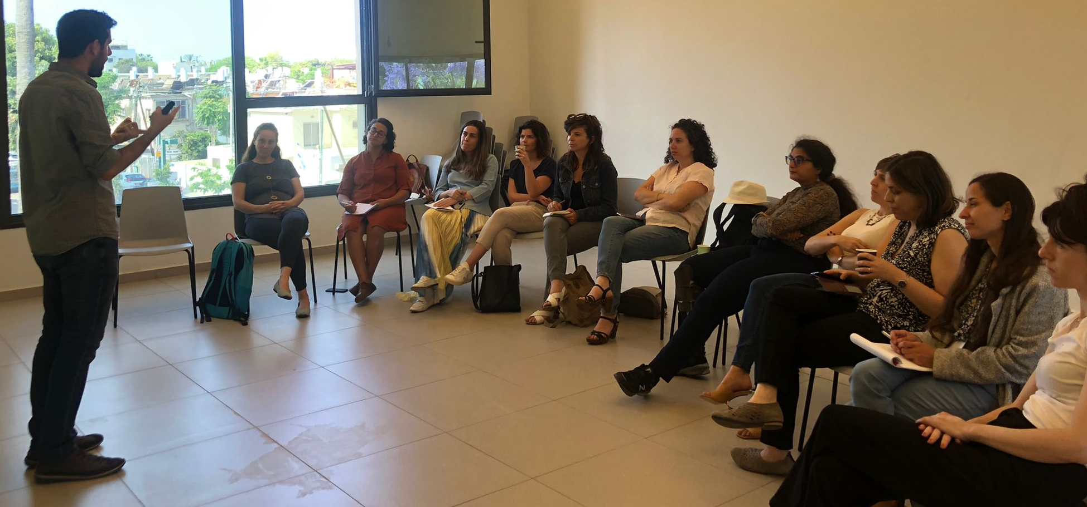
Background on the trainings for municipal teams
In 2022, there were three training sessions for municipal teams (33 completed responses):
Time | Participants | Training
May 2022 | City administrations leaders from Tira and Beit Shemesh; the Tel Aviv-Jaffa municipal team, strategy team, and assessment and evaluation team | Storytelling workshop
September 2022 | Urban95 IL community: Tel Aviv-Jaffa municipal team, municipal teams from the three anchor cities (Tira, Beit Shemesh, Ashdod), team from Gavrieli-Segal Architects, headquarters teams, strategy team, assessment and evaluation team | Workshop on tools and strategies to promote walking in and spending time in public spaces
December 2022 | Administration and strategy teams from the three anchor municipalities | Digital marketing workshop with Arava Garzon Raz
82% participated in the entire training session; 15% participated partially (at least half of the session).
For most indicators, training participants reported a high level of satisfaction
About ⅔ said they used the tools and materials after the training (75% among the respondents from the Storytelling workshop)

Slide 18
Contributions of the trainings for municipal teams
Compared to the training in 2021 (N=36), more participants said they acquired practical tools (19% vs. 73%) and the percentage of those who predicted that they would implement the knowledge and tools in their work increased (from 58% to 70%).
Comparing the municipal teams (Beit Shemesh N=7, Ashdod N=9, Tira N=3), found the Ashdod team was more likely to say they gained knowledge about the Urban95 program (N=5), and gained new information and practical tools that they predicted they would use in the near future (N=6). The Beit Shemesh team said the greatest contribution was in being motivated to implement ideas (N=6) and learning from colleagues (N = 4).
Comparing all respondents (N = 33): A higher percentage of those in the Storytelling workshop said they acquired practical tools (100%) and new professional knowledge (62%) and predicted using them in their work in the near future (87%). Respondents described what they learned in this workshop:
“It clarified the need to present ideas in a way that is adapted to the listener, and the tools to do so.“
"How to present and publicize my projects.“
"How to look at the information from a different perspective"
In the workshop on tools and strategies to promote walking and spending time in public spaces, a higher percentage said they acquired knowledge on the subject (40%). It can be assumed that these are responses from the Ashdod team, as this was their first exposure to the program. In addition, the respondents said that they contributed by adopting a different point of view and "thinking outside the box".
A lower percentage of respondents from the digital marketing workshop reported receiving new professional knowledge.

Slide 19
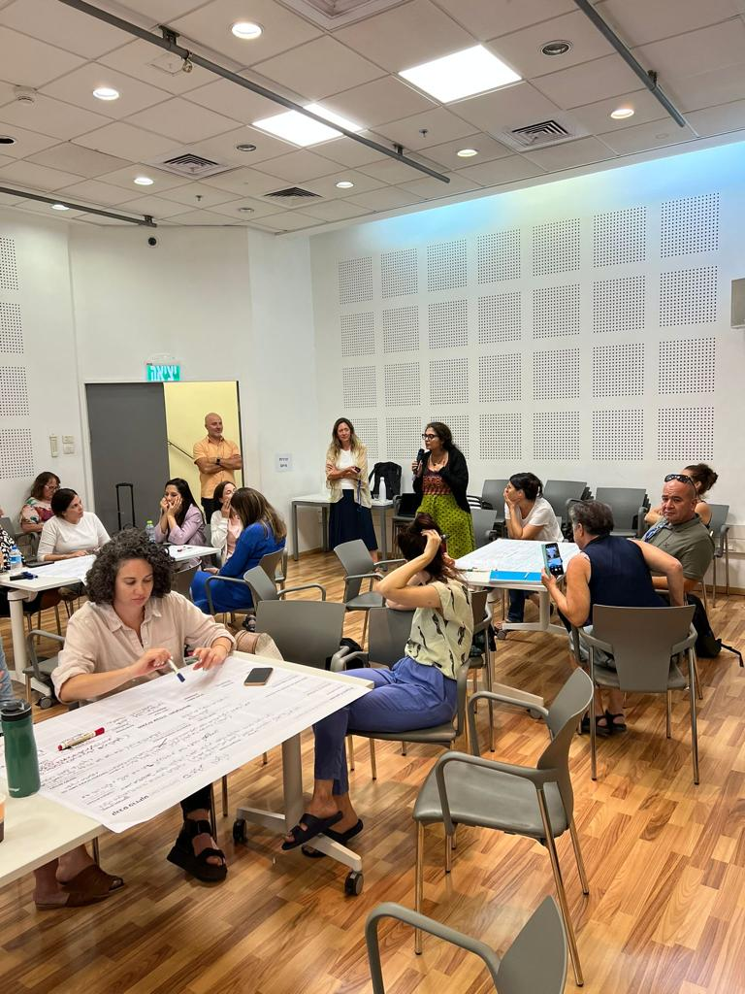
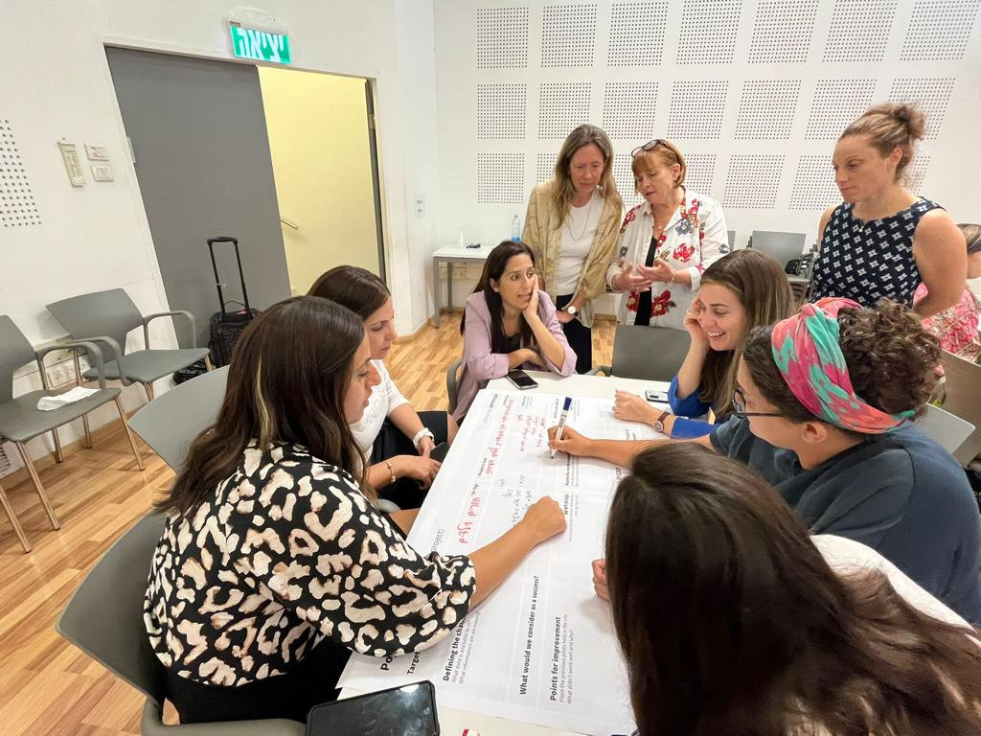
Contributions of training for municipal teams
An absolute majority of respondents said they would recommend participating in Urban95 trainings to others. About half said they shared what they learned with their colleagues who were not present at the training and that the training was an opportunity for them to work with new organizations.
Compared to the trainings in 2021, there were significant increases in the percentages of respondents who said: they shared what they learned with colleagues (from 20% to. 55%), the training provided an opportunity to develop new work connections (from 25% to. 55%) and they would recommend the training to others (from 72% to 95%).
Below are suggestions and requests for future trainings:
A workshop in which ideas are translated into practice : "Many of the things that were presented are a wonderful inspiration, but when it comes to implementation, challenges in safety and standards will prevent us from carrying out these beautiful ideas.“
Training in crisis management and conflict resolution, as well as in the aspects of working in the local authority: "Crisis management and working with the politics in a local authority.“
Training to help define goals and develop a work plan.
Gaining professional knowledge from other places in Israel and around the world.
An example of a contribution of the training: "Local administrators who know how to tell the story of their city in a better way, headquarters staff who know how to give better support to the municipal teams." (Storytelling workshop)
Half of the participants from municipal teams said that the training offered opportunities to develop new work connections (this was low compared to the general target audience (70%) and teams from anchor municipalities (72%).
Notes:
מחציתם דיווחו שההכשרה פתחה בפניהם הזדמנויות לממשקי עבודה חדשים (נמוך בהשוואה לקהל יעד כללי- 70% ורשויות עוגן- 72%).

Slide 20
סיכום: תרומות ההכשרות עבור קהלי היעד השונים (במה ההכשרה תרמה לך?*)
As expected, the main effect is among the general audience, which has not yet been exposed to Urban95 (as noted in a previous question).
הכשרות 2021: 44%
0%
100%
הרחבת ידע ביחס לתוכנית Urban95 בארץ ובעולם
יוצרי המרחב הבנוי – 70%
בעלי תפקידים ברשויות עוגן: 39%
צוותים עירוניים: 24%
Because the trainings in 2021 greatly contributed to deepening knowledge on the subject, municipal teams participating in 2022 said they already have sufficient knowledge. There may be room for further enrichment of knowledge. The other audiences benefited to a large extent.
יוצרי המרחב הבנוי – 50%
העמקת ידע אודות צרכי הגיל הרך ומלוויהם
הכשרות 2021: 64%
צוותים עירוניים: 18%
בעלי תפקידים ברשויות עוגן: 50%
Officials in the anchor authorities benefited more than others, being “at the junction": while they had little previous knowledge about Urban95 and its principles, they hold key positions in the anchor authority, which enables them to implement the initiatives.
Similarly, the other audiences benefited, according to the various parameters. Comparison between the reports from the 2021 and 2022 trainings for the municipal teams indicates that the trainings continue to provide participants with innovative ideas and relevant professional knowledge.
יוצרי המרחב הבנוי: 55%
השראה לרעיונות חדשים ליישום ברוח התוכנית
בעלי תפקידים ברשויות עוגן: 72%
הכשרות 2021: 50%
צוותים עירוניים: 48%
בעלי תפקידים ברשויות עוגן: 67%
יוצרי המרחב הבנוי: 40%
מוטיבציה ליישום רעיונות נוספים ברוח התוכנית
הכשרות 2021: 44%
צוותים עירוניים: 48%
בעלי תפקידים ברשויות עוגן: 56%
יוצרי המרחב הבנוי: 35%
ידע מקצועי חדש בתחום העיסוק
הכשרות 2021: 36%
צוותים עירוניים: 30%
It can be seen that the trainings in 2022 specifically for the municipal teams provided the best response to their needs, but contributed less to the other audiences (which were more heterogeneous).
צוותים עירוניים: 73%
בעלי תפקידים ברשויות עוגן: 39%
יוצרי המרחב הבנוי: 20%
רכישת כלים פרקטיים ליישום בעבודה
הכשרות 2021: 19%
Both in 2021 and 2022, the municipal teams, who undergo training with relative frequency, continue to benefit in this aspect
הכשרות 2021: 56%
צוותים עירוניים: 45%
יוצרי המרחב הבנוי: 35%
למידת עמיתים
בעלי תפקידים ברשויות עוגן: 33%
The trainings do not seem to provide opportunities to create new connections, either because lectures for a general audience do not encourage dialogue, or because, in some cases, the participants already know each other.
יוצרי המרחב הבנוי: 15%
יצירת קשרים חדשים
בעלי תפקידים ברשויות עוגן: 17%
צוותים עירוניים: 18%
הכשרות 2021: 25%
100%
0%
*מדובר בשאלת בחירה מרובה

Slide 21
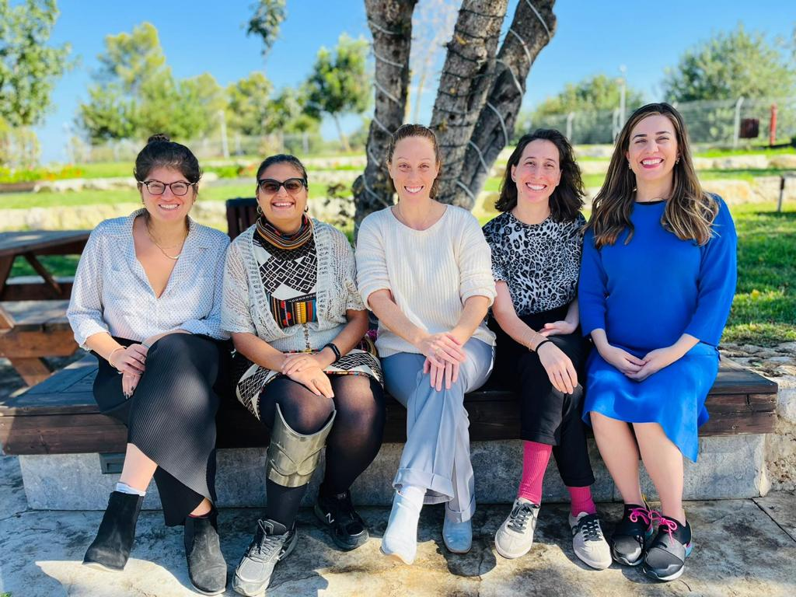
Case Study-Leadership Training for Municipal Teams

Slide 22
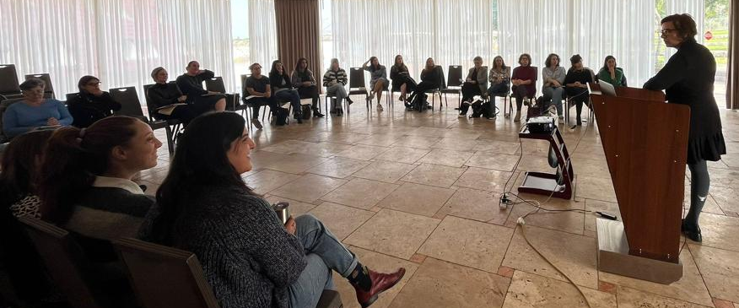
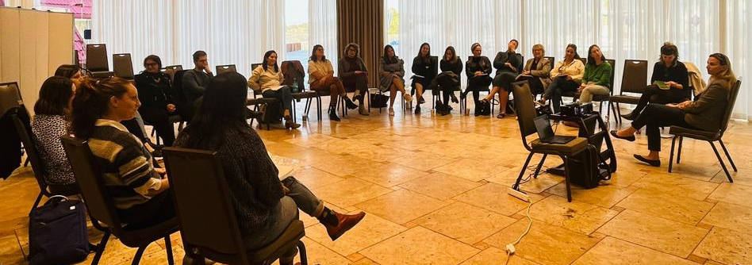
Background on leadership training for municipal teams
In November 2022, a two-day Offsite leadership training session was held for the anchor municipalities’ teams and the Tel Aviv-Jaffa team.
During the training, feedback was collected after each activity, and an overall summary for the whole training was done as well. There were a total of 71 complete responses:
Number of responses | Training
11 | Case studies of leadership types (top-down and bottom-up)
12 | Adaptive leadership workshop with Netali Ofir
16 | Activist leadership with children lecture by Ran Cohen Aharonov
11 | “At age 10, I lifted an elephant" lecture by ‏‎Tal Tenne Czaczkes
12 | “Community leadership fosters change” with Matan Israeli
1 | Workshop on strategy for making a work plan
8 | General summary of the leadership training
Feedback according to team affiliation

Slide 23
Contributions of leadership training: Summary of feedback
The main contributions of the training were inspirating and motivating participants to implement new ideas in the spirit of the program, and gaining new professional knowledge. In participants’ words: “The training was fascinating training and full of inspiration!" "Motivating. Drive to action. Horizon-broadening." In addition, respondents noted the training introduced them to unconventional fields of knowledge and innovative ideas : "I was exposed to creative work models to create leadership, with maximum utilization of costs and budgets.”
5 out of 8 respondents said they benefitted to a large/very large extent in acquiring practical tools for implementation, and 4 respondents said that the training contributed to them terms of learning from colleagues. For future trainings, participants recommended: "more time for learning from colleagues, making connections between partners," "tools that are relevant for implementation, given regulatory limitations.”
In addition, 6 respondents said that they intend to share with others what they learned in the training (to a large/very large extent).
* Absolute numerical data is shown

Slide 24
Contributions of the leadership trainings: Feedback on activities
The feedback shows a high level of satisfaction with the quality of the instruction.
Regarding all the activities, 71% of the respondents said that they received new knowledge relevant to their work. The highest rating was for the workshop on activist leadership with children (94%), while lower percentages said the lecture on case studies of leadership types and the adaptive leadership workshop contributed new knowledge (36% and 58%, respectively).
Regarding all the activities, 68% of the respondents said that they received tools and methods to use in their work and 62% predicted that they will use this knowledge and tools in their work in the next six months. However, these rating were lower for the lecture on case studies of leadership types and the adaptive leadership workshop (27% and 50%, respectively).
The respondents noted the practical tools and methods they received in the trainings:
Motivation for professional collaborations: “I am full of ideas for projects and connections for new directions of action.“
Sustainability and environmental initiatives as a new practice for individuals: “Everything can be recycled and reused," “Beekeeping on rooftops.”
Respondents said contributions of the trainings included strengthening their self-confidence and optimism, giving them positive energy, motivating them to take action, expanding their range of thought and encouraging them to “step out of the box.”
Respondents said they intend to implement in practice the following innovations, in the spirit of the Urban95 program, within several months after the leadership training:
The City Beautification Department of the Beit Shemesh municipality submitted a proposal to the Fund for Cleanup Activities of the Ministry of the Environment, with the goal of starting a program for cleanup and enrichment activities in public parks “A Garden Birthday.".
A member of the Ashdod team contacted Ran Cohen Aharonov to implement the "Lost Treasure" activity in the city’s preschools (a letter to preschool teachers is shown on the next slide).

Slide 25
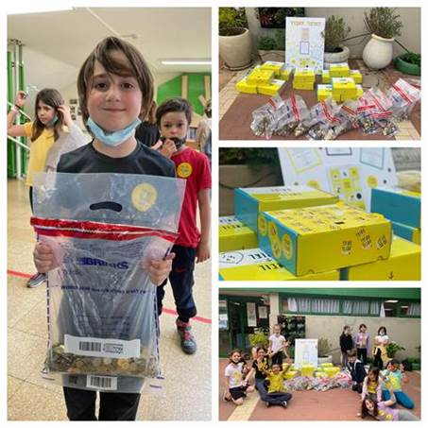

Examples of implementing ideas inspired by the training - Ashdod
  Dear teachers,
  The early education department is embarking on a unique national project called "The Lost Treasure.” Preschool/kindergarten children will collect 10-agora coins from their homes and donate the collected money to a meaningful and important cause.
  This experiential journey provides an opportunity for solidarity and group work through an experience in joint giving. The Lost Treasure is part of an educational program that encourages discovering responsibility for the environment and community, leading to meaningful learning by doing for others.
  The idea of the project is simple: Preschool/kindergarten children undergo a valuable experiential learning journey (between 4-5 lesson plans, led by the kindergarten teacher), in which they will learn about giving, volunteering and social entrepreneurship, by collecting real "lost treasures" -- ten-agora coins.
  As part of this process, the class will together choose an organization or cause that is close to their heart, to which they would like to donate their treasures. At the end of the project, a truck from the Brinks company will arrive to collect the children's bags of coins and deliver them to the various organizations.
  A kit with an educational plan and map will be provided directly to each kindergarten.

Slide 26
סיכום: השוואה בין סוגי ההכשרות
To what extent were you satisfied with the training? (Only the percentage of respondents answering to a large/very large extent is shown)
100%
0%
The content transmitted in the trainings was particularly relevant for officials in the anchor municipalities. The same is true for the municipal teams, especially in comparison to last year – the content has been refined.
בעלי תפקידים ברשויות עוגן: 94%
צוותים עירוניים: 76%
יוצרי המרחב הבנוי: 60%
הכשרות 2021: 33%
ידע מקצועי חדש, הרלוונטי לעבודתי
הכשרת מנהיגות: 71%
The teams of the anchor municipalities (the leadership team and those with other positions) reported that they received useful tools and methods in the 2022 trainings to a large extent; with a significant increase as compared to last year.
צוותים עירוניים: 79%
הכשרת מנהיגות: 68%
יוצרי המרחב הבנוי: 40%
הכשרות 2021: 33%
פרקטיקות ו/או כלים מעשיים שאוכל להשתמש בהם בעבודתי
בעלי תפקידים ברשויות עוגן: 78%
The teams of the anchor municipalities (the leadership team and those with other positions) were more likely to say they acquired knowledge and tools that will be used in their work to a great extent, as compared to the audience of creators of the built environment.
בעלי תפקידים ברשויות עוגן: 83%
הכשרת מנהיגות: 62%
הכשרות 2021: 58%
כלים וידע שישמשו אותי בעבודתי בפועל, בחצי השנה הקרובה
צוותים עירוניים: 70%
יוצרי המרחב הבנוי: 45%
In response to the multiple choice question, all the target audiences said that the training made a relatively low contribution to creating new collaborations. However, the more heterogeneous target audiences said they experienced this aspect to a large/very large extent.
בעלי תפקידים ברשויות עוגן: 72%
צוותים עירוניים: 50%
הכשרות 2021: 25%
הזדמנויות חדשות לממשקי עבודה משותפים עם גורמים חדשים
יוצרי המרחב הבנוי: 70%
In summary, the contributions of the trainings were directly related to work processes in the anchor municipalities and to improving familiarity with Urban95:
The main contribution to participants from the audience of the creators of the built environment was in becoming familiar with the program and its impacts, especially given that two-thirds of them were not familiar with the program prior to the training.
Officials in anchor municipalities primarily benefitted from the trainings terms of being inspired and motivated to implement ideas in the spirit of the program, and gaining new professional knowledge relevant to their work. They strongly expected to use the tools they acquired in their work in the next six months.
In the regular trainings and the leadership training, the municipal teams said they benefitted to a large extent in terms of receiving relevant knowledge and practical tools, which they expected to use in the near future.
In 2022, the professional trainings provided only a partial response to the issues of: learning from colleagues, and opportunities to create new collaborations and connections, (as compared to 2021, when the contribution to these aspects was rated higher). However, among respondents for whom opportunities for collaborations became possible during the 2022 trainings, these were reported to a large/very large extent.

Slide 27
סיכום: השוואה אל מול מדדי המודל הלוגי
Insights from the evaluation of the 2022 training program
Main points of the logic model* for the Urban95 IL program
for the anchor municipalities
  During 2022, 16 professional trainings were held as part of the national expansion program, including Urban95 presentations at 7 conferences.
  As noted, one of the main activities in Urban95's national expansion plan is planning and implementing a training program for selected municipalities and offering seminars for creators of the built environment, in order to provide participants with knowledge and practical tools and to raise their awareness of the importance of early childhood in all life arenas.
  The measured outputs include the officials’ participation and degree of satisfaction with the trainings and study days, according to the various indicators.
  There is an expectation that participation in the trainings will lead to effective engagement of key stakeholders, the creation of inter-administrative collaborations, and the sharing of internal and external knowledge within the municipalities and between the municipality and the outside world.
  The short-to-medium term outcomes include:
  Officials in the municipalities and the creators of the built environment gained knowledge and understanding regarding the needs of young children and their caregivers, the ability to find appropriate responses for meeting these needs, and awareness of potential planning constraints.
  The anchor municipalities will make use of new knowledge and methods in implementing action models in the spirit of Urban95 and cooperation mechanisms among municipal officials and with external partners, in order to advance the needs of young children.
  The anchor municipalities serve as a source for learning from colleagues for other municipalities and creators of the built environment. They will carry out official and interagency collaborations.
  There were dozens of participants in the trainings for the creators of the built environment. All the anchor municipalities took part in trainings and tours. Participants were either members of the municipal leadership teams or held other positions. Dedicated trainings were held for municipal leaders.
  Overall, there was a high level of satisfaction with all the trainings. During joint trainings for the anchor municipalities, internal and external knowledge sharing (learning from colleagues) between the municipalities occurred naturally.
The feedback shows a complex picture regarding the contribution of the training for the various target audiences, depending on how long the anchor municipalities have been involved in the program and the degree of familiarity with Urban95 among municipal officials and creators of the built environment.
The trainings provided relevant knowledge, tools and methods, and contributed to improving participants’ understanding of the needs of young children, but there is room for deepening the content.
It seems that the operating models and cooperation mechanisms have not yet been integrated into the work processes in the anchor municipalities. There are budding initiatives for interagency collaborations, but there is a clear need for additional platforms for learning from colleagues and opportunities to create new relationships and collaborations.
  * The full logic model is given in the appendix.

Slide 28
Appendix A – feedback questionnaire for the built environment creators & anchor municipalities officials
8. To what extent do you feel the training format was successful (tour/seminar/lecture/webinar)?
a. To a very large extent
b. To a large extent
c. To a moderate extent
d. To a small extent
e. Not at all
9. To what extent was the content relayed in clear and coherent way?
a. To a very large extent
b. To a large extent
c. To a moderate extent
d. To a small extent
e. Not at all
10. What did you gain from the training?
(Please mark all relevant answers)
- I’ve acquired new knowledge in my areas of occupation
- I’m more knowledgeable of EC & caregivers’ needs
- I’ve acquired tools to implement in my work
- I’m more knowledgeable of Urban95 and its local & global impact
- I’m motivated to implement Urban95 ideas
- The training inspired me to think of new Urban95 ideas
- I’ve met with professional colleagues & learned from them
- I’ve made new professional / business / social contacts
- Other, please specify:
11. To what extent did the training provide you with new and relevant knowledge?
a. To a very large extent
b. To a large extent
c. To a moderate extent
d. To a small extent
e. Not at all
12. To what extent did the training provide you with practical tools and/or methods you can implement in your work?
a. To a very large extent
b. To a large extent
c. To a moderate extent
d. To a small extent
e. Not at all
13. What practical tools and/or methods did you gain from the training?
Open-ended
14. To what extent, do you believe the tools and knowledge you acquired will serve you in performing your job over the next 6 months?
a. To a very large extent
b. To a large extent
c. To a moderate extent
d. To a small extent
e. Not at all
15. What additional tools and/or working methods would you like to receive in future Urban95 trainings?
Open-ended
16. To what extent did the training open you to new possibilities for working together on joint areas with new officials?
a. To a very large extent
b. To a large extent
c. To a moderate extent
d. To a small extent
e. Not at all
17. Please share with us any suggestions for improvements we could implement in future trainings.
Open-ended
1. Please state your role and organization
Open-ended
2. How long have you been active in the field?
Open-ended
3. What’s your gender?
Woman/man
4. What training did you participate in?
כנס איגוד המתכננים
מושב Urban95 בכנס המועצה הישראלית לבנייה ירוקה
פורום תוכנית 360 לילדים בסיכון
כנס צוערים
הצגת אורבן בכנס city pro
הרצאה בנושא תכנון טבע ומשחק לגיל הרך
סיור לימודי בת"א-יפו
הרצאת גן המשחקים הטבעי
5. How much of the session did you participate in?
a. All of it
b. Part of it
6. Did you know or hear about Urban95 before the training?
a. I hadn’t heard anything about it
b. I heard the name, but didn’t know anything about it
c. I heard and knew about the program
d. I’m part of the Urban95 team/one of the program’s partners
7. Do you think the training was long enough in terms of the number and length of the sessions?
a. It was too short
b. It was too long
c. It was just right
The CET’s Program Evaluation Unit offers a range of tools and services to support social and educational initiatives and aid in their success

Slide 29
Appendix B – feedback questionnaire for anchor municipalities’ teams
7. To what extent did the supporting material contribute to your understanding of the training’s topic and content?
a. To a very large extent
b. To a large extent
c. To a moderate extent
d. To a small extent
e. Not at all
f. Not relevant
8. To what extent did you use the supporting material, if you received any, after the training?
a. To a very large extent
b. To a large extent
c. To a moderate extent
d. To a small extent
e. Not at all
9. What did you gain from the training?
(Please mark all relevant answers)
- I’ve acquired new knowledge in my areas of occupation
- I’m more knowledgeable of EC & caregivers’ needs
- I’ve acquired tools to implement in my work
- I’m more knowledgeable of Urban95 and its local & global impact
- I’m motivated to implement Urban95 ideas
- The training inspired me to think of new Urban95 ideas
- I’ve met with professional colleagues & learned from them
- I’ve made new professional / business / social contacts
- Other, please specify:
10. To what extent did the training provide you with new and relevant knowledge?
a. To a very large extent
b. To a large extent
c. To a moderate extent
d. To a small extent
e. Not at all
במסגרת איזה תפקיד הגעת להכשרה?
צוות עירוני טירה
צוות עירוני בית שמש
צוות עירוני אשדוד
צוות עירוני תל אביב-יפו
צוות מטה Urban95
2. What training did you participate in?
כלים ואסטרטגיה לקידום הליכות ושהייה במרחב הציבורי 14.9.2022
סדנת סטוריטלינג
סדנת שיווק דיגיטלי
3. How much of the session did you participate in?
a. All of it
b. Part of it
4. Do you think the training was long enough in terms of the number and length of the sessions?
a. It was too short
b. It was too long
c. It was just right
5. To what extent do you feel the training format was successful (tour/seminar/lecture/webinar)?
a. To a very large extent
b. To a large extent
c. To a moderate extent
d. To a small extent
e. Not at all
6. To what extent was the content relayed in clear and coherent way?
a. To a very large extent
b. To a large extent
c. To a moderate extent
d. To a small extent
e. Not at all
11. To what extent did the training provide you with practical tools and/or methods you can implement in your work?
a. To a very large extent
b. To a large extent
c. To a moderate extent
d. To a small extent
e. Not at all
12. What practical tools and/or methods did you gain from the training?
Open-ended
13. To what extent, do you believe the tools and knowledge you acquired will serve you in performing your job over the next 6 months?
a. To a very large extent
b. To a large extent
c. To a moderate extent
d. To a small extent
e. Not at all
14. What additional tools and/or working methods would you like to receive in future Urban95 trainings?
Open-ended
15. To what extent did the training open you to new possibilities for working together on joint areas with new officials?
a. To a very large extent
b. To a large extent
c. To a moderate extent
d. To a small extent
e. Not at all
16. To what extent did you share what you learned from the training with colleagues who didn’t participate in it?
a. To a very large extent
b. To a large extent
c. To a moderate extent
d. To a small extent
e. Not at all
f. Not relevant
17. To what extent would you recommend this training to others?
a. To a very large extent
b. To a large extent
c. To a moderate extent
d. To a small extent
e. Not at all
18. Please share with us any suggestions for improvements we could implement in future trainings.
Open-ended
The CET’s Program Evaluation Unit offers a range of tools and services to support social and educational initiatives and aid in their success

Slide 30
Appendix C – feedback questionnaire for the leadership training offsite
במסגרת איזה תפקיד הגעת להכשרה?
צוות עירוני טירה
צוות עירוני בית שמש
צוות עירוני אשדוד
צוות עירוני תל אביב-יפו
צוות מטה Urban95
2. באילו חלק של הכשרת המנהיגות של השתתפת זה עתה?
קייס סטאדיס של סוגי מנהיגות (מלמעלה ומלמטה)
סדנת מנהיגות הסתגלותית עם נטע-לי אופיר
הרצאה "בגיל 10 הרמתי פיל" של טל טנא צ'צ'קס
מנהיגות אקטיביסטית אצל ילדים עם רן כהן אהרונוב
מנהיגות קהילתית מצמיחה שינוי עם מתן ישראלי
סדנת אסטרטגיה לתוכנית עבודה
סיכום כללי של הכשרת המנהיגות 30.11-1.12
חלק שחוזר על עצמו עבור כל אחד מחלקי ההכשרה - תשובות 1-6 בשאלה 2
3. To what extent was the content relayed in clear and coherent way?
a. To a very large extent
b. To a large extent
c. To a moderate extent
d. To a small extent
e. Not at all
4. To what extent did the training provide you with new and relevant knowledge?
a. To a very large extent
b. To a large extent
c. To a moderate extent
d. To a small extent
e. Not at all
5. To what extent did the training provide you with practical tools and/or methods you can implement in your work?
a. To a very large extent
b. To a large extent
c. To a moderate extent
d. To a small extent
e. Not at all
6 What practical tools and/or methods did you gain from the training?
Open-ended
7. To what extent, do you believe the tools and knowledge you acquired will serve you in performing your job over the next 6 months?
a. To a very large extent
b. To a large extent
c. To a moderate extent
d. To a small extent
e. Not at all
8. Please tell us more about what you gained from the training: Open-ended
סיכום הכשרת המנהיגות
9. Do you think the training was long enough in terms of the number and length of the sessions?
a. It was too short
b. It was too long
c. It was just right
10. To what extent do you feel the training format was successful (2-days offsite)?
a. To a very large extent
b. To a large extent
c. To a moderate extent
d. To a small extent
e. Not at all
11. To what extent did the supporting material contribute to your understanding of the training’s topic and content?
a. To a very large extent
b. To a large extent
c. To a moderate extent
d. To a small extent
e. Not at all
f. Not relevant
12. To what extent did you use the supporting material, if you received any, after the training?
a. To a very large extent
b. To a large extent
c. To a moderate extent
d. To a small extent
e. Not at all
13. What did you gain from the training?
(Please mark all relevant answers)
- I’ve acquired new knowledge in my areas of occupation
- I’m more knowledgeable of EC & caregivers’ needs
- I’ve acquired tools to implement in my work
- I’m more knowledgeable of Urban95 and its local & global impact
- I’m motivated to implement Urban95 ideas
- The training inspired me to think of new Urban95 ideas
- I’ve met with professional colleagues & learned from them
- I’ve made new professional / business / social contacts
- Other, please specify:
14. What additional tools and/or working methods would you like to receive in future Urban95 trainings?
Open-ended
15. To what extent did the training open you to new possibilities for working together on joint areas with new officials?
a. To a very large extent
b. To a large extent
c. To a moderate extent
d. To a small extent
e. Not at all
16. To what extent did you share what you learned from the training with colleagues who didn’t participate in it?
a. To a very large extent
b. To a large extent
c. To a moderate extent
d. To a small extent
e. Not at all
f. Not relevant
The CET’s Program Evaluation Unit offers a range of tools and services to support social and educational initiatives and aid in their success

Slide 31
Appendix D: Urban95 IL Primary Evaluation Model – For Anchor Municipalities
Target Audience | Inputs | Actions | Outputs | Short and Mid-Term results (up to 3 years from program’s onset) | Long Term Results (5-10 Years) | Impact
Officials & decision-makers in the municipalities & government offices Academics, professionals, and build environment creators (BEC) | ILGBC staff Consultants and experts Urban95 program administrator in the anchor municipality Program partners (outside & within the anchor municipality) Pilots’ budgeting International knowledge from BvLF Accumulated knowledge and experience from the ILGBC, Urban95 TLV, and national committee Assessment & evaluation resources | Participate in meetings with anchor municipalities to promote early childhood development (ECD) in the different administrations. Train and accompany the programs’ administrators in the anchor municipalities. Learn each anchor municipality agenda and strategic outline regarding early childhood to identify possible integrations with the Urban95 program. Engage stakeholders & partners from anchor municipalities to take part in interventions implementation. Develop and conduct trainings & seminars for officials in anchor municipalities to provide knowledge & tools and raise awareness for ECD's importance. Map potential interventions in public spaces and mobility domains in the anchor municipalities. Identify opportunities and map the needs of young children & caregivers to provide them with enriching content to support the interventions in the urban environment in anchor municipalities. Initiate pilots in the urban environment of anchor municipalities, including accompanying contents. Promote inter-administrative collaboration to create models for cooperation between different municipal units. Build a website for data collection & retention to share professional knowledge on facilitating holistic municipal policies for build environment adjustments for young children & caregivers. Hold professional events for BEC on urban planning that considers the needs of young children & caregivers. | Anchor municipality's program manager actively participates in strategic meetings to promote young children & caregivers’ needs in the different municipal units. Key stakeholders & BEC participate in professional trainings & seminars. High satisfaction of trainings & seminars’ participants. Effective engagement of key stakeholders and establishment of inter-administrative collaborations. Openness, willingness, and capability of municipal officials for pilots' implementation. Sharing internal & external knowledge among municipal officials and from the municipality outwards. Pilots' implementation in the public space & mobility domains, including accompanying contents, to scale. The program’s website is operated as a professional knowledge base regarding early childhood, based on models developed in the program. The program’s website gets exposure and users' traffic. | Municipal officials are knowledgeable, understand early childhood needs, and are capable of matching potential responses to these needs. BEC that participated in ILGBC events are conscious of needs and potential planning solutions for improving the public space for young children & caregivers. Urban95 action models & collaboration mechanisms (between anchor municipalities' officials and external partners advancing ECD) are embedded in the work routine. Early childhood is on the anchor municipalities' agenda: re-thinking positions and budget allocation for ECD, using collaboration mechanisms, new management practices, and pooling resources efforts. Young children & caregivers’ POV is considered when planning and designing public spaces (playgrounds, sidewalks, public transportation, shade, clean air, green lungs) – in the short term. Increase in the number of public spaces & urban infrastructures, designed and adjusted for young children & caregivers’ use, according to the Urban95 principles in anchor municipalities – in the short/ mid-term. In-scale projects are executed in all municipalities, adjusting the built environment for a safe and accessible stay, use, and mobility of young children & caregivers – in the mid-term. Anchor municipalities are a source for peer learning to other municipalities and BEC. The nationwide expansion program municipalities are collaborating with municipal & inter-municipal entities while using the program’s website as a professional source of knowledge when deciding on ECD. | Program sustainability: Urban95 is established as a guiding principle for urban planning for early childhood. The urban planning of anchor municipalities, based on Urban95 principles, is recognized as a “success story” and echoes in other municipalities. Young children & caregivers’ POV is considered in public space planning and promotes mobility and accessibility in local municipalities nationwide. The program's website is updated, municipalities and BEC nationwide regularly learn how to implement interventions according to Urban95 principles. All municipalities seek funding sources and act independently to advance young children. All municipalities operate in light of a long-term planning vision, including ECD needs, while making data-driven decisions. | Policies to advance urban environment suitable for optimal early childhood development, properly and sustainably embedded throughout all municipal departments, working in full coordination and collaboration. A supportive urban and communal environment, enabling equal opportunities in early childhood development and parental wellbeing.
The CET’s Program Evaluation Unit offers a range of tools and services to support social and educational initiatives and aid in their success

