Slide 1
Blender Financial Technologies
Summary of Activity
Q2 2023

Slide 2
Legal Disclaimer
This presentation constitutes the principle and marketing presentation of Blender Financial Technologies Ltd. and its subsidiaries (henceforth referred to, together, as "the Company" and/or "Blender" and/or "the Group") and is meant for marketing purposes. It does not constitute a public offering of securities by the Company and should not be construed as a public offering of securities by the Company. The information contained in this presentation is solely abridged information to be used as a general presentation of the Company and does not contain exhaustive data on the Company and its activities. The information contained in this presentation and any other information that may be provided when this presentation is presented (henceforth: "the Information") does not constitute a recommendation or the opinion of an investment advisor or a tax advisor. Investment in securities, and particularly, in the Company's securities, carries risk. One must bear in mind that past data is not necessarily indicative of future performance. Purchasing Company securities requires a thorough review of the data the Company publishes in the Company's reports on the Maya and Magna systems (henceforth: "Company Reports") and the performance of a legal, financial, fiscal, and accounting analysis of that data. The presentation contains additional data that will not be displayed in Company Reports to the public and/or information displayed differently than how it will be displayed in the Company Reports to the public. The presentation is not designed to substitute for a review of Company Reports whenever they are publicized by the Company. In the event of a contradiction between this presentation and Company Reports, the content of the Company Reports shall prevail.
Forward-looking Information Disclaimer
The Company’s forecasts and assumptions specified in this are all considered forward-looking information, as defined in the Securities Law of 1968. Among other things, this information is based on the Company’s assessments regarding developments and events that may or may not take place at an uncertain time in the future that are not within the Company’s control.
By nature, forward-looking information might not materialise as it is uncertain, as aforementioned. Whether forward-looking information materialises or not may be affected by risk factors inherent in the Company’s activity, developments in the financial environment in which the Company operates and external factors, including regulation, that can affect its activity. Therefore, it is hereby emphasised and clarified that the Company’s actual future results and achievements may fundamentally differ from the forward-looking information presented here.
For the avoidance of doubt, it is hereby clarified that the Company does not undertake to update and/or change the information included in the presentation to reflect events and/or circumstances that occur after the presentation has been prepared.

Slide 3
Our Mission
To provide fast and innovative credit solutions according to our clients preferences and needs

Slide 4
Blender’s Success by the Numbers
3
76K
81M
752M
1.6B
Countries:
Israel, Lithuania and Poland
Paying customers
Total annual revenue
Credit portfolio balance
Total financed loans
36%
75%
33%
Financial data in NIS and is accurate as of June 30, 2023; including loans in the credit brokerage system; the rate of increase in revenues and the growth data refer to Q2 2023 compared to Q2 2022; NON-GAAP gross revenues
Notes:
לתקן רווחים בין שורות

Slide 5
Blender’s Credit Platform
blenderCar
Investors (P2P)
blenderPay
Institutional Facilities
Lending Segments
Funding Sources
Credit Platform Rating 2.0™
blender Loan
Bank LOC
Blender Mortgage Solutions

Slide 6
Key Events from the IPO
(Jan 2021 – March 2023)
February 2022
Line of Credit established for car loans from Bank Mizrahi for approximately NIS 50 million
March 2023
Launching of blenderPay BNPL
Credit line of NIS 40 million received from Bank HaPoalim
November 2021
Agreement signed establishing the blenderPay BNPL company with Bank Hapoalim
December 2022
Completion of rights issue and loans for NIS 22 million
July 2023
Bank Hapoalim increased the line of credit for blenderPay BNPL to a total of 82 million NIS
January 2021
IPO at the Tel Aviv Stock Exchange
February 2021 blenderPay for E-Commerce solution launched for E-Commerce online checkouts
September 2021
Extended consumer credit brokerage licence obtained
Israel
Europe
May 2022
LOC obtained from the Pollen Street Capital investment fund for a total funding of € 50 million
December 2022- March 2023
Cancelation of the LTL deal and return of the investment money.
New credit in Latvia is frozen.
January 2022 Credit activity extended in Poland
February 2022
Acquisition of the LTL credit union in Lithuania
November 2021
4th LOC received from the French investment group Eiffel, for total funding amount of € 18 million
April 2021
A 3rd LOC (line of credit) received from, the French investment group Eiffel

Slide 7
Risk Diversification Strategy
Maintaining flexibility and adapting to a changing reality
Geographical dispersion
Israel
Europe
BNPL
Risk Diversification
Car loans
Diversity in providing credit
Diversification of funding sources
P2P
Credit for any purpose
Mortgage Solutions

Slide 8
Maintaining growth while striving for profitability
Significant growth of 33% in the credit portfolio in Q2 2023 (millions of NIS)
33%
Growth
Managed credit portfolio including loans in a credit brokerage system as of June 30, 2023;

Slide 9
Maintaining growth while striving for profitability
Increase of 70% in the group’s income Q2 2023
(thousands of NIS)
70%
Growth
NON-GAAP gross revenues include interest from loans in a credit brokerage system. Financial data in thousands of NIS as of June 30, 2023.

Slide 10
Technological Leadership for Fast & Accurate Underwriting
Data Driven
Broad mapping, forecast and managed credit risks of wide ranged information sources
Fast Underwriting
Credit risk assessment in seconds without prior client engagement
Rating2.0™
A propriety credit rating and underwriting system developed by Blender, enables clients’ quick and accurate digital credit
Secured Integral Architecture
Fraud Prevention
A robust Salesforce based system, significant process efficiency, driven by data-based decisions and APIs
A multi-dimensional model for credit risk assessment and fraud prevention
Digital
An advanced, accessible, and simple digital platform - no forms or paperwork required!
Notes:
Rating2.0TM

Slide 11
Fast and Efficient Customer Experience
6 Steps in 30 seconds
Collateral valuation & underwriting
(vehicle/real estate)
6
Onboarding
(Store, Car agency, E-Commerce site)
Advanced client identification & authentication
5
1
30
Seconds to get a loan
4
2
Client rating and loan profile
Client check with Blender’s propriety platform
3
Automated customer risk and evaluation assessment
30 seconds -Minimal time period

Slide 12
Digital Credit Solutions

Slide 13
in collaboration with
The preferred option for payment installments for large purchases in Israel
Activity started in March 2023 with a wide spread of thousands of distribution points.
POS Growth
JV- 80% owned by Blender, 20% by Bank Hapoalim, with funding of NIS 82 million from Bank Hapoalim
Technology enabling payment through extended installments using rapid, non-bank credit at points of sale
Potential market of NIS 30 billion annually for large purchases in Israel (excluding vehicles)

Slide 14
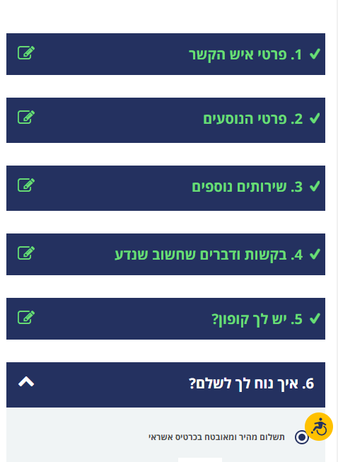
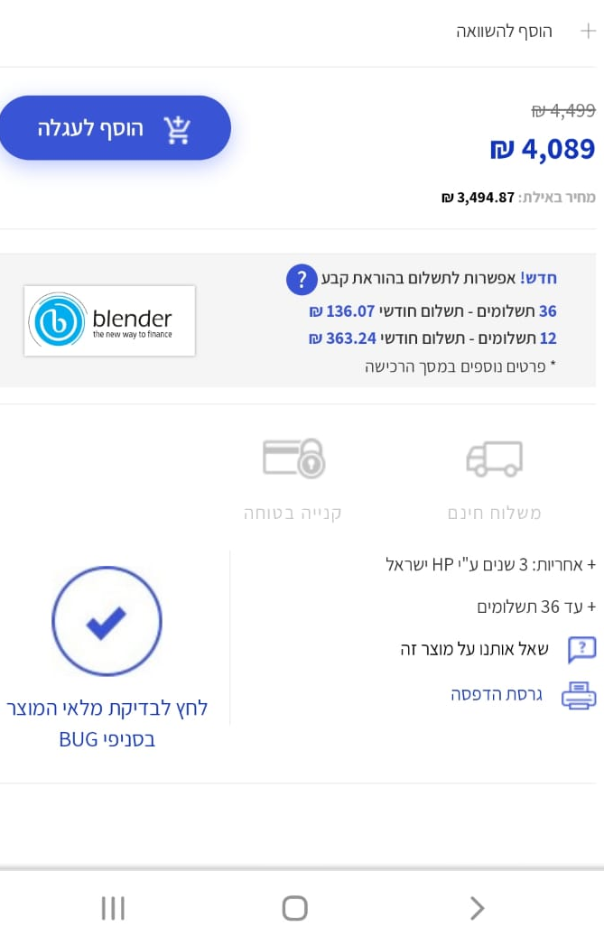
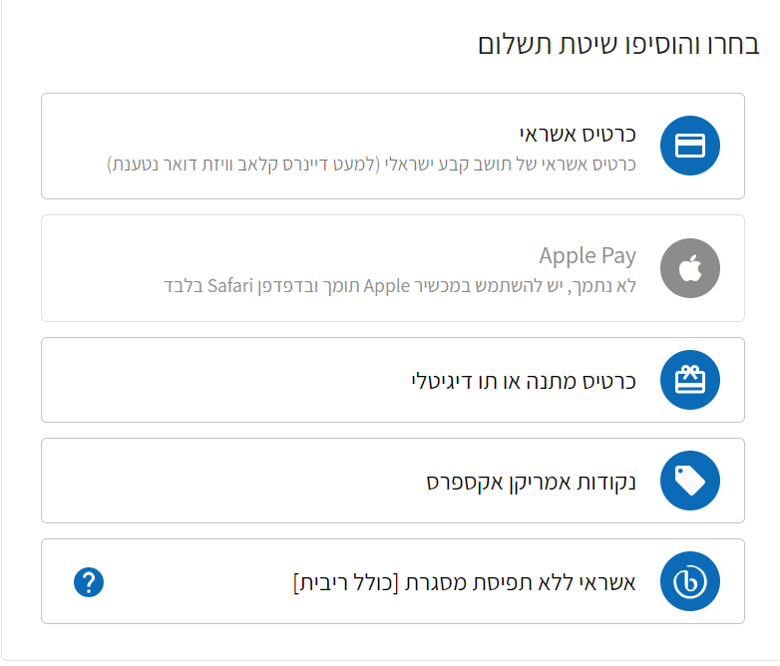
blenderPay - BNPL Market Leader
A complete and unique solution for E-commerce sites for leading brands

Slide 15
blenderCar
The fastest option for car loans in Israel and Europe
In collaboration with:
Wide selection of car dealers operate with blenderCar in Israel and Europe
Transaction authorization within seconds -no forms or paperwork!
Convenient and easy-to-use digital platform for car dealers
A unique technology with a holistic system of rapid credit evaluation and establishment
Wide installment spread tailored to the customer’s needs

Slide 16
Blender Israel: Continued growth
Sector Profit (in thousands of NIS
Credit brokerage and provision of credit in Israel
Adjusted EBITDA (in thousands of NIS)
Credit brokerage and provision of credit in Israel

Slide 17
Blender Israel: Continued growth
Revenue in Israel (thousands of NIS)
Total credit portfolio (thousands of NIS)
40%
Growth
81%
Growth
PROFIT
NON-GAAP gross revenues that include interest from loans in a credit brokerage system. Financial data in NIS as of June 30, 2023.

Slide 18
Blender Israel: Increased volume of loans
Paying customers
Total loans provided (in thousands of NIS)
Consistent growth in the number of customers
33%
Growth
Loans in a credit brokerage system. Financial data in NIS as of June 30, 2023.

Slide 19
Blender Europe
Revenue (thousands of NIS)
Total credit portfolio (thousands of NIS)

Slide 20
Proven and Meticulous Credit Risk Management in a Dynamic Market with Changing Interest Rates
Proven underwriting and risk management model
Diversifying loan origination while promoting collateral based loans
Controlled and supervised lender and borrower processes
In Israel, a security fund, unique in the industry, to protect investors from borrower default and credit risk insurance for the security fund by an international insurance company
Europe
Israel
Provisions for
Credit Portfolio Balance
Interest APR
Interest APR
Failure rate
As detailed in the security fund regulations and insurance policy.
Actual cost was calculated at the time that the loan was made.
The failure rate data refer to the credit brokerage sector.
In the credit sector in Israel, the provision rate for doubtful debts stands at 2.6%

Slide 21
Blender Group - Increasing Revenue and Reducing Loss
Adjusted EBITDA
Loss was reduced by about 79% in the first half of 2023
Change
In % | In NIS | 1-6/2022 | 1-6/2023
36% | 4,689 | 12,930 | 17,619 | Gross Revenue
(43%) | 4,422 | (10,244) | (5,822) | Reported net loss
29% | 280 | 973 | 1,253 | Depreciation and amortization | Non-cash expenses/income
(50%) | (224) | 448 | 224 | Share-based payment
- | 600 | - | 600 | Non-cash advertising expenses
16% | (106) | (675) | (781) | Net financing expenses (income) not attributable to current activity
- | (134) | 134 | - | Legal expenses for settling a lawsuit | Cash expenses/revenues
- | 2,440 | 183 | 2,623 | Commissions from credit provision activities classified as net income in advance
- | (720) | 720 | - | One-time costs for an international bank license and international line of credit
- | 146 | 10 | 156 | Income taxes
(79%) | 6,704 | (8,451) | (1,747) | Adjusted EBITDA
Financial data in thousands of NIS as of June 30, 2023

Slide 22
Activity Strategy for 2023
Israel as a profit center:
blenderPay in partnership with Bank Hapoalim as a growth engine
Continued development of the credit provision sector
Varied funding sources: Establishing new credit lines and strengthening credit brokerage activity
Europe:
Maintaining ongoing activity in other countries
Selling technology:
Cooperation agreement with Amdocs

Slide 23
THANK YOU

