Slide 1
Document contents
Project goals
Participating local authorities
Program content
Pilot projects in local authorities
Feedback
Team insights
Summary of the “Network Cities” Program Cycle 1
2023-2024

Slide 2
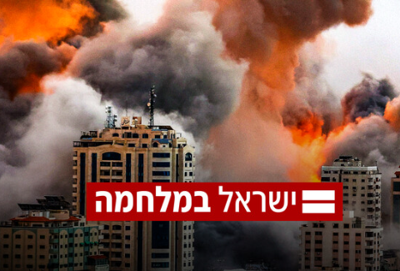
Background
1. During the year in which the program took place, two significant events affected the number of participating local authorities, the composition of participants, their shared experience, and everyone’s emotional state.
October 7 and the Swords of Iron War
Elections in the local authorities
Nevertheless, attendance at each meeting was high and there were open and sensitive discussions about the complex social situation.
2. There were changes in the team during the program’s duration.

Slide 3
1. Goals of the Network Cities Program

Slide 4
Goals of the Network Cities Program
Peer learning and
forming a community of local authorities connected with Urban95, Israel, and the world.
Establishing a cross-organizational professional team from each local authority and supporting every participant to be a change leader.
Creating a toolbox of actions that promote a child-friendly environment.

Slide 5
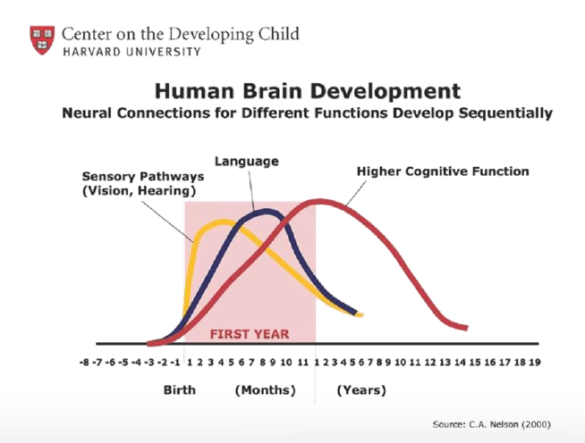
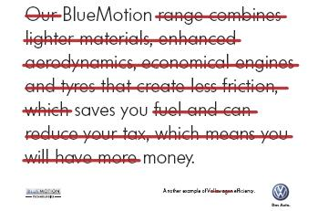
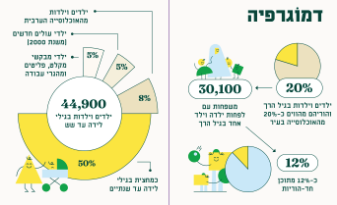
Network Cities
Creating a toolbox of actions that promote a child-friendly urban environment.

Slide 6
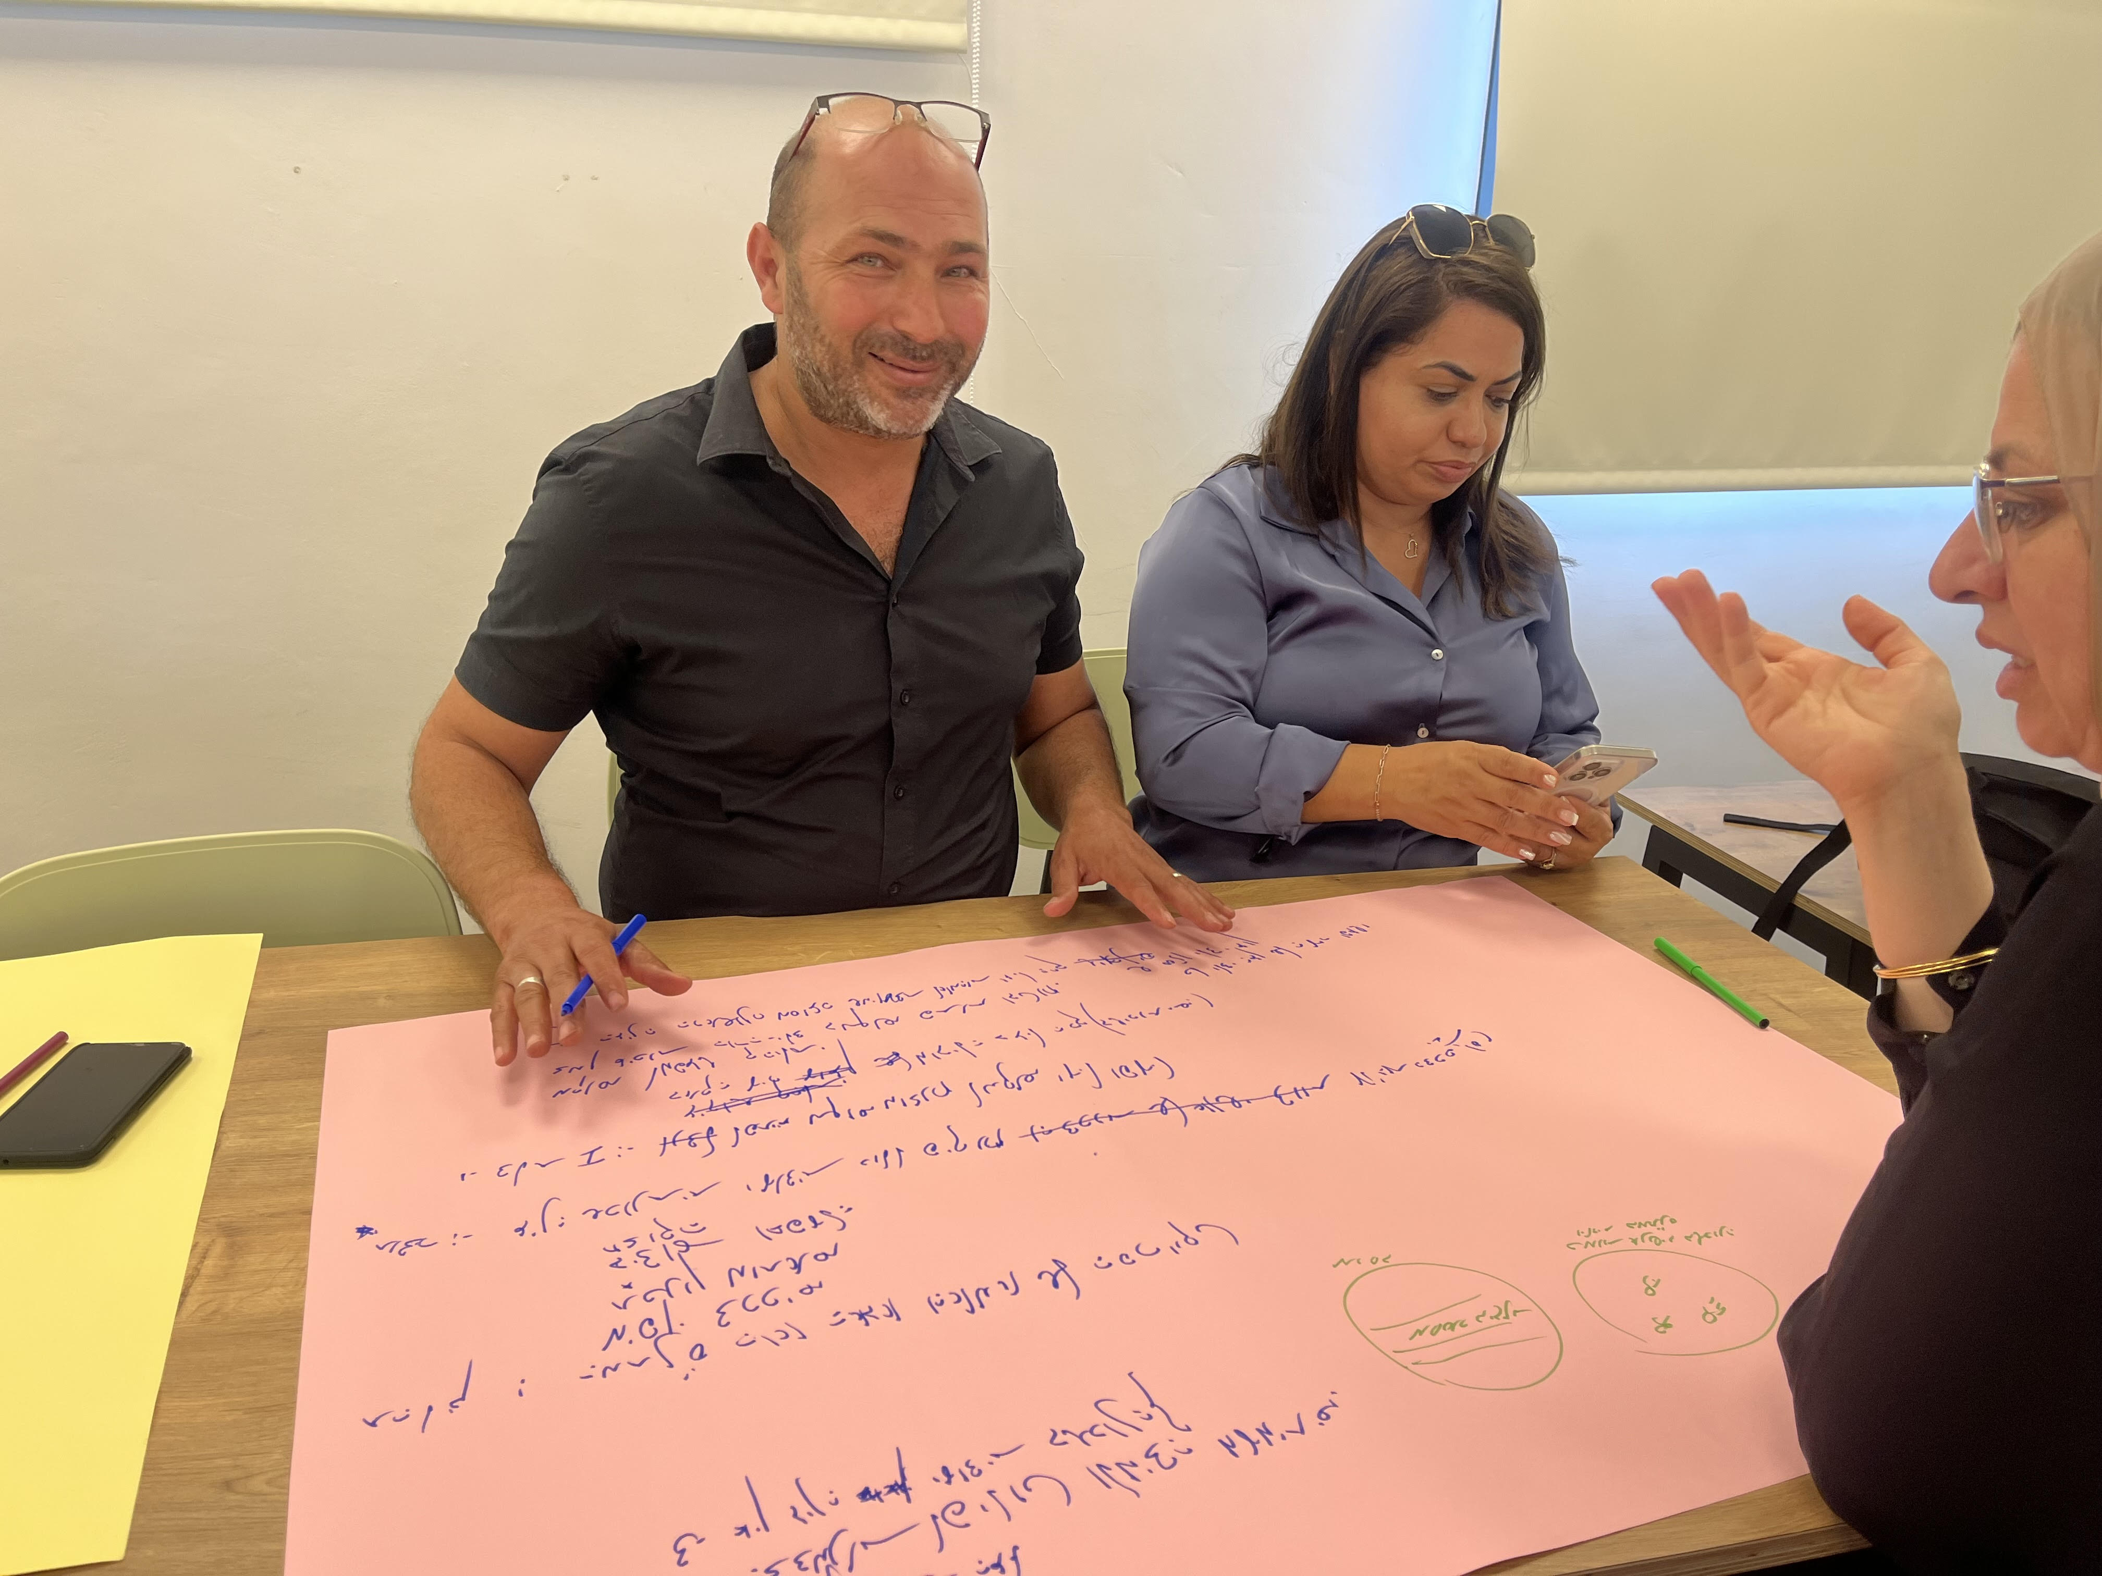
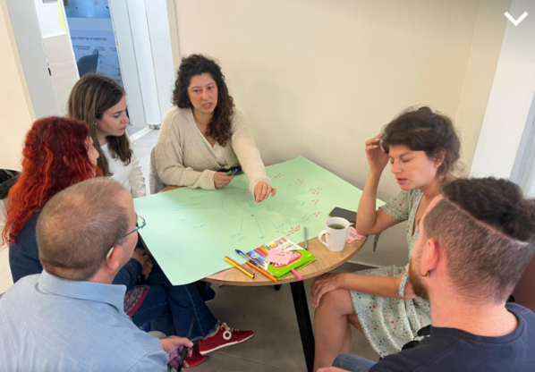
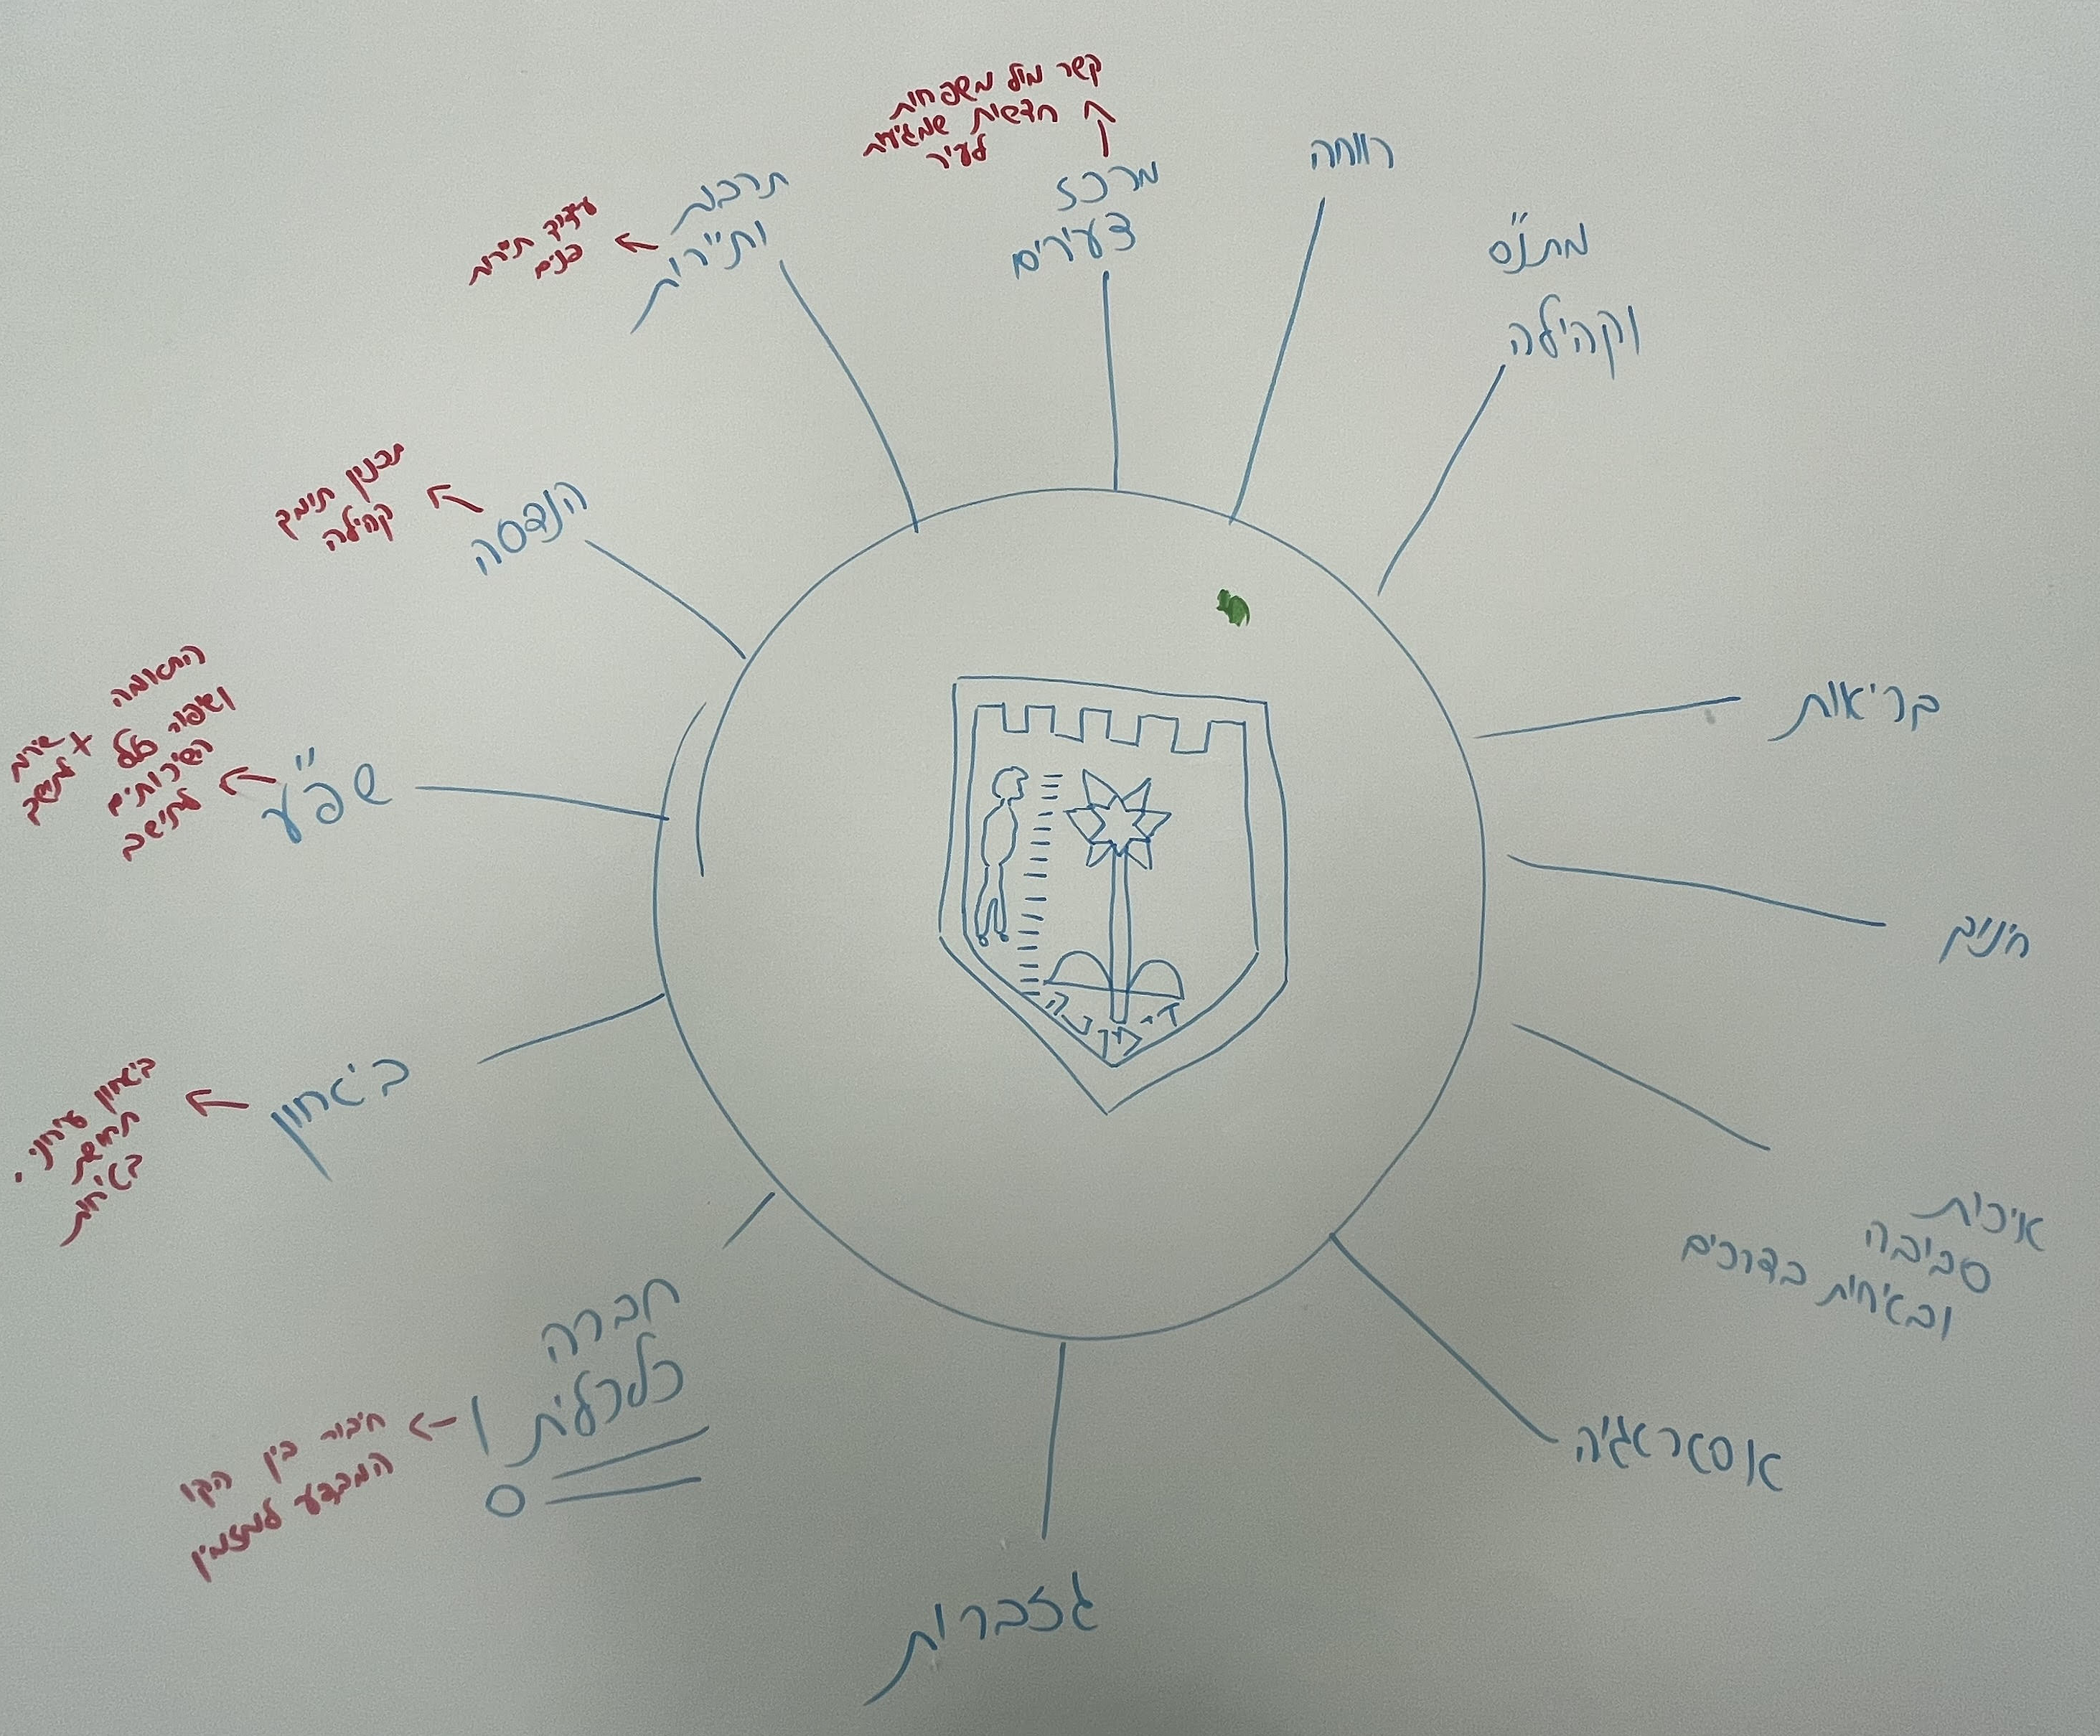
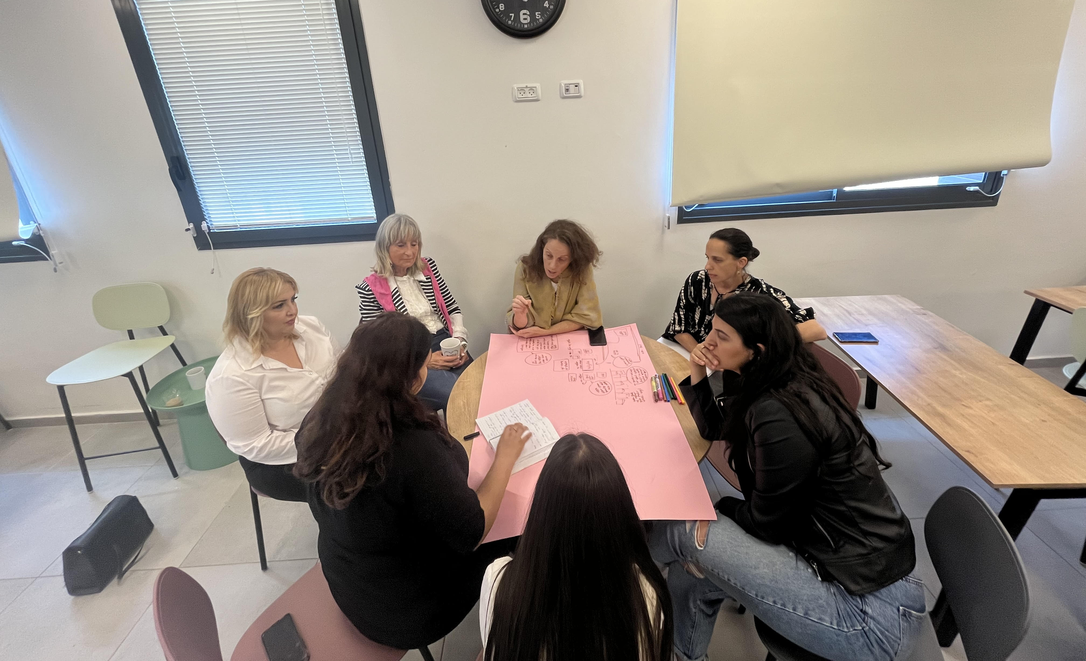
Network Cities
Establishing a cross-organizational professional team from each local authority,
and supporting every participant to be a change leader.

Slide 7
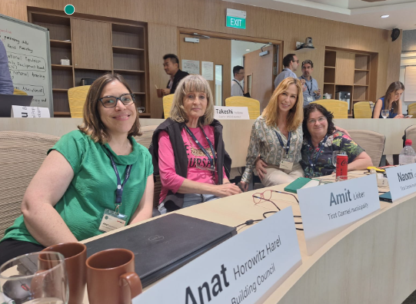
Network Cities
Peer learning and
forming a community of local authorities connected with Urban95, Israel, and the world.

Slide 8
2. Participating Local Authorities

Slide 9
The Four Participating Local Authorities and the Composition of the Participants
Local Authority | Role | Name
Lod | Deputy Director of the Operations Division | Yoni Tari
 | Director of the Department of Strategic Planning and Transportation | Yuval Shtalrid
 | Director of the Early Childhood Department of the Ministry of Welfare | Miri Melek
Baqa | Director of the City Improvement Department | Ziad Ghanem
 | Deputy Engineer for the Baqa Municipality | מרוות שתיווי
 | Representative in the Department of Education for the Baqa Municipality | Razan Masrwe
 | Municipal Director for children aged 0-3 | וופא מסואסי
 | Community Center Director and pilot project leader | Aber Ghanayim
Dimona | City Engineer | Guy Donenfeld
 | Director for Parents at the Community Center | Shosh Biton
 | Manager of the Smart City Department | Oren Oster
 | Referent for Organizational Development | Esti Elishayev
Tirat Carmel | Deputy Director of the Community Relations Division | Hagit Liberman
 | Director of the Innovation Hub: Center for Entrepreneurship and Technology | Naomi Aldes
 | Community Coordinator, Innovation Hub: Center for Entrepreneurship and Technology | Inbar Berge

Slide 10
3. Program Content

Slide 11
3. Program content
Topic | Date | Location | Meeting
Urban95: Introduction to the program | 15/06/23 | Tel Aviv | 1
Integrating the Urban95 perspective in the city | 11/07/23 | Tel Aviv-Jaffa | 2
Adapting the content for young children | 12/09/23 | Beit Shemesh | 3
Community resilience | 22/11/23 | Zoom | 4
Community activity and residents’ initiatives | 19/12/23 | Pardes Hana | 5
Developing and supporting a pilot project in preparation for the peak meeting | January-February | Urban95 Network City | 6-8
Public space as a space for generating initiatives, community activity, and integrating tools for change leaders | 07/03/24 | Baqa al-Gharbiyye | 9
Storytelling in the daycare center model | 02/05/25 | Tirat Carmel | 10
Peak meeting | 02/07/24 | Ven Leer Institute | 11
Individual mentoring sessions with each local authority in preparation for a meeting of the management |  |  | 12-13
Concluding meeting of the program led by the city administration |  |  | 14

Slide 12
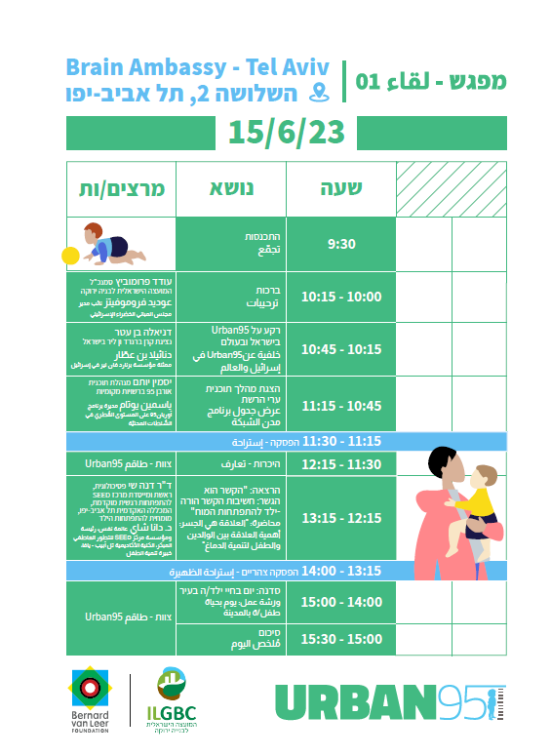
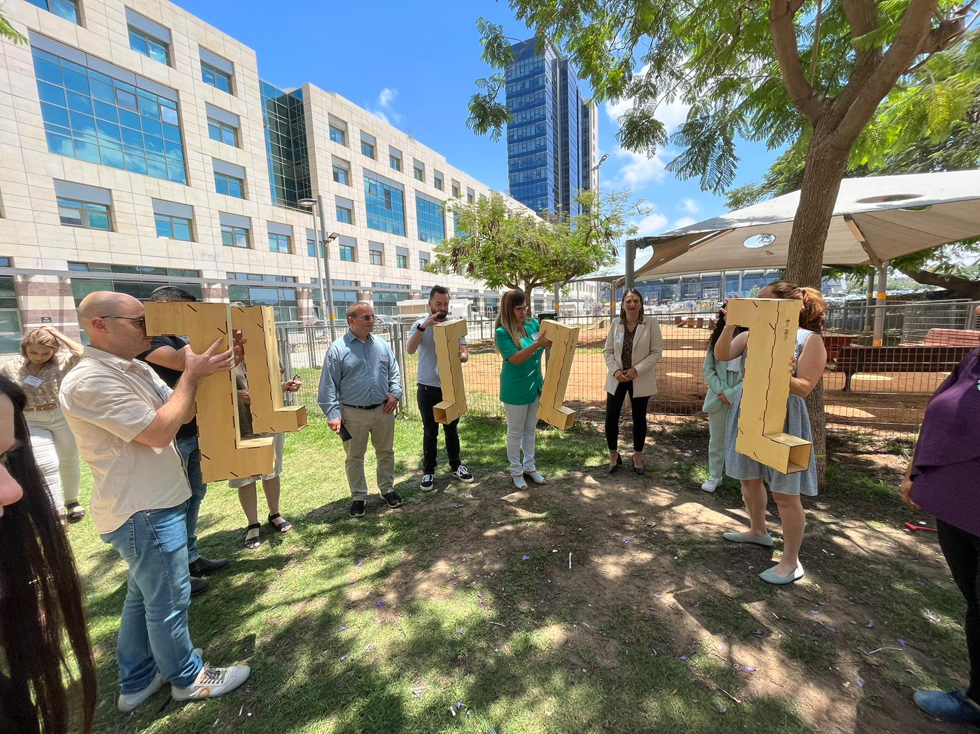

Slide 13
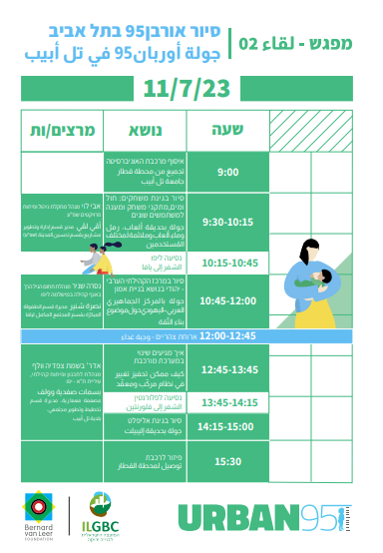
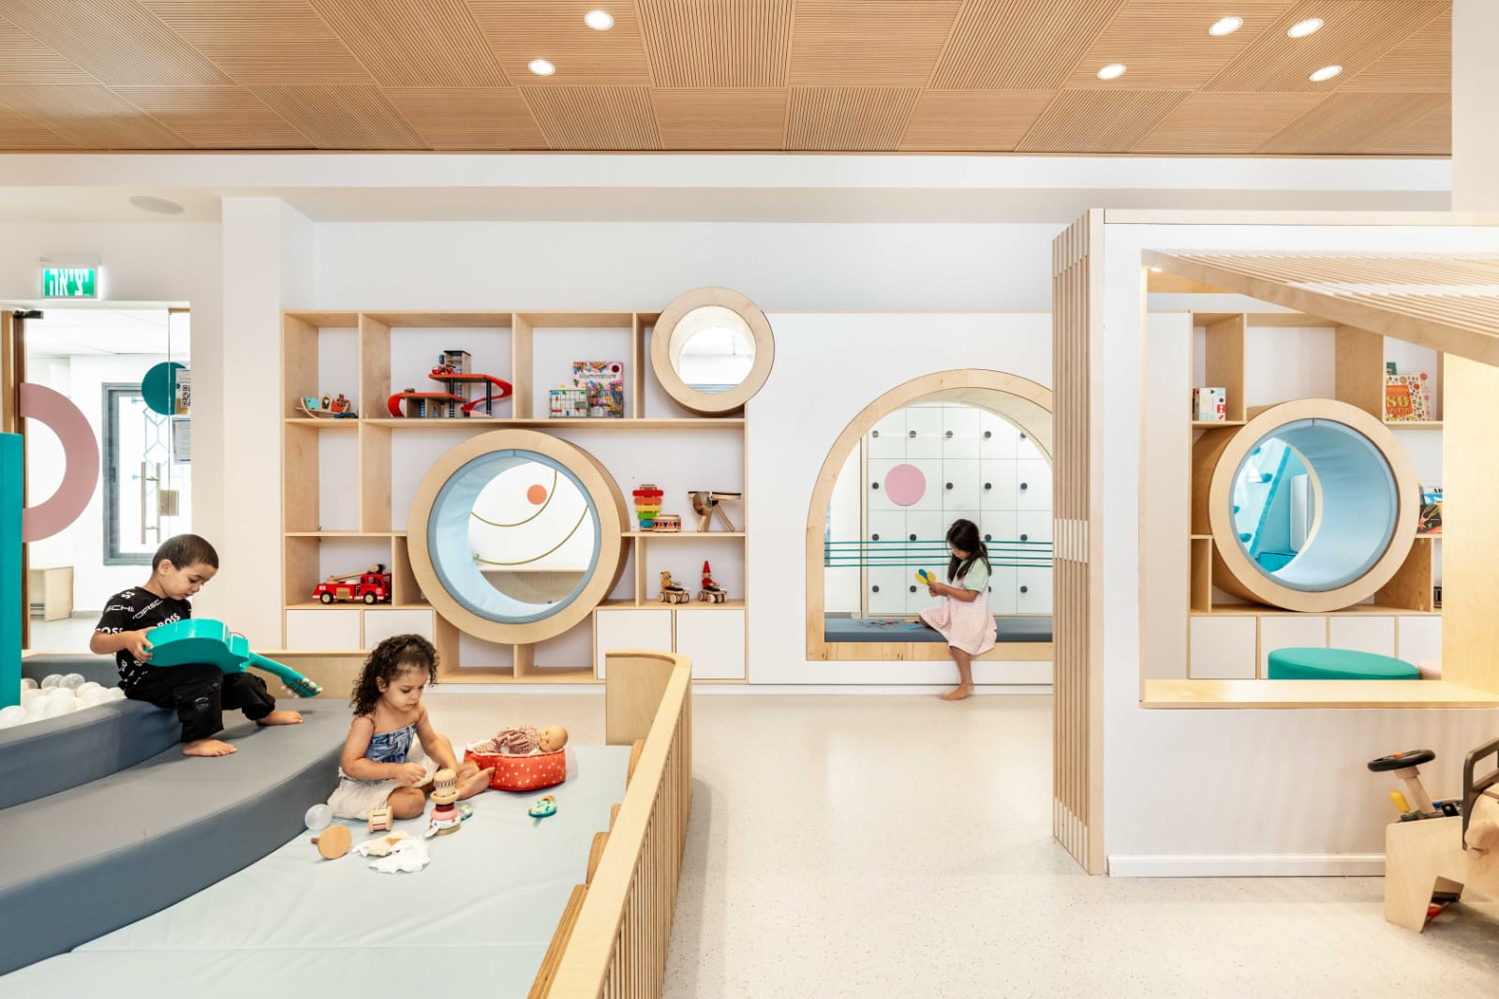

Slide 14
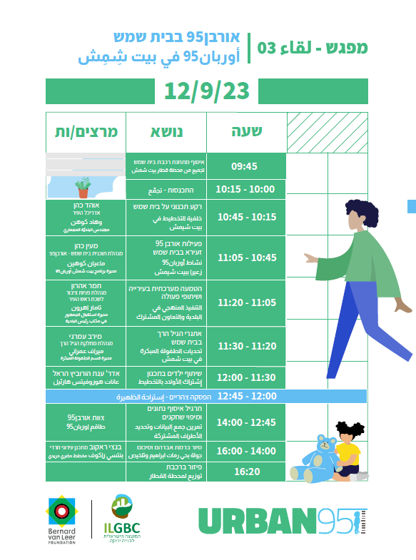
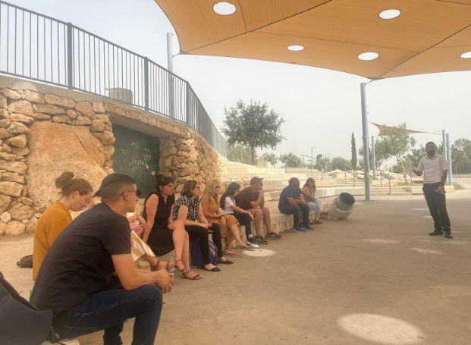

Slide 16
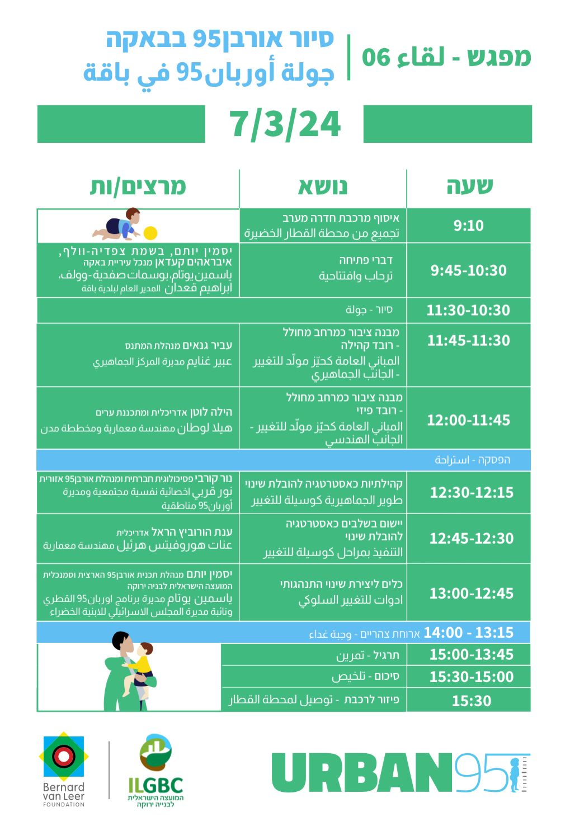
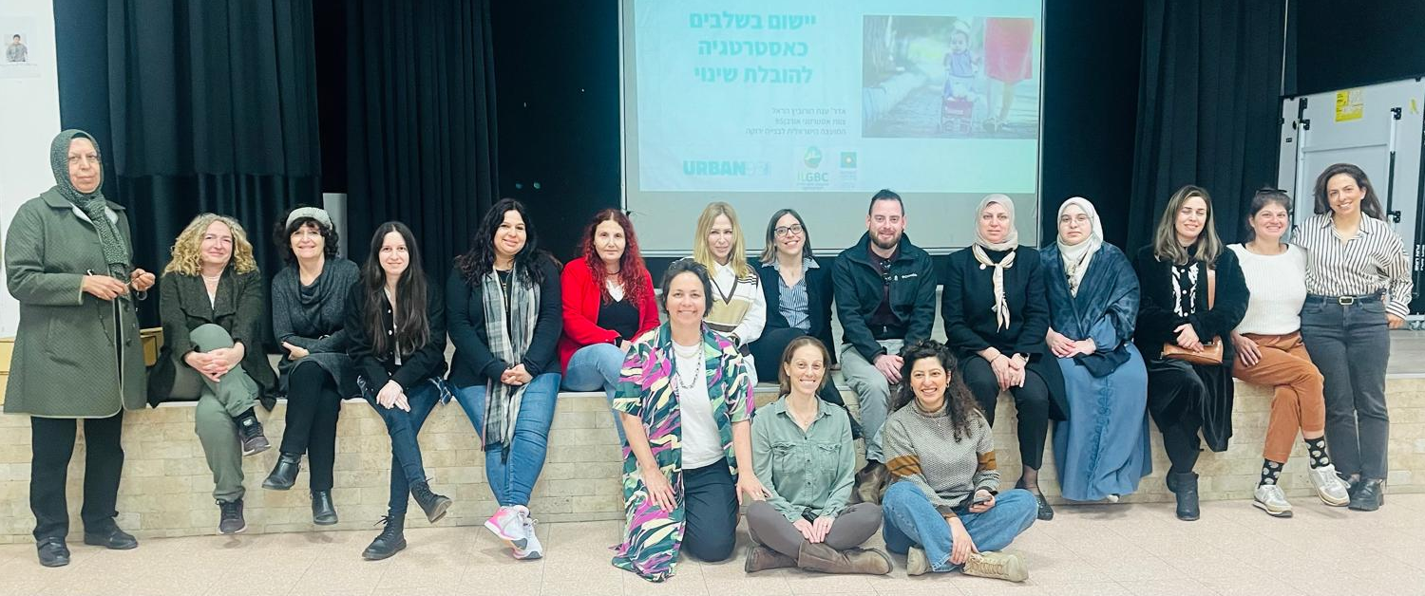

Slide 17
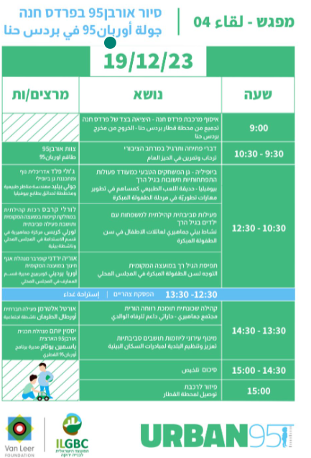
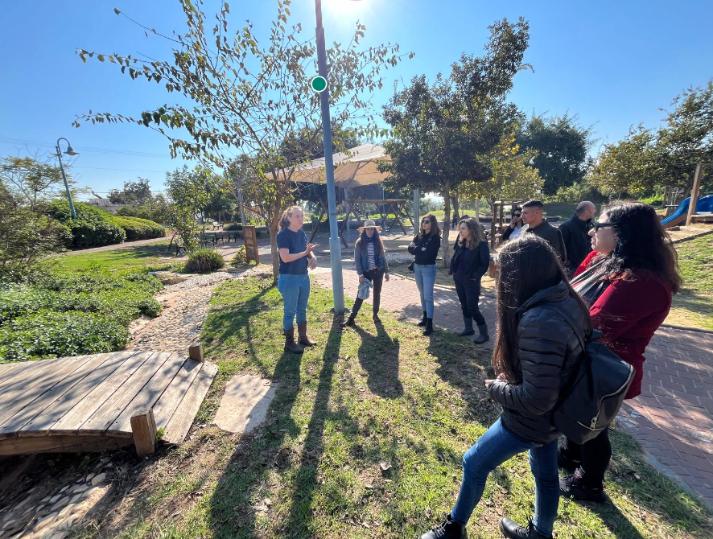

Slide 18
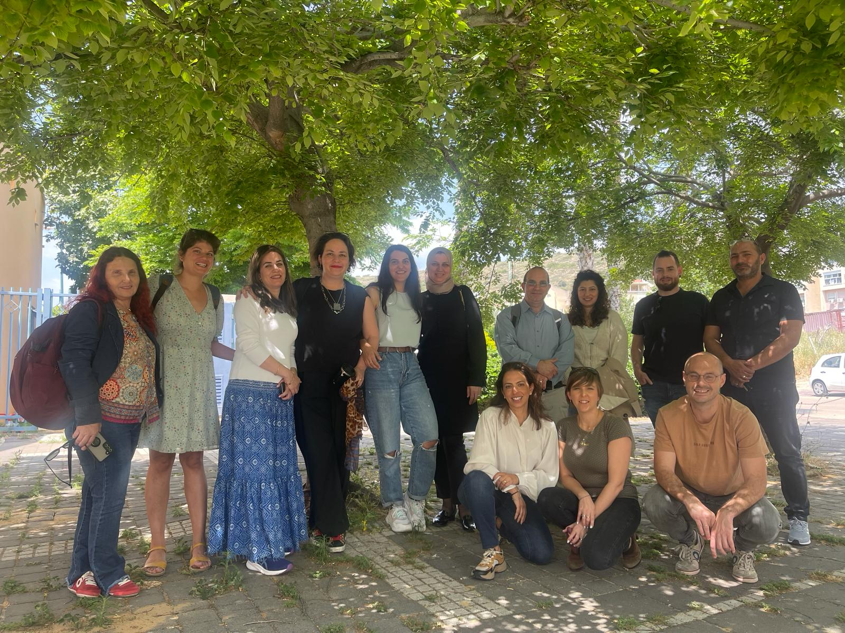

Slide 19
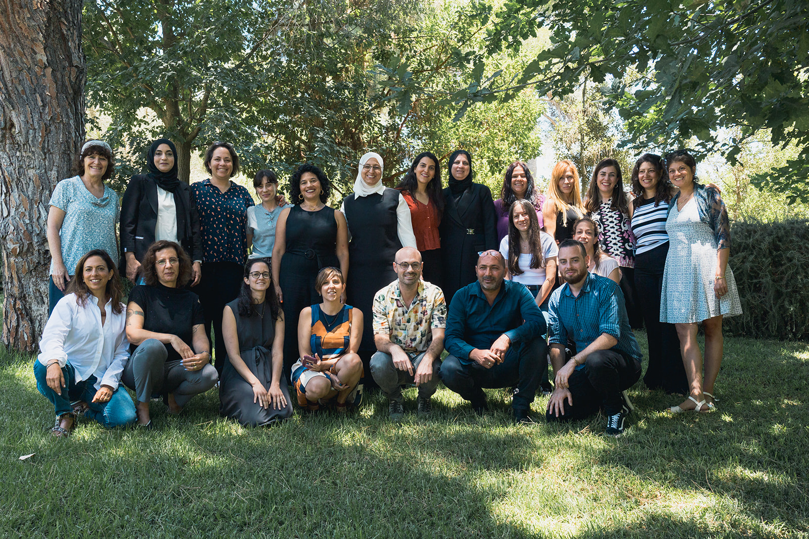

Slide 20
4. Pilot Projects in the Local Authorities

Slide 21
The City of Lod

Slide 22
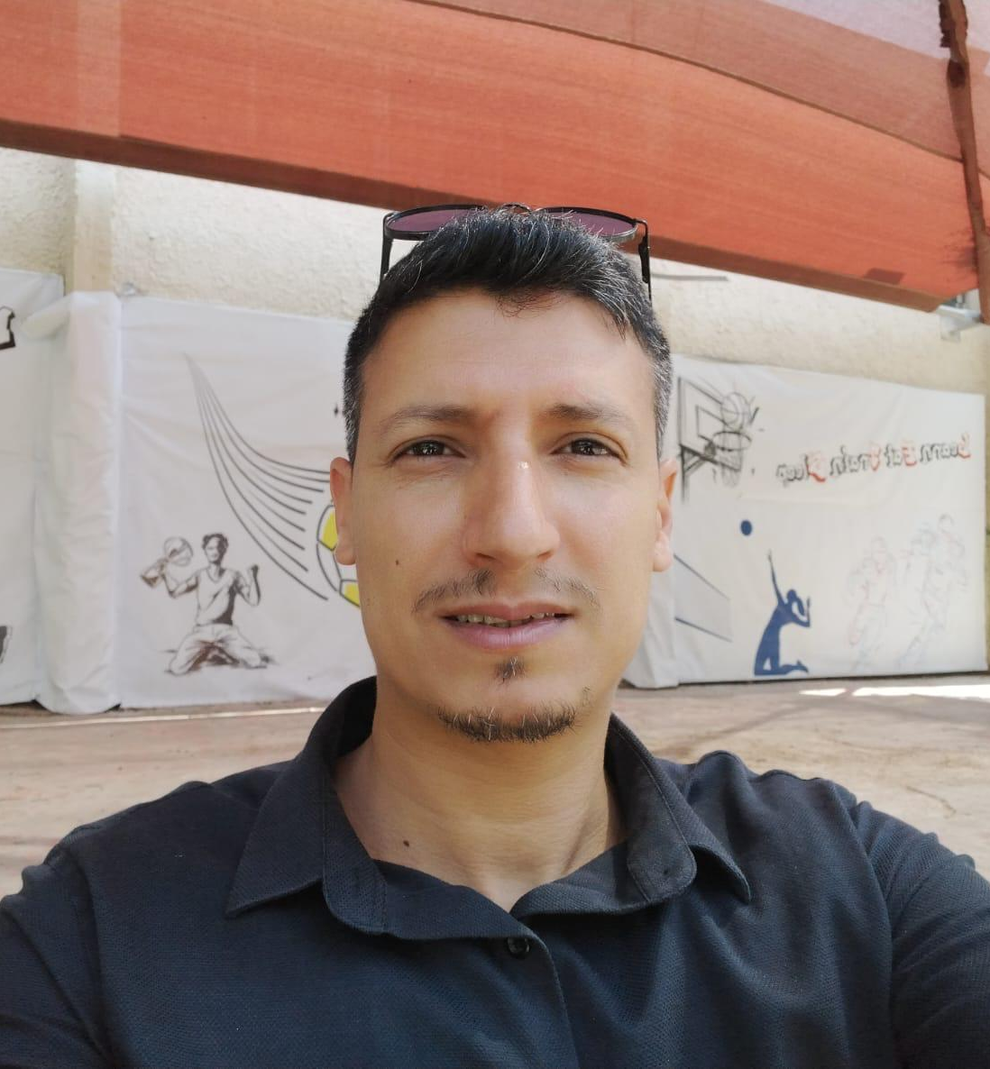
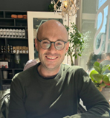
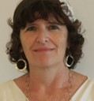
Lod Municipality Team
Yoni Tari
Deputy Director,
Operations Division
Yuval Shtalrid
Director of the Strategic Planning, Transportation, and Engineering Department
Miri Malak
Director for the Early Childhood Branch of the Welfare Department

Slide 23
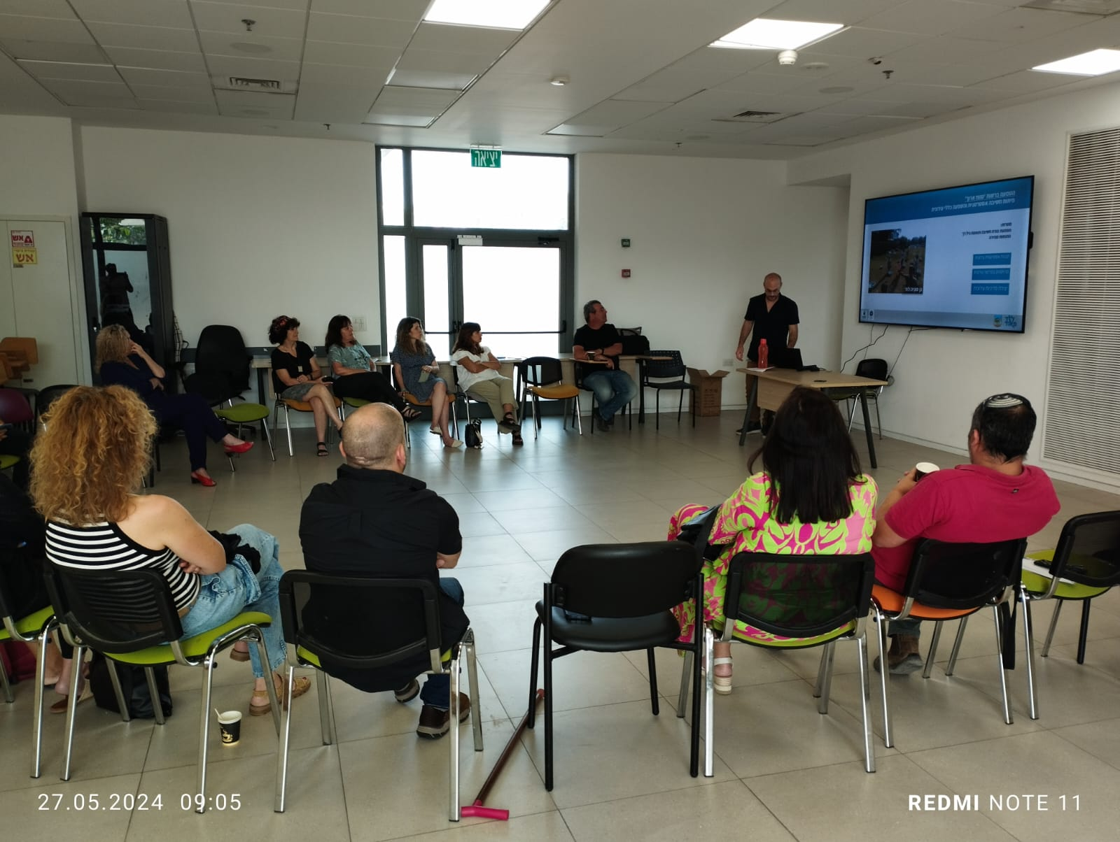
Presentation on Pilot Projects
Development of a work mechanism in the local authority for planning and constructing public spaces on behalf of young children and their parents in the city of Lod.
The pilot has three stages:
Training for municipal employees who interface with the field of early childhood.
Establishing an interdepartmental work team and creating work routines for planning and construction (a municipal work mechanism).
Incorporating early childhood-oriented thinking into the work plans of the various municipal departments.
Program goals:
Raising awareness of the importance of early childhood with an emphasis on public spaces.
Recruiting partners into the process.
Creating regulated work routines to promote cooperative planning.

Slide 24
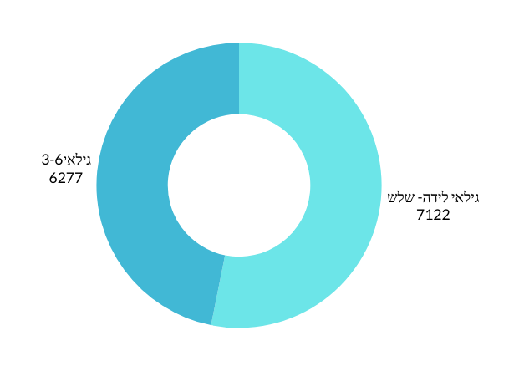
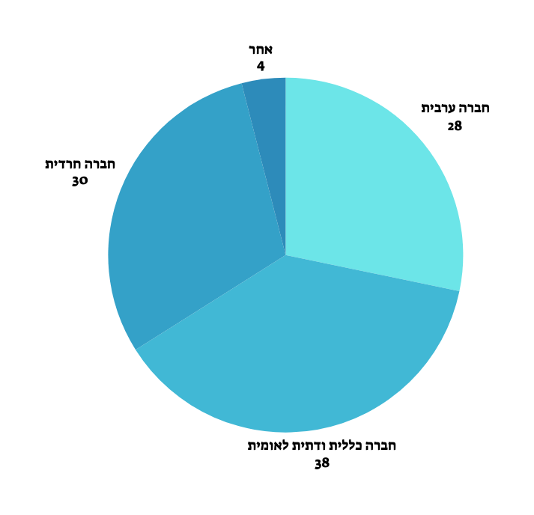
Needs and Data
Young children (birth-6 years) constitute 14.4% of the city's population.
Only 28.1% of children aged birth-3 are in supervised settings. The remainder are in unsupervised settings or the family home.
About 16% of children between the ages of birth and 6 are defined as at-risk children and are known by the Welfare Department.
Lod is a cultural mosaic, and the city’s facilities and services require geographical and cultural adaptation.
In the municipal system, the early childhood department is under the supervision of the Department for Social Integration. Since daycare centers were transferred to the Ministry of Education, the most significant interface is with the Education Department.
By 2030, some 50,000 new residents are expected to settle in Lod.
Every year, on average, there are about 500 children aged 0-3 in families new to the city, and a total of about 3150 additional children.

Slide 25
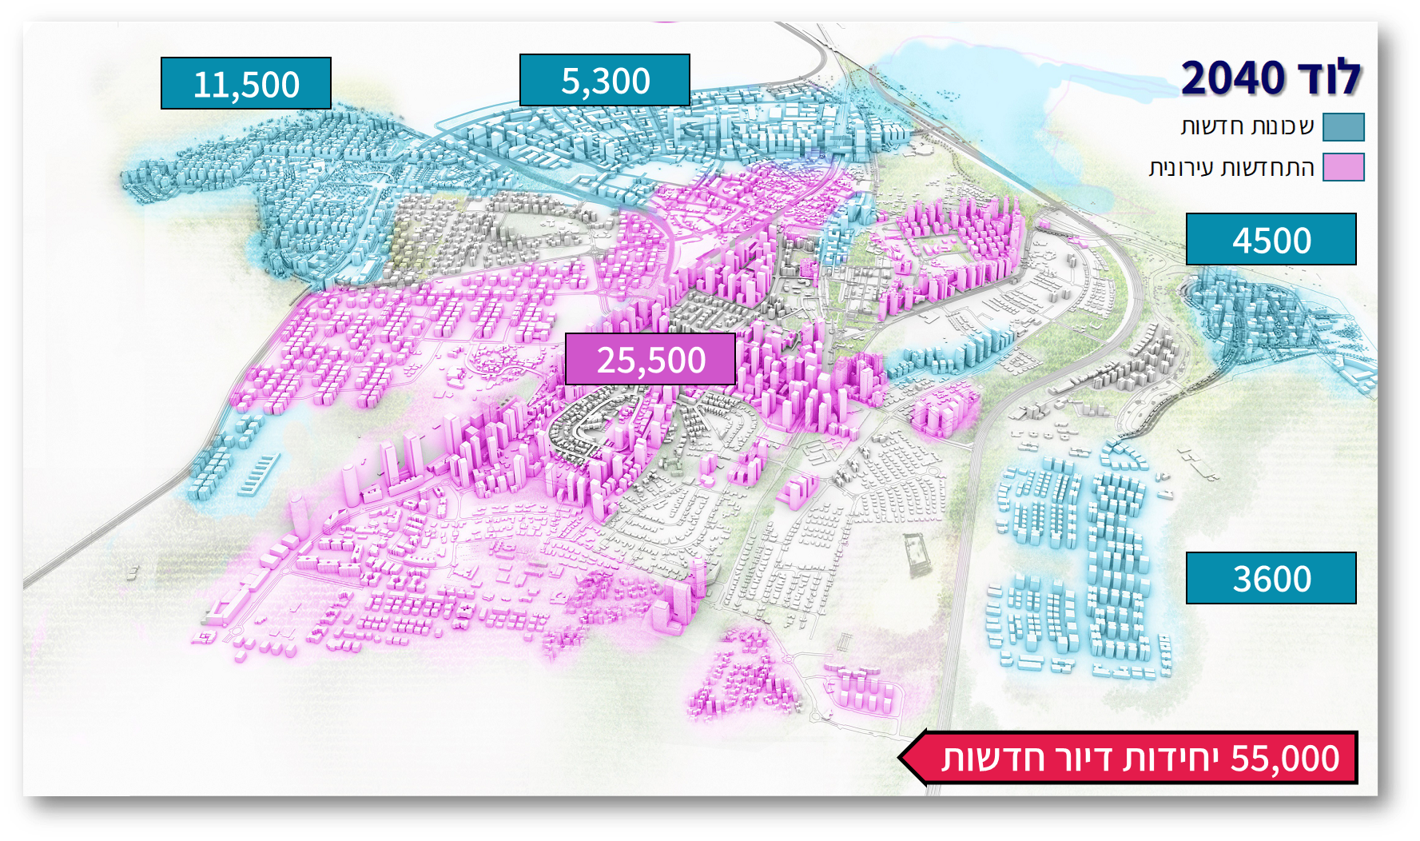
The strategic “roof agreement” of 2017 for major development of the city in the coming years
LOD
תוספתיים

Slide 26
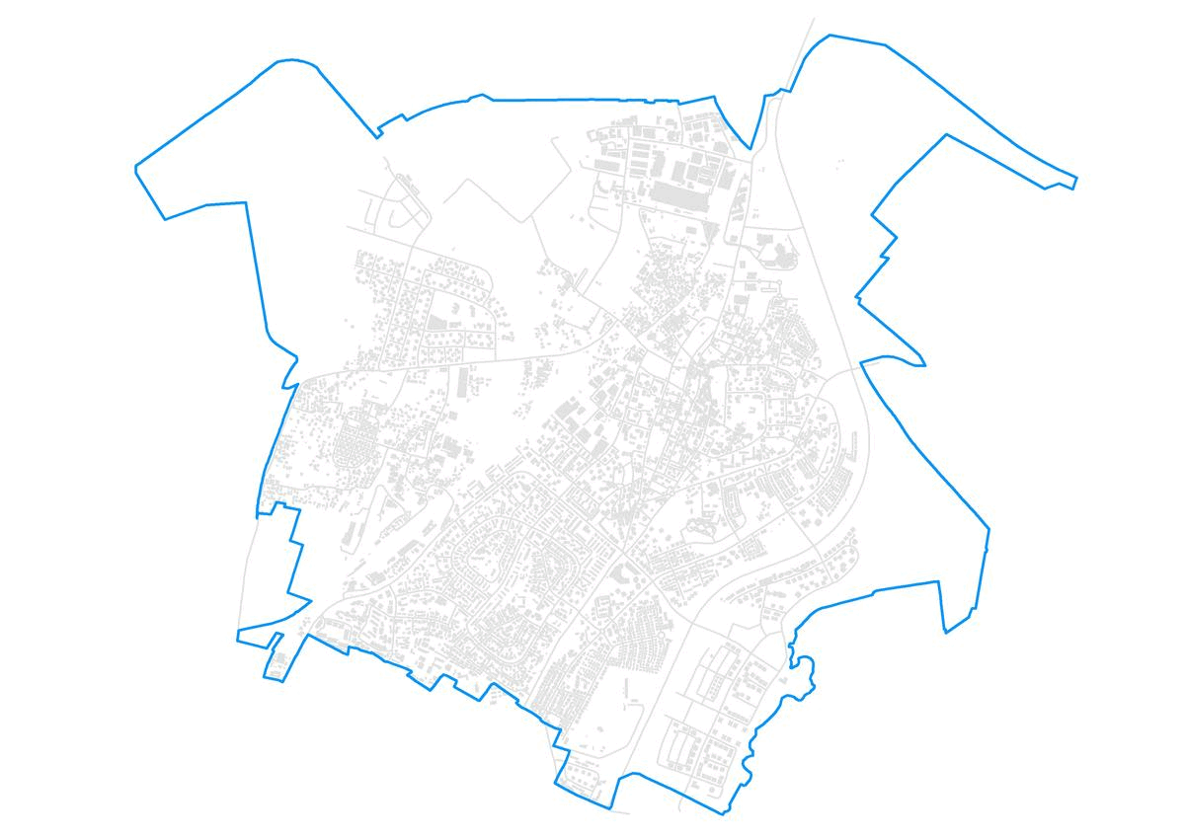
A complete urban makeover
86% of the city's area is covered in detailed plans

Slide 27
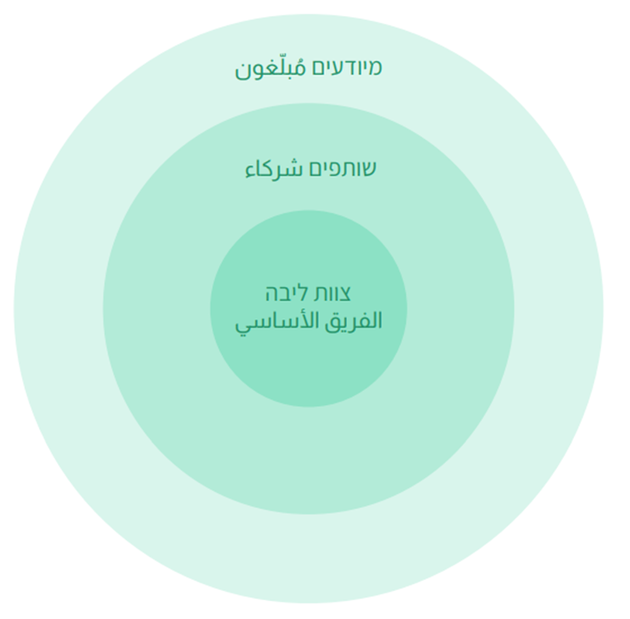
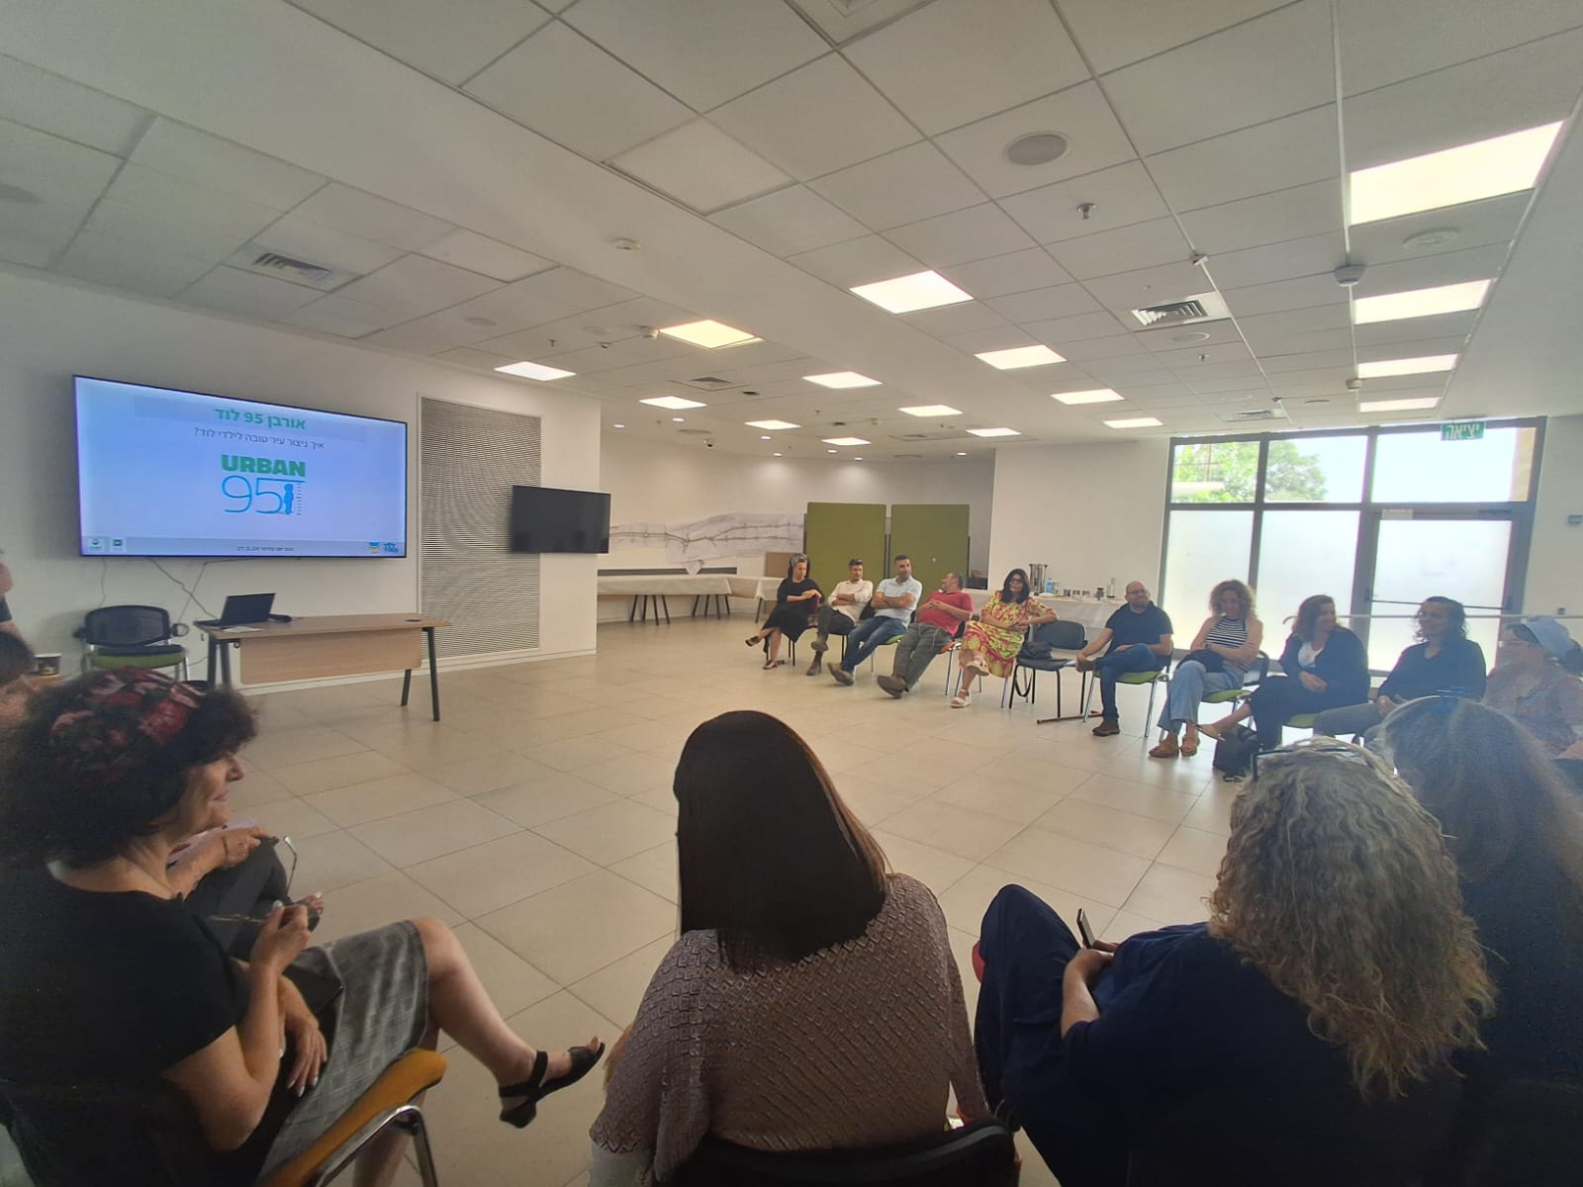
Partnerships
Departments and Divisions of the Lod Municipality that are partners
in the program implementation:
Director General’s Office, Engineering Administration,
Operations Department, Treasury, Community Division,
Legal Department, Department of Projects, Security, Culture Department,
Environmental Quality Department
Other involved agencies:
HaZira Project, Lod Economic Company, Association of Community Centers,
the Dorot Library, muni100 Project, Mixed Cities Projects,
360º National Program for Children and Youth at Risk, government agencies
Other involved entities:
The Ministry of Health’s Tipat Halav (family health clinics),
Pesher-Association of Welfare Development Services.
The voluntary sector: the Joint, the Rashi Foundation, Yad HaNadiv,
associations of daycare centers, Israeli Green Building Council, Urban95 team,
parents and residents.

Slide 28
Target Audiences
The pilot will focus on:
Municipal employees: out of the desire to create an in-depth and long-term process, we are investing in the training of municipal employees in all departments involved in the field of early childhood in the public space. We aim to assimilate this issue into the work processes for the planning of public spaces and to expand the circle of involved partners in the field.
The intention is for each department to know how to integrate the topic of early childhood into their routine activities and to work in synergy and cooperatively with other municipal departments.
2. Other urban partners involved in the field of early childhood.

Slide 29
Gathering resources (existing programs, government offices, donations, community resources, etc.)
A training day and professional work processes in the Urban95 program
Continued cooperation with the 360 ​​program
Cooperation with the Joint’s muni100 program and the Ministry of the Interior’s HaZira project.
An invitation for proposals for mixed cities (topic of parental guidance)
Invitations for proposals

Slide 30
Leading Change How will we create change? What are the perceptual and behavioral tools?
1
Training. The training day gave participants
background knowledge about strengthening
the parent-child relationship and how this is
essential for the benefit of early childhood
development. Data and illustrative examples
from similar places in other cities that underwent
planning were presented to connect participants with
the idea and “whet their appetite” to undertake
similar planning.
3
Professionals will meet for quarterly training
on early childhood and to strengthen
interpersonal ties between officials in the
local authority.
Training
Integrating thinking
2
4
Knowledge will be applied to carry out
departmental projects with municipal
cooperation and following the Urban95 approach.
Round table. The second meeting will be
dedicated to setting up a round table and writing a
practical work procedure for planning public spaces
adapted to young children, with a broad view of all
aspects of the issue and all project partners.
Round Table
Applying knowledge

Slide 31
Stages of the pilot projects (the pilot stages and long-term thinking)
2025
Fourth quarter 2024
May 2024
Stage 3:
Project implementation and execution in the departments
Stage 2:
Developing a work mechanism
Stage 1:
Professional training
Round table for about 10 professionals
Training day for about 30 professionals

Slide 32
Cooperation between all local authority entities involved with the issue. Raanan Seton economic company: "It is important that this economic company is involved. We have the budgets, and it is important that the content is linked to the activities we carry out." Thinking that includes and considers urban areas: "There is a lack of cohesive thinking that puts us all at the same table.” "If we work correctly and cooperatively as a local authority, we will save money for the local authority." The importance of mapping needs and public participation: Amelia Kodish - city library director: "From the public’s point of view, it's a sense of feeling seen." The importance of introducing concepts of developmental thinking into public spaces and their development: Helen Jacobson - Pesher Association of Welfare Development Services: "It is important to introduce developmental thinking that conveys independence and success to children, such as water faucets that children can turn on themselves by pressing a button (not by turning a faucet).” The importance of public spaces for encouraging creativity: Keren Shalom-social worker: "Public spaces should teach creativity. Simplicity is genius." Establishing the place of young children in the local authority: Moriah Abramowitz - Parent mentor at the Welfare Department: “Children from birth to three years old are ‘invisible’.”
Insights from the opening conference
The meeting was attended by about 20 participants with seniority of 1-5 years in various municipal departments

Slide 33
Impact of the training session and metrics for the continuation of the process
Awareness of the importance and criticality of investing in young children and their families has increased
A seed was sown regarding the importance of an ongoing connection between the entities dealing with implementation and planning and the entities dealing with education and community
Initial interpersonal contacts were made among professionals in the local authority who address the subject of early childhood
There was a high level of responsiveness from professionals in the local authority from all departments and divisions
Metrics for evaluation
Measuring the effectiveness of the cooperative work among professionals via feedback.
Assessing the number of joint projects carried out over the course of two years according to the budgetary situation.
After implementation, it will be possible to assess residents' satisfaction with the project.

Slide 34
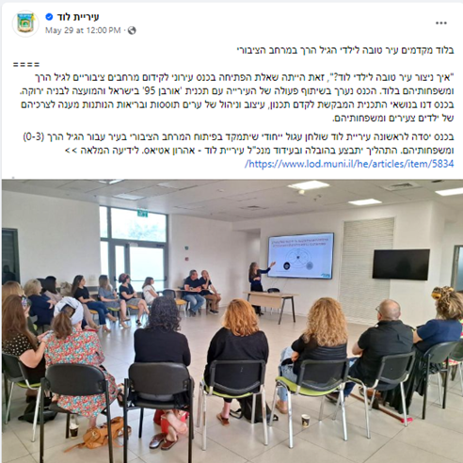
Transparency (to the public and to municipal authorities)
Throughout the process, spokespeople will publicize the project in all municipal media )website, newsletter, Facebook, the written press).
Procedures will be uploaded as shared Teams files and distributed by email.

Slide 35
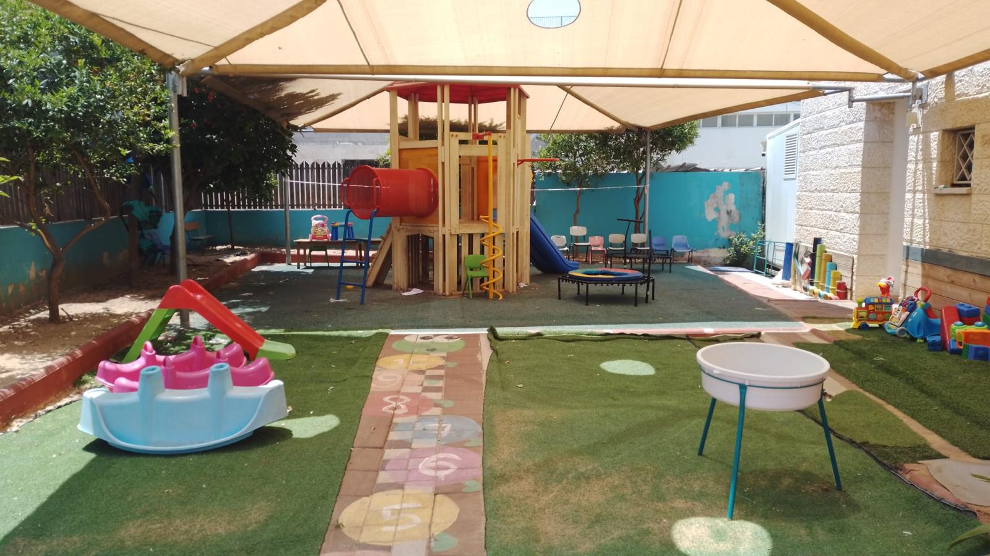
In Our Courtyard Baqa al-Gharbiyye

Slide 36
Municipal Team
Municipal team
Ziad Ghanem--Urban95 project leader
מרוות שתיווי –
Deputy engineer in Baqa
Razan Masrwe
Representative of the Department of Education of the Municipality of Baqa
וופא מסואסי-
Director in the municipal government responsible for children aged 0-3
Community center team
עביר גנאיים
Community center director and pilot project leader
אסל עלוש
Resource development
סחר עויסאת
Community center representative for young children
לינא מוואסי
Community center representative for young children

Slide 37
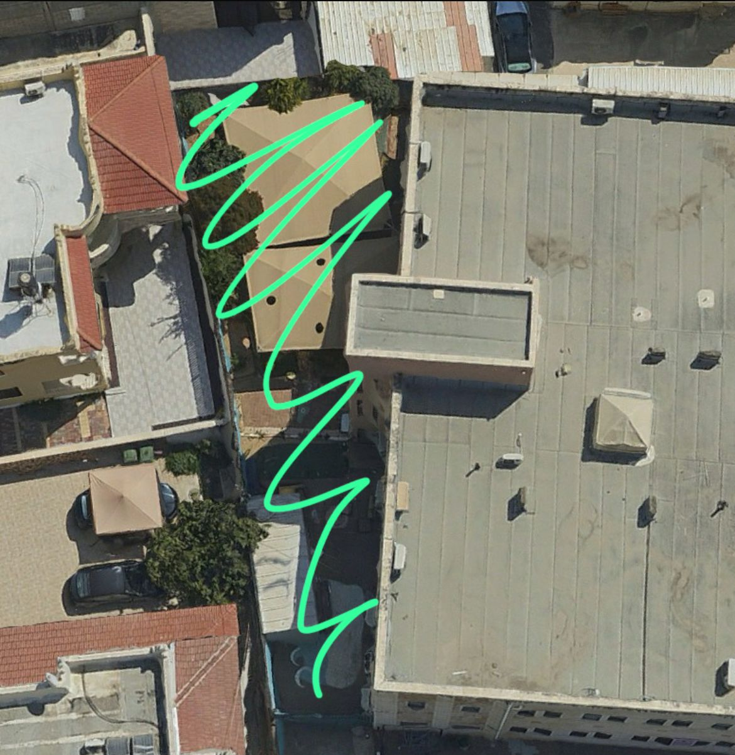
From training to practice:
Renovation of the community center courtyard and opening it to the general public in the afternoons

Slide 38
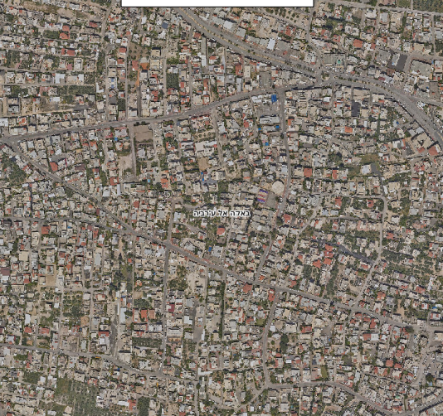
Why did we choose the community center courtyard as a pilot project?
Lack of public parks in the area: there are six public parks in the city with a total size of 9.1 km.
The community center is an activity locus for the community and especially for young children; about 150 children come to the center every day
The center is close to many kindergartens/daycare centers and offers a solution for the afternoon (after school) hours.
The community center is supervised and managed. This solution was suggested by “Ima/Abba” as a pilot project and for ongoing support.
The courtyard park offers an opportunity to strengthen the sense of belonging, community, and connections among people in the neighborhood.

Slide 39
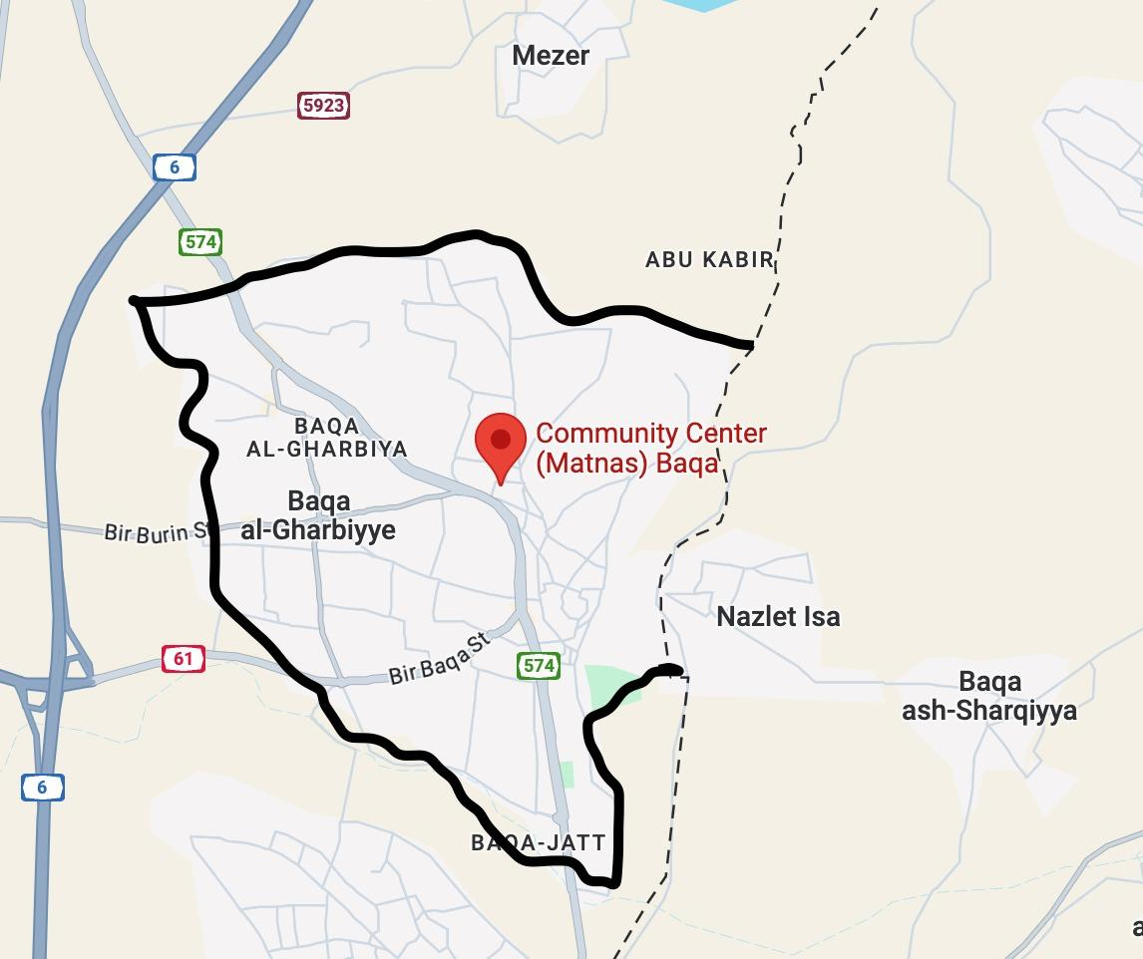
Target audiences
Parents and children who use the community center’s services
Mothers on maternity leave
Neighborhood residents
Young children in the city
Youth: Recruitment for activity

Slide 40
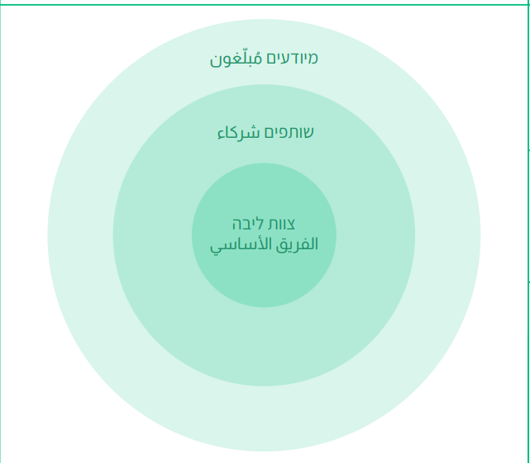
Partners
Core Partners:
Community centers
Engineering Department
City Improvement Department
Departments for young children
Active Partners:
Groups of volunteer retirees
Groups of participating parents
Youth groups
Tnuva: “A Home to Grow Well”
Informed Partners:
City government spokespeople
Community center spokespeople

Slide 41
Pilot Project Stages
Stage 4:
Content-based activities in the park
Stage 3:
Implementation in the field
Stage 2:
Planning the park
Stage 1:
Mapping needs
Stage 1- Mapping needs through questionnaires, a focus group, and training for early childhood caregivers and childcare workers.
Stage 2- Park planning led by the city's engineering team and reflecting the needs that were raised.
Stage 3- Carrying out the renovation in the area.
Stage 4- Content-based activities in the park.

Slide 42
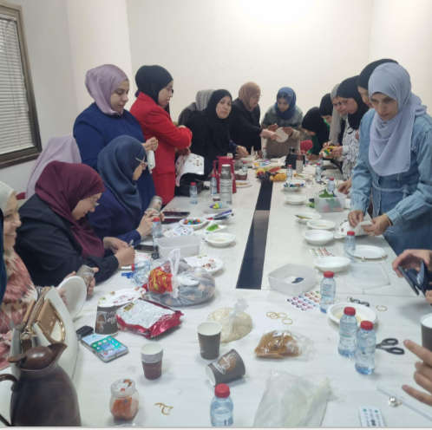
Change makers
Stage 1: Public participation in decision-making processes: Reaching out to parents and neighborhood residents and encouraging children’s participation to bring about a perceptual and behavioral change regarding the use of public spaces in the city; implementing public education regarding spending time in public spaces and improving walkability so that neighborhood residents will come by foot.
Stage 2: Involving the public in activities and encouraging initiatives to transform people from service consumers into partners in leading and driving the services, while looking to the future to replicate the model in other neighborhoods in the city.
Stage 3: Partnerships, community renovation work in the park; public participation in decision-making beginning at the planning stage.

Slide 43
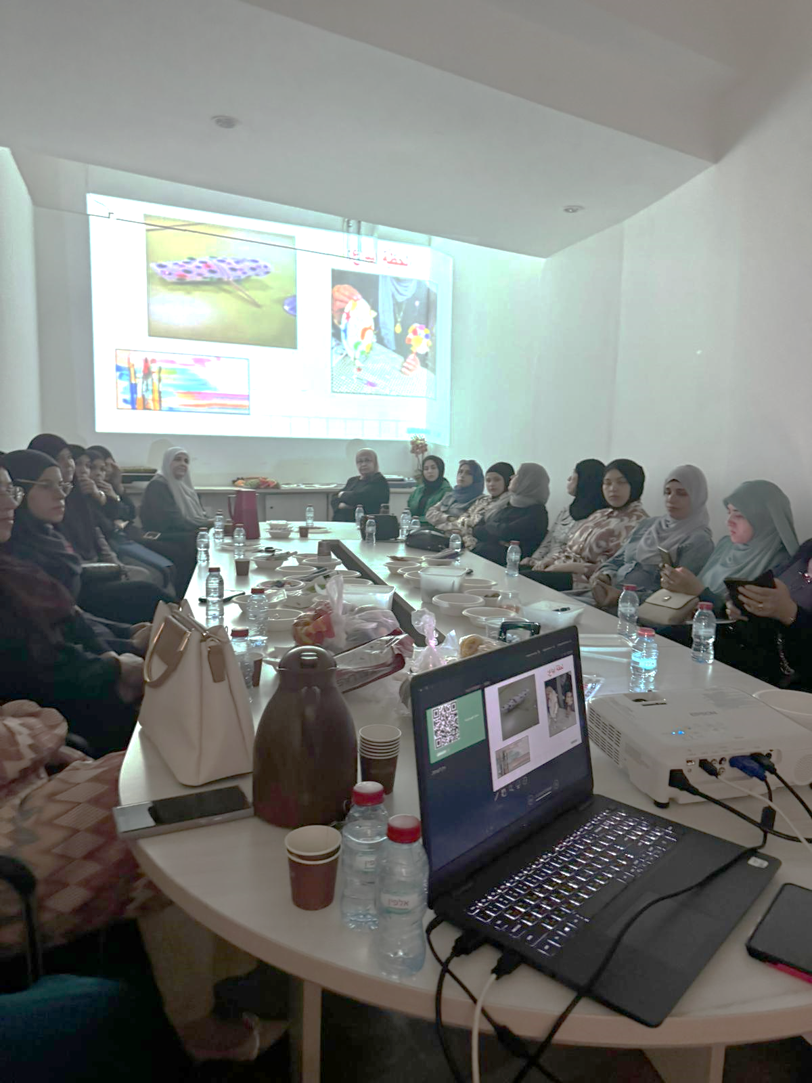
Assessment and measurement
Questionnaire for mapping needs
Focus group for mothers
Participation of children
Observation of children’s participation
Satisfaction questionnaire at the end of the process
Observation of activity in the park after the renovation

Slide 44
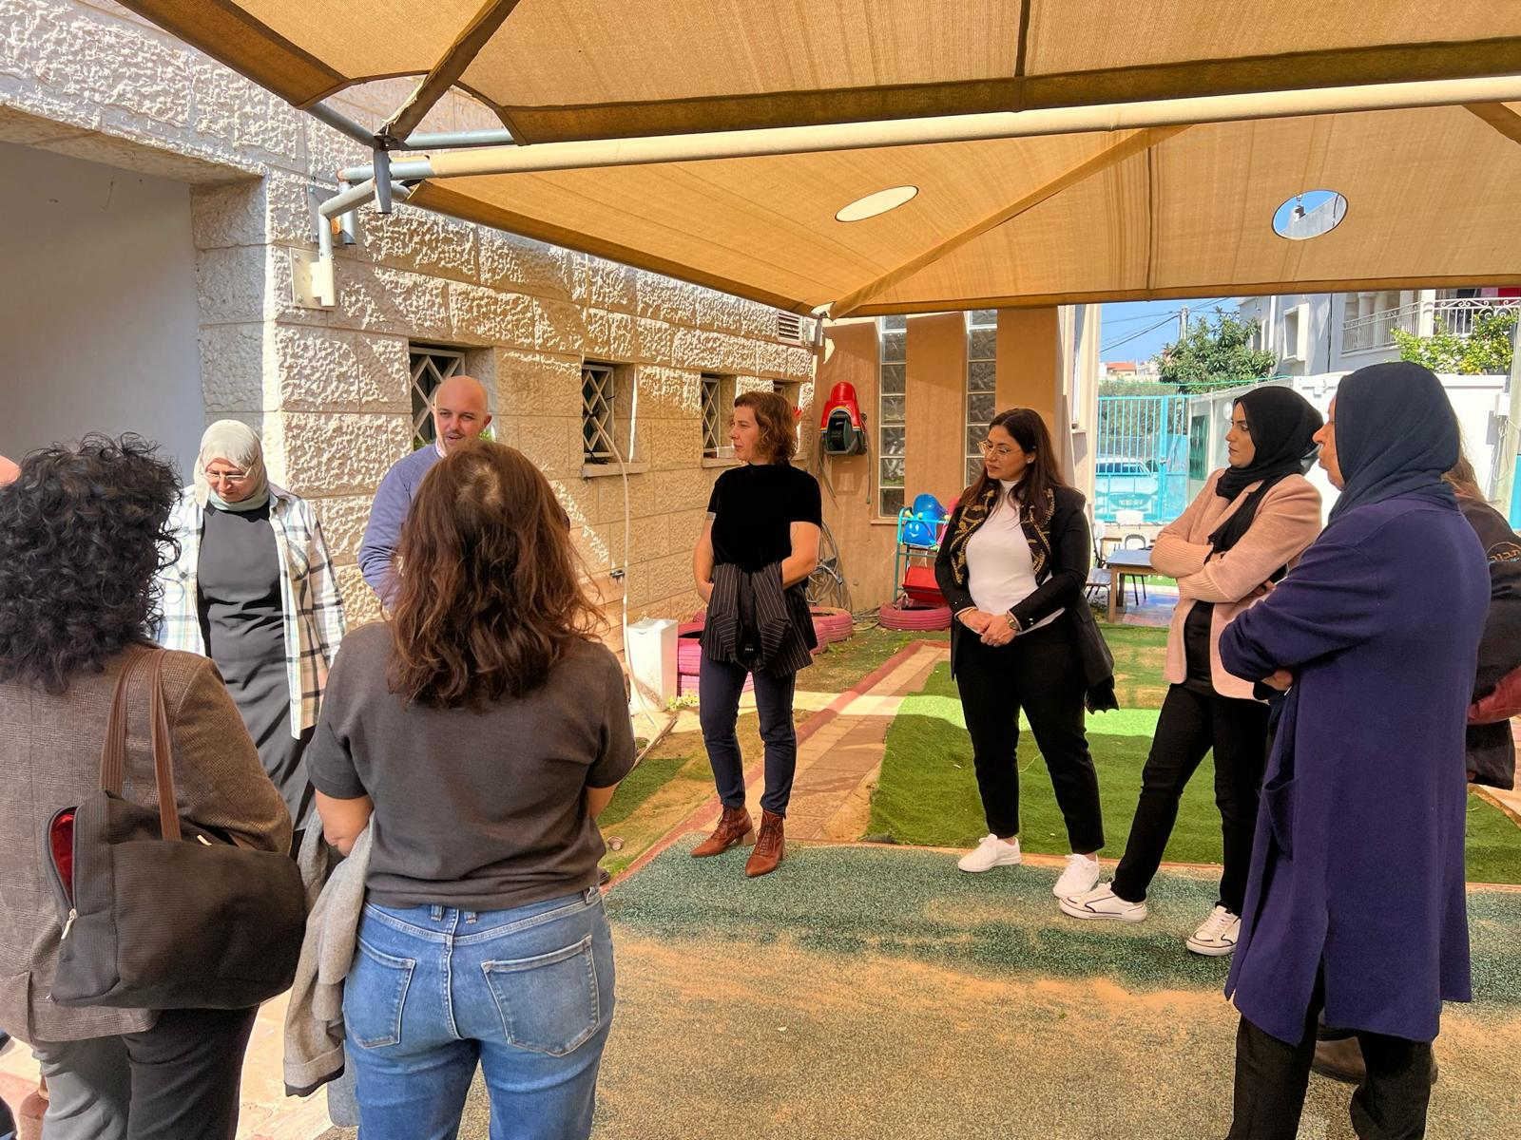
Impact
A model that can be replicated in other neighborhoods
Small changes that create a large perceptual change
Recruitment for community work
Expanding the audience of visitors to the community center
Cooperation between municipal departments and community centers
Young children as a new target audience

Slide 45
Insights from the pilot project
First stages: 1 . Relatively large natural dropout rate necessitating significant recruitment. 2. Environmental barriers beyond the scope of the pilot (multisystem view) 3. The community center staff members were responsible for carrying out the pilot project with full coordination and cooperation with the municipal team, as needed.
4. Effective use of space and relatively low costs
The LSE London course – provided tools for making small changes in the public space and making knowledge accessible to the public

Slide 46
Tirat Carmel Network Cities Training “HaYam” Project: Parents, children, and educators

Slide 47
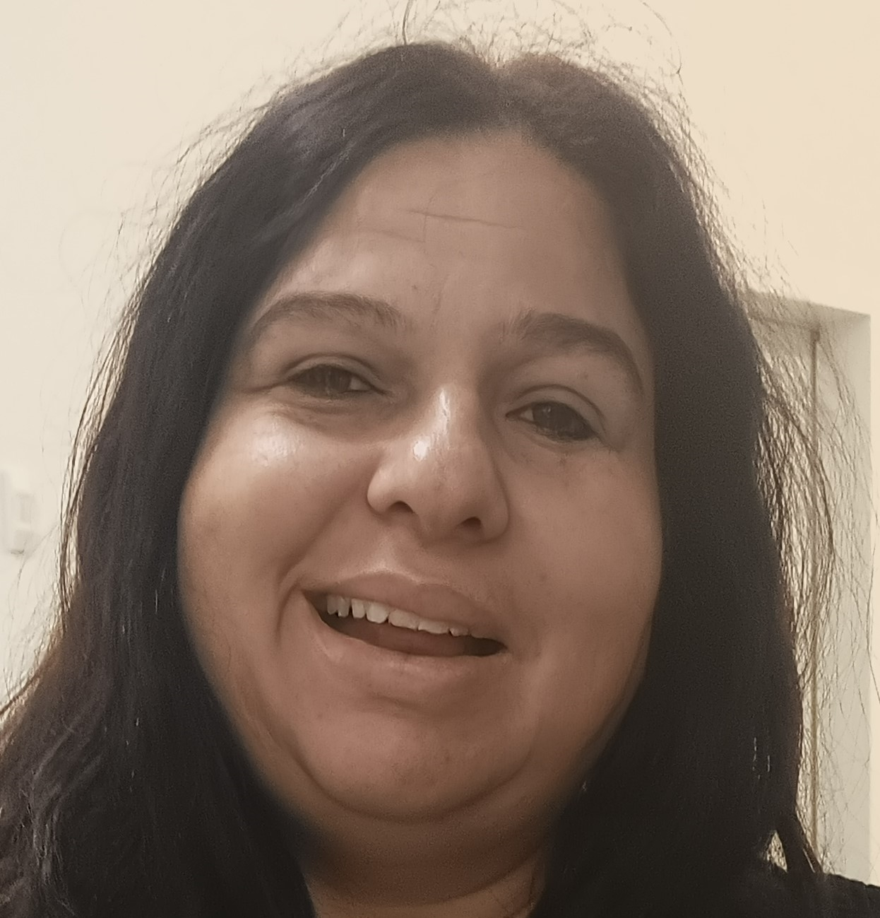
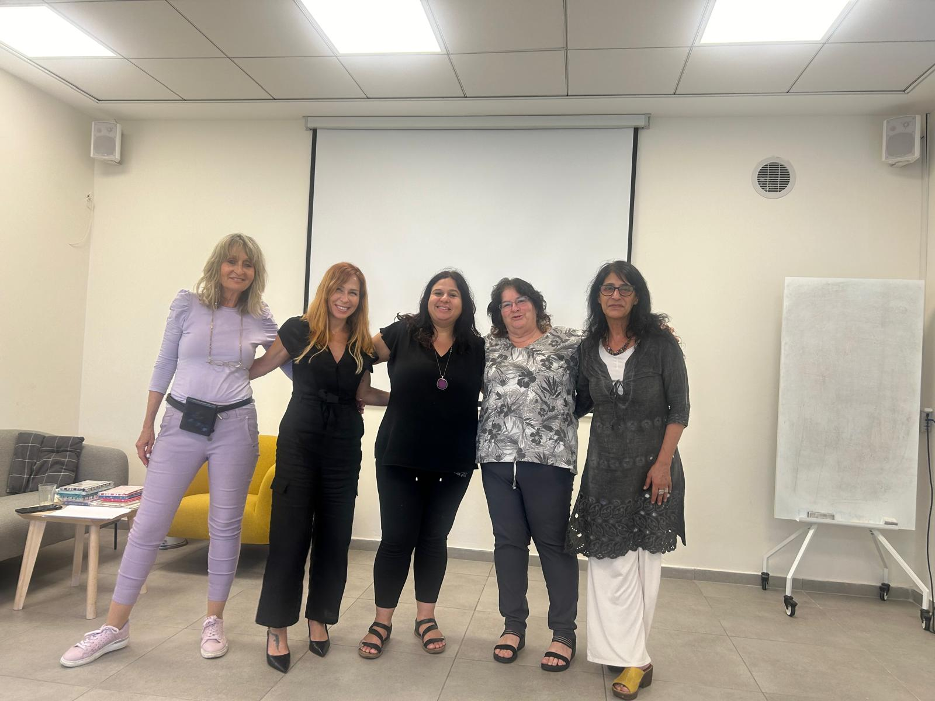
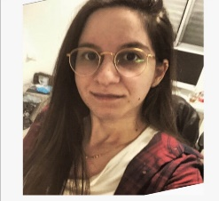
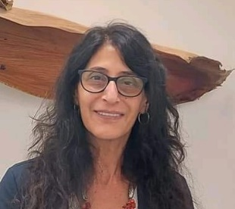
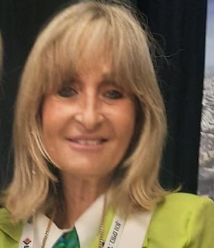
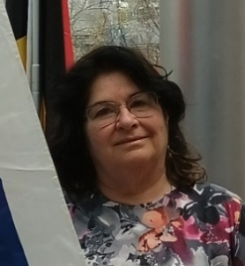
Municipal Team A team of professionals working in the field of early childhood alongside a team focused on community relations
Community Team
Participants of the Urban95 training in Israel
Coordination and communication between the Tirat Carmel municipality and the Urban95 management
Hagit Lieberman - Deputy Director of Community Relations Division
Participant in planning and leading marketing and public relations for the program
Naomi Aldes - Director of the Innovation Hub: Center for Entrepreneurship and Technology
Partner in planning and developing the program
Inbar Berger - Community coordinator, Innovation Hub: Center for Entrepreneurship and Technology
Content development team
Project coordinator
Zehava Ovadia - Director of daycare and early childhood department
Partner in developing and evaluating the program
Amit Lieber – Daycare manager for the Tirat Carmel community center
Director of the municipal partnership
Dr. Anat Bar - director of the early childhood department

Slide 48
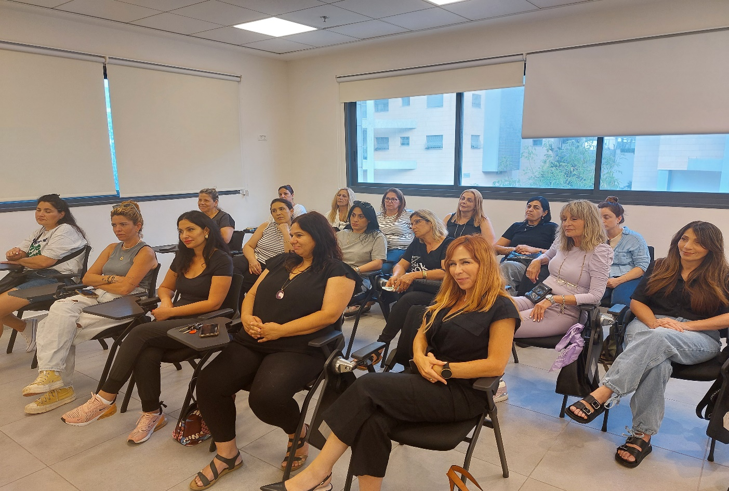
Needs and Data
Current figures for dropout among primary daycare center educators is 20%
Lack of primary daycare center educators currently stands at 27%
"Parents don't appreciate me and if I'm sick there's no substitute”
"There is no fund for professional training and the salary is as low as working in the supermarket.”
“The parents don't appreciate the work; they think I'm a babysitter."

Slide 49
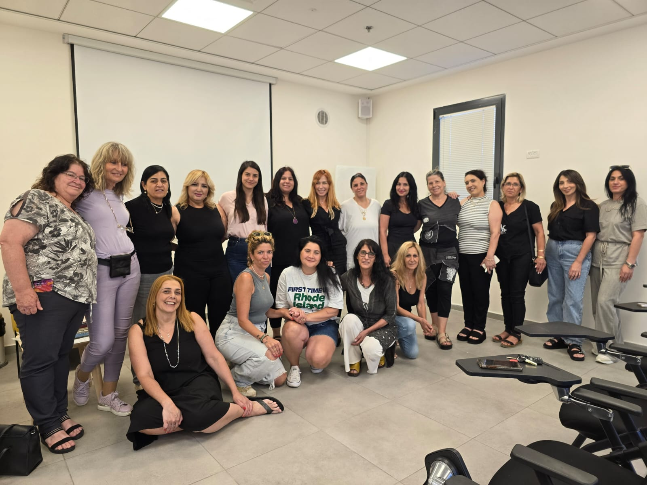
What are our goals? With educators: * Enhancing the profession’s value. *Making the staff familiar with and connected to the families of the children in the classroom. *Maintaining high-quality work over the long term. *Preventing professional burnout. With parents: * Raising parents' awareness of the value of the educational framework. *Giving parents ideas for quality time and activities at home. With children: * Enabling them to share their familiar daycare center environment with their parents. *Strengthening the children’s relationship with the daycare staff and with their parents.
Meeting the area’s needs - “HaYam” program for parents, children, and educators
Daycare center educators lead small group activities and workshops for children and their parents

Slide 50
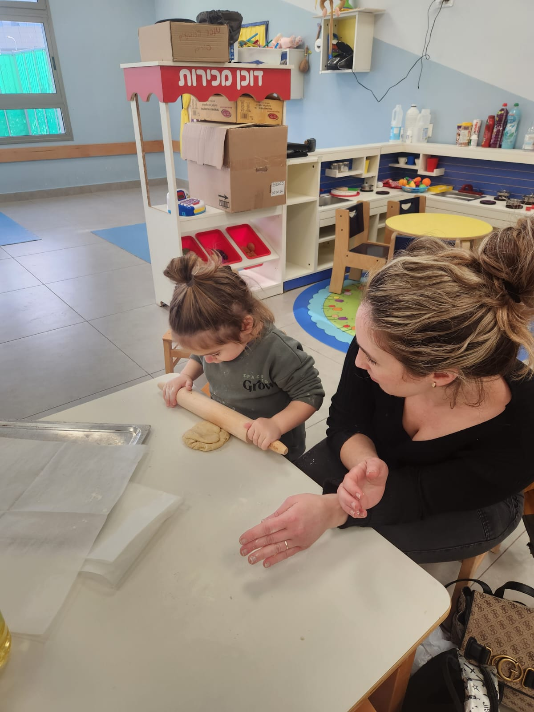
Target audiences for the training process
Primary educators in the daycare center who hold a teaching certificate.
The pilot will include 10 educators (14 registered).
Content topics in the field of parent-child relationships.
Theory and experiential processes.
Perceptual and behavioral change

Slide 51
Partnerships and pooling resources
Cross-organizational divisions and departments
Department of Education, Early Childhood Division.
Daycare centers
HaPaot Early Childhood Developmental Center
Division for Community Relations
Innovation Hub: Center for Entrepreneurship and Technology
Tirat Carmel Community Center for Young Children and their Families
Project support and guidance
Urban95
Israel Green Building Council
INSEAD School of Business
Van Leer Foundation

Slide 52
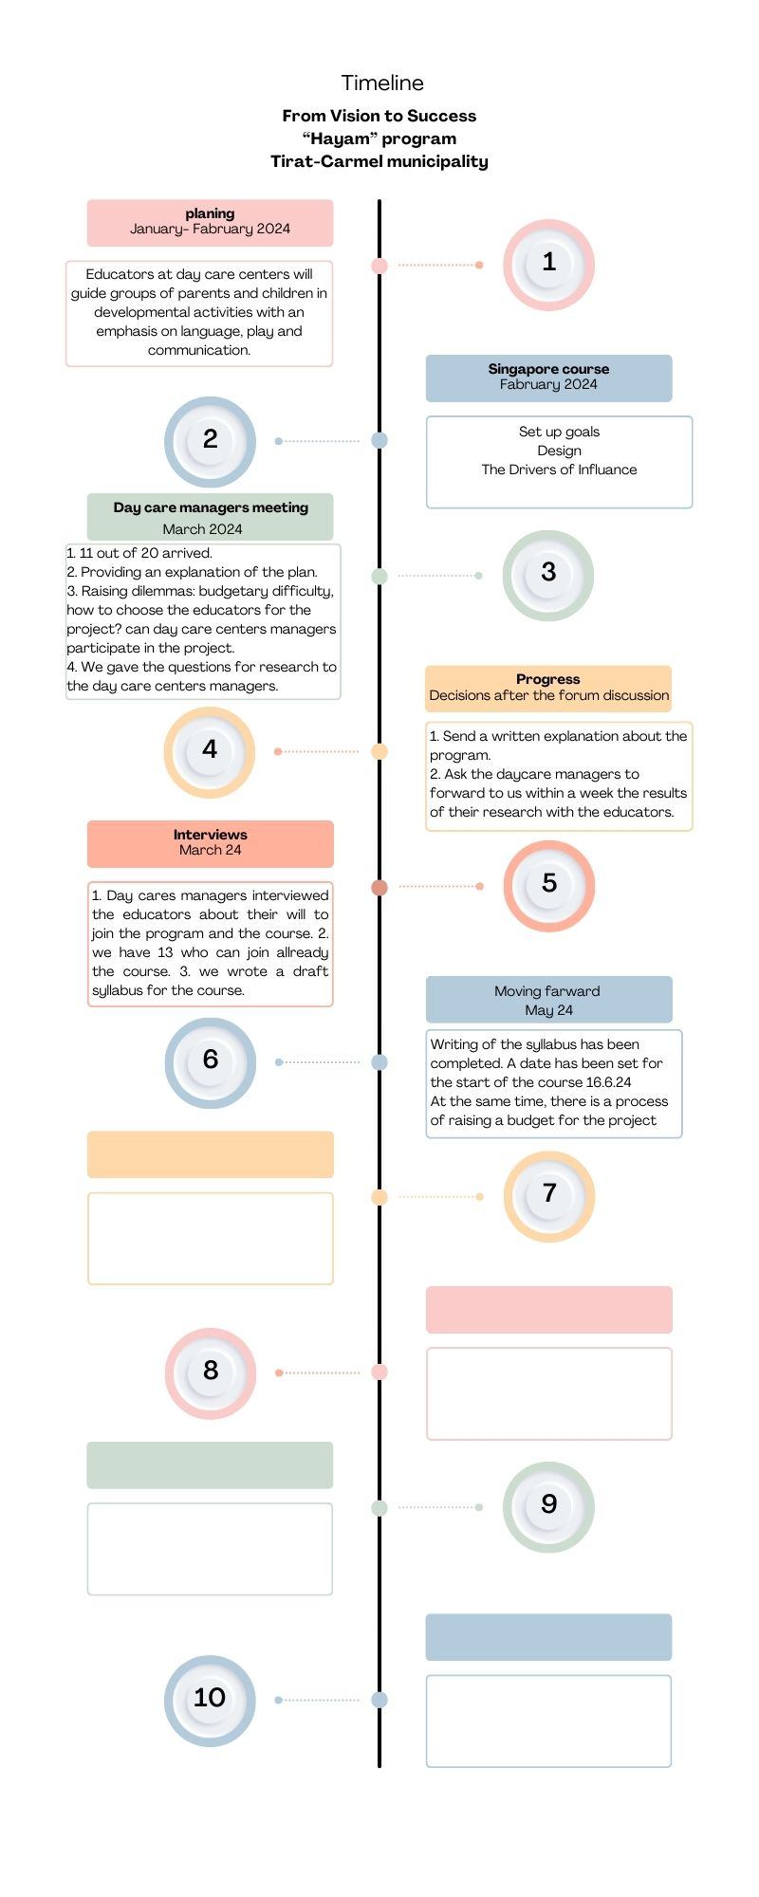
Project Stages
Stage 4:
Summary of the project and evaluation data
June 2025
Stage 3:
Administering the program with group training
2024 academic year
Stage 2:
Participation in the training
June - July 2024
Stage 1:
Interviews and recruiting participants
April-May 2024
שלב ד: מילוי שאלון עמדות עם סיום הפעילויות
מילוי שאלון עמדות
ע"י משתתפות הקורס לפני תחילת הקור
שלב ד: מילוי שאלון עמדות עם סיום הפעילויות

Slide 53
Measurement and Evaluation
Observations of the training process
Participants complete an attitudinal questionnaire before and after the course
Parents complete a satisfaction questionnaire

Slide 54
Impact
Improving the set of services available for young children in the local authority.
Expanding the pilot project to other daycare centers in the local authority.
10-15 educators in daycare centers will acquire new knowledge about parent-child relationships and new ways of communicating with groups of parents.
200 children will participate in small developmental groups with their parents in the daycare center, giving them quality time with their parents in the daycare center where they spend many hours each week.
To expand the circle of influence, multiple educational frameworks will be exposed to the program and will be inspired by learning new ways of working.

Slide 55
Insights from HaYam
The importance of:
Parents' participation in kindergartens/preschools and public spaces.
Recruiting department managers and creating a trust-based relationship to catalyze municipal activity.
Dissemination and distribution of information and motivating municipal employees and city residents to take action.
Clearly defining and delineating between the duties of the various departments in the local authority.
Using measurement, evaluation, and assessment tools.
Gaining insights from this comprehensive urban plan for a project with a real impact on the city.

Slide 56
תובנות תוכנית הים

Slide 57
תובנות תוכנית הים

Slide 58
תובנות תוכנית הים

Slide 59
תובנות תוכנית הים

Slide 60
תובנות תוכנית הים

Slide 61
תובנות תוכנית הים

Slide 62
Existing Services in the City

Slide 63
שירותים קיימים בעיר

Slide 64
שירותים קיימים בעיר

Slide 65
הפיילוט

Slide 66
הפיילוט

Slide 67
הפיילוט

Slide 68
הפיילוט

Slide 69
הפיילוט

Slide 70
The Pilot Project
Community - A community event in the city, offering guidance to parents and young children.
Development - Updating a program for developmental games.
Local authority – Municipal forum to promote early childhood.

Slide 71
5. Feedback

Slide 72
Summary of feedback given in each session
There was a high level of satisfaction with the format and length of the training sessions (lectures and tours).
The training inspired and motivated the teams to promote early childhood in the city, as well as professional connections, a shared vocation, and peer learning.
The teams benefitted from the training. In addition to being inspired, they acquired practical knowledge and applicable tools. The more examples from the field, the more the teams learned and engaged with the program.
Most teams understand the importance of inter-departmental cooperation in the municipality and recruit other municipal partners to the program, for working and learning.
In terms of practical learning and applicable tools, it became evident that a face-to-face format is better than online meetings (only Meeting 4 took place online, due to the war).
Recommendations from the feedback: allocate more time for the teams to work with guidance from Urban95, provide more practical tools for implementation, and hold more discussions, sharing, and fruitful learning among the participants.

Slide 73
Take-aways from the training program: The Lod Team
Inspiration and knowledge gained from peer learning.
Creative ideas in other cities in Israel and around the world.
Fun and motivation!
Familiarity with the field of early childhood and its applicability to work in my department (early childhood, engineering, operations).
Holistic thinking in promoting early childhood.
Acquaintances among team members from different departments deepened significantly.
Strengthened awareness and understanding of the importance of investing in promoting early childhood development and the parent-child relationship.

Slide 74
Take-aways from the URBAN95 training program
Baqa Team
The training program provided theoretical understanding, practical knowledge, and individual skills that promote optimal action in the public realm, drive broad processes, and influence decision-making in the areas of community and early childhood.
Tirat Carmel Team
Awareness of the critical impact on development at ages 0-3
Awareness of the child's point of view in public spaces: low faucets, signage and guidance, ecological creative corners (sand and water), natural play environment (wooden play facilities set among trees, the “bird forest”).
Making municipal partners aware of the child's point of view
Motivation for cooperative activity between the local authority and residents
Addressing challenges through discussion groups and round tables
A city that is good for children is good for everyone
Notes:
ברזיות נמוכות, שילוט והכוונה הטמעת פינות יצירה אקולוגיות ( חום ומים ) , יצירת סביבת משחק טבעית ( מתקני משחק מעץ בסביבת עצים – יער הציפורים)

Slide 75
6. Staff insights

Slide 76
Teams’ strategic insights regarding the training
Program structure
Create a process to funnel and filter the training.
The training should be divided into basic training and continued application, according to the team's abilities, motivation, and cooperation.
Create a graded distinction between programs for consideration as an “Urban95 city" reflecting the depth of training, the participants, and the impact of the process the city has undergone.
Impact
The teams’ work exposed other entities in the city to the importance of early childhood. These entities (i.e., the director of the library in Lod and the director of the early childhood department in Dimona) asked for guidance and support in adapting their services to young children.
Content
Measurement and evaluation in an experiential workshop. Show participants the measurements and evaluation data.
Public participation and children’s participation as a strategy.
Issues related to walkability and mobility: streets, play streets, climate, shade and the heat crisis in Israel, data-based knowledge management, playing in the public space, and more.
Notes:
ברזיות נמוכות, שילוט והכוונה הטמעת פינות יצירה אקולוגיות ( חום ומים ) , יצירת סביבת משחק טבעית ( מתקני משחק מעץ בסביבת עצים – יער הציפורים)

Slide 77
Teams’ strategic insights regarding the training
Methodology and content:
Each meeting should include a variety of methodologies. Avoid a series of presentations. Include experiential learning and team experiences in each meeting.
Storytelling should be introduced and examined during earlier stages.
Present challenges and discuss where the program fell short, not just successful test cases.
Give the Dimona program operator the tools and ability to work with the suppliers - a checklist of working principles.
Empower the teams to present their work in the city (for example, have Yoni Tari from Lod talk about himself and his challenges).
Evaluating each meeting was not reflective or experiential in determining what is important.
Invest in a toolkit of knowledge products, such as guides for building playhouses, early childhood by the numbers, creating an urban forum, mapping stakeholders, etc.
Send messages when new tools are received: Today three new tools are being introduced: .............. Specify in the message what tools they will receive.
Balance knowledge-building training with practical experience in implementation and assimilation processes. The various tools must be modeled and made accessible so they can be "taken home" both as a presentation and as documents. Provide a toolkit of tools such as a public space evaluation indicator, measurement and evaluation, early childhood by the numbers, parent surveys, stakeholder mapping, etc.
Create a language and graphic packaging for the training products such as announcements, agendas, and presentations, with visibility in every meeting (for example, by putting a branded sticker on “Flying Tiger” notebooks).
Notes:
ברזיות נמוכות, שילוט והכוונה הטמעת פינות יצירה אקולוגיות ( חום ומים ) , יצירת סביבת משחק טבעית ( מתקני משחק מעץ בסביבת עצים – יער הציפורים)

Slide 78
The teams’ strategic insights regarding the training
Mentoring
Build a database of professionals who "speak Urban": consultants, operators, landscape architects, etc.
The projects in Arab society require closer mentoring and fewer initiatives. Their team perceives that the value of the investment is low in relation to our requests: “You invest ₪ 20,000 and expect a park to be built, but you are living in a fantasy.”
It is essential to organize some mentoring sessions in the local authority not only online.
The mentoring team must be professionally guided: the desired outcome for each meeting; clearly defined guidelines for mentoring.
Provide a budget for breakfast for the in-person meetings.
Develop a program format: times, budget, coordination of expectations
Teams
Team composition: ensure there are a variety of team members from different units in the municipality.
Clarify responsibilities and leadership within the team.
Notes:
ברזיות נמוכות, שילוט והכוונה הטמעת פינות יצירה אקולוגיות ( חום ומים ) , יצירת סביבת משחק טבעית ( מתקני משחק מעץ בסביבת עצים – יער הציפורים)

