Slide 1
Voices Behind Bars: Rehabilitation Processes Among Incarcerated Radio Broadcasters
Irit Adamchuk - Bar Ilan University and Ashkelon Academic College
Tomer Einat - Bar Ilan University

Slide 2
Purpose of the presentation:
To describe the preliminary findings from a study on incarcerated community radio broadcasters

Slide 3
Community Radio
Community radio is a means of communication that operates, for the most part, in a defined geographical location, and emerges from dissatisfaction among the public with the content broadcast by mainstream communication media (Howley, 2005).
A physical community is based on geographic location.
A community of interest is based on shared social, cultural, and political interests.

Slide 4
Community radio honors freedom of expression and democracy. It strives to strengthen solidarity and social relations between members of the community in which it operates.
Researchers have found that community radio represents disadvantaged populations or minority groups, provides them with a sense of belonging, and has a positive effect on listeners’ mental and social well-being.
Community radio can have a positive influence in changing negative and stereotypical perceptions of various social groups.
Examination of the research literature on community radio for prisoners indicates the existence of two central models: (a) prisoners’ radio; (b) prison radio.

Slide 5
Prisoners’ Community Radio
Prisoners’ radio is part of a community radio station located outside the prison that broadcasts programs dedicated to prisoners, their families, and community members.
The content is related to the legal systems, law enforcement, regulation and incarceration, personal messages sent from prisoners to their families, and prisoners sharing their life stories.
Its focus is maintaining connections between prisoners and their families and community members outside the prison.
It can facilitate former prisoners’ successful return to the community after their release.

Slide 6
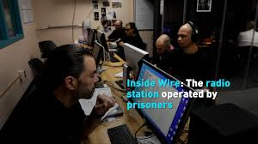
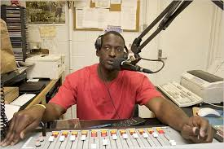
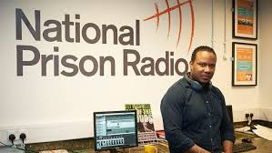
Prison Radio
This is a radio station located inside a prison. It is operated by prisoners and broadcast only to the incarcerated population.
The content specifically pertains to the correctional facility where the radio operates and the incarcerated population. It addresses prisoners’ needs.
The radio broadcasts announce support services and counseling available in the community and campaigns encouraging participation in educational and treatment frameworks after release from prison.
Prison radio also broadcasts talk shows by celebrities, music, and conversations between prisoners on topics related to their needs.

Slide 7
The Israeli Model: Radio Focus
In 2017, a radio station was founded in the Ayalon prison.
The station was established thanks to a collaboration between the Topaz Association for Entrepreneurship and Social Innovation, the Communication Department at Sapir College, the Israel National Insurance Institute, and the Israel Prison Service. Radio Focus broadcasts to all criminal prisons in the State of Israel via a closed circuit. Only people in prison can hear the broadcast content.

Slide 8
The Radio Focus station broadcasts 24 hours a day, seven days a week. Program content includes news, current events, economics, sports, health, and music.
Radio Focus is operated almost entirely by prisoners. They are assisted by a civilian professional team that includes the project manager, radio station manager, and producer.
Prisoners upload and broadcast the radio station’s content. The target audience is the entire population of criminal inmates in the State of Israel.

Slide 9
Professional training courses on radio work are offered approximately once every six months. Courses formerly lasted one month but have been shortened to two weeks. Courses include:
Theoretical and practical training for producing radio broadcasts
Basic principles of language use (Hebrew, diction, and intonation)
Advanced delivery (broadcasting music, personal delivery, the art of interviewing, and diction)
Editing content using computer software

Slide 10
Research on Prisoners Broadcasting Via Radio Focus
This study examined rehabilitative and therapeutic processes experienced by prisoners working at Radio Focus.
The primary focus was on the content they chose to broadcast, their reasons for choosing this content, their subjective experiences in this framework, and their perceived ability to influence their peers in prison.

Slide 11
Theoretical Basis
RNR Model for Rehabilitation of Offenders
The Risk-Need-Responsivity (RNR) model offers applied practices for working with criminal offenders (Andrews et al., 1990, 2011; Bonta & Andrew, 2007).
Risk factors specific to each offender must be examined, evaluated, and considered when developing an individualized intervention plan. The core premise of the model is the need to assess, before implementation, which types of interventions will be most appropriate for the offenders who are expected to benefit from them.
This theoretical model defines basic assumptions and guidelines for developing intervention programs for criminal offenders. It does not differentiate between programs offered in the community versus programs implemented in prison. It emphasizes the central role of therapists and professionals in identifying criminogenic factors to be addressed and adapting the rehabilitation to the specific offender population.

Slide 12
The Wounded-Healer Approach
According to the concept of the “wounded healer” the power to heal comes from the caregiver’s own wounds. Only therapists who have experienced pain and understand its consequences can help others recover. In other words, therapists’ past or present wounds nurture and encourage an empathic therapist-patient bond and positively assist the patient's recovery process (Conti-O'Hare, 1998; Elisha, 2022; Miller & Baldwin, 2000).

Slide 13
As early as the mid-1950s, Cressey (1955, 1965) emphasized theoretical and practical reasons for integrating ex-prisoners into the treatment and rehabilitation of current prisoners or offenders. Cressey called this "retroflexive reformation.“
Ex-prisoners interested in helping others can identify with the people they are trying to support. Thus, the supportive prisoners are encouraged to actively change their own behavior in a positive and normative direction. This is similar to the "helper therapy principle," according to which the person offering help and assistance gains more than the one receiving it (Gartner & Riessman, 1984).
In the context of prison radio, the wounded healers are the broadcasting prisoners. They undergo a double empowerment process by doing something meaningful for others (the prisoners listening to the station) and realize they are capable of doing something positive for others (“I'm not all bad”).

Slide 14
A literature review found that for many prisoners, imprisonment has characteristics of a traumatic experience reflected in the “pains of imprisonment” (Haggerty & Bucerius, 2020; Sykes, 1958). The pains of imprisonment may lead to emotional difficulties and create obstacles to implementing treatment and rehabilitation programs aimed at reducing criminal behavior (Cook & Haynes, 2021).
Participating in rehabilitation programs in prison has been found to lessen the pains of imprisonment and even decrease criminal behavior, both in prison and after release (Behan, 2014; Taylor, 2014). This insight led to the development of rehabilitation programs in prisons such as educational-occupational rehabilitation, for example working at a community radio station in the prison that enables prisoners to create content and broadcast it to the population of incarcerated prisoners (Bedford, 2018).

Slide 15
Currently, many prison radio stations broadcast in Europe and the United States (Bedford, 2015, 2016; Doliwa, 2013; Grimes & Stevenson, 2012). Most previous studies on prison radio projects examined the issue from a media perspective and focused on the effects the radio broadcasts had on the prisoners listening to them. These studies found high rates of prisoners listening to programs broadcast by other inmates (Einat, & Nagar, 2023). Moreover, listening to these programs was found to have a therapeutic and calming effect and even increased listening prisoners’ motivation to participate in rehabilitation programs (Bonini & Perrota, 2007; Wilkinson & Davidson, 2010).
There have been few studies on the effect of working at a prison radio station, but the limited research led to a similar conclusion – producing radio programs allows prisoners to see themselves as contributing citizens who do something good for others. This mitigates the negative self-label that emerged from their criminal behavior and thus can form the basis for encouraging rehabilitation among those involved in transmitting the radio programs (Churcher, 2008; Doliwa, 2013).

Slide 16
The current study is the first to focus on the experiences of prisoners working at a prison radio station in Israel. The aim is to understand how the broadcasting prisoners describe and perceive this work and the contribution of participating in this project.

Slide 17
Methods
Semi-structured in-depth personal interviews were conducted with prisoners participating in broadcasting the radio program. Interviews were done in two stages. The first was done after the training course, about a month after entering the project. The second was done after the prisoner had participated in the project for at least nine months.
Characteristics of the prisoners:
A total of 28 prisoners participated in the study.
Most were recidivist prisoners with two or more previous prison terms. Their prison terms ranged from five years to life imprisonment limited to 30 years.

Slide 18
Results: A three-step change
Internal change
Internal dialogue about positive self-perception
Cognitive-Behavioral change
Integration into therapy groups
Avoidance and prevention of violence
Work persistence
Interpersonal change
Improvement in verbal communication
Improvement in social relations
(with prison staff, prisoners, civilians, and family members)

Slide 19
Preliminary conclusions:
The radio station is a rehabilitation tool that improves prisoners’ mental well-being on multiple levels and helps them deal with the pains of imprisonment.
Personal empowerment by improving verbal communication and expressiveness, using normative language, and doing “good” for others.
The choice of content is not accidental, it serves the needs of the broadcasting prisoners.
Improved relationships with family members who feel their imprisoned relative is doing something significant.
Acquiring professional and technical skills and work experience that will be beneficial after release.
Informal meetings with prison staff that improve relations.
Encounter with a civilian population that is a bridge to the outside world and helps break down stigmas and negative labeling.
The dropout rate of prisoners participating in the project is low.

Slide 20
Summary
Incarceration policies are usually characterized by the use of force against prisoners and total control over their daily lives to achieve absolute discipline.
In contrast, prison radio is an empowering tool that informally enforces discipline and obedience, reducing the pains of imprisonment.
This improves prisoners’ well-being during incarceration and perhaps even after their release. This could help reduce the rates of recidivism and manifestations of violence during imprisonment and after release.
In general, community radio allows disadvantaged groups to express their voices. However, prisoners operate within a limited framework (very limited, in their perception) that does not allow for maximizing the potential of community radio as it exists for other (non-incarcerated) populations.

Slide 21
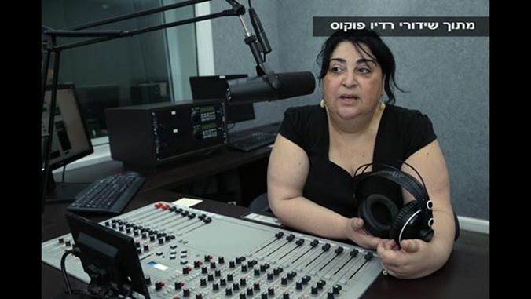
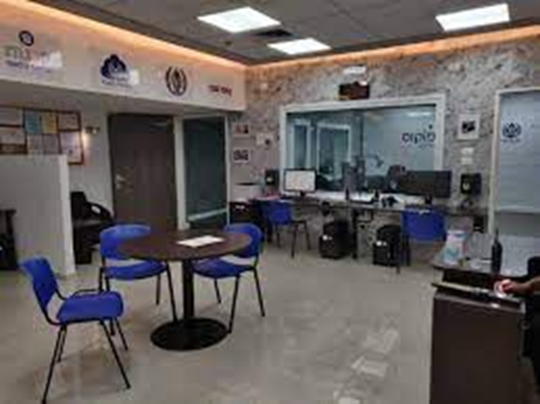
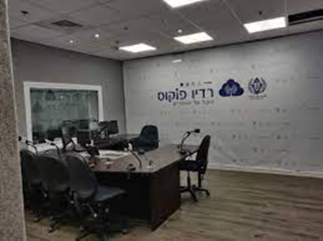
Thank you for listening
Questions?

