Slide 1
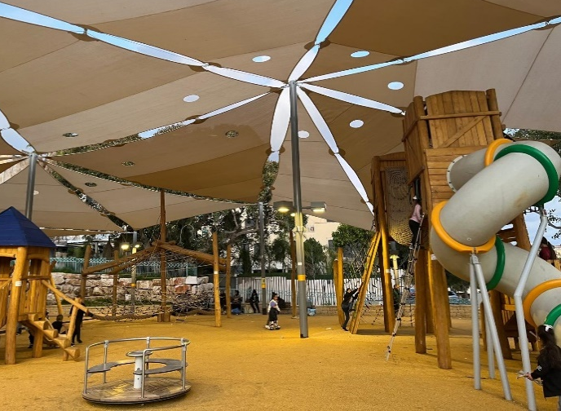
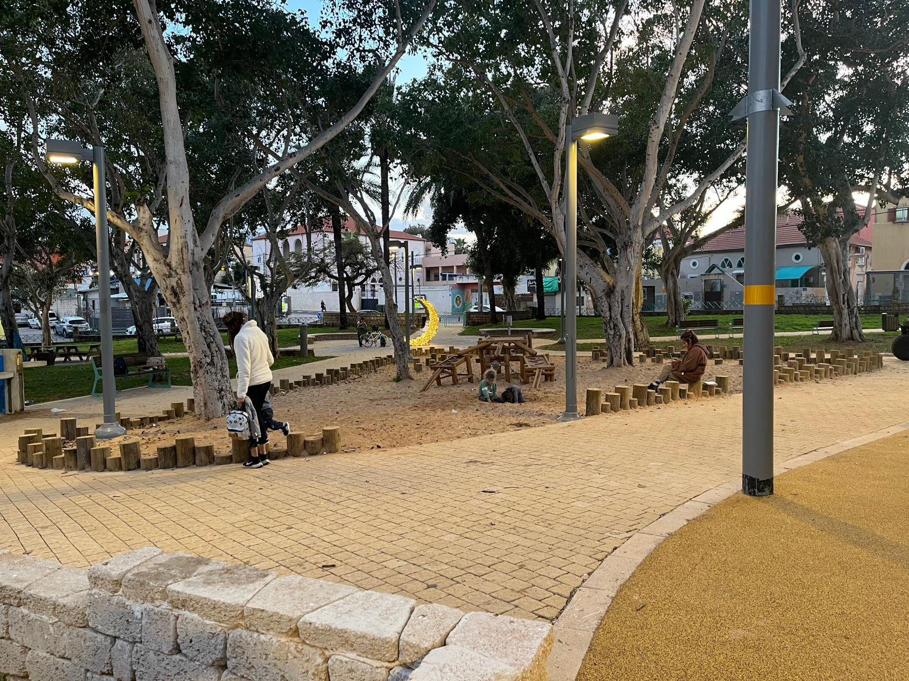
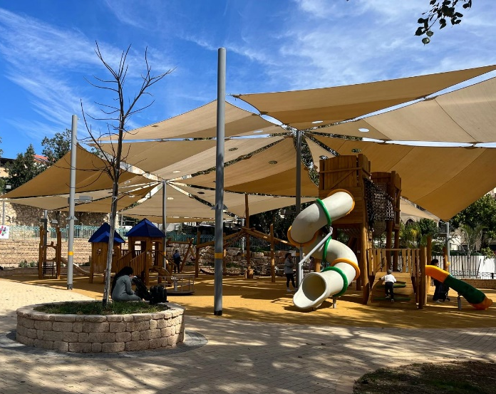

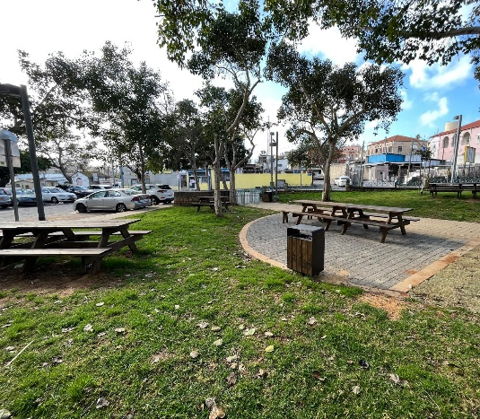
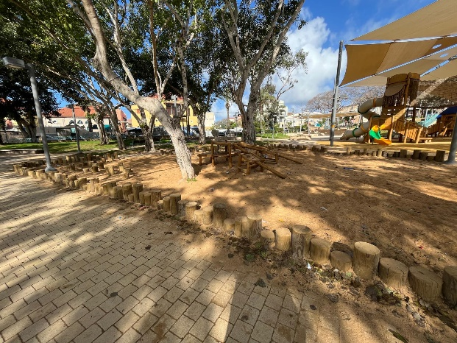


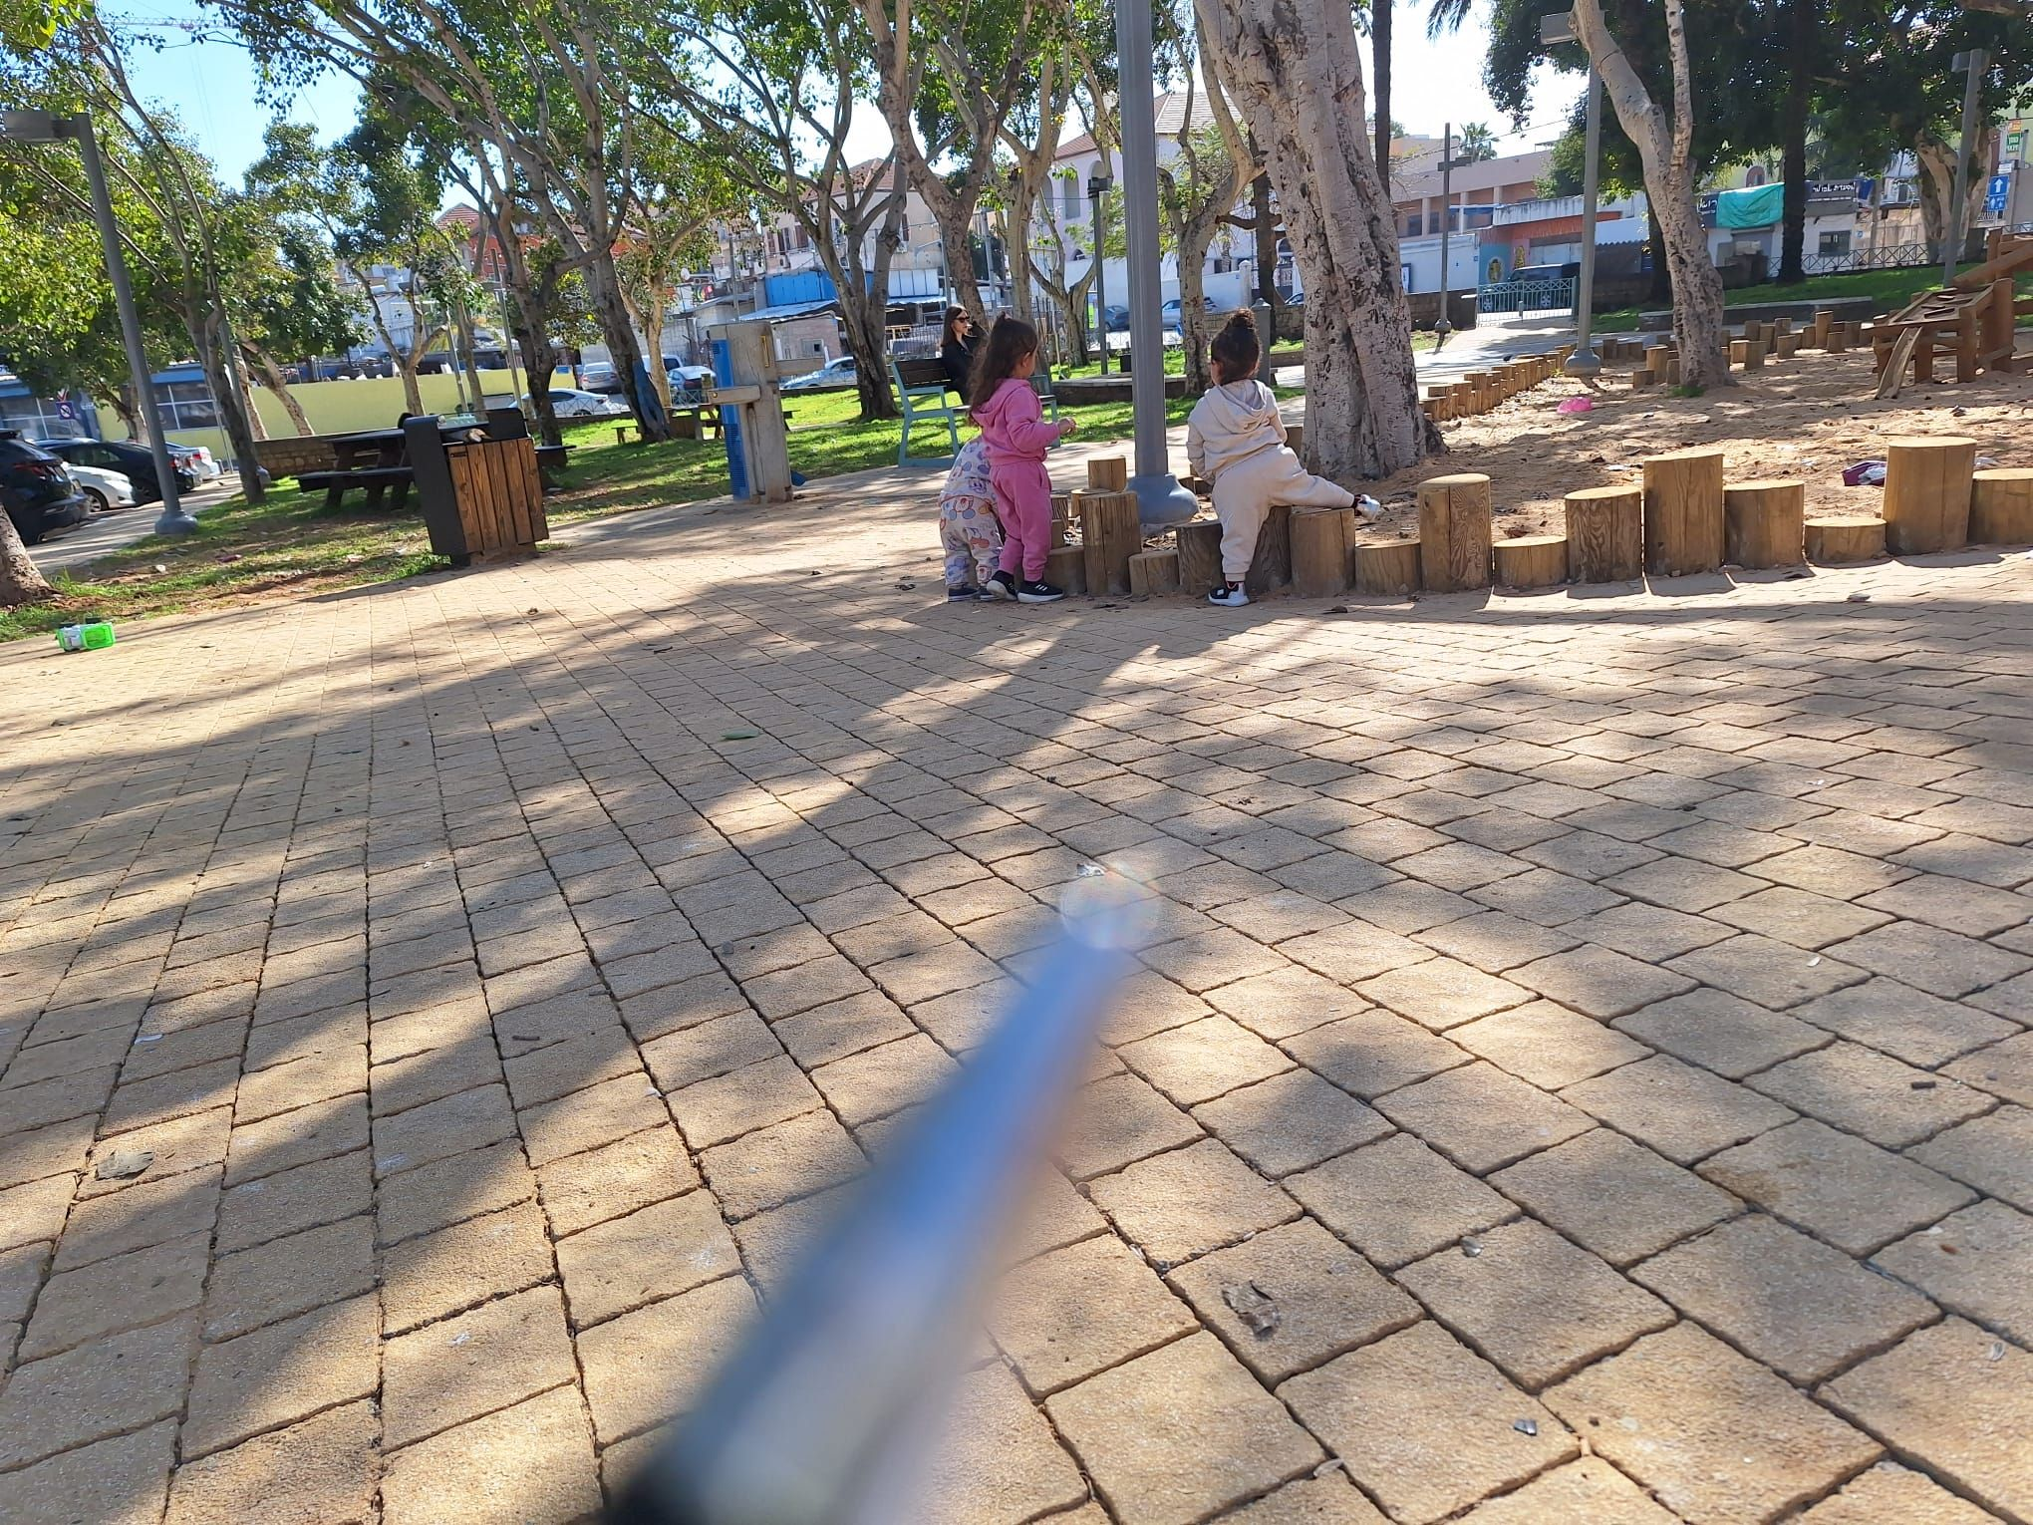
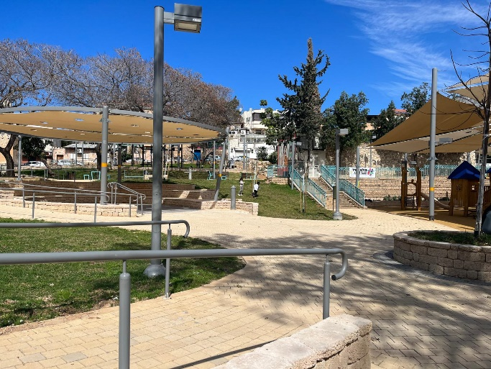
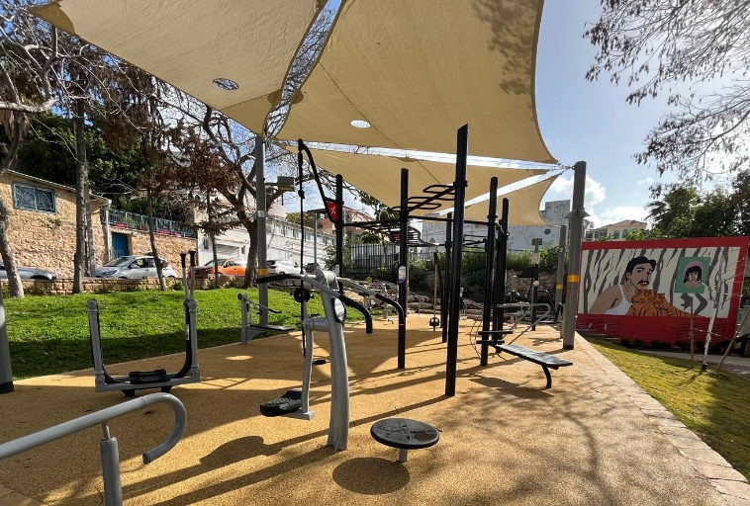
סיכום הערכת פרויקט
גן השניים
2021-2024
מוגש כחלק מהערכת שלב ב' של תוכנית Urban95 TLV
מאי 2024

Slide 2

תוכן העניינים
14-09
ממצאים לאחר התערבות
03-04
תוצאות ההתערבות – תקציר ממצאי המחקר
11-10 מתחם לשהייה והתכנסות קהילתית
05
רקע
13-12 מתקני משחק לילדים
14 Wellbeing – מתקני כושר
06
מערך המחקר – פירוט פעולות הערכה
18-15
נספחים
16 נתוני תנועת העוברים במתחם
07
מדידה לפני התערבות
17 נתוני מגדר הנוכחים במתחם
18 שימוש במתקני המשחק
08
שיתוף ציבור

Slide 3
This project highlights the importance of public participation in interventions in public spaces, especially a place that the local community considers culturally important and for which they feel a special affinity. A full public participation process includes a campaign launch to explain what will be done and an event to inform the public of the project’s completion and report that their requests were fulfilled.
Fulfilling all of the community's requests during the intervention strengthened the community’s sense of responsibility towards the place, expanded the scope of appropriate use of the park, and strengthened their trust in the municipality.
The main evidence of changes in visitors’ behavior and the success of the intervention:
Improved ratings of criteria assessing the quality of visits to the site, such as ease of moving through the park, seating facilities, safety and security, play options, and protection from cyclists.
Traits of visitors to the park complex: increased presence of women; increased movement of young children in the park complex; decreased number of cyclists in the visiting areas.
Evidence of changes in desired behaviors: use by diverse social groups, community meetings, shared meals, and joint caregiver-child play mainly in the areas defined as "facilities for young children".

Slide 4
Intervention Results: Research Findings Summary
The renovation resolved the main issues residents raised at the public participation event when they were asked about their wants and needs: a park complex for community gatherings and play facilities for children. In addition, residents’ requests for fitness equipment were met, but almost no record of it being used was found during observations.
17 of the interviewees knew about the public event. 13 had participated in the event and were satisfied with the results.
Significant improvement was found for all evaluation indicators comparing the park complex’s conditions before and after renovation, including comfort of staying and ease of movement across the park, sense of security, social climate, and sense of community.
Increase in women’s presence from 25% to 57% indicates a higher sense of security.
Increase in young children’s presence* from 3% to 12% indicates improved accessibility.
Decrease in percentage of cyclists from 26% to 4% of those passing through the park, making it a more suitable environment for spending time in the park complex.
Starting from around noon - increase in visitors with children, engaging in community interactions such as sitting, eating, and playing together.
The peak of activity is in the afternoon, when the park bustles with children, playing with their caregivers and with children they met in the park.
The play facilities cater to a wide age range and invite active and varied play. The use of the facilities is dynamic and changes according to the prominent age group at any given time.
Seating is distributed throughout the space to enable a comfortable visit both for caregivers who want to stay near their children as they play, and for those who prefer to watch from a distance and sit with other adults.
Areas for improvement:
Shade: In the morning to noon hours, there is no shade on the benches at ​​the fitness and play facilities.
Cleanliness: During all observations, garbage was seen throughout the park, including at the seating areas, near the play facilities, and in the sandbox, such as disposable cups, cigarette butts, sunflower seeds, etc. The interviewees also raised this issue.
Public bathrooms: There are no nearby public bathrooms to meet visitors’ needs. The interviewees also raised this issue.
Dangerous cycling: Although the presence of cyclists decreased considerably thanks to fences that restrict traffic, isolated cases of cycling in the visiting areas and on the sidewalks were observed.
In addition, observation recorded three cases of motorcycles in the park and one case of an ATV crossing the sidewalk near small children.
Free play: Some interviewees expressed a need for a dedicated area for ball games. At the time of the observation, these took place on the sidewalk near the play facilities.
Recommendations:
Visitors expressed a willingness to participate in community activities and events in the park complex.
Community picnics: Events may satisfy residents’ desire for a community experience and provide opportunities for sharing and purchasing refreshments together. This aligns with visitors’ tendency to host joint picnics in the park complex and the absence of a commercial hub in the area.
Strengthening attachment to the area: The area’s historical background may offer a means for residents to connect and strengthen their sense of belonging. Informative and activating design elements may be combined to educate residents and strengthen their ' connection to the place.
Signage: Signs may be added with names of the facilities, recommendations for how to use them, game suggestions, and desired behaviors such as maintaining cleanliness, being cautious when cycling, etc.
.* More details are given in the main body of the report.
4

Slide 5
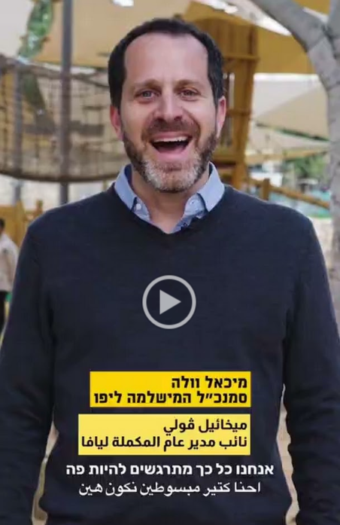
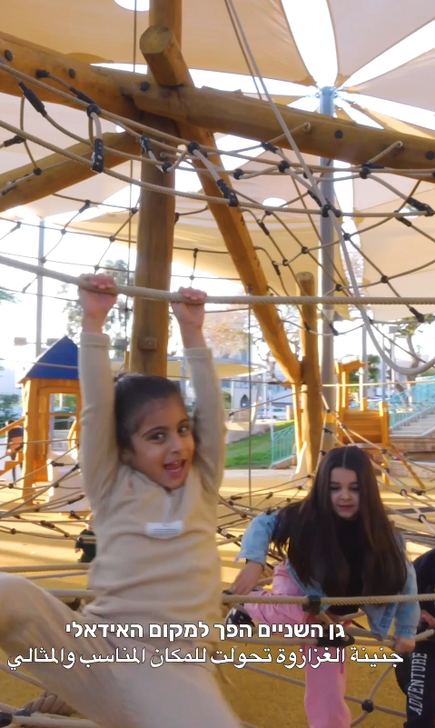
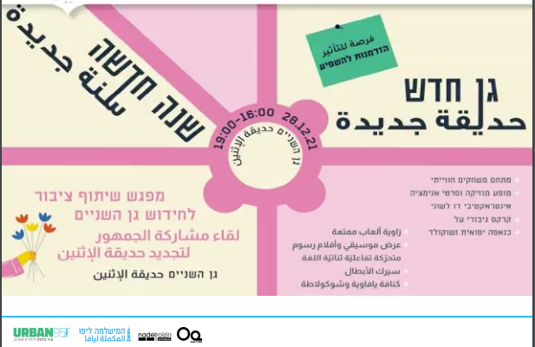
Background
Gan HaShnayim is centrally located and connects several Jaffa neighborhoods. It is a regular meeting place for residents, with significant intrinsic historical, nostalgic, and cultural value.
Motive for the intervention: HaMishlama for Jaffa recognized the park complex’s inherent potential to be an accessible and high-quality destination to improve the well-being of all residents, especially families with young children. They invited Urban95 to join the project.
Starting point: There was a widespread perception among the public that the park was not a pleasant or safe place to visit and spend time.
At the same time, residents from the Arab population feel a valuable connection to the park (“It is like Rabin Square of Jaffa").
April 2023
January 2024
March
2024
March –April 2021
June -
July 2021
December
28, 2021
Historical Research - Including meetings with residents to understand the park’s heritage
Park renovations began, implemented by the Department for Urban Improvement
Completion of the Intervention
January 17, 2024 - A festive launch event was held
Public participation event
for the renovation of Gan HaShnayim
led by HaMishlama for Jaffa, the Department for Urban Improvement, and Urban95
Community Activities in the Park Continue
Pre-Intervention Observations
Post-Intervention Observation
5
Notes:
פברואר 2022 – מחקר מקדים – מפגש זום על מורשת

Slide 6
The Research Design: Evaluation Actions
Post-intervention Study March 2024 | Preliminary Study March-April 2021 | Observation Tools
Friday mornings: 9:00-13:00 Full weekdays: 8:30-20:00 Weekdays (interviews only): 17:00-18:30 Weekdays (qualitative observation only): 15:30-18:00 | Friday mornings: 10:00-13:00 Full weekdays: 9:30-21:00 | Field observations: Mapping using the XPLORE approach, which includes reference to features of the space. Qualitative observation of events, emphasizing caregiver-child interactions and play at various times of day. Collecting data on traffic through and time spent in the park using Gehl Architects’ Public Life app
Interviews with 43 caregivers accompanying 68 children: 33 mothers 6 fathers 2 grandmothers 30 interviewees were neighborhood residents Social affiliation: 23 Arabs 16 Jews 3 from the former Soviet Union 1 (father) from Nepal | Interviews with 25 caregivers accompanying about 50 children: 6 mothers 4 fathers 3 grandparents 12 older siblings 16 interviewees were neighborhood residents | Field interviews with caregivers
Data from the public participation event were analyzed and integrated into the overall evaluation

Slide 7
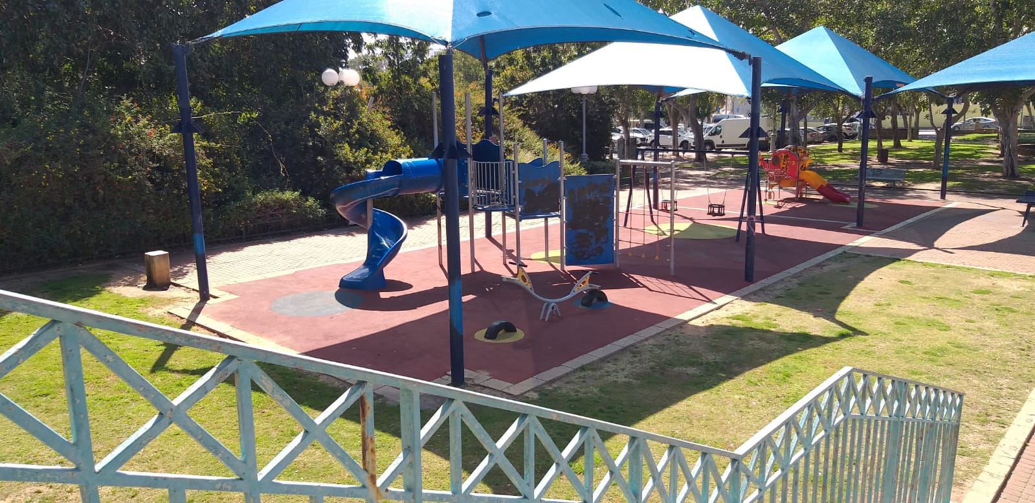
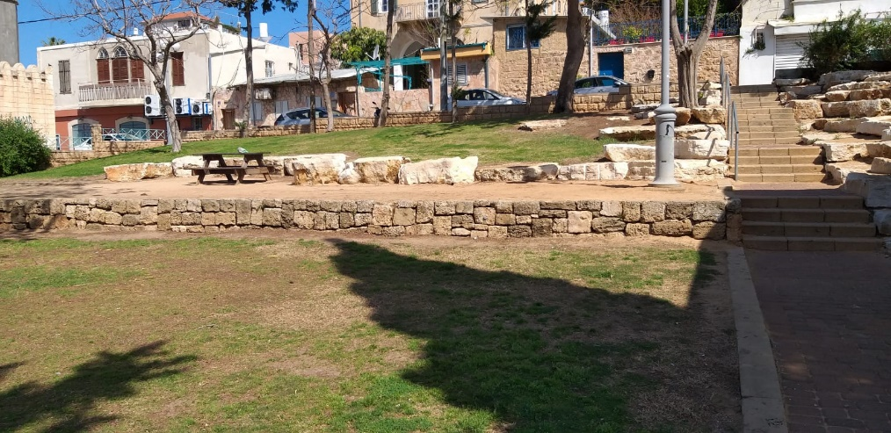
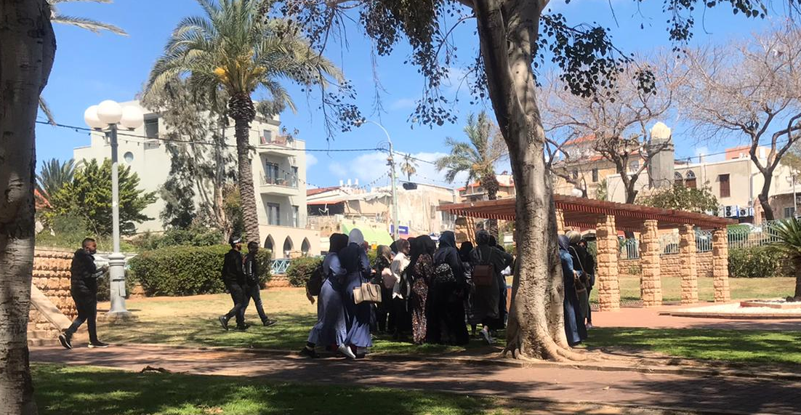
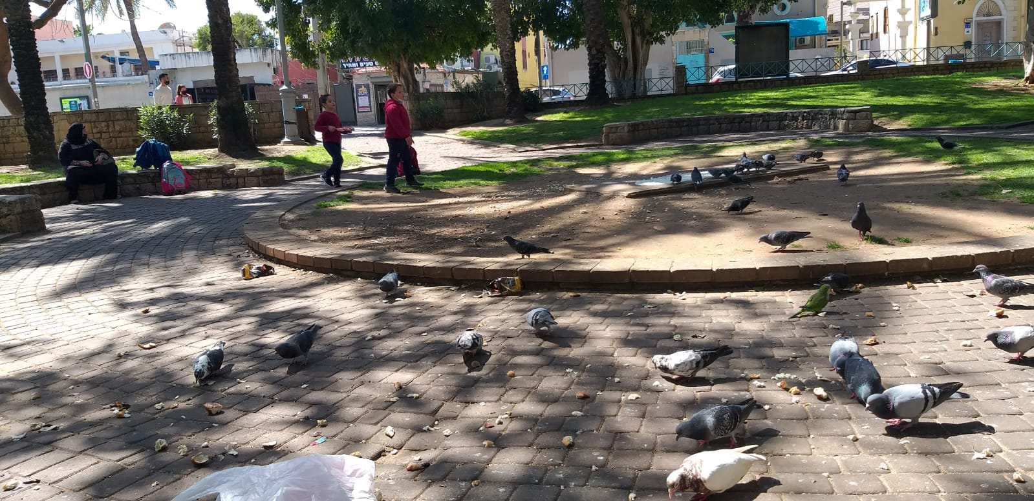
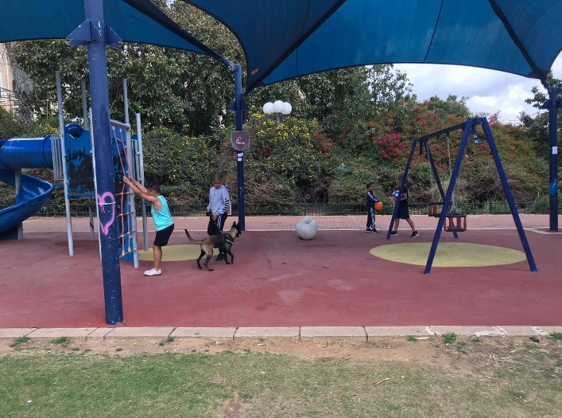
Pre-intervention Observation Findings
Dilapidated play facilities
The following findings emerged from the observations conducted in March-April 2021
on Friday mornings and full weekdays (mornings through evenings):
The play facilities were dilapidated and unsafe. They offered limited opportunities for play and were not appropriate for a wide age range.
Traffic safety was impaired by damaged sidewalks, lack of bike paths, inaccessibility for baby strollers between the levels in the park, and unregulated cycling that put young children at risk. Visibility was limited. There were few drinking fountains or trash cans. Vegetation was thorny and wild with a lot of bare dirt.
The sense of security was challenged by various factors. The environment of neglect in the park complex encouraged the presence of social groups perceived as incompatible with families and children spending time there.
Few places to spend time, limited accessibility
A place for community meetings
Scattered trash
Older children and adolescents in the park
7

Slide 8
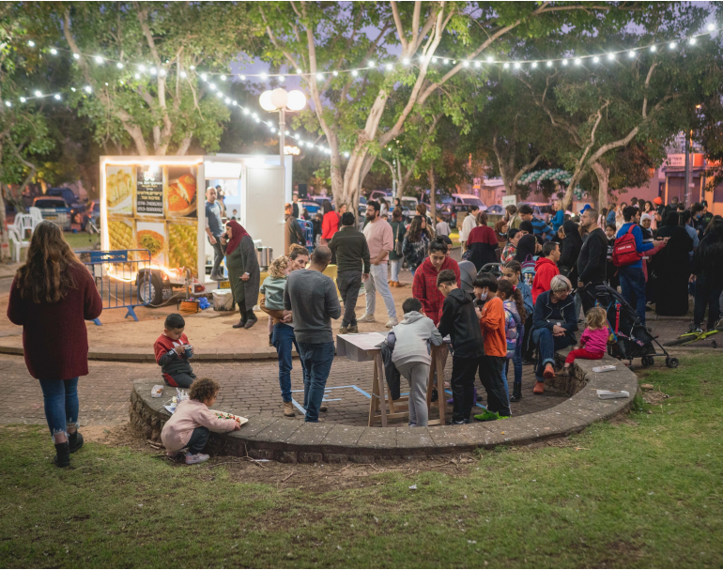
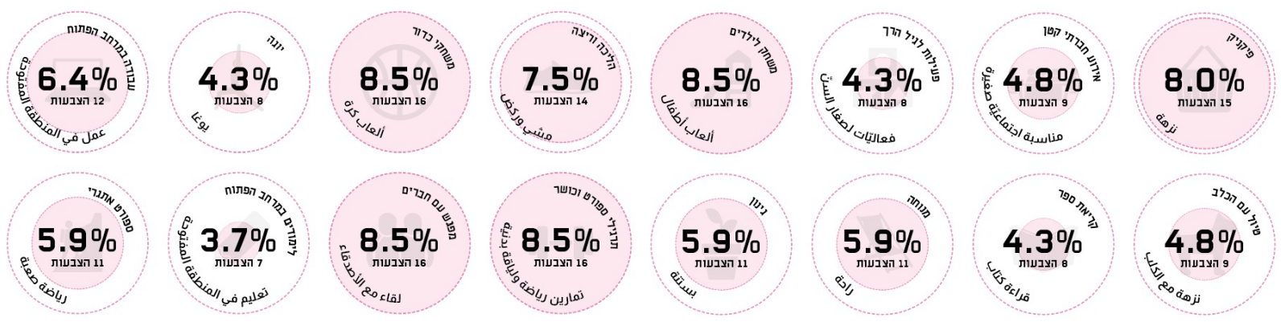
Public Participation
On February 28, 2021, a public participation event was held in the park complex, in collaboration with:
The event was held in Hebrew and Arabic.
About 500 people took part. 574 responses were collected on three issues:
What facilities would I like to see in Gan HaShnayim?
What activities take place in the neighborhood?
For me, what is Gan HaShnayim?
Ratings of Requests for Facilities:
Photo from the summary presentation of the event - received from the project team
 | Type of response/renovation suggested (the categories appeared on the voting slips) | Number of votes
A complex for community visits and gatherings | A place to relax | 81
 | Vegetation and community garden | 58
 | A community space | 56
 | Diverse seating arrangements | 26
 | Gatherings | 17
Children's play facilities | Play facilities | 72
 | Play environment | 33
Wellbeing | Health and fitness | 61
 | Work environment | 30
 | Educational space | 22
The four most common activities reported were ball games, fitness and sports activities, children's games, and picnics.
The four least common activities reported were: studying in open areas, yoga, reading a book, and activities for young children.
8

Slide 9
Post-intervention Evaluation Findings
The park complex is a place for the community to gather and spend time together.
A variety of seating facilities were placed in the park complex - benches of different sizes and heights, chairs, tables, and picnic facilities.
The vegetation was cared for and herbs were planted throughout the park.
Sidewalks, bicycle paths, and routes for strollers were defined and maintained. The renovated infrastructure differentiates areas for safe play and visiting from paths for moving around the site.
Trash cans and drinking facilities appropriate for children and adults were added.
Fences were installed at the entrances to the park complex to limit traffic and reduce cyclists’ speed.
.
Children's play facilities
New and varied play facilities and a play center that combines natural elements -- sand and water -- were installed.
*On the observation days, the water play equipment did not work.
Fitness equipment
An area for exercise was developed In the upper section of the park, with a variety of fitness equipment installed in it.
Interviews with park visitors indicated improvement for all indicators examined:
Pre-intervention (N = 25) | Post-intervention (N = 30) | Interviewees’ ratings (scale of 1-7)
4.5 | 7.0 | Ease of movement
5.6 | 6.5 | Shade
3.5 |  | Lighting
2.9 | 6.8 | Seating facilities
4.2 | 4.9 | Cleanliness and maintenance
3.4 | 5.5 | Protection from bicycles and vehicles
4.7 | 6.2 | Sense of safety
3.1 |  | Child safety
Not asked | 6.4 | Appropriateness for multiple ages
Not asked | 6.4 | Independent play
Not asked | 6.4 | Joint play
5.2 | 6.6 | Opportunities for community interaction
Not asked | 6.6 | Positive social environment
In general, the interviewees expressed positive sentiments. They said they feel connected to the park, enjoy spending time in it with their children, and it meets their needs. Many expressed willingness to participate in special events for children.
17 of the interviewees knew about the public participation event.
13 participated in it and were satisfied with the results.
9

Slide 10
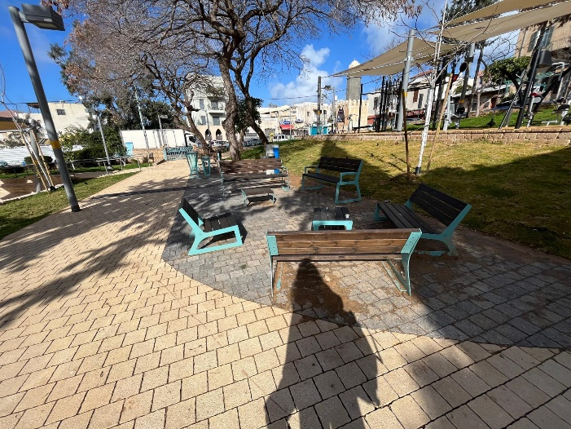


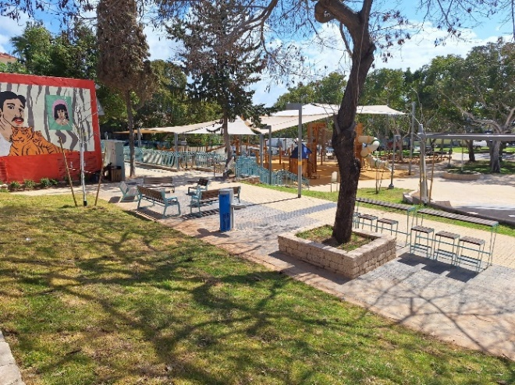
A Park Complex for Community Visits and Gatherings
The park offers a place for visits at all hours of the day, accessible to residents from various social groups in the local population (secular, religious, Jews, Arabs, Russian speakers, Amharic speakers). In the mornings, we mainly observed adults, the elderly, adolescents, and people walking dogs either passing through the park or sitting to talk.
Starting around noon, the number of visitors with children increased. Community gatherings were observed, apparently based on acquaintances from educational settings or multi-generational family gatherings (parents, grandparents, and children). Parents interviewed at the park expressed a willingness to attend community events for children in the park.
The distribution of benches offers a comfortable visit for caregivers who want to be near their playing children and those who prefer sitting with other adults and watch from a distance (in the case of older children).
People eat together in the park. Visitors arrived with food. Some people ate breakfast there. At lunchtime, groups including children ate in the park. Families had picnics In the early afternoons after children were picked up from their educational frameworks. The amphitheater near the play facilities is used as a place for family picnics.
"The park is useful for us. All my children come here to play, including those from my extended family. We often meet here to be together.”
(Arab father with a baby girl)
"I feel a strong sense of belonging. Thanks to the renovation, many more people come and there is more neighborhood cohesion than before. We are all here together.”
(Arab mother with a 9-year-old daughter)
"This is our children’s park. We feel very connected and affiliated. Everything is done in the park."
(Arab mothers related by marriage with children aged 2-9)
"Yes [we participated in the public event]. We registered and came for the voting. I am very satisfied with how the park turned out. It addressed pretty much everything we said in the public referendum. I would just like it to be cleaner."
(secular Arab mother)
10

Slide 11




A Park Complex for Community Visits and Gatherings
Analysis of the gender data of people passing through or spending time in the park found a significant increase in women’s presence. Before the intervention, women represented only a quarter of visitors. In the post-intervention observation, more than half the visitors were women.
Analysis of the data on traffic in the park complex found:
A significant reduction in cyclists passing through the park. Before the intervention, they represented 26% of the traffic in the park. This dropped to only 4% after the intervention.
A noticeable increase in the percentage of young people (birth to 5 years old) in the park, from 3% before the intervention to 12% afterward.
Issues for improvement:
Shade: From morning to noon, there is no shade on the benches near ​​the fitness equipment or ​​the play facilities.
Cleanliness: Throughout the observations, garbage was seen near the benches, play facilities, and sandbox, including disposable cups, cigarette butts, sunflower seed shells, and more. The interviewed caregivers raised this as an issue for improvement.
Public bathrooms: There is no nearby public bathroom to serve this need. The interviewees also raised this necessity for the park.
Dangerous riding: Although the number of riders decreased significantly, throughout the day there are isolated cases of riding in the visiting/walking areas. Three motorcycles were observed driving through the park and one ATV crossed the sidewalk near young children. Some interviewed caregivers expressed concern about this, as well as about the park’s proximity to the road.
11

Slide 12


Children’s Play Facilities
The new facilities are suitable for a wide age range. They encourage active and varied play that combines physical challenge, free movement, sensory exploration, creativity, and imaginative social games. The use of the facilities is dynamic and can be adapted to the dominant age group using the facility at any time.
The playground complex is a place for family and community gatherings. Groups comprised of parents, grandparents, and friends brought their children to the park and played with them and/or supervised them while having a relaxed social conversation with other adults. The parents’ level of involvement and support varied according to the ages of the children playing.
Activity at the park peaked in the afternoon when more joint play was observed between caregivers and children, especially at the facilities designated for young children. Children who met at the park played together in mixed-age groups.* In the sandbox, children played independently, with other children, and/or with caregivers. Children used the logs surrounding the sandbox for climbing or as balance beams. At the water play equipment, interactions were observed among children who did not necessarily know each other previously. Other areas, such as the tree grove, pigeon square, the area near the fitness equipment, and the grassy areas were used for imaginative games and free play (hide and seek, tag).
Children played soccer on the sidewalks by the visiting areas and play facilities in a way that was sometimes excessive for the space. Interviewed parents suggested allocating an area for ball games.
Even during peak hours, visitors reported a sense of well-being and comfort. We did not observe overcrowding in the park complex.
"We came with the little children to get refreshed because they aren’t in any framework."
(two Arab mothers with young children)
“Ori likes the logs around the sandbox and the play facilities. The park is diverse. It’s very nice to have a lot of equipment." (secular Jewish mother with a young daughter)
“Our favorite play facilities are the ones made of natural materials, sand, and wood. It reminds me of the games I played as a child." (father from India with children ages 2 and 10)
"We come after kindergarten. The park is pleasant, and my child enjoys it here. The water fountain is special and encourages imagination."
(Arab mother of a 3-year-old son)
"Today is a free day for the girls [...] they came here for the first time with their school, which is close to here. They told me, 'Mom, there is a nice playground here, let's go to it. They wanted to come back here, so we came"
(Religious Arab mother, with children ages 4, 7, and 9)
* For details on modes of play in the facilities see the appendix.
12

Slide 13
Children’s Play Facilities
In the mornings, few groups with young children were observed, and only for short periods. In the absence of young children, teenage boys and girls were seen in the playground area, and there were cyclists in the area.
Starting around noon, some caregivers with children were seen. Apparently, these children are not yet in educational frameworks or only attend for a short time. Later in the afternoon, after children are picked up from school, large numbers arrive at the park, which bustles with children.
Analysis of quantitative data on park visitors indicated that the age distribution remained similar before and after the intervention. However, the distribution at various times of day changed. The number of children from birth through 5 years old at the park in the afternoons increased after the intervention compared to before the intervention.
There are several possible explanations for the decline in the number of people in the park in the mornings, especially young children:
One day of pre-intervention observation, a large group of young children came to the park complex with their kindergarten class. Students from the nearby anthroposophist school also came to the park. Many children from the Christian population enjoyed their Sunday free day at the park without strict parental supervision.
However, the post-intervention observation period was characterized by high tensions regarding security in the shadow of the Swords of Iron War. This affected groups from educational settings going to public spaces in general. Children’s presence at the park without adult supervision decreased.
Another phenomenon that can be attributed to the security tensions is the number of people in the park in the late afternoon or evening. Before the intervention, older children (through age 14) were seen spending time at the park. After the intervention, their presence (and the presence of people in the park in general) decreased greatly towards evening.
13

Slide 14

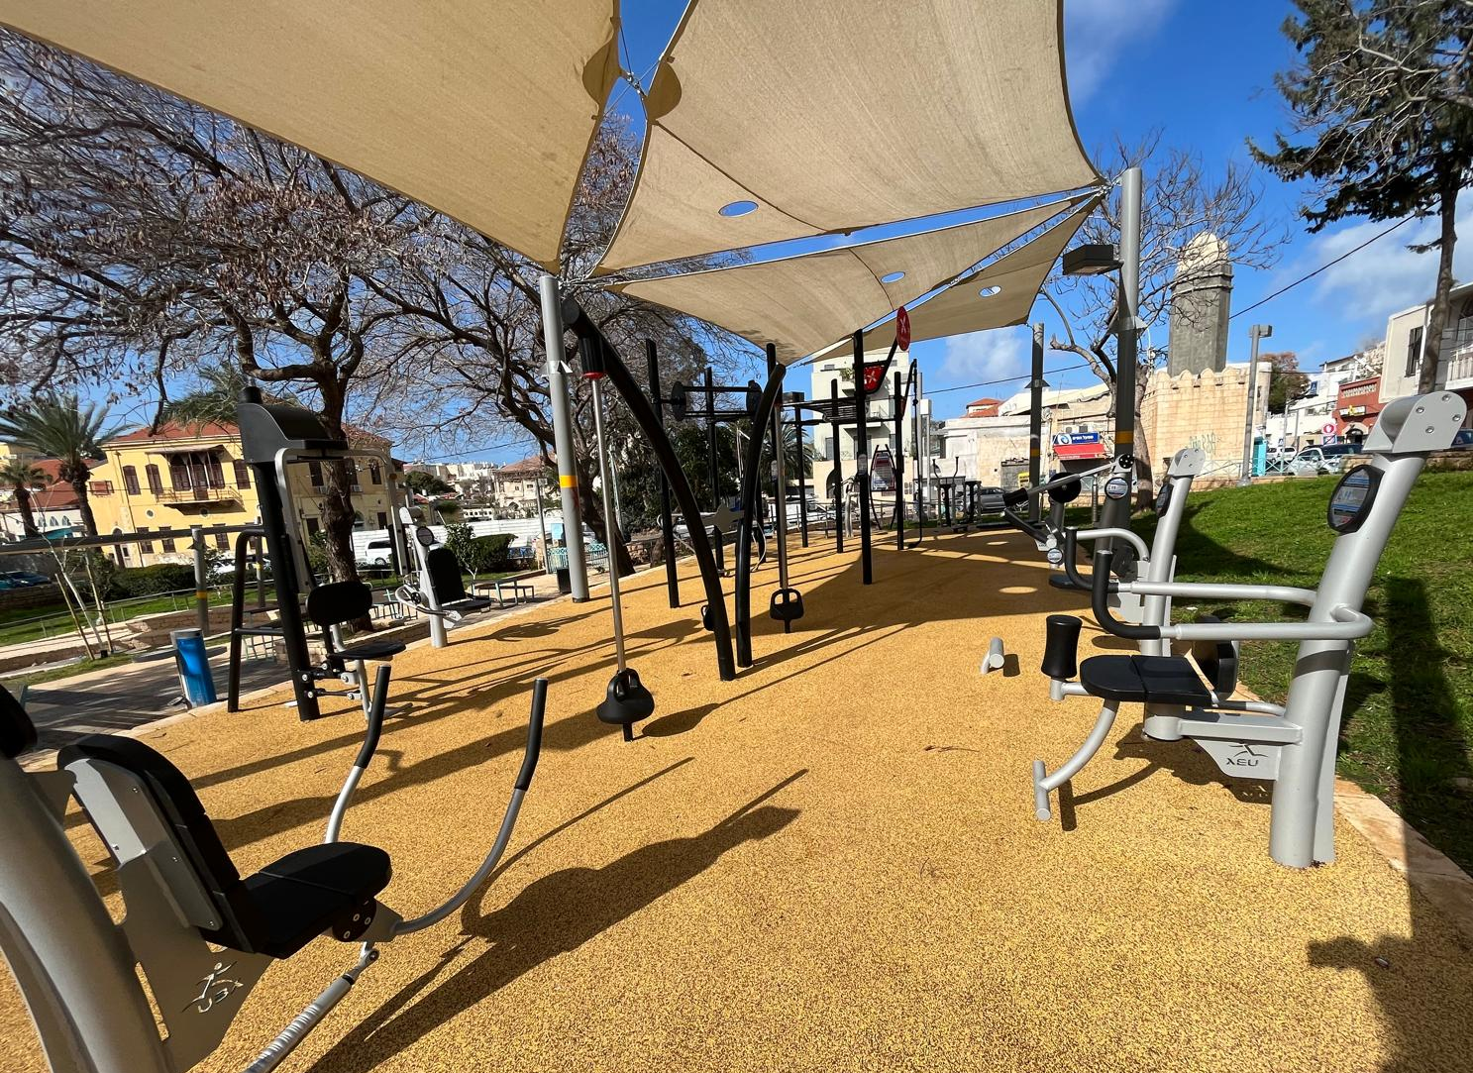
Well-being – Fitness Equipment
Individuals worked out on the fitness equipment during all observation times. In the morning, the fitness facilities and adjacent benches were used for social visits, not physical workouts.
In the afternoons, the use of these facilities increased. Adults and teenagers were observed exercising.
Older children and teenagers use the exercise area as a spacious and quiet alternative when the playground is crowded with small children.
No visitors were observed studying, working, or doing other similar activities in this area.
14

Slide 15
נספחים

Slide 16
Data on Pedestrian Traffic in the Park Complex
Analysis of modes of movement through the park found a significant decrease in the percentage of cyclists, from 26% of the total number of people passing through before the intervention to only 4% after the intervention.
Children from birth to 5 years increased from 3% of people passing through the park before the intervention to 12% after the intervention. Their presence was observed mainly in the afternoon, reflecting times of family recreation after school.
16

Slide 17
Data on Visitors’ Gender
Analysis of data on the gender of those present in the park (passing through or staying) found a significant increase in the percentage of women. Before the intervention, women represented only a quarter of the visitors, while after the intervention, more than half the visitors were women. For most of the day, until 4:00 p.m., women are consistently in the majority. The presence of men notably increases towards evening.
17

Slide 18
Use of Play Facilities
Description of use and whether children were accompanied by adults | Average users’ age | Main facilities used
Children of all ages played with the sand. Some put sand in the water dispenser. Others dug in the sand. Some children jumped over the logs. Parents mostly watched from outside the sandbox. When mainly young children were playing in the sand area, their parents sat with them. | 0-9+ | Sandbox
Children of all ages used the water play equipment. They put sand in it and moved the spout. Most parents watched while their children played. Young children were supervised by their parents who encouraged them to turn the wheel and examine the equipment. | 0-9+ | Water play equipment *The water dispenser did not work, it was dry.
Older children mainly played on the slide alone. They climbed and slid while their parents watched them from a distance. Younger children’s parents supported them as they slid down. | 0-9+ | Slides
Mainly independent play of the older children, supervised by the parents from a distance. | 3-9+ | Climbing equipment attached to the slides
Children climbed and moved freely, without close parental supervision. | 3+ | Climbing ropes
Children were relatively closely supervised by their caregivers. Sometimes they were helped to enter the playhouse. It seems that they felt safe there. In one case, a young child stood in front of the slide and then slid down it on her own. A 6-year-old boy played in the playhouse independently although his companions were not interested in it at all. | 0-6 | Playhouse for young children
Parents stood close by to help young children in this facility. | 0-6 | Toy train for young children
Parents put young children on the baby swing (with a built-in seat) and pushed them. Older children played freely in this area while their parents watched. When the park was not filled with children, adolescents were seen sitting on the swings and talking. | 0-9 *some presence of adolescents | Swings
A wide age range of children used the carousel. Young children sat still on it while their parents stood beside the equipment and closely supervised and sometimes talked to their children. Older children spun the carousel quickly. Each group was mainly homogenous in terms of age and their behavior was adapted accordingly. When there were few young children in the park, adolescents were observed sitting on the carousel and talking. | 0-9 *some presence of adolescents | Carousel
Mostly young children wandered around and explored this area. They walked from side to side, sat on the crescent that was placed in the square in honor of Ramadan, and interacted with their peers. Parents watched from a fairly close distance and talked. | 0-6 | Pigeon Square
Throughout the park we saw children playing on the fitness equipment, engaging in free play such as hide and seek, playing soccer on the sidewalk, and riding scooters.
18

