Slide 1
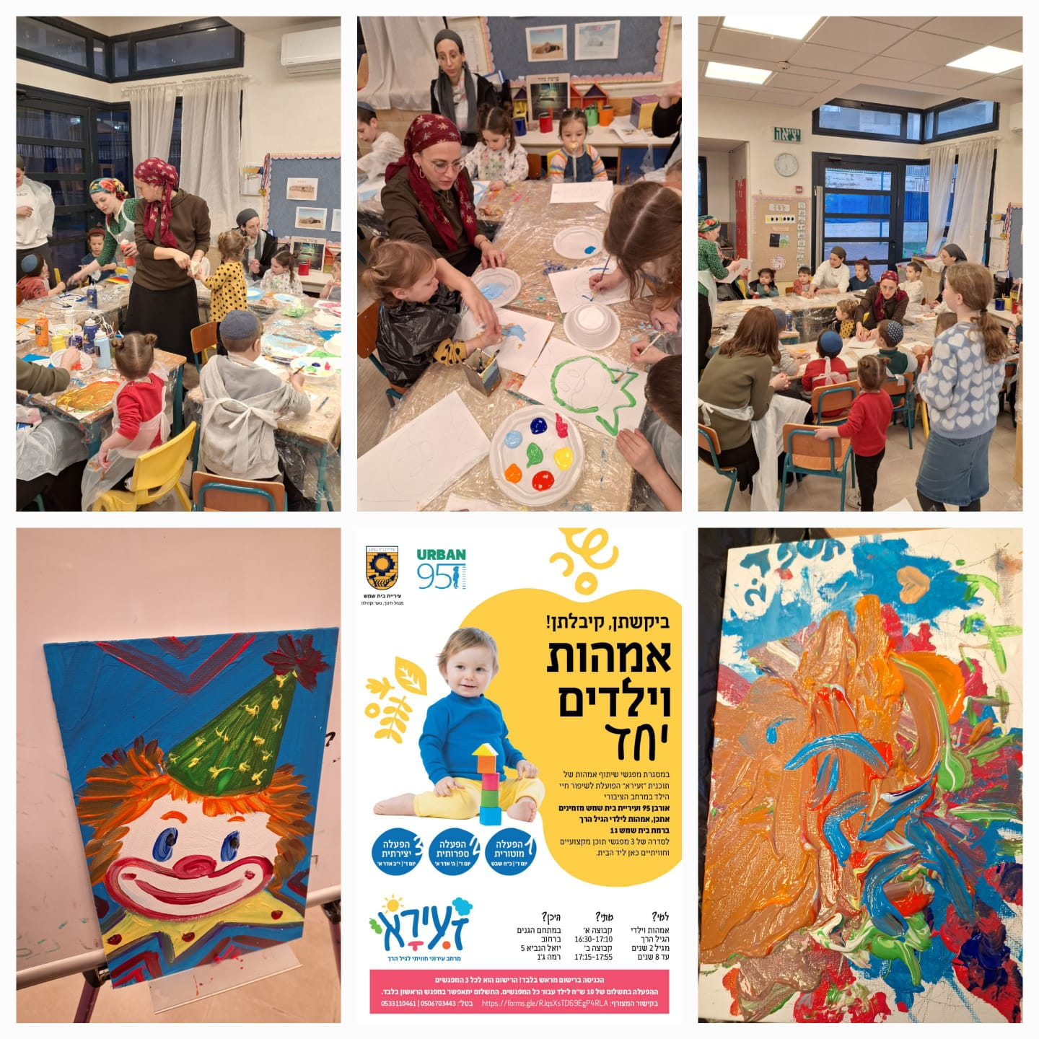
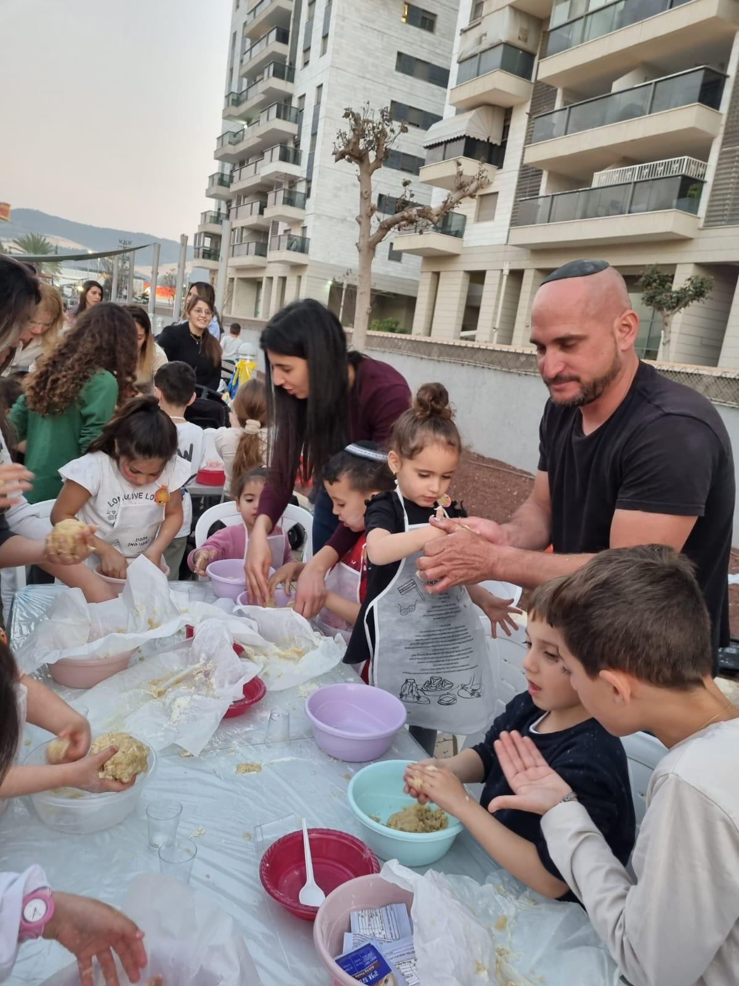
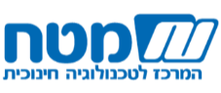
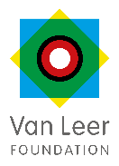


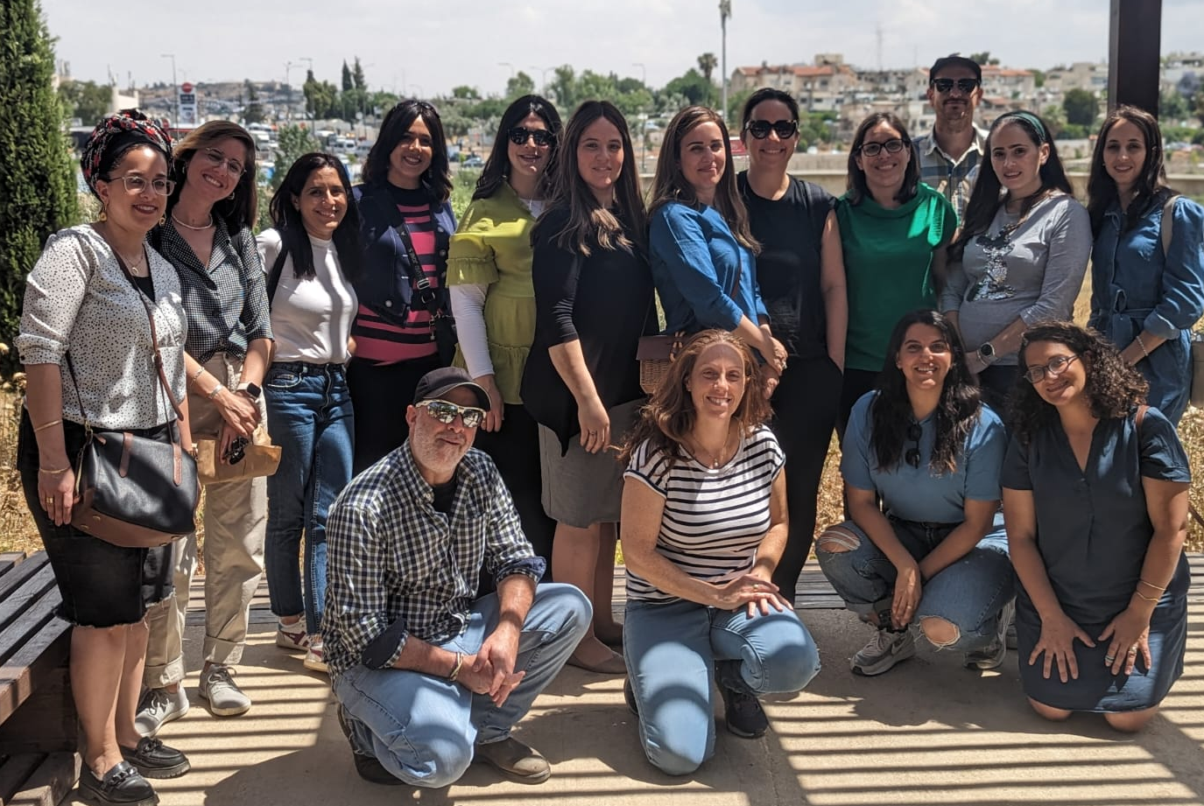
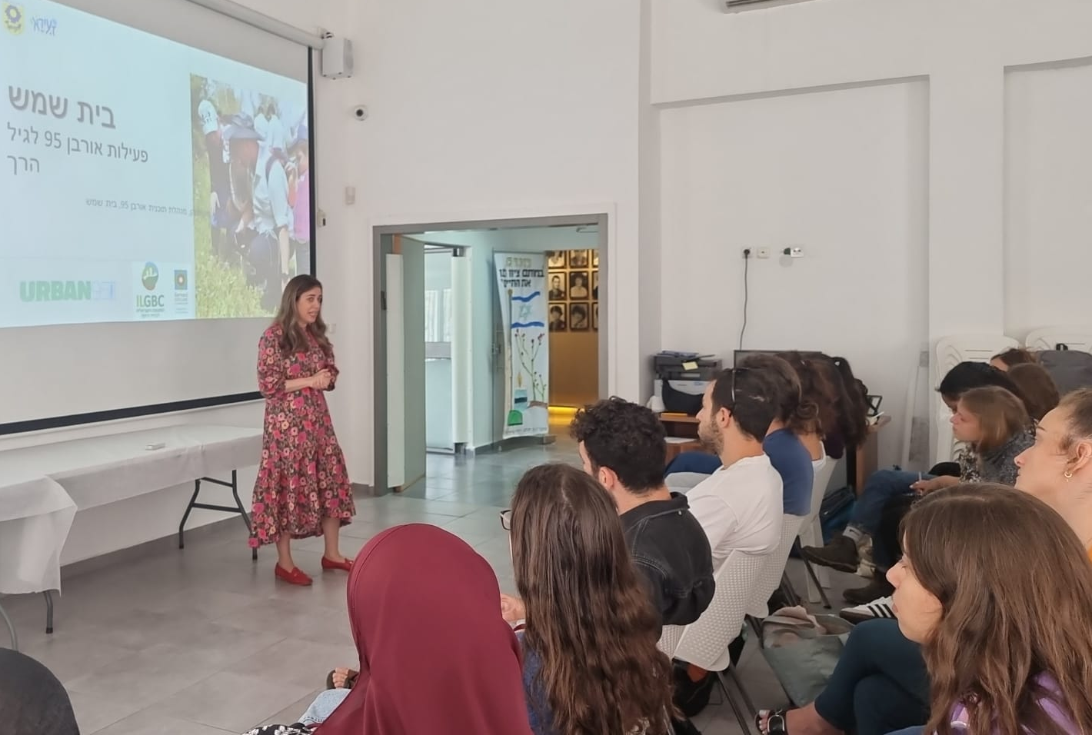
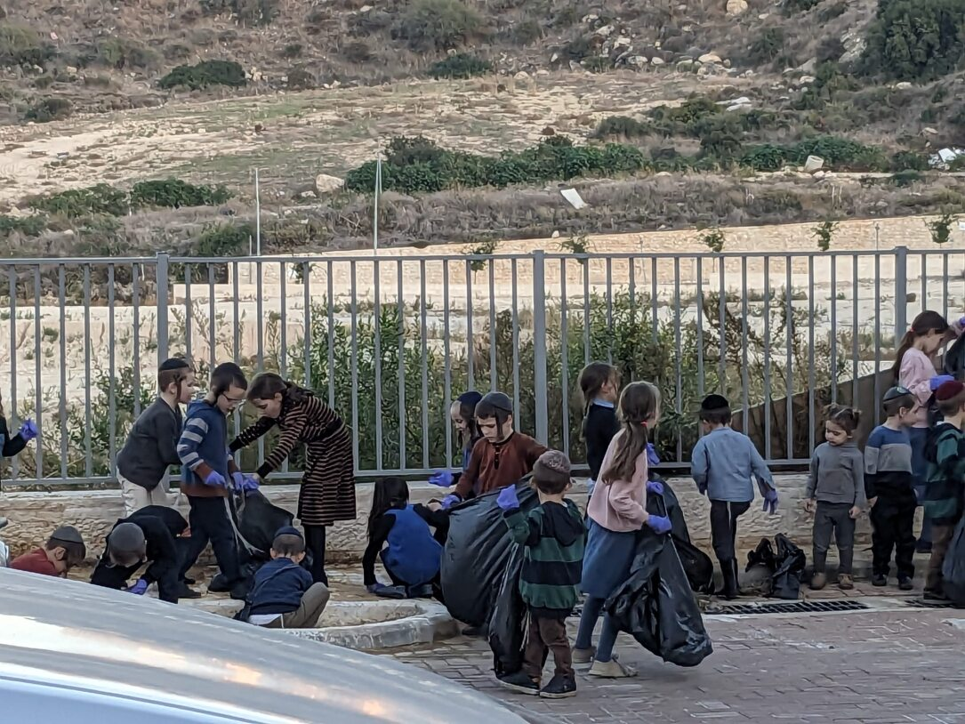
2023 Summative Evaluation Report
Urban95 Beit Shemesh
August 2024

Slide 2
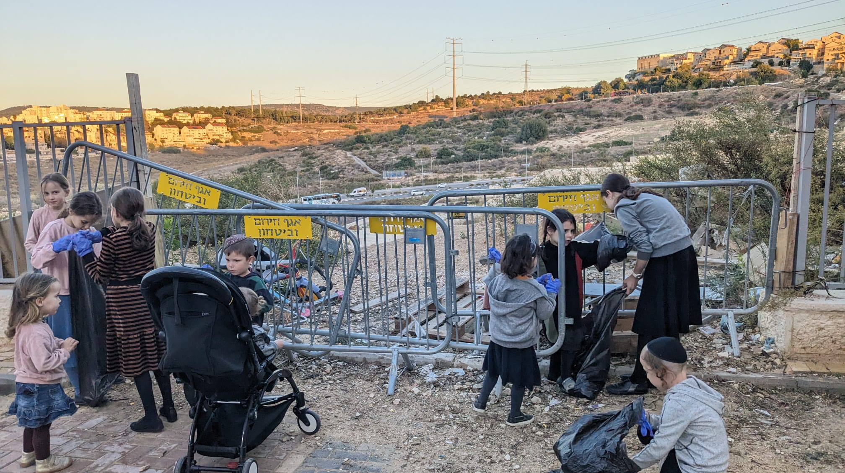
Table of Contents
10-14
03-04
Summary of Evaluation Findings​ Based on
Short- and Long-Term Outcome indictors (Impact)
Executive Summary – Key Insights and
Urban95 Beit Shemesh Outcomes in 2023 Based on Evaluation Indicators
11-12 Municipal officials, partners and professional workforce
13-14 Young children and their caregivers​
05
Research Work Plan –
Evaluation actions in 2023 and first quarter of 2024
15-19
Appendixes
16-17 Detailed Activities and Outputs of Urban95 Beit Shemesh in 2023
06-09
18 פירוט ממצאי מיזם גינה קהילתית: טיפת חלב קריה חרדית
Overview of the Main Projects Measured and Evaluated in 2023
19 פירוט ממצאי קורס ‘We plan’ בצלאל - השלוחה החרדית
07 "הכשרת גורמי עירייה - כשקהילה פוגשת מרחב"
08 תוצרי סדנת 'רשות פוגשת קהילה’
09 הכשרות והשתלמויות למטפלות מחנכות
2

Slide 3
Executive Summary – Key Insights
Cost Effectiveness - The Program Maintained a Balance Between Involving a Large Number of Participants and Preserving the Principles Of Urban95 Zaira.
Content-based activities for residents and conferences for professionals were attended by hundreds of caregivers-educators and dozens or even hundreds of parents and their children. The investment/participant ratio calculation yielded a very high ratio score of less than 1%. Following the principles of Urban95 Zaira, the number of participants in each activity for parents and children was limited to ensure that the experience would promote the children’s development and strengthen the parent-child bond.
Activities for residents and training sessions for professionals and municipal officials each had between 15 and 30 participants. The investment/participant ratio was moderate (3%-5%). The intimate group size allowed participants to deepen their knowledge about early childhood and acquire new tools, ideas, and work practices (long-term impact).
Launching projects to improve and adapt public spaces to the needs of early childhood yielded a low investment/participant ratio (8%-20%). The focus on in-depth processes made it possible to learn about the needs of residents and their young children, which was beneficial for subsequently targeting and culturally adapting the responses (long-term impact).
Funding Sources and Partners* - In 2023, the Local Authority Took Responsibility for the Field of Early Childhood, Including Financing Activities for All Target Audiences
The vast majority of the budgeting for all activities for the various target audiences (residents, professional field teams, municipal officials) conducted during 2023 and the first quarter of 2024 was based on municipal funding and external resource pooling (the Joint, the Israel National Lottery, and the inter-ministerial 360 National Program), along with donations from private parties who funded emergency responses for residents. Urban95’s direct budgetary investment in Beit Shemesh in 2023 and the first quarter of 2024 was approximately NIS 60,000, in addition to leveraging the position of the Urban95 municipal manager.
Municipal Involvement and Program Sustainability – Full Assimilation of the Program Principles in Official Work and the Desire and Ability to Expand the Field of Early Childhood Were Evident
The program offered many successful activities in 2023, primarily professional training for municipal officials, high-quality content-based activities for parents and their children, and conferences and training for kindergarten staff. The extensive work in all activity channels can be attributed to the many and varied collaborations that the municipal administration of Urban95 in Beit Shemesh forged with various business, academic, and professional entities in the municipality who expressed a high degree of involvement. From the beginning of 2024, with the establishment of the early childhood department in the municipality of Beit Shemesh, the director of Urban95 began devoting considerable time and resources to the guidance of the incoming director of the department, who is expected to lead the field of early childhood in the municipality after the end of the program's activity in the city.
*Details pertaining to the partners, funding sources, cost-effectiveness scores, and a description of municipal involvement in the projects are provided in the appendices.

Slide 4
Executive Summary - Urban95 Beit Shemesh Outcomes in 2023 Based on Evaluation Indicators
Municipal Officials and Partners
The Urban 95 municipal manager promoted initiatives and collaborations between various municipal units and external partners for the benefit of young children. The manager is a regular participant in the committee on early childhood and leads a mentoring process for the incoming director of the early childhood department.
Content-based activities for parents and young children and enrichment and training sessions for municipal officials and professional teams took place, fully funded by the municipality and with the mayor’s involvement. Additional private donations were raised to finance respite and resilience activities for residents in times of emergency.
Planning interventions in public spaces and developing responses to residents’ needs were done following public participation processes. Different trends among the ultra-Orthodox public, the children’s ages, and the conditions of the physical infrastructure were considered.
Forty municipal employees participated in professional trainings and tours, during which they acquired knowledge and tools to promote the needs of early childhood. They were exposed to and adopted new work mechanisms. Intra-city collaborations and partnerships with other entities promoted projects for the benefit of young children.
  EC is on the municipal agenda
Municipal officials are knowledgeable and understanding of EC needs
Use of new work mechanisms and public participation practices
Inter-municipal collaborations, onboarding of external stakeholders
Providing EC contents and services with municipal investment
Professional Field Workforce
Participation in training to acquire knowledge and practical tools
Applying lessons learned at work with young children, including independent initiatives
Peer learning, collaboration within a professional inter-city community
About 750 caregivers-educators participated in professional conferences and training, which provided them with knowledge and practical tools for working with young children.
Most participants gained professional knowledge, ideas, and applied practices for their work with young children.
The participants reported making professional and interpersonal relationships. They expressed a desire to participate in future events, lectures, and training days.
A s part of their studies, about 145 students were exposed to the activities of the Urban95 program in Beit Shemesh.
Young Children and their Caregivers
The scope of activities for young children and their caregivers, adapted to the different sectors in the city
Use of spaces, services consumption & satisfaction
Sense of security and safety in intervention areas
Trust in the local authority
Familiarity with Urban95 and repeated participation
Acquiring knowledge and tools, parental well-being
Joint caregiver-child play & time spent in public spaces
Community and social belonging
About 3,800 children and 1,200 parents (mostly mothers) participated in content-based parent-caregiver activities (adhering to Zaira principles). About 890 residents (parents and their children) participated in respite and resilience activities during the "Swords of Iron" war.
For more than half of the participants, this was their first Zaira activity. They said they were interested in more activities.
It was evident there was a high level of satisfaction with the activity format (mainly small groups), quality of the content and activity materials, organization and professionalism of the staff, and conditions of the physical space.
The activities took place close to residents’ homes and responded to the needs raised in the public participation processes. This increased residents' sense of trust in the municipal authority.
The activities improved parent-child interaction, contact, and joint play and developed children’s motor, emotional, and social skills.
The participants gained knowledge and tools to promote child development and address parenting challenges, ideas for joint play, and strengthening parental well-being, and they got to know other parents in the city.
4

Slide 5
Research Work Plan – Evaluation actions in 2023
Research Period is February 2023- March 2024
 | הכשרת 'כשקהילה פוגשת מרחב' | קורסWe Plan -בצלאל השלוחה החרדית | גינה קהילתית בטיפת חלב קריה חרדית | הכשרת מטפלות – כנסים | מתנ"ס נייד ג'1 – תוצר סדנת 'רשות פוגשת קהילה' | פעילויות 'זעירא בשכונות' | הרצאת 'הורות מיטיבה בזמן מלחמה' | סיור צוות אורבן95 עירוני לירושלים
Interviews |  | ראיון עם מרצת הקורס | ראיון עם מובילת הקבוצה
Focus Groups | N=9 |  | N=8 תושבות השכונה
Surveys | N=14 | N=10 מחזור ב' |  | N=25 'תזונה נכונה' 59= N'כוח לגדול' | N=22 | N=28 | N=19 | N=10
Formative Evaluation, Strategic Consulting and Capacity Building | ניתוח מסמכים וחומרים מהתוכנית | ניתוח תוצרים מהתוכנית | Formative evaluation and strategic consulting: providing raw data from evaluation actions for immediate implementation recommendations Capacity building: guiding of Urban95 Beit Shemesh municipal manager in surveys’ data analysis and deriving insights and accompanying in independent development of questionaries

Slide 6
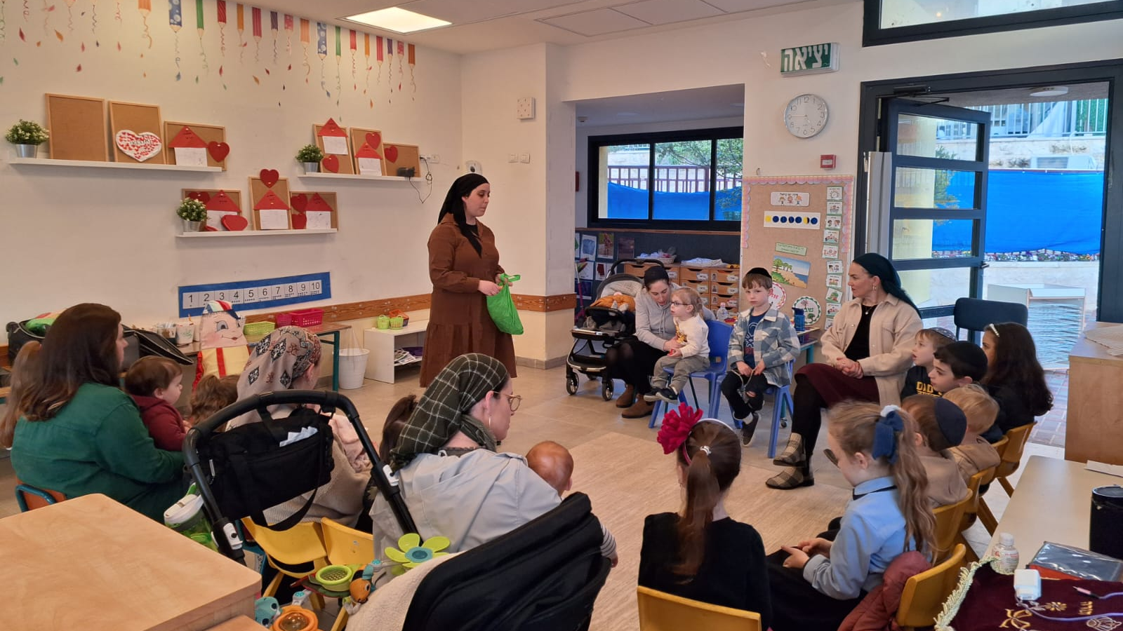
Overview of the Main Projects Measured and Evaluated in 2023

Slide 7



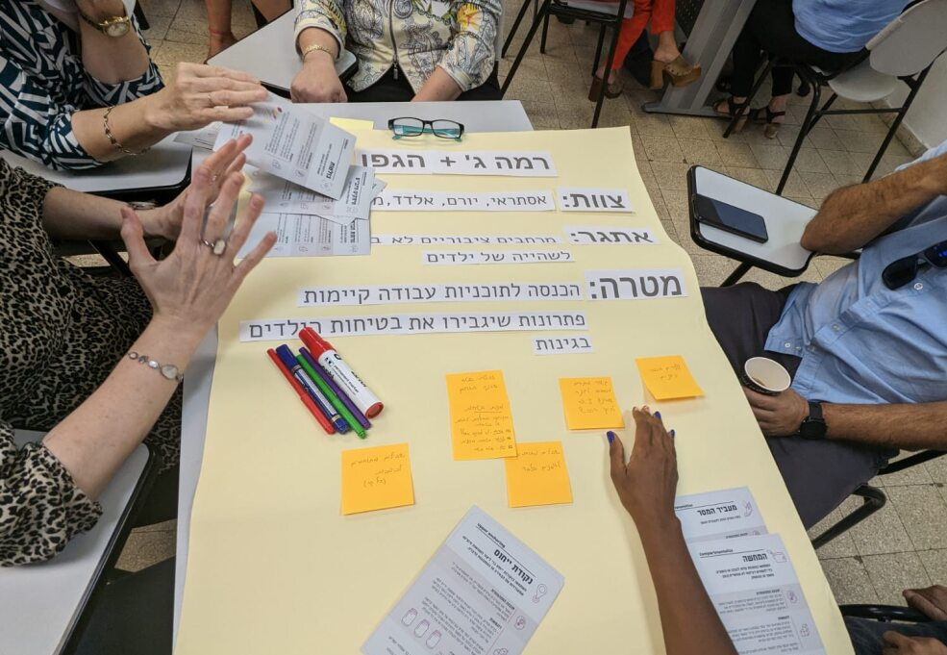
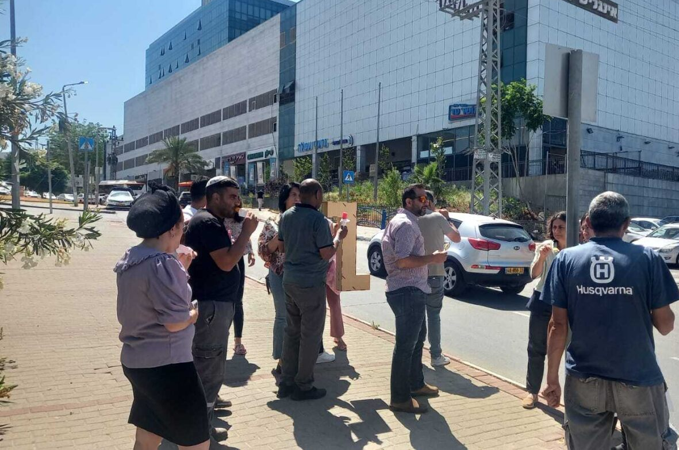
The training was successful due to:
Enlisting the support of the mayor and city officials.
The instruction team: The training instructors hold roles in the municipality (as opposed to being from an external entity).
Timing and content of the training: Meetings were held during working hours and addressed daily work challenges.
The program structure: Combines imparting knowledge and tools, field learning, public participation, and developing responses.
All of these contributed to participants’ commitment and involvement
Participants benefitted beyond their expectations:
They acquired knowledge about the needs of young children and tools for assessing the public space and changed their perceptions of public space in terms of its logistical and developmental aspects (i.e., encouraging joint play and strengthening the parent-child bond).
They acquired new work practices and tools for enlisting and recruiting functionaries.
They strengthened connections and created partnerships between entities. They improved their understanding of their role and their ability to bring about change.
Training Municipal Officials: "When the Community Encounters the Space."
Municipal inter-departmental training created connections between operations personnel and the community. The training included professional lectures held during working hours, field tours, practical experience, and the launch of pilot projects.
The “Local Authority Meets the Community" workshop
Municipal workers got their first experience with a behavioral change process in this workshop.
Tour to Jerusalem for 15 municipal officials from the fields of engineering, planning, community, and welfare.
October 2022-March 2023
"I wasn’t familiar with Urban95 and its language of 'look at the steps of a ladder in the playground’. Suddenly, I realized that the child is not climbing because the steps are too big.“
"Before, we only thought about lighting, benches, trash bins. Now we think about interaction between parents and children and how it is possible to do more activities in the space.“
"I learned about breaking down barriers, enlisting and recruiting people to deeply understand our plans and why we do what we choose to do."
May 2023
"We got a real gift! Every employee in the municipality should go through this course, it should be made a permanent model.“
"Every time, I left feeling that I had received a practical tool that I could immediately apply at work.”
"The planning stage has changed a lot. There is cooperation from the first moment. We sit with the space and plan it together."
"The course contributed to a deeper understanding of everyone's role. A lot of shortcuts were created, and this gives us more time to work."
June-August 2023
April 2023
Targeted training for 25 municipal field officials
7-session workshop on development and leadership for members of the delegation to INSEAD.
Behavioral Change Course (INSEAD)
Delegates from Urban95 Beit Shemesh who completed the Local Authority Meets the Community workshop participated in the ABC4ECD course sponsored by the Van Leer Foundation.

Slide 8
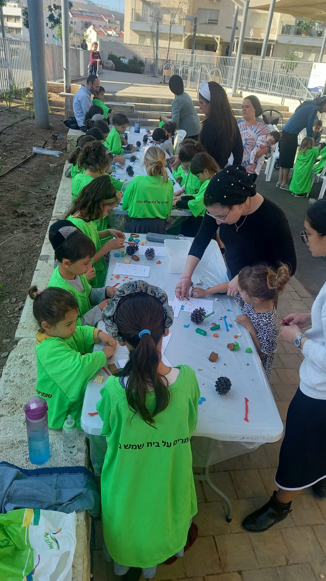
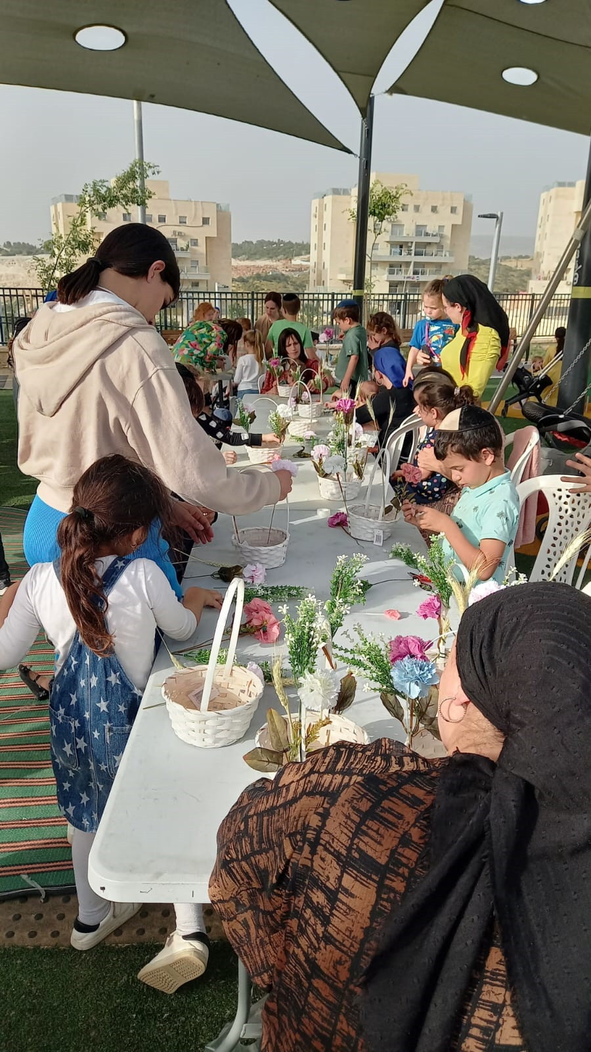
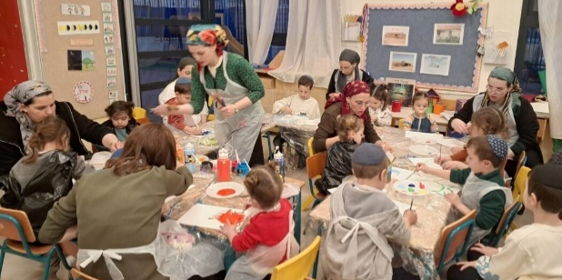
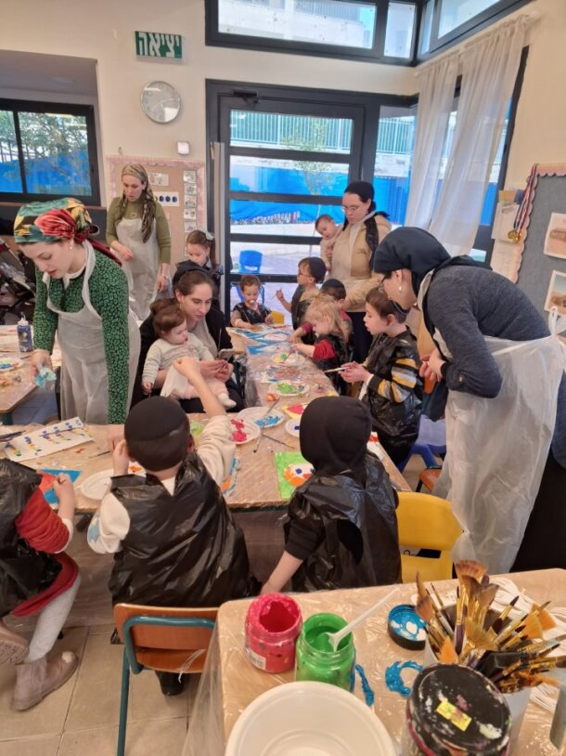

Zaira in the Neighborhood
The Mobile Community Center in Ramat Beit Shemesh Gimmel-1
Results of the Local Authority Meets the Community Workshop
Most of the children who participated in the activity were at least three years old (multi-age)
Most of the children participating in the activity were between the ages of 2-8 and were accompanied by a parent who brought only 1-2 children.
Content-based activities for parents and their children were created and refined following a public participation process conducted during the Local Authority Meets the Community workshop for municipal officials.
Location:
The mobile community center operates in kindergartens in the Gimmel-1 neighborhood during afternoon hours.
Zaira activities took place in 12 different centers throughout Beit Shemesh.
Activity Goals:
To make guided content-based activities accessible close to residents’ homes. Activities are adapted to develop early childhood skills, encourage beneficial parent-child interaction, and provide parents with tools and ideas.
Model:
The mobile community center initiative includes a series of three activities (movement, language, and creative arts) in the kindergarten complex, responding to the lack of a community center in the Gimmel-1 neighborhood.
Zaira activities throughout Beit Shemesh: the activities adhere to Urban95 principles (close to home, pre-registration, a limited number of participants, and participants pay symbolic commitment fees). The Beit Shemesh municipality adopted the activity format and expanded to all city neighborhoods in 2023, funded by the Lottery.
The activities created positive and high-quality interactions between parents and their children close to their homes.
There was a high level of satisfaction with the activity space and the instructors' professionalism. The activities developed the children's skills and the parent-child relationship, providing ideas for joint play.
"The activity was high quality, in terms of both content and materials.“
"The activity product beautified the holiday table and gave the child a sense of success and pride .“
"It was really fun, especially because it wasn’t overly full and crowded.“
"It was fun that there was room for everyone, good and clear guidance, personal attention, and quality materials.“
"Painting with gouache, me and the kids, that’s something we don't do at home, and it's very relaxing and liberating.“
Measurement and Evaluation:
28 feedback responses from Zaira activities in the neighborhoods for Shavuot (June 2023).
22 feedback responses to a series of three activities (February -March 2024).

Slide 9


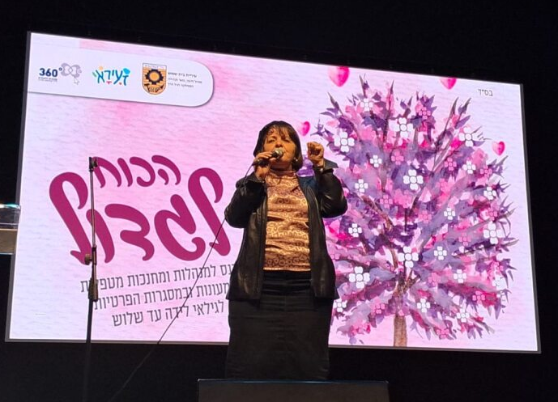
Training Conferences and Professional Enrichment Sessions
There was a high level of satisfaction and a sense that the meetings significantly deepened the target audience’s professional knowledge and provided tools and ideas for activities with young children.
Strength to Grow Conference:
About half had not participated in previous enrichment sessions.
High level of satisfaction with the Strength to Grow conference format, especially the lecture on empowerment and the talks by people holding various positions in the municipality.
85% are interested in annual enrichment sessions.
Nutrition Training Course:
Over 90% were satisfied with the organization, the presenters, and the content.
80% received new information, tools, and applied practices for their work.
40% benefitted from the opportunity to learn with their colleagues.
Urban95 activity in Beit Shemesh in 2023 included conferences, professional training, and enrichment sessions designed for the city’s staff of caregivers-educators. The municipality’s investment in training education teams has been made permanent.
Target Audience:
Managers and educators-caregivers in subsidized daycare centers and private settings for ages birth to three.
Content and Purpose of the Training:
In July 2023, a nutrition training course provided practical tools for creating a proper eating environment for young children.
In February 2024, the Strength to Grow conference was held under the mayor's auspices to inaugurate the early childhood department.
The municipality fully funded all conferences and training courses for caregivers-educators.
"The conference provided me with new recipes and ideas that are quick and easy to prepare and healthy for both me and the children.“
- Nutrition training course participant
"The information about children's needs and realizing how many children there are in the city made me think differently about the world around me in Beit Shemesh.“
- Strength to Grow conference participant
Measurement and Evaluation:
25 feedback responses to the nutrition training course.
59 feedback responses to the Strength to Grow conference.
Notes:
Reinforcement and a pat on the back. Realizing the importance of working with a very, very young age is most decisive for the child’s future and a positive future for all of us. It was good to meet friends and caregivers. The feedback from the mayor and the head of the education administration was important.

Slide 10
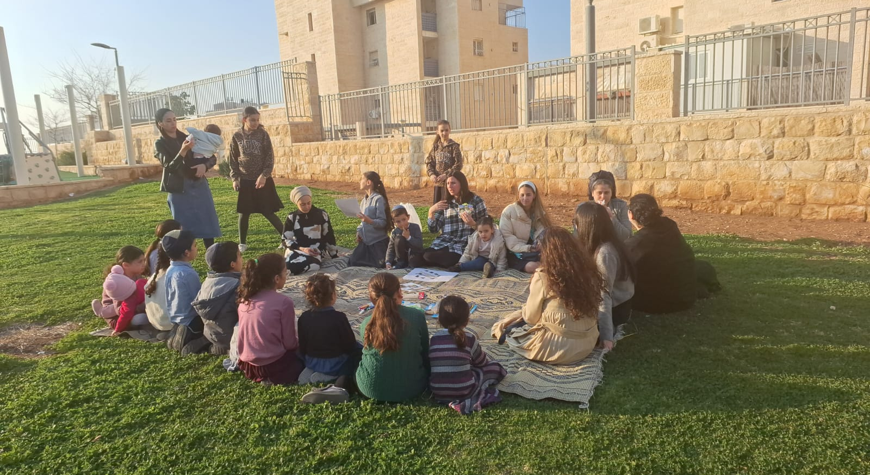
Summary of Evaluation Findings​ Based on
Short- and Long-Term Outcome indictors (Impact)

Slide 11



Training and Tours for Municipal Officials: 'When the Community Meets the Space' and a Tour to Jerusalem
25 municipal employees from the urban renewal and community departments participated in the training on behalf of the municipal staff, with the approval of the mayor and the municipal administration. The participants benefitted in many ways:
Acquiring knowledge and tools for evaluating the public space for adaptation to the needs of early childhood. "We went out into the field, and suddenly I realized that when making an opening for a garbage bin, it should be lower.“
Experience with public participation and developing responses for young children and their caregivers. "I realized that there is room for improvements, such as encouraging interaction between parents and children and getting children to play in the space.“
Interdepartmental collaborations at the intermediate and field levels and implementation of new work mechanisms. "I chose the topic of collaborations and professional connections. Many issues in the field were resolved in the process we went through. It greatly enhanced our position and work and especially motivated us. This project allows us to think big.”
15 municipal employees participated in a tour to Jerusalem. They acquired professional knowledge about early childhood needs, tools, and work practices (“creative thinking outside the box, using connections and collaborations, focusing on the possible”). They were inspired and motivated to implement ideas (“It was an inspiring learning day that opened the mind to new ideas”). They expanded their interfaces at work and learned from colleagues (met colleagues in other local authorities and learned from them, developed inter-departmental work interfaces in the municipality, and built relationships that promote work processes). Most said they intend to use the reference materials they received and share what they learned with their colleagues.
Municipal Officials & Partnerships
EC is on the municipal agenda
Municipal officials are knowledgeable and understanding of EC needs
Training and Professional Enrichment for Caregivers-Educators
A training program for caregivers-educators was jointly funded by the early childhood department of the Beit Shemesh municipality and the 360 ​​National Program for Children and Youth at Risk.
The annual meeting for daycare staff was cooperatively produced by the Ministry of Education and the Beit Shemesh municipality (Education Administration, Early Childhood Department, and Urban95), with municipal funding.
The Strength to Grow conference and nutrition training for caregivers-educators were produced by the Beit Shemesh municipality, under the auspices of the mayor and with municipal funding.
Inter-municipal collaborations, onboarding of external stakeholders
Community Garden at the Tipat Halav Family Care Center in Kirya Haredit*
The steering committee of this pilot project included various municipal departments (health, public inquiries, community, early childhood) and external partners (Ministry of Health, Bezalel Academy’s “Between the Drops“ project).
The “Between the Drops” team prepared an architectural plan to improve the intervention space with a catalog of designated elements for the design of the courtyard of the Tipat Halav family center in Kirya Haredit.
The preliminary research included a public meeting to map residents’ needs and adapt the response and its contents to the needs of young children and their caregivers.
Providing EC contents and services with municipal investment
Outcomes of the Local Authority Meets the Community’ Workshop, the Mobile Community Center, and Zaira Activities in the Neighborhoods
Development of content-based activities for young children and their parents, with full municipal funding. Activities were adapted to the needs of the various sectors in the ultra-Orthodox public, as identified in a public participation process as part of a workshop for municipal officials.
Operations and Outputs
The municipal director of Urban95 is leading a mentoring process for the incoming director of the new early education department, established in 2023 under the municipality's education department.
The municipal manager of Urban95 is a regular member of the early childhood committee of the national program 360 for Children and Youth at Risk, alongside representatives of the welfare, community, health, education , and other departments.
The Beit Shemesh municipal units, the Joint's Benevolent Community project, Urban95, the Beterem organization, the National Road Safety Authority, and the health insurance funds cooperatively sponsored a session on child safety.
A cleanup activity in Ramat Avraham was led by the operations department, which held a preliminary residents' meeting to coordinate expectations between the community and the municipality.
Private donors were recruited (enlisting partners and pooling external resources) to finance respite and resilience activities for parents and children in an emergency, which were led by the community department in the municipality.
Use of new work mechanisms and public participation practices
* Details about the project and evaluation findings can be found in the appendices..

Slide 12


The 'We Plan’ Course: The Ultra-Orthodox delegation from Bezalel
25 female students attended in two cohorts (cohort 1: October 2022–February 2023, cohort 2: October 2023–March 2024).
According to feedback from the second cohort (n=10), they all acquired new professional knowledge and benefitted to a very large extent from the experiences of conducting mapping observations and public participation events. “There was a balance between students' work and outside lectures, between quality architectural activity and budgetary applicability. They got a sense of closing a circle, not doing an exercise that remains in the realm of research.“
The course created a professional community between the partners, contributing to its success: "If I had to do it alone, I wouldn't have achieved the results we achieved together."
Professional Workforce
Training and Further Training for Caregivers-Educators
20 caregivers-educators participated in six training sessions (February–June 2023) conducted by Urban95, the municipal early childhood department, and the national 360 ​​program.
About 400 caregivers-educators attended an annual meeting (November 2023) to meet the supervisors for Ministry of Education daycare centers and Urban95 activities in Beit Shemesh.
30 caregivers-educators participated in nutrition training (July 2023). They said it deepened their knowledge about the nutritional needs of young children and inspired them with new recipes and practices to implement in their work. ("I learned how to turn mealtime into an experience by serving interesting food, not forcing, and bringing about sensitive eating."). The training strengthened professional and personal ties between the participants (“The meeting with kindergarten teachers contributed a lot. They all learn from each other"). The majority are interested in additional training sessions.
About 300 caregivers-educators participated in the Strength to Grow conference, held to inaugurate the early education department in the Beit Shemesh municipality (February 2024).
According to feedback from the conference (n=59), the participants acquired professional knowledge and new ideas for activities. "I realized how important it is to invest in young children. It will determine their future.“
The conference was an opportunity for colleagues to learn and to dedicate time for themselves. "It was good to meet friends and caregivers. I created professional and social connections... and recognition for caregivers.“
There is a clear desire to continue; about half participated for the first time in the enrichment activity. The majority are interested in annual events, and about a third prefer one-time meetings.
Participation in training for acquiring knowledge and practical tools
Applying lessons learned at work with young children, including independent initiatives
Community Garden: Tipat Halav in Kirya Haredit*
The pilot project seeks to establish an informal, inviting space adapted for young children that will be used for professional training and community meetings. It will strengthen the relationship between residents and Tipat Halav and position Tipat Halav nurses as knowledge agents for mothers and their children.
Peer learning, collaboration within a professional inter-city community
Operations and Outputs
About 200 official planners attended the launch of national guidelines for planning for children (May 2023), with the participation of the mayor and the Urban95 Israel community.
120 social work students from Ben Gurion University participated in a tour of Beit Shemesh (June 2023) to raise their awareness of the importance of early childhood and the needs of the population of ultra-Orthodox mothers and to strengthen the connection between community work and optimal planning for early childhood. "The meeting opened my mind, and I really want to continue with practical training.“
A tour for the Taub Center team (May 2023) of Urban95 intervention areas in Beit Shemesh (public participation, educational frameworks, and public space).
* Details about the project and evaluation findings can be found in the appendices.

Slide 13


Activities of the Mobile Community Center (n=22)
About 150 children and 70 mothers participated in 9 activities. All participants live in Ramah Gimmel-1, where the activity took place. This responded to their need to have “someplace fun to go in the afternoons”.
They were all highly satisfied with the level of organization, conditions in the activity space, professionalism of the instruction team, and the quality of the activity materials and content.
"The instructor gave personal attention to make every child and mother happy (small group).“
"It was excellent, varied, and professional. We really enjoyed ourselves!"
“A fully guided activity! That was important.“
"The children enjoyed the music, the movement activity, using their hands; everything was perfect."
Young Children and their Caregivers
Zaira Activities in the Neighborhoods (n=28)
About 3,500 children and 1,100 parents participated in 36 joint parent-child community activities in 12 parks throughout the city.
The majority of the neighborhood residents where the activity took place were reached through an advertisement on the neighborhood WhatsApp group. They appreciated the activities’ proximity to the house. “The children enjoyed the accessibility and the pleasant atmosphere.”
There was a high level of satisfaction with the professionalism of the staff and the activity format, which included limiting the number of participants. "We attended all the activities. Everything was excellent, the precise organization, the exemplary order. It was not crowded. Fun for the whole family.“
The scope of activities for young children and their caregivers adapted to the various sectors in the city.
Use of spaces, services consumption & satisfaction
The 'We Plan’ Course: The Ultra-Orthodox Delegation from Bezalel*
18 preschool girls participated in a meeting in a public space designated for the intervention, led by an art therapist together with students from the course.
Community Garden: Tipat Halav in Kirya Hasidim
16 residents participated in a public activity. They raised the need for activities for young children adapted to the distinctive sectors in the neighborhood and strengthen the trust between the community and Tipat Halav.
Sense of security and safety in intervention areas
Other Operations and Outputs
150 children, 40 mothers, and 15 fathers participated in a cleanup activity in the Ramat Avraham neighborhood, which strengthened residents’ trust in the municipality, which agreed to clean private open spaces.
Parental resilience during an emergency: 300 participants attended an honorary event sponsored by the municipality to support, strengthen, and honor the families of military recruits.
Parental resilience lecture: 23 mothers participated in an online lecture on ‘beneficial parenting in times of war' delivered by a resident parent coach on behalf of the municipality.
Activities for children during emergencies: 115 children and 40 mothers participated in respite activities for residents of 3 neighborhoods, and 200 children and their mothers participated in a game for young children.
Activity sets and games for young children were given to evacuated families and families of military recruits: 40 children of 25 drafted women and 150 children from 50 evacuated families received this response offered by Hamal (war room).
Trust in the municipality
* Details about the project and evaluation findings can be found in the appendices section.

Slide 14

Young Children and their Caregivers
Activity of the Mobile Community Center (n=22)
For 73%, this was their first Zaira activity. All of them are interested in participating in an ongoing course at a regular cost. “It was so good for all of us. We will continue to come.“
They all reported that the activity was an opportunity for positive interaction with their children. “Painting with gouache, mothers with their children.“
73% acquired new ideas for joint play in the areas of movement and creativity. “They throw something to the mother, and the mother throws it back.“
Over half said the activity developed the children’s gross and fine motor skills and encouraged free play, creativity, and imagination.
27% of the mothers and 36% of the children created new social relationships.
Zaira Activities in the Neighborhoods - Activity for Shavuot (n=28)
For about half, this was their first Zaira activity, reflecting the program’s expansion into more neighborhoods in the city, and publicity among people recreating in the park. “It was fun to be with the children in the park.“
96% reported that the activity created a positive interaction with their children. “The joint creative time and the baking and cooking were meaningful activities for parents and children.“
93% received new ideas for joint play with their children. (“It is possible to make big creations from small things. This gives the children confidence in the beautiful things they make.")
50% contacted or met new parents/families in the city. “We got to know the neighbors. The children enjoyed it that there were also friends."
Familiarity with Urban95 and repeated participation
Acquiring knowledge and tools, parental well-being
The 'We Plan’ Course: The Ultra-Orthodox Delegation from Bezalel*
The course instructor reported that the children who participated in the public meeting benefited from the experience itself, which contributed to the future development of their independent thinking: "They were the public. It gave them skills and ideas that will be assimilated into their subconscious. They will acquire the habit of walking in a place and thinking, ‘What can be done here better, or what can I imagine for it?“’
Community Garden: Tipat Halav in Kirya Hasidim
The public participation process raised the need to position Tipat Halav as a professional entity that provides parents with knowledge that promotes child development and tools to strengthen their parenting skills.
The public participation process also raised the need for a green and safe community space that encourages developmental skills and can be used for community meetings.
Joint caregiver-child play & time spent in public spaces
Other Operations and Outputs
A cleanup activity in the Ramat Avraham neighborhood raised residents' awareness of maintaining cleanliness in their residential area while offering a joint activity for parents and children in the public space.
Lecture on parental resilience: The respondents (n=10) benefitted greatly by acquiring tools to create quality time with their children during an emergency and the knowledge to hold an emotionally sensitive conversation with their children. “They were very calm in their attitude with the children during the war." “They were able to acquire tools for patience and a smile." Most respondents were interested in additional meetings (return participation).
Parental resilience and children's activities during an emergency: An honorary event was held for families of enlisted soldiers. Respite activities offered in neighborhoods and at a playground for young children encouraged caregiver-child joint play and contributed to strengthening parental well-being and the sense of community.
Community and social belonging
* Details about the project and evaluation findings can be found in the appendices.

Slide 15
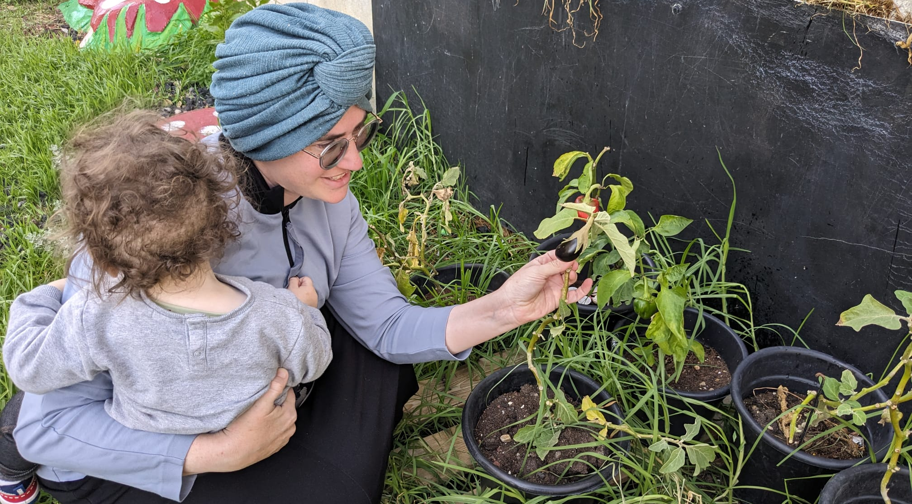
Appendices

Slide 16
Detailing of activities and outputs* in 2023​ and 1st quarter of 2024
Services and Activities for Residents (Routine and in state of Emergency)
Activity | Period | Participants | Partners | Budget (NIS)) | Funding Sources | Cost Effectiveness
שיתוף ציבור ילדות בגן עץ הדעת במסגרת מחזור א' של קורס We Plan | ינואר 2023 | 23 ילדות ו-3 גננות | בצלאל השלוחה החרדית/ עיריית בית שמש | 20,000 | אורבן 95 | 3.85%
זעירא בשכונות פעילויות להורים וילדים ב-12 שכונות ברחבי העיר | פברואר-יוני 2023 | כ-3,500 ילדים ו- 1,100 הורים ב-36 פעילויות | עיריית בית שמש - אגף קהילה/ מפעל הפיס/ אורבן95 | 567,600 | עיריית בית שמש, מפעל הפיס | 0.02%
התנעת פרויקט גינה קהילתית בטיפת חלב קריה חרדית | אפריל 2023 | 16 תושבות הקריה החרדית | משרד הבריאות/ מחלקות בריאות וגיל רך בעיריית בית שמש | 1,000 | אורבן95 | 16.6%
פעילויות הפוגה מתחת לבית שכונות נווה שמיר, ג'1, ד | אוקטובר-דצמבר 2023 | 115 ילדים ו-40 אימהות ב-3 מוקדים | אגף קהילה עיריית בית שמש | 120,000 | תורמים פרטיים | 0.65%
ערכות משחק ומשחקייה לגיל הרך למשפחות מפונות ומשפחות מגוייסים | אוקטובר-דצמבר 2023 | 40 ילדים ו- 25 נשות מגוייסים, 150 ילדים (50 משפחות מפונות מהדרום) | בית ספר חרדי 'נצח ישראל'/ עיריית בית שמש | 700,000 | תורמים פרטיים | 0.38%
יום ניקיון שכונתי ברמת אברהם לאמהות וילדים | נובמבר 2023 | 150 ילדים, 40 אימהות ו-15 אבות | עיריית בית שמש אגפי תפעול קהילה/ אורבן 95 | 5,000 | עיריית בית שמש | 0.49%
אירוע משפחות מגוייסים | נובמבר 2023 | 300 משתתפות | אגף קהילה עיריית בית שמש/ עמותת "ביחד ננצח" / נציגת קהילה – תושבת מתנדבת | 50,000 | תורם פרטי | 0.33%
הרצאה מקוונת בנושא 'חוסן לאמהות ילדי הגיל הרך בעת לחימה' | נובמבר 2023 | 23 אימהות | "בית ספר להורים" - עיריית בית שמש/ אורבן 95 | 1,300 | אורבן95 | 4.35%
פעילויות מתנ"ס נייד ברמה ג'1 | פברואר-מרץ 2024 | כ-150 ילדים ו- 69 אימהות ב-9 מפגשים | מחלקת גיל הרך בעיריית בית שמש | 16,200 | אורבן95 | 0.45%
*לפי נתונים שנמסרו ממנהלת Urban95 בית שמש

Slide 17
Detailing of activities and outputs* in 2023​ and 1st quarter of 2024
In the Municipality
Activity | Period | Participants | Partners | Budget (NIS)) | Funding Sources | Cost Effectiveness
שת"פ אורבן95 וארגון 'בטרם' -מושב בנושא בטיחות ילדים במסגרת מיזם 'קהילה מיטיבה' | אפריל 2023 | 12 אנשי רשות הבטיחות | הג'וינט/ אורבן95/ עיריית בית שמש/ רלב"ד/ קופות חולים מאוחדת, מכבי וכללית | 5,000 | הג'וינט | 8.33%
יום עיון וסיור בירושלים | מאי 2023 | 15 עובדי עירייה | עיריית בית שמש/ אורבן95 | 6,500 | אורבן 95 | 5%
הכשרת 'כשקהילה פוגשת מרחב' | יולי 2023 | 25 עובדי עירייה | צוות מוביל מעיריית בית שמש/ אורבן95 | סיור באשדוד 11,000 | אורבן 95 | 4%
קטלוג אלמנטים לטיפת חלב | ספטמבר 2023 | 5 נשות צוות | פרויקט "בין הטיפות" בצלאל/ אורבן95 | 1,500 | בצלאל | 20%
הכשרות וכנסים עבור גורמי מקצוע:
Activity | Period | Participants | Partners | Budget (NIS)) | Funding Sources | Cost Effectiveness
תוכנית הכשרה למטפלות מחנכות | פברואר-יוני 2023 | 20 משתתפות ב-6 מפגשים | מחלקת גיל רך בעיריית בית שמש/ אורבן95/ 360 התוכנית הלאומית לילדים בסיכון | 1,800 – אורבן95 7,200 – עיריית בית שמש 9,000 – תוכנית 360 |  | 5%
השתלמות תזונה למטפלות מחנכות | יולי 2023 | 30 מטפלות מחנכות | מחלקת גיל רך בעיריית בית שמש/ אורבן95 | 3,500 | עיריית בית שמש | 3.33%
קורס ‘WE PLAN’של השלוחה החרדית בצלאל | מחזור א': אוקטובר 2022 - פברואר 2023 מחזור ב': אוקטובר 2023-מרץ 2024 | 25 סטודנטיות | בצלאל השלוחה החרדית/ עיריית בית שמש | 5,000 ל-2 מחזורים | אורבן 95 ובצלאל | 4%
מפגש שנתי לצוותי מעונות | נובמבר 2023 | כ-400 מטפלות מחנכות | מינהל חינוך בעיריית בית שמש | 40,000 | עיריית בית שמש | 0.25%
כנס 'כוח לגדול' – השקת המחלקה לגיל הרך | פברואר 2024 | 300 מטפלות מחנכות | עיריית בית שמש | 25,000 | עיריית בית שמש | 0.33%
*לפי נתונים שנמסרו ממנהלת Urban95 בית שמש

Slide 18
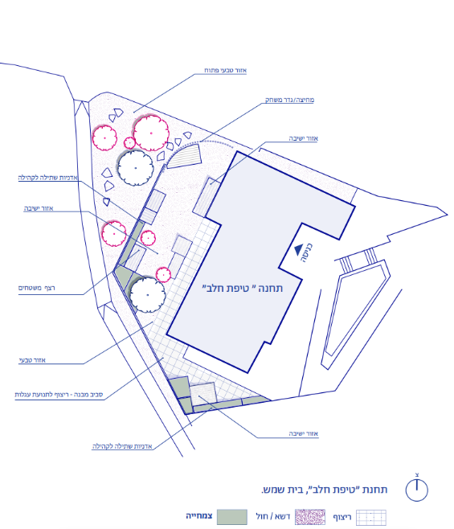

In the framework of the project planning:
A preliminary study mapped residents’ needs. This included a focus group with 8 mothers from the neighborhood and an interview with the leader of the initiative.
A steering committee was established to launch the pilot, with the cooperation of all the relevant municipal units.
A catalog of garden design elements was developed by the Bezalel Between the Drops project team and the Van Leer Foundation in cooperation with the Beit Shemesh municipality and the Ministry of Health.
In the Residents’ Words:
Community Garden in the Courtyard of Tipat Halav in Kirya Haredit
A pilot project to establish a natural community space in the Tipat Halav courtyard was launched in June 2023 at the initiative of a city resident and in cooperation with the Municipality of Beit Shemesh, the Ministry of Health, the 'Between the Drops' project of Bezalel Academy, the Ministry of Health, and the Van Leer Israel Foundation.
Location:
Tipat Halav Margalit in the Kirya Haredit neighborhood of Beit Shemesh.
"My son loves really loves space. For him, being at home is literally a prison. I feel it is a loss for him that I don't live in a village."
Target audiences:
Residents of Kriya Haredit
Mothers of preschool children.
"I want there to be something for me, a nice place to sit, so that I don't have to go down to Ramah Gimmel."
Project goals:
Offer opportunities to make contact with the residents, strengthen their trust in Tipat Halav, and encourage a healthy lifestyle.
To provide a safe and green community space that encourages young children’s developmental skills.
To make the Tipat Halav nurses into agents of knowledge and active figures in the community.
"Things that encourage their motor development, experimenting with materials. They shouldn’t be afraid of the soil and what it grows."
“There should be a place that connects. The ultra-Orthodox community is very diverse and there are not many things that connect everyone in a neutral way."

Slide 19
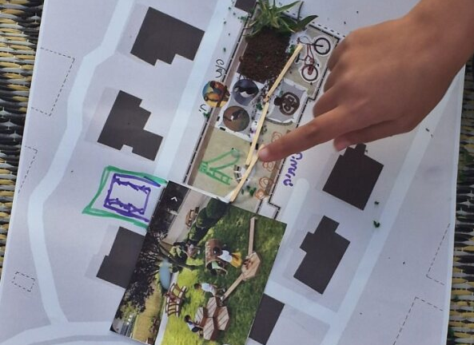
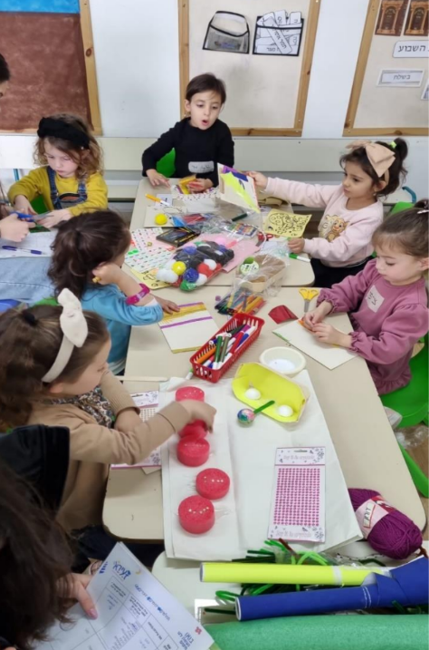
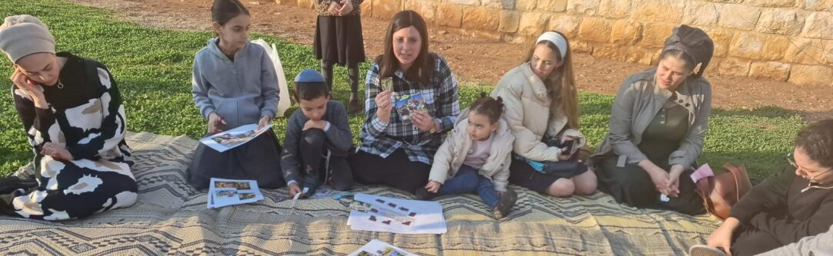

The ‘We Plan’ Course: The Ultra-Orthodox Delegation from Bezalel
A course was offered in the framework of BA studies in architecture that deals with the research and planning for urban spaces adapted to the world and the scale of the children who use them, following the guiding principles of Urban95 and cultural adaptation to ultra-Orthodox society.
Model:
The course combined lectures, practical work, and a concluding exercise. Additionally, during the first cohort, Beit Shemesh hosted a public participation event.
The academic supervisor and the core partners developed the course structure and content, and they facilitated many of the sessions.
Core partners: The Israeli Green Building Council, the Urban95 Israel team, the Gavrieli-Segal architectural firm (which led the process of writing the national planning guidelines for young children), the Olami organization (which specializes in public participatory activities with children), a preschool, and the Beit Shemesh municipality's engineering department.
There were two cohorts:
Cohort 1: 10 female students, November 2022 - February 2023, with public participation of 18 kindergarten girls (January 2023).
Cohort 2: 15 female students, December 2023 - March 2024. Ten of these female students provided feedback after the course.
After the course, it was evident that all participants benefitted by gaining an understanding of the importance of adapting the public space to the needs of early childhood.
The course provided the students with professional knowledge and practical experience in planning an urban space adapted to the needs of early childhood. “The meeting in the planning space in the park - making a map of the children's dreams, how they see the world; it focused my thinking about the users.”
The course instructor reported that the public participation was successful thanks to professional project operation and that the children benefitted from its very existence: " They were the public. It gave them skills and ideas that can be assimilated into their subconscious. They will acquire the habit of walking in a place and thinking, ‘What can be done here better, or what can I imagine for it?“’
The course instructor recognized a change in the way the municipal planning officials think about the public space: “From today, they will think differently about who will use the park, and not just open a catalog and choose a slide and a swing.“
Long-term impact on a culturally adapted planning process: "I see value in a student who remains ultra-Orthodox and will go back to work in the ultra-Orthodox space in a way that she is proud of and that she understands the subtleties of what she is doing." (course instructor)

Slide 20
Ashdod Executive Summary – Key Insights
Cost Effectiveness – Park Renovation that Provides a Response for all District Residents and In-depth Training for Part of the Municipal Staff
Emergency activities and projects to renovate and adapt public spaces to the needs of early childhood responded to hundreds of households, yielded a very high ratio in the calculation of investment/resident - about 0.1%. This included activity kits and public spaces that can continue to be used by the children and their caregivers in the coming years (long-term impact).
Content-based activities and public participation events for residents achieved a high investment/participant ratio of 1.4%-2.9%. These targeted activities contribute short-term to parent-child relationships, develop community ties, and strengthen the sense of trust in the local authority.
Training and lectures for municipal officials yielded a low ratio - 6%-20%. Long-term impact: Participants acquired knowledge and practical tools to develop responses for the needs of early childhood in both routine and emergency situations.
Funding Sources and Partners* – Content Activities for Residents and Training for Municipal Officials Funded by Urban95 and Building Collaborations in the First Year of Activity
The content-based activities for residents, training sessions, and consultations for municipal officials were funded by Urban95. The majority of the budget for implementing the interventions in the public space was provided by the Ashdod Municipality.
From the beginning of the war, initiatives were launched for the well-being of residents with the help of external donations and volunteers.
The direct budgetary investment of Urban95 in Ashdod in 2023 was more than NIS 60,000, alongside leveraging the position of Urban95's municipal manager, who initiated cooperation with the municipal units, out of which these projects grew. (These include the operations and engineering administrations in charge of logistics and technical aspects and units from social-community fields such as educational administrations, social services, and more).
Municipal Involvement and Program Sustainability - Implementing Pilots in the Public Sphere in a Year of Crises and Adapting the Work Plan to Routine and Emergency Situations
In the first year of activity, the program launched pilots that focused on interventions in the public sphere and training municipal officials to assist residents in routine and emergency situations in light of disrupted work routines, local elections, and the war, among other things. In subsequent activity, the program will focus on expanding the existing pilot projects and collaborations, launching new initiatives, and making additional partnerships in accordance with the work plan for 2024 to meet the needs of early childhood in routine and emergency situations. These were adjusted and refined in light of the ongoing emergency situation.

Slide 21
Executive Summary - Urban95 Ashdod Outcomes in 2023 Based on Evaluation Indicators
Municipal Officials and Partners
The Directorate of Urban95 promotes cooperation between various municipal units for the benefit of early childhood: activities for parents and children, together with the manager of the Ashdod community and the director of the Muni100 project, while pooling resources allocated to strengthen the intergenerational bond.
About 15 municipal employees participated in training sessions that provided them with knowledge and tools for integrating the needs of early childhood into their planning and inspired them to implement projects that will improve public spaces and buildings, following the principles of Urban95 (establishment of an early childhood center and a resilience center for the city’s children, who are facing an ongoing emergency situation).
The Ashdod municipality invested approximately NIS 1,000,000 in renovating two playgrounds in their districts and adapting them to the needs of young children and their caregivers. Officials of the Ashdod municipality held peer learning with officials from other anchor cities during a tour of Tel Aviv. They hosted the Beit Shemesh municipal staff in Ashdod.
EC is on the municipal agenda
Municipal officials are knowledgeable and understanding of EC needs
Inter-municipal collaborations, onboarding of external stakeholders
Public space pilots Implementation, providing EC contents and services with municipal investment
Considering EC needs when planning while pooling external resources
Young Children and their Caregivers
Scope of public spaces and EC activities
Use of spaces, services consumption & satisfaction
Sense of security and safety in intervention areas
Trust in the local authority and public participation events
Familiarity with Urban95 and repeated participation
Acquiring knowledge and tools, parental well-being (including dealing stress and anxiety)
Joint caregiver-child play & time spent in public spaces
Community and social belonging
About 100 residents and their children attended two public participation events for the renovation of parks in the selected intervention areas.
The renovation of these parks, which serve approximately 4,700 children between the ages of birth and 6, yielded a high level of general satisfaction and contributed to community development.
The residents reported using the parks more frequently. They said that after the intervention, the renovated areas were safer and more secure for their children.
Since the beginning of the war, about 800 families received emergency kits prepared for the city’s children. These were distributed by about 25 volunteers and municipal employees led by Urban95’s municipal director.
In the first week of the war, over 150 of the city’s children participated in online story-reading sessions led by about 5 volunteer kindergarten teachers.

Slide 22
Detailing of activities and outputs* in 2023​ - Ashdod
Services and Activities for Residents (Routine and in state of Emergency)
Activity | Period | Participants | Partners | Budget (NIS)) | Funding Sources | Cost Effectiveness
שיתוף ציבור ושיפוץ גינת משחק "רמט" ברובע ד' | אוקטובר-דצמבר 2023 | שיתוף ציבור – כ-35 ילדים והורים מבקרי הגינה – כ-1,300 תושבים וילדים בגיל הרך | עיריית אשדוד/ אורבן95 | אורבן95 – 6,000 עיריית אשדוד - 500,000 |  | 2.9% 0.08%
שיתוף ציבור ושיפוץ גינת משחק "שפירא הקטן" ברובע ו' | אוקטובר-דצמבר 2023 | שיתוף ציבור – כ-70 ילדים ואימהות מבקרי הגינה – כ-3,350 תושבים וילדים בגיל הרך | עיריית אשדוד/ אורבן95 | אורבן95 – 20,000 עיריית אשדוד - 500,000 |  | 1.4% 0.03%
4 מפגשי פעילות "סיפורי ספתא" | אוגוסט 2023 | כ-50 ילדים ומלוויהם | אשדודטף/ קהילת מגדלור/ אורבן95 | 10,000 | אורבן95 | 2%
העברת תכנים מקוונים לילדים במלחמה | אוקטובר 2023 | כ-5 גננות מתנדבות הקריאו סיפורים לכ-150 ילדים | אשדודטף/ מחלקת חינוך בעיריית אשדוד/ אורבן95
חמ"ל ערכות חירום לילדי העיר | אוקטובר-נובמבר 2023 | חולקו לכ-800 משפחות, על ידי כ-25 מתנדבים ועובדי עירייה | מינהל רווחה בעיריית אשדוד/ אורבן95 | 37,000 | אורבן95, תרומות | 0.12%
In the Municipality
Activity | Period | Participants | Partners | Budget (NIS)) | Funding Sources | Cost Effectiveness
יום סיור ולמידת עמיתים בת"א | ינואר 2023 | 10 עובדי עירייה | אורבן95/ עיריית אשדוד/ עיריית ת"א | 10,000 | אורבן95 | 10%
הרצאה בנושא "גן המשחקים הטבעי" מאת יפעת גל שפייזמן | ינואר 2023 | 10 עובדי עירייה | אורבן95/ עיריית אשדוד | 1,500 | אורבן95 | 10%
קיום מפגש חשיפה לאשדודטף ואורבן95 והפקת סרטון תדמית לתוכנית באשדוד | פברואר 2023 | 35 עובדי עירייה | עיריית אשדוד/ אשדודטף/ אורבן95 | 8,830 | אורבן95 | 2.9%
2 מפגשי ייעוץ למרכז לגיל הרך על ידי רם אייזנברג | פברואר, יוני 2023 | 15 עובדי עירייה | אורבן95/ עיריית אשדוד | 3,500 | אורבן95 | 6.7%
הרצאה בנושא "מרחבים בטוחים לילדים במצבי חירום" מאת רן כהן אהרונוב | דצמבר 2023 | 5 עובדות עירייה | אורבן95/ עיריית אשדוד | 1,750 | אורבן95 | 20%
*לפי נתונים שנמסרו ממנהלת Urban95 אשדוד

Slide 23
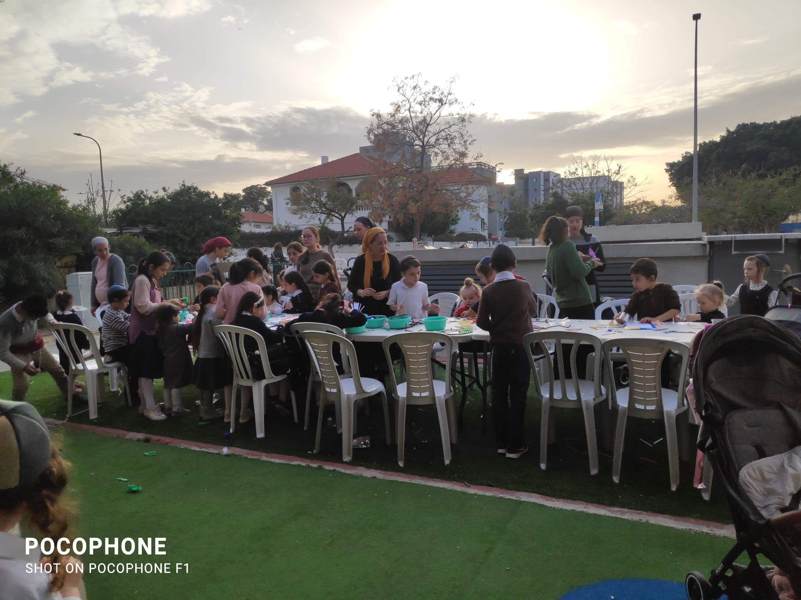
Summary of Evaluation Findings​ Based on
Short- and Long-Term Outcome indictors (Impact)

Slide 24
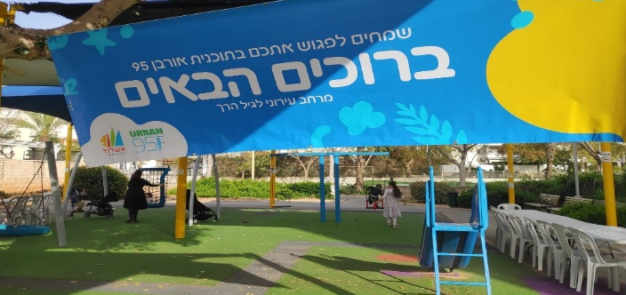
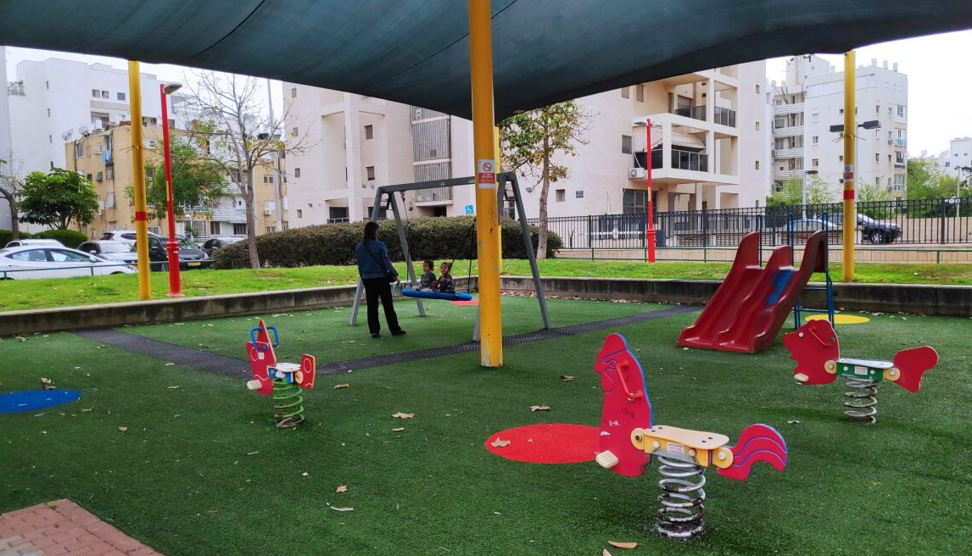
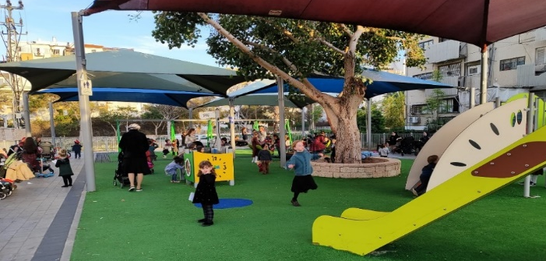
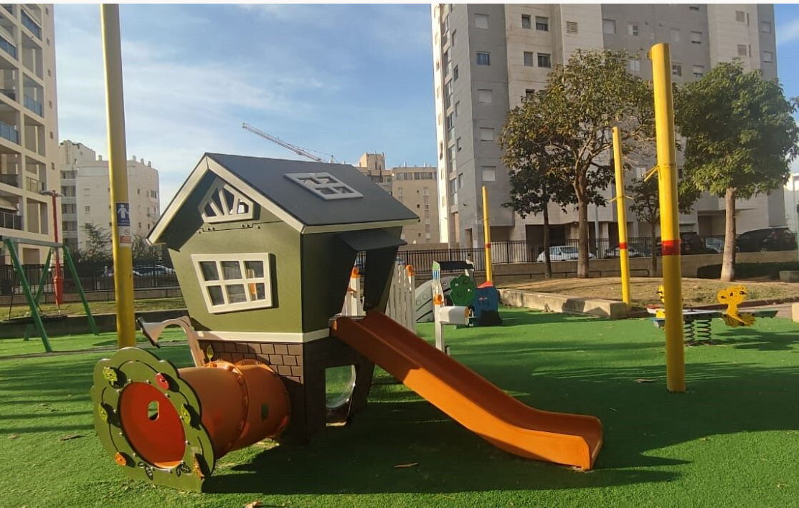
Little Shapira Park in District 6
Ramat Park in District 4
Public Participation and Renovation of the Ramat and Little Shapira Parks
Before the intervention
Before the intervention
Two playgrounds in the focus area were identified as opportunities during the district mapping and were renovated in a way that responded to residents’ needs that emerged in public participation events for parents and children in the parks.
Locations:
Ramat Park in District 4
The Little Shapira Park in District 6
After the intervention
After the intervention
Goals of the public participation events (March/April 2023):
To promote dialogue between the residents and the municipality and allow parents and children to express their desires regarding the renovation of the parks.
Renovation of the playgrounds (October – December 2023):
Park renovations were carried out by the Ashdod municipality.
"In the past, we didn’t come here. There was hardly anything to do. Today, there are options for play, and it attracts more children to meet.“
"A huge change. It seems to be in line with the choices of the people of the neighborhood. The number of benches in the park has changed a lot."
"The park is very suitable for her age. I am not afraid when she climbs on the equipment, because it is appropriate for her."
Measurement and evaluation (March/April 2023 – March 2024):
After the intervention was completed, observations were conducted in the parks, during which field interviews with mothers (N=13) found a high level of general satisfaction with the park renovations. “The results are good. The park is more colorful and lively and it keeps the children busy.”

Slide 25
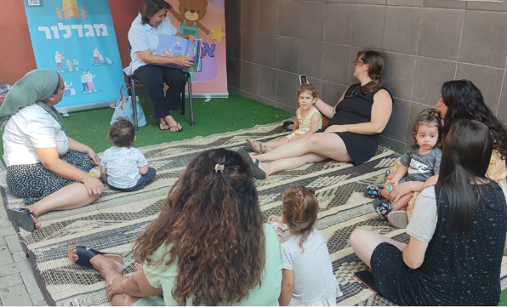
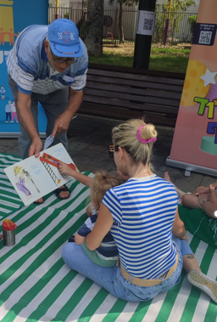
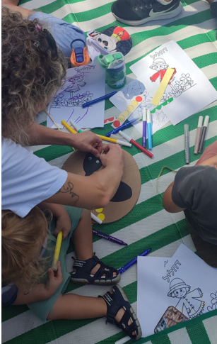
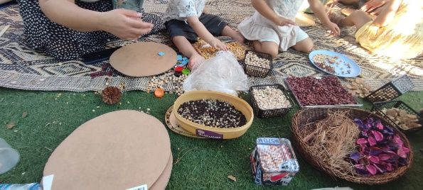
Tana Community Center, District 5
Re’im Park, District 4
Pilot: Grandmothers’ Stories
In August 2023, four story-reading and creative activities for preschool children were offered by residents of the third age and a professional creative arts instructor.
Location of the observations:
Re’im Park in District 4
Tana Community Center in District 5
Activity Goals:
An intergenerational meeting between residents of the third age and preschool age; strengthening language literacy; strengthening the parent-child bond; and developing fine motor skills and creativity.
Measurement and evaluation:
Observations of two activities were conducted. These included interviews with participating parents, senior citizens who read the stories, and activity leaders. Feedback (n=9) was given to evaluate the activity experience. The participants (parents and their children) expressed a high level of satisfaction with the sessions.
The activity offered the children sensory exploration and encouraged the development of their fine motor skills, creativity, and imagination.
The activities enabled positive interactions between the children and the activity chaperones who mediated the story for the young children and worked with them on the creative projects.
According to the feedback, the participating parents gained new ideas for joint play with their children.
The activities developed community interactions. The parents talked and consulted each other about parenting issues. The children played with each other and competed in coloring and pasting.
"The story was excellent. There was a lot of cooperation. My daughter listened and enjoyed it.”
“A very nice and engaging story, good for my grandchildren."
“The reading was done with patience and a smile by a charming grandfather who spoke the children's language."
"The creative activity was good, age-appropriate. There was community involvement.”

Slide 26

Tours and Trainings
Lecture to the Municipal Staff: Safe Spaces for Children in Emergency Situations
5 members of the municipal team attended the lecture, 4 provided feedback:
All respondents expressed a very high degree of satisfaction with the lecture format.
The main contribution of the lecture was deepening team members’ knowledge about the needs of young children and their caregivers and motivating them to implement new ideas in the spirit of the Urban95 plan.
Some participants said the lecture opened opportunities for them to work in partnership with new entities. Most stated that they intend to share the knowledge they acquired in the lecture with their colleagues.
All participants stated that the lecture provided them with new knowledge that is relevant to their work to a very great extent. Most of them said that the lecture provided them with practices and practical tools that they could use in their work in the near future.
After the lecture, the municipal team members began the process of establishing a resilience center for the city's children.
As part of the Urban95 activity in Ashdod in 2023, the municipal team participated in conferences and trainings* to deepen their knowledge and understanding about the needs of early childhood and to benefit the promotion of projects and pilots in Ashdod.
Measurement and evaluation:
Study tour of Tel Aviv-Yafo** (N=9) - Jan. 15, 2023
Lecture on The Natural Playground** by Yifat Gal Speizman, landscape architect (N=7) - Jan. 22, 2023
Lecture on Safe Spaces for Children in Emergency Situations by Ran Cohen Aharonov, CEO and co-founder of Early Starters International (N=4) - July 12, 2023
"What new practices and/or practical tools did you get in the training?"
"The possibility of business entities helping to realize a public vision."
“We are constantly busy with doing, so a time-out for listening and thinking was right on time. "
*Details about the tours and training can be found in the overview on operations and outputs in Ashdod.
**The evaluation findings from these trainings were reported in the Ashdod baseline report.
Notes:
Reinforcement and a pat on the back. Realizing the importance of working with a very, very young age is most decisive for the child’s future and a positive future for all of us.
It was good to meet friends and caregivers. The feedback from the mayor and the head of the education administration was important.

