Slide 1
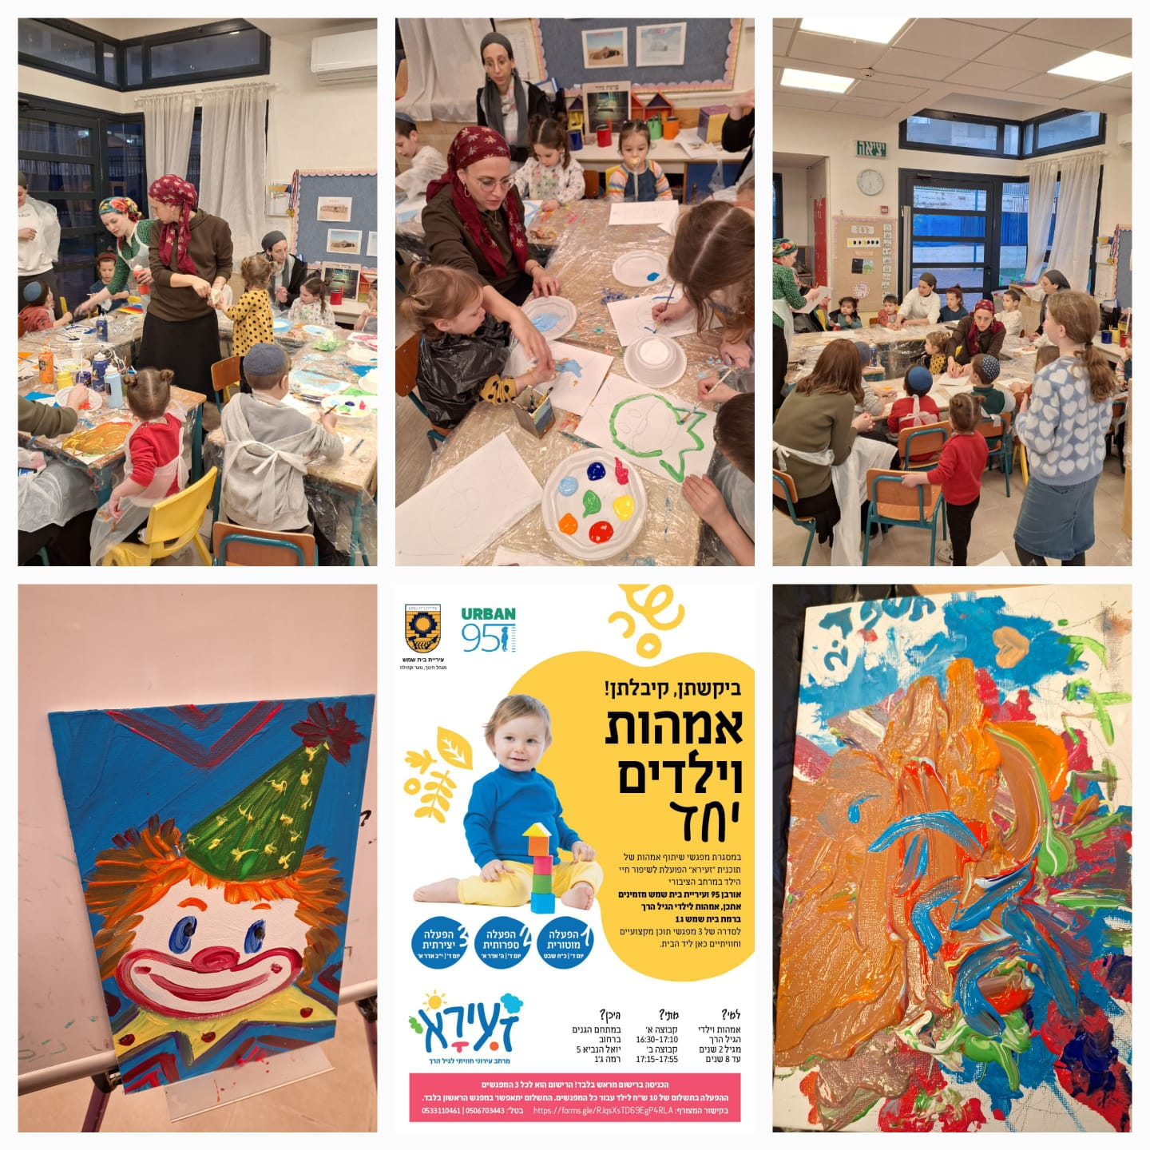
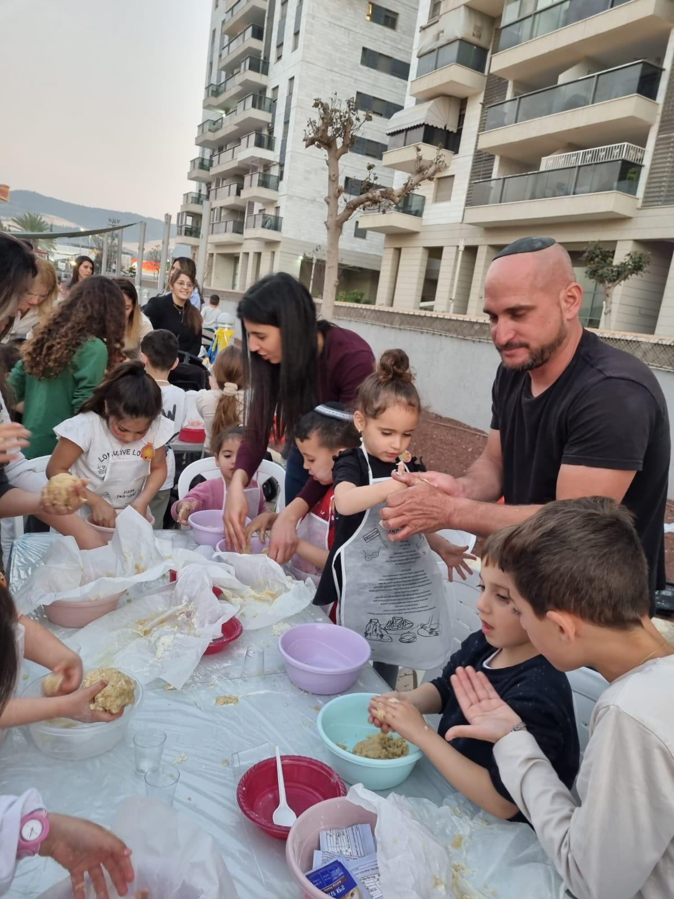




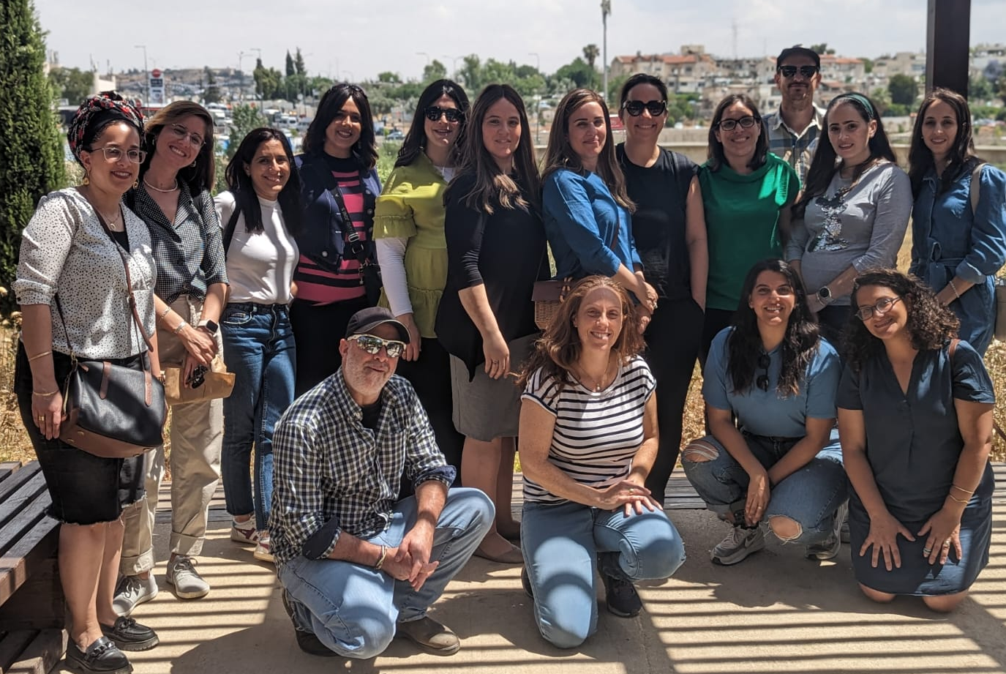
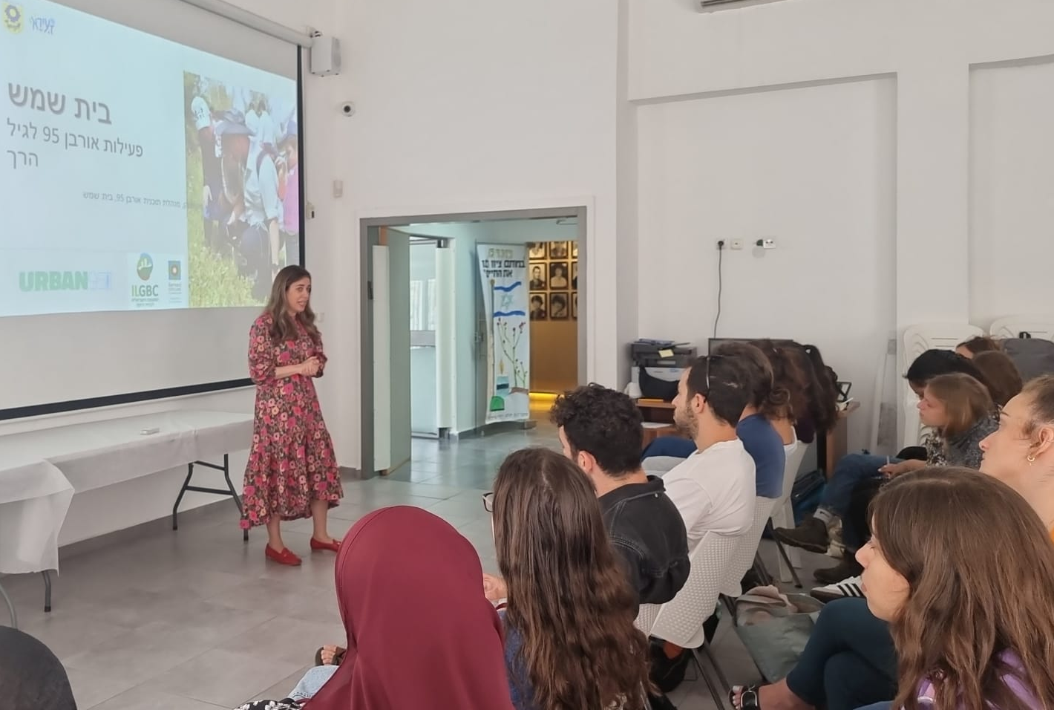
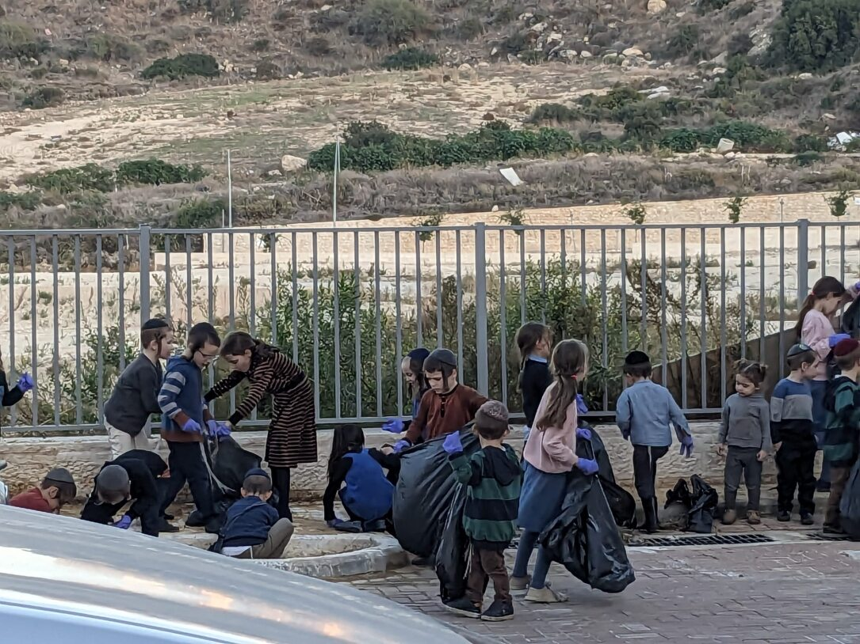
2023 Summative Evaluation Report
Urban95 Beit Shemesh
August 2024

Slide 2
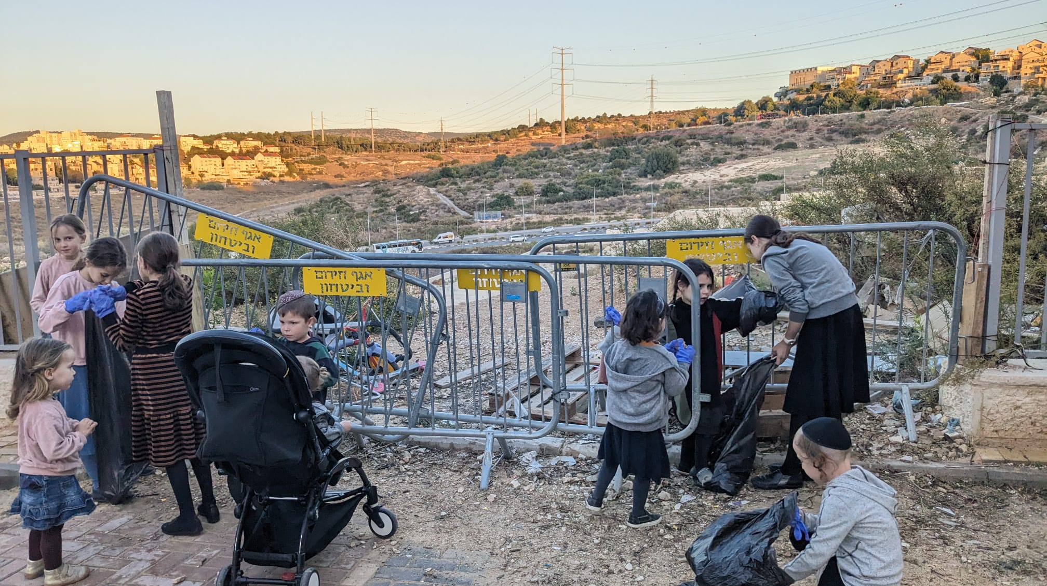
Table of Contents
10-14
03-04
Summary of Evaluation Findings​ Based on
Short- and Long-Term Outcome indictors (Impact)
Executive Summary – Key Insights and
Urban95 Beit Shemesh Outcomes in 2023 Based on Evaluation Indicators
11-12 Municipal officials, partners and professional workforce
13-14 Young children and their caregivers​
05
Research Work Plan –
Evaluation actions in 2023 and first quarter of 2024
15-19
Appendixes
16-17 Detailed Activities and Outputs of Urban95 Beit Shemesh in 2023
06-09
18 פירוט ממצאי מיזם גינה קהילתית: טיפת חלב קריה חרדית
Overview of the Main Projects Measured and Evaluated in 2023
19 פירוט ממצאי קורס ‘We plan’ בצלאל - השלוחה החרדית
07 "הכשרת גורמי עירייה - כשקהילה פוגשת מרחב"
08 תוצרי סדנת 'רשות פוגשת קהילה’
09 הכשרות והשתלמויות למטפלות מחנכות
2

Slide 3
Executive Summary – Key Insights
Cost Effectiveness* - The program maintained a balance between involving a large number of participants and preserving the principles of Urban95 ‘Zaira'
Content-based activities for residents and conferences for professionals were attended by hundreds of caregivers-educators and by dozens or even hundreds of parents and their children. The calculation of the investment/participant ratio yielded a very high ratio score of less than 1%. Following the principles of the Urban95 ‘Zaira’ project the number of participants in each activity for parents and children was limited to ensure that the experience would promote the children’s development and strengthen the parent-child bond.
Activities for residents and training sessions for professionals and municipal officials each had between 15-30 participants, so the investment/participant ratio was moderate (3%-5%). The intimate group size allowed participants to deepen their knowledge about early childhood and acquire new tools, ideas, and work practices (long-term impact).
Launching projects to improve and adapt public spaces to the needs of early childhood yielded a low investment/participant ratio (8%-20%). The focus on in-depth processes made it possible to learn about the needs of residents and their young children, which was beneficial for subsequently targeting and culturally adapting the responses (long-term impact).
Funding Sources and Partners* - In 2023, the local authority took responsibility for the field of early childhood, including the financing of activities for all the target audiences
The vast majority of the budgeting for all activities for the various audiences (residents, professional field teams, municipal officials) conducted during 2023 and the first quarter of 2024 was based on municipal funding and external resource pooling (the Joint, the Israel National Lottery, and the inter-ministerial program 360), along with donations from private parties who funded emergency responders for residents. Urban95’s direct budgetary investment in Beit Shemesh in 2023 and the first quarter of 2024 was approximately NIS 60,000, in addition to leveraging the position of the Urban95 municipal manager.
Municipal Involvement and Program Sustainability - Full assimilation of the program principles in the official work is evident, as is the desire and ability to expand the field of early childhood
The program offered many successful activities in 2023, primarily professional training for municipal officials, high-quality content-based activities for parents and their children, and conferences and training for kindergarten staff. The extensive work in all activity channels can be attributed to the many and varied collaborations forged by the municipal administration of Urban95 in Beit Shemesh with various business, academic, and professional entities in the municipality that expressed a high degree of involvement.
* Details pertaining to the partners, funding sources, and cost-effectiveness scores, as well as description of municipal involvement in the projects, are provided in the appendices.

Slide 4
Executive Summary - Urban95 Beit Shemesh Outcomes in 2023 Based on Evaluation Indicators
Municipal Officials and Partners
The municipal manager of Urban95 promoted initiatives and collaborations between various municipal units and external partners for the benefit of early childhood. The manager is a regular participant in the committee on early childhood and leads a mentoring process for the incoming director of the early childhood department.
Content-based activities for parents and young children and enrichment and training sessions for municipal officials and professional teams took place, fully funded by the municipality and with the mayor’s involvement. Additional private donations were raised to finance respite and resilience activities for residents in times of emergency.
Planning interventions in the public space and developing responses to residents’ needs were done after public participation processes. Different trends among the ultra-orthodox public, the children’s ages, and the conditions of the physical infrastructure were taken into account.
Forty municipal employees participated in professional trainings and tours, during which they acquired knowledge and tools to promote the needs of early childhood. They were exposed to and adopted new work mechanisms. Intra-city collaborations and partnerships with other entities promoted projects for the benefit of early childhood.
  EC is on the municipal agenda
Municipal officials are knowledgeable and understanding of EC needs
Use of new work mechanisms and public participation practices
Inter-municipal collaborations, onboarding of external stakeholders
Providing EC contents and services with municipal investment
Professional Field Workforce
Participation in training to acquire knowledge and practical tools
Applying lessons learned at work with young children, including independent initiatives
Peer learning, collaboration within a professional inter-city community
About 750 caregivers-educators participated in professional conferences and training, which provided them with knowledge and practical tools for working with young children.
Most participants gained professional knowledge, ideas, and applied practices for their work with young children.
The participants reported that they made professional and interpersonal relationships. They expressed a desire to participate in future events, lectures, and training days.
About 145 students were exposed to the activities of the Urban95 program in Beit Shemesh as part of their studies.
Young Children and Their Caregivers
The scope of activities for young children and their caregivers, adapted to the different sectors in the city
Use of spaces, services consumption & satisfaction
Sense of security and safety in intervention areas
Trust in the local authority
Familiarity with Urban95 and repeated participation
Acquiring knowledge and tools, parental well-being
Joint caregiver-child play & time spent in public spaces
Community and social belonging
About 3,800 children and 1,200 parents (mostly mothers) participated in content-based parent-caregiver activities (adhering to the Zaira principles). About 890 residents (parents and their children) participated in respite and resilience activities during the "Swords of Iron" war.
For more than half of the participants, this was their first 'Zaira' activity. They said they were interested in more activities.
It was evident there was a high level of satisfaction with the activity format (mainly small groups), quality of the content and activity materials, organization and professionalism of the staff, and conditions of the physical space.
The activities took place close to residents’ homes and responded to the needs raised in the public participation processes. This increased residents' sense of trust in the municipal authority.
The activities improved parent-child interaction, contact, and joint play and developed children’s motor, emotional, and social skills.
The participants gained knowledge and tools to promote child development and address parenting challenges, ideas for joint play, strengthening parental well-being, and they got to know other parents in the city.
4

Slide 5
Research Work Plan – Evaluation actions in 2023
Research Period is February 2023- March 2024
 | הכשרת 'כשקהילה פוגשת מרחב' | קורסWe Plan -בצלאל השלוחה החרדית | גינה קהילתית בטיפת חלב קריה חרדית | הכשרת מטפלות – כנסים | מתנ"ס נייד ג'1 – תוצר סדנת 'רשות פוגשת קהילה' | פעילויות 'זעירא בשכונות' | הרצאת 'הורות מיטיבה בזמן מלחמה' | סיור צוות אורבן95 עירוני לירושלים
Interviews |  | ראיון עם מרצת הקורס | ראיון עם מובילת הקבוצה
Focus Groups | N=9 |  | N=8 תושבות השכונה
Surveys | N=14 | N=10 מחזור ב' |  | N=25 'תזונה נכונה' 59= N'כוח לגדול' | N=22 | N=28 | N=19 | N=10
Formative Evaluation, Strategic Consulting and Capacity Building | ניתוח מסמכים וחומרים מהתוכנית | ניתוח תוצרים מהתוכנית | Formative evaluation and strategic consulting: providing raw data from evaluation actions for immediate implementation recommendations Capacity building: guiding of Urban95 Beit Shemesh municipal manager in surveys’ data analysis and deriving insights and accompanying in independent development of questionaries

Slide 6
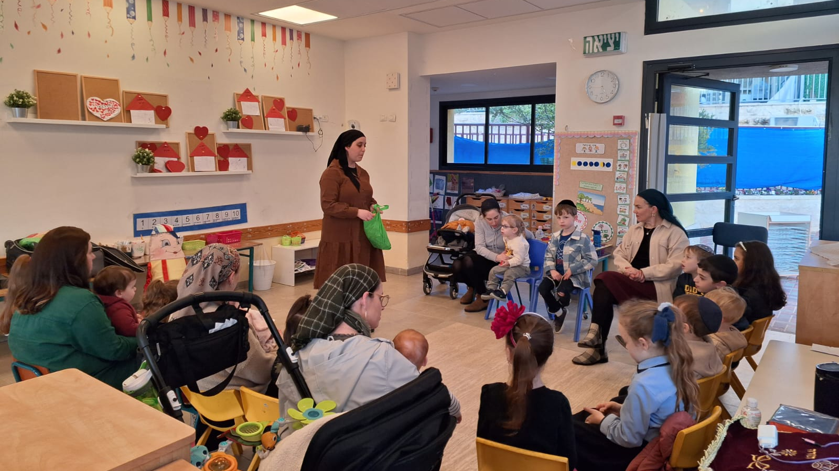
Overview of the Main Projects Measured and Evaluated in 2023

Slide 7



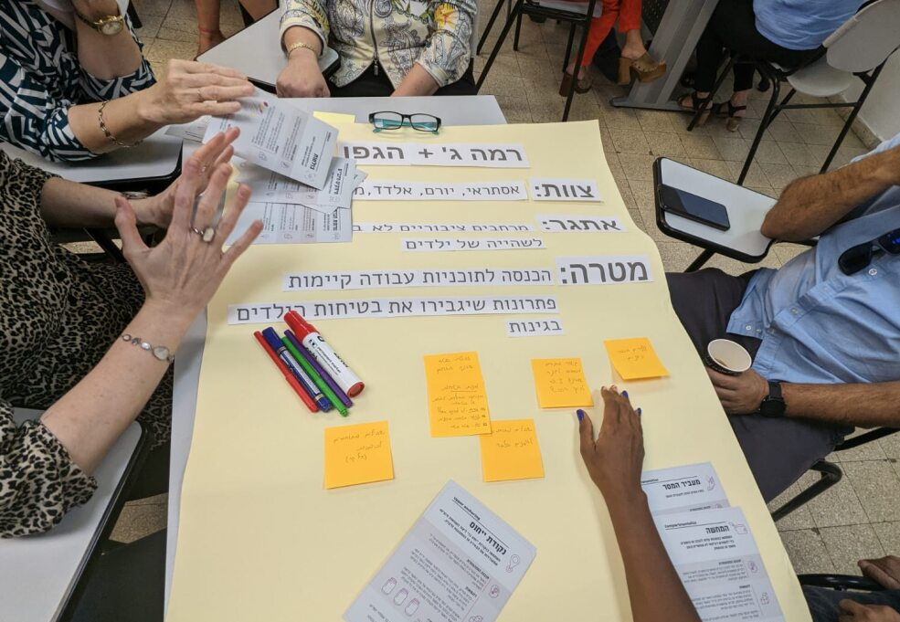
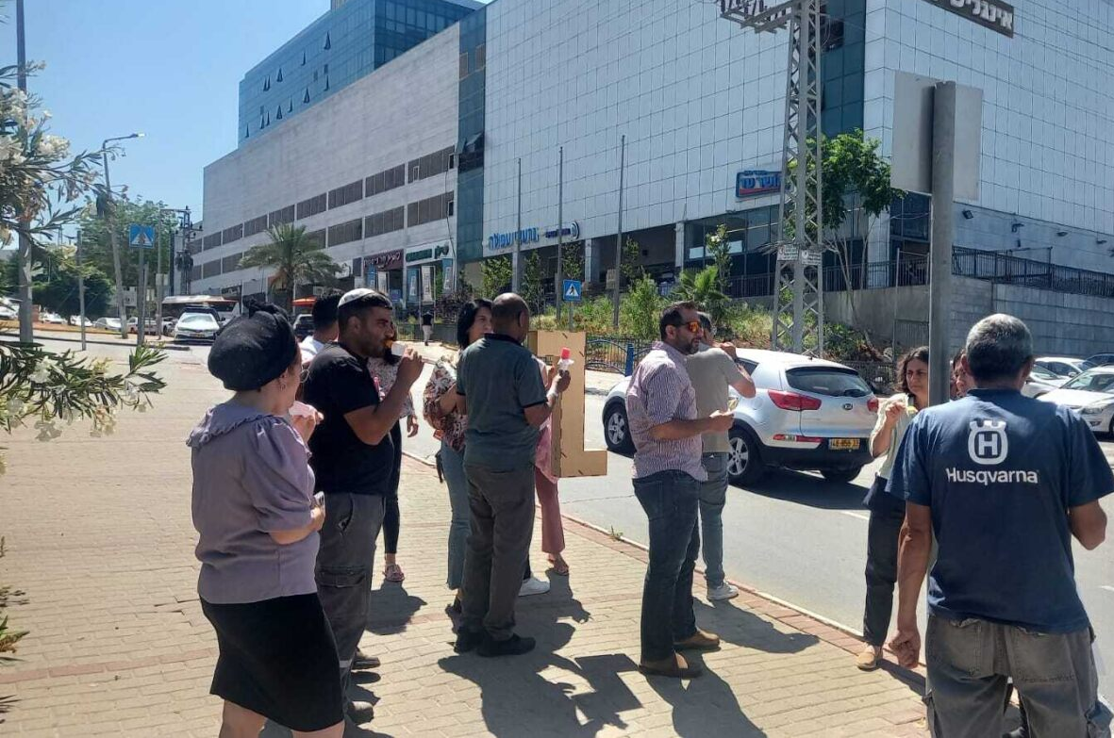
The training was successful due to:
Enlisting the support of the mayor and city officials.
The instruction team: the training instructors hold roles in the municipality (as opposed to being from an external entity).
Timing and content of the training: meetings were held during working hours and addressed daily work challenges.
The program structure: combines imparting knowledge and tools, field learning, public participation, and developing responses.
All of these contributed to participants’ commitment and involvement
Participants benefitted beyond their expectations
They acquired knowledge about the needs of young children and tools for assessing the public space and changed their perceptions of public space in terms of its logistical and developmental aspects (i.e., encouraging joint play and strengthening the parent-child bond).
They acquired new work practices and tools for enlisting and recruiting functionaries.
They strengthened connections and created partnerships between entities. They improved their understanding of their role and their ability to bring about change.
Training municipal officials: "When the community encounters the space"
Municipal inter-departmental training created connections between operations personnel and the community. The training included professional lectures held during working hours, field tours, practical experience, and launching pilot projects.
The “Local Authority Meets the Community" workshop
Municipal workers got their first experience with a behavioral change process in this workshop
Tour to Jerusalem for 15 municipal officials from the fields of engineering, planning, community, and welfare
October 2022-March 2023
"I wasn’t’ familiar with Urban95 and its language of 'looking at the steps of a ladder in the playground’, and suddenly I realized that the child is not climbing because the steps are too big.“
"Before, we only thought about lighting, benches, trash bins. Now we think about interaction between parents and children and how it is possible to do more activities in the space.“
"I learned about breaking down barriers, enlisting and recruiting people to deeply understand our plans and why we do what we choose to do."
May 2023
"We got a real gift! Every employee in the municipality should go through this course, it should be made a permanent model."."
"Every time, I left feeling that I had received a practical tool to apply at work immediately.”
"The planning stage has changed a lot. There is cooperation from the first moment, we sit with the space and plan it together."
"The course contributed to a deeper understanding of what everyone's role is. A lot of shortcuts were created, and this gives us more time to work."
June-August 2023
April 2023
Targeted training for 25 municipal field officials
7-session workshop on the development and leadership for members of the delegation to INSEAD
Behavioral Change Course (INSEAD)
Delegates from Urban95 Beit Shemesh who completed the Local Authority Meets the Community workshop, participated in the ABC4ECD course sponsored by the Van Leer Foundation

Slide 8
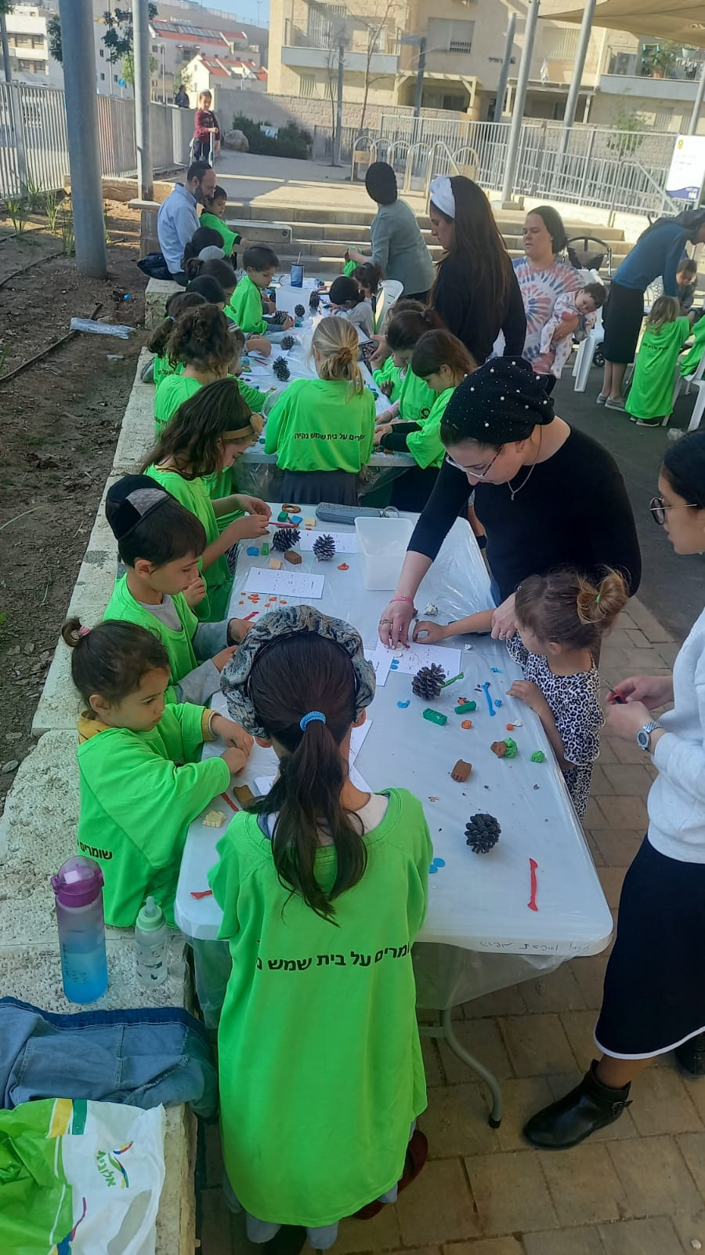
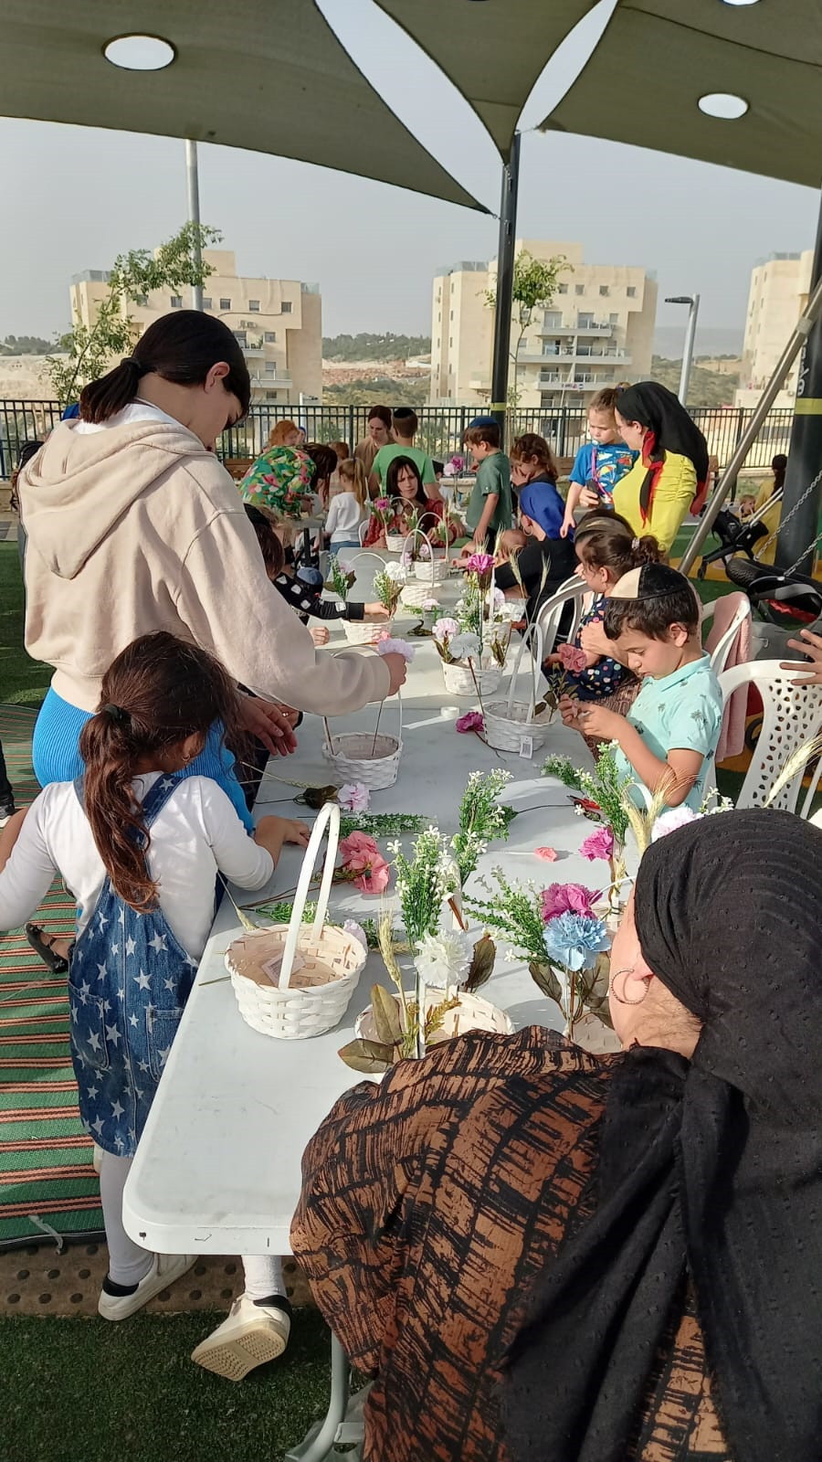
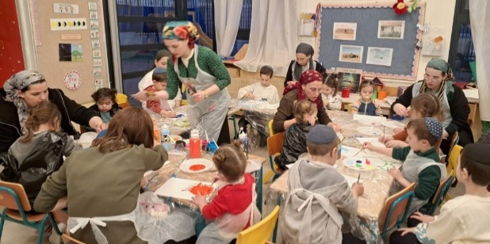
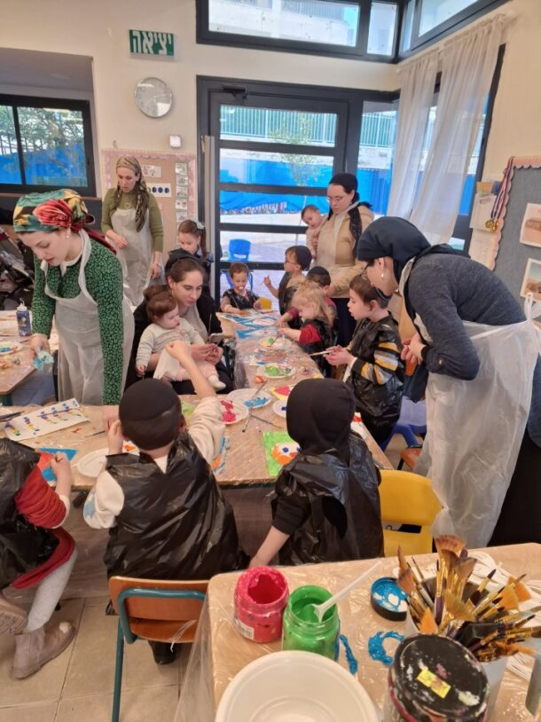

Zaira in the Neighborhood
The Mobile Community Center in Ramat Beit Shemesh Gimmel-1
Results of the ‘Local Authority Meets the Community' workshop
Most of the children who participated in the activity were at least three years old (multi-age)
Most of the children participating in the activity were between the ages of 2-8 and were accompanied by a parent who brought only 1-2 children.
Content-based activities for parents and their children were created and refined following a public participation process conducted during the ‘Local Authority Meets the Community' workshop for municipal officials.
Location:
The mobile community center operates during the afternoon hours in kindergartens in the gimmel-1 neighborhood.
Zaira activities took place in 12 different centers throughout Beit Shemesh.
Goal of the activities:
To make guided content-based activities accessible close to residents’ homes. Activities will be adapted to develop early childhood skills, will encourage beneficial parent-child interaction, and provide tools and ideas to parents.
The activities created positive and high-quality interactions between parents and their children close to their homes.
Model:
The mobile community center initiative includes a series of three activities (movement, language, and creative arts) in the kindergarten complex, as a response to the lack of a community center in the gimmel-1 neighborhood.
Zaira activities throughout Beit Shemesh: the activities adhere to Urban95 principles (close to home, pre-registration, limited number of participants, participants pay symbolic commitment fees). The activity format was adopted by the Beit Shemesh municipality and expanded to all city neighborhoods in 2023, funded by the Lottery.
There was a high level of satisfaction with the activity space and the professionalism of the instructors. The activities developed the children's skills and the parent-child relationship, providing ideas for joint play.
"The activity was high quality, in terms of both content and materials“
"The product beautified the holiday table and gave the child a sense of success and pride .“
"It was really fun, especially because it wasn’t overly full and crowded.“
"It was fun that there was room for everyone, good and clear guidance, personal attention, and quality materials“
"Painting with gouache, me and the kids, that’s something we don't do at home and it's very relaxing and liberating"
Measurement and evaluation:
28 feedback responses from 'Zaira' activities in the neighborhoods for Shavuot (June 2023).
22 feedback responses to a series of three activities (February-March 2024).

Slide 9


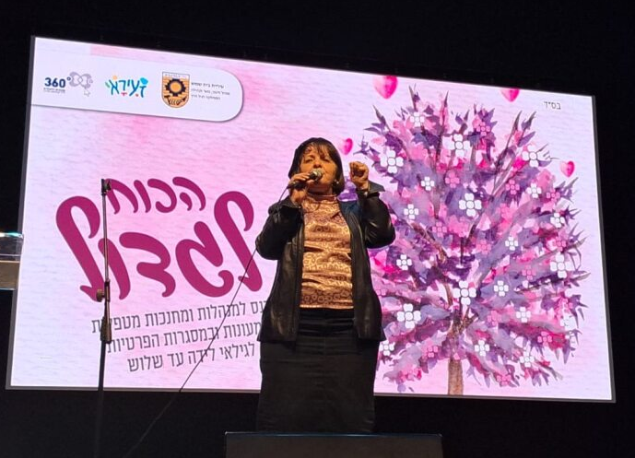
There was a high level of satisfaction and a sense that the meetings significantly deepened the target audience’s professional knowledge and provided tools and ideas for activities with young children.
Power to Grow conference:
About half had not participated in previous enrichment sessions.
High level of satisfaction with the format of the Power to Grow conference, especially the lecture on empowerment and the talks by people holding various positions in the municipality.
85% are interested in annual enrichment sessions.
Nutrition training course:
Over 90% were satisfied with the organization, the presenters, and the content.
80% received new information, tools, and applied practices for their work.
40% benefitted from the opportunity to learn with their colleagues.
Training conferences and professional enrichment sessions
Urban95 activity in Beit Shemesh in 2023 included conferences and professional training and professional enrichment sessions designed for the city’s staff of caregivers-educators. The municipality’s investment in training education teams has become permanent.
Target audience:
Managers and educators-caregivers in subsidized daycare centers and private settings for ages birth to three.
Content and purpose of the training:
In July 2023, a training course on nutrition provided practical tools for creating a proper eating environment for young children.
In February 2024, the Power to Grow conference was held to inaugurate the early childhood department under the auspices of the mayor.
All conferences and training courses for caregivers-educators were fully funded by the municipality.
"The conference provided me with new recipes and ideas that are quick and easy to prepare and healthy for both me and the children“ Nutrition training course participant
"The information about children's needs and realizing how many children there are in the city made me think differently about the world around me in Beit Shemesh.“ Power to Grow conference participant
Measurement and evaluation:
25 feedback responses to the nutrition training course.
59 feedback responses to the Power to Grow conference.
Notes:
Reinforcement and a pat on the back. Realizing the importance of working with a very, very young age is most decisive for the child’s future and a positive future for all of us. It was good to meet friends and caregivers. The feedback from the mayor and the head of the education administration was important.

Slide 10
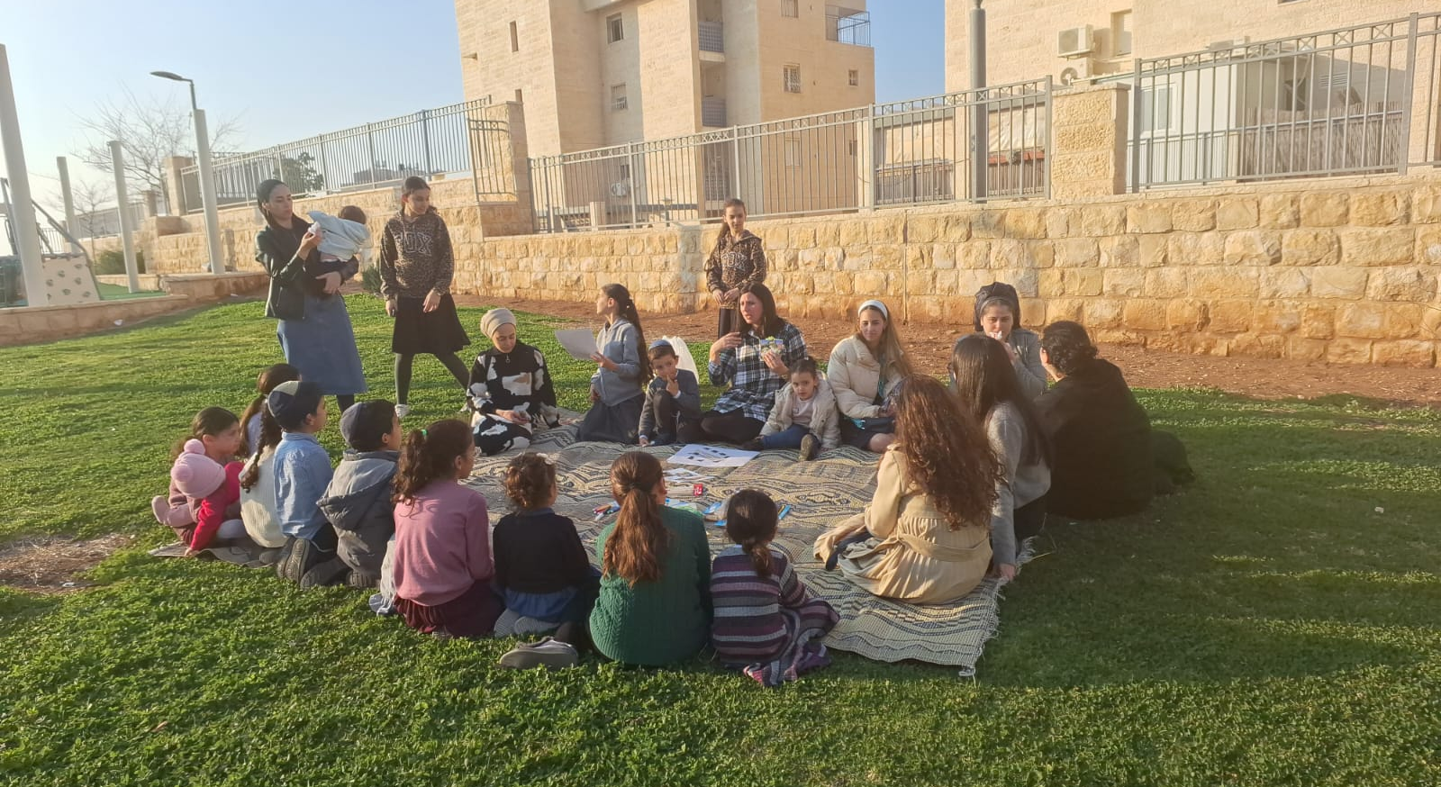
Summary of Evaluation Findings​ Based on
Short- and Long-Term Outcome indictors (Impact)

Slide 11



Trainings and Tours for Municipal Officials: 'When the Community Meets the Space' and a Tour to Jerusalem
25 municipal employees from the urban renewal and community departments participated in the training on behalf of the municipal staff, with the approval of the mayor and the municipal administration. The participants benefitted in many ways:
Acquiring knowledge and tools for evaluating the public space for adaptation to the needs of early childhood. "We went out into the field, and suddenly I realized that when making an opening for a garbage bin, it should be lower.“
Experience with public participation and developing responses for young children and their caregivers. "I realized that there is room for improvements such as encouraging interaction between parents and children and getting children to play in the space.“
Interdepartmental collaborations at the intermediate and field levels and implementation of new work mechanisms. "I chose the topic of collaborations and professional connections. In the process we went through, many issues in the field were resolved. It greatly enhanced our position and work and especially gave us a lot of motivation. This project allows us to think big.”
15 municipal employees participated in a tour to Jerusalem. They acquired professional knowledge about early childhood needs, tools, and work practices (“creative thinking outside the box, using connections and collaborations, focusing on the possible”). They were inspired and motivated to implement ideas (“It was an inspiring learning day that opened the mind to new ideas”). They expanded their interfaces at work and learned from colleagues (met colleagues in other local authorities and learned from them, developed inter-departmental work interfaces in the municipality, and built relationships that promote work processes). Most said they intend to use the reference materials they received and share what they learned with their colleagues.
Municipal Officials & Partnerships
EC is on the municipal agenda
Municipal officials are knowledgeable and understanding of EC needs
Training and Professional Enrichment for Educators-Caregivers
A training program for caregivers-educators was jointly funded by the early childhood department of the Beit Shemesh municipality and the 360 ​​National Program for Children and Youth at Risk
The annual meeting for daycare staff was cooperatively produced by the Ministry of Education and the Beit Shemesh municipality (Education Administration, Early Childhood Department, and Urban95), with municipal funding.
The Power to Grow conference and nutrition training for caregivers-educators were produced by the Beit Shemesh municipality, under the auspices of the mayor, and with municipal funding.
Inter-municipal collaborations, onboarding of external stakeholders
Community Garden at the Tiptat Halav Family Care Center in Kiriya Haradit*
The steering committee of this pilot project included various municipal departments (health, public inquiries, community, early childhood) and external partners (Ministry of Health, Bezalel Academy’s “Between the Drops“ project).
The “Between the Drops” team prepared an architectural plan to improve the intervention space with a catalog of designated elements for the design of the courtyard of the Tiptal Halav family center in Kirya Haradit.
The preliminary research included a public meeting to map residents’ needs and adapt the response and its contents to the needs of young children and their caregivers.
Providing EC contents and services with municipal investment
Outcomes of the Local Authority Meets the Community’ Workshop, the Mobile Community Center, and Zaira Zeighborhood Activities
Development of content-based activities for young children and their parents, with full municipal funding. Activities were adapted to the needs of the various sectors in the ultra-orthodox public, as identified in a public participation process as part of a workshop for municipal officials.
Operations and Outputs
The municipal director of Urban95 is leading a mentoring process for the incoming director of the new early education department, established in 2023 under the municipality's education department.
The municipal manager of Urban95 is a regular member of the early childhood committee of the national program 360 for Children and Youth at Risk, alongside representatives of the welfare, community, health, education and other departments.
A session on child safety was cooperatively sponsored by the Beit Shemesh municipal units, the Joint's Benevolent Community project, Urban95, the Beterem organization, the National Road Safety Authority, and the health insurance funds.
A cleanup activity in Ramat Avraham was led by the operations department, which held a preliminary residents' meeting to coordinate expectations between the community and the municipality.
Private donors were recruited (enlisting partners and pooling external resources) to finance respite and resilience activities for parents and children in an emergency, which were led by the community department in the municipality.
Use of new work mechanisms and public participation practices
* Details about the project and evaluation findings can be found in the appendices section.

Slide 12


The 'We Plan’ Course: The Ultra-Orthodox delegation from Betzalel
25 female students attended, in two cohorts (cohort 1: October 2022–February 2023, cohort 2: October 2023–March 2024).
According to feedback from the second cohort (n=10), they all acquired new professional knowledge and benefitted to a very large extent from the experiences of conducting mapping observations and public participation events. “There was a balance between students' work and outside lectures, between quality architectural activity and budgetary applicability. They got a sense of closing a circle, not doing an exercise that remains in the realm of research.“
The course created a professional community between the partners, which contributed to its success: "If I had to do it alone, I wouldn't have achieved the results we achieved together."
Professional workforce
Training and Further Training for Caregivers-Educators
20 caregivers-educators participated in six training sessions (February–June 2023) by Urban95, the municipal early childhood department, and the national 360 ​​program.
About 400 caregivers-educators attended an annual meeting (November 2023) to meet the supervisors for Ministry of Education daycare centers and Urban95 activities in Beit Shemesh.
30 caregivers-educators participated in nutrition training (July 2023). They said it deepened their knowledge about the nutritional needs of young children and inspired them with new recipes and practices to implement in their work. ("I learned how to turn mealtime into an experience by serving interesting food, not forcing, and bringing about sensitive eating."). The training strengthened professional and personal ties between the participants (“The meeting with kindergarten teachers contributed a lot. They all learn from each other"). The majority are interested in additional training sessions.
About 300 caregivers-educators participated in the Power to Grow conference, held to inaugurate the early education department in the Beit Shemesh municipality (February 2024).
According to feedback from the conference (n=59), the participants acquired professional knowledge and new ideas for activities. "I realized how important it is to invest in young children. It will determine their future.“
The conference was an opportunity for colleagues to learn and to dedicate time for themselves. "It was good to meet friends and caregivers. I created professional and social connections... and recognition for caregivers.“
There is a clear desire to continue; about half participated for the first time in the enrichment activity. The majority are interested in annual events, and about a third prefer one-time meetings.
Participation in training for acquiring knowledge and practical tools
Applying lessons learned at work with young children, including independent initiatives
Community Garden: Tipat Halav in Kiryat Haradit*
The pilot project seeks to establish an informal, inviting space adapted for young children, which will be used for professional training and community meetings. It will strengthen the relationship between residents and Tipat Halav, and position Tipat Halav nurses as knowledge agents for mothers and their children.
Peer learning, collaboration within a professional inter-city community
Operations and Outputs
About 200 official planners attended the launch of national guidelines for planning for children (May 2023), with the participation of the mayor and the Urban95 Israel community.
120 social work students from Ben Gurion University participated in a tour of Beit Shemesh (June 2023), to raise their awareness of the importance of early childhood and the needs of the population of ultra-Orthodox mothers, and to strengthen the connection between community work and optimal planning for early childhood. "The meeting opened my mind, and I really want to continue with practical training.“
A tour for the Taub Center team (May 2023) of Urban95 intervention areas in Beit Shemesh (public participation, educational frameworks, and public space).
* Details about the project and evaluation findings can be found in the appendices section.

Slide 13


Young Children and Their Caregivers
Activities of the Mobile Community Center (n=22)
About 150 children and 70 mothers participated in 9 activities. All participants live in Ramah Gimmel-1, where the activity took place. This provided a response to their need to have “someplace fun to go in the afternoons”.
They were all highly satisfied with the level of organization, conditions in the activity space, professionalism of the instruction team, and the quality of the activity materials and content.
"The instructor gave personal attention to make every child and mother happy (small group).“
"It was excellent, varied, and professional. We really enjoyed ourselves!"
“A fully guided activity! That was important.“
"The children enjoyed the music, the movement activity, using their hands; everything was perfect"
The scope of activities for young children and their caregivers adapted to the various sectors in the city.
Zaira Activities in the Neighborhoods (n=28)
About 3,500 children and 1,100 parents participated in 36 joint parent-child community activities in 12 parks throughout the city.
The majority of the residents of the neighborhood where the activity took place were reached through an advertisement on the neighborhood WhatsApp group. They appreciated the activities’ proximity to the house. “The children enjoyed the accessibility and the pleasant atmosphere.”
There was a high level of satisfaction with the professionalism of the staff and the activity format, which included limiting the number of participants. "We attended all the activities. Everything was excellent, the precise organization, the exemplary order. It was not crowded. Fun for the whole family.“
Use of spaces, services consumption & satisfaction
The 'We Plan’ Course: The Ultra-Orthodox Delegation from Bezalel*
18 preschool girls participated in a meeting in a public space designated for the intervention, led by an art therapist together with students from the course.
Community Garden: Tipat Halav in Kirya Hasidim
16 residents participated in a public activity. They raised the need for activities for young children adapted to the distinctive sectors in the neighborhood, and to strengthen the trust between the community and Tipat Halav.
Sense of security and safety in intervention areas
Other Operations and Outputs
150 children, 40 mothers, and 15 fathers participated in a cleanup activity in the Ramat Avraham neighborhood, which strengthened residents’ trust in the municipality, which agreed to clean private open spaces.
Parental resilience during an emergency: 300 participants attended an honorary event sponsored by the municipality to support, strengthen, and honor the families of military recruits.
Parental resilience lecture: 23 mothers participated in an online lecture on ‘beneficial parenting in times of war' delivered by a resident parent coach, on behalf of the municipality.
Activities for children in time of emergency: 115 children and 40 mothers participated in respite activities for residents of 3 neighborhoods, and 200 children and their mothers participated in a game for young children.
Activity sets and games for young children were given to evacuated families and families of military recruits: 40 children of 25 drafted women and 150 children from 50 evacuated families received this response offered by Hamal (war room).
Trust in the municipality
* Details about the project and evaluation findings can be found in the appendices section.

Slide 14

Young Children and Their Caregivers
Activity of the Mobile Community Center (n=22)
עבור 73% זוהי פעילות 'זעירא' ראשונה, וכולן מעוניינות להשתתף בחוג קבוע בעלות רגילה - היה כל כך טוב לכולנו. נמשיך להגיע".
כולן דיווחו כי הפעילות הייתה הזדמנות לאינטראקציה חיובית עם ילדיהן – "צביעה עם גועש , האימהות יחד עם הילדים".
73% נתרמו ברעיונות חדשים למשחק משותף בתחומי התנועה והיצירה – "לזרוק חפצים לאמא ואמא זורקת חזרה"
מעל למחצית דיווחו על פיתוח מיומנויות מוטוריקה גסה ועדינה, עידוד משחק חופשי, יצירתיות ודמיון בקרב הילדים.
27% מהאימהות ו-36% מהילדים יצרו קשרים חברתיים חדשים.
Familiarity with Urban95 and repeated participation
פעילויות זעירא בשכונות – פעילות לקראת שבועות (n=28)
עבור כמחצית זוהי פעילות "זעירא" ראשונה, בזכות התרחבות התוכנית לשכונות נוספות בעיר, וחשיפה לבילוי בגינה – "כיף להיות עם הילדים בגינה".
96% דיווחו שהפעילות תרמה לאינטרקציה חיובית עם ילדיהן ("שעת יצירה משותפת, גם אפייה ובישול זה משמעותי לפעילות הורים וילדים").
93% קיבלו רעיונות חדשים למשחק משותף עם ילדיהן ("שאפשר לעשות מדברים קטנים יצירות גדולות וביטחון לילדים בדברים היפים שהם עושים").
50% יצרו קשר או הכירו הורים/משפחות חדשות בעיר – "להכיר את השכנות, הילדים נהנו שגם החברים היו".
Acquiring knowledge and tools, parental well-being
קורס 'We Plan’ - השלוחה החרדית של בצלאל*
מנחת הקורס מעידה כי הילדות שהשתתפו במפגש שיתוף הציבור נתרמו מעצם החוויה, שתרמה לפיתוח חשיבה עצמאית שלהן בעתיד: "הן היו הציבור. זה נתן להן מיומנות ומחשבה שתיטמע בתת מודע שלהן. ההרגל של ללכת במקום ולחשוב מה אפשר לעשות פה טוב יותר או מה אני רוצה לחלום עליו".
גינה קהילתית – טיפת חלב קריה חרדית*
משיתוף הציבור עלה צורך במיצוב טיפת חלב כגוף מקצועי שמקנה להורים ידע לקידום התפתחות הילד וכלים לחיזוק מיומנויות הוריות.
משיתוף הציבור עלה צורך במרחב קהילתי, ירוק ובטוח, המעודד פיתוח מיומנויות התפתחותיות, שישמש גם למפגש קהילתי.
Joint caregiver-child play & time spent in public spaces
פעולות ותפוקות נוספות
פעילות ניקיון בשכונת רמת אברהם תרמה להעלאת מודעות תושבים לשמירה על ניקיון באזור מגוריהם, תוך פעילות משותפת להורים וילדים במרחב הציבורי.
הרצאת חוסן הורי: המשיבות (n=10) נתרמו במידה רבה עד מאוד בכלים ליצירת זמן איכות משותף עם ילדיהן בעת חירום וכן בידע לניהול שיח רגשי עם ילדיהן - "הרבה רוגע בקשר לגישה כלפיי הילדים במלחמה" "היכולת לרכוש כלים מתוך סבלנות וחיוך". רוב המשיבות מעונינות במפגשים נוספים (השתתפות חוזרת).
חוסן הורי ופעילויות לילדים בעת חירום: אירוע הוקרה למשפחות מגויסים, פעילויות הפוגה בשכונות ומשחקייה לגיל הרך עודדו משחק משותף מלווה-ילד ותרמו לחיזוק הרווחה ההורית ותחושת הקהילתיות.
Community and social belonging
* Details about the project and evaluation findings can be found in the appendices section.

Slide 15
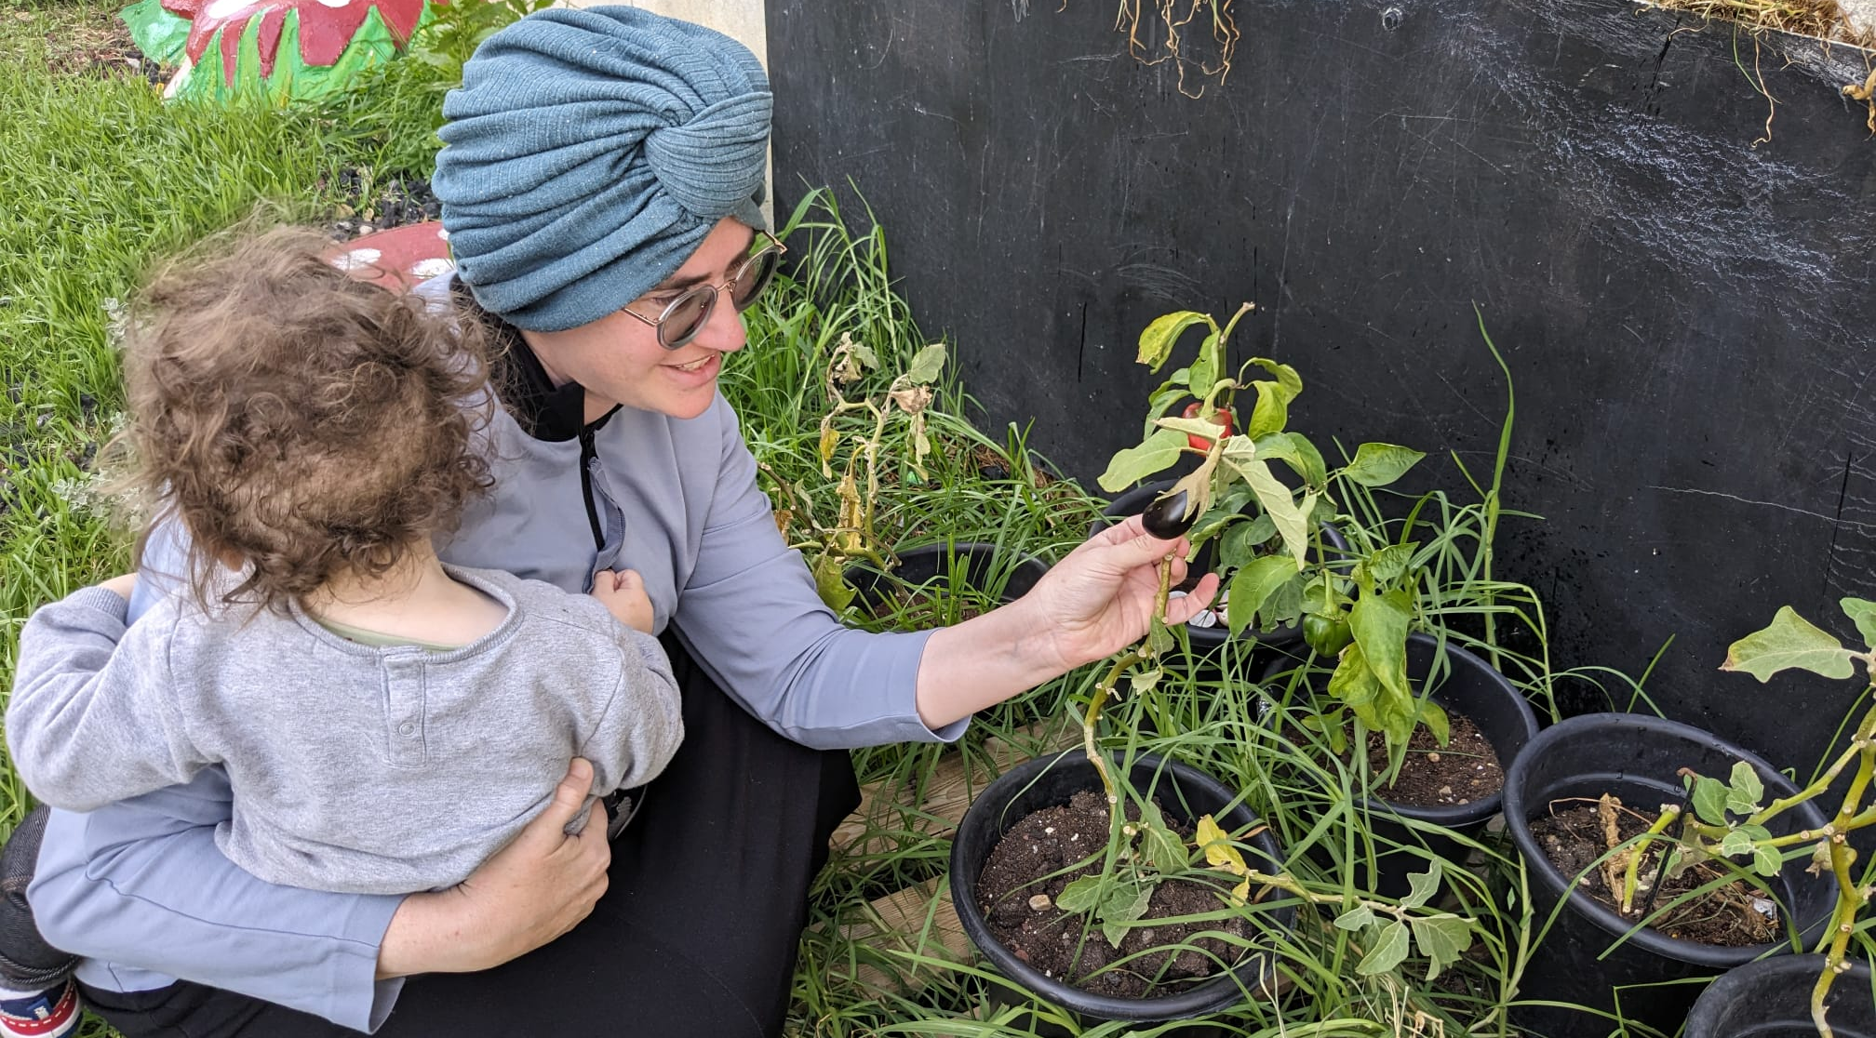
Appendixes

Slide 16
Detailing of activities and outputs* in 2023​ and 1st quarter of 2024
Services and Activities for Residents (Routine and in state of Emergency)
Activity | Period | Participants | Partners | Budget (NIS)) | Funding Sources | Cost Effectiveness
שיתוף ציבור ילדות בגן עץ הדעת במסגרת מחזור א' של קורס We Plan | ינואר 2023 | 23 ילדות ו-3 גננות | בצלאל השלוחה החרדית/ עיריית בית שמש | 20,000 | אורבן 95 | 3.85%
זעירא בשכונות פעילויות להורים וילדים ב-12 שכונות ברחבי העיר | פברואר-יוני 2023 | כ-3,500 ילדים ו- 1,100 הורים ב-36 פעילויות | עיריית בית שמש - אגף קהילה/ מפעל הפיס/ אורבן95 | 567,600 | עיריית בית שמש, מפעל הפיס | 0.02%
התנעת פרויקט גינה קהילתית בטיפת חלב קריה חרדית | אפריל 2023 | 16 תושבות הקריה החרדית | משרד הבריאות/ מחלקות בריאות וגיל רך בעיריית בית שמש | 1,000 | אורבן95 | 16.6%
פעילויות הפוגה מתחת לבית שכונות נווה שמיר, ג'1, ד | אוקטובר-דצמבר 2023 | 115 ילדים ו-40 אימהות ב-3 מוקדים | אגף קהילה עיריית בית שמש | 120,000 | תורמים פרטיים | 0.65%
ערכות משחק ומשחקייה לגיל הרך למשפחות מפונות ומשפחות מגוייסים | אוקטובר-דצמבר 2023 | 40 ילדים ו- 25 נשות מגוייסים, 150 ילדים (50 משפחות מפונות מהדרום) | בית ספר חרדי 'נצח ישראל'/ עיריית בית שמש | 700,000 | תורמים פרטיים | 0.38%
יום ניקיון שכונתי ברמת אברהם לאמהות וילדים | נובמבר 2023 | 150 ילדים, 40 אימהות ו-15 אבות | עיריית בית שמש אגפי תפעול קהילה/ אורבן 95 | 5,000 | עיריית בית שמש | 0.49%
אירוע משפחות מגוייסים | נובמבר 2023 | 300 משתתפות | אגף קהילה עיריית בית שמש/ עמותת "ביחד ננצח" / נציגת קהילה – תושבת מתנדבת | 50,000 | תורם פרטי | 0.33%
הרצאה מקוונת בנושא 'חוסן לאמהות ילדי הגיל הרך בעת לחימה' | נובמבר 2023 | 23 אימהות | "בית ספר להורים" - עיריית בית שמש/ אורבן 95 | 1,300 | אורבן95 | 4.35%
פעילויות מתנ"ס נייד ברמה ג'1 | פברואר-מרץ 2024 | כ-150 ילדים ו- 69 אימהות ב-9 מפגשים | מחלקת גיל הרך בעיריית בית שמש | 16,200 | אורבן95 | 0.45%
*לפי נתונים שנמסרו ממנהלת Urban95 בית שמש

Slide 17
Detailing of activities and outputs* in 2023​ and 1st quarter of 2024
In the Municipality
Activity | Period | Participants | Partners | Budget (NIS)) | Funding Sources | Cost Effectiveness
שת"פ אורבן95 וארגון 'בטרם' -מושב בנושא בטיחות ילדים במסגרת מיזם 'קהילה מיטיבה' | אפריל 2023 | 12 אנשי רשות הבטיחות | הג'וינט/ אורבן95/ עיריית בית שמש/ רלב"ד/ קופות חולים מאוחדת, מכבי וכללית | 5,000 | הג'וינט | 8.33%
יום עיון וסיור בירושלים | מאי 2023 | 15 עובדי עירייה | עיריית בית שמש/ אורבן95 | 6,500 | אורבן 95 | 5%
הכשרת 'כשקהילה פוגשת מרחב' | יולי 2023 | 25 עובדי עירייה | צוות מוביל מעיריית בית שמש/ אורבן95 | סיור באשדוד 11,000 | אורבן 95 | 4%
קטלוג אלמנטים לטיפת חלב | ספטמבר 2023 | 5 נשות צוות | פרויקט "בין הטיפות" בצלאל/ אורבן95 | 1,500 | בצלאל | 20%
הכשרות וכנסים עבור גורמי מקצוע:
Activity | Period | Participants | Partners | Budget (NIS)) | Funding Sources | Cost Effectiveness
תוכנית הכשרה למטפלות מחנכות | פברואר-יוני 2023 | 20 משתתפות ב-6 מפגשים | מחלקת גיל רך בעיריית בית שמש/ אורבן95/ 360 התוכנית הלאומית לילדים בסיכון | 1,800 – אורבן95 7,200 – עיריית בית שמש 9,000 – תוכנית 360 |  | 5%
השתלמות תזונה למטפלות מחנכות | יולי 2023 | 30 מטפלות מחנכות | מחלקת גיל רך בעיריית בית שמש/ אורבן95 | 3,500 | עיריית בית שמש | 3.33%
קורס ‘WE PLAN’של השלוחה החרדית בצלאל | מחזור א': אוקטובר 2022 - פברואר 2023 מחזור ב': אוקטובר 2023-מרץ 2024 | 25 סטודנטיות | בצלאל השלוחה החרדית/ עיריית בית שמש | 5,000 ל-2 מחזורים | אורבן 95 ובצלאל | 4%
מפגש שנתי לצוותי מעונות | נובמבר 2023 | כ-400 מטפלות מחנכות | מינהל חינוך בעיריית בית שמש | 40,000 | עיריית בית שמש | 0.25%
כנס 'כוח לגדול' – השקת המחלקה לגיל הרך | פברואר 2024 | 300 מטפלות מחנכות | עיריית בית שמש | 25,000 | עיריית בית שמש | 0.33%
*לפי נתונים שנמסרו ממנהלת Urban95 בית שמש

Slide 18
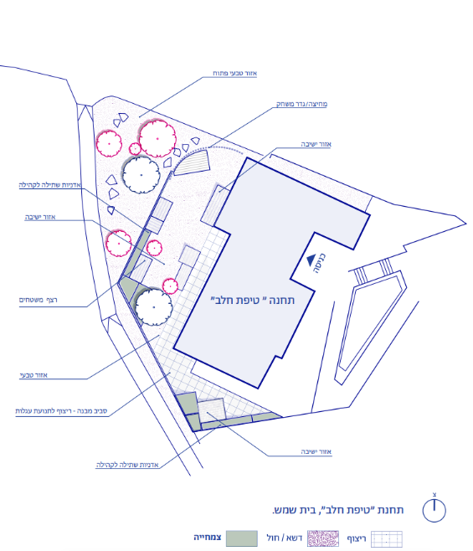

במסגרת תכנון הפרויקט:
בוצע מחקר מקדים למיפוי צרכי התושבים, שכלל קבוצת מיקוד עם 8 אימהות מהשכונה וראיון עם מובילת היוזמה.
הוקמה ועדת היגוי להתנעת הפיילוט, בשיתוף כלל יחידות העירייה הרלוונטיות.
פותח קטלוג אלמנטים לעיצוב הגינה על ידי צוות פרויקט 'בין הטיפות' של בצלאל וקרן ון ליר, בעבודה משותפת עם עיריית בית שמש ומשרד הבריאות.
מדברי התושבות
גינה קהילתית בחצר טיפת חלב קריה חרדית
פיילוט להקמת מרחב קהילתי טבעי בחצר טיפת חלב יצא לדרך ביוני 2023 ביוזמת תושבת העיר, בשיתוף עיריית בית שמש, משרד הבריאות ופרויקט 'בין הטיפות' של בצלאל, משרד הבריאות וקרן ון ליר ישראל.
מיקום:
טיפת חלב מרגלית, הקריה החרדית בבית שמש.
"הבן שלי אוהב מאוד מרחב, בשבילו להיות בבית זה ממש כלא. אני מרגישה פספוס בשבילו שאני לא גרה בכפר."
קהל יעד:
תושבות קריה חרדית, אימהות לילדים בגיל הרך
"רוצה שיהיה משהו בשבילי, מקום שנעים לשבת, שלא אצטרך לנסוע לרמה ג'. "
מטרת המיזם:
הזדמנות ליצור קשר עם התושבים, לחזק את האמון בטיפת חלב ולעודד אורח חיים בריא.
לאפשר מרחב קהילתי, ירוק ובטוח, המעודד פיתוח מיומנויות התפתחותיות של ילדים בגיל הרך.
להפוך את אחות טיפת החלב לסוכנת ידע ודמות פעילה בקהילה.
"דברים שמעודדים אותם להתפתחות מוטורית, התנסות בחומרים, לא לפחד מהאדמה וממה שהיא מצמיחה."
"שיהיה מקום מחבר. הקהילה החרדית מאוד מגוונת ואין הרבה דברים שמחברים את כולם באופן נייטרלי."

Slide 19
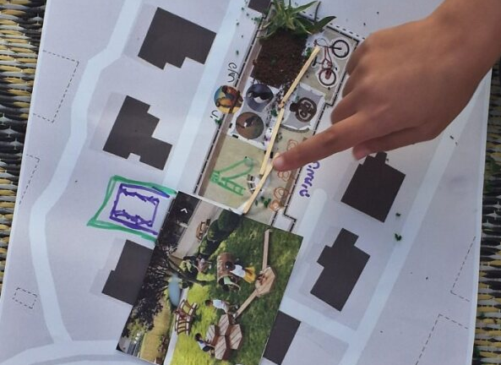
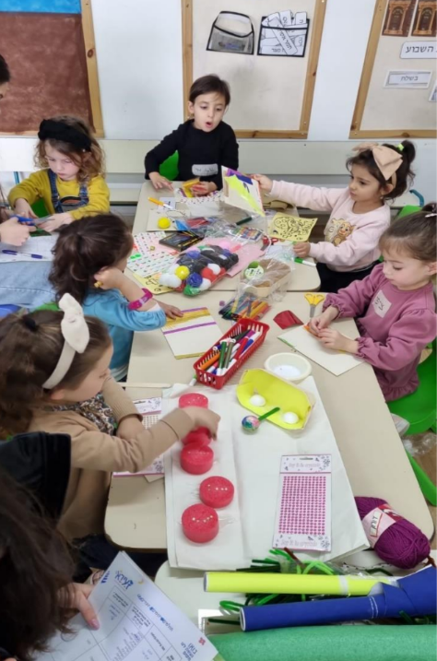
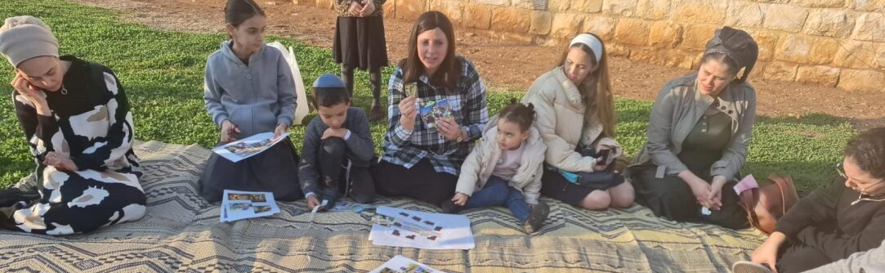

קורס'We plan’ בצלאל - השלוחה החרדית
קורס במסגרת לימודי BA באדריכלות, העוסק בחקר ותכנון מרחבים עירוניים המותאמים לעולמם ולקנה המידה של הילדים המשתמשים בהם, בהתאם לעקרונות המנחים של אורבן95 ולהתאמה התרבותית לחברה החרדית.
מודל:
הקורס שילב הרצאות, עבודה מעשית ותרגיל מסכם, לצד מפגש שיתוף ציבור בבית שמש במחזור א'.
מבנה ותכני הקורס נבנו על ידי המנחה האקדמית יחד עם השותפים המרכזיים, שהנחו רבים מהמפגשים.
שותפים מרכזיים: המועצה הישראלית לבנייה ירוקה וצוות אורבן95 ישראל, משרד אדריכלים גבריאלי-סגל (שהוביל את מהלך כתיבת הנחיות התכנון הארציות לגיל הרך), חברת 'עולמי' המתמחה בשיתוף ציבור עם ילדים, גן ילדים לגילי טרום חובה, ומחלקת הנדסה בעיריית בית שמש.
התקיימו שני מחזורים:
מחזור א' – 10 סטודנטיות: נובמבר 2022 – פברואר 2023, כולל שיתוף ציבור עם 18 ילדות גן (ינואר 2023.)
מחזור ב' – 15 סטודנטיות: דצמבר 2023 - מרץ 2024, 10 סטודנטיות ענו על משוב סיום.
בעקבות הקורס, ניכרת תרומה עבור כלל השחקנים בהבנת חשיבות התאמת המרחב הציבורי לצרכי הגיל הרך
הקורס סיפק לסטודנטיות ידע מקצועי והתנסות מעשית בתכנון מרחב עירוני המותאם לצרכי הגיל הרך - "המפגש במרחב התכנון בפארק- עשיית מפת החלומות של הילדים, איך הם רואים את העולם. זה חידד אצלי את המחשבה על המשתמשים. "
מנחת הקורס מעידה כי שיתוף הציבור היה מוצלח בזכות הפעלה מקצועית וכי הילדות נתרמו מעצם קיומו: " הן היו הציבור. זה נתן להן מיומנות ומחשבה שתיטמע בתת מודע שלהן. ההרגל של ללכת במקום ולחשוב מה אפשר לעשות פה."
מנחת הקורס זיהתה שינוי באופן החשיבה של גורמי התכנון בעירייה כלפי המרחב ההציבורי: "לחשוב אחרת מהיום על פארק שעתיד להיות מאוכלס, ולא רק לפתוח קטלוג ולבחור מגלשה ונדנדה".
אימפקט ארוך טווח על תהליכי תכנון מותאמים תרבותית: "אני רואה ערך בסטודנטית שתישאר חרדית, ותחזור לפעול בתוך המרחב החרדי בצורה שהיא גאה ומבינה את הדקויות של מה שהיא עושה." (מנחת הקורס)

Slide 20
Executive Summary Ashdod – Key Insights
Cost Effectiveness – שיפוץ גינות שנותן מענה לכל תושבי הרובע, לצד הכשרות עומק לצוות העירוני מצומצם
פעילויות בשעת חירום ופרויקטים לשיפוץ והתאמת מרחבים ציבוריים לצורכי הגיל הרך, אשר נתנו מענה למאות בתי אב, הניבו יחס גבוה מאוד בחישוב השקעה/תושב– כ-0.1%. מדובר בערכות ובמרחבים ציבוריים שיוכלו להמשיך לשמש את הילדים ומלוויהם בשנים הבאות (אימפקט ארוך טווח).
פעילויות תוכן לתושבים ומפגשי שיתוף הציבור השיגו יחס השקעה/משתתף גבוה של 1.4%-2.9%. מדובר בפעילויות נקודתיות עם תרומה קצרת טווח לקשר הורה-ילד ולפיתוח קשרי קהילה, וכן לחיזוק תחושת האמון ברשות.
הכשרות והרצאות לגורמי עירייה הניבו יחס נמוך – 6%-20%. אימפקט ארוך טווח: המשתתפים נתרמו בידע וכלים יישומים לפיתוח מענים לצורכי הגיל הרך בשגרה ובחירום.
Funding Sources and Partners*– פעילויות תוכן לתושבים והכשרות לגורמי העירייה במימון אורבן95 לצד רקימת שיתופי פעולה בשנת פעילות ראשונה
פעילויות התוכן לתושבים, ההכשרות ופגישות הייעוץ לגורמי העירייה מומנו על ידי אורבן95, בעוד התקציב הגדול ליישום התערבויות במרחב הציבורי הגיע מעיריית אשדוד.
לצד זאת, בתחילת המלחמה הותנעו יוזמות לרווחת התושבים גם בעזרת תרומות חיצוניות ומתנדבים.
ההשקעה התקציבית הישירה של אורבן95 באשדוד בשנת 2023 הינה מעל ל- 60,000 ₪, לצד מינוף משרת מנהלת אורבן95 העירונית, שרקמה את שיתופי הפעולה בין יחידות העירייה מהם צמחו הפרויקטים (ביניהן מינהלי התפעול וההנדסה האמונים על הפן הלוגיסטי / טכני, ויחידות מהתחום החברתי-קהילתי כגון מינהלי חינוך ושירותים חברתיים ועוד).
Municipal Involvement and Program Sustainability– יישום פיילוטים במרחב הציבורי בשנה רצופת משברים והתאמת תוכנית העבודה לשגרה ולחירום
בשנת הפעילות הראשונה עסקה התוכנית בהתנעת פיילוטים שהתמקדו בעיקר בהתערבויות במרחב הציבורי ובהכשרת גורמי עירייה למתן מענים לתושבים בשגרה ובחירום,
תוך התמודדות עם שגרת עבודה מקוטעת בין היתר לאור הבחירות המקומיות והמלחמה. בשנות הפעילות הנותרות התוכנית תתמקד בהרחבת פיילוטים ושיתופי פעולה קיימים, וכן בהתנעת יוזמות חדשות ושותפויות נוספות בהתאם לתוכנית העבודה של שנת 2024, לטובת מענה לצורכי הגיל הרך בשגרה ובחירום, שהותאמו ודויקו לאור מצב החירום המתמשך.

Slide 21
Executive Summary - Urban95 Ahsdod Outcomes in 2023 Based on Evaluation Indicators
Municipal Officials and Partners
EC is on the municipal agenda
Municipal officials are knowledgeable and understanding of EC needs
Inter-municipal collaborations, onboarding of external stakeholders
Public space pilots Implementation, providing EC contents and services with municipal investment
Considering EC needs when planning while pooling external resources
מנהלת אורבן95 העירונית מקדמת שיתופי פעולה בין יחידות עירוניות שונות לטובת הגיל הרך: פעילויות להורים ולילדים יחד עם מנהלת קהילת אשדודטף, וכן עם מנהל מיזם Muni100, תוך איגום משאבים המוקצים לטובת חיזוק הקשר הבין-דורי.
כ-15 עובדי עירייה השתתפו בהכשרות שהקנו להם ידע וכלים לשילוב צורכי הגיל הרך בתכנון והשראה ליישום פרויקטים לשיפור המרחב הציבורי ומבני ציבור בהתאם לעקרונות אורבן95 (הקמת מרכז גיל רך, הקמת מרכז חוסן לילדי העיר, המתמודדים עם מצב חירום מתמשך)
משתתפי ההכשרות ציינו כי המפגשים פתחו בפניהם הזדמנויות חדשות לממשקי עבודה משותפים עם גורמים חדשים.
עיריית אשדוד השקיעה כ-1,000,000 ש"ח בשיפוץ 2 גינות משחק ברובעים שבמיקוד, והתאמת לצורכי בני הגיל הרך ומלוויהם.
גורמים בעיריית אשדוד קיימו למידת עמיתים עם ערי העוגן האחרות במסגרת סיור בתל אביב ואירוח של הצוות העירוני של בית שמש באשדוד.
Young Children and Their Caregivers
Scope of public spaces and EC activities
Use of spaces, services consumption & satisfaction
Sense of security and safety in intervention areas
Trust in the local authority and public participation events
Familiarity with Urban95 and repeated participation
Acquiring knowledge and tools, parental well-being (including dealing stress and anxiety)
Joint caregiver-child play & time spent in public spaces
Community and social belonging
כ-100 תושבים וילדיהם השתתפו ב-2 אירועי שיתוף ציבור לקראת שיפוץ גינות באזורי ההתערבות שנבחרו.
שיפוץ הגינות, המשרתות קהל של כ-4,700 ילדים בגילי לידה עד 6, זכה לשביעות רצון כללית גבוהה ותרם לפיתוח קהילתיות.
התושבים דיווחו על עלייה בתדירות הביקור בגינות, וציינו כי אזורי ההתערבות לאחר השיפוץ בטוחים ובטיחותיים יותר לשימוש ילדיהם.
כ-50 ילדים בגיל הרך ומלוויהם השתתפו בפעילויות 'סיפורי ספתא', שזכו לשביעות רצון גבוהה ועודדו משחק משותף מלווה-ילד ופיתוח קשרי קהילה.
בתחילת המלחמה כ-800 משפחות קיבלו 'ערכות חירום' לילדי העיר, שחולקו על ידי כ-25 מתנדבים ועובדי עירייה בהובלת מנהלת אורבן95 העירונית. הערכות תרמו לחיזוק יכולת ההתמודדות עם תחושות דחק וחרדה ולהגברת תחושת האמון ברשות.
בשבוע הראשון למלחמה השתתפו למעלה מ-150 מילדי העיר במפגשים מקוונים להקראת סיפור בהנחיית כ-5 גננות מתנדבות.

Slide 22
Detailing of activities and outputs* in 2023​ - Ashdod
Services and Activities for Residents (Routine and in state of Emergency)
Activity | Period | Participants | Partners | Budget (NIS)) | Funding Sources | Cost Effectiveness
שיתוף ציבור ושיפוץ גינת משחק "רמט" ברובע ד' | אוקטובר-דצמבר 2023 | שיתוף ציבור – כ-35 ילדים והורים מבקרי הגינה – כ-1,300 תושבים וילדים בגיל הרך | עיריית אשדוד/ אורבן95 | אורבן95 – 6,000 עיריית אשדוד - 500,000 |  | 2.9% 0.08%
שיתוף ציבור ושיפוץ גינת משחק "שפירא הקטן" ברובע ו' | אוקטובר-דצמבר 2023 | שיתוף ציבור – כ-70 ילדים ואימהות מבקרי הגינה – כ-3,350 תושבים וילדים בגיל הרך | עיריית אשדוד/ אורבן95 | אורבן95 – 20,000 עיריית אשדוד - 500,000 |  | 1.4% 0.03%
4 מפגשי פעילות "סיפורי ספתא" | אוגוסט 2023 | כ-50 ילדים ומלוויהם | אשדודטף/ קהילת מגדלור/ אורבן95 | 10,000 | אורבן95 | 2%
העברת תכנים מקוונים לילדים במלחמה | אוקטובר 2023 | כ-5 גננות מתנדבות הקריאו סיפורים לכ-150 ילדים | אשדודטף/ מחלקת חינוך בעיריית אשדוד/ אורבן95
חמ"ל ערכות חירום לילדי העיר | אוקטובר-נובמבר 2023 | חולקו לכ-800 משפחות, על ידי כ-25 מתנדבים ועובדי עירייה | מינהל רווחה בעיריית אשדוד/ אורבן95 | 37,000 | אורבן95, תרומות | 0.12%
In the Municipality
Activity | Period | Participants | Partners | Budget (NIS)) | Funding Sources | Cost Effectiveness
יום סיור ולמידת עמיתים בת"א | ינואר 2023 | 10 עובדי עירייה | אורבן95/ עיריית אשדוד/ עיריית ת"א | 10,000 | אורבן95 | 10%
הרצאה בנושא "גן המשחקים הטבעי" מאת יפעת גל שפייזמן | ינואר 2023 | 10 עובדי עירייה | אורבן95/ עיריית אשדוד | 1,500 | אורבן95 | 10%
קיום מפגש חשיפה לאשדודטף ואורבן95 והפקת סרטון תדמית לתוכנית באשדוד | פברואר 2023 | 35 עובדי עירייה | עיריית אשדוד/ אשדודטף/ אורבן95 | 8,830 | אורבן95 | 2.9%
2 מפגשי ייעוץ למרכז לגיל הרך על ידי רם אייזנברג | פברואר, יוני 2023 | 15 עובדי עירייה | אורבן95/ עיריית אשדוד | 3,500 | אורבן95 | 6.7%
הרצאה בנושא "מרחבים בטוחים לילדים במצבי חירום" מאת רן כהן אהרונוב | דצמבר 2023 | 5 עובדות עירייה | אורבן95/ עיריית אשדוד | 1,750 | אורבן95 | 20%
*לפי נתונים שנמסרו ממנהלת Urban95 אשדוד

Slide 23
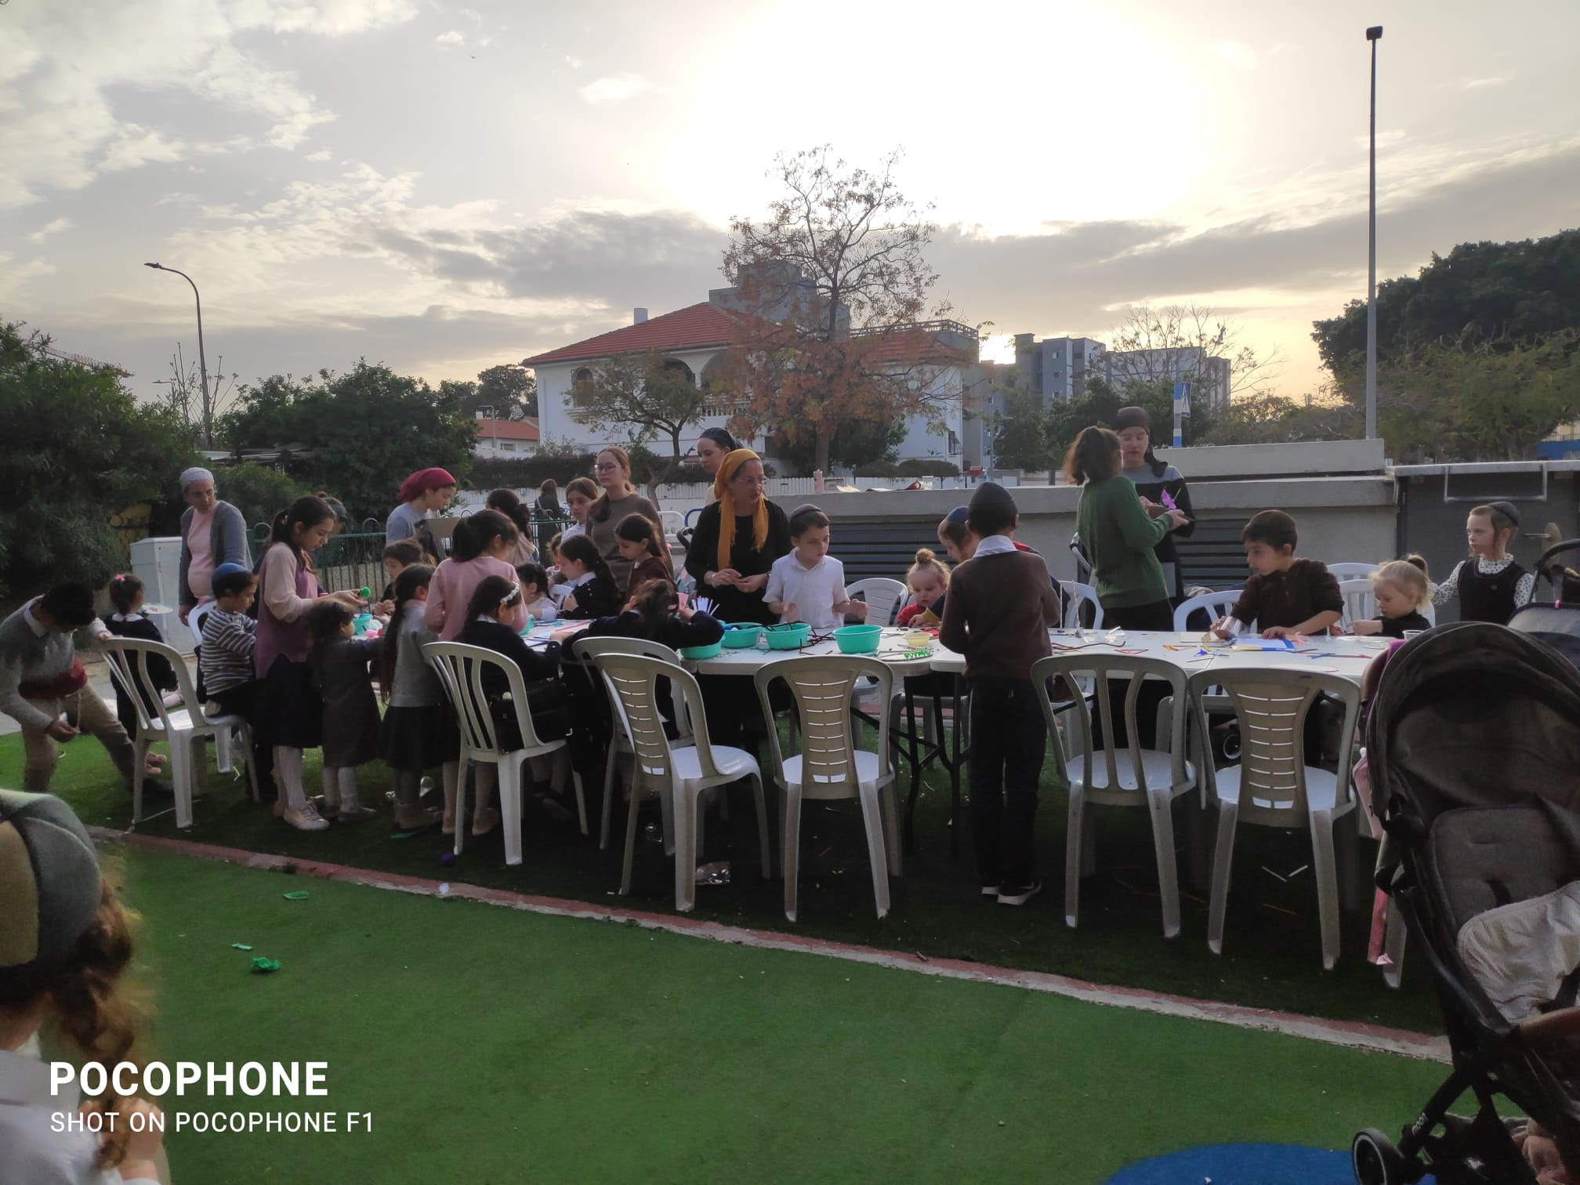
Summary of Evaluation Findings​ Based on
Short- and Long-Term Outcome indictors (Impact)

Slide 24
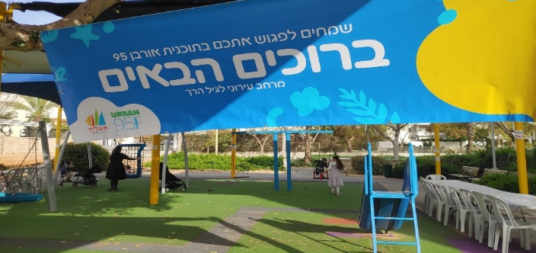
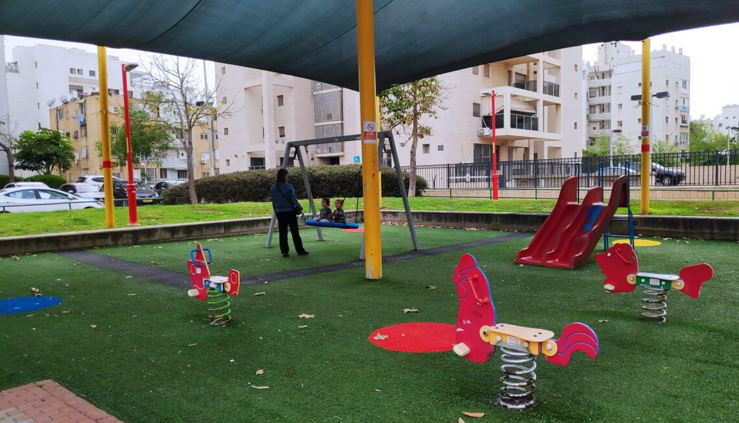
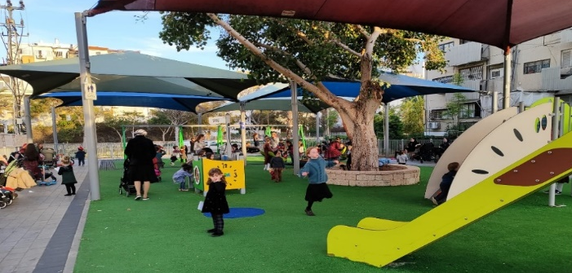
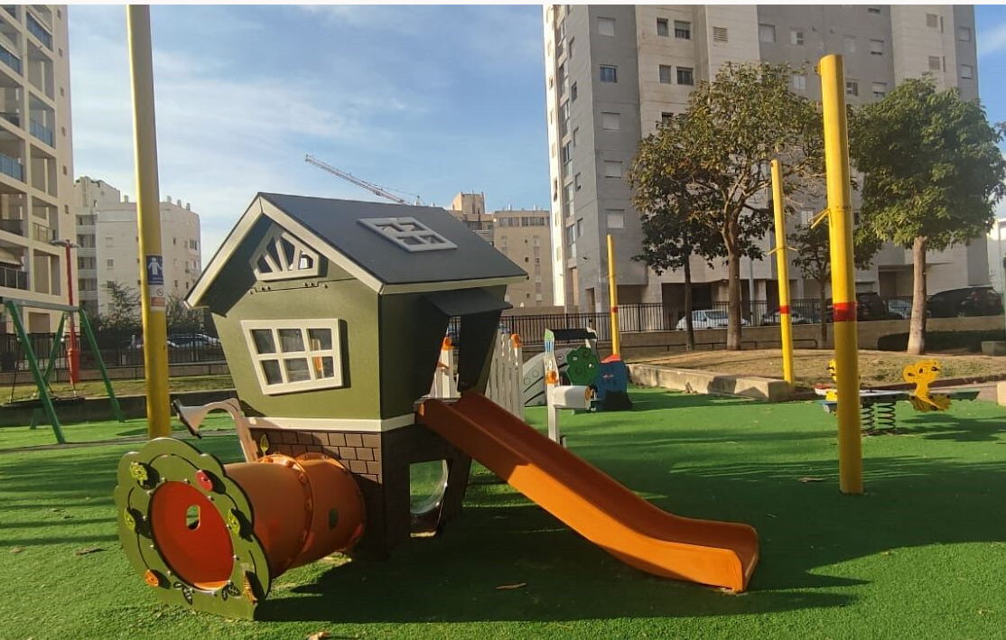
גינת 'שפירא הקטן' רובע ו'
גינת 'רמט' רובע ד'
שיתוף ציבור ושיפוץ גינות 'רמט' ו'שפירא הקטן'
לפני התערבות
לפני התערבות
שדרוג שתי גינות משחק שזוהו במסגרת מיפוי הזדמנויות ברובעים שבמיקוד​, תוך מענה על צרכי התושבים כפי שעלו ממפגשי שיתוף ציבור עם הורים וילדים בגינות.
מיקום:
גינת 'רמט' ברובע ד'.
גינת 'שפירא הקטן' ברובע ו'.
אחרי התערבות
אחרי התערבות
מטרת פעילויות שיתוף הציבור (מרץ/אפריל 2023):
לקדם הזדמנות לשיח בין התושבים לעירייה, ולאפשר להורים ולילדים לבטא את רצונותיהם ביחס לשיפוץ הגינות.
שיפוץ גינות המשחק:
במהלך אוקטובר-דצמבר 2023 בוצעו שיפוצי הגינות ע"י עיריית אשדוד.
מדידה והערכה (מרץ/אפריל 2023 – מרץ 2024):
לאחר ביצוע ההתערבות התקיימו תצפיות בגינות שכללו ראיונות שטח עם אימהות (N=13), מהם עולה שביעות רצון כללית גבוהה משיפוץ הגינות – "תוצאה טובה, יותר צבעוני וחי ומעסיק את הילדים".
במהלך התצפיות תועדה מידה גבוהה של אינטראקציה ומשחק משותף בין ילדים – "הבן שלי נפגש עם ילדים מהמסגרת בפארק ששם, ואז בדרך הביתה אנחנו עוצרים פה כשהוא רואה פה ילדים".
גם בין המלווים בגינות נצפתה מידה גבוהה של קהילתיות.
מרחבי המתקנים חודשו באופן המעודד אתגר פיזי, בעיקר לגילי לידה עד 4.
"בעבר לא ביקרנו פה, בקושי היה מה לעשות. היום יש אפשרויות משחק וזה מושך עוד ילדים שאפשר לפגוש."
"שינוי אדיר, נראה שתואם את הבחירות של אנשי השכונה. השתנה מאוד מספר הספסלים בגינה."
"הגינה מאוד מותאמת לגיל שלה, אני לא מפחדת שהיא תעלה על מתקנים, כי זה מותאם לה״.

Slide 25
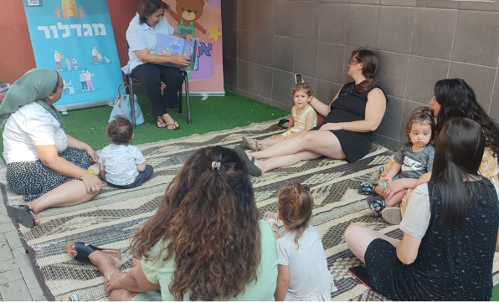
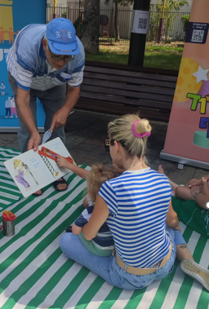
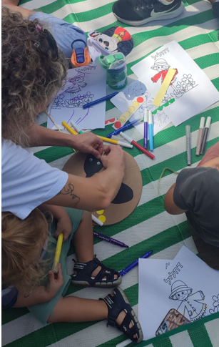
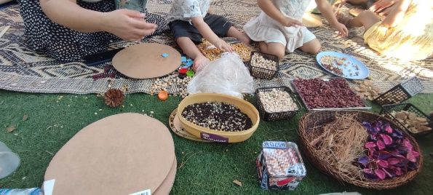
מתנ"ס טנה רובע ה'
פארק רעים רובע ד'
פיילוט 'סיפורי ספתא'
במהלך חודש אוגוסט 2023 התקיימו 4 פעילויות הקראת סיפור ויצירה לילדים בגיל הרך על ידי תושבים בני הגיל השלישי ומנחה יצירה מקצועית.
מיקום התצפיות:
פארק רעים ברובע ד'.
מתנ"ס טנה ברובע ה'.
מטרת הפעילויות:
מפגש בין דורי בין הגיל השלישי לגיל הרך; חיזוק אוריינות שפתית; חיזוק קשר הורה-ילד​; פיתוח מוטוריקה עדינה ויצירתיות.
מדידה והערכה:
על שתי פעילויות נערכו תצפיות שכללו ראיונות עם הורים משתתפים, עם אזרחים ותיקים שהקריאו סיפורים ועם המפעילות​, וכן הועברו משובים (n=9) להערכת חוויית הפעילות.
המשתתפים (הורים וילדיהם) הביעו שביעות רצון גבוהה מהמפגשים.
פעילות היצירה איפשרה חקירה חושית ועודדה פיתוח מוטוריקה עדינה, יצירתיות ודמיון בקרב הילדים.
הפעילויות זימנו גם אינטראקציות חיוביות של מלווה-ילד, כשהמלווים תיווכו את הסיפור לילדים הקטנים ועבדו יחד איתם על היצירות.
לפי המשוב, המשתתפים קיבלו רעיונות חדשים למשחק משותף עם ילדיהם.
הפעילויות עודדו פיתוח קשרי קהילה, כשההורים שוחחו והתייעצו ביניהם בענייני הורות, והילדים שיחקו זה עם זה והתחרו בצביעה והדבקה.
"הסיפור היה מצוין, היה הרבה שיתוף פעולה, הילדה שמעה ונהנתה"
​"סיפור מאוד נחמד ומשתף, טוב לנכדים"
"הקראה סבלנית וחייכנית, סבא מקסים שדיבר בשפת הילדים"​
"היצירה טובה, מותאמת גיל, יש מעורבות של הקהילה"

Slide 26

סיורים והכשרות
הרצאה לצוות העירוני בנושא 'מרחבים בטוחים לילדים במצבי חירום'
בהרצאה השתתפו 5 מחברות הצוות העירוני, 4 מתוכן מילאו את המשוב:
כלל המשיבות הביעו שביעות רצון גבוהה במידה רבה–רבה מאוד מפורמט ההרצאה ומהמרצה.
עיקר התרומה של ההרצאה היה בהעמקת הידע של חברות הצוות בנושא צרכי הגיל הרך ומלוויו,
ובמתן מוטיבציה ליישום רעיונות נוספים ברוח תוכנית אורבן95.
חלק מהמשתתפות אף ציינו כי ההרצאה פתחה בפניהן הזדמנויות חדשות לממשקי עבודה משותפים עם גורמים חדשים, ורובן ציינו כי הן מתכוונות לשתף את עמיתיהן בידע שרכשו בהרצאה.
כלל המשתתפות ציינו כי ההרצאה סיפקה להן ידע חדש הרלוונטי לעבודתן במידה רבה–רבה מאוד, ורובן ציינו כי ההרצאה סיפקה להן פרקטיקות וכלים מעשיים שיוכלו לשמש אותן בעבודתן בטווח הזמן הקרוב.
בעקבות ההרצאה החל תהליך התנעה של חברות הצוות העירוני להקמת מרכז חוסן לילדי העיר.
במסגרת פעילות אורבן95 באשדוד לשנת 2023 השתתף הצוות העירוני בכנסים והכשרות* להעמקת הידע וההבנה אודות צורכי הגיל הרך ולטובת קידום פרויקטים ופיילוטים באשדוד.
מדידה והערכה:
סיור לימודי בת"א-יפו** (N=9) – 15/1/23
הרצאה בנושא 'גן המשחקים הטבעי'** מאת יפעת גל שפייזמן, אדריכלית נוף N=7)) – 22/1/23
הרצאה בנושא 'מרחבים בטוחים לילדים במצבי חירום' מאת רן כהן אהרונוב, מנכ"ל ומייסד שותף של הארגון Early Starters International (N=4) – 7/12/23
"אילו פרקטיקות ו/או כלים מעשיים חדשים קיבלת בהכשרה?"
"האפשרות להיעזר בגורמים עסקיים למימוש חזון ציבורי"
"עסוקים כל הזמן ב-doing, פסק זמן להקשבה ולחשיבה, היה בזמן"
*פירוט על הסיורים וההכשרות בשקף פעולות ותפוקות באשדוד.
**ממצאי ההערכה של הכשרות אלה דווחו במסגרת דוח בייסליין אשדוד.
Notes:
חיזוק וטפיחה על השכם. חשיבות העבודה עם גיל מאוד מאוד צעיר אך הכי קובע לעתידו ולעתיד טוב לכולנו
היה טוב לפגוש חברות ומטפלות. הפידבק מראש העיר וראש מינהל חינוך היה חשוב

