Slide 1
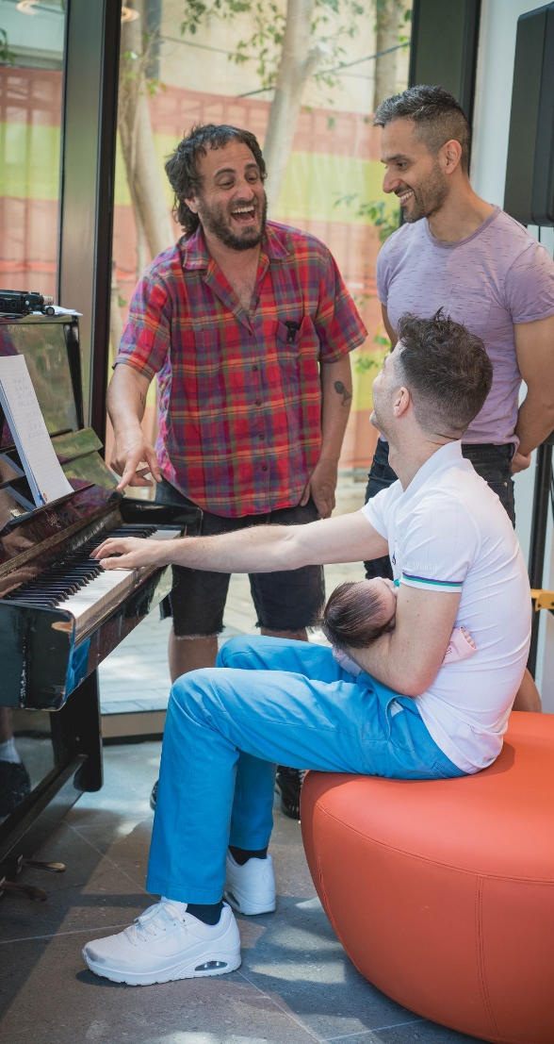
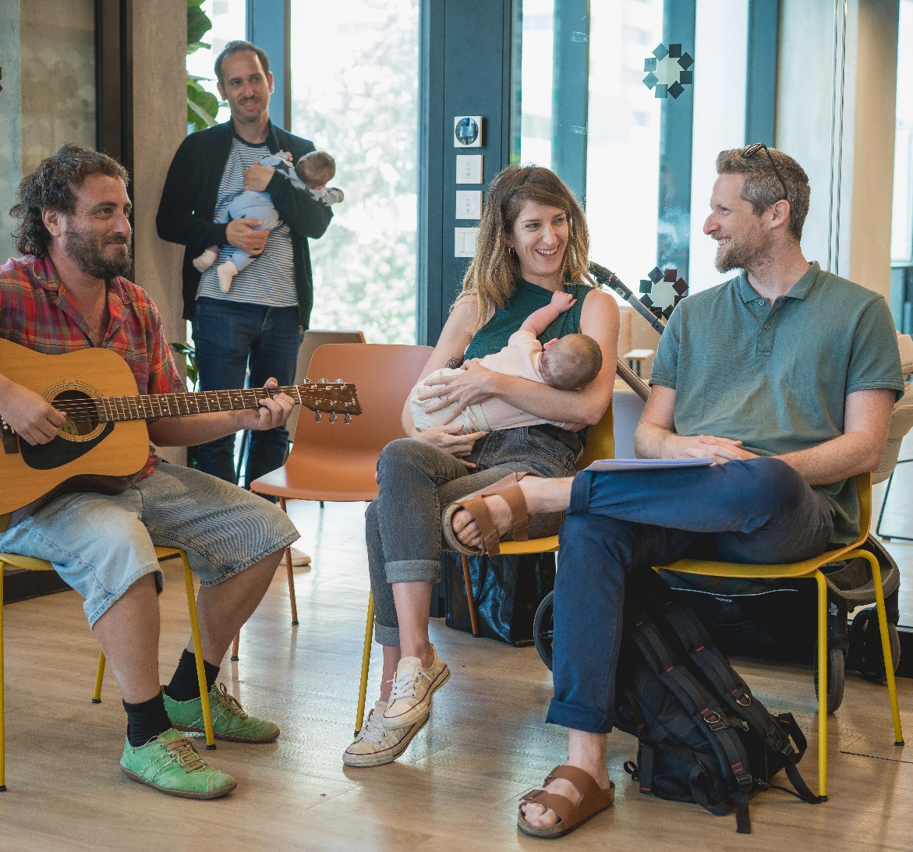



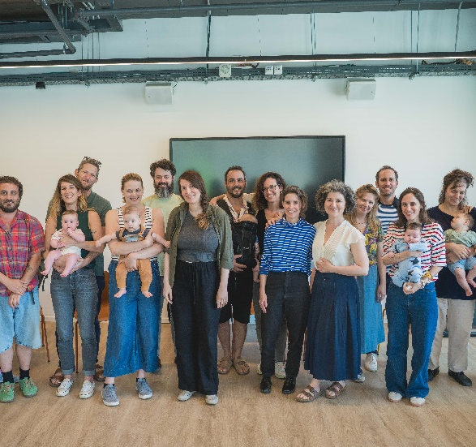
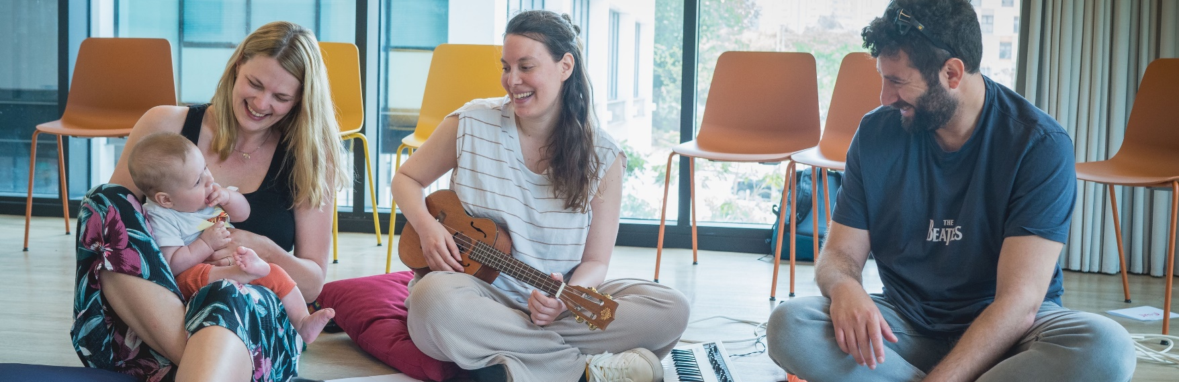
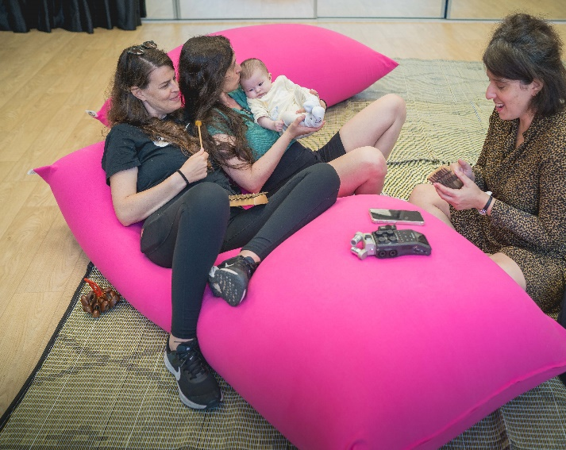
"לילה לילה"
הורים ומוזיקאים יוצרים
שיר ערש משפחתי
מוגש כחלק מהערכת תוכנית Urban95 TLV
ספטמבר 2024
שרון ברנד מרטין
אלונה צירולניקוב
ד"ר טל משען שפיגל
המרכז לטכנולוגיה חינוכית, חברה לתועלת הציבור, רח' קלאוזנר 16 תל-אביב, טל' 03-6460163
www.cet.ac.il

Slide 2

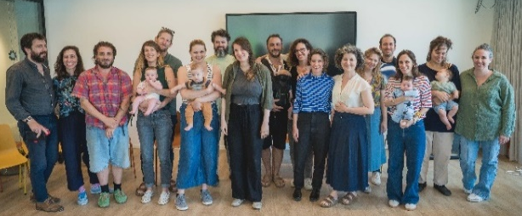
Pilot Background and Objectives
“Laila Laila”: An innovative pilot project where independent musicians collaborate with families of newborns to create, compose, and record a personalized lullaby for their baby.
The Lullaby Project, a decade-long initiative by Carnegie Hall's Weill Music Institute implemented in various institutions worldwide, connects parents and musicians to create personalized lullabies for newborns.
Inspired by the international project, the Urban95 team in Tel Aviv-Jaffa set out to create a citywide model for creating personalized lullabies for local parents. The “Laila Laila” pilot connected musicians with parents of infants (birth to six months) to collaborate in a creative process to compose a unique, personal lullaby. The aim was to spark a new family tradition, strengthen the bond between parents and their newborn, and reflect the family’s values and traditions.
The project began as a small-scale pilot to gather insights before expanding it citywide, with the goal of reaching more families from diverse communities throughout the city.
The pilot was conducted among three parent communities in Tel Aviv-Jaffa, each guided by a relevant community professional, and featured three distinct activity models.
    Parents from the LGBTQ+ community (6 families) in collaboration with the Tel Aviv-Jaffa LGBTQ Center. The workshop, held at the LGBTQ Center, consisted of a single session featuring group activities, a writing workshop, and individual guidance from a musician.
    New immigrant parents (5 families) in collaboration with the Municipal Immigration Absorption Authority. Held at the Da Vinci Cultural Center, this two-session workshop included group activities, a writing workshop, and individual guidance from a musician.
    Parents of premature infants (2 families) in collaboration with the Lis Maternity Hospital NICU. The workshop consisted of a one-on-one session with a musician, without group activities, and was held at the hospital near the NICU.
  Each family received a writing assignment to complete before the sessions. At the end of the workshop, they were given a recording of their personalized song along with a letter offering suggestions on how to continue using the song they had created.
  Each family was paired with a musician for individual guidance, who was selected for the project in collaboration with the city’s Department of Culture. The musicians underwent online professional training by a teaching artist from the international project, which allowed them to join the Lullaby Project artist community and participate in future projects.
  The group sessions (excluding the NICU families) were guided by a professional writing facilitator.
2
* Information provided by the Urban95 Tel Aviv-Jaffa team.

Slide 3












Summary of the Findings
Participation Experience and Benefits
Workshop Structure and Supporting Framework
Everyone involved in the project who participated in the evaluation – the parents, the musicians and musical director, and the producer - felt the project was successful, high-quality, and deeply meaningful. As a result, they all stated that they would recommend the workshop to other parents.
The workshop catered to a diverse range of people from different communities, each with varying levels of music-making skills and inclinations.
The musicians reported a very positive personal and professional experience and expressed a desire to continue participating in the project in the future.
Most participants and the professional team found the two-session format optimal, as it deepened the experience, strengthened connections between the participants and musicians, and allowed for a more relaxed, process-oriented creative journey.
However, to reach more families and meet the needs of unique communities with limited resources, it was apparent that even a single session could offer a meaningful experience.
Participants reported that the workshop provided an opportunity for a moving and bonding family and couple experience, offering a chance to pause and focus inward on the family and their babies, which helped deepen their connection and relationship. However, they also noted that it did not lead to any noticeable changes in their family routine or parenting experience.
The participants’ demographic and socio-economic characteristics suggest a positive foundation. All had established routines that included playing music at home, reported strong family or social support, and described positive parenting experiences.
Participants noted that the group session enhanced the overall experience, even though it did not directly influence the development of the songs. While no social connections were formed outside the workshop, the temporary communal space created a sense of belonging. The musicians also viewed the group element as beneficial and valuable.
Participants and musicians reported strong connections in their individual pairings, with a clear and genuine sense of intimacy that enriched their collaborative creative process.
Participating in the workshop contributed to parental well-being by offering participants a break from their routine and an opportunity to meet other parents in a group setting.
The songs created during the workshop captured a range of emotions, hopes, wishes, and everyday experiences, offering participants a meaningful opportunity for creative self-expression directed toward their loved ones.
The participants’ feedback indicated that the creative process, including writing the lyrics, occurred primarily within the individual participant-musician pairings. While the pre-workshop writing assignment was helpful, the dedicated writing facilitator played a less prominent role and was seen more as part of the general support staff. At the same time, the musicians expressed a need for tools and methods to better guide the writing process.
Some participants and musicians felt that the final product was somewhat basic. The professional team wanted to refine the musical arrangements further, and some participants suggested offering the option of additional professional production for a fee. However, the project’s producer believed that the simplicity of the recordings was in line with the project's spirit, which was to make the opportunity of creating a song more accessible and provide a more relaxed, less intimidating experience for participants who have no musical experience.
Most participants reported being satisfied with the song and shared that they primarily used it by singing or humming it themselves. Their feedback indicated that they mainly used the song at bedtime to soothe their babies and in random moments with their children throughout the day, which was in line with its intended purpose of serving as a “portable sanctuary.”

Slide 4
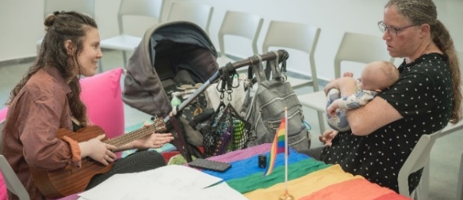
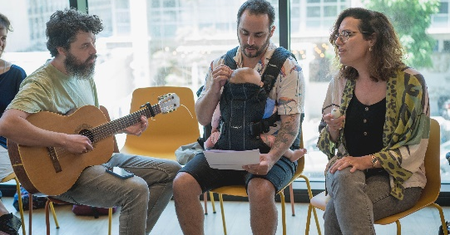
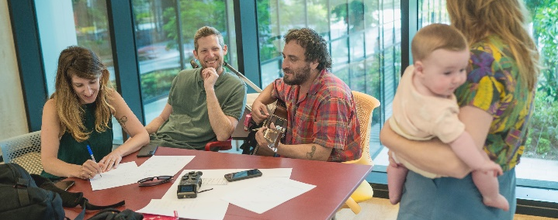
Key Points and Recommendations for Implementing the Pilot on a Citywide Scale
Collaboration with relevant municipal partners at every stage of the pilot helped create a format that was well-suited for both the musicians and the participating families. Maintaining this collaboration throughout the various stages as the project expands is essential.
  Identifying and recruiting suitable musicians with the help of a professional municipal music representative.
  As the project expands, we recommend engaging community stakeholders in the process of recruiting participants and managing communication with them. Holding a preliminary meeting with partners to define workflows and align expectations can foster effective collaboration.
  Promoting the workshop among families through local community channels, ensuring linguistic and cultural adaptation for different population groups.
  Tailoring the workshop format to the characteristics of each community, including providing a convenient, community-based venue, adjusting the scope and structure of the project (one or two sessions, group or individual), and matching musicians to families (e.g., based on similar life experiences).
It is crucial to manage expectations with both the musicians and participants about the process and nature of the workshop as well as the final product while highlighting the value and benefits of the experience (particularly couple and family bonding, strengthening the connection with the baby, and enhancing parental well-being).
Handing out a printed letter at the start of the workshop, along with consistent messaging throughout the process, from the recruitment stage through the sessions, and at the end of the workshop, will help reinforce and encourage lasting behavioral change.
A two-session, in-person workshop provides an optimal experience for everyone involved and contributes to a more complete creative process. However, given the constraints of participants’ and musicians’ schedules and commitments, as well as the need to accommodate a larger number of families, a high-quality outcome can still be achieved with a single in-person session.
The international project’s training for musicians brings professional prestige to the workshop and adds community value for the artists. Alongside keeping the pre-workshop writing assignment for participants, we recommend providing musicians with tools and methods for leading the writing process rather than relying on the dedicated writing facilitator (who was less involved in terms of the participants’ experiences).
Musicians also expressed a need for peer discussions for consultation and reflection during the workshop, as well as ongoing professional support throughout the process.
Conducting the activities throughout the city in collaboration with community centers will provide an opportunity to strengthen community bonds among those participating in the workshop and encourage the ongoing development of new relationships between families.
As the project expands, there is potential for further impact, as it creates opportunities for musicians and other professionals to develop within the community, which in turn enriches the city’s broader cultural landscape.

Slide 5
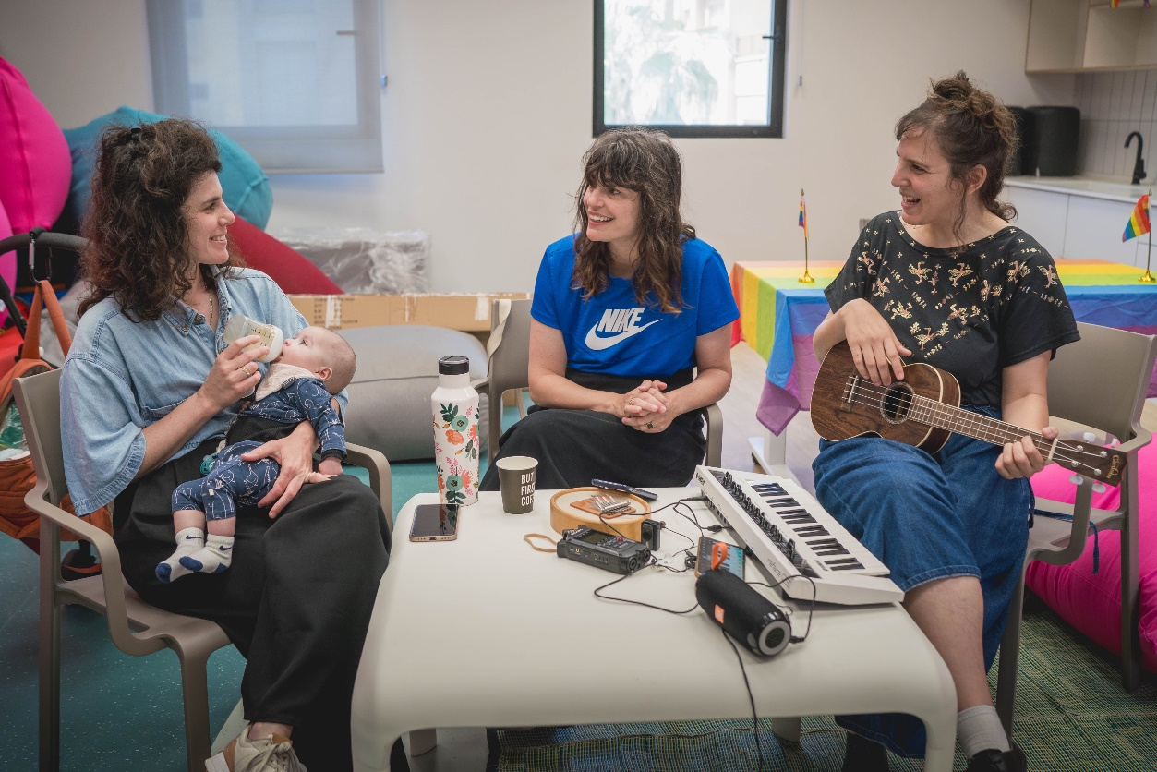
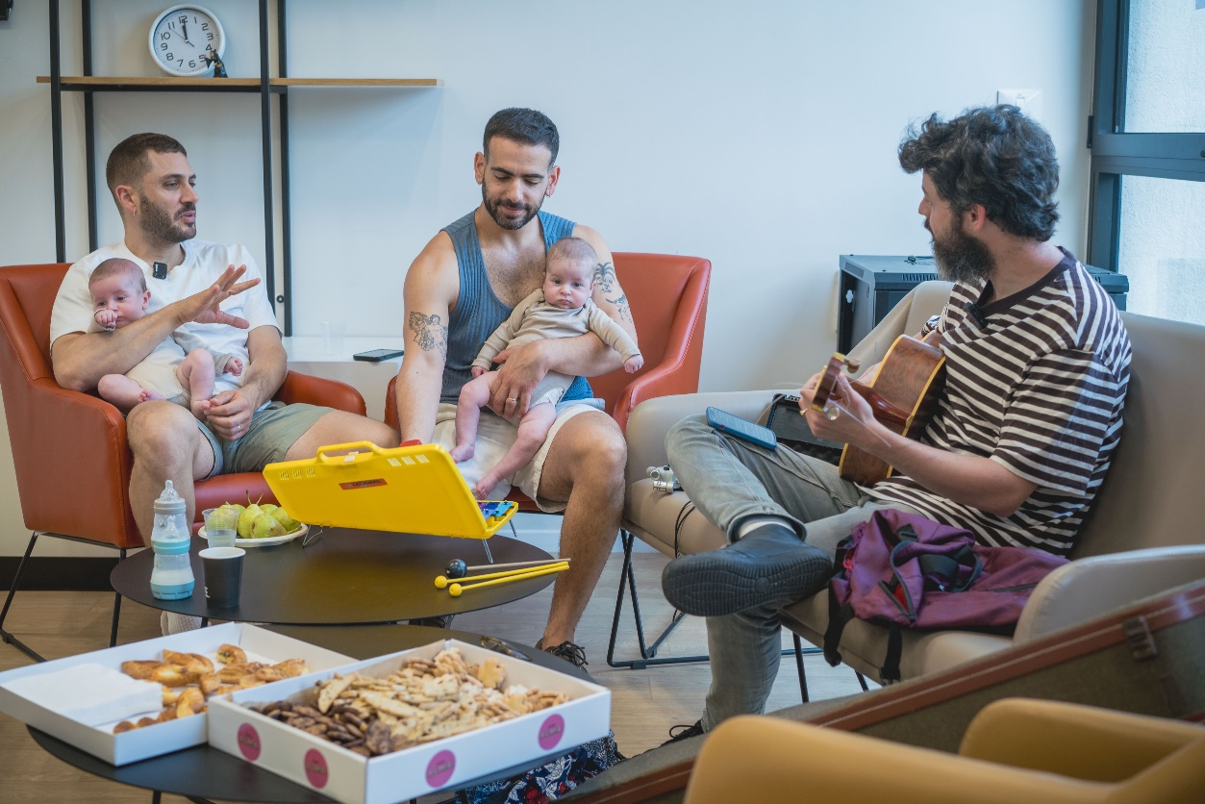
Research Design
Participant Surveys
An opening survey (N=19) was distributed to all participants before the workshop began.
A closing survey (N=24) was distributed at the end of the workshop or a few days later.
A follow-up survey (N=9) was distributed about a month and a half after the song was completed.
Individual/Couple Interviews with Participants
5 interviews were conducted: 2 with participants from the one-session workshop, 2 with participants from the two-session workshop, and 1 with participants from the individual session at the NICU.
A Personal Interview with the Project’s Musical Director
A focus Group with 5 Musicians who Participated in the Workshop
A Personal Interview with the Project’s Producer
Content Analysis of 13 of the Songs Written as Part of the Project

Slide 6








The activity model** centered around a group session with five pairs of parents and five musicians. The session included introductions and discussions about the unique role singing and music play in family life, as well as the participants’ personal connection to music from their own childhoods and as parents.
During the workshop, each pair of parents was matched with a musician, and together, they created their song - from writing the lyrics to developing the melody and finally recording it.
The writing process began with a pre-workshop assignment, where parents were asked to think about their baby and write a few sentences describing them, along with a heartfelt wish or blessing.
A melody was composed with the musician’s guidance to capture the family’s qualities and unique lyrics. At the end of the session, they recorded the final product – an original, personalized lullaby.
At the end of the process, parents received a letter with tips on how to keep using the song they had created. The suggestions focused on strengthening the parent-child bond through eye contact and by singing the song at various moments —at bedtime, bath time, or playtime, with the whole family and in everyday activities such as car rides, doing laundry, or going for walks.
Activity Model and Participant Characteristics (Based on Survey Responses)
14 Families Participated in the Pilot
Survey Response Data
Number of respondents per survey across the different group types
  14 Mothers
  14 Fathers
6 Same-sex couples
2 New immigrants from the US
1 From Germany
1 From Russia
  All the parents were in their 30s-40s
  16 Babies (including 2 sets of twins/siblings close in age)
  3 Families with older siblings aged 5-8
  For 9 families*, this was their first time as parents, with no other children.
The infants’ ages*
Number of infants in every age group
Parents’ employment status
Under 1 month
1-3 months
3-6 months
6-12 months
Over 1 year
*For one of the family's data on the baby’s age and additional siblings is missing. **Information provided by the Urban95 Tel Aviv-Jaffa team.

Slide 7
Workshop Structure
Overall, the two-session workshop format appears preferable, but a single session provides a good solution given time and resource constraints.
Participants in the two-session workshop stated that this format was excellent, with only one believing that a single session would have been sufficient. Among the NICU participants who had only experienced the individual format, two stated that they would have preferred an additional session to give them time to be better prepared and complete the song. Concerns about holding more than one session were related to availability and missing a day of work.
Was the Workshop Long Enough?
Segmentation by Group Type
Closing Survey
N=24
In two of the groups, the workshop was split between group sessions and individual sessions. Most participants (16) indicated that the balance between group and individual time was ideal for them. However, four participants from the single-session group felt that more time was needed for the individual session.
Participants from the single-session group explained during the interviews:
“The session needs to be longer, or there should be two sessions because the time we had wasn’t enough. It’s a creative process, and all the ‘hurry, hurry’ was stressful.”
“It’s better to split it… so there’s a process you go through, then some time to absorb it, and then another session for finishing touches. And we’d also be able to communicate between sessions to refine things."
In the musicians’ focus group, there was unanimous agreement that a two-session workshop format was preferable, as it fostered a deeper connection with the participants and resulted in a more polished and meaningful final product:
“This project is all about the connection between the musician and the parents, so while I really enjoyed the one session, I think having two would make things feel more relaxed and allow for a stronger bond to develop."
“[In the single session] I felt rushed. It didn’t feel like enough time, and the atmosphere was less relaxed. I also felt a sense of responsibility toward the parents and worried that we might not succeed... With the second couple, it was much more relaxed. We met twice, and the experience felt much more present and grounded."
"There was time to process things, and I really made the most of it. I gave them something that had undergone a process and it was much more refined. It wasn’t just about having two sessions but also about the time in between. I even sent them the draft on WhatsApp before the second meeting. That was very meaningful for me."
The musical director also noted that the process is better served by conducting more than one session.
At the same time, it is clear that flexibility is essential to cater to different communities, as some groups may only be able to participate in a single session and still derive great value from it .
“Taking real-world limitations into account for a moment... In our first meeting with the team from Carnegie Hall, they told us about situations where they go into women’s prisons and, due to certain constraints, they can only visit once. Or in the NICU, for example... there’s real value in that. We just need to develop a toolkit that works within these limitations.”
Both the musicians and the project producer highlighted the significant social value of managing resources in a way that would allow the project to accommodate more participants, and that a single-session format could meet this goal without compromising the quality of the program.

Slide 8
High Satisfaction Rates
Overall, the survey respondents expressed a very high level of satisfaction; they enjoyed the workshop and would recommend it to other parents.
“It doesn't really matter if the baby is a few months old or one, two, or three years old; it's all part of early childhood." (Parent interview)
“The workshop is unique; I haven’t come across anything like it before. Everything was original, and it felt good, inclusive, and professional! It was a joy to come and hear the songs. The warm-up at the beginning was helpful and refreshing, and the connections between the parents and musicians were excellent. Thank you for a wonderful opportunity!“
"The workshop was a fantastic experience - we enjoyed every moment and the final result. To this day, we sing the song and share it with our friends." – Parent survey
“For any parent who wants to do something for their child and strengthen their bond.”
To what extent did you find the registration process simple and convenient?
To what extent did you find the physical conditions of the space comfortable?
The workshop space was comfortable and met the participants’ needs. The interviewees described the team as pleasant and dedicated, and everyone valued their professional and personal connections with the musicians. While the participants were unaware of each person’s role during the meeting, they noted that the entire team was friendly.
“They were wonderful. I’m not sure who was responsible for what, but there was a great sense of teamwork, from helping with the babies to anything else that was needed."
"They were amazing. The staff took care of our needs, and the atmosphere was very pleasant. There was food and drink, which was great, and they also helped with feeding and holding the babies."
"Everything was above and beyond; it was truly ideal. The space was organized, comfortable, and accessible, and everything was well managed."
To what extent did you enjoy the workshop?
To what extent would you recommend the workshop to other parents?
Not at all
Score of 2
Score of 3
Score of 4
Score of 5
Score of 6
To a very large extent
It’s important to note that even in their feedback and suggestions for improvement, the participants expressed gratitude and appreciation for the project, with most saying they wouldn’t change a thing. However, some participants suggested adjusting the time allocation and recommended providing activity mats for the babies, who were mostly in strollers or being held during the session.

Slide 9
Expectations and Benefits
In the interviews, participants were asked to reflect on any concerns they had leading up to the workshop:
In most respects, the activity’s impact exceeded expectations. The chance to relax and strengthen relationships with their partners was a surprise, with many participants noting it as one of the greatest benefits, despite not expecting it at the start.
Participants joined the workshop mainly out of curiosity, seeking a unique experience and a chance for emotional and creative expression with professional support. These expectations were not only met but, to a large extent, surpassed.
Two interviewees were worried that they weren’t musical enough and wondered if they would actually be able to create a song:
“Creating songs isn’t really my forte; my wife is the creative one, so I wondered how it would go and if we’d be able to make a song.”
They noted that the thoughtful organization and guidance helped ease those concerns.
Participants felt the experience helped deepen their connection with their baby: “You think about her – how to describe her, what soothes her. It’s a few hours dedicated just to her.” – Parent interview
In interviews, many said the experience strengthened their family bond: “It gave us something personal and unique, just for our family,” and “It brought us closer together as a family.”
Others emphasized the joy of the experience: “It was fun, doing something fun with the baby,” and cherished the result: “We have a song that’s just ours.”
Participants also reported that the benefits of taking a break from their routine and forming new connections were nearly double what they had initially expected in these areas.
Two participants raised concerns about the session's length. One worried that a three-hour session would be too long to manage with a baby, while the other was concerned that an hour and a half wouldn’t be enough time for writing, composing, and recording the song:
"I couldn’t see how we’d manage to do everything in just an hour and a half, and in the end, we didn’t. We didn’t compose or record anything; we left with a rough draft of the lyrics, and [the musician] made a few changes to fit the music. We had a general idea of the melody, and she ended up recording the song herself."
Expectations and Benefits
Multiple choice question
Another interviewee expressed concerns about exposure:
"They told us we would be recorded and filmed, and we were concerned about the exposure because we're very private people. Later, they made it clear that it would be done in a very low-key way."
One couple mentioned that they “went with the flow” because it sounded like a nice idea and didn’t express any concerns on the matter.
*This statement was not presented to participants whose babies were hospitalized at the NICU at the time. Further reference to this statement can be found under Support Networks and Social-Community Belonging.

Slide 10
The Creative Experience: The Process as an Outcome
Highly positive feedback regarding the connection with the musicians emerged from both the surveys and the interviews: “There was a deep sense of intimacy during those few hours. We shared and talked, and she [the musician] was very sensitive as we worked together on our ideas and suggestions, drawing from her experience and expertise. I wouldn’t change a thing - I think she was perfect." – Parent interview
“She [the musician] was really wonderful, and the whole experience was great. I think it was even more powerful for [my partner] because they really connected... they had that spark that happens between people, and they had a lot of fun together... I don’t think it would’ve happened without her.” – Parent interview
To what extent did you feel comfortable sharing your experiences, thoughts, and feelings with the musician?
To what extent did you and the musician collaborate productively while working on the song?
A NICU participant shared how a personal connection developed because the musician could relate to the NICU experience: “She was wonderful, and since she's also a 'NICU graduate,' it really brought us closer. There was a real sense of intimacy and trust."
To what extent did the pre-workshop writing assignment help you prepare for the session and contribute to the songwriting process?
Nearly 70% of survey respondents said that the pre-workshop writing assignment greatly helped them prepare, a benefit echoed by some interviewees. As for the writing process, participants generally credited the professional guidance to the musicians, while the writing facilitator was viewed as part of the broader support team. Interviewees noted that most of the writing and creative process took place within the intimate setting of the family working together with the musician.
“The actual writing process was done together with the musician. There was someone who moved between the groups, but she wasn’t very involved in the process, and we didn’t really feel her presence.” - Parent interview
To what extent did the group session help you connect to the songwriting process?*
N=20
To what extent did the involvement of the writing facilitator contribute to the songwriting process?*
The group session was valued mainly for the social experience and opportunity to share rather than for its creative contribution to the final product.
“The group format was nice, but it didn’t really help with the songwriting process. We did the writing with the musician, not with the group.” (Parent interview)
“I wouldn’t change a thing - starting and ending with the group and having the individual work in the middle.”
“[The group] made it feel more fun and relaxed.”
N=20
Not at all
Score of 2
Score of 3
Score of 4
Score of 5
Score of 6
To a very large extent
*These statements were not presented to participants whose babies were hospitalized in the NICU as their activity did not include a group session or a writing workshop.

Slide 11

The Creative Experience: The Process as an Outcome
Interviewed participants felt that meeting in person added real value to both the experience and the creative process, compared to using a content generator: “There’s an instant connection when the person sitting in front of you understands you. It adds something extra - it’s not like creating a song with an app.” They pointed out two key aspects: the interaction with the musicians, staff, and other participants: “Connection, social interaction," “Meeting families in different group settings,” and creating something that felt more authentic and meaningful: “Creating something more intimate and personal," "A deeper connection to the song."
For some of the participants interviewed, the creative process felt like the core of the experience and was seen as an even more significant outcome than the song itself.
Some of the musicians also noted that the creative process and experience, rather than the end product, was the most meaningful aspect of the journey. It might be helpful to highlight this perspective more clearly when setting expectations in the initial stages.
“The real focus is on the emotional experience of the session itself, rather than creating the expectation that parents will walk away with an incredible song that will stay with them for life.” – Musicians’ Focus Group
On the other hand, some participants commented about the production quality. Some didn’t have enough time to record the song in their own voice, others mentioned that the recording was done on a phone, and some simply said they expected a more polished final product. They suggested offering participants the option of a follow-up session that would include full production.
“I imagined a final product that would be a studio-quality recording… this feels a bit underwhelming.” – Parent interview
"I’d like to have the option to record the finished song in a studio, with a fee for the studio and musician, for those who want it.” – Parent survey
Some of the musicians also expressed a preference for making the song itself the main goal: “Personally, I like the idea of the song being the goal, with a finished product at the end... A few days ago, the mother sent me a video of herself singing the song we created to her baby, and I thought, wow, it worked. If that’s happening, it’s a sign the song is alive and being used.”
– Musicians’ Focus Group
Regarding the song’s level of polish, the professional team, i.e., the musicians and music director, distinguished between what they considered a “sketch” or draft, which was the official product given to the participants, and a fully finished song, which would require further professional work.
The project producer felt that the simplicity of the recordings, both in terms of time and resources, was in line with the project’s goal of making the songwriting experience accessible to non-musicians. This approach was also intended to create a more relaxed atmosphere, reducing pressure and lowering participants’ self-expectations.
“There’s a bit of a 'reality TV' vibe to these made-to-order songs... but that’s fine," “Most of us come from more experimental or free-form backgrounds, not the typical singer-songwriter style... but even so, something great came out of it, and the songs turned out amazing.” – Musicians' focus group
Some musicians mentioned that they continued working on the song after the workshop had ended, as the session didn’t provide enough time to finish it. Looking ahead, the music director expressed a desire to involve more musicians in the project to assist with the arrangements after the sessions with the participants.
11

Slide 12
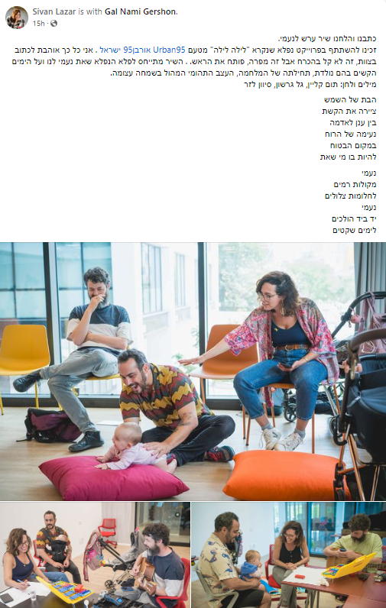
The Song as an Opportunity for Emotional and Creative Expression
Content analysis was performed on 13 of the written songs, revealing several prominent features:
In almost all of the songs (12), the babies are addressed directly in the second person. One song includes a first-person narrative, as if written from the baby’s perspective. Additionally, in most of the songs, the parents refer to themselves in the first person.
“Mommy, come here. I just have one more question. Why did the moon rise? Where do the stars come from?”
“Flowing through my body. We’re right here with you.”
“My heart is overflowing with joy because he’s my perfect little copy.”
Expressions of love for the children reflect the parents’ gratitude, appreciation, and the sense of security they wish to provide.
“Don't be afraid to wander off, we're here.”
“You remind us how beautiful the world is.”
“We waited for you for many years. You brought us back to life."
Descriptions of daily moments and shared experiences between children and parents reflect their everyday interactions and special moments, deepening the family bond and sense of connection. Some songs reference playful moments, while others describe bedtime routines and sweet wishes to accompany the children as they fall asleep.
“Play with your toys, take a look around“
“She’s splashing around in the water.”
“Now it's time for bed, time to dream. With your head resting quietly on the pillow. Drift off to sleep, it’s getting late. Your eyes grow calm and start to close, it's time for dreams.”
“I don’t want to sleep, you ask for one more story. Just one more, and that’s it.”
“From noisy sounds to peaceful dreams."
The children’s names or affectionate nicknames were used in 10 of the 13 songs.
“The daughter of the sun painted a rainbow, between the clouds and the earth. The wind sings its melody in the safe place.”
“You're an amazing blend of fire and water, waves upon waves of bright light, splashing around in the water.”
“Hear the birds sing, gaze above the trees, facing the sky. You caught a ray of sunshine in your eye.”
Most of the songs include elements related to the natural world: landscapes, the four elements (air, water, earth, and fire), plants, weather, and more, enriching the songs and connecting the children to nature.
Photo from Facebook
Expressions that convey parents’ hopes, dreams, and concerns for their children’s future, as well as the way they encourage their children to dream, imagine, and develop freely and creatively.
“Sail, Passionita, across the water.”
“Take that twinkle with you wherever you go.”
“We'll float above the sea, sail through the clouds, and touch the tree tops.”
“David, go explore the world. Don’t be afraid to wander. Set off on an adventure by plane, by ski, or by ship. Go your own way, the path will open for you.”
“Your dreams are on their way. Your dreams are just waiting."
About half the songs feature physical descriptions of the children, creating a vivid image and adding a visual layer to the lyrics. Most of these focus on the children’s eyes and smiles.
“Ori looks at me in the eye, full of patience and wonder at the world.”
“My Maya is wise and sensitive, full of love and generosity.”
“The two are oh so different. One waits patiently while the other screams. One opens up, the other goes within.”
“You're a little captain with a brave beating heart."
References to the children’s traits in the songs offer insight into their personality as perceived by the parents, who describe them as being wise, sensitive, loving, generous, patient, and full of wonder.
"Our dream came true, and once again, we became proud parents. Whispering to all three of you, you are the light of our home.” (A referencing the other siblings in the family)
“Dad wanted one last cigarette, but that didn’t happen because Dani was born. We waited for you for so many years, and Dad still sleeps with earplugs. Even if there are sleepless nights, you brought us back to life. We were given a gift - a calm, sweet baby girl.”
Expressions describing how the children have impacted and changed the parents’ lives and the family.

Slide 13
Musical Routine and Using the Song
Most survey respondents expressed high satisfaction with the song they had created and indicated that they expected to continue using it in the future.
In the opening survey, all respondents indicated that they listen to music at least two to three times a week, with most (74%) listening to music daily. Additionally, 84% reported that they frequently sing to their babies (scores of 5-7). In the follow-up survey, five respondents noted that they sang to their babies as much as they did before the workshop, while three reported singing to them more often since participating in the workshop.
Before the workshop, participants reported using music and singing during various activities with their babies, with bedtime being the most common. In the follow-up survey (N=8), all respondents said they sang or played the song they created during bedtime. In interviews, four couples shared that they use the song to help their baby fall asleep. Most interviewees noted that they tended to sing the song themselves rather than play the recording. Some also mentioned humming it at random times during the day, when the baby is restless, or during quiet moments together.
“I sing the song to him all the time. It’s very catchy and fun. When he’s with me, I hum and sing to him. I feel it calms him. Not necessarily this specific song - any sound, I feel, soothes him."
– Parent interview (NICU).
To what extent do you think you will use the song you created?
To what extent are you satisfied with the song you created?
How often do you sing to your baby (well-known songs or ones you've made up)?
Opening survey N=19
In the interviews and survey, some participants mentioned that they expected a more polished and refined final product, so they didn’t use the recording that much. Additionally, one parent shared in an interview that they didn’t find the song catchy enough.
“The song is a bit complicated, and I don’t remember it well. Aside from the lyrics, there are various breaks you need to keep in mind. It takes some practice, but once you go over the words, it flows better."
Not at all
Score of 2
Score of 3
Score of 4
Score of 5
Score of 6
To a very large extent
The musicians also noted the song’s usability as a key factor to consider in the creative process, highlighting the need to take into account the parents’ preferences and vocal abilities (in the context of recording the song in their own voices).
*This question was not presented to participants whose babies were hospitalized in the NICU at the time of the activity.

Slide 14
The Parenting Experience
Ways to Soothe and Comfort your Baby:
“Hug her, sing to her, play with her, smile at her and make her laugh, take her for walks in the stroller or carrier.”
“Sing to her, make sounds, play music for her, bounce on the physio ball.”
“Play calming songs, talk to him.”
Overall, parents’ responses in the opening survey reflected positive feelings about their daily parenting routines.
Most parents agreed that the family atmosphere was generally calm and relaxed, with many expressing confidence and satisfaction in their parenting. None identified with statements describing tension or stress in their daily home routine. However, about a third rated their skills as moderate or lower when handling crises and creating a positive family atmosphere.
In the opening survey, almost all respondents described their parenting experience as “happy.” About half said they felt supported and identified with expressions describing the parenting experience as “smooth and manageable” and “calm.” About half also described parenting as “hectic” and “exhausting,” while a small number expressed feelings of frustration and needing a break.
Opening Survey*
N=13
Our family atmosphere is generally calm and relaxed.
Our daily routines (waking up, bedtime, meals, etc.) are often tense and stressful.
I feel confident in my parenting skills.
I know how to handle daily crises with my baby effectively
I generally derive satisfaction from parenting.
Only a small number of participants responded to the follow-up survey (N=8), and of them, only a few reported higher ratings on statements reflecting positive experiences and feelings about their routine, as well as on the reverse statement indicating tension and stress in daily activities. Additionally, no notable changes were observed in the choice of expressions. Due to the low response rate, it is difficult to identify any significant differences between the opening and follow-up indicators.
I have good tools, methods, or ideas for soothing my baby.
I have good tools, methods, or ideas for creating a positive atmosphere in the family.
Not at all
Score of 2
Score of 3
Score of 4
Score of 5
Score of 6
Strongly agree
What best describes your current parenting experience?
Opening survey N=19, multiple choice question
In the interviews, participants reported that the workshop provided an exciting and enjoyable family and couple experience, giving them a chance to pause and focus inward on the family and the babies, strengthening their bond. However, it seems the workshop’s main impact was felt primarily within the sessions themselves, as interviewees found it difficult to attribute any lasting effects on their family relationships or daily routine, noting no significant changes in their family life or parenting experience beyond the experience of participating in the workshop itself.
11%
53%
53%
Frustrating
Hectic
21%
I feel supported
I need a break
95%
42%
53%
Happy
Smooth and manageable
42%
Calm
Exhausting
*These statements were not presented to participants whose babies were hospitalized in the NICU while the activity was being held.

Slide 15
Support Networks and Social-Community Belonging
Childhood Memories:
“They sang songs to me, rocked me in a cradle, whispered 'shhh' until I fell asleep, hugged and kissed me.”
“They would sing songs to me, play with me, hug me, and hold me in their arms.”
In the opening survey, almost all respondents said they consulted and shared information about baby care with their partners. Over half mentioned seeking advice from friends, and 42% said they sought advice from extended family. Additionally, 21% reported that grandparents often played music or sang to their babies. In the follow-up survey, all respondents (N=8) said they shared the song they had created or their workshop experience with extended family, and most also shared it with friends.
“We shared the song, sent it to a few close friends and family WhatsApp groups, without really thinking about whether they’d actually use it." – Parent interview
“The workshop was a wonderful experience, and we loved every moment of it, including the final result. To this day, we still sing the song and share it with friends.” – Parent survey
שיתוף והתייעצות בנוגע לטיפול בתינוק*
סקר פתיחה N=19 שאלת בחירה מרובה
84% of respondents to the opening survey reported having a strong family or social support system
(scores of 5-7) regarding baby care. In the follow-up survey, no significant changes were observed.
Twice as many respondents noted that the workshop helped them connect with other parents and form new relationships (29% in the closing survey, N=24, compared to 16% in the opening survey, N=19).
Four respondents from the closing survey expressed a desire for the program to continue within the community, suggesting various platforms to maintain and strengthen connections.
“Creating a platform to stay connected with the other families - maybe another musical activity for the families and babies, something that strengthens group bonds.” – – Parent survey
Respondents to the follow-up survey (N=8) reported not staying in touch with other participants.
In the interviews, participants highlighted the added value of the group experience. While the connections did not continue once the workshop ended, the group setting seemed to enrich the overall experience.
“The group aspect was really important. I think the key was being exposed to others. It wouldn’t have been as meaningful if we had only met with the musician.”
“It made it more fun."
32%
42%
11%
One interviewee shared that the workshop introduced him to the LGBTQ+ Center, and he was happy to discover its activities for the first time. He mentioned already marking a few events that would be relevant for his family.
I have a supportive family/social network when it comes to caring for my baby.
11%
*In the NICU, the question was phrased: Who do you talk to and/or seek advice about your feelings as a parent these days?
**This question was only asked in the NICU.
5%
Not at all
Score of 2
Score of 3
Score of 4
Score of 5
Score of 6
Strongly agree
15

Slide 16

The Professional Team
“An amazing project. It really lit up my month.”
“Such a beautiful initiative. I’m very curious to see how it will develop." (Musicians)
In the focus group, the musicians spoke about feeling a personal connection to the project, which inspired them to join.
Additionally, the project’s professional framework, which included a solid, well-informed foundation, academic support, and respectful conditions, strengthened the musicians’ commitment and motivation to participate.
“I love lullabies! That's how I got into music. There's something so fundamental and powerful about them, it just really moved me.”
“Meeting the parents, being part of that soft, hopeful beginning.”
“It felt like AI was offering me a job... something musical, community-driven, and process-oriented, with the lullaby aesthetic - that’s what I’m all about as an artist."
" Knowing that this project is well thought out and truly meaningful gave me confidence."
Training: The musicians gained in-depth theoretical knowledge throughout their preparation, which enhanced their intuitive understanding of the experience the project sought to offer. Their professional expertise as musicians also helped them lead the sessions and adapt to the diverse communities they worked with.
"A musician doesn‘t need to come from the same background or belong to the same community. They need to be a sensitive professional, that’s all."
– Musical Director
The main concerns raised were about the musicians' preparedness to guide the lyric-writing process and the feasibility of completing everything within in a short timeframe, particularly in the single-session workshop. To address this, they requested a toolkit to help them guide the writing process and suggested various exercises and methods that could be used in both group and one-on-one settings during the creative process.
The musicians’ personal experience seems to have been very positive; they noted the supportive environment and strong sense of belonging they experienced.
However, they also mentioned the challenge of balancing their own creative connection to the process as artists, with the need to respect the participants' creative wishes as facilitators.
“There's room here for everyone to make their own unique contribution... something about the approach feels very inclusive and welcoming. It’s all about being attentive and present."
The project’s musical director noted that beyond its clear benefits for participants and the community, the initiative has the potential to foster community development among the musicians, contributing to a broader cultural impact on the city.
“As facilitators, having the opportunity to meet after each session, even briefly, to talk and process our experiences was incredibly valuable.”
They also emphasized the value of their discussions with one another for seeking advice, offering support, and processing their experiences as facilitators.
*The complete transcript of the focus group was submitted to the Urban95 team as part of the full set of raw materials.

Slide 17
Production
As the project expands, here are a few key issues to consider in terms of planning and production:
Adapting the Project for Unique/underprivileged Populations:
  For underprivileged groups, availability during standard working hours may be limited Therefore, we recommend scheduling sessions during leisure hours to allow both partners to participate.
  Siblings may also need to be accommodated, either by involving them in the activity or by providing a supervised parallel program.
  For non-Hebrew-speaking communities, we recommend adapting recruitment materials, preliminary information, and registration forms to their language. However, the professional team agreed that the activity itself can be conducted as-is, without requiring a linguistic or cultural match between the musician and the family.
Location:
  Involving local community teams improves the overall experience at the meeting site by helping to prepare the space, greet participants, and create a sense of community around the event.
  For example, at the LGBTQ+ center, the space was set up welcomingly, and the local staff introduced the center’s activities (one participant mentioned they were previously unaware of the center’s offerings and appreciated the exposure). In contrast, at the Da Vinci Center, the setup was more business-like, requiring greater involvement from the project team in preparing the space for the activity.
  Having a space equipped with larger instruments is a big advantage. While the musicians brought their own keyboards and portable instruments, having a piano on-site significantly enhanced the quality of the musical experiences.
Collecting and Organizing Outputs:
  We recommend using continuous recording devices for the entire session. While musicians brought portable recording devices and used smartphones as backups, the project producer suggested recording each session from the beginning to free musicians from technical tasks and ensure that no “magical moments” are missed.
  Recording archive: As the project expands and the number of recordings grows, we recommend creating a dedicated digital platform to organize and store all outputs.
NICU:
  The constraints and unique circumstances in the NICU led to shorter sessions compared to those with other groups.
  The NICU staff demonstrated a high level of care and sensitivity toward their patients, which made the recruitment and coordination process more challenging and time-consuming. In this context, engaging and collaborating closely with the staff is essential to the initiative's success.
  Considering the shorter session time and the high level of involvement from NICU staff, it was suggested that some preparatory work be included in the initial communication with participants. For example, when explaining the project and obtaining consent, the staff could initiate a discussion with the parents, encouraging them to reflect on the song by using simple methods such as jotting down feelings, wishes, or ideas they’d like to include. This way, participants might come better prepared, helping to make up for the limited session time.
  Given the limited space in the hospital, it’s important that the activity kit be compact and portable and include both musical instruments and recording equipment.
Measurement and Evaluation:
  To minimize the need for multiple follow-ups with participants for surveys, we recommend conducting evaluations during the session itself, either before or after, depending on the type of survey.

