Slide 1
Urban95 Israel
Strategy
October 2024

Slide 2
A City in which to Grow up
Early Childhood:
A Cornerstone for Improving Quality of Life
in Israeli Cities
Notes:
This would also be suitable as ‘A City to Grow up in’

Slide 3
Chapters
The Work Process
Strategic Baseline based on a Current Situation Analysis
Strategy | Goals, Values, Model, and Picture of Success
The Action Plan
Implementation and Integration
Slides 4-10
Slides 11-28
Slides 29-48
Slides 49-60
Slides 61-64

Slide 4
1
The Work Process

Slide 5
The Work Process | Goals
1
2
3
4
Formulating and developing a strategic plan and spheres of impact for Urban95 Israel, including implementation models
Engaging
key stakeholders
and establishing
cross-sector partnerships
Building a
supportive organizational infrastructure
for implementing the strategic initiative
Positioning Urban95 Israel as an innovative national center for practical knowledge with strong international connections

Slide 6
The Work Process | Milestones
Current Situation Analysis
Extracting Insights and Identifying Opportunities
Shaping a Vision and Developing Areas of Action
Approving the Strategy
April-May
June-July
August-September
November
In-depth interviews
Document and report analysis
Teamwork meetings
Extracting practical knowledge
Workshop for developing the vision and areas of action
Teamwork meetings
Developing strategic interfaces
Presentation to the BVL Foundation and the Green Building Council and applying feedback
Council Conference
Flagship meeting with network cities
Lighthouse tour
Lighthouse cities workshop

Slide 7
The Work Process | Current Situation Analysis
What can we learn from Urban95’s activity and partnerships in Israel so far?
What can we learn from various models for working with municipalities in Israel and around the world?
What can we learn from the
BVL Foundation’s global network?
What insights we gain based on the current situation of early childhood in Israel?
What
How
In-depth interviews
Workshops and roundtables
Analysis of documents and reports from the Center for Educational Technology (CET)
Extracting practical knowledge from working with municipalities
Learning from global practices

Slide 8
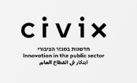
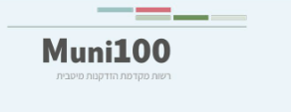
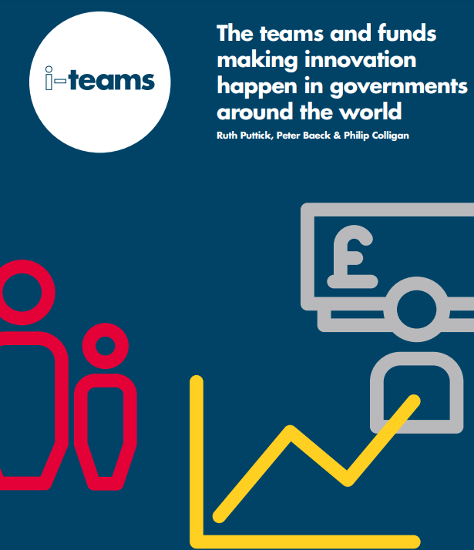
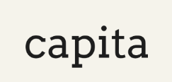
The Work Process | Analyzing Models for Working with Municipalities
Categories:
Goals
Target Audiences
Partnerships
Programs
Products
Networking and Community
In Israel:
Globally:

Slide 9
The Work Process | In-Depth Interviews
Daniella Ben Atar & Michal Warnick | BVL Foundation
Tal Mills | Israeli Green Building Council
Dr. Dana Shai | SEED Center
Landscape Architect Ram Eisenberg | REED Environmental Design
Tami Gavrielli and Architect Gido Segal | Gavrielli Segal
Prof. Els Verbakel and Adva Matar | Bezalel Academy of Arts and Design
Architect Michal Kugler | Studio 1:1, Technion
Matan Barel | Maoz
Roy Bigger | Civix
Edith Bar | Bloomberg-Sagol Center for City Leadership
Neta Rosenthal | Hazira
Simon Battisti | Qendra Marrëdhënie
Ankita Chachra |Capita
Hila Bar Ner | GDCI
Hagit Na’ali Yosef | Director of Strategic Planning, Tel Aviv-Yafo Municipality
Maya Kratbary | Forum 15
Architect Inbar Weiss | Former City Engineer of Beit Shemesh
Vered Carmon and Mimi Ackerman | Ministry of Welfare and Social Affairs
Architect Vered Salomon-Maman | Ministry of Construction and Housing
Architect Naomi Angel
Claudia Vidigal | BVL Foundation
Alona Tsirolnikov | CET

Slide 10
The Work Process | Arab Society and Ultra-Orthodox Society
1
3
Extracting practical knowledge from working
with municipalities
Mapping relevant stakeholders and initiatives
Analyzing CET documents and reports
2
4
Identifying partnerships and developing a tailored strategic initiative
Building the team’s capacity to lead the process

Slide 11
2
Strategic Baseline based on a Current Situation Analysis
Notes:
נקודות מותא לאסטקטגיה, על בסיס ניתוח המצב הקיים.......

Slide 12
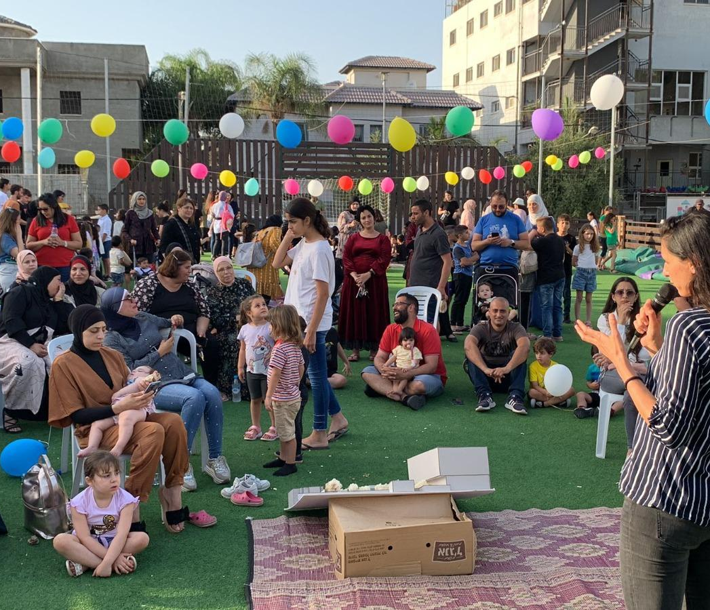
Baseline | Insights Gained from Working with Municipalities
טירת הכרמל
Beit Shemesh
Tirat Hacarmel
Baqa al-Gharbiyye
דימונה
Be’er Sheva
Rishon Lezion
Tira
Ashdod
Dimona
Lod
Netanya
Ra’anana
Afula
הכשרת ערי מגדלור
Anchor cities
Training network cities
Training lighthouse cities

Slide 13
Baseline | Insights Gained from Working with Municipalities
Process Framework
Designing a phased “city journey” - a structured, step-by-step approach enabling deeper knowledge development and broader participation within the municipality.
Incorporating a municipal filtering mechanism tailored to the level of collaboration, teamwork, and capacity for implementation and integration.
Engaging with Municipality
Delivering customized solutions for Arab municipalities, addressing the needs of both individual municipalities and the group as a whole within the Urban Israel network.
Refining Urban’s support model to balance investment versus impact across municipalities (e.g., anchor cities vs. network cities).
Models
The anchor city as a completed learning model, with Beit Shemesh going on to continue as a strategic city.

Slide 14
Baseline | Insights into Arab Society
Violence and Crime in Arab Society The escalation of violence in Arab society over the past decade has reached unprecedented levels. This phenomenon has far-reaching consequences that impact every aspect of daily life, particularly effective parenting, the sense of security and trust in the authorities, and walking through and spending time in public spaces. Challenges in Working with Municipalities
Difficulty with recruiting skilled professionals, with existing staff often lacking the necessary qualifications or being unsuitable for their role.
A noticeable gap between verbal commitments and proactive efforts to take ownership and drive progress independently.
Regarding the municipal team - limited availability for and attention to programs and tasks not directly tied to salary incentives.
Sustainability issues with maintaining staff, public spaces, and initiatives over the long term.

Slide 15
Baseline | Insights into Arab Society
Looking Ahead (Insights from Consultant Mohanad Birkadar)
Arab society needs to see tangible, visible actions. Observable changes hold more value for this population than capacity building or working with municipal teams.
We recommend beginning with stronger cities to achieve meaningful results that can resonate across the Arab community, amplifying both the impact and the message.
The Arab media plays a critical role in connecting cities. Success in one city can reverberate and inspire change in others. Therefore, engaging with the Arab media is crucial for the program to gain momentum and visibility.
To effectively address the needs of Arab society, it is important to develop a dedicated ecosystem that includes tailored communication strategies, peer groups, and safe zones.

Slide 16
Baseline | Insights into Ultra-Orthodox Society
Working with the Municipality
Allocating energy and resources to manage and build the municipal team.
Establishing a direct and meaningful communication channel with the city leadership.
Direct Engagement and Communication with Key Female Residents
Establishing a structured approach to resident engagement by identifying influencers in each neighborhood and street, listening to their perspectives, and connecting them with municipal representatives based on needs raised in the conversations.
Tailoring communication methods to the community’s needs, with an emphasis on building strong local connections, down to knowing the names of mothers and children.

Slide 17
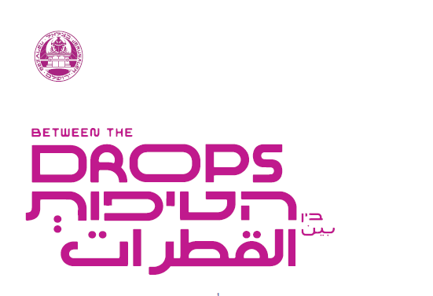
Baseline | Insights from Existing Partnerships

Slide 18
Baseline | Insights from Current Partnerships
Establishing the Partnership
Engaging municipalities early in the process – connecting a research body, government entities, and the municipality from the outset.
Ensuring each partner contributes to the collaboration with a clear understanding of needs and available resources at the start.
Pooling resources by identifying funding partners beyond government ministries.
Developing the Work Process
Developing a collaborative process that includes all relevant stakeholders.
Creating a transparent and structured work plan with clear timelines, milestones, and defined deliverables.
Aligning expectations on desired outcomes and impact, be it a competition, a strategic document, or a collaborative initiative.
Implementation and Accessibility
Focusing on developing practical, actionable knowledge tailored to meet the end users' needs.
Working with the Council
Adding interfaces with various council departments, including knowledge-sharing, personnel, and networking with municipalities and the business sector.

Slide 19
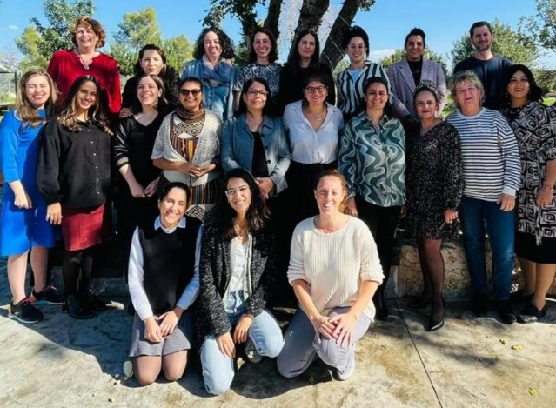
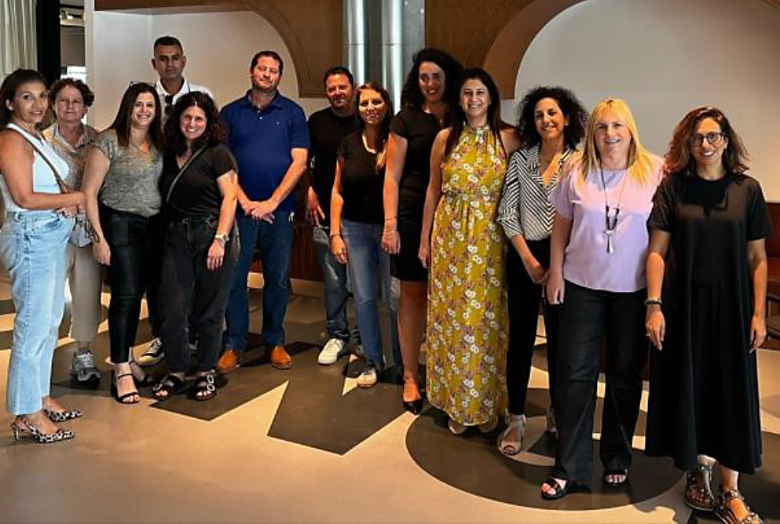
Baseline | The Significance of the Urban Community
קהילה

Slide 20
Baseline | The Significance of the Urban Community
Benefits
Facilitating networking among municipalities to enable effective peer learning.
Key Features
Creating a space for open dialogue that encourages sharing failures and challenges to foster in-depth learning.
Building a community that feels like a movement - both professionally and personally: “I’m part of Urban!” as a source of pride and identity.
Hosting events that promote meaningful connections, professional advancement, and personal growth.
Tools
Leveraging digital platforms for communication and knowledge transfer.
Resources
The Green Building Council is a valuable resource and presents an opportunity to expand and strengthen the community.
The Tel Aviv-Yafo Municipality is a key partner, and building and developing shared interfaces collaboratively is important.
תהליך אסטרטגי אורבן95 ישראל
קהילה
קהילה

Slide 21
Baseline | The Context of the Challenges Facing Israel in 2024
Population Growth and Density
Urban Densification and Depletion of Natural Resources
Climate Change and the Heat Crisis
Cost of Living, Socioeconomic Gaps, Poverty, and Work Hours
War, Crime, and Violence
Psychological Impact and Emotional Availability

Slide 22
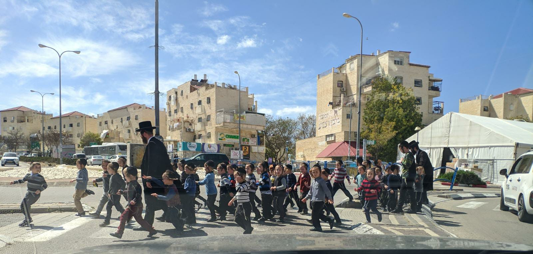
Baseline | The Context of the Challenges Facing Israel in 2024
Israel has the fastest population growth rate and is projected to be the OECD’s most densely populated country by 2040.
Photo by architect Ohad Cohen

Slide 23
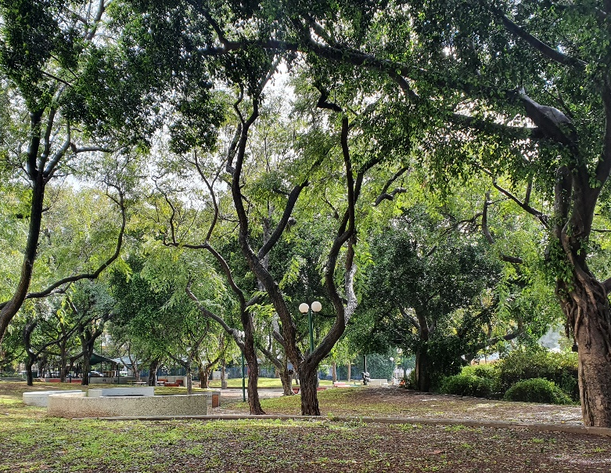
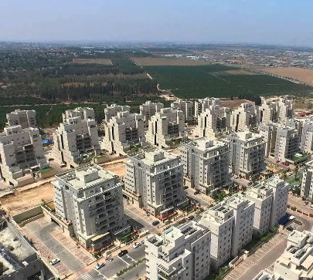
Baseline | The Context of the Challenges Facing Israel in 2024
Increasing urban densification and corresponding depletion of natural resources

Slide 24
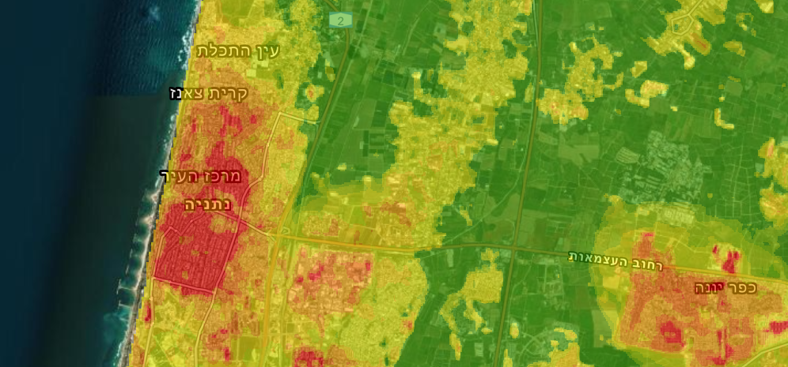
Baseline | The Context of the Challenges Facing Israel in 2024
ציפוף עירוני גובר וצמצום משאבי טבע בהתאמה
Climate Change and Heat Crisis

Slide 25
Baseline | The Context of the Challenges Facing Israel in 2024
Cost of Living, Socioeconomic Gaps, Poverty Rates, and Work Hours
Israel ranks as the most expensive country in the developed world for 2024, with its workforce logging more hours than the average in developed nations.
(Taub Center, State of the Nation Report, 2023)

Slide 26
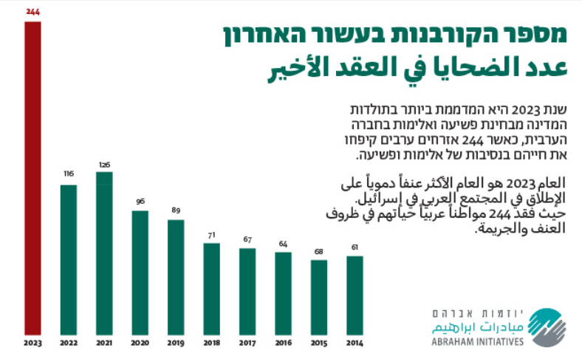
Baseline | The Context of the Challenges Facing Israel in 2024
War, Crime, and Violence

Slide 27
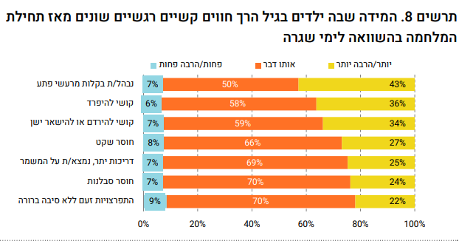
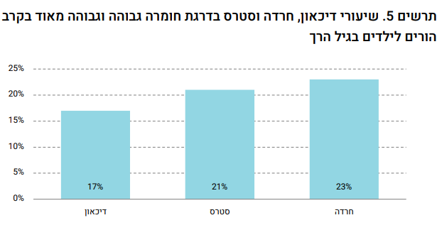
Baseline | The Context of the Challenges Facing Israel in 2024
The Psychological Impact on Parents and Their Lack of Emotional Availability
Emotional and Behavioral Challenges among Young Children and Their Parents: An Updated Overview in Light of the War, by Carmel Blank, Dana Shay, Yael Navon, Sarit Silverman, and Yossi Shavit, February 2024

Slide 28
Baseline | The Context of the Challenges Facing Israel in 2024
Population Growth and Density
Urban Densification and Depletion of Natural Resources
Climate Change and the Heat Crisis
Cost Of Living, Socioeconomic Gaps, Poverty, and Work Hours
War, Crime, and Violence
Psychological Impact and Emotional Availability
Critical Issues and Relevant Content Areas
Potential Partnerships
Positioning Urban95 Israel among the Key Stakeholders in the Public Arena

Slide 29
3
Strategy
Goals, Values, Model, and Picture of Success

Slide 30
Overarching Goals
Transforming perceptions and advancing early childhood initiatives, recognizing early childhood as the foundation for improving social, economic, and environmental conditions in Israeli cities.
Building capacity and cultivating public leadership, empowering leaders to champion early childhood, develop a clear vision, craft effective policies, and implement actionable plans.
Creating a multi-sectoral interdisciplinary movement that brings together professionals committed to advancing early childhood initiatives and public policy leaders who prioritize early childhood as a key agenda at both the local and national levels.

Slide 31
Guiding Values
Inclusion, diversity, and tailored approaches for unique communities
Advancing healthy and inclusive cities that benefit everyone
Engaging and building cross-sectorial and intra-municipal partnerships

Slide 32
Parental Well-Being
Heat and Climate Change
Healthy Development
Urban95 Israel
Content Areas
Resilience and Growth
Beneficial Public Space
Community

Slide 33
Community
קהילה
The Spheres of Impact Model
Knowledge
Municipal Programs
Strategic Partnerships

Slide 34
Sphere of Impact #1 | Municipal Programs
Goals
קהילה
Community
Supporting municipalities in comprehensive and in-depth processes
Developing and extracting practical knowledge
Implementing and driving real change – across organizational structures, services, and public spaces
Building capacities and cultivating leadership across municipal departments
Incorporating an innovative approach within municipalities
Fostering networking and peer learning among municipalities
Knowledge
Municipal Programs
Strategic Partnerships

Slide 35
Sphere of Impact #1 | Municipal Programs
Urban95 Training Models for Municipalities
קהילה
Training Network Cities
Training Lighthouse Cities
Target audience: Mid-level professionals
Description: Introductory training
Duration: 2 phases (basic training + advanced training) – 1 year in total
Goal: Knowledge acquisition, tool implementation, and practical application
Outcome: Pilot program in the municipality
Target audience: Senior-level professionals
Description: Intensive “fast-track” training
Duration: 3-day tour + joint training – 6 months in total
Goal: Knowledge transfer + peer learning among municipalities
Outcome: Establishing a forum within the municipality

Slide 36
Sphere of Impact #1| The Municipalities’ Journey with Urban 95
קהילה
Phase II – Delving Deeper and Implementation
Phase III - Continuity
Phase I – Knowledge Transfer
Training Network Cities
Mapping and data collection + submitting a municipal challenge via a call for proposals
Joint training for municipalities in relevant content areas
+
Pilot program in the municipality with mentoring support
Training mid-level professionals
Topic-specific calls for proposals / International
Strategic City
Training Lighthouse Cities
Training senior-level professionals
Joint training
+
Advancing a forum within the municipality
The Urban Community
Anchor City

Slide 37
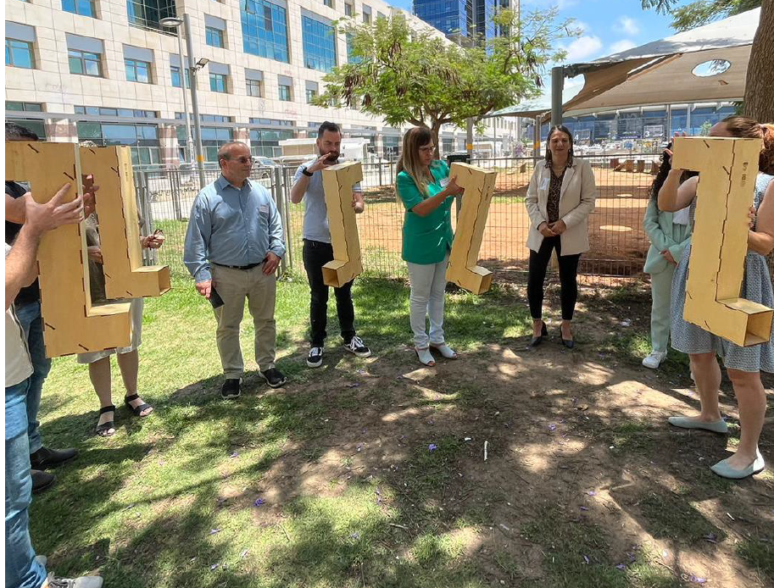
Sphere of Impact #1 | Strategic City
What’s a Strategy City?
One that has completed the practical knowledge development stage and is ready to deepen and expand its efforts.
Prioritizes the needs of children and their families, fostering collaboration across municipal departments to address those needs.
Expands early childhood initiatives into diverse areas, including community development, climate action, construction, public spaces, and more.
Dedicates a professional team specifically assigned to early childhood initiatives, supported by an engaged and proactive municipal leadership.
Demonstrates high capacity for implementation, resource allocation, and effective leadership.
Seeks to be part of a national and international network of cities.

Slide 38
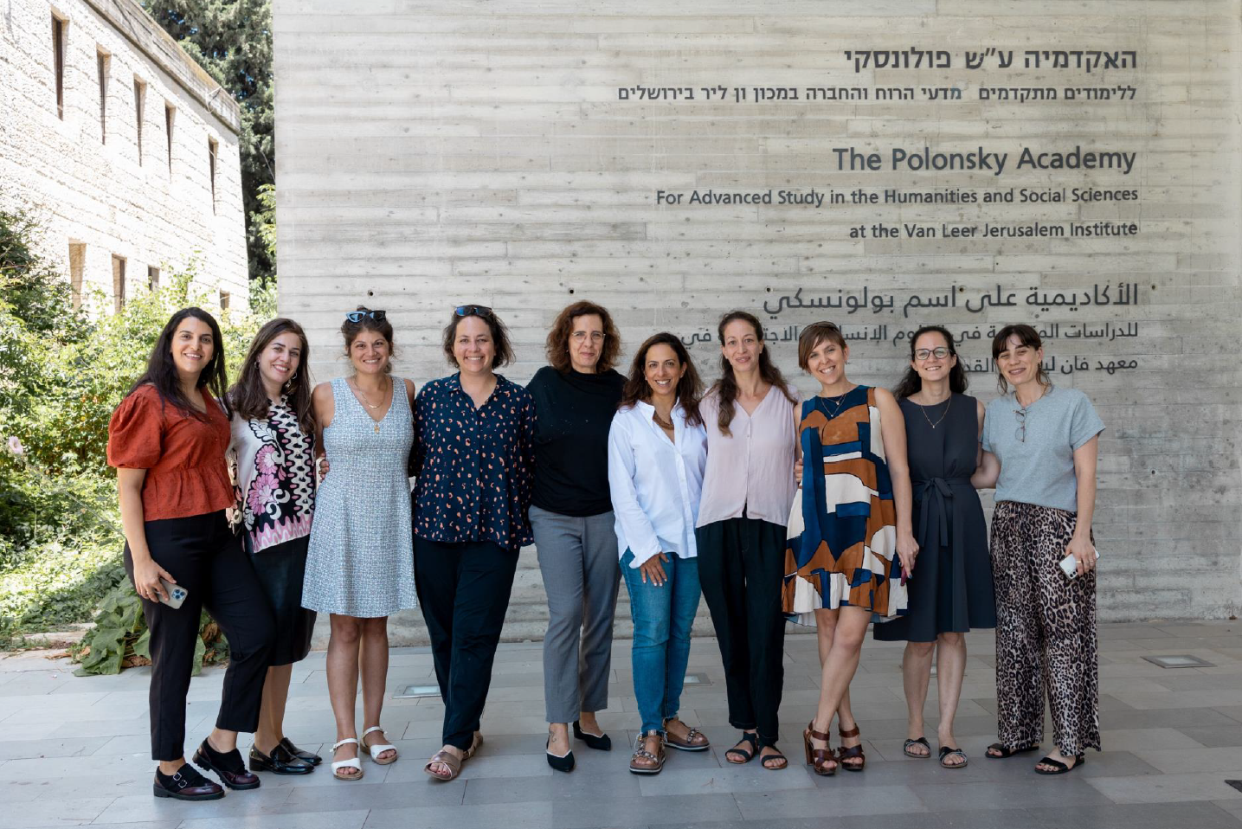
Sphere of Impact #1 | Strategic City
How does Urban95 Israel support strategic cities?
Platform and partnership infrastructure supporting a structured process
Tailored training days focused on principles for planning for children
Professional mentoring and guidance
International content and training, including tours, webinars, and community meetings
Funding for development and research
Evaluation and measurement
Connection to the Israeli Green Building Council: providing tools, knowledge, and communication
Promotion, exposure, and showcasing and sharing projects

Slide 39
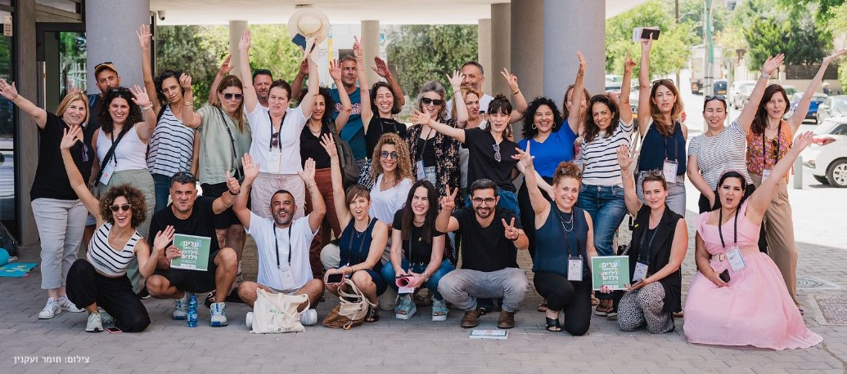
Sphere of Impact #1 | Transitioning from a Strategic City to the Next Lighthouse City
Scaling
Impact
Policy
Management
Organization
Innovation
Expanding activities and establishing a mechanism
Impacting the majority of children in the city; “visible results on the ground”
Formulating and adopting a municipal policy
Engaged and proactive leadership
Cross-departmental action, integrated into the city’s DNA
Innovative and creative solutions to challenges

Slide 40
Sphere of Impact #2 | Strategic Partnerships
Goals
קהילה
Community
Influencing policy and action on the ground
Knowledge development and expansion
Broadening target audiences
Engaging additional sectors: government, civil society, private sector, and academia
Pooling resources
Strengthening efforts within municipalities
Knowledge
Municipal Programs
Strategic Partnerships

Slide 41
Sphere of Impact #2 | Strategic Partnerships
Potential Directions for Action
קהילה
Government
Dedicated guidelines for adapting spaces for early childhood in urban renewal processes - Urban Renewal Authority
Expanding planning guidelines – Ministry of Construction and Housing
Ministry of Welfare
Civil Society
Ma’oz / Bloomberg-Sagol
Municipalities
Tel Aviv-Yafo Municipality – knowledge development
Strategic cities
Academia
NUR (Negev Urban Research)
Business Sector
Unique populations:
Ultra-Orthodox
Arab

Slide 42
Sphere of Impact #3 | Knowledge
Goals
קהילה
Community
Enhancing accessibility and dissemination of knowledge and initiatives
Developing practical knowledge
Training programs
Standardization
Preserving and managing organizational knowledge
Positioning Urban95 Israel
Making global knowledge accessible
Knowledge
Municipal Programs
Strategic Partnerships

Slide 43
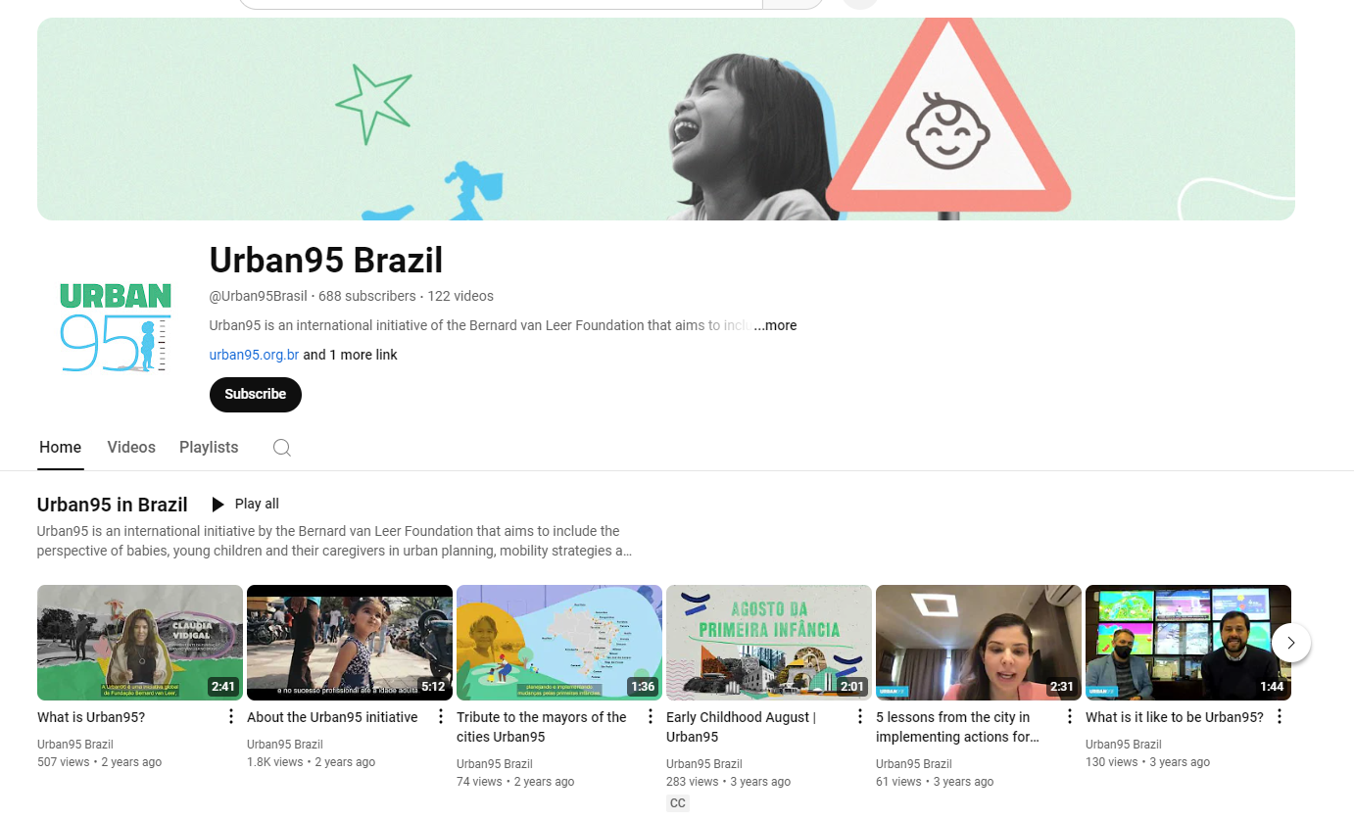
Sphere of Impact #3 | Knowledge
Directions for Action
קהילה
Establishing Dedicated Platforms
Launching a website, opening and managing a YouTube channel, managing an Instagram account, hosting webinars, and creating a podcast.
Developing Knowledge for Distribution
Producing guides, delivering lectures, summarizing tours, and more.
Making Knowledge Accessible
Sharing content via digital platforms
Delivering lectures at training sessions and seminars (e.g., Forum 15)

Slide 44
Sphere of Impact #4 | Community
Goals
קהילה
Community
A sense of pride in being part of urban95
Developing and making professional knowledge accessible
Increasing the number of change agents across sectors
Peer learning and networking
A platform for collaboration and initiatives
Connection to Urban95’s international community
Knowledge
Municipal Programs
Strategic Partnerships

Slide 45
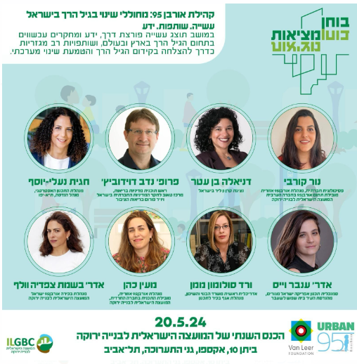
Sphere of Impact #4 | Community
Directions for Action
קהילה
Mapping urban communities and tailoring content and training
An Urban95 session at the Green Building Council conference
An annual gathering for the municipality community
Community management across various platforms

Slide 46
How will we know we succeeded?
קהילה

Slide 47
How will we know we succeeded?
קהילה
Municipal Programs
Many municipalities in Israel prioritize early childhood development. The political leadership within these municipalities acknowledges the significance of this issue and drives the development of policies, while professional teams implement tailored practices through cross-departmental collaboration. This paradigm shift is evident in organizational, community, and spatial aspects. Residents experience the tangible benefits of these efforts through enhanced services and public spaces designed to meet the needs of young children and their caregivers.
Strategic Partnerships By collaborating with government ministries, civil society organizations, academia, and the business sector, Urban95 has expanded its reach to additional sectors and target audiences, amplifying its influence on early childhood in Israel. These partnerships are pivotal in advancing and implementing innovative policies, conducting research, and promoting best practices.

Slide 48
How will we know we succeeded?
קהילה
Knowledge Urban95’s work with municipalities and strategic projects is translated into accessible, clear, tailored, and practical knowledge. This knowledge supports data-driven decision-making processes and optimizes the adaptation of services and infrastructure for young children and their caregivers. Urban95 disseminates this knowledge through diverse platforms, reaching a broad audience in Israel and worldwide.
Community Members of the Urban95 community feel a strong sense of belonging to the community, which serves as a hub for peer learning and professional and personal growth. The community infrastructure includes interest groups, joint activities, and events that strengthen pride and foster connections among members and with Urban95. Community members grow as agents of change, driving innovative initiatives and leading projects to advance early childhood development across various sectors and platforms.

Slide 49
4
The Action Plan

Slide 50
The Action Plan | Goals to Achieve by the End of 2025
Municipals Plans
Strategic Partnerships
Knowledge
Community
Scaling: Expanding the number of municipalities participating in Urban95 Israel training.
Enhancement: Broadening the scope of activities and engaging a diverse range of stakeholders within municipalities to advance the field of early childhood.
Building cross-sector interdisciplinary partnerships to advance early childhood development in research, policy, and practice
Developing multidisciplinary practical knowledge and adapting it for diverse target audiences
Fostering a sense of belonging and engagement
Maintaining and increasing the number of change agents
At least:
1 government partnership
1 civil society partnership
2 strategic cities
About 20 municipalities belonging to the Urban95 Israel city network
2 knowledge products
grounded in practical knowledge extraction
Launching research initiatives
2 dedicated Urban sessions
2 tours/training sessions per year
1 webinar

Slide 51
The Action Plan | Goals to Achieve by the End of 2028
Municipals Plans
Strategic Partnerships
Knowledge
Community
Scaling: Expanding the number of municipalities participating in Urban95 Israel training.
Enhancing: Broadening the scope of activities and engaging a diverse range of stakeholders within municipalities to advance the field of early childhood.
Building cross-sector interdisciplinary partnerships to advance early childhood development in research, policy, and practice
Developing multidisciplinary practical knowledge and adapting it for diverse target audiences
Fostering a sense of belonging and engagement
Maintaining and increasing the number of change agents
Every year:
1 dedicated Urban sessions
2 tours/training sessions
1 webinar
At least:
3 government partnerships
1 business sector partnership
2 research body partnerships
2 civil society partnerships
5 strategic cities
40 municipalities belonging to the Urban95 Israel city network
6 knowledge products
grounded in practical knowledge extraction

Slide 52
The Action Plan | Decision-Making Mechanisms and Project Development
Policy Development
An integrated mechanism: The VLF Foundation and the Israeli Green Building Council
Topic-Specific Expert Advisory Committee
Establishing multi-sectoral advisory committees for strategic topics requiring development and innovation, e.g., a healthy neighborhood index/climate and heat/ parental well-being and resilience
Dedicated Roundtables
Holding dedicated roundtables as part of strategic projects for the Arab and ultra-Orthodox communities.
Israeli Green Building Council
BVL Foundation
Multi-sectoral Partnerships

Slide 53
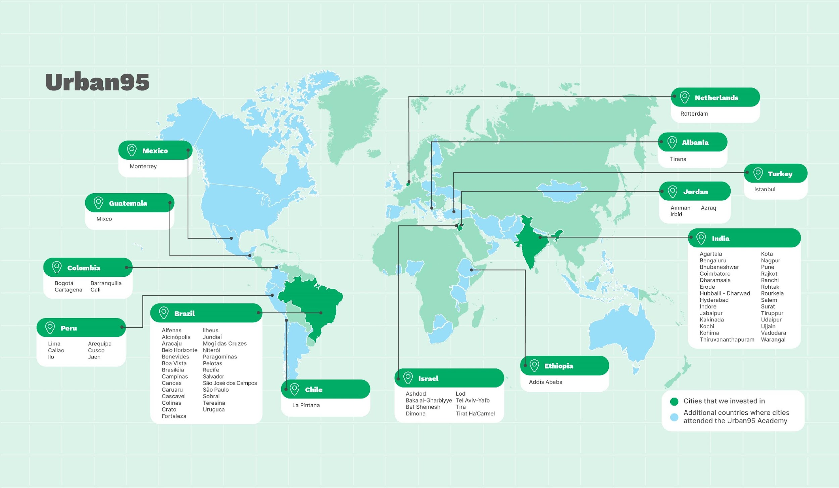
The Action Plan | Organization
Knowledge management and preservation, including establishing mechanisms and digital platforms for ongoing management, preservation, and dissemination of knowledge through various means (website, videos, podcasts, documents, and more).
Building a supportive organizational infrastructure for the team, including professional and personal development opportunities and access to digital tools.
Strengthening international ties with the BVL Foundation, including networking with foundation staff and international experts, providing access to knowledge, invitations to conferences, and more.

Slide 54
The Action Plan | Updating the Organizational Infrastructure
The Current Organizational Infrastructure
Urban Expansion Director
Ashdod Coordinator
Tira Coordinator
Beit Shemesh Coordinator
Professional Advisor
Strategic
Advisor

Slide 55
Action Plan | Updating the Organizational Infrastructure
Proposed Organizational Infrastructure
Urban95 Israel Director
Municipalities and Partnerships Director
Knowledge and Training Director
Operations Director
Urban Israel Community
Municipalities Lead and Director of the General Population Sector
Municipalities Lead and Director of the ultra-Orthodox Sector
Municipalities Lead and Director of the Arab Sector
Digital Content and Assets
Urban Ashdod Director

Slide 56
The Action Plan | Role Description for the Urban Team
Operations Director
Budget management (monitoring and oversight)
Logistics
Planning and logistics for community events, tours, seminars, and training sessions
Responsible for the digital infrastructure and streamlining processes for the team
Reporting to the BVL Foundation
Tracking and delivering outputs
Administrative management
Urban Community Director (position not yet filled)
Developing a plan for managing Urban communities (general community, lighthouse cities, network cities)
Organizing ongoing community events based on needs and opportunities identified from the field (content development will be done in collaboration with the Knowledge and Training Director)
Managing communities on digital platforms (WhatsApp groups, Facebook groups)

Slide 57
The Action Plan | Role Description for the Urban Team
Knowledge and Training Director
Developing a plan to disseminate and share urban95’s knowledge:
Extracting practical knowledge from Urban95’s work with municipalities and strategic partnerships.
Structuring knowledge for accessibility and distribution (e.g., guides, videos, one-pagers) in collaboration with the Digital Content and Assets Team.
Creating new knowledge based on strategic topics identified by Urban95 (e.g., heat and climate; resilience and war).
Preparing specialized materials for municipality training programs - lighthouse cities and network cities.
Crafting materials for Urban95 events, such as sessions at council conferences and professional tours for the Urban community.
Supervising the Digital Content and Asset Director
Digital Content and Assets
Creating and maintaining dedicated digital platforms to disseminate knowledge and increase Urban95’s visibility.
Developing relevant materials for digital platforms (e.g., websites, social media, newsletters).
Publishing materials and tracking their reach.
Planning and executing digital campaigns to promote Urban95 initiatives.
Implementing strategies to foster user engagement, managing digital interactions, responding to inquiries, and building a dialogue with audiences.

Slide 58
The Action Plan | Role Description for the Urban Team
Municipalities and Partnerships Director
Team: Providing ongoing guidance and support for municipal leads.
Municipal Programs
Managing mentorship for Urban95 cities, including hands-on involvement to advance initiatives and develop solutions for early childhood and urban infrastructure challenges.
Direct management of municipal programs (network cities + lighthouse cities) from the advanced development phase through implementation.
Tel Aviv-Yafo Lighthouse partnership (city selection + tour).
Spearheading the development of partnerships with strategic cities and providing ongoing support.
Developing, organizing, and managing topic-specific calls for proposals (e.g., climate and heat, resilience and war).
Coordinating and managing cities’ participation in international programs (e.g., INSEAD, LSE).
Developing collaborations with various sectors to amplify the impact on municipalities.
Managing strategic partnerships, including overseeing and executing joint projects.
Local Authority Leads and Directors of the Ultra-Orthodox, Arab, and General Society Sectors
Co-management of the network cities training program
Providing mentorship for 2-3 network cities
Providing mentorship for 2-3 lighthouse cities
Supporting a partnership with a strategic city
Initiating, leading, and managing a sectoral or topic-specific strategic project

Slide 59
The Action Plan | Partnership Framework within the Green Building Council
קהילה
Municipal Programs
Engagement with Municipal Leadership Consultations, screening processes, and agenda promotion
Integrating Content into Programs The importance of public spaces Climate change
Community
Urban95 Global Network Connections with the BVL Foundation and international stakeholders Peer learning
The Urban Israel Community Managing and fostering connections between the Urban community and the Council’s Initiatives
Community
Knowledge
Municipal Programs
Strategic Partnerships
Internal – Interfaces with the Council The Forestry Center / The Public Space Department (participation in training sessions, joint initiatives with another municipality)
External – Partnerships with Other Stakeholders: Government Ministries, the Tel Aviv-Yafo Municipality, Ma’oz
Knowledge
Sharing and Making Knowledge Accessible The Council Conference Knowledge dissemination and training in collaboration with the Public Space Department, for example
Knowledge Development Extracting practical knowledge and modeling
Strategic Partnerships

Slide 60
The Action Plan | Partnership with the Tel Aviv-Yafo Municipality
קהילה
Municipal Programs
Lighthouse Engaging cities in the Lighthouse initiative Participation in expert tours for sharing knowledge and experience Mentoring and training
Network Cities Delivering professional content – the Tel Aviv-Yafo Municipality Involving municipal stakeholders in training programs
Community
Expert Meetings and In-Depth Tours For example, developments in parks for City Beautification Department workers
The Council Conference Participation of municipal partners
Community
Knowledge
Municipal Programs
Strategic Partnerships
Joint Document Extracting practical knowledge and creating a joint document
Development – Think Tank Knowledge tables
Advancing Regulation 2026
Strategic Partnerships
Knowledge
Knowledge Management Mini-site Test cases
Peer Learning E.g., Nur and Nasra
Knowledge Products Accessible documents, webinars, for example

Slide 61
5
Implementation
& Integration

Slide 62
Implementation and Integration | Initial Rollout alongside the Strategic Process
Municipal Programs
Strategic Partnerships
Community
Organizational
Completing the Network Cities Program 4 municipalities having completed the training and implementation process
Urban Israel + Tel Aviv Strengthening and establishing interfaces with Urban95 centered on the lighthouse initiative
Dedicated Session at the Council Conference
Launching the Urban 95 community initiative
Compass - The strategic plan: Establishing an optimized organizational infrastructure within the Urban 95 team
From Anchor City to Strategic City Beit Shemesh transitions to the strategic model
Mentoring Lighthouse Cities Supporting the Ra’anana Municipality’s development process
Well-Baby Clinics as an Opportunity
The Urban 95 community’s first tour of well-baby clinics in Tel Aviv-Yafo
Urban Israel + The Green Building Council Developing interfaces

Slide 63
Implementation and Integration | Principles for Continuing to Execute the Program
Processes
Developing a work plan based on a Gantt chart
Resource development and team staffing, including hiring a director
Defining success indices and measurement
Updating the strategic plan every three years
Interfaces
Collaboration and connections (local and international)
Establishing management mechanisms – with the Council and the Foundation
* Budgeting: Implementing the program and achieving its goals rely on securing sufficient budget resources.
* Adaptability and flexibility: The strategic plan was developed based on current circumstances. Urban 95 and the Green Building Council are committed to adapting their efforts to meet changing realities.

Slide 64
Thank you!

