Slide 1




Mobileye’s New Share Plan
Essential Information
for the Employee

Slide 2


Plan Objectives
Dear Employees!
The company's management is pleased to launch its new share plan that will come into effect during the coming months. Beginning in November 2020, Mobileye will be moving over to a share-granting model for its employees on an annual basis. The transition to an annual model guarantees the continuity of the previous share plan, and creates an infrastructure for a new compensation plan that reflects the company’s growth and encompasses both veteran and new employees.
The new share-granting model is flexible and dynamic. Each year, we will perform an evaluation process to make sure that we are providing the appropriate remuneration plans for you. Each year, you will be able to get information about the salary and full benefits package for the following year. As an employee, you can influence your salary and benefits package by your achievements throughout the year.
Mobileye aims to continue being a home for excellence, innovation and continuous performance, made possible by its employees and their dedication to the company’s success. We see the transition to the annual award plan as a significant achievement; establishing a stable infrastructure for ensuring competitive compensation plans that contribute to the preservation of the company’s human capital.
In the following pages you will find detailed information about the nature of the plans, which will help you understand the plan’s structure and its advantages; individual information will be sent to you close to the grant date by your department’s managers.
Sincerely Yours,
Mobileye Management

Slide 3

Who is Eligible for the Share Plan?
Shares are a granted component in the salary and benefits package that Mobileye provides its employees. This component is supplementary and eligibility is not automatic. It is determined by the nature of the position, its scope, and each employee’s respective performance level.
Each year, during the few months before the grant date, each manager will perform a comprehensive evaluation process that takes into consideration the following components:
The contribution by each employee to the organization and meeting the expectations of their position.
The level of existing (and future) share plans available to the employee.
It is expected that new employees, who have been recruited during the past two years, will have shares granted when they joined the company. These programs are also significant for the coming years. It is therefore unlikely they will be included in the 2020 grant plan but only in the next cycle.
Details of an employee's eligibility to be included in the 2020 grant plan will be provided to you by your managers.
The share plans will be flexible and enable us, as an organization, to grant shares to each employee according to the evaluation for his achievements and the extent of his contribution to the organization.

Slide 4
As of November 2020, the share plans at Mobileye will be awarded on an annual basis with vesting dates spread gradually over three consecutive years.
The reason for the phased vesting process is rooted in the transition from a three-year model to an annual one.
For example, let's look at a share plan of an employee who previously received shares evaluated* at $9,000 a year; i.e., $27,000 for 3 years. Let's assume that this employee meets his manager’s expectations, his position and has demonstrated steady and stable accomplishments over time.
In November (11/20), a new $16,500 share plan will open for this employee, which will mature over the following three consecutive years (21-23) in a graduated manner, as follows:
The Main Points of the Plan
* It should be noted that in order to simplify the following explanations, the grant level is expressed in dollar sums.
In practice, only the initial dollar sum of the recommendation will be conveyed to Intel’s Board of Directors from which will be derived the dollar-value in shares to be granted to the employee (the number of shares is determined by the average share price in the period before the grant day). Share prices are dynamic, according to the supply and demand in the share market, and therefore the share value and the actual value of the grant is also dynamic.
At each vesting period, the block of shares derived from the presented plan and from the initial recommended quantity will be vested; the final value will be determined on the day of sale.
Notes:
** Please flip the order of columns on the graph so that they appear from left to right and note the change in numeric values **

Slide 5
Before next November (11/21), a decision will be made regarding the level of this employee’s next share package. For this example, we will assume that the manager's decision is to maintain the same share amount, in accordance with constant and stable achievements throughout the year.
The new share plan will open for this employee in November ‘21 at a level of $10,500, and will mature over the following three years (22-24) in a graduated manner, as follows:
What Will the Programs Look Like?
Notes:
** Please flip the order of columns on the graph so that they appear from left to right and note the change in numeric values **

Slide 6
From November 2022 onward, the share plans will have a unified vesting character. For example, let's assume that for this year the manager's decision is to maintain the same share amount, in accordance with constant and stable achievements throughout the year.
The new share plan will open for this employee in November ‘22, at a level of $9000, and will mature over the following three years (23-25) in a graduated manner, as follows:
From ‘22 onward, the annual grants, and all the plans will be vested evenly over three consecutive years.
What Will the Programs Look Like?
Notes:
** Please flip the order of columns on the graph so that they appear from left to right and note the change in numeric values **

Slide 7
The total vestings between the years 2021-23 for this employee, described in this example, will be:
The graduated vesting during first two years enables a steady transition to the annual grant model. Therefore, the shares to be granted in the coming November will be vested according to the following template:
The shares to be granted in November 2021, will be evaluated according to the following format:
In this manner, the employee's income level is not expected to be harmed by the transition to annual grants. From November 2022 onwards, the share plans will have a unified vesting characteristic.
The Main Points of the Plan
2023 | 2022 | 2021
18.18% | 27.27% | 54.55%
2024 | 2023 | 2022
28.57% | 28.57% | 42.86%
Notes:
** Please flip the order of columns on the graph so that they appear from left to right and note the change in numeric values **

Slide 8
The annual grant model enables organization, manager, and employee flexibility and conformity of the remuneration plans. You can impact the annually-determined level through personal contribution and accomplishments. Through the transition to annual-grant basis, within a short time, your manager will be able to translate your success into a more accurate remuneration package.
New employees, when entering the organization, will continue receiving share plans with an equal vesting characteristic (vesting of 33.3% annually). In accordance with the basic assumptions listed above, each year the manager will evaluate the relationship between the share plans available to each employee and his development and contribution to the organization. Gradually, all employees will be included in a graduated grant model, in a manner that will ensure them a competitive remuneration package.
The Main Points of the Plan

Slide 9
The amount of vesting to be calculated for an employee in a given year, resulting from the share grants, will depend on the number of different grants. The goal is that the total grant amounts will create a suitable share plan for each employee.
Therefore, each year you will receive full information about the total vesting for the coming year. The following is an example that illustrates the relationship between grants and expected vesting over the next three years:
The Main Points of the Plan
Share vesting for Nov. 2021
Influenced by the stock market in Nov. ‘20
Share vesting for Nov. 2022
Influenced by share grants in Nov. ‘20 & Nov. ‘21
Share vesting for Nov. 2023
Affected by share grants over 3 years;
in Nov. ‘20, Nov. ‘21 & Nov. ‘22

Slide 10
During August and October, conversations will be held between the managers and the organization’s relevant employees. The conversations will include managers’ feedback relating to the employee’s contribution and achievements; additionally, each employee will be provided with a "Pay Letter" which indicates the grant level for 2020, as recommended by the organization to Intel's Board of Directors.
After the start of the share plan, the information will be reflected on the E-trade system. Please note: this system is defined as the system of record for this information. Information about the granted share-plan level can also be found via the ‘Workday’ system.
The Grant Process
Notes:
Board of Directors?...

Slide 11
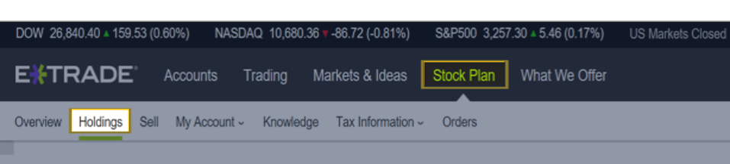
How does the information appear on the E-trade System?
1
2
Stock Plan > Holdings
By entering your E-trade account and choosing these menus, you can view your personal stock plan(s).

Slide 12
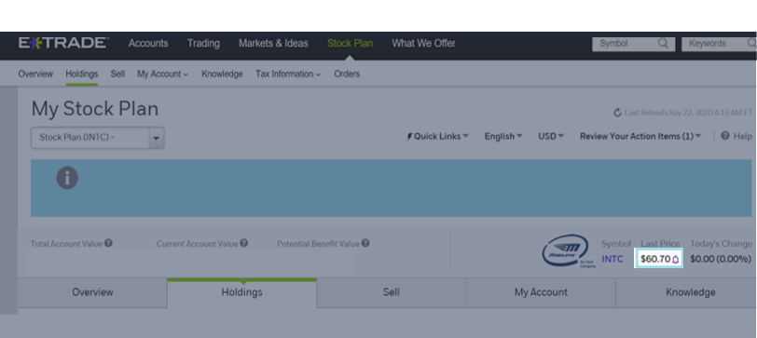
How does the information appear on the E-trade System?
Last known INTC stock price

Slide 13
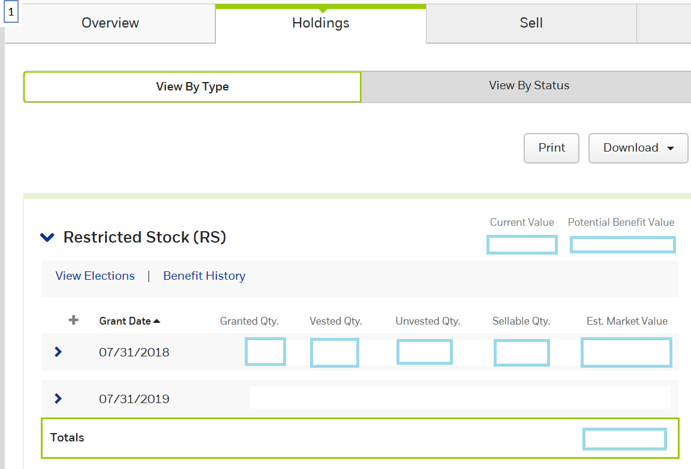
How does the information appear on the E-trade System?
Value of vested shares, according to Last known INTC stock price
Estimated value of unvested shares, according to Last known INTC stock price
Amount of granted RSU for specific granting
Amount of vested RSU for specific granting
Amount of unvested RSU for specific granting
Amount of sellable shares for specific granting
estimated value of total specific grant (vested & unvested) Last known INTC stock price
Estimated value of all grants (vested & unvested) Last known INTC stock price
1
2
3
4
5
6
7
8

Slide 14
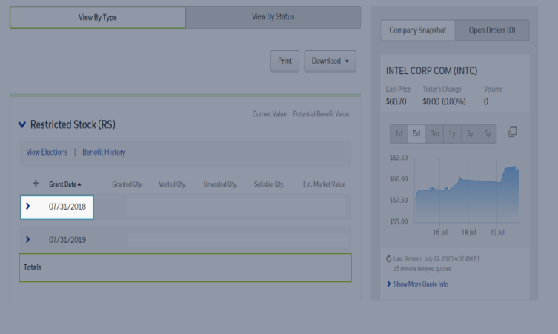
How does the information appear on the E-trade System?
By clicking on the blue arrow, the specific grant information will appear

Slide 15
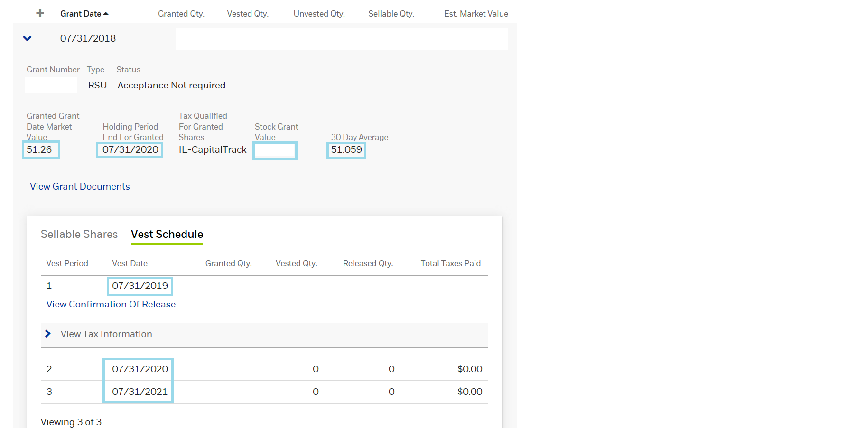
How does the information appear on the E-trade System?
The original dollar’s recommendation for 3 years
The average price that was used for determining the RSU quantity (due to original dollar’s recommendation).
Enables view of the vest dates and amount of RSUs to be vested in each vest-date.
Benefit value at grant date for tax calculation under section 102.
End of blocking period for tax calculation under section 102.
4
5
1
2
3
Israeli Specific fields.
Will be shown only if relevant:

Slide 16
Thank you

