Slide 1
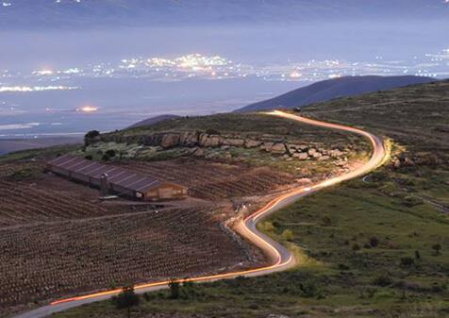
“Gandhi” Heritage Center
Land of Israel and Jewish heritage studies
In memory of Knesset member and cabinet minister, Maj. Gen. (res.) Rehavam Ze’evi-“Gandhi”

Slide 2
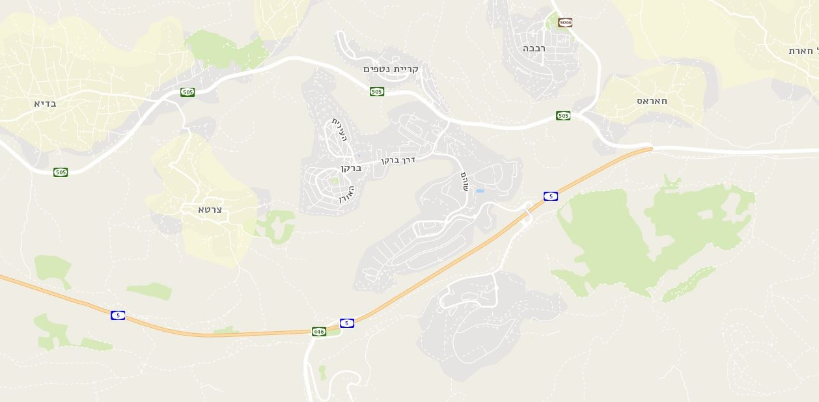
Site location

Slide 3
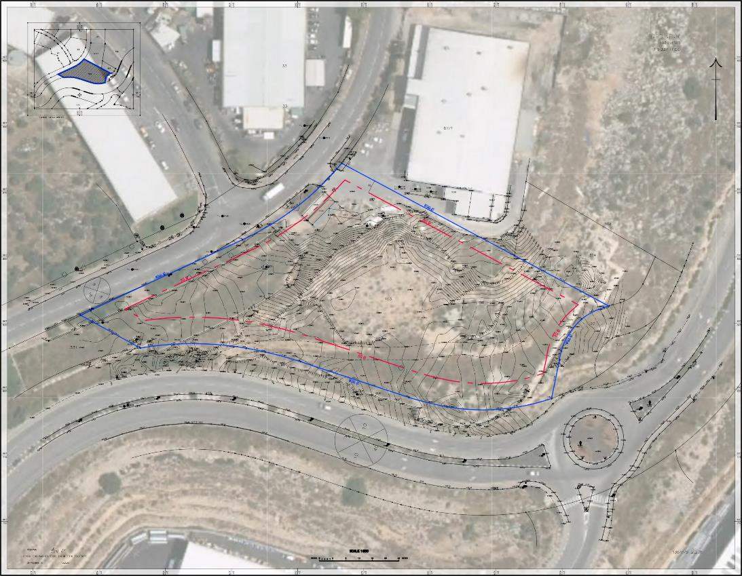
Location on aerial photo

Slide 4
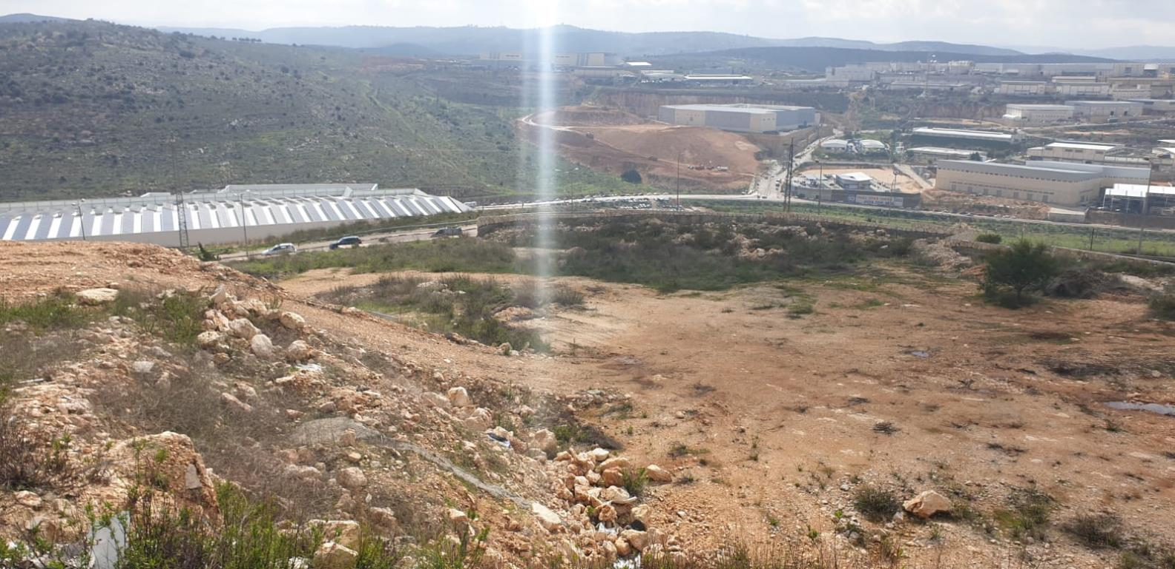
View from the site

Slide 5
Values
A window to Samaria
Innovation
“Gandhi” Heritage Center
Architectural icon
Sustainable construction

Slide 6
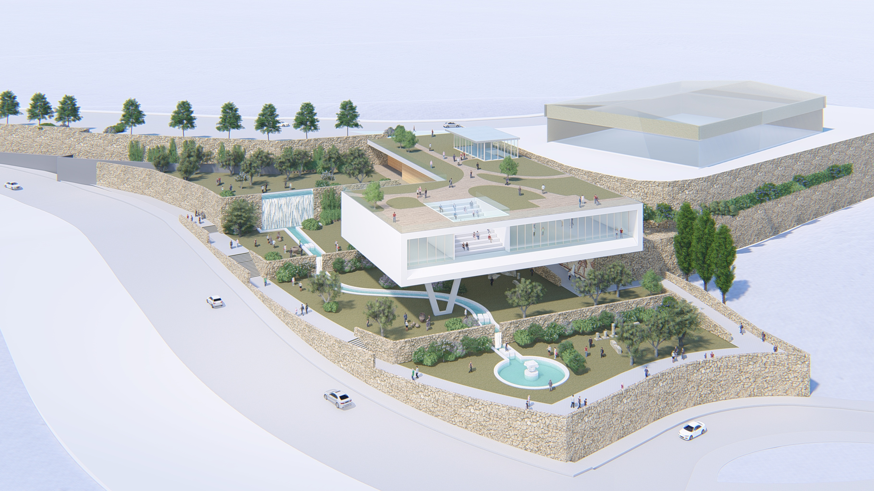
Genral top view

Slide 7
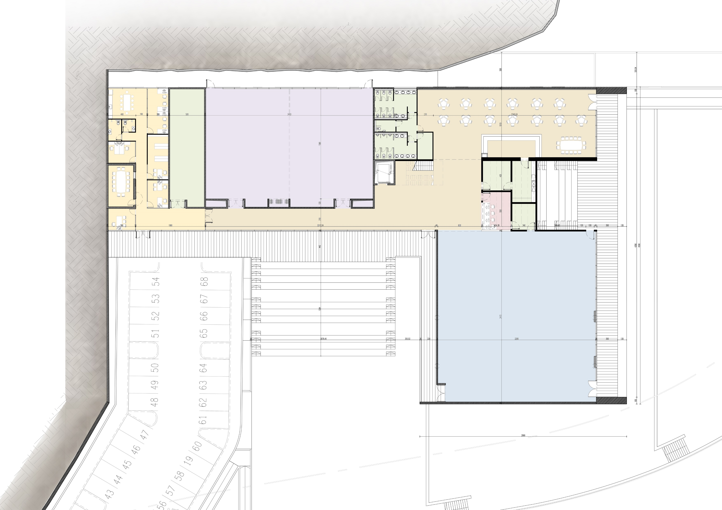
The center floor plan
C
D
E
B
G
F
Plan Legend
A- Main gallery
B- Conference hall
C- Cafeteria
D- administration
E- Storage
F- Reception
G- Sky Amphitheater
I- Garden Amphitheater
I
A

Slide 8
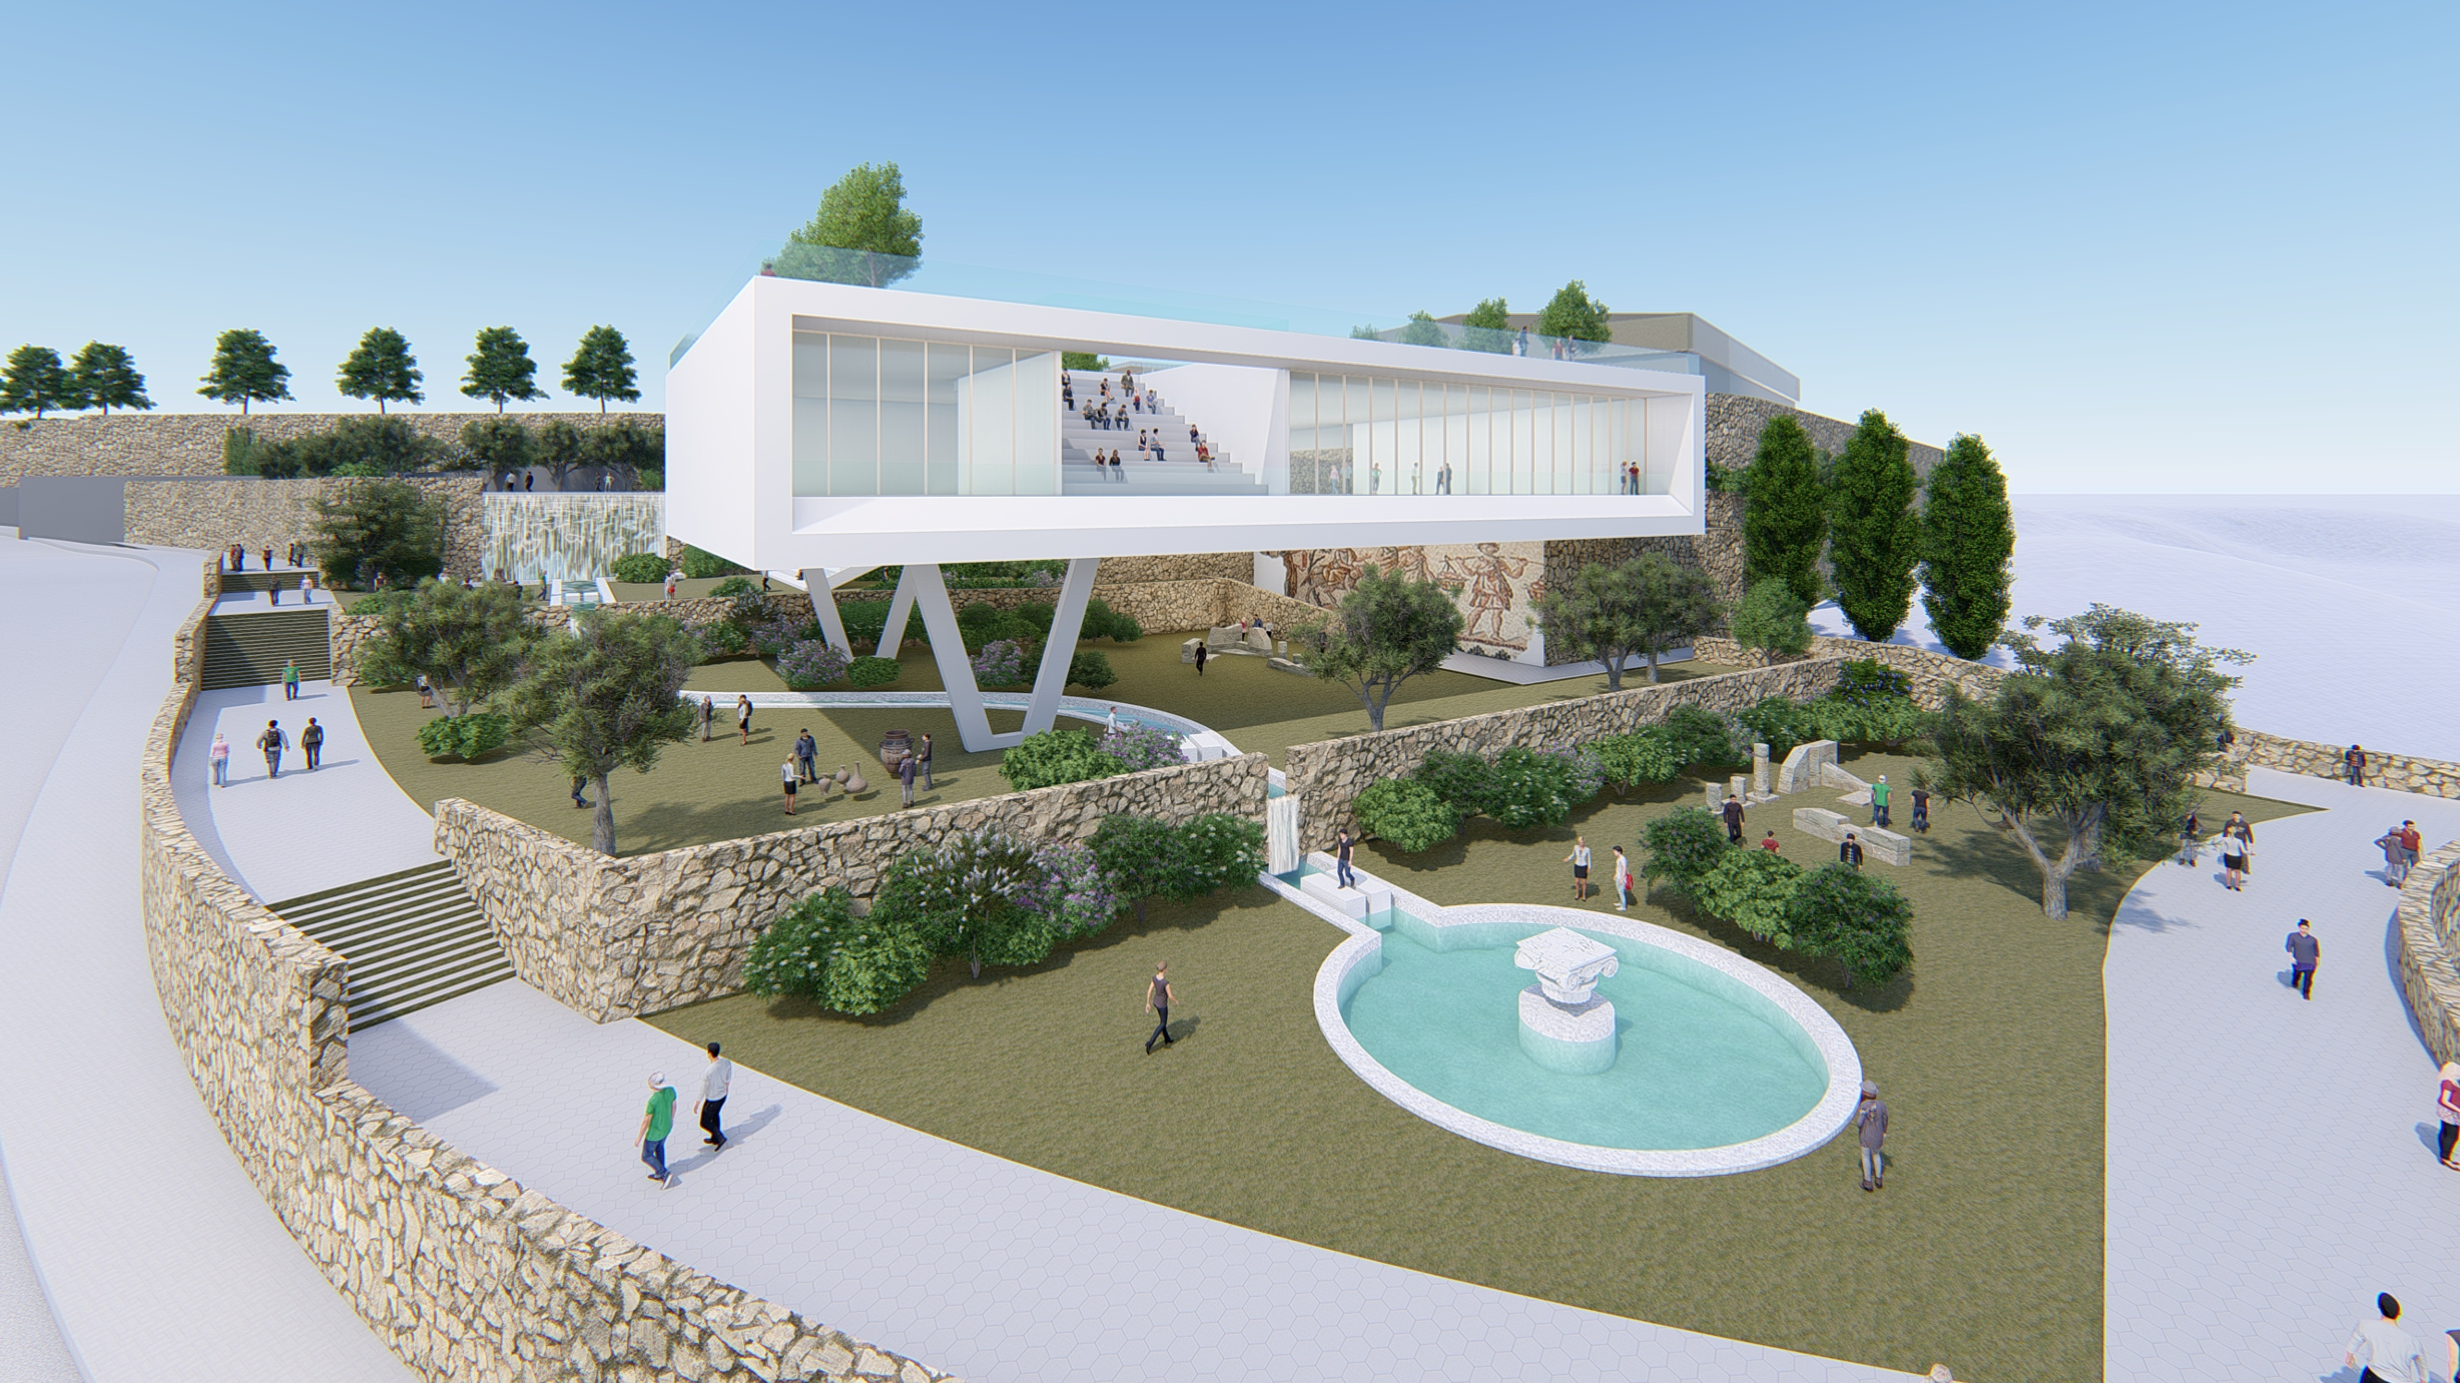
View from south east

Slide 9
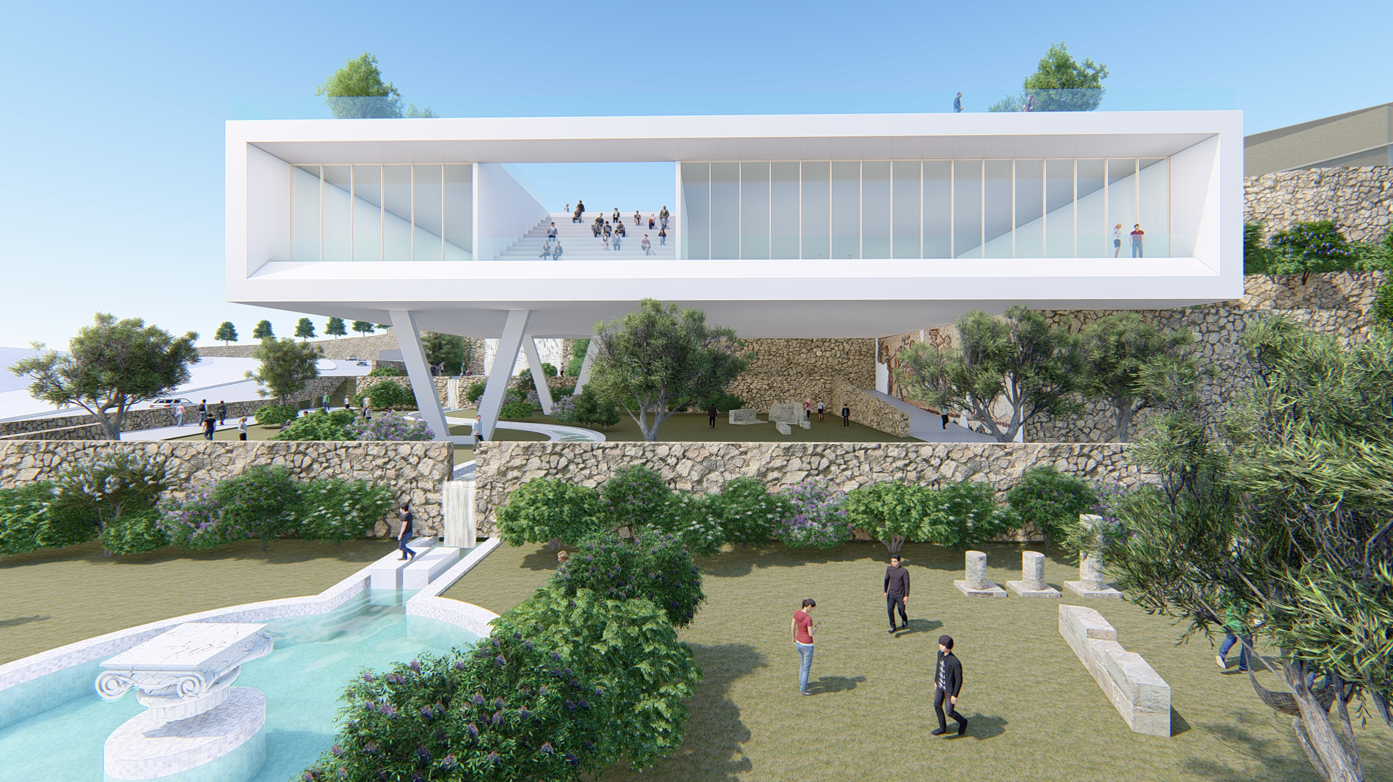
View from main road

Slide 10
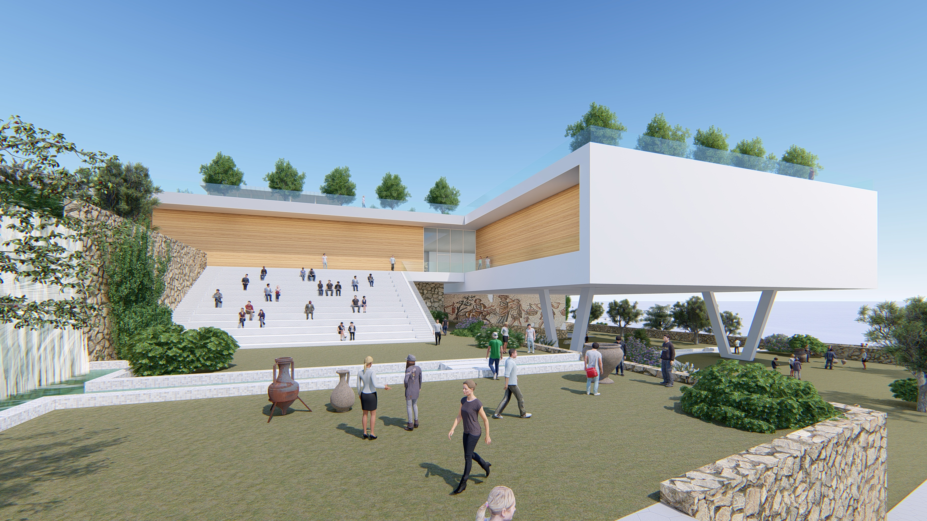
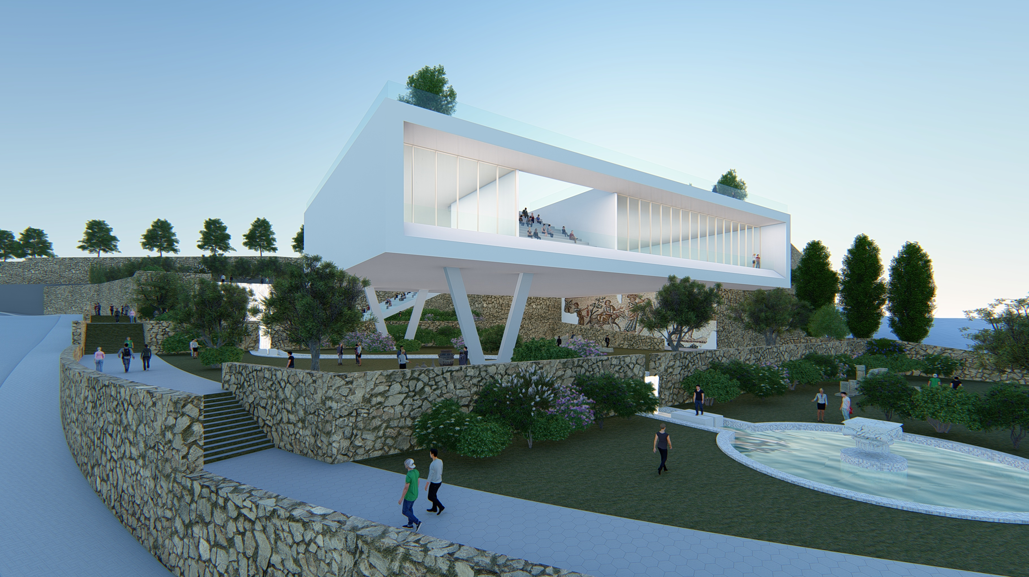
View from the Archaeological garden top terrace

Slide 11
Night view from the Archaeological Garden

Slide 12
Budget for ‘Derech Eretz’ Gandhi Heritage Center
 | Description | Phase | Amount including VAT
1 | Execution cost for structure, as per budget of RCH (regional council head) | Construction | 14,410,618.00 NIS
2 | Execution cost for development and infrastructure, as per budget of RCH | Infrastructure | 2,277,739.00 NIS
3 | Execution costs for content and exhibits | Content | 5,616,000.00 NIS
4 | Costs for management and supervision and RCH project control company | General | 921,609.00 NIS
5 | Costs for planners and structural advisors | Planning | 1,341,990.00 NIS
6 | Content planning costs | Planning | 1,053,000.00 NIS
7 | Coordination costs between planning and RCH project control company | Planning | 378,299.61 NIS
Total existing budget 26,000,000 NIS

Slide 13
Expenditures and budget supplement
 | Description | Phase | Amount including VAT
1 | Phase 1 development costs for walls and earthwork | Development | 6,500,000.00 NIS
2 | Enlargement of assembly hall from 250 to 480 seats | Construction | 3,000,000.00 NIS
3 | Modular roofing for exterior dais | Infrastructure | 2,000,000.00 NIS
4 | Glass walled winter enclosure for lower assembly hall underneath the building | Infrastructure | 1,000,000.00 NIS
5 | Flooring/paving, development, gardening and lighting – lower garden area | Infrastructure | 1,500,000.00 NIS

