Slide 1
Examining the dual-language teaching model in the Hand in Hand schools

Slide 2
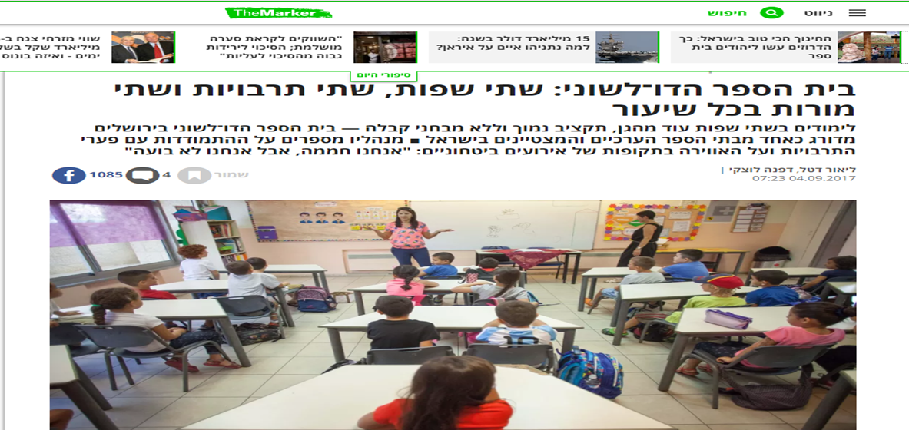

Slide 3
Principles of the Hand in Hand dual-language model
Arab and Jewish students learn together
Two teachers in the classroom: one Jewish, one Arab
Each teacher speaks in her native language and is responsible for its acquisition
In language classes - students are divided into separate groups for the study of their first language and second language
In other classes - teaching takes place in 2 languages, in a continuous and concurrent manner, without translation ($#*&?)
Only in lessons with a Jewish teacher with one teaching language - Hebrew
What are the challenges? What are the issues?

Slide 4
What have we done so far?
2005 - Amara Report
2013-present - various studies on first and second language acquisition in early childhood
2017-18 - experimental research in the Haifa pre-school examining how changes in the model affect second language output among Jewish and Arab children, DLI MODEL
2018 - Meirav Hofi and Moran Ofek conducted a comprehensive mapping exercise examining the whole teaching system in the elementary classes, mapping the number of weekly hours per language/ in each school and class, mapping the subjects studied jointly and separately, what and how many were taught in Arabic/Hebrew or in both languages; as well as many other questions.

Slide 5
What we have done in the past year
Internal mapping exercise
Mapping process for all schools: classroom observation, conversations with teachers and students
Establishing a team of teachers - representatives from every school, charting and collating study material for Arabic as a second language
Timetable analysis for each school - which languages were used in each class?
External mapping exercise:
Examining dual-language models in other locations around the world
For learning purposes, identifying and selecting the models that bear the closest resemblance and relevance to our own situation and goals

Slide 6
Findings: The state of Arabic language studies (internal mapping)
No organized curriculum for teaching Arabic as a second language, each school uses material that it has developed itself
No organized teacher training for teaching Arabic as a second language
Jewish students’ level of Arabic is high compared with other schools, but could be higher considering the amount of exposure and teaching hours that they receive:
Higher passive competency (oral and reading comprehension)
Lower active competency (oral and written expression)
No lessons conducted solely in Arabic
Because of the difficulty, teachers sometimes doubt whether the situation can be improved

Slide 7
Language of instruction: Findings from the Galilee, Gesher, and Jerusalem schools
[**insert pie charts– we cannot edit the original images**]
Arab student
Only Hebrew 26%
Only Arabic 22%
Dual language: 52%
Jewish student
Only Hebrew 37%
Only Arabic 11%
Dual language 52%

Slide 8
Integration and separation in schools: Findings from the Galilee, Gesher, and Jerusalem schools
[**insert pie charts– we cannot edit the original images**]
Separated lessons 32%
Joint lessons 68%

Slide 9
Factors we can influence that also emerged in the Amara Report
Lack of teacher training for teaching second language
Lack of measurements for teaching goals in accordance with age group, syllabus, and appropriate curriculum
Level of Arabic as a second language could be higher
Analysis of the dual-language, two-teacher classroom model found that:
Significant representation is given in the classroom to the two sides, particularly in specialized subjects like history, dialogue, identity, and culture
The model does not provide a sufficient response for second language acquisition
The model leads to children being taught in separate lessons for 35-50% of the week

Slide 10
Conclusions and new directions
There are many factors that we can improve and gain proficiency in, in order to produce better results while preserving ideological, national, and cultural aims.
Alternative models exist that are based on theory, research, and achievements and which contain components that better meet our goals.

Slide 11
The DLI/TWI model of dual-language education
Following the mapping process that we conducted, we found the American TWI/DLI model to be closest to our situation and aims.
Schools have been using this model since the 1960s, and it is currently in operation in hundreds of schools.
The model combines principles and insights from various models.
Principles of the model:
Separation between the languages: one lesson – one language
• The minority language is the language of instruction in no less than 50% of lessons
There are a number of various models, with the ratio of languages ranging from 90:10 to 50:50

Slide 12
Challenges and difficulties in changing the model
Preserving the multicultural ideal and bi-national representation
A prolonged, gradual process—a perceptual and pedagogic change that requires gradualism and significant support
Reducing the teacher-student ratio
Comprehensive pedagogical changes in order to support the change
Large budgetary investment to assimilate the model (in order to achieve a more stable model going forward)
Enlisting the educational staff and parent body for change

Slide 13
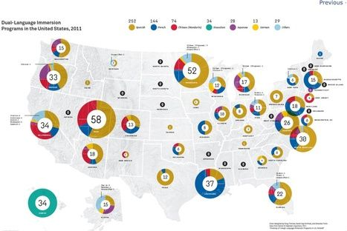
There is a large cohort of schools operating this model in the United States, and the academic and professional research and supporting materials have evolved significantly over the past decade.

Slide 14
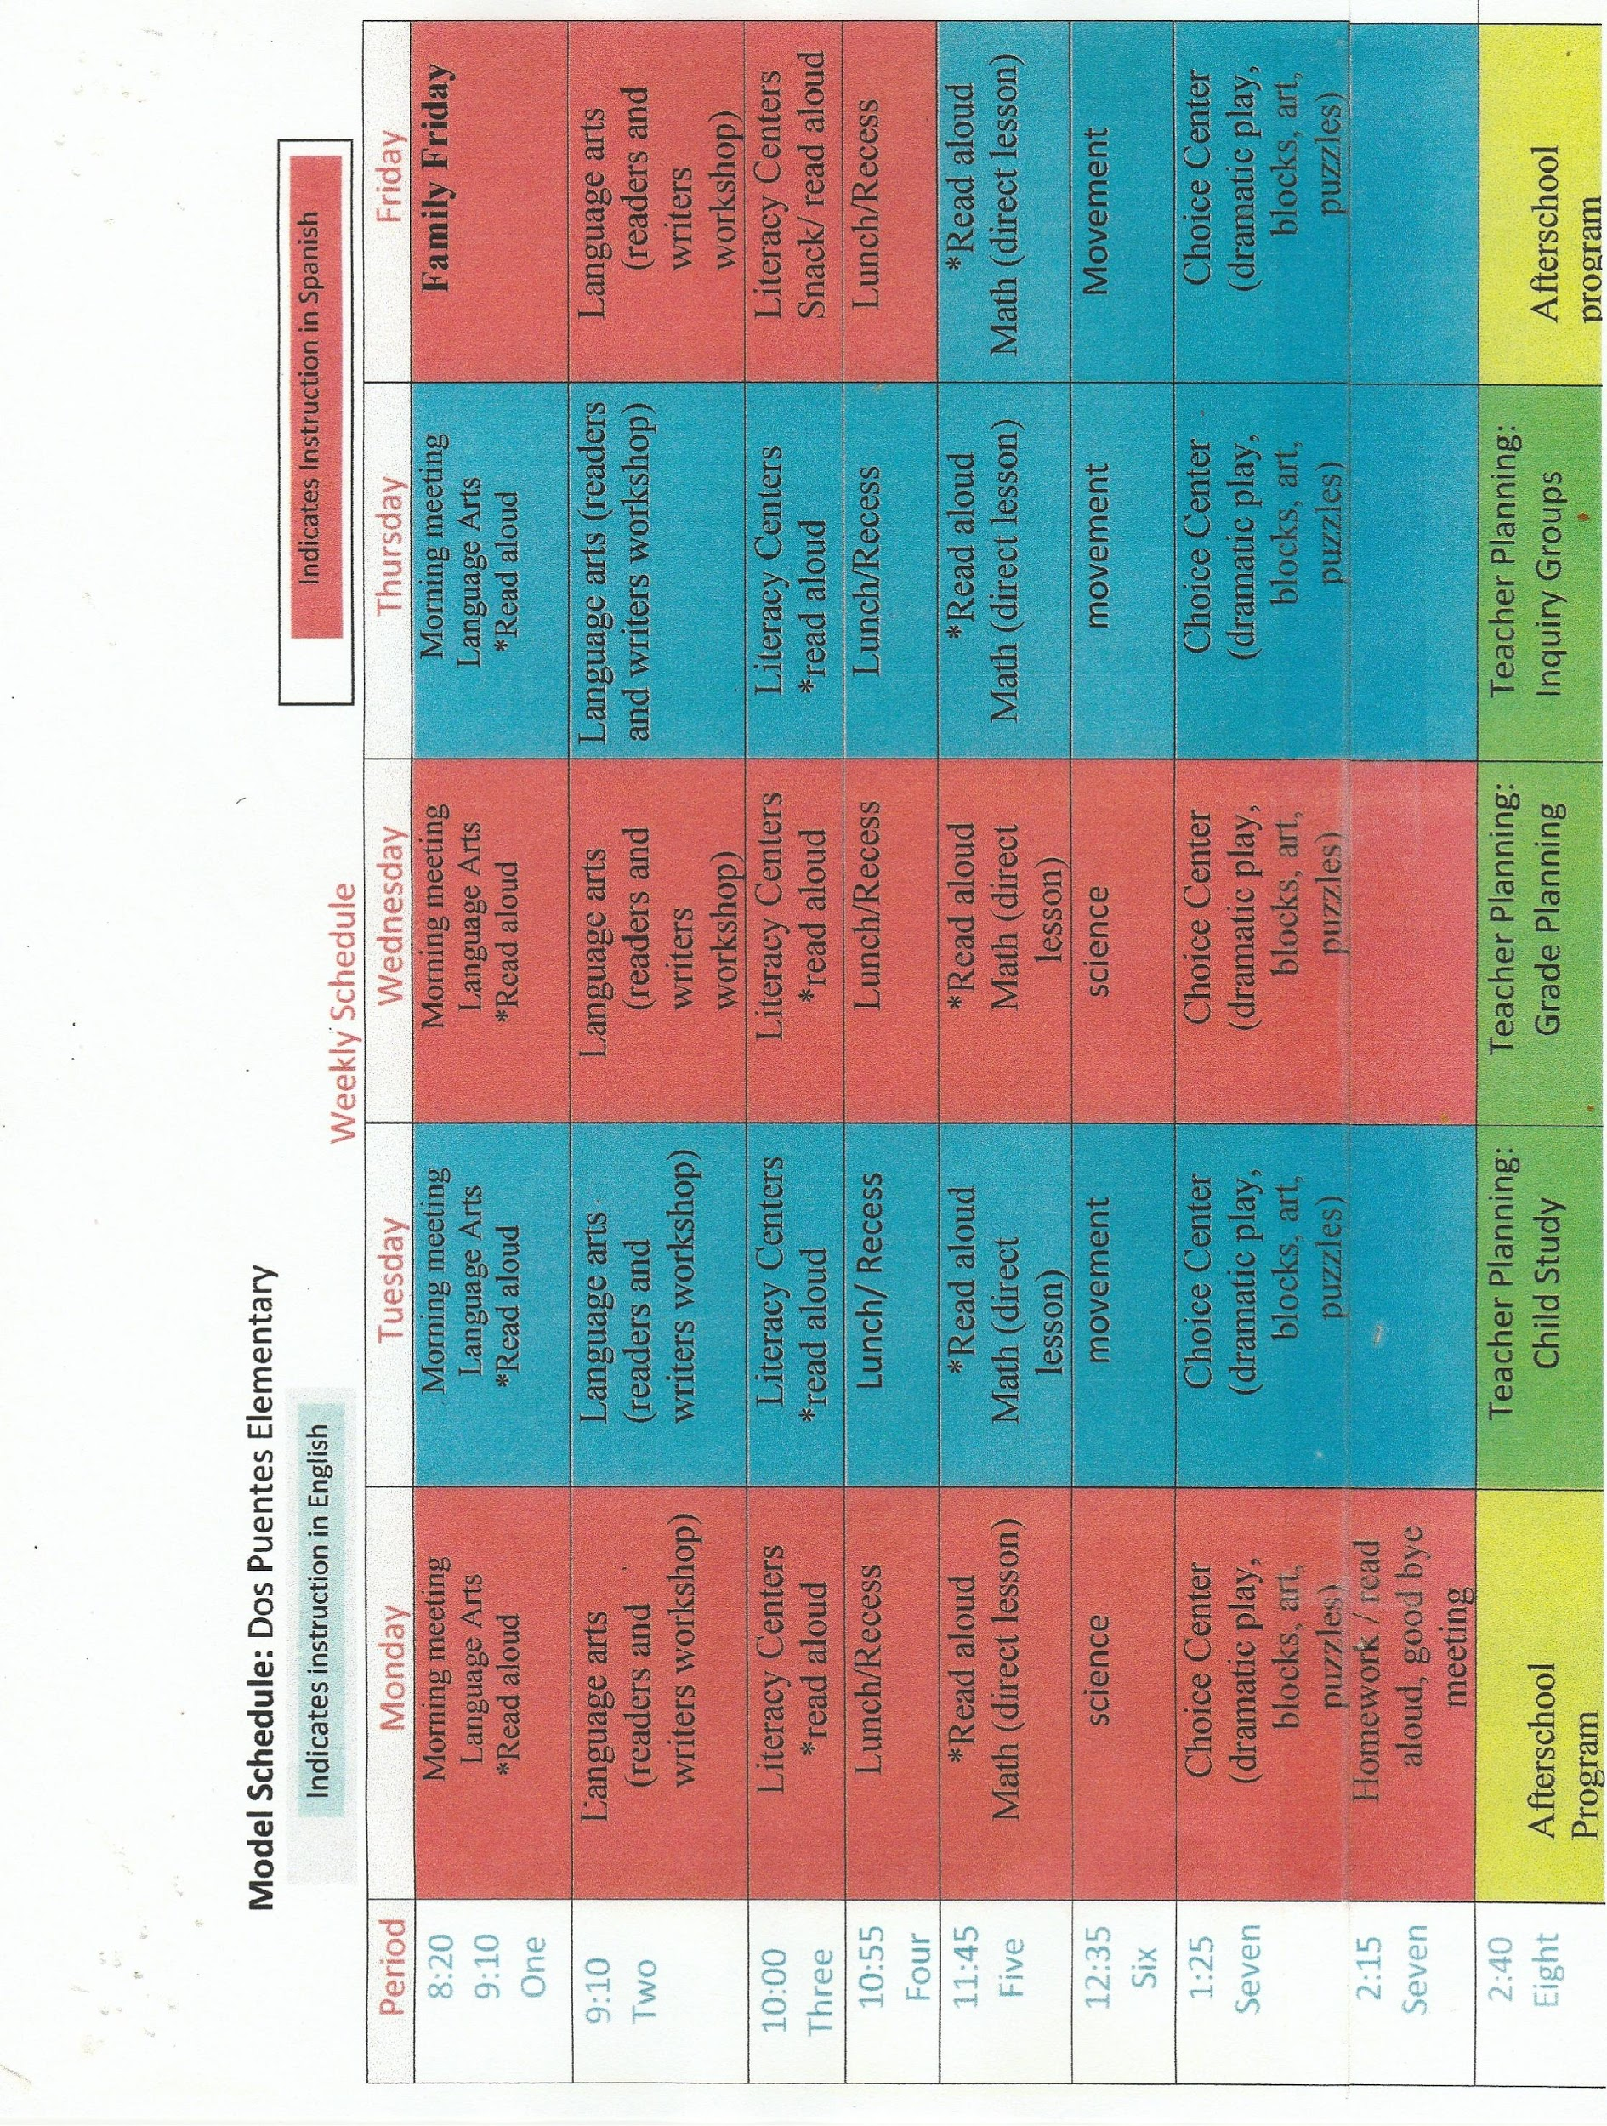
Timetabling: Various models

Slide 16
Various models and emphases in the United States
Models:
One dual-language teacher - teaches classes in the two languages
Two teachers per classroom - usually one is for regular education and one for special education in integrated schools. (In both cases, one language!)
Two teachers per classroom - one is the teacher and one the assistant / division into groups - speaks in the same language as the lesson!
Two teachers teach two classes side by side - teaching in a line of two classes (up to 26 students, usually fewer)
Other emphases:
Recruitment of additional teaching resources - special education assistants, students in training
A school guide, in some cases for each grade, highlighting close mentoring for new teachers
In the SBS model, coordination meetings almost every day, at least 3 times per week
Frequent work in small groups - differential education by level and/or based on peer learning

Slide 17
Training teachers according to the American model
A teaching certificate cannot replace the need for staff training and continuing education about dual-language education.
In some places, a dual-language teaching certificate is required
In some places, a dual-language teaching certificate need not be required and teachers may be trained on the job
Content:
Theories of language acquisition and dual-language education
Multicultural approaches to education
Cultural and developmental aspects of language acquisition
Teaching a second language (strategies for teaching each language specifically as a second language)
Teaching specific subjects to students for whom the language is their mother tongue and for students for whom the language is not their mother tongue

Slide 18
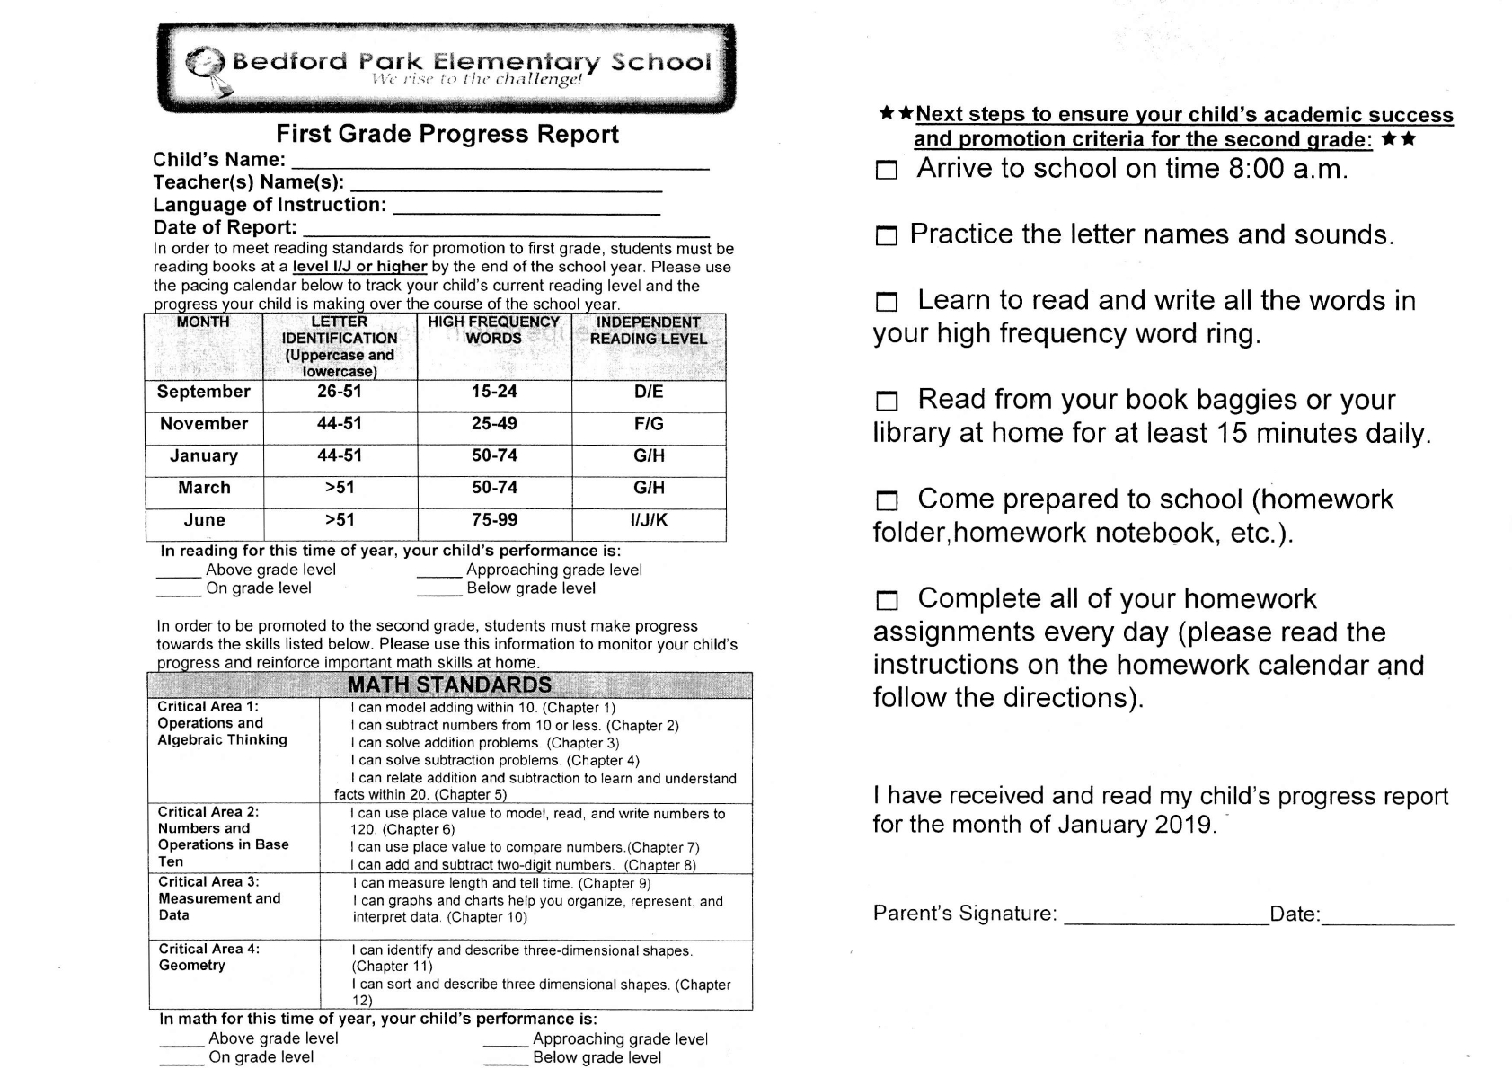
Evaluating language level at every age

Slide 19
Next stages
Discussion in the management forum and with the organization's management:
Continuing to study and develop principles for improving our model
Macro-management questions - budget, number of teachers, instruction, remuneration
2. Work meetings in every school
To discuss learning, clarification and strategy for the work plan to select a model and attempt to build a suitable model
Convening a team from every school that can lead the process alongside management
Developing a process that includes a management/leadership team, teachers, parents, and any other forum whose participation in the process shall be deemed appropriate by the principal and staff
3. Pilots
Sharpening and strengthening the pilots that began in Haifa and Beit Berl according to the principles of the DLI model, and the possibility of commencing additional pilots next year in Jaffa.

Slide 20
Next stages
4. Developing an accessible knowledge base for the DLI dual-language education model
Translation, adaptation, and production of material for learning and for training team decision-makers
Developing collaborations with schools, teachers, and supervisors who can support us in the process and access theoretical knowledge and knowledge from the field
5. Teacher training:
Work with the Seminar Hakibbutzim to develop a teaching certificate and a master's degree in dual-language education
Continuing education courses in teaching a second language shall continue in all schools
Develop a cluster of training courses that can complement the basic knowledge for veteran teachers so that they do not need to undertake a teaching certificate

Slide 21
Next stages
6. Continue to develop a syllabus and goals for Arabic as a second language, and, later, for Hebrew as a second language
Develop goals for each age group and a syllabus, followed by development of appropriate, detailed curricula
In the future, in schools that operate under the DLI model - these will be the only hours where the children are separated according to their native language.
7. Other components
Training Jewish teachers to have proficiency in Arabic
Strengthening Arabic in the school's discourse space and not just on the walls
Development of a program for those who enter the school in first grade, and in older grades
Development of a measurement and evaluation system to examine the achievements and challenges that arise in each school.

Slide 22
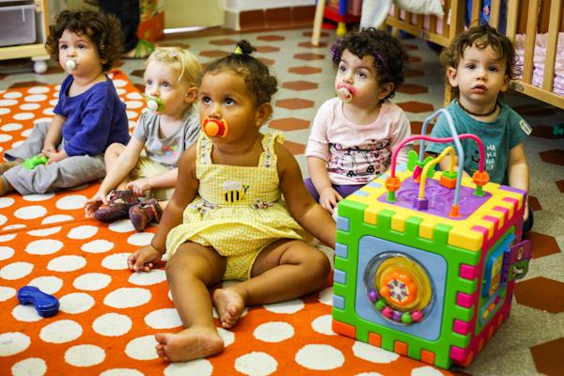
Thank you!

