Slide 1
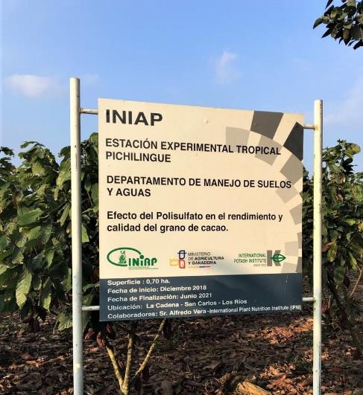
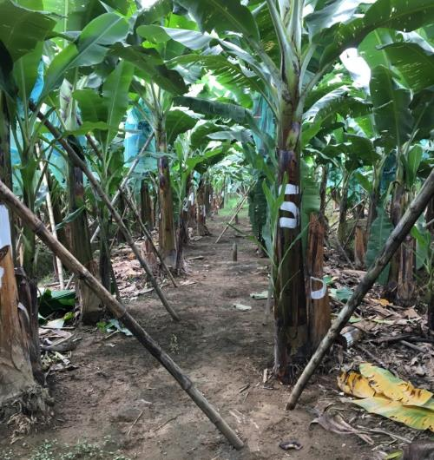
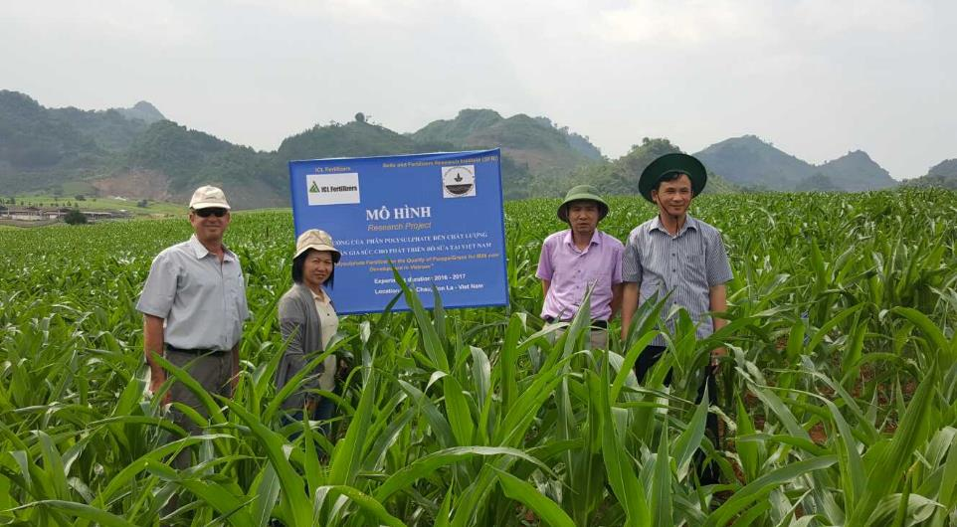

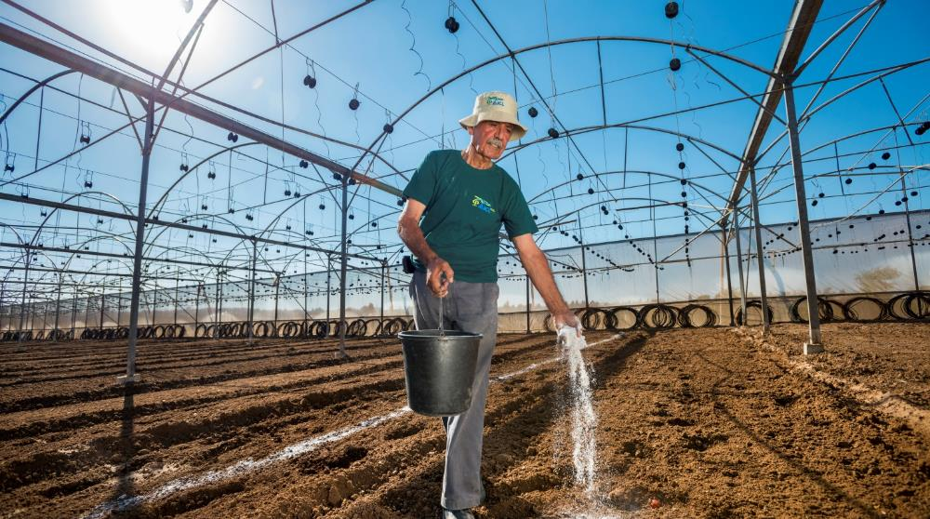
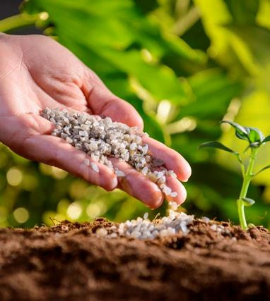
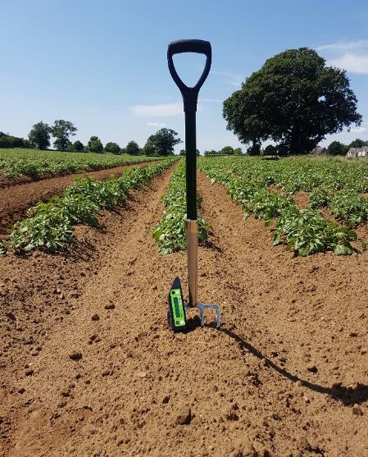

Polysulphate trial
Alfalfa
Brazil

Slide 2
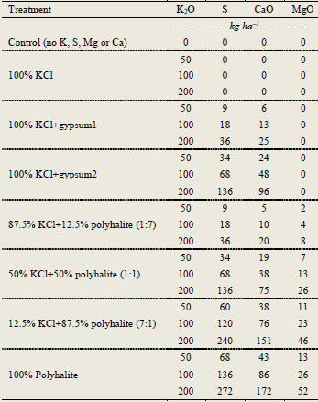
Treatments in alfalfa: doses

Slide 3
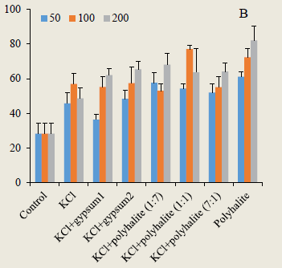
Treatment in alfalfa: combinations
Dry biomass per plant (g)
Bars indicate standard error (SE)

Slide 4
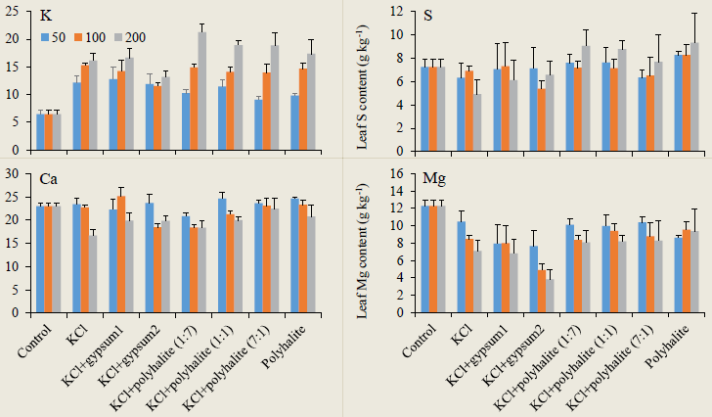
Higher leaf K, S, Ca, and Mg due to polyhalite
Leaf concentration (g kg^{–1})
Bars indicate standard error (SE)

Slide 5
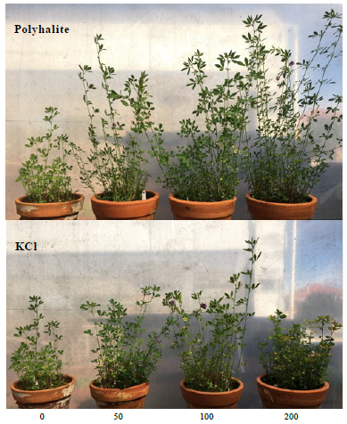
Superiority of polyhalite over KCl
kg ha^{–1} of K₂O

Slide 6
Conclusions
Polyhalite seems to be a better source than KCl for alfalfa on Brazilian acidic soils, not only as a source of K but also of Ca, Mg, and S.
This superiority is probably owing to polyhalite being a more stable and long-term source of K in contrast to the abrupt peaks and troughs in available K when K is supplied through KCl.
These conclusions from pot-culture experiments need to be tested in the field.

