Slide 1
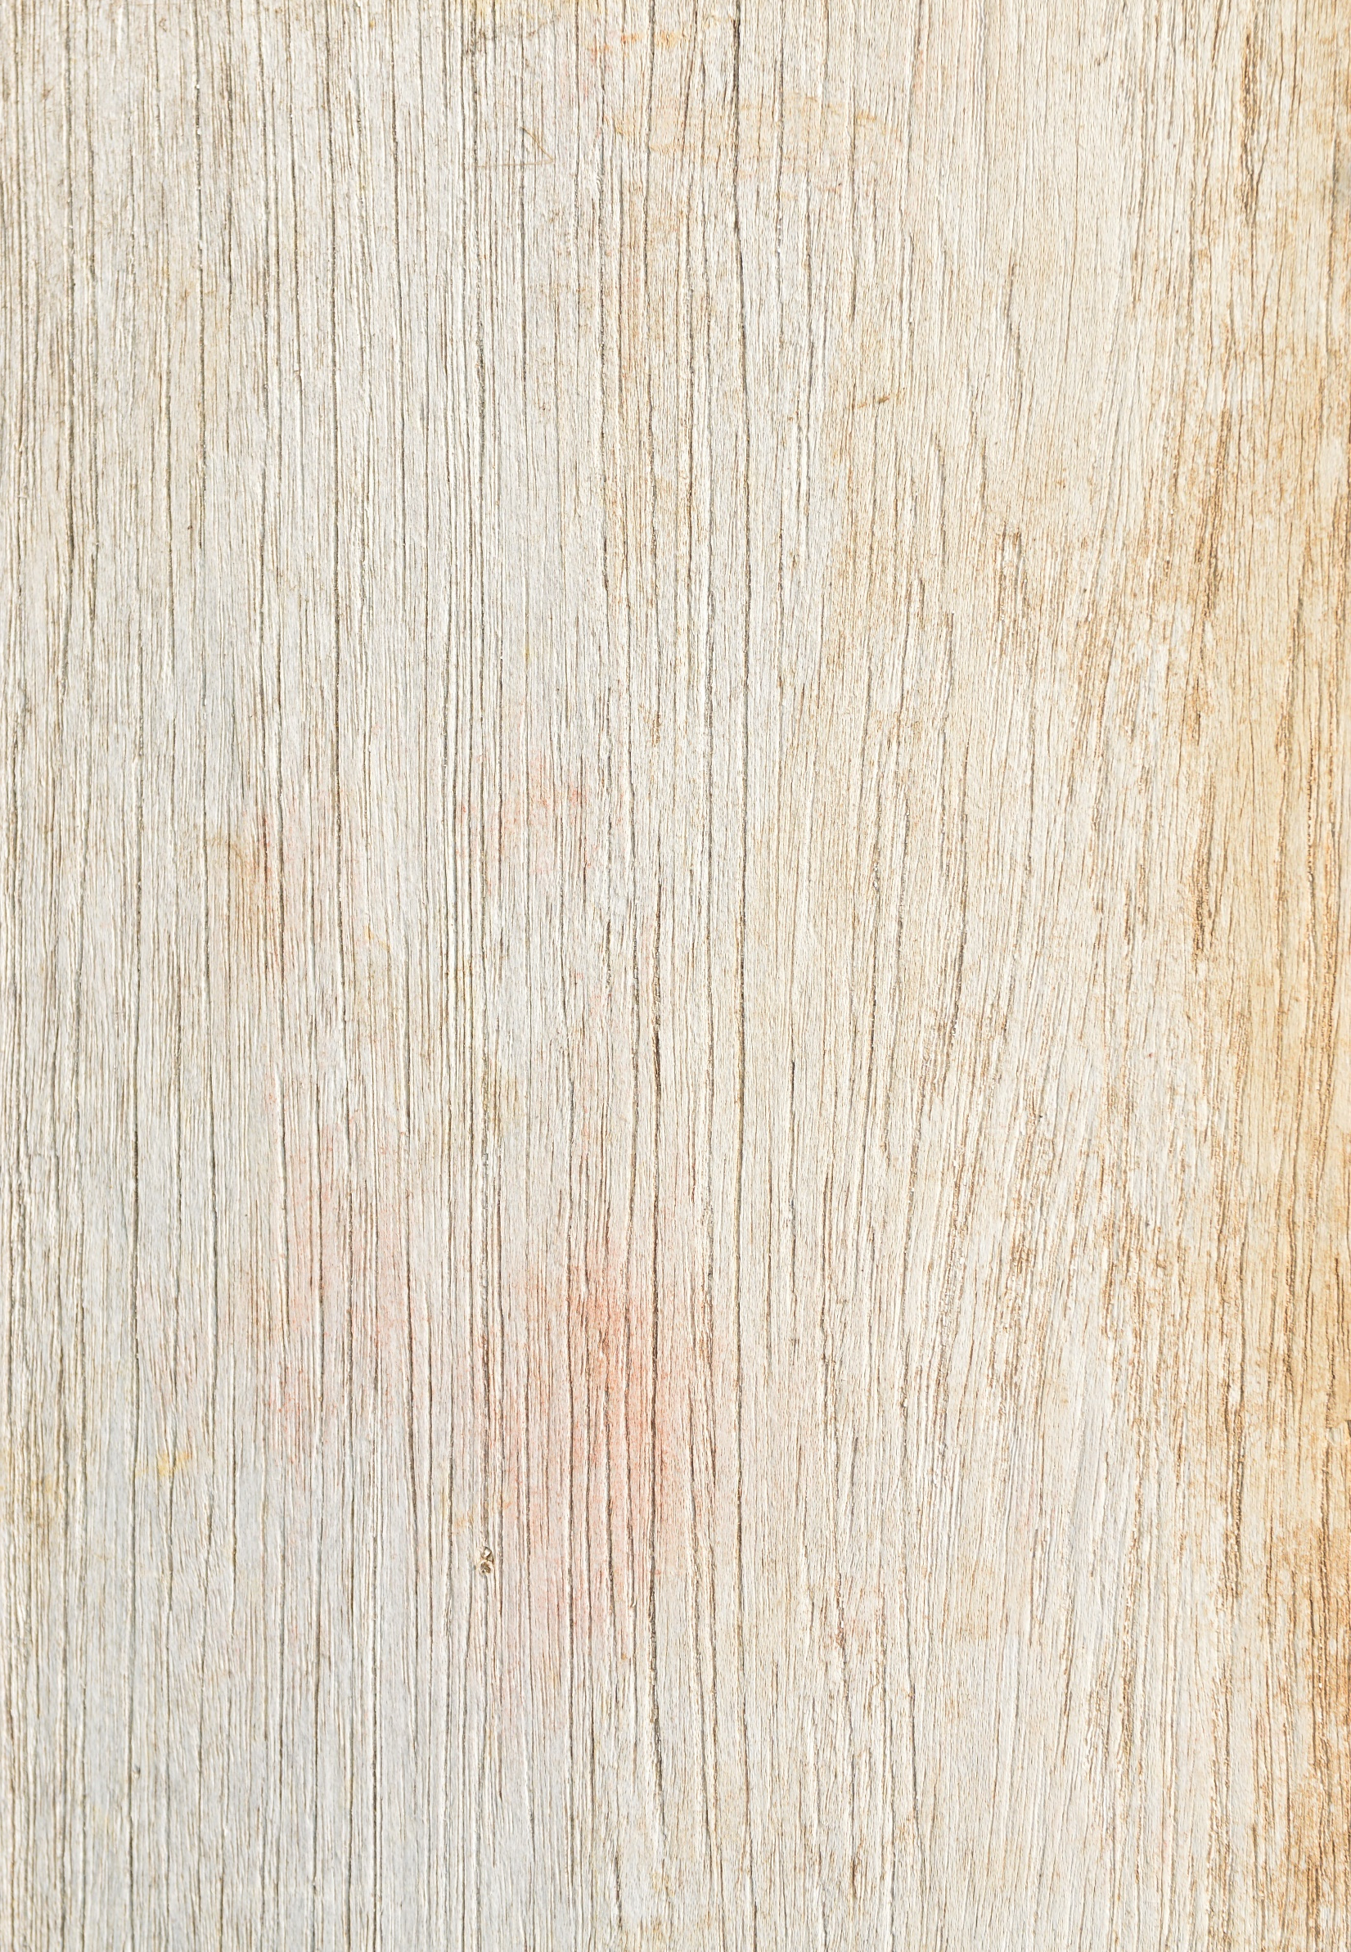
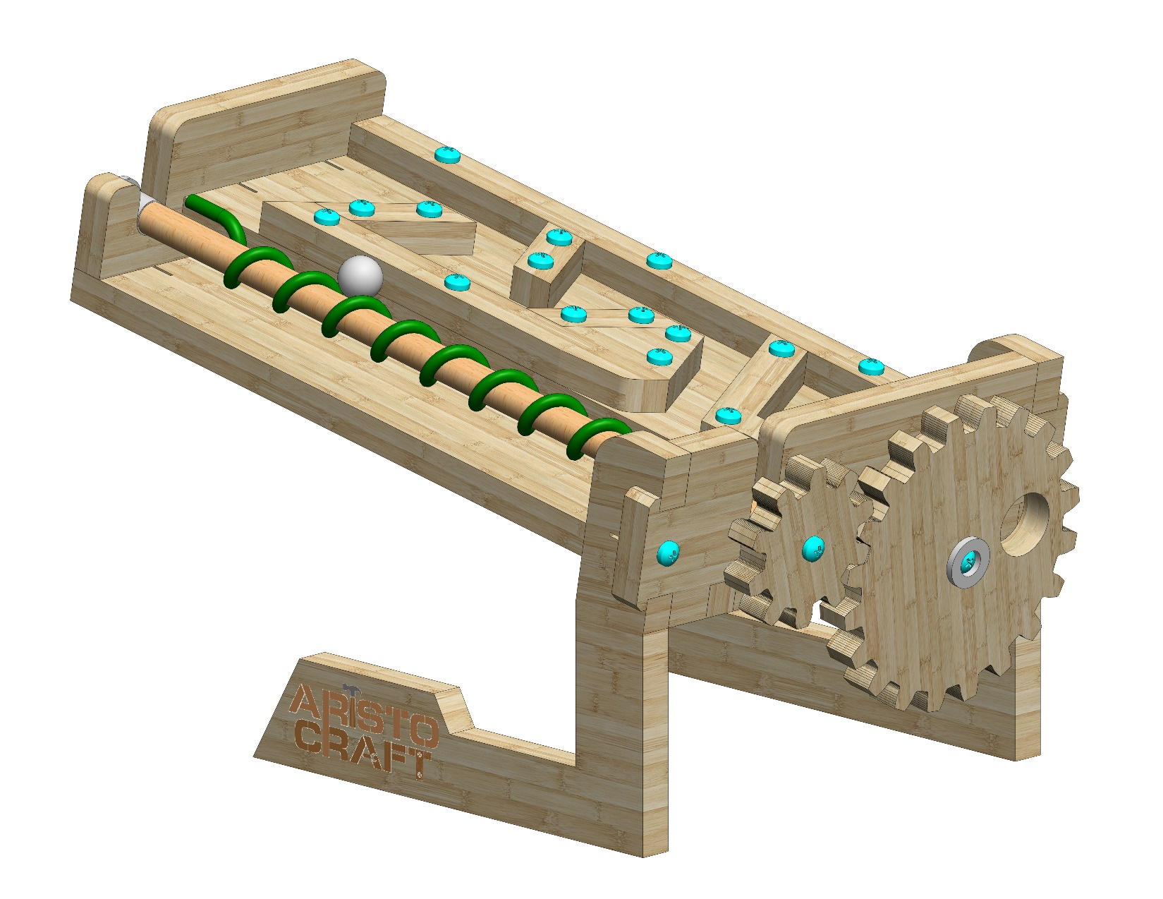
ARCHIMEDES SCREW
Assembly instructions

Slide 2
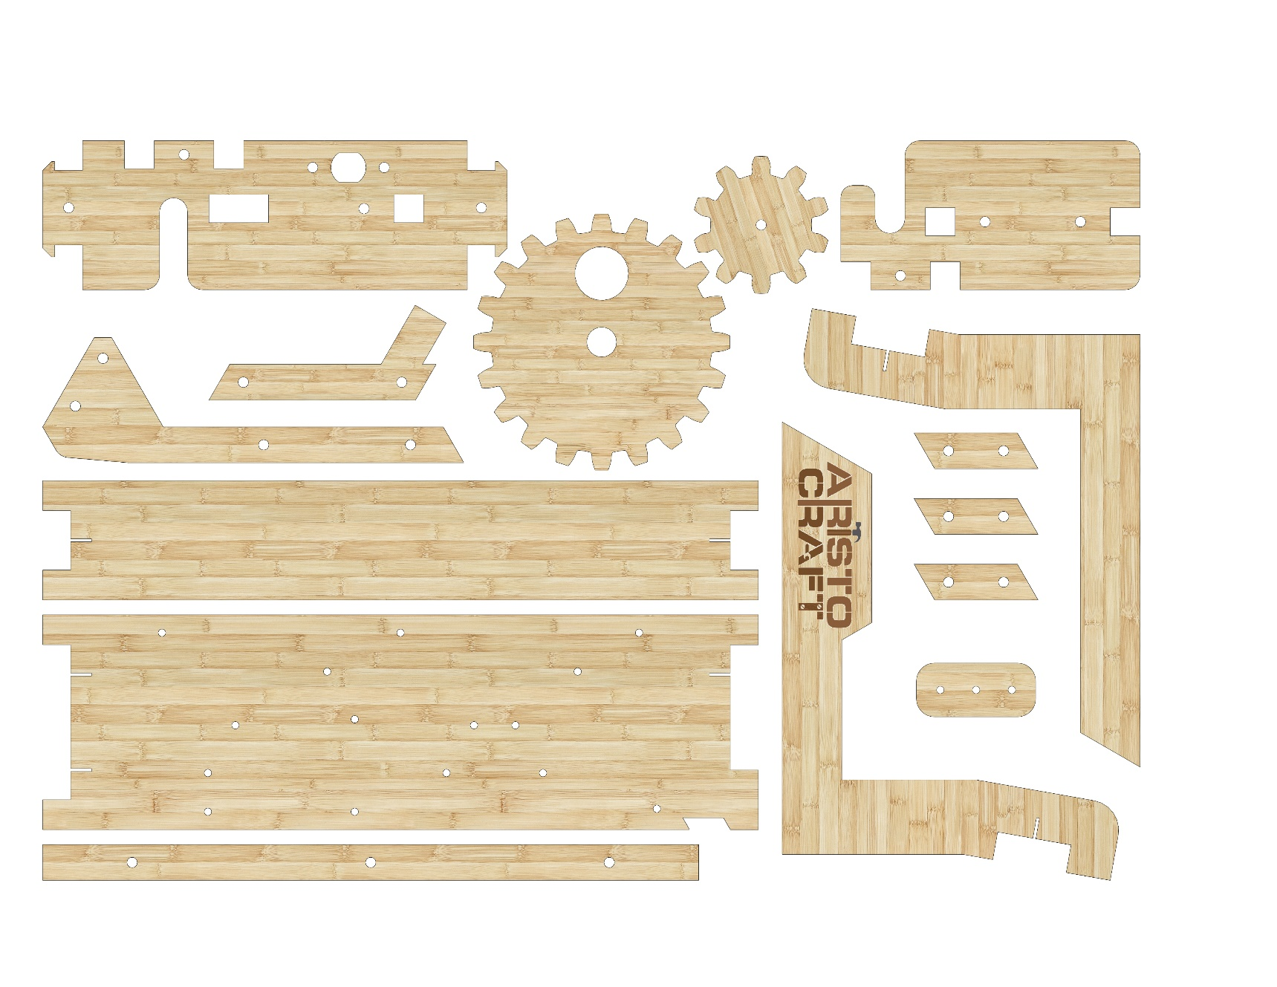
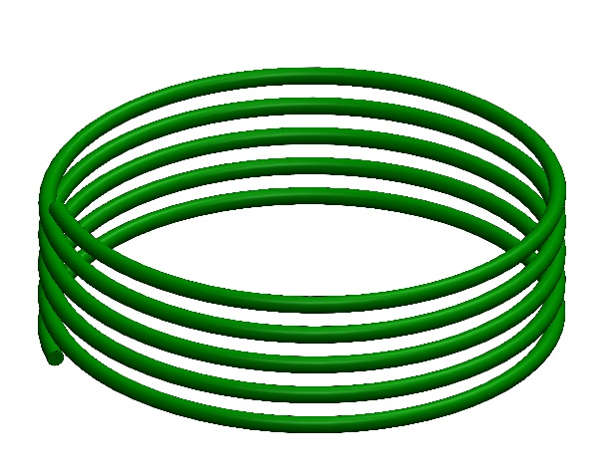
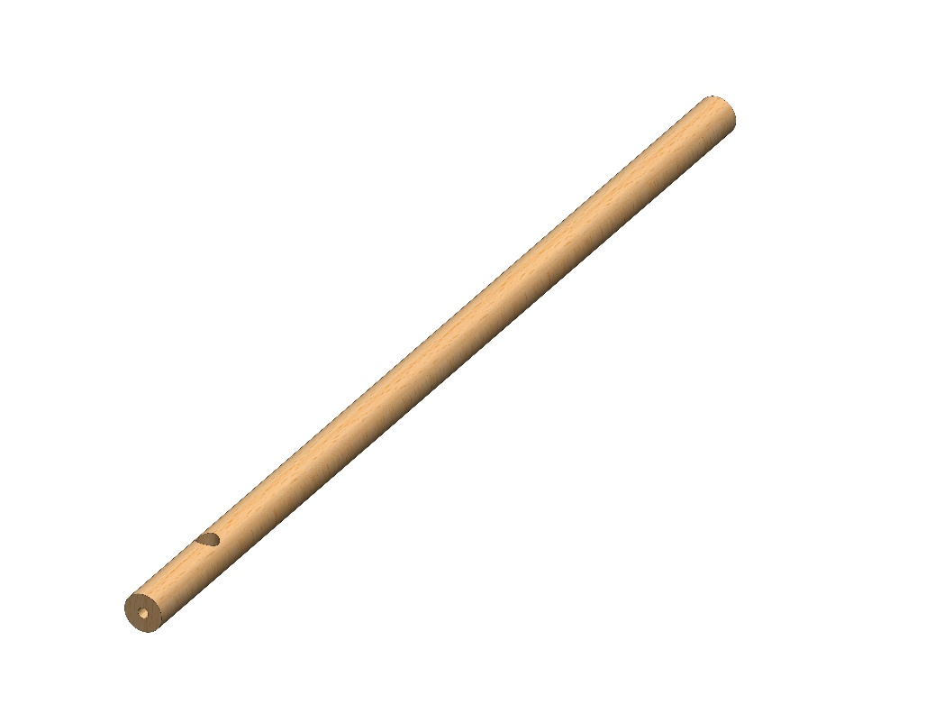
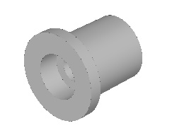
Part list
1
3
4
6
2
5
8
7
8
9
10
11
12
13
14
15
16
17
© All rights reserved to AristoCraft Ltd. Do not copy or reproduce without written permission.

Slide 3
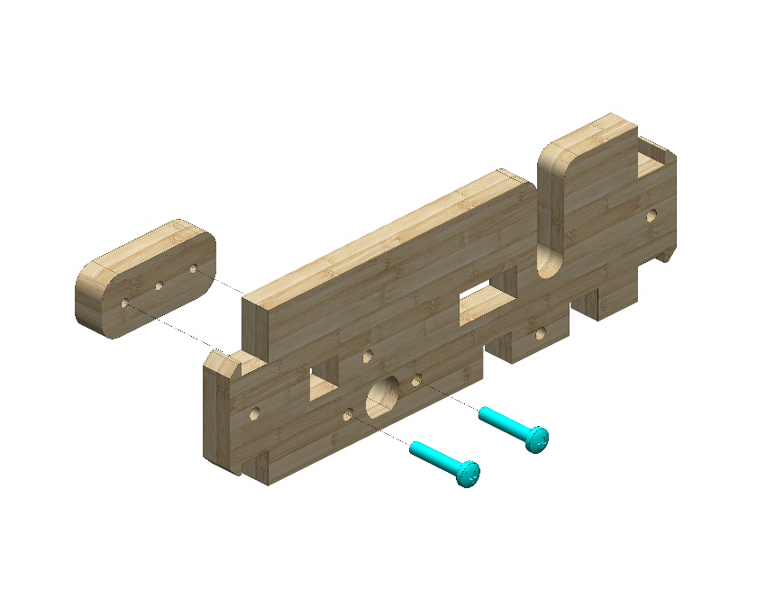
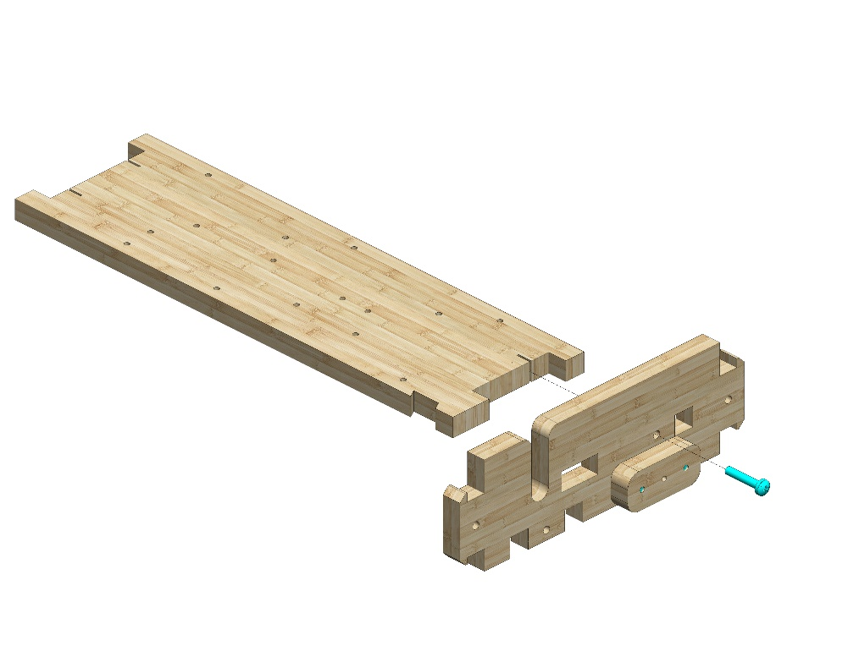
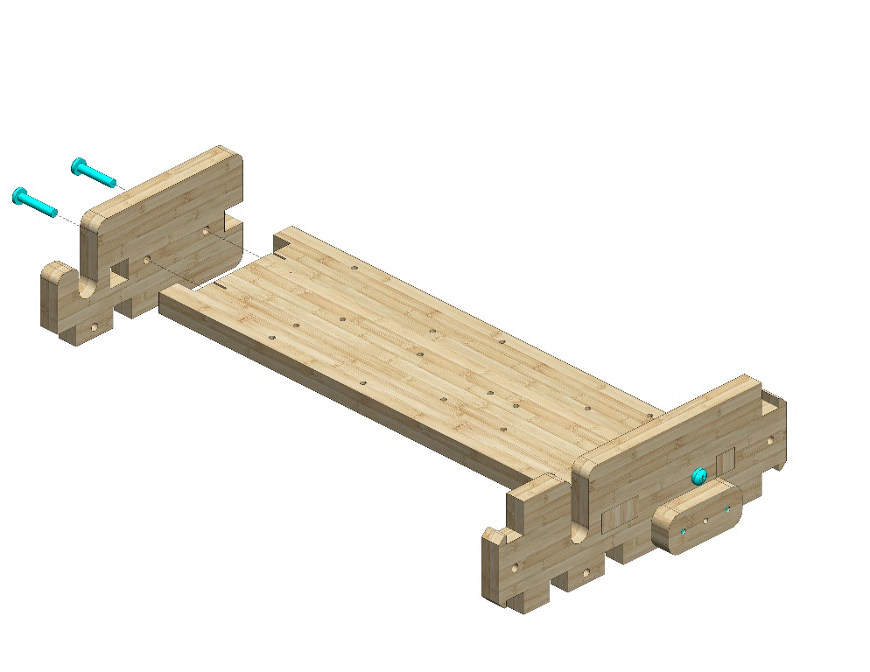
Instructions
12
1
Attach Part 1 to Part 12. Use two #20 bolts.
10
Attach the prepared assembly to Part 10. Use one #20 bolt.
Attach Part 4 as shown in the picture. Use two #20 bolts.
4
© All rights reserved to AristoCraft Ltd. Do not copy or reproduce without written permission.

Slide 4
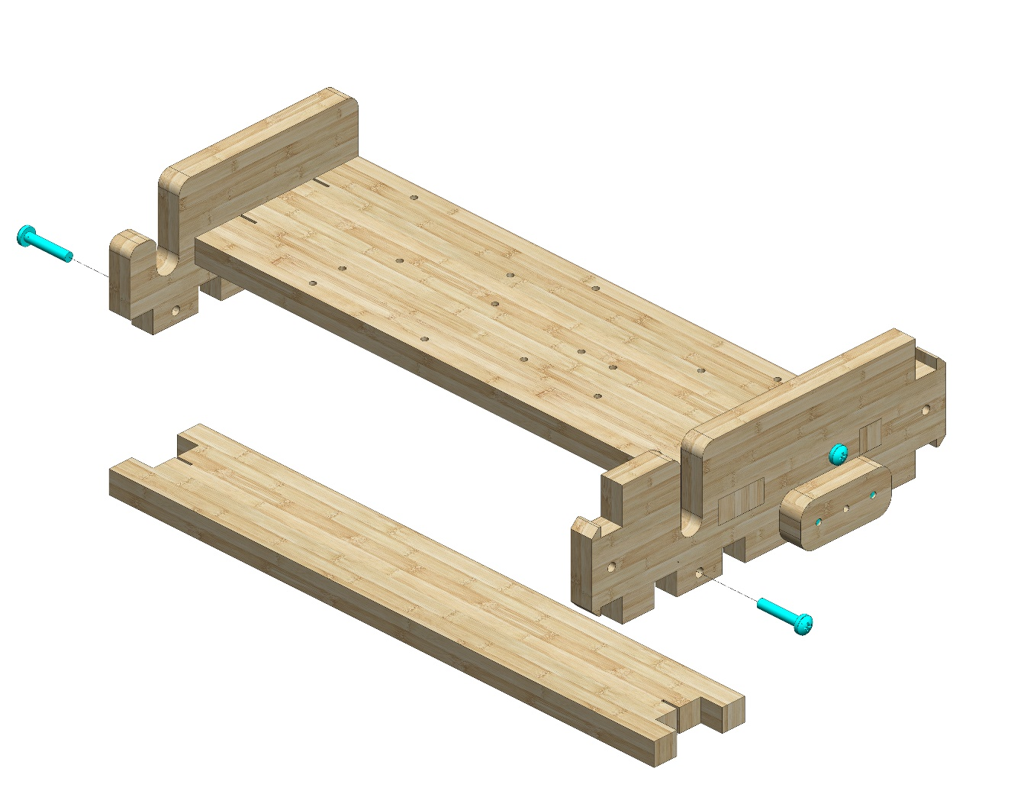
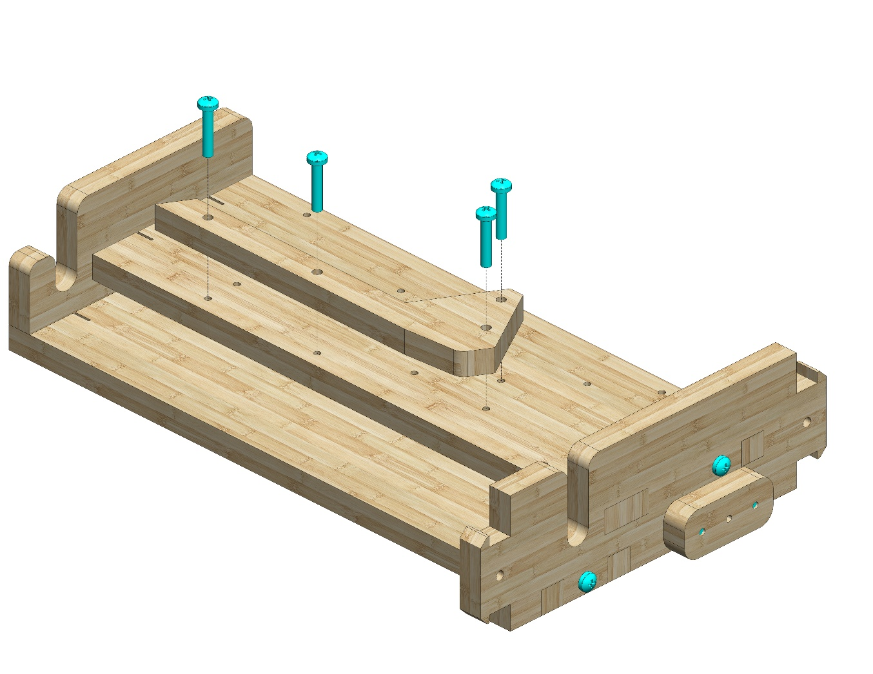
Insert Part 7 as shown in the picture. Use two #20 bolts.
7
Insert Part 5 as shown in the picture. Use two #20 bolts.
5
© All rights reserved to AristoCraft Ltd. Do not copy or reproduce without written permission.

Slide 5
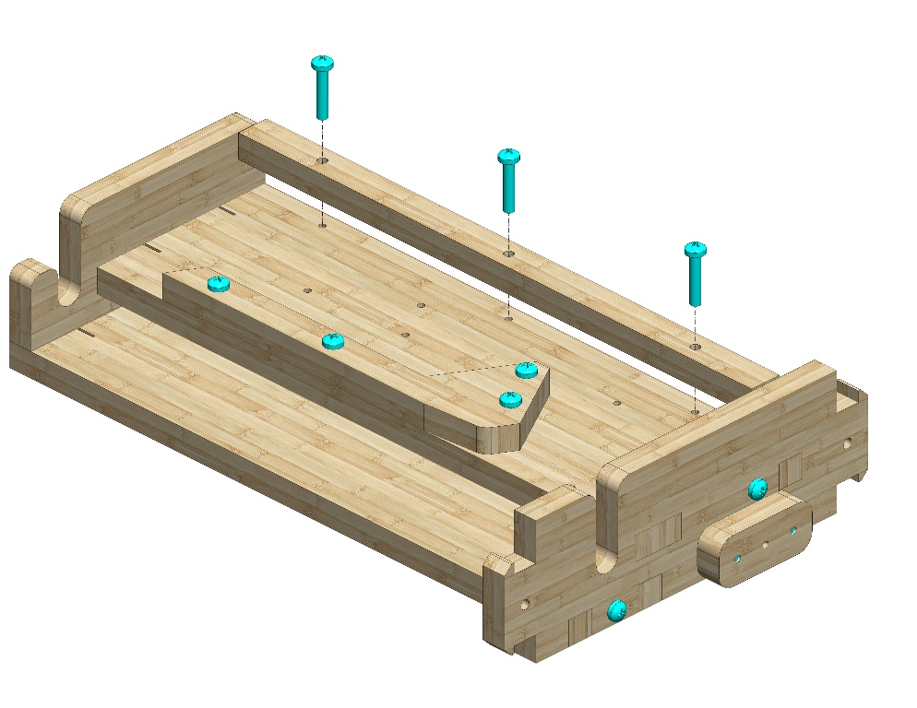
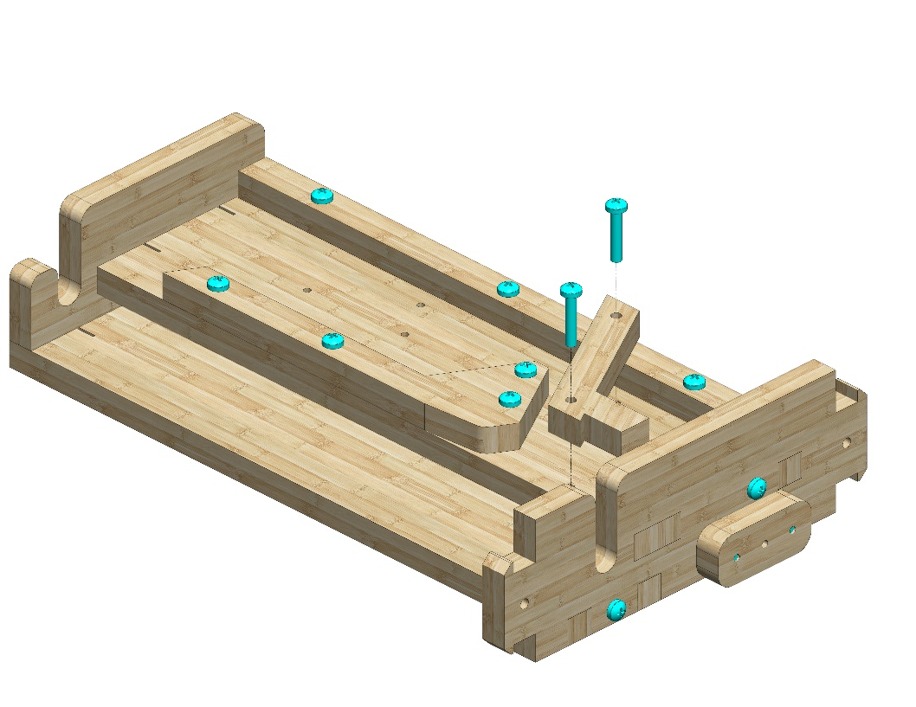
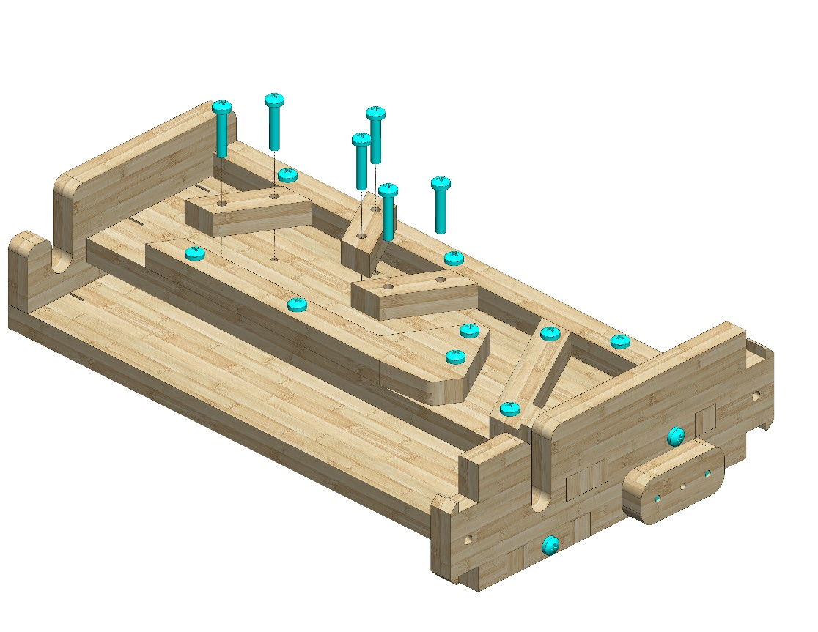
Attach Part 13. Use three #20 bolts.
13
Attach Part 6. Use six #20 bolts.
6
8
Attach three Part 8s as pictured. Use six #20 bolts.
8
8
© All rights reserved to AristoCraft Ltd. Do not copy or reproduce without written permission.

Slide 6
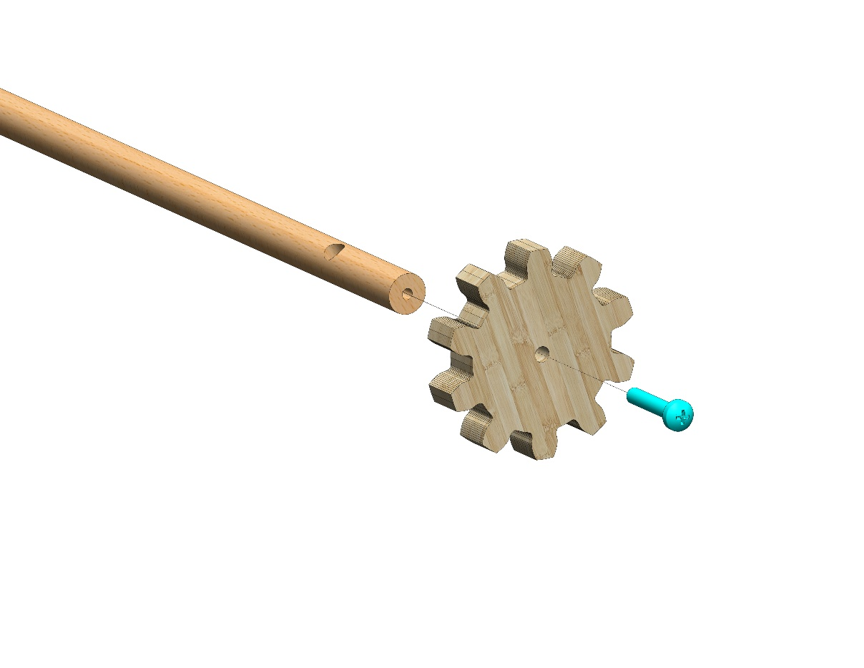
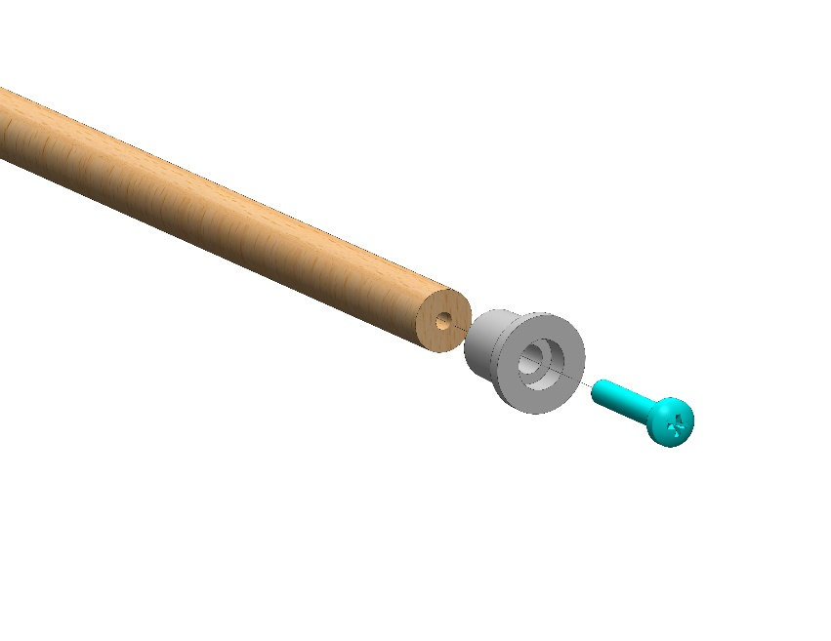
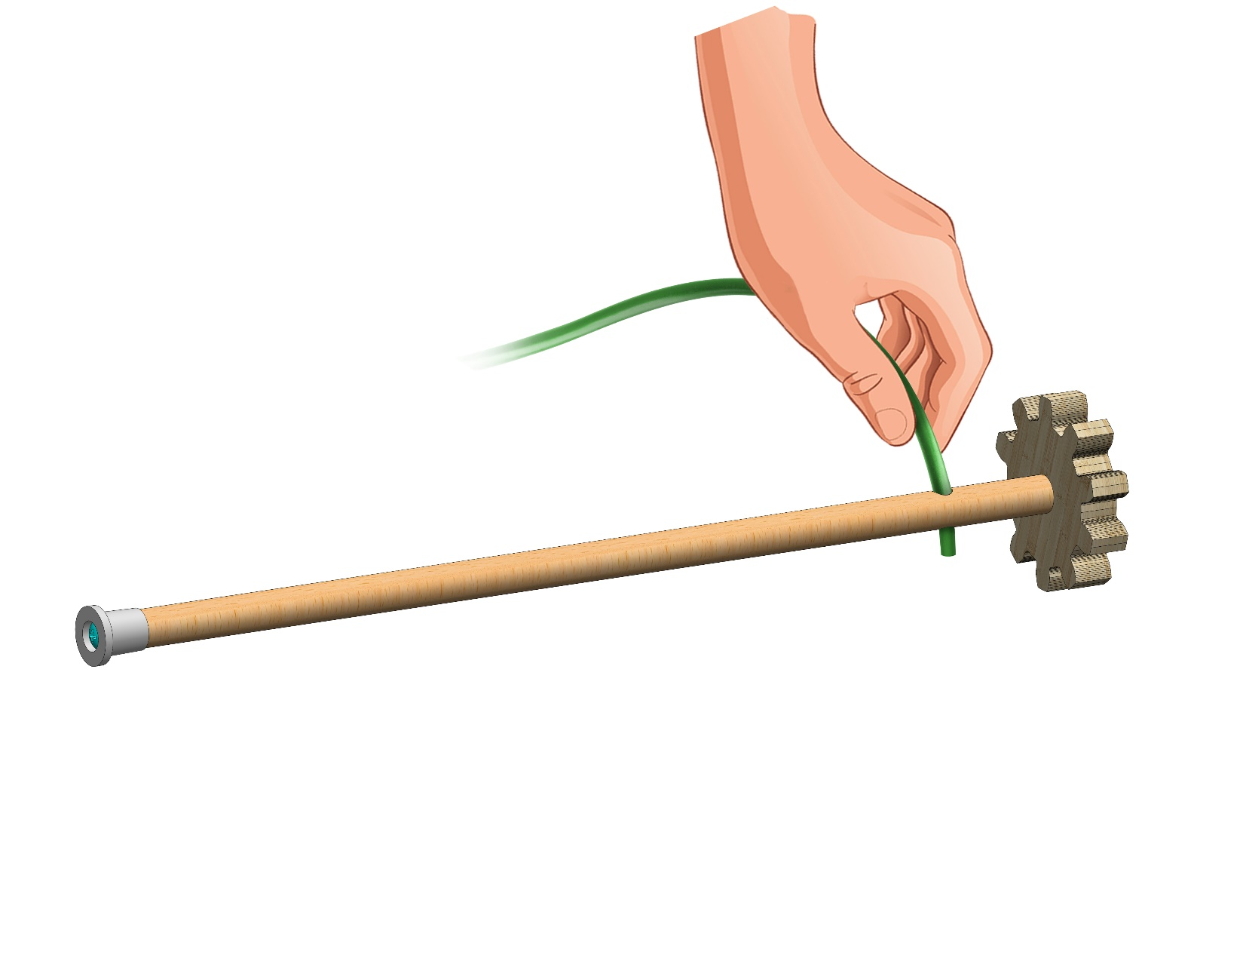
Attach Part 3 to Part 15 as pictured. Pay attention to the position of the hole on the rod. Use one #20 bolt.
15
3
Attach Part 17 to the other side of the rod. Use one #20 bolt.
17
Thread one end of the flexible wire (Part 14) into the hole at the end of the rod as pictured.
14
© All rights reserved to AristoCraft Ltd. Do not copy or reproduce without written permission.

Slide 7
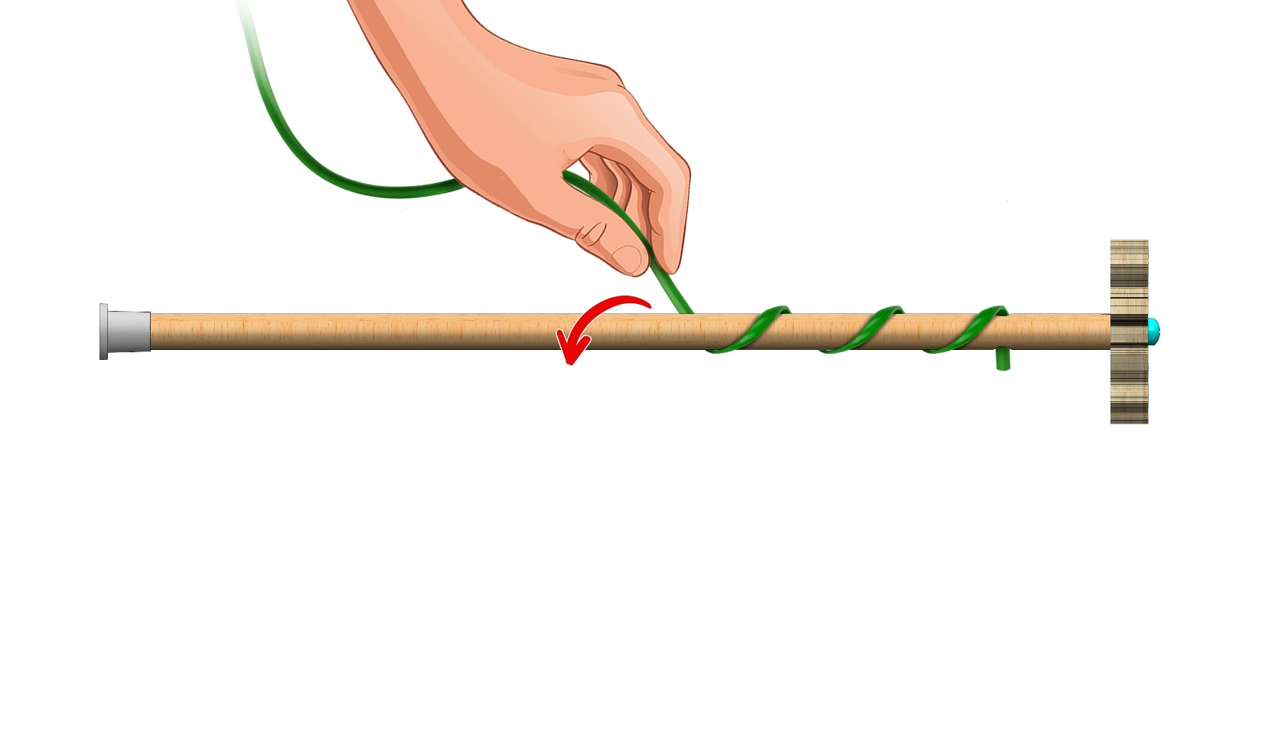
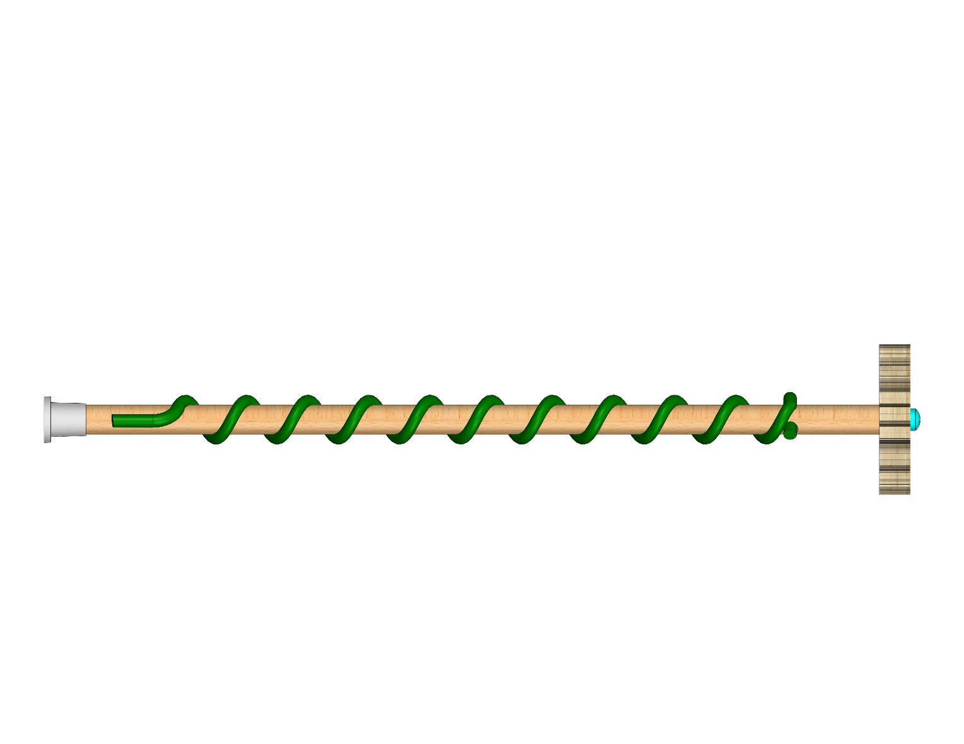
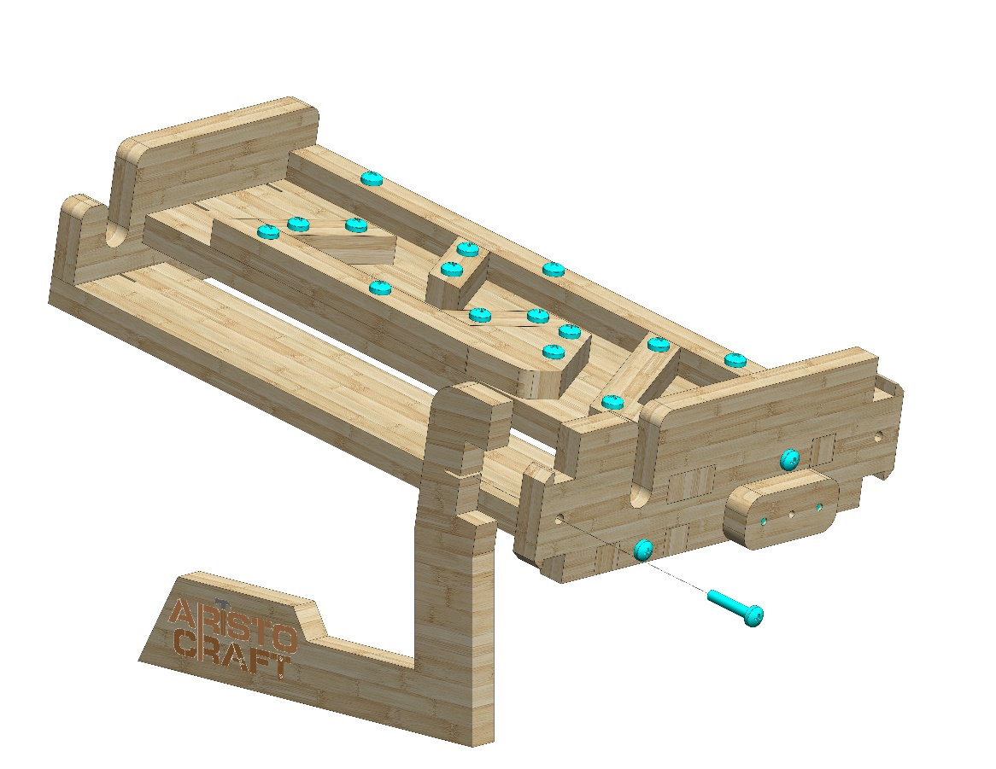
Wind the flexible wire in the direction pictured! Wind the flexible wire so it is evenly spaced and reaches the other end of the rod.
Make sure the flexible wire reaches the other end of the rod as pictured.
Attach Part 11 as pictured. Use one #20 bolt.
11
© All rights reserved to AristoCraft Ltd. Do not copy or reproduce without written permission.

Slide 8
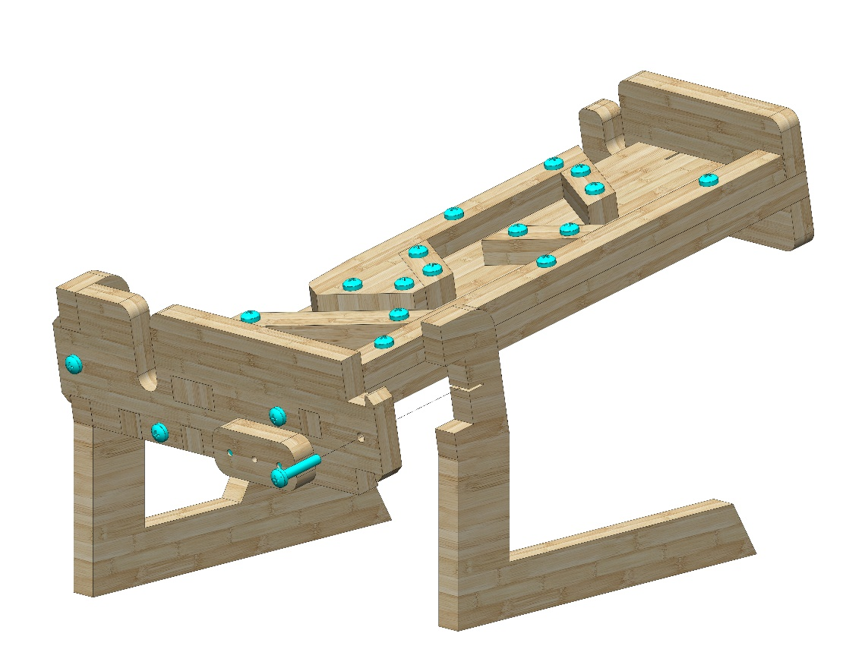
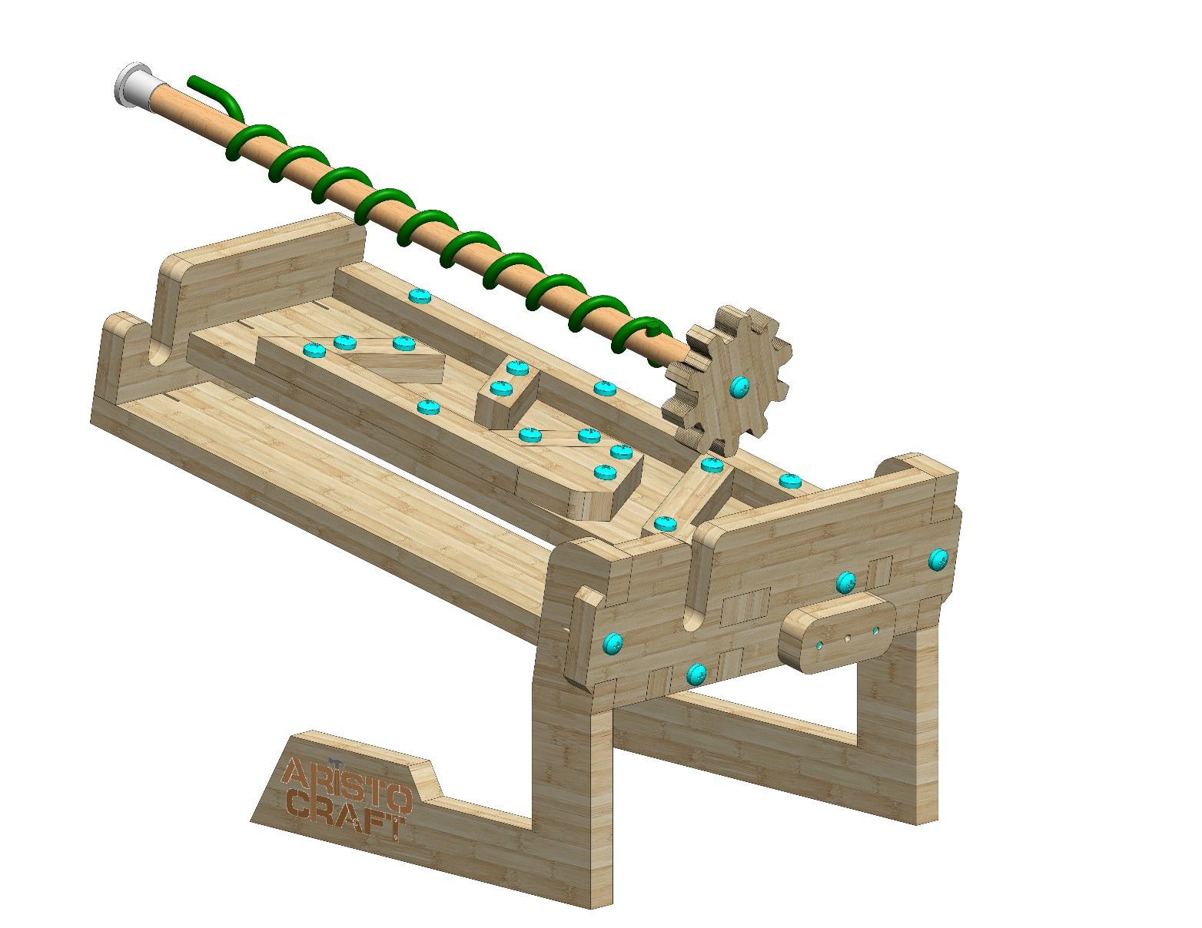
Attach Part 9 as pictured. Use one #20 bolt.
9
Position the dowel (wound with the flexible wire) as pictured.
© All rights reserved to AristoCraft Ltd. Do not copy or reproduce without written permission.

Slide 9
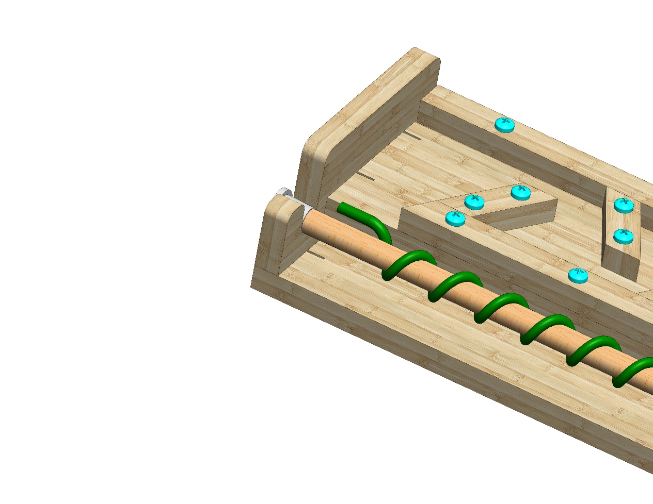
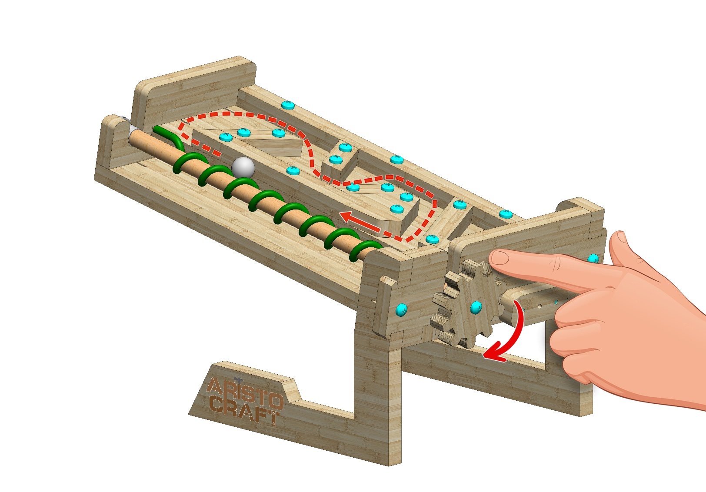
Ensure that the end of the flexible wire is bent as pictured so that the rod can turn freely.
Turn the gear as illustrated. If the marble (Part 18) does not move up smoothly, remove the flexible wire and rewind it.
© All rights reserved to AristoCraft Ltd. Do not copy or reproduce without written permission.

Slide 10
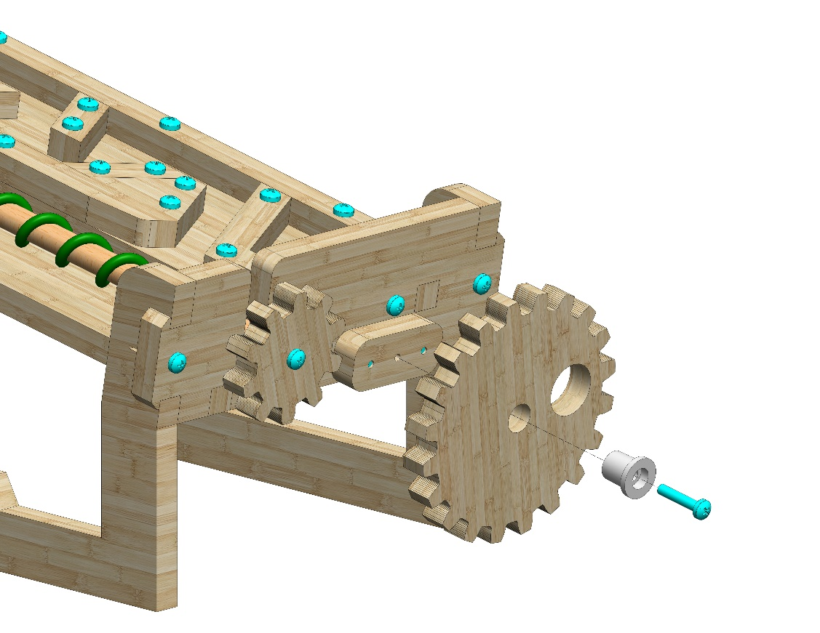
Attach Part 2 using Part 17 as pictured. Use one #20 bolt.
2
17
© All rights reserved to AristoCraft Ltd. Do not copy or reproduce without written permission.

