Slide 1
This Math News Snapshot was created by Nitsa Movshovitz-Hadar in collaboration with Batya Amit, with later enhancements contributed by Shlomo Feder, Atara Shriki, Varda Zigerson and Clara Zisken (listed alphabetically) Last updated on 13-Oct-2016 Slides that may require update: 8, 18 ("40 years")
Technion – Israel Institute of Technology
Technion R&D Foundation Ltd.

Slide 2
Development Team Statement on Presentation Use
This presentation has been developed for research experimentation purposes and may only be used with written permission from the Technion research team.
The presentation may not be transferred to a third party nor may any use be made of it without written permission from the research team.
Permission requests may be submitted via email to:
keshercham.technion@gmail.com
indicating the following on the subject line: permission for [MNS name] MNS use
Israel Science Foundation

Slide 3
The Art Gallery Problem
Technion R&D Foundation Ltd.
Israel Science Foundation
Technion – Israel Institute of Technology
Technion R&D Foundation Ltd.
© כל הזכויות שמורות ל"קשר חם", הטכניון
Notes:
To the teacher:
1. Before introducing this MNS to the students, make sure they are familiar with the concepts convex polygon, concave polygon and prism.
**2. We recommend checking the Ramzor program to read the feedback of teachers who have already introduced the MNS into their classrooms. Add your own comments after you have introduced it so that others can gain from your experiences. ** relevant in English version?**
3. It suffices to present slides 1 through 18. We recommend proceeding until the end, of course, if time allows.
4. In preparation for the MNS, if time permits, we recommend introducing the concept of polygon triangulation -- the decomposition of a polygon into a set of triangles by drawing non-crossing diagonals. In polygon triangulation each triangle consists of three vertices of the original polygon. It can be proven by induction that any polygon triangulation is constructed from 3n diagonals and is composed of 2n triangles (for details, see, for example: http://mathforum.org/mathimages/index.php/Art_Gallery_Theorem)

Slide 4
Did you know that…
The first museum was established in Alexandria, Egypt in the third century B.C. as a center of inspiration for studies and research.
The word "museum" comes from the Greek Μουσεῖον (Mouseion) which means a place or temple dedicated to the Muses -- the patron divinities of inspiration and creativity, the arts and the sciences – of Greek mythology.
The earliest museum in Alexandria conserved nearly a million (!) papyrus scrolls from ancient Greek civilization.
Only scientists and select intellectuals were permitted to enter the Muse temple.
Here‘s an illustration of the first museum‘s library --
(From http://upload.wikimedia.org/wikipedia/commons/6/64/Ancientlibraryalex.jpg)

Slide 5
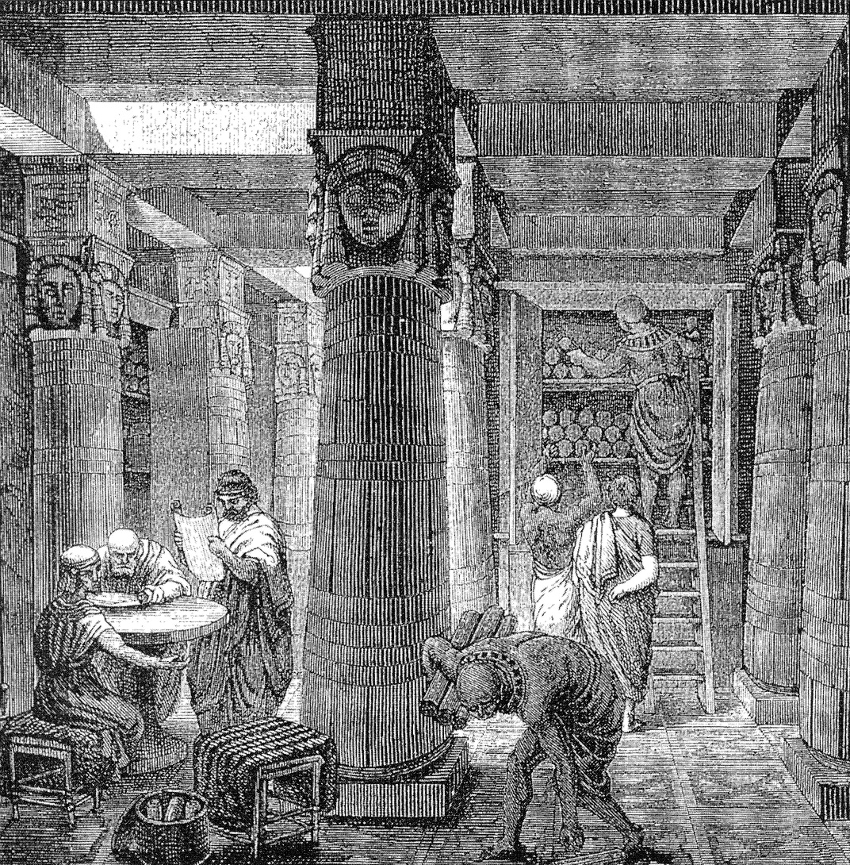
Notes:
Image from
http://upload.wikimedia.org/wikipedia/commons/6/64/Ancientlibraryalex.jpg

Slide 6
Historical changes
Over time, museums began to open their doors to the general public, allowing easy access to the exhibits for anyone interested.
This raised a new problem -- protecting the valuable exhibits from damage or destruction, and safeguarding them from theft.
The International Council of Museums tracks theft from museums and damage to exhibits; visible on their website. http://www.artsandcollections.com/index.php?/coll_item/lost_art/

Slide 7
The Art Gallery Problem
In order to address the problem of museum security, guards must be positioned inside the museum, or preferably --
security cameras connected to an alarm system should be strategically placed so that they can "keep an eye" on all exhibits at all times.
As the cost for this can run quite high, the following question arises:
What is the minimum number of guards or cameras necessary, that suffice to provide coverage of every corner and every wall of the museum?
This is a question tailor-made for mathematicians.
One of the first people who expressed interest in this problem was the American mathematician Victor Klee.

Slide 8
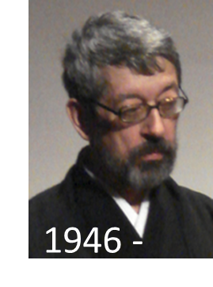
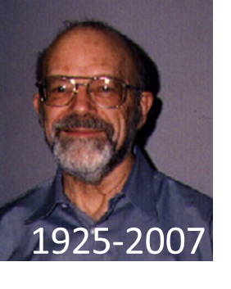
How is the solution to a math problem "born"?
In 1973, Victor Klee, already a well-known mathematician at that time, participated in a large conference in Stanford, California.
V. Chvátal
V. Klee
A brilliant young mathematician named Václav Chvátal, who was forced to leave his Czech homeland with the 1968 Soviet invasion, was in attendance at that conference too.
In a discussion at the conference, Chvátal asked Klee to suggest a challenging research topic. Klee proposed that he address the art gallery problem.
Six months later, Chvátal submitted his solution for publication.
His surprising solution 40 years ago gave rise to a new field of mathematics -- computational geometry -- which became particularly applicable with the development of computer-aided design and manufacturing (CAD/CAM).
Notes:
To the teacher:
Please note that computational geometry does not refer to computations in geometry performed in school!

Slide 9
Let's drill down through the problem and its solution
We begin with the case of a museum with a simple structure that has the following properties:
1. The museum building is a right prism; that is:
Its floor and ceiling are parallel and congruent, their shape is an n-sided polygon (where n ≥ 3), and its walls are perpendicular to the floor;
2. The museum is a single-story structure;
3. There are no interior walls;
4. All museum exhibits hang on the walls or stand on the floor, such that visitors move around in the interior space of the prism;
5. The guard (or video camera) situated in the corner of this space sees every spot on the floor, on the two walls adjacent to that corner, and on those opposite it if they are not blocked by other walls.
Notes:
To the teacher: A few comments on property 5:
1. Further explanation will be provided in the next slide. But you may already point out the floor of the concave prism in the left sketch. If the guard stands at one of the two vertices that are on either side of the concave vertex, he can see everything except those things that are blocked by the wall that is on the other side of the concave corner (because the wall blocks them). You may already begin to discuss the "field of view" that is between the "lines of sight".
2. Furthermore, at this point we are talking about the guard because it more tangible; later on we will move over to cameras (an electronic eye instead of a human eye). You may explain that this makes no difference in terms of mathematical thinking (it is only more efficient and up-to-date).
3. Note that there are exhibits on the walls and on the floor but not on the ceiling... so that the security is as described in property 4

Slide 10
Phrasing the problem for a simple structure
What is the minimum number of guards (or cameras) necessary for simultaneously safeguarding all the exhibits in a museum with a simple structure (having the five properties listed above)?
Notice -- a "simple" structure can also be quite complex.
Consider, for example, a prism-shaped museum whose floor plan looks as follows:
A camera located in any corner of the building ( ) can "see" every point on any wall, on condition that its line of sight does not "hit" any other wall, because that would form a "dead zone".
Notes:
To the teacher:
The purple lines in the animation indicate lines of sight. At the end of the animation, it is important to point out the "dead zones" in which the camera at the indicated point could not see what is happening (for example, the entire upper left, and parts of the lower right).

Slide 11
Let's simplify the problem
If the eye of the guard (or camera) can see an edge of the building’s floor, or a part of that edge, then it can also see the wall above it.
The spatial problem can now be "thrown" on the floor; it suffices to find a solution to the following planar problem:
What is the minimum number of corners at which guards (or cameras) must be positioned in order to guarantee that every spot on the floor of the museum is visible to at least one guard?

Slide 12
The simplest case: a space whose floor plan is a convex polygon
If the floor plan of the museum is a convex polygon, it suffices to position a single camera at one of the vertices.
In this case, the solution
does not depend on the number of walls,
their dimensions,
nor the angles between them.
Thus, positioning a single camera
at one of the vertices is the solution to the security
problem of the entire space of a prism with a polygonal floor plan.
This is really quite simple, but what if the museum space is a bit more complex?
Notes:
To the teacher: We assume that the students can distinguish between a convex and a concave polygon. Even if they can’t, however, the diagram should speak for itself.
Please note that although the problem is addressed on the planar level, the solution solves the spatial problem; we’ve already seen that to solve the spatial problem it suffices to solve the planar one. "It suffices to solve the planar problem" means that its solution solves the spatial one.

Slide 13
What if the museum floor plan is a concave polygon?
One of the solutions would be to position a camera at every vertex, thus providing security for the entire space, no matter how complex it is.
This is the easiest solution, of course, but cameras are expensive.
How many of them would suffice? Which of them are unnecessary?

Slide 14
The general art gallery problem
Finding the minimum number of cameras necessary to secure a particular museum with a specific floor plan is not simple.
The problem that young Chvátal was challenged with by his renowned colleague Klee at the 1973 conference was even tougher:
What is the number of cameras that suffice to secure any museum with an n-sided polygonal floor plan -- no matter what its (polygonal) shape is!
This problem is called the general art gallery problem.
That is, if a museum director contacts a security company and indicates only the number of walls in the museum, what is the minimum number of cameras that must be sent to the museum in order to properly safeguard it?
We will address this question using two examples:

Slide 15
Let us examine two different museums having 15 walls each
For a museum with a spiral layout, three cameras would suffice ( ).
Three cameras are also necessary, since each one of the purple points requires a separate camera; there is no spot from which two of them would be visible.
For the museum with a comb layout, 5 cameras would suffice.
The spiral-layout museum
Fewer than 5 would not suffice,
because viewing each one of the 5 purple points requires a distinct camera; there is no point in the space from which two of them may be viewed simultaneously.
The comb-layout museum
Notes:
To the teacher:
Recommended guidelines for this slide:
1. Count the sides in the diagrams out loud to make it clear that there are in fact 15 sides in each.
2. After the first part**??** go over all the possible combinations of two purple points so that it’s clear that no two can be viewed simultaneously.
3. Emphasize that three guards for the spiral museum are both necessary and sufficient. For the comb museum five are necessary as well as sufficient.
5. Point out that although three guards suffice for the spiral museum, they must be positioned properly. This may be demonstrated by positioning guards on the three purple points, and showing that although there are three guards, dead zones remain. This can be taken a step further by adding "beams" of regions that can be viewed from each point, in order to show that positioning guards at the purple points does not suffice, but guards at the white points do.

Slide 16
What did Chvátal prove in 1973?
Chvátal proved (among other things) that the number of cameras that suffice for all "simple" museums -- those with a 15-sided polygonal floor plan and walls perpendicular to the floor -- is 5.
More guards would certainly not be necessary for any such space. There are also cases, however, where fewer than 5 would not suffice.
So, for example, in a museum with a comb floor plan, 5 is also the number of cameras necessary
for securing it.
But the spiral museum
could make do with fewer,
as we saw above.
The spiral-layout museum
The comb-layout museum
Notes:
To the teacher: Here the students grasp the important distinction between necessary and sufficient conditions.

Slide 17
A comb museum with 16 or 17 sides
It turns out that for securing a 16- or 17-sided comb museum, 5 cameras are necessary as well.
Chvátal further proved that
the number of guards that suffice
for any space with a 15-, 16- or 17-sided polygonal floor plan whose floor and walls are perpendicular,
is at most 5.
5 is the floor of 15/3=5,
of 16/3=5 and of 17/3=5 .
A comb museum (16 sides)
A comb museum (17 sides)
Notes:
To the teacher: At the end you may add the question "What is the floor of 3/18? of 3/19?", in order to clarify the concept of "floor".

Slide 18
The Art Gallery Theorem
Chvátal in effect proved that in general, for any number of sides n,
the number of guards sufficient for safeguarding a museum whose structure is a right prism, and whose floor plan is an n-sided polygon (convex or concave of any shape or form!) is:
the floor of , denoted: ⎣ ⎦ .
In certain cases, this is also the necessary number.
The theorem has since been known as
The Art Gallery Theorem
Chvátal thus established an upper bound (that is, a maximal number) for the solution to the art gallery problem for a museum with a simple structure.
As we mentioned earlier, this solution brought about a flurry of new mathematical development in the last 40 years.
Notes:
To the teacher:
1. As far as the floor of n/3, you may add that it refers to the largest number that is less than or equal to n/3.
2. More on the last bullet: The new area is mentioned in slide 8 and it is computational geometry, which became particularly useful with the development of computer-aided design and manufacturing!
3. The presentation of this MNS may end here, or you may continue on and spend a bit more time on this topic than in most other MNS’.

Slide 19
The proof of the Art Gallery Theorem
In mathematics we often find that a first proof for a difficult problem is quite cumbersome.
Chvátal’s proof was, in fact, quite “a pain in the neck”.
It is a proof by exhaustion.
Mathematicians not only like to prove new things; they also like to find newer and simpler proofs to theorems that have already been proven.
The discovery of a proof is an ongoing thought process that often takes place under unexpected circumstances --

Slide 20
How is a proof "born"?
Steve Fisk (1946-2010), a mathematician born in San Francisco, saw Chvátal's paper in the math library of the University of Tehran about a year after its publication, on a visit to Iran.
The problem and its solution piqued his interest, but he did not have the patience to sit in the library and read the complex proof.
In his own words, "A few weeks later we were traveling on a bus between Herat and Kandahar in Afghanistan. It was hot, dusty and noisy with squawking chickens on the roof. I was thinking about it -- well I was probably dozing off actually -- and I thought of the proof." Fisk's proof was simple and elegant.
Notes:
To the teacher:
No picture of Fisk was found on the internet. **picture: https://books.google.co.il/books?id=M-qK8anbZmwC&pg=PA222&lpg=PA222&dq=steve+fisk+mathematician+tehran&source=bl&ots=wzPSOxSzdF&sig=VxwKc8mZP1YHo_bkWQTrR17bI4s&hl=iw&sa=X&ved=0ahUKEwjqxb-i69XRAhWJOsAKHaeLA4wQ6AEIJTAB#v=onepage&q=steve%20fisk%20mathematician%20tehran&f=false He died after a 10-year battle with a serious illness, and donated his body to science. Interested students may be asked to search for additional biographical details about Fisk, and to present them to the class in the next lesson. For example: http://bowdoinorient.com/article/
Fisk loved math and his mathematical abilities stood out as early as his high school days. His curiosity led him to discoveries, the climax of which was in 1978 when he proved the art gallery problem.
But Fisk's curiosity took him in many directions beyond mathematics:
Ancient cultures, Buddhist meditation practice, the arts, especially the performing arts, travel inside and outside the United States, experiencing the outdoors, learning to get by, and occasionally getting into trouble, in many languages, solving crossword puzzles (together with his wife) and cats!

Slide 21
Fisk's brilliant proof (1978)
The assertion: To secure a prism-shaped museum with any n-sided polygonal floor plan, it suffices to position ⎣n/3⎦ guards at its vertices.
Step 1: Divide the polygon into triangles. This is called triangulation. A polygon can be triangulated in multiple ways.
But, can every polygon be triangulated? in at least one way?
-- Fisk knew that the answer is positive (the proof is by induction, which we will forego for today).
B
B
A
C
A
C
F
D
F
D
E
E
Assertion 5
Notes:
To the teacher: The proof by induction is:
Proof (by induction for number of sides n ≥ 3).
Basis: For n=3 the assertion is true by the trivial case.
Triangulation of a triangle is the triangle itself.
Inductive hypothesis:
Let k be a natural number not less than three (k ≥ 3) and let us assume that every polygon whose number of sides is between 3 and k may be triangulated.
The inductive step:
If we can prove for all k that this hypothesis leads to the validity of the assertion for polygons with k+1 sides, then we can infer from this that the assertion is true for a polygon of any integral number of sides, n. [Why?]
Let us imagine a polygon with k+1 sides, convex or concave.
Clearly it has at least one internal diagonal.
By drawing an internal diagonal, we divide it into two distinct polygons with at least one common side. **זרים is 'disjoint' but my understanding is that the definition of disjoint is that they share no elements, thus I used the non-mathematical term 'distinct'**.
The number of sides in each is less than or equal to k.
Thus the induction hypothesis holds for them; that is, each of the two sub-polygons may be triangulated.
The union of the triangulation of each of the distinct sub-polygons yields the triangulation of the original polygon of k+1 sides. From here it follows (based on the axiom of induction!) that the assertion is true for all polygons, no matter how many sides they have.
Q.E.D.

Slide 22
Fisk's brilliant proof (1978)
The assertion: To secure a prism-shaped museum with any n-sided polygonal floor plan, it suffices to position ⎣n/3⎦ guards at its vertices.
Step 1: Carry out any triangulation of the polygon without adding or removing any vertices.
Step 2: Color the three vertices of every triangulated triangle in three different colors.
For example like this:
Notes:
To the teacher:
The assertion appears as a reminder. It is not necessary to repeat it on each slide, unless you wish to mention it to the class once again.`

Slide 23
Coloring the vertices of a 12-sided polygon in 3 colors
Let us choose a triangulation
Let us choose a triangle
From this point on, the color of every other vertex is uniquely defined.
Fisk proved (also by induction) that the process works for every triangulation of every polygon, and called this coloring a 'proper 3-coloring'.
Notes:
To the teacher:
In classes that have not yet learned proof by induction, the students should at least become familiar with its existence. In classes where students have already learned the method, they may be encouraged to practice the proof as an exercise, if time permits.
Proof:
Proof by induction on the number n of polygonal sides.
Basis:
For a single triangle (n=3) the assertion is true by the trivial case.
Induction hypothesis:
Let k be a natural number not less than 3 (k ≥ 3).
Now let us assume that we can properly color all vertices of every triangulation of every 3-sided to k-sided polygon.
Induction step: If we can prove for all k that the assertion leads to the validity of the assertion for k+1-sided polygons, then we can infer that the statement is true for every n-sided polygon, where n is an integer. Imagine any k+1-sided polygon which has been triangulated.
Let us remove a triangle for which two of its sides are congruent to two sides of the polygon (in every triangulation of every polygon there exists
at least one such triangle).
We remain with a k-sided polygon, because
(k+1)−2+1=k
Based on the induction hypothesis, we can properly color the vertices.
Two of the vertices in the removed triangle are congruent to the colored vertices and have already been colored in two different colors.
Let us color the third vertex in the third color. At this point all vertices in the k+1-sided polygon are properly colored. - - - Q.E.D.
This can also be proven without induction. The following is from
http://www.cut-the-knot.org/Curriculum/Combinatorics/Chvatal.shtml
"given a diagonal triangulation, how do we color the vertices to satisfy #2? Observe that, in a diagonal triangulation, the sides of any triangle are either sides or the diagonals of the polygon, and at most 2 may be of the latter kind. The triangles could only abut each other at the diagonals, not at the sides of the polygon. Furthermore, only two triangles in a triangulation may share the same diagonal. It follows that each triangle in a triangulation is adjacent to 1 or 2 other triangles. The neighboring triangles share a side and, consequently, two vertices.
Start with any triangle of the triangulation and color its vertices with three colors in a random fashion. Its neighbor triangles already have two vertices assigned two different colors; the requirements of #2 force a unique color on the remaining vertex. Continue in this manner with 1 or, as the case may be, 2 adjacent triangles until all vertices have been assigned a color. The process stops when on either end we run into a triangle composed of 2 sides and 1 diagonal of the polygon.”

Slide 24
We now continue with Fisk's brilliant proof (1978)
The assertion: To secure a prism-shaped museum with any n-sided polygonal floor plan, it suffices to position ⎣n/3⎦ guards at the vertices.
Step 1: Carry out any triangulation of the polygon without adding or removing any vertices.
Step 2: Properly color the three vertices of every triangulated triangle in three different colors.
In our example, the result is:
3 red vertices
4 blue ones
and 5 green ones
Each triangle in the triangulation has a green vertex, therefore --
Notes:
To the teacher: Here, too, it is not necessary to repeat the assertion and the two previous steps. They appear as a reminder, and you may quickly move on to the third bullet.

Slide 25
Solution to the art gallery problem for a given polygon
If a guard is placed at each of the 5 green vertices, the dodecagonal (12-gonal) museum is well-secured, because every spot in the museum is in one of the triangles and can be viewed from any of its vertices. Each triangle has a green vertex, thus each spot may be viewed from one of the green vertices.
The same holds true for the 4 blue vertices, and for the 3 red ones.
Thus, according to Fisk, 3 guards suffice in this case.
It is possible that a different dodecagonal prism-shaped museum will require fewer than 3 guards (for example, if its floor plan is convex, a single guard will suffice).
But no dodecagonal museum will require more than 4 guards (12/3). Because when there are 12 vertices in 3 colors, in the worst case there are exactly 4 vertices of each color (why?).
Notes:
To the teacher:
The title uses the word "dodecagon". ***how do you want this treated? we can use "dodecagon", and we can use "12-gon", or "12-sided polygon". What do you prefer in the slides, and what do you want indicated in the teacher's note?
The explanation in the first bullet is very important, and it should be reviewed slowly and carefully, coloring the diagram where appropriate. After the students have understood it, they should have no difficulty grasping the second bullet.
The "worst case" described in the last bullet is that there are exactly 4 vertices of every color, since if there would be more than 4 vertices of a particular color, there would need to be less than 4 of a different color (as we saw in one of the examples). Therefore 4 is the largest possible number.

Slide 26
We now return to Fisk's brilliant proof (1978)
The assertion: To secure a prism-shaped museum with any n-sided polygonal floor plan, it suffices to position ⎣n/3⎦ guards at the vertices.
Step 1: Carry out any triangulation of the polygon,
without adding or removing any vertices.
Step 2: Properly color the three vertices of every triangulated triangle,
in three different colors. The outcome: When there are n vertices, there could not be more than n/3 vertices of each color.
Therefore there exists (at least) one color that appears in ⎣n/3⎦ vertices or fewer.
Step 3: Each triangulated triangle has one vertex in this color,
and every spot in a triangle may be viewed from that vertex.
It therefore suffices to position guards at the vertices of this color in order for every spot in the museum to be under the watchful eye of one of the guards.
Q.E.D.
Notes:
To the teacher:
Here is a more "formal" proof for Step 2, taken from
http://www.cut-the-knot.org/Curriculum/Combinatorics/Chvatal.shtml
“For example, assume there are B blue vertices, R red vertices and G green vertices. Then obviously B + R + G = n. One of the numbers does not exceed the other two. Without loss of generality we may assume that
B ≤ R and B ≤ G.
Then
3·B ≤ B + R + G = n,
so that B ≤ n/3, and, since B is a whole number,
B ≤ [n/3]. “

Slide 27
Fisk's proof is elegant
it is simple
it is short
and it is practical! Because from it we derive a four-step procedure guaranteeing the positioning of the guards for any polygon:
A. triangulate the polygon;
B. properly color the vertices;
C. find the color with the smallest number of vertices;
D. place guards at those vertices.
Thanks to Chvátal, we know that this number will not exceed ⎣n/3⎦,
and thanks to Fisk we also know where to position them (there's an algorithm)!

Slide 28
Recommended sources for additional reading (books, articles and websites)
Chvátal, V., (1975). "A combinatorial theorem in plane geometry", Journal of Combinatorial Theory, Series B Volume 18, Issue 1, February 1975, Pages 39-41 , doi:10.1016/0095-8956(75)90061-1
Fisk, S., (1978). "A short proof of Chvátal's watchman theorem", Journal of Combinatorial Theory, Series B 24 (3): 374, doi:10.1016/0095-8956(78)90059-X
Honsberger, R., (1976). “Chvatal’s Art Gallery Theorem.” Mathematical Gems II, Chapter 11, 104-110, MAA Inc. 1976 1976
Garey, Michael R.; Johnson, D. S. (1979). Victor Klee. ed. Computers and Intractability: A Guide to the Theory of NP-Completeness. A Series of Books in the Mathematical Sciences. W. H. Freeman and Co.. pp. x+338. ISBN 0-7167-1045-5. MR519066.
Notes:
Recommended sources for additional reading (books, articles and websites)
Chvátal, V., (1975). "A combinatorial theorem in plane geometry", Journal of Combinatorial Theory, Series B Volume 18, Issue 1, February 1975, Pages 39-41 , doi:10.1016/0095-8956(75)90061-1
Fisk, S., (1978). "A short proof of Chvátal's watchman theorem", Journal of Combinatorial Theory, Series B 24 (3): 374, doi:10.1016/0095-8956(78)90059-X
Honsberger, R., (1976). “Chvatal’s Art Gallery Theorem.” Mathematical Gems II, Chapter 11, 104-110, MAA Inc. 1976
Garey, Michael R.; Johnson, D. S. (1979). Victor Klee. ed. Computers and Intractability: A Guide to the Theory of NP-Completeness. A Series of Books in the Mathematical Sciences. W. H. Freeman and Co.. pp. x+338. ISBN 0-7167-1045-5. MR519066.

Slide 29
Recommended sources for additional reading (books, articles and websites)
O'Rourke, Joseph (1987). Art Gallery Theorems and Algorithms, Oxford University Press, ISBN 0-19-503965-3, http://cs.smith.edu/~orourke/books/ArtGalleryTheorems/art.html
http://maven.smith.edu/~orourke/ The problem of securing a fortress appears in Chapter 6 of this book. ***404 error -- page not found***
Proof that the art gallery problem is NP-complete appears on pages 239-242.
The difficult problem of securing a polyhedral museum (the three-dimensional problem) is addressed in Chapter 10. An example of a polyhedral non-prismatic museum whose interior space is not visible from the corners is addressed on page 255.
Bjorling-Sachs, I. and Souvaine, D. L. "A Tight Bound for Guarding Polygons with Holes." Report LCSR-TR-165. New Brunswick, NJ: Lab. Comput. Sci. Res., Rutgers Univ., 1991.
Bjorling-Sachs, I. and Souvaine, D. L. "An Efficient Algorithm for Guard Placement in Polygons with Holes." Disc. Comput. Geom. 13, 77-109, 1995.
DIMACS Research and Education Institute. "Art Gallery Problems." http://dimacs.rutgers.edu/~cristofa/Xfiles/art.html
MathForum: http://mathforum.org/mathimages/index.php/Art_Gallery_Theorem
Notes:
Recommended reading (continued)
O'Rourke, Joseph (1987). Art Gallery Theorems and Algorithms, Oxford University Press, ISBN 0-19-503965-3, http://cs.smith.edu/~orourke/books/ArtGalleryTheorems/art.html
http://maven.smith.edu/~orourke/
http://maven.smith.edu/~orourke/ The problem of securing a fortress appears in Chapter 6 of this book. ***404 error -- page not found***
Proof that the art gallery problem is NP-complete appears on pages 239-242.
The difficult problem of securing a polyhedral museum (the three-dimensional problem) is addressed in Chapter 10. An example of a polyhedral non-prismatic museum whose interior space is not visible from the corners appears on page 255.
Bjorling-Sachs, I. and Souvaine, D. L. "A Tight Bound for Guarding Polygons with Holes." Report LCSR-TR-165. New Brunswick, NJ: Lab. Comput. Sci. Res., Rutgers Univ., 1991.
Bjorling-Sachs, I. and Souvaine, D. L. "An Efficient Algorithm for Guard Placement in Polygons with Holes." Disc. Comput. Geom. 13, 77-109, 1995.
DIMACS Research and Education Institute. "Art Gallery Problems." http://dimacs.rutgers.edu/~cristofa/Xfiles/art.html

Slide 30
Recommended sources for additional reading
Garey, M. R.; Johnson, D. S.; Preparata, F. P.; and Tarjan, R. E. "Triangulating a Simple Polygon." Inform. Process. Lett. 7, 175-179, 1978.
Hoffmann, F.; Kaufmann, M.; and Kriegel, K. "The Art Gallery Theorem for Polygons with Holes." Proc. 32nd Annual IEEE Sympos. Found. Comput. Sci., 39-48, 1991.
Kahn, J.; Klawe, M.; and Kleitman, D. "Traditional Galleries Require Fewer Watchmen." SIAM J. Alg. Disc. Math. 4, 194-206, 1993.
Klee, V. "On the Complexity of -Dimensional Voronoi Diagrams." Archiv. Math. 34, 75-80, 1980.
O'Rourke, J. §2.3 in Computational Geometry in C, 2nd ed. Cambridge, England: Cambridge University Press, 1998.
Stewart, I. "How Many Guards in the Gallery?" Sci. Amer. 270, 118-120, May 1994.
Tucker, A. "The Art Gallery Problem." Math Horizons 1, 24-26, Spring 1994.
Wagon, S. "The Art Gallery Theorem." §10.3 in Mathematica in Action. New York: W. H. Freeman, pp. 333-345, 1991.
Wells, D. The Penguin Dictionary of Curious and Interesting Geometry. London: Penguin, p. 9, 1991.
For proof of the theorem as well as updates and new proofs from 1991 and 1995, see the math website: http://mathworld.wolfram.com/ArtGalleryTheorem.html
Notes:
Recommended sources for additional reading (continued)
Garey, M. R.; Johnson, D. S.; Preparata, F. P.; and Tarjan, R. E. "Triangulating a Simple Polygon." Inform. Process. Lett. 7, 175-179, 1978.
Hoffmann, F.; Kaufmann, M.; and Kriegel, K. "The Art Gallery Theorem for Polygons with Holes." Proc. 32nd Annual IEEE Sympos. Found. Comput. Sci., 39-48, 1991.
Kahn, J.; Klawe, M.; and Kleitman, D. "Traditional Galleries Require Fewer Watchmen." SIAM J. Alg. Disc. Math. 4, 194-206, 1993.
Klee, V. "On the Complexity of -Dimensional Voronoi Diagrams." Archiv. Math. 34, 75-80, 1980.
O'Rourke, J. §2.3 in Computational Geometry in C, 2nd ed. Cambridge, England: Cambridge University Press, 1998.
Stewart, I. "How Many Guards in the Gallery?" Sci. Amer. 270, 118-120, May 1994.
Tucker, A. "The Art Gallery Problem." Math Horizons 1, 24-26, Spring 1994.
Wagon, S. "The Art Gallery Theorem." §10.3 in Mathematica in Action. New York: W. H. Freeman, pp. 333-345, 1991.
Wells, D. The Penguin Dictionary of Curious and Interesting Geometry. London: Penguin, p. 9, 1991.
For proof of the theorem as well as updates and new proofs from 1991 and 1995, see the math website:
http://mathworld.wolfram.com/ArtGalleryTheorem.html

Slide 31
Recommended sources for additional reading (from 2000 and onward)
C. D. Tóth (2000), Art Gallery problem with guards whose range of vision is 180°. Computational Geometry, 17, 121-134. doi:10.1016/s0925-7721(00)00023-7
T. S. Michael (2009), How to Guard an Art Gallery and Other Discrete Mathematical Adventures, John Hopkins Univ. Press, Baltimore , Chapter 3: How to guard an Art Gallery. pp. 73-113
Joseph O'Rourke (2011) Computational Geometry in C (Cambridge Tracts in Theoretical Computer Science), 2nd edition, Cambridge University Press; ISBN-13: 978-0521649766
Couto, M.; de Rezende, P.; de Souza, C. (2011), "An exact algorithm for minimizing vertex guards on art galleries", International Transactions in Operational Research: no–no, doi:10.1111/j.1475-3995.2011.00804.x .
Couto, M.; de Rezende, P.; de Souza, C. (2011), Benchmark instances for the art gallery problem with vertex guards, AGPLIB - Art Gallery Problem Library, http://www.ic.unicamp.br/~cid/Problem-instances/Art-Gallery/
T. S. Michael (2011) Guards, Galleries, Fortresses and the Octoplex. College Mathematics Journal, Vol . 42 No. 3., pp. 191-200.
Urrutia, J. "Art Gallery and Illumination Problems." Ch. 22 in Handbook of Computational Geometry (Ed. J.-R. Sack and J. Urrutia). Amsterdam, Netherlands: North-Holland, pp. 973-1027, 2000.
Notes:
Recommended sources for additional reading (continued)
C. D. Tóth (2000), Art Gallery problem with guards whose range of vision is 180°. Computational Geometry, 17, 121-134. doi:10.1016/s0925-7721(00)00023-7
T. S. Michael (2009), How to Guard an Art Gallery and Other Discrete Mathematical Adventures, John Hopkins Univ. Press, Baltimore , Chapter 3: How to guard an Art Gallery. pp. 73-113
Joseph O'Rourke (2011) Computational Geometry in C (Cambridge Tracts in Theoretical Computer Science), 2nd edition, Cambridge University Press; ISBN-13: 978-0521649766
Couto, M.; de Rezende, P.; de Souza, C. (2011), "An exact algorithm for minimizing vertex guards on art galleries", International Transactions in Operational Research: no–no, doi:10.1111/j.1475-3995.2011.00804.x .
Couto, M.; de Rezende, P.; de Souza, C. (2011), Benchmark instances for the art gallery problem with vertex guards, AGPLIB - Art Gallery Problem Library, http://www.ic.unicamp.br/~cid/Problem-instances/Art-Gallery/
T. S. Michael (2011) Guards, Galleries, Fortresses and the Octoplex. College Mathematics Journal, Vol . 42 No. 3., pp. 191-200.
Urrutia, J. "Art Gallery and Illumination Problems." Ch. 22 in Handbook of Computational Geometry (Ed. J.-R. Sack and J. Urrutia). Amsterdam, Netherlands: North-Holland, pp. 973-1027, 2000.

