Slide 1
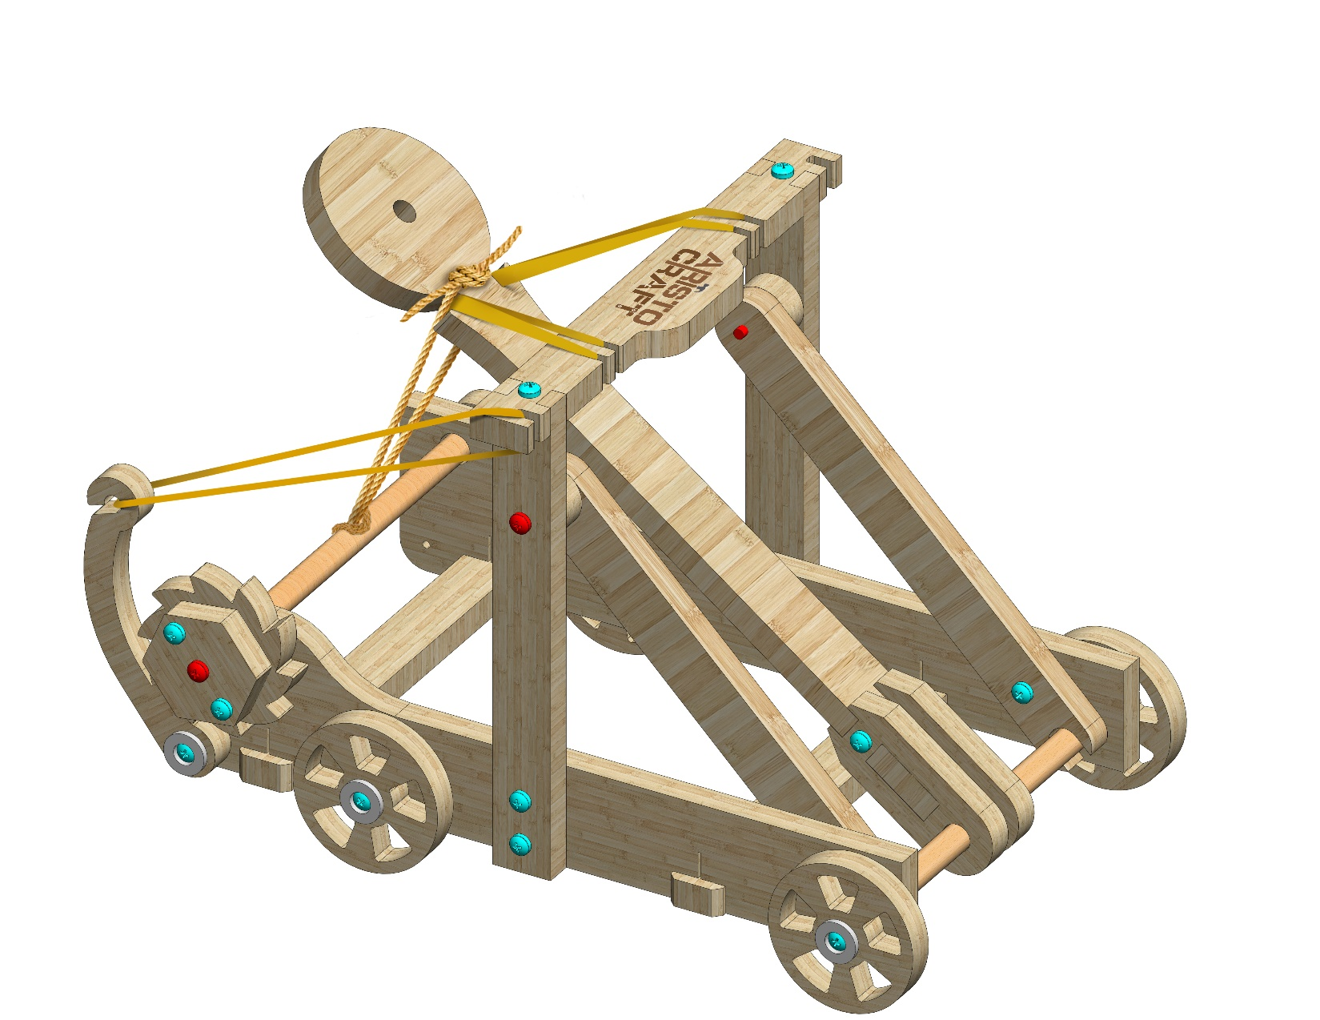
CATAPULT
Assembly instruction
© All rights reserved to AristoCraft Ltd. Do not copy or reproduce without written permission.

Slide 2
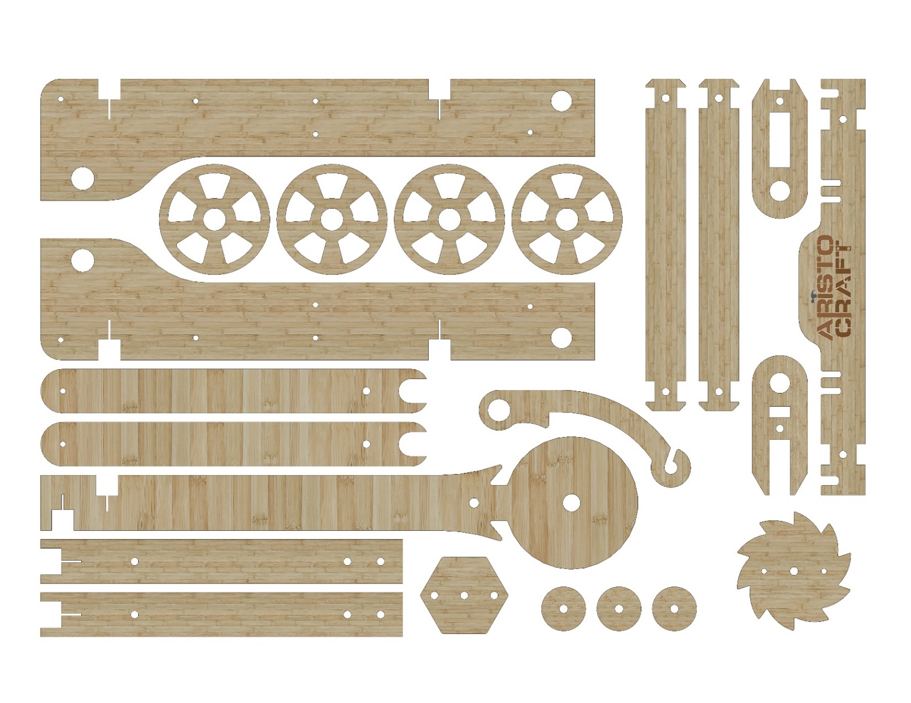
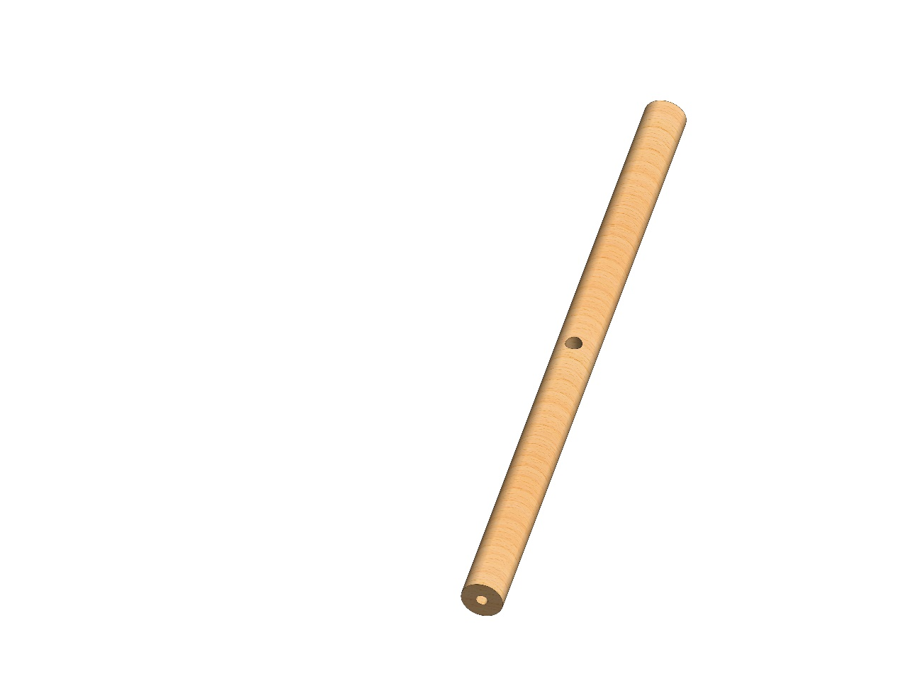
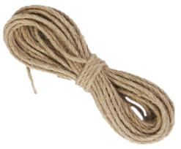
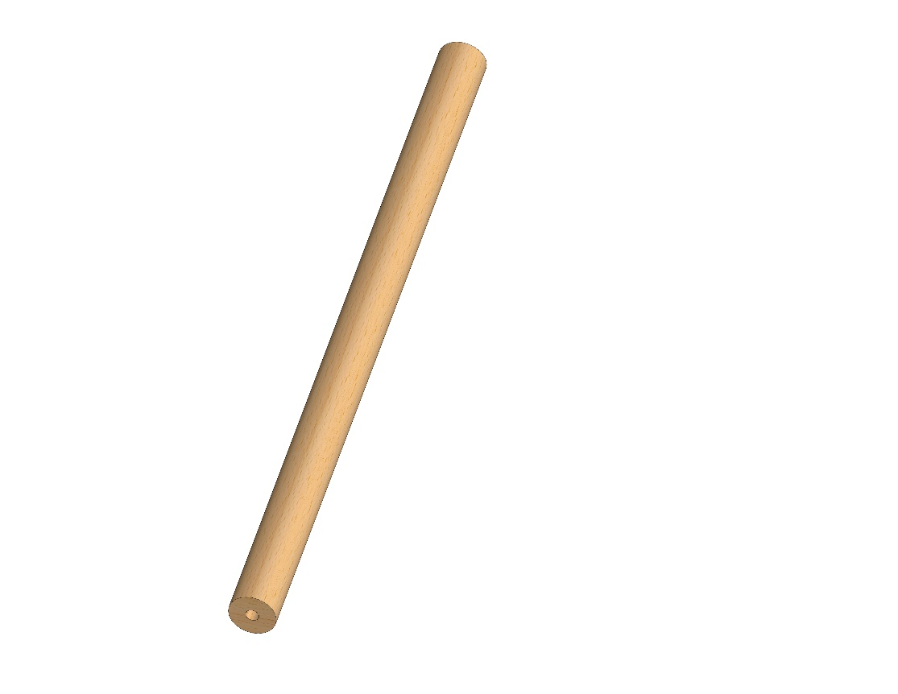
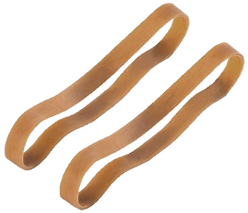
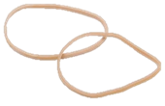
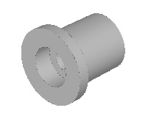
Part list
1
4
2
2
2
3
3
5
1
6
7
8
9
10
11
12
13
14
15
17
18
19
16
© All rights reserved to AristoCraft Ltd. Do not copy or reproduce without written permission.

Slide 3
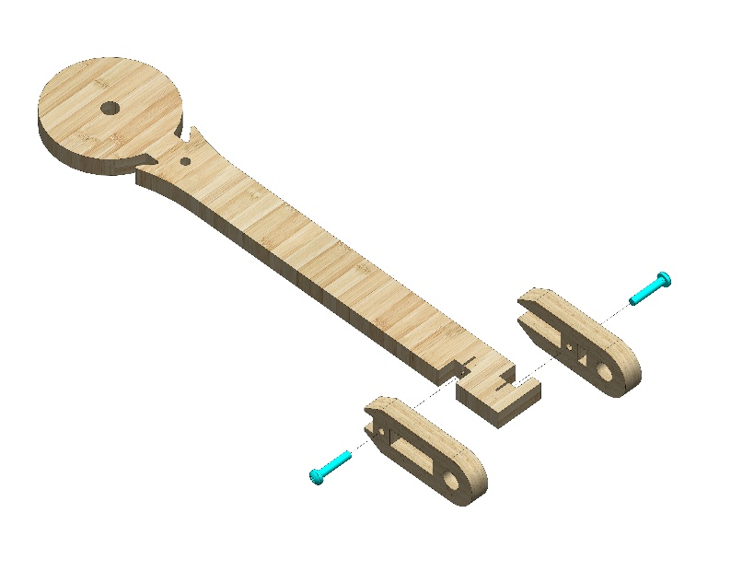
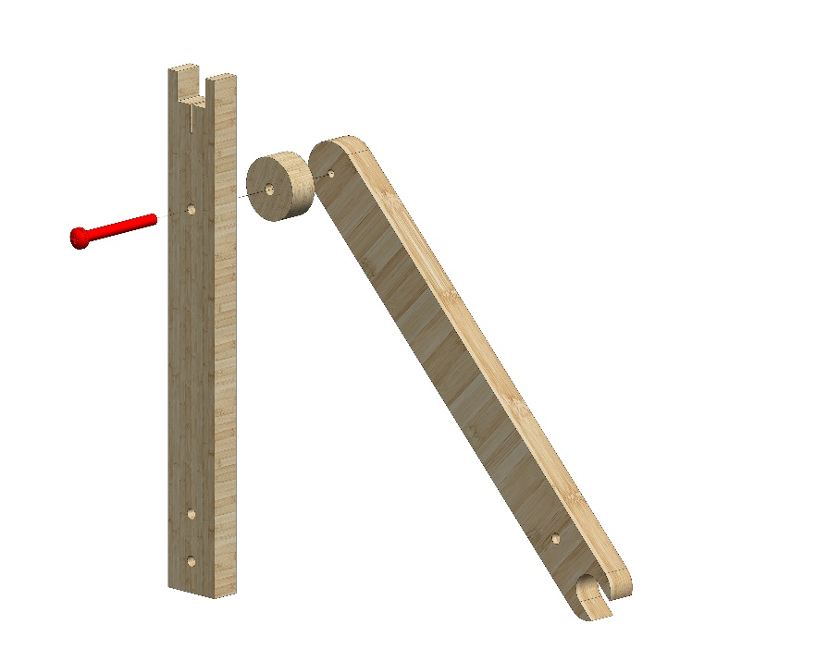
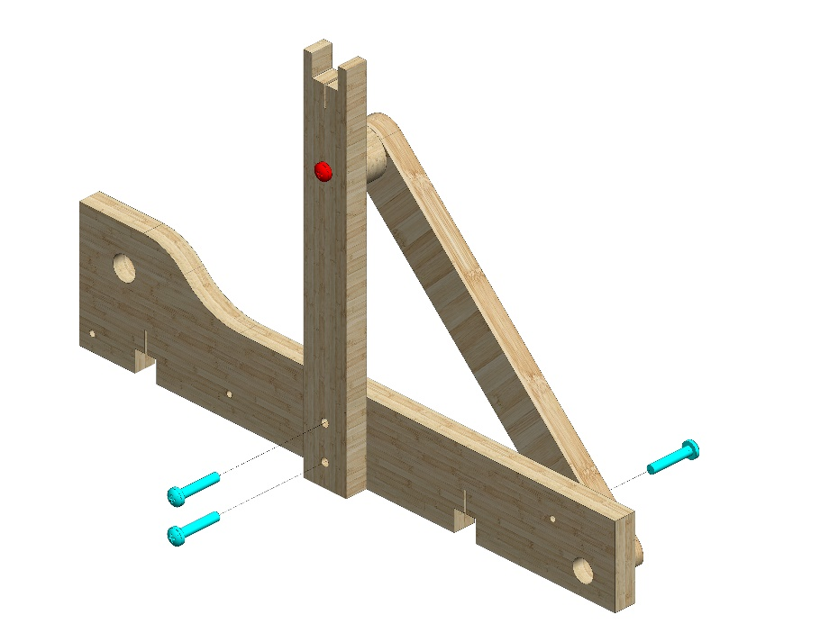
Instructions
Attach Part 4 and Part 8 to Part 9 as pictured. Use two #20 bolts.
9
8
4
X2
12
6
Insert a #30 bolt through Part 10 and Part 12 to attach them to Part 6.
Make two modules like this.
10
1
Connect one of these modules to Part 1 as pictured.
Use three #20 bolts.
© All rights reserved to AristoCraft Ltd. Do not copy or reproduce without written permission.

Slide 4
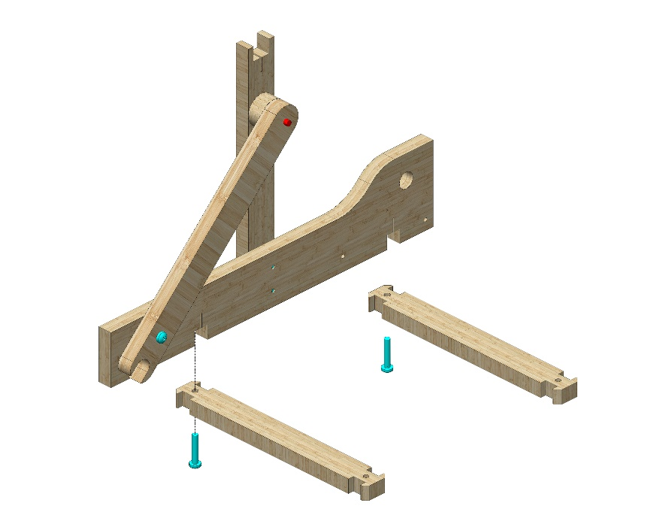
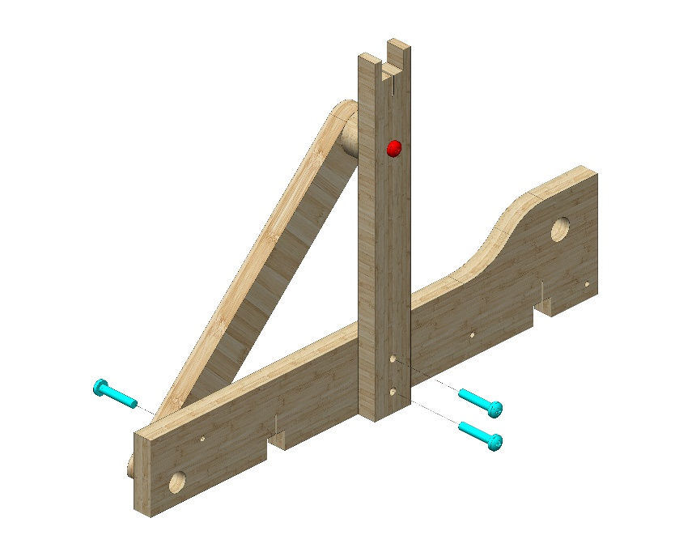
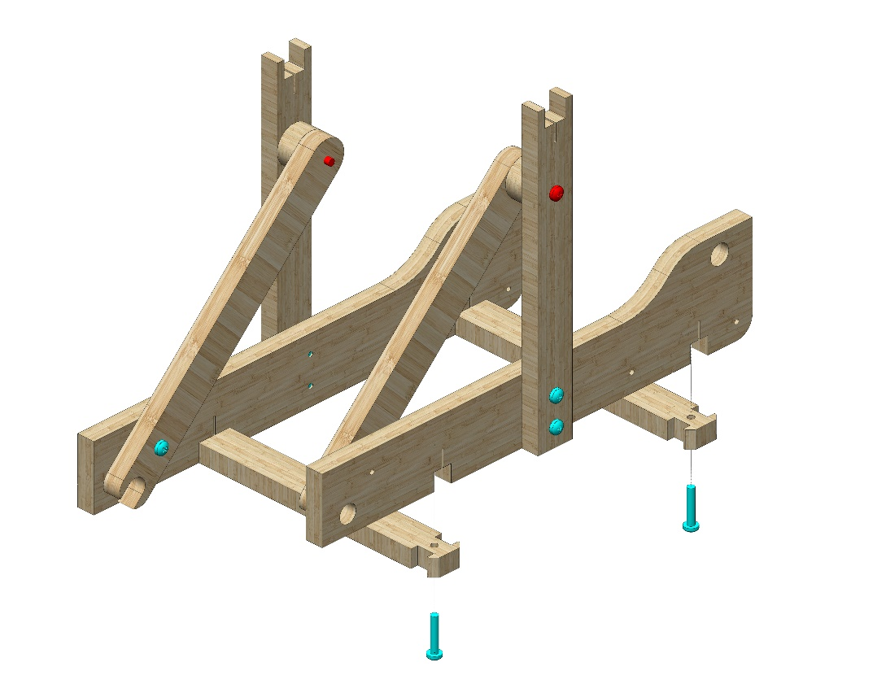
Attach two Part 3s.
Use two #20 bolts
3
1
3
Join the second module to the other Part 1 as pictured.
Use three #20 bolts.
Attach this second set as pictured.
Use two #20 bolts.
© All rights reserved to AristoCraft Ltd. Do not copy or reproduce without written permission.

Slide 5
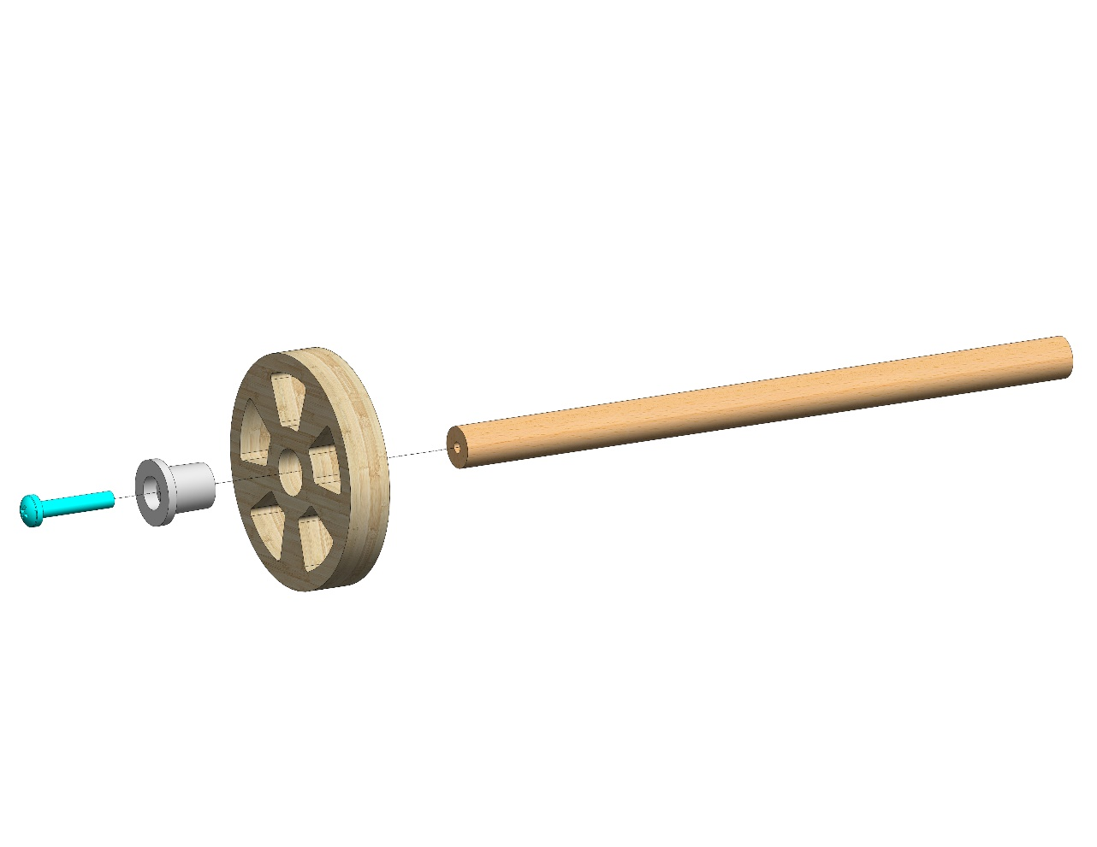
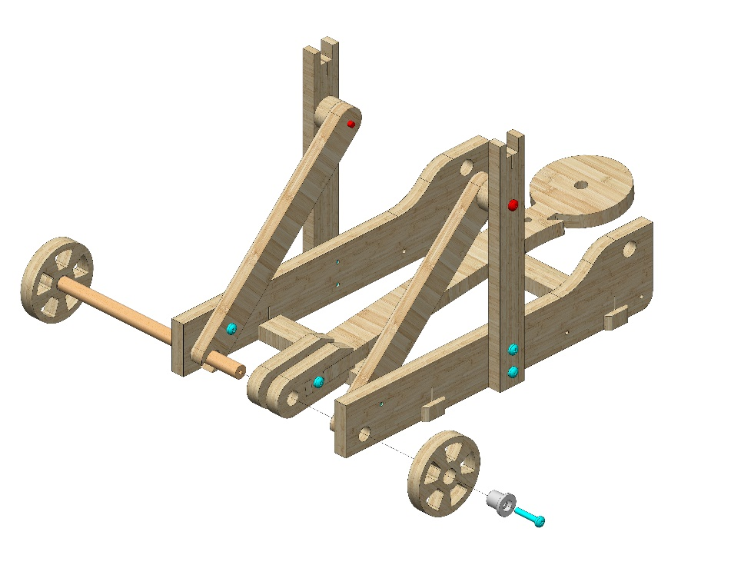
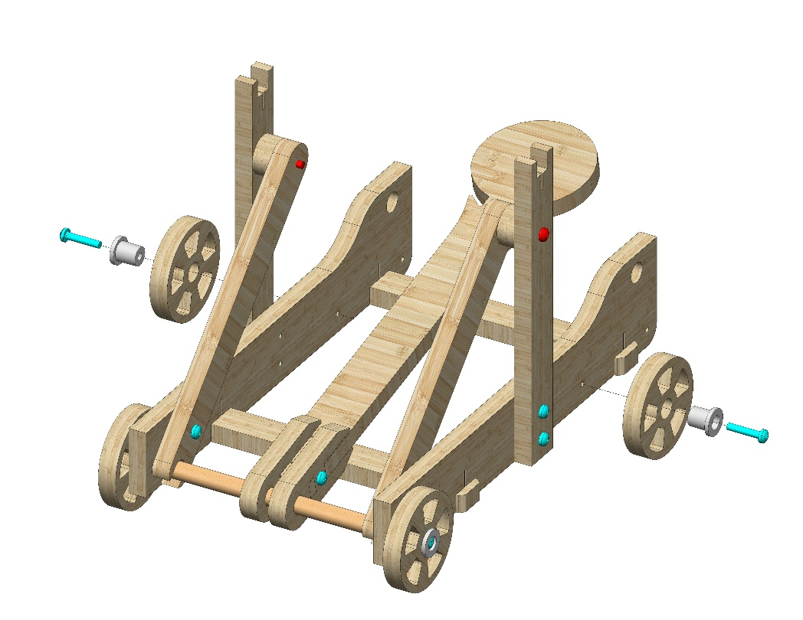
Insert a #20 bolt through Part 19 and Part 2 to attach them to Part 16.
19
16
2
Insert the rod into the set already assembled. Attach Part 2 using Part 19 as pictured. Use a #20 bolt.
2
19
Attach two Part 2s using two Part 19s. Use two #20 bolts.
2
19
19
2
© All rights reserved to AristoCraft Ltd. Do not copy or reproduce without written permission.

Slide 6
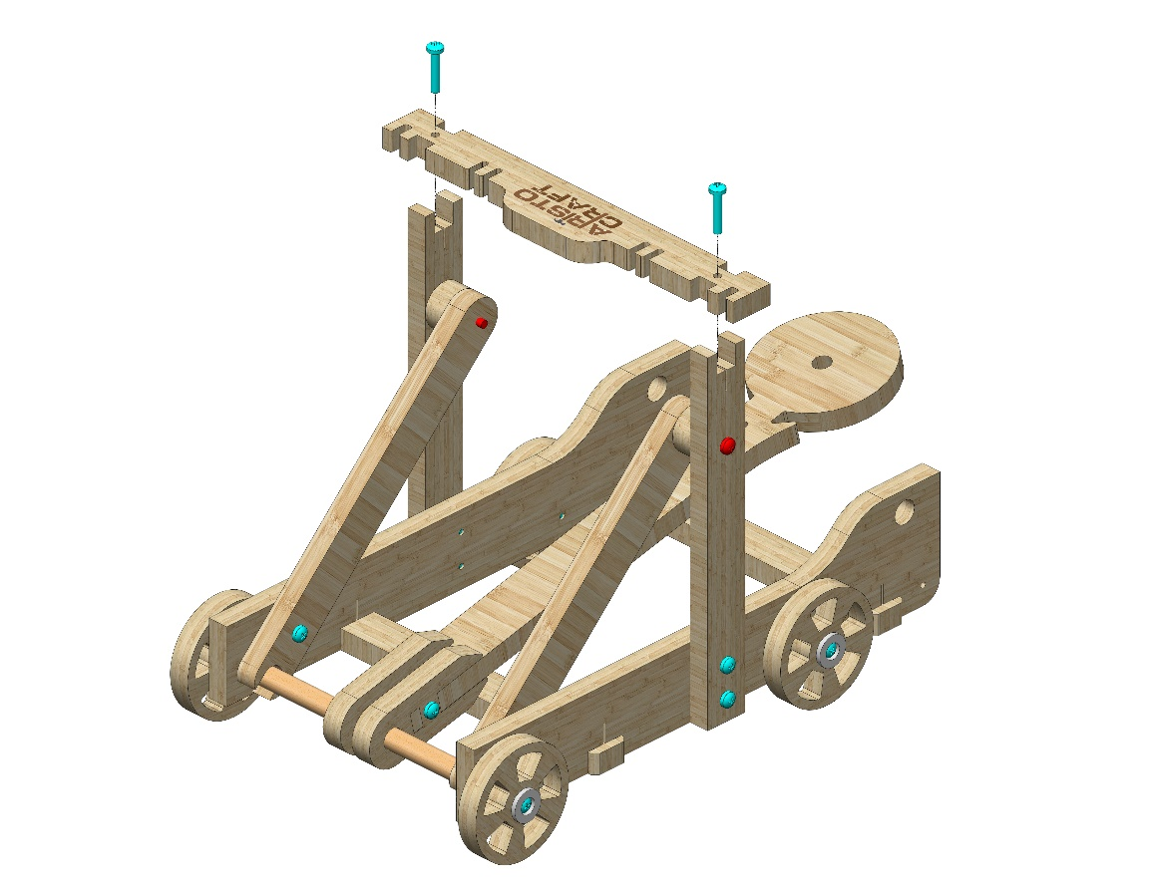
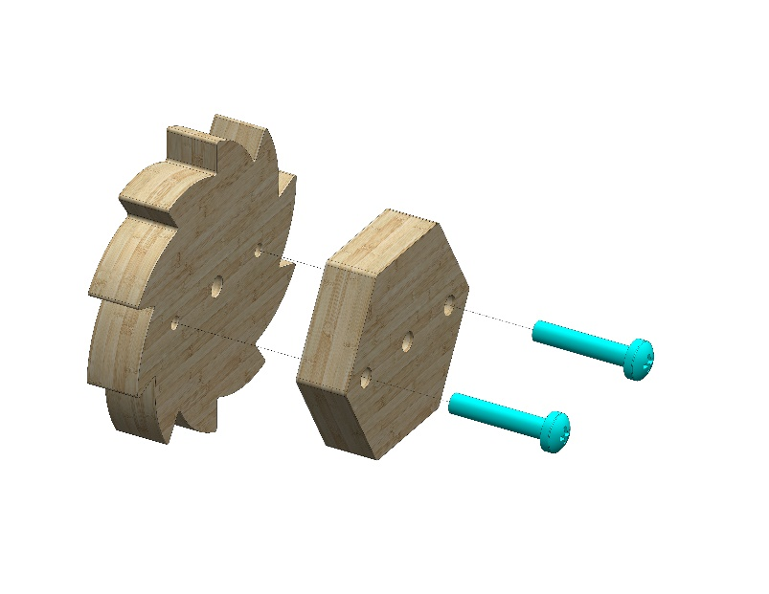
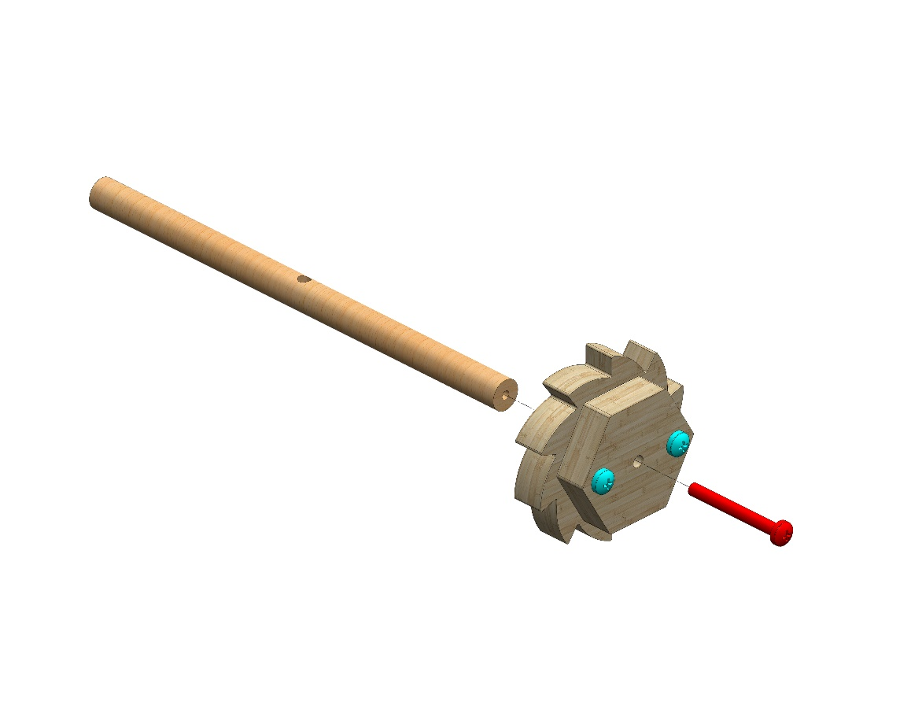
Attach Part 5 as pictured.
Use two #20 bolts.
5
Connect Part 11 to Part 13.
Use two #20 bolts.
13
11
Pay attention to the direction of the teeth!
Attach this module to Part 17 as pictured.
Use a #30 bolt. Tighten the bolt well!
17
© All rights reserved to AristoCraft Ltd. Do not copy or reproduce without written permission.

Slide 7
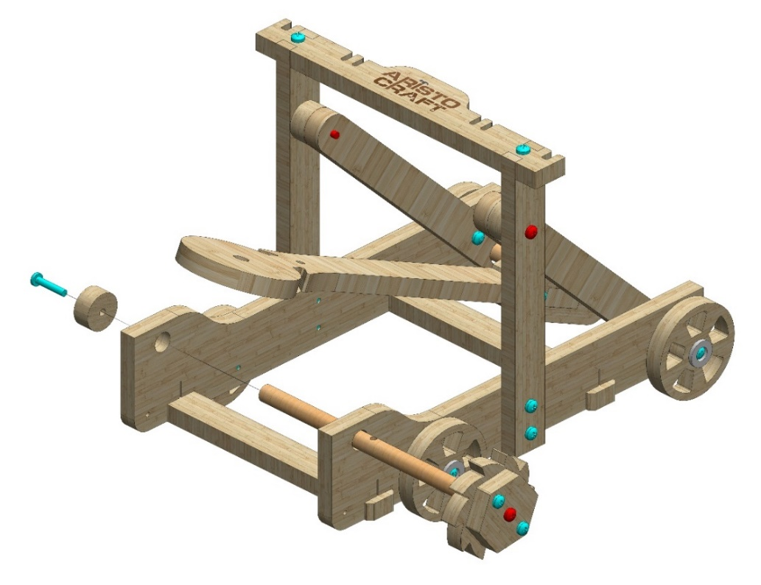
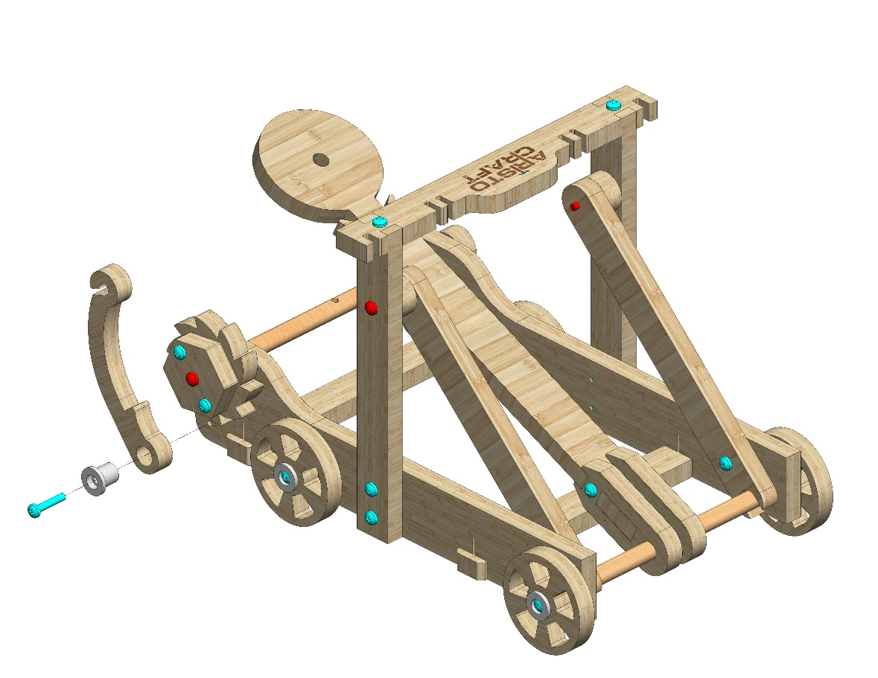
Insert the gear axle as pictured. Attach Part 12 to its end.
Use a #20 bolt.
12
Attach Part 7 using Part 19 as pictured. Use a #20 bolt.
7
19
© All rights reserved to AristoCraft Ltd. Do not copy or reproduce without written permission.

Slide 8
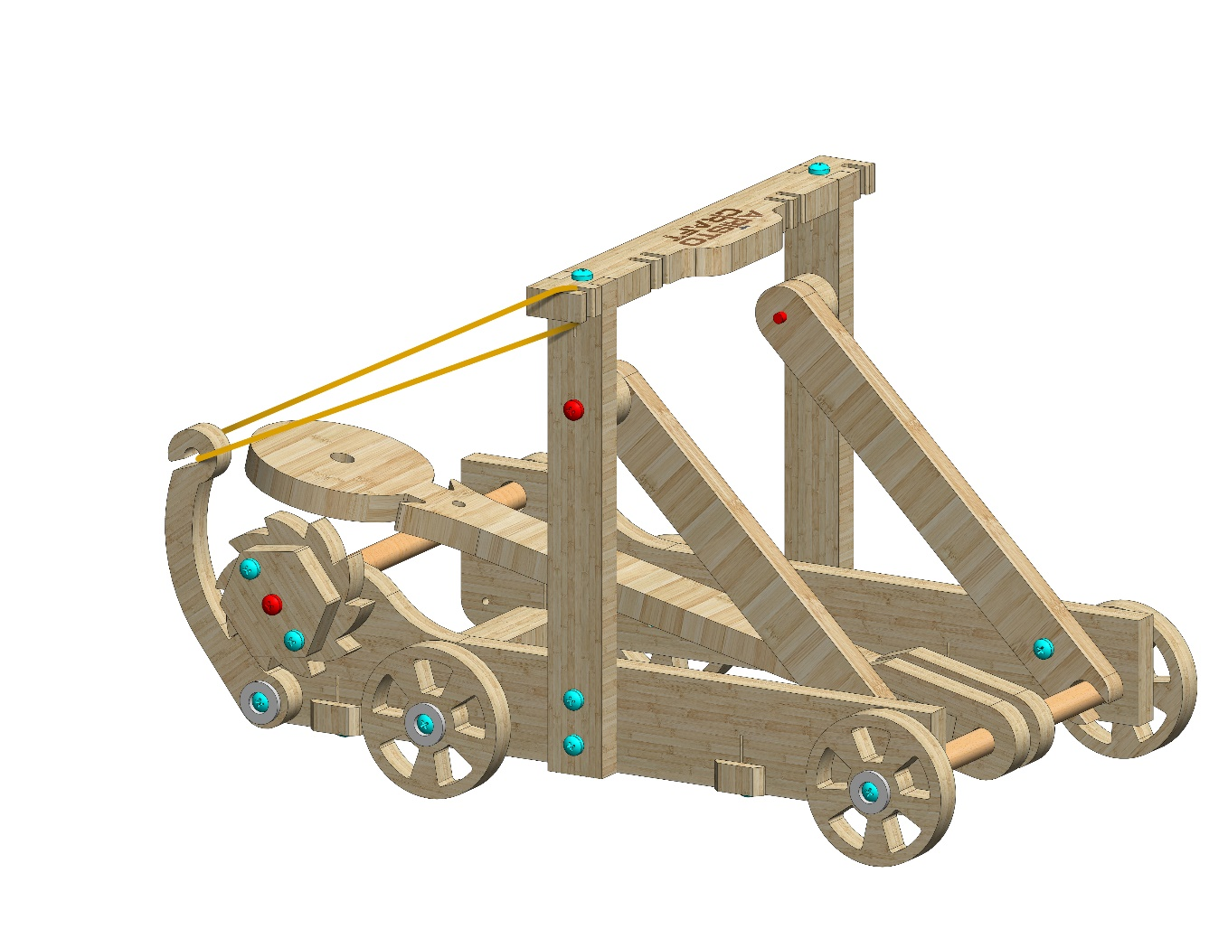
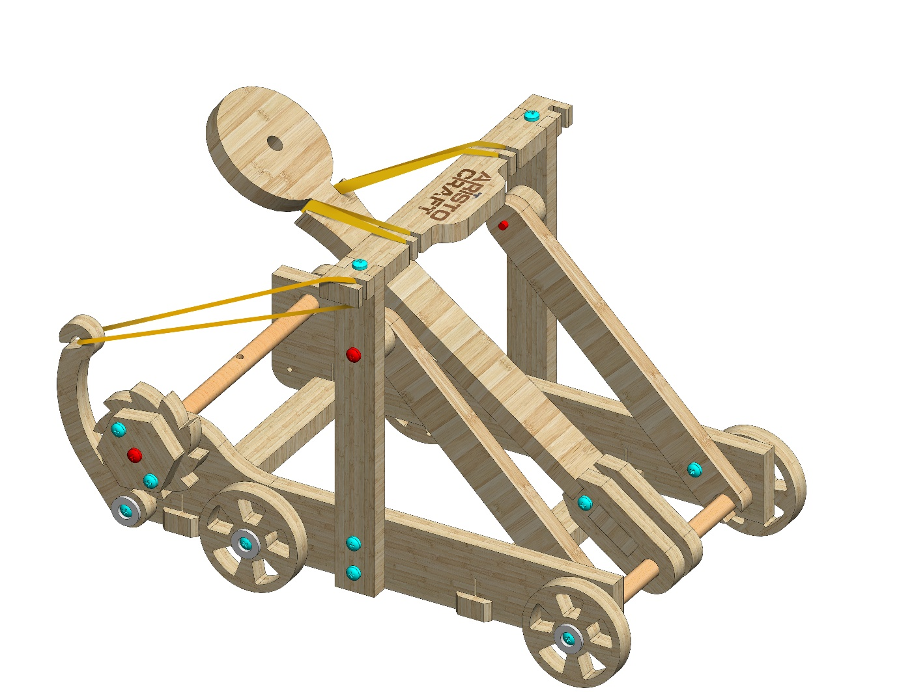
Place the elastic band (Part 18) as pictured.
18
Place the wide elastic band (Part 15) as pictured.
15
© All rights reserved to AristoCraft Ltd. Do not copy or reproduce without written permission.

Slide 9
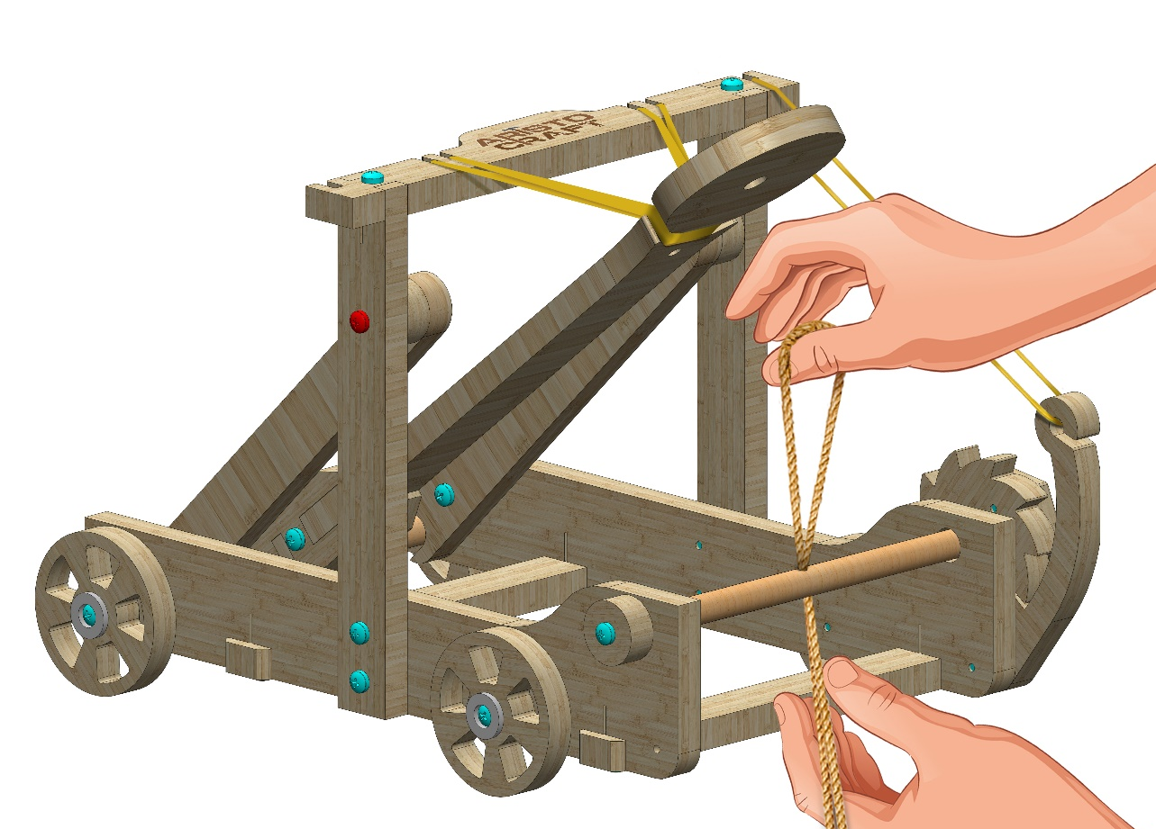
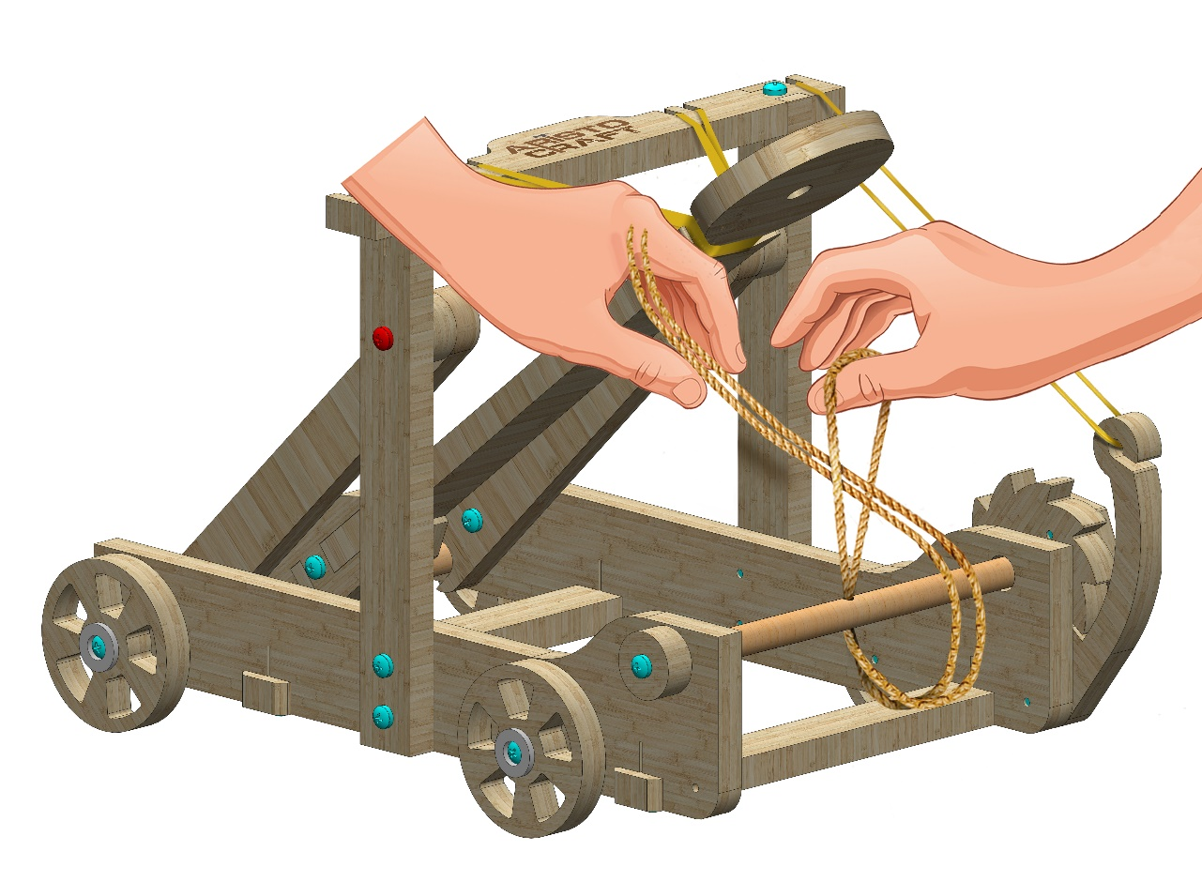
Feed the string (Part 14) through the hole in the middle of the gear axle as pictured.
14
Feed the two free ends of the string through the loop, and pull it tight as pictured.
© All rights reserved to AristoCraft Ltd. Do not copy or reproduce without written permission.

Slide 10
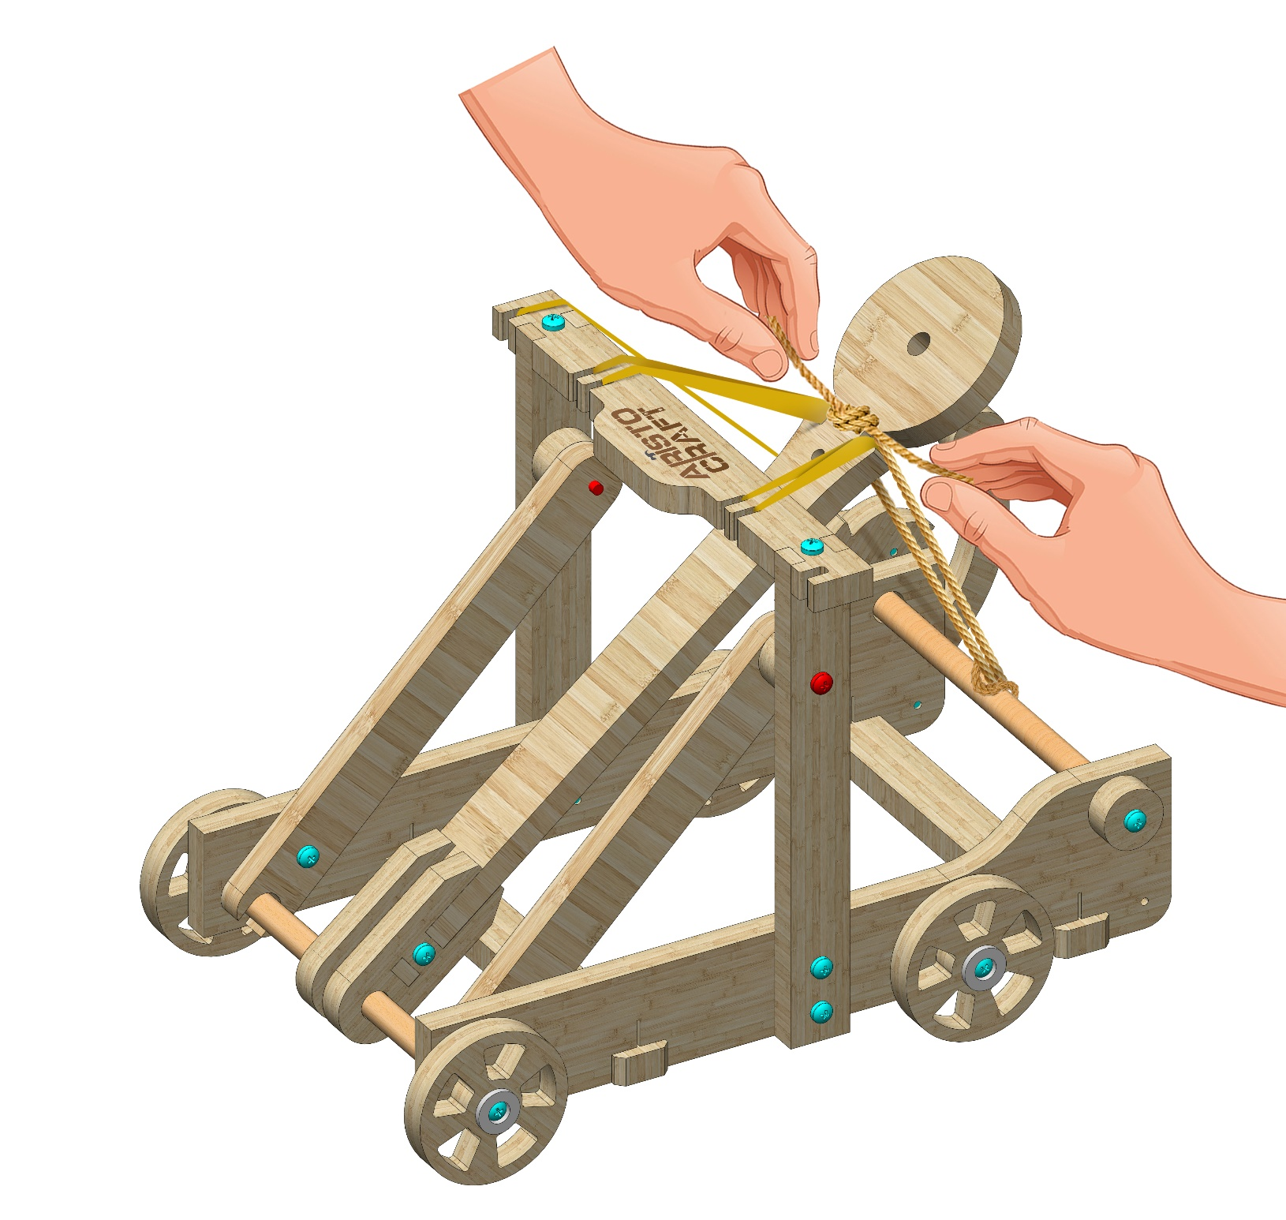
Tie the string around the shooting arm as pictured.
© All rights reserved to AristoCraft Ltd. Do not copy or reproduce without written permission.

