Slide 1
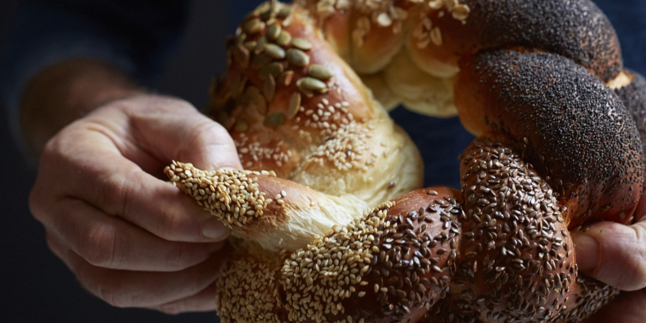
Nice to meet you

Slide 2
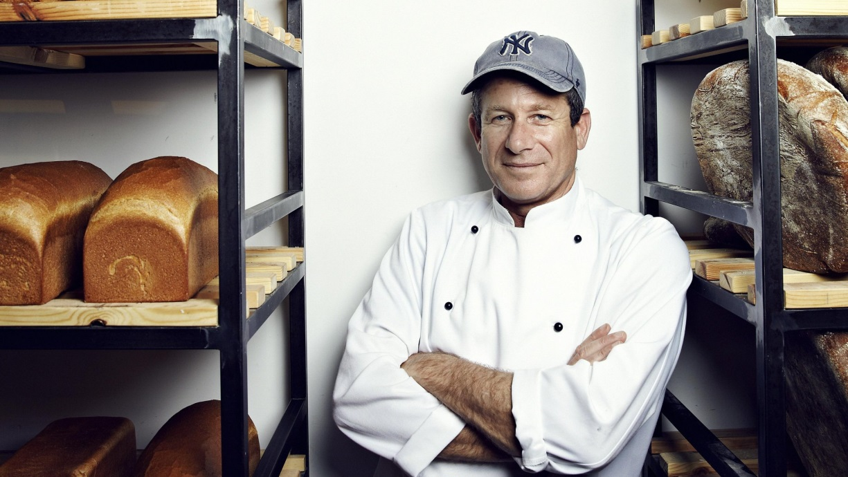
Baking bread involves all the senses; the experience is highly emotional. In every dough is the promise of a small taste of the lost garden of paradise. Every loaf of bread is a unique and breath-taking act of genesis” ~ Uri Scheft Uri Scheft

Slide 3
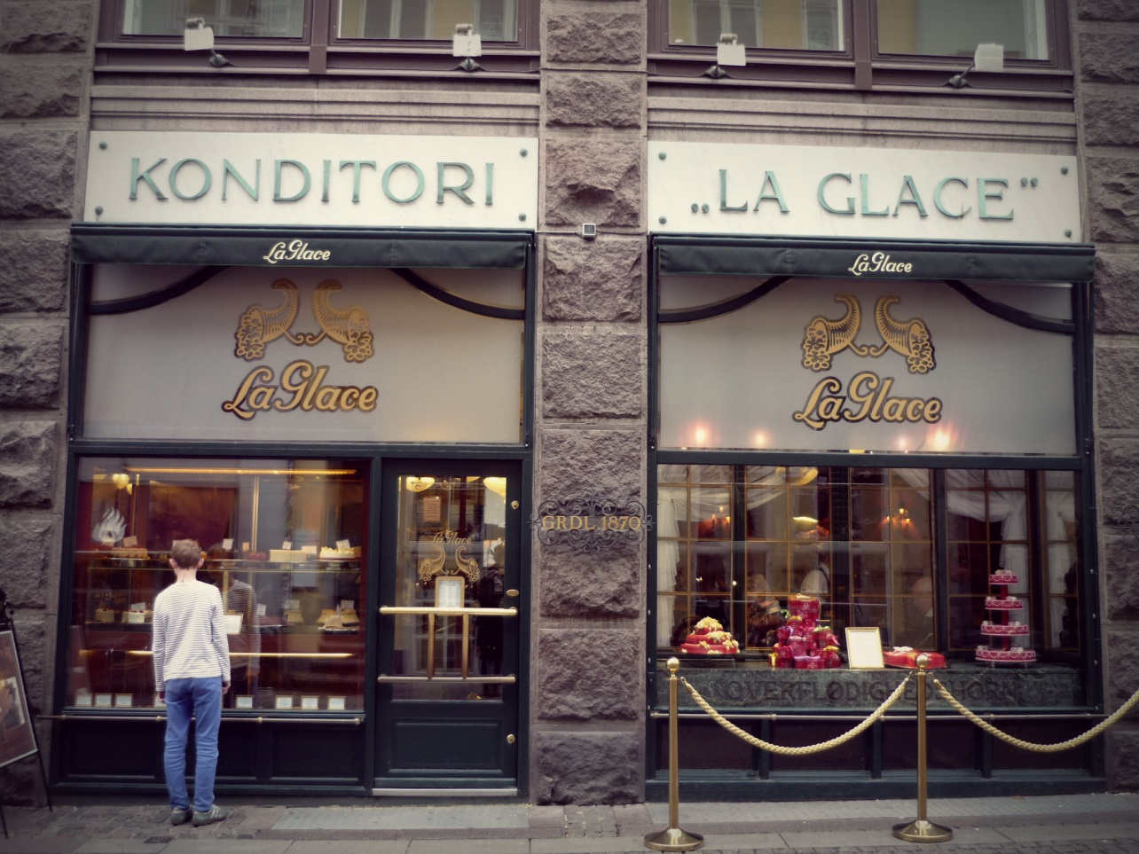
Our love story with bread begins in Denmark, where Uri Scheft, our chief baker and founder, learned the art of baking

Slide 4
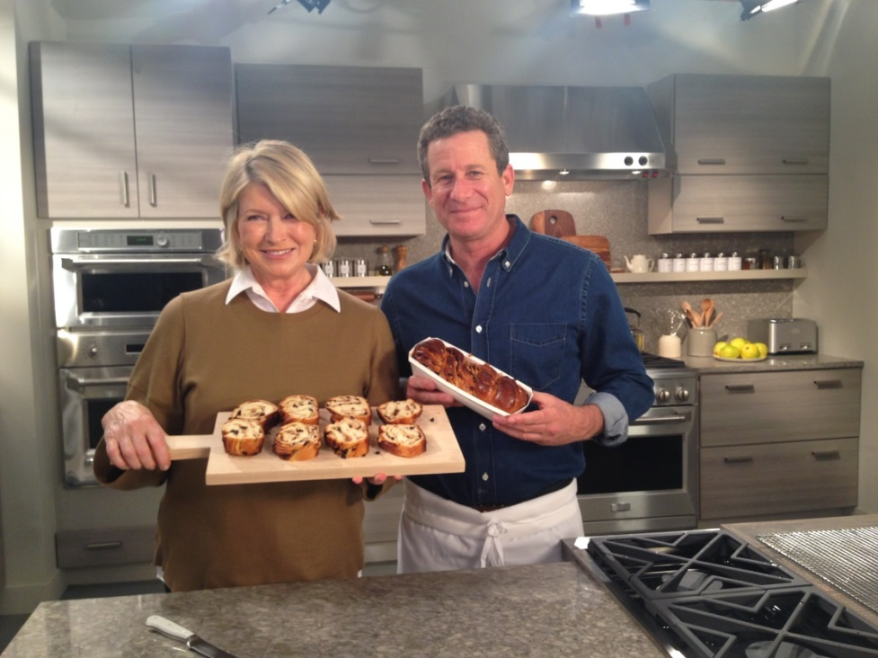
His travels in his homeland and overseas helped him develop as an expert baker, and to find and gather inspiration which accompanies him each day in his life and work

Slide 5
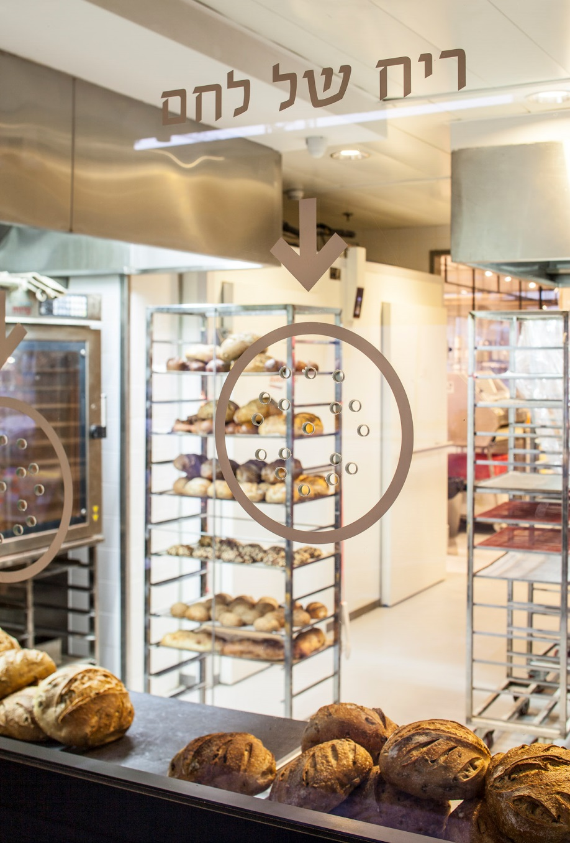
In 2002, Uri decided to established Breads Bakery and ensured that the bakery would be accessible and near to the street so that the bread’s addictive aroma would spread beyond the doors and be noticed by by-passers. The dream is realised daily in the brand’s six stores in Israel and New York.
Breads Bakery was selected three years in a row as the best boulangerie in Tel Aviv by Time Out magazine.

Slide 6
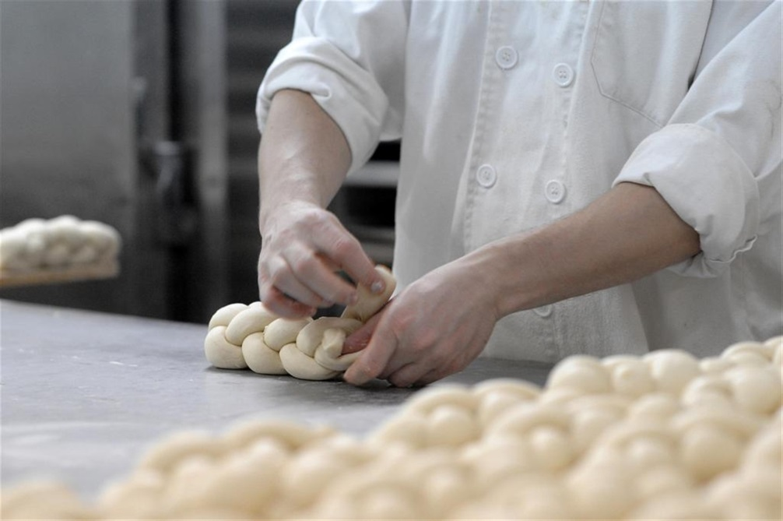
At Breads Bakery, we’re experts in breadmaking; an expertise which we’re careful to preserve and develop with one aim in mind – to produce the highest quality, most delicious and finest breads every day
Breads Bakery creates 30 types of bread

Slide 7
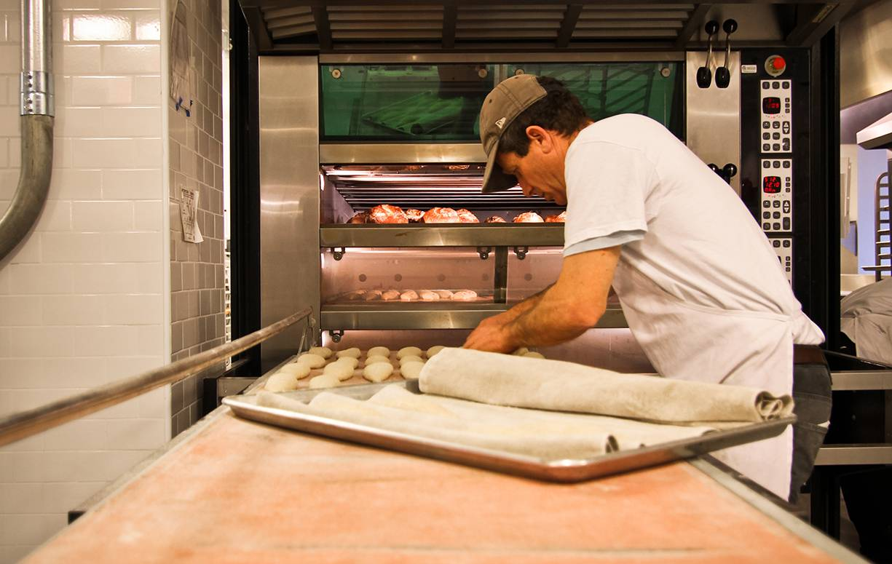
That's why our work begins in the small hours of the night and continues around the clock, with rules and strict adherence to the smallest details – beginning with precise measurements of the raw materials and the technique with which the dough is kneaded, and ending with selecting the most appropriate yeast and calculating the ultimate rising time required for each product

Slide 8
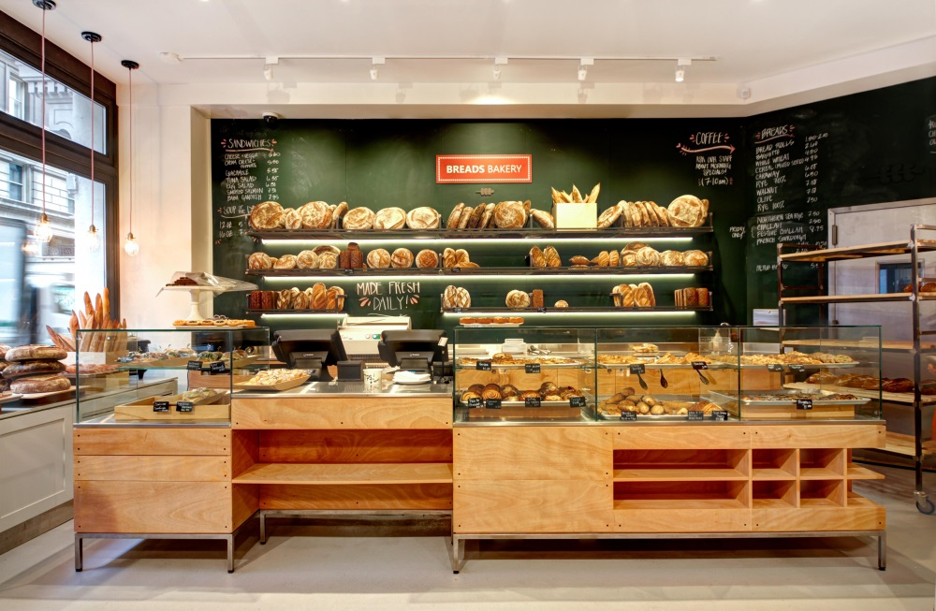
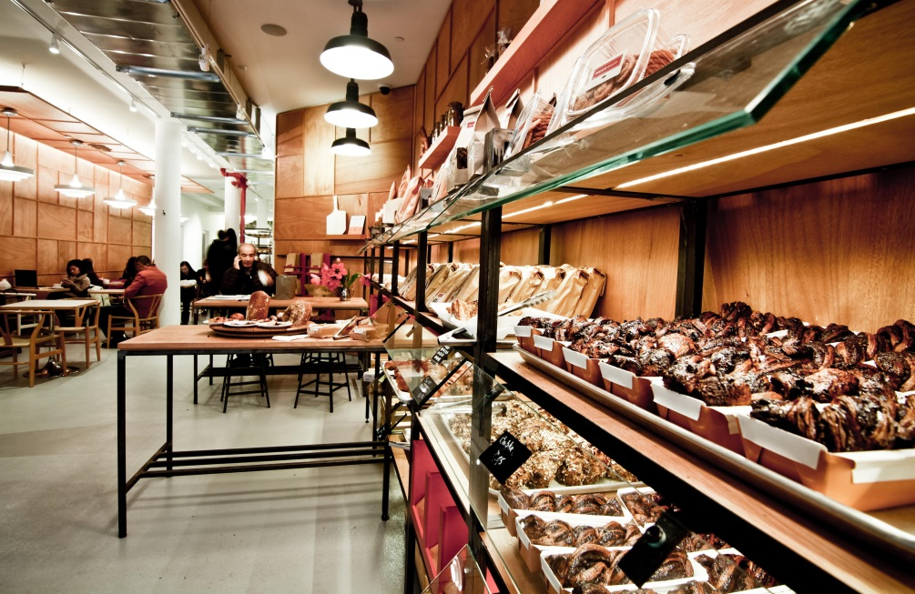
In 2013 we set out to spread our product to the world, opening the first branch of Breads Bakery in Union Square, New York
Later on we opened more branches in the city – Briant Park area (2015) and Lincoln Center (2016)

Slide 9
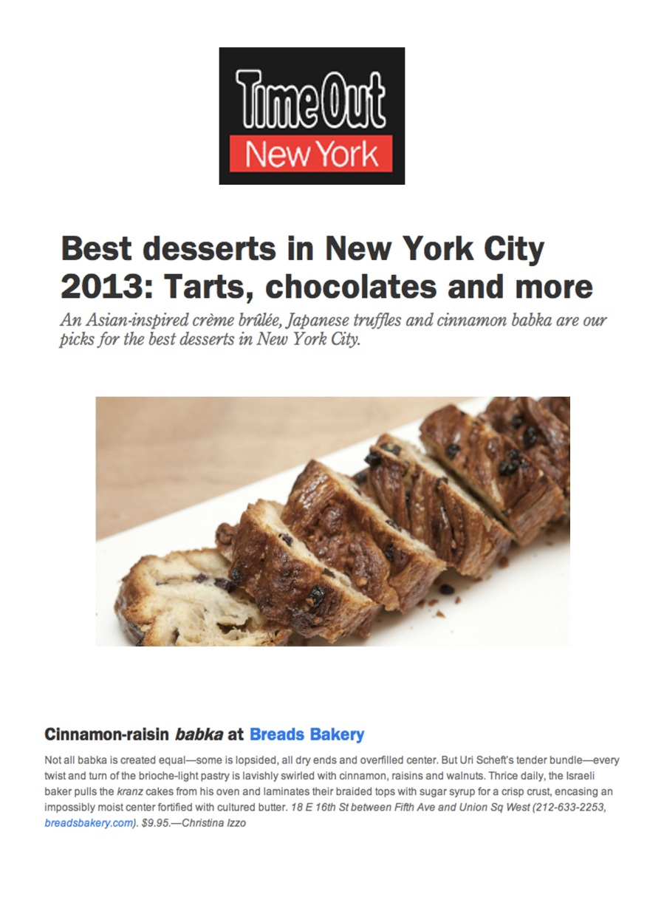
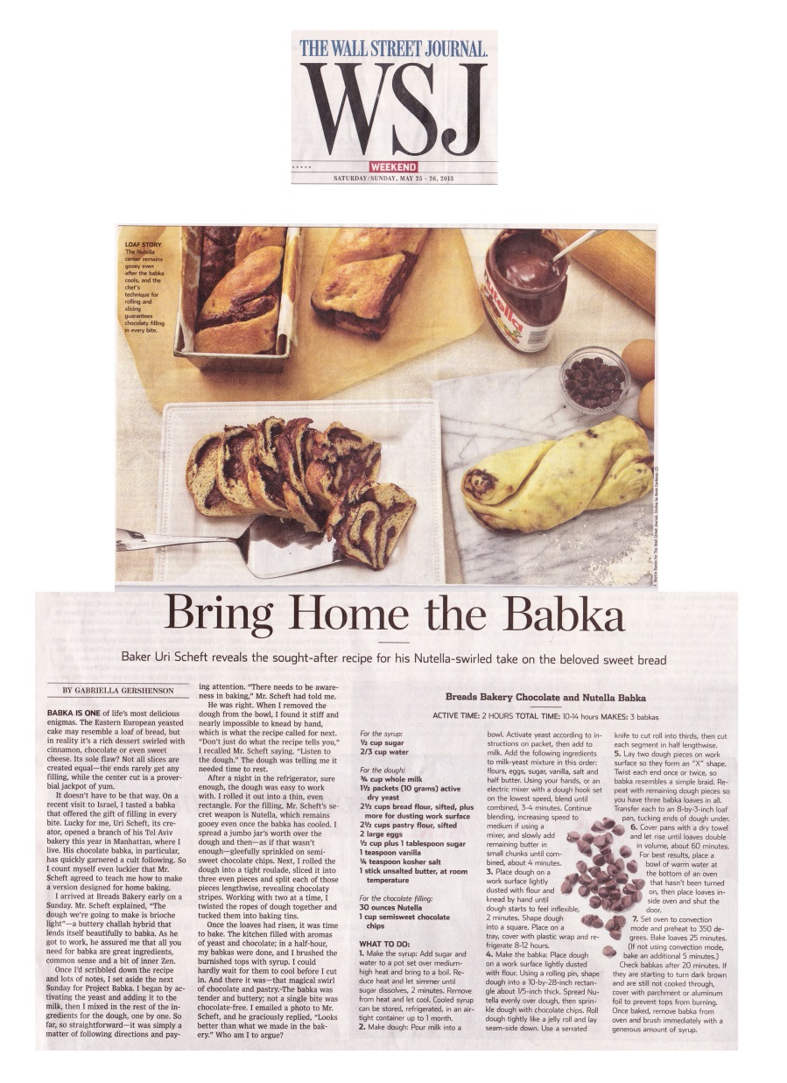

Slide 10
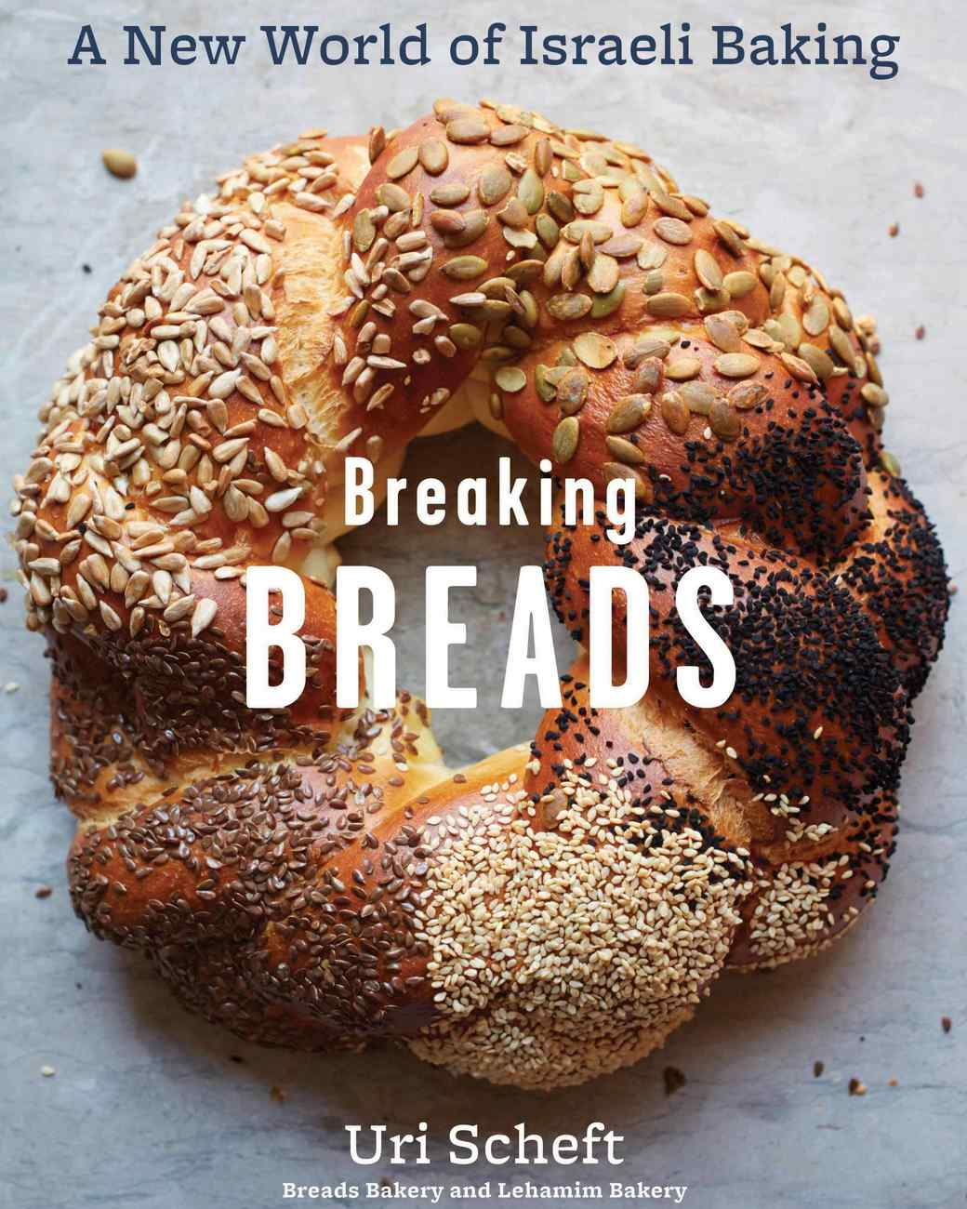
In 2016, Uri published his second book, Breaking Breads a bread recipe book adapted to the American public. Considered a pioneer in the Israeli baking industry, the book, which was received to critical acclaim, was named amongst 2016’s 20 best cookbooks

Slide 11
”The Israeli culinary movement continues to flourish as baker Uri Scheft follows his successful Tel Aviv and New York City bakeries with his first cookbook”
“From babka to breadsticks, Breaking Breads is a definitive guide”
“Uri Scheft’s new cookbook falls midway between two trends — Old World baking and Israeli cuisine — and the results are deeply satisfying”
Breads is one of our favorite bakeries in New York City, and we’re thrilled that Uri Scheft has released a cookbook with recipes for beloved items such as their famous babka (we especially love their walnut version) and challah -- perfect for a snow-day weekend project.
“In Breaking Breads, Uri Scheft — the master baker behind Breads Bakery in New York City and Lehamim Bakery in Tel Aviv — takes the combined influences of his Scandinavian heritage, his European pastry training, and his Israeli and New York City homes to provide sweet and savory baking recipes that cover European, Israeli and Middle Eastern favorites”

Slide 12
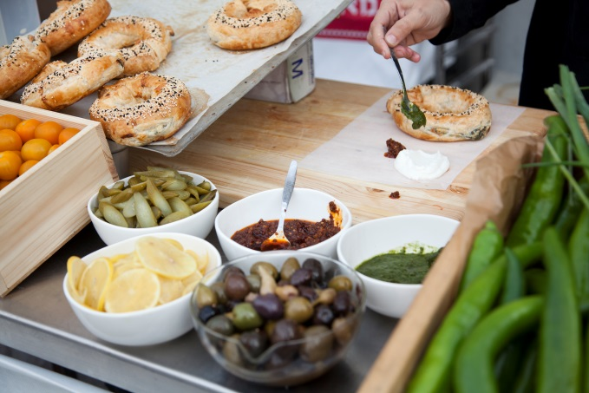
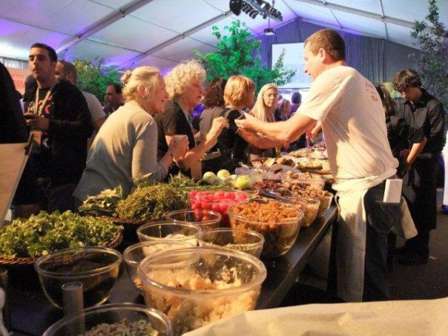
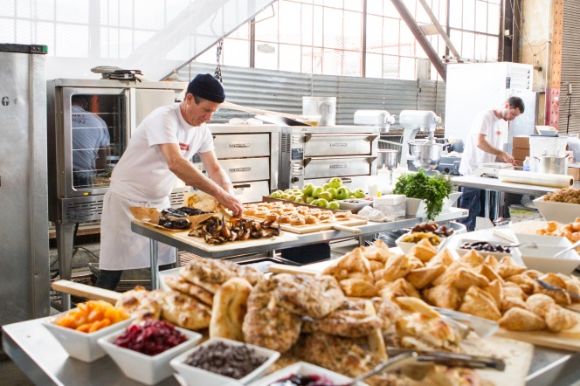
In order to spread the word of our brand and serve as ambassadors on behalf of the Israeli baking industry, we are happy to take part in major events in Israel and around the world
A pop-up stand with hot bourekas baked on-location stand, at an event held by Subaru, 2016
Uri demonstrating recipes inspired by his new book at a stall at an event by Golan Vintage in the Golan Heights, 2015
A pop-up bakery at an event where we presented the bakery's real-time capabilities, at an event held by Ernst & Young in San Francisco, 2016-2017

Slide 13
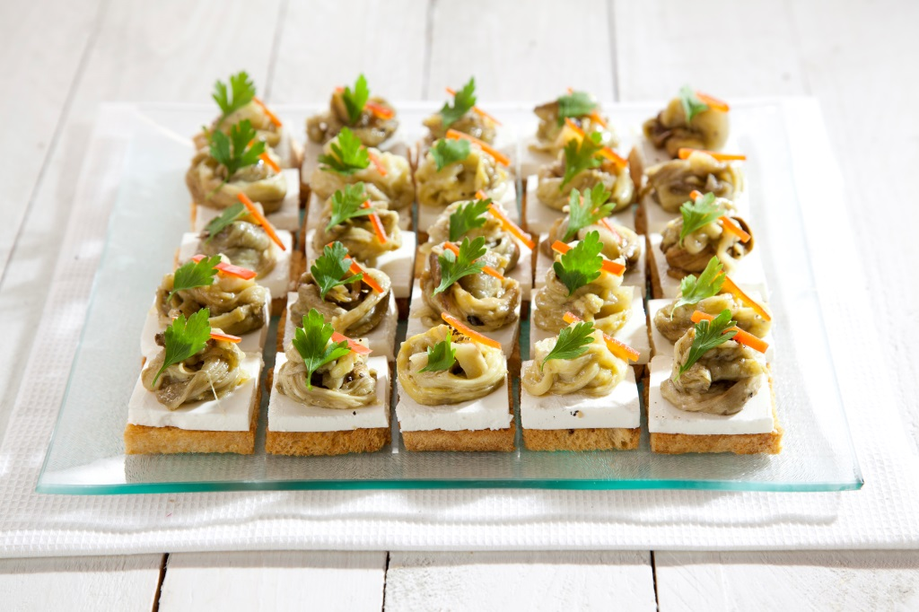
In 2009, we established “Kibbudim", a dairy restaurant offering festive and painstakingly perfect platters for every occasion - at home or in the office

Slide 14
Why are we here today?

Slide 15
During our travels in America, we drank a lot of coffee

Slide 16
And we discovered that the biggest coffee shop chains are missing fresh, high quality pastries to be served alongside the coffee

Slide 17
Therefore, we decided to establish a project aimed at providing the American people with a new experience of high quality pastries that are baked throughout the day and served to customers straight from the oven while they’re still warm and fresh

Slide 18
Or, as we call it: Chunka

Slide 26
The product concept

Slide 27
Fresh products are baked on location, around the clock

Slide 28
Production method
Combining traditional production methods and manual processes with high-quality modern baking equipment
Ensuring uniformity in product quality between the various branches
Emphasis on cooling and freezing methods aimed at maintaining product quality during the various production stages
Later, a shift to production lines will add flexibility and save time and manpower

Slide 29
Ingredients
Careful selection of the highest quality and most appropriate ingredients - after research and cost analysis
Use of ingredients that match the market trends in various regions throughout the United States
Healthy, organic, vegan and gluten-free ingredients
Ingredients sourced in the immediate geographical area of the various branches (localization)

Slide 30
A range of flavours
A wide variety of flavours, including:
Chocolate Nutella
Fruits
Cinnamon
A selection of cheeses
Spinach
Nuts
Potato
Some of the pastries offered will be innovative to the American palate. For example, Tunisian pastries.
The products are filled with rich and generous fillings
The products are coated with grains and seeds (sesame, sunflower and pumpkin seeds, etc.)

Slide 31
Drinks
Coffee
Black coffee (filter) - ground on location and undergoing a meticulous infusion process in order to provide the customer with the specified “drip.”
Espresso - espresso, macchiato, cappuccino – ground on-site and served by a dedicated barista skilled in latte art.
Cold coffee - from a barrel that has undergone a brewing process
Other beverages - unique drinks that are adapted to the geographical area of each branch
Yogurt drinks and milk substitutes - almond milk drinks, cashews, oats and soybeans
Bottled juices. For example: ginger beer in different flavours, a variety of apple jack flavours and cold-pressed juices

Slide 32
How will it look?

Slide 33
The Creative Concept

Slide 34
Creative Concept Slides

Slide 35
Illustrations

Slide 36
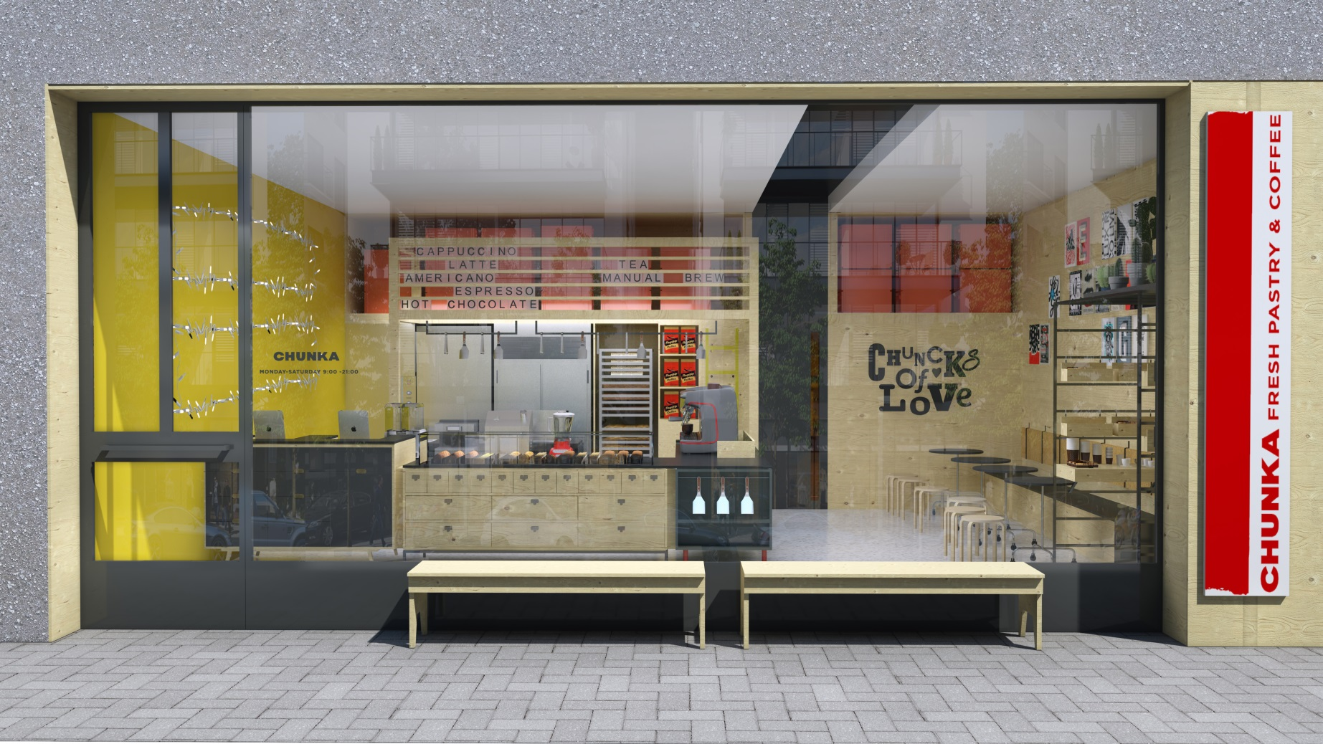
New illustration with the customer’s materials

Slide 37
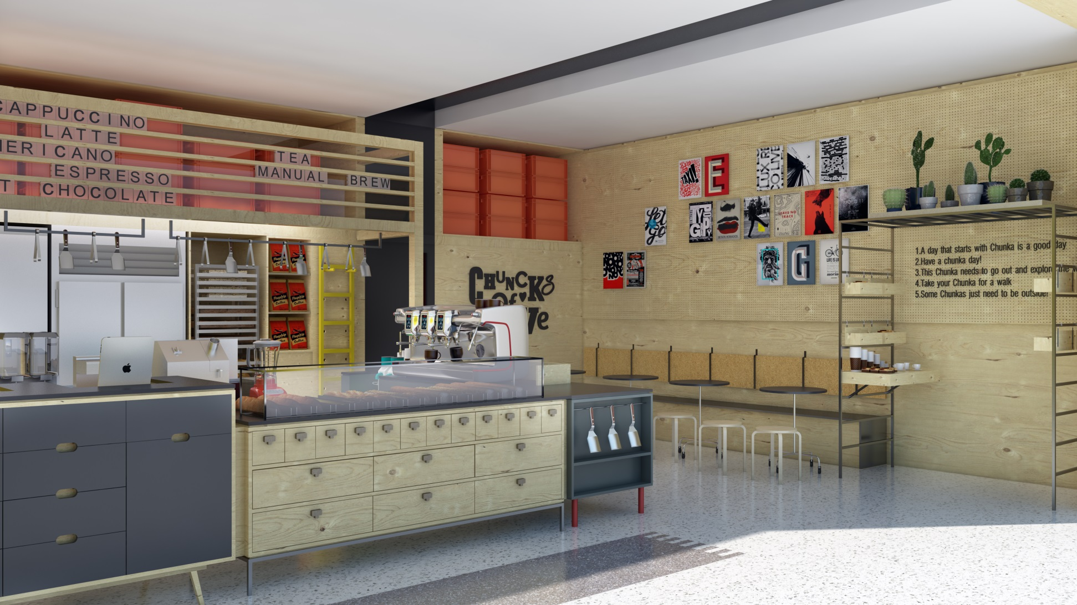
New illustration with the customer’s materials

Slide 38
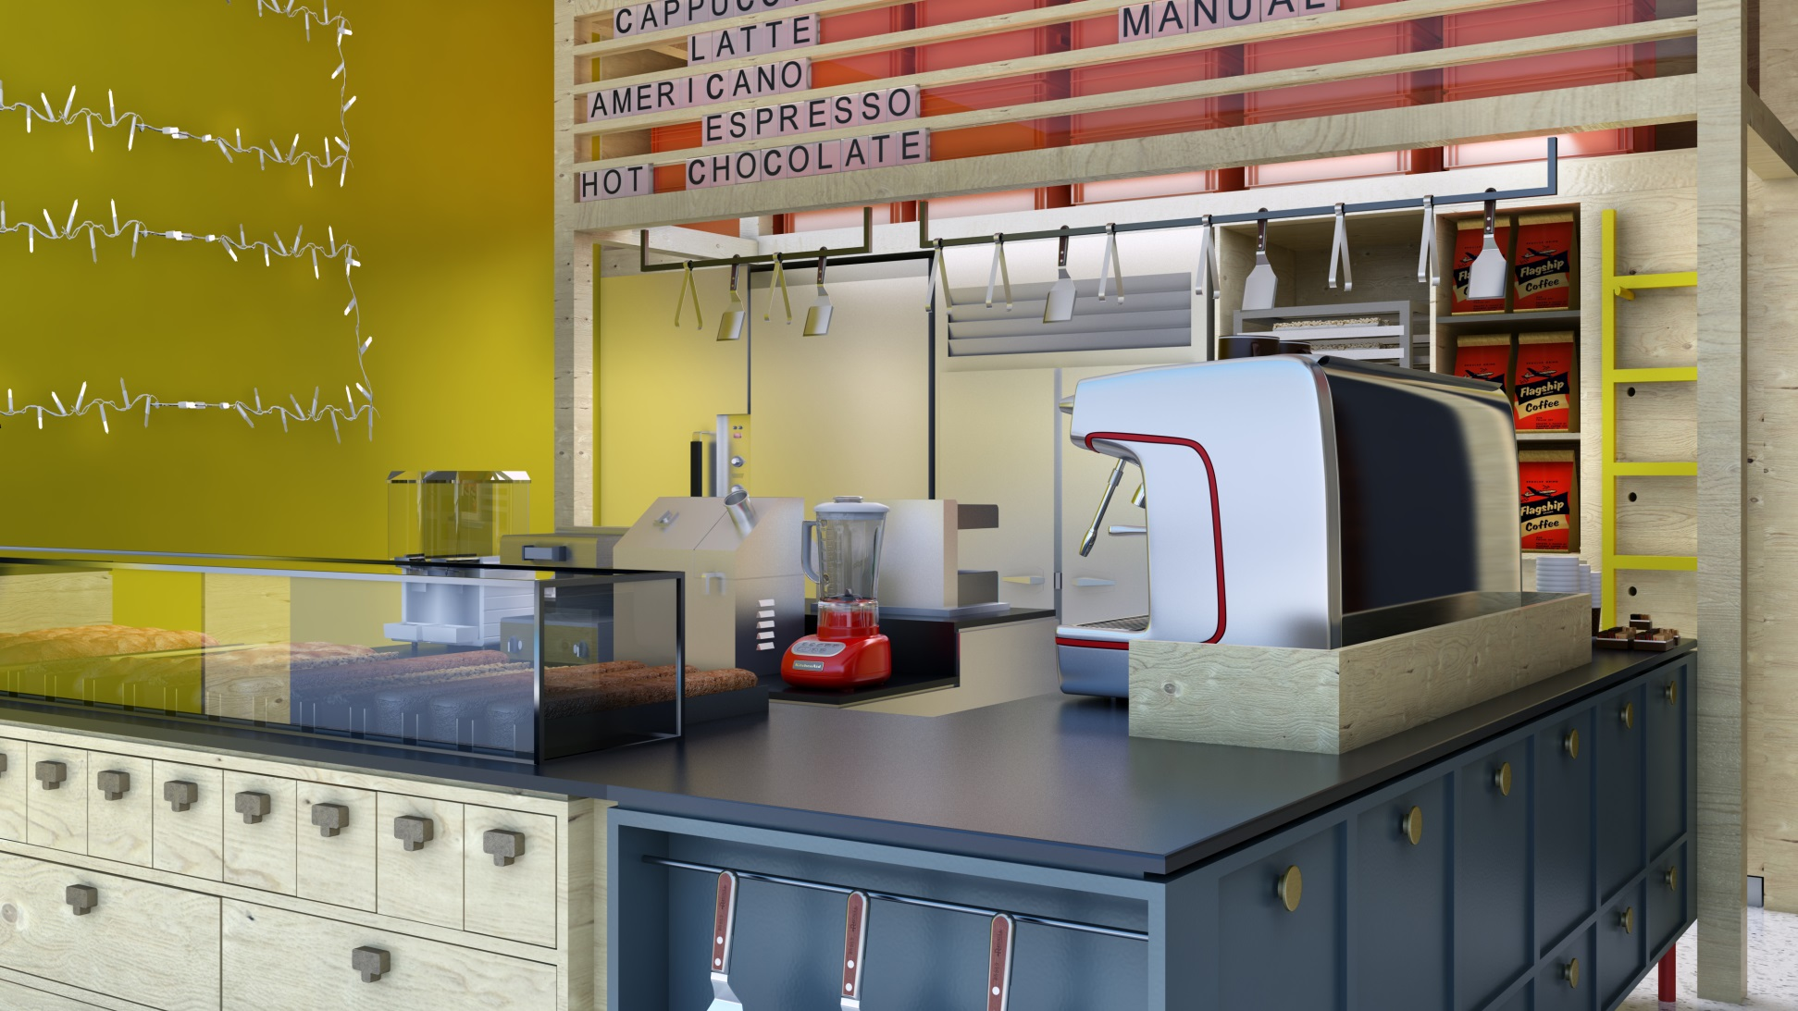

Slide 39
Financial Plan and Valuation Highlights

Slide 40
The first shop of 'Chunka‘ is expected to be established at a premium location with higher-than-average consumer traffic and a higher-than-average average transaction value, thus generating higher revenues than other company shops to be established later on
A main bakery was estimated to hold production capacity for up to 20 shops. Therefore, for this business plan a single bakery was estimated for the following five years

Slide 41
The following chart presents anticipated formation of new and cumulative 'Chunka' shops for the next five years:

Slide 42
The following table summarizes anticipated financial results from operating activities for years 1-5 in USD(millions):
 | Year 1 | Year 2 | Year 3 | Year 4 | Year 5
Cumulative Number of shops | 2 | 4 | 8 | 12 | 16
Overall Revenues | 2.6 | 5.04 | 11.09 | 17.6 | 24.3
Food Cost% | 20.7% | 19.0% | 18.0% | 18.0% | 18.0%
Labor Cost% | 9.1% | 8.2% | 6.3% | 4.8% | 3.6%
Gross Profit | 1.8 | 3.7 | 8.4 | 13.6 | 19.1
Gross Profit% | 70.2% | 72.8% | 75.7% | 77.2% | 78.4%
Operating Profit (Loss) | -0.56 | -0.18 | 1.5 | 3.7 | 6.2
% | -21.7% | -3.6% | 13.9% | 21.0% | 25.3%
EBITDA | -0.33 | 0.2 | 2.1 | 4.4 | 6.9
% | -12.8% | 4.1% | 18.7% | 24.9% | 28.2%
Profit (Loss) After Taxes | -0.6 | -0.2 | 1.3 | 2.4 | 4.1
% | -22.3% | -4.0% | 11.4% | 13.8% | 16.7%

Slide 43
'Chunka's negative cumulative cash flow is projected to reach its lowest value by the end of the second year of activity. The investment necessary for the establishment and operation of the venture is approximately $3 million
ROI, according to a discount rate of 15%, is anticipated in 4.5 years
The value of activity derived from the discounted cash flow using the Gordon Growth Model is approximately $22.6 million (pre-seed valuation)

Slide 44
The following chart presents net annual cash flow alongside cumulative cash flow in years 1-5 in USD thousands, including Period 0:

Slide 45
Thank You

