Slide 1

Testing Polysulphate in Vietnam
Coffee
Preliminary results with courtesy of PetroVietnam

Slide 2
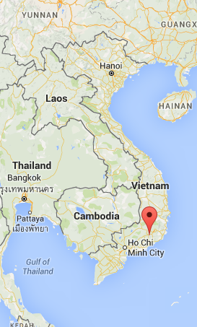
Testing Polysulphate in Vietnam
Vietnam, the second largest producer of coffee in the world – next only to Brazil – produces about 1.2 million tons of coffee annually.

Slide 3
Testing Polysulphate in Lam Dong, Vietnam
With more than 144,000 ha of coffee and annual production of about 347,000 tons, Lam Dong province is the country’s second largest coffee-growing region. The experiments were conducted in Bao Lam and Di Linh districts of Lam Dong.

Slide 4
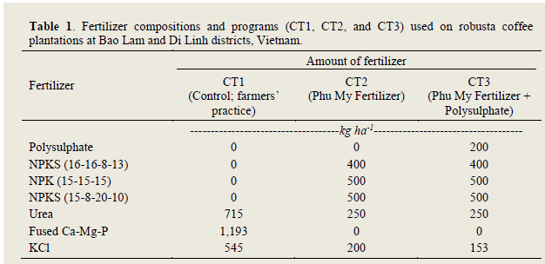
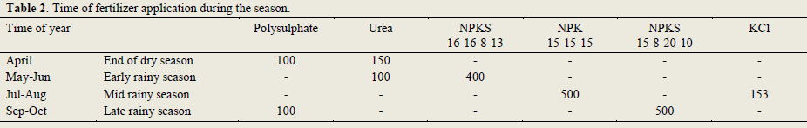

Treatments in coffee

Slide 5
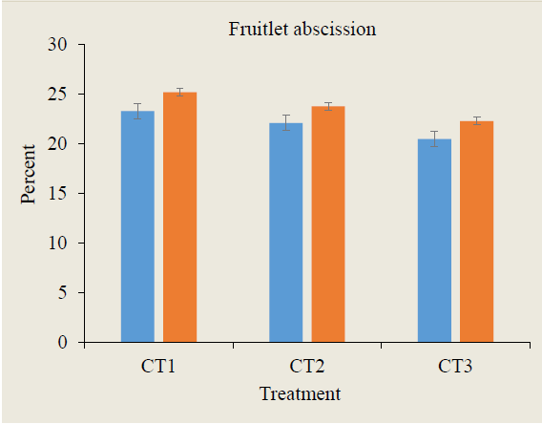

Least fruit shedding due to Polysulphate (CT3)
Bars indicate LSD at 5%.

Slide 6
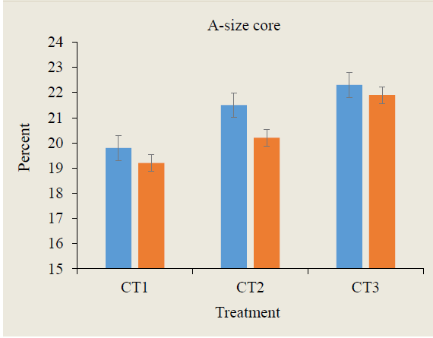
More A-size cores due to Polysulphate (CT3)
Bars indicate LSD at 5%.

Slide 7
Conclusions
Polysulphate application to coffee grown in Lam Dong province
  Resulted in faster growth and longer fruiting branches
  Lowered the extent of shedding of immature fruit
  Increased the weight and size of beans
  Increased productivity by 9%–11.5%
  Fetched 10%–14% higher profits
2. Calcium and magnesium are important for higher yields and should be applied in higher doses: this can be achieved by applying Polysulphate at 200 kg/ha, a stable and slow-release source of Ca, Mg, S, and K.

Slide 8
Thank You

