Slide 1
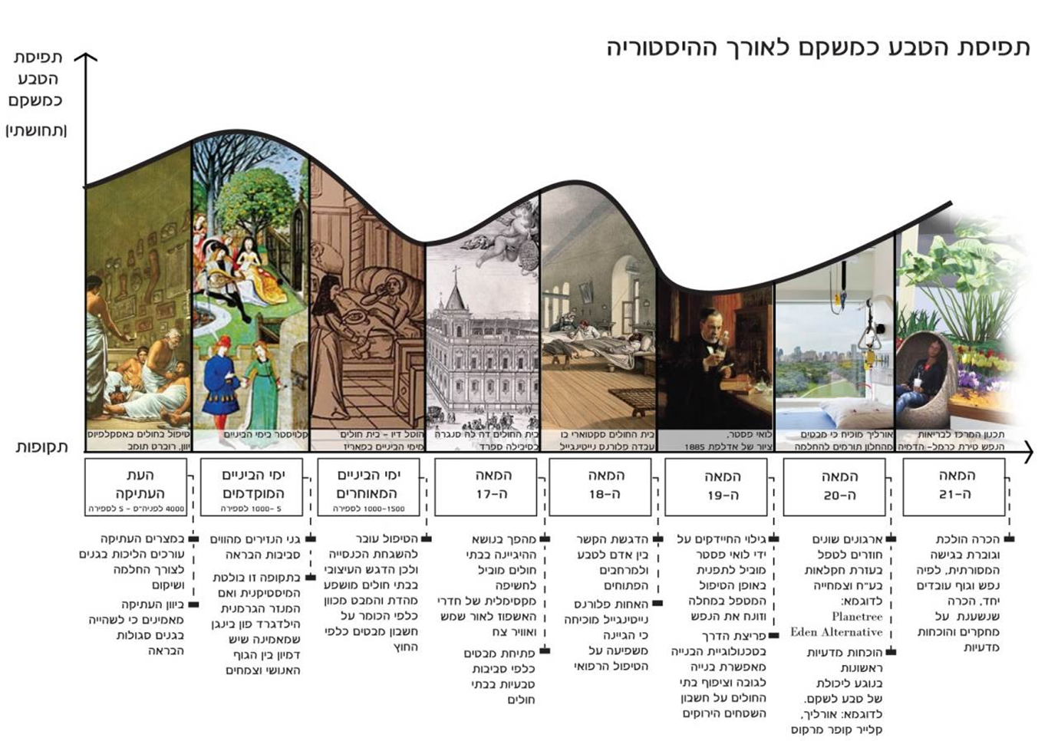
The notion of nature as rehabilitative throughout history
The notion of nature as rehabilitative (sensory)
Time periods
Treating patients with Asclepium
Greece, Robert Tomb
Cloister in Middle Ages
Dio Hotel – Hospital
Paris in the Middle Ages
Hospital de la Sangre
Seville, Spain
Scutari Hospital where Florence Nightingale worked
Louis Pasteur,
Painting by Edelfelt 1885
Urlich proves that glances from the window contribute to recovery
Planning the Tirat Carmel Mental Health Center - Simulation
Ancient Period
4000 BCE – 5 CE
Early
Middle Ages
5 – 1000 CE
Late
Middle Ages
1000 – 1500 CE
17th
Century
18th
Century
19th
Century
20th
Century
21st
Century
In Ancient Egypt people stroll in gardens for recovery and rehabilitation
In Ancient Greece people believed that spending time in gardens had health benefits
Monks’ gardens are a recovery environment
In this period the prominent mystic and mother of the German convent, Hildegard Von Bingen, believed in the resemblance between humans and plants
Therapy is transferred to the church, thus the design emphasis in hospitals is influenced by religion and the gaze is directed to the priest at the expense of gazing outside
A hygiene revolution in hospitals leads to maximum exposure of inpatient rooms to sunlight and fresh air
Opening the gaze to natural environments in hospitals
Emphasizing the connection between man and nature and to the open landscape
The nurse Florence Nightingale proves that hygiene affects medical treatment outcomes
Discovery of bacteria by Louis Pasteur leads to a turnaround in the way treatment treats diseases and neglects the soul
A breakthrough in construction technology enables building up, condensing hospitals at the expense of green spaces
Different organizations return to treatment by breeding animals and plants e.g.
Planetree,
Eden Alternative
Scientific proof of the ability of nature to rehabilitate e.g. Urlich, Clare Cooper Marcus
Increasing recognition of the traditional approach, which states that body and soul work together. Recognition is based on research and scientific proof

