Slide 1

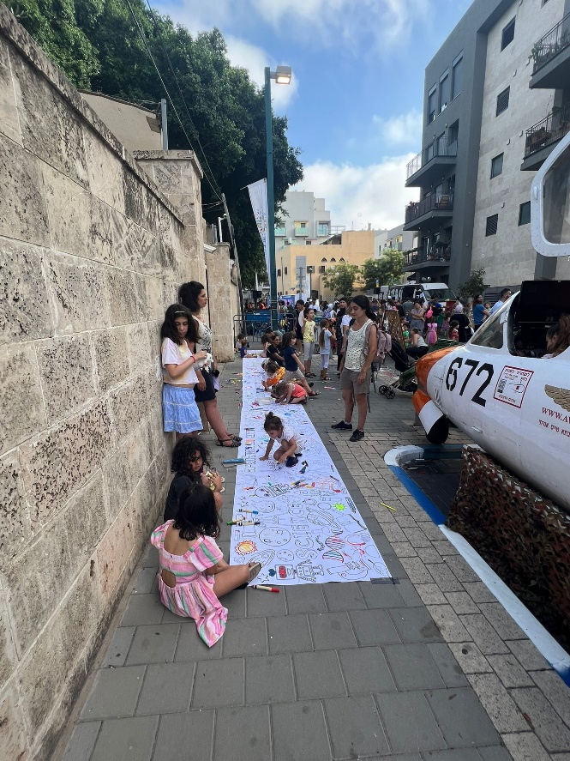
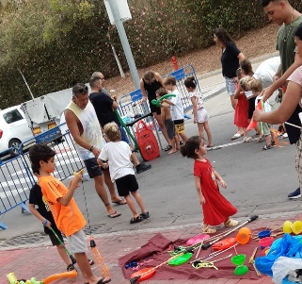
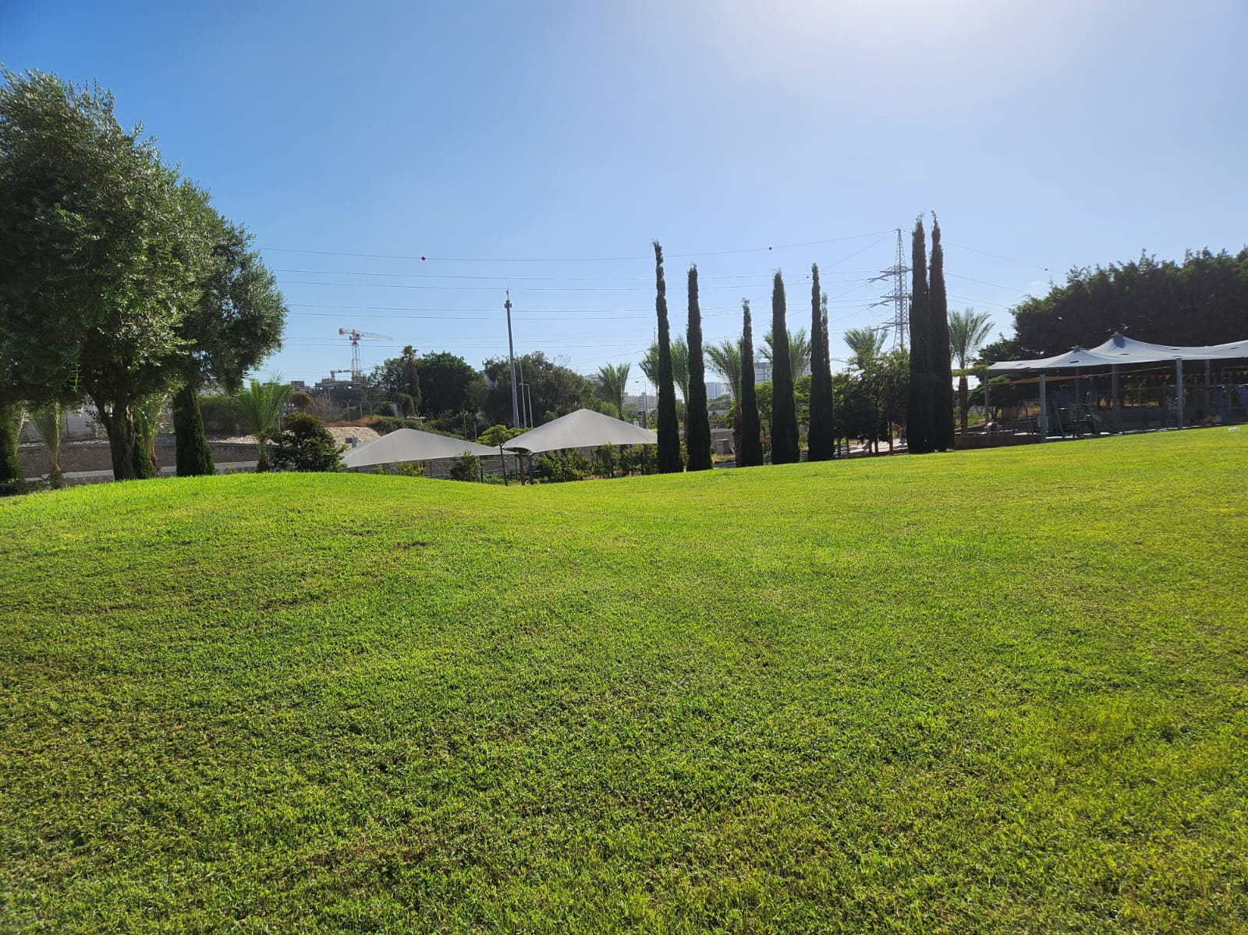
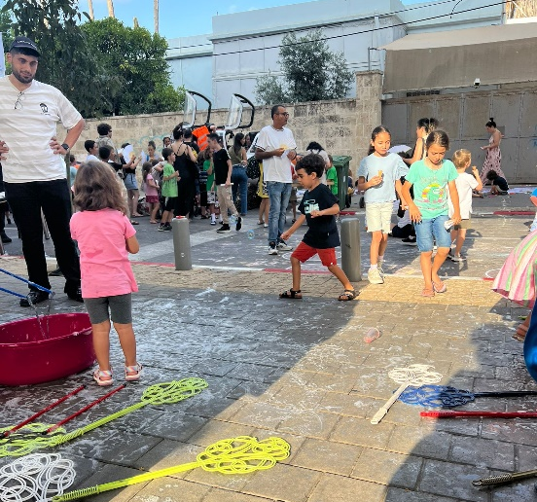
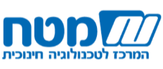


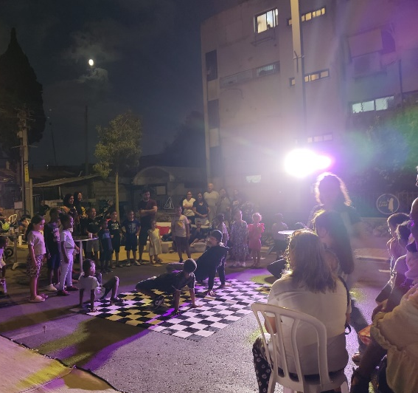
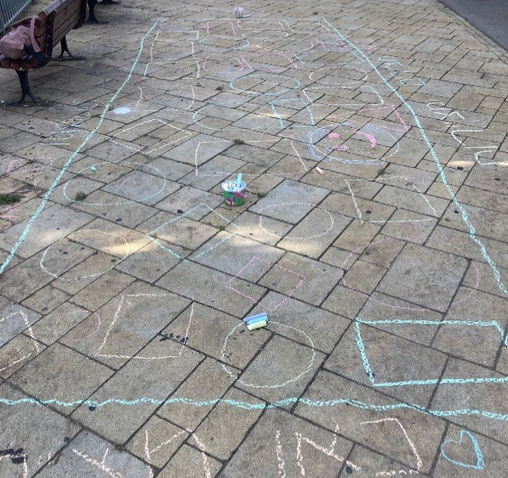
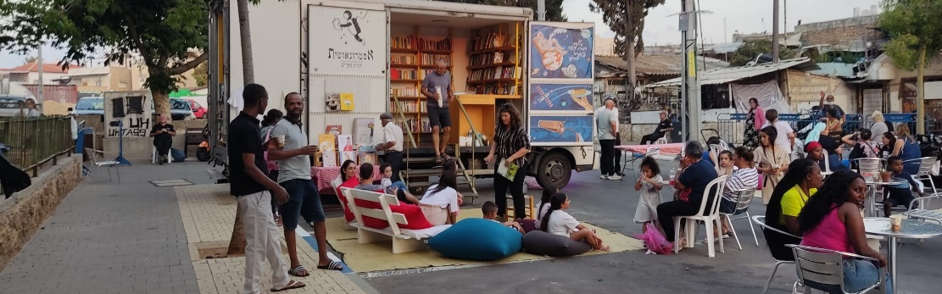
סיכום הערכת פעילות 2023
מוגש כחלק מהערכת שלב ב' של תוכנית Urban95 TLV
פברואר 2024
www.cet.ac.il המרכז לטכנולוגיה חינוכית, חברה לתועלת הציבור, רח' קלאוזנר 16 תל-אביב, טל' 03-6460163

Slide 2
תוכן העניינים
09-14
03
סיכום ממצאי הערכה על בסיס מדדי תוצאות בטווח קצר וארוך (הישגי אימפקט(
מערך המחקר –
פעולות הערכה במהלך 2023
10-12 מדדים המתייחסים לגורמי עירייה ושותפים
13-14 מדדים המתייחסים לבני הגיל הרך ומלוויהם
04
תקציר ניהולי –
הישגי אורבן95 ת"א-יפו בשנת 2023 על פי מדדי ההערכה
15-21
נספחים
16-19 פירוט פעולות ותפוקות תוכנית אורבן95 ת"א-יפו במהלך 2023
05-08
20-21 התערבות בנווה עופר
OVERVIEW על פרויקטים מרכזיים שלוו במדידה והערכה במהלך 2023
22 רחובות משחק – פירוט ממצאי תצפיות
06 קהילה ומרחב ציבורי בנווה עופר– הובלת שינוי התנהגותי: פרויקט במסגרת קורס ABC4ECD
07 רחובות משחק
:School-Street 08
מדרקובנר
3

Slide 3
Research Design – Evaluation Activities in 2023
The research was conducted between April 2023 and January 2024 (activities conducted in the first third of 2023 were reported in the 2022 Summary Report
 | Neve Ofer |  | Play street | Playroom at the Arab-Jewish Center | Midrakovner – pre-intervention | Reading workshop at the library - the Pajama collaboration | Online workshop – parental resilience | Professional and strategic guidance for the Departmental Coordinators team
 | Preliminary research | Intervention evaluation
Field observations | 2 | 2 | North - 1 Jaffa - 2 | 1 | 3
Field interviews with caregivers | N=13 | N=15 | N=20 | N=3 N=2 (team members)
Focus group | N=9 residents
Survey |  |  |  |  | Analysis of public engagement findings (survey and resident meetings) | N=23 | N=9*
Guidance on formative evaluation, strategic consulting, and capacity building. | The lead researcher was part of the municipal team that participated in the course; she took part in the preparations, the series of online meetings, and was a member of the delegation. The evaluation team took part in leading the brainstorming session held to prepare for implementing the intervention.. |  | Providing raw data from evaluation activities and recommendations for immediate implementation. |  |  |  |  | Development and facilitation of a learning session on data measurement and collection.
Due to the low response rate, survey data is not included in the report. The raw data was provided directly to the Urban95 team, similar to all other raw data collected as part of the evaluation activities.

Slide 4
Executive Summary - Summary of outputs and key results based on evaluation metrics
Municipal officials and partners
Promoting inter-administrative partnerships within the municipality and independent municipal initiatives
Implementing projects and pilots on an city-wide scale with an emphasis on underprivileged populations.
Data-driven planning while increasing knowledge and awareness of early childhood in the municipality.
In 2023, hundreds of Salta workshops were held alongside activities in public spaces (fully funded by the municipality) in which thousands of families from all over the city participated. Urban95 also collaborated with municipal partners to provide tailored emergency responses to families.
The Urban95 team facilitated independent municipal initiatives and held regular discussions with municipal officials dealing with early childhood, and promoted inter-administrative partnerships to improve the solutions provided to residents, especially underprivileged populations.
Interventions that underwent evaluation involved inter-administrative collaborations at various stages of the project, and preliminary research was conducted.
Data-driven planning and intervention measurements are carried out regularly; during the coordinator training, a learning session led by the Center for Educational Technology was conducted.
‘Tel Aviv as a lighthouse': A professional body of knowledge accessible to both internal and external stakeholders.
A sustainable municipal standard for early childhood policy implemented within the municipality
Municipal positions have been allocated for an Urban95 program manager and early childhood departmental coordinators in the Community Administration.
Urban95 participates in core strategic processes for integrating the early childhood perspective into the municipality's work in a sustainable way.
Urban95 is developing an online platform for making information accessible to professionals and residents and leads learning tours for local authorities and stakeholders.
Play Street activities were conducted and a playroom in the Arab-Jewish Center was established according to guidelines developed by Urban95.
The Neve Ofer and Midrakovner intervention initiatives arose after the collaborators’ were exposed to professional knowledge during learning tours sponsored by Urban95.
Urban environment and public spaces tailored to young children and their caregivers, investment in physical infrastructure in the city
The locations for events in public spaces were selected based on the residents' needs, physical infrastructure conditions, and logistical considerations.
An evaluation of the interventions in public spaces that were funded by the municipality indicated an improvement in the adaptation of the physical infrastructure to early childhood needs.
Young children and their caregivers
Service consumption and satisfaction
Acquiring knowledge and tools for parenting, parental well-being
Shared play and positive, beneficial caregiver-child interaction
Conditions for optimal development in early childhood
In the evaluated interventions, high satisfaction was observed and/or reported in regard to the activities and the facilitators/operators. This was in reference to activities, workshops, and ongoing consumption of the community service.
In all the interventions, positive interaction and shared play were observed between caregivers and children, as the content and/or characteristics of the space were adapted to the needs of the different communities, and a multi-age solution was provided.
Feedback from reading workshops and observations of the playroom in the Arab-Jewish Center indicate that participants/visitors, especially those from underprivileged populations (residents of South Tel Aviv and Jaffa) acquired knowledge and positive practices.
The various activities and events reflect a community-driven approach geared toward providing focused solutions tailored to the different characteristics of each community/neighborhood.
Based on the intervention evaluations, the initiatives promoted social gatherings and strengthened the neighborhood residents’ sense of belonging.
Observations show that the residents appreciated the activity of the community team, who are aware of the importance of connecting with residents to improve services and promote community involvement.
Community and social belonging

Slide 5
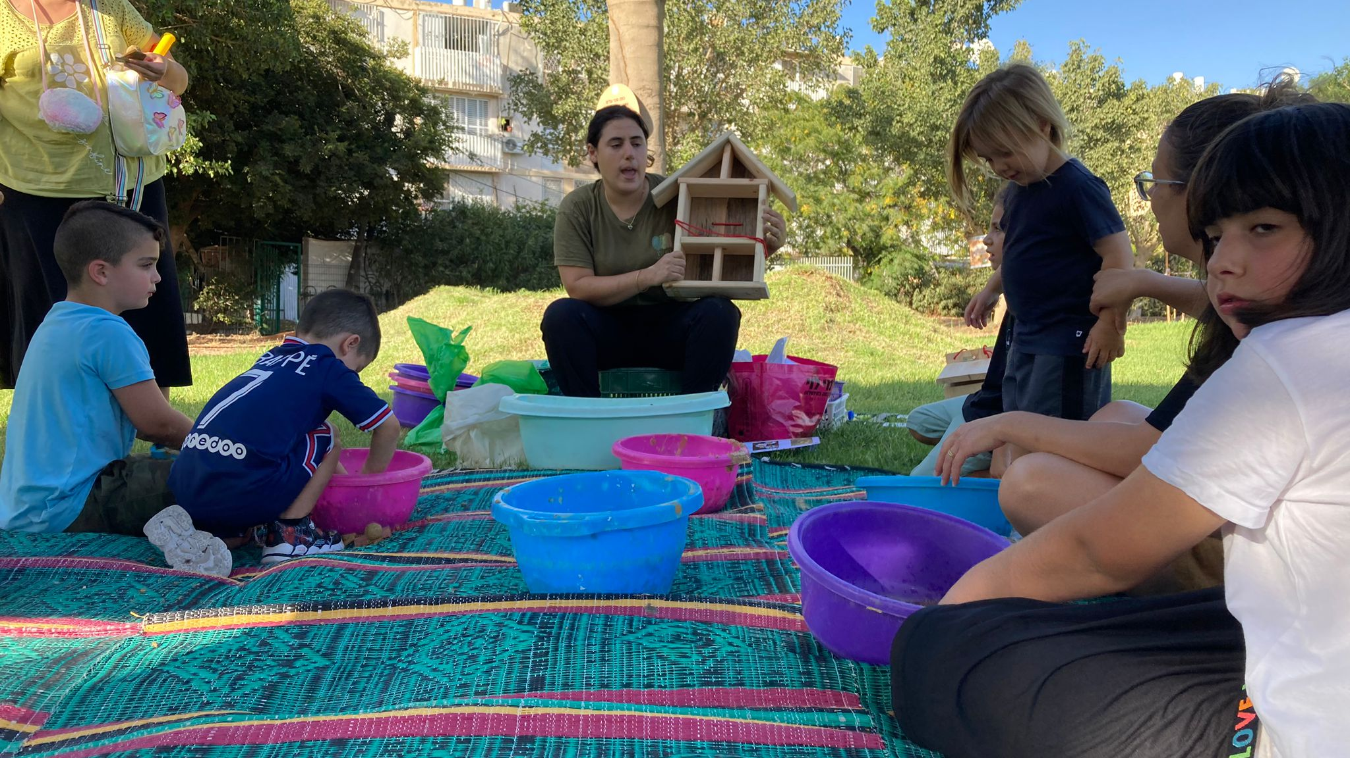
Overview of the Main Projects Measured and Evaluated in 2023

Slide 6
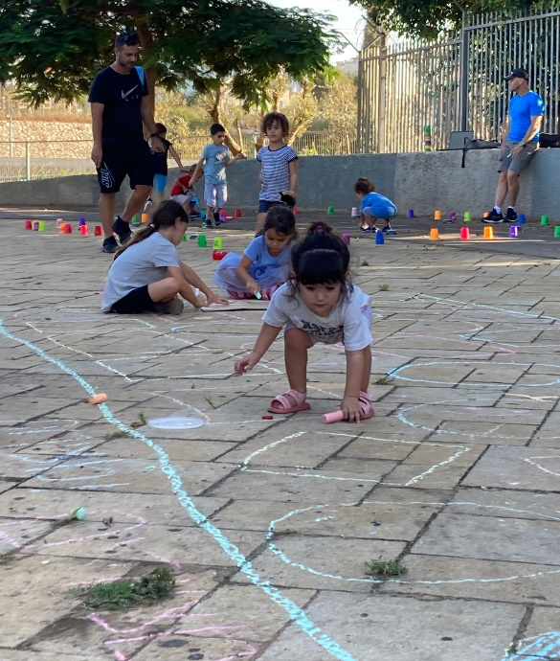
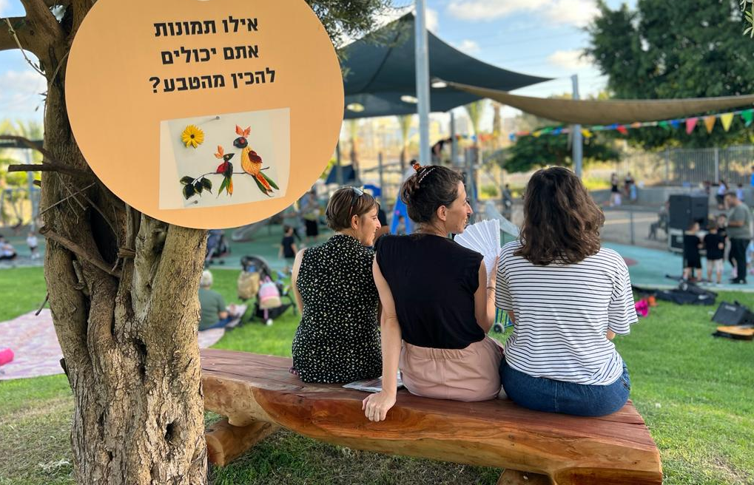
The Community and Public Space in Neve Ofer - Leading Behavioral Change: A project conducted as part of the ABC4ECD course
The event proved successful for examining parent-child interactions
The residents were:
Exposed to the existing garden
Excited about the stations
Got to know new games and activities
Used the playground equipment
Expressed a desire for more
The ABC4ECD course for Behavioral Change (INSEAD) – participated by a delegation from Tel Aviv-Yafo Municipality, which includded the Urban95 Tel Aviv-Yafo Program Manager, the Neve Ofer Community Center Manager, and the Gardens and Parks Department Manager in the City Beautification Division.
April
2023
June
2023
October
2023
Conducting preliminary research to gauge the current situation
Conducting follow-up research:
Preferred activities for integrating into the regular activity
The quality and impact of the event in the immediate term.
Behavioral change: Promoting positive parent-child interaction and shared play in the public space
Brainstorming session with participants from various municipal administrations
The week of the course:
Setting a location and planning the pilot
Implementing the pilot:
The ‘Neighborhood Holiday’ event in the Iris Garden
A range of activity stations
Immediate upgrading of the public space (trees and seating)
Adapting the neighborhood to the intervention:
Promoting underprivileged populations
Previous successful inter-municipal collaborations (Play Street, renovating the Kilcha children's garden).
The ‘nostalgia station’
At the peak of the event, about 45 adults (mainly women) and about 80 children were present, including long-time residents, secular and religious residents, and Arab and Russian-speaking residents.
A new bench and activity sign

Slide 7




Play Streets
Play Street’s most significant effect is in creating an
“island fun and relaxation”
in the public space, all the more so in neighborhoods that are normally less safe and inviting, where the local population includes underprivileged social groups.
North Tel Aviv Tsukei Aviv
The activity involves closing off a street section to vehicle traffic and converting it into an area for leisure activities by placing activity stations and seating areas.
At the peak of the activity
About 50-60 adults and children
6+
0-3
Participant age
‘Play Street' was launched in July 2021 as one of several solutions developed for young children and their caregivers in public spaces. The initiative was promoted in collaboration with the Community, Culture and Sports Administration, the Urban95 program, and other municipal bodies(Transportation, Sanitation, Supervision, and City Beautification Departments).
Among adults
10%
Grand-
parents
60% Women
3-6
2021
Socially homogenous populations (high socio-economic status)
Jaffa Tsihatli
Due to high demand, the Urban95 team developed a guidebook detailing how to promote such initiatives in every neighborhood through community centers. The concept was adopted across the city and expanded in 2022 to include activities in the city’s south and center.
About 750 adults and children participated
0-3
Among adults
6+
Female majority
Participant age
2022
Socially and socio-economically diverse population
3-6
The Transportation Authority approached the Urban95 team to expand the activity to additional areas in the city, with funding from the Authority, in order to promote walking - a central issue on the municipality's transportation agenda. Nine activities were held in North and South Tel Aviv and Jaffa, of which three activities were sampled for observation: two in Jaffa and one in the northwest part of Tel Aviv.
Jaffa Kehilat Canada
About 40 adults participated at the peak of the activity
The Jaffa area - Tsihatli
Participants from a variety of underprivileged populations were observed - including longtime residents, religious individuals, members of the Ethiopian community, Arabic speakers, and Russian speakers.
2023
Among adults
20% grand-parents
60% women
70
children
Babies and toddlers
6+
Jaffa – Kehilat Canada

Slide 8
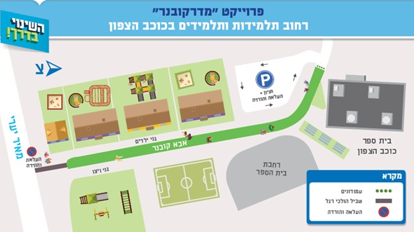
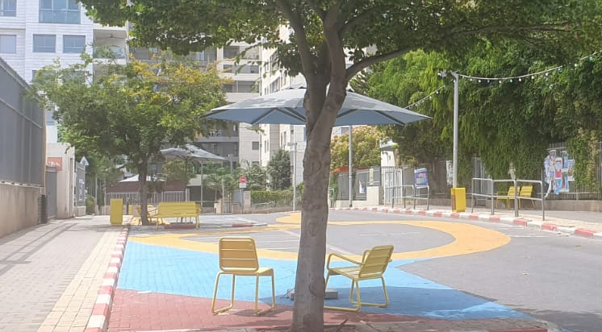
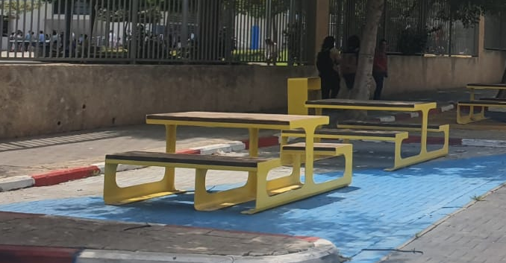
School-Street: Midrakovner
The Midrakover School-Street pilot was launched at the beginning of 2023 by the Department of Transportation in collaboration with the City Architect’s team, the Community Administration North Division, and Urban95. The plan was to test it for about a year, as part of the '100 Points' umbrella project*.
The preliminary evaluation demonstrates the project’s significant potential contribution to improving mobility and creating an accessible and safe space for residents and their children to play and spend time in during the afternoon, a space they can also use while the children are in their educational frameworks.
Location:
A residential street segment with educational institutions (kindergartens and elementary schools) and a synagogue.
Intervention goals:
Implementing the municipality’s strategy for making streets pedestrian-friendly and encourage walking.
Providing a safe solution for those going to the educational institutions.
Making it possible to spend time in the area during school hours and leisure time.
As part of planning the project:
The project team conducted a public participation process to inform the residents of the project and get their perspective.
Pre-intervention observations were conducted to further map opportunities and barriers.
“We’re very happy with the idea of the pedestrian walkway. Also in terms of safety... It’s very nice... It’s fun for us to come here in the afternoons to play.“
A neighborhood resident – excerpt from the launch video
Conducting the pilot:
A public parking lot was arranged at the entrance to the street to replace the parking on the street.
The street segment was converted into a pedestrian-friendly zone and was closed to vehicle traffic.
Seating and leisure facilities were installed, and the area was painted and made to be inviting.
A festive launch event was held in collaboration with the neighborhood residents
* Details about the project and the locations where the evaluation was conducted can be found in the 2022 Mobility and Urban Space Summary Report.
** Post-intervention observations were initially scheduled for October 2023 but were postponed due to the war; they will be conducted during 2024.

Slide 9
Summary of Evaluation Findings
based on Short- and Long-Term Outcome Measures
(Impact Achievements)

Slide 10
The intervention in Neve Ofer
The location was chosen to cater to the underprivileged population in the area.
Preliminary research was conducted to map the needs of the community.
The brainstorming team that planned the intervention included 25 participants from various administrations (community, education, engineering, and more).
Play Street
The initiative and funding for 9 activities in 2023 were provided by the Transportation Authority, based on the knowledge and experience accumulated and promoted by the Urban95 team who led the activities in 2021/22.
Planning the initiative required partnering with stakeholders from various areas in the city, managing resources, and tailoring responses to the population characteristics and diverse conditions of each area.
With each event, there were evident improvements in terms of production and logistics, with adaptations being made to accommodate the diverse communities.
גורמי עירייה ושותפים:
קידום שותפויות בין-מינהליות בעירייה ויוזמות עירוניות עצמאיות
יישום פרויקטים ופיילוטים בקנה מידה עירוני ובדגש על אוכלוסיות מוחלשות
תכנון מבוסס נתונים תוך העלאת הידע והמודעות לגיל הרך בעירייה
3 dedicated books were handed out in kindergartens.
Establishing the Midrakovner School-Street
The pilot was planned and executed as part of the “100 Points” project led by the Transportation Authority, the City Architect's Office, Urban95, and other municipal partners.
Reading workshops in libraries
A series of Salta reading workshops was combined with the Pajama Library project. The facilitators were trained by Urban95.
25 guided reading workshops were held focusing on the books
Departmental Coordinators’ Training
As part of the Departmental EC Coordinators’ training, a learning session was held on measuring and collecting data, lead by the CET.
Led by 4 facilitators
And attended by around 400 participating dyads
Activities and outputs (detailed information provided in the appendixes):
450 Salta workshops, fully funded by the municipality, were held in community institutions.
Joint initiatives to produce content and service solutions:
  The Urban95 team fosters dialogue and mutual assistance among other municipal bodies dealing with early childhood to improve and promote optimal services for the target audience.
  Emergency initiatives: activities for evacuees, reserve families, and women before and after childbirth.
The Urban95 team provides advice and guidance in project initiation, assisting in the development of operational mechanisms for continued independent work among the involved organizations:
  Cooking workshop for fathers in Jaffa.
  The Wandering Workshop - in collaboration with the Beit Ha’ir Museum.
Collaboration between departments and organizations providing assistance to underprivileged populations:
  Partnership with Mesila, an organization that assists the asylum seeker community in South Tel Aviv.
  Family Kindergarten (in collaboration with the Education Department and the Community Administration): operating kindergarten frameworks in collaboration with parents in community centers in Jaffa and South Tel Aviv.
Pre- and post-intervention data is collected systematically and budgeted at the initiative of various municipal departments (among others), to measure the projects’ impact (City under Construction, the Midrakovner School-Street, Gan Hashnaim, and the cooking workshop for fathers in Jaffa).

Slide 11
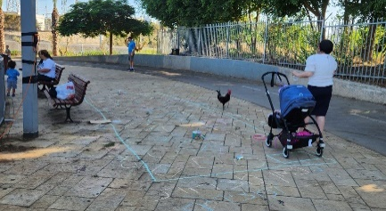
The intervention in Neve Ofer
Participants from the Tel Aviv-Yafo Municipality (Urban95, Community Administration, and the City Beautification Division) attended the ABC4ECD (INSEAD) course, during which a behavioral change intervention for early childhood was developed.
The knowledge acquired in the course was conveyed in a brainstorming session attended by various municipal officials who are regularly involved with Urban95, in order to implement the vision of the project.
The 'Influencing Factors' tool that was taught in the course was translated by the Urban95 team and produced as a printed aid for stakeholders.
Play Street
The Urban95 team produced a guidance document detailing how to promote the initiative through the community center in the neighborhood. The document was updated from time to time based on experience and insights gained from the field.
גורמי עירייה ושותפים:
'תל אביב כמגדלור':
גוף ידע מקצועי, הנגיש לגורמי פנים וחוץ
תו תקן עירוני למדיניות הגיל הרך מוטמע בעירייה באופן בר קיימה
Establishing a playroom in the Arab-Jewish Center in Jaffa:
The playroom was planned and designed according to the guidelines and standards of Urban95’a Program for Designing Play Areas.
Establishing the Midrakovener School-Street
The intervention was executed based on Urban95’s guidelines for adapting public spaces to early childhood needs, as part of the 100 Points program.
Activities and outputs (detailed information provided in the appendixes):
Starting January 2023, a municipal position was allocated for managing the Urban95 program, reflecting recognition of the importance of the subject and to ensure the continuation of activities.
Establishing a departmental work model in the Community, Culture, and Sports Administration – recruiting and training departmental coordinators, providing support in building a departmental work plan for early childhood.
The Urban95 team is involved in planning and decision-making tables in a variety of municipal unit activity channels, and Urban95 principles are being integrated into the core processes:
  Formulating urban planning guidelines for public spaces with a broad municipal team and the support of professional consultants brought in by Urban95.
  Developing a strategic plan for early childhood led by the Strategic Planning Unit in the Engineering Department.
  Continued involvement in planning and implementing solutions using the tactical urbanism approach to address mobility challenges in a city under construction ("100 Points").
  Involvement in developing a five-year plan for Community, Culture, and Sports Administration activities in the field of informal education.
Developing an online knowledge space for professionals from various cities in Israel and around the world. The website will serve as a tool for managing information, sharing knowledge, and inspiration, by presenting about 30 projects implemented as part of the Urban95 Tel Aviv-Yafo program.
Early childhood lobby on the municipal website - Developing an online space for residents on the municipality's website that centralizes all the information about services for young children and their caregivers.
Hosting and leading learning tours for local authorities and stakeholders: Urban95 city tours of Tirah and Beit Shemesh, tours to Holon and Ramat Gan, and hosting 43 participants in Seminar Hakibbutzim’s training course on their way to become supervisors of daycares across the country under the Ministry of Education.
As part of emergency operations during the war, the Urban95 team was in ongoing contact with the Green Building Council and program administrators in other cities to share information, projects, and ideas for responding to residents’ needs.

Slide 12
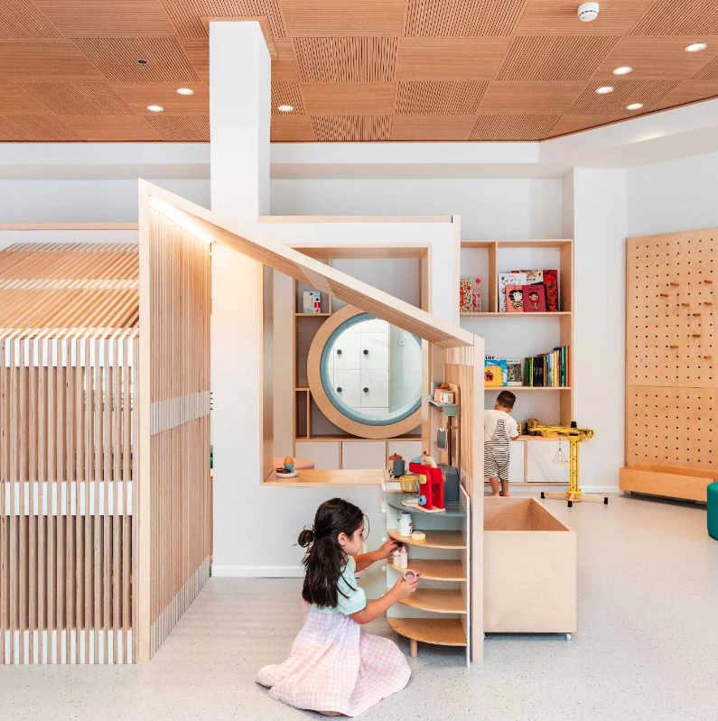
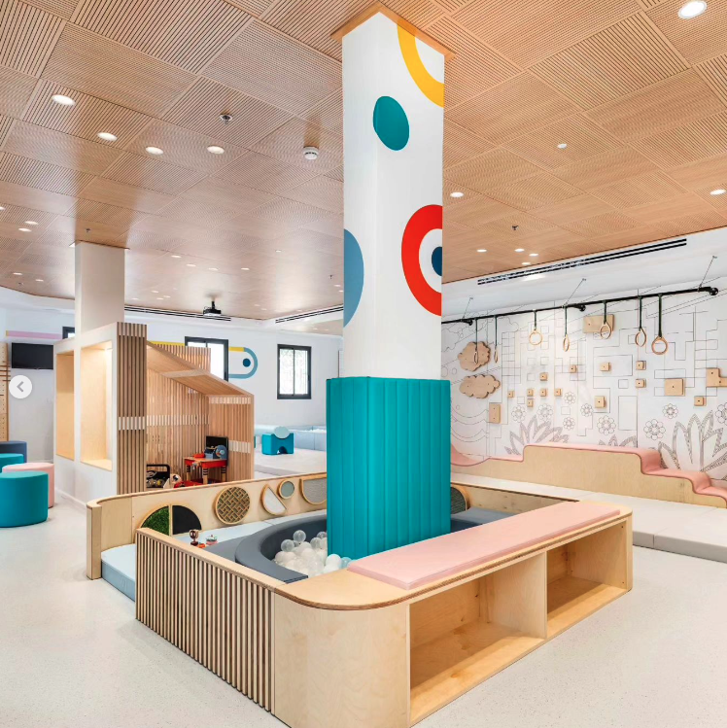
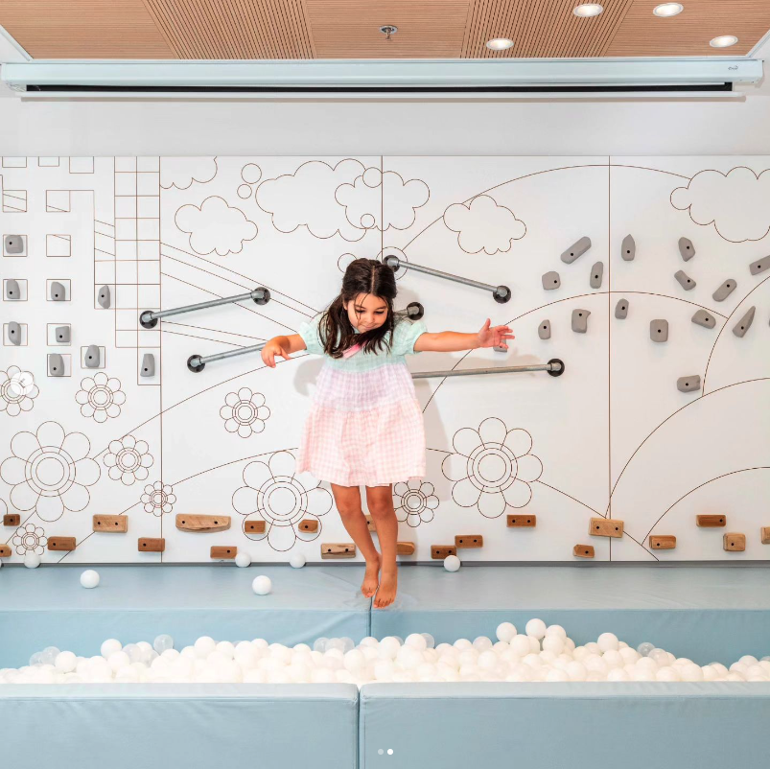
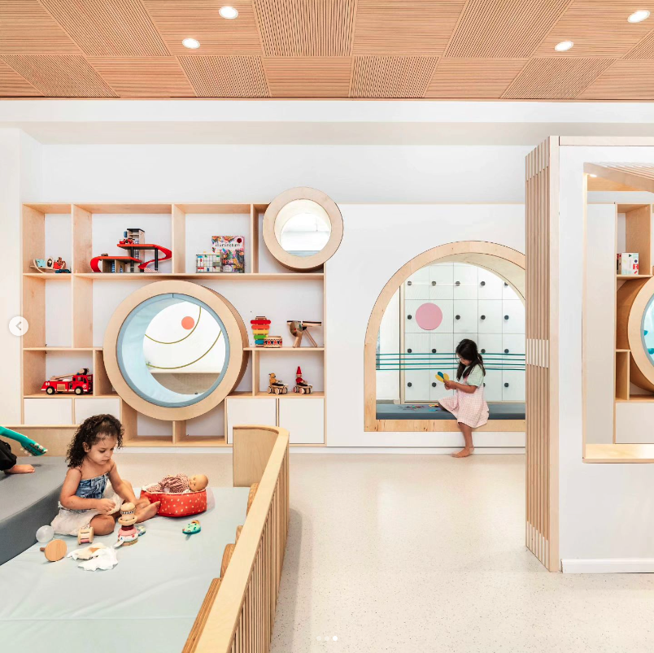
The intervention in Neve Ofer
As a result of the intervention, public space conditions and have improved (shading, vegetation, cleanliness, and seating areas).
Residents expressed the need for a renovation and long-term improvement of the spatial conditions (e.g. facilities for young children, permanent shading and seating facilities), as well as enforcement actions against routine barriers (e.g. cleanliness, noise, vandalism, and two-wheeled traffic).
Play Street
Spatial and logistical planning was done based on the unique characteristics of each event:
In the event in Jaffa, , which included adults and senior citizens, a variety of seating facilities were arranged, which created a relaxed atmosphere for the community gathering.
The event in the north was held near a school and after summer camp hours, in order to make the space immediately accessible to those coming out of camp.
The event held in Jaffa as part of the launch of a new community science center included activities themed around science and space. A large number of stations were set up to accommodate the hundreds of visitors who attended the event.
גורמי עירייה ושותפים:
סביבה עירונית ומרחב ציבורי מותאמים לגיל הרך ולמלוויהם, השקעה בתשתית פיזית בעיר לטובת הגיל הרך
Establishing the Midrakovner Play Street
A pilot program involving closing streets around educational institutions to promote walkability, and investing in adapting the physical infrastructure to create a space for playing and spending time that is accessible and safe for residents and their children during and outside of school hours.
Establishing a playroom in the Arab-Jewish Center in Jaffa
The room was renovated and optimally adapted to the needs of young children: the space is designed to encourage caregivers to sit with children in various play areas. The design and equipment offer ideal developmental support, enhancing movement and motor skills, facilitating symbolic play, and engaging children in interactive, auditory, and sensory activities.
A reading workshop in libraries – the Pajama collaboration
The workshops catered to residents all over the city. Respondents evaluated the physical conditions of most libraries as being comfortable and well-suited for activities.
The event locations (Play Street, Neve Ofer) were carefully chosen, taking into account the residents' needs, physical infrastructure conditions, and the administrative requirements of the partners involved in implementing the project.
Activities and outputs (detailed information provided in the appendixes)
Promoting and supporting initiatives for developing public spaces adapted to early childhood:
  Creating play areas in community centers across the city.
  Gan Hashnaim in Jaffa: The renovation was executed based on extensive preliminary research, a large public participation process, and an architectural plan. It was adapted for the use of young children, their caregivers, and the general public, with a budgetary investment double that of the original budget designated for the project.
  The Kilcha Children's Garden: The renovation was conducted in South Tel Aviv as part of the City Beautification Division’s ongoing work plan, with municipal funding, following a public participation process.
  Emergency operations during the war – preparing shelters for welfare family day care centers in South Tel Aviv.

Slide 13
The intervention in Neve Ofer
The stations encouraged learning and exploration, creating craftwork together, social interaction, free movement, and physical challenges. The activities promoted joint caregiver-child play and encouraged the caregivers to connect, participate, and enjoy themselves.
Caregivers and children, particularly those aged 3-6, viewed the event as an exciting journey of discovery through the various activities. Children were seen engaging in free play together, using the lawn and hills for riding, running, and rolling around.
The atmosphere was very positive, and it was evident that residents were pleased with the community team, facilitators, and station operators, who encouraged the participants to be highly involved.
Play Street
The events were well-suited to the various communities:
  Accessible, close, and free; each event included different features based on the space and the community.
  The variety of stations catered to a broad age range, from toddlers to elementary school aged children, providing opportunities for caregivers and children to play together.
  Residents appreciated the initiative - "It's the safest when they close the street and kids can play freely." Play Street, Kehilat Canada. "I enjoy being outdoors and meeting parents from the neighborhood. I liked that the games were thought-provoking, everything was reusable, and the toys were made of wood." Play Street, Tsukei Aviv.
  Participants in the events in Jaffa praised the concept, and it is clear that the intervention was more significant in areas with weaker populations, where public spaces are normally less suitable for children's leisure activities. Conversely, in more affluent areas that have a range of public spaces designed to accommodate the target audience’s needs, the concept can probably be implemented using existing municipal resources.
בני הגיל הרך ומלוויהם:
צריכת שירותים ושביעות רצון
רכישת ידע וכלים להורות, רווחה הורית
משחק משותף ואינטראקציית מלווה-ילד חיובית ומיטיבה
תנאים להתפתחות מיטבית בגיל הרך
Reading workshop in libraries – the Pajama Collaboration (N=23)
  The workshops met the expectations of all respondents (82% “to a high-very high extent”) and 96% felt the facilitators were professional.
  Respondents primarily benefited from acquiring knowledge and practices, especially residents of South Tel Aviv – “The workshop was highly experiential for children and enriching for us as parents. We really loved it!”
  Indirect finding: more than half the respondents were familiar with the free library services and about half of them (all from the north) said they were members.
Establishing the playroom in the Arab-Jewish Center in Jaffa
Most of the families who visited the facility spent their time together engaged in caregiver-child play and it was evident they had come to spend meaningful quality time together.
“Parents want to spend more time with their children, not just at home”
Playroom staff member at the Arab-Jewish center.
The staff members were accessible and interacted with the visitors in a positive and inviting way, offering advice and encouraging joint play. Both are experienced in working with young children, however they mentioned that they had not received specific training for working in the playroom.
Interviews with visitors highlighted the need for monitoring visitor crowding in the facility and/or extending the activity hours:
    Optimizing the experience and accessible use of the facilities – “Sometimes children want to play at a particular station and they need to wait a long time for others to finish.‘”
    Maintaining homogeneous age groups to provide a safe and toddler-friendly experience - ‘”When there are 4-5-year-olds, they dominate the space and there’s no suitable place for younger ones. My child is still new to walking, and I feel it’s unsafe when older kids run around him.‘”
Activities and outputs (detailed information provided in the appendixes)
  450 Salta workshops were held in 2023, in which approximately 4,500 families participated. In addition, a variety of activities were organized in public spaces throughout the city, offering diverse and tailored solutions for young children and their caregivers (the Wandering Workshop, summer activities).
  The Urban95 team collaborated with various partners to provide comprehensive support to families during the war, including by mapping the needs of evacuees, providing support for reserve families and women before and after childbirth, providing accessible information and services, and developing and adapting workshops to an emergency format.

Slide 14
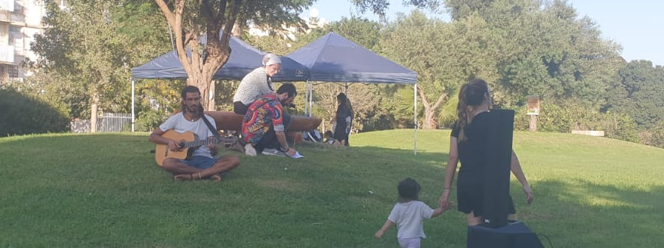
בני הגיל הרך ומלוויהם:
The intervention in Neve Ofer
  The event was designed to promote community engagement and strengthen residents' sense of belonging in the public space, by creating inviting conditions for spending leisure time together and designing activities to reinforce residents' connection to the neighborhood (e.g. heritage, nostalgia, social sports games).
  Participants from diverse population groups attended the event, but the interactions mostly remained within inner circles.
  The official gathering naturally facilitated extended playtime on the facilities, which were previously neglected and underused.
  The space was intended for recurring gatherings, and several insights were derived from the evaluation:
  We recommend holding frequent events or regularly operating some of the stations featured in the event.
  Interviewees suggested linking activities in Iris Garden to those in the community center, and establishing shared facilities such as a library and a game storage room.
קהילתיות והשתייכות חברתית
Play Street
  The events at each location reflected different characteristics of the neighborhood and community:
  In the north, there was significant interaction among the visitors, and it was clear the community was homogeneous and many people knew each other.
  The event on the small residential street in Jaffa was designed to encourage social gatherings (seating and a coffee area), and the activity stations exposed visitors to community center classes. There were relatively many senior citizens and parents of older children, who sat together in various social and ethnic groups.
  At the event that coincided with the launch of the Science Center in Jaffa, the crowd was diverse, representing both the community typical of Central Tel Aviv/North Jaffa (high socio-economic status), which is familiar with the community services, and long-time residents of Jaffa from the Arab community who have only been exposed to services for young children in recent years.
  The community teams in Jaffa interacted extensively with the residents. At the smaller event, the team reported challenges in promoting the event to an audience not accustomed to using community services. The high turnout at the launch event speaks to the intensive recruitment efforts and well-maintained relationships of the community team with the local residents.
"I liked this idea, I haven't participated in street activities before.. I think we need more things like this, it creates a neighborly atmosphere and it's an opportunity for children to feel part of the place."
Play Street, Tsihatli
Establishing the playroom in the Arab-Jewish Center in Jaffa
  The playroom is located in the Arab-Jewish community center in Jaffa, which serves as a hub for community collaborations between Jewish, Christian and Muslim residents. The signage appears in both Arabic and Hebrew to cater to various visitors.
  The staff is engaged with the community and friendly with the visitors, and it is evident that the team is aware of how important it is to connect with the local community in order to improve the service and experience.
  Most of the interactions occurred between the caregivers and the children, and among the adults themselves. Limited play was observed among children who did not know each other beforehand.
  A sign with a QR code was placed at the entrance of the playroom to help visitors join the community WhatsApp group, and the interviewees reported that they used the group regularly to keep updated on events .
Actions and outputs (detailed information provided in the appendixes):
  The various Satla workshops and activities are designed to promote a sense of connection among the community. Additionally, as part of the emergency response efforts, women before and after childbirth were proactively approached to offer support and make community services accessible, and to connect them to neighborhood community groups.
“I enjoy just being outdoors, and the fact that everything ‘s free is great. My child’s having a good time, playing with kids he doesn't know."
Play Street, Tsukei Aviv

Slide 15
Appendixes

Slide 16
Detailing of activities and outputs* in 2023
In the municipality:
Starting January 2023, a position was allocated for managing the Urban95 program with full municipal funding, reflecting recognition of the importance of the issue and ensuring the continuation of activities.
Establishing a work methodology based on the departmental model in the Community, Culture, and Sports Administration - recruiting a departmental coordinator in the south and center of the city, creating training days for coordinators, and accompanying the construction of the departmental work plan for early childhood.
Maintaining dialogue and mutual assistance among municipal bodies dealing with early childhood – Community, Culture, and Sports Administration units, Culture Department, family health clinics, Digitaf, the Parenting Center, and the Birth-3-Year-Old Department in the Education Administration.
The Urban95 team is involved in planning and decision-making processes in various activity channels of different municipal units:
  Formulating urban planning guidelines for public spaces, led by the city's chief architect in collaboration with professional consultants from Urban95; incorporating the early childhood perspective into the planning document.
  Developing a strategic plan for early childhood, led by the strategic planning unit in the Engineering Department.
  The '100 Points' project**: Planning and implementing tactical solutions to address mobility challenges in a "city under construction"; incorporating the early childhood perspective in the planning of interventions.
  Participation in a round table dedicated to developing a five-year plan for the activities of the Community, Culture, and Sports Administration in the field of informal education.
An Urban95 team member participated in a learning tour in Rotterdam on green-blue courtyards, as part of a municipal delegation that included the city's public space architect and an agronomist from the Parks and Landscape Department. Insights from the tour led to mapping municipal partners and connecting to existing city projects on urban nature, forest gardens, and more, in collaboration with the Education Administration, among others.
Promoting the establishment of an online body of knowledge – website characteristics were defined and 30 projects were selected to be mapped in-depth and presented as a means for managing information, sharing knowledge, and providing inspiration.
Early childhood lobby on the municipal website - developing an online space on the city's website to connect and synchronize all early childhood service providers in the city, centralizing all the necessary and current information for residents – including service centers, gardens and parks, playrooms, adapted paths, and libraries, and coordinating the playrooms field on online media (the municipal website and GIS).
Hosting and leading learning tours for local authorities and stakeholders: Urban95 city tours of Tira and Beit Shemesh, tours to Holon and Ramat Gan, and hosting 43 participants in a training course from Seminar Hakibbutzim on their way to becoming supervisors of daycares across the country working under the Ministry of Education.
*According to data provided by the Urban95 team at the Tel Aviv-Yafo Municipality, Community Administration.
**Details about the initiative and evaluated locations are provided in the 2022 Urban Mobility and Spatial Planning Summary Report.

Slide 17
פירוט פעולות ותפוקות* בשנת 2023
Routine activities and services for residents:
Continuation of Salta activities - During 2023, 450 workshops with full municipal funding were held in community and cultural centers (community institutions), with approximately 4,500 families participating.
Dozens of summer activities for young children throughout the city initiated by the various district and department coordinators under the guidance of Urban95, including a community sandpit – summer activities for young children at the northern beaches and in the city center, following the "Community Center without a Center" pilot at Tel Baruch beach.
Reading workshops in libraries: Salta's reading workshops in community libraries initiative was combined with the "Pajama Library" project and a reading workshop was developed focusing on 3 books distributed in kindergartens. Twenty-five activities were held in libraries and community centers throughout the city, led by four facilitators, participated by about 400 parent-child dyads (a survey was distributed, findings are presented in the report).
Cooking workshops for fathers and daughters in Jaffa: An initiative based on the method developed as part of the Yafa is Reading project - four meetings led by a chef with psychological support, aimed at creating quality time for fathers and children. Eleven families participated in the workshops (25 participants in each meeting), and an independent evaluation was conducted using a survey.
Family kindergarten: A project conducted in collaboration with the Education Administration and the Community, Culture, and Sports Administration, operating kindergartens in community centers for underprivileged populations.
Eight groups were opened in Jaffa (some in Arabic and some in Hebrew) and four groups were opened in the south and east of the city.
  The kindergarten teachers were employed by the Education Administration and recruited for the project, receiving pedagogical guidance and training, including measurement and evaluation, and the parents' tuition fees were either subsidized or free.
  The process began under the guidance of the Urban95 team and was further expanded by the Department for Birth-3-Year-Olds in the Education Administration and community centers.
  The project was showcased as part of an educational tour focusing on early childhood education frameworks in Jaffa and a booklet detailing the project's operational model was produced.
Continued collaboration with Mesila, the organization providing assistance to the asylum seeking community in South Tel Aviv: translating books (including a book on sex education after identifying a need in the field), solving structural challenges in the renovated playroom, and promoting and adapting Salta and Play-Car activities. In planning: training employees and volunteers within the community team to equip them with tools for impactful action.
*לפי נתונים שנמסרו מצוות Urban95 בעיריית תל אביב-יפו, מינהל קהילה.

Slide 18
פירוט פעולות ותפוקות* בשנת 2023
Improving EC solutions in public spaces and public buildings:
Iris Garden in Neve Ofer: Leading behavioral change in the public space – a project conducted as part of the ABC4ECD course initiated by the Van Leer Foundation and the INSEAD Business School, participated by a municipal delegation (evaluation findings presented in the report).
Play Streets: The Transport Authority approached the Urban95 team with a proposal to expand the activity to additional areas in the city, with funding from the authority. Nine activities were conducted in the northern, southern, and Jaffa areas, of which three activities were sampled for observation: two in Jaffa and one in the city’s northwest (evaluation findings presented in the report).
Midrakovner School Street: A pilot for closing streets around educational institutions to promote walking. The area chosen for the pilot is Abba Kovner Street, which includes a cluster of kindergartens and an elementary school. The pilot involved a public participation process to raise awareness and recruit residents, along with pre- and post-intervention measurement and evaluation. (Findings of the pre-intervention evaluation were submitted to the Urban95 team, the intervention measurement and full pilot evaluation will be conducted and reported in 2024).
Establishing a playroom for young children at the Arab-Jewish Center in Jaffa: Planning was carried out with professional guidance from Urban95 based on the program developed for designing playrooms (evaluation findings presented in the report).
  The Urban95 team also provides professional guidance to community centers for creating play spaces suitable for young children.
The Wandering Workshop: Activities in the public space based on the "Play-Car" concept that has been successfully operated in recent years. The project, conducted in collaboration with the Beit Ha’ir Museum, was launched in July 2023 and included 40 activities throughout the city focusing on the city's cultural history, combined with craftwork and play.
The Gan Hashnaim renovation in Jaffa: After conducting a series of pre-intervention observations, collecting data on residents' needs and usage patterns, conducting a large public participation process, and developing a comprehensive architectural plan, the renovation was completed. The park was adapted for young children, their caregivers, and the general public, with a budgetary investment double that of the original. The park was reopened in January 2024 and observations will soon be carried out to evaluate the intervention.
The Kilcha Children's Garden renovation in South Tel Aviv, conducted as part of the City Beautification Division’s ongoing work plan and funded by the municipality, following a public participation (the garden was included in the pre-intervention playground measurement carried out on behalf of Urban95 in 2020).
**פירוט על המיזם והמוקדים בהם בוצעה ההערכה- בדוח סיכום תחום ניידות ומרחב עירוני 2022
*לפי נתונים שנמסרו מצוות Urban95 בעיריית תל אביב-יפו, מינהל קהילה.

Slide 19
פירוט פעולות ותפוקות* בשנת 2023
4th quarter – emergency operations:
Mapping EC needs in about 20 evacuee hotels: examining equipment and infrastructure and providing recommendations for activity routines.
Operating the Salta workshop online offerings, in shelters and community centers.
Creating multi-age Salta workshops for reserve families to facilitate children aged 1-8.
Designing and assembling 500 activity kits aimed to support residents and evacuees by offering creative and playful activities, fostering community bonds and resilience, providing tailored developmental content, promoting sustainability, and involving youth as guides and instructors. The kits were translated into Arabic and intended for widespread distribution (link to article). Evacuee kits featured drawings by Brazilian children expressing support and solidarity..
Collaboration and ongoing updates vis-à-vis the national Urban95 program: continuous and direct contact with the Green Building Council and the Anchor Cities Administration for sharing information and ideas. A dedicated ZOOM meeting was held focusing on the activity kits and sharing information on all the outputs, in order to make adjustments for target audiences in other cities.
Preparing a shelter for 4 welfare daycare centers from Neve Ofer (in collaboration with the Education Department).
Proactive outreach to pregnant women and new mothers – after mapping the needs of reserve duty families a thorough search was conducted and about 35 calls were made to women before/after childbirth to offer a listening ear and let them know about tailored and accessible support and assistance services. The initiative was conducted in collaboration with Digitaf, family health centers, and the Parenting Center of the Education Administration. As part of the initiative:
  A “Journey to Parenthood” workshop was developed and operated for pregnant reserve duty women.
  Connections were facilitated between new mothers and post-partum doulas, parenting counselors, and private mothers’ groups in the mothers’ neighborhoods.
  All the dedicated activities in the community centers were adapted to provide solutions to reserve duty families.
  A one-time online workshop on “parental resilience” led by the Parenting Center and Dr. Dana Shai (of Urban95) was participated by 100 parents.
*לפי נתונים שנמסרו מצוות Urban95 בעיריית תל אביב-יפו, מינהל קהילה.

Slide 20
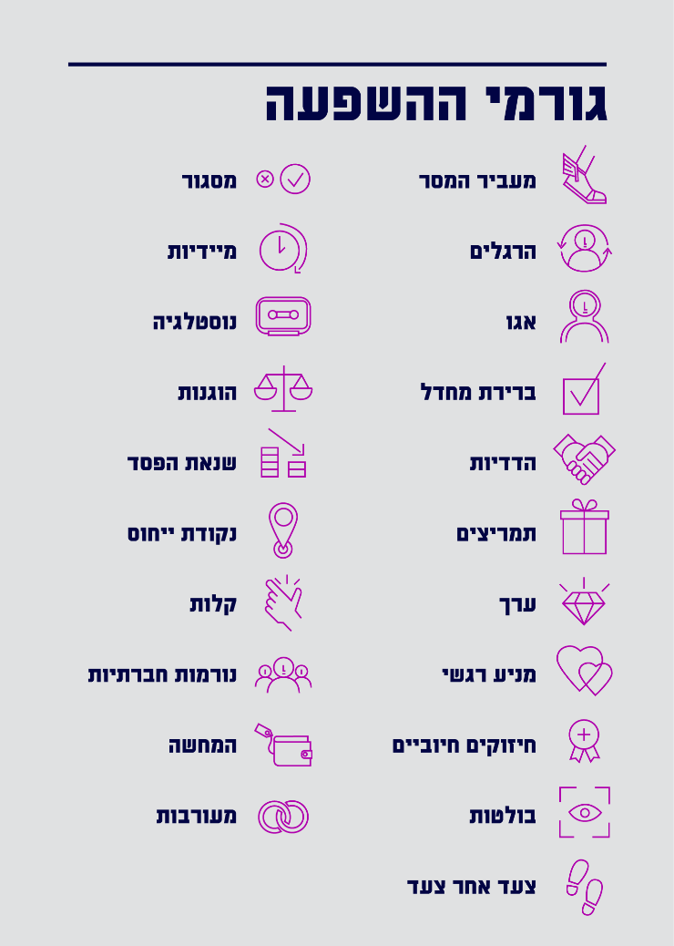
The Neve Ofer Intervention
In the preliminary research*, residents suggested ways to improve conditions and raised ideas for initiatives that would upgrade community life.
Mapping the residents' suggestions by influencing factors:
Conveys a message: Activities organized by the community center / kindergarten teacher are perceived as high quality.
Habits, incentives: Residents reported that when activities are held, they come with their children and participate together with the community.
Nostalgia: Old games and board games evoke childhood memories for adults and a desire to pass the experience on to their children.
Ego, value: Residents offered solutions they had seen around the city. When introducing an activity/content/initiative of any kind to the neighborhood, it’s important to mention that the solution has been tailored to the residents' needs, based on their wishes, and to highlight its value.
Ease: Many of the solutions relate to the availability and accessibility of content, games, and activities in the garden.
Guiding criteria for planning a behavioral change intervention were taught during the course, along with the "influencing factors" tool, which were translated by the Urban95 team and produced as printed learning materials for distribution among stakeholders.
At the brainstorming session for planning the intervention, decisions regarding implementation were formulated as follows:
Community initiatives for the immediate term:
Neve Ofer Professional Forum
Iris Garden event – activities and games to promote caregiver-child interaction
“Green wall” with the residents
Ongoing collaboration with the Beit Ha’ir Museum and Sustainability Authority
Infrastructural and long-term initiatives:
Picnic tables
Logs for sitting on
Planting fruit trees
Mobile community library
Improving the lighting at the entrance to the garden
Implemented and evaluated
* Two field observations that included 13 interviews and a focus group with 9 female neighborhood residents.

Slide 21
The Intervention in Neven Ofer
  During the observation, the extent to which the activity at each station encouraged caregiver-child interaction was evaluated (3 - high interaction, 1 - low interaction) based on criteria such as the duration of play, suitability for infants and toddlers as opposed to older children, adult involvement, and more. In addition, each station was rated to reflect its level of popularity (3 - high popularity, 1 - low popularity).
Station | Popularity | Caregiver-child interaction | סוגי משחק | גורמי השפעה מרכזיים | Suited to a broad age range
Sustainability |  |  | למידה וחקירה יצירת תוצר משותף | מעביר המסר המחשה מידיות | Limited joint activity was observed between caregivers and children, and occurred mainly among children aged 2-4. The activities sparked interest among older children and even among the caregivers, with children aged 4 and above working independently.
Heritage |  |  | יצירת תוצר משותף למידה וחקירה | בולטות חיזוקים חיוביים מעביר המסר | This station was the best suited to young children, but most participants grew tired of the activity after fifteen minutes. The station invited creative collaboration, with the children coming up with imaginative ideas and the caregivers assisting with the technique.
Nostalgia |  |  | אתגר פיזי משחק חברתי | נוסטלגיה מעביר המסר חיזוקים חיוביים | The games were appealing to caregivers and children alike. Older children (6+) played independently, while the caregivers played with their younger children.
Sports |  |  | תנועה חופשית משחק חברתי | קלות מעביר המסר חיזוקים חיוביים | The activity mainly appealed to children aged 4-6, with the younger ones joining in only when the crowd thinned. The jumping and colorful lights game was innovative and unconventional for the residents. Parents and even grandmothers played it several times together with the children.
Activity card and lottery |  |  |  | תמריצים ערך | The children and caregivers enjoyed filling out the markings together and discovering what the next activity would be. The card successfully prompted the children and caregivers to make sure they went through all the stations.
Fruit trees, pebble path, and interactive/ explanatory signage |  |  | למידה וחקירה תנועה חופשית | קלות בולטות הרגלים מעביר מסר מעורבות (חלוקי נחל) | The signs were hung all around the park and included game ideas for children and caregivers, based on the activity stations and the conditions of the space. When collaborating with kindergartens (e.g. the preliminary pebble decorating activity), it's important that the staff update the caregivers so they know where to look for the items in the public space.
"The sustainability station was the best, because they did things you could also do at home and in the kindergarten yard."
“The graffiti was eye-catching”
“It’s an important initiative, the nostalgia station is really nice. It’s very engaging for the children and it also reminds us of how we used to be”
“My 7-year-old liked the sports station, she likes to run”
“It’s a nice idea, I didn’t know it was here”; “Keep the sustainability and put it in a fruit tree garden”

Slide 22
Play Street
North Tel Aviv – Tsukei Aviv
Jaffa - Tsihatli
Jaffa – Kehilat Canada
There were stations tailored for toddlers and stations for preschool-aged and slightly older children. Attendance was moderate, which allowed for free-flowing interaction and a broad range of vision for the supervising caregivers. There was a lot of interaction among the visitors - it was clear that this was a tight-knit community and that many of the visitors knew each other.
Toddlers aged 0-3 years mostly played with soap bubbles and balloons, while the rest of the children played with almost all the games that were scattered around the space. Most parents actively participated and played with the children or stayed close to them. Most of the time, the children played at the activity stations, but they also spent time in the space itself. When popsicles were handed out the activities quieted down briefly.
There were stations suitable for toddlers (play mats, story time) and for older children.
The guided activities were designed to promote joint caregiver-child interaction requiring the caregiver's support (making date balls, potting plants). Among other things, this was facilitated by the height of the tables and chairs.
In practice, mainly older children participated in the guided stations on their own, with a few toddlers participating on their caregivers' laps. There were also more challenging and educational activities that were suitable for older children, such as paper folding and looking at soil through a microscope.
At the wooden toy stations children and caregivers were observed playing together. For toddlers, the main activity was on the mat, where children played with their caregivers.
Many seniors attended the activity, as well as parents of older children, who sat in various social groups in the seating areas (weaker populations).
The stations were suitable for a range of ages, providing options for babies and toddlers (bubbles, mats, painting), and more challenging thinking and number games for older children. The congestion and crowding made the space less ideal for very young children, requiring caregivers to be vigilant. In the future, it may be helpful to fence the toddler stations with seating areas or place them on the side.
The visitors were diverse, representing both the community typical of the city center/North Jaffa (regular consumers of high socio-economic status) as well as Arab residents of Jaffa who have been exposed to community services and activities for young children mainly in recent years.
Event summary
Overall, the interviewees (N=6) expressed satisfaction with the event; however, varied opinions were heard regarding its success and significance: those who appreciated the event cited its proximity to their home, the enjoyment it provided the children, and the savings compared to alternative activities. One interviewee suggested that events should be held in public parks, and complaints were raised regarding the intense heat during the event hours. Some respondents were neutral, stating that the event was nice but not necessarily something that should be done regularly.
The interviewees (N=9) expressed great appreciation for the event and high satisfaction with it, as well as a high demand for continued and similar activities and events during the summer. The only complaints raised were in regard to the large number of participants, which created crowding at the stations and in the space. There were also reservations regarding the choice of location due to disturbance to neighbors and traffic, especially around educational institutions.
Interviewee impressions
The interviewees (N=5) expressed appreciation and high satisfaction, as well as a strong demand for more events to be held on various occasions and holidays. It was evident that the residents valued the effort that was made and the fact that the event was held close to their homes.

