Slide 1
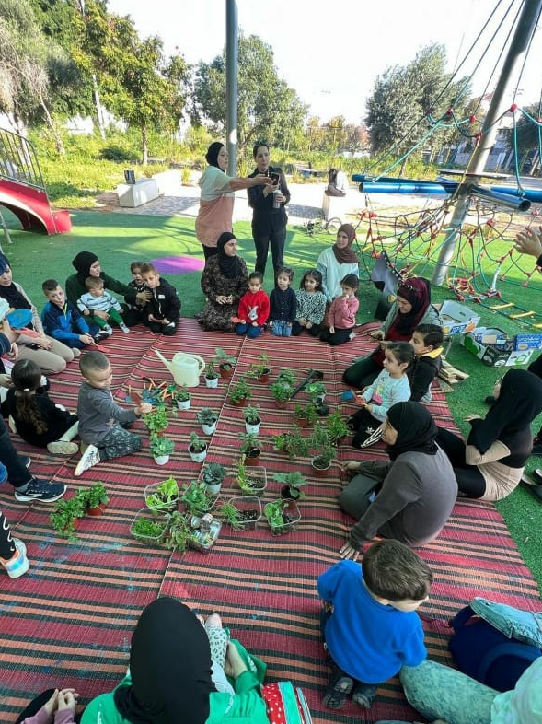
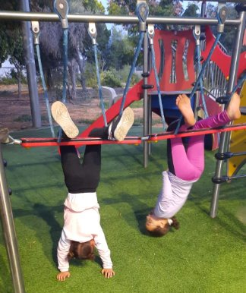




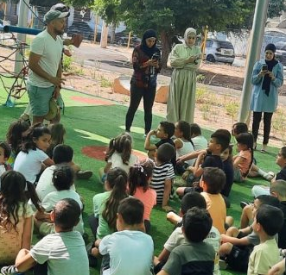
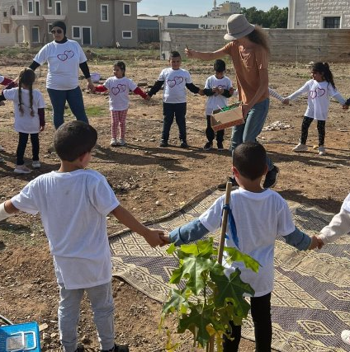
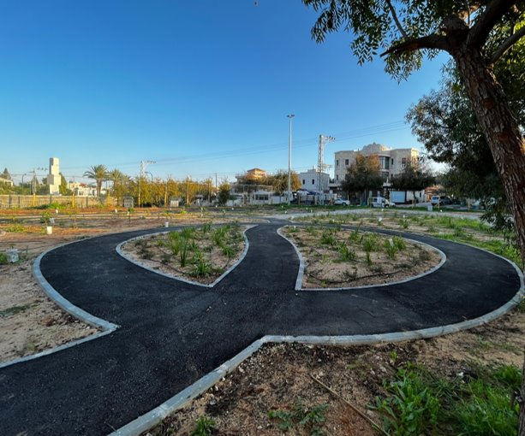
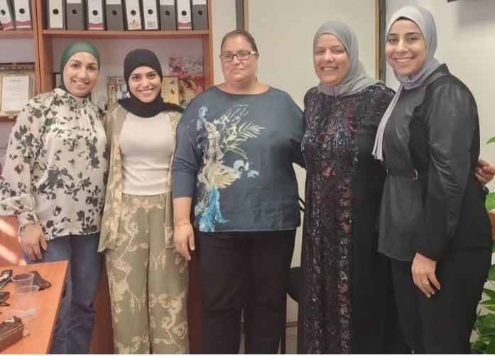
סיכום הערכת פעילות לשנת 2023
תוכנית Urban95 טירה
יוני 2024

Slide 2
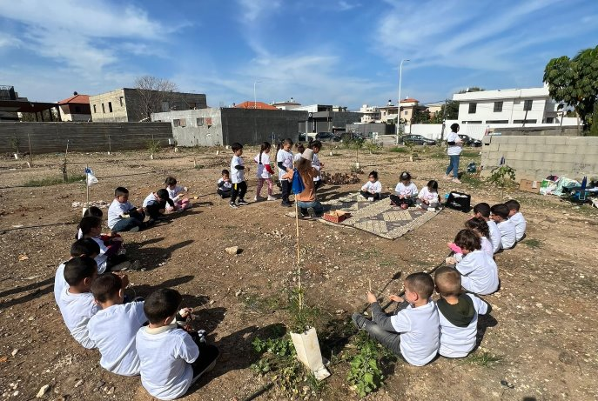
תוכן עניינים
11-15
03
סיכום ממצאי הערכה על בסיס מדדי תוצאות בטווח קצר וארוך (הישגי אימפקט(
מערך המחקר –
פעולות הערכה במהלך 2023
12-13 מדדים המתייחסים לגורמי עירייה, שותפים וצוותי שטח מקצועיים
14-15 מדדים המתייחסים לבני הגיל הרך ומלוויהם
04-05
תקציר ניהולי –
תובנות עיקריות והישגי אורבן95 טירה בשנת 2023 על פי מדדי ההערכה
16-21
נספחים
17-18 פירוט פעולות ותפוקות תוכנית אורבן95 טירה במהלך 2023
19 פעילות ספורט לגני ילדים בגינת האופניים
20 פעילויות 'לומדים בבוסתן' בגינת האופניים
21 פירוט ממצאי תוכניות "מאמאת" ו-"הורה להורה"
06-10
OVERVIEW על פרויקטים מרכזיים שלוו במדידה והערכה במהלך 2023
07 גינות קהילה
08 גינת המשחקים קריית החינוך ופעילויות לגיל הרך
09 תוכנית "הורה להורה"
10 "מאמאת" – הדרכת אימהות בחל"ד
2

Slide 3
מערך המחקר - פעולות ההערכה במהלך 2023
המחקר נערך בין פברואר 2023 – פברואר 2024 (פעולות שבוצעו בשלישון הראשון של 2023 דווחו במסגרת דוח סיכום 2022)
 | פעילות גינות קהילה | שיפוץ "גינת האופניים" | פעילות ספורט בגינת אופניים | "לומדים בבוסתן" (בגינת אופניים) | סדרת הרצאות מקוונות להורים | תוכנית "הורה להורה" | הדרכת אימהות בחל"ד | הכשרת מרבד הסיפורים | הכשרות לגננות ומטפלות
תצפיות שטח | 1 | 1 | 1
ראיונות |  | N=6 תושבים | N=3 מפעיל ו- 2 גננות N=6 אימהות מלוות |  |  |  | N=1
קבוצת מיקוד | N=5 אימהות |  |  |  |  |  | N=6
סקר | N=22 צוותי גנים |  |  | N=79 תושבים | N=140 | N=12 פתיחה N=15 סיום | N=23 פתיחה N=11 סיום | N=14 גמלאיות מתנדבות | N=19 הרצאת 'גן יער’ N=20 סיור לירושלים
ליווי בהערכה מעצבת, ייעוץ אסטרטגי ו-capacity building | הערכה מעצבת וייעוץ אסטרטגי: מסירת נתונים גולמיים מפעולות ההערכה ומתן המלצות מיידיות ליישום Capacity Building: הדרכת מנהלת אורבן95 בטירה בניתוח ממצאי משובים והסקת תובנות, ליווי בפיתוח עצמאי של שאלונים

Slide 4
Executive Summary – Key Insights
Cost Effectiveness*
Content-based activities in the kindergarten/afternoon frameworks and online lectures for parents achieved a very high investment/participant ratio score corresponding to less than 1% due to the large number of participants.
Content-based activities for selected kindergartens yielded a high investment/participant ratio score corresponding to 1%-2%. Kindergarten staff members acquired knowledge and practical tools for working with young children (long-term impact).
Workshops and training sessions for parents and kindergarten staff achieved a medium ratio score corresponding to 3%-6%. The intimate group size allowed participants to acquire in-depth content that will contribute to the children's long-term development.
Funding Sources and Partners**
The funding sources for the content-based activities for residents and professional field teams and the interventions in public spaces conducted during 2023 were almost equally split between Urban95 and external resource pooling (government ministries’ calls for proposals, the Israel National Lottery, and the Community Centers Corporation), alongside donations from various business entities and academic and professional partners that supported the program through volunteer work.
The external budgets were not fully utilized due to difficulties faced by municipal officials in implementing the projects and integrating the activities into routine operations, among other reasons due to the local elections and the war.
Municipal Involvement and Program Sustainability
The program achieved multiple successful outcomes during 2023, by building and establishing a resident community, training kindergarten teams, and implementing interventions in public spaces. The activity was led by a municipal manager on behalf of Urban95, with the assistance of several municipal entities. In light of governance challenges in the city and the ongoing state of emergency, once the program activities in the city end in 2024, it is likely that the services for residents (parents and children) and for professional field teams, as well as the maintenance of public spaces, will be almost entirely discontinued if a municipal EC coordinator is not appointed.
We recommend investing in establishing the municipal capacity to sustain the program's outcomes by the time the program's activities in the city come to an end, for example, by training a municipal EC coordinator.
* The cost effectiveness percentage represents the calculation of the investment cost per participant. The lower the percentage, the higher the ratio score.
** Details pertaining to the partners, funding sources, and cost effectiveness scores are provided in the appendices.

Slide 5
Executive Summary - Urban95 Tira Outcomes in 2023 based on Evaluation Indicators
Municipal Officials and Partners
EC is on the municipal agenda
Municipal officials possess knowledge and an understanding of EC needs
Internal municipal collaborations were established and external partners were recruited
Projects for improving public spaces and providing accessible EC content were implemented with municipal investment
EC needs were integrated in plans, while pooling external resources
A municipal manager, strategic organizational consultant, and maintenance worker funded by the municipality supported the municipality's Urban95 work throughout 2023.
Planning the interventions in public spaces and the choice of their locations were done while taking into account EC and resident needs, conditions of the physical infrastructure, and cultural considerations.
The implementation of most of the projects, both for improving public spaces and for making EC content accessible, was facilitated through intra-municipal collaborations, as well as by recruiting partners and mobilizing external funding.
9 out of 13 content-based initiatives, activities for residents and their children, and field team training were funded exclusively by Urban95.
Professional Field Teams
Participation in training for acquiring knowledge and practical tools.
Applying the knowledge in working with young children, including independent initiatives.
Peer learning, collaboration within a professional inter-city community.
About 100 staff members, mostly kindergarten teachers and assistants, participated in professional training sessions and/or guided activities, which provided them with knowledge and practical tools for working with young children.
About 90% of the participants reported gaining knowledge and tools they could implement independently, as well as practical experience, ideas for activities, and the ability to integrate new practices into their routine work with young children.
About 80% of the participants belong to the Urban95 WhatsApp group for education professionals from Tira, which serves as a space for peer learning.
Many of the projects were made possible through collaboration between several professional entities, which became a fertile ground for an inter-city professional community for the Arab population.
Young Children and Their Caregivers
Scope of public spaces and activities for young children and their caregivers
Consumption of services, use of space, and satisfaction
Sense of security and safety in intervention areas
Trust in the local authority
Familiarity with Urban95 and repeated participation
Acquisition of knowledge and tools for parenting, parental well-being
Joint caregiver-child play and time spent in public spaces
Perception of community and social belonging
About 850 young children and 630 parents (mostly mothers) participated in EC content activities and/or lectures and guidance on parenting topics during 2023.
About half of them had participated in previous Urban95 activities and were familiar with the Bicycle Playground through the program, in addition to being members of the local WhatsApp group.
There is notable satisfaction with the activities and Bicycle Playground renovation, contributing to a sense of trust in the authority and safety in the public space.
Participants benefitted from acquiring knowledge and tools for promoting child development and coping with parenting challenges, getting new ideas for play, strengthening parental well-being, and getting to know other parents in the city.
The content-based activities enhanced interaction, connection, and shared play between parents and children and among the children themselves, in addition to improving motor, emotional, and social skills.
The activities held in the public space enhanced the sense of belonging and responsibility for the space - among both children and their caregivers.

Slide 6
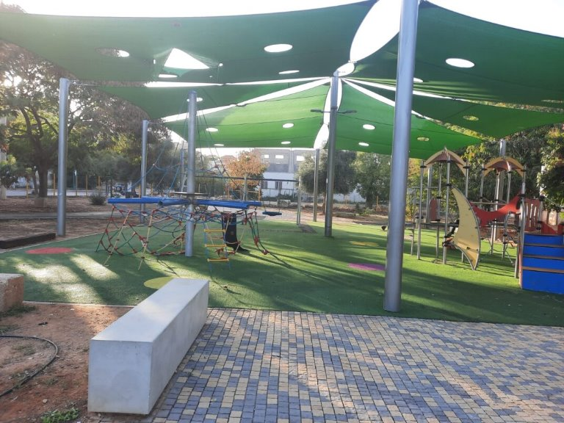
OVERVIEW על הפרויקטים המרכזיים
שלוו במדידה והערכה במהלך 2023

Slide 7
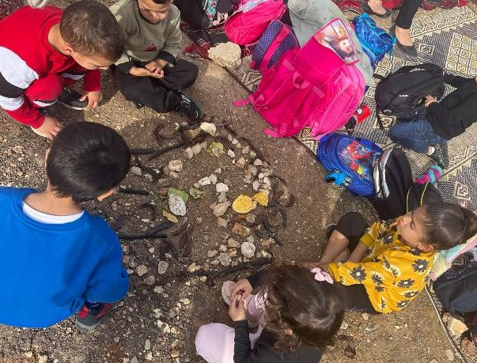

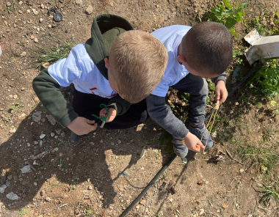
Community Gardens
Outcomes: The Activity’s Contribution to the Children's Development
Sensory and motor activities for kindergarten children, under professional guidance.
Following the 4 sessions that took place in 2022, an additional 4 sessions were held between February and June 2023 focusing on beekeeping, nature crafts, seeds, and cooking from the garden.
Location:
The climate forest, near the culinary school.
Target audience:
5 kindergartens participated in the activities, accompanied by kindergarten teachers, assistants, and mothers:
3 compulsory kindergartens: 100 children
1 special education kindergarten: 10 children
1 preschool: 35 children
The kindergarten staff also benefited, gaining new knowledge and tools, ideas for activities with the children, and implementing practices as part of the daily routine in the kindergarten.
Activity goals:
To encourage children to develop a personal connection with the natural environment near their kindergarten and understand how living systems function in nature and why this is important.
To promote the development of the senses of touch and smell, as well as imagination, creativity, and a sense of capability.
“The activities were very special. We could see how successful the were from the stories the children shared when we came back to the kindergarten.”
Kindergarten staff member

Slide 8
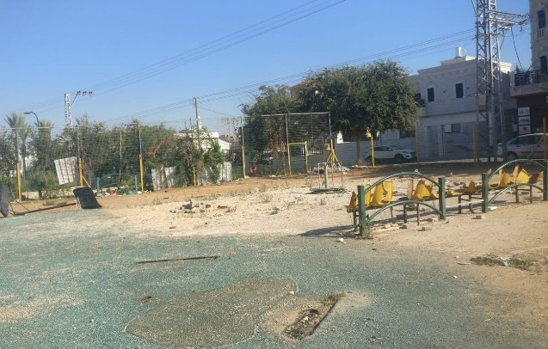


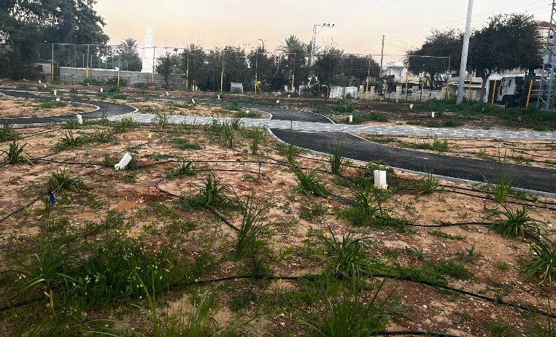



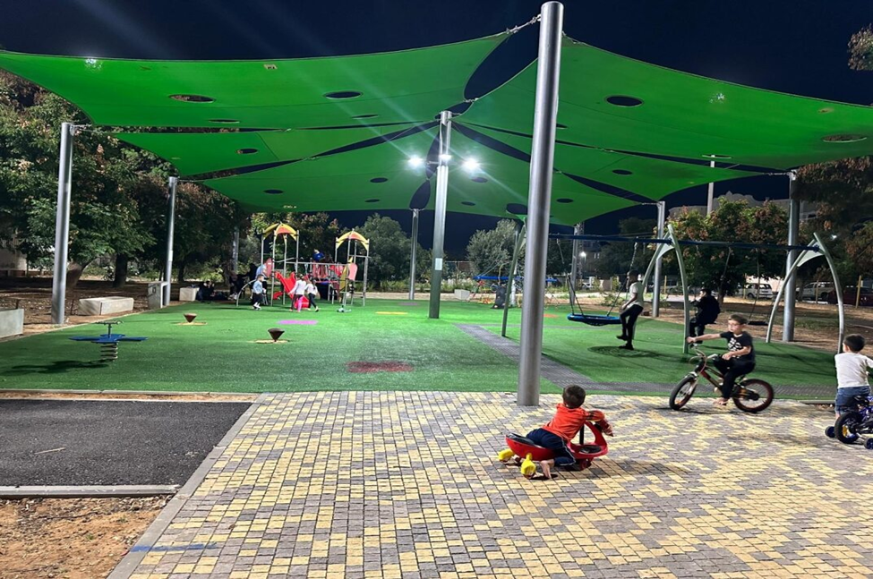
The Education Campus Playground and EC Activities
The Education Campus Playground (3.4 dunams) is located between the Tira swimming pool (which is inactive) and the Memorial Park. The playground renovation was carried out by the municipality, with funding from the Ministries of Health and Housing, a call for proposals from the Ministry of Agriculture, and irrigation systems donated by Netafim.
Observation of routine activity
The playground is in good condition, well-maintained and clean. Some of the broken facilities were repaired, but no new facilities were added.​
Pre-renovation observation
There was an abandoned area with broken equipment and an area with worn-out facilities, with dirt and waste throughout the entire playground.
Pre-renovation
Start of sports activities for the
Al-Umariyah kindergartens
November 2023
December 2023
October 2021
November 2023
June 2023
December 2023
Learning in the Garden activities* begin
Final observation of sports activities*
Post-renovation observation
The playground underwent extensive renovations: the facility area was cleaned, vegetation was planted, and bicycle paths and a walking trail were added.
Post-renovation
Post-renovation observation of routine activity
Outcomes
The guided children’s activities revealed the renovated playground to the city's residents. Observations of the routine activity indicate that the playground equipment, seating areas, and bike paths are used regularly and frequently by city residents - mothers and children and groups of teenagers. The playground is clean and well-maintained (compared to previous observations). There have been reports of personal initiatives by residents who clean the playground with their children, but the municipality is responsible maintaining the space. In addition, community interaction among mothers and interactions and joint play among children were observed.
* Details about the project and evaluation findings can be found in the appendices section.

Slide 9
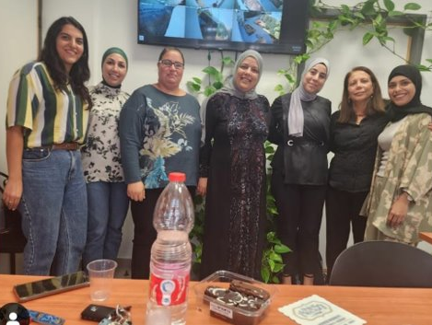
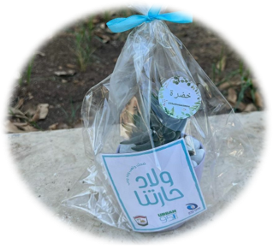
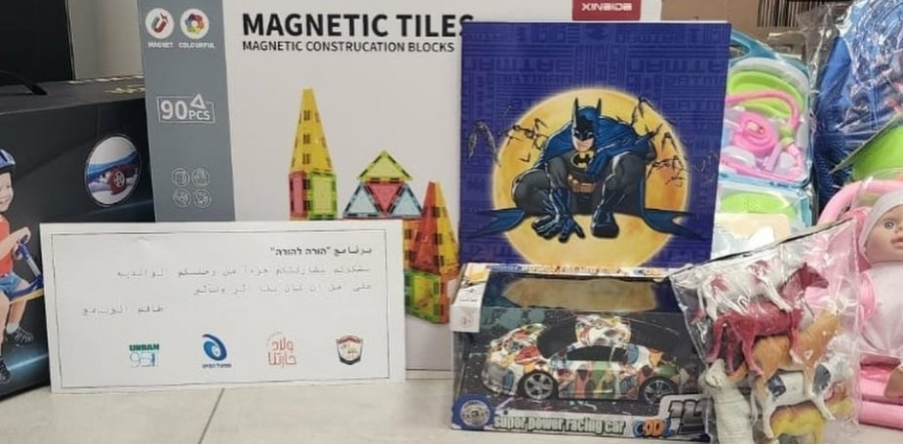
The Parent to Parent Program
This type of intervention, which included six months of weekly meetings, was particularly effective in meeting the welfare population’s needs.
The respondents markedly and significantly benefited from the knowledge and tools pertaining to child development and coping with parenting challenges, which also led to changes in their perceptions and habits.
The program involves home visits by experienced caregivers and/or mothers, accompanied by child development professionals and a social worker from the municipality's welfare department, intended to help new mothers cope with the challenges of parenting.
Location:
Monthly visits to participants' homes for about six months
Target audience:
16 young mothers of very young children from the welfare population
Model:
The instructors were trained in the SEED Center’s Journey to Parenting program established by Dr. Dana Shai of the Tel Aviv-Yaffo Academic College.
The instructors were guided by the program coordinator (a social worker) through monthly meetings, during which a personal support plan was developed for each participant.
Program goals:
To provide ongoing support and guidance to new mothers and connect them to community and health services as needed. The approach is based on partnership and understanding the parental role, offering encouragement and support based on personal experience, good advice, emotional support, and empowerment.
“Any time a mother spends with her child is important. It doesn’t matter what types of activities they do.
Program participant

Slide 10
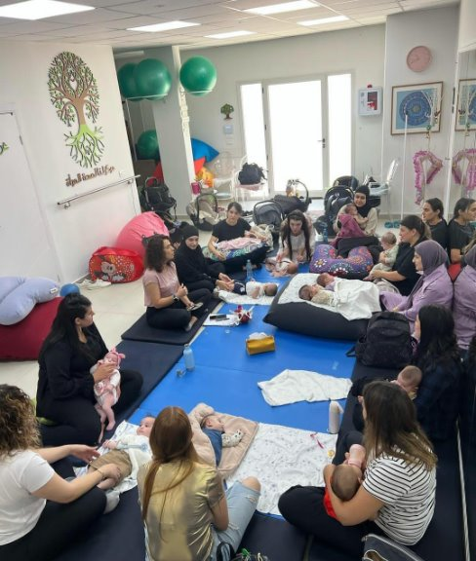
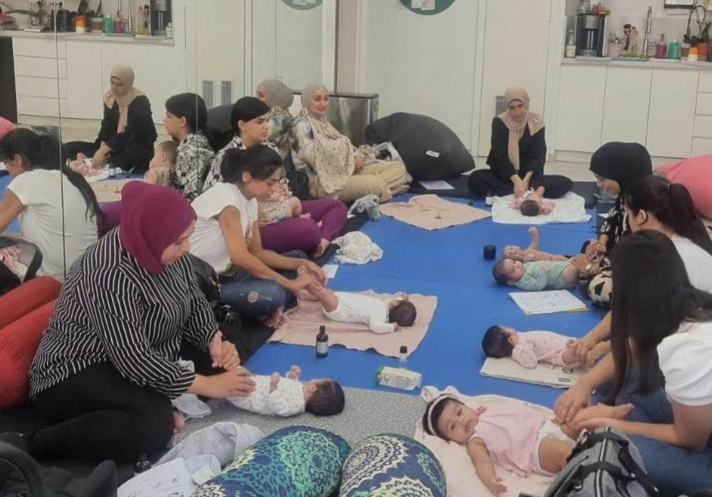

The Mama’at Program
The participants' expectations were met, and they received solutions for the challenges that had led them to join the program, including:
Knowledge and tools for coping with the challenges of infancy.
Tools and practices for dealing with changes in the family and couple dynamics, and paying attention to their own personal needs. ​
Getting to know other mothers. The conversations they had allowed them to learn from similar experiences and support each other.​
The goal of the program is to provide mothers on maternity leave with knowledge and tools for coping with the challenges of infancy.
Location:
The Lana Women's Health Center
Target audience:
25 mothers on maternity leave with infants up to 6 months old, from the general population in Tira.
Model:
As part of the program, participants received guidance from early childhood experts over 7 sessions that were conducted between September and November 2023.
“We heard stories and experiences from other mothers, and it gave us the feeling that we were not the only ones going through these things.”
Program participant
Content:
Introduction and the birth experience
Baby massage
Mindfulness and CBT tools for coping with changes and stress
Nutrition for mothers and getting back in shape
Baby’s sleep and establishing healthy habits​
Changes in the family unit and intimacy
“The most important benefit they received was that over the 6-7 weeks of the program, they met other mothers who were going through the same experience - new mothers, listening to each other, and facing the same challenges.”
Program leader

Slide 11
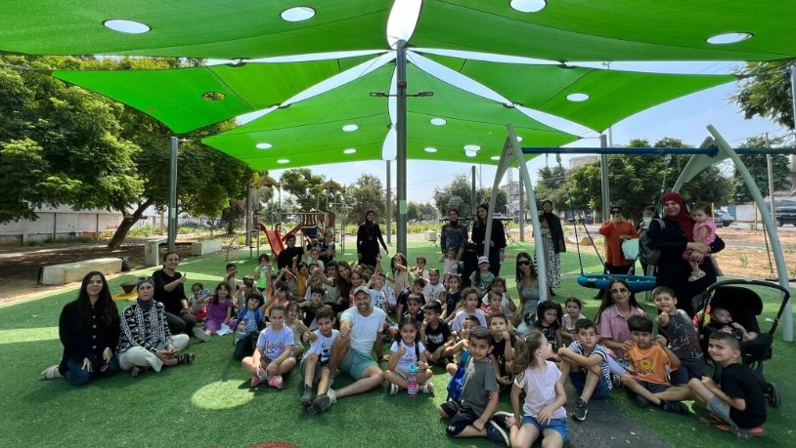
סיכום ממצאי הערכה
על בסיס מדדי תוצאות בטווח קצר וארוך
(הישגי אימפקט)

Slide 12


גורמי עירייה ושותפים:
Bicycle Playground renovation and EC activities (sports, Learning in the Garden)
The decision to renovate the playground took into account its central location as part of the Education Campus and its proximity to the newly renovated community center building and the municipal swimming pool.
The playground’s design, led by consultants from Urban95, took EC needs into account.
The renovation was carried out by municipal authorities, while securing funding from three government ministries as well as a donation of irrigation systems from Netafim.
It is clear that he intervention area has undergone a major change; residents notice the difference and are pleased with the significant improvement.
Learning in the Garden activities were conducted in collaboration with the Smile Association.
גיל הרך נמצא על סדר יום העירייה
Guided activities: Community gardens
The choice of the climate forest plot for community garden activities took into account the importance of children developing a sense of belonging and responsibility towards the natural environment near the kindergartens:
“Children feel a sense of belonging to the land, especially to the area they visit regularly” (Kindergarten teacher).
Professional training for kindergarten teachers and assistants in Tira
The kindergarten teachers' tour to East Jerusalem took place at a dedicated center for the Arab community that focuses on social-environmental education.
The safety lecture for assistants was delivered by Beterem – Safe Kids Israel.
The forest kindergarten lecture was delivered by educator Ran Cohen Aharonov.
גורמי העירייה בעלי ידע והבנה בנוגע לצורכי הגיל הרך
The Parent to Parent program
The program coordinator is a social worker from the municipality's welfare department, who led the program as part of her role.
The participating mothers and their children are supported by the welfare department, and some were identified through the program.
Mama’at – Guidance for Mothers on Maternity Leave
The workshop facilitator was apprehensive about collaborating with the municipality and was pleasantly surprised: “When I found out the municipality was going to pay, I was a bit scared about the quality of management, but once I heard that Urban95 was involved, that changed.”
Addressing a need: “This doesn’t exist in the Arab sector. Well done for identifying a specific need and reaching out to mothers.”
שיתופי פעולה פנים-עירוניים ורתימת שותפים חיצוניים
יישום פרויקטים לשיפור מרחב ציבורי והנגשת תוכן לגיל הרך ומלוויו, בהשקעה עירונית
Actions and Outputs
The municipal program manager regularly participates in routine staff meetings with the mayor, during which they discuss the interventions promoted as part of the program.
The Story Carpet is a project conducted in collaboration with the Community Centers Corporation through its Coming to Do Good (Ba’im Betov) initiative.
The Recalculating Our Route course is a collaboration between Amal High School, a sustainability lecturer, the Rechter Center for Architecture, Urban95, and the Tira Municipality.
A maintenance worker was recruited with municipal funding to operate and maintain the public spaces renovated under Urban95, and is responsible for cleaning the spaces and repairing malfunctions.
Tira Municipality’s Urban95 work was accompanied by a strategic organizational consultant from the Arab community with extensive experience in working with local authorities.
שילוב צרכי הגיל הרך בתכנון,
תוך איגום משאבים חיצוניים

Slide 13


צוותי שטח מקצועיים:
Bicycle Playground renovation and EC activities (sports, learning in the garden)
The Learning in the Garden facilitator underwent gardening therapy training through the Urban95 program in 2022.
The sports activities at the Education Campus Playground demonstrated the importance of having an experienced Arabic-speaking instructor.
Participating in the sports activities provided the kindergarten staff with the skills required to conduct similar activities independently: “It was a new experience for me, doing an activity outside the kindergarten. I was always afraid of doing it, taking responsibility and going out alone with the children. Now, with Urban95, I feel that I have support” (Kindergarten teacher).
Guided activities: Community gardens
Kindergarten teachers and assistants from 5 kindergartens participated in a series of 8 environmental activities in Tira.
The kindergarten teams were satisfied with the activities, to a greater extent compared to 2022. This can probably be attributed to issues for improvement having been addressed.
All kindergarten teams reported gaining knowledge and tools, ideas for activities, and implementing new practices into the kindergarten routine: “The activities were very interesting for both me and the children. I learned a lot from the instructors.”
Kindergarten Teachers Tour to Jerusalem
32 kindergarten teachers from Tira and nearby Arab communities participated in the tour. Most reported gaining new knowledge, ideas for outdoor activities with children, and practices for involving parents in kindergarten activities.
85% felt ready to conduct outdoor activities with the children independently.
80% were members of the Urban95 WhatsApp group for Tira kindergarten teachers.
השתתפות בהכשרות
להקניית ידע וכלים יישומיים לעבודה עם הגיל הרך
Online workshop series
The lectures were delivered in collaboration with several facilitators (a professional inter-city community), which served as a basis for additional initiatives (in-person lectures for fathers, mother and child activities).
יישום הידע הנרכש בעבודה עם הגיל הרך, כולל יוזמות עצמאיות
The Parent to Parent program
The instructors underwent parental guidance training at the SEED Center’s Journey to Parenthood program and then applied the knowledge they had acquired as they accompanied the mothers in the program.
Mama’at – Guidance for Mothers on Maternity Leave
The activity took place at the Women's Health Center, which is managed by a well-known physiotherapist, located near Tira: "When I saw that the program was at Lana, it was very encouraging. It's close to Tira, the center is pleasant, and she’s very special.”
Actions and Outputs
32 kindergarten teachers participated in the Forest Garden lecture (January 2023), where they received tools and ideas that they could use in their work.
Story Carpet training: All respondents reported benefitting to a large to very large extent from the knowledge, tools, and practical storytelling experience they gained and were able to apply during their time with the children.
The Recalculating Our Route Course is an initiative by the head of the design track at the Amal high school, who established a collaboration between several professional entities.
20 kindergarten teachers and assistants participated in a safety lecture (May 2023) as part of a municipal employee training session.
למידת עמיתים, שיתופי פעולה של קהילה מקצועית בין-עירונית

Slide 14


שיפוץ "גינת אופניים" ופעילויות לגיל הרך (ספורט, לומדים בבוסתן)
Respondents were highly satisfied with the renovation. According to the mothers: “Even though there’s a closer playground in our neighborhood, my child prefers to go to the Bicycle Playground.”
  The various observations held in the Education Campus Playground indicated an increase in the scope and frequency of time spent in the playground, including extensive use of the bicycle track.
  Limited sense of safety and trust in the municipality: visitors expect the city to maintain the playground and ask that opening hours be set to prevent vandalism.
  67 children from 2 kindergartens participated in 8 sports activity sessions in the Bicycle Playground and enjoyed it very much: “The children look forward to Wednesdays, they really enjoy the activity” (kindergarten teacher).
  The activity takes place in the public space: “I focus on outdoor activities. They go out, breathe fresh air, play, and use their imagination” (instructor).
  Going out into the public space promotes a sense of safety: “They learned to look out for each other's safety, and how to cross the road” (kindergarten teacher).
  180 children and 85 mothers participated in 6 Learning in the Garden sessions, which included a series of activities for mothers and children focusing on gardening, art, and the environment in the Bicycle Playground.
Most mothers reported that the activity met their expectations to a very large extent.
82% reported that the planting activity’s main benefit was promoting the importance of cultivating and maintaining the public space.
בני הגיל הרך ומלוויהם:
היקף מרחבים ציבוריים ופעילויות לגיל הרך ומלוויהם
פעילויות מונחות - גינות קהילה
About 150 children from 5 kindergartens, along with accompanying mothers, participated in 6 guided environmental activities in the Climate Forest plot, which was renovated under Urban95.
According to the kindergarten staff: “They enjoyed going out of the kindergarten and exploring the outdoors,” and asked to visit the plot again: “My daughter now knows an easier way to get to the garden.”
סדרת הרצאות מקוונות
About 450 parents participated in a series of 10 online lectures (dozens of participants in each session), which provided a supportive space for guidance during the emergency period.
Most of the respondents were Tira residents, with additional participants from a variety of Arab settlements.
צריכת שירותים, שימוש במרחבים ושביעות רצון
תוכנית 'הורה להורה'
16 mothers from the welfare population received personal support in their homes for about six months.
There was very high satisfaction with the duration of the support, the quality of guidance, and the instructors’ availability.
Despite the initial difficulty in sharing their challenges, by the end, all the mothers trusted the instructors: “She listens, I share things that bother me, and the conversations really help me feel better.”
מאמאת – הדרכת אימהות בחל"ד
25 mothers and their babies participated in 7 sessions with EC experts. None of them had previously attended parent meetings or lectures on the subject.
The respondents expressed very high satisfaction with the program in terms of content, meeting location, and the instructors’ professionalism and availability.
“The workshop made me realize that we have very good experts in our society.”
תחושת ביטחון ובטיחות באזורי ההתערבות
פעולות ותפוקות נוספות
The Story Carpet: 15 grandmothers trained by Urban95 read stories to about 350 children from approximately 10 kindergartens in Tira.
20 high school students from the design track participated in the Recalculating Our Route course, as part of which a public participation event was held and participated by 35 kindergarten children.
45 children from 2 kindergartens participated in a planting activity for Mother's Day in Salwa’s Garden, which was renovated under Urban95.
6 parents attended a dedicated lecture on dealing with violence.
תחושת אמון ברשות

Slide 15

בני הגיל הרך ומלוויהם:
שיפוץ "גינת אופניים" ופעילויות לגיל הרך* (ספורט, לומדים בבוסתן)
  Parents were familiar with the playground through Urban95 activities and were members of the program's WhatsApp group.
  According to the parents, the renovation created a space for free play (without equipment). There was also a notable improvement in interaction and joint play between parents and children and among the children themselves.
  The playground encourages community gatherings and enhances parents’ well-being. Mothers noted that spending time with their children and meeting friends in the playground is helpful when spending time outside the city is not possible.
  Visitors developed a sense of belonging and responsibility toward the space: they initiated independent playground clean-ups with their children and raised awareness of the issue among the neighborhood residents.
  Kindergarten staff and mothers reported that the sports activities contributed to the children's sense of belonging and responsibility for the space, their motor and social skills, and outdoor fun: “They feel like they’re going on a trip every Wednesday. They love moving around and the sports activities and playing with their friends outside” (accompanying mother). “They learn how to wait and be patient, skills they wouldn’t learn by staying in the classroom,” and “They feel a sense of belonging to the place and take it upon themselves to keep it clean” (kindergarten teacher).
  About half of the participants in the Learning in the Garden activity had participated in previous Urban95 activities in Tira.
For all the mothers, the activity was an opportunity to strengthen community ties with other parents and families from the city.
About 80% benefited from strengthening the bond with their children, and over two-thirds gained new ideas for play (88% of them from the activity involving creating art from recycled materials).
היכרות עם אורבן95 והשתתפות חוזרת
פעילויות מונחות - גינות קהילה
The meaningful experiential activity allowed the children to develop their senses and motor skills, as well as additional values.
The mothers attested to how the activity benefited their children: “My daughter always wants to invite me to come to the field and see how the flower she planted has grown,” and “I love how independent they are in the field, their self-confidence has increased.”
The accompanying mothers also reported developing a sense of mutual responsibility and community toward the kindergarten staff: “I go there not only for my son but also to help the kindergarten teacher and be with her."
סדרת הרצאות מקוונות
About half of the respondents had participated in a previous lecture series.
Most respondents greatly benefited from gaining knowledge and tools for coping with stressful situations, daily parenting challenges, and child development issues.
רכישת ידע וכלים להורות, רווחה הורית
תוכנית 'הורה להורה'*
The respondents benefited beyond their expectations in terms of gaining knowledge and tools for promoting child development, dealing with parenting and their extended family, strengthening bonds with their children, ideas for joint play, and even changing perceptions and habits.
Most noted that the program provided a safe space to vent, share difficulties, and receive support.
The participants expressed a need for meeting with other mothers and strengthening community ties.
מאמאת – הדרכת אימהות בחל"ד*
All the respondents benefited to a large to very large extent from gaining knowledge and tools in the areas of child development, strengthening the family support system, and resources for consultation.
All the respondents reported getting to know new mothers and having a safe space to vent and share parenting dilemmas: “We all encouraged each other.”
Parental well-being: “We put ourselves as mothers in the center, we talked about ourselves.”
משחק משותף מלווה-ילד ושהייה במרחב הציבורי
פעולות ותפוקות נוספות
Story Carpet Training: All respondents benefited to a large to very large extent in terms of knowledge, tools, and ideas for joint play with children.
The Recalculating Our Route course promoted a sense of belonging among the students toward the public space in Tira and connected them to the city’s kindergarten children.
The Mother's Day planting activity in Salwa's Garden allowed children from 2 kindergartens in the city to get to know each other, strengthened the bond between mothers and their children, and facilitated community interaction among the mothers.
תפיסת קהילתיות והשתייכות חברתית
* Details about the project and evaluation findings can be found in the appendices section.

Slide 16
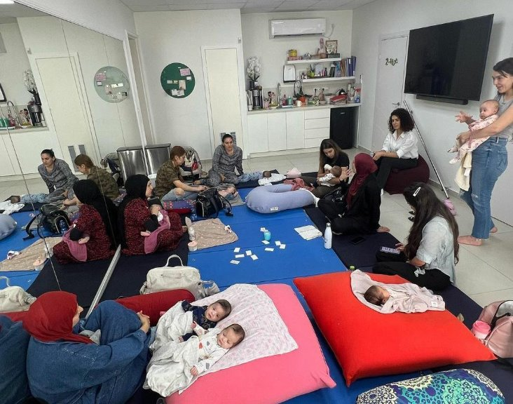
נספחים

Slide 17
פירוט פעולות ותפוקות* בשנת 2023
פעילויות ושירות לתושבים (בשגרה ובחירום):
פעולה | תקופה | משתתפים | שותפים | תקציב (בש"ח) | מקורות מימון | Cost Effectiveness
מרבד הסיפורים | 2022: הכשרה לסבתות פעילות בגנים: ינואר – יוני 2023 | לאחר קבלת הכשרה להקראת סיפורים, 15 סבתות הקריאו סיפורים לכ- 350 ילדים מכ-10 גנים | "באים בטוב" של החברה למתנ"סים | 6,000 להכשרה 25,000 למפגשים ולסרטון תדמית | אורבן95 החברה למתנ"סים | 6.5% 0.3%
פעילויות גינות קהילה | אוקטובר 2022 - יוני 2023 | 150 ילדים מ-5 גנים צוותי הגנים (גננות וסייעות) ואימהות מלוות ב-8 מפגשים | מפקחת גני ילדים | 60,000 | אורבן95 | 0.65%
פעילות יום האם בגינה של סלווה | מרץ 2023 | 2 גנים - 45 ילדים ואימהות מלוות | מפקחת גני ילדים | 3,800 | אורבן95 | 2.25%
פעילויות ספורט בגינת אופניים | מרץ - יוני 2023 | 2 גנים - 67 ילדים, צוותי הגנים והורים מלווים, ב-6 מפגשים מונחים | מפקחת גני ילדים | 4,680 | אורבן95 | 1.5%
תוכנית 'הורה להורה' | אפריל - אוקטובר 2023 | 16 אימהות מאוכלוסיית הרווחה מפגשים מדי שבוע במשך חצי שנה | מחלקת רווחה בעירייה המדריכות הוכשרו ע"י "מסע להורות" של מרכז SEED | 70,000 | מפעל הפיס | 6.25%
הרצאה להורים בנושא התמודדות עם אלימות | ספטמבר 2023 | 6 הורים |  | 2,500 | אורבן95 | 16.5%
מאמאת – הדרכת אימהות בחל"ד | ספטמבר - נובמבר 2023 | 25 אימהות ותינוקותיהן ב-7 מפגשים | לנא מנסור - מרכז לנא לבריאות האישה | 11,400 | מפעל הפיס | 4%
סדרת הרצאות מקוונות להורים | אוקטובר-דצמבר 2023 | כ-450 הורים ב-10 הרצאות |  | 4,000 | אורבן95 | 0.25%
פעילויות 'לומדים בבוסתן' | נובמבר 2023-ינואר 2024 | כ-180 ילדים וכ- 85 אימהות ב-6 מפגשים | המפעילה עברה הכשרת טיפול בגינון במימון אורבן95 בעבודתה ביחידה להתפתחות הילד | 5,000 | מפעל הפיס | 0.55%
*לפי נתונים שנמסרו ממנהלת Urban95 טירה

Slide 18
פירוט פעולות ותפוקות* בשנת 2023
שיפור המענה לגיל הרך במרחב הציבורי ובמבני ציבור:
פעולה | תקופה | משתתפים | שותפים | תקציב (בש"ח) | מקורות מימון
קורס 'מחשבים מסלול מחדש' | ינואר - יוני 2023 | 20 תלמידי תיכון השתתפו בקורס שיתוף ציבור עם גן ילדים (35 ילדים) | תיכון עמל, יאיר אנגל (מרצה לקיימות), מרכז רכטר לאדריכלות, עיריית טירה | 7,000 להדרכה בלבד ביצוע פלייסמייקינג במרחב ציבורי הסמוך לגן הילדים לא התממש בגין חוסר תקצוב מהעירייה | אורבן95
הגינה של סלווה- טיפול במפגעי בטיחות ותחזוקה שוטפת | יולי - נובמבר 2023 | מחלקת הנדסה בעירייה יועץ בטיחות סטודיו 1:1 | לאחר מספר פגישות עם כלל השותפים, נמסרה לעירייה מצגת מפגעים, כולל כתב כמויות. העירייה ביקשה לבצע את התיקונים באמצעות הספקים שלה, אך הדבר לא התממש. כמו כן, לא מתבצעת תחזוקה שוטפת של הגינה.
תכנון גינה קהילתית בחצר מתנ"ס ו/או בגינת אופניים | יולי - נובמבר 2023 | מתנ"ס טירה מחלקת הנדסה בעירייה Re-forest | במסגרת תכנון הגינה בחצר המתנ"ס התקיים מפגש שיתוף ציבור בהובלת Re-forest. מימון ממשרד החקלאות, מיועד לביצוע ע"י מחלקת ההנדסה. הפרויקט נעצר בשלב התכנון. מכיוון שהמתנ"ס לא לקח אחריות על הפרויקט וכל עובדי המתנ"ס התפטרו, נעשה ניסיון להסיט את הפרויקט למרחב גינת האופניים. כיום, גויס מנהל חדש למתנ"ס. האחריות על מימוש ודיווח במסגרת הקול הקורא הועברה לעיריית טירה. |  | 10,530 ש"ח מאורבן95 עבור תכנון הגינה קול קורא של משרד החקלאות
העסקת עובד תחזוקה לטיפול בגינת האופניים ובחלקת יער האקלים | ספטמבר - דצמבר 2023 | אורבן95 עיריית טירה | לבקשת אורבן95 הועסק עובד במתנ"ס, שיהיה אמון על תחזוקת המרחבים הציבוריים שעברו שיפוץ במסגרת פעילות אורבן95 בעיר. העובד קיבל הכשרה והדרכה על ידי מנהלת אורבן95 בטירה והחל לדאוג לטיפוח ותחזוקת המרחבים הציבוריים. העסקתו הסתיימה בסוף 2023. מאז, לא מתבצעת תחזוקה של המרחבים הציבוריים. |  | קול קורא של משרד החקלאות
במסדרונות המוניציפאליים:
פעולה | תקופה | משתתפים | שותפים | תקציב (בש"ח) | מקורות מימון | Cost Effectiveness
הרצאת גן יער לגננות | ינואר 2023 | 32 גננות | גן יער | 2,574 | אורבן95 | 3.1%
סיור גננות לירושלים | ינואר 2023 | 32 גננות מטירה וטייבה | מרכז סינסלה | 8,500 | אורבן95 | 3.3%
הרצאה בנושא בטיחות לסייעות | מאי 2023 | 20 סייעות של גני ילדים | ארגון 'בטרם' לבטיחות | 1,100 | אורבן95 | 5%
ייעוץ ארגוני אסטרטגי | מאי 2023- מרץ 2024 | עיריית טירה | מוהנד בירקדאר – יועץ ארגוני | 25,000 | אורבן95
*לפי נתונים שנמסרו ממנהלת Urban95 טירה

Slide 19
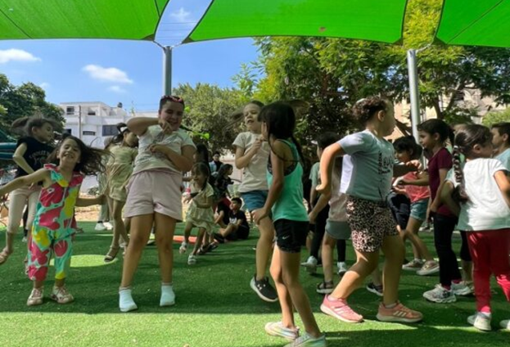

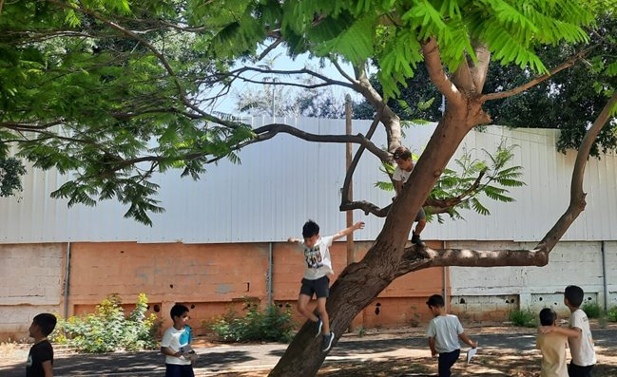

Sports activities for kindergartens in the Bicycle Playground
Choosing an experienced Arabic-speaking instructor was highly appropriate and beneficial. The activity under his guidance was a positive experience for the children, the kindergarten staff, and the mothers.
The activity’s main goals were achieved:
Between March and June 2023, weekly sports activities were held in the playground to introduce the new and renovated public space to the city’s residents and their children.
Location:
The Bicycle Playground - the renovated playground at the Education Campus.
“The children benefited from it. They feel more connected to the village and the public space. They’ve started asking their parents to come the garden.”
Kindergarten teacher
Target audience:
67 children from 2 kindergartens, accompanied by kindergarten staff and volunteering parents.
Benefit to the children:
Getting to know urban nature environments, spending time and engaging in activities outside the kindergarten
A strengthened sense of belonging and responsibility for the space
Developing motor, sensory, and emotional skills through play
An enhanced sense of capability and ability to cooperate through individual and group training
Benefit to kindergarten teachers:
Free time and a break from the routine
An opportunity to see the children from a different perspective
Acquiring skills for conducting outdoor activities with the children on their own
"The children come home, repeat the movements they learned, and teach them to their siblings. Now, when they play and jump at home, they use the movements they learned during the activity.“
A mother
“The kindergarten teachers told me they want to continue with the program, even if it has to be done independently through them.”
The instructor

Slide 20
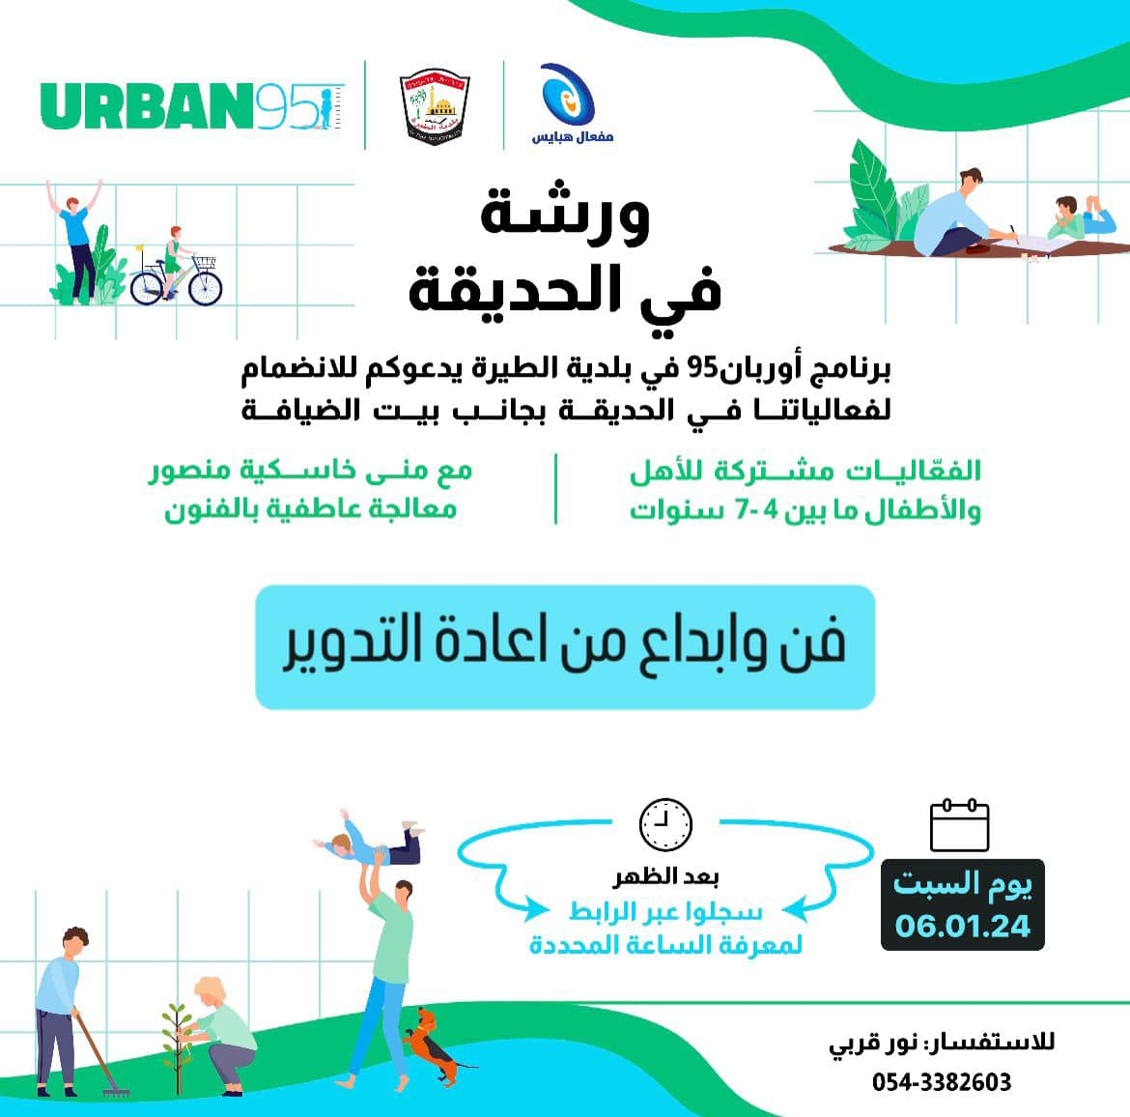
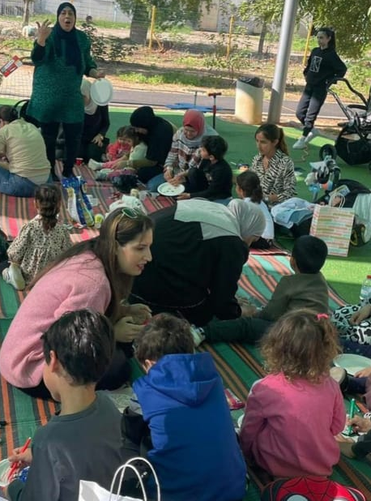
Learning in the Garden
The most significant benefit to parents were positive interactions between mothers and their children and getting new ideas for play.
For almost all participants, the sessions were an opportunity to meet families and parents from the city.
A series of 6 joint activities for mothers and their children took place between November 2023 and January 2024, led by a therapist who underwent gardening therapy training as part of Urban95.
Time and location: Saturday afternoons in the Bicycle Playground
Target audience: Tira residents, mothers and their children
“I was surprised to meet a childhood friend whom I had been trying to arrange a meeting with for a long time and it just didn’t work out. I was happy to see her at the activity, we enjoyed planting together, and our children got to know each other. This is the fist time I’ve felt proud of a project in Tira."
Main benefits to the children based on the activity:
Session topic | Main benefit
Kokedama planting Creating a “grass head” | Creating things using elements from nature
Musical instruments from recycled materials | Encouraging free play, imagination and creativity
Artwork from nature | Developing gross and fine motor skills by using tools
Planting in the garden Artwork from recycled materials | Cultivating and taking care of the public space Getting to know the playground
“We learned new concepts, my child interacted with other children and also spent time with me. It was a fun outing outdoors.”
The number of participants in each session ranged from:
15 to 35 parents and children
“I learned how to do activities with simple materials we have at home and in the garden, without spending money, and the children really enjoyed it.”
99% women
8+
Birth-3
Among the adults
Children’s ages
“We got to take home the instruments we created from the recycled materials, and we ‘re also taking home some beautiful memories.”
4-7
Most of the children who participated were in the intended age range

Slide 21
The Mama’at Program for Mothers on Maternity Leave and the Parent to Parent Program
The Mama’at Program - Evaluation Findings
The Parent to Parent Program – Evaluation Findings
The Parent to Parent program was participated by mothers from the welfare population, while the Mama’at program was participated by mothers from the general society. There are similarities and differences between the two target audiences:
  In both populations, mothers mainly consulted with their extended family. However, Mama’at participants also consulted with the Tipat Halav nurse and the pediatrician. Accordingly, while Parent to Parent participants did not use consultation services at all, about half of the Mama’at participants used pre- and/or post-natal parental guidance services provided by the health fund.
  Among both populations, the sought-after services were workshops on child development, public EC play spaces, and strengthening the community of mothers through regular meetings. However, Mama’at participants also sought services for themselves, not just in their parental role.
  The evaluation findings indicate that the Parent to Parent participants’ starting point was lower (in terms of knowledge and tools, parental perceptions, and more), and accordingly, they benefited significantly from the program. However Mama’at participants, despite their more advanced starting point, also gained additional knowledge and tools.

