Slide 1


Meeting of the Board of Directors – Exelot, Ltd.
October 20, 2020
Confidential – This presentation contains proprietary information and TM. All rights reserved © 2016-2020 www.exelot.com

Slide 2
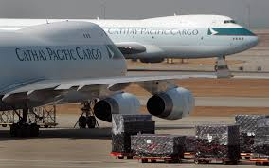
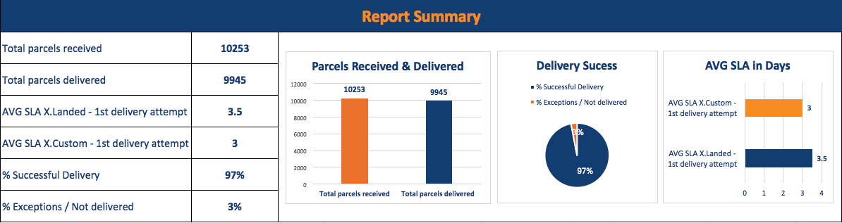


Agenda
On the Agenda:
Board of Directors and Observers – New Structure
Update on raising capital (Round A), new shareholders in the Company and ESOP
Summary of [business] results and Trial Balance – 3/2020 Quarter and outlook for 4/2020
Activity for 4/2020
Staff recruitment, new organizational structure, and building USA staff
General principles for the 2021 budget and work plan
Update – India “Smart Money” Program

Slide 3
New Structure – Board of Directors and Observers
Members of the Board of Directors:
Daniel Cohen (Founder, Chairman and CEO)
Yitzchak Varsano (Co-founder, CTO)
Daniella Bendor, Representative of new USA investors
Permanent Observers:
Motti Glick, CEO Overseas Commerce, Ltd.
Tuvya Barak, Representative for new investors
Ilan Maimon, Representative for existing investors
The company welcomes and thanks its new investors for investing in the Company as well as its existing investors for their further investment and their ongoing trust in the Company.

Slide 4
List of New Company Shareholders
Shareholder’s Name | Investment in USD
William E. Conway | $2,000,000
Allan M. Holt | $1,000,000
Jeffrey Keswin / Fishing Pole | $450,000
Albert Amon / Investmon Corp. | $350,000
David Rothenberg / RGN Growth Equity | $300,000
Neil Chriss | $200,000
Stanford Warshawsky | $150,000
Tuvia Barak | $100,000
Total | $4,550,000

Slide 5
ESOP Existing Shareholders –
Supplemental Investment and Approval
Shareholder’s Name | Investment in USD
Overseas Commerce Ltd. | $700,000
Ilan Maimon | $207,000
Erez Dassa | $131,000
Lior Arditi | $40,000
Chaim Fruchter | $11,000
Total | $1,089,000
Total Investment Sum for this Round of Capital Raising [Round A]: $5,639,000
ESOP: The Board of Directors will serve as an Options Committee to implement the decision of the shareholders' meeting of August 23, 2020, allocating options to managers and employees for years 2021-2024.

Slide 6
Trial Balance Summary for September 30, 2020
In NIS thousands / USD thousands
2019 | Until 30.09.2020 USD [NIS 3.4/$] | Until 30.09.2020 NIS | Item
23,320.3 | $21,720.1 | 73,848.6 | Income
20,448 | $19,176.8 | 65,201.4 | Sales Cost
2,871.4 | $2,543.2 | 8,647.1 | Gross profit
294.9 | $226.6 | 870.6 | R&D expenses
2,538.8 | $898.6 | 3,055.2 | Marketing, operations, general & administrative expenses
37.8 | $1,418.0 | 4,721.3 | Operating Income (Loss)
251.1 | $37.9 | 128.8 | Net financing expenses, fees & rates
(213.3) | $1,350.7 | 4,592.5 | Income (Loss) for the period

Slide 7
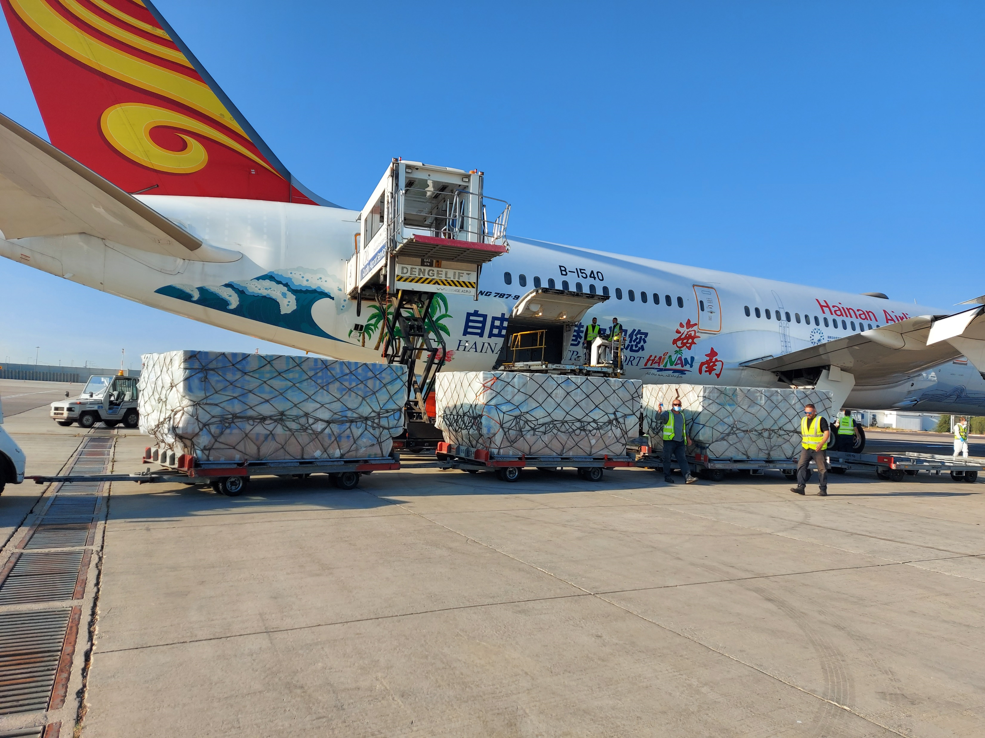
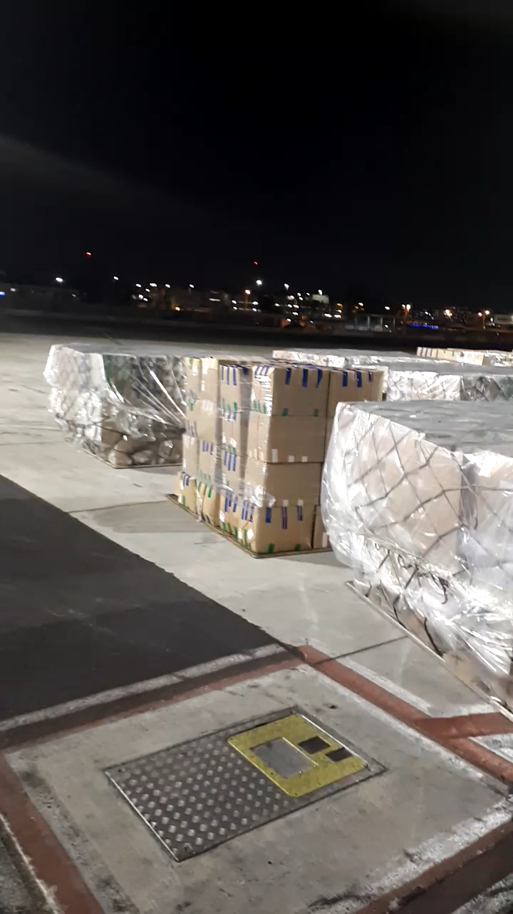
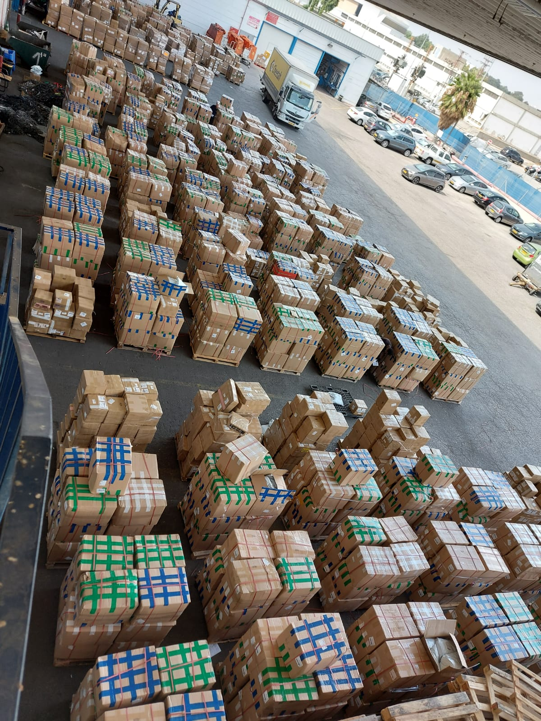
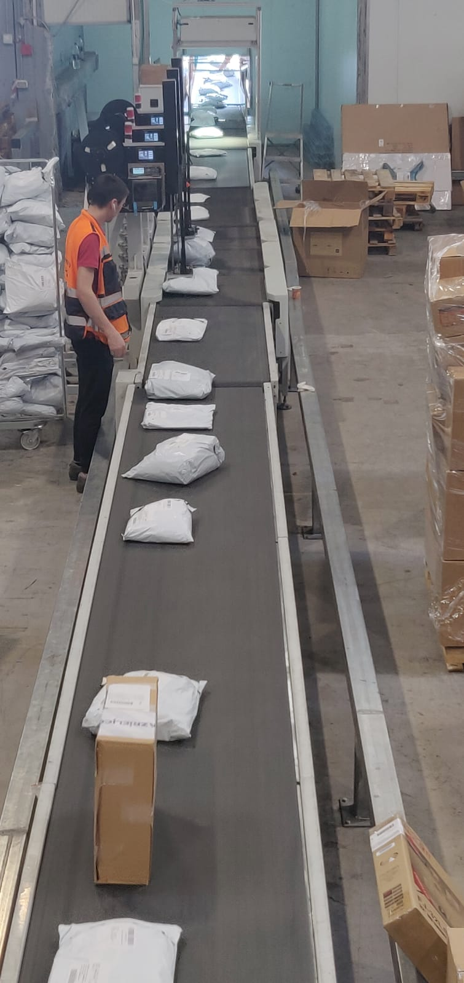
Company activities – Shipments: Q3 2020
China-Israel – Actual Shipment Implementation Rate for 30.09.2020:
Quarter/ Month | Q1 | Q2 | H 1 | July | August | Sept. | Q3 | Month
Actual Volume | 142,750 | 309,513 | 452,263 | 242,012 | 280,430 | 232,843 | 755,255 | Actual Quantity
Accumulated |  |  |  |  |  |  | 1,207,518

Slide 8
Company Activity for Q3 2020
Support for Shipments at Every Level: Marketing and sales, technological system, operations, logistics and customer service.
2) Technological Development: Issues and logistic controls; increasing capacity (phase 1).
Moving to the new “Partners System” and preparing vendor permissions. Integrating SMS for increasing income (upgrading Forwarder / response to Covid-19). New system architecture; beginning of additional staff recruitment for promoting development and interfaces.
New system architecture:
3) Developing Infrastructures Abroad: Locating partners, agreements, price lists, system and interfaces: Customs agents and distribution in the USA, UK, Europe.
Objective: China–USA and China–UK lines, USA/UK to Israel and other countries in 2021.

Slide 9
Summary until 30.09.2020 and forecast for Q4/2020
Expected actual implementation: 0.9-1 M shipments for Q4 | Expected work plan: 0.3 M shipments | Israel
Expected January – December 2020: 2.2 M+ shipments | January – September 2020: 1,207,508 October – December 2020: 970,000 – 1,050,000 | Sales and shipment implementation rate
Income for Q3 2020: Bank receipts from customers [actual] in thousands
September | August | July
$4,496.1 thousands | $4,771.4 | $3,752.9 thousands
 | $13,020.5 | Total bank receipts for Q3 2020
 | $22,472.7 | Total bank receipts until 30.09.2020
 | $30,000.0 | Total expected bank receipts for end of 2020
Expected end of year net earnings: $1,500 | Expected work plan: $220 | Net Earnings:
Expected free cash flow at 31.12.2020 $1,300 [without investments] | Expected free cash flow at 30.09.2020 $960 [without investments] | Cash Flow:

Slide 10
Activity for end of 2020
Technology: (1) Support for new target countries,
(2) support and improvement of collection processes,
(3) support for level of up to 1 M shipments per month / 12 M annually.
Overseas: Locating partners, agreements, price lists, interfaces. Implementing initial trial forwarding and distribution to 1-2 new target countries by the end of the year: (UK / USA or one of the following: Poland, Sweden, Norway).
CS / CSM: Bot upgrades, SMS’, and automatic customer service follow-up system.
Finances: Increased control over vendor accounts, improve collection times from small customers, examining and improving gross profit and quarterly reports.

Slide 11
Staff Recruitment and Beginning Overseas Operations
USA Staff:
Daniella Bendor – CCD – USA business development
Ido Ofir – Operations establishment and operations management
Liran Dassa – Routine operations and locating Last-Mile partners
England: Locating a Marketing and Sales Manager [and later on, operations and logistics assistance].
Israel and Support for International Activity:
Operations: Dov Lahman – CEO of operations, active from September 1.
Israel – Operations and CMS: 2.5 began activity in September.
Finances: Sagi Pavri – ACEO of Finances, active from October 1.
Technological Development: A development staff of 9, until May 2021,
subject to the budget – a total of 12, until Q4 2021.

Slide 12





New Organizational Structure: Q4/20 – 2021
CEO (Chair and Founder) – Daniel Cohen
ADVISORY BOARD
Itzik Varsano (Co-founder) – CTO
Yaakov Gazit, ACEO International Business Development
Daniella Bendor
CCD USA
Dov Lahman
ACEO COO Operations
Eli Koretzki, ACEO China
business development, sales & operations
Sagi Pavri – CFO
Einat Mezamer
Director, Israel supply chain
Amir Ariel
Assistant to CTO
Einat Efron, Data mining, invoicing & collections
Roy Ben Saadon, logistics, China
Overseas representation (Spain, Turkey, Poland)
Ofiir Awad
Director CMS, Israel
Liran Dassa, USA operations
2 Sales Managers, China
Omer Sasson – Sales UK
Amir Hochberg,
Nir Amsalem,
Stores & Returns
Tair Vaknin
Supervisor CMS, Israel
Itamar Aviv
Logistic Coordinator
Programmers:
Monkey Tech 3* (OS)
Logistics supervision, China
CS / CSM:
Link 10* (OS)
Programmers:
Irox 3* (OS)
5 programmers 2021
(OS) = Outsourcing

Slide 13
Technological & System Development –
Operating Segments & Key Tasks
(1) Computing Architecture
(2) Improving Logistical IT System – Country support, follow-up processes and collection oversight, improve interface with forwarders and logistic vendors
(3) Data Cleansing
(4) Adjusting the logistics system for vendor use
(5) Separating the existing database into databases for operations and BI
(6) Continued development of system infrastructures Support for a total of 10-12 M shipments annually
(7) Improving interface with forwarders and logistic vendors
(8) Establishing a development team (total of a development manager +5-6 internal developers + outsource)
(9) Support for integrating more CMS advanced tools: Bots / SMS / automatic mailings / automatic follow-up actions

Slide 14
General Planning – Median 1 / 2021
Israel: Expansion with a goal of 3.5-3.7 M shipments by 31.12.2021.
Operations, logistic, and system support for above quantity, including: Full control, CMS, minimizing custom agent mishaps, improvements in terminal (including initial sorting, delay handling, transfer forward distribution) at required SL level.
2) Technological Development:
Interfaces for forwarders, improving customer collection processes, continued Data Cleansing processes.
Preparing an architecture for 3-5 M shipments per month.
3) Business Development, Marketing: Expansion, China – Israel + USA & UK to Israel.
Developing Overseas Infrastructures & Operations: Continue locating partners, agreements, price lists, interfaces, supervision & CMS.
[Business development in India – subject to state financing (“Smart Money” Program, Ministry of Economy)].
Manpower: Staff: Overseas CFO and accountant: 2 logistic supervisors and CMS as per target countries.

Slide 15
Budget Principles 2021 – General Planning
Objectives – The Budget is intended to support:
1) Exelot’s overseas expansion and increasing quantities in Israel = increasing income and profit.
2) Advancing the Company’s technological system to the level of a global leader in the sector.
3) Establishing Company staff in Israel and overseas to support its activity.
Based on income and investment in the Company:
The total average monthly expenditure for 2021: $375 thousand (of that, $100 thousand per month from investment).
Total budget for 2021: $4.5 million with quarterly adjustments as per progress, income and cash flow.
Total bank balance as at 30.09.2020: $5.5 million / NIS 19 million.

Slide 16
Budget & P&L 2021

Slide 17
Principles for 2021 Work plan – General
Marketing & Sales
Source Countries:
Deepening and expanding in China
1-2 additional sources to China (USA + UK / Europe, Turkey / India)
Target Countries:
Reaching 5-6 target countries by the end of 2021
(General potential: USA, UK, Europe in general / Scandinavia, Greece & Cyprus, India, Emirates).
Operations & Logistics
Continuous relationship with partner vendors.
Managing, full control / activity support / staff training and guidance.
Customer Service.

Slide 18
Principles for the Work Plan
Technology:
Expanding infrastructures for supporting 10-12 M shipments annually
Data Cleansing
Promoting optimization between vendors, exception alerts, and a BI infrastructure
Improving support in general management: Collections & marketing image
Organizational structure and its management:
Moving to control at an international level – USA, UK, Europe, India + Israel
Finances and risk management
Improving controls – vendors, collections, banks (reducing fees and interest expenses), investments
Risk management: Covid-19 effects, diversifying sources – countries and segments, expanding targets, currency protections, customer insurance, supervision of overseas activity

Slide 19
India – The “Smart Money” Program
JV in India with Anthill Ventures: Exelot – 85%; Anthill – 15%
Partner's Role: Marketing, business development, locating partners, raising capital as needed for the subsidiary.
Ministry of Economy’s Authorization: A sum of approximately NIS 600 thousand for two years (2021-2023).
Grant: NIS against NIS.
Implementation stages:
Stage I: Market survey and partner characterization, potential customers, target markets, processes and regulations.
Stage II: Business plan and operation plan.
Stage III: Implementation: Business development and marketing.
Interfaces and technological adjustments.
Beginning shipments via Exelot.

Slide 20
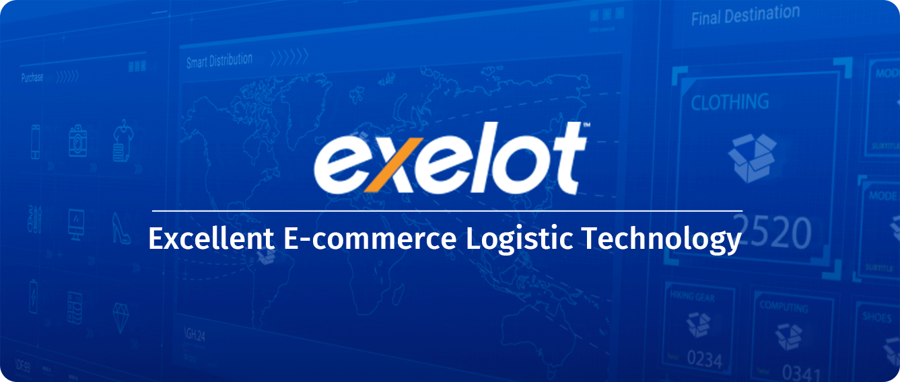
Thank you!

