Slide 1
TouAlphaBio Tech. Factory Tour

Slide 2
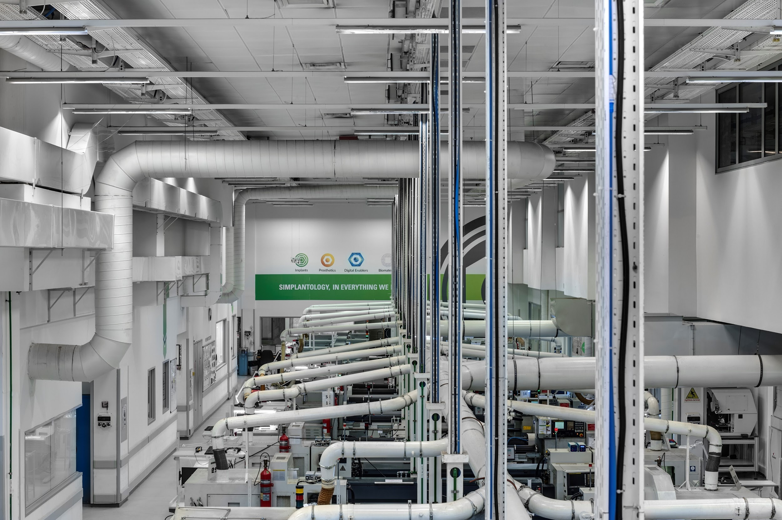

Slide 3
Protocol for Factory Tours
Please use this procedure when conducting a tour:
Email the entire factory at least 3 days before the date, informing them of the number of participants, date and time of the tour.
Tour hours - due to the employees’ lunch breaks the tour should not take place between 12-2pm.
Number of participants - 15-20 (as few as possible - the passageways are very narrow).
An internal guide from the quality engineering department should be reserved in advance (through Levi Shteinberg/Yuval Biti).
Check which of the machines is operating before the tour in order to get there directly for a live demonstration.
Photography on the production floor is prohibited.

Slide 4
Track your location on the map:

Slide 5
At the entrance to the factory:
Greetings,
My name is ____________ and job description
Before we go into the factory, we’d like to tell you about the “Kodak house”. This building is one of the greenest and most innovative production sites and headquarters in Israel and in the world. It meets American standards for environmentally friendly structures. All the building’s systems: air, electricity and water, are economical, monitored, and make efficient and calculated use of energy and resources.
In addition, AlphaBio Tech. considers the issue of environmental protection a top priority. As this is integral to all the company’s activities, we are committed to protecting our employees and guests and invest many resources to ensure this is the case.

Slide 6
Entrance and Safety Supplies
Safety Regulations:
A closet with safety supplies for the guests is situated at the entrance to the kitchenette:
Branded safety postcards in Hebrew and English with a summary of the safety procedures, which can be handed out to the guests before entering the factory.
Safety glasses – should be worn in the production hall at all times - since air pistols are used in the production hall, the safety glasses will keep particles from getting into your eyes.
Anti-slip shoe covers - The floor of the production hall is slippery due to the use of oil for production purposes - all guests including the guides must wear shoe covers (the covers are organized by size in the closet, sizes 34-46, and we also have covers for high-heeled shoes).
In case of an emergency - the emergency system will be activated. Leave through the nearest emergency exit, which are scattered throughout the factory. They can be recognized by the green signs that read “EXIT”.
Do not touch any of the equipment or place your hands inside the machinery, do not bring food or drink into the factory.
Notes:
Note: the guide must make sure that the closet remains organized after everyone has received their equipment, and that all the supplies are returned to their place after the tour is over. You may call Paulina for additional help if necessary.

Slide 7
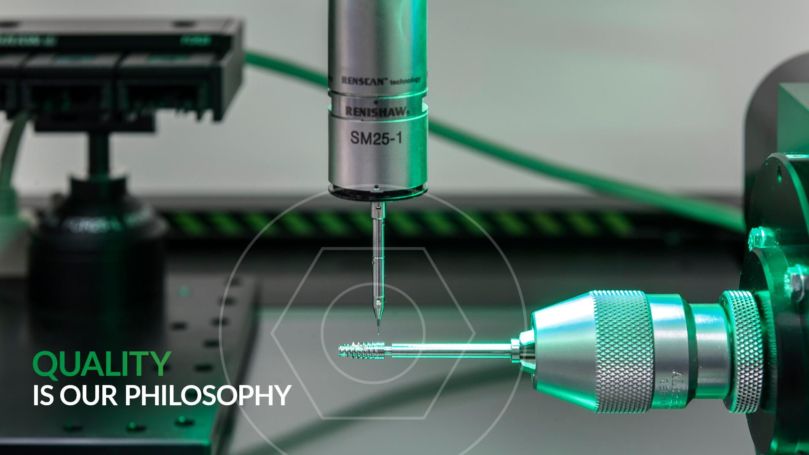

Slide 8
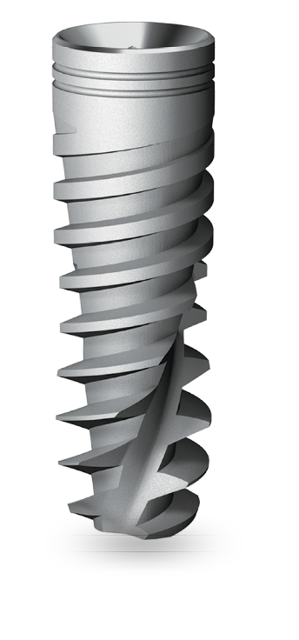
Factory Entrance
Welcome to the “AlphaBio Tech” production facility. In the next half hour we will show you in a nutshell, the complex, rigorous process of producing an AlphaBio Tech implant, the prosthetic parts and surgical instruments. We’ll pass through the different production stations, surface room, cleanroom and quality control points which accompany the entire process.
We’ll start with a brief background on the company:
AlphaBio Tech. is a global company specializing in the development and production of advanced dental solutions, with a focus in the area of implants and prosthetics.
AlphaBio Tech. was established in 1988 by Dr. Ophir Fromovich - 3 decades ago.
We launched the ATID implant in 1996, and the DFI implant in 1999.
In 2003 we launched the world’s first spiral implant, which led in 2008 to the purchase of AlphaBio Tech. by Nobel Biocare, the world’s leading implant company. In September 2010 the decision was made to move our production facility to its present location, while emphasizing the improvement and optimization of production processes and quality control procedures. The move cost approximately 6 million Euros.

Slide 9
Factory Entrance
AlphaBio Tech. developed a large, innovative product line aimed at providing the most comprehensive and efficient array of solutions in the field of dental implants:
The ICE implant in 2013, NICE in 2014, the launching of the digital unit (computer-assisted surgery and digital rehabilitation CAM/CAD) in 2015 and the NEO implant in 2016.
Working in close contact with our clients has helped us become familiar with their daily practice in the clinics and labs, understand their needs and thus create products that would make their work easier, more convenient and more efficient.
Now we will go through each and every stage of the “life” of the implant. Please feel free to ask questions.

Slide 12
Research and Development Department
The department where everything begins - the department of clinical research and development - will not be shown to you in this tour due to patents still in the process of being filed. The engineers who work in this department develop the new products for dental specialists while refining and improving the existing products. The first stage of development is to create a blueprint, and in the second stage, a prototype is produced for clinical examination of the product. Development work closely involves the clinical research staff, who are responsible for presenting needs and clinical indications. They conduct the research procedures and clinical experiments in Israeli and international universities, in order to achieve proven results and clinical evidence of the advantages, functions and safety of the product.
The development team depends on the work of the research team. The purposes of this team are A) to ensure that our products are adapted to the market’s changing needs, and B) to provide the most innovative existing technologies which address the clinical needs of the dentists in their daily work.
Notes:
Do not bring guests into this part of the factory - due to patents not yet filed as required.

Slide 13
Quality Control Department
Quality control will accompany us throughout the whole tour - the responsible department is involved in all the stages in the “life” of the product.
From development and design of the product up to its final packaging, this department has predetermined rigorous methods of performing quality checks in each stage of production.

Slide 14
Quality Engineering Lab
Quality engineering is the most important aspect in the transition from development to production.
Quality engineering staff play an active role in the development process. At the end of that process they prepare an inspection order for production.
The inspection order guides the quality inspector on how to check the part in the safest, simplest and most efficient way.
A great deal of thought is put into the preparation of an inspection order because it is the foundation of production work in the machining department.
The quality engineering lab performs measurements of parts in the development process, the first parts of production (validations) and investigations of special cases such as investigations of production irregularities or customer complaints, that is, non-routine tests that are related to the current production process.

Slide 15
Quality Engineering Lab
The rationale behind investing so many resources in Quality Engineering is to invest most of our efforts into the beginning of the process, starting with the development stage. This is first and foremost out of consideration of the quality of the product, and, of course, the efficiency of production. This way, we spare ourselves delays and other issues in the production stage.
Machine monitoring is used for a number of quality checks:
Alicona, one of the most advanced optimal scanners, can perform a 3D scan of the parts at a resolution of less than one micron, yield surface results, and produce sizes at the highest possible quality in today’s industry.
We house one of the most sophisticated comparators in our lab, which allows us to upload blueprints of products that were planned by the development department and perform a comparison. This tool gives an accurate measure of the quality of production compared to the blueprint. This multi-sensor measuring instrument is unique in that it combines 4 measuring machines. Aside from the large instruments, there are special measuring tools in the lab, some of which are the result of our own development work. Any size necessary can be checked by these, with no exceptions.
Calibrations for the measuring tools themselves, which determine their degree of accuracy, are regularly conducted in this lab.
Notes:
The multi-sensor measuring machine, a unique measuring tool that combines 4 measuring machines, enables the following measurements:
Unique probe scanner with an accuracy of 0.001mm.
Unique laser scanner 180° with an accuracy of 0.001mm.
Optical measurement for “blind drilling”, upper light.
Regular optical measuring, lower light.
Fourth axis enabling a 360 degree inspection of the part.

Slide 16
Production Hall - Raw Materials
The implant production process begins in the hives. The titanium rods (medical titanium) constitutes the raw material for the implant production (you’ll see other raw materials like פיק rods which are used to build temporary structures).
*The titanium is ELI titanium, which is highly biocompatible - with 6% aluminum and 4% vanadium.
When we reach the CNC machines in a few minutes, we’ll talk about the medical oil.
Each raw material is labeled the moment it reaches the factory, and its consistency is preserved throughout the production process, from the batches of raw material, the machine in which it is produced, the oil used in the metalworking process, the inspector who performs the quality control, up until final packaging.
That is, we can identify the exact composition and even the production date of the raw material of each and every implant if necessary, even after the implant is sold. Raw material must be approved by medical standards.
In addition, each raw material undergoes a number of examinations before it enters the assembly line:
the consistency of the material is checked at the supplier’s location, as well as meeting demands for dimensions, standards, hardness, and weight of the material.
Notes:
We won’t physically see the raw materials in the hives due to their location in an inaccessible area in the back - we can see part of the rod in a CNC machine.
Biocompatibility - is a property of the material which determines its compatibility with the host. Biocompatible materials are materials that do not produce any interaction or harmful response with the living biological fabric. The use of biocompatible materials is vital to the clinical success of implanting a medical instrument and an important criterion when selecting materials in the field of biotechnology. For example, nanocapsule shells for controlled release of medicine must be composed of biocompatible materials.

Slide 17
Production Hall
The new production hall enables significant increase in production capacity alongside improved working conditions and production environment. The factory is equipped with a controlled climate system and includes an advanced air purification system.
The innovative system ensures a clean working environment, free of oil vapor in the air, which is significant to the employees’ health. We are among the first factories in Israel to have installed this system - we believe the key to success is to create high working standards for the employees.
The entire production system is controlled by a computerized system that receives real-time reports on production and allows for precise planning and control.

Slide 18
The CNC Machines
The CNC machines perform metalwork using computer software. Each product has its own software that instructs the machine how to produce the part.
Each machine has 2 production sections - primary and secondary. The primary section begins the production process by working on the outer/lower part (such as external bolts). After completing its action, the part will move on to the secondary section, which will produce the internal/upper part (such as processing the inner hexagon and inner bolts).
Today we have 30 machines operating. The machines are a product of Japan and Switzerland. Some of the machines are used for development and not for stock production.
We work 24/5 on the production floor (we don’t work on holidays or weekends). The machines are operated by skilled machine operators.

Slide 19
Production Hall
The oil used for the production machinery is medical oil. It is very expensive and enables precise and high quality cutting work by softening the friction between the metals. Notice that due to the advanced air monitoring system, the smell is barely noticeable. Above us you can see the oil vapor sucking system we talked about at the entrance to the hall.
The inspection for each part is carried out separately based on the instruction pages, and include guidelines for quality engineering.
Production is carried out by batch. When work begins the operator receives a batch file which includes the blueprint, setup instruction for the machine and inspection pages.
All the production data (amount of standard and defective products, inspection results, processing tool replacements etc.) is collected during the production of the batch.
The batch file accompanies the product throughout the entire production process up until its final “release” into the distribution warehouse.
The batch files are kept in the archive for more than 15 years.

Slide 20
Production Hall
The first quality control for the product is performed at the quality inspection table, and 30-40 different dimensions of the implant are inspected. Each product is checked visually, the first part that comes out of the machine is always checked on the functional level as well. Every hour another part is checked visually and functionally.
In addition, we can see the comparators scattered throughout the production floor, in which all the implant’s dimensions are checked.
In the case of a defective part, production is halted and more thorough tests are performed.
Each machine has its own inspection table - it’s not possible to mix batches.
Other than the tests performed in the factory, there are also external tests, for example:
SEM test - performed in the Technion lab, where an electronic microscope can produce a close-up image for meticulous observation of the surface - to ensure the required level of roughness and surface cleanliness.
XPS test - inspection of the upper metallic layer by a laser beam - makes sure that the chemical composition of the metal is identical and consistent.
FTIR test - checks for leftover mineral oil after cleaning and before sterilization.

Slide 21
Initial cleaning and separating prosthetic products from the implants
The implants and prosthetic products are transferred from the production floor to be cleaned in the Degrezer machine, which removes the oil and particles left over from the production process.
The cleaning process takes place in the chemical room, which we cannot enter due to safety regulations.
After the cleaning, the implants and prosthetic parts go their separate ways. The implants move on to the stage of roughening the surface, which we will follow in the next stations.
The prosthetics are finished in the following stage (not biologically - painting a mark by *anodization, shine, laser mark, sealing-strengthening the material etc.). After that the prosthetics are sent to quality control for inspection and packaging.
הפרוטטיקה עוברת לגימור עיצובי (לא ביולוגי – צביעת סימון ע"י אנודציה*, ברק, סימון לייזר, חיסום – חיזוק החומר וכו'), לאחר מכן הפרוטטיקה מועברת לבקרת איכות לביקורות ואריזה.
שטיפת כל החלקים המיוצרים
פרוטטיקה
גימור עיצוב
בקרת איכות ואריזה
Notes:
*Anodization - sending an electrical voltage through an acid where the parts needed for painting remain. The metal from which the part is made conducts the voltage, resulting in a permanent change in color. The color depends on the voltage level and the concentration of the acid.

Slide 22
Surface Processing
The process of finishing the surface of the implant using AlphaBio’s NanoTec™ technology involves two stages:
First Stage: Roughening by spraying aluminum oxide sand, which creates a rough surface on the macro level - 20-40 micron. One to three implants are charged into the machine at a time (depends on the machine) and its work ensures consistent, high quality surface roughening.
The machine processes the surface in such a way that ensures a perfect consistency. The process is extremely precise and meticulous.
After that, the implant is cleaned in an ultrasonic* bath (this cleaning is always performed using **treated water).
Second Stage: ***chemical digestion creates holes on the micro level - 1-5 micron - this stage is performed by connecting the implant to a tray through the inner hexagon (a part of the implant that must be protected from the roughening stage to conserve the precision of connecting the implant to the structure).
The cleaning and chemical digestion stage is performed in the chemical room, which we cannot enter due to safety regulations. We’ll see the final cleaning stage in the clean room.
Notes:
*Ultrasonic cleaning - the ultrasonic frequencies transmitted through the bath produces a vibration that causes the particles from the roughening process to disengage from the implant.
**Treated water - water purification is a process of removing substances, chemicals, and unwanted pollutants from the water. The purpose of purification is to produce water that is suitable for medical purposes (but not only). The purification process reduces concentration of substances and pollutants, including different melted particles, parasites, bacteria, seaweed, viruses, fungi.
***Chemical digestion - a double burning process in heat and acid, which deepens the surface pores.

Slide 23
Surface Processing
In other companies, where ReCalls for products were performed, the reason was usually issues with the surface quality.
Advantages of NanoTec™ technology:
Increasing the surface area of the implant and thus reinforcing the contact between bone and implant.
Greater stability.
Shorter recovery period.
Greater ability to predict results.

Slide 24
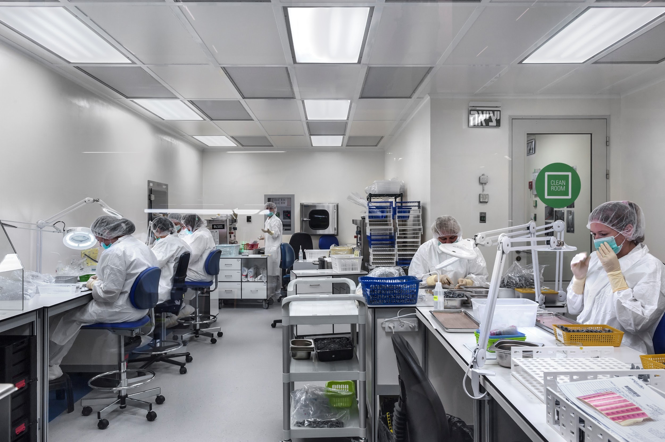
^{HIGHEST}
^{STANDARDS}

Slide 25
The Clean Room
After the surface roughening process, the implants are sent for an additional cleaning in an ultrasonic bath in the clean room, in order to reach a higher level of cleanliness.
Each room in the factory is ranked according to its permitted particle levels (PPM). The higher the rank, the lower the level of permitted particle levels. Therefore, many microbial tests are performed in each room to ensure that the required level is maintained.
The air pressure in the clean room is higher than in the atmosphere. Air leaves the room, but cannot enter, except through the purification system.
The clean room undergoes daily, monthly and annual routine tests in order to monitor the bacterial and particle load on the implants. We check the bacterial levels in the air, work surfaces, the employees themselves and, of course, on the implants in order to ensure an efficient sterilization process, and the patients’ safety.
The clean room has undergone very rigorous testing and meets the requirements of the relevant international standards. Any product concerning the skin (and up to implanted into the tissues) must undergo biocompatibility tests.

Slide 26
The Clean Room
Once the implants are packaged in nothing but transparent test tubes, they are sent for sterilization using gamma waves.
The implants must reach the gamma wave stage with a high level of surface cleanliness:
When the gamma waves kill the bacteria, the membrane of the bacteria breaks down and endotoxins are released - these substances lead to infections and allergies in the patient’s body. Therefore, the goal is to reach the sterilization stage with the lowest possible levels of bacteria. This requires maintaining sterility and rigorous inspection throughout the entire process.
After they are packaged in the clean room, the implants are sent for a final inspection - 100% of the implants undergo a visual inspection for correlation between the product and the description on the packaging, and to see that the packaging is intact. The prosthetics undergo the same inspection but for a sample from each batch.
The prosthetic part is sent from the packaging room to the distribution warehouse.

Slide 27
The Clean Room
The AlphaBio Tech company supports a strict quality control system, which is subject to the chief quality standards: standard 13485:2006 of the International Standard Organization (ISO), including the Canadian Medical Devices Conformity Assessment System, and Council Directive EEC/93/42. The company products are approved by the European Conformity (CE) and approved for use in the US.

Slide 28
Overview of the Process
Finish and Design
Quality control and Packaging
Final Inspection
Prosthetics
Cleaning
Surface Roughening 1
Cleaning
Surface Roughening 2
Cleaning
Implants
Packaging
Projection
Final Inspection

Slide 29
Packaging Room
All the company’s factory products are packaged here.
In this room, a final visual inspection is conducted for the prosthetic products and a final inspection for the packaging of the implant.
The final inspection for quality assurance for each batch, with no exceptions, is also performed in this room.
In the final inspection, we make sure that all the processes have been carried out and approved, that we have all the files, that the labels are correct, that the defects have been separated from the ordinary parts, that all the processes were appropriately reported in the enterprise resource planning (ERP) system, and that the part is in line with the production instructions.

Slide 30
Distribution Warehouse
AlphaBio Tech. has two distribution warehouses - in Israel and Holland -
these two distribution warehouses are responsible for providing the merchandise to over 50 different states.
We cannot show you the distribution warehouse for security reasons.

Slide 31
Training Center
AlphaBio Tech’s global training center provides a wide variety of professional training courses, from basic courses on dental implants to advanced courses for experienced dentists.
AlphaBio has made training as a top priority its motto. Our goal is to grant added value to doctors in their work, give them access to knowledge that will ease their practice, exposing doctors to the most advanced clinical research in the world, thereby continuously improving the medical services received by the patient.
In order to provide access to knowledge, AlphaBio holds scientific conferences and international courses in parallel to the local trainings in each one of the states where AlphaBio Tech. products are sold.

Slide 32
Computer-Assisted Surgery
As mentioned in the history of AlphaBio Tech., our digital unit was launched in 2015.
The unit was established in order to provide our customers with a variety of solutions, services and products which are necessary for success in the world of digital dentistry.
Computer-assisted surgery makes advanced technologies in the dental field - of the industry’s most precise and highest quality products - accessible to dentists. All with the help of designated computer software using CT technology and advanced 3D simulations.
Guidelines for the clinical process:
Clinical test and measurements.
Making a gypsum model in the lab.
Patient CT scan.
Placing the implants according to the doctor’s instructions and the clinical parameters - the doctor sees the plan through the Viewer program, provided free of cost.
AlphaBio Tech. produces the surgical brace (printed).
Local production guarantees a very high response time (you can see the 3D printer, which produces the braces), uncompromising precision and quality (meets the world’s highest standards, the only company with an ISO standard) - very high compatibility between the planned location of the implant to the location in practice allows us to safely place the implant closely to the physiological structures.
High precision guarantees high predictability for the doctor to prepare for a temporary recovery before the surgery.

Slide 33
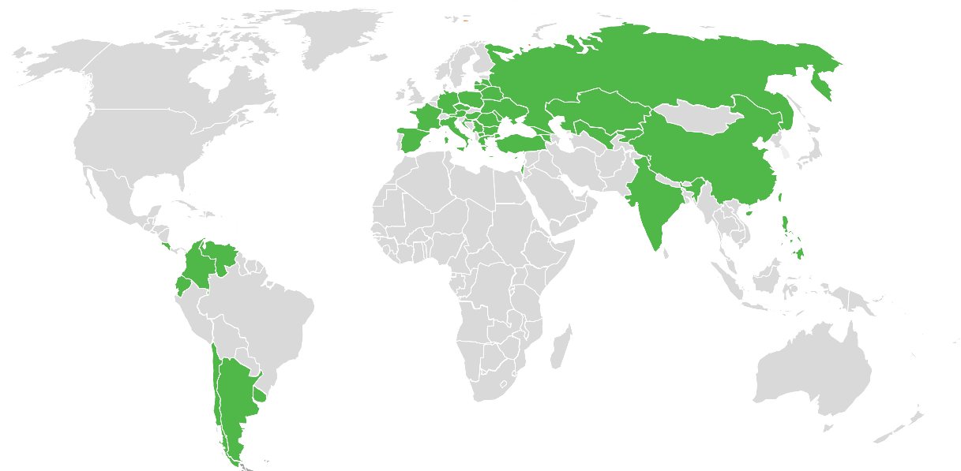
Customer Service Center
AlphaBio Tech. operates a local customer service center as well as service and sales centers in over 50 states worldwide, through a carefully selected distribution system.
The customer service centers are skilled in providing professional support for all the distributors’ and end-customer’s needs.
The tour ends here - are there any questions?

