Slide 1


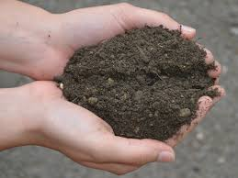
How to better nourish our Earth!

Slide 2

The agronomic foundations of fertilization
1) The fundamentals
Soil and fertility
Mineral elements, roles and forms
2) Making fertilizer
The plant – the needs of crops
Winning couples
3) Recommendations
4) Responsible nutrient management

Slide 3
1) Fundamentals
The soil and fertility
Physical fertility
Chemical fertility
Biological fertility

Slide 4
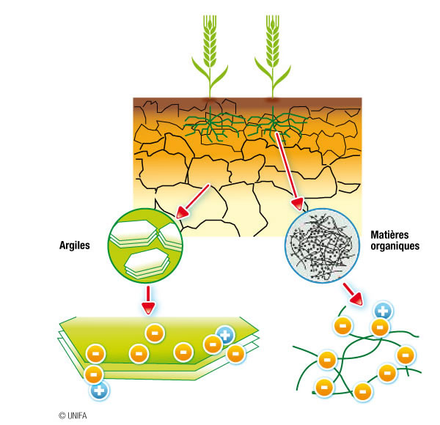
Physical fertility
Definition: the greater or lesser ease of creating and maintaining a physical condition of the soil that is conducive to a cropping system (Monnier et al, 1981).

Slide 5
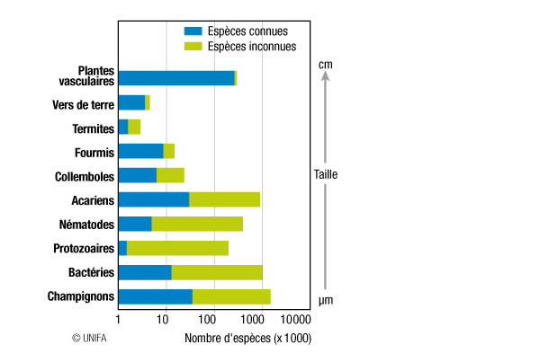
Biological fertility
Soil is a living environment in which a multitude of varied organisms develop, belonging to all the kingdoms of life (animal, vegetable, fungi, bacteria….)
The biological component of fertility affects the physical condition of the soil, the amount of organic matter and nutrient availability.

Slide 6
Chemical fertility
Definition: the ability of a soil to create and maintain a chemical status characterized by its pH, which promotes plant growth by providing a sufficient amount of nutrients.
pH
  The acidity of the soil is determined by its pH value;
  Soil is said to be:
  acidic when the pH value of the water is below 6.5
  neutral when the pH value of the water is between 6.5 and 7.2
  alcaline when the pH value of the water is above 7.2
< 6.5
>7.2
Target pH range

Slide 7
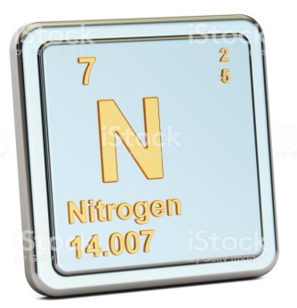
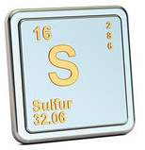
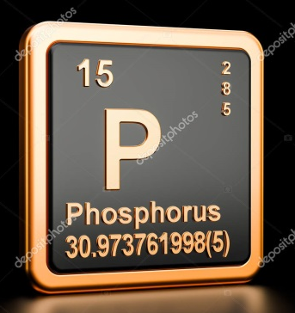
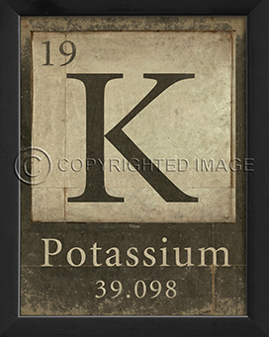
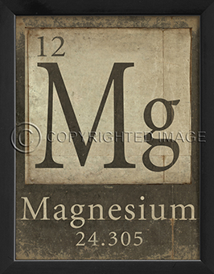
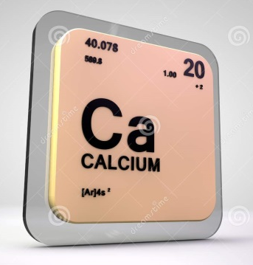
The mineral elements
Z- Atomic number (no. of protons)
A -Atomic mass (number of mass: protons + neutrons)
N : Nitrogen
S: Sulfur
P: Phosphorus
K: Potassium
Mg: Magnesium
Ca: Calcium

Slide 8
Nitrogen - N
Nitrogen and life
      One of the main components of amino acids, proteins and nucleic acids (DNA and RNA).
      Nitrogen deficiency reduces protein synthesis and therefore chlorophyll content.
      =>Relation used in the diagnosis of nitrogen nutrition based on the varying degrees of greenness of the leaves (chlorophyll content)
The role of nitrogen in plants
      Nitrogen plays a crucial role
      in yield
      in production quality.
      About 1 kg of mineral nitrogen is needed to produce 6 kg pf plant protein.
      In 100 kg of common wheat (DM),
      there is on average 11.5 kg of proteins, namely 1.9 kg of nitrogen (N).
      Apart from plants of the legume family which are able to fix atmospheric nitrogen (N₂₎ through symbiosis, plants take up mineral nitrogen from the soil:
      ammoniacal nitrogen NH₄⁺ and nitric nitrogen NO₃⁻
      Annual crops absorb nitrogen preferentially in nitric form when this is available
8

Slide 9
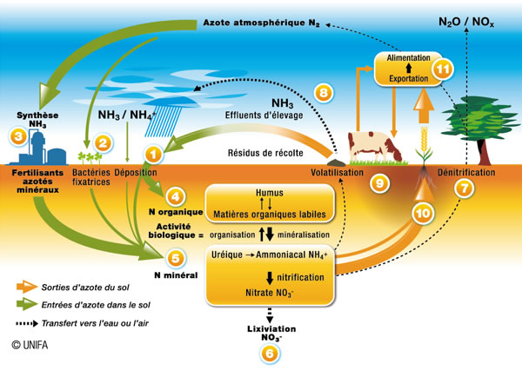
The nitrogen cycle

Slide 10
Sulfur - SO3- Sulfur trioxide
Sulfur and life
      Sulfur is the main component of 3 out of the 20 amino acids essential to the formation of proteins: methionine, cysteine and homocysteine.
      Methionine is one of the 8 essential amino acids for human beings because the human organism cannot synthesize a sufficient amount. It must therefore obtain it from plant and animal products in the diet.
The role of sulfur in plants
      Plants absorb sulfur through their roots in the form of sulfate SO₄⁻⁻
      They need this at an early stage because this element is essential to the synthesis of proteins, particularly the formation of chlorophyll in leaves (S is a component of 3 essential amino acids).
      These sulfur amino acids help to form the structure of complex proteins that are found, for example, in wheat grain (gliadins, glutenins).
      The yellowing of leaves is a symptom of sulfur deficiency (as with nitrogen) since less chlorophyll is formed.
      It can also affect the level and composition of proteins in cereals or other crops.

Slide 11
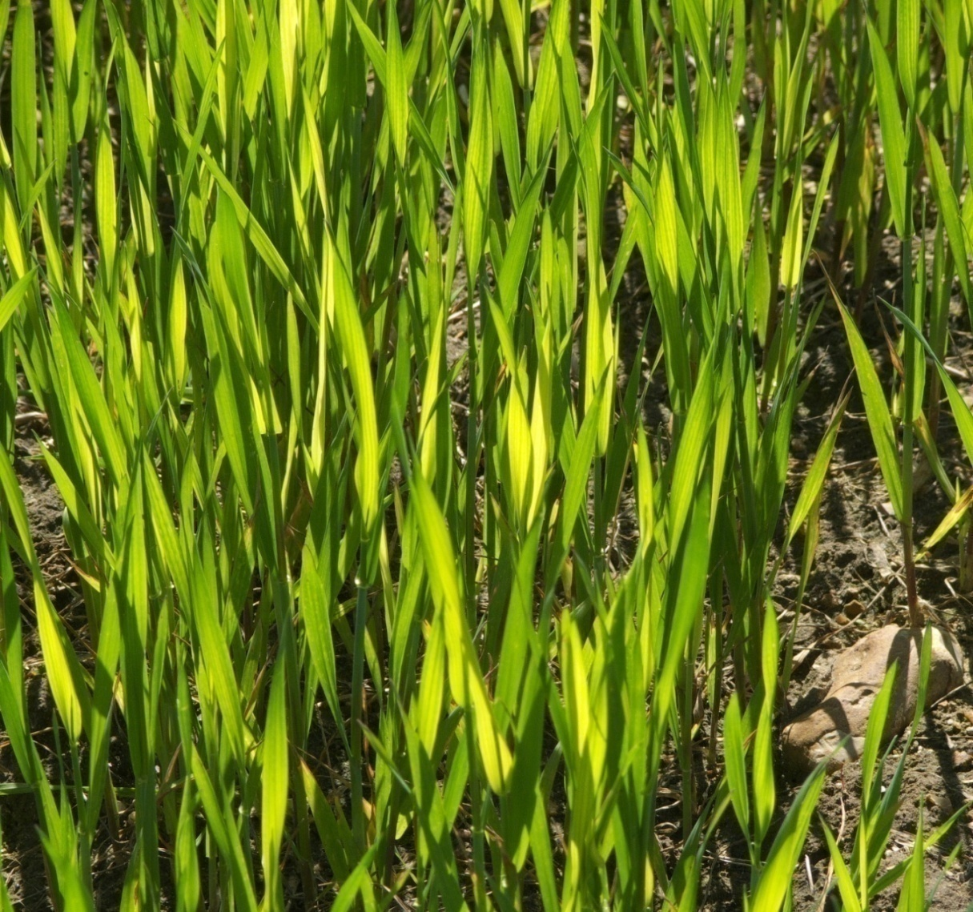
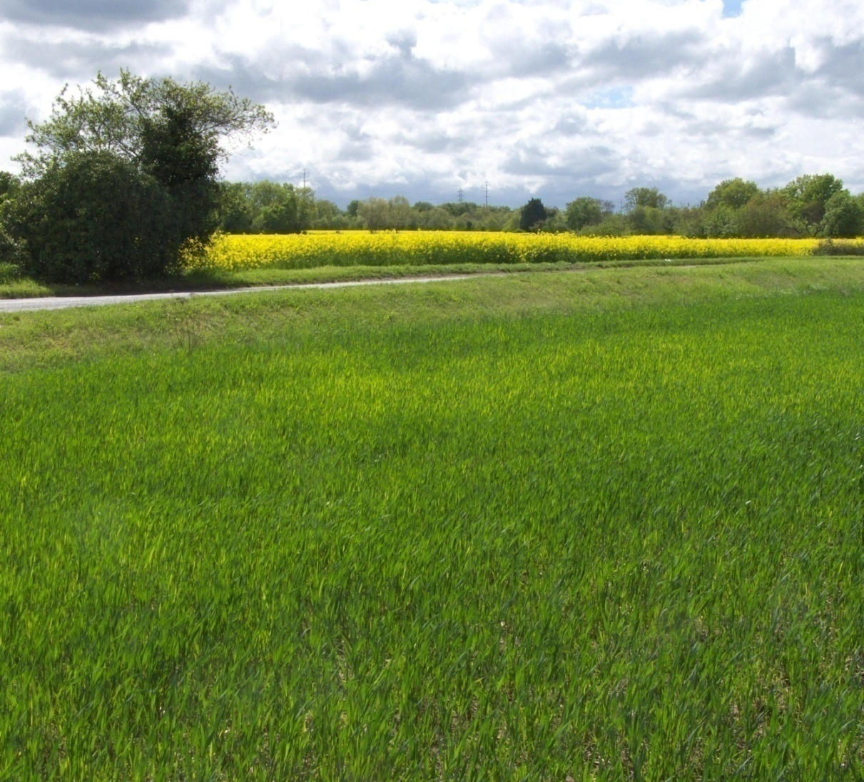

Sulfur deficiency

Slide 12
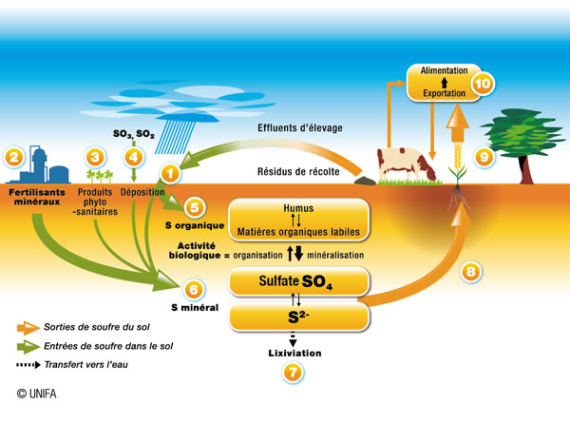
The sulfur cycle

Slide 13
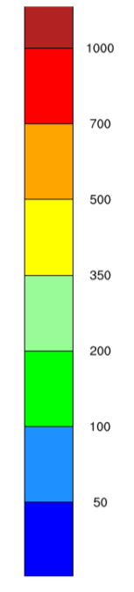
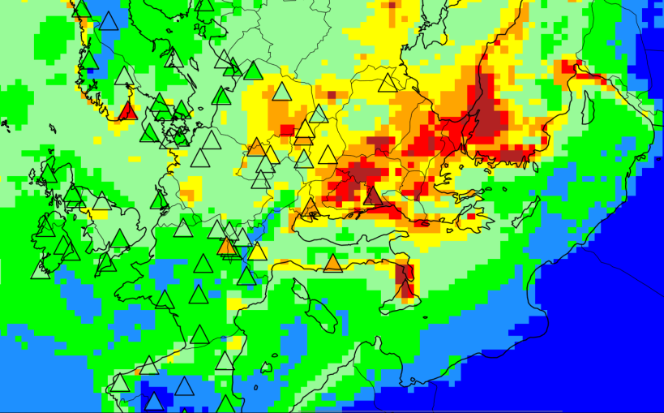
Why should sulfur be applied?
Sulfur emissions caused by human activity
Atmospheric deposition of sulfur S in 2014 (EMEP status report 2016)
What are we learning?
Over the past 40 years, emissions have decreased considerably (divided by 7 – source COMIFER), which means that sulfur fertilizers are needed today to ensure an optimal N:S balance for the synthesis of proteins.
“Since 2013 the average atmospheric deposition on agricultural soils has been less than 5 kg of SO₃/ha, some of which is leached out in winter.”
(COMIFER, 2007)

Slide 14
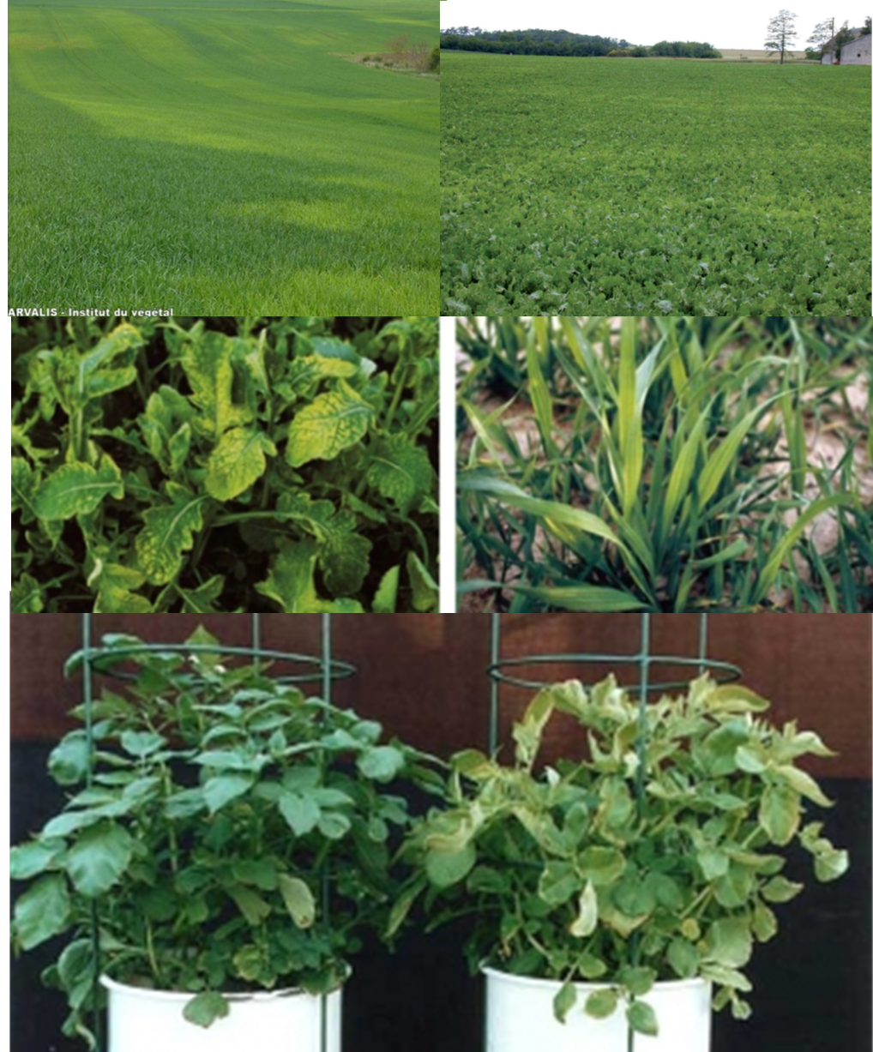
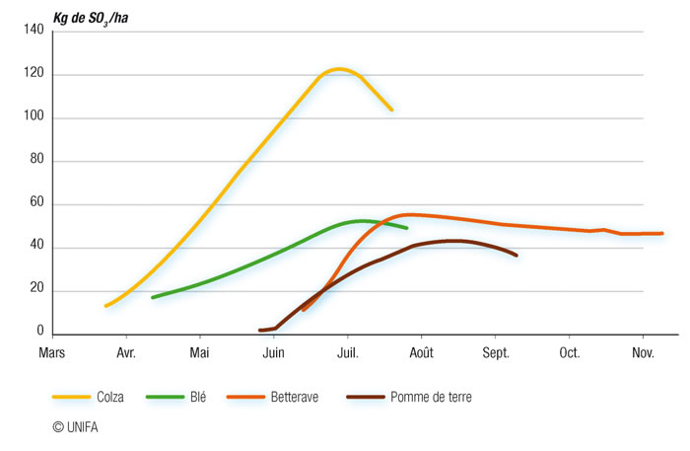
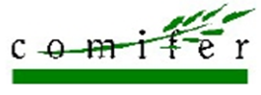
Why should sulfur be applied?
Risk of deficiencies
Mobilization of sulfur by crop –
in France, % of hectares without sulfur contributions:
Rape: 20 %
Cereals: 35 %
Pastures: 90 %
Gain per hectare:
Rape: + 8 qtx
Cereals: + 5 qtx source Basf

Slide 15
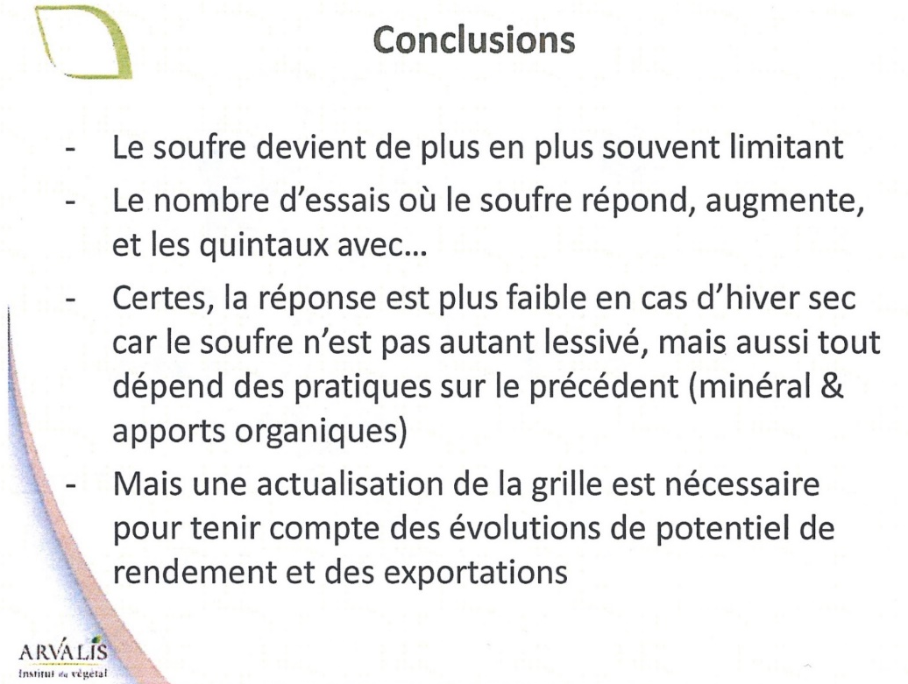
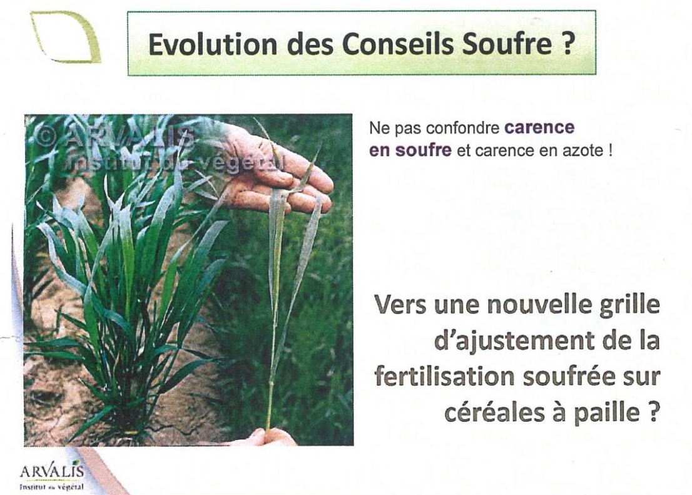
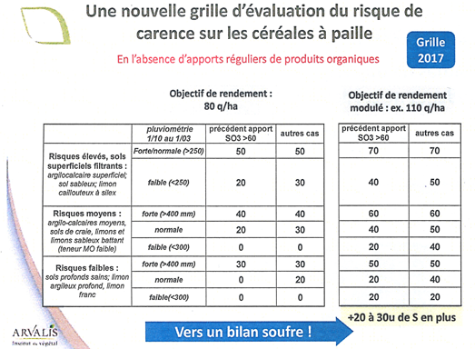

Why should sulfur be applied?
Review of recommendations …

Slide 16


Recommendations for balanced fertilization
Products | Kg/ Ha | Levels of S, P, K, Mg, Ca provided
 |  | SO3 | P2O5 | K2O | MgO | CaO
 | 100 150 200 | 48 72 96 | 0 0 0 | 14 21 28 | 6 9 12 | 17 25 34
 | 150 200 300 | 60 80 120 | 14 18 28 | 14 18 28 | 6 8 12 | 21 28 42
 | 200 300 400 | 50 75 100 | 36 54 72 | 14 21 28 | 6 9 12 | 32 48 64
PKpluS
18-7+3
X7

Slide 17

Phosphorus - P2O5 - Phosphoric anhydride
Phosphorus and life
      Essential role in many molecules of living matter.
      It is found to be present in multiple organic combinations: nucleic acids, DNA and RNA for which it forms the structural framework
      as well as many proteins and lipids: phosphoproteins and phospholipids.
      It is the central component of ATP (adenosine triphosphate) an energy producer when it releases a phosphorus atom in the conversion to ADP.
The role of Phosphorus in plants
      Cellular multiplication in meristems (DNA, RNA) root development (in the fall…)
      Cellular respiration and the transfer of energy (ATP, ADP) growth – (especially in spring)
      Photosynthesis in synergy with nitrogen and many other elements
      NB: Once the seed’s phosphorus reserves have been depleted, the plant must immediately find this element in the soil close to its roots since this element is practically not mobile.
      At this stage, phosphorus may be a major limiting factor and inhibit growth and development. Phosphorus applied at sowing strengthens and stimulates the growth of the root system so that the phosphorus reserves of the soil can be explored more quickly.

Slide 18
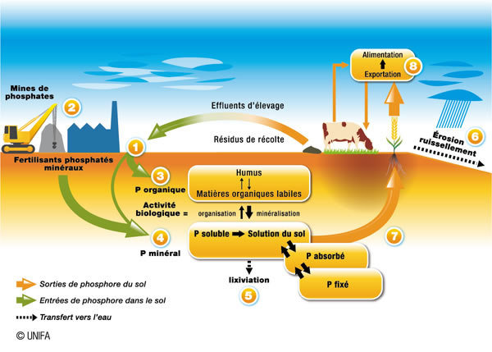
The phosphorus cycle
(2 kg/ha)

Slide 19
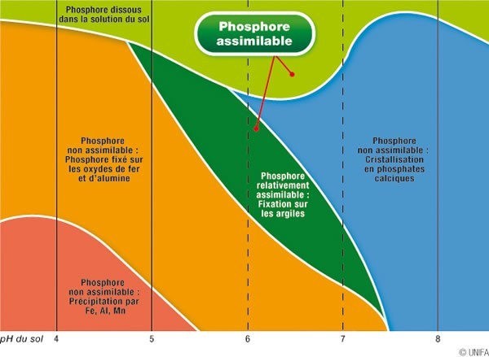
Effects of pH on the bioavailability of phosphorus
Wider spectrum than other elements.
A certain acidity of the soil is conducive to its assimilation.

Slide 20
What happens to the phosphorus input of a fertilizer material
The isotopic labelling of a phosphate fertilizer makes it possible to measure the Real Utilization Coefficient (RUC %) of the phosphorus of a fertilizer added to a crop for the season.
Main result achieved (for the first time around 1946): the RUC % of P of a fertilizer material is between 0.1 % and 20 % at most.
RUC % depends on:
  the nature of the fertilizer (water soluble or water insoluble).
  the nature of the earth, its pH
  the period of contact between the fertilizer and the constituents of the earth. The RUC decreases when the period of contact between the supply and the constituents of the earth increases.
  the crop (root system…)
An RUC in the 1st year, between 20 % and 0.01 %, indicates that, according to the fertilizer material used and the nature of the soil, between 80 % and 99.9 % of the P input stays in the soil at the end of the 1st year of cultivation.
(Jean-Claude Fardeau 2010)

Slide 21
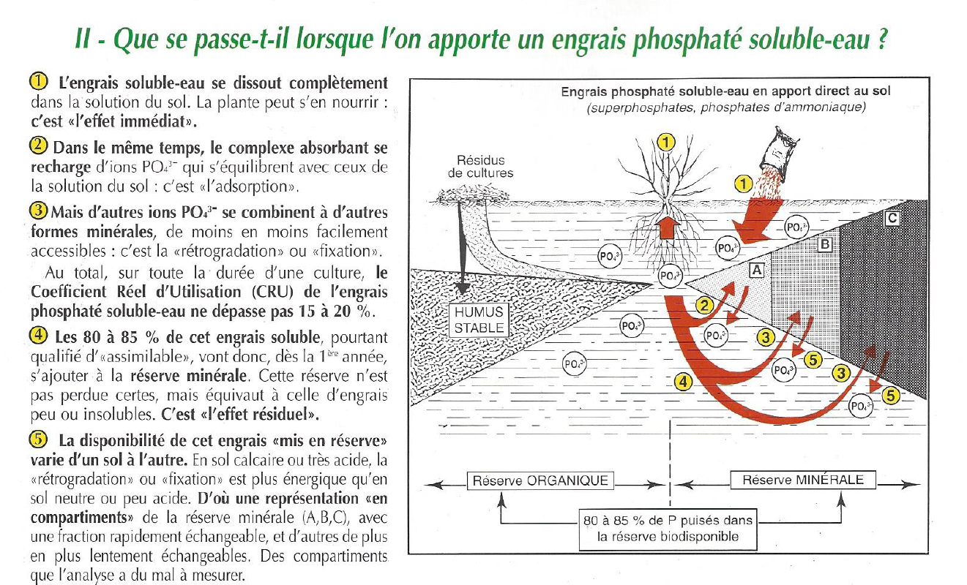
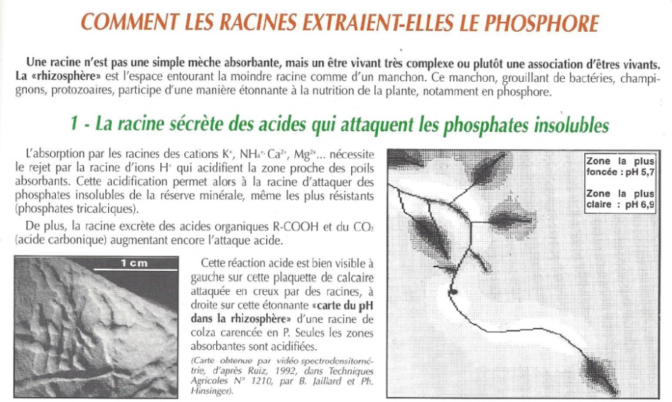
Soltner depuis 50 ans

Slide 22
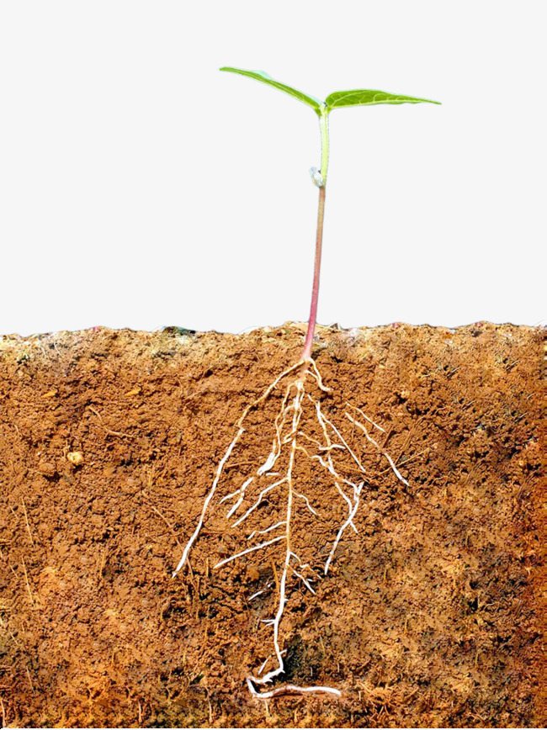
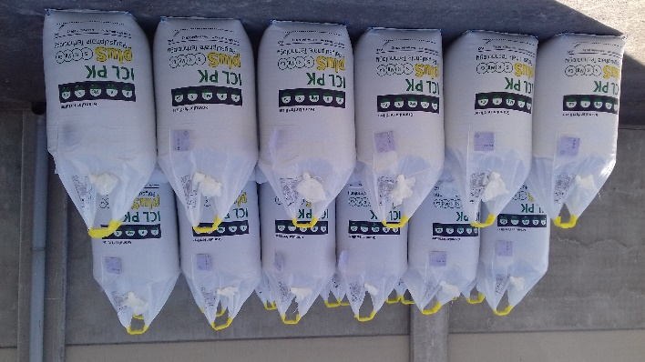


Phosphorus… use in soil solution
100 U absorbed
Soil reserve
Water-soluble fertilizer added over the year
N
Will join the soil reserve
20 U
80 U
Will be used immediately

Slide 23
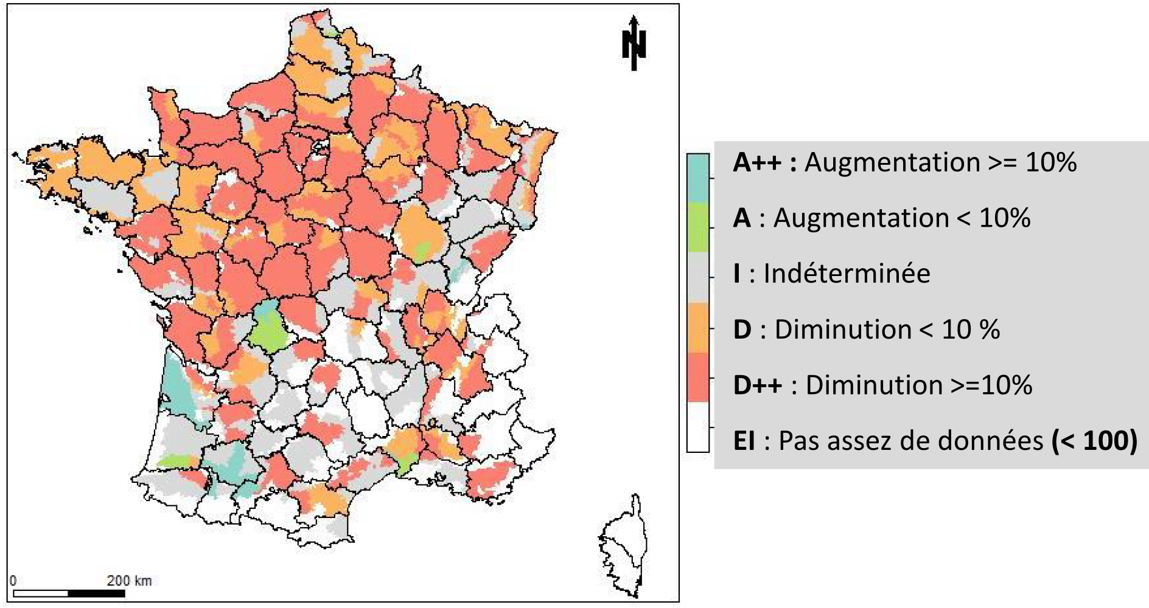

Changes in levels – P₂O₅ (mg/kg) content
2004-2014 / 1990-2004
source

Slide 24
Acid attack of phosphates
Production
- Super 18 (SSP)
- Phosphoric acid
- Super 45 (TSP)
Phosphate rock = Insoluble
Soluble phosphorus
tricalcium sulfuric calcium monocalcium
phosphate acid sulphate phosphate
Ca₃(PO₄)₂ + 2 H₂SO₄ => 2 CaSO₄ + Ca(H₂PO₄)₂
SSP
tricalcium sulfuric calcium phosphoric
phosphate acid sulphate acid
Ca₃(PO₄)₂ + 3 H₂SO₄ => 3 CaSO₄ + 2 H₃PO₄
tricalcium phosphoric sulfate monocalcium
phosphate acid calcium phosphate
Ca₃(PO₄)₂ + 2 H₃PO₄ => 3 Ca(H₂PO₄)₂
TSP

Slide 25
Recommendations for Balanced Fertilization
Products | Kg/ Ha | Levels of S, P, K, Mg, Ca provided
 |  | SO3 | P2O5 | K2O | MgO | CaO
 | 100 150 200 | 48 72 96 | 0 0 0 | 14 21 28 | 6 9 12 | 17 25 34
 | 150 200 300 | 60 80 120 | 14 18 28 | 14 18 28 | 6 8 12 | 21 28 42
 | 200 300 400 | 50 75 100 | 36 54 72 | 14 21 28 | 6 9 12 | 32 48 64
PKpluS
18-7+3
X7

Slide 26
Potash - K2O - Potassium oxide
Potassium and life
      Involved in the formation and growth of cells. It is found inside cells in animals and plants in the form of the K⁺ cation, which helps to maintain osmotic pressure.
      It ensures that many vital functions in animals are performed, and contributes to the proper functioning of the heart, muscles, brain and nerves.
The role of Potassium in plants
      Abundant in plant dry matter.
      Absorbed in the form of cation K⁺ and circulates throughout the plant in this form.
      Multiple functions in plant metabolism :
      Maintains the growth habit of the plant thanks to its major effect on the tugidity of cells and the formation of strong cell walls
      Acts on photosynthesis by activating more than 80 enzyme systems
      Encourages the circulation of sap upwards within the xylem and downwards within the phloem.
      Allows for the transfer of assimilates (sugars, amino acids) towards the roots and reserve organs (grains, fruits, tubers).
      Controls the opening and closing of the stomata and regulates the water cycle in the plant
      Affects the composition and quality of numerous productions (sugar/acidity balance, vitamin C content, aromatic compounds, fibre quality…).
      Interaction between N and K:
      a plant better nourished in nitrogen will have more need of potassium.

Slide 27
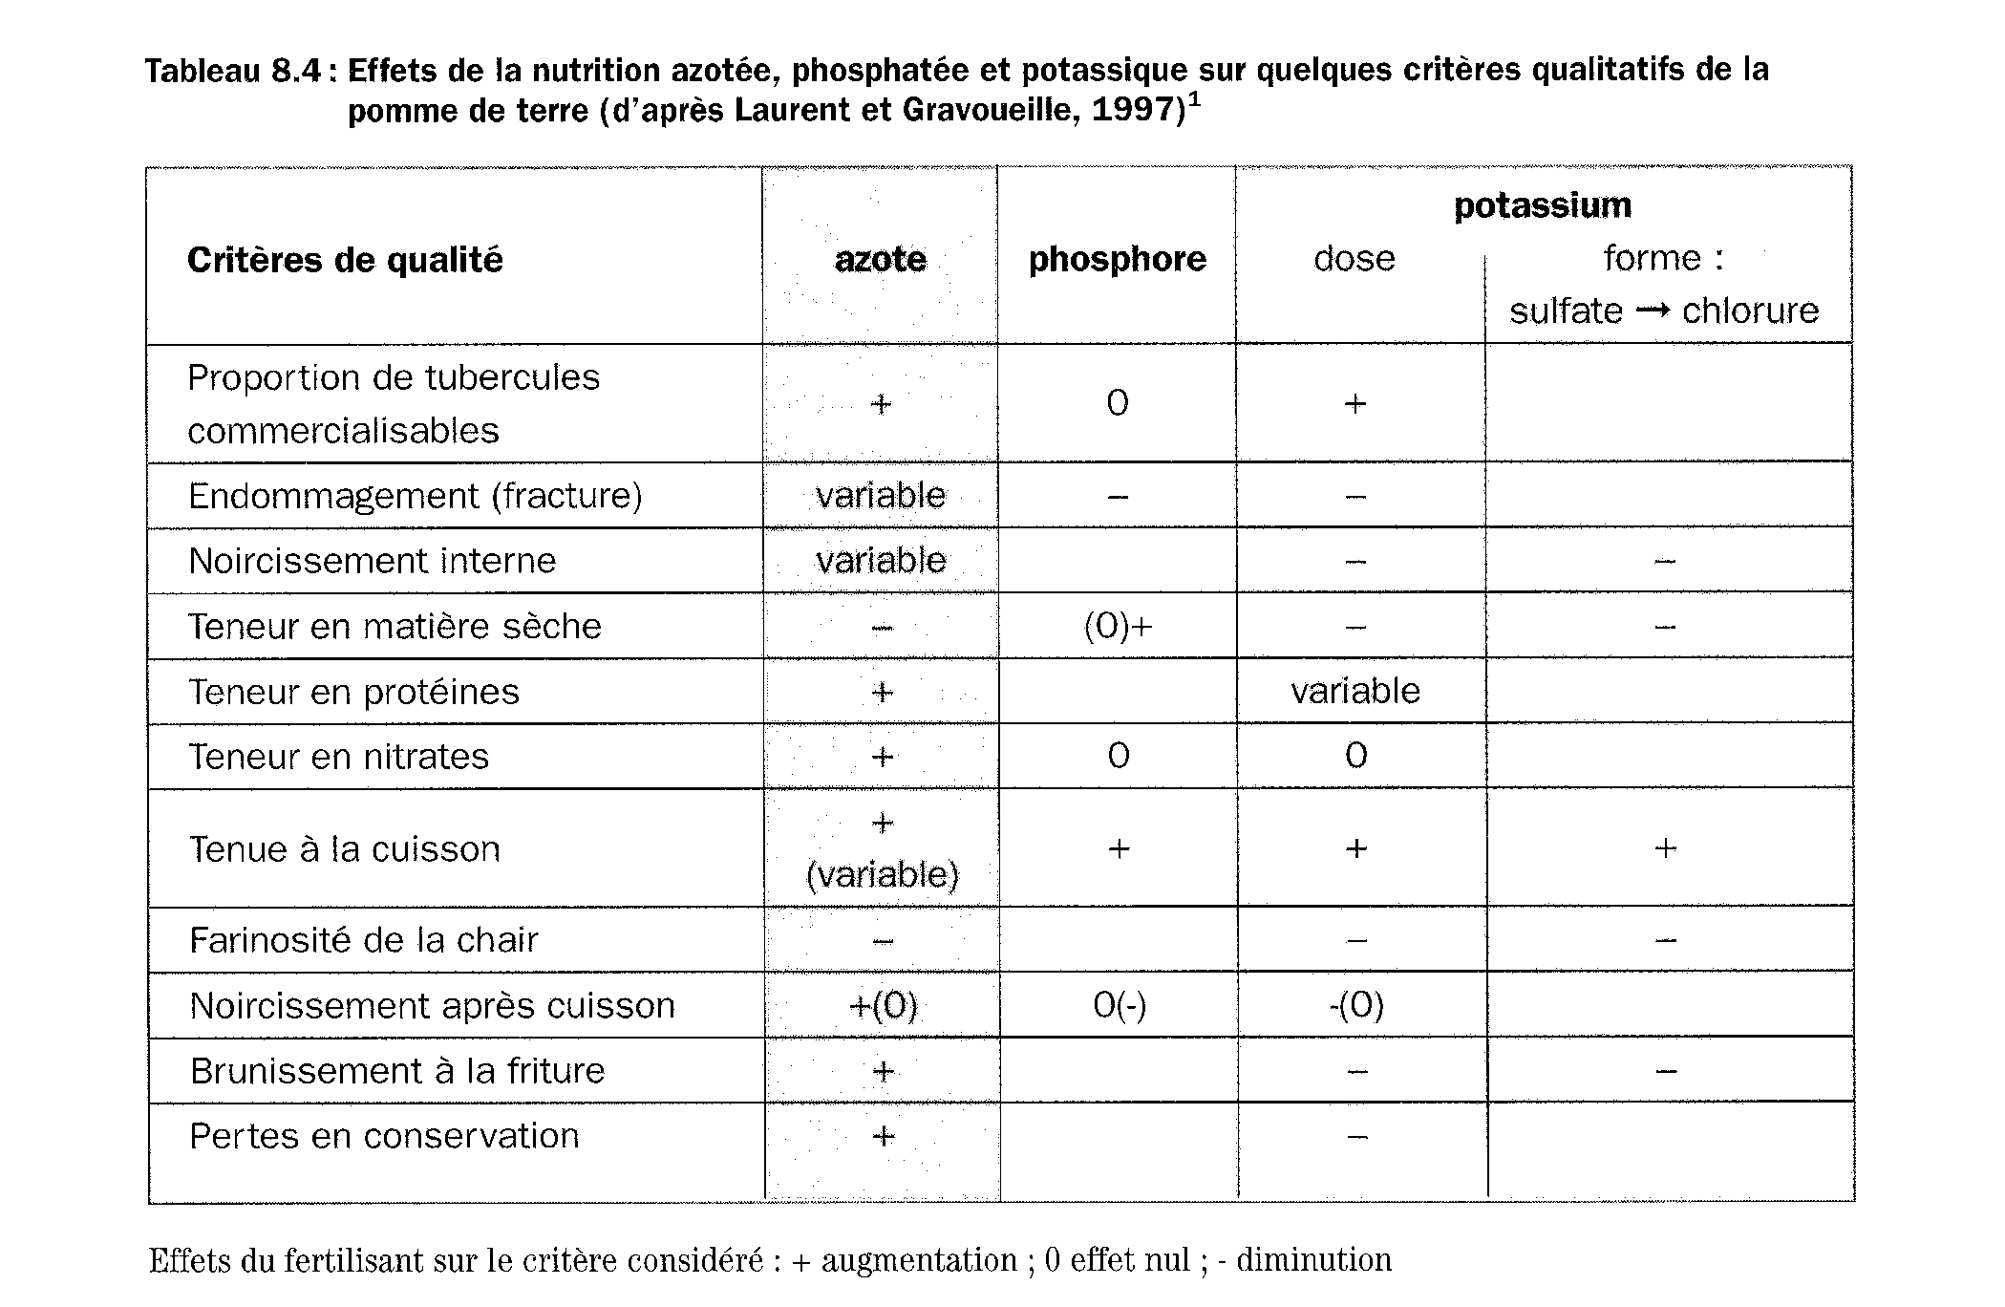
Role of potassium: quality
+
+
_
_
_
+
+
+
+
+
_
_
_
_
_

Slide 28
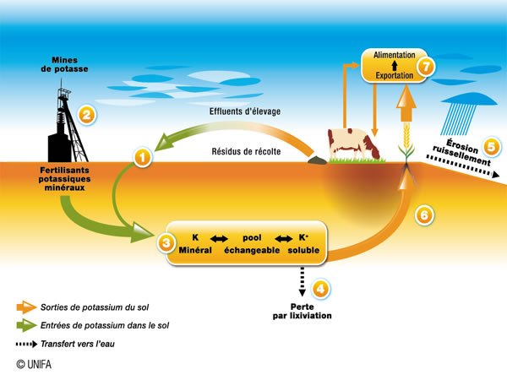
The potassium cycle

Slide 29
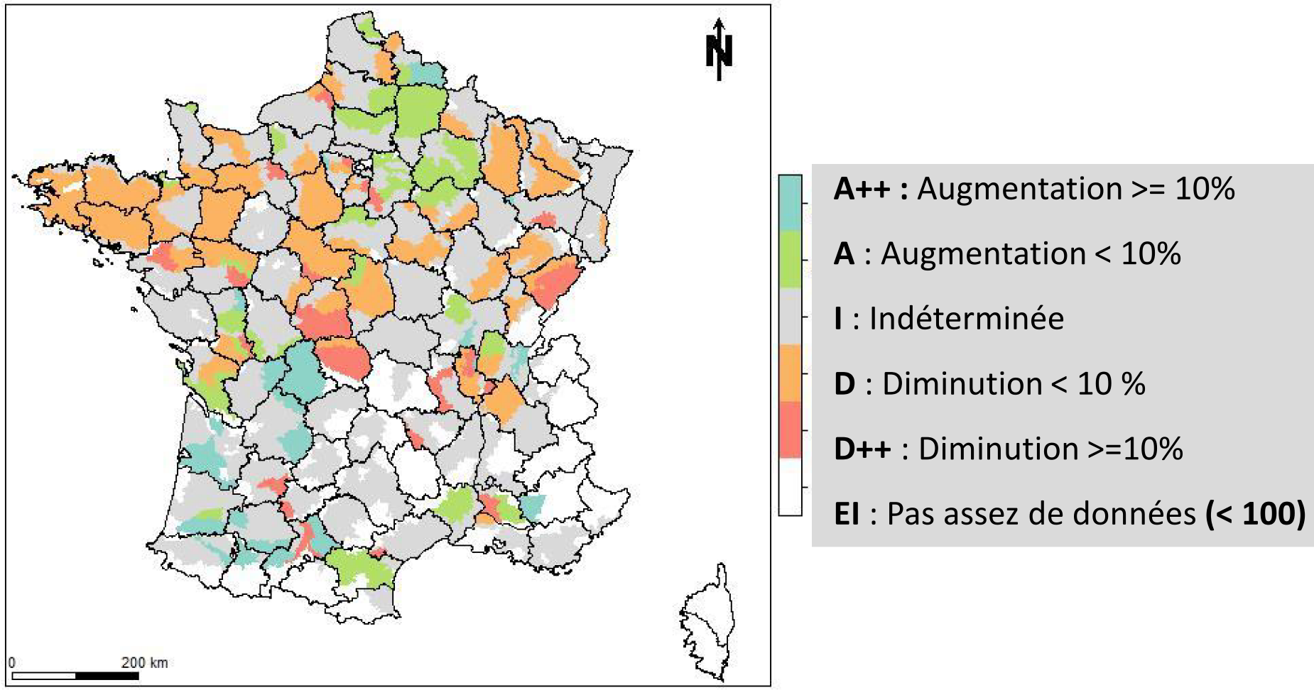
Changes in levels - K₂O (mg/kg) content
2004-2014 / 1990-2004
source

Slide 30
Recommendations for Balanced Fertilization
Products | Kg/ Ha | Levels of S, P, K, Mg, Ca contributed
 |  | SO3 | P2O5 | K2O | MgO | CaO
 | 100 150 200 | 48 72 96 | 0 0 0 | 14 21 28 | 6 9 12 | 17 25 34
 | 150 200 300 | 60 80 120 | 14 18 28 | 14 18 28 | 6 8 12 | 21 28 42
 | 200 300 400 | 50 75 100 | 36 54 72 | 14 21 28 | 6 9 12 | 32 48 64
PKpluS
18-7+3
X7

Slide 31
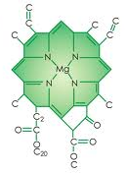
Magnesia - MgO – Magnesium oxide
The role of Magnesium in plants
      Along with nitrogen, magnesium is an essential component of the chlorophyll nucleus
      Magnesium also acts at the level of:
      the activation of numerous enzymes
      the synthesis of proteins and sugars
      and their loading into the phloem (transport of descending sap)
      phosphorus metabolism
      intracellular osmotic pressure together with potassium
      cell wall stiffness with calcium which maintains the plant’s growth habit.
      Magnesium is absorbed by the roots in the form of the cation Mg⁺⁺
      The amount of magnesium absorbed is 4 to 5 times less than that of potassium.
      It is less easily absorbed by the roots than potassium.
      The competition between Mg⁺⁺ and K⁺ is expressed in transfers within the plant.
      It is necessary to consider these two elements together by expressing the K / Mg ratio for interpreting plant analyses.

Slide 32
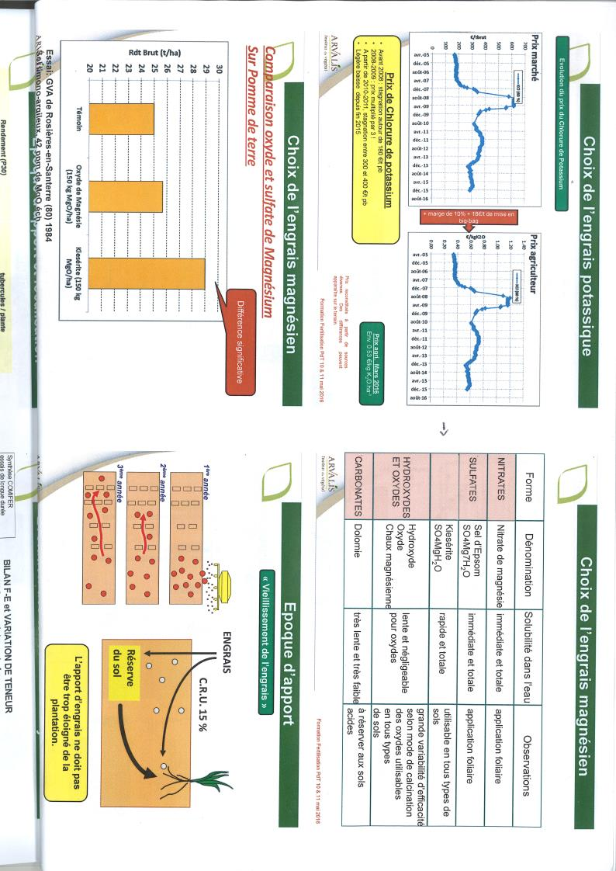
Choice of magnesium fertilizer
Magnesium – Importance of the form of the supply
Sulfate de magnésie
Magnesium Sulphate
Magnesium Oxide
X2
Trial: GVA of Rosières-en Santerre (80)
Sol limono-argileux, 42 ppm of MgO ech.
+12%
X7
Control
Magnesium oxide (150 kg MgO/ha
Magnesium sulfate (150 Kg MgO/ ha)

Slide 33
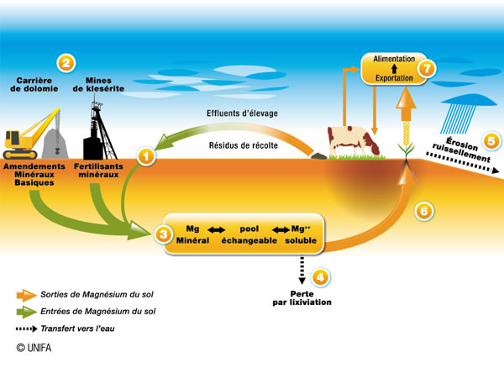
The magnesium cycle

Slide 34
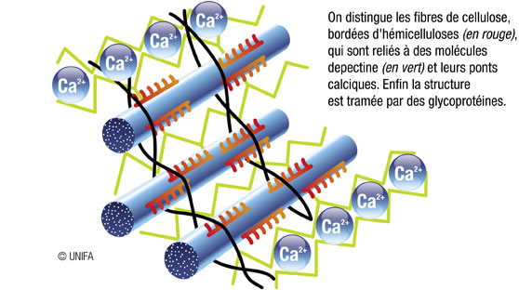
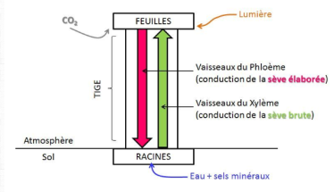
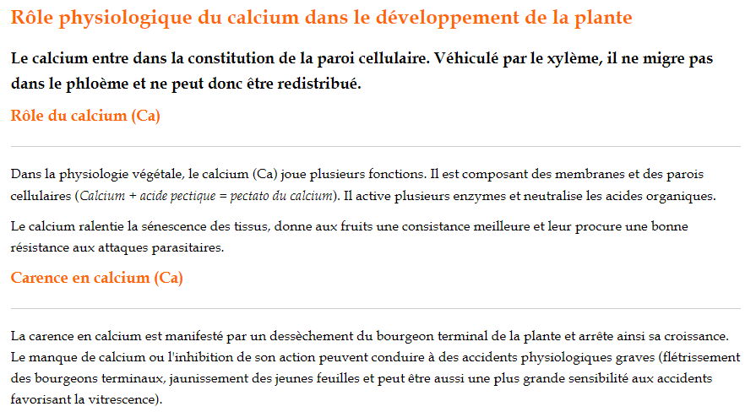
Calcium – CaO – Calcium Oxide
The role of Calcium in plants
      Calcium is an essential nutrient for plants. Generally abundant in the soil, it is taken up as Ca⁺⁺ cation by the roots.
      Its main functions :
      plays a part in the formation of cell walls
      of plants by stiffening them
      activates different enzymes including nitrate reductase
      which reduces nitrate to ammonium
      in the leaves
      promotes the growth of young roots in synergy with the other elements
      Unlike potassium, calcium is less mobile in the plant.
      Its transfer to reserve organs or areas of new growth can be too slow and result in
      symptoms of localized deficiencies. To alleviate this nutritional problem,
      foliar fertilization is sometimes necessary. DEFICIENCES MUST BE AVOIDED.
Cellulose fibres can be distinguished, bordered by hemicelluloses (in red), which are connected to pectin molecules (in green) and their calcium bridges. Finally, the structure is screened by glycoproteins.

Slide 35

Calcium – CaO – Calcium Oxide
      Calcium Nutrient (fertilizer) vs. Calcium Amender (amendment)
Ca
Amendment
Fertilizer
Soil structure – pH correction
Nutrition of the plant
Role in the functioning of vegetation

Slide 36
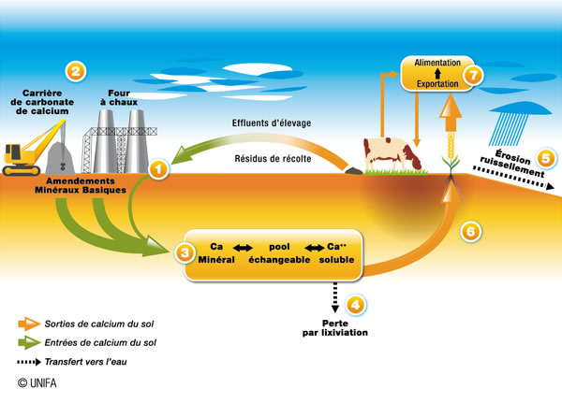
The calcium cycle

Slide 37
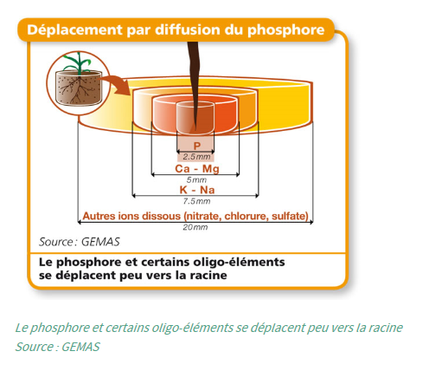
Mobility of the elements in the soil

Slide 38
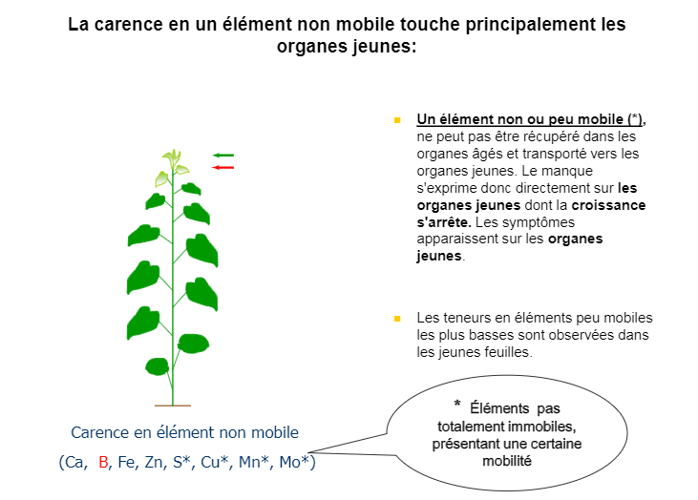
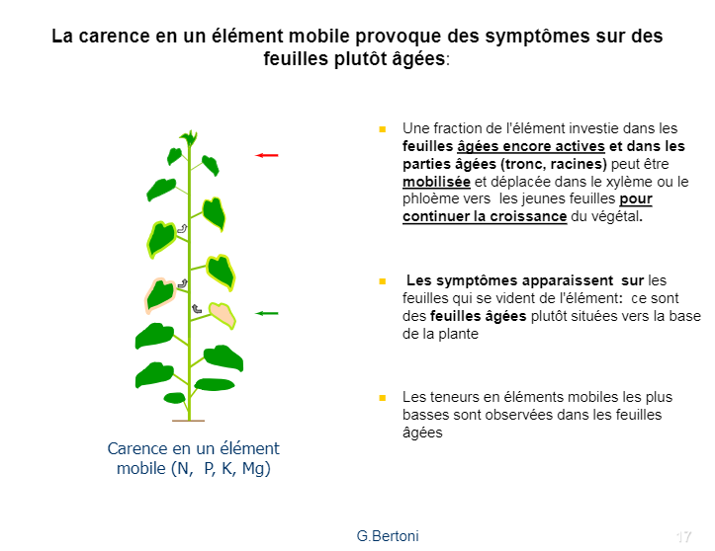
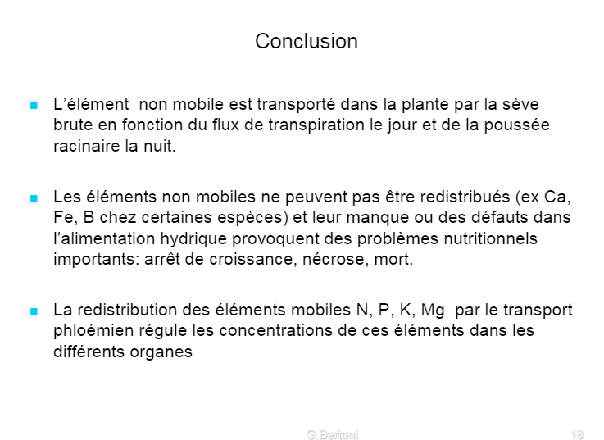
Mobility of the elements in the plant

Slide 39
To sum up:
Nitrogen N
  Constituent element of living matter (proteins)
Sulfur S
  Constituent of certain proteins (sulfur amino acids)
Phosphorus P
  Development of the root system
  Transmission of energy (ATP) and part of the genetic code (nucleic acids : DNA, RNA)
Potassium K
  Transfer of water and sugars… the quality element
Magnesium Mg
  Constituent of chlorophyll
Calcium Ca
  Constituent of the cell membranes (solidity)
To complete the picture… the trace elements (Cu, Zn, B, Fe, Mn, Mo) are necessary for balanced plant nutrition in very small amounts (expressed in grams).

Slide 40



Slide 41
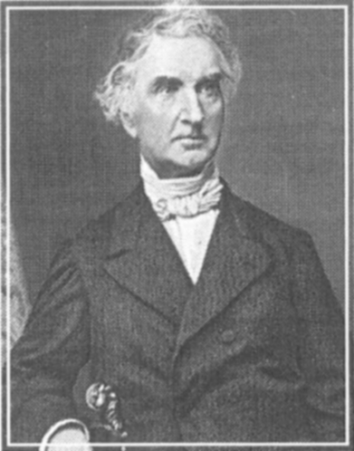
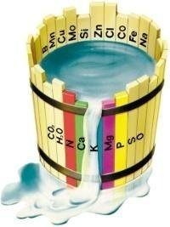
2) Making a fertilizer…
A story of balance
Justus Von Liebig
  Mineral absorption of plants: gas and mineral salts
  Law of the limiting factor

Slide 42



Making a fertilizer
Exports (harvest…)
2 bis
Feeding a plant
Restitution (straw…)
Compensate for exports
Extractions (requirements)
2
4
5
1
Kept in reserve
Meet production needs
Maintain soil capital
"Do not decapitalize"
3
Soil analysis

Slide 43









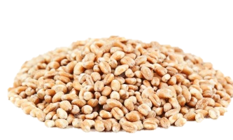
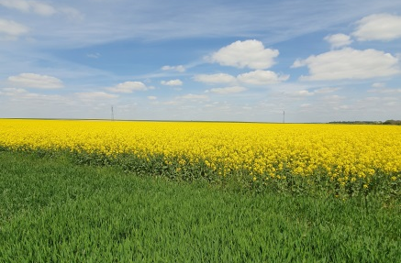

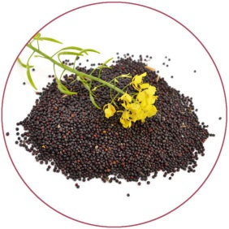
As in the kitchen
Cooking preparation
Tasting
Fresh products
Storage
Germination
Growth
Harvest
Fertilizer
Reserve
Soil solution

Slide 44
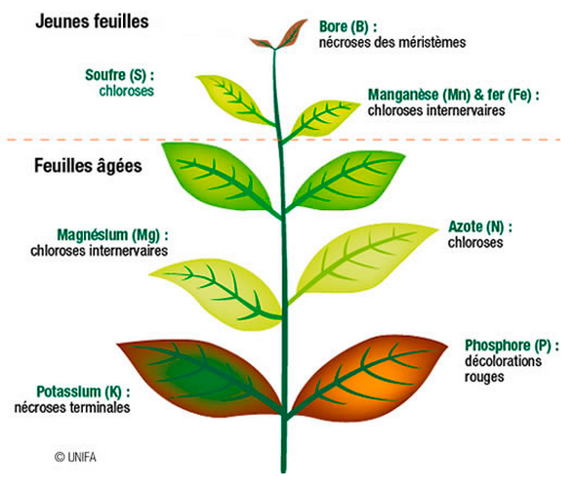
Role of the mineral elements in the plant
Synthesis of proteins
Synergy N
Chlorophyll and photosynthesis
Growth
Root development
Energy transmission
Quality
Water regulation

Slide 45
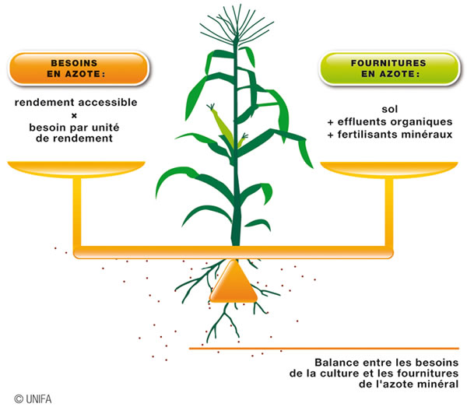
Basic reasoning behind fertilization
Nitrogen: principle of the
budget
P & K: Comifer method
  Recommended dose of P or K = exports x multiplication coefficient
Mg: no official method
  Recommended dose = exports if soil fertility status is unsatisfactory
And sulfur?

Slide 46
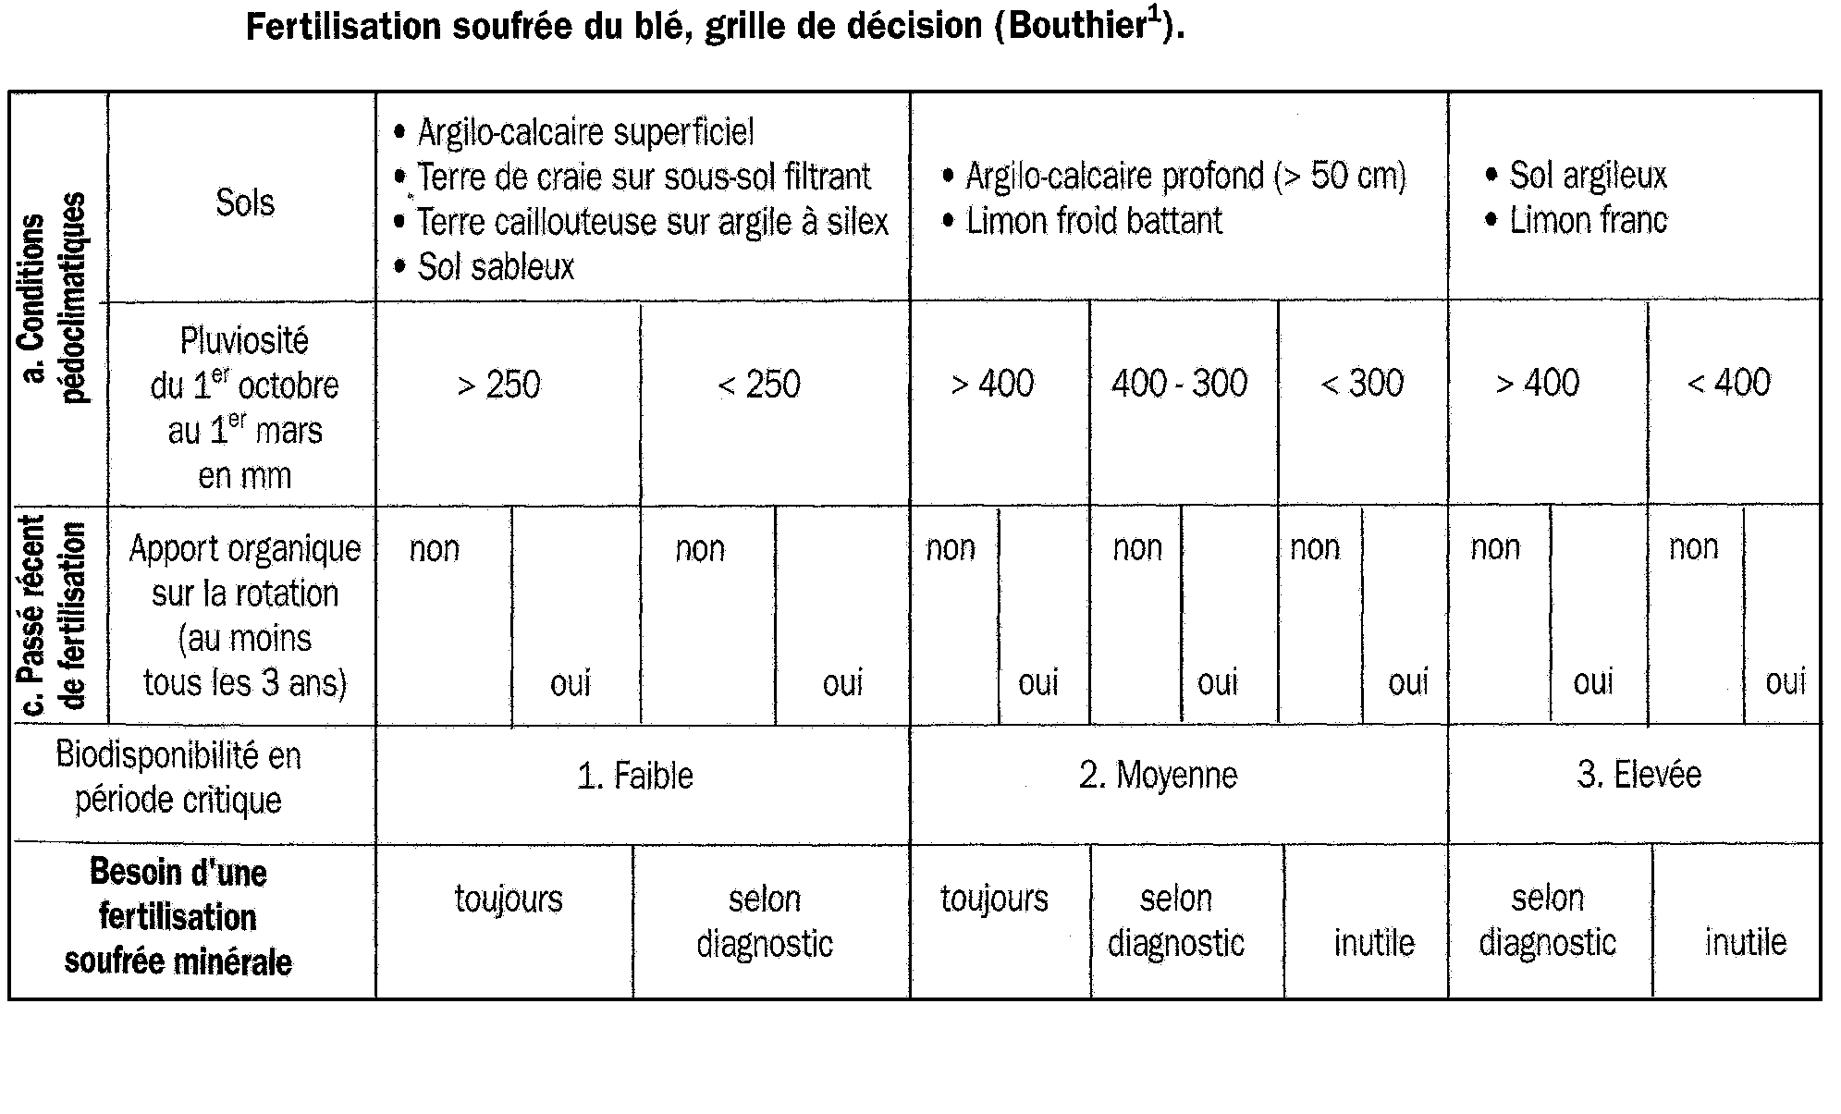
Reasoning behind sulfur fertilization
Grid

Slide 47

Table of crop requirements for P & K (Comifer)
1
 | P₂O₅ | K₂O
High requirement | Canola, Alfalfa, Potatoes, Beets | Beets, Potatoes
Average requirement | Durum wheat, Corn silage, Barley, Peas, Ryegrass, Sorghum, Wheat on wheat | Canola, Alfalfa, Corn silage, Grain corn, Peas, Ryegrass, Soybean, Sunflower
Low requirement | Oats, Common wheat, Grain corn, Soybean, Sunflower | Oats, Durum wheat, Sorghum, Common wheat, Barley

Slide 48
Soil analysis: an indicator of bioavailability for each element
2
Soil analysis measures the content of extractable element said to be assimilable for phosphorus or exchangeable for potassium and magnesium.
The interpretation of the content requires an agronomic frame of reference which experimentally establishes thresholds for a soil type in a given region. Two thresholds have been defined by COMIFER:
    A high threshold called content C_{imp} for “impasse”. Above this threshold, a lack of intake will not pose a risk of reduced crop yield in a given requirement class.
    A low threshold called content C_{renf} for “reinforced”. Below this threshold, the supply required to meet the needs of the crop is higher than the maintenance dose (export of the crop).
    Both thresholds thus define three classes corresponding to different input strategies. In addition, these thresholds are defined for each class of crop requirement.
Black Box
Laboratory
Expertise
Distribution advice

Slide 49
Making fertilizer
Principle of the Comifer method for P & K
3
T_{renf}
T_{imp}
2
1
Elevée
0
Crop requirement
2
Moyenne
1
Number of years without input
Faible
0
T_{renf}
T_{imp}
Content of assimilable element
n Reinforced supply
n Maintenance supply
n Reduced or zero supply
  Recommended dose of P or K (in kg / ha) =
  Multiplication Coefficient Expected yield P or K content
  of exports X (standard yield X of the exports
  (varies between 0 and + de 3) unit) (kg per yield unit)

Slide 50

Mg - Ca
- Avoid deficiencies… and excesses
- Magnesium supply:
Choose the Magnesium Sulphate form over Magnesium Oxide (dolomite… very little assimilation)

Slide 51
Winning couples
N/S
K/Mg
P and K
Agronomic couples
Functional couple

Slide 52
N- S synergy for wheat
Agronomic couple
N/ SO3= 4 (wheat and grass)
N/SO3=2.5 (canola)

Slide 53

Nitrogen–Sulfur synergy… the case of pastures
Grass samples
Grass yield
Kg N
Kg SO3
Production MS
150
SO3
-
37.5
100
- 25
N + S
N
50
-
12.5
N
|
|
|
|
30 March
9 August
1
2
3
4
N° coupe
Source : INRA
Source : Skinner 1987
Simultaneous absorption
More effective fertilization
Notes:
Rôle du soufre
Le soufre est absorbé en même temps que l ’azote
En outre, en présence de soufre, il y aune synergie avec l ’azote qui augmente la valorisation de celui-ci par la plante

Slide 54
K / Mg balance
Agronomic couple
K/Mg ratio regardless of the plant: 2 to 3/1
An excess amount of one blocks the other element
Maintain the right balance
Soil analysis
Monitoring deficiencies

Slide 55


P and K : the importance of regular application! Functional couple

Slide 56





3) Recommendations
Guide to recommendations
Take into account the local particularities:
Possible imbalances in the soil and organic inputs
Crops Input of S, P, K, Mg, and Ca elements in Kg/Ha
 |  | SO3 | P2O5 | K2O | MgO | Ca
 | Protein cereals | 60 | 70 | 60 | 25 | 50
 | Canola | 80-100 | 80 | 60 | 25 | 50
 | Corn, Pastures | 60 | 50 | 150 | 25 | 60
 | Alfalfa | 100 | 70 | 220 | 35 | 80
X7

Slide 57
As in the kitchen
Cooking preparation
Tasting
Fresh products
Storage
Germination
Growth
Harvest
Fertilizer
Reserve
Soil solution

Slide 58

4) Responsible nutrient management
Source
Dose
Date
Place

Slide 59

Responsible nutrient management
The 4 ‘rights’ of responsible nutrient management
Right source
Right dose
Right date
Right place

Slide 60

Short width centrifugal spreading
...and the perfect gesture of the sower !
Otherwise…

Slide 61

Wide width centrifugal spreading
Suitable equipment,
a quality fertilizer,
the right dose
at the right time
=
quality production!

Slide 62
Recommendations for Balanced fertilization
Products | Kg/ Ha | Levels of S, P, K, Mg, Ca contributed
 |  | SO3 | P2O5 | K2O | MgO | CaO
 | 100 150 200 | 48 72 96 | 0 0 0 | 14 21 28 | 6 9 12 | 17 25 34
 | 150 200 300 | 60 80 120 | 14 18 28 | 14 18 28 | 6 8 12 | 21 28 42
 | 200 300 400 | 50 75 100 | 36 54 72 | 14 21 28 | 6 9 12 | 32 48 64
PKpluS
18-7+3
X7

