Slide 1
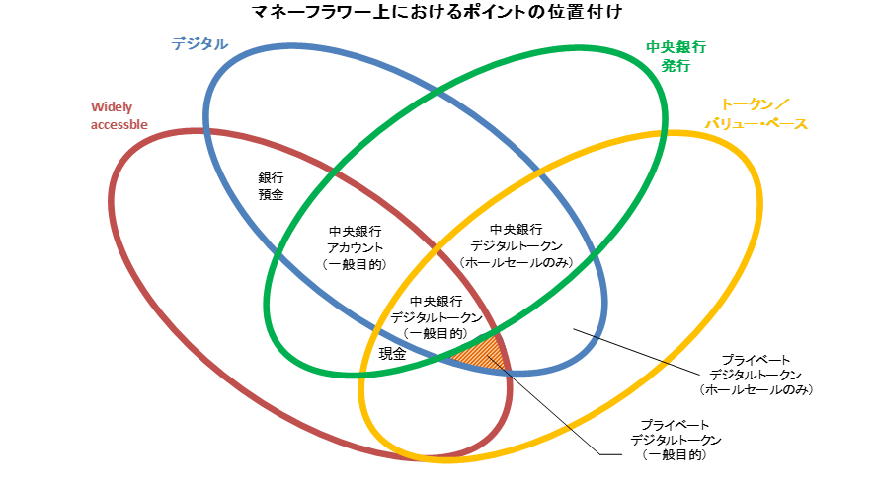
Positioning of Loyalty Points on the Money Flower
Electronic
Central bank- issued
Peer-to-peer
Bank deposits
Central bank accounts (general purpose)
Central bank
digital tokens (wholesale only)
Central bank
digital tokens (general purpose)
Cash
Private digital tokens
(wholesale only)
Private digital tokens
(general purpose)

