Slide 1
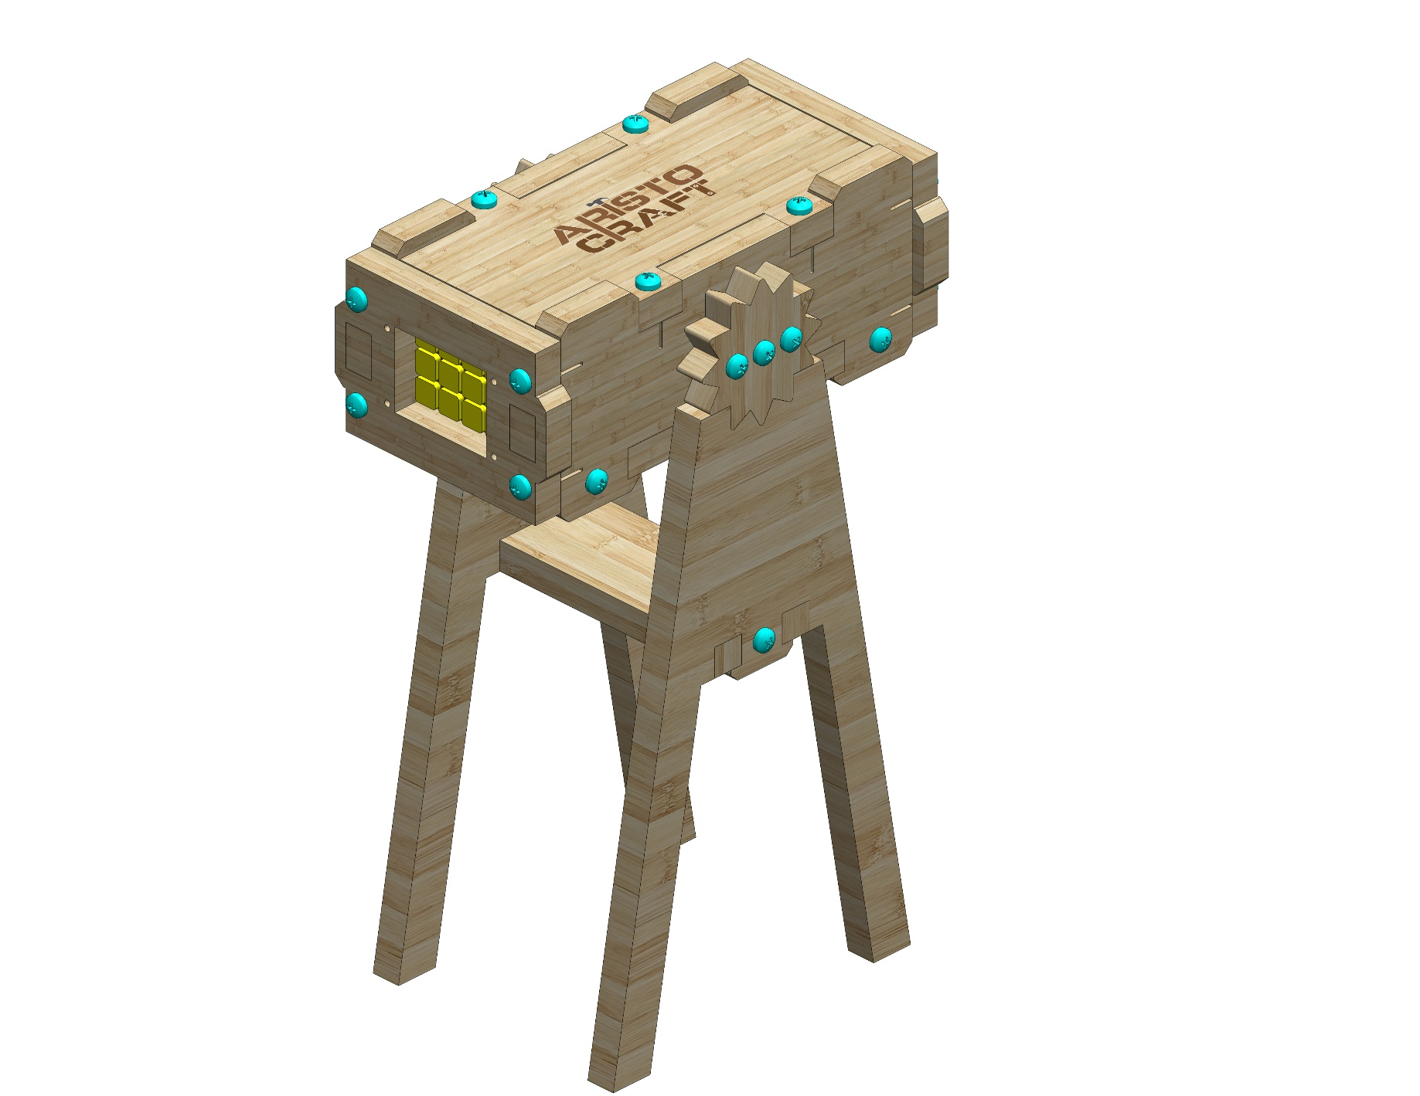
FLASH LIGHT
Assembly instruction
© All rights reserved to AristoCraft Ltd. Do not copy or reproduce without written permission.

Slide 2
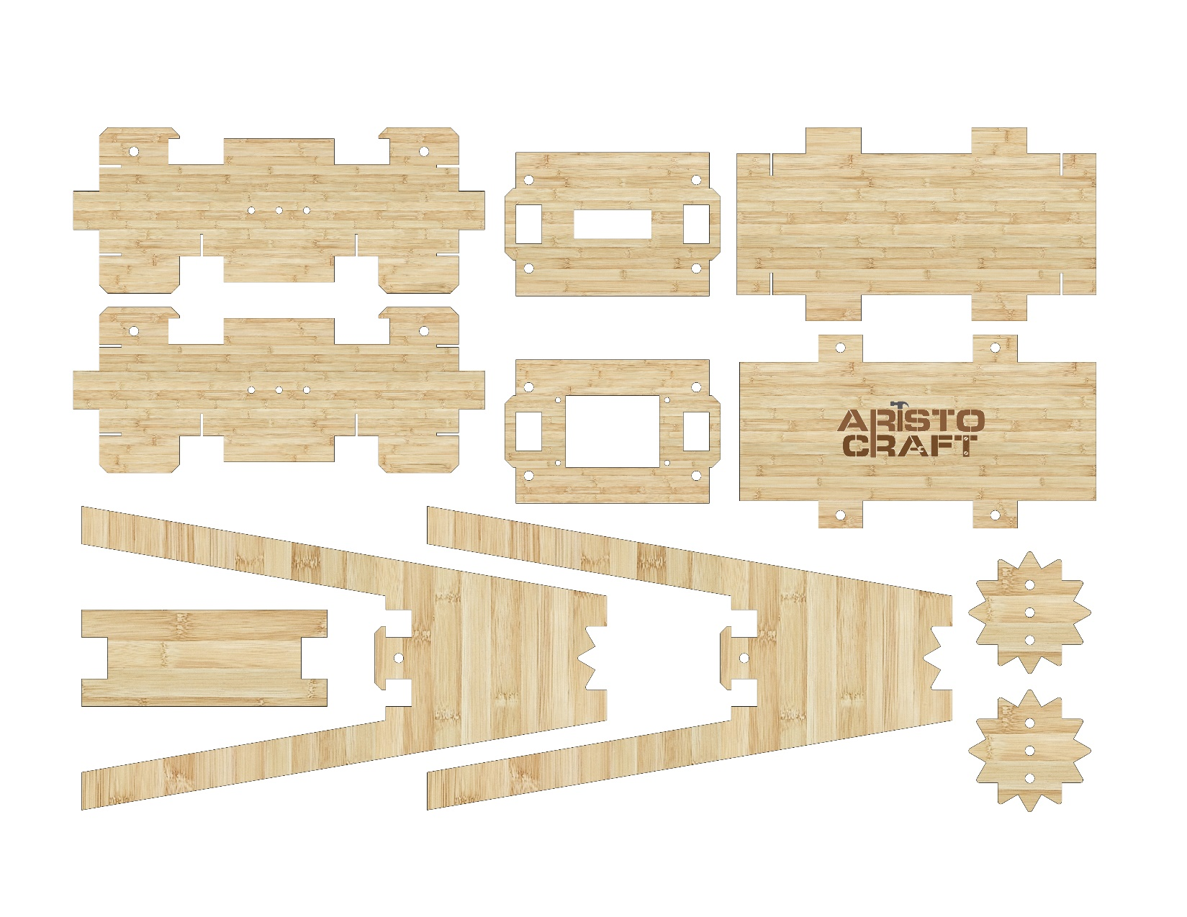
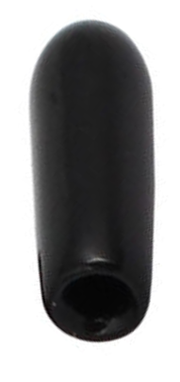
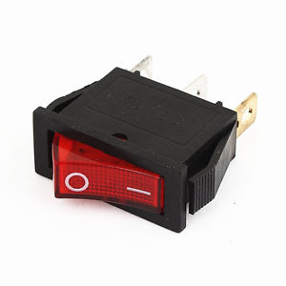
Part list
1
2
4
1
3
5
8
6
7
7
8
9
13
11
12
10
© All rights reserved to AristoCraft Ltd. Do not copy or reproduce without written permission.

Slide 3
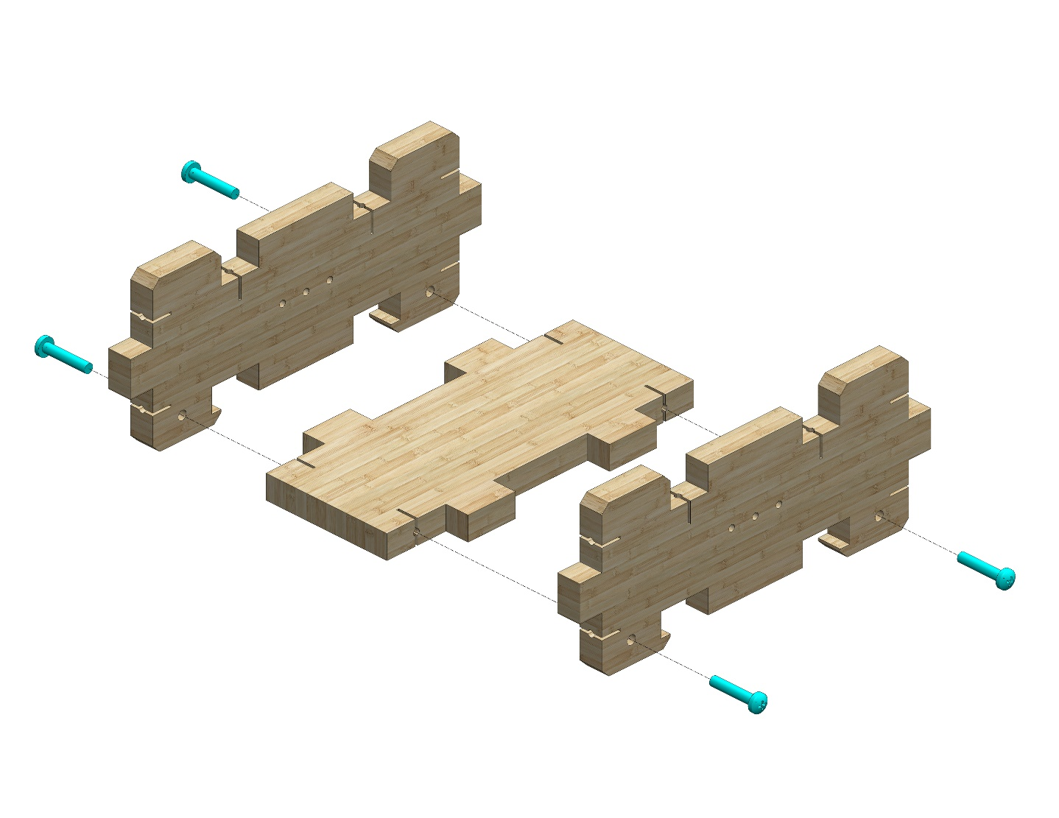
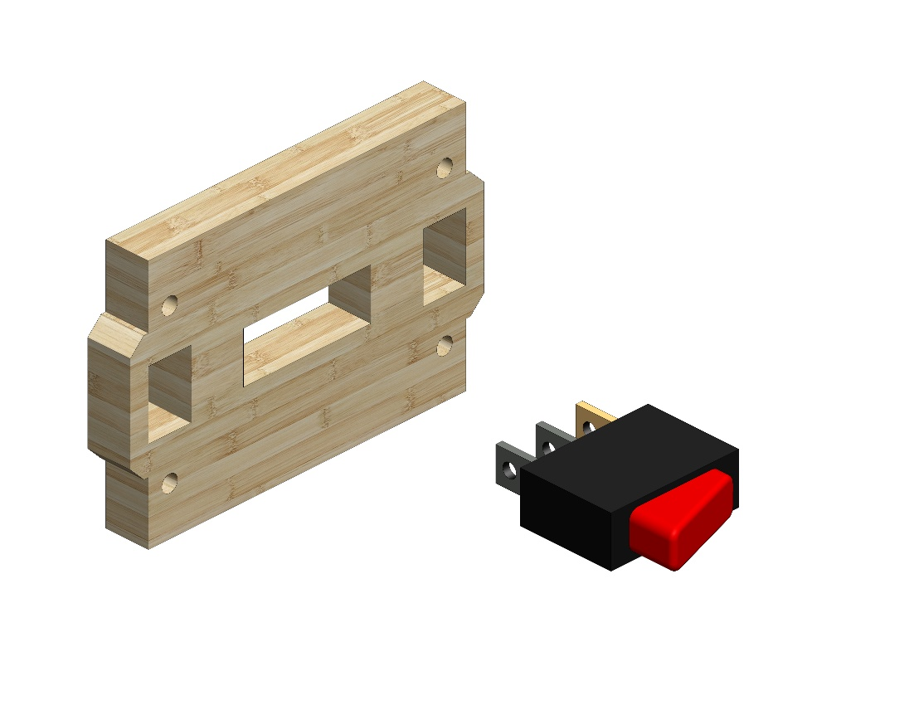
Instructions
1
Attach two Part 1s to Part 4 as illustrated in the diagram. Use four #20 bolts.
1
4
Insert the switch (Part 10) into the appropriate opening in Part 2.
2
10
© All rights reserved to AristoCraft Ltd. Do not copy or reproduce without written permission.

Slide 4
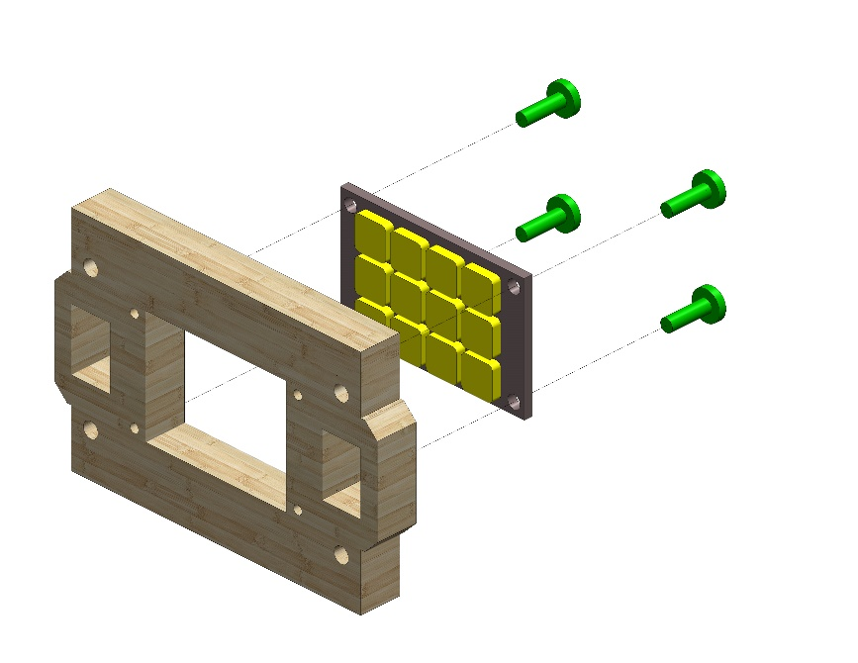
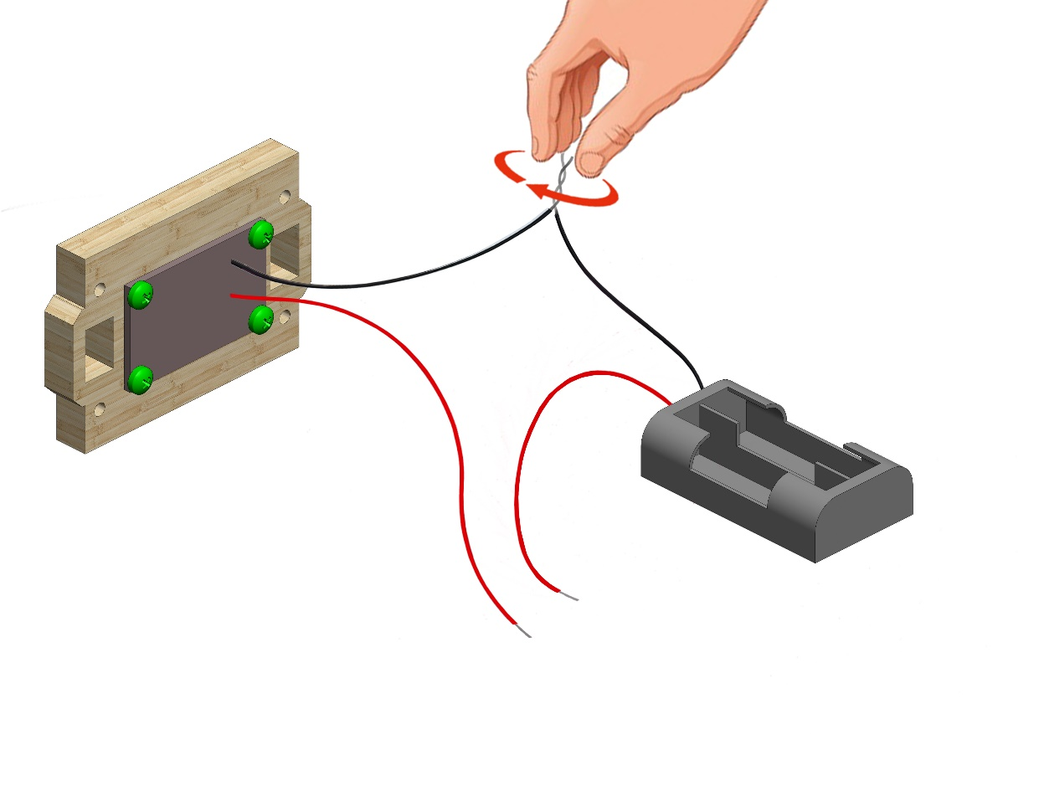
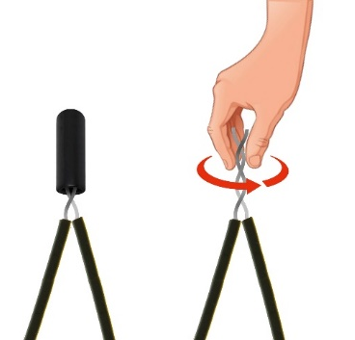
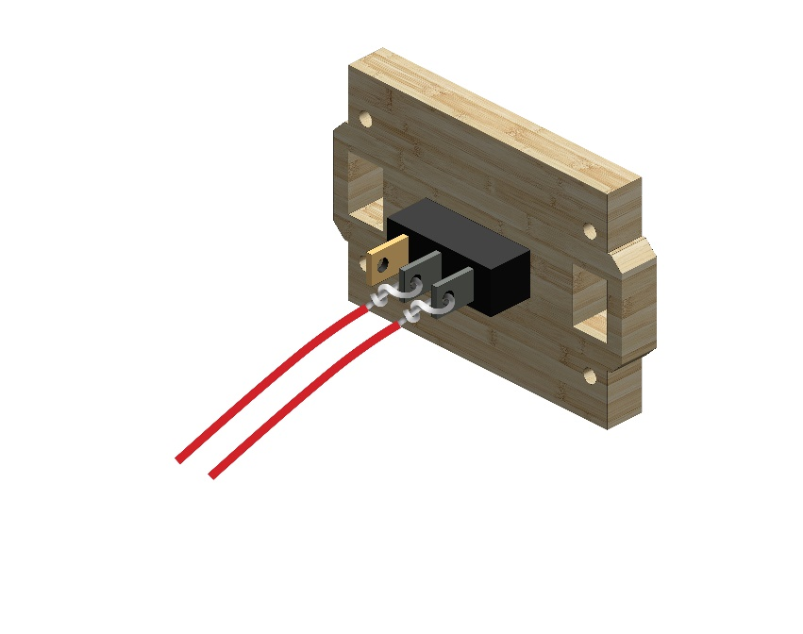
9
3
Attach the LED strip (Part 9) to Part 3. Use four #10 bolts.
Twist the black wire from the battery housing (Part 11) with the black wire emerging from the LED strip. Attach an insulating cap as pictured.
11
13
Twist the ends of the two wires onto the silver contacts from the switch as pictured.
© All rights reserved to AristoCraft Ltd. Do not copy or reproduce without written permission.

Slide 5
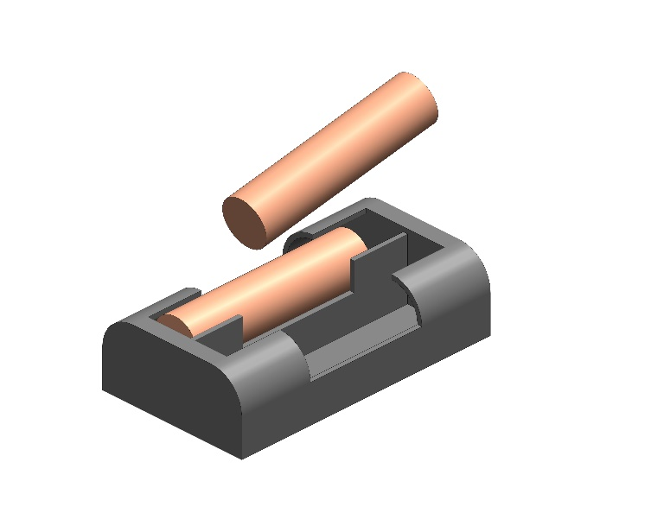
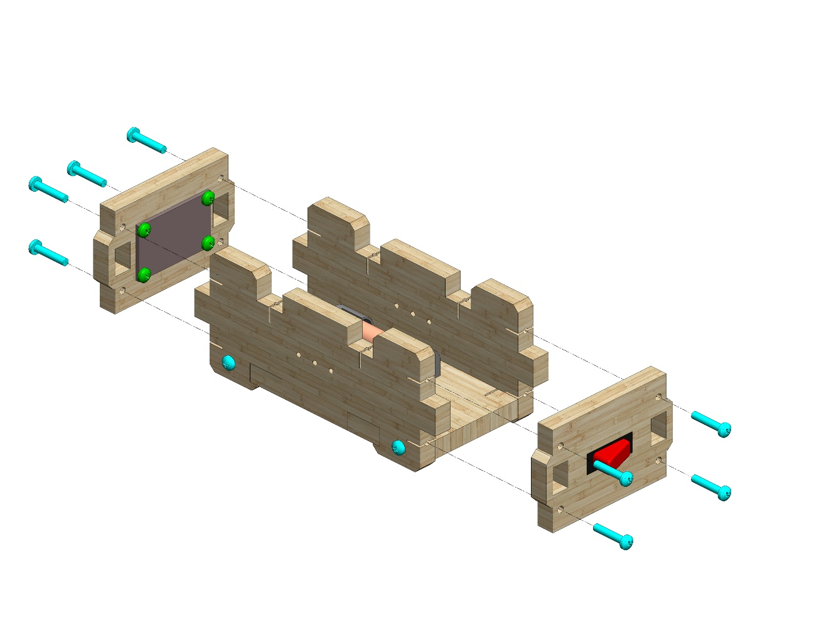
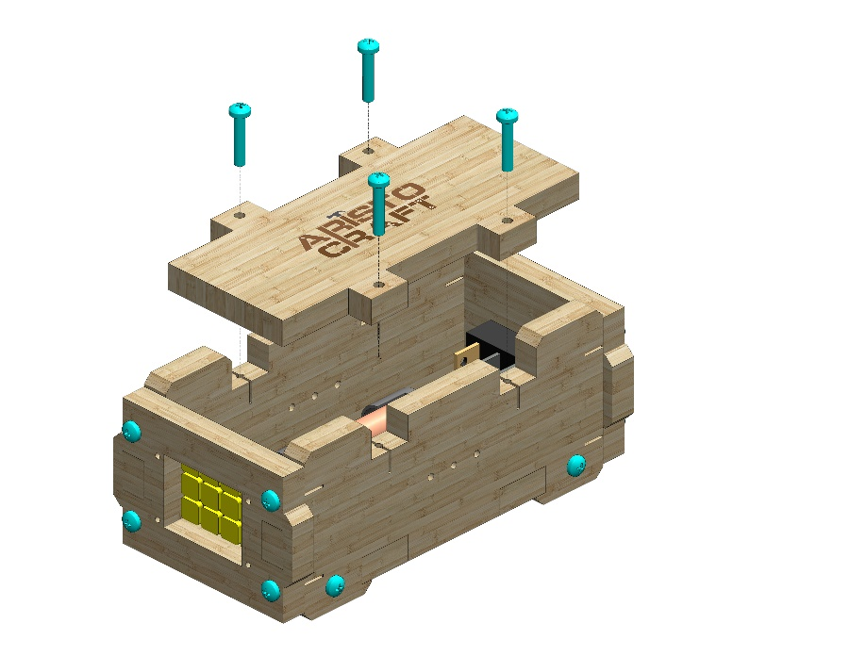
12
Insert the batteries (Part 12) into the battery housing. Make sure the + and – ends match the markings in the housing.
Attach the two assembled covers as pictured. Use eight #20 bolts.
Attach Part 5 as pictured. Use four #20 bolts.
5
© All rights reserved to AristoCraft Ltd. Do not copy or reproduce without written permission.

Slide 6
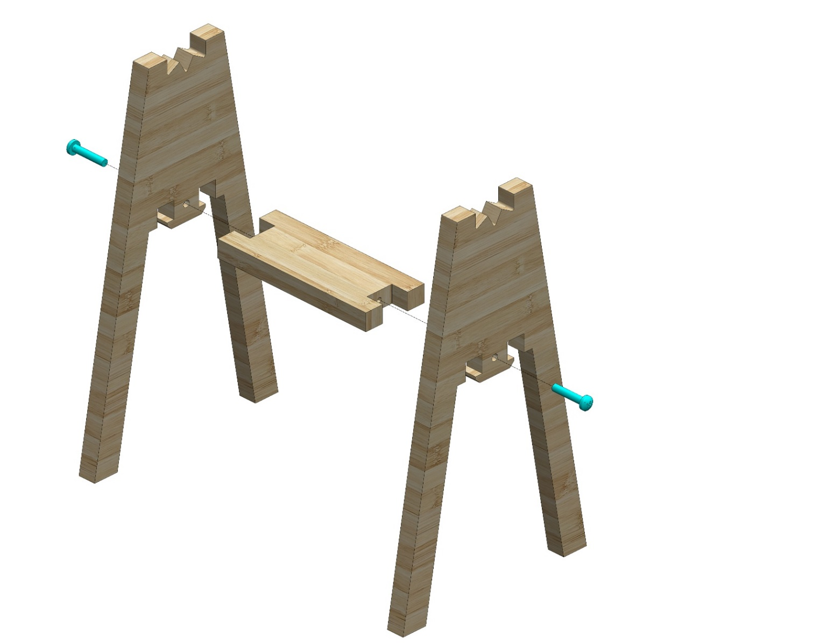
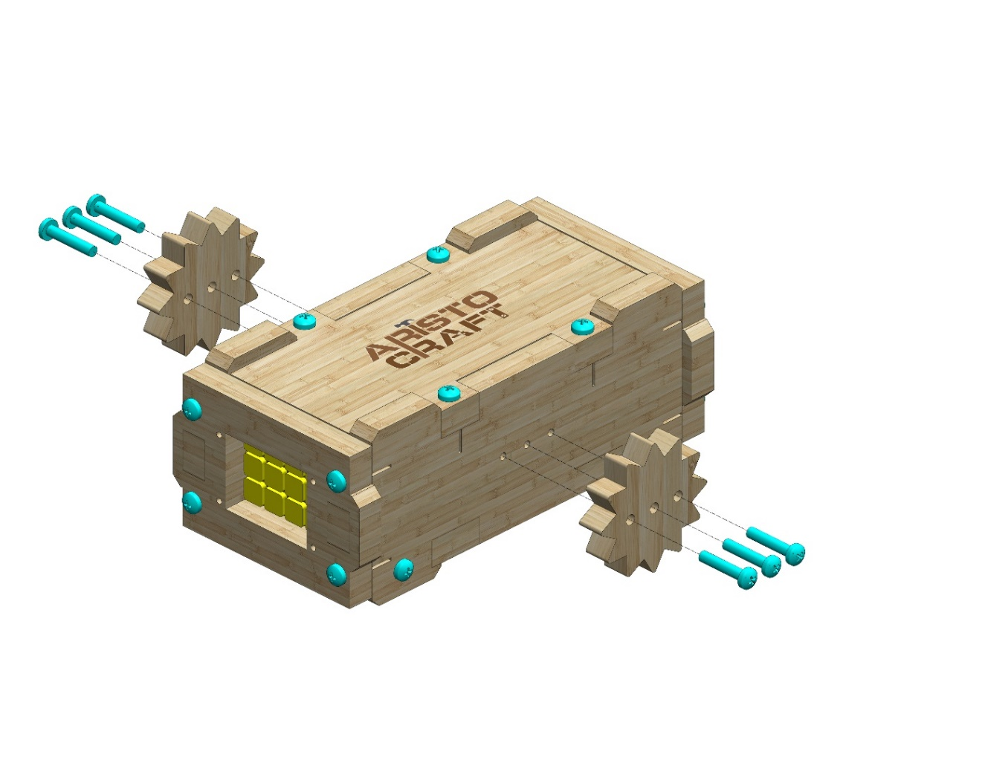
Attach two Part 7s to Part 6 as pictured. Use two #20 bolts.
6
7
7
Attach two Part 8s as pictured. Use six #20 bolts.
8
8
© All rights reserved to AristoCraft Ltd. Do not copy or reproduce without written permission.

