Slide 1
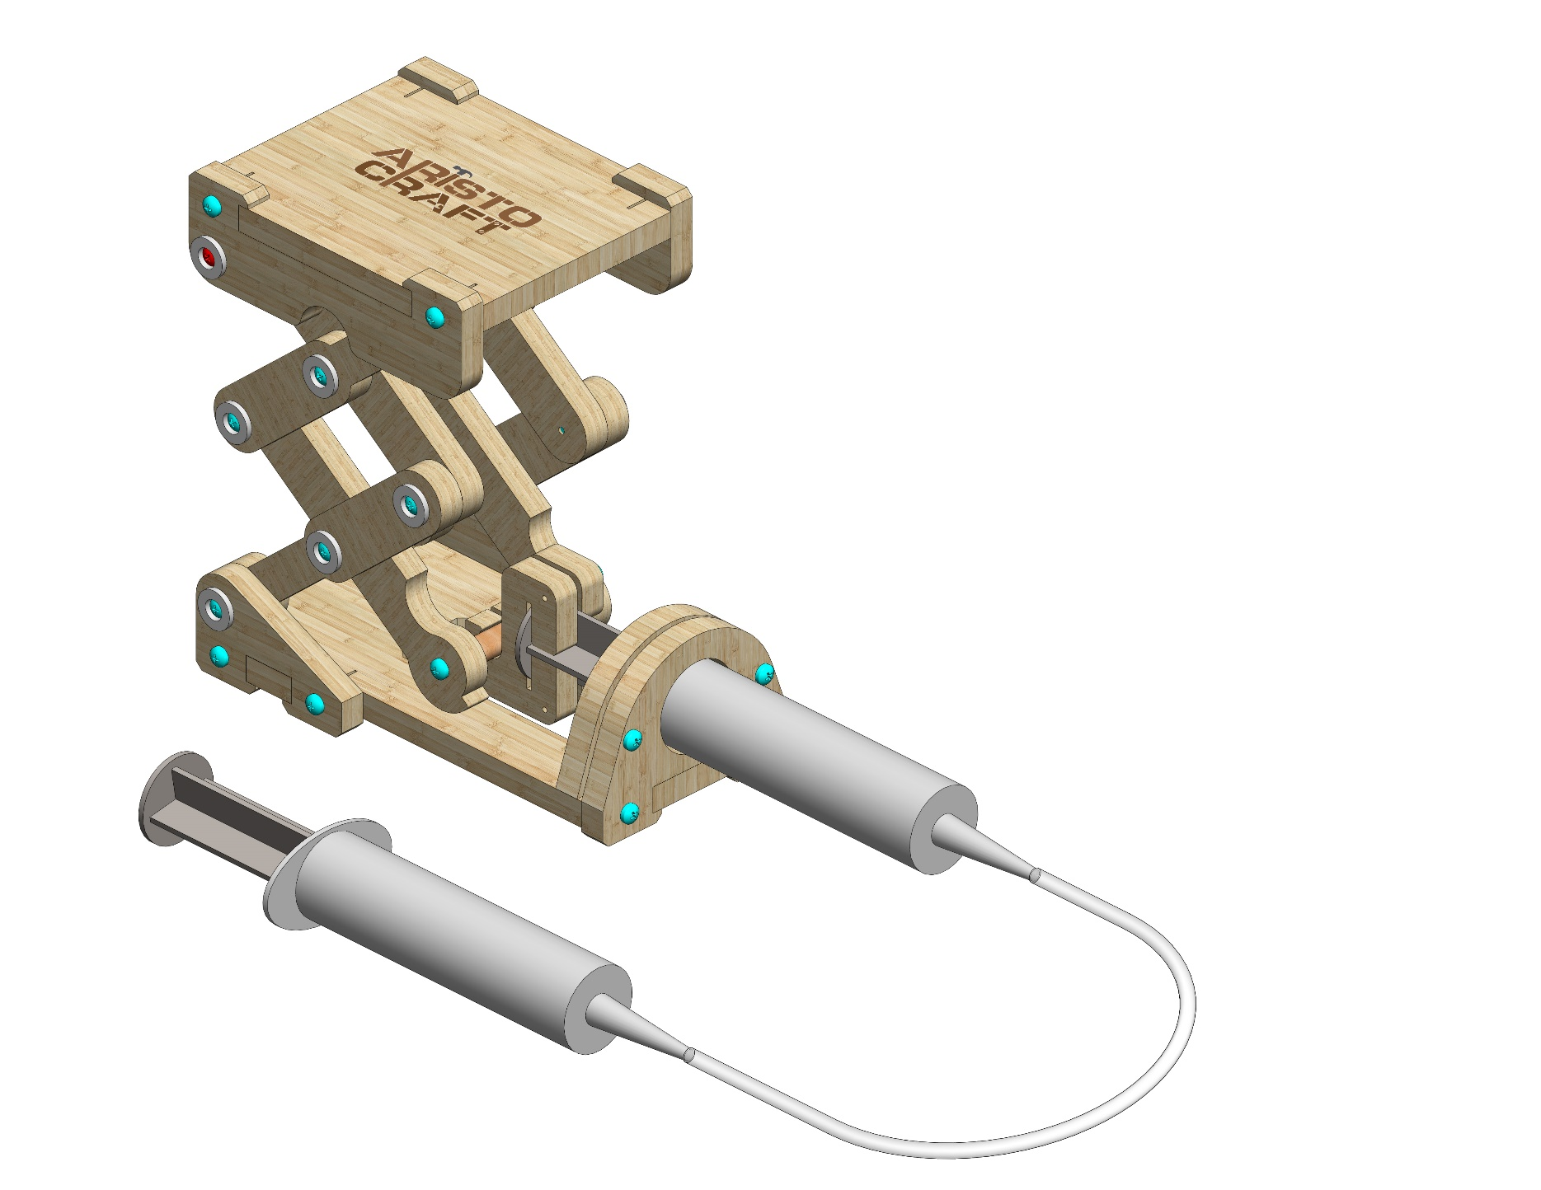
HYDRAULIC LIFT
Assembly instruction
© All rights reserved to AristoCraft Ltd. Do not copy or reproduce without written permission.

Slide 2
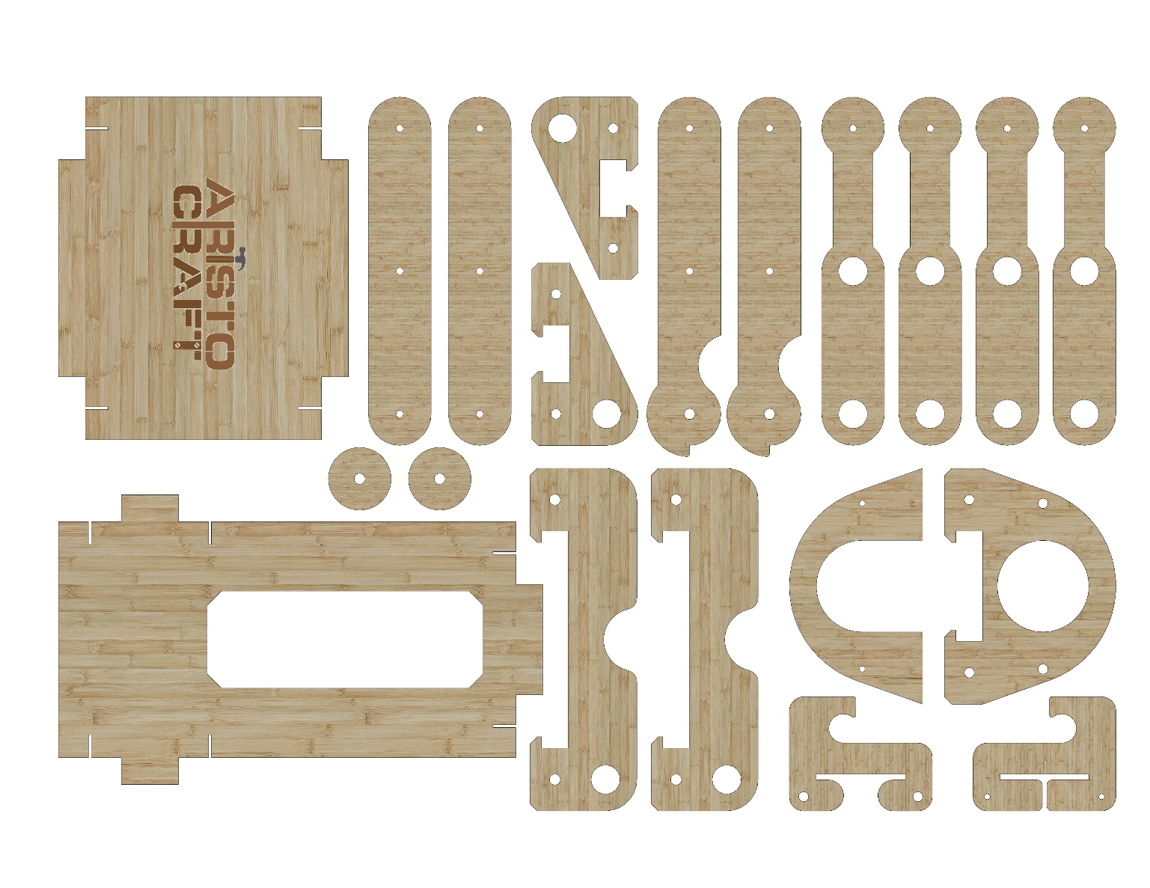
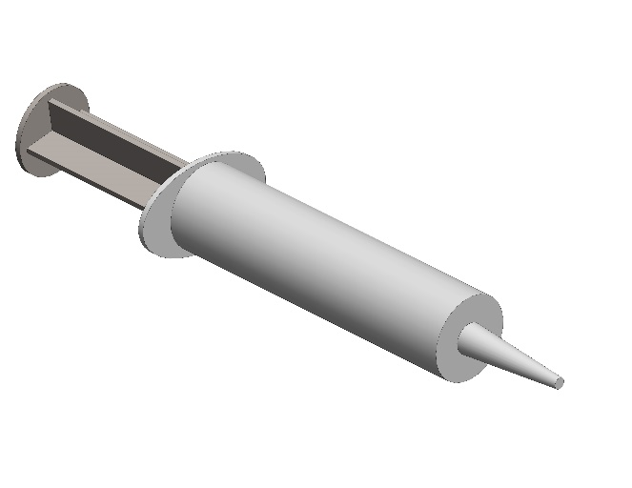
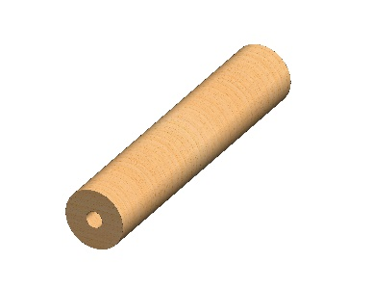
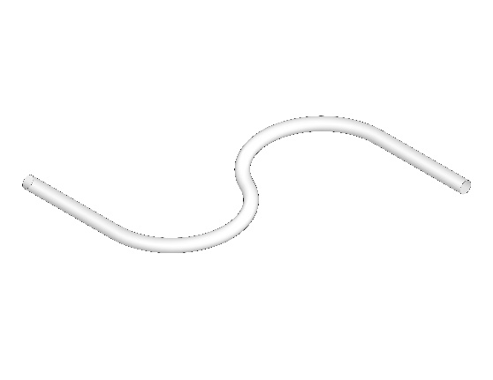
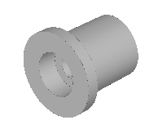
Part list
2
2
3
4
4
5
5
5
5
1
3
7
7
8
8
9
10
6
11
12
14
13
15
16
X12
1
© All rights reserved to AristoCraft Ltd. Do not copy or reproduce without written permission.

Slide 3
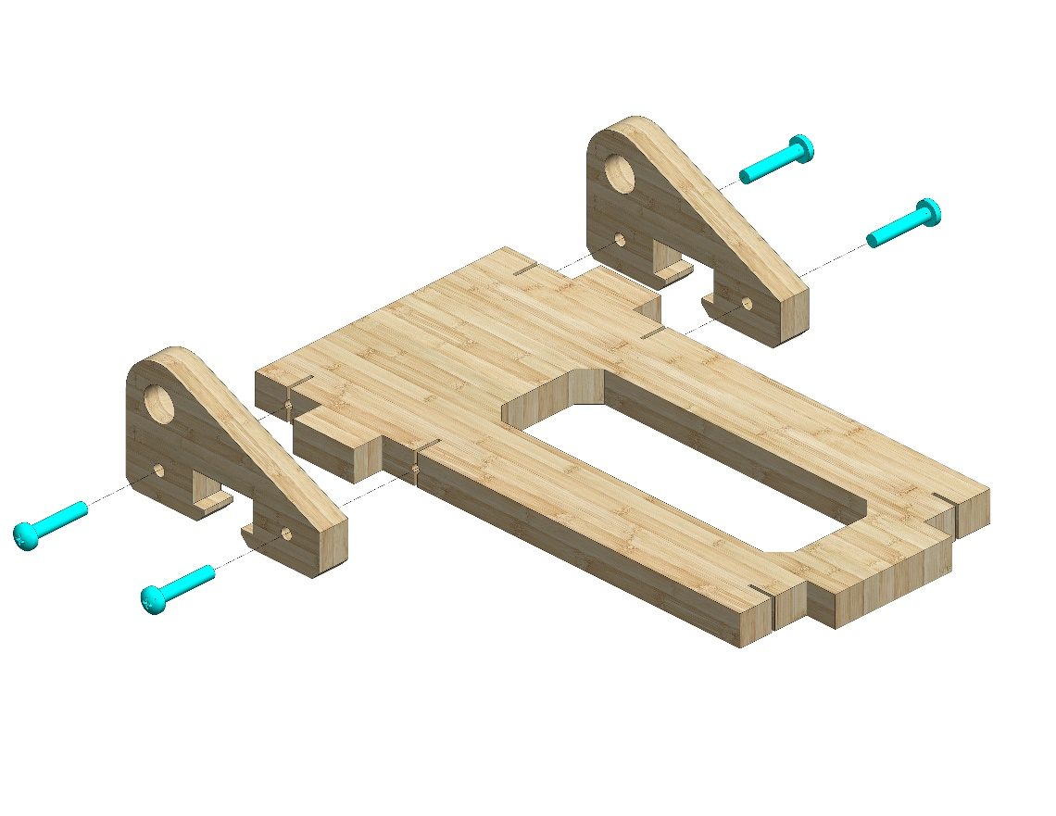
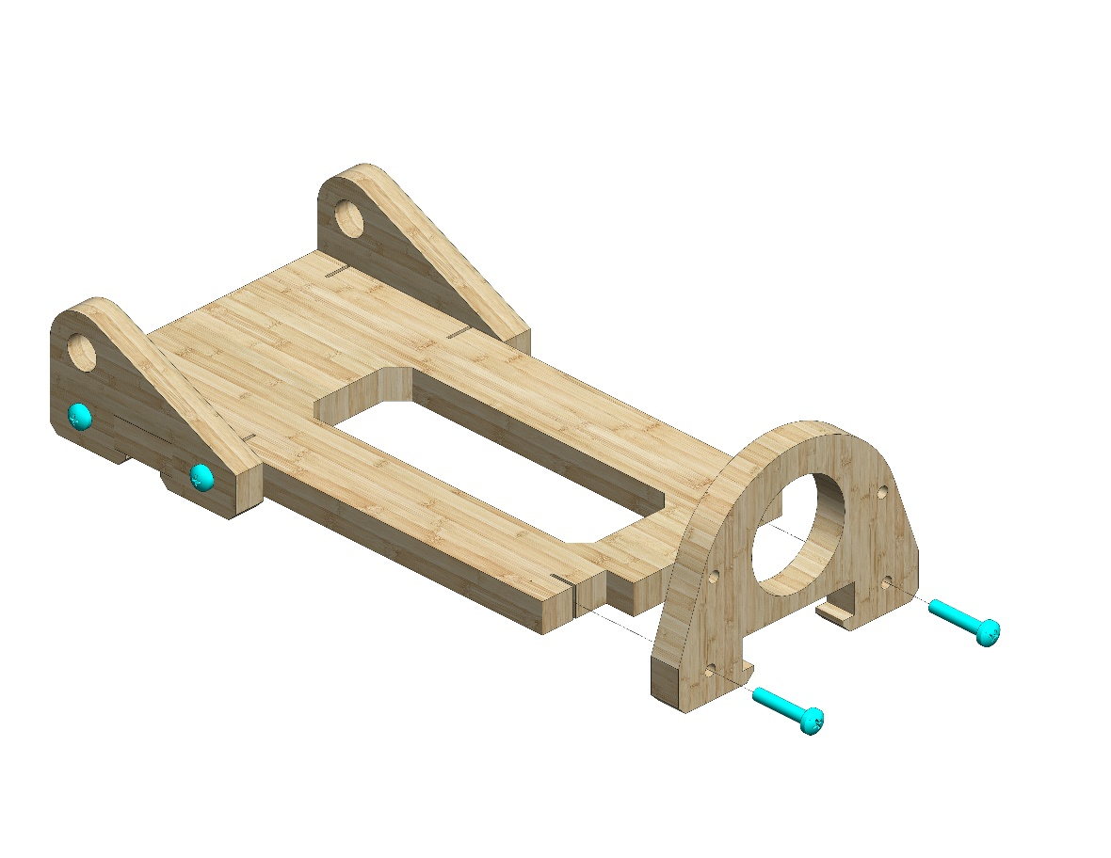
Instructions
Attach two Part 3s to Part 6. Use four #20 bolts.
3
3
6
Attach Part 10. Use two #20 bolts.
10
2
© All rights reserved to AristoCraft Ltd. Do not copy or reproduce without written permission.

Slide 4
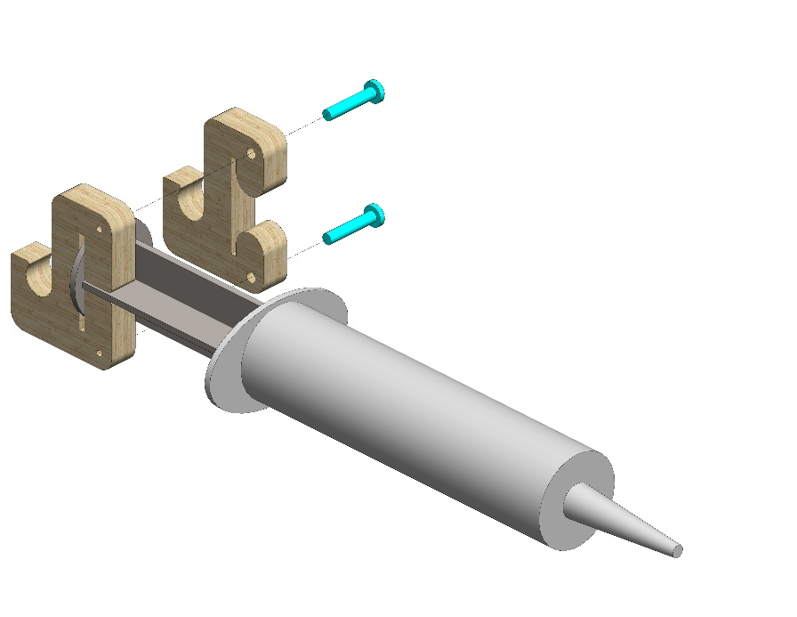
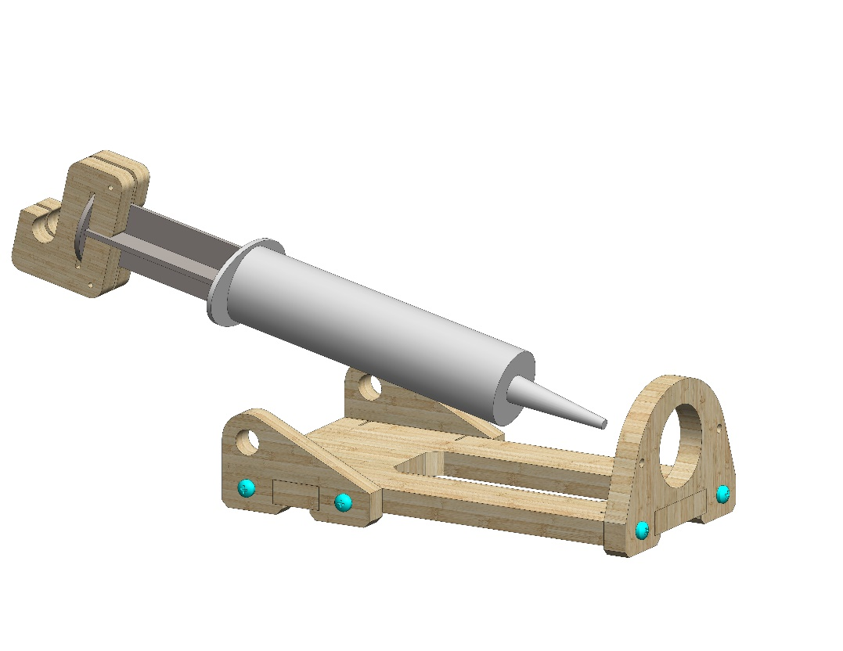
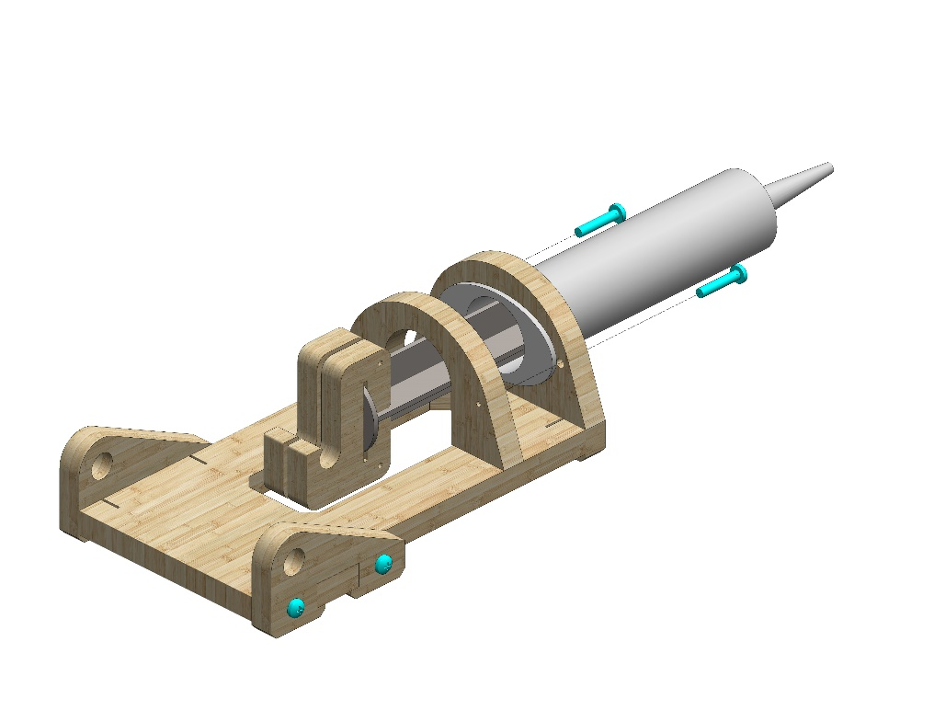
11
Position Part 12 in Part 13 as pictured.
Attach Part 11. Use 2 #20 bolts.
13
12
Insert the prepared module into the opening..
9
Place Part 9 as pictured.
Use two #20 bolts.
3
© All rights reserved to AristoCraft Ltd. Do not copy or reproduce without written permission.

Slide 5
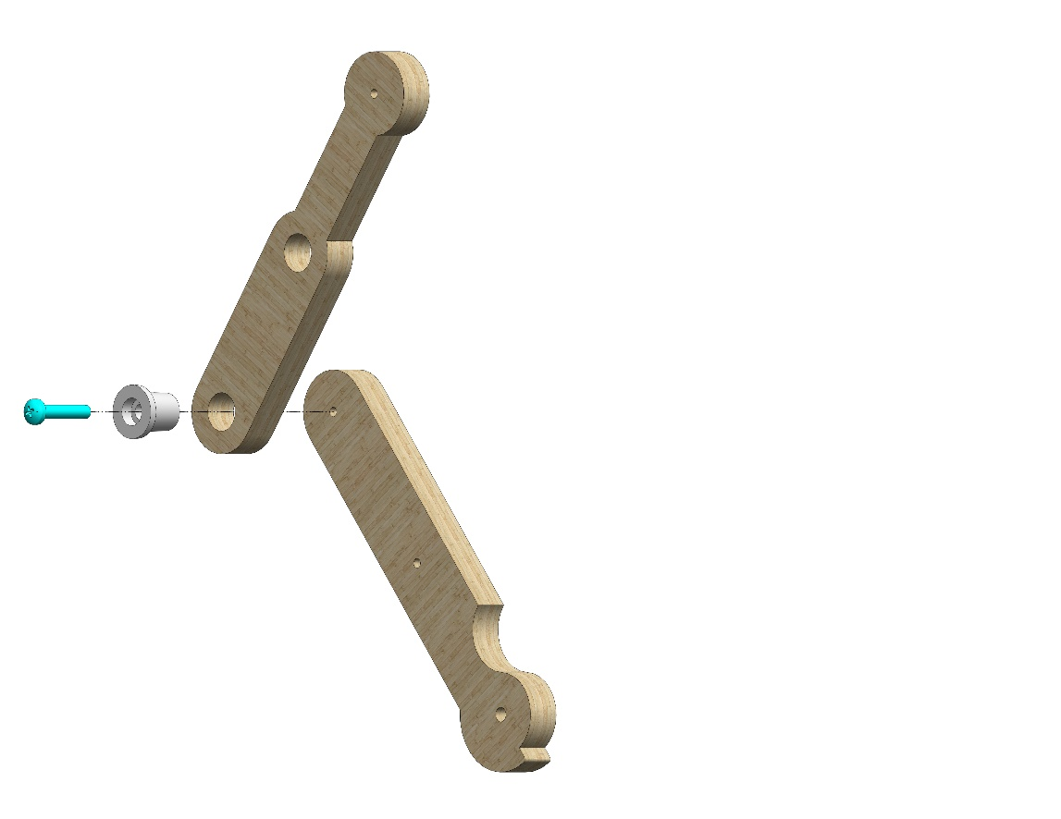
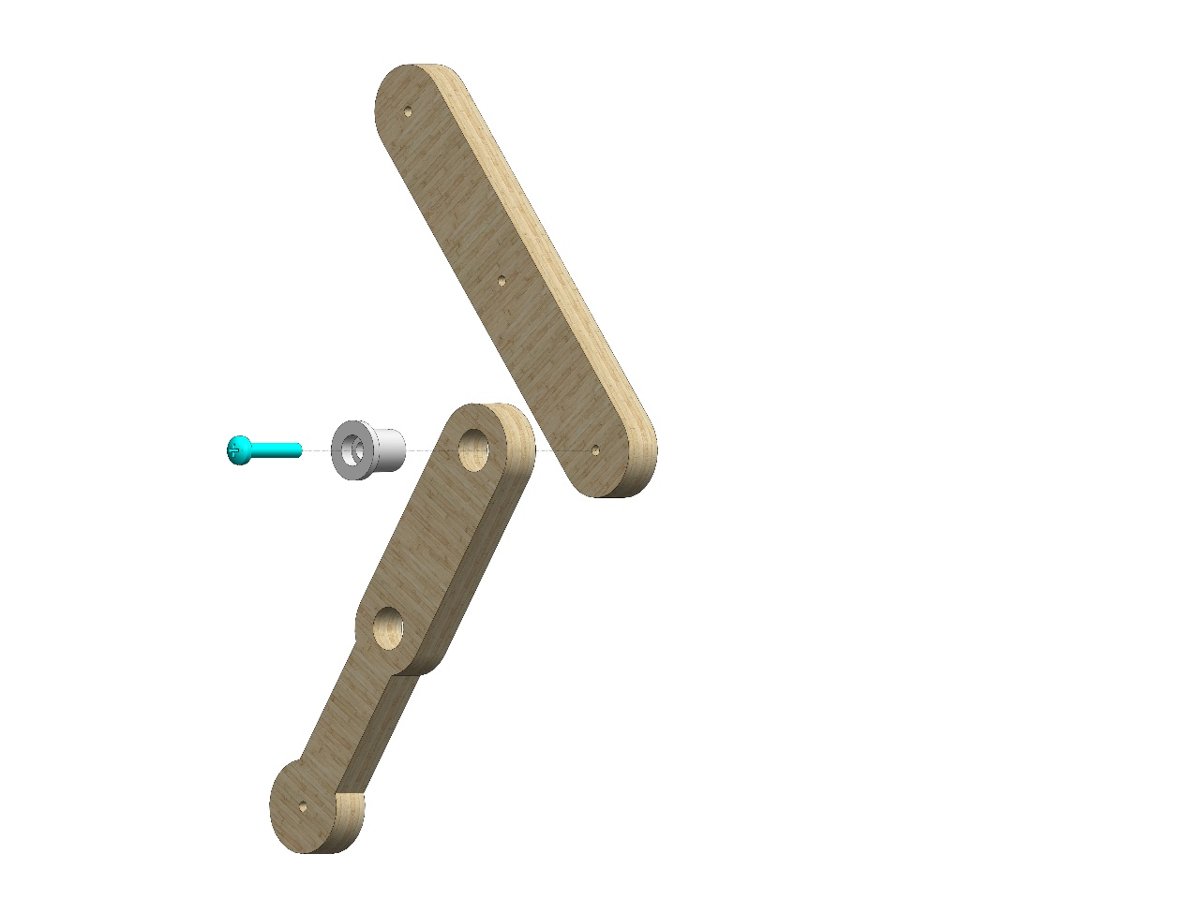
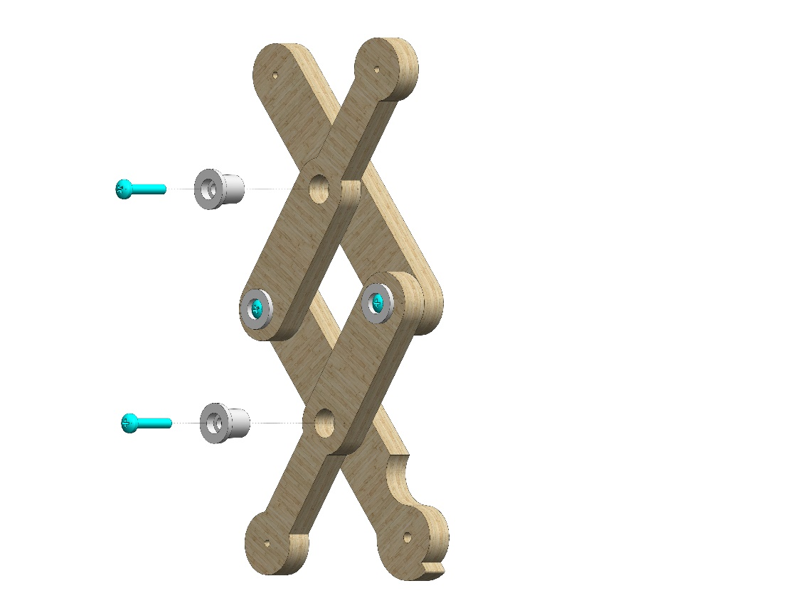
Attach Part 5 to Part 4 using Part 16. Use one #20 bolt..
5
4
16
2
16
Attach Part 5 to Part 2 using Part 16. Use one #20 bolt.
5
16
16
Join the two assembled modules together using two Part 16s. Use two #20 bolts.
4
© All rights reserved to AristoCraft Ltd. Do not copy or reproduce without written permission.

Slide 6
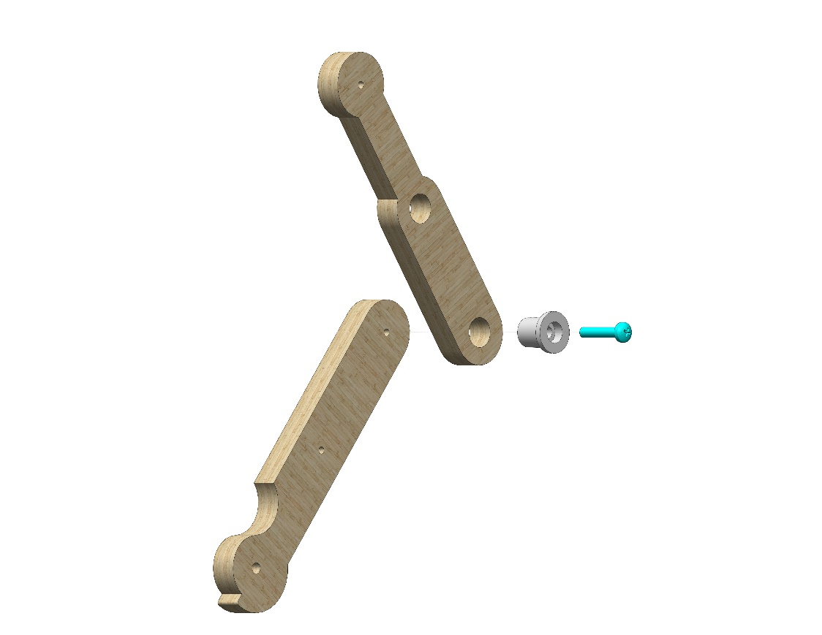
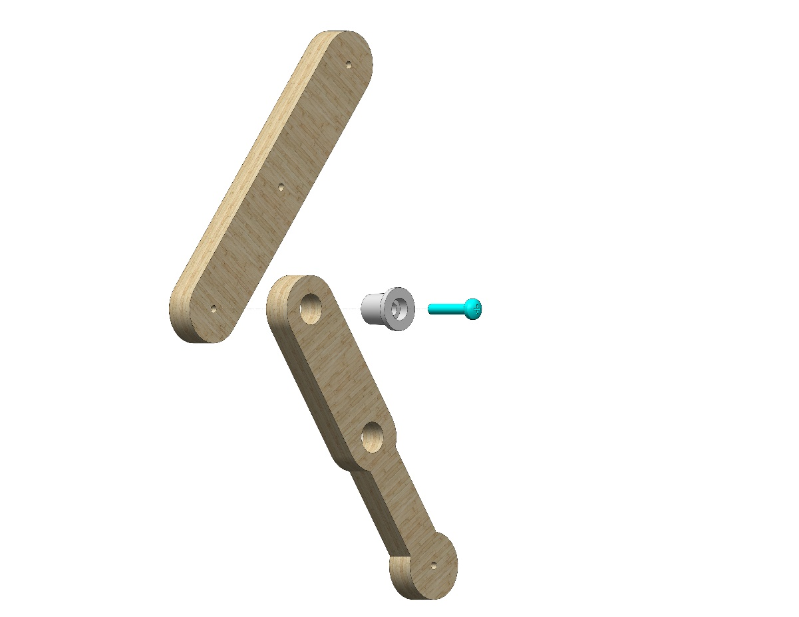
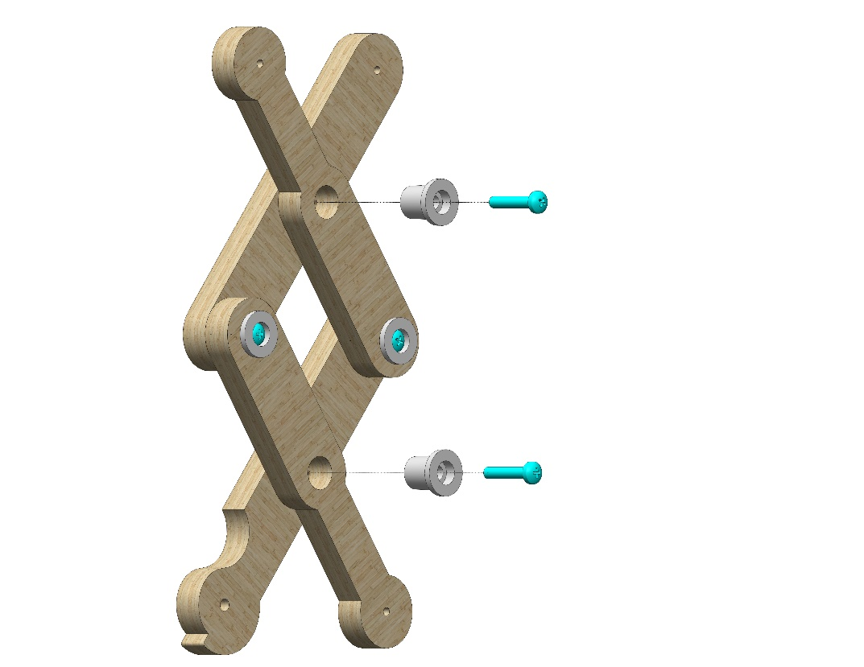
Attach Part 5 to Part 4 using Part 16. Use one #20 bolt..
5
16
2
4
16
Attach Part 5 to Part 2 using Part 16. Use one #20 bolt..
5
16
16
Join the two assembled modules together using two Part 16s. Use two #20 bolts.
5
© All rights reserved to AristoCraft Ltd. Do not copy or reproduce without written permission.

Slide 7
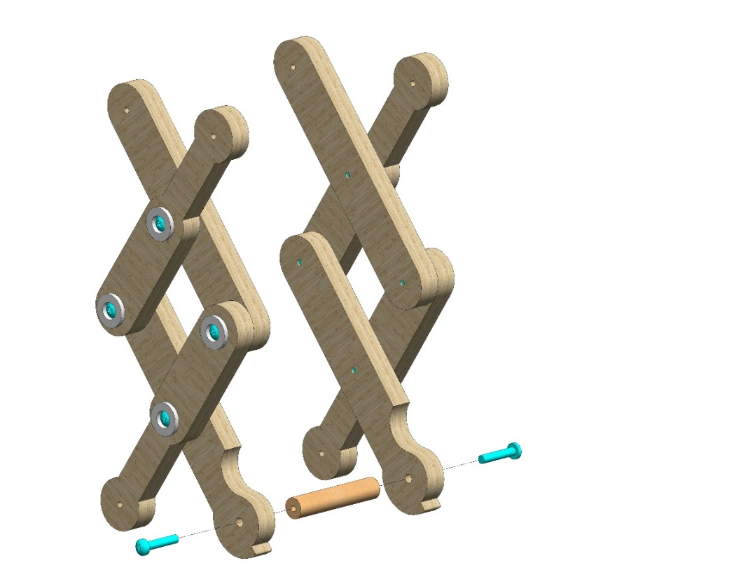
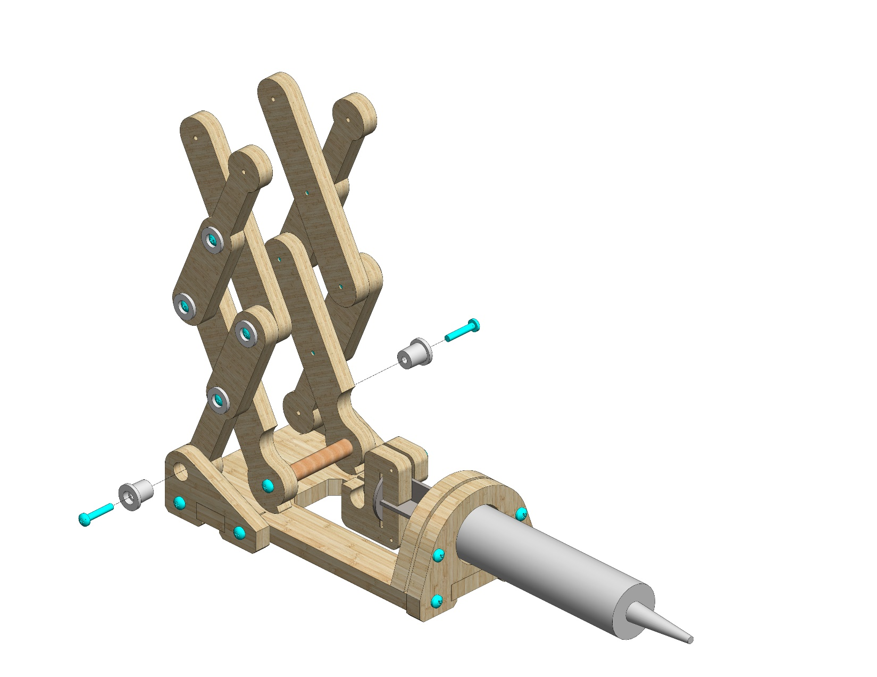
Attach the two modules to Part 14 as pictured. Use two #20 bolts.
Do not tighten!
14
Attach two Part 16s to the prepared module as pictured.
Use two #20 bolts.
16
16
6
© All rights reserved to AristoCraft Ltd. Do not copy or reproduce without written permission.

Slide 8
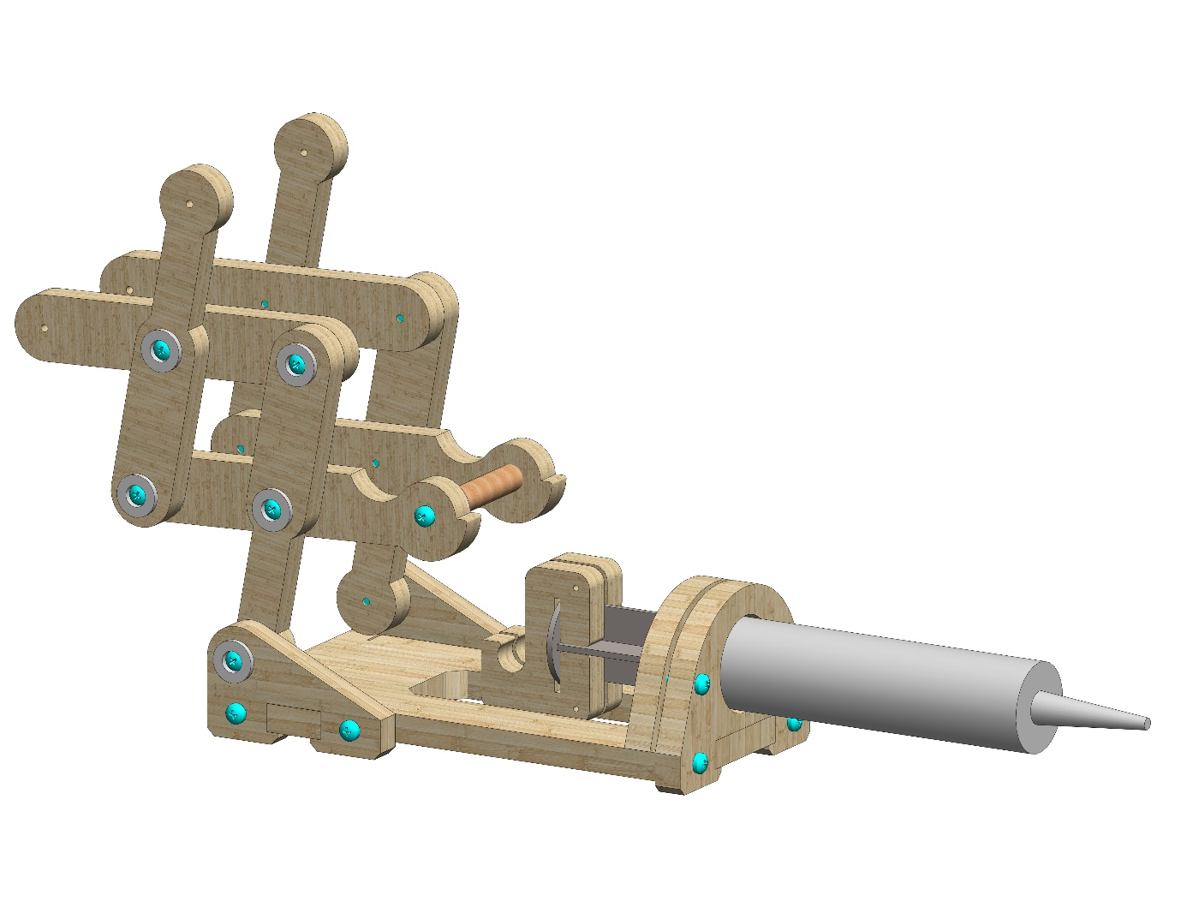
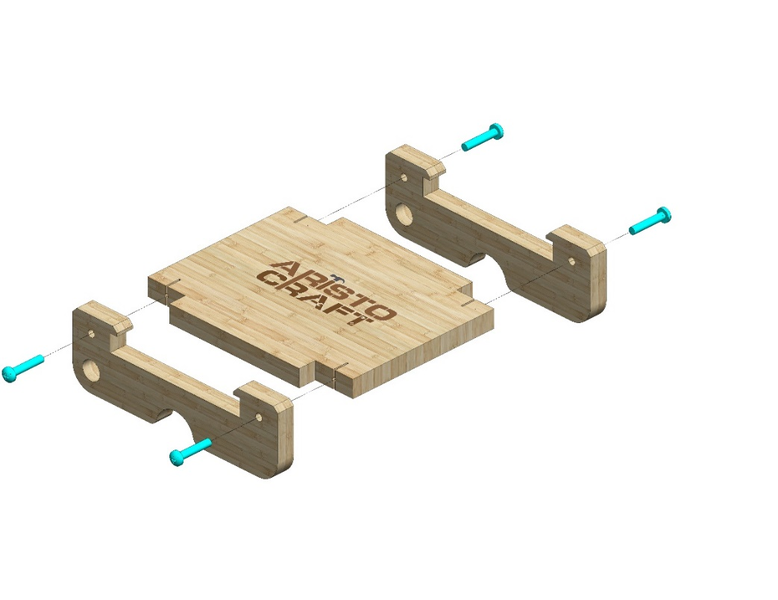
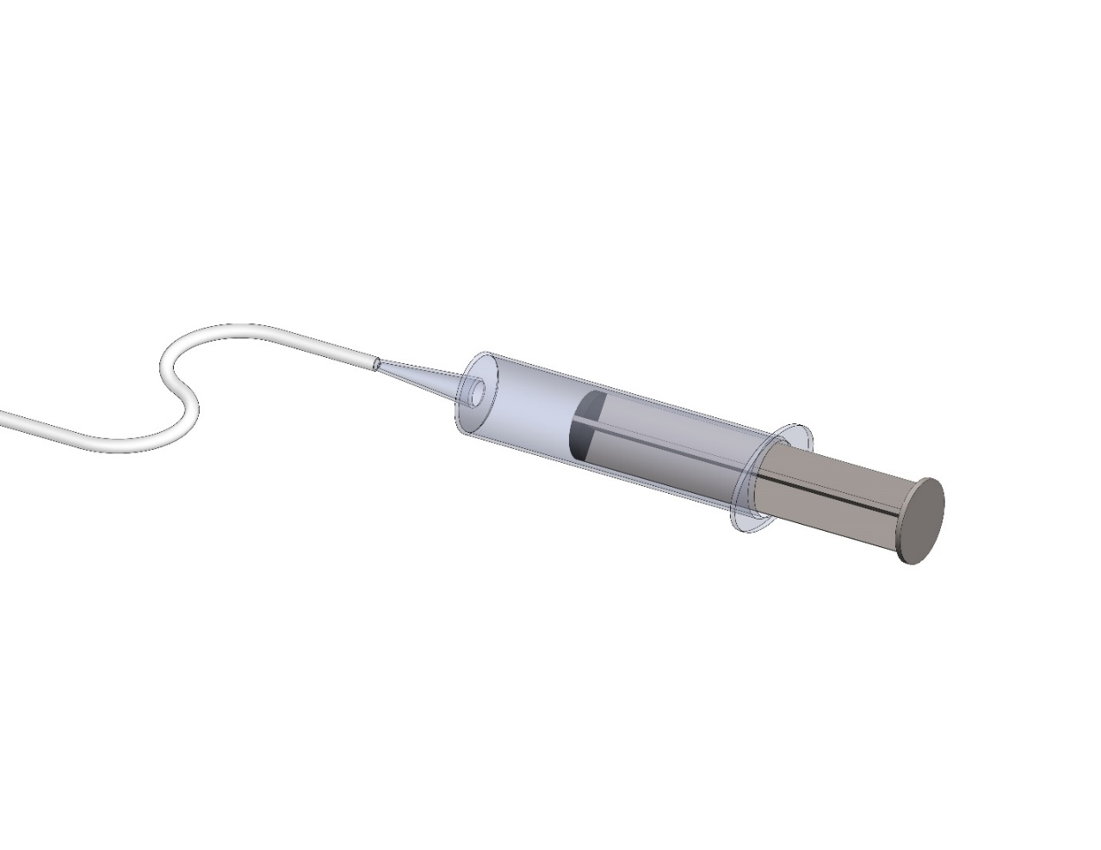
Using gentle pressure, insert the rod into place as pictured.
1
8
8
Attach two Part 8s to Part 1.
Use four #20 bolts.
Attach the tubing (Part 15) to the end of the syringe (Part 13). Apply pressure to make sure that the tubing is attached properly. Press the syringe into the closed position.
15
13
7
© All rights reserved to AristoCraft Ltd. Do not copy or reproduce without written permission.

Slide 9
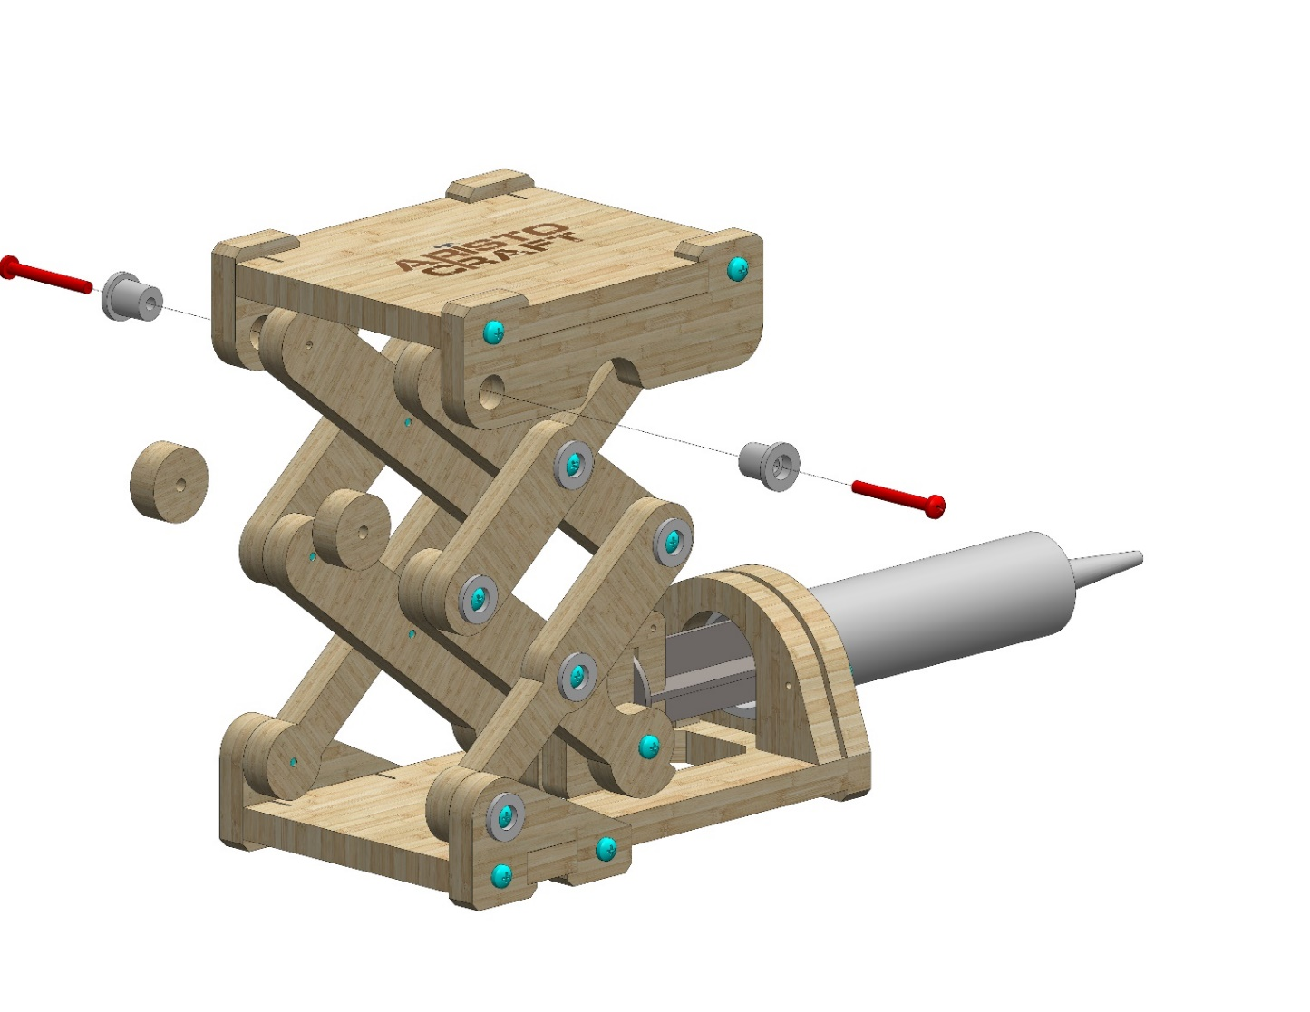
Insert two Part 7s as pictured and attach them using two Part 16s.
Use two #30 bolts.
16
16
7
Fill a cup with water. Make sure the syringe is in the closed position.
Insert the tubing into the cup of water. After that, draw water through the tubing (by pulling the syringe open) up to the ‘40’ line.
10
20
30
40
50
8
© All rights reserved to AristoCraft Ltd. Do not copy or reproduce without written permission.

Slide 10
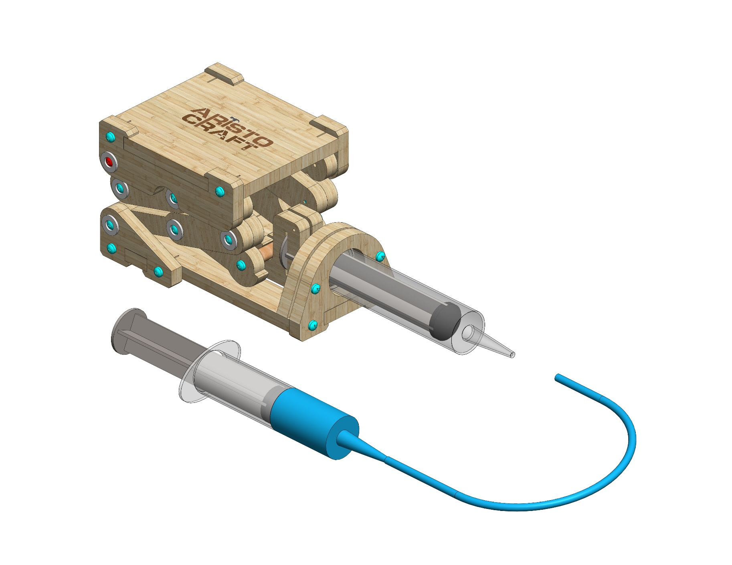
Make sure the platform is lowered.
Attach the end of the tubing to the syringe as pictured.
9
© All rights reserved to AristoCraft Ltd. Do not copy or reproduce without written permission.

