Slide 1
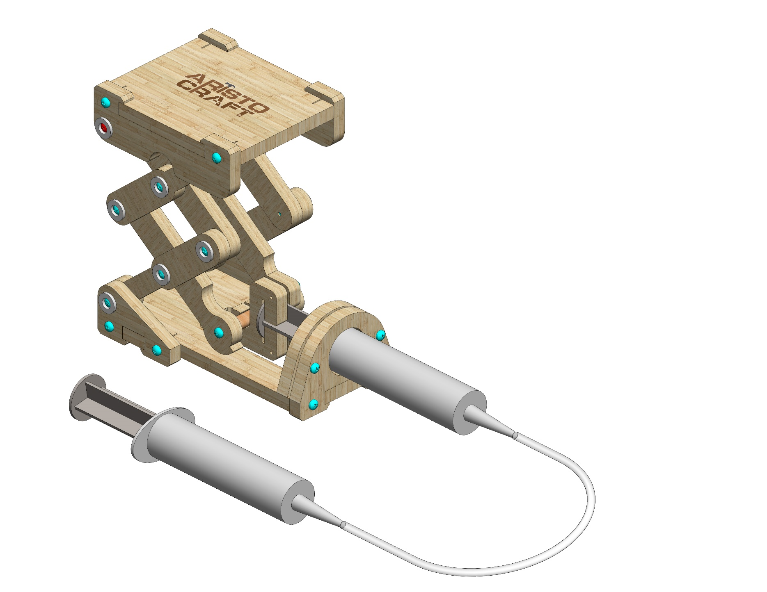
Jack-Lift Platform
Assembly instructions

Slide 2
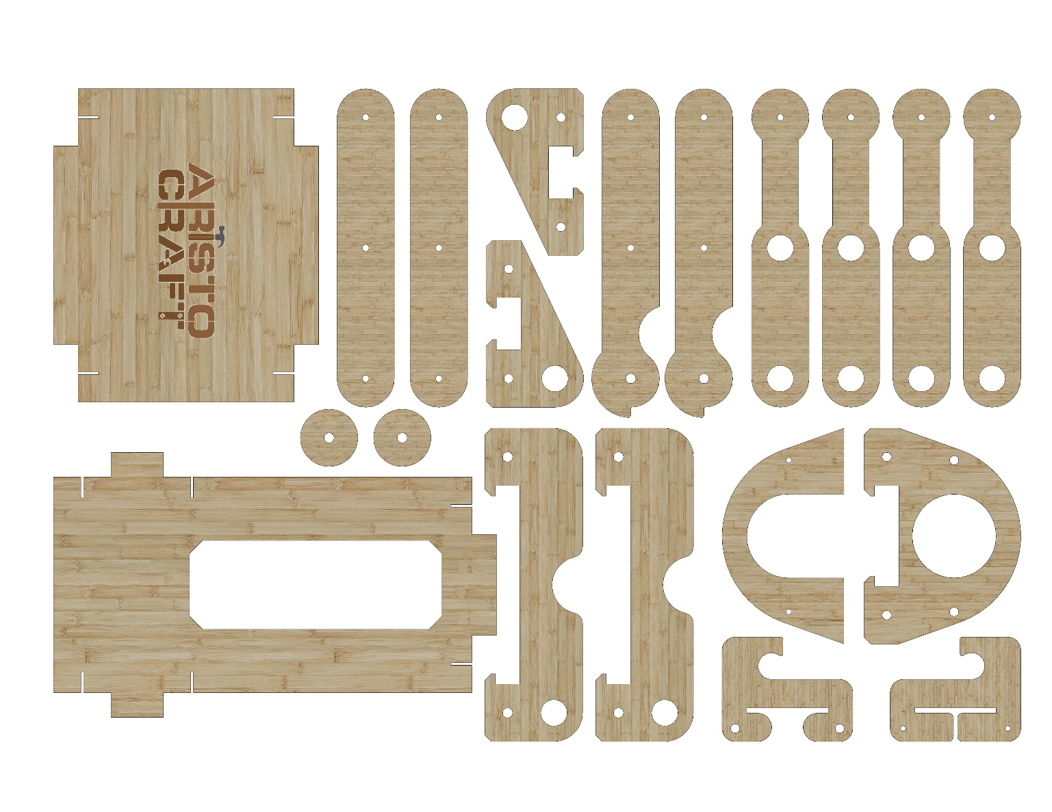
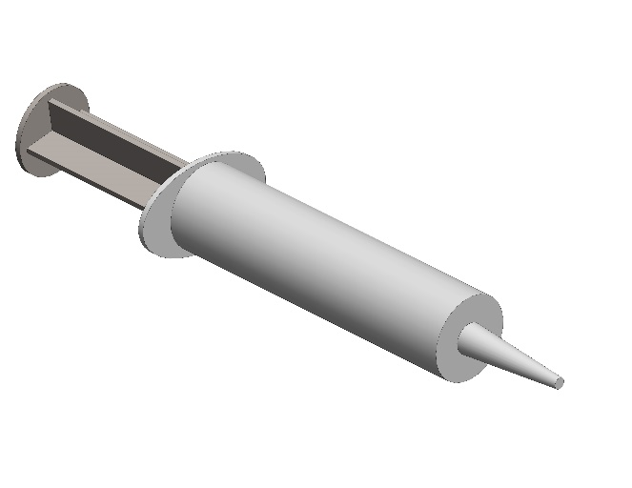
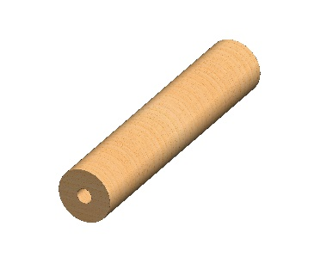
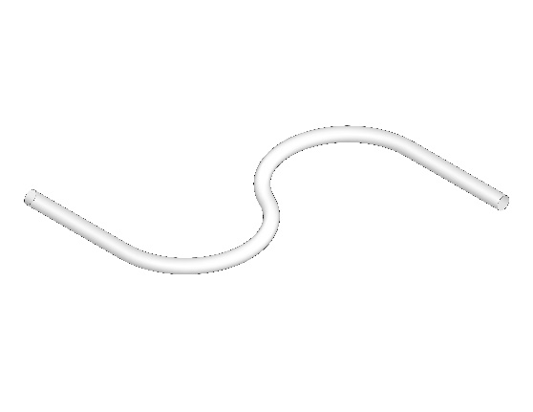
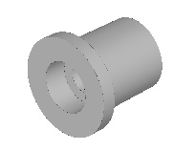
Part list
2
2
3
4
4
5
5
5
5
1
3
7
7
8
8
9
10
6
11
12
14
13
15
16
X12
© All rights reserved to AristoCraft Ltd. Do not copy or reproduce without written permission.

Slide 3
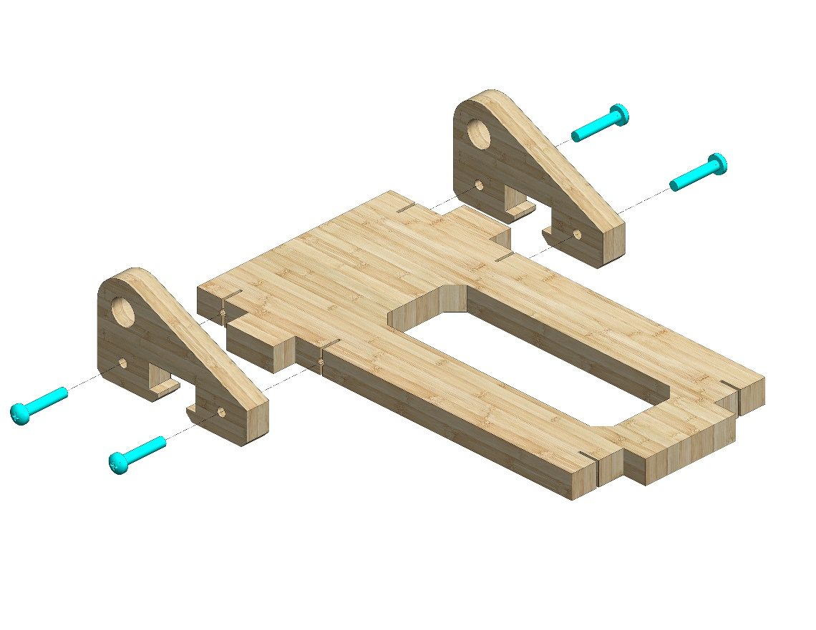
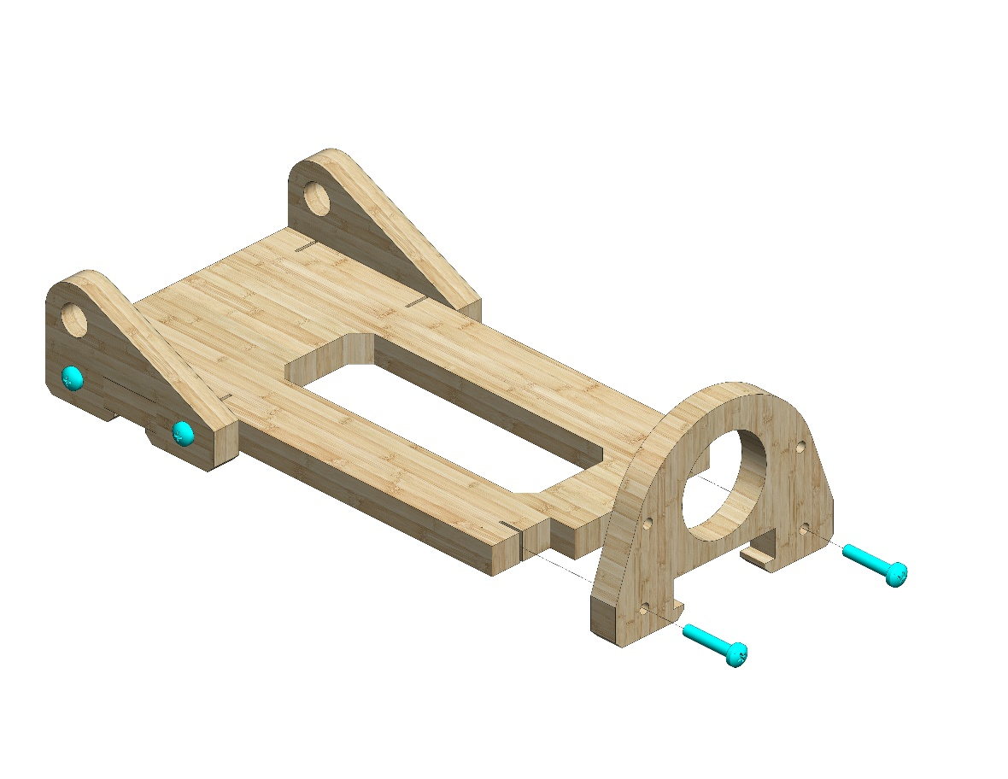
Instructions
Attach two Part 3s to Part 6. Use two #20 bolts.
3
3
6
Attach Part 10. Use two #20 bolts.
10
© All rights reserved to AristoCraft Ltd. Do not copy or reproduce without written permission.

Slide 4
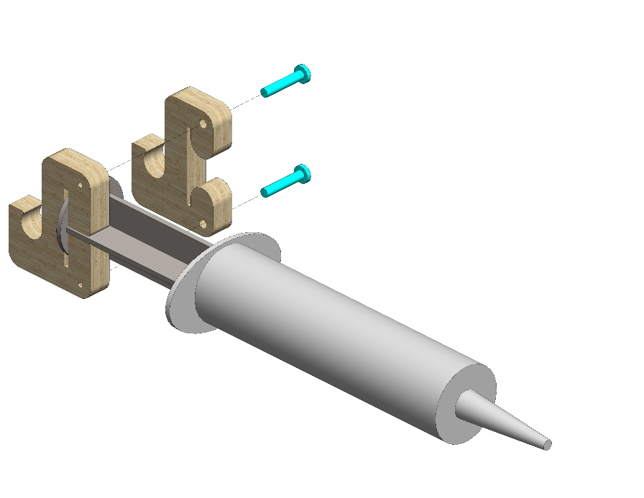
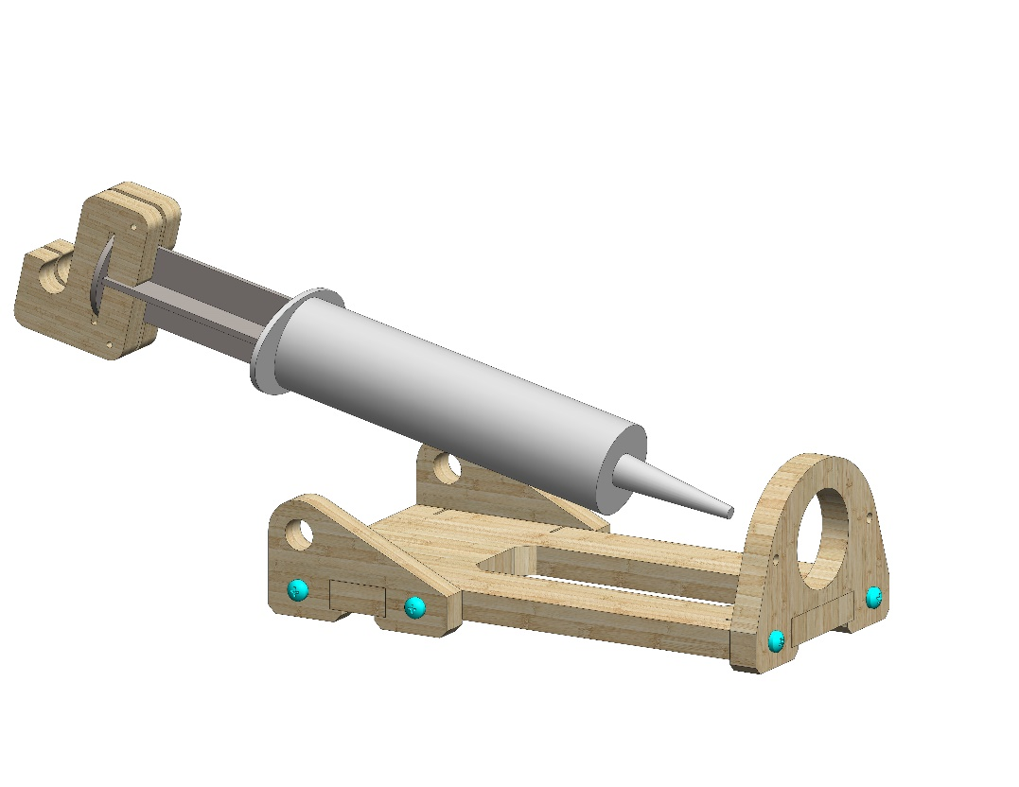
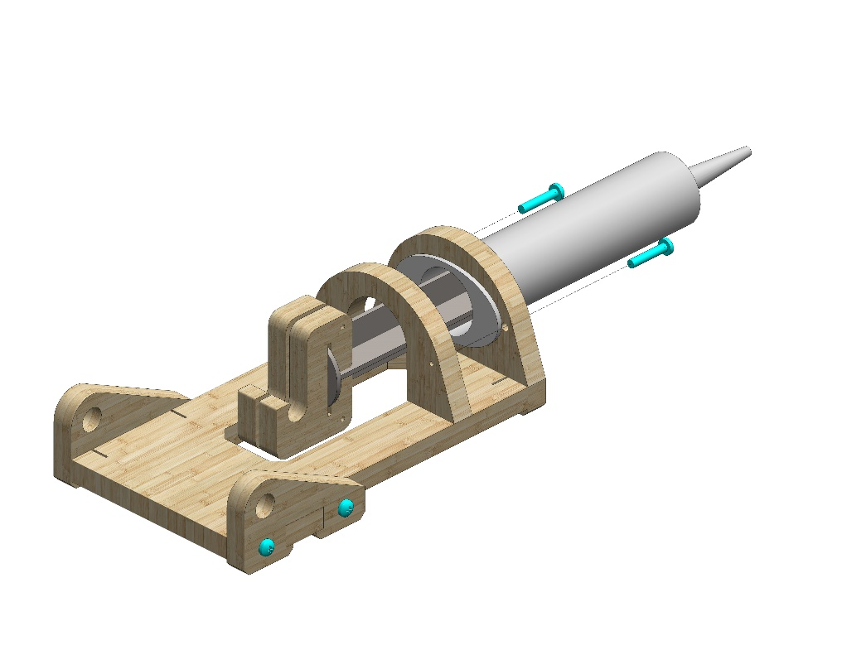
11
Position Part 12 in Part 13 as pictured.
Attach Part 11. Use 2 #20 bolts.
13
12
Insert the prepared module into the opening..
9
Position Part 9 as pictured.
Use two #20 bolts.
© All rights reserved to AristoCraft Ltd. Do not copy or reproduce without written permission.

Slide 5
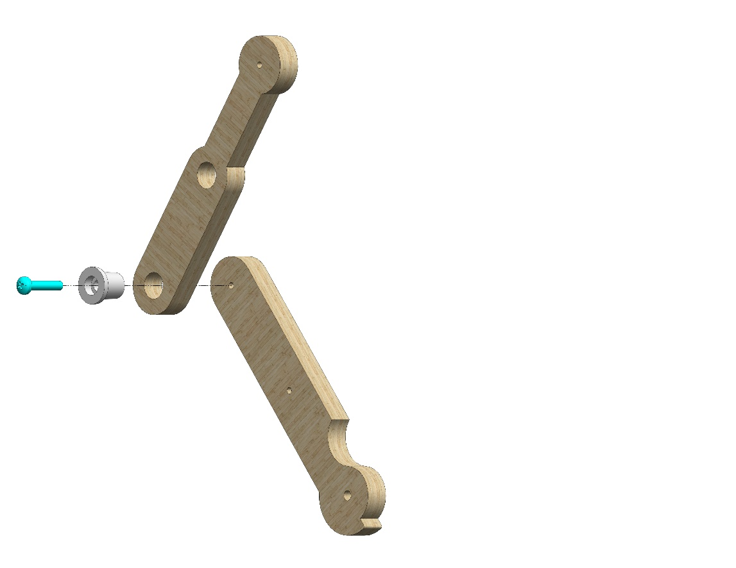
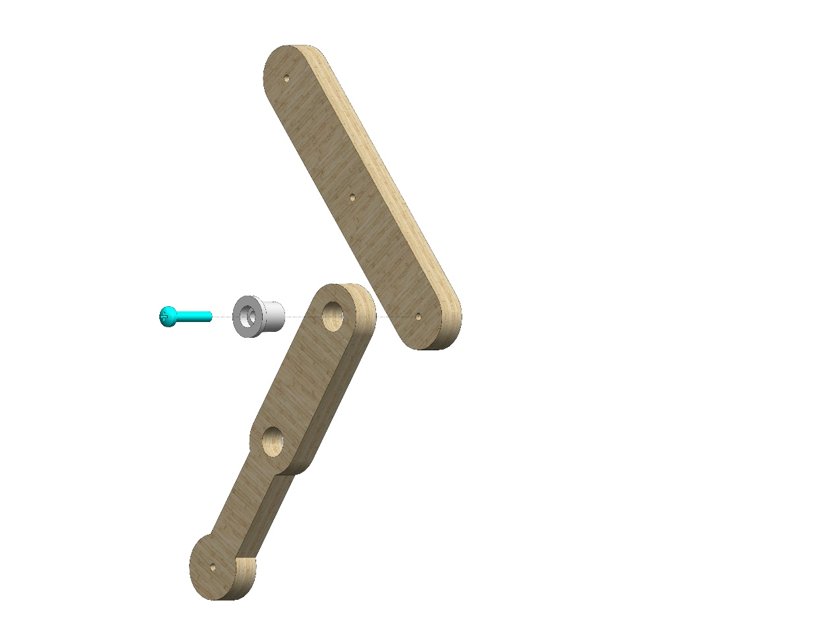
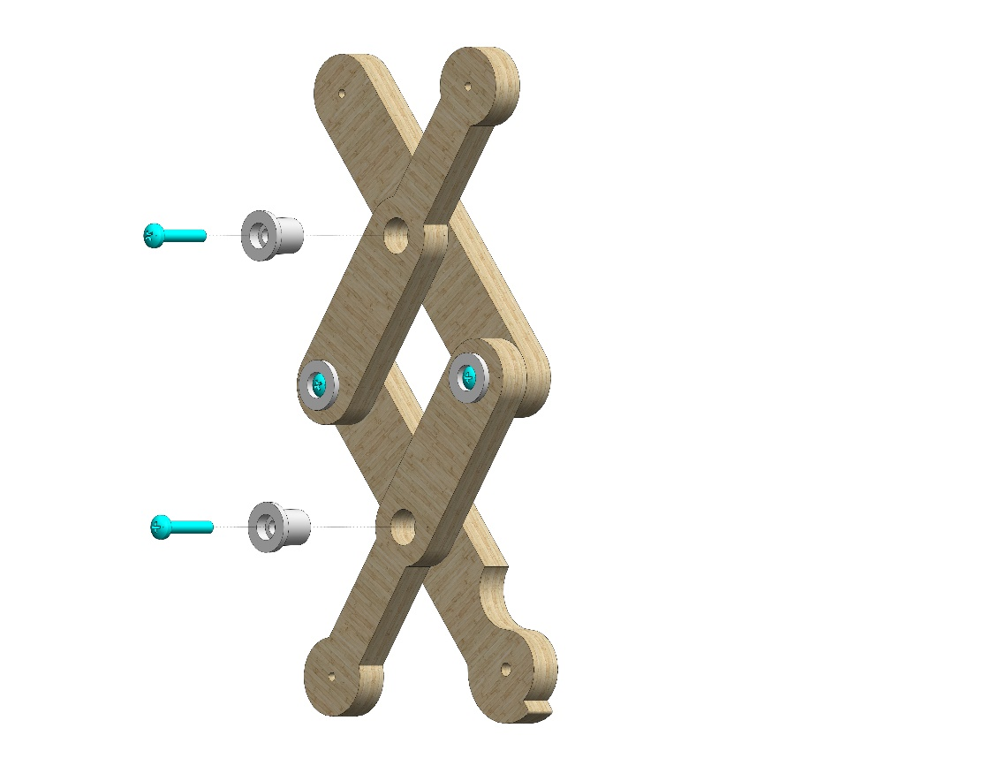
Attach Part 5 to Part 4 using Part 16. Use one #20 bolt.
5
4
16
2
16
Attach Part 5 to Part 2 using Part 16. Use one #20 bolt.
5
16
16
Join the two assembled modules together using two Part 16s. Use one #20 bolt.
© All rights reserved to AristoCraft Ltd. Do not copy or reproduce without written permission.

Slide 6
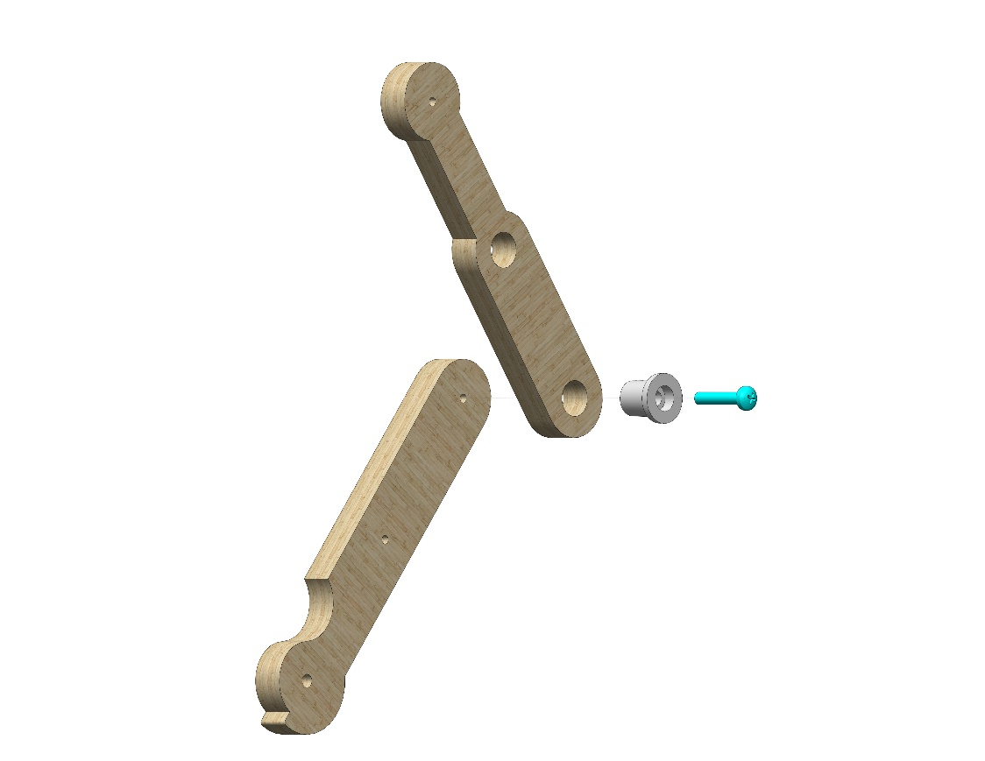
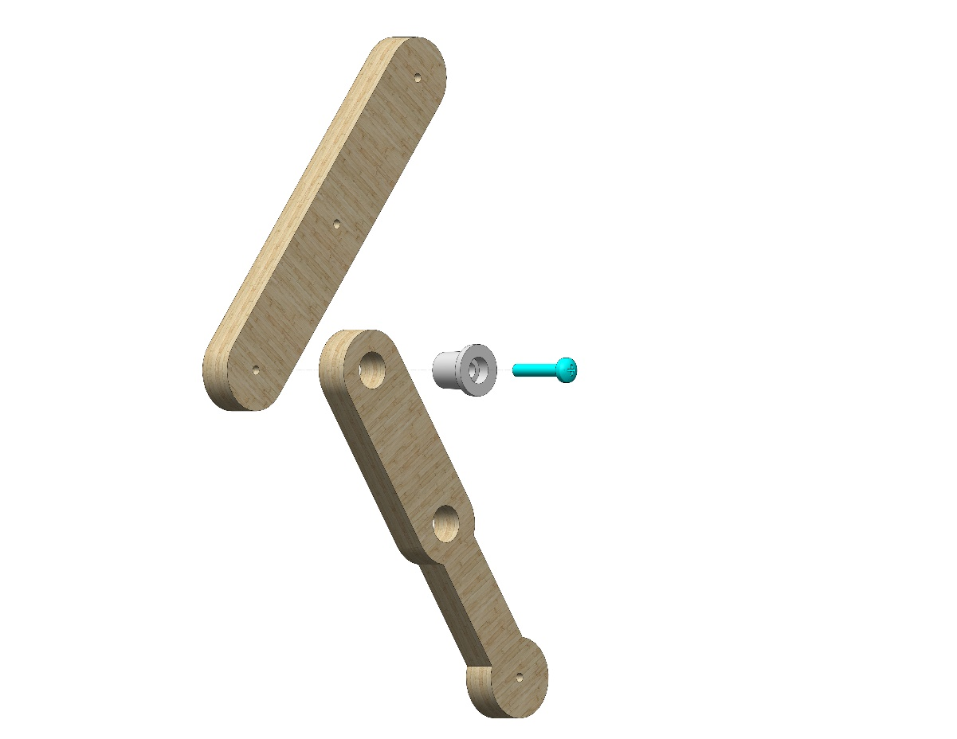
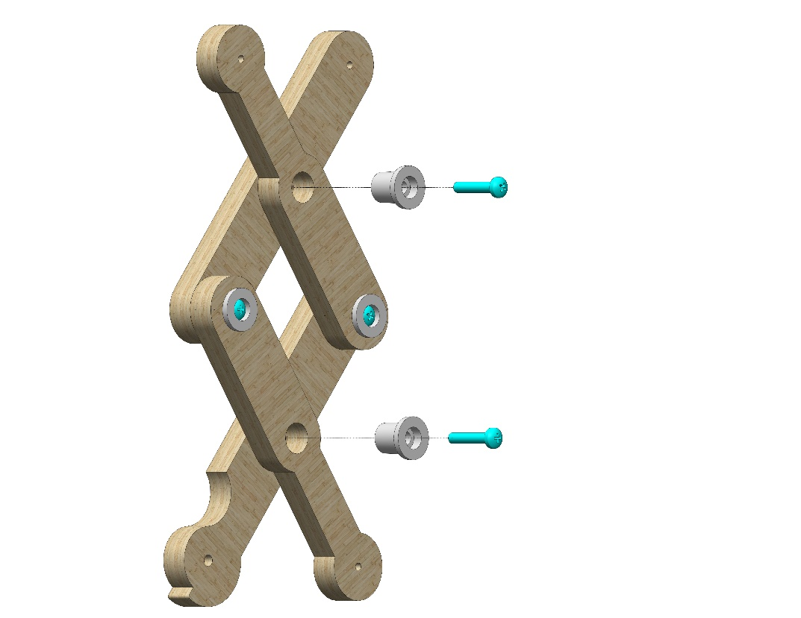
Attach Part 5 to Part 4 using Part 16. Use one #20 bolt.
5
16
2
4
16
Attach Part 5 to Part 2 using Part 16. Use one #20 bolt.
5
16
16
Join the two assembled modules together using two Part 16s. Use one #20 bolt.
© All rights reserved to AristoCraft Ltd. Do not copy or reproduce without written permission.

Slide 7
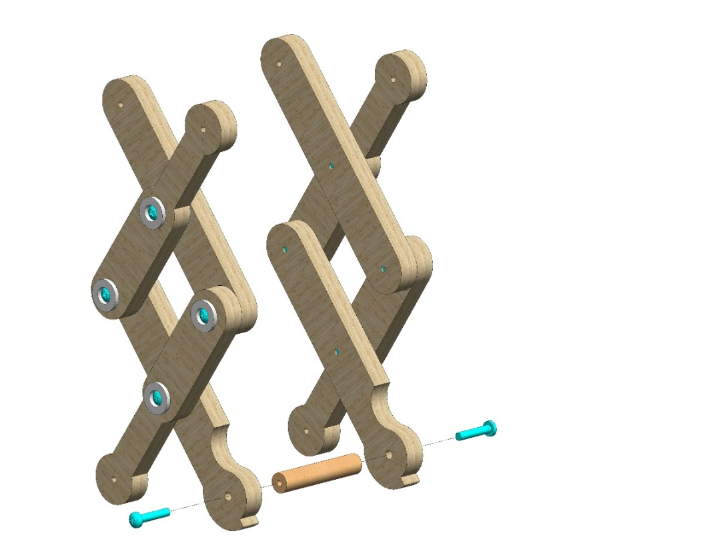
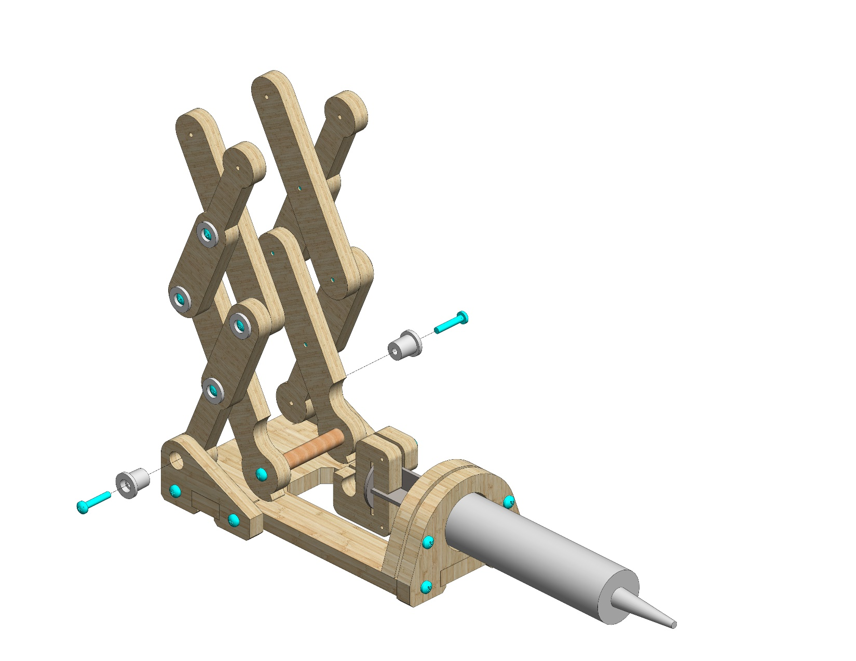
Attach the two modules to Part 14 as pictured. Use two #20 bolts.
Do not tighten!
14
Attach two Part 16s to the prepared module as pictured. Use two #20 bolts.
16
16
© All rights reserved to AristoCraft Ltd. Do not copy or reproduce without written permission.

Slide 8
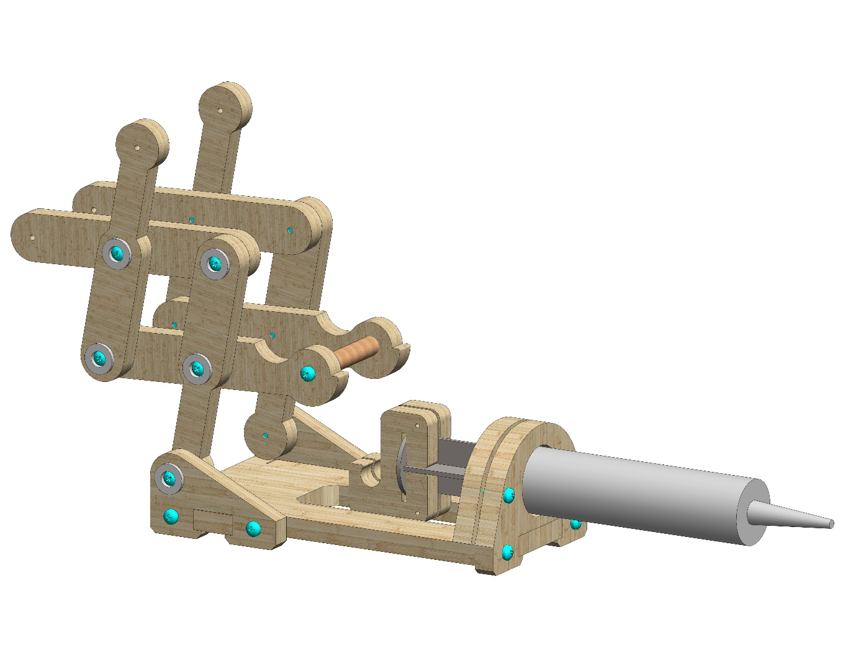
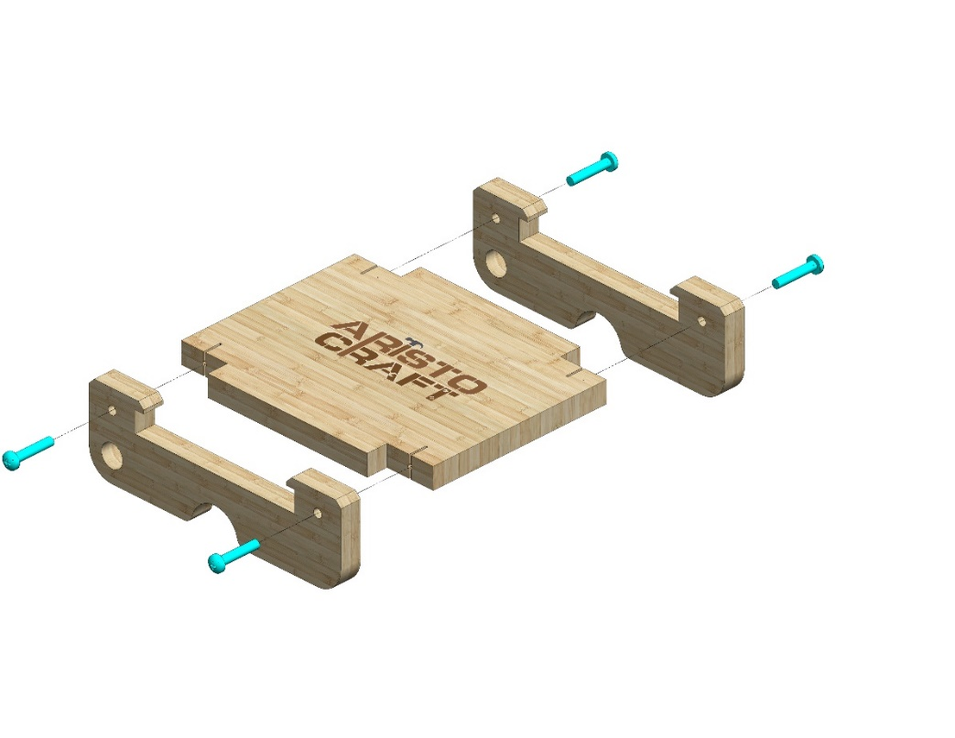
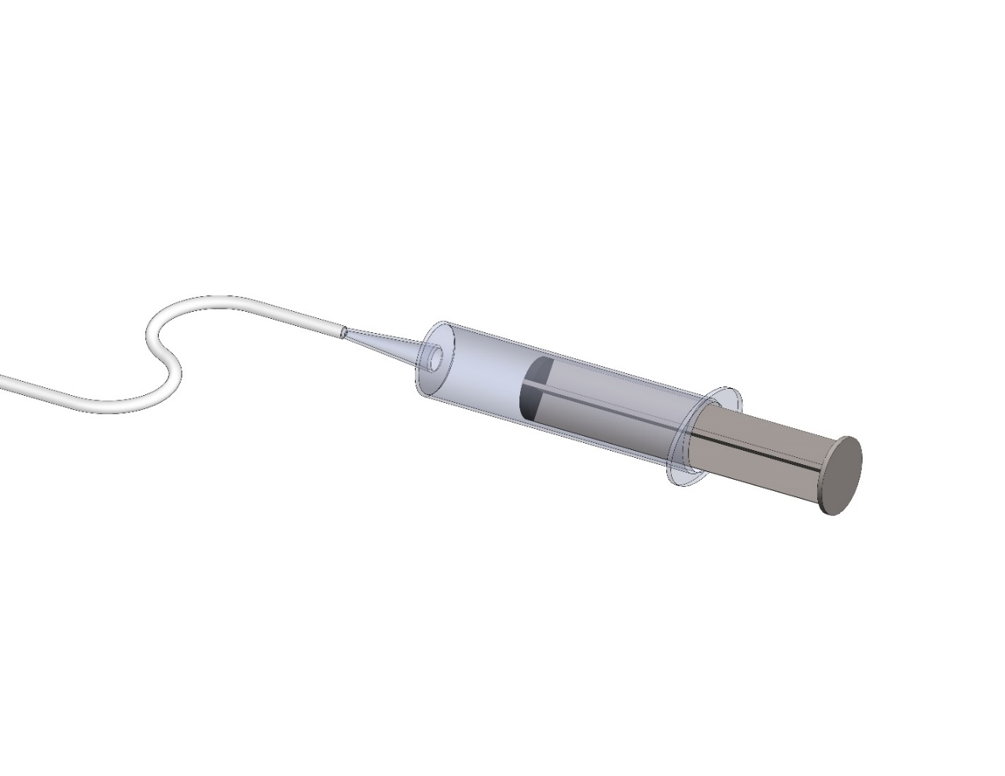
Using gentle pressure, insert the rod into place as pictured.
1
8
8
Attach two Part 8s to Part 1.
Use four #20 bolts.
Applying pressure, insert the end of the piston (Part 13)
into the tubing (Part 15).
Make sure the syringe is fully extended before attaching the tubing to the second syringe.
15
13
© All rights reserved to AristoCraft Ltd. Do not copy or reproduce without written permission.

Slide 9
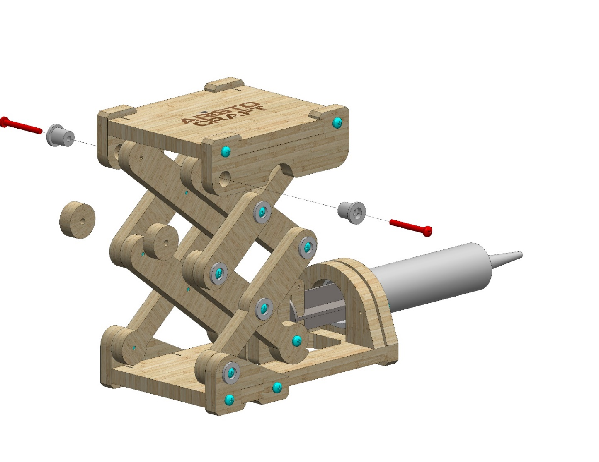
Insert two Part 7s as pictured and attach them using two Part 16s. Use two #30 bolts.
16
16
7
Connect the other end of the tubing (Part 13) to the second piston (Part 13).
13
15
© All rights reserved to AristoCraft Ltd. Do not copy or reproduce without written permission.

Slide 10
© All rights reserved to AristoCraft Ltd. Do not copy or reproduce without written permission.

