Slide 1

Biblical Narratives in The Handmaid’s Tale
(Margaret Atwood)
Dr. Bina Nir, Department of Multidisciplinary Studies, The Max Stern Yezreel Valley College, Israel
14th International Conference on Religion & Spirituality in Society,
Institute of Religious Studies
Complutense University of Madrid,
Spain, 23-24 May 2024

Slide 2
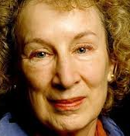
This article examines biblical narratives in The Handmaid’s Tale by Canadian author Margaret Atwood, published in 1985.
This literary work has become a symbol for the struggle for women’s rights and it deals with a whole range of issues that lie at the foundations of feminism.
In her book, Atwood paints a picture for her readers of an extreme dystopian future based on many elements from the past as well as from our cultural present.
The author warns us against fundamentalist readings of the Bible and other canonical texts at the base of our culture – interpretations that could stem from political motives.

Slide 3
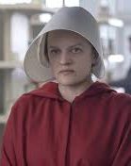
Is it possible to have an intellectual discussion about women’s status in the current century based on a novel that describes a fictional reality?
In Keren’s approach (2015), fine literature serves as a layer in the refinement of political ideas and is effective in mobilizing masses or at least wakening a sense of moral values in them.
It deepens our ability to relate to issues on the contemporary agenda even if does not correspond precisely to reality.
Paul Dolan claims that it is impossible to understand politics only in the way that political scientists, historians, or even philosophers do. The novel provides us with its special type of knowledge – the unconscious experience of politics as a human, moral, psychological and aesthetic phenomenon (Dolan 1976, 3).

Slide 4
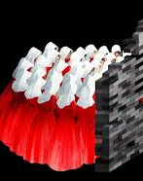
Warning Sign
• Atwood's dystopian novel is, in its extreme, a moral warning sign, because humanity “is so adaptable...[It's] truly amazing, what people can get used to, as long as there are a few compensations” (Atwood 1985, 273).
• The story takes place in the ‘not-too-distant future’, in which radical Protestant Christians have staged a coup d’état and established the “Republic of Gilead”, a military-theocratic dictatorship that exists in a region within the boundaries of the former United States.

Slide 5

“The Normal Status”
• In this society, people are segregated according to criteria of class and gender, and are required to dress in clothes desginated for their role in society. In the chaos that followed the coup, its perpetrators took power into their own hands and established a new order in the spirit of the Old Testament and ultra-conservative values.
• The women were returned to their “normal” status from the dawn of history, as subservient bearers of children
• “The Commander said... All we’ve done is return things to Nature’s norm” (ibid., 222).

Slide 6
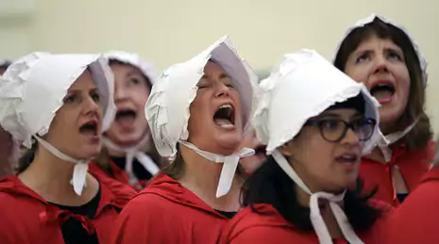
“The Gilead Period”
• In response to the question of whether the book is more relevant today than it was when it was first published, Atwood has replied that many people, especially in the US, think it is more relevant these days, noting that during the election campaign in 2012 the book’s title was invoked on social media. She stated that it may be said in general that absolutist regimes have always shown excessive interest in women's reproductive abilities (Atwood 2022, 284).
• Atwood calls on us to re-examine the extreme interpretations given to these texts over generations, in various traditions.

Slide 7
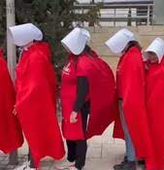
Biblical Narratives
• The Hebrew Bible is a collection of scrolls that became one book. Its texts were written in different periods, by different authors, and it contains many conflicting messages. It conveys a sympathetic message towards widows, orphans, the poor, and slaves, alongside advocating the trampling of enemies to the point of a curse for generations. In The Handmaid's Tale, an ostensibly literal interpretation of the Bible is used to control women for political reasons (Atwood 2022, 282).
• Atwood weaves many biblical ideas, names, and motifs into her novel, relating to the status of women with a focus on the concept of handmaids, who are assigned the role of childbirth.
• The author moves from the fictional future to the biblical past, from which Western culture emerged, and reminds us that this past has not completely disappeared from the world and it remains as a deep structure in contemporary culture (Filipczak 1993, 171).

Slide 8
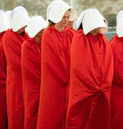
Women in the Hebrew Bible
• We must, of course, be cautious about generalizations concerning the attitude towards women in the Hebrew Bible –a composite work preserving a variety of voices regarding women.
• When ideas occur with high frequency in canonical literature, such as biblical texts, and persist over time, they attest to psychological, social, and cultural structures within which individuals and groups direct their behavior (Nir 2016, 11).
• When worldviews are deeply rooted in religious experience, as יונג suggests (1987), they have a latent capacity to be preserved in secular experience.

Slide 9
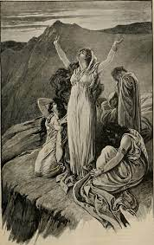
Gilead
• The story takes place in the “Republic of Gilead” inspired by the name of the biblical place – Gilead.
• As recounted in the Bible, Jephtah the Gileadite was the son of a prostitute, and therefore, his brothers, the sons of his father’s legal wife, expelled him from the house of his father Gilead (Judges 11:1–2).
• After being driven from his home, Jephtah turned to the Land of Tob in the north, east of the Jordan river. When the Ammonites went to war against the people of Gilead, the elders of Gilead approached him and asked him to be their leader and save Gilead from the Ammonites. Jephtah agreed to their request (Judges 11: 4–10).
• Jephtah battled the Ammonites and was successful.

Slide 10
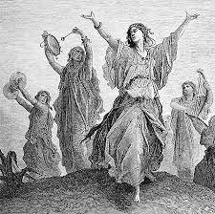
“there was his daughter coming out to meet him with timbrels and with dancing”
• Before he went to war with the Ammonites, Jephtah made a vow: “And Jephthah made a vow to the LORD, and said, 'If you will give the Ammonites into my hand, then whoever comes out of the doors of my house to meet me, when I return victorious from the Ammonites, shall be the LORD’s, to be offered up by me as a burnt-offering” (Judges 11:30–31).
• But when he returned from the war after his victory, “there was his daughter coming out to meet him with timbrels and with dancing… When he saw her, he tore his clothes and said, ‘Alas, my daughter! You have brought me very low; you have become the cause of great trouble to me. For I have opened my mouth to the Lord, and I cannot take back my vow.’” (Judges 11: 34–35).
• The daughter understands that a vow to the Lord cannot be revoked even when it comes to human sacrifice (Judges 11: 36–37).

Slide 11
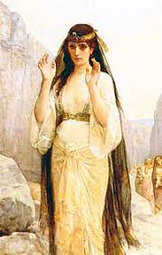
“she had never known a man”
Jephthah allows his daughter to fulfill her last wish: “So she departed, she and her companions, and bewailed her virginity on the mountains. At the end of two months, she returned to her father, who did with her according to the vow he had made. She had never slept with (lit. “known”) a man. So there arose an Israelite custom” (Judges 11:38–40).
The mourning for the loss of his daughter relates mainly to the fact that “she had never known a man” and therefore she asks to cry “for her virginity”.
Fertility, virginity, and barrenness are recurring contexts for descriptions of women in the Bible. In Gileadite society in the novel, the word “sterile” was removed from the lexicon: fertility is the domain of women, and they are either fertile or barren. There are no infertile men in the Bible either. Barrenness is always the domain of women.

Slide 12
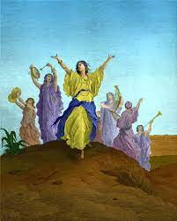
The Republic of Gilead
Jephthah sacrifices his daughter just as all the women in the novel were essentially sacrificed – they lost their freedom and became slaves of reproduction.
Jephthah’s daughter laments that she never knew a man in her life – knowing a man and giving birth is the primary task of the women of the Republic in the novel.

Slide 13
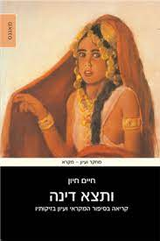
Women as Reproductive Handmaidens in Scripture
In the Republic of Gilead, women’s bodies are a tool used for the political and personal goals of those in power.
The objectification of women’s bodies and their use as sexual objects through the exertion of force to the point of rape appears in the Bible in the rape of the concubine at Gibeah (Judges 19–11), the rape of Tamar (2 Samuel 13), and in the case of Dinah (Genesis 14) – “Now Dinah the daughter of Leah, whom she had borne to Jacob, went out to visit the women of the region. When Shechem son of Hamor the Hivite, prince of the region, saw her, he seized her and lay with her by force.” (Genesis 34:1–2) (אלבוים 2022, 63–72).

Slide 14

In the literary work, the government created a new class of women called “handmaids,” whose role is to bear children for men of high status in the society. Procreation is the primary purpose of every woman.
“My body seems outdated ... I avoid looking down at my body, not so much because it's shameful or immodest but because I don’t want to see it. I don’t want to look at something that determines me so completely” (Atwood 1985, 62–63).

Slide 15
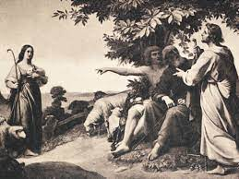
“‘Give me children, or I shall die!’”
• "‘You want a baby, don't you?’ ‘Yes,’ I say. It's true and I don't ask why because I know. ‘Give me children or else I die.’ There’s more than one meaning to it” (Atwood 1985, 61) – like Rachel’s statement to Jacob (Genesis 30:1).
• “Be fruitful, and multiply, and replenish the earth. Then comes the moldy old Rachel and Leah stuff we had drummed into us at the Center. Give me children, or else I die. Am I in God's stead, who hath withheld from thee the fruit of the womb? Behold my maid Bilhah. She shall bear upon my knees, that I may also have children by her. And so on and so forth. We had it read to us every breakfast” (Atwood 1985, 89).

Slide 16
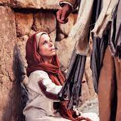
“’Go in to my handmaid’”
• Every month, at the “appropriate time” in her menstrual cycle, a sacred religious ceremony takes place during which Offred has to have sex with Fred while the pillow supporting her head is placed between the loins of his wife Serena.
• According to the government, the ceremony is based on Sarah’s words to Abraham in Genesis: “and Sarai said to Abram, ‘You see that the Lord has prevented me from bearing children; go in to my handmaid; it may be that I shall obtain children by her.’” (Genesis 16:2).
• The position of the women, one on top of the other, is derived from Rachel’s words: “Then she said, ‘Here is my maid Bilhah; go in to her, that she may bear upon my knees and that I too may have children through her.’” (Genesis 30:3).
• Serena, Fred's wife, is suspected of being infertile, although the sexual history of her and her husband suggests that he is in fact the infertile one. As noted, the regime that sanctifies childbirth – only allows the assumption that women are barren.

Slide 17
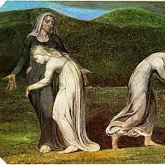
“’Go in to my handmaid’”
• The fate of every handmaid in theRepublic of Gilead is to be degraded, silenced, submissive, inferior, and obedient.
• The voice of the biblical “Hagar” is not heard. She is the other, marginalized in a society where her voice holds no significance (Shinhar 2011, 19).
• Hagar is a sort of surrogate mother, just as the barren Rachel handed her handmaid Bilhah over to Jacob, and after Bilhah gave birthm she declared, “And he has given me a son” (Genesis 30:6).
• The suffering Hagar runs away and sets out alone, pregnant, on a path of loneliness. There in the wilderness, an angel of the Lord finds her and asks her, “And he said, ‘Hagar, handmaid of Sarai, where have you come from and where are you going?” She said, “I am running away from my mistress Sarai.”” (Genesis 16:8). Even in his question, the angel also emphasizes her status as the handmaid of Sarai.

Slide 18
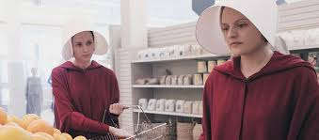
• In Gilead society, women are divided into hierarchical categories of “legitimate women,” and two categories of “illegitimate” women who exist outside the social mainstream.
• The legitimate women are the wives, at the top of the female hierarchy. They are married to Commanders.
• Handmaids are fertile women whose societal role is to conceive and bear children for Commanders.
• The illegitimate or non-women, are barren women, widows, feminists, lesbians, nuns, and any woman who opposes the regime or the social order: they are all women who are unable to assimilate into Gilead’s enforced gender division.
• Jezebels are women who are forced into prostitution and entertainment roles for elite men. They are usually attractive and intelligent women who are unable to adapt to the role of handmaid.

Slide 19
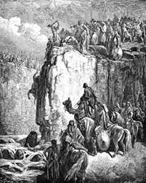
The Biblical Jezebel
• Jezebels are talented and corrupt, similar to the description of Jezebel in the Bible – “Indeed, there was no one like Ahab, who sold himself to do what was evil in the sight of the Lord, urged on by his wife Jezebel.” (1 Kings 21:25).
• The biblical Jezebel maintained the worship of Baal in Israel. She was considered a dominant lady who overshadowed her husband Ahab, who was influenced by her.
• Jezebel faced strong opposition from the prophet Elijah, and she pursued him with the aim of killing him, forcing him flee to neighboring lands.
• The biblical narrator also portrays Jezebel as receiving retribution for her pride. At Jehu’s command, she and her eunuchs are thrown out of a window.

Slide 20
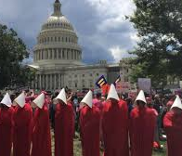
Possessive Mastery over Women
Offred is a woman from the first generation of the Republic of Gilead, who still remembers life before.
She records her memories on a tape recorder, and tells about her life as a sex slave whose role is to bear a child for a Commander in the new regime and his wife.
The name “Offred” is a slave name, which means “of Fred,” where the man’s name is any man with whom she is associated at the given time. “My name isn't Offred, I have another name, which nobody uses now because it’s forbidden… I keep the knowledge of this name like something hidden, some treasure I’ll come back to dig up, one day… like an amulet, some charm that’s survived from an unimaginably distant past” (Atwood 1985, 84).
Atwood draws from descriptions of quite a few women in the biblical narrative who are situated under the shadow of men and, sometimes, are not even mentioned at all.

Slide 21
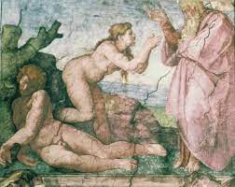
“a complementary helpmeet”
• In the second creation story, the man is created first, while the woman is created to serve man as “a complementary helpmeet”: “And the Lord God said, ‘It is not good for the man to be alone; I will make a complementary helpmeet for him” (Genesis 2:18).
• “And the rib that the Lord God had taken from the man he made into a woman and brought her to the man. Then the man said, “This at last is bone of my bones and flesh of my flesh; this one shall be called Woman, for out of Man this one was taken” (Genesis 3:22–23).
• Later in the story, after the woman tempts her husband into eating from the forbidden fruit, she is punished and the man is given mastery over her: “To the woman he said, ‘I will make your pangs in childbirth exceedingly great; in pain you shall bring forth children, yet your desire shall be for your husband, and he shall rule over you” (Genesis 3:16).
• The biblical creation story is the only ancient creation story in which a male deity alone creates the world, without a female partner, and this fact has profound implications for the status of women and the status of the feminine principle in the Bible (Ankori and Azari 2004, 196).

Slide 22
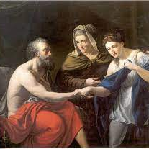
Possessive Mastery over Women
Sarah adhered to the widespread custom in ancient Near Eastern lands and called her husband, “my lord”: “Sara laughed within herself, saying: After I have become worn, is there to be pleasure for me? And my lord is old!” (Genesis 18:12).
Later, we see that Abimelech, the king of Gerar, “took” Sarah as a wife, “So Abimelech, King of Gerar sent and took Sarah. And God came to Abimelech in a dream by night and said to him, ‘You are to die because of the woman that you have taken, for she is a wedded wife’” (Genesis 20:2–3 ).
And when Sarah gave birth to Isaac, she “bore Abraham a son in his old age”: “Sarah conceived and bore a son to Abraham in his old age, at the set time of which God had spoken. Abraham gave his newborn son, whom Sarah had borne him, the name of Isaac” (Genesis 21:2–3).

Slide 23
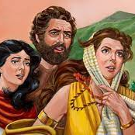
Possessive Mastery over Women
• The daughter of Jephthah the Gileadite has no name in the Bible other than the modifier “the daughter of Jephthah” (Judges 11:30–40).
• Similarly, Lot's wife is mentioned in only one verse about the destruction of Sodom and Gomorrah, and with no name, but only by association with her husband: “But his wife, behind him, looked back, and she became a pillar of salt” (Genesis 19:26).
• The name of Noah’s wife is unknown.
• The wives of the sons of Jacob are not identifed, except for “the daughter of Shua”, Judah’s wife, and there is also no mention of Jephthah's wife, the mother of his daughter.
• There are women who are exceptions to this rule, and the explanations for these deviations relate to the function of the women in each specific story (Zakovitch 1987, 14–32).

Slide 24
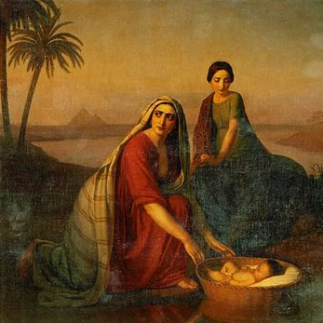
Atwood describes a regime that ranks women by fertility.
The biblical story puts the woman in the center when she is about to give birth to a son – then the woman deserves full attention.
In the story of Moses’ birth and childhood, the role of the father in his marriage to the mother is minimized: “And a man from the house of Levi went and took a daughter of Levi” (Exodus 2:1).
From then on, only female figures act: his mother, who hides him and is later hired to nurse him, his sister, who watches from afar, and mediates between the mother and Pharaoh’s daughter, who adopts Moses as her son and names him: “And he became her son. She named him Moses, explaining, ‘I drew him out of the water’”(Exodus 1:10)

Slide 25
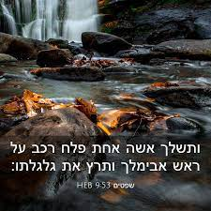
“lest they say, ‘A woman killed him’”
• And if a woman will prevail over a man, in his male domain, it will not be honorable for him.
• In the book of Judges, Abimelech, sensing his imminent death due to his injury at the hands of a woman, turned to the bearer of his armor: “He immediately cried out to his attendant, his arms-bearer, ‘Draw your dagger and finish me off, that they may not say of me, “A woman killed him!”’ So his attendant stabbed him, and he died,” but the deathblow from the sword of his attendant did not remove the disgrace from him.
• The bad name that the woman left him remained as an eternal disgrace, as emerges from the later reference of the general Joab to that historical precedent “Who struck down Abimelech son of Jerubbesheth? Was it not a woman who dropped an upper millstone on him from the wall at Thebez?” (2 Samuel 11:21)

Slide 26
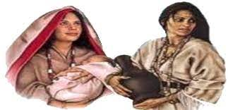
She is the Other
• In the Bible there are clear hints of the ancient status of the feminine, although as a general rule, in the androcentric Bible, the feminine was rejected – the Bible killed the goddesses. The renunciation of the feminine and its understanding is the price (Ankori and Ezrachi 2004, 199–201).
• The ancient creation stories of the Babylonians and Assyrians describe a struggle between the male and female, and the victory of patriarchy.
• The transition to the patriarchal order occurred through slow changes. At the time when the human race put its laws and mythologies in writing, patriarchy was already fully established and it was the men who wrote the law books (de Beauvoir 2001, 114–115), in which the woman is defined and delineated in relation to the man; she is secondary and non-essential – she is “the other” (Bryson 2001, 419).

Slide 27
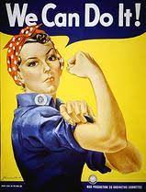
Summary
• The feminist movement was born in response to the plight of women, with the aim of improving women’s position in the world, through a combination of social activism and theoretical and academic thought.
• Atwood is well aware of the gap between the achievements of the feminist revolution and the actual situation of women around the world (Keren 1999, 89).
• The freedom of a significant portion of women is still severely restricted, among other reasons, because they do not have the basic right to make decisions about their bodies and their sexuality (Fogel-Bizaoui, 2011).

Slide 28
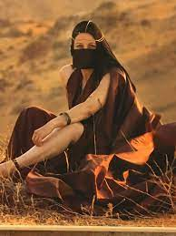
The Distant Biblical Past Echoes through Today
Patriarchal culture forced women to define themselves through their body, which is seen, at best, as a sexual object and a reproductive tool (Tamir, 2007; Nardi, 2007).
Browning (2003) argues that alienation towards the female entity is a primal fear of the feminine, which has been ingrained by different cultures around the world for thousands of years.
Atwood’s work overtly points to elements that appear in biblical narrrative as sources of inspiration for the foundation of this republic, with particular emphasis on reproductive handmaids as mentioned in the Bible.

Slide 29
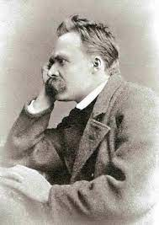
When we tell a story about the cultural past of a phenomenon –in this case, the attitude towards women in patriarchy – and the origins of that phenomenon, we are actually studying the present and seeking to work for a different future.
The main goal in this approach is to deconstruct the seemingly self-evident assumptions in a certain way of life.
Humans, according to Nietzsche, live historically – conscious and conditioned by their past (Nehamas 1994, 270–272)

