Slide 1
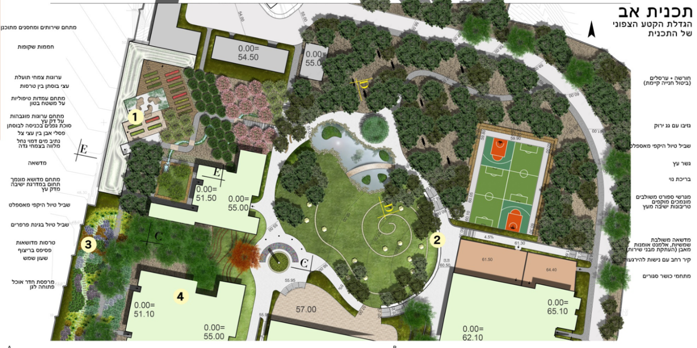
A
Master plan
Enlargement of north section of plan
Planned service and storage area
Transparent hothouses
Beneficial plant
Fruit trees among terraces
Grove xand hammocks
(cancellation of existing parking lot)
Therapy stations on a concrete surface
Raised planters on a wooden deck
Grape arbor at entrance to bustan
Stone sculptures among
shady trees
Artificial watercourse with
stream bank vegetation
Gazebo with green roof
Peripheral asphalt walking trail
Lawn
Wooden bridge
Sunken lawn area bounded by wooden bleachers
Fish pond
Peripheral asphalt walking trail
Sunken, combined sports courts surrounded by wooden bleachers
Walking trail in a butterfly garden
Lawn with parasols,
stone art elements (relocated service buildings)
Lawn terraces
Mosaic floor
Sundial
Wide wall with alcoves for relaxation
Dining room balcony overlooking
the garden
Closed fitness areas

Slide 2
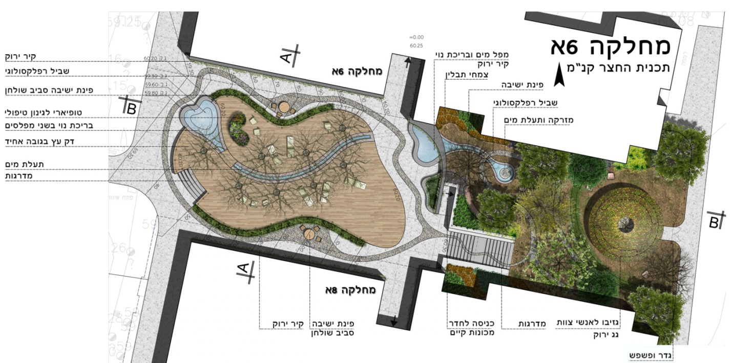
B
Green wall
Waterfall and fish pond
WARD 6A
Reflexology trail
WARD 6A
Green wall
Herbs
Scale of courtyard plan
Seating around a table
Sitting corner
Topiary for horticultural therapy
Reflexology trail
Two-tier fish pond
Fountain and canal
Level wooden deck
Canal
Stairs
WARD 8A
Green wall
Seating
around a table
Existing entrance to machinery room
Stairs
Gazebo for staff
Green roof
Fence and gate

Slide 3
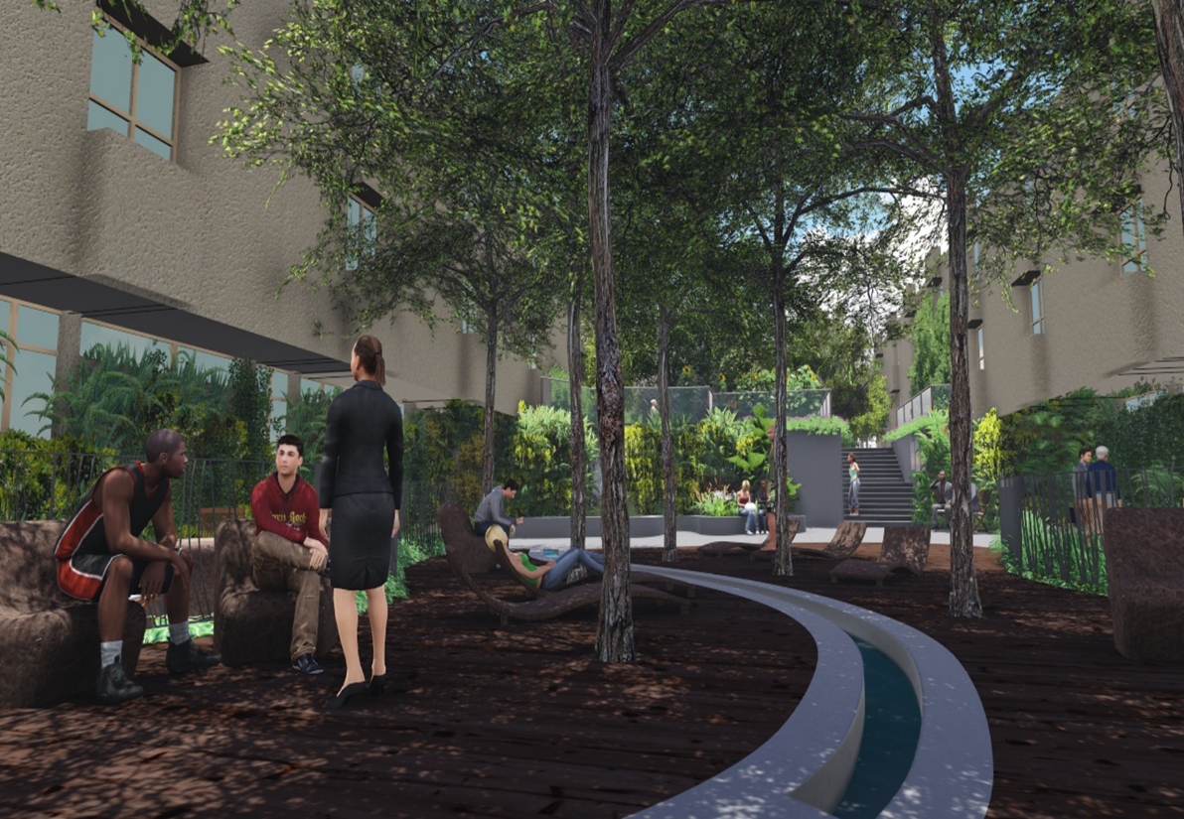
C

Slide 4
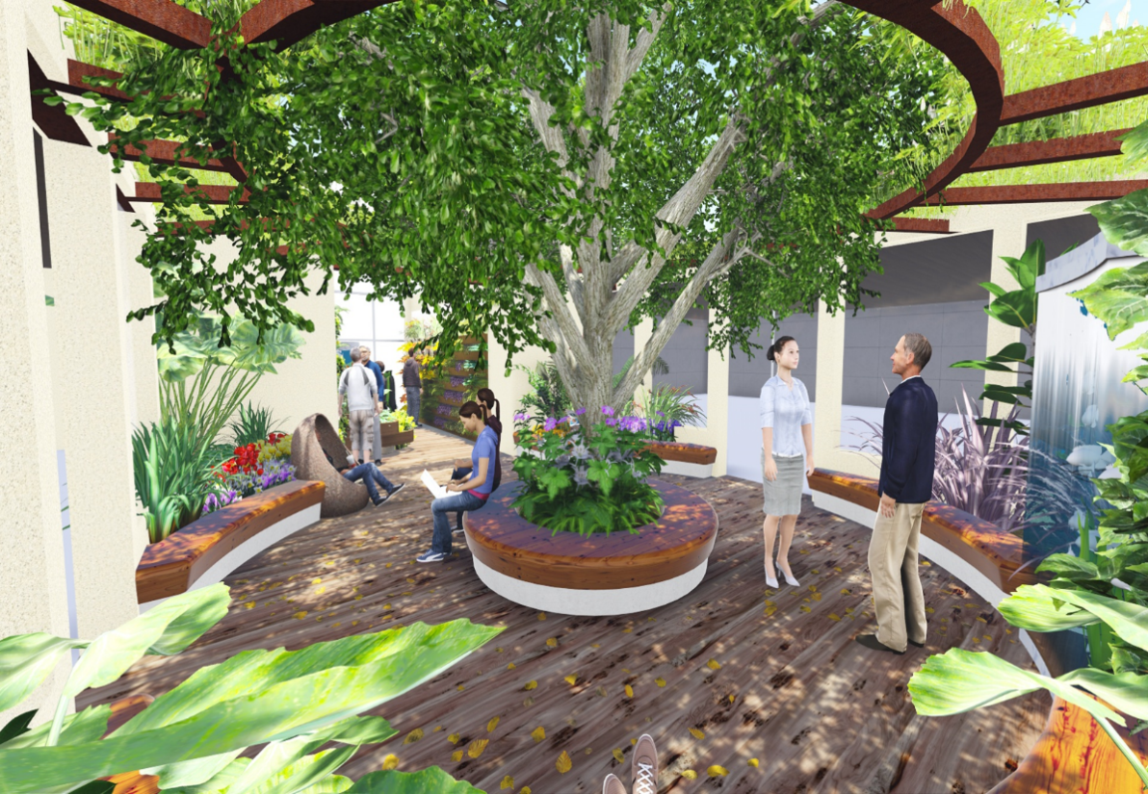
D

Slide 5
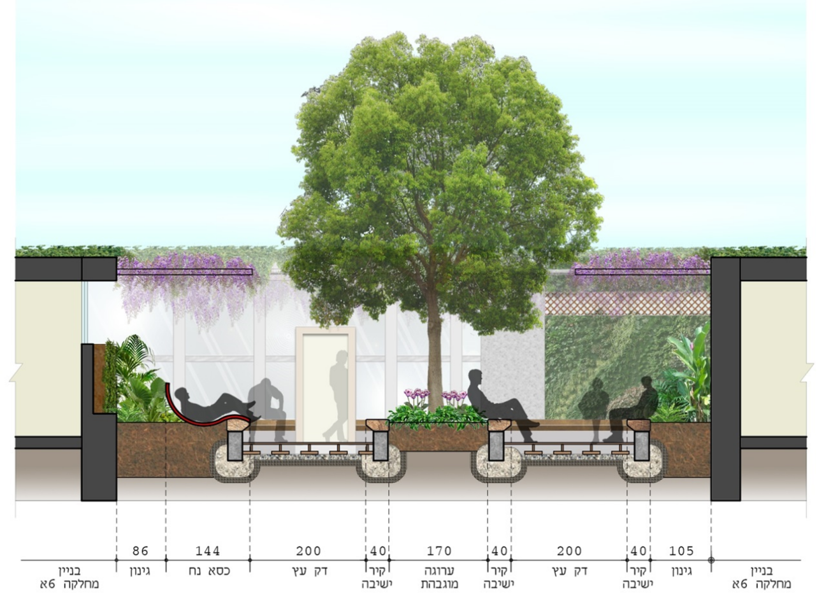
E
WARD 6A BUILDING
GARDEN
PLANTS
EASY CHAIR
WOODEN DECK
WALL SEATING
RAISED PLANTER
WALL SEATING
WOODEN DECK
WALL SEATING
WARD 6A BUILDING
GARDEN
PLANTS

