Slide 1



Blender Financial Technologies
Summary of Activity
Q3 2023

Slide 2
Legal Disclaimer
This presentation constitutes the principle and marketing presentation of Blender Financial Technologies Ltd. and its subsidiaries (henceforth referred to, together, as "the Company" and/or "Blender" and/or "the Group") and is meant for marketing purposes. It does not constitute a public offering of securities by the Company and should not be construed as a public offering of securities by the Company. The information contained in this presentation is solely abridged information to be used as a general presentation of the Company and does not contain exhaustive data on the Company and its activities. The information contained in this presentation and any other information that may be provided when this presentation is presented (henceforth: "the Information") does not constitute a recommendation or the opinion of an investment advisor or a tax advisor. Investment in securities, and particularly, in the Company's securities, carries risk. One must bear in mind that past data is not necessarily indicative of future performance. Purchasing Company securities requires a thorough review of the data the Company publishes in the Company's reports on the Maya and Magna systems (henceforth: "Company Reports") and the performance of a legal, financial, fiscal, and accounting analysis of that data. The presentation contains additional data that will not be displayed in Company Reports to the public and/or information displayed differently than how it will be displayed in the Company Reports to the public. The presentation is not designed to substitute for a review of Company Reports whenever they are publicized by the Company. In the event of a contradiction between this presentation and Company Reports, the content of the Company Reports shall prevail.
Forward-looking Information Disclaimer
The Company’s forecasts and assumptions specified in this are all considered forward-looking information, as defined in the Securities Law of 1968. Among other things, this information is based on the Company’s assessments regarding developments and events that may or may not take place at an uncertain time in the future that are not within the Company’s control.
By nature, forward-looking information might not materialise as it is uncertain, as aforementioned. Whether forward-looking information materialises or not may be affected by risk factors inherent in the Company’s activity, developments in the financial environment in which the Company operates and external factors, including regulation, that can affect its activity. Therefore, it is hereby emphasised and clarified that the Company’s actual future results and achievements may fundamentally differ from the forward-looking information presented here.
For the avoidance of doubt, it is hereby clarified that the Company does not undertake to update and/or change the information included in the presentation to reflect events and/or circumstances that occur after the presentation has been prepared.

Slide 3


Our Mission
To provide fast and innovative credit solutions according to our clients preferences and needs

Slide 4





Blender’s Success by the Numbers
3
80K
90M
744M
1.7B
Countries:
Israel, Lithuania and Poland
Paying customers
Total annual revenue
Credit portfolio balance
Total financed loans
28%
73%
19%
Financial data, accurate as of 30 September, given in NIS; data has been neither audited nor reviewed. Includes loans in the credit brokerage system; the rate of increase in revenue and the growth data refers to 30 September 2023, in relation to the corresponding quarter last year; gross NON-GAAP income.
Notes:
לתקן רווחים בין שורות

Slide 5

Key Events 2023
Transition to cash flow profitability at the Group level (including European and Israeli operations)
Growth in revenue and credit portfolio
Beginning of blenderPay activity in collaboration with Bank Hapoalim
Sale of technology – distribution agreement with Amdocs for international financial institutions
Adapting activity to an environment with rising interest rates, including P2P activity
Flexible business operations during the Swords of Iron conflict

Slide 6


Blender’s Credit Platform
A technological leap forward to support BNPL's activities
blenderCar
Investors (P2P)
blenderPay
Institutional Facilities
Lending Segments
Funding Sources
Credit Platform Rating 2.0™
blender Loan
Bank LOC
Blender Mortgage Solutions

Slide 7











Risk Diversification Strategy
Maintaining flexibility and adapting to a changing reality
Geographical dispersion
Israel
Europe
BNPL
Risk Diversification
Car loans
Diversity in providing credit
Diversification of funding sources
P2P
Credit for any purpose
Mortgage Solutions

Slide 8
Maintaining Growth While Striving for Profitability
Growth of approximately 19% in the credit portfolio in the 3rd quarter of 2023 (millions of NIS)
19%
Growth
Europe
Israel
Consolidated
Managed credit portfolio including loans in the credit brokerage system, as of 30 September, 2023; data has been neither audited nor reviewed.

Slide 9
Transition to Cash Flow Profitability at the Group Level
53%
Growth
Growth of approximately 53% in the Group’s income in the 3rd quarter (in thousands of NIS)
Transition to cash flow profitability at the Group level
Positive Cash Flow
Europe income Israel income Consolidated
Gross NON-GAAP income, including interest from loans in the credit brokerage system and deferred revenues in the credit provision segment. Data is accurate as of 30 September, 2023; data has been neither audited nor reviewed.

Slide 10





Technological Leadership for Fast & Accurate Underwriting
Data Driven
Broad mapping, forecast and managed credit risks of wide ranged information sources
Fast Underwriting
Credit risk assessment in seconds without prior client engagement
Rating2.0™
A propriety credit rating and underwriting system developed by Blender, enables clients’ quick and accurate digital credit
Secured Integral Architecture
Fraud Prevention
A robust Salesforce based system, significant process efficiency, driven by data-based decisions and APIs
A multi-dimensional model for credit risk assessment and fraud prevention
Digital
An advanced, accessible, and simple digital platform - no forms or paperwork required!
Notes:
Rating2.0TM

Slide 11






Fast and Efficient Customer Experience
6 Steps in 30 seconds
Collateral valuation & underwriting
(vehicle/real estate)
6
Onboarding
(Store, Car agency, E-Commerce site)
Advanced client identification & authentication
5
1
30
Seconds to get a loan
4
2
Client rating and loan profile
Client check with Blender’s propriety platform
3
Automated customer risk and evaluation assessment
30 seconds -Minimal time period

Slide 12

Digital Credit Solutions

Slide 13































in collaboration with
The preferred option for payment installments for large purchases in Israel
As of March 2023, blenderPay activities are carried out in collaboration with Bank Hapoalim
POS Growth
JV- 80% owned by blenderPay, 20% by Bank Hapoalim. This increased the credit line to a total of 100 million NIS
Technology enabling payment through extended installments using rapid, non-bank credit at points of sale
Potential market of NIS 30 billion annually for large purchases in Israel (excluding vehicles)

Slide 14



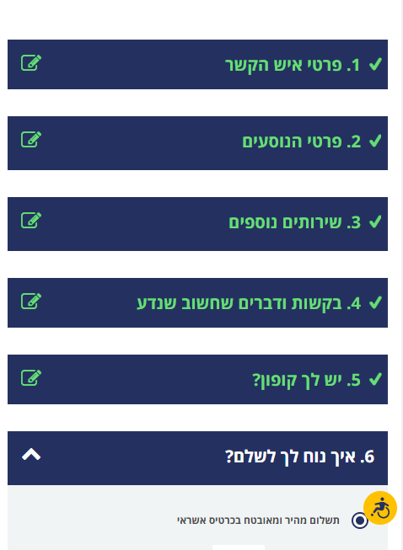
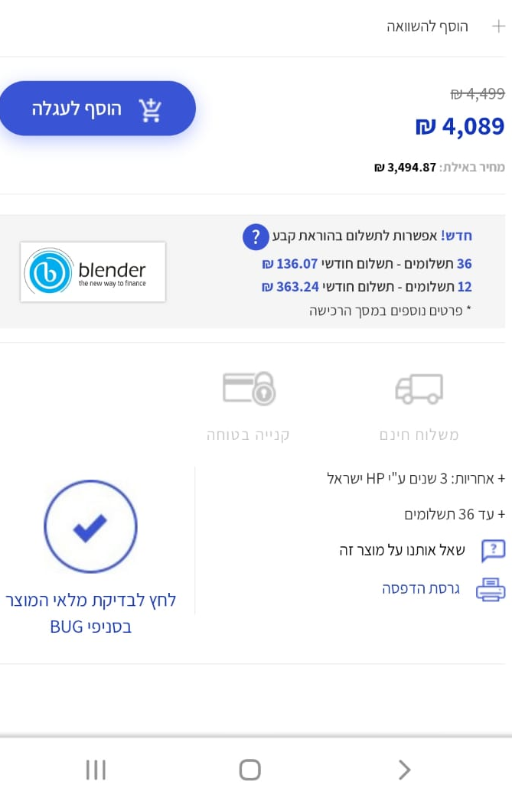
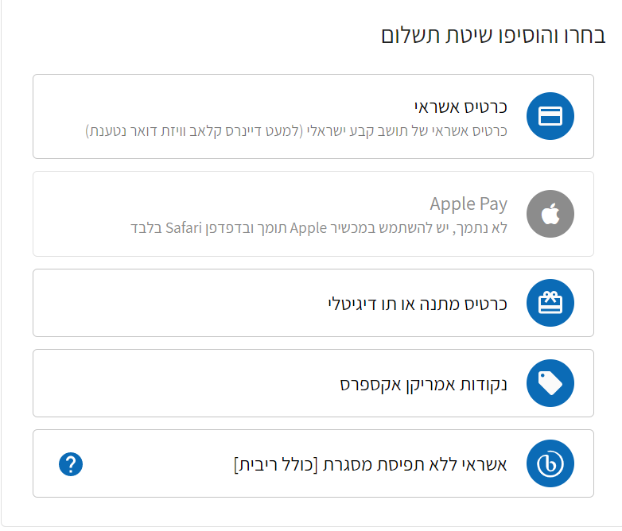

blenderPay - BNPL Market Leader
A complete and unique solution for E-commerce sites for leading brands

Slide 15

blenderCar
The fastest option for car loans in Israel and Europe
In collaboration with:
Wide selection of car dealers operate with blenderCar in Israel and Europe
Transaction authorization within seconds -no forms or paperwork!
Convenient and easy-to-use digital platform for car dealers
A unique technology with a holistic system of rapid credit evaluation and establishment
Wide installment spread tailored to the customer’s needs

Slide 16
Blender Israel: Continued Growth in Revenue and Credit Portfolio and Increased Cash Flow Profitability
Israel income (thousands of NIS)
Total credit portfolio (thousands of NIS)
22%
Growth
55%
Growth
Gross NON-GAAP income, including interest from loans in the credit brokerage system and deferred revenues in the credit provision segment. Data is accurate as of 30 September, 2023;
data has been neither audited nor reviewed.

Slide 17
Blender Israel: Credit Standing and Total Customers
Paying Customers
Total loans provided
(in thousands of NIS)
Increase in number of clients
28%
Growth
Data is accurate as of 30 September, 2023; data has been neither audited nor reviewed.

Slide 18
Blender Europe: A Continued Trend of Transition to Cash Flow Profitability
Total credit portfolio (thousands of NIS)
Income
(thousands of NIS)
Data is accurate as of 30 September, 2023; data has been neither audited nor reviewed.

Slide 19


Proven and Meticulous Credit Risk Management in a Dynamic Market with Changing Interest Rates
Proven underwriting and risk management model
Diversifying loan origination while promoting collateral based loans
Controlled and supervised lender and borrower processes
In Israel, a security fund, unique in the industry, to protect investors from borrower default and credit risk insurance for the security fund by an international insurance company
Europe
Israel
Provisions for
Credit Portfolio Balance
Interest APR
Interest APR
Failure rate
As detailed in the security fund regulations and insurance policy.
Actual cost was calculated at the time that the loan was made.
The failure rate data refer to the credit brokerage sector.
The provision rate for credit portfolio stands at 2.6% in the credit segment in Israel.

Slide 20

Swords of Iron
Rapid response to prepare for the economic situation during this crisis
Providing rapid and ongoing response to customers
Offering benefits to residents of the Gaza border communities immediately after the start of the war
Adapting processes and models to the changing reality
Photo credit: Public Relations

Slide 21
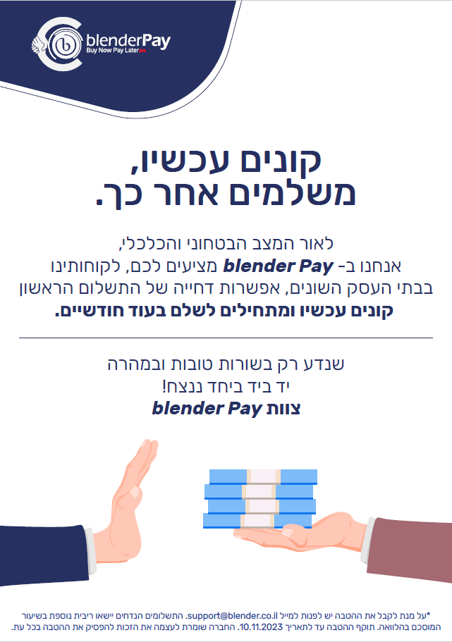
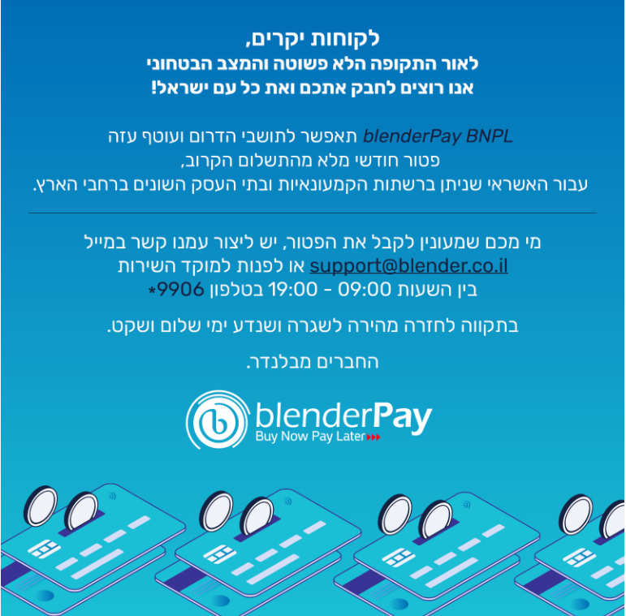
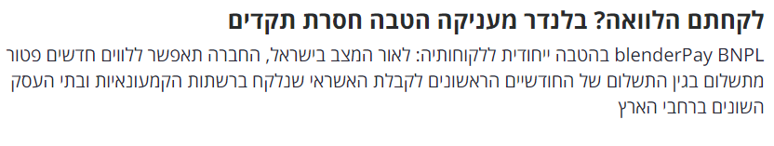

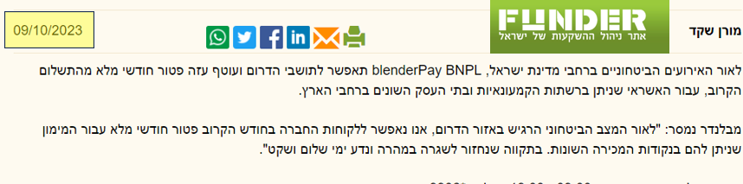
Swords of Iron: Rapid Response and Communication with Customers

Slide 22


Activity Strategy 2023
Israel:
blenderPay collaboration with Bank Hapoalim as a growth engine
Continued development of the credit brokerage sector
Variety of funding sources – new credit lines and strengthening credit brokerage activity
Europe:
Maintaining profitability of the activity
Technology sale:
Cooperation agreement with Amdocs – enhancing joint activity

Slide 23
THANK YOU

