Slide 1

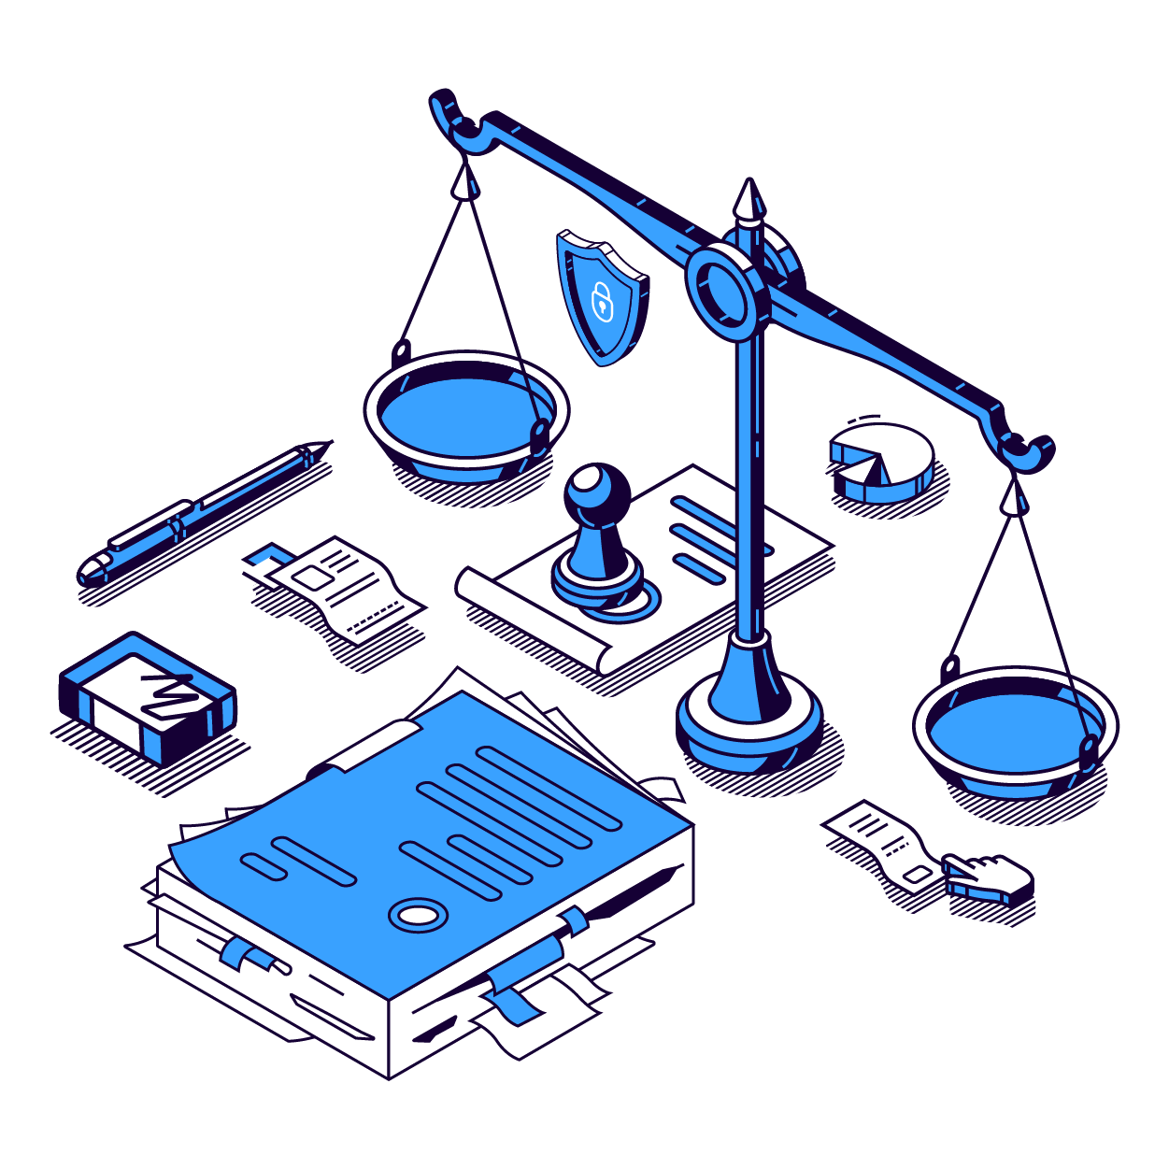
The Arrangements Law and its Effects on Public Policy
Seven major policy proposal processes in which we were involved
Finance
Urban renewal
Digital literacy
Women’s retirement age
Government services
Transit
Education

Slide 2
1
Education

Slide 3
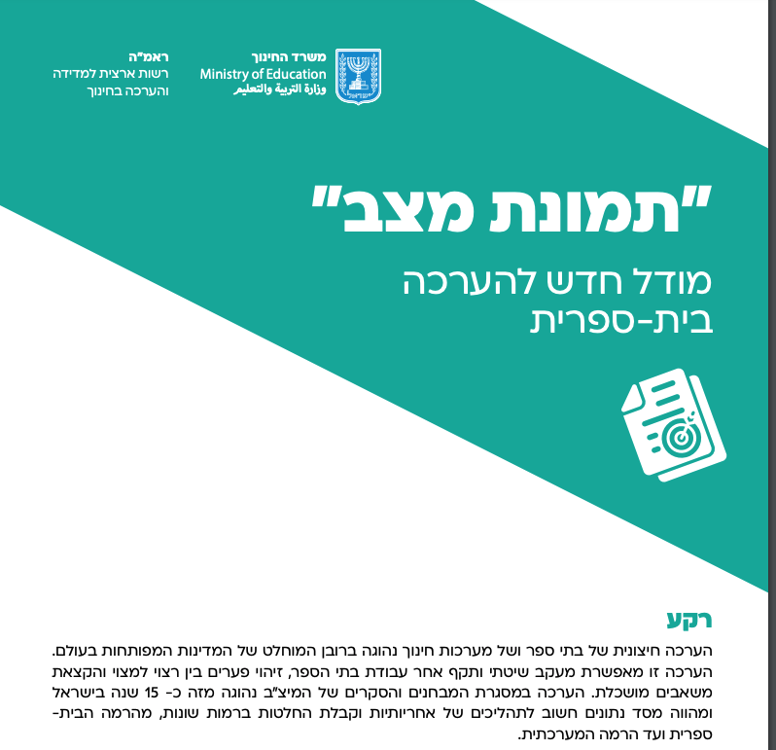

Minimizing disparities in the educational system
Providing tools for improvement:
Measurement and evaluation policy
1
In the wake of the “Meitzav Revolt” and the suspicions of cheating on tests, kayma launched a study with the Budgets Department to learn how to improve measurement.
A study among 628 teachers enabled evaluation of the scale and characteristics of teachers’ cheating in the Meitzav test and the reasons for this widespread conduct. The study set the stage for an improvement in the Meitzav apparatus.
May
2019
Kayma report:
RAMA: National Authori for Measurement and Evaluation in Education; Ministry of Education
“Situation Snapshot”:
A New Model of School Evaluation
Background
External evaluation of schools and educational systems is commonplace in the vast majority of developed countries worldwide. This evaluation enables methodical and valid oversight of schools’ work, identification of disparities between aspirations and reality, and intelligent resource allocation. Evaluation through the Meitzav surveys and tests has been practiced in Israel for about 15 years and is an important database for responsiveness and decision-making processes on various levels, from the school to system-wide level.
Kayma advises the professional staff of RAMA (the National Authority for Measurement and Evaluation in Education) to consider school evaluation.
Based on the study’s findings, guidelines are set for the new evaluation format and kayma takes part in writing the recommendations for the committee’s report.
Aug. ‒ Sept.
2019
October
2019
RAMA’s professional staff announces a comprehensive reform (“situation snapshot” model)
Kayma’s recommendations are implemented in the reform.

Slide 4
Minimizing disparities in the educational system
Offering tools for improvement: Measurement and evaluation policy
1
“The Revolution Begins”: Minister Yifat Shasha-Biton’s Plans for the Education System
In the field of ethics, the Education Minister intends, as she announced, “to restore education to the education system. We will restore attention to the social, Zionist, Jewish, and democratic values that express the diversity and wealth we have here in Israel.”
Regarding the Bagrut exams, she is expected to work to reduce the number of external Bagrut exams and change the testing method…”
Ynet June 14, 2021
COVID as an opportunity: Rethinking Bagrut exams.
The study examined the influence of the number of elective fields for Bagrut study on the effectiveness of learning. The study found a more positive correlation between the two variables in math and sciences, but a negative connection between the quality of learning and the existing testing method, primarily in the humanities.
The study’s findings were presented to then-Minister of Education Yoav Galant, with the recommendation of reducing the number of Bagrut exams from 10 to 5.
August
2020
Incoming Education Minister Shasha-Biton announces the “Student in the Center” reform and the plan to reduce the number of Bagrut exams to 5 permanent exams:
English, math, science, a humanities field, and a language.
June
2021

Slide 5
Minimizing disparities in the educational system
Expanding autonomy in schools: 2021 Arrangements Law
2
"...about half a billion shekels will be dedicated in the Education Ministry to promote “autonomy for principals.” This significant addition, which was also inserted into the budget’s base, will be spread over three years, from 2021 to 2023, and is supposed to be transferred to school principals so they can independently manage their schools’ budgets. This is in accordance with Education Minister Yifat Shasha-Biton’s approach that principals know their schools’ needs better than the central regulator in Jerusalem and they can navigate the budget more efficiently and focusedly. The Ministry is in the process of formulating a work plan on the topic…”
Walla, November 3, 2021
Promoting managerial flexibility in the education system
The study involved 250 participants at the levels of administrators, teachers, and inspectors. The study’s goal was to assist the Ministry of Education to set policy that strengthens the status and independence of principals at the municipal level, disperse the Education Ministry’s authorities, and reduce its areas of responsibility. The findings showed that bureaucratic overload comes at the cost of the professional and pedagogical development of principals and harms management quality..
.
August
2020
Assistance in research and policy development regarding autonomy in the Education Ministry, in collaboration with the Ministry of Finance and the Ministry of Education.
April
2021
A reform in the Arrangements Law:
“Principals will be responsible for the school’s budget, organizing studies, and adapting it to students’ needs…local authorities will be responsible for setting their education policy…”
November
2021

Slide 6
2
Transit

Slide 7
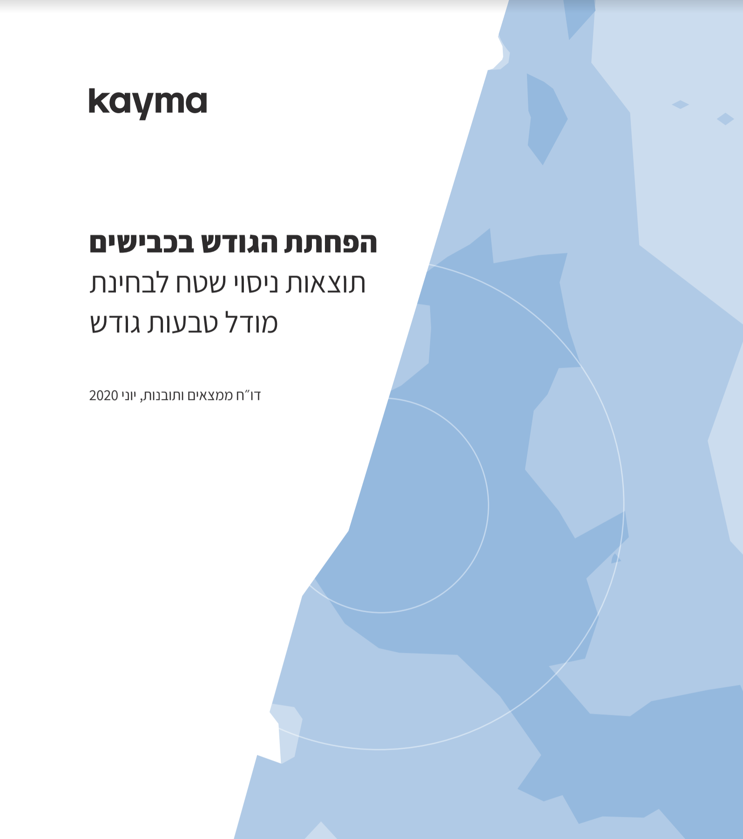
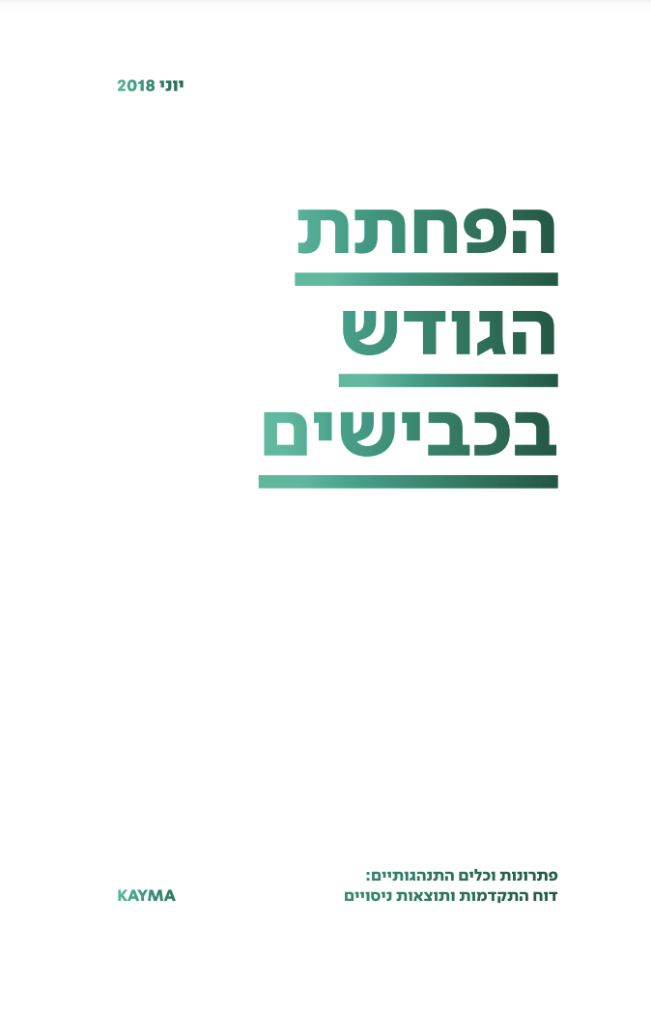
Minimizing traffic
Interventions to change commuter behavior: From Exploration to the 2021 Arrangements Law
Stage A: Research to evaluate the expected effectiveness of policy alternatives (Evidence Based Policy)
1
Along with the Ministry of Finance, we examined how to minimize the problem of traffic.
Mapping the problem of traffic in Israel and focusing possible interventions
June2017
Kayma report
Decreasing road congestion
Results of the field experiment examining a congestion rings model
Findings and Insights Report, June 2020
~~~~~~~~~~~~~~~~~~~~~~~~~~
Kayma report June 2018
Decreasing Road Congestion
Behavioral tools and solutions: Progress report and experiment results
June 2017 ‒June 2018
Three field experiments (RCT model) to examine different models for changing commuter behavior
A model encouraging alternatives to private car use in collaboration with employers; a model of flexible work hours; a congestion fee mechanism to manage demand
Significant potential was identified for a congestion fee policy.

Slide 8
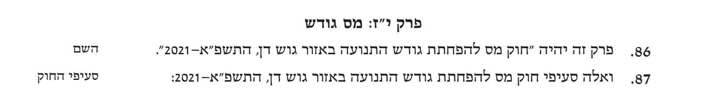
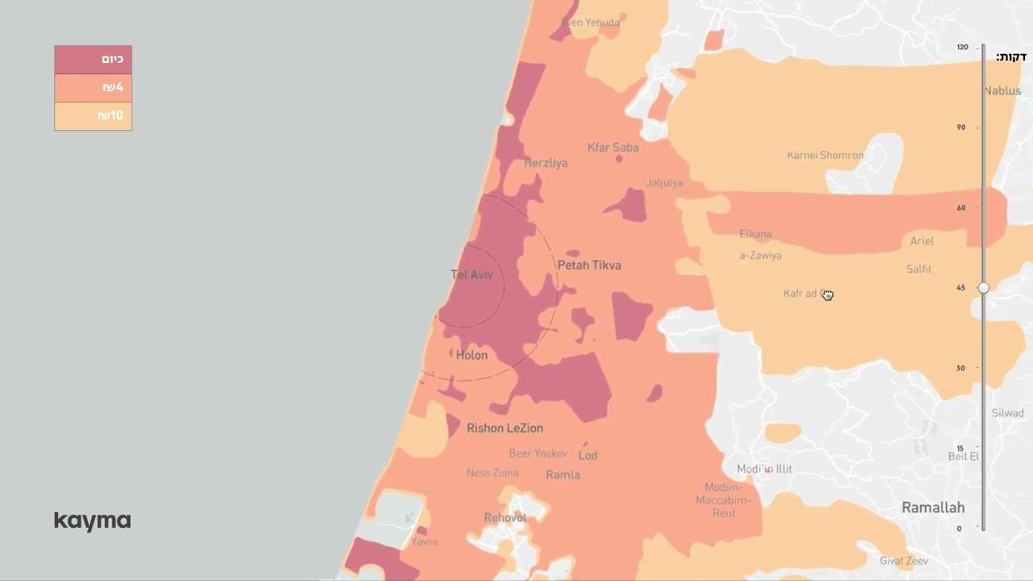
Minimizing traffic
Interventions to change commuter behavior: From Exploration to the 2021 Arrangements Law
Stage B: Evaluating the influence of a congestion fee on behavior and on periphery residents’ opportunities
1
Chapter XVII: Congestion Fee
86. This chapter will be ״Tax to Decrease Traffic Congestion in the Gush Dan Region Law, 5781-2021” (the name).
87. And these are the sections of the Tax to Decrease Traffic Congestion in the Gush Dan Region Law, 5781-2021: (the law’s sections)
From the 2021 Arrangements Law
January
2020
We launched a field experiment to identify the minimal congestion fee amount that would cause behavioral change.
Over 800 drivers participated in the experiment for a month. The findings assisted in determining that a fee of NIS 10 would cause the maximal decrease in car use during congestion hours.
Congestion fee (Arrangements Law)
The congestion fee mechanism, which entails a fee for entering the Gush Dan metropolitan area during congestion hours, was formulated based on the study kayma conducted.
November
2021
An estimate of the effect in terms of decreasing travel time and residents’ opportunities by residential region

Slide 9
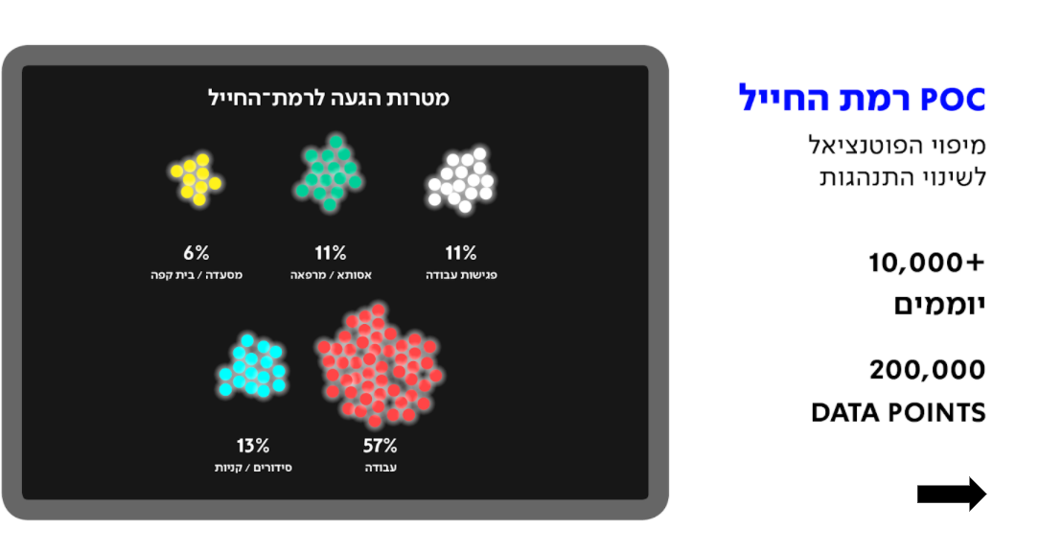
Minimizing traffic
Building Infrastructure - Planning public transit on the basis of data:
Policy-setting tools for Transport Ministry use
2
Goals for visiting Ramat Hahayal
11% work meetings
11% Assuta Hospital / clinic
6% Restaurant / coffee shop
57% work
13% Errands / shopping
Using big data to analyze commuter behavior in employment areas
Public transit does not fit residents’ needs because of bad planning. Why? It turns out that since the 1980s, planning has been based on responses from surveys and reports on a small scale, held once every five years, rather than on real-time data of actual behavior.
As part of a joint study by the Ministries of Finance and Transport held in 2018, we mapped the transit behavior of commuters traveling to the Ramat Hahayal employment area through cellphone data.
March
2018

Slide 10
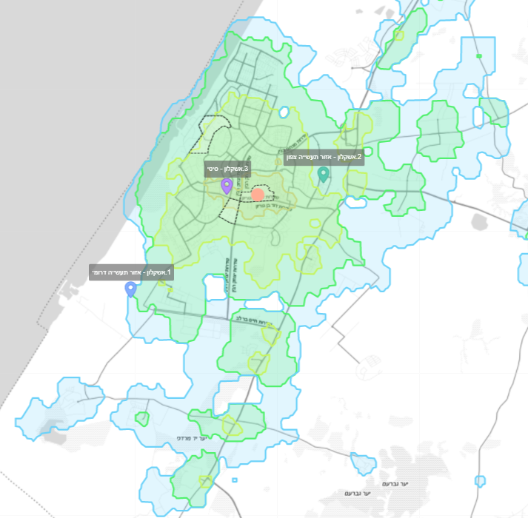
Minimizing traffic
Building Infrastructure - Planning public transit on the basis of data:
Policy-setting tools for Transport Ministry use
2
On the basis of the methodology developed in Ramat Hahayal, a tool was developed for planning public transit and implemented in Herzliya Pituah as a case study.
Analysis of commuter behavior data led to a series of recommendations to improve public transit to the Herzliya Pituah employment area. As a result of the recommendations, comprehensive changes were made in the public transit offerings.
August 2019
Developing tools to assist planners to plan public transit on the basis of data, based on commuter conduct in 36 statistical regions
In collaboration with the National Public Transit Authority, we chose 36 statistical regions throughout Israel and analyzed several aspects connected to commuter behavior. As a result, we created a tool to support decision-making by transit planners that presents actual behavior, and which is planned to be incorporated into the existing planning system.
November
2021
Captions on the map:
2. Ashkelon - Northern industrial zone
3. Ashkelon - City
1. Ashkelon - Southern industrial zone

Slide 11
3
Improving Government Services

Slide 12
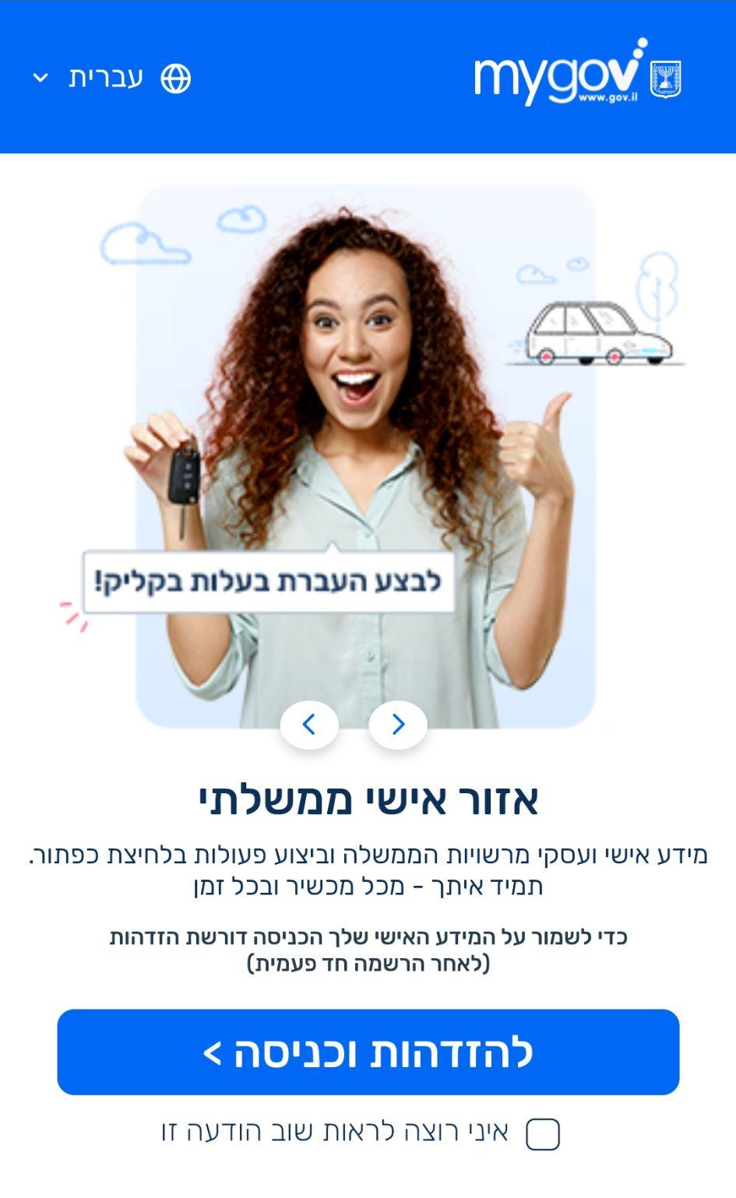
Decreasing the bureaucratic burden on citizens
Creating a norm of formulating government services that put the citizen in the center:
Implementing Government Decision 260 (July 2020)
mygov Hebrew homepage:
“Transfer ownership in a click!”
Personal government space
Personal and business information from the government authorities and performing activities with the click of a button. Always with you - from any device at any time. To protect your personal information, entry requires identification (after a one-time registration)
To identify and enter >
_ I don’t want to see this notification again
Presenting the vision of “The Citizen’s Personal Space”
A joint study with the Budgets Department that set the stage for the view of digital services that place the citizen in the center, and presented a new methodology for characterizing government services.
June
2018
The Citizen’s Personal Space goes online
November
2019
Mapping thousands of government services and creating a method for prioritizing change and digitization processes in the public sector
Dimensions considered: potential for behavioral change, size of financial savings, ease of technological implementation, ease of regulatory implementation, potential for enlisting the ministry, scalability
December
2019

Slide 13
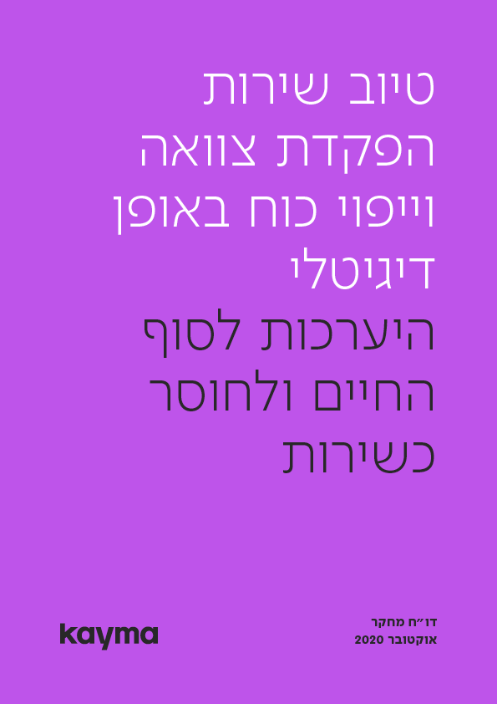


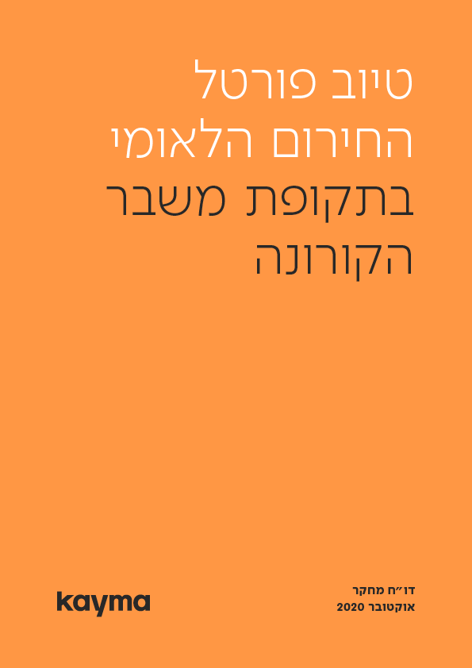

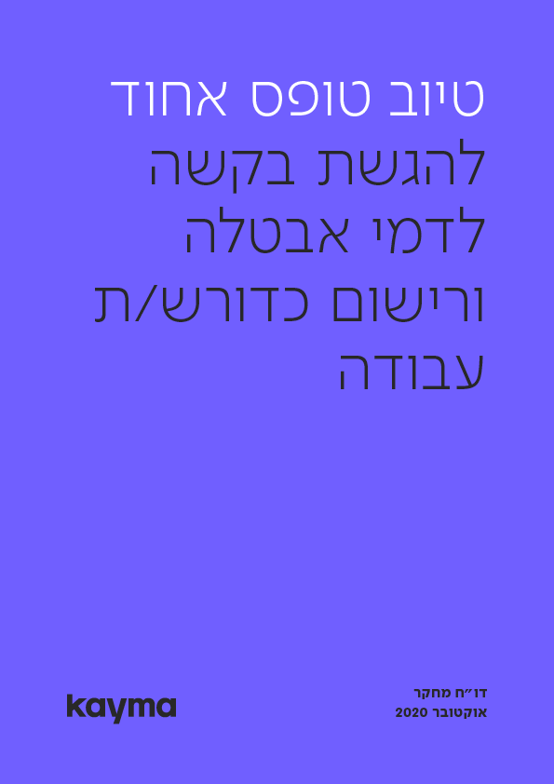
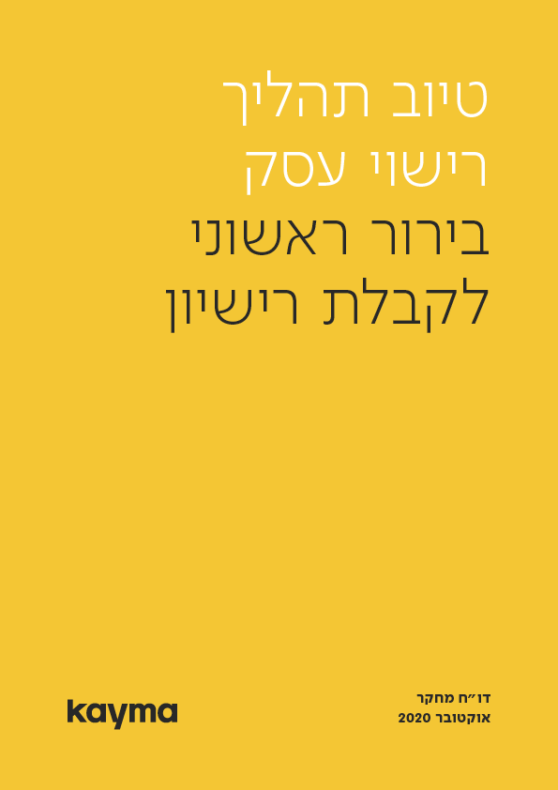
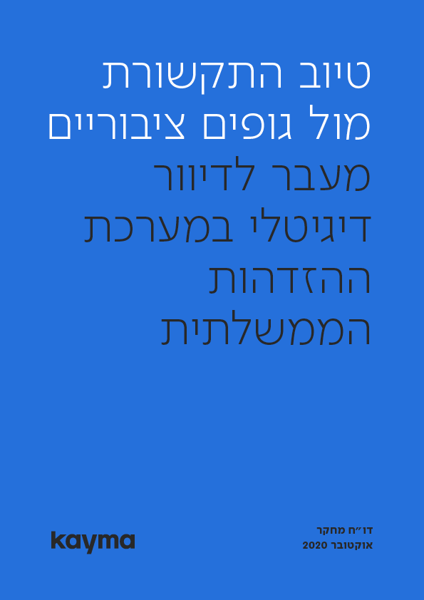
Decreasing the bureaucratic burden on citizens
Recent kayma reports:
Improving communications with government entities: Transitioning to digital mail through the government identification system. Research report October 2020, kayma
Improving the business licensing process: Initial clarification for receiving a license. Research report October 2020, kayma
Improving the uniform form for submitting a request for unemployment insurance and registration as a job seeker. Research report October 2020, kayma
Improving the employment encouragement stipend during the post-COVID period. Research report October 2020, kayma
Improving the National Emergency Portal during the COVID crisis period. Research report October 2020, kayma
Improving home moving processes: Tell Us Once service. Research report September 2020, kayma
Improving interfaces: A service to launch bureaucratic steps after a relative’s death. Research report September 2020, kayma
Improving services for digitally submitting wills and power of attorney declarations: Preparing for end of life and incapacitation. Research report October 2020, kayma
Creating a norm of formulating government services that put the citizen in the center:
Implementing Government Decision 260 (July 2020)
Building and validating a new index for measuring Pain of Bureaucracy (POB).
Creating a uniform language for evaluating the bureaucratic burden of government services.
June
2020
Assistance in the implementation of the government decision to accelerate digital services to the public
Several experiments we conducted assisted in data-informed decision-making about how to formulate eight digital services.
March
2021

Slide 14
Decreasing the bureaucratic burden on citizens
Creating a norm of formulating government services that put the citizen in the center:
Future implementation as part of Government Decision 225 (August 2021)
Is the Digital Revolution Arriving? The Government Will Stop Sending Citizens Letters by Mail
The Arrangements Law contains a memorandum for the Digital Communications Law, which seeks to create a revolution:
Government ministries and auxiliary units will be required to communicate with the public digitally.
The Budgets Department estimates that this will save at least NIS 200 million.
Globes, July 28, 2021
Digital mail: A “no paper no line” policy and adapting the way the government contacts residents in the digital age
In collaboration with the Ministry of Finance’s Budgets Department, DIgital Israel and Available Government, we characterized the process of renewed registration for providing a digital address and receiving digital mail. The characterization was based on an RCT experiment in which 887 Israelis took part and on behavioral principles that will lead to the receipt of digital mail and completion of the identification process.
Kayma is currently assisting the interministerial committee to incorporate the principles and set mandatory standards for sending messages as part of the government mail policy.
September
2021

Slide 15
Decreasing the bureaucratic burden on citizens
Creating a norm of formulating government services that put the citizen in the center:
Implementing Government Decision 260 (July 2020)
The Government Approved a Program for Accelerating Digital Services
The government approved today (Sunday) a program for accelerating digital services…this decision promises that all populations receive fitting services - a program for those lacking digital literacy, placing self-service facilities, developing alternative service channels, and promoting natural language processing (NLP) and artificial intelligence capabilities in Hebrew, which will enable a conversation with a computer (bot) in a written conversation (chat) and a spoken conversation (IVR). NIS 10 million will be allocated to creating a dedicated team that will formulate a plan for making the services in the Personal Space accessible.
Ynet, July 26, 2020
Formulating government services for populations lacking digital literacy
Kayma will conduct a broad-reaching project with Digital Israel and a series of government ministries to formulate government services that best serve populations lacking digital literacy: elderly citizens, Arab society, Haredi society, and individuals with disabilities.
We will examine which basic conditions should be offered to the target populations for specific services based on a view of infrastructure and end-user equipment through which the user makes use of the service, the user’s digital skills and capabilities, and the user’s general motivation to use digital government services. The study will also examine the effectiveness of a pilot of placing clerks at the physical service facilities that will be placed in four local authorities.
Future
2022

Slide 16
4
Raising Women’s Retirement Age

Slide 17
Raising women’s retirement age: 2021 Arrangement Law
Understanding the public’s views and the preferences of women working in arduous professions
(Dealing with the obstacles of the Budgets Department in advance of the Arrangements Law (2021)
An experiment with the Budgets Department to examine preferences of raising retirement age dependent on norms and the way the pension benefit is presented
Participants in the experiment said the retirement age should rise to 64.25 (on average). The experiment’s finding set the stage for promoting the reform.
November
2018
After Years of Disagreements: Raising the Women’s Retirement Age Was Approved in the Committee
The Finance Committee approved the proposal as part of the Arrangements Law in its second and third readings. Already in 2022 the retirement age will rise by 4 mounts, and within 11 years it will rise to 65. As a result of the increase in the compensation to women in arduous professions and professional training programs, the plan will cost the state NIS 930 million.
Ynet, October 21, 2021
A joint meeting of kayma, the Budgets Department, and the Women’s Caucus
The study’s findings were presented to the caucus’s members - the main opponents of raising the retirement age.
December
2018
An experiment to examine preferences to raise the retirement age depending on the extent to which a field of work is arduous
65% of workers in “greatly” arudous professions expressed willingness to raise the retirement age.
December
2020
The women’s retirement age is raised to 65 (Arrangements Law)
November
2021

Slide 18
5
Digital Literacy

Slide 19
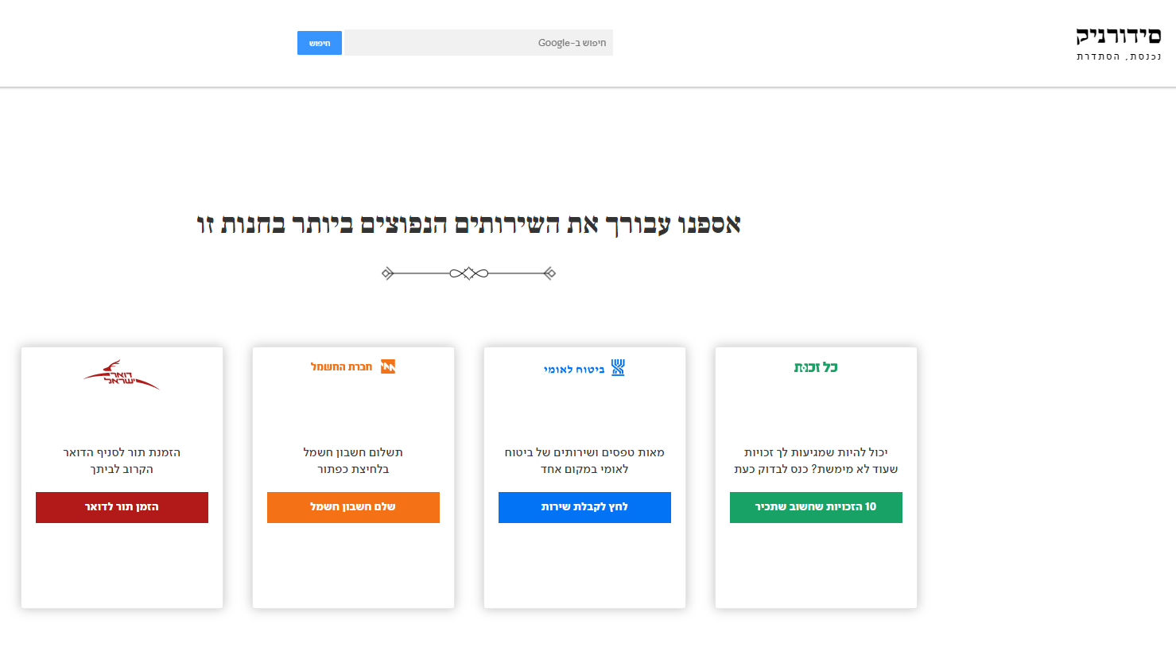
Expanding digital literacy among excluded populations: Government Decision 260
Intervention to create behavioral change: reducing digital literacy disparities
Stage A: An RCT field study to evaluate the effectiveness of policy tools
1
Field experiment to encourage the use of digital government services among the Haredi population
In the experiment, government services were presented on the homepage at four Jerusalem stores that offer paid public computer terminals (“computer stores”).
Changing the homepage at the terminals led to an increase of 160% in the use of the Kol Zchut website.
June
2017
We collected for you the most commonly used services in this store
Israel Postal Service: Make an appointment at the postal branch near your home. Make an appointment in a click.
Israel Electric Company: Pay electricity bills at the press of a button. Pay electricity bills.
National Insurance Institute: Hundreds of forms and services for the NII in one place. Click to receive service.
Kol Zchut: Are you eligible for rights you have not made use of? Enter to check now. The 10 rights that are important for you to know.

Slide 20
Expanding digital literacy among excluded populations: Government Decision 260
Learning and building supportive policy tools: Reducing digital literacy gaps
Stage B: Developing measurement tools in local authorities and presenting a picture of the situation through a dedicated policy tool for municipal decision-makers
2
"...The government sees importance in promoting proper solutions for populations that face difficulty using digital services, and thus a team will be formed led jointly by Digital Israel and the Computing Authority, with the participation of the Budgets Department in the Finance Ministry and the Prime Minister’s Office. The team will formulate a program within 30 days aimed at making currently accessible the digital government services in the government personal space for populations lacking digital literacy and lacking digital facilities…”
“Deciding” - A program to accelerate digital services to the public and promote digital learning, 2021
Developing a tool for measuring programs to promote digital literacy among Arab, Haredi, and elderly citizens
The tool measures aspects connected to participants’ views (of their ability to perform various tasks, their subjective evaluation of their knowledge level…) and examines performance of tasks that require various literary levels through dedicated tests.
July-September 2020
We assisted in characterizing and developing a dashboard that was incorporated by and is currently used by the government, which presents the results of measurement from intervention programs to promote literacy in local authorities.
The dashboard serves the Digital Israel staff and 100 local authorities that will participate in these programs.
August
2021

Slide 21
6
Urban Renewal

Slide 22
Encouraging urban renewal: 2021 Arrangements Law
Behavioral policy study: Expanding the scale of urban renewal projects (2021 Arrangements Law)
The study showed that the uncertainty stemming from the long amount of time the process takes is the most threatening and influential factor on the decision to join an evacuation-construction project.
The Arrangements Law makes processes shorter and more efficient in order to increase certainty, through several tools:
4
3
2
1
The real estate tax law and the value-added tax law were amended so as to encourage urban renewal deals and create tax certainty
Transferring authorities to additional entities: creating a government team for expediting processes, and a commitment by the local authority to approve authorization requests within 90 days
Decreasing the size of the majority needed to sue a resident who rejects a renewal plan
Limiting the amount of time for a plan to be accepted and setting deadlines for its approval in the local planning committee

Slide 23
7
Finance

Slide 24
Finance
Assisting the government policy-making process: The open banking reform (2021 Arrangements Law)
1
As part of the reform to expand competitiveness and improve service in the banking system, we developed at the Ministryof Finance’s Budgets Department (along with the Ministry of Justice, Bank of Israel, and additional partners) a set of directives to Israel’s banks aimed at minimizing friction and transfer obstacles in the banking system:
4
3
2
1
Enable access to third parties to bank accounts (with account holders’ approval) to offer new services:
improving mortgages, automatically comparing conditions, consultation on minimizing expenditures, etc.
Support innovation in transferring funds.
Enable a convenient comparison among banking services fees.
Enable transferring between banks at the click of a button.
* In the original plan, the significant friction (which was in the clear interest of the banks) was very likely to leave the reform “on paper” only. In the current plan, which does not involve similar difficulty, the reform’s chances of influencing the market significantly is much higher.

Slide 25
Finance
Assisting change processes: An interest model for those declaring bankruptcy
2
Kayma advised the Ministries of Justice and Finance on how to formulate the behavioral model of interest for those declaring bankruptcy
The Accountant General’s Office Will Recommend: Decreasing the Late Payment Interest Rate and Changing the Base Interest Rate
The recommendations of the team to examine a change in the interest mechanism to be publicized today are expected to offer dramatic changes in the way interest paid by the public for late payments of fines, accounts, and debts to the execution office is calculated.
Calcalist, May 6, 2021
We conducted discussions with the professionals at the Ministries of Finance and Justice to understand the role of the interest rate during bankruptcy.
July‒September 2020
We examined data of people with various debt levels to understand the influence of the interest rate at the various debt levels on behavior.
We identified that the interest rate in the existing mechanism creates a disincentive to the desired behavior. Our work led to a change in the view of the effectiveness of the interest rate at various debt levels, an update of the structure of the mechanism for early payment, and canceling excess interest in the payment arrangement.
Formulating a mechanism that encourages earlier payment through identifying the minimal price so as to not depress payment
B
In the last stage: When people pay at the right rate - there is no need to “incentivize,” the interest rate should be dropped to zero.
C

Slide 26
Thank you very much❤
We are eager to continue our work.
Finance
Urban renewal
Digital literacy
Women’s retirement age
Government services
Transit
Education

