Slide 1
2021 Executive Summary
Urban95 IL:
Stages in Incorporating A New Municipality
Insights based on the Program’s First Year
Presented as part of a comprehensive evaluation of the Urban95 Program
June 2022
www.cet.ac.il המרכז לטכנולוגיה חינוכית, חברה לתועלת הציבור, רח' קלאוזנר 16 תל-אביב, טל' 03-6460163

Slide 2
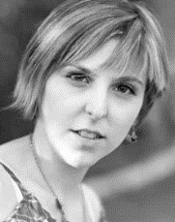
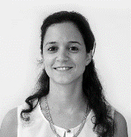
צוות המחקר
ד"ר רעות דריי דיאמנט
חוקרת ומעריכת תוכניות
אלונה צירולניקוב
חוקרת ומעריכת תוכניות
נואית קדוש
רכזת תפעול
תסניים מסרי
רכזת מחקר וסטטיסטיקאית
ד"ר חוה ניומן
ראש מינהלת מדידה והערכה
ד"ר טל משען שפיגל
מנהלת היחידה להערכת תוכניות במטח

Slide 3
Background
Over the past year Urban95 has expanded to include two additional municipalities in Israel: Tira and Beit Shemesh. In preparation for absorbing a new municipality into the program over the upcoming months, we have concentrated insights gained from the two anchor municipalities’ absorption process in the first year of activity. We hope these serve to optimize the next municipality’s absorption process and that of all future municipalities joining Urban95.

Slide 4
Criteria for Choosing a Municipality
Criteria for choosing a municipality and reviewing progress
The criteria for admitting a municipality into the program include several values, among them: political willingness, implementation, and the ability to serve as a model. These criteria are important and even critical for the success of the program, and should be heavily considered during the decision making process. We recommend examining how well the municipality meets these preconditions when considering its candidacy and once the activity has been launched in the city.
The screening tools (e.g. the admission interview and other tools) need to be structured based on detailed indicators that can weight the criteria for choosing a municipality.
To date, these criteria have been evaluated based on the admission interview, municipal reports, and information from previous programs. We recommend thinking of additional tools for examining these values, e.g. questionnaires for aligning expectations and/or submitting an example of a work plan. In addition, once the program has been launched, it is important to create a work routine that is congruent with these values, to instill them, and examine how well they are implemented along the way.
Currently, as part of the admission process, every chosen municipality presents data, challenges, and a map of the city’s population. This is a highly valuable aspect of the process and it should certainly be preserved. At the same time, we recommend thinking about how this part should be structured.
Despite the above, it is important to be flexible and consider the municipality’s ability to respond to the call for proposals, so as not to weaken the motivation to join the program.
Choosing a municipal program director to represent Urban95
As a rule, it is clear there is major value in appointing a program director from within the municipality – one who is familiar with its challenges and barriers, highly motivated to enact change, passionate and connected to the program’s goals, who knows the residents, and is able to get local stakeholders on-board. However, in situations where this could lead to office tension and create an unpleasant work environment, an external director from a similar municipality who is familiar with the local culture and its challenges should be considered for the role.
Appointing a program leader to represent the municipality
It is important to choose someone who holds a central position in the municipality and is strongly connected to the fields of early childhood or urban planning in the city. When choosing a municipality, the potential program leader’s role and seniority should be examined and special emphasis should be placed on their political status and influence within the municipality. Likewise, during the admission interview it is important to verify that the potential leader is available and motivated to lead the program.
Work routines: Aligning expectations
When choosing a municipality, expectations should be aligned regarding work routines in the municipality and vis-à-vis Urban95. This includes allocating a station, computer, and peripheral equipment for the municipal program director, establishing municipal roundtable discussions to be held every set period, sending current reports to the ILGBC and BvLF, implementing a certain number of projects in the city within a year, etc.

Slide 5
Getting Started and On-boarding Municipal Stakeholders
Mapping needs, challenges, and barriers regarding fields that are relevant to Urban95
Mapping the municipality in terms of its needs and the challenges it faces is one of the first steps that needs to be taken.
It is important to perform mapping at this stage, including potential barriers among residents and municipal stakeholders that could prevent the program goals from being achieved on time.
Information is collected through in-depth interviews with stakeholders followed by a workshop for developing a logic model and assimilating result-oriented thinking. As part of the workshop, it is important to examine how well the needs and challenges mapped will be met by taking the chosen actions, and how these will serve to advance achievements in relation to the success indicators.
Team training
As a rule, we recommend conducting a preliminary survey among municipal officials to understand which topics the training should focus on in each city. It is important to hold dedicated training for each municipality based on the issues that are relevant to it, mainly in the beginning stages, in order to get the various stakeholders on-board, demonstrate relevance, and recruit other officials. Highlights from the current anchor municipality teams (Tira and Beit Shemesh) include the need to go deeper into the practical aspects and adapt the training to the specific nature of each municipality.
In joint training sessions, we recommend allowing room for sharing and peer learning, similar to the format of the national Urban95 community. Our recommendation is based on the training participants' feedback, in which they noted the importance of cultivating relationships and peer learning within the municipality and with external officials, including professionals in government ministries.
Work routines vis-à-vis the municipality and stakeholders
Based on the expectations set when the municipality is chosen, it is important to stabilize work routines in regard to absorbing the municipal program director and establishing the frequency of municipal roundtable meetings, as well as reports and meetings with Urban95.
Being particularly meticulous from the start about establishing work routines makes it possible to implement Urban95 activities faster and achieve the program’s goals, giving all those taking part in the effort the experience of success.

Slide 6
Baseline Measurement - Residents
Baseline measurement in the municipality among parents of children aged 0-6
The program’s initial actions vis-à-vis the residents involve developing a survey to map needs and viewpoints of parents with children aged 0-6 who are residents of the municipality, followed by focus groups held with parents to gain more in-depth and complete findings. These findings are used when deciding which projects should be done as part of the program and as a point for comparison, in order to learn about changes in parents’ viewpoints over the course of the program’s activity in the municipality. This comprehensive survey can also serve the municipality in examining central issues regarding residents’ experience of living in the city.
Obtaining a respondent list from the municipality
Conducting the survey requires a list of respondents who are residents of the municipality and are parents of children aged 0-6. In some cases, this list can be acquired from survey companies. However, this is not always a possibility. It is often possible to get a list of respondents from the municipality, but this requires the municipality’s cooperation and getting stakeholders onboard. We recommend presenting findings from parallel surveys conducted in different municipalities and demonstrating how these are used to optimize decision making, in order to encourage on-boarding and corporation among the relevant bodies. In addition, even when the municipality cooperates, the process for obtaining lists involves a lot of bureaucracy due to privacy issues. It takes a considerable amount of time to deal with this, which could delay the survey. To avoid this, we recommend requesting a respondent list at the early stages of joining Urban95.
Distributing the survey
The survey is conducted by phone. This must be taken into account, as the survey is conducted among a closed and specific sample of parents of young children living in a specific city, and this requires screening that city’s population to reach appropriate respondents.
This type of survey generally costs more than an online survey. The respondent list does not include email addresses, so online distribution is not possible; also, internet use is low among the ultra-Orthodox population.

Slide 7
Implementing Urban95 Interventions in the Municipality
Launching the program among the residents of the municipality – permanent/temporary/event model
The program can be launched in several ways. In most cases, there is a peak event to mark the launch, and the event itself creates ripples and allows several possible directions to be examined (pilots); the event does not stand on its own. Follow-up interventions in the municipality can be temporary and/or permanent.
Event
A peak event to gain quick wins/low hanging fruit when entering a new municipality. The event creates high visibility and anticipation for future events of the same magnitude (honey trap). This is a major tool for launching the program (as a one-time event) or after some time, to demonstrate the program’s capabilities to those at the top levels and those on the ground.
When planning the event, it is important to begin by clarifying the desired goals. These may include proving feasibility, raising awareness among residents, and on-boarding external partners and business owners.
In addition, it is important to think of ways ahead of time to leverage events to other activities in the municipality, and ensure the event creates a ripple effect throughout the year.
Temporary
A series of short-term/limited number of events, or a temporary change in the environment to examine findings from the first stage, en route to making a permanent change. For example: holding a number of consecutive events for parents and children, in a different neighborhood each time, as was done in Beit Shemesh, closing off streets temporarily (PlayStreet in Tira), activities such as PlayCar (a car with games that comes by for a set period of time/specific activity).
Two types of interventions complement each other to advance the program’s goals in various ways, e.g. combining permanent events that offer stable routines for parents and children in a certain area, with temporary events that expose the program to a new audience in the municipality. This raises public awareness of the program and values it promotes.
Permanent
Permanent interventions include bringing a new product into the municipality, changing the physical space, or a long term activity over many/an unlimited number of sessions. For example: permanently closing a road and turning it into a pedestrian zone; a permanent schedule of activities and workshops for parents and children; establishing or renovating the community center; setting up a community garden, and more.

Slide 8
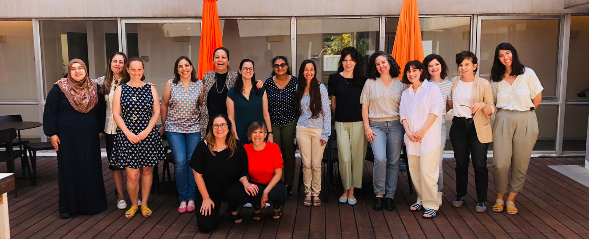
Urban95 IL Community Gatherings
A community for learning and sharing
As Urban95 expanded to other municipalities in Israel, the Urban95 IL community was formed. The community’s goal is to promote peer learning and inter-municipal collaboration. Each municipality’s program director and all Urban95 partners in Israel gather once every two months for a joint learning session.
In these sessions, the directors raise issues that are relevant to all the municipalities. Each shares from her own experience, based on her current status. Each director is encouraged to raise dilemmas she is dealing with and gain insights from her peers. To encourage the sense of community, the session format is semi-formal, so that in addition to the theoretical/structured part, each session also includes a more open, round-table part. As the community grows closer, members consult each other outside the sessions, too.
The sessions are led by the evaluation team, whose members have a unique perspective regarding all the municipalities, which offers an in-depth understanding of each municipality’s needs and challenges. The team is also familiar with the municipalities’ status and challenges in relation to the program.
We recommend encouraging the formation of a similar community for the teams leading the program in the municipalities. This topic is meant to be addressed in the general team training sessions. However, it is possible that a more open and less structured format would better serve in forming this community and encourage non-formal peer learning among stakeholders and professional counterparts in the municipalities participating in the program.

Slide 9
Evaluative Accompaniment from the Beginning
Evaluative accompaniment of the municipality at every stage of the program
The evaluation team accompanies the municipality from the moment it is chosen. This begins with conducting learning interviews with stakeholders and mapping the municipality’s needs and challenges, continues with leading a logic model workshop to instill results-oriented thinking and promote on-boarding, as well as conducting a baseline review, pre- and post-intervention research, and providing ongoing accompaniment and counselling, to deriving insights from one intervention to the other. Accompanying all Urban95 municipalities in Israel provides the evaluation team with insights that help promote the program in each municipality and accelerate inter-municipal learning.
A logic model workshop and assimilating result-oriented thinking
After conducting interviews with stakeholders, in which they are encouraged to share their personal views regarding the municipality’s needs and challenges, and which also allow the evaluation team to identify perceptual gaps and barriers, a joint workshop is held for all stakeholders in the municipality. The focus of the workshop varies according to the central challenge raised during the interviews. However, its main purpose is to map the municipality’s needs and define success indicators accordingly. These serve to determine the main actions the municipality must take to meet the targets. The workshop is important for creating a joint language, aligning and on-boarding stakeholders, clarifying the actions required, and supporting the decision making process (mainly in cases of disputes regarding prioritization and project selection).
Formative assessment
The dynamic nature of Urban95 activity requires the evaluation team to be flexible, and the leading approach to program accompaniment is formative assessment. Before every intervention, an evaluation program is built together with the program director in the municipality, which includes pre-intervention mapping, mid-/post-intervention assessment, and in certain cases a follow-up assessment. The findings and insights are shared as close as possible to the time the data was collected to allow the lessons learned to be implemented when expanding the intervention to other events/regions in the municipality. In addition, a summarizing assessment is conducted to provide a broader annual view of Urban95 activity in the municipality in relation to how well the goals were achieved.

Slide 10
Good luck!
www.cet.ac.il המרכז לטכנולוגיה חינוכית, חברה לתועלת הציבור, רח' קלאוזנר 16 תל-אביב, טל' 03-6460163
צילום: "מסע"

